Slide 1
Installation of CMS VAX service lines during LS3
Sequencing of works on CMS FIN
O. Boettcher / WP8
https://indico.cern.ch/event/1569397/

Slide 2
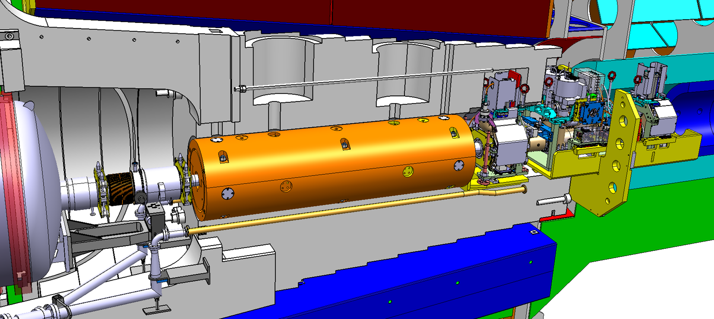
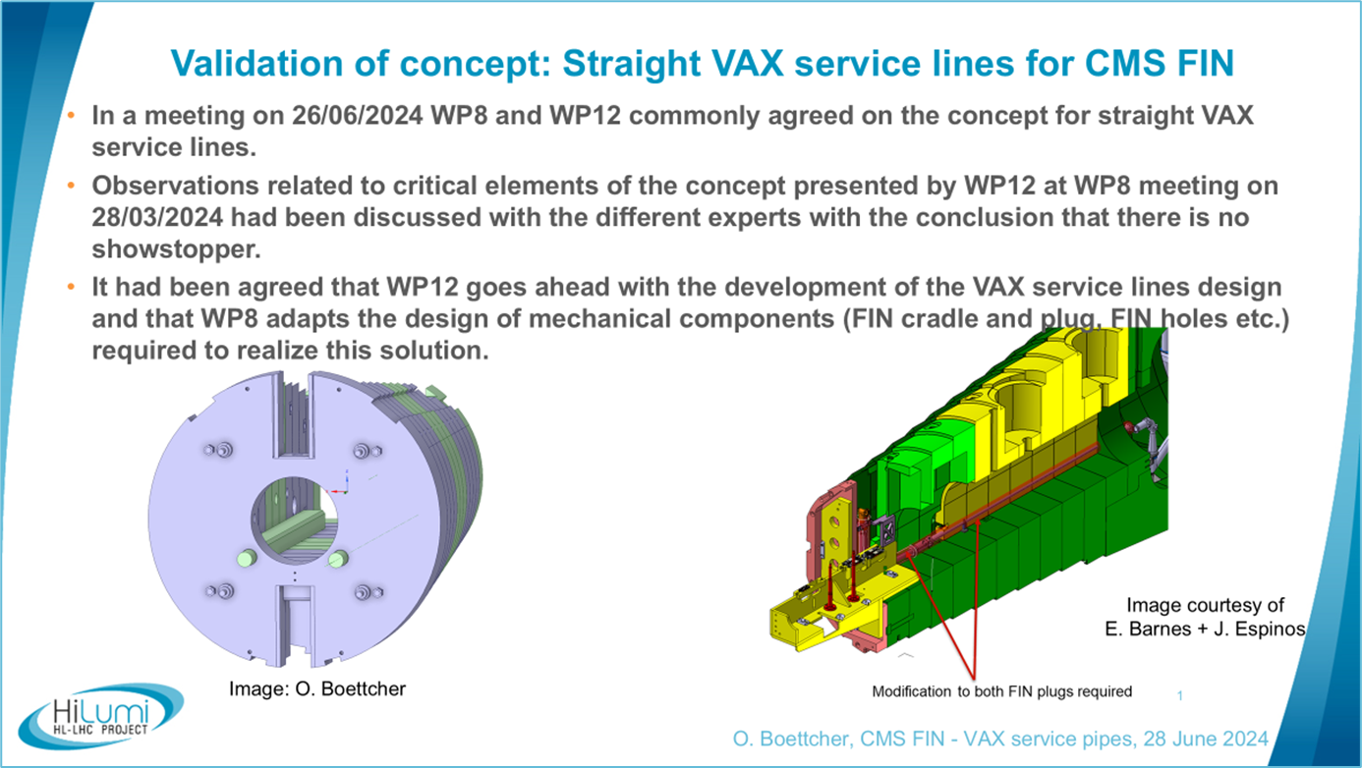
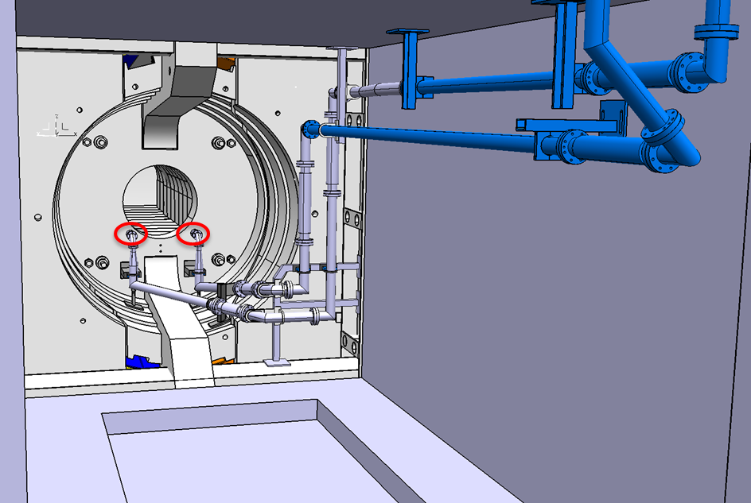
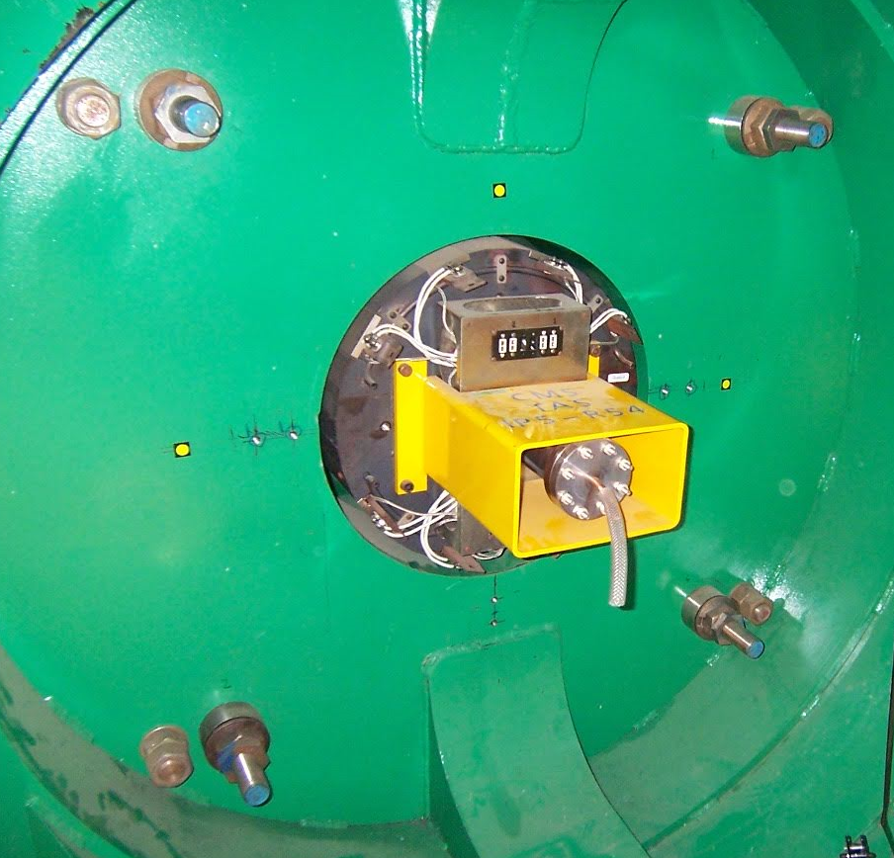
Introduction
LHC vacuum equipment between Q1 and TAS will be moved for HL-LHC to the experimental caverns of ATLAS and CMS.
New space need to be created for the VAX components at the new positions and for the rooting of vacuum services.
This presentation tries to resume on the status of the steps to and the actual planning during LS3:

Slide 3
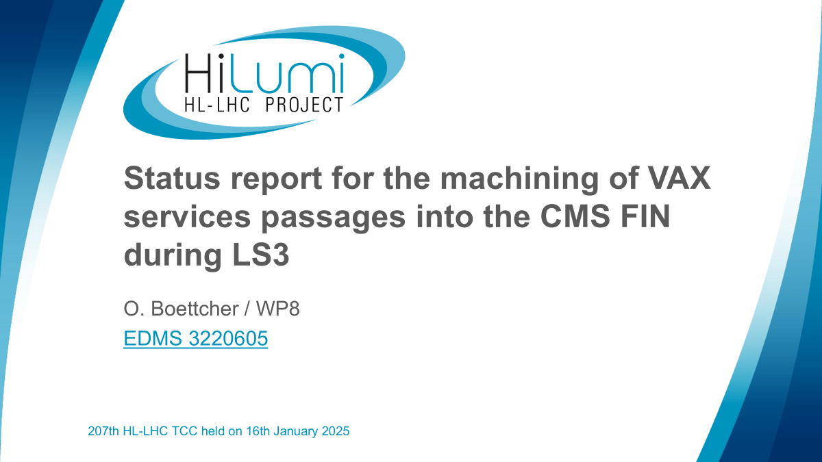

Slide 4
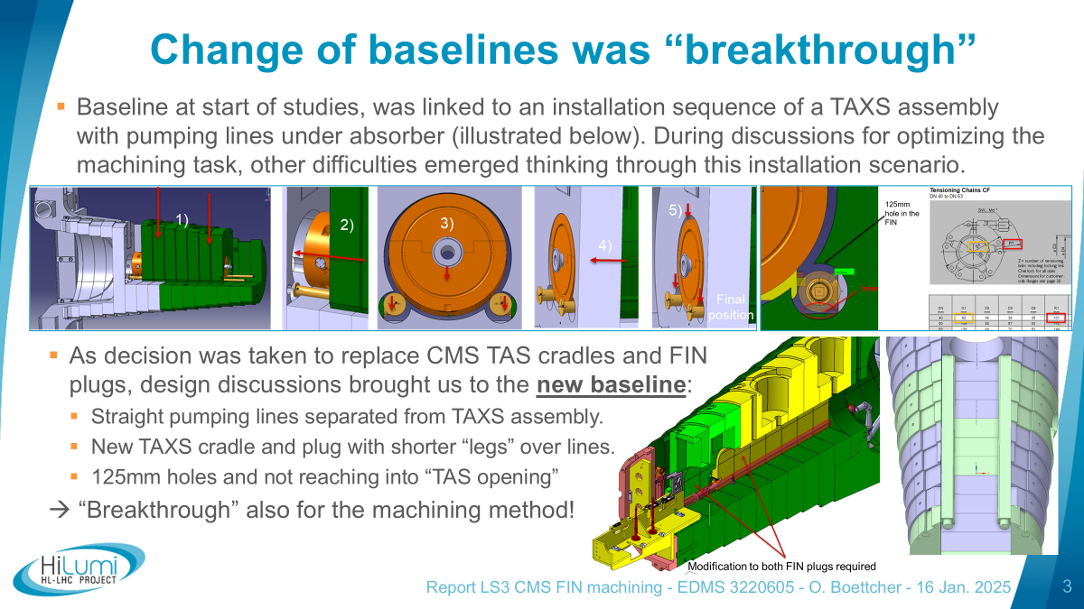

Slide 5
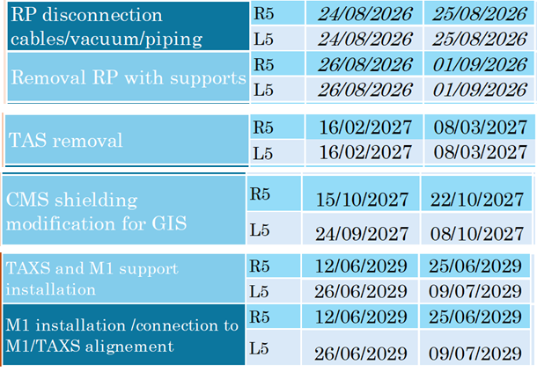
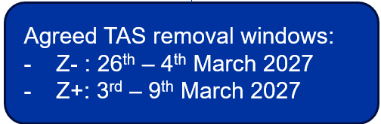
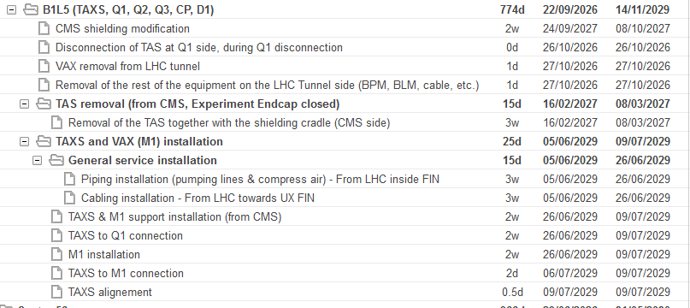
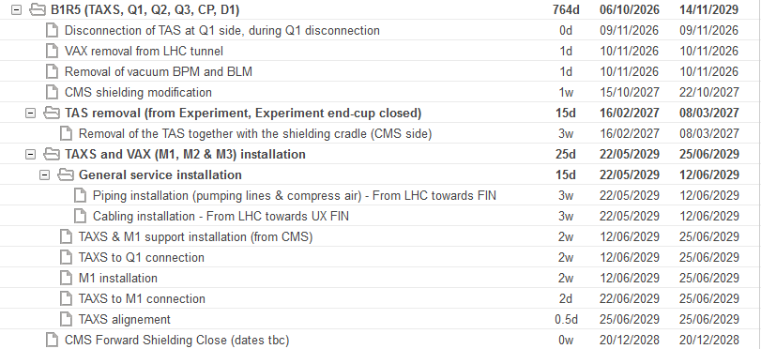
LS3 planning dates
HL-LHC Coordination Group meeting 07.07.25 – P. Fessia
Many presentations and activity at the moment on LS3 planning.
Difficult to check if logic is correct.
Harmonization will still need some discussions and additional work!
HL-LHC Coordination Group meeting 07.07.25 - T. Loiseau + F. Sanchez Galan
EN-ACE Scheduling Tool (extraction: 2025-07-14)

Slide 6
LS3 planning dates
LS3 schedule in B1R5 is actually listing the process quite good and can be taken as a guide!
EN-ACE Scheduling Tool (extraction: 2025-07-14)

Slide 7
WP8 steps
WP8 intervention on tunnel side
  Removal Z-stop, He-stop etc.
WP8 steps to TAS removal and to FIN configuration LS3 for CMS opening
  Remove horizontal survey equipment,
  Remove horizontal alignment mechanism
  Remove vertical survey equipment
  Remove TAS with cradle
    ~500mm movement towards IP
    evtl. add. slinging or mechanical structures for handling to surface
    Lifting to surface (far side through cavern crane first)
  Installation of FIN holes machining structures (cavern side)
  Installation of protection hood (cavern side)
CMS opening (FIN not accessible from cavern side)
FIN machining (as following validated machining method – refer to EDMS … )
Installation of IP5 VAX service lines on tunnel side (see presentation Edward)
CMS “closing” - Access to FIN (opening of lateral doors)
Preparatory works (WP8) for VAX service lines installation inside FIN TAXS compartment
  Remove protection hood
  Remove FIN holes machining structures
  Installation of TAXS cradle support structures (outside verticals)
  evtl as well support structures for plug (to be decided)
Installation of VAX service lines cavern side (see presentation Edward)
TAXS cradle and FIN plug support structures installation (WP8)
EN-ACE Scheduling Tool (extraction: 2025-07-14)

Slide 8
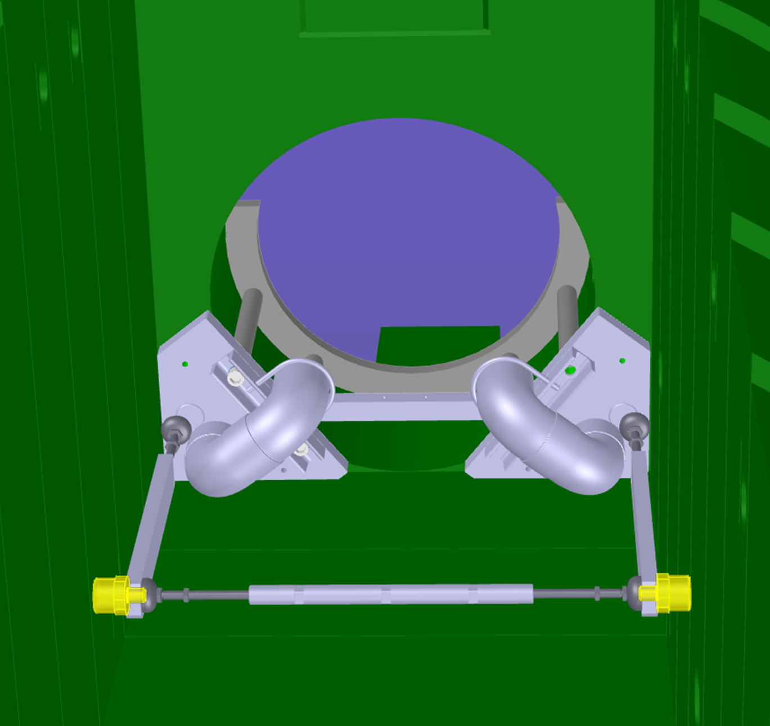
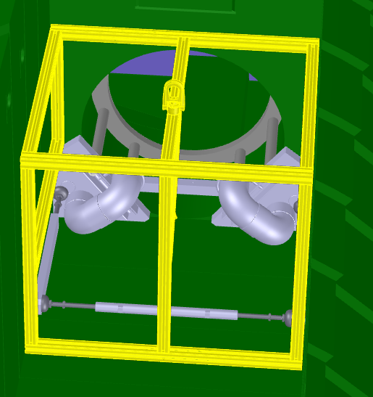
WP8 steps
WP8 intervention on tunnel side
  Removal Z-stop, He-stop etc.
WP8 steps to TAS removal and to FIN configuration LS3 for CMS opening
  Remove horizontal survey equipment,
  Remove horizontal alignment mechanism
  Remove vertical survey equipment
  Remove TAS with cradle
    ~500mm movement towards IP
    evtl. add. slinging or mechanical structures for handling to surface
    Lifting to surface (far side through cavern crane first)
  Installation of FIN holes machining structures (cavern side)
  Installation of protection hood (cavern side)
CMS opening (FIN not accessible from cavern side)
FIN machining (as following validated machining method – refer to EDMS … )
Installation of IP5 VAX service lines on tunnel side (see presentation Edward)
CMS “closing” - Access to FIN (opening of lateral doors)
Preparatory works (WP8) for VAX service lines installation inside FIN TAXS compartment
  Remove protection hood
  Remove FIN holes machining structures
  Installation of TAXS cradle support structures (outside verticals)
  evtl as well support structures for plug (to be decided)
Installation of VAX service lines cavern side (see presentation Edward)
TAXS cradle and FIN plug support structures installation (WP8)

Slide 9
Backup slides

Slide 10

34th HL-LHC coordination group
CMS TAXS and VAX installation
Tristan Loiseau, Francisco Sanchez Galan
07/07/2025

Slide 11
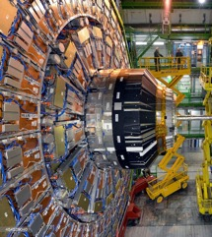
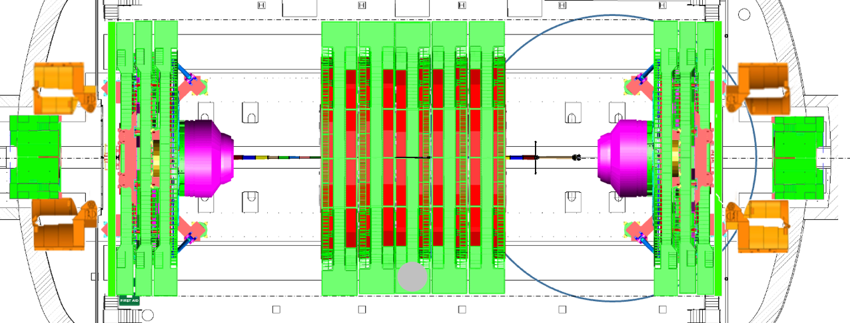
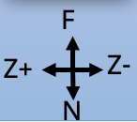
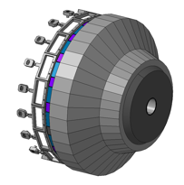
Few definitions
Legacy nose:
HCAL+ECAL+Preshower
YEs: endcaps
YBs: barrels
Sector 45
L5
+ Z end
- Z end
Sector 56
R5
New nose:
HGCAL+ME0+ETL
nose
YB0
YB1
YB2
YE3
YE2
YE1

Slide 12
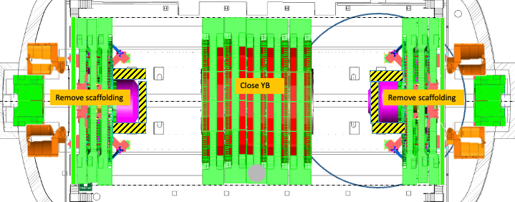
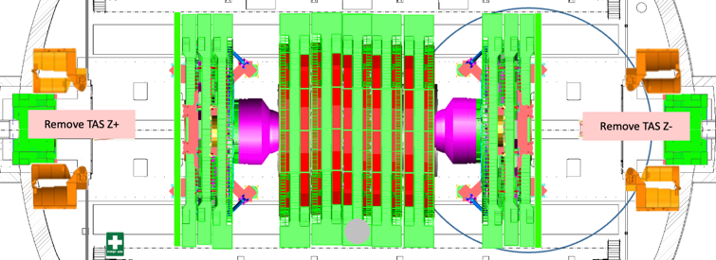
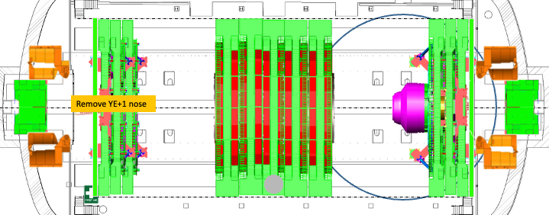
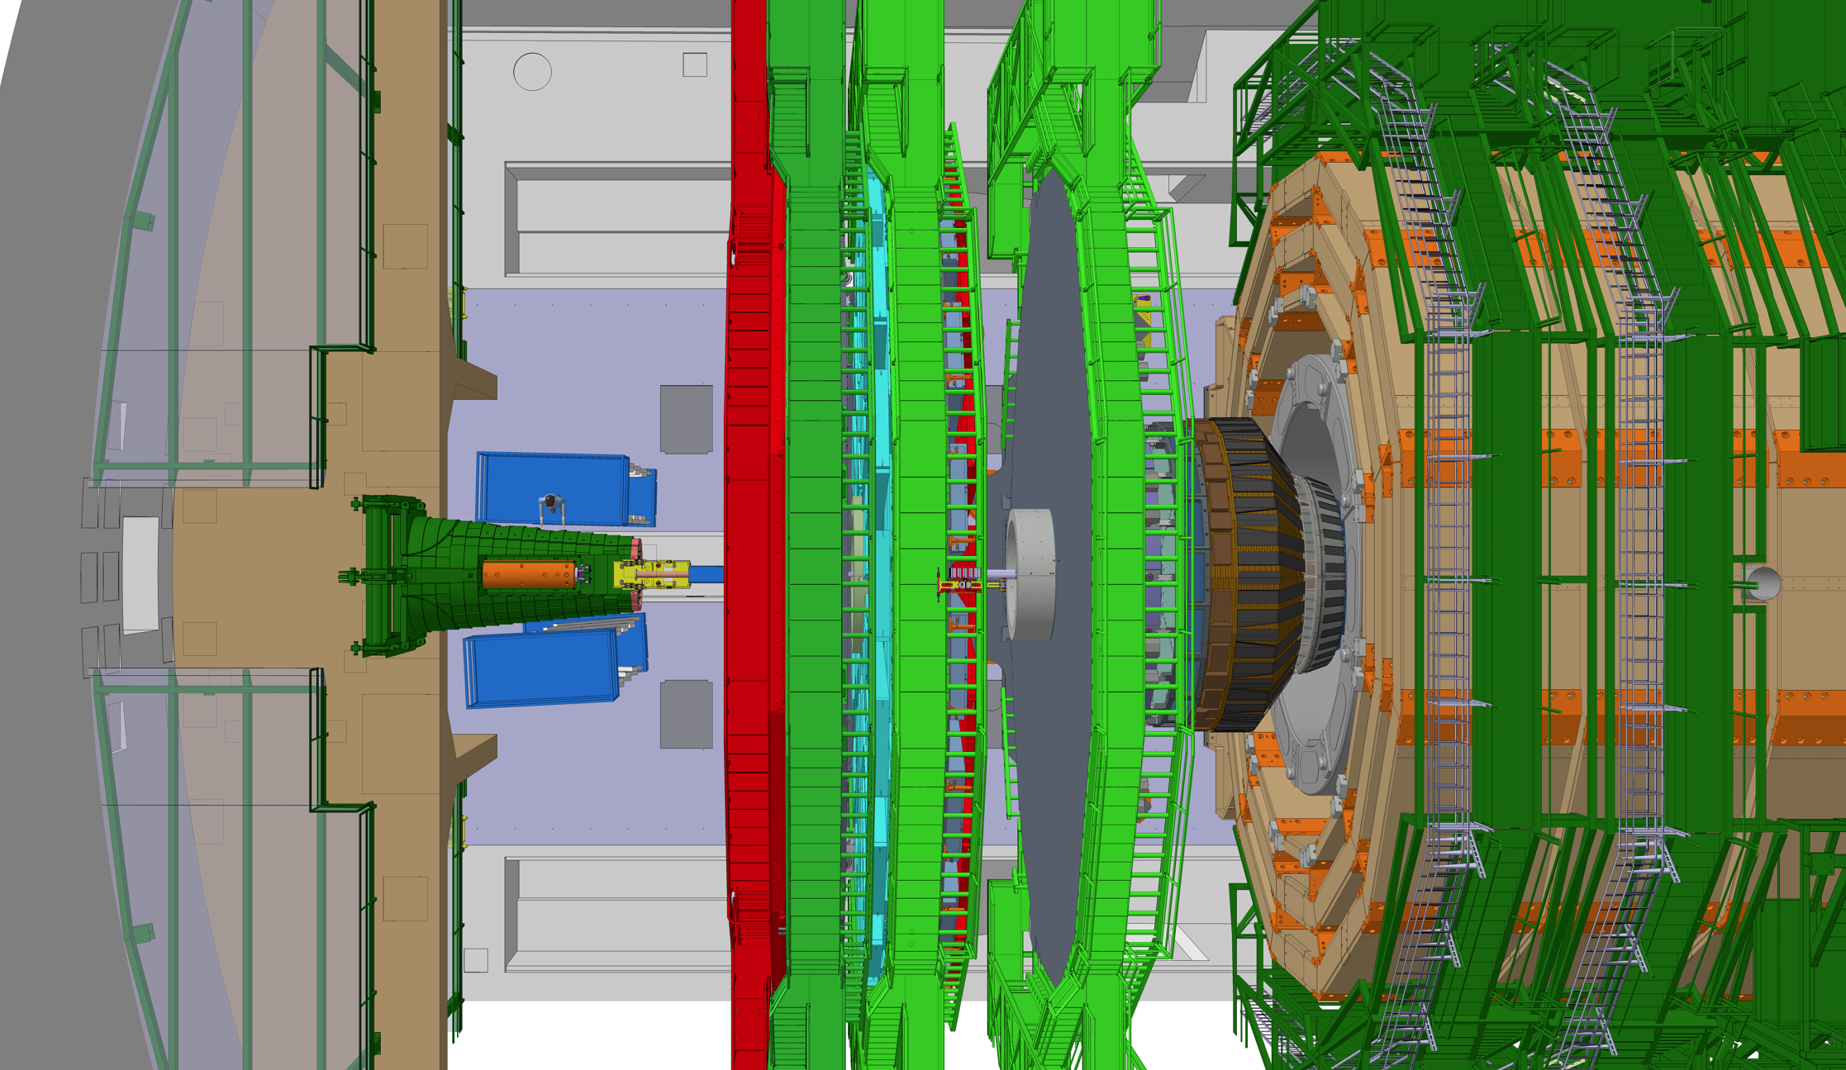
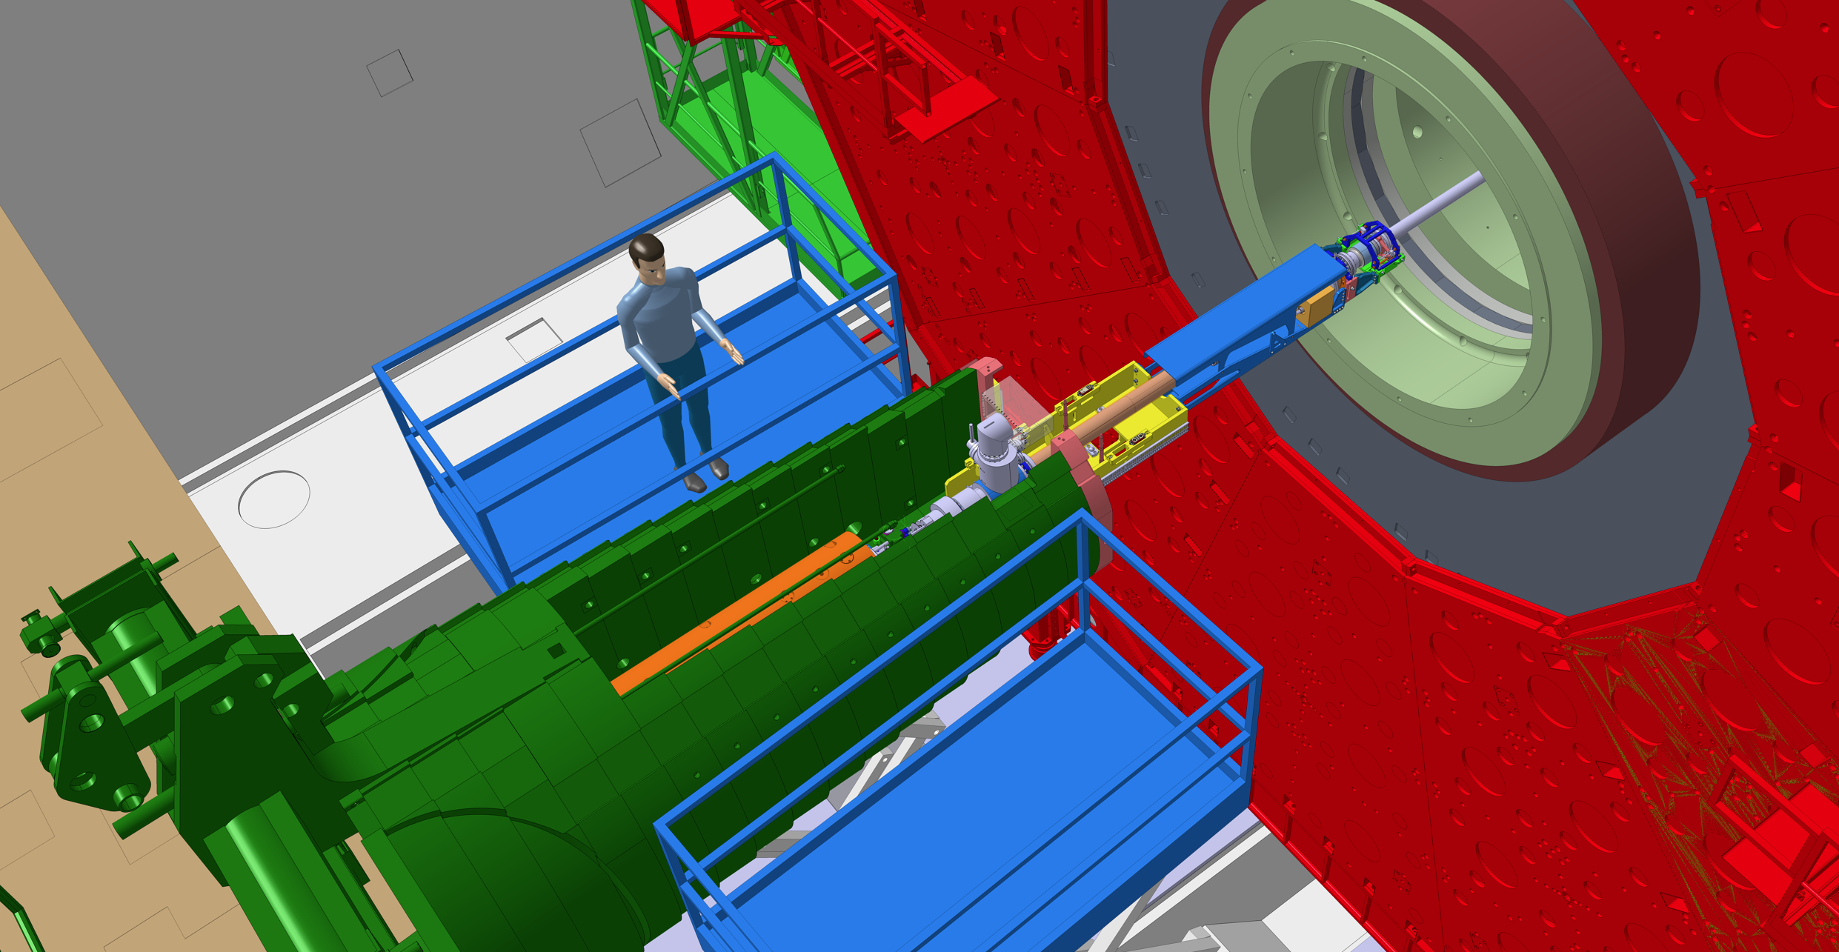
2nd window: March 2027
EP-CMX
BE-EA
EN-HE
TE-VSC
HSE-RP
CMS agreed to create a new access window later, before the nose removal.
This solution comes at a "cost" for CMS: approximately one additional week per endcap to move the Endcaps and free the TAS area.
Note: This window could also be used for the TAXS installation and would have the positive consequence of removing the TAXS installation from the CMS closure critical path at the end of the LS3.
However, this option was not retained because the fix nose needs to be drilled, which would delay the CMS schedule (see slide 14).
Agreed TAS removal windows:
Z- : 26th – 4th March 2027
Z+: 3rd – 9th March 2027

Slide 13
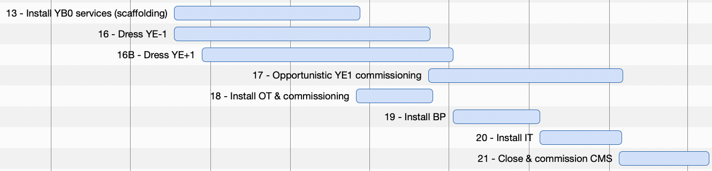
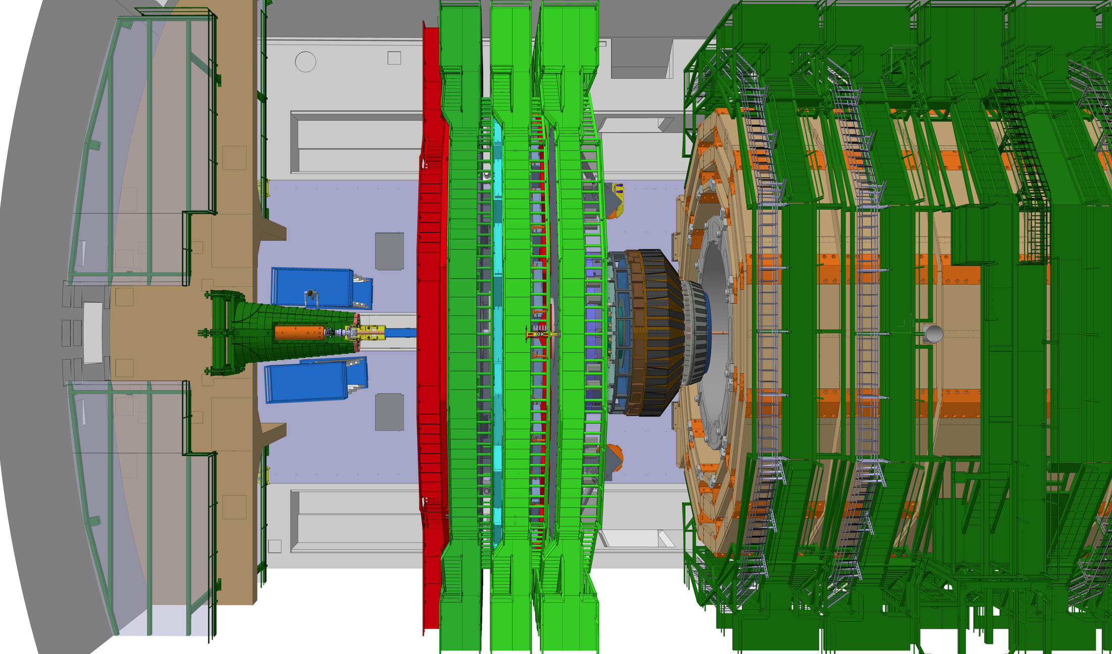
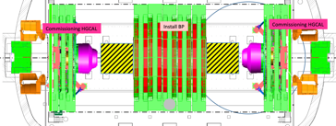
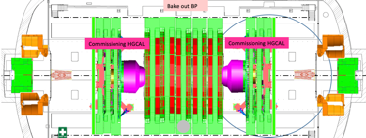
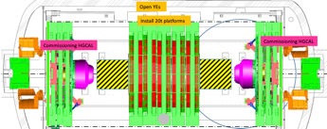
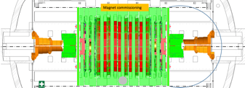
3rd window : June 2029
EP-CMX
BE-EA
EN-HE
TE-VSC
HSE-RP
The next chance to access the FWD region for TAXS installation is during the Beam Pipe installation sequence, in the 'bake-out' position.
Is it possible to find an installation window before?
No, because CMS endcaps need to be maintained fully open after TAS removal.
For more details, see full schedule and detector configuration on following link:
EDMS 3075524 v.4 file “241030_WS_combined.pptx”
Agreed TAXS installation windows:
Z- : 15th – 29th June 2029
Z+: 29th June – 13th July 2029

Slide 14
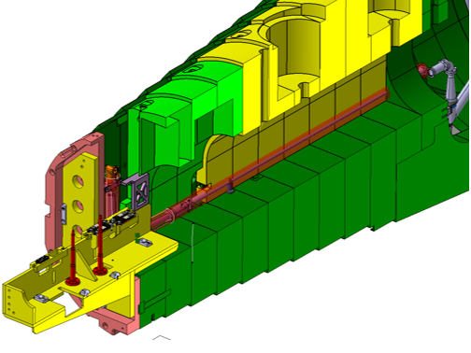
Proposed Installation Global Sequence CMS
Installation TAXS & M1 support
Installation piping (pumping lines & compressed air) & cabling
  From LHC [tbd]
  Inside UXC & TX1S
Connection TAXS to Q1
Installation M1
  Connection TAXS to M1
Installation VAXBOX w. M2,M3 & Fwd chambers→ inside CMS & TE-VSC Fwd chambers planning
  Connection M1 to M2
  Alignment VAXBOX
LHC & CMS schedules, needed for LHC commissioning

Slide 15
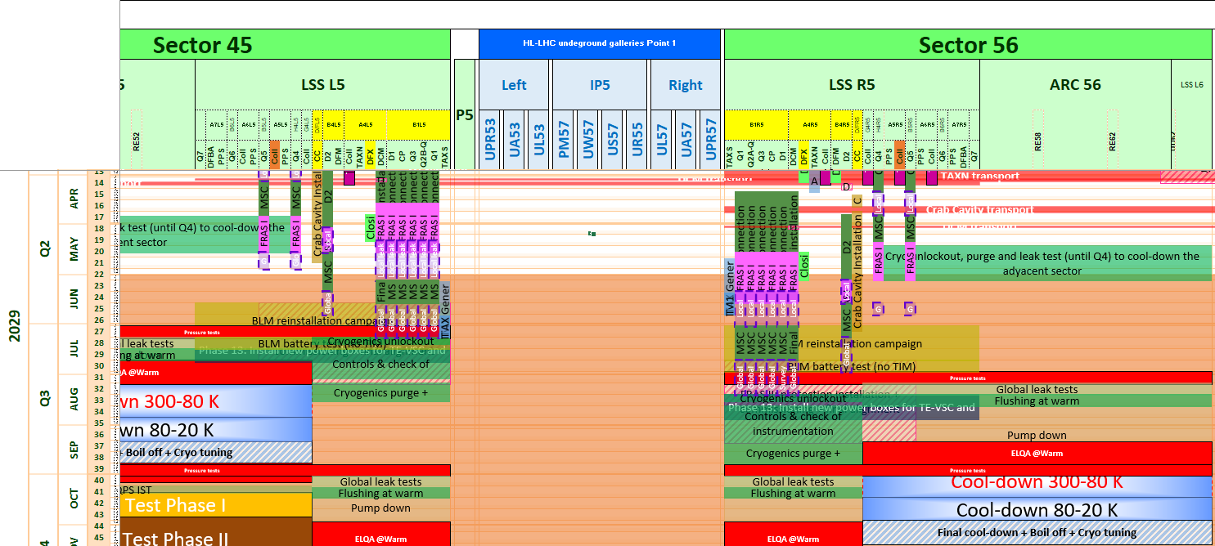
Does it match LHC schedule?
E. Vergara
Agreed TASX installation windows:
Z- : 15th – 29th June 2029
Z+: 29th June – 13th July 2029
Margin without impact on critical path
Margin without impact on critical path
Floating until the LHC critical path is impacted:
- R5: ~ 6 weeks
- L5: ~ 5 weeks

Slide 16
Conclusion
CMS UXC55 planning is sequential, and most CMS activities are carried out with the Endcaps open.
There are only very few possible windows to access the TAS region
So far, the LHC and CMS planning are aligned.
There is a float of approximately 5 to 6 weeks to install the TAXS before impacting the LHC critical path
However, CMS is currently working on the integration of several disruptions and updates to work packages that will directly impact the CMS critical path and reduce this float:
EN-EL maintenance
PSS Cons test
Details of Heavy Lifting procedure of HGCAL
…
Version 5 of CMS planning is expected to be released in September 2025: EDMS 3075524 v.4

