Slide 1






Funded by the European Union (EU). Views and opinions expressed are however those of the author only and do not necessarily reflect those of the EU or European Research Executive Agency (REA). Neither the EU nor the REA can be held responsible for them.
Can we rely on remote-handling interconnections?
Jose A. Ferreira Somoza, Cedric Garion
CERN

Slide 2
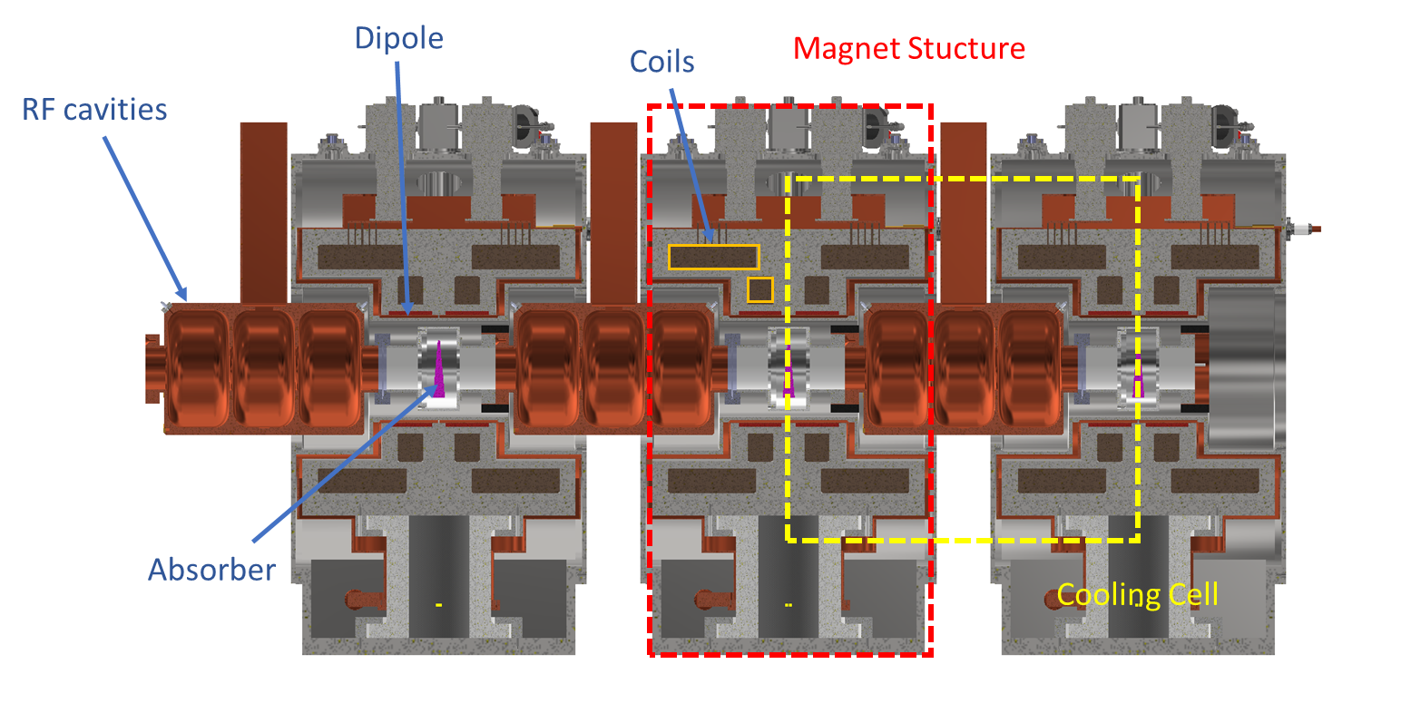
Introduction
Present design requires the remote connection of at least one flange inside the magnet structure
Very limited radial access (inside solenoid)
The connection shall allow the alignment of the cavities independently
The absorbers do not require vacuum, but very likely required to avoid differential pressure on the cavity windows
Mattia Castoldi, Review of the 1st cooling cell integration, 6 May 2025

Slide 3
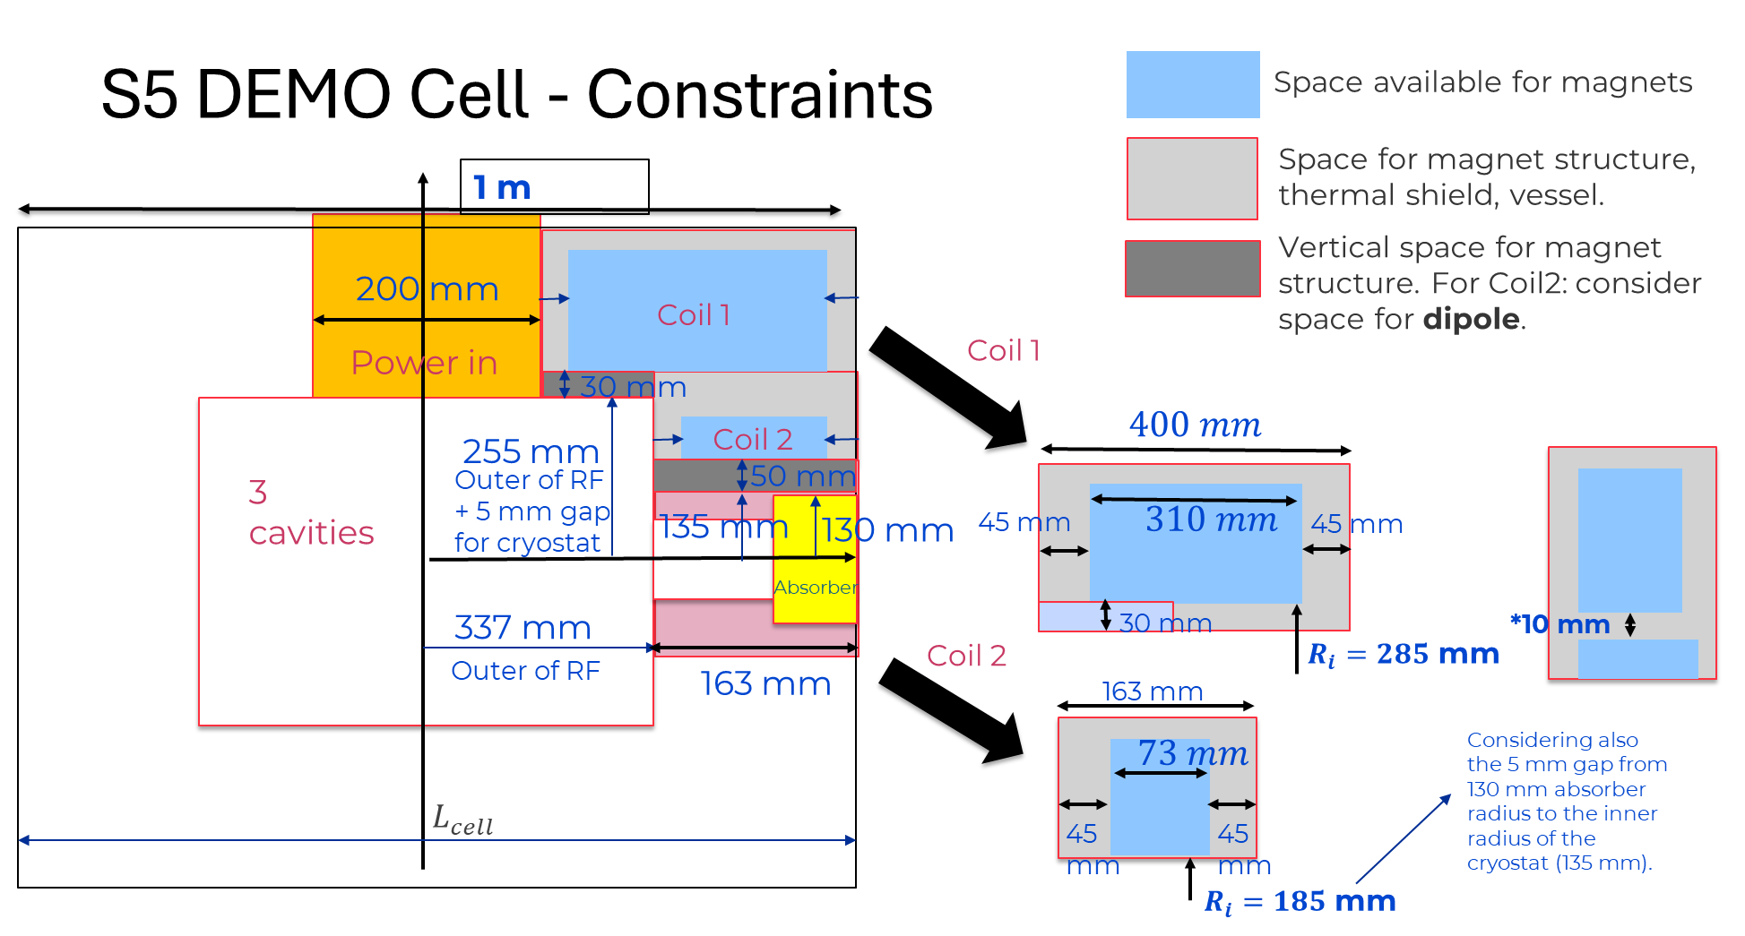
Introduction
Room temperature vacuum connections:
One side can be assembled before the cryostat is in place, DN120 (=> CF 202/150).
Other side has to be connected remotely once the cryostat is in place (Max. OD 270).
What are the possible solutions for this connection?
Giuseppe Scarantino, Review of the 1st cooling cell integration, 6 May 2025

Slide 4
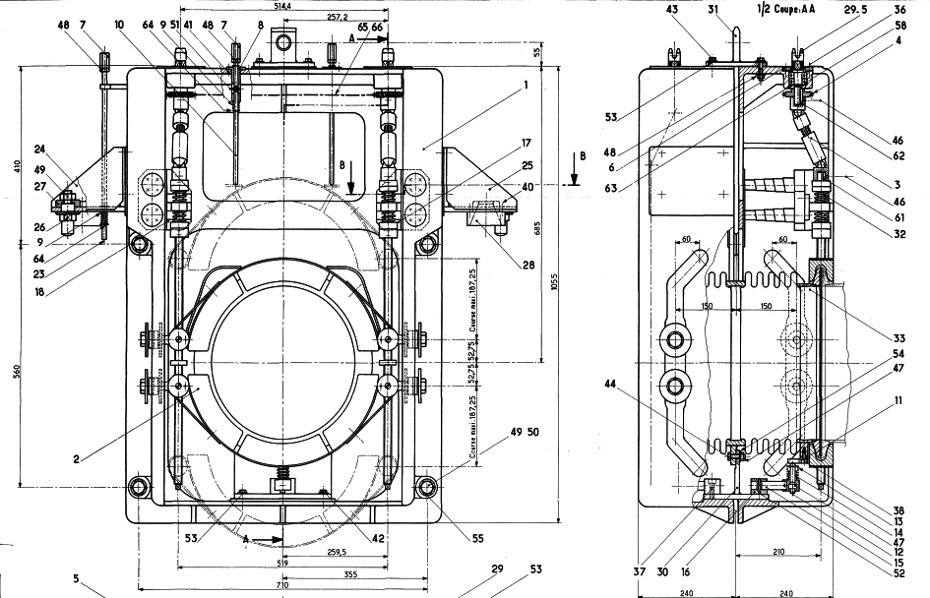
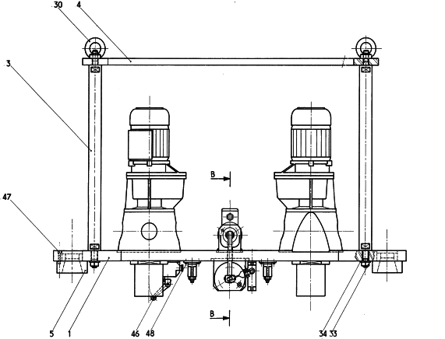
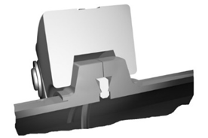
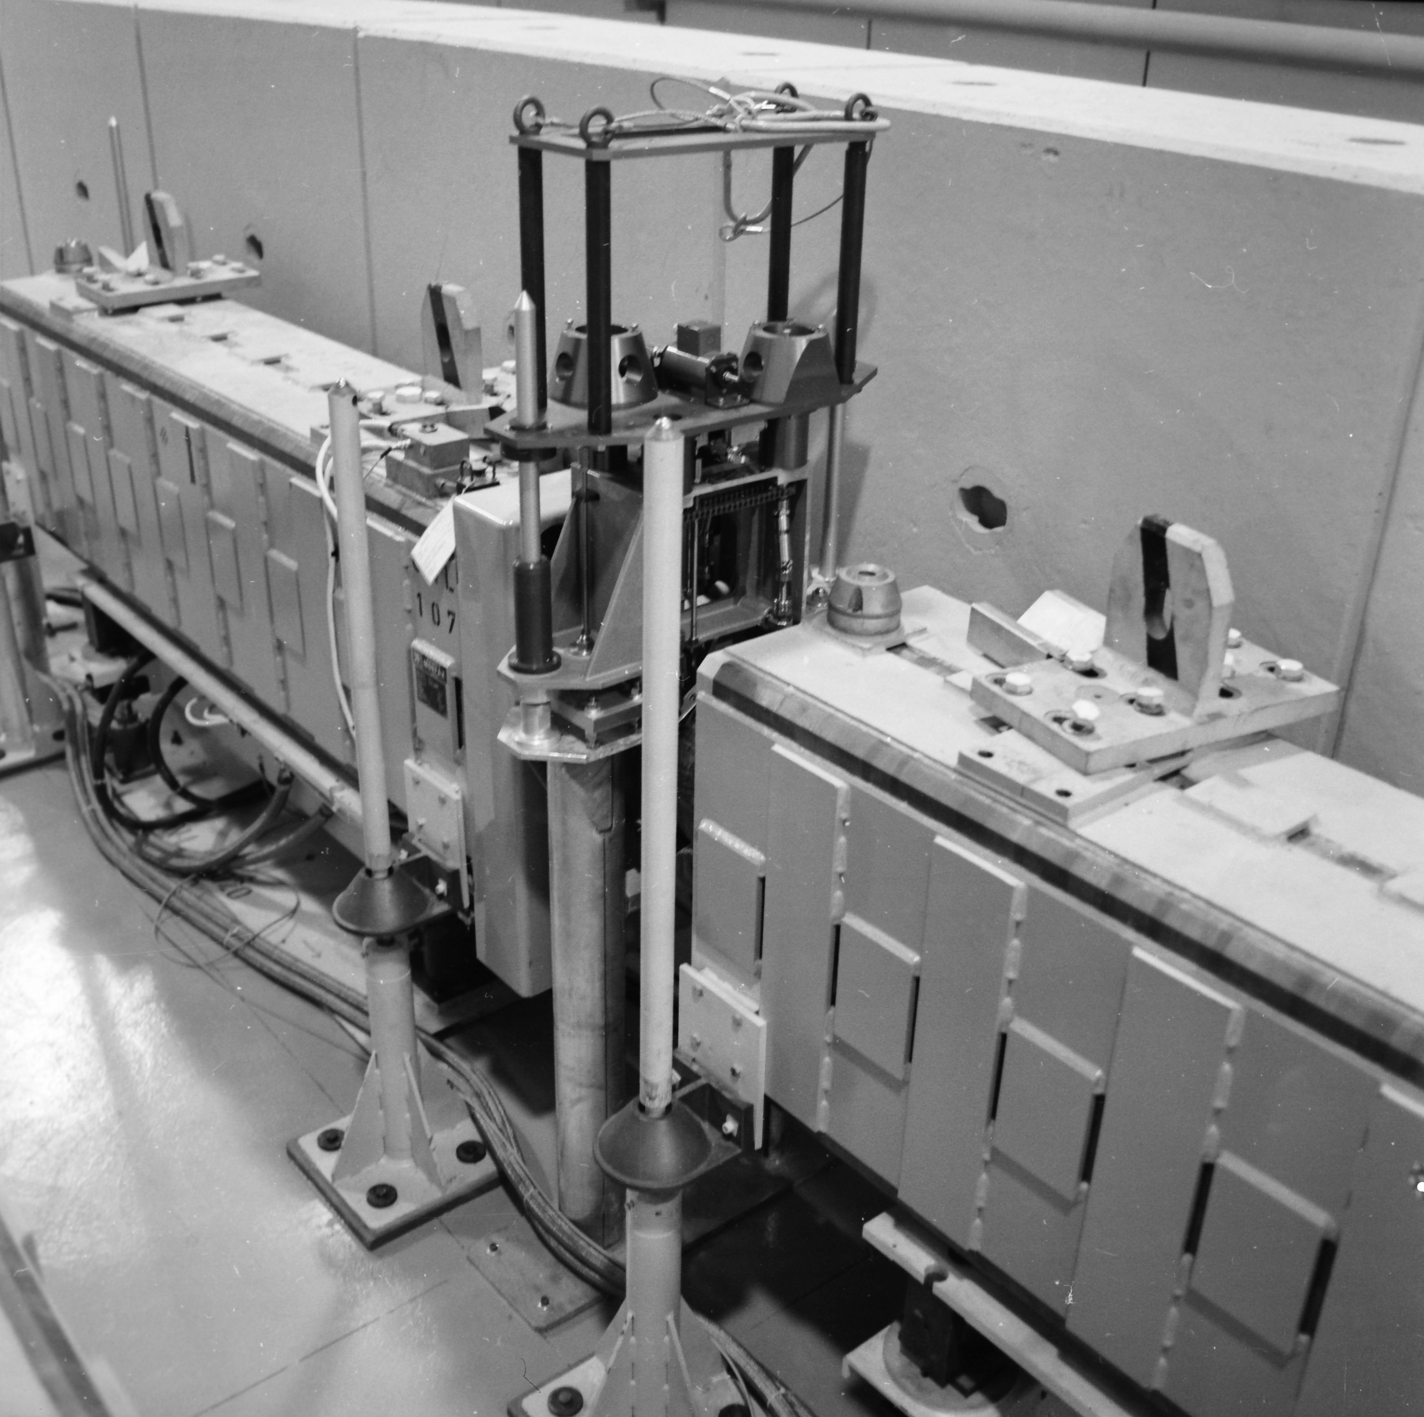
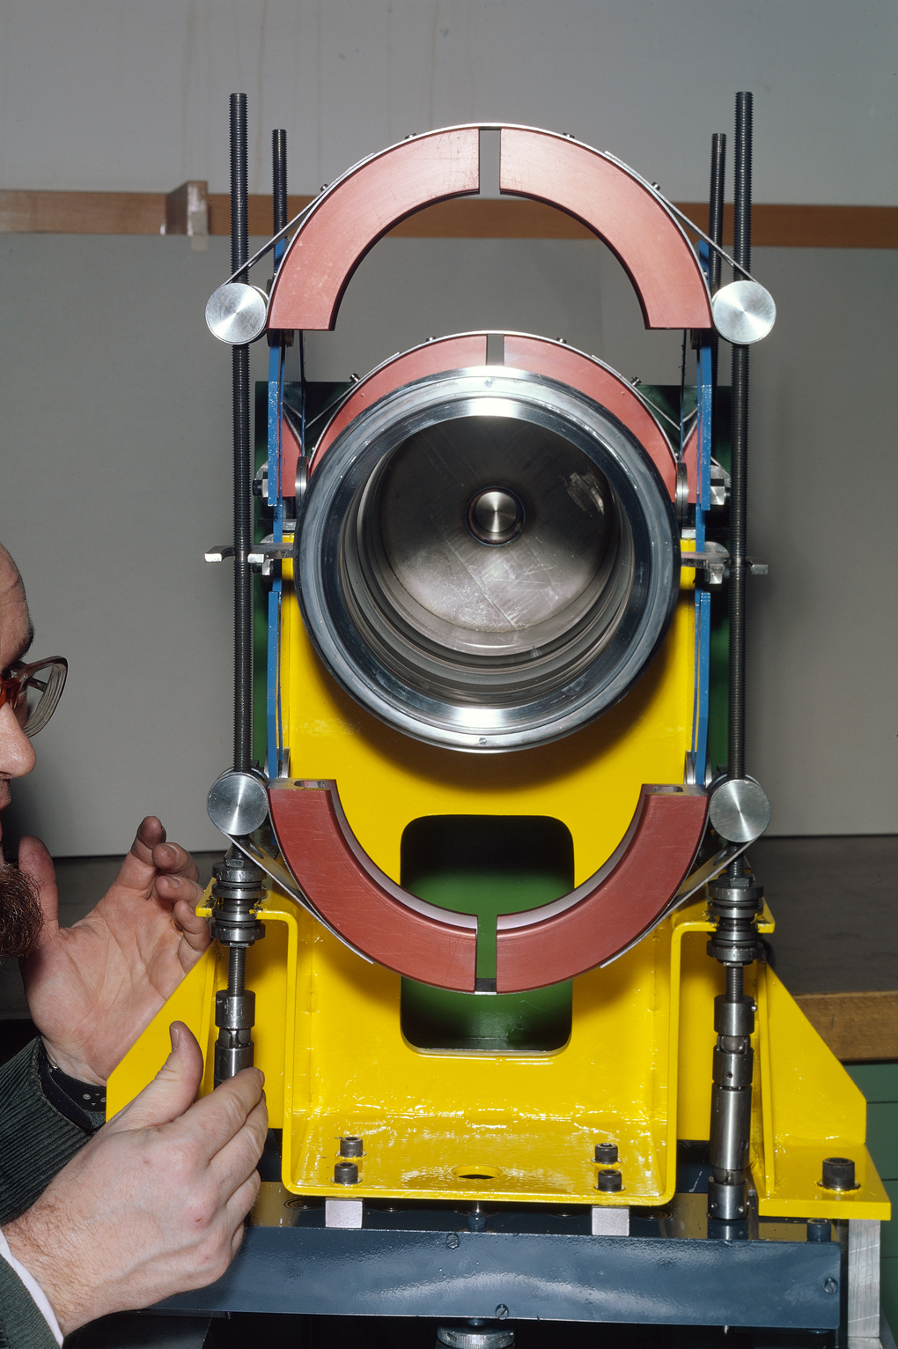
Automatized clamps/collars
1979 SPS clamp for remote handling: Two sizes DN159 and DN350 in double and single configuration NAHIF plugin magnet

Slide 5
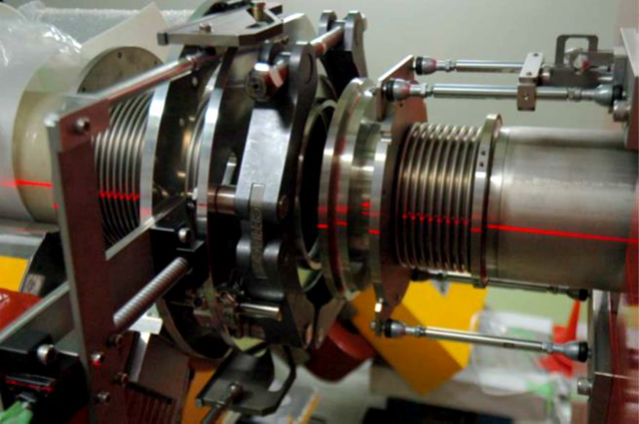
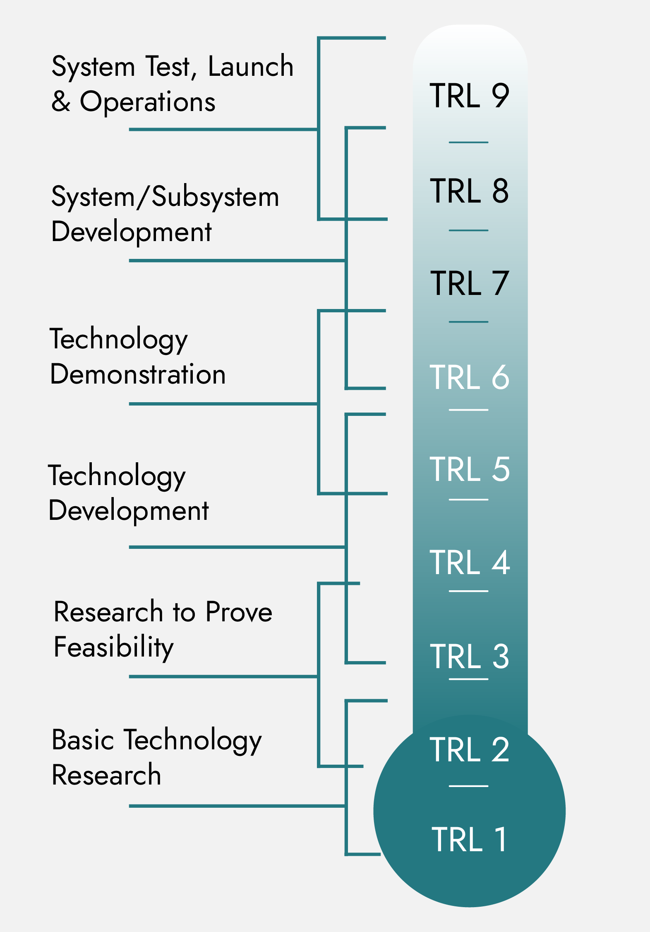
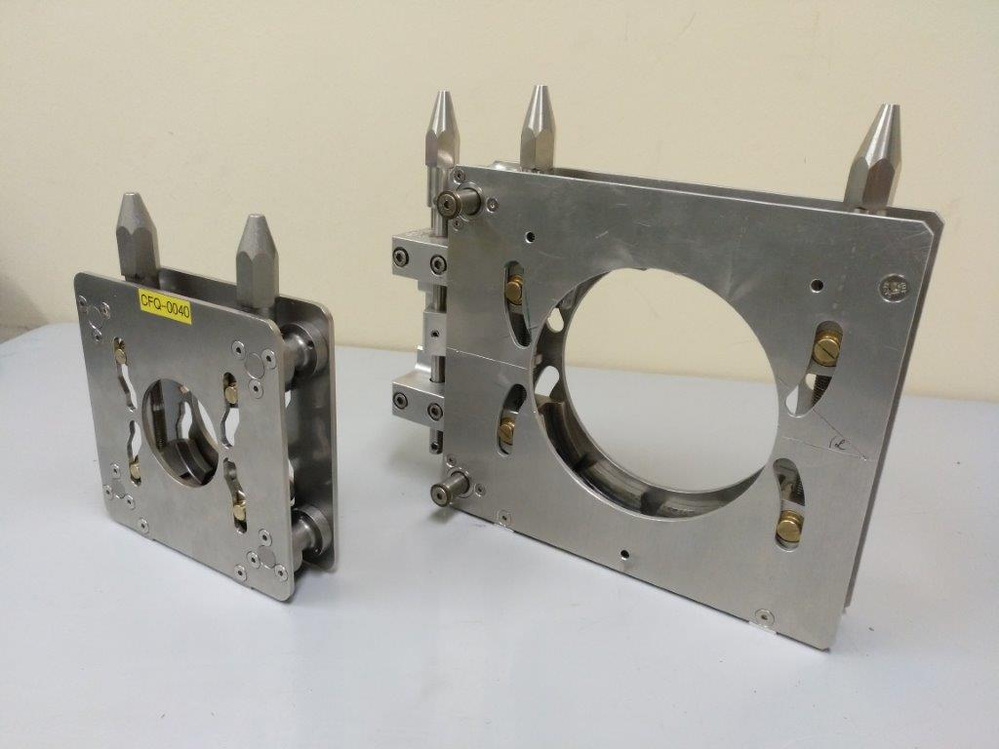
Automatized clamps/collars
J-PARC
Pros:
Similar systems widely used in different accelerators. Reliable and rely on well‑known proven technology, but difficult to integrate in the limited space (TRL 5-6)
Once it is closed no risk of losing tightness. Can tolerate moderate external forces
Cons:
Require a significant radial space. Even a full redesign of the solution may not be enough
CERN

Slide 6
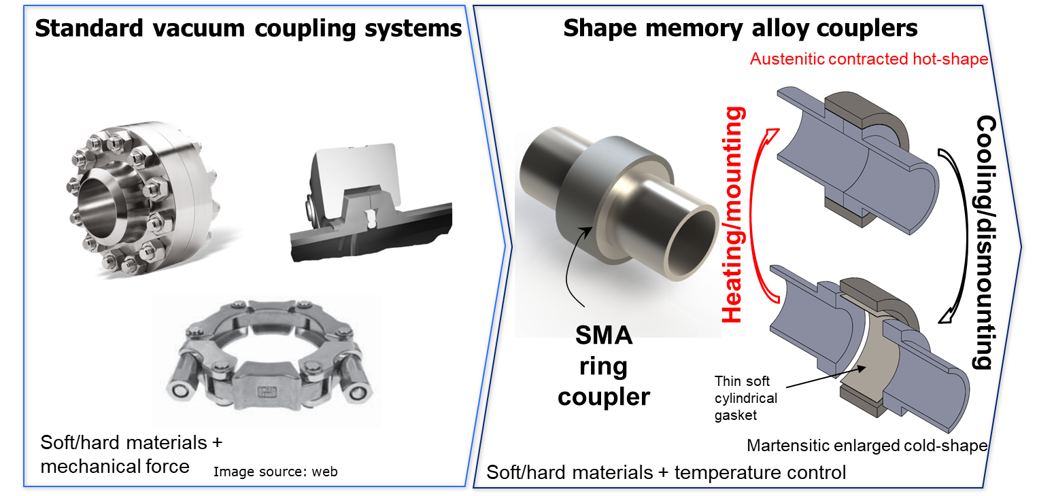
Shape Memory Alloys
Sealing by temperature control
Radial sealing force, self equilibrated
Typical specific sealing contact pressure: ≈10 Mpa
Material properties:
NiTi based alloys
Magnetic permeability < 1.002
Thermal outgassing: <10^{‑13} mbar×l×s⁻¹×cm⁻²
Radiation hard
Corrosion resistant

Slide 7
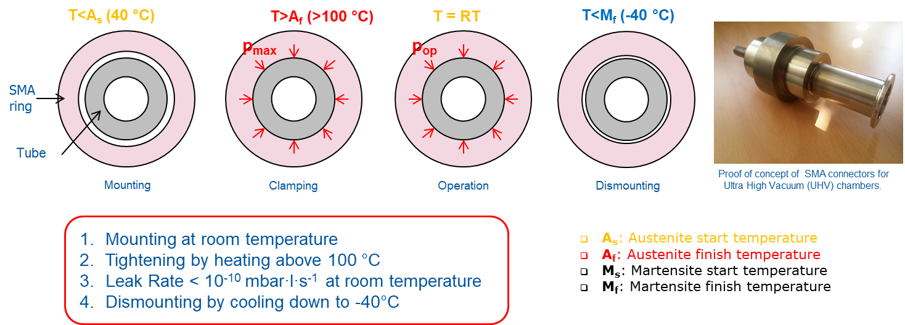
Shape Memory Alloys
Pros:
Tests at prototype level in relevant environment, but limited operational experience (TRL 3-4)
Very compact radial integration
No requires mechanics inside the solenoid
Cons:
Not developed at the size required
While heating is simple, cooling at -40°C requires specific systems (i.e. circulate acetone in cooling bath with dry ice, -77°C)
More demanding alignment tolerances and surface finishing
Seal insertion/replacement has to be addressed
Limited operational experience
Presently limited to ≈130 mm ID Ring

Slide 8
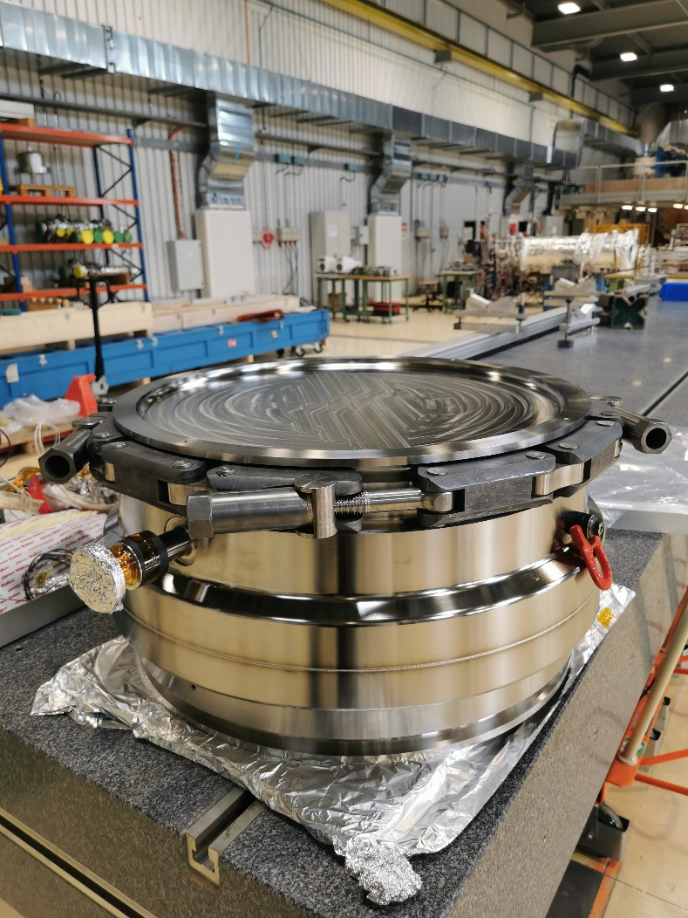
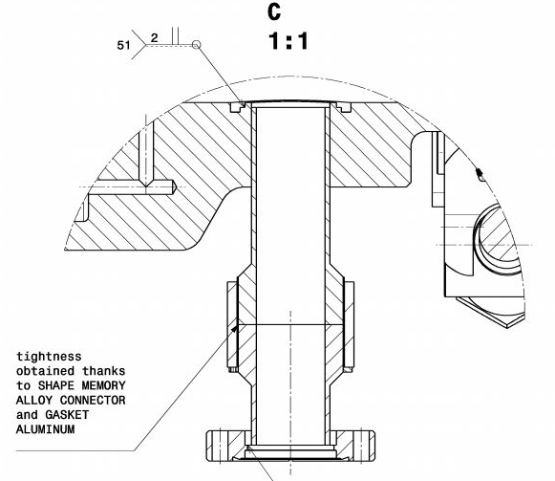
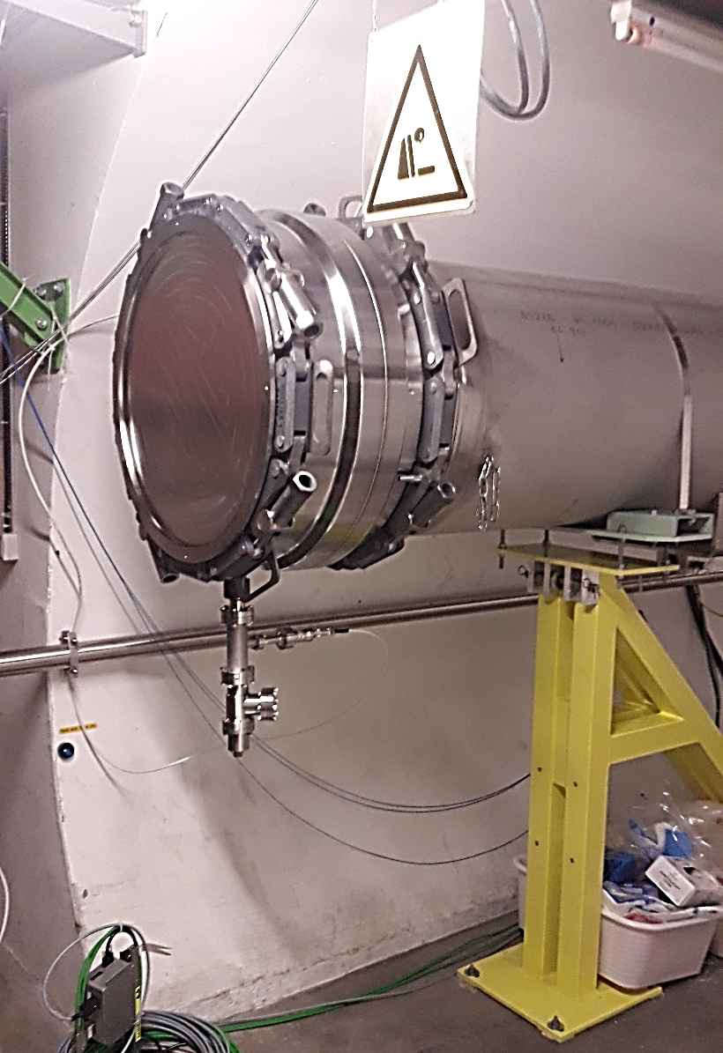
Shape Memory Alloys
SMA joint (Ti-St transition)
Conflat St flange (to connect pump/gages)
Ti window

Slide 9
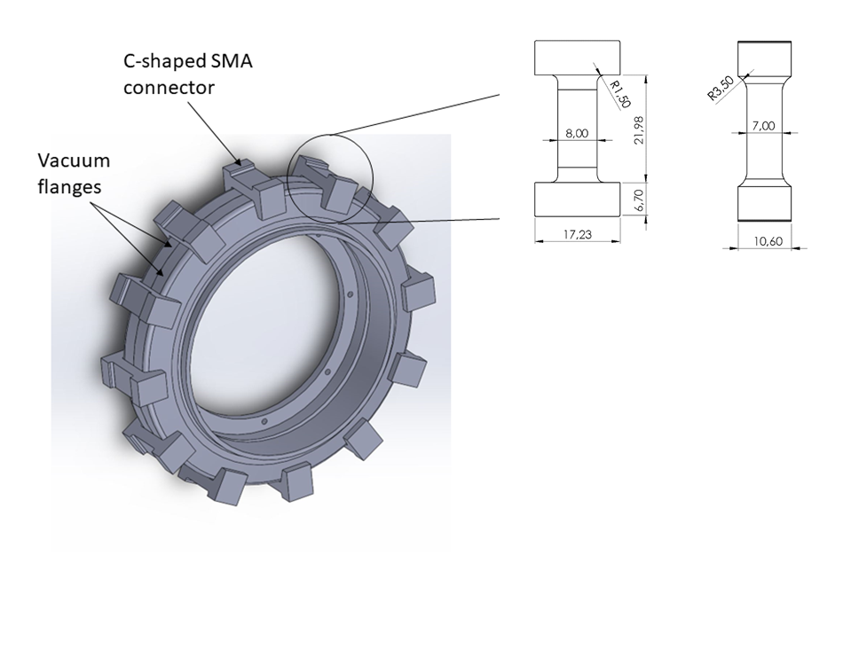
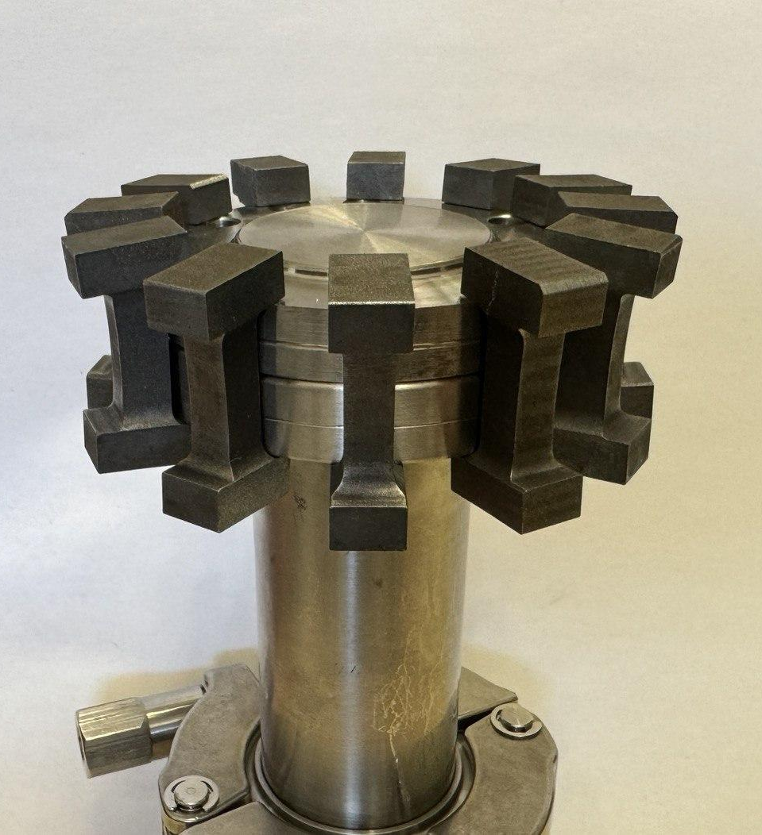
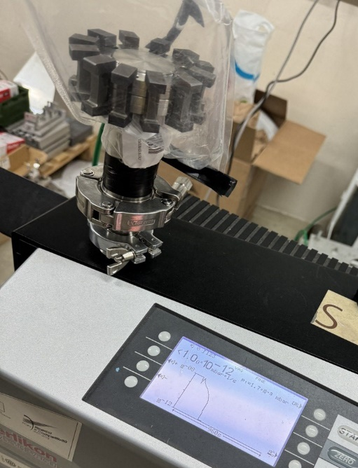
SMA C-Shaped connectors
Pros:
Proof of principle demonstrated (TRL 2-3)
Very compact radial integration
Combines classic seals and flanges with SMA (i.e. use of reusable elastomer seals)
Cons:
While heating is simple, cooling at -40°C requires specific systems (i.e. circulate acetone in cooling bath with dry ice, -77°C)
The positioning of the C-shape connectors and its movement to be addressed
No operational experience
Leak rate < 10⁻¹⁰ mbar×l×s⁻¹

Slide 10
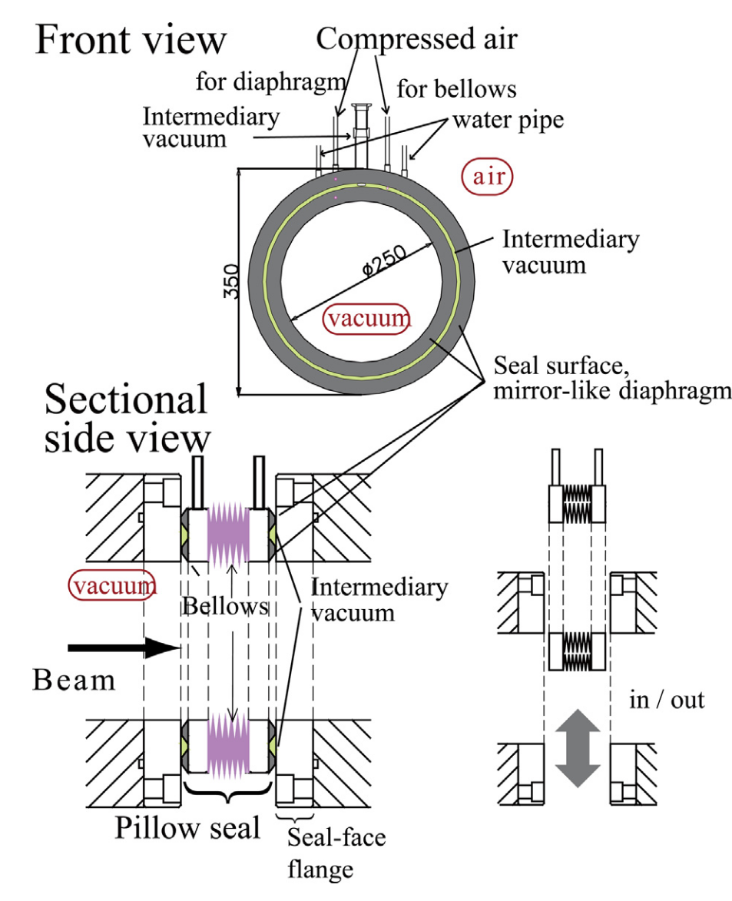
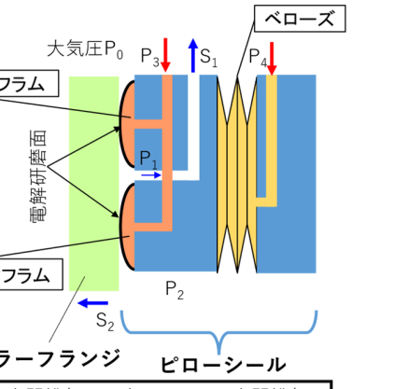
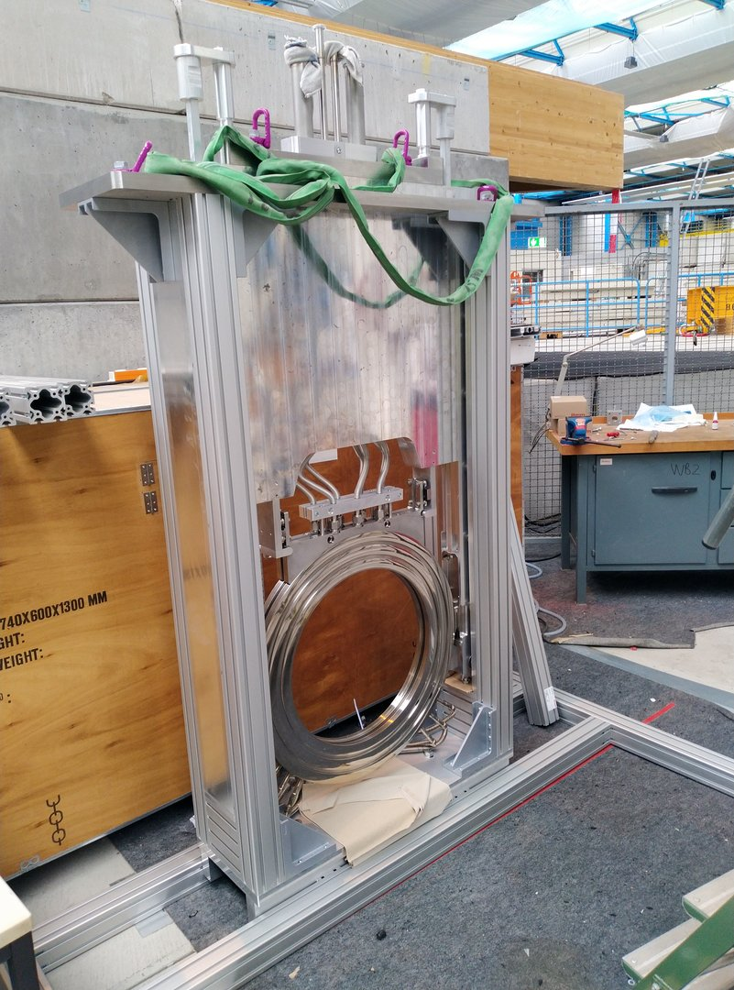
Pillow seals
Metal to metal sealing:
Compressed air in a space between two edge welded bellows (limited force)
Compressed air on the membranes (pillow) in contact with the other surface
Vacuum in the interspace between the two membranes
Typical pressure 3 bar
Commercially available for hard radiation areas (all metal no friction manipulation from outside)
Experience => PSI, GSI, J-PARC, etc.
[1] Kurasaki, Ruri et al In Proceedings of the 19th annual meeting of Particle Accelerator Society of Japan, pp. 521-525. 2022.
[2] K. Tanaka, N. Inabe, K. Yoshida, K. Kusaka, and T. Kubo, Nucl. Instrum. Methods Phys. Res. B: Beam Interact. Mater. At. 317, 734–738 (2013).

Slide 11
Pillow seals
Pros:
Available (TRL 8)
Compact radial integration
Simple operation
Could manage certain misalignment
Cons:
Surface finishing important (but not critical thanks to the intermediate pumping)
The double seal and intermediate pumping requires a significant radial space
Compressed air shall be guaranteed
[1] Kurasaki, Ruri et al In Proceedings of the 19th annual meeting of Particle Accelerator Society of Japan, pp. 521-525. 2022.
[2] K. Tanaka, N. Inabe, K. Yoshida, K. Kusaka, and T. Kubo, Nucl. Instrum. Methods Phys. Res. B: Beam Interact. Mater. At. 317, 734–738 (2013).
[3] N. Kurichiyanil, A. Bergmann, C. Karagiannis, et al., J. Phys. Conf. Ser. 2687(8), 82031 (2024).

Slide 12
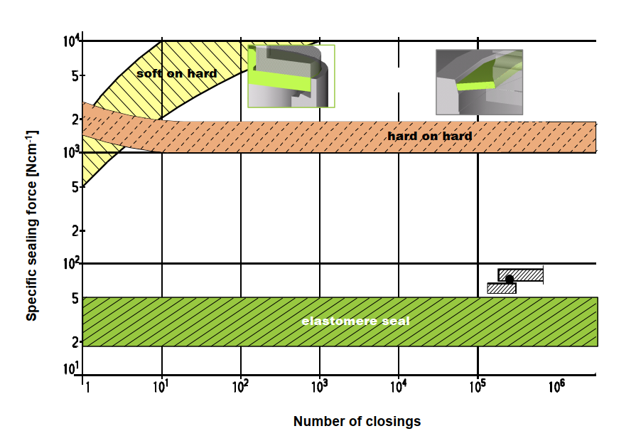
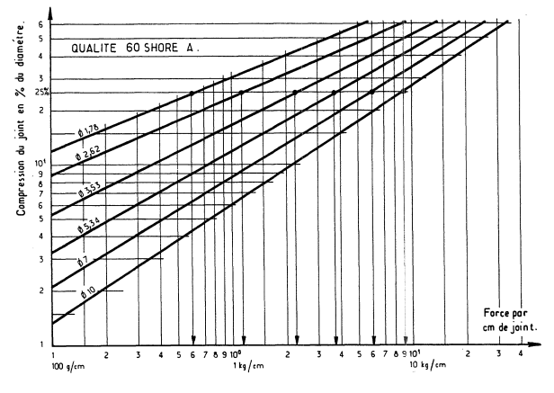
O-ring based pillow seal
Moving to elastomer seals relaxes significantly the requirements

Slide 13
O-ring based pillow seal
Disconnection
O’ring
Absorber flange
Bellows
Cavity flange
Vacuum
Ø150mm
Ø230mm
O-ring: Ø 3.5 mm
Compression 20% => ≈2 kg/cm
Total force (two O-ring) → < 240 kg
ΔP → 1 bar (spring force not considered)
Single O-ring seems also feasible (no interspace vacuum) => Increase pressure may reduce space between the internal and external bellow => Less radial space
Connection
Interspace pumping
Pressure

Slide 14
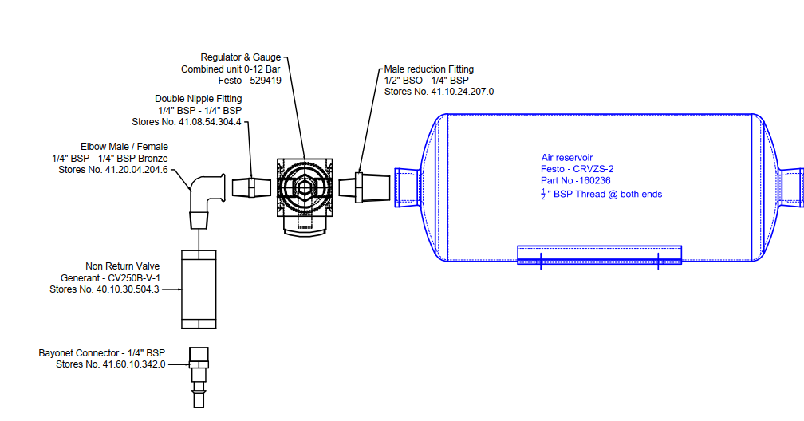
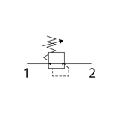
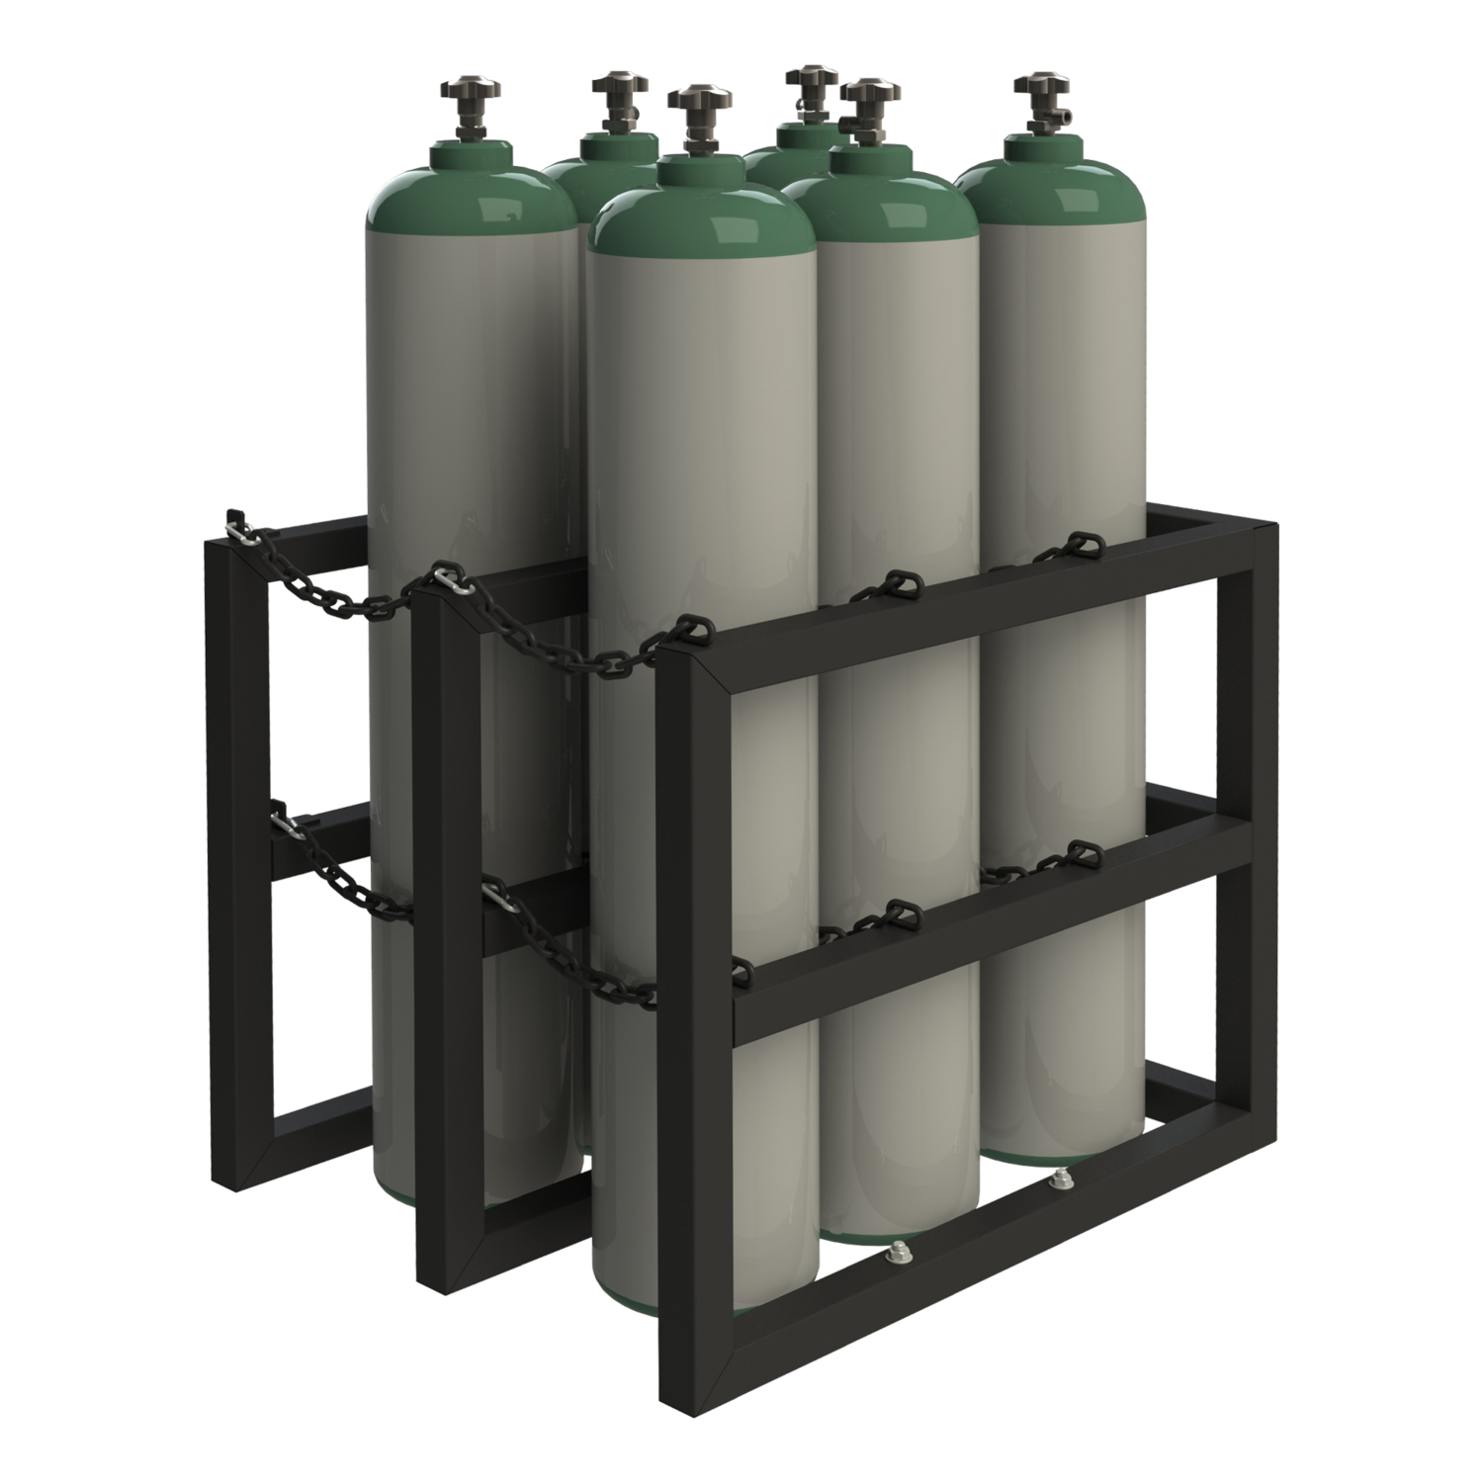
Compressed air availability
Comment from WP8 review: Concerns about compressed air supply
Option 1: Ensure compressed air availability
Use small accumulation volume (pillow seal <10 l) + check valve connected to the compressed air line + backup line fed with bottles
Option 2: Add a locking mechanism (i.e. pneumatic latch)
To bellows
NO valve

Slide 15
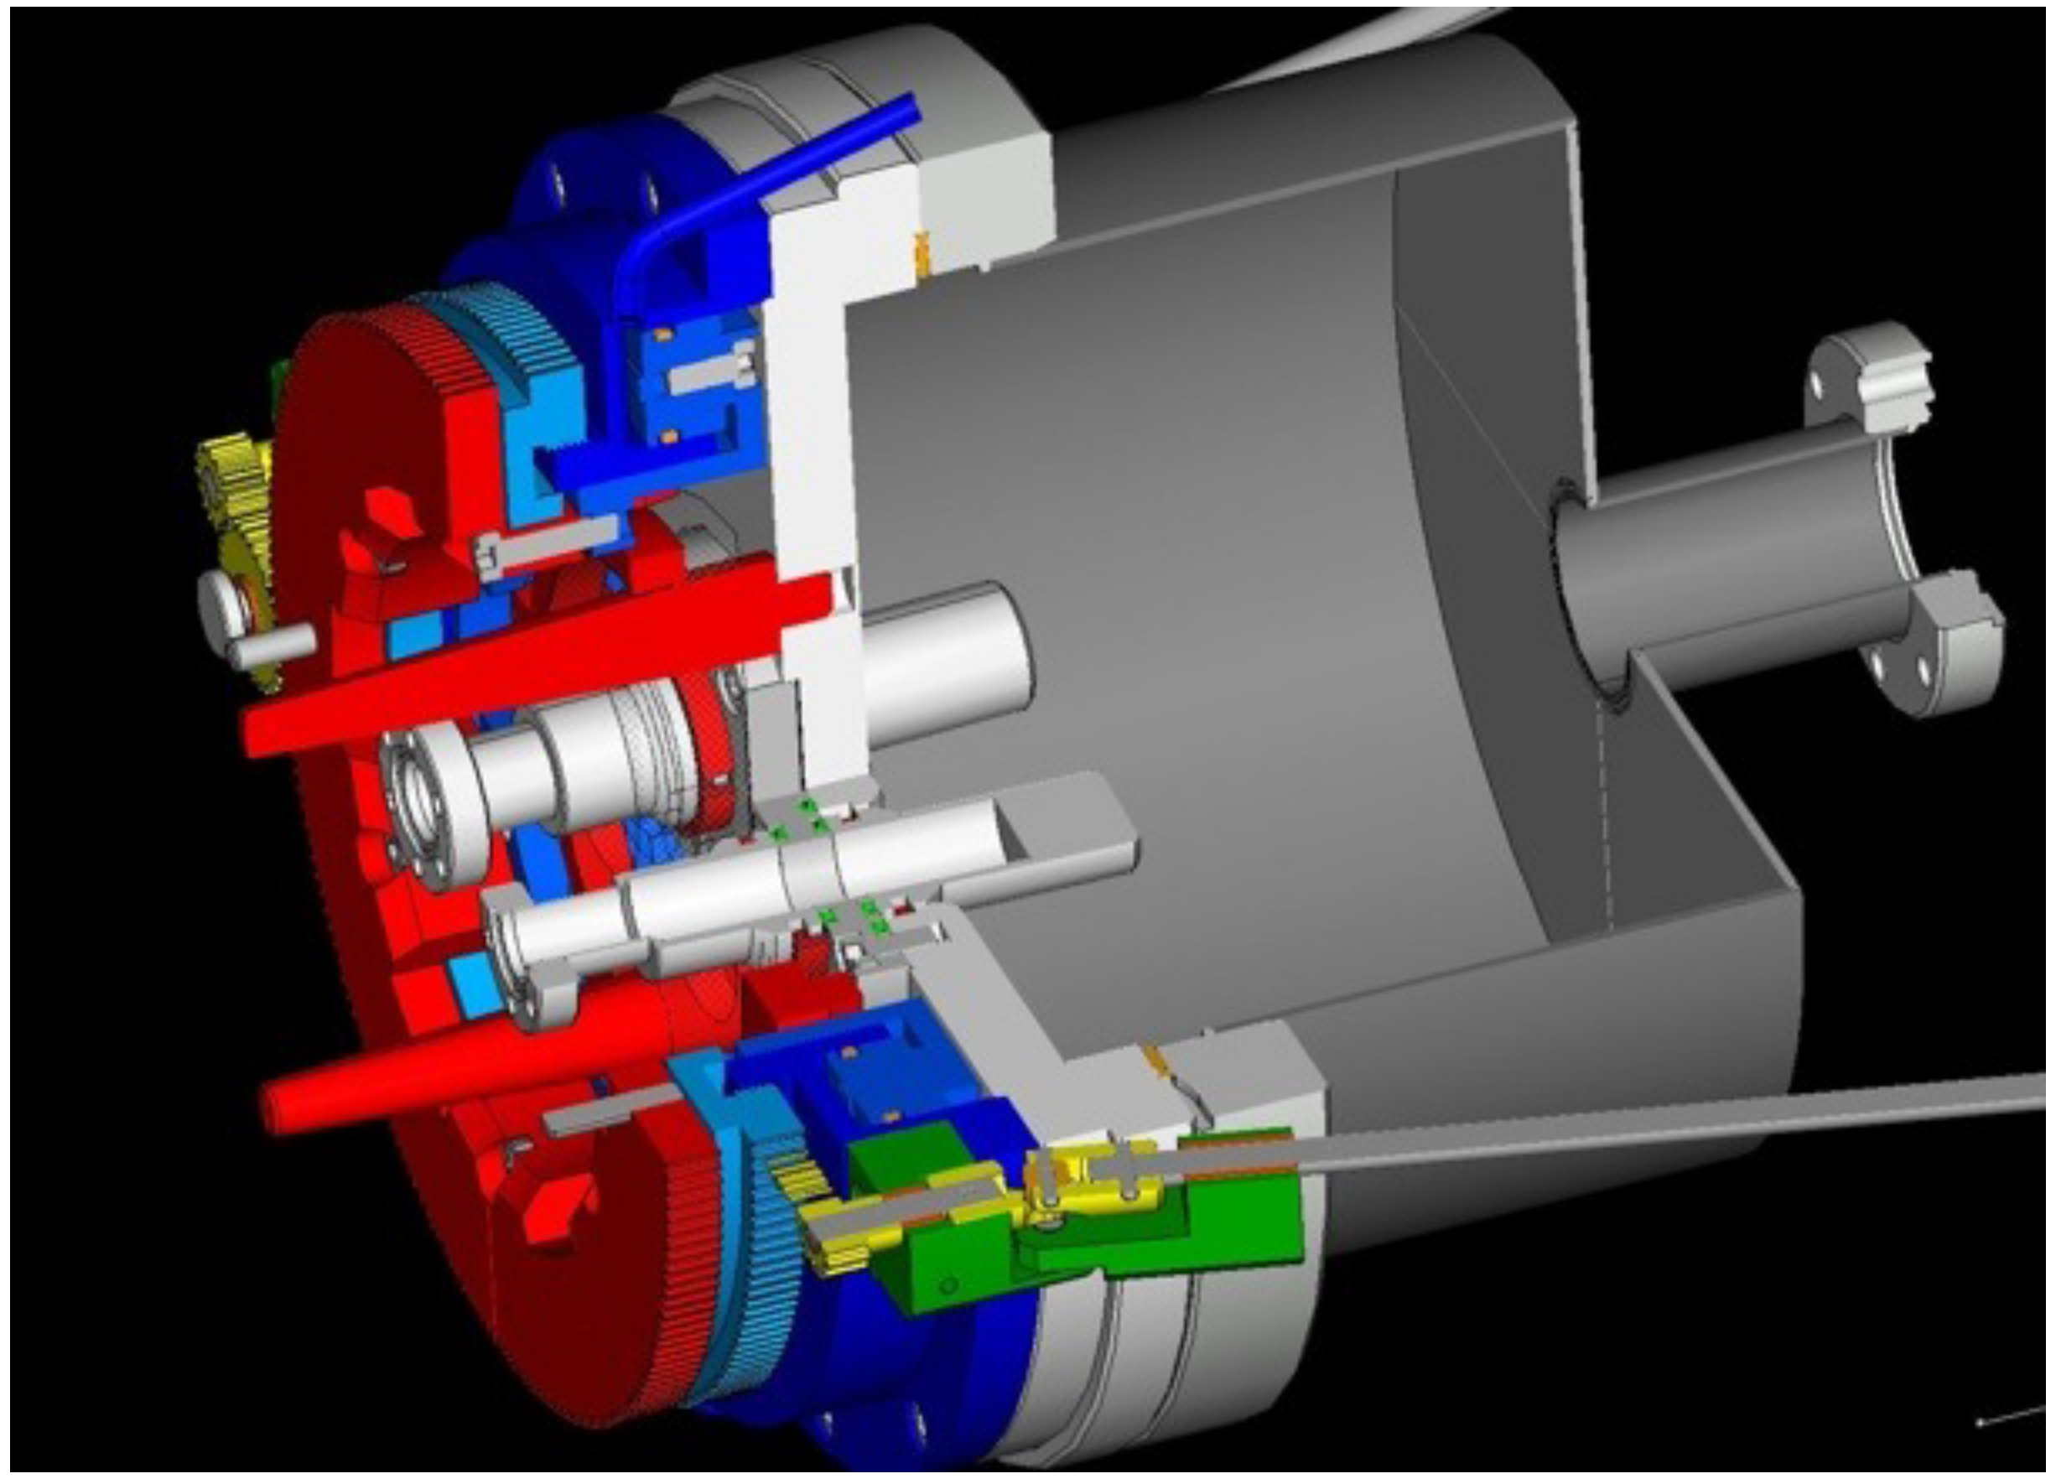
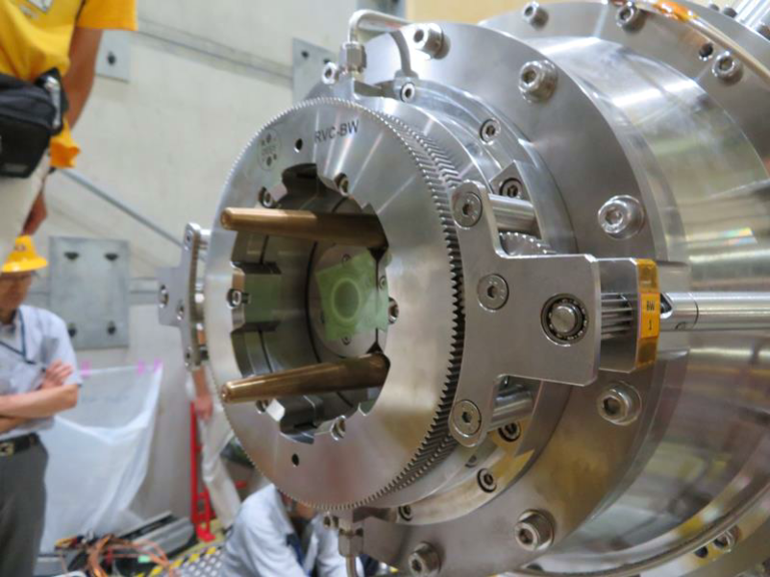
Other concepts
Remote Vacuum Connection at DESY (Belle collaboration)
Combination of pneumatics + mechanical system for locking permanently
https://indico.mpp.mpg.de/event/1636/contributions/1418/

Slide 16
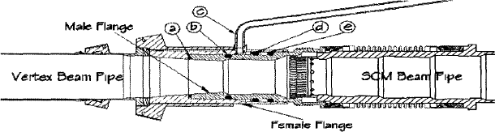
Other concepts
Differentially pumped radial flange
[1] Y. Li, J.J. Cherwinka, Y. He, and N.B. Mistry, “A novel differentially pumped UHV flange in the CESR interaction region,” in PACS2001. Proceedings of the 2001 Particle Accelerator Conference (Cat. No.01ch37268), (2001), pp. 3514–3516 vol.5.

Slide 17
What about pumping?
Two separate volumes: Absorber and RF cavity
RF cavity:
Pumping and instrumentation on the waveguide => To be checked if that is enough
Absorber:
Small tube for primary pumping and monitoring
Pumpdown from atmospheric with both volumes connected (control ΔP) to avoid damaging the RF windows
Control system to ensure the ΔP do not exceed a certain threshold that could damage the window => Safety valve connecting both volumes

Slide 18
Summary
Standard solutions require significant radial space and require a considerable integration effort
Innovative concepts like SMA connections are not available in that size and significant R&D required before use
Pneumatic actuated bellows combined with elastomer seals seem a good compromise due to its simplicity and the relaxed requirements => A prototype is required
Other options should be explored while the design evolves, including the immersion of all the elements into the insulation vacuum (absorbers and cavities) => Maintainability? Power dissipation? Complexity?
The integration of the vacuum system (pumping and instrumentation) is still pending.
All the different volumes (sectors) separated just for RF windows => Behaviour in case of accidental venting? Sectorization?

Slide 19
Thank you!

