Slide 1



Cryogenics for the cooling cell magnets
P. Borges de Sousa, T. Koettig, R. van Weelderen
IMCC: Cooling Demonstrator Workshop, 5-7 November 2025, Milan, Italy

Slide 2
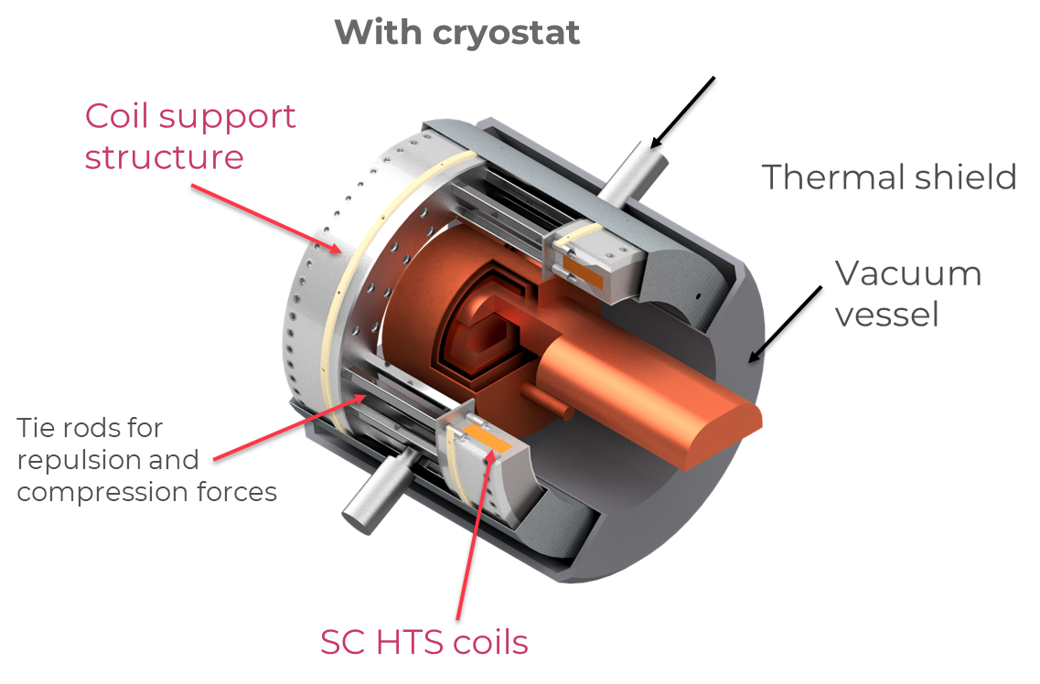

Introduction
As we start to have some preliminary numbers on heat loads for the magnets in the RF Magnetic Field Test Facility (RFMFTF), as well as the required temperature levels, we will try to lay out a few options on how the cryogenic system for the RFMTF could look like, considering that:
There is limited space available
There is no existing He/cryo infrastructure
Please keep in mind that:
The design of the magnet cryostat is at an early stage and being updated,
the heat loads are likely to change → this can affect ideal solution
The options for cooling infrastructure discussed here have not been
validated w.r.t. installation, cost, etc..
They are shown merely for discussion!
Artist’s rendering of an RF Magnet cell
courtesy of
M. Statera (link)

Slide 3
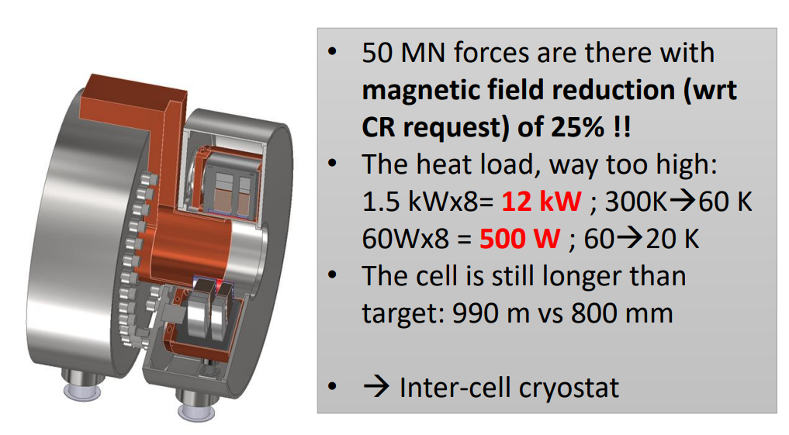
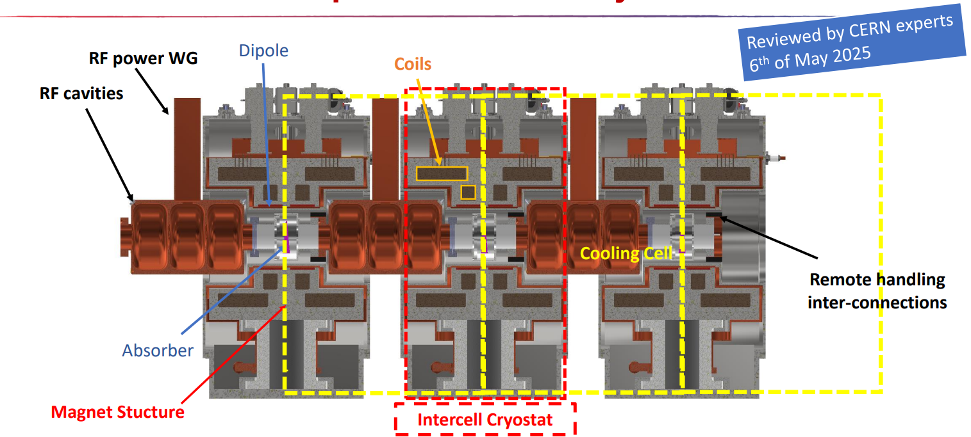
Changes since Fermilab workshop end of ’24
Heat loads on the previous design were excessively high
Concept of ‘inter-cell cryostat’ developed and reviewed – forces intercepted at cold
Breakdown of heat loads at the different T levels to come soon – update will come soon, and cooling strategy will be updated/refined

Slide 4
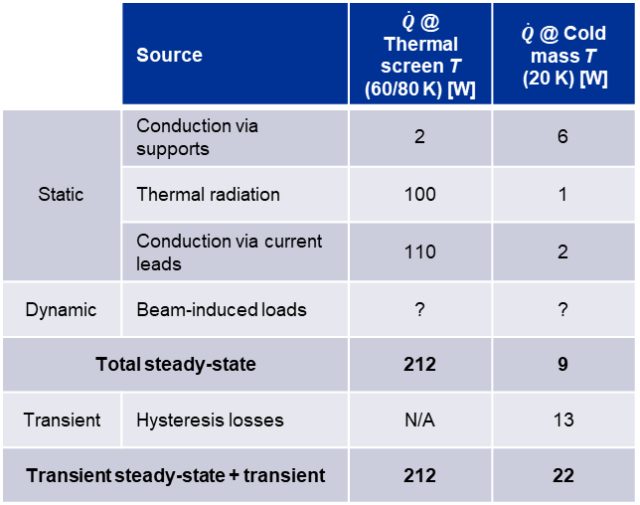
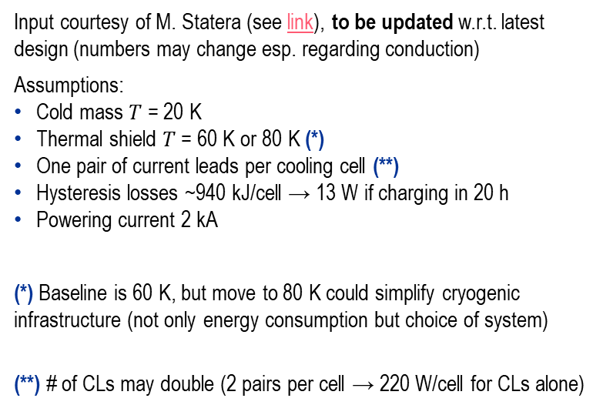
Preliminary heat load estimation for one cell
Values from Jan 2024 – to be updated
Input courtesy of M. Statera (see link), to be updated w.r.t. latest design (numbers may change esp. regarding conduction)
Assumptions:
Cold mass $T$ = 20 K
Thermal shield $T$ = 60 K or 80 K (*)
One pair of current leads per cooling cell (**)
Hysteresis losses ~940 kJ/cell → 13 W if charging in 20 h
Powering current 2 kA
(*) Baseline is 60 K, but move to 80 K could simplify cryogenic infrastructure (not only energy consumption but choice of system)
(**) # of CLs may double (2 pairs per cell → 220 W/cell for CLs alone)
Values per cell !
 | Source | $\dot{Q}$ @ Thermal screen T (60/80 K) [W] | $\dot{Q}$ @ Cold mass T (20 K) [W]
Static | Conduction via supports | 2 | 6
 | Thermal radiation | 100 | 1
 | Conduction via current leads | 110 | 2
Dynamic | Beam-induced loads | ? | ?
Total steady-state |  | 212 | 9
Transient | Hysteresis losses | N/A | 13
Transient steady-state + transient |  | 212 | 22
For 30 cells:
6.4-9.7 kW @ 60/80 K
660 W @ 20 K

Slide 5
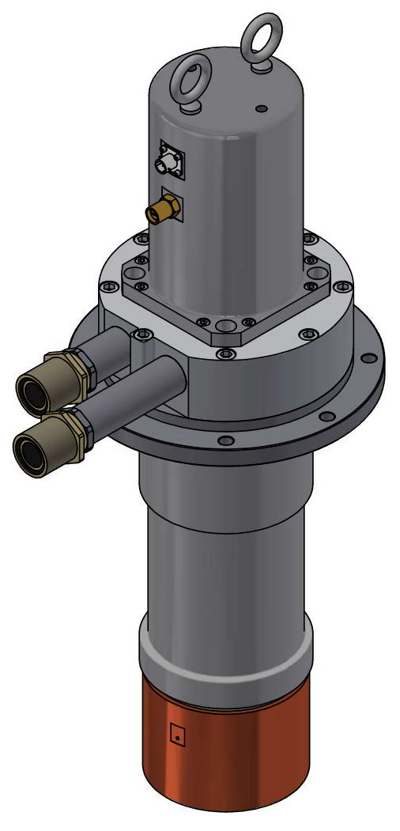
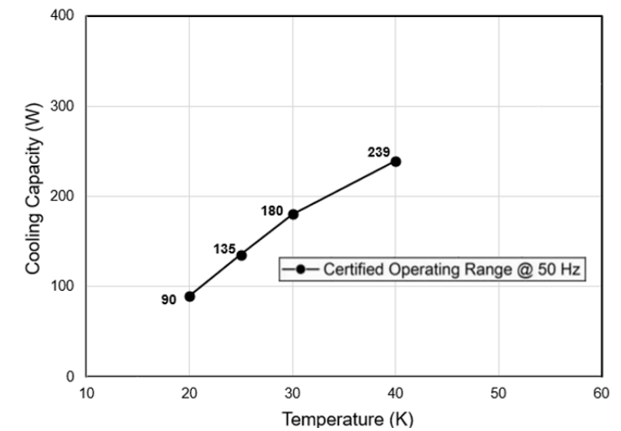


Option I – cryocoolers + turbo-Brayton (1/2)
Cold mass temperature level @ 20 K
Motor
Single-stage GM-type cryocooler such as Cryomech/Bluefors AL630, cooling power
90 W @ 20 K → <10 cryocoolers for the 30-cell cooling channel cold masses
A few considerations:
The cryocooler cold head should remain in < 1 T background magnetic field (moving piston)
The cryocooler motor stalls in magnetic field > 30 mT (“remote”, i.e., decoupled options not available for single-stage GMs)
Option to circulate He in a closed circuit, which extracts heat from the coils to the cryocoolers a few meters away from cryostat (need extra cooling capacity for circulator losses)
For 30 cells:
6.4-9.7 kW @ 60/80 K
660 W @ 20 K
Source: Cryomech AL630
Cold head
For $T_{magnet}$ = 20 K, $T_{cryocooler}$ needs to be 2-3 K lower
⌀127 mm
Capacity curve AL630
heat exchangers coupled to coils
What about the thermal shield/current lead temp. level?
cold circulator
delivering specified $\dot{m}$ and restoring $∆p$
magnets
2-3 m
cold
source
heat exchanger on GM stage

Slide 6
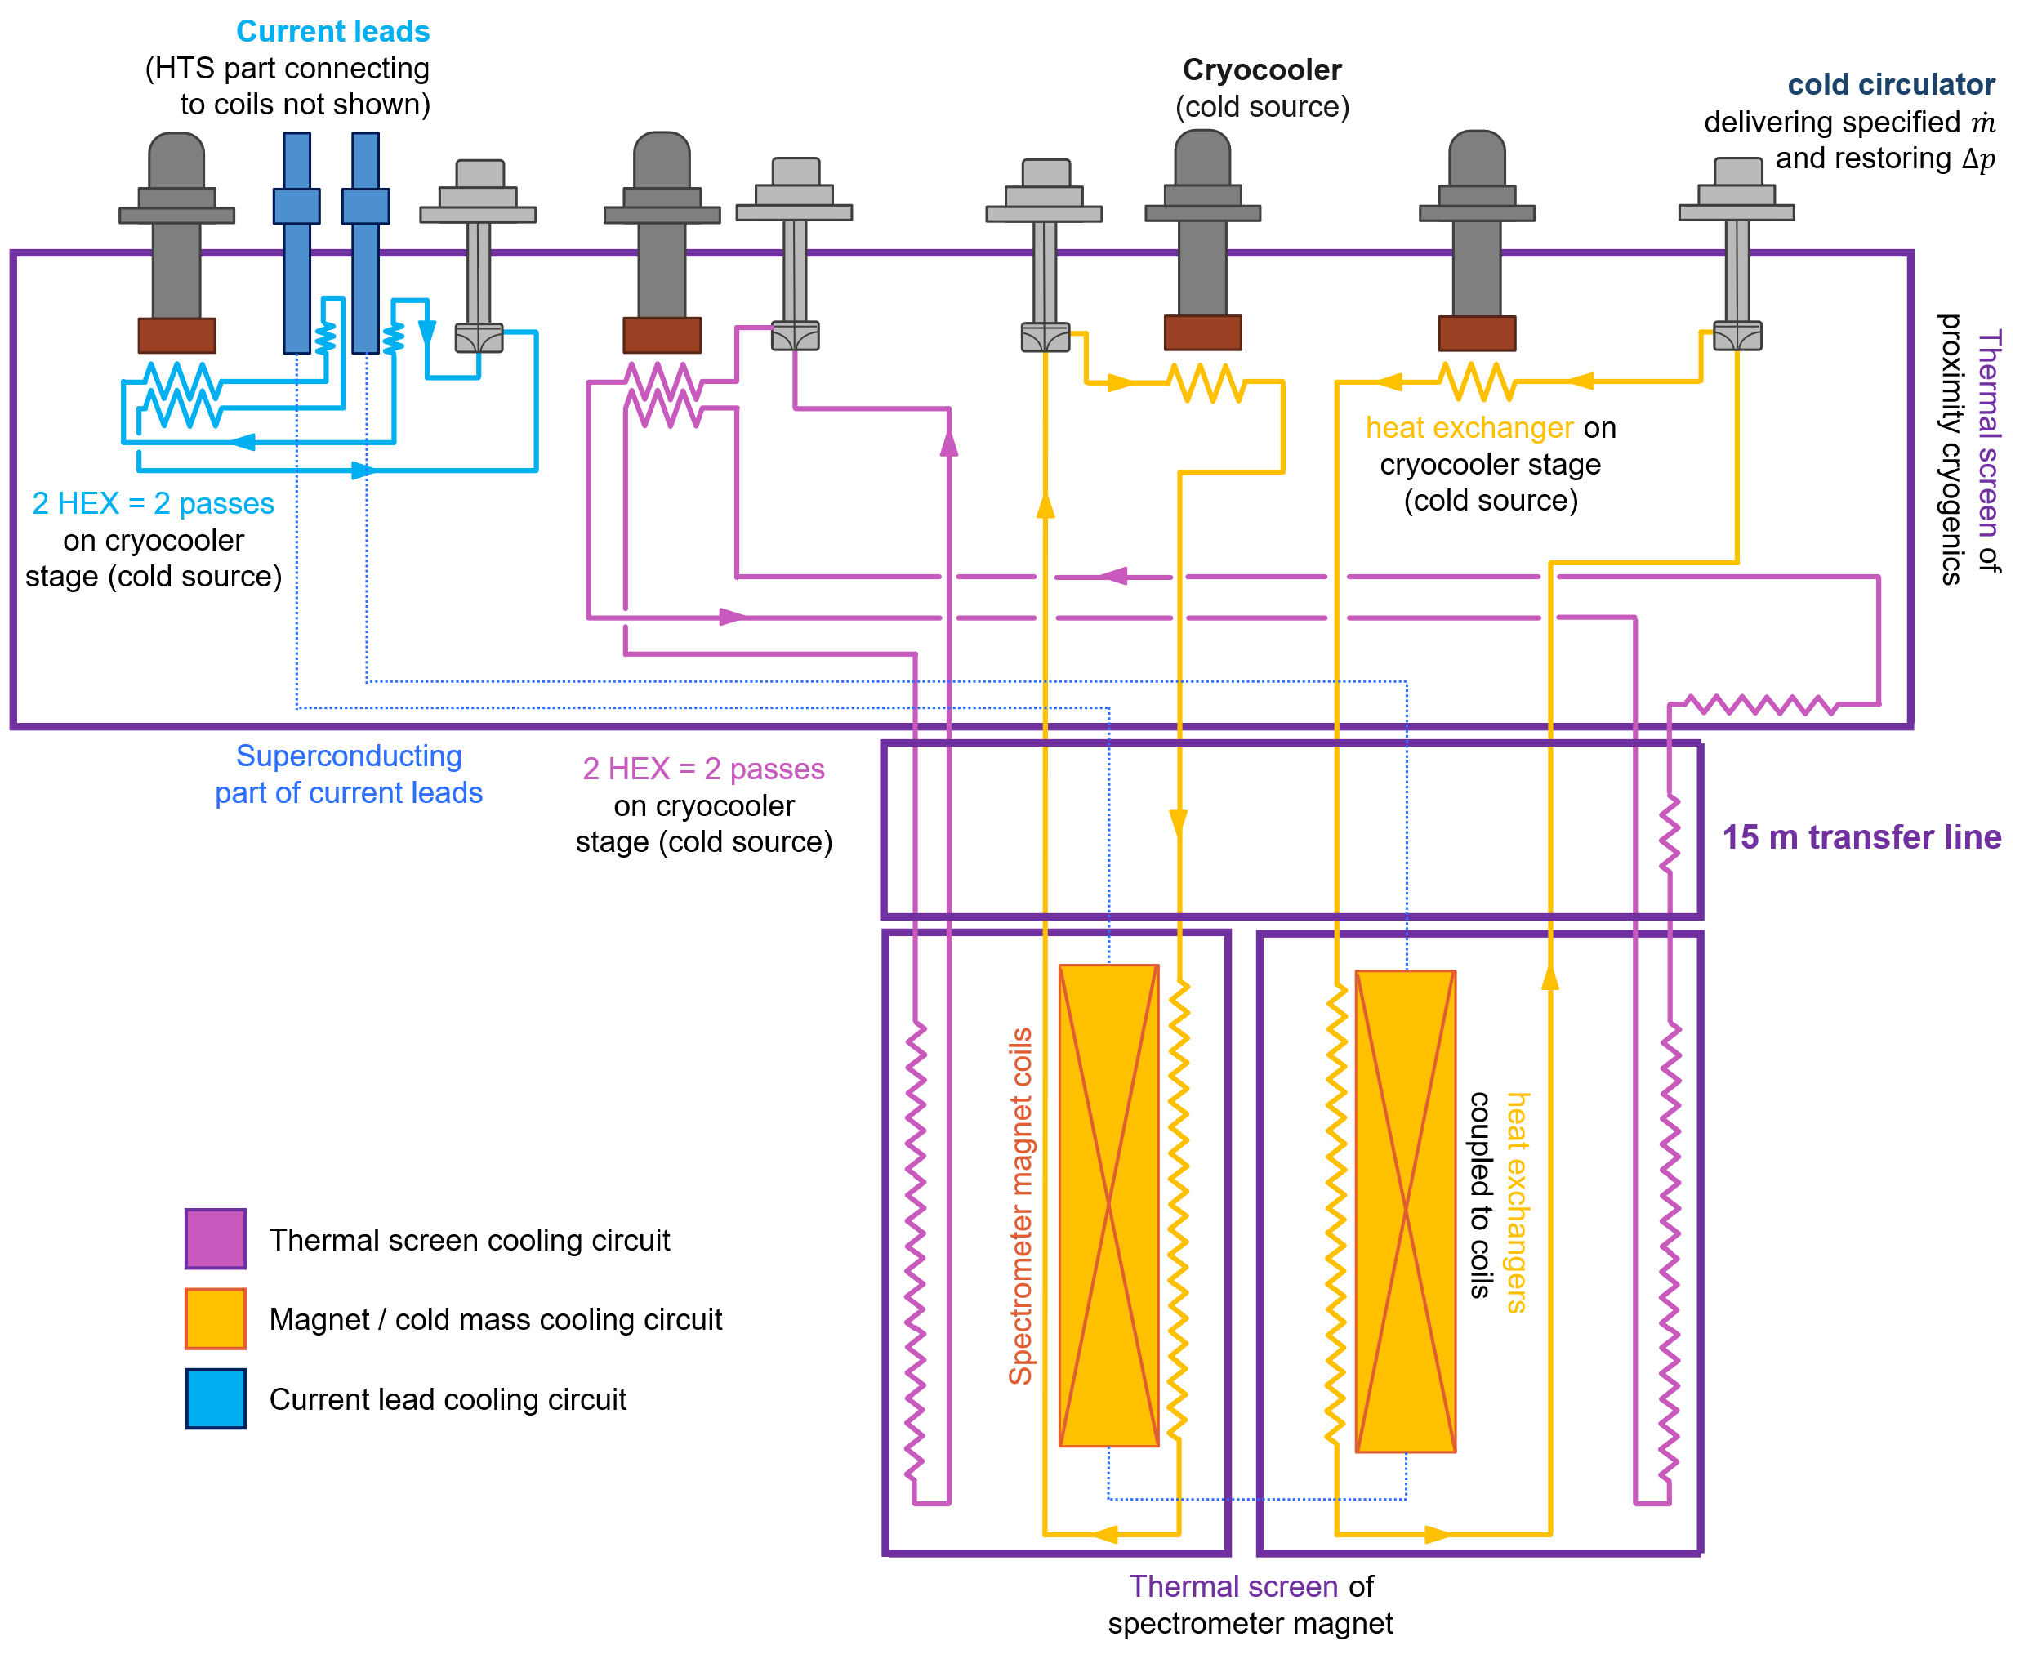
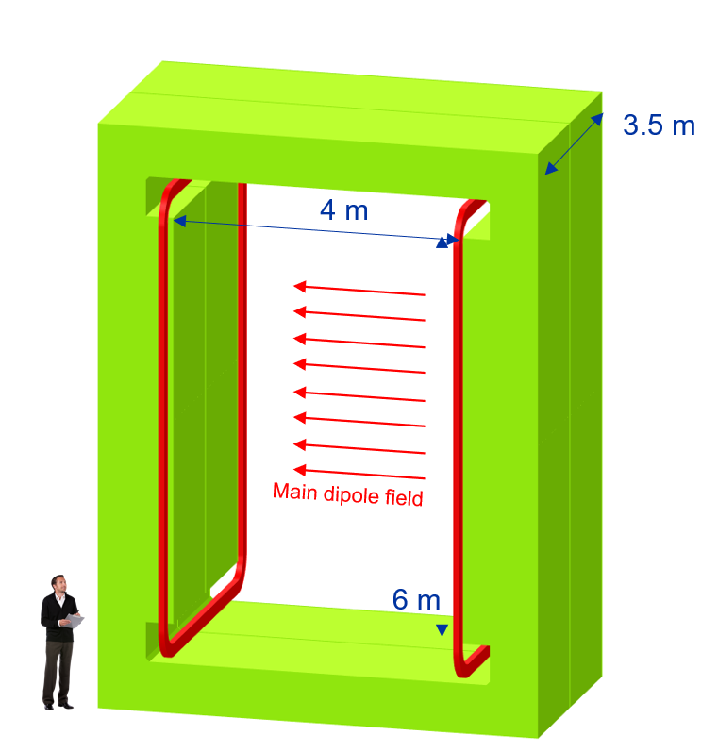
Example of cooling at 20 K - SHiP
Large aperture (4 m x 6 m) superferric magnet
Conductor: MgB₂ operating at 18-20 K
Significant energy savings w.r.t. normal conducting option (even when considering cryogenic consumption!)
Installation in area without He infrastructure (ECN3), and relatively low heat load → ideal case for use of use of cryocoolers and a remote supercritical He loop
Three loops using He gas @ ~10 bara and
18-20 K for the cold mass (~ 5 g/s)
70-80 K for the thermal screen (~ 6 g/s)
50-55 K for the current leads (~ 2 g/s)
Advantages:
Cooling infrastructure 15 m away from magnet (high penalty if conduction cooled)
Almost no He inventory
Operation at higher T
Courtesy L. Baudin (Indico)

Slide 7
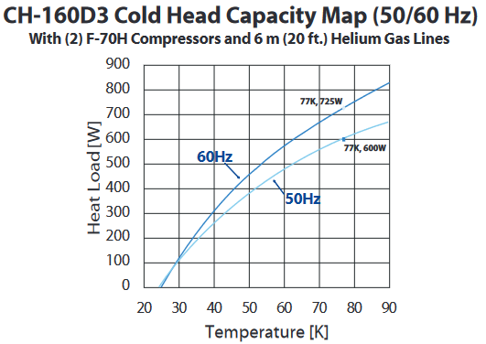
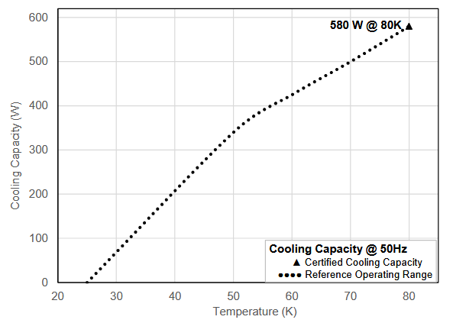
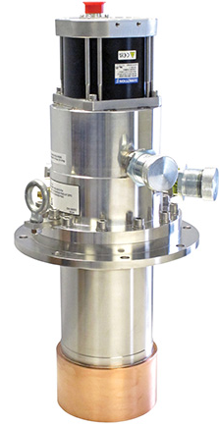
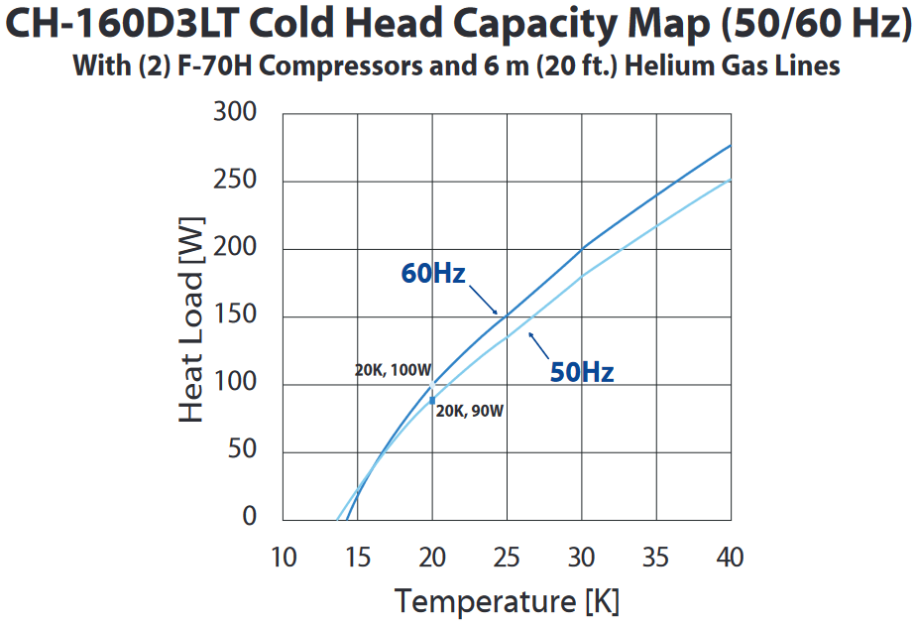
Option I – cryocoolers + turbo-Brayton (1/2)
Cold mass temperature level @ 20 K
Capacity curve AL600
2 x F70 compressor
6 m lines
=13.5 kW
385 W
@ 55 K
What does it mean for the cold source for 1 cell:
330 W @ 55 K (TS and CL at 70 K)
22 W @ 17 K (CM at 20 K)
440 W
@ 55 K
Capacity curve AL630
TS: 1 cell per cryocooler
CM: 2 cells per cryocooler
Start with LT version alone until change to TBF
2 x F70 compressors
6 m lines
=13.5 kW
Source: Cryomech AL630 and Al600
Source: Sumitomo CH-160 D3 (LT)
50 W
@ 17 K
~30 W
@ 17 K ?

Slide 8
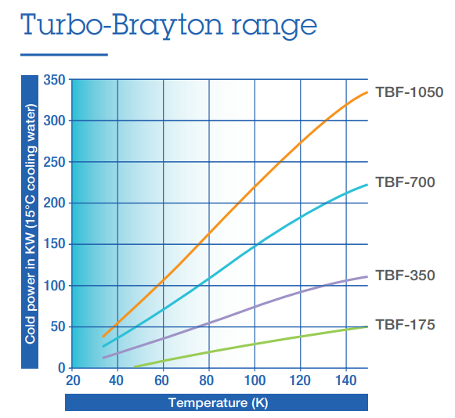
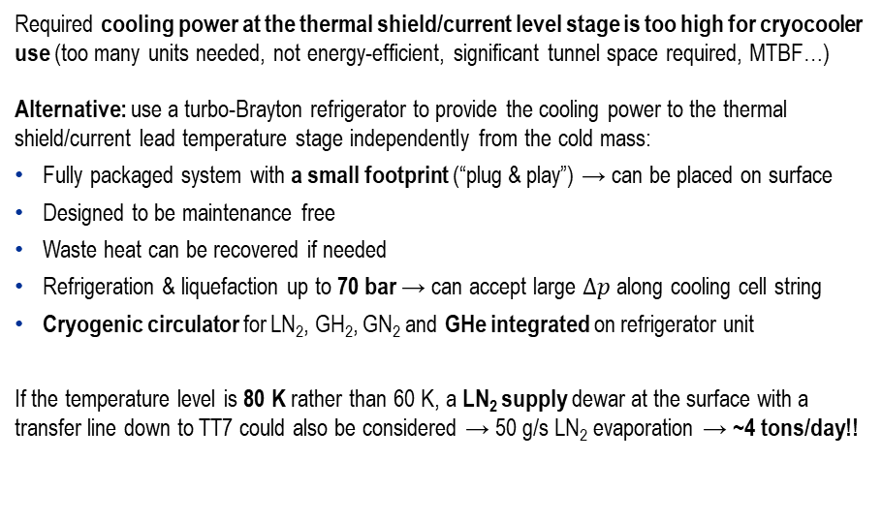
Option I – cryocoolers + turbo-Brayton (2/2)
Shield / current leads temperature level @ 60/80 K
For 30 cells:
6.4-9.7 kW @ 60/80 K
660 W @ 20 K
Required cooling power at the thermal shield/current level stage is too high for cryocooler use (too many units needed, not energy-efficient, significant tunnel space required, MTBF…)
Alternative: use a turbo-Brayton refrigerator to provide the cooling power to the thermal shield/current lead temperature stage independently from the cold mass:
Fully packaged system with a small footprint (“plug & play”) → can be placed on surface
Designed to be maintenance free
Waste heat can be recovered if needed
Refrigeration & liquefaction up to 70 bar → can accept large $∆p$ along cooling cell string
Cryogenic circulator for LN₂, GH₂, GN₂ and GHe integrated on refrigerator unit
If the temperature level is 80 K rather than 60 K, a LN₂ supply dewar at the surface with a transfer line down to TT7 could also be considered → 50 g/s LN₂ evaporation → ~4 tons/day!!
210 kW_{el}
For a cryocooler- or LN₂-based solution, choosing a higher T for the thermal shields/current leads (i.e., 80 K) is essential
Source: Air Liquide (link)

Slide 9
Cooling strategy: from a few cells to whole demo
Cooling cell
14 cooling cells
14 cooling cells
x1 @ 60 K
x14 @ 60 K
x1 @ 60 K
TBF-175
CH-160LT
CH-160LT
- OR -
x0.5 @ 20 K
x7 @ 20 K
x5 @ 20 K
CH-160LT
CH-160LT
CH-160LT
~ 20 kW_{el} per cell
~ 273 kW_{el} for 14 cells
~ 300 kW_{el} for 14 cells
Evaluating by power consumption alone, one can progressively implement cooling cells in a modular way using cryocooler-based cooling sources for both TS and CM… if 14-15+ cells, TS can be taken over by a TB machine, and cryocoolers previously used for TS can cool down CMs of future cells

Slide 10
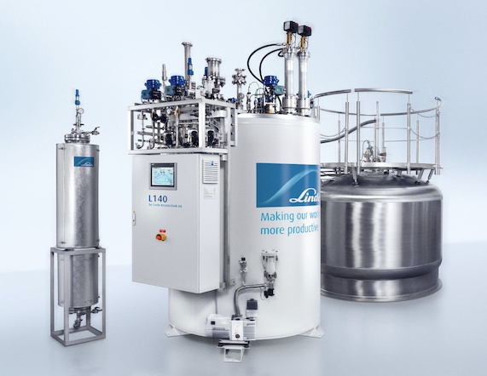
Option II – Small cryoplant for test facility
Both Air Liquide and Linde (and others!) offer compact, small-scale liquefiers or refrigerators with significant cooling power at around 20 K and at 60-80 K
To be investigated if such small refrigerators can provide such asymmetric cooling capacity (~10x more cooling power at 60/80 K than at 20 K)
Using a cryoplant for both temperature levels:
Reduces the number of systems running in parallel
Is more energy-efficient than using cryocoolers
The entire cryoplant can be installed at the surface, only transfer line goes down to TT7
Ancillary services (cooling water, etc.) also remain at surface level
Has possibly a higher cost when compared to cryocooler + turbo-Brayton alternative
Could have synergies with neighboring experiments (larger, shared cryoplant = more efficient, lower cost per W)
Source: Linde Kryotechnik (link)
For 30 cells:
6.4-9.7 kW @ 60/80 K
660 W @ 20 K

Slide 11


(Qualitative) comparison of cryo system options
Cryocoolers + turbo-Brayton or LN₂
Independent cooling circuit for each temp. level
TB system installed at surface level
Modularity with increasing # cells, can add cryocoolers as cooling channel grows
Cryocoolers + compressors installed underground (needs cooling water + electricity)
High energy consumption (12 kW/cryocooler + TB (?))
Maintenance of cold heads every 15’000 h
Requires trained operators for TB part
He liquefier/refrigerator
(can have) independent cooling circuit for each temp. level
Cold box + ancillary services all at surface level, only transfer line to cooling channel
Most energy-efficient option
Likely higher cost than cryocooler + TB option
High He inventory incl. gas management + storage
Complex maintenance of cryoplant every 8’000 h
Requires trained operators

Slide 12

Thank you
for your attention!

