Slide 1




Cooling Demo R&D Plan
Marco Statera, INFN
With the contribution of
Lucio Rossi and Stefano Sorti, UNIMI and INFN
Dario Giove, Barbara Caiffi and Mattia Castoldi INFN
Giuseppe Scarantino, Roma Sapienza and INFN
Luca Bottura, Cédric Garion and Rui Franqueira Ximenes CERN

Slide 2
Outline
6D cooling R&D: a common development with HFM
The R&D for the cooling cell demo: time, people and cost
  Magnets
  RF
  Adsorber and vacuum
Conclusion

Slide 3
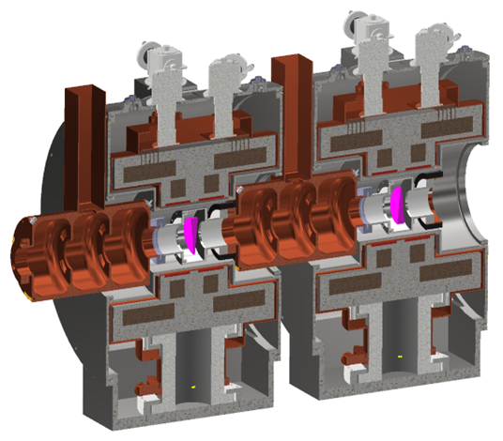
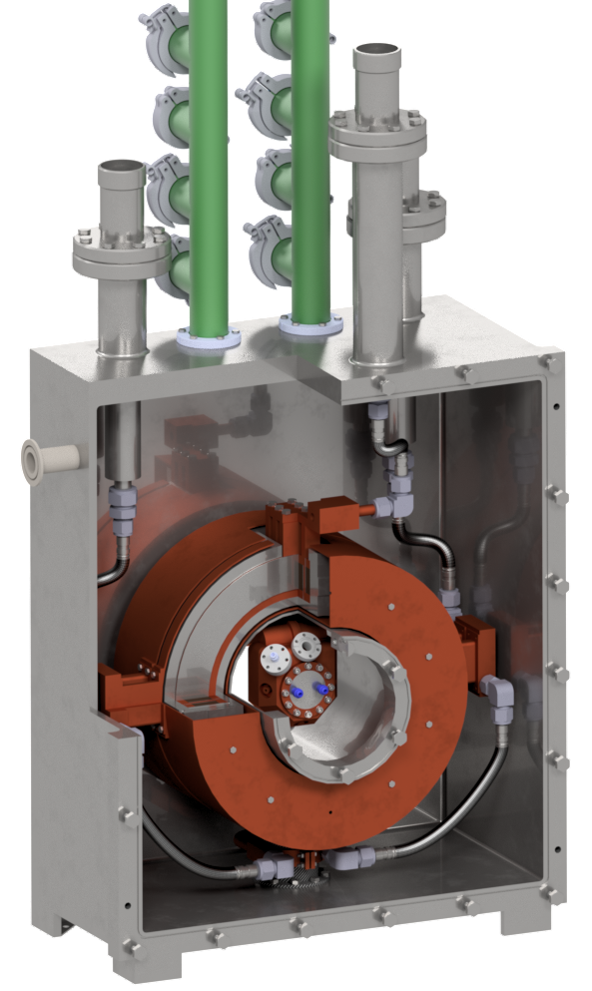



R&D MC and HFM
What is a good intermediate goal?
What do want to build?
All R&D by ourself?
building S5 like cell
building RFMFTF
Radio Frequency in Magnetic Field
Test Facility
No
Strong synergies with HFM
HTS magnets program
See L. Rossi and G. Scarantino

Slide 4

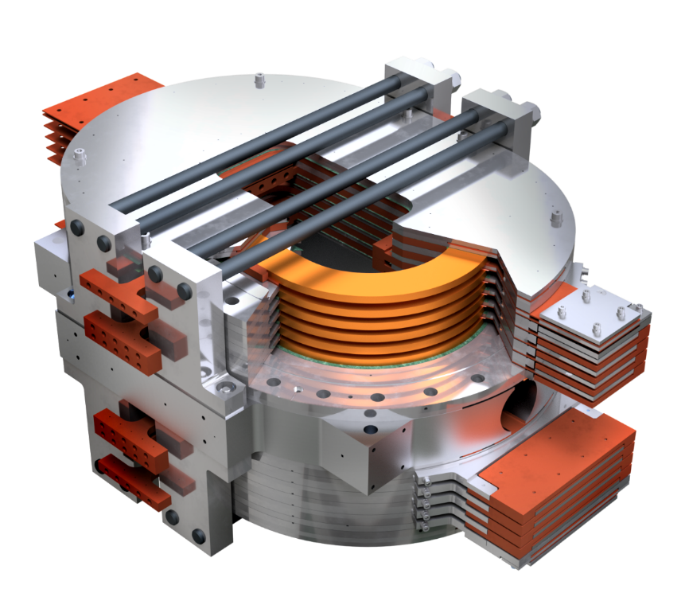
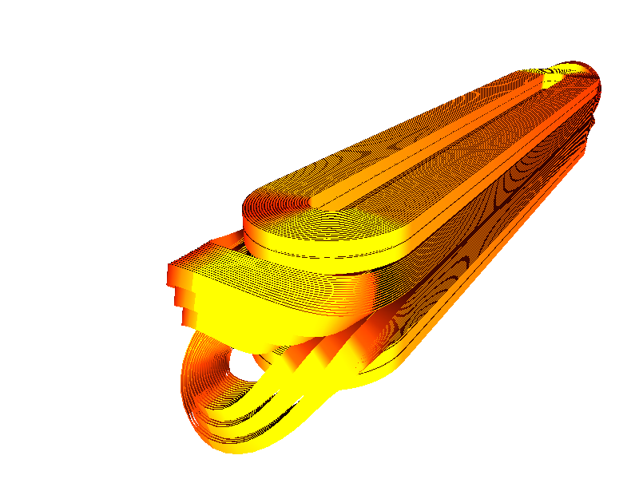
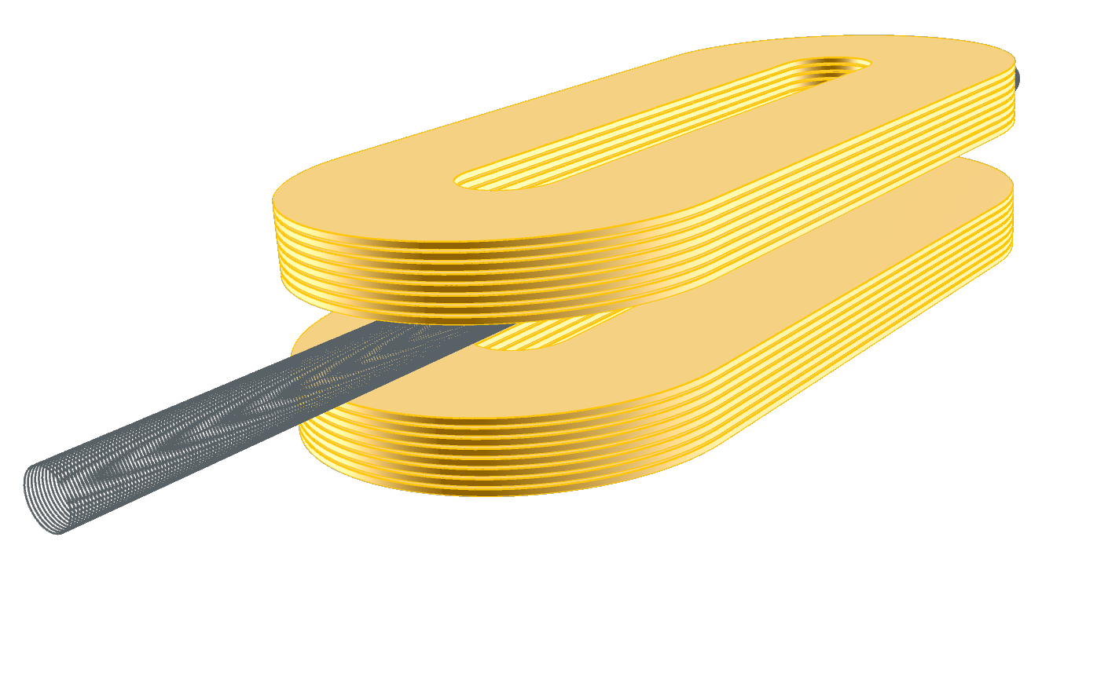
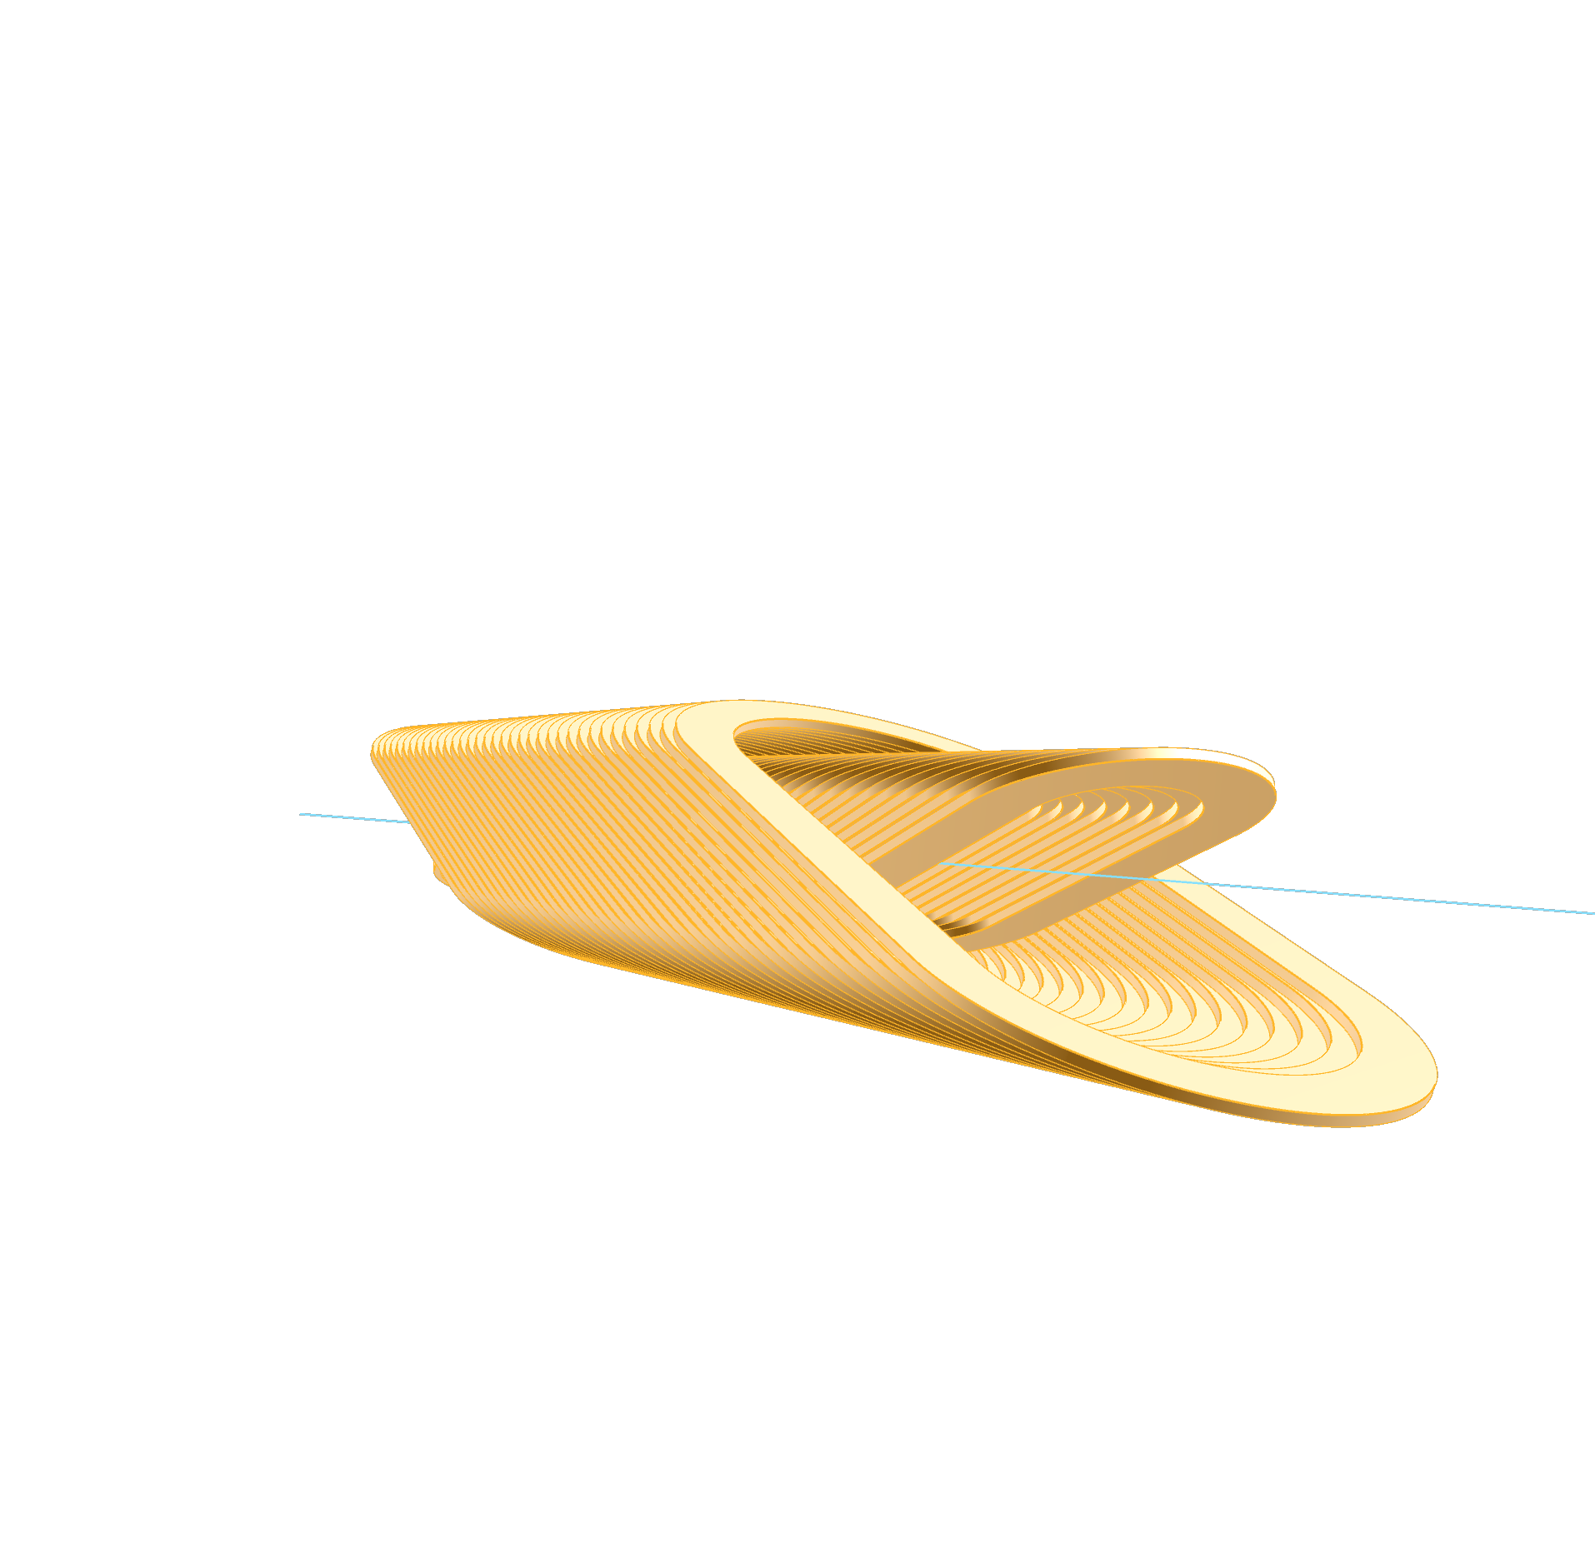
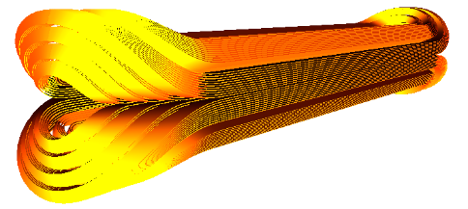

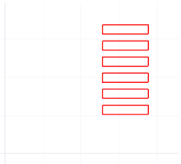
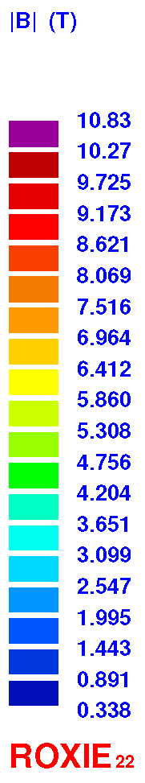
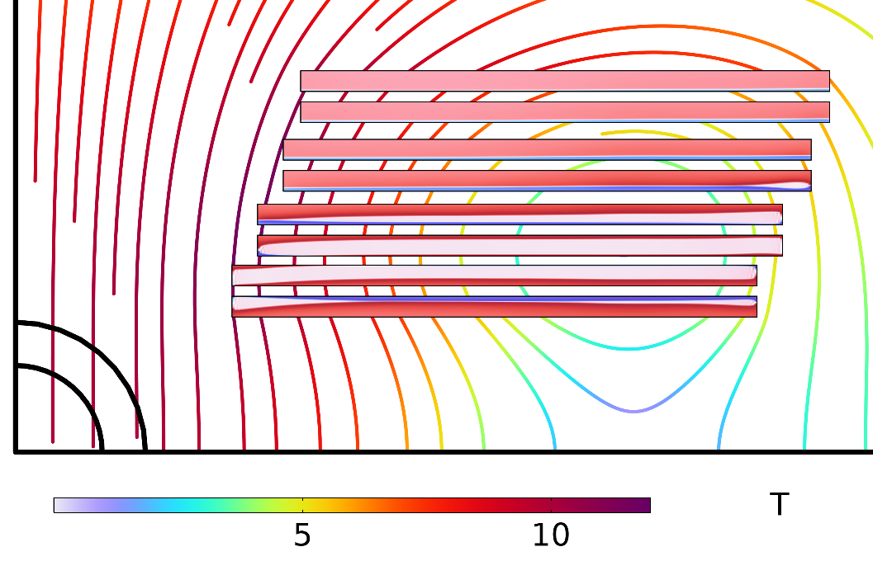
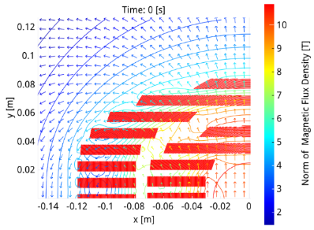
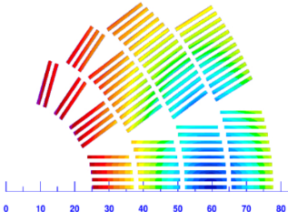
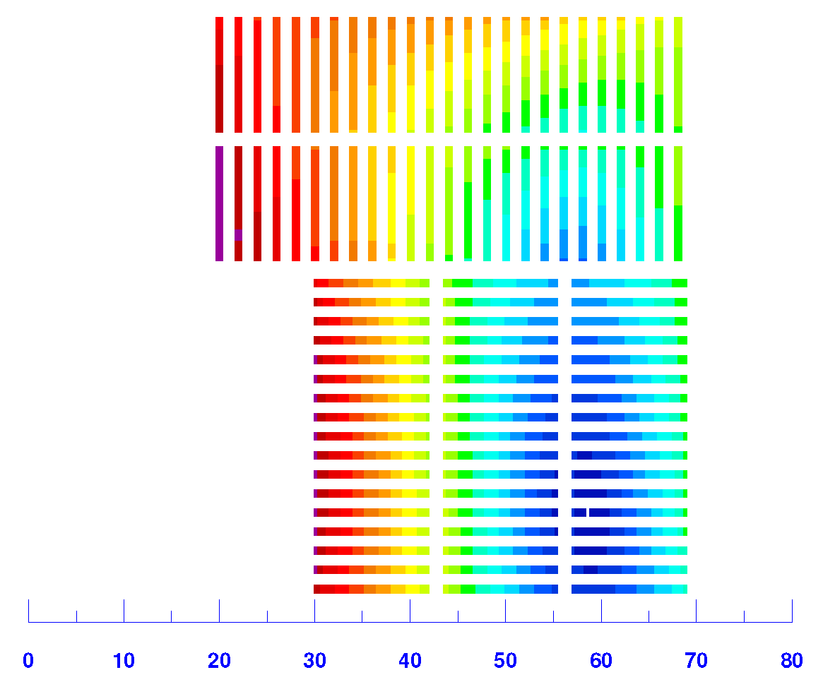
INFN HFM-HTS Roadmap: target
Already identified some conceptual designs:
B centre | Aperture diameter | T_{op} | Straight section | Fiel quality target | Target J_{Cu}
10 T | 50 mm | 20 K | 400 mm | units | 800 A/mm²
13 km da 4 mm equiv.
12 km da 4 mm equiv.
8.5 km da 4 mm equiv.
15 km da 12 mm

Slide 5
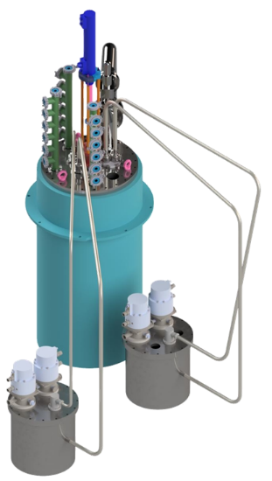
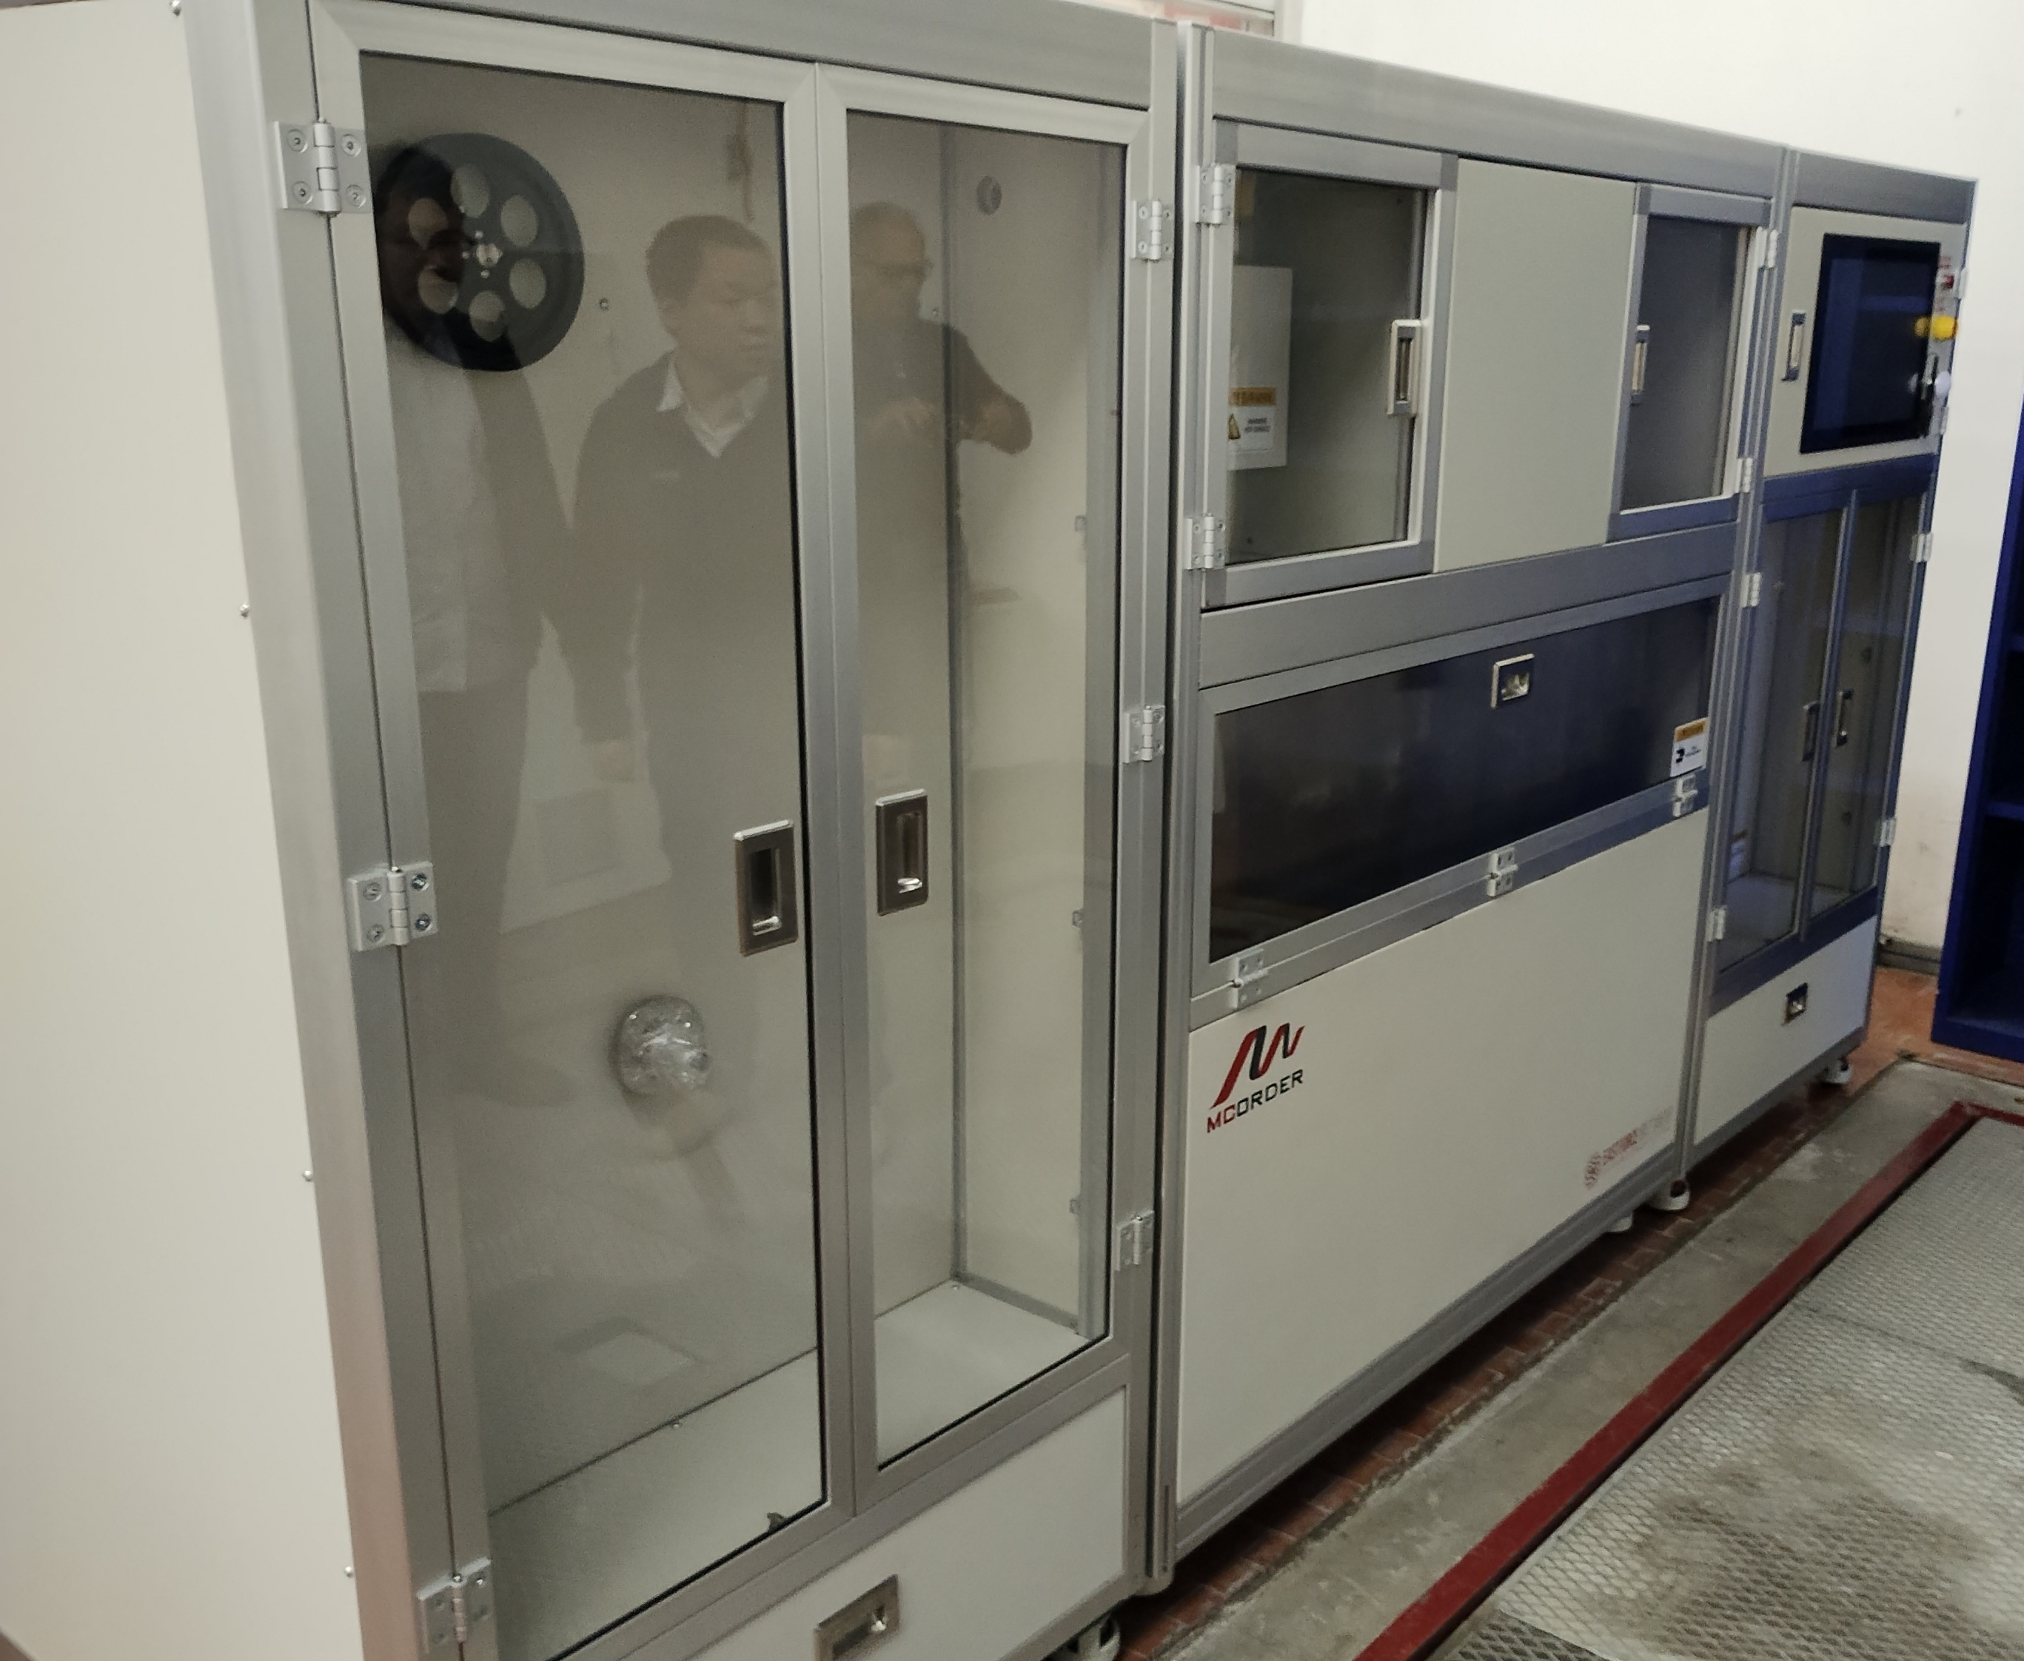
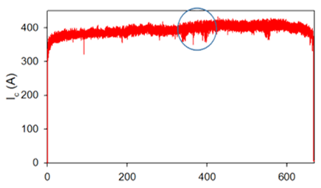

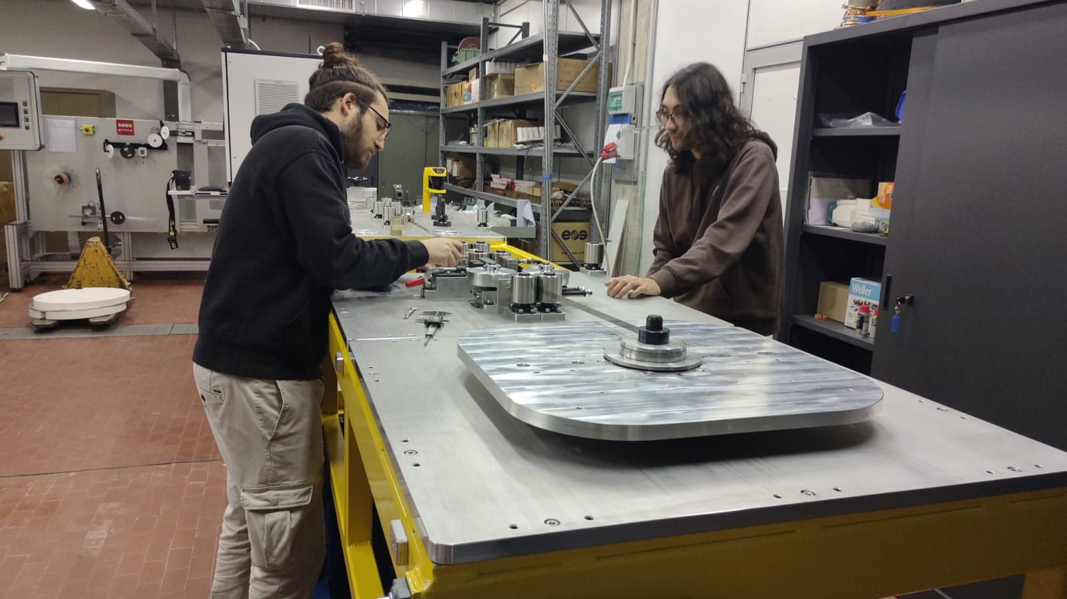
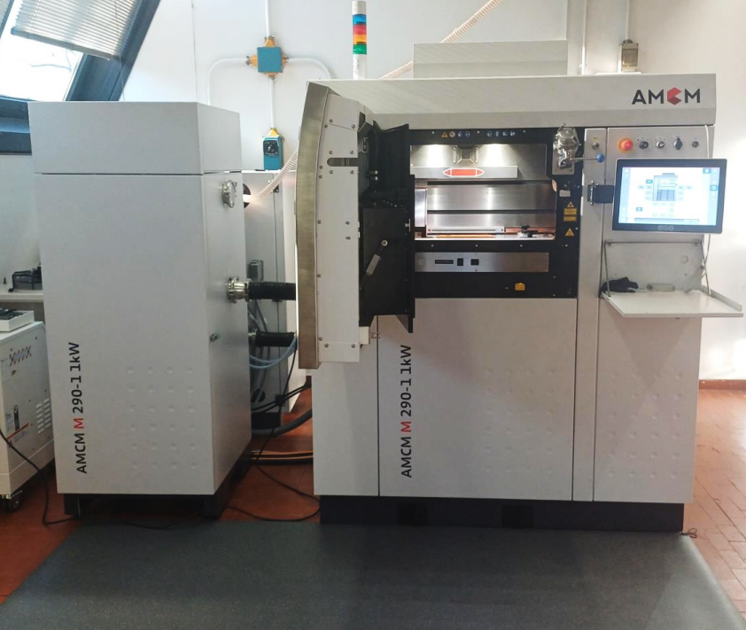
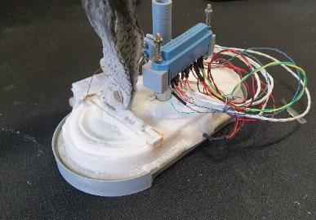
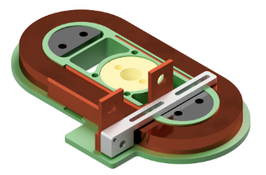
HTS R&D: experimental activities
Tape QA and characterization
→ ordered EF Mcorder
(with visual inspection module)
Splicing and joints repeatable manufacturing online
(while winding)
Small coils with different insulation technologies
→ multi-tape winding machine
Under-development apparatus for variable-temperature tests, with optional background field
Commissioned in-house Additive Manufacturing polymeric & metallic (3D printer), starting R&D activity on mechanical structures for advanced 3D winding of tapes.
20 K
55K

Slide 6
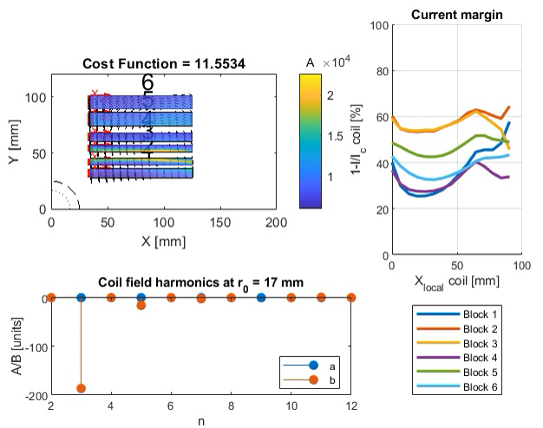

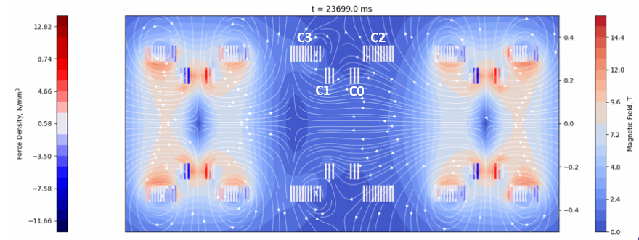
HTS R&D : numerical tools
(in addition to commercial software)
Optimization
Protection
Jc×mm²
Matlab + FEMM for Magnet design, aiming at ad-hoc routines for HTS,
allowing for:
  Estimation of losses and dynamic field quality
  from the beginning (semi-analytical models)
  (Cost) optimization of magnet design accounting
  for tape features
  → also to explore non-standard geometries
Quench simulations
Littel Beast Engineering
CERN
QLASA including HTS
Quench development over time is critical for detection and protection schemes
Define margin for HTS tape
The margin may vary on cross section of the tape
Courtesy of T. Boulder, CERN
Mariani, Mariotto, Scarantino, Sorti

Slide 7
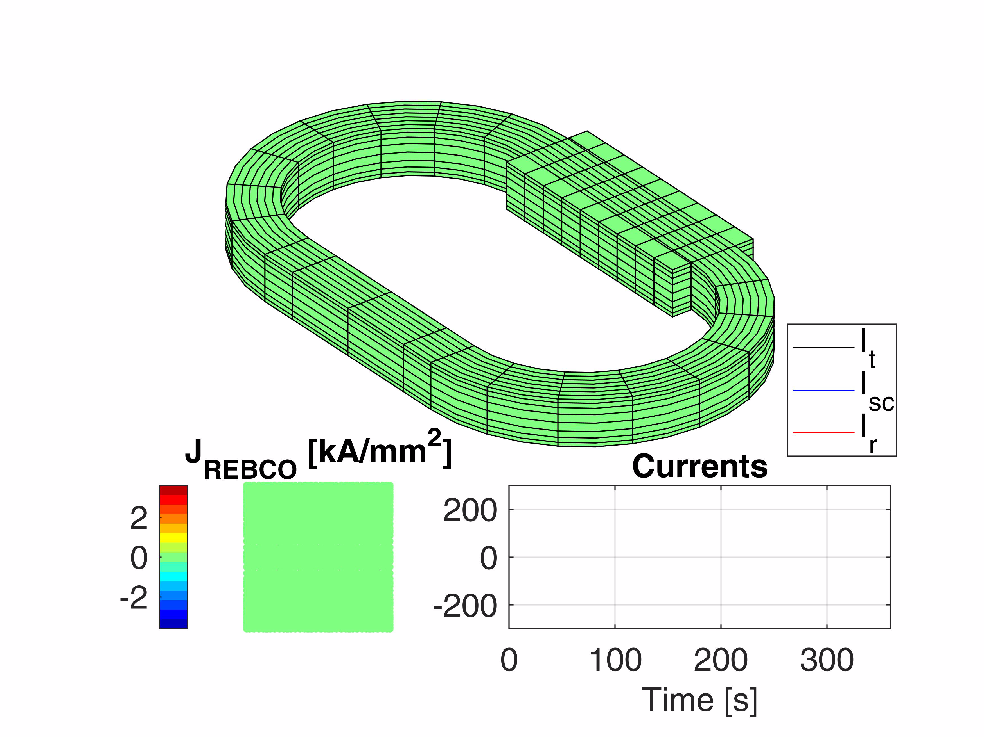
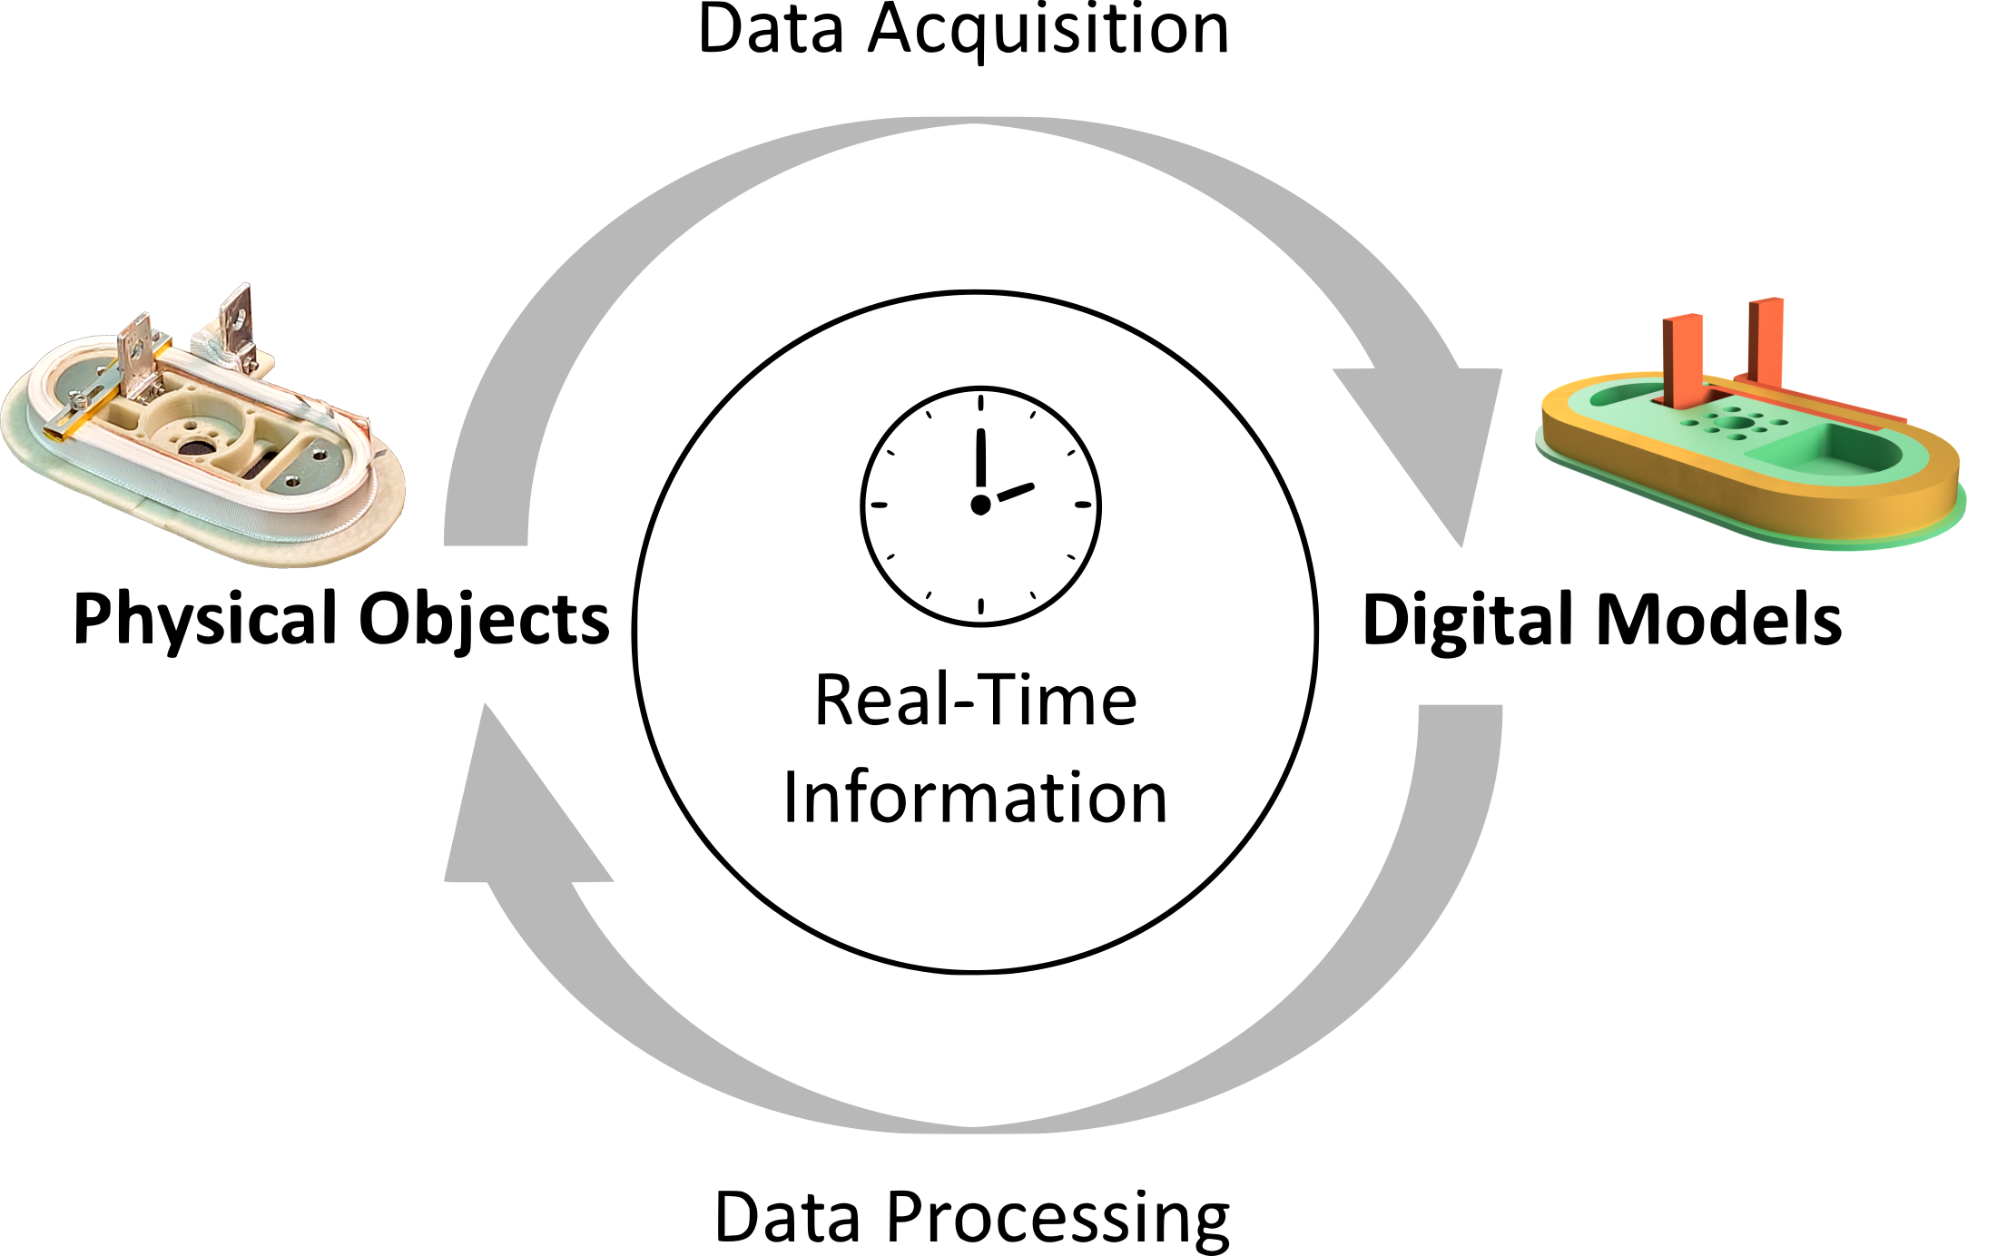
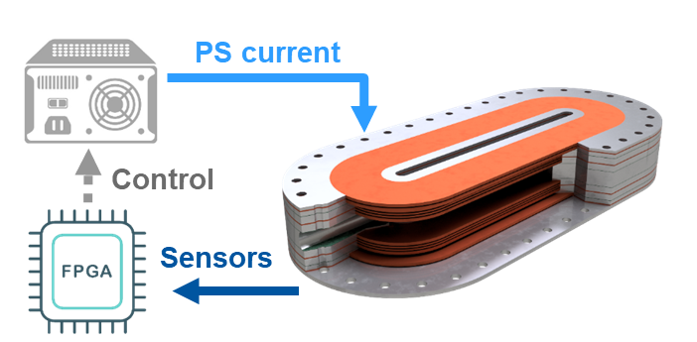
HTS R&D: numerical tools
(in addition to commercial software)
For Magnet operation: Aiming at modern automation for HTS magnets:
  Model + data online monitoring, measurements and diagnostic
  Optimal control of charge/discharge:
Strongly physics-based approach: full 3D model of magnet, E.M., thermal and possibly mechanical
+ model order-reduction and data-driven correction
The same code will serve also as complementary
to QLASA, for quench of NI magnets
Digital twin
Model-order reduction through Proper Orthogonal Decomposition for real time applications
[Sorti et al. IEEE TAS (2025)]
Charging optimization based on Pontryagin's Min. Principle
[Balconi et al. IEEE TAS (2024)]
Effort to develop protection schemes based on
quench prevention

Slide 8
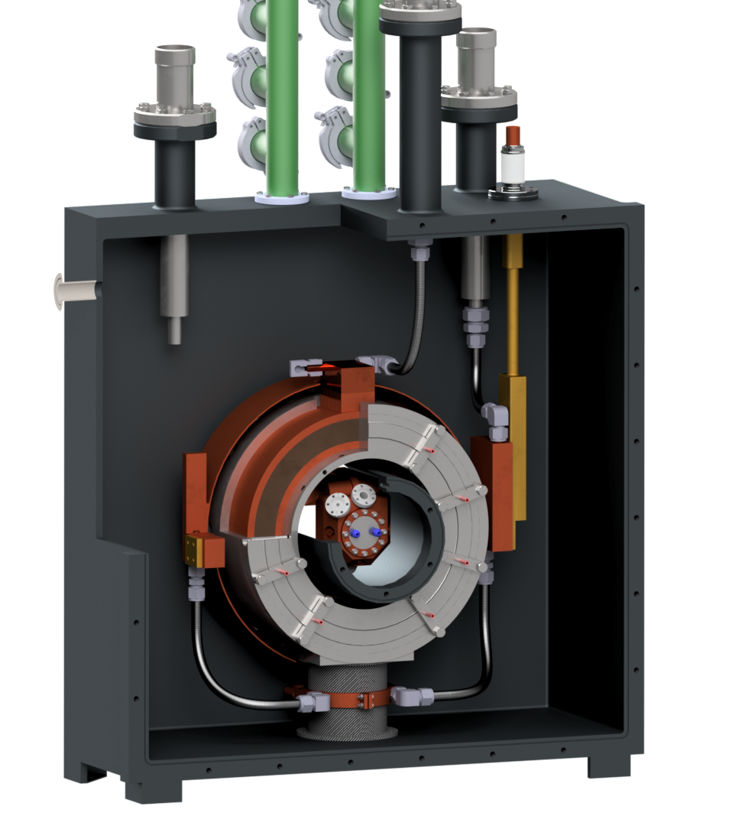
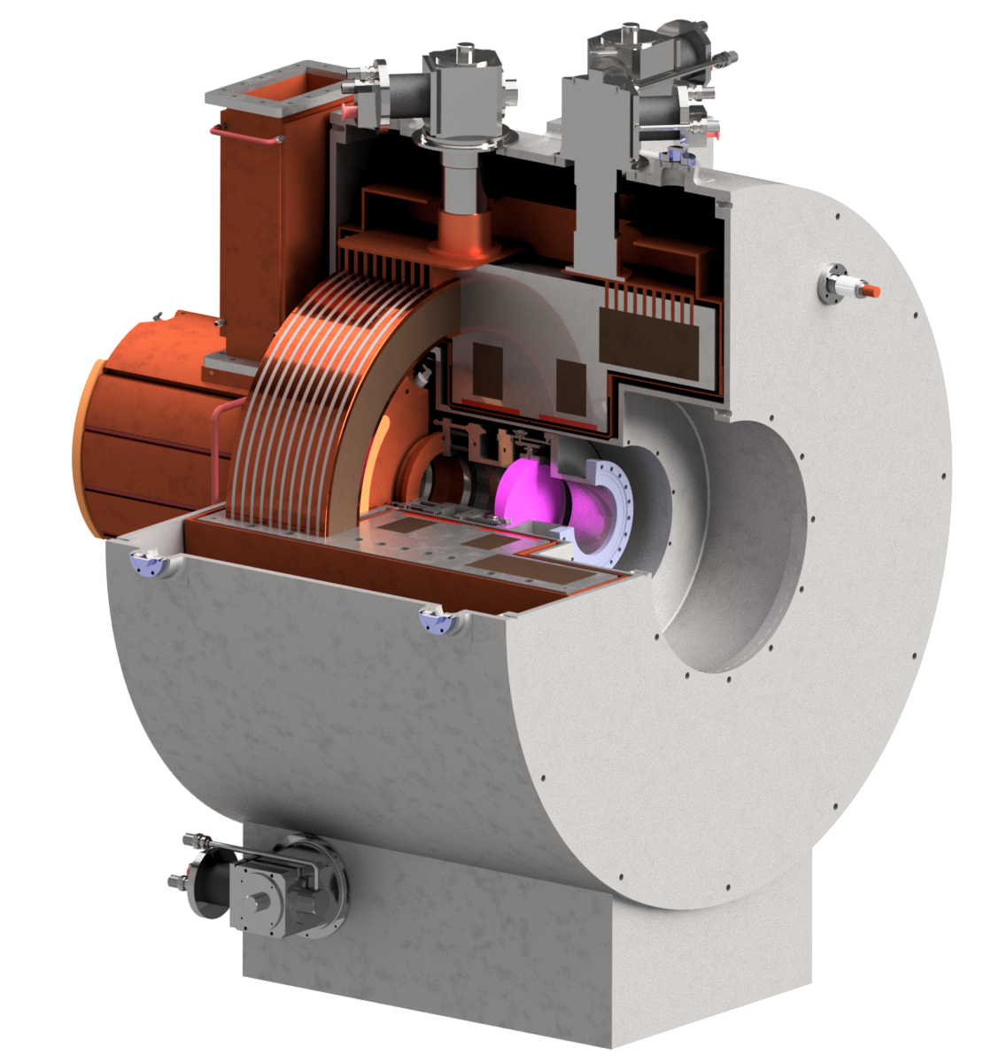
HTS R&D
IRIS
Modeling
Conductor
Design
Construction
Test
CONDUCTOR
Explore
conductor
geometry
design
protection
10 T Demonstrator
MODELING
14 T
conceptual design
DESIGN
RF in Magnetic Field Test Facility
Cooling cell Demo

Slide 9

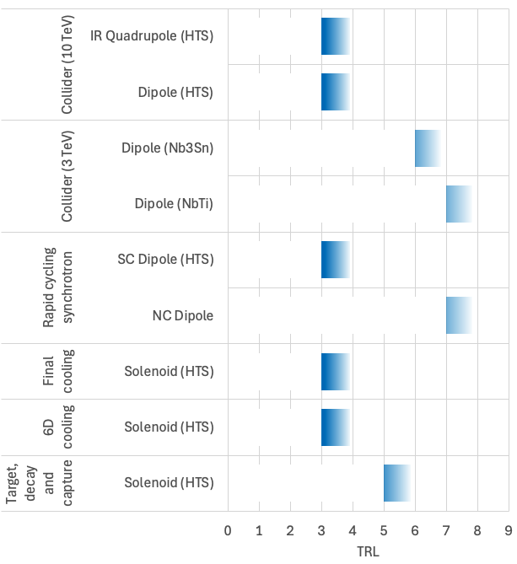
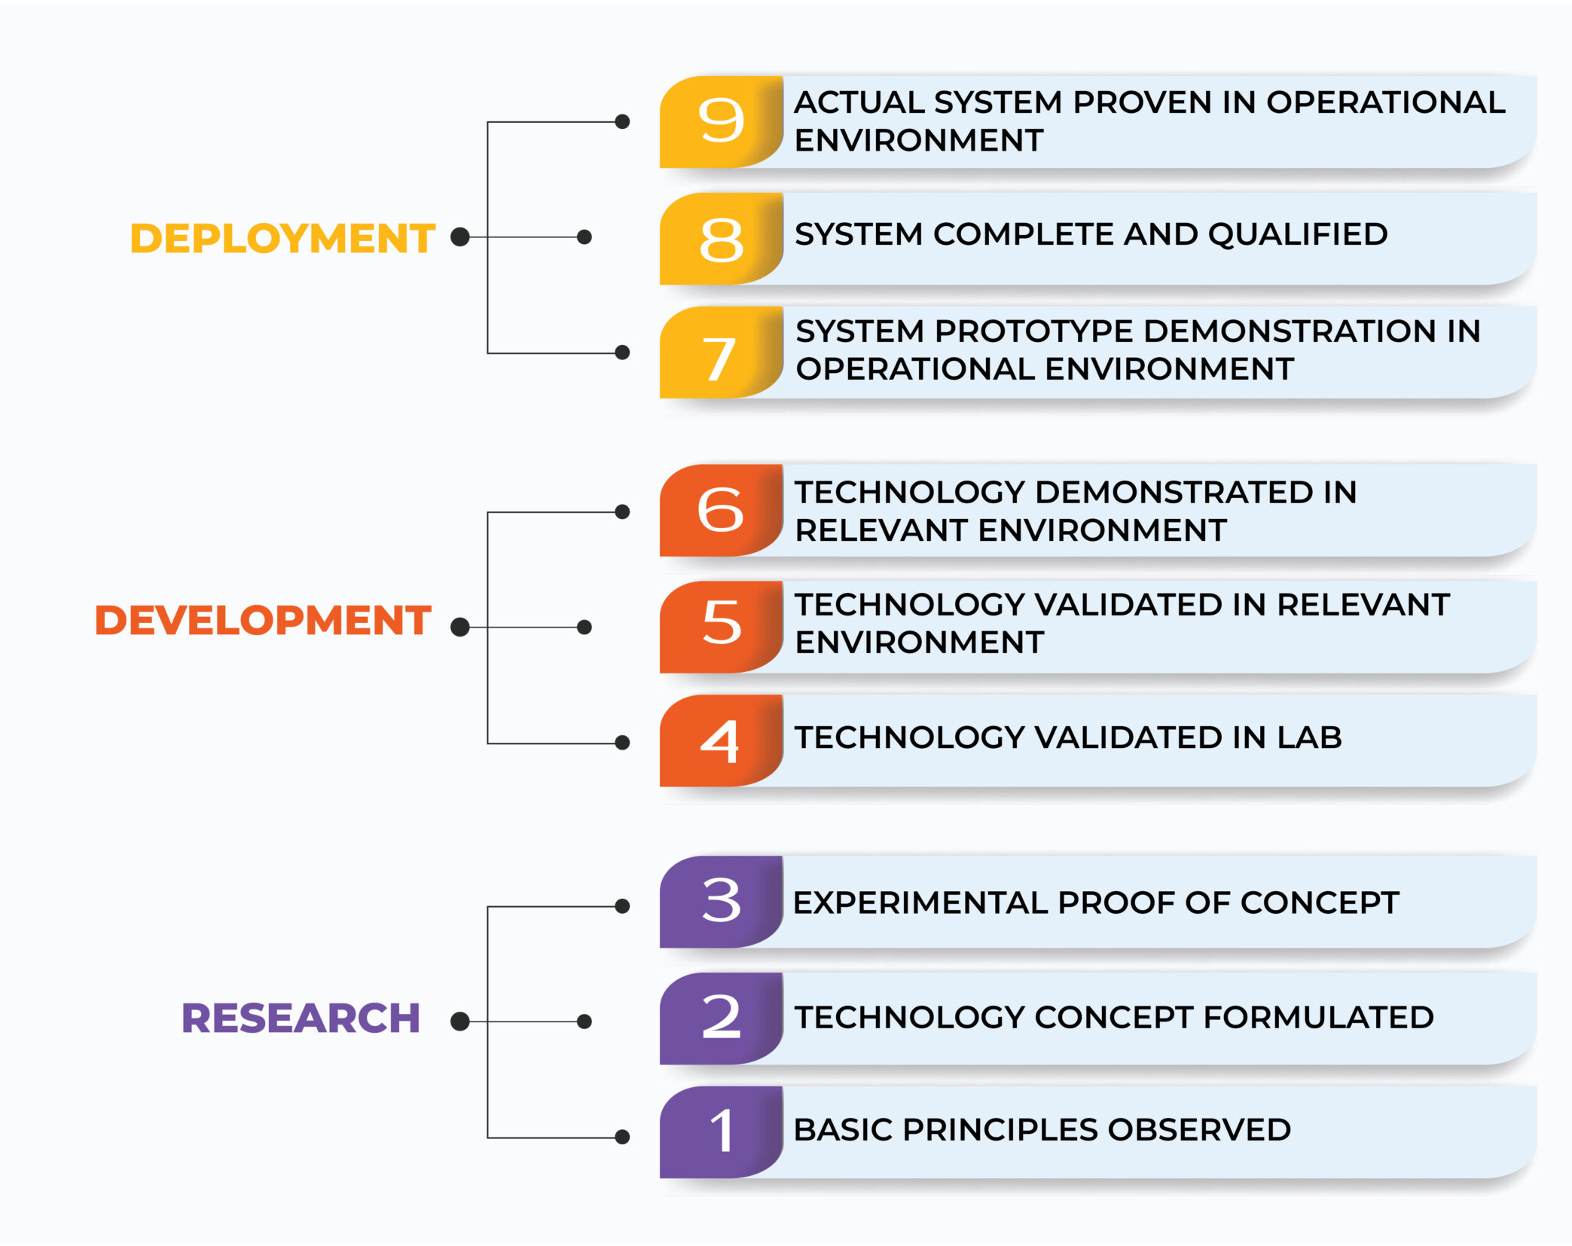
TRL Drives the R&D
We wish to reach a TRL 6 for the decision of construction, the level of readiness appropriate to enter the industrialization
Courtesy of L. Bottura

Slide 10
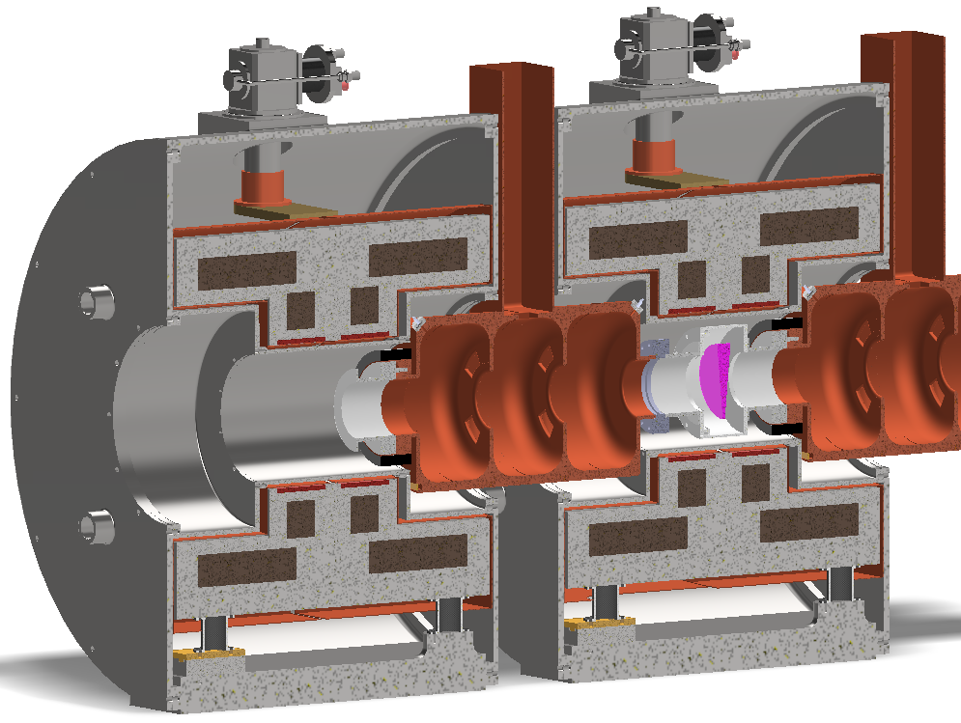
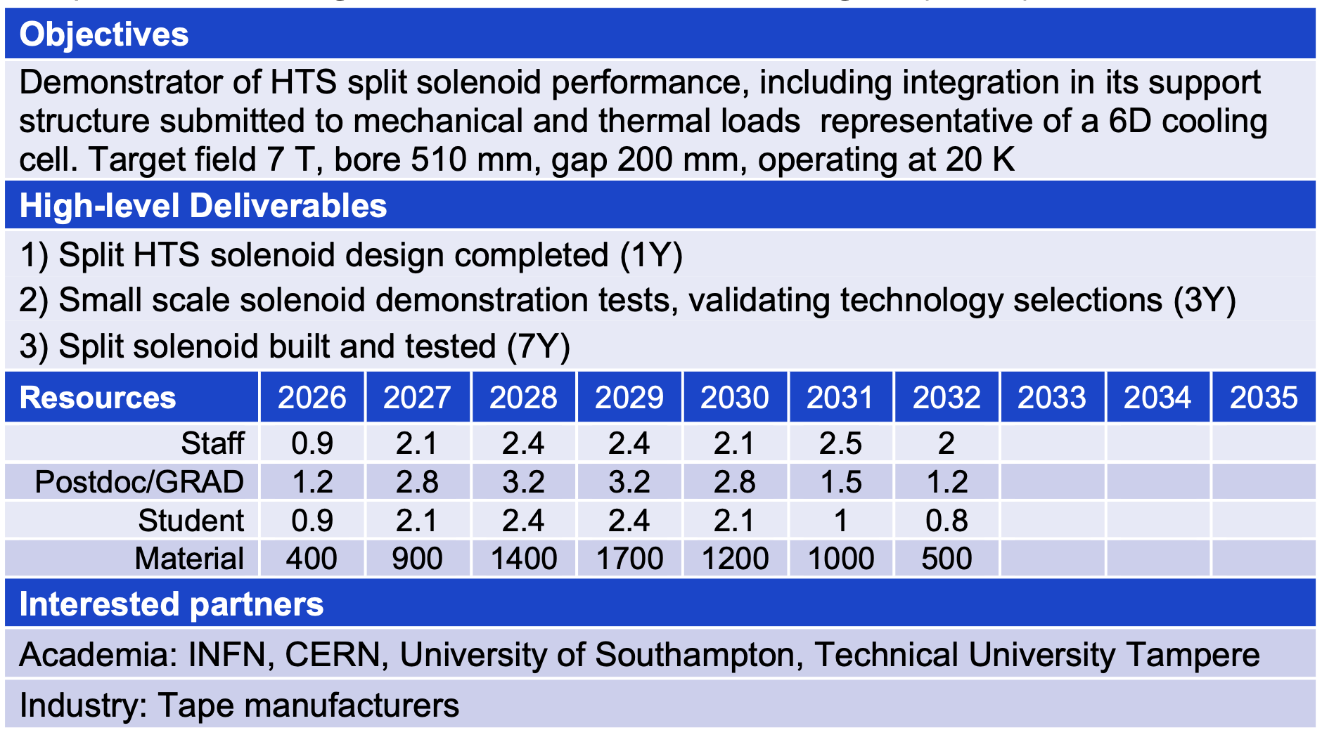
Split coils Demonstrator
Updates
ESMA dipole in construction
1.5 km 12 mm tape eq.
Demonstrator 2028
Test coils
Delivered
5 km of 4 mm tape form SST by INFN R&D MC
Funding requests
HE-EPITA 50k€ tape
ASTRA (MUR, IRIS continuation)): 685 k€ for Cryo-mechanics mechanics

Slide 11
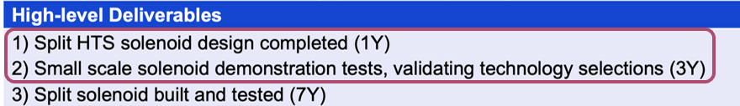
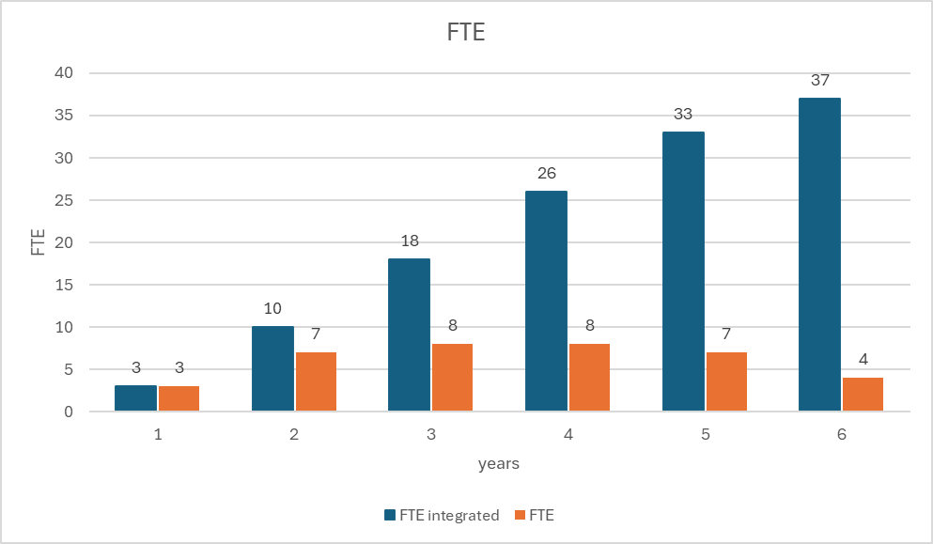
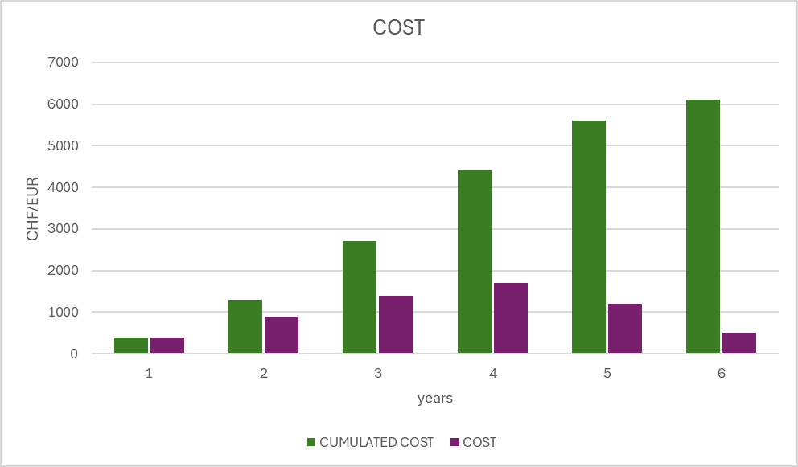
People and Cost profiles
Ongoing , partially completed or expected to be completed within 2026

Slide 12
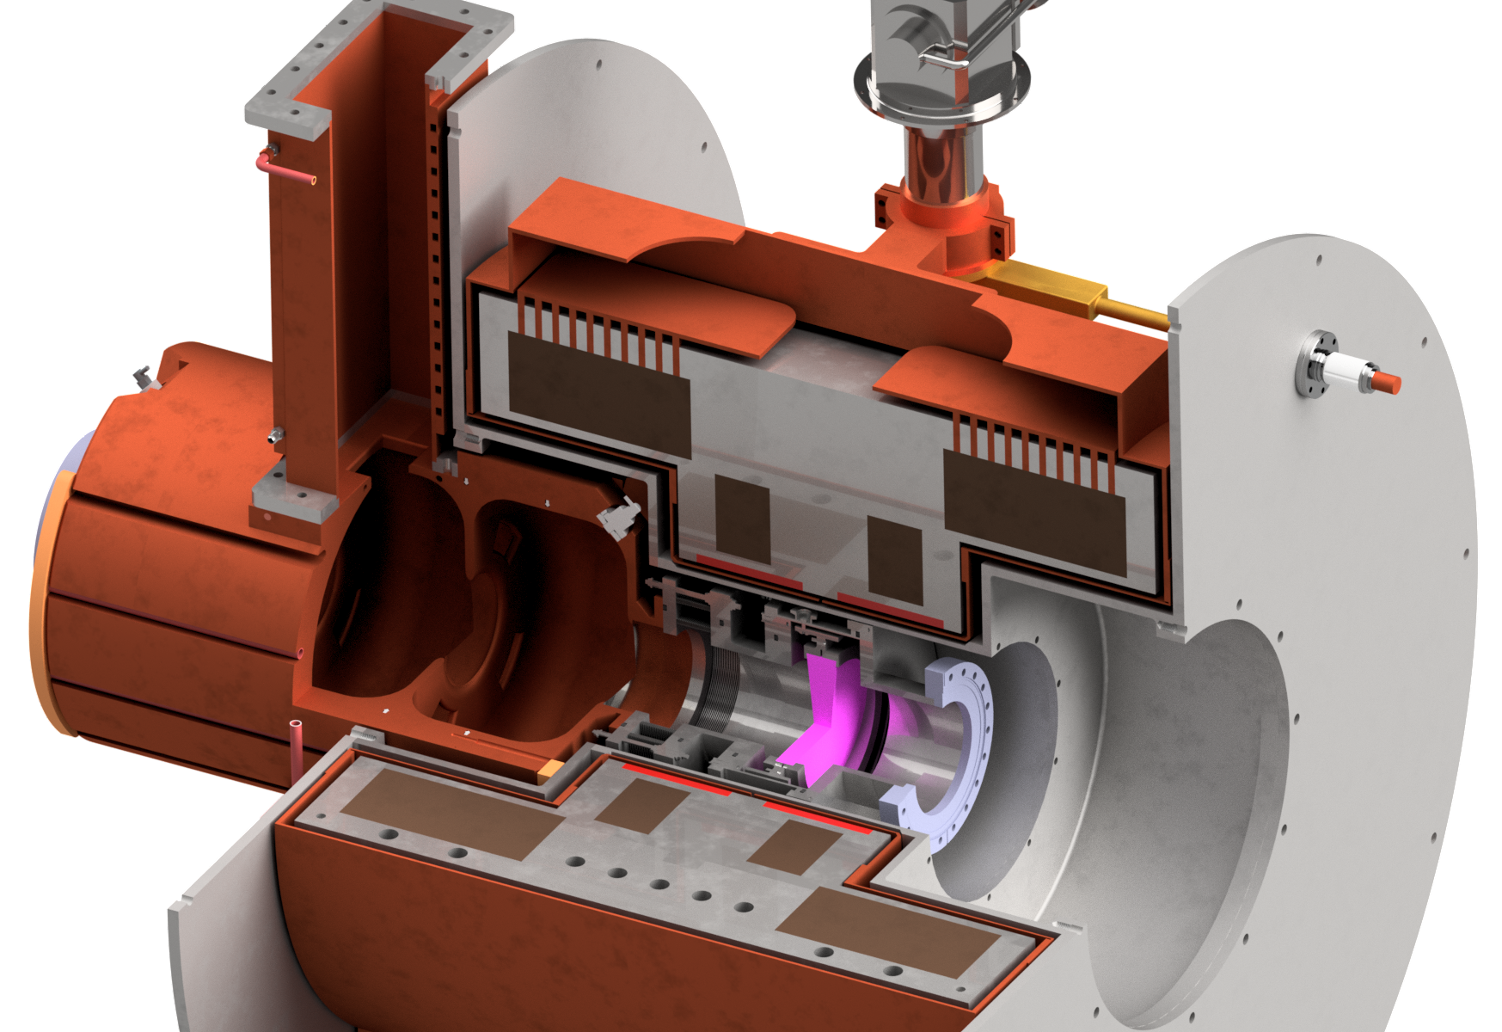
RF
R&D
Aluminum foils production and positioning
Custom waveguide
About 10 months - 40k€
Cavity design done and integrated
Production of one test cavity about 7 months - 120 k€
8 person month required
Issue on 704 MHz modulator and klystron
2 years + 2 M€
Showstopper? See discussion in the dedicated session
Courtesy of Dario Giove

Slide 13
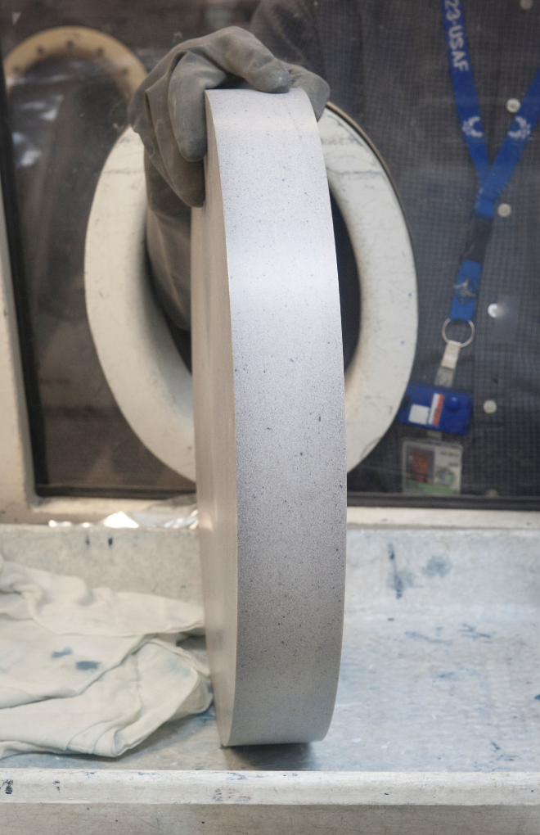
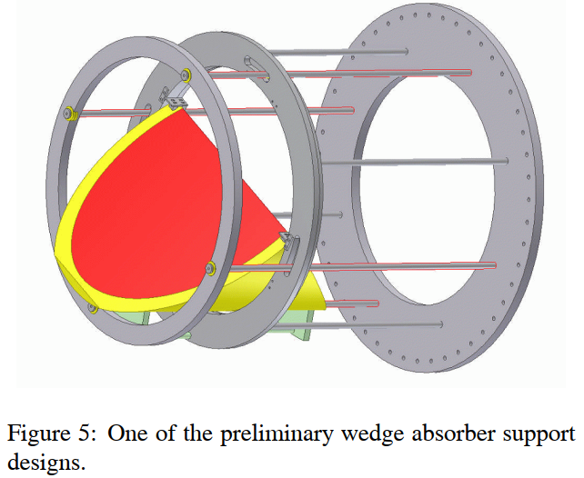
Adsorber and Vacuum
Lithium hydride (LiH)
Melts at ~690 C
Coated is compatible with low vacuum
Reactive!
  w/ H2O produces Li hydroxide and H2 gas
  Can explode even with humid air or due to static electricity
  Flammable, corrosive, toxic…
Operation
Safety
Integration
Procurement Manufacturing
MICE experience
R&D
Courtesy of Rui Franqueira Ximenes

Slide 14

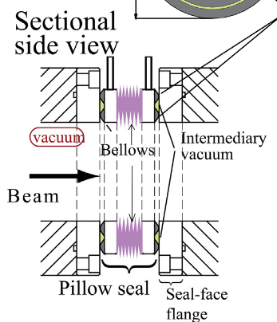
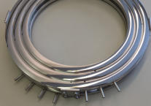
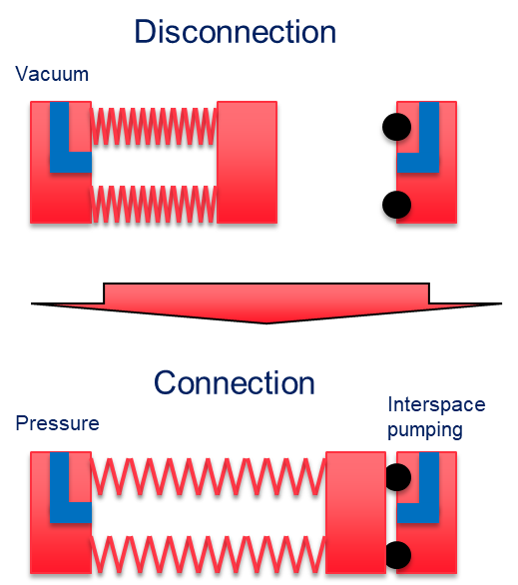
Adsorber and Vacuum
Pillow seal system
To be fully integrated
NIMB 317 734-738
Tanaka et al.
Axial force
Double differential vacuum metal/metal
Single vacuum for oring
Migth be bulky
Courtesy of Cédric Garion and Rui Franqueira Ximenes

Slide 15
Conclusion 1
Clear vision of the R&D goals: RFMFTF and S5-like cell are technology demonstrators
HTS R&D
  Probe tapes specs (to be able to better specify next procurements)
  Test winding techniques and conductor
  Incremental complexity tests
  Both common and complementary studies with the final cooling solenoid development
Some infomations will arrive by ESMA magnet by IRIS
Strong improvements in modeling
  Some tools are available, some are in development
  We need experimental crosschecks

Slide 16
Conclusion 2
Magnets
  a path has been prepared, it has to be financed
  many synergies with final cooling and HFM
  Some funding requested
RF
  a baseline design has been finalized
  Main issues have been highlighted
Adsorber and Vacuum
  Baseline solution have been identified for vacuum connections and adsorber
  Solutions have to be developed
Takeaway message
Funding R&D and device construction is crucial for technology development
We are looking for funding through different lines and by sinergies with HFM

