Slide 1






Funded by the European Union (EU). Views and opinions expressed are however those of the author only and do not necessarily reflect those of the EU or European Research Executive Agency (REA). Neither the EU nor the REA can be held responsible for them.
EU Project MuCol
Status and Plans
R. Losito
CERN

Slide 2


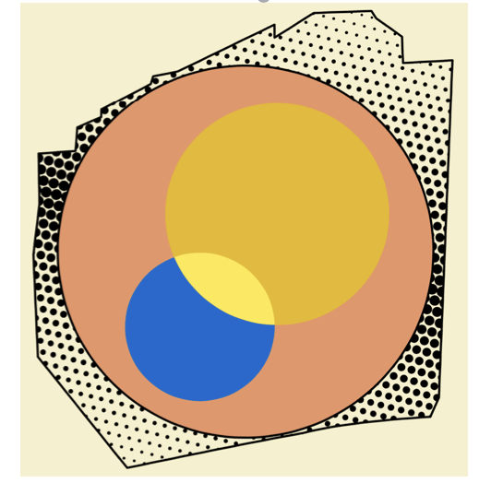
IMCC International Muon Collider Collaboration
Collaboration formed 2022, currently hosted by CERN
61 formal member institutions, still growing
Currently centred in Europe, strong US contribution
R&D progamme developed with global community
In response to strategic requests:
Last ESPPU demanded integration into European Accelerator R&D Roadmap
EU is co-funding design study MuCol since 2023
Different US recommendations: Snowmass, P5 and National Academy of Science
2

Slide 3
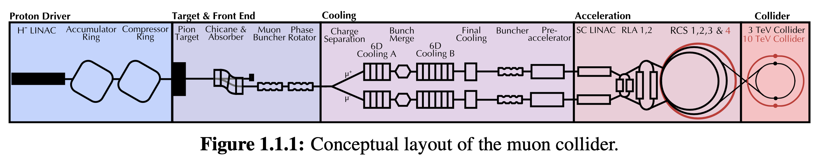
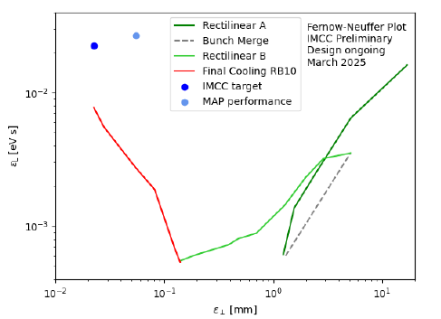
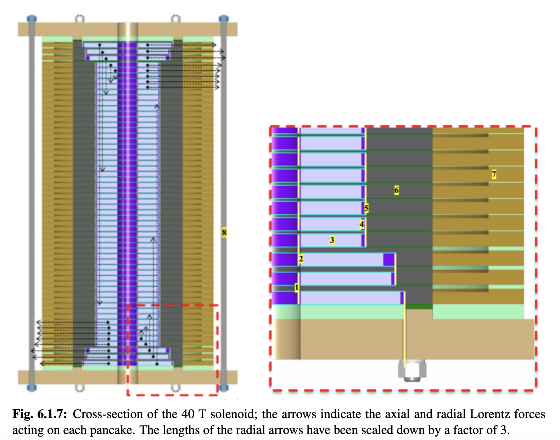
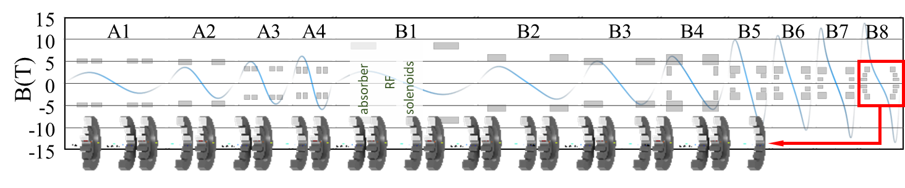
Muon Cooling Lattice Design
Challenges:
Novel, complex lattice with cavities and absorbers in solenoids
High magnetic field
Previous design (MAP)
Goal
Achieved
Achieved:
Much improved lattice design
Developed simulation tools: BDSIM and RFTrack
This allowed to start collective effects studies
Magnet scaled and conceptual designs for 6D cooling
40 T final cooling solenoid conceptual design (55 T is identified to be the limit)
better
better
Key conclusions:
Can in principle reach or exceed performance target
Magnet models and prototypes need to be built
Much improved longitudinal, is useful for collider ring
Study of collective effects important

Slide 4
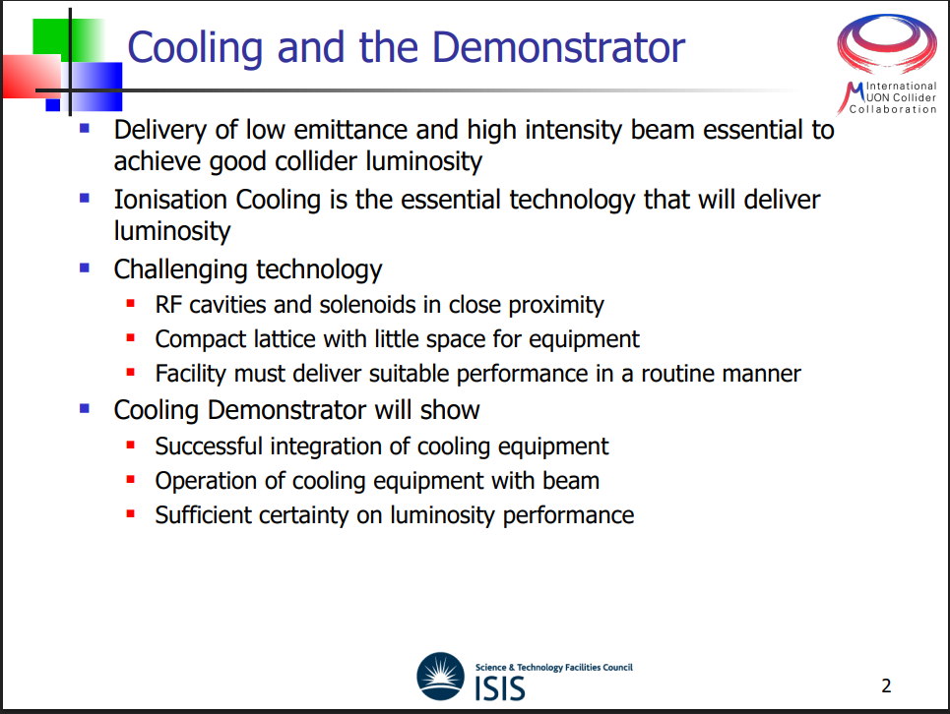

Slide 5
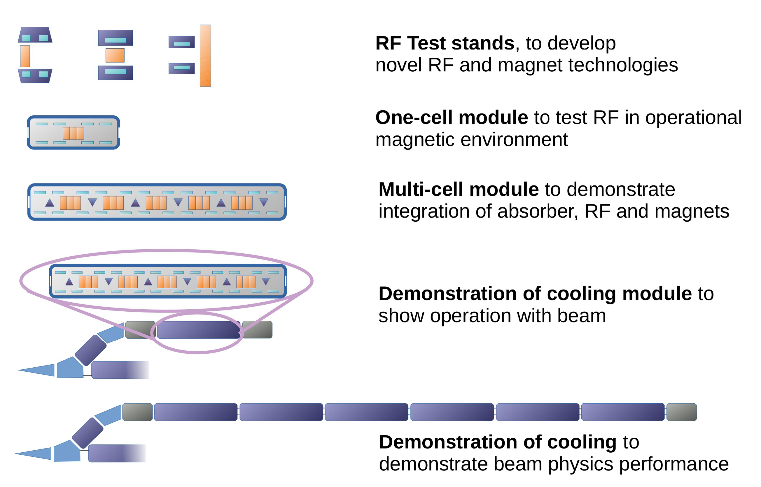
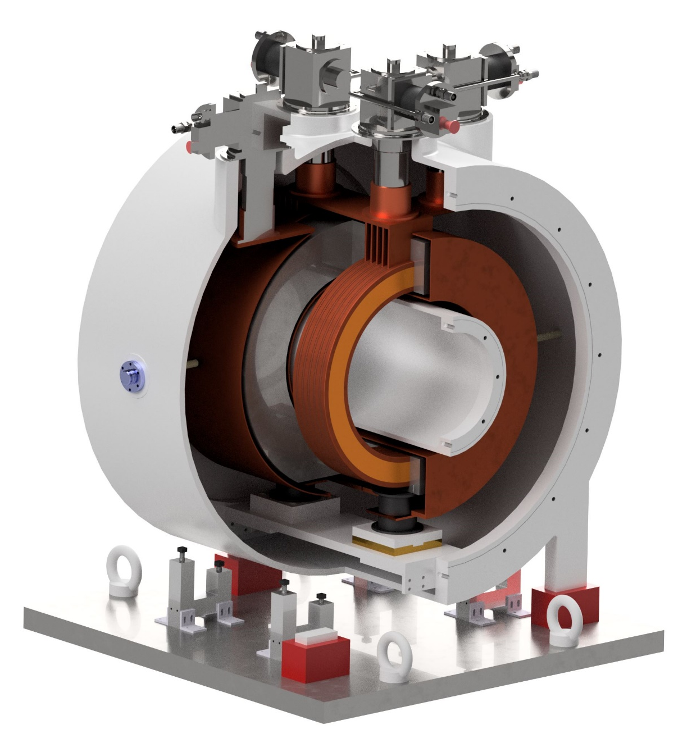
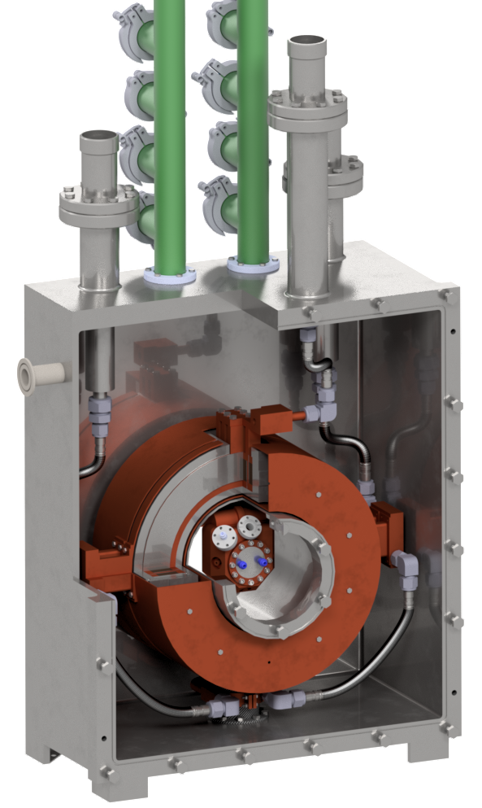
Muon Cooling Demonstrator Programme
… A Technological Point of View
Radio Frequency in Magnetic Field Test Facility (RFMFTF)
v2.0 Split Coil >704 MHz RF testing
v3.1 Single Coil >1 GHz RF testing
v3.2 Split Coil >1 GHz RF testing

Slide 6
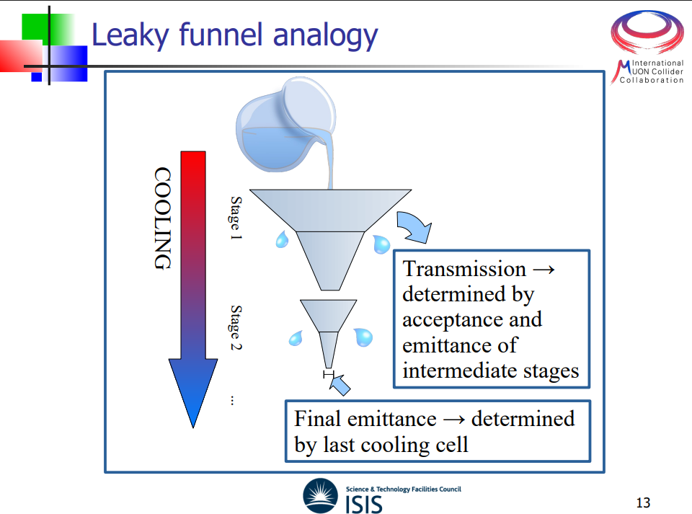

Slide 7
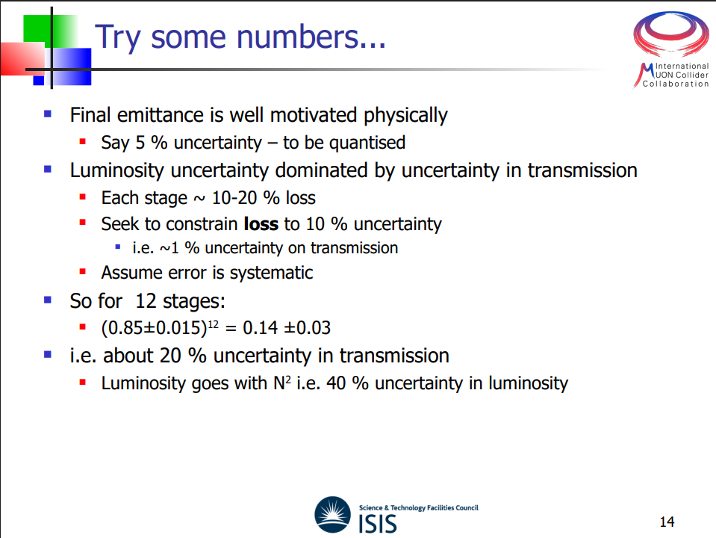

Slide 8
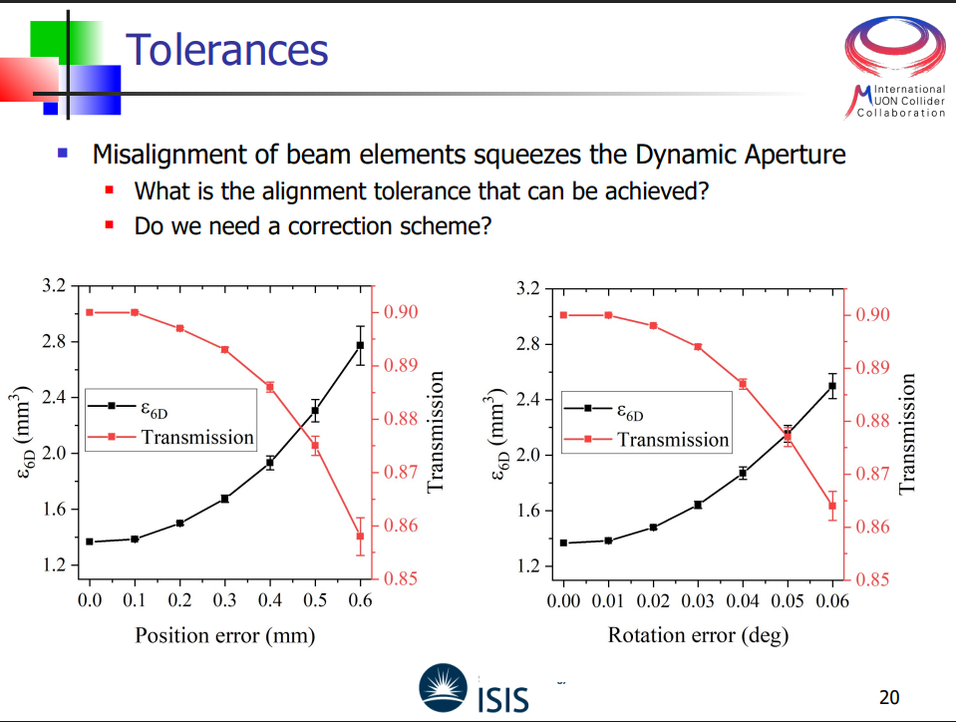

Slide 9

















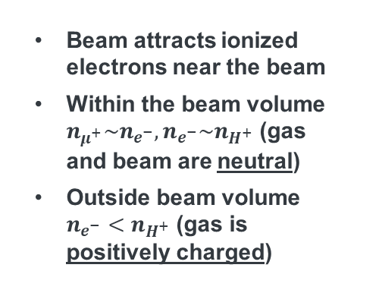













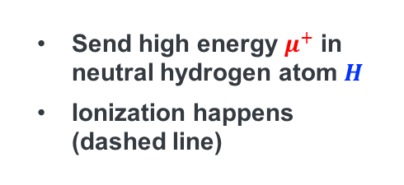
















Plasma Sheath Formation around a Muon Beam
1. Ionization
$$H$$
$$H$$
$$H$$
Send high energy $μ^{+}$ in neutral hydrogen atom $H$
Ionization happens (dashed line)
$$μ^{+}$$
$$μ^{+}$$
$$μ^{+}$$
$$μ^{+}$$
$$μ^{+}$$
$$H$$
$$μ^{+}$$
$$H→H^{+}+e^{−}$$
$$H$$
$$H$$
$$H$$
$$H$$
$$H$$
$$H$$
Beam attracts ionized electrons near the beam
Within the beam volume $n_{μ^{+}}\sim n_{e^{−}}, n_{e^{−}}\sim n_{H^{+}}$ (gas and beam are neutral)
Outside beam volume $n_{e^{−}}<n_{H^{+}}$ (gas is positively charged)
2. Charge neutralization (within ~10 ps)
$$H^{+}$$
$$H$$
$$e^{−}$$
$$H^{+}$$
$$H^{+}$$
$$H$$
$$μ^{+}$$
$$H^{+}$$
$$H^{+}$$
$$μ^{+}$$
$$e^{−}$$
$$e^{−}$$
$$e^{−}$$
$$e^{−}$$
$$μ^{+}$$
$$μ^{+}$$
$$μ^{+}$$
$$H^{+}$$
$$μ^{+}$$
$$e^{−}$$
$$e^{−}$$
$$H$$
$$H^{+}$$
$$H$$
$$H^{+}$$
$$H^{+}$$
$$H$$
$$H$$
$$H$$

Slide 10
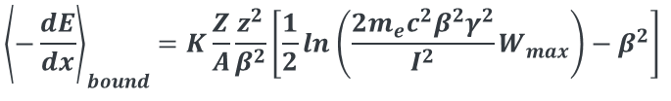
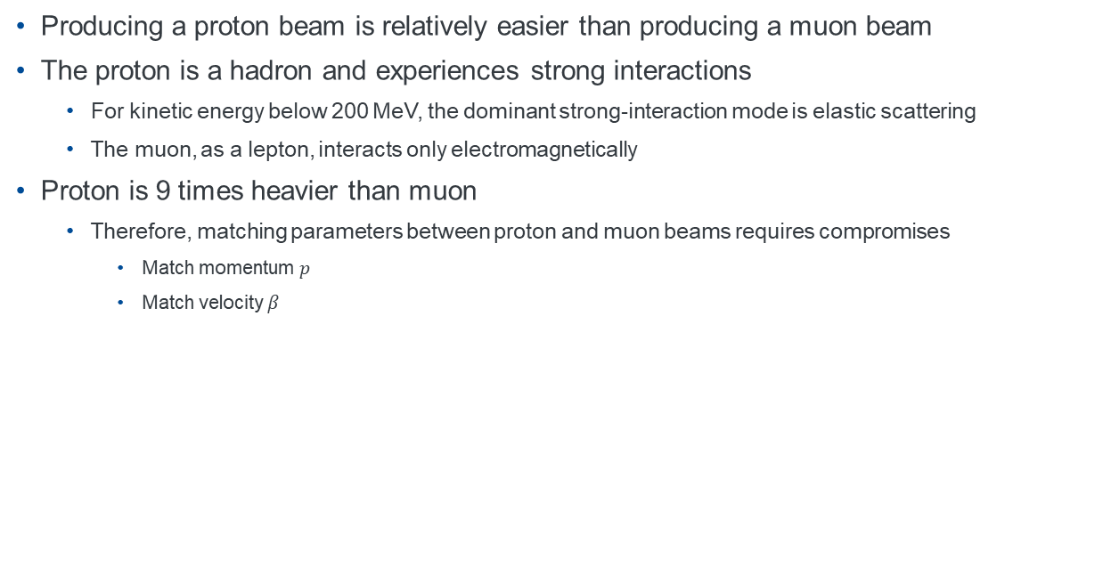
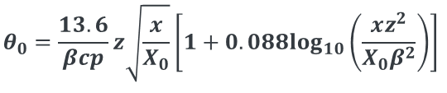

Proton beam for Ionization-Cooling Demo
Producing a proton beam is relatively easier than producing a muon beam
The proton is a hadron and experiences strong interactions
For kinetic energy below 200 MeV, the dominant strong-interaction mode is elastic scattering
The muon, as a lepton, interacts only electromagnetically
Proton is 9 times heavier than muon
Therefore, matching parameters between proton and muon beams requires compromises
Match momentum $p$
Match velocity $β$
Basic equations for ionization cooling
$${\left\langle −\frac{dE}{dx}\right\rangle }_{bound}=K\frac{Z}{A}\frac{z^{2}}{β^{2}}\left[\frac{1}{2}ln\left(\frac{2m_{e}c^{2}β^{2}γ^{2}}{I^{2}}W_{max}\right)−β^{2}\right]$$
$$W_{max}=\frac{2m_{e}c^{2}β^{2}γ^{2}}{1+2{γm_{e}}/M+{\left({m_{e}}/M\right)}^{2}}$$
$$θ_{0}=\frac{13.6}{βcp}z\sqrt{\frac{x}{X_{0}}}\left[1+0.088\log_{10}\left(\frac{xz^{2}}{X_{0}β^{2}}\right)\right]$$

Slide 11
Summary and Outlook
Collective electromagnetic fields induced in the absorber
Beam-induced plasma neutralizes the space charge of the beam
The beam current generates an axial magnetic field that focuses the beam (plasma z-pinch)
The betatron function can be 10-20 % shorter than the design value
Numerical simulations are planned to validate the model
Enhancement of energy-loss rate using intense plasma
Nominal plasma density in the absorber is too low to significantly increase the energy-loss rate
If 10 % of the absorber electrons are ionized, the energy-loss rate increases by about 10 %
Preforming plasma with a laser and particle beam could further enhance the effect
Possible ionization cooling demo using a proton beam
Two cases were evaluated: same momentum and same beta
The results indicate that hadronic interactions can be eliminated by momentum-cuts
Search low-energy proton beam facility

Slide 12
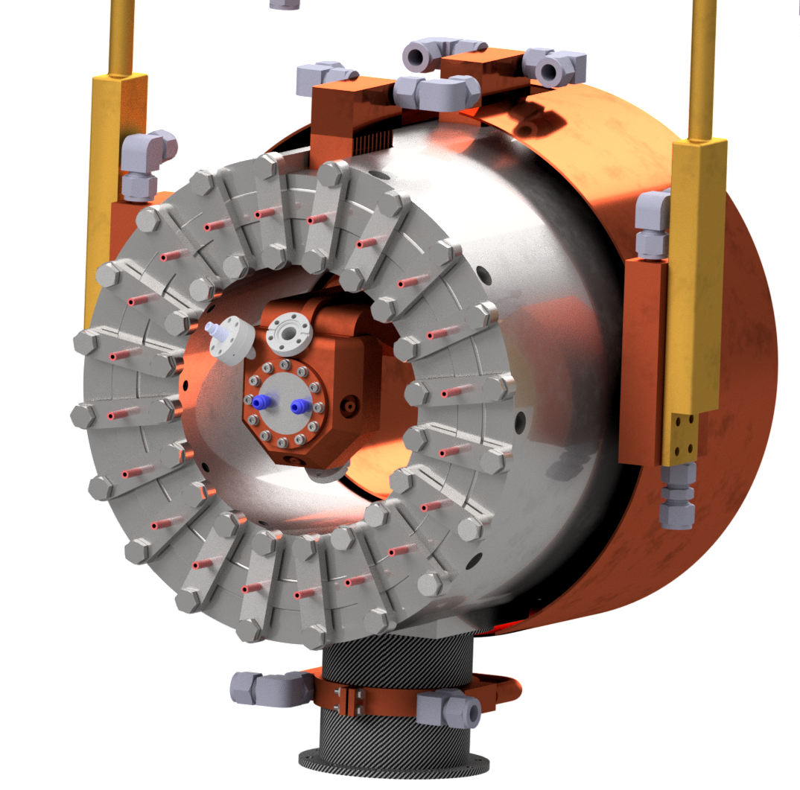
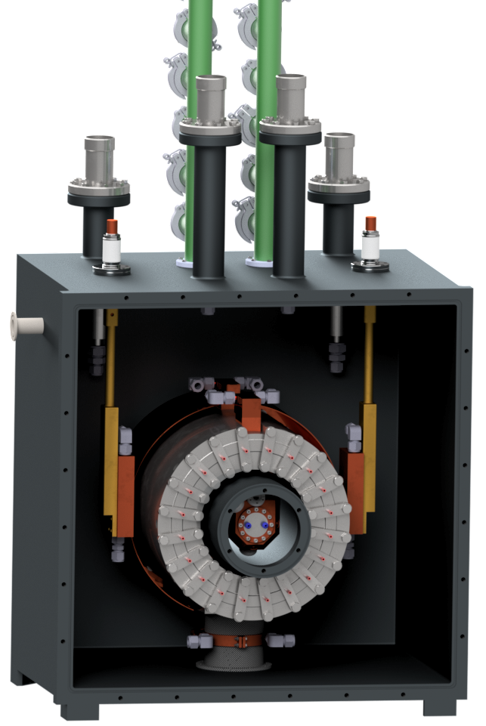
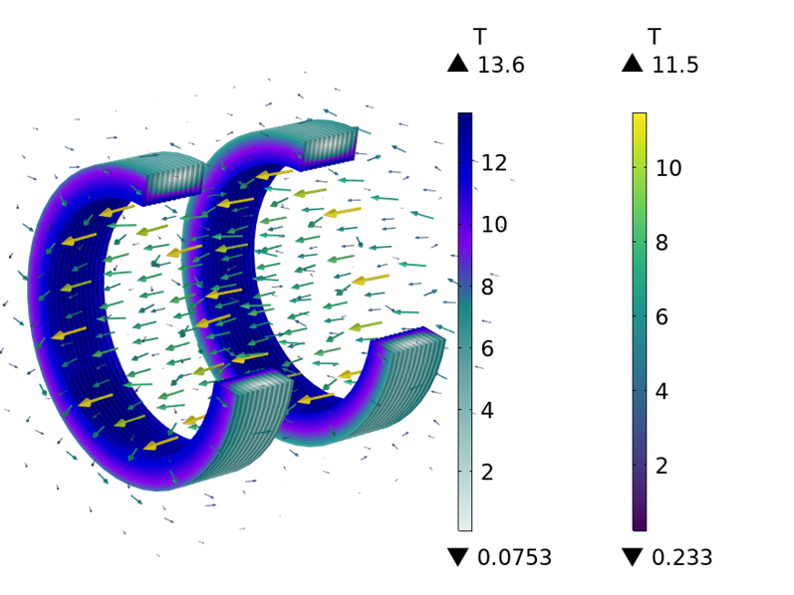
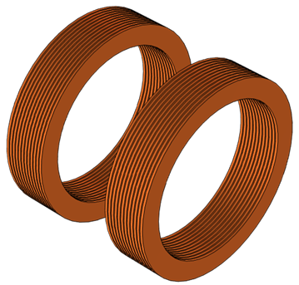
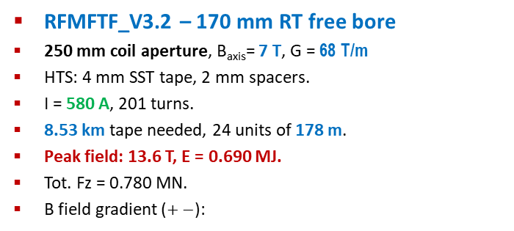
RFMFTF_v3: re-scaled for a 3 GHz cavity 170 mm RT bore, B_{axis}=7 T
RFMFTF_V3.2 – 170 mm RT free bore
250 mm coil aperture, B_{axis}= 7 T, G = 68 T/m
HTS: 4 mm SST tape, 2 mm spacers.
I = 580 A, 201 turns.
8.53 km tape needed, 24 units of 178 m.
Peak field: 13.6 T, E = 0.690 MJ.
Tot. Fz = 0.780 MN.
B field gradient ($+−$):

Slide 13
Funding for the RFMFTF_V3 [Magnet PART] Deadline for decision: March 2026
INFN MuCol: 145 k€ (5 km of 4 mm tape form SST): done!
INFN IRIS: tape 120 k€ (1.5 km 12 mm tape or 4 km of 4 mm or a mix)
In pipeline (under scrutiny…)
HE-EPITA: 50 k€ with 95% CL (2σ)
ASTRA (MUR, IRIS continuation)): 685 k€ for Cryo-mechanics mechanics: 68% CL (1σ) response by Dec.2025
INFN (and UMIL) have already put some 4 FTE-y on this project and 50% of a PhD and 3 MS thesis.
INFN-UMIL can continue to put further 6 FTE-y (2 FTE rate), 1 PhD thesis + 3 MS thesis
Necessary from CERN to INFN (or UMIL) (HFM program, dedicate task, or other)
V3.1 (single coils) : 600 k€
200 k€ mainly for mechanics
400 k€ for 4 FTE (2 y x 2 people in TD, 1 Academic, 1 Technician )
V3.2 (Split coil): + 800 k€
200 k€ for 7 km 4 mm tape
200 k€ for mechanics
200 for cryogenics
200 for 1 y extending both TDs)
TOTAL for the project: 1400 k€ (HTS tapes, other cryomechanical part or design activity can be in-kind…)

Slide 14
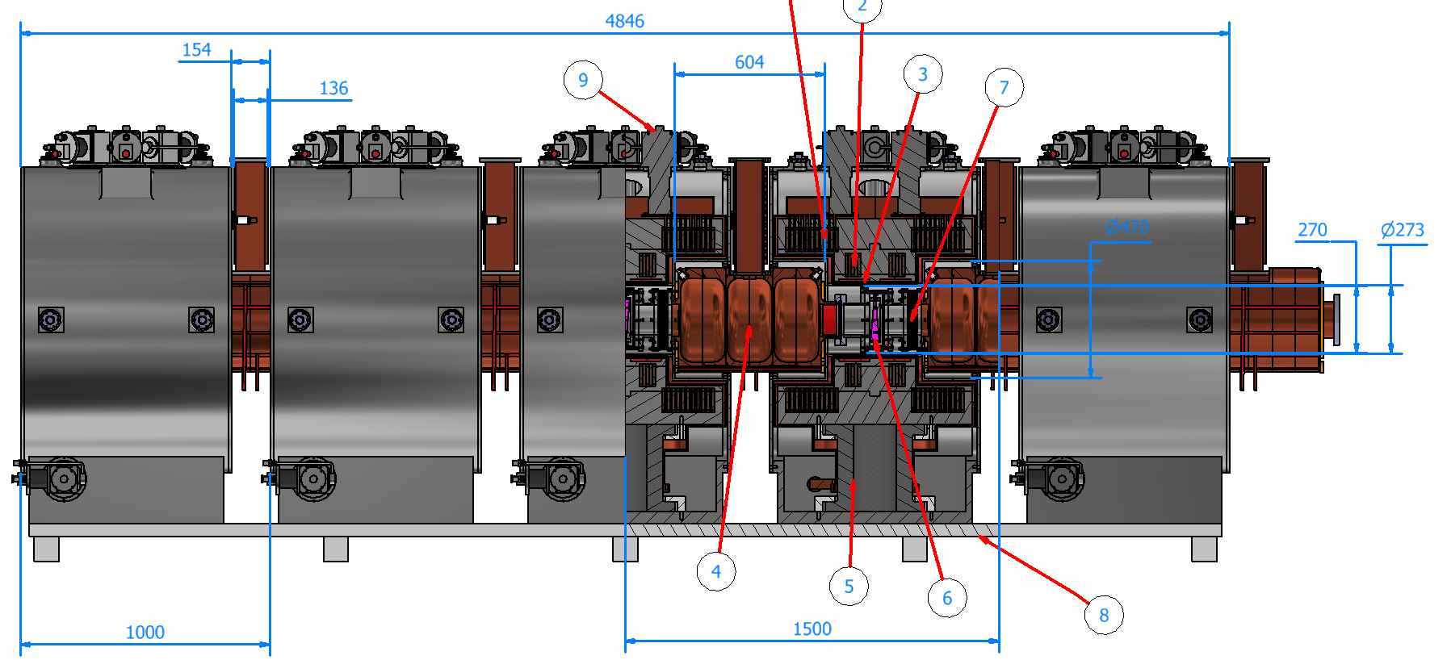
Demo Cooling Cell Module MAG 2.4

Slide 15
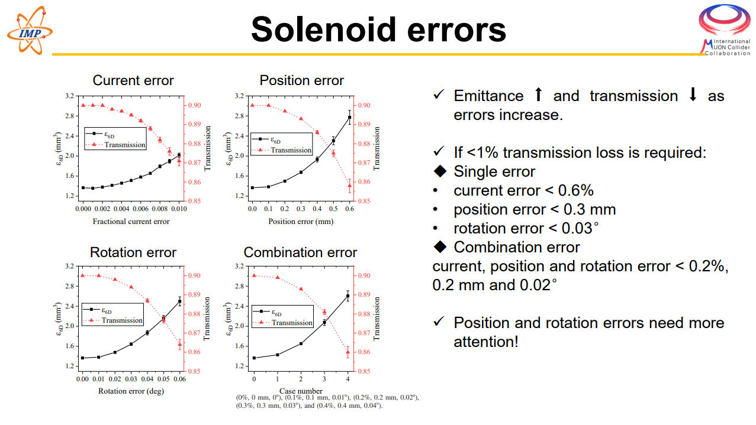

Slide 16
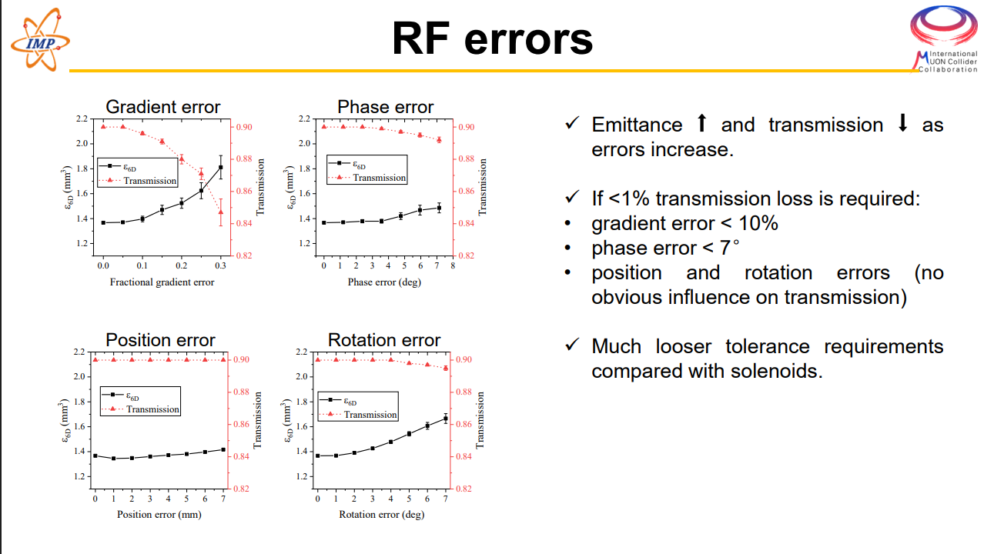

Slide 17
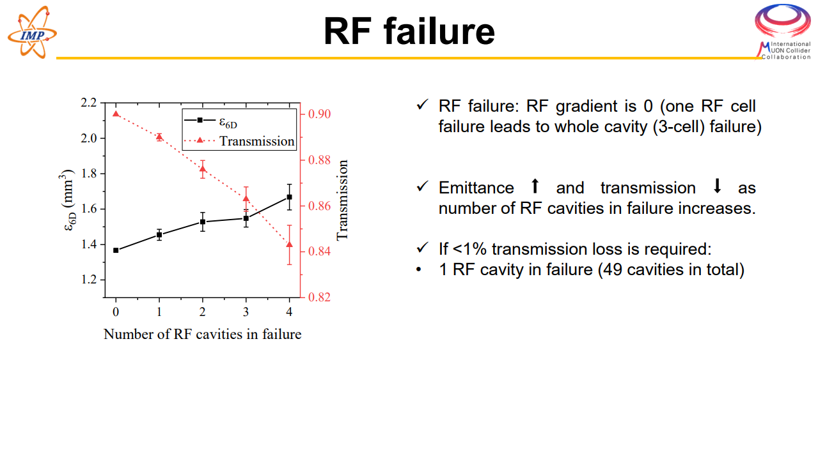

Slide 18
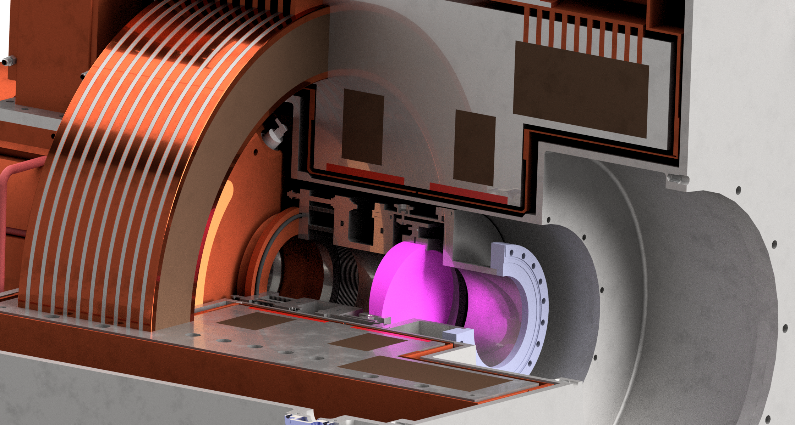
Beam pipe overview
LiH holder
(adgiustable support)
Custom pillow seal system
LiH

Slide 19
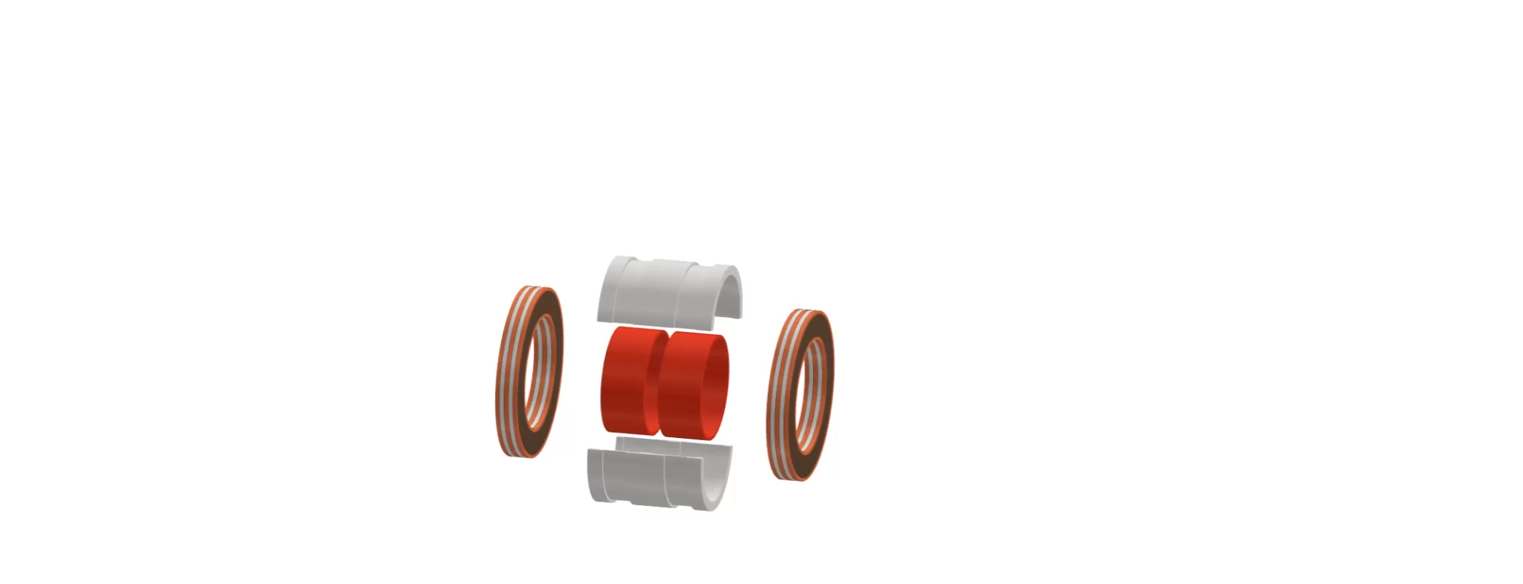
Cooling Cell Integration Short Movie (version 2.4)

Slide 20
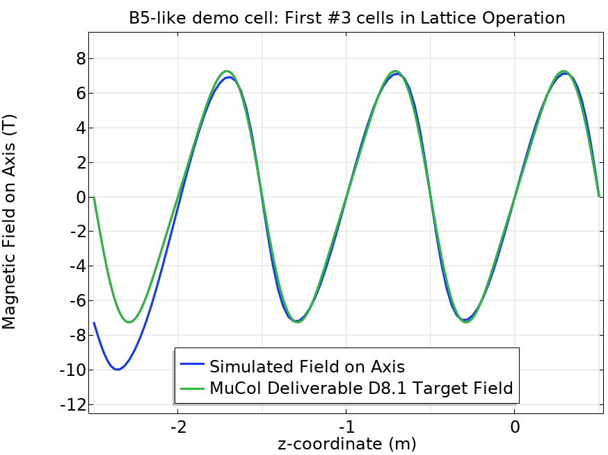
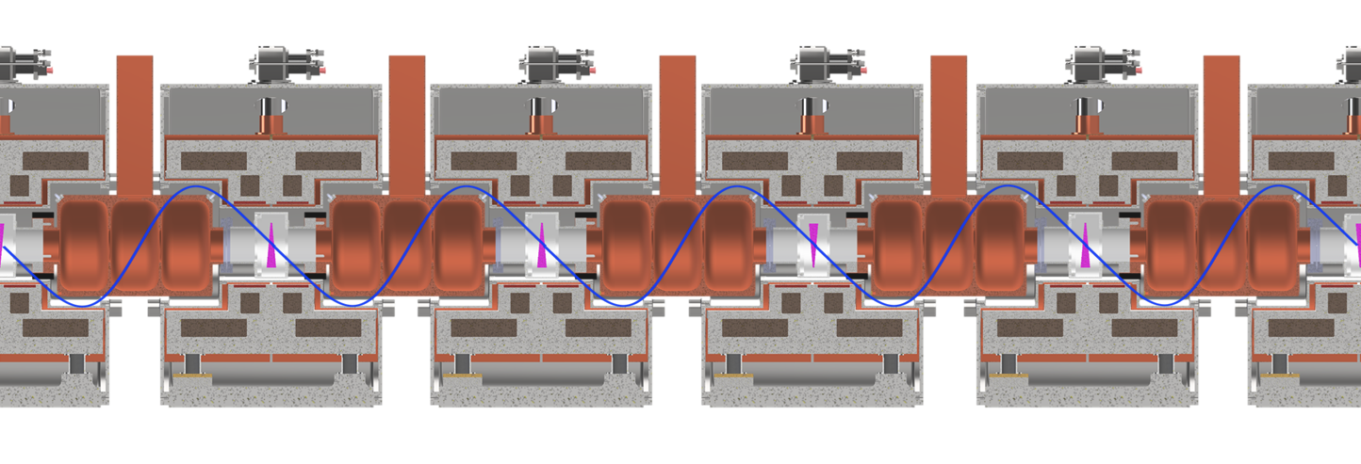
Initial – Final Module Evaluation
Initial - final module design not yet considered.
Loss of symmetry: 10 T peak field on axis
25% current reduction: match peak field on axis.
Unbalanced forces in the first (last) two inter-cell units.
Adiabatic matching?

Slide 21
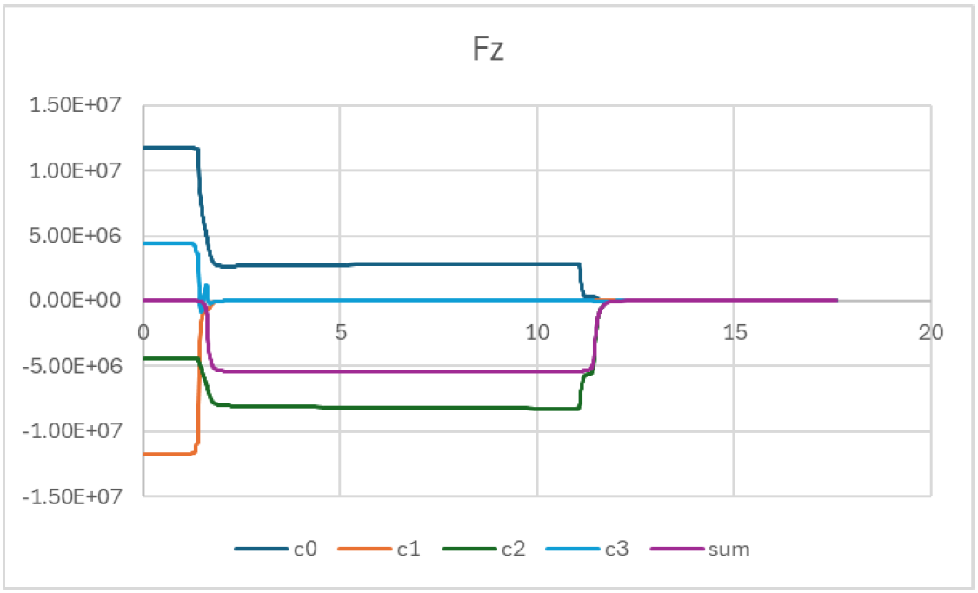
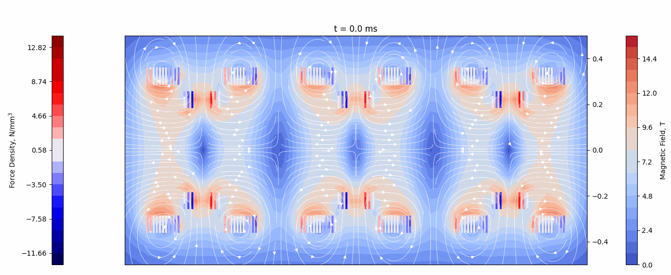
Quench Simulations – Forces Unbalance Courtesy of T. Mulder (CERN)
Quench – no protection system:
Quench initiated on one of the inner turns of C1
Quench propagation in C1 and neighbouring coils.
5.4 MN unbalanced force in the central inter-cell module.
Support structure designed for max 1 MN unbalance!
5.4 MN Unbalance
C3
C2
C1
C0

Slide 22
O-ring based pillow seal
Disconnection
O’ring
Absorber flange
Bellows
Cavity flange
Vacuum
Ø150mm
Ø230mm
O-ring: Ø 3.5 mm
Compression 20% => ≈2 kg/cm
Total force (two O-ring) → < 240 kg
ΔP → 1 bar (spring force not considered)
Single O-ring seems also feasible (no interspace vacuum) => Increase pressure may reduce space between the internal and external bellow => Less radial space
Connection
Interspace pumping
Pressure

Slide 23
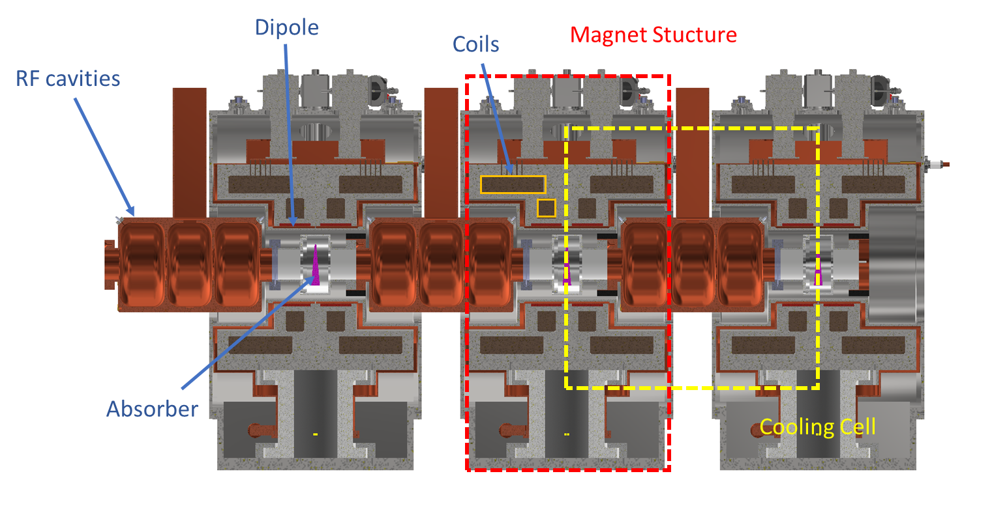
What about pumping?
Two separate volumes: Absorber and RF cavity
RF cavity:
Pumping and instrumentation on the waveguide => To be checked if that is enough
Absorber:
Small tube for primary pumping and monitoring
Pumpdown from atmospheric with both volumes connected (control ΔP) to avoid damaging the RF windows
Control system to ensure the ΔP do not exceed a certain threshold that could damage the window => Safety valve connecting both volumes

Slide 24



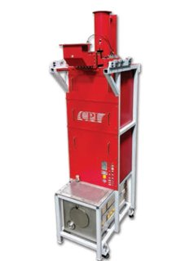
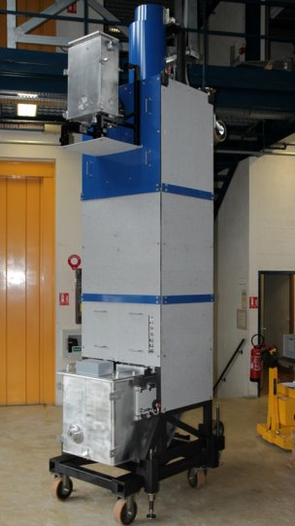
Immediately Available Solutions
Existing solutions at 704MHz are typically single beam devices with peak powers <2MW
E37504
Frequency - 704MHz
Peak Power – 1.5MW
Efficiency – 66%
µPerveance– 0.59
Total Length – 3m
VKP7952 | VKP8292A
Frequency - 704MHz | Frequency - 704MHz
Peak Power – 1.3MW | Peak Power – 1.5MW
Efficiency – 65% | Efficiency – 65%
µPerveance – 0.71 | µPerveance – 0.58
Total Length – 4.72m | Total Length - 3.88m
TH2180
Frequency - 704MHz
Peak Power – 1.5MW
Efficiency – 69%
µPerveance – 0.6
Total Length – 4.5m
CPI VKP-8292A
Thales TH2180

Slide 25
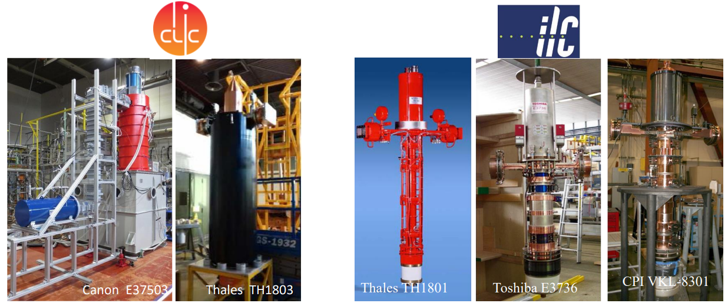
Direct Scaling Solution
A medium-term (3-4 years) solution.
Directly scaling allows the reuse of elements (gun, focussing, collector*)
Frequency: 1.0 GHz
Peak RF Power: 20 MW
Efficiency: 70%
Frequency: 1.3 GHz
Peak RF Power: 10 MW
Efficiency: 65%
*Collector size can be reduced for this scaling example due to lower duty cycle, lower thermal load.
Notes:
Canon E37503, Thales TH1803 is 10 Beam device.
Cavities would still have to be designed – may as well redesign the interaction region with equivalent gun.
Introduction of MBK on this slide – simply multiple beams, perveance is per beam not overall system, shared interaction geometry, interdependent + more points of failure

Slide 26
Conclusion
Existing single-beam klystrons are readily available at this frequency. (Higher power MBKs exist at 1GHz and 1.3GHz)
Feasible medium-term prospects are presented: reuse of component designs and direct scaling. (3-4 years)
Entirely Custom 22-Beam CSM Klystron as a potential long timescale solution.
Two-Stage Klystrons may be viable at this frequency – is the increased complexity worth the size / efficiency improvements?

Slide 27
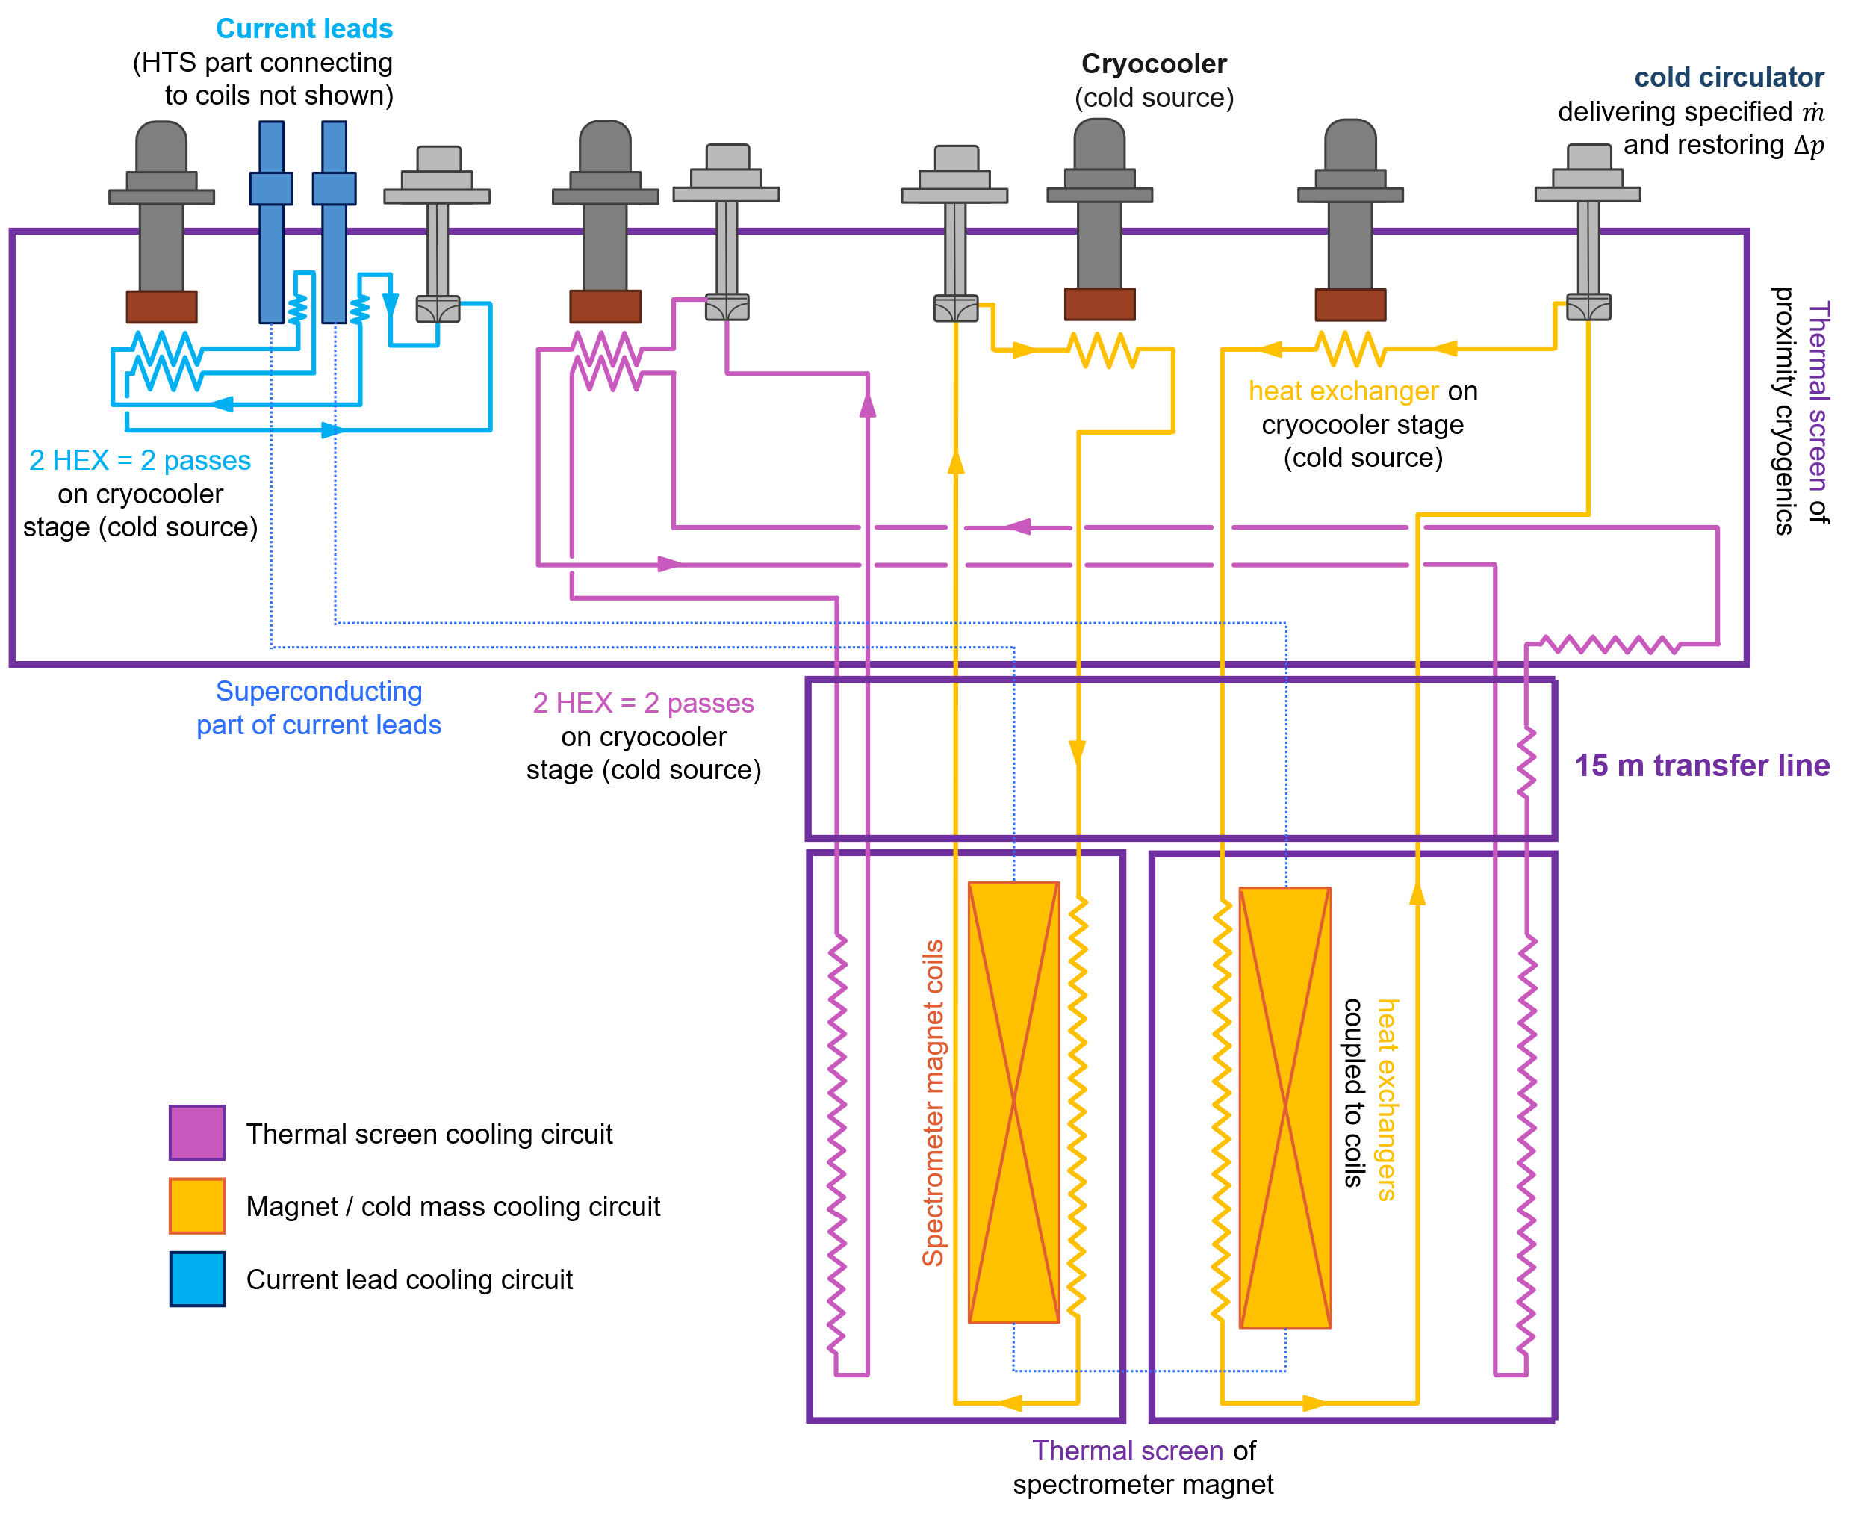
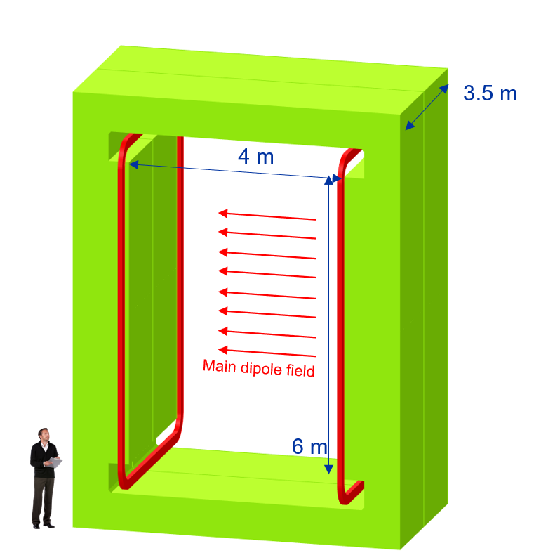
Example of cooling at 20 K - SHiP
Large aperture (4 m x 6 m) superferric magnet
Conductor: MgB₂ operating at 18-20 K
Significant energy savings w.r.t. normal conducting option (even when considering cryogenic consumption!)
Installation in area without He infrastructure (ECN3), and relatively low heat load → ideal case for use of use of cryocoolers and a remote supercritical He loop
Three loops using He gas @ ~10 bara and
18-20 K for the cold mass (~ 5 g/s)
70-80 K for the thermal screen (~ 6 g/s)
50-55 K for the current leads (~ 2 g/s)
Advantages:
Cooling infrastructure 15 m away from magnet (high penalty if conduction cooled)
Almost no He inventory
Operation at higher T
Courtesy L. Baudin (Indico)

Slide 28


(Qualitative) comparison of cryo system options
Cryocoolers + turbo-Brayton or LN₂
Independent cooling circuit for each temp. level
TB system installed at surface level
Modularity with increasing # cells, can add cryocoolers as cooling channel grows
Cryocoolers + compressors installed underground (needs cooling water + electricity)
High energy consumption (12 kW/cryocooler + TB (?))
Maintenance of cold heads every 15’000 h
Requires trained operators for TB part
He liquefier/refrigerator
(can have) independent cooling circuit for each temp. level
Cold box + ancillary services all at surface level, only transfer line to cooling channel
Most energy-efficient option
Likely higher cost than cryocooler + TB option
High He inventory incl. gas management + storage
Complex maintenance of cryoplant every 8’000 h
Requires trained operators

Slide 29
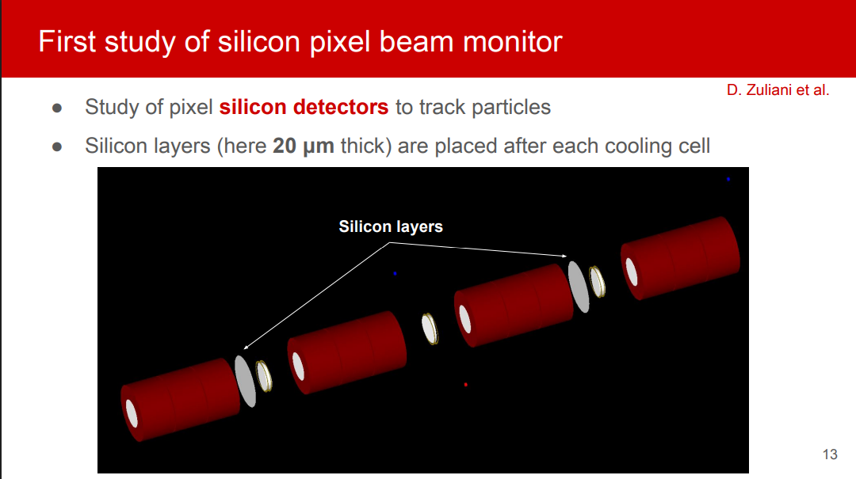

Slide 30


Slide 31


Slide 32


Slide 33


Slide 34


Slide 35


Slide 36


Slide 37


Slide 38


Slide 39


Slide 40


Slide 41


Slide 42


Slide 43


Slide 44


Slide 45


Slide 46


Slide 47


Slide 48


Slide 49
A possible plan for 1st Cooling Module
It assume only a moderate increase of resources wrt today
2025 2026-I 2026II 2027-I 2027-II 2028-I 2028-II 2029-I 2029-II 2030-35
RF test stand SLAC 3 GHz → 1.3 GHz?
RF test material LASA (1 T resistive magnet)
RFMFTFV3.1 →V3.2 operation
Cryomagnets RFMFTFV3.1 →V3.2
Prototypes RF cells
Prototype C. cell magnets
Design C. Module – ends → Design 1st Cooling cell
construction 1st Cooling cell
Construction & test 1st Cooling Module

Slide 50




R&D MC and HFM
What is a good intermediate goal?
What do want to build?
All R&D by ourself?
building S5 like cell
building RFMFTF
Radio Frequency in Magnetic Field
Test Facility
No
Strong synergies with HFM
HTS magnets program
See L. Rossi and G. Scarantino

Slide 51



TRL Drives the R&D
We wish to reach a TRL 6 for the decision of construction, the level of readiness appropriate to enter the industrialization
Courtesy of L. Bottura

Slide 52
Conclusion 1
Clear vision of the R&D goals: RFMFTF and S5-like cell are technology demonstrators
HTS R&D
Probe tapes specs (to be able to better specify next procurements)
Test winding techniques and conductor
Incremental complexity tests
Both common and complementary studies with the final cooling solenoid development
Some infomations will arrive by ESMA magnet by IRIS
Strong improvements in modeling
Some tools are available, some are in development
We need experimental crosschecks

Slide 53
Conclusion
Many thanks to Nadia and Dario!
Excellent progress on every aspect of the Demonstrator
Eagearly waiting for the conclusion of the EUSPP…. Don’t forget to contact editors of national inputs!!!
Have a safe trip

