Slide 1
Debunched beam cleaning using ADT in the LHC
Anna Radoslavova, Xavier Buffat, Sofia Kostoglou, Daniel Valuch
26.08.2025

Slide 2
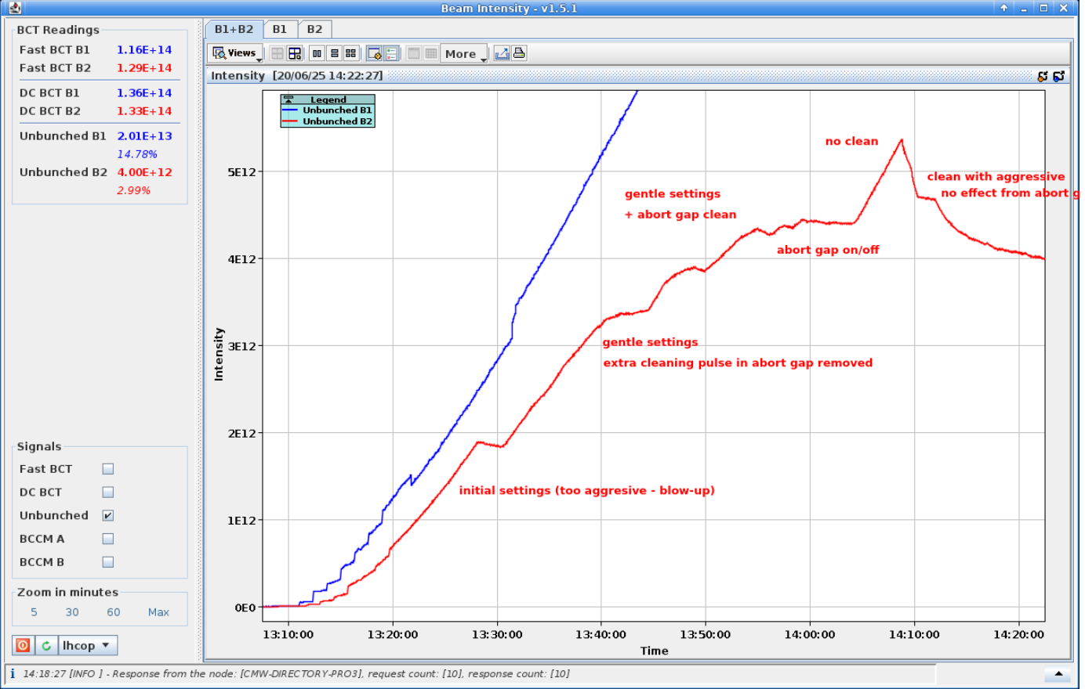
Introduction
  Debunching building up during injection due to IBS:
  Brightness depended mechanism, especially relevant for HL-LHC beams.
  If extended stay at injection and/or high bunch intensity → beam dump due to losses exceeding BLM thresholds.
Courtesy of Daniel Valuch
  Finding the best way to clean the debunched beam.
  Based on the work of RF team (H. Timko and B. Karlsen-Baeck) and IBS implementation of M. Zampetakis and F. Soubelet
  Comparing 3 different excitation types – white noise excitation, frequency sweep and rectangular excitation.
  Condition: the neighboring bucket should remain unaffected!
  Excitation applied to the ADT elements in xsuite – adtkh.d5l4.b1 and adtkv.d5r4.b1.
MD15425 Improved cleaning of de-bunched beam
H. Timko, D. Valuch

Slide 3
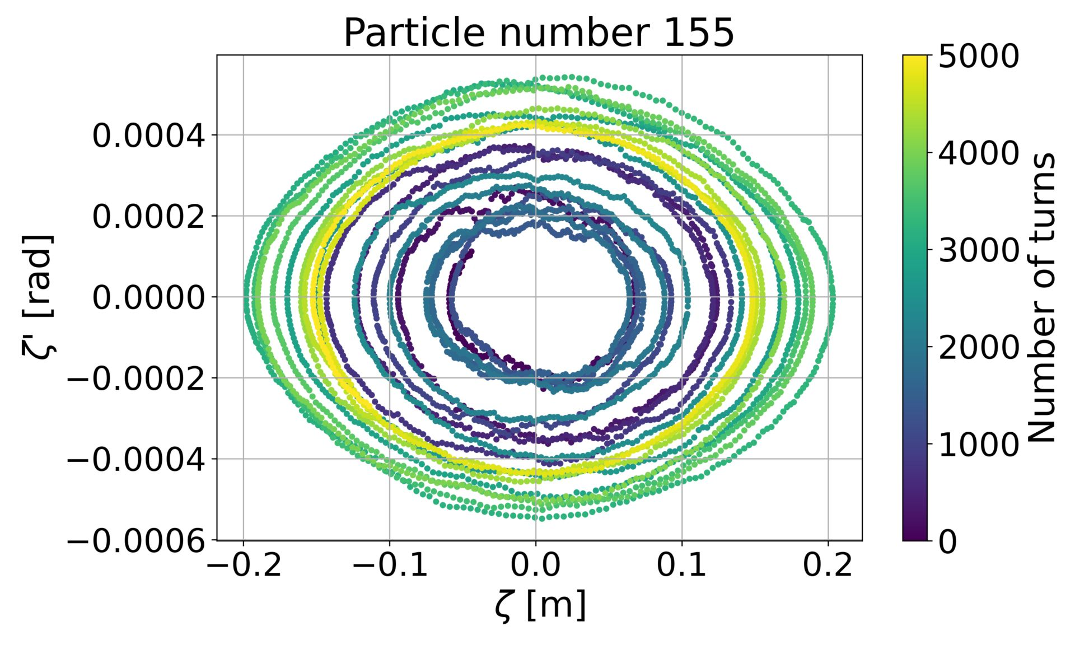
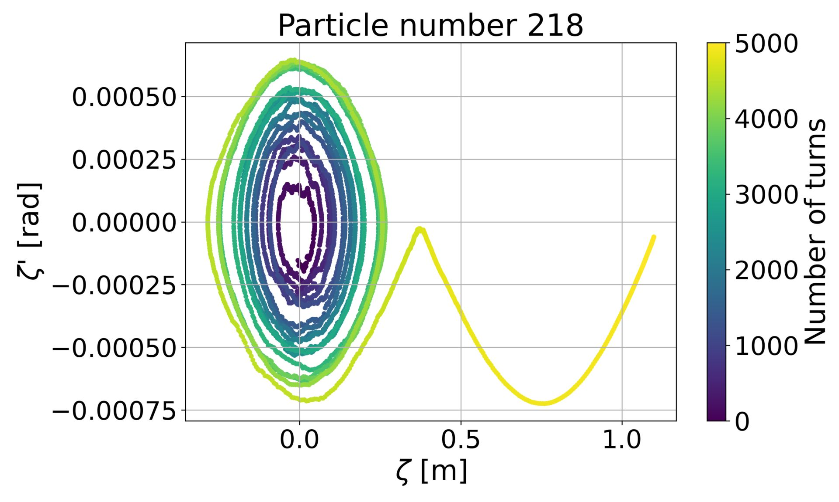
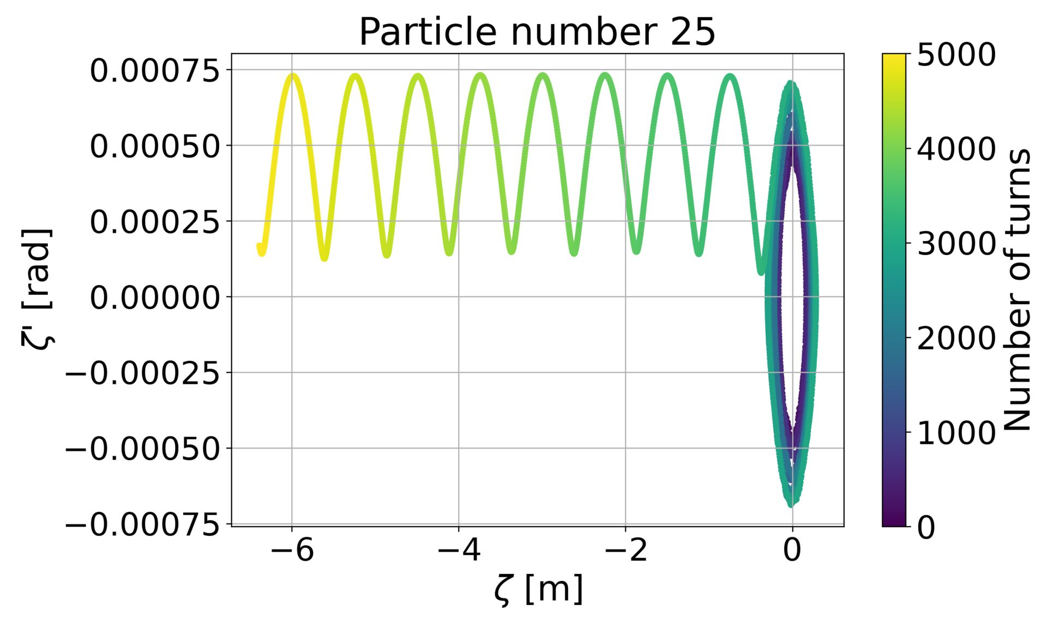
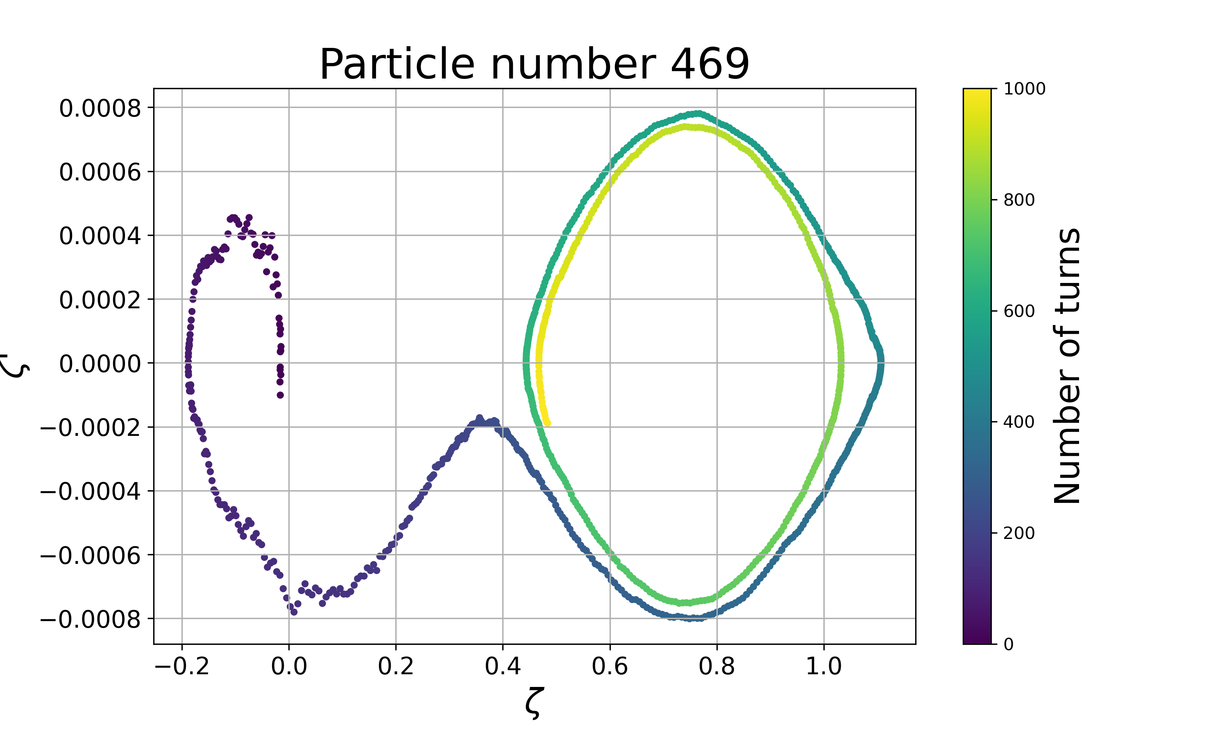
Simulations of debunched beam: LHC injection + IBS kicks

Slide 4
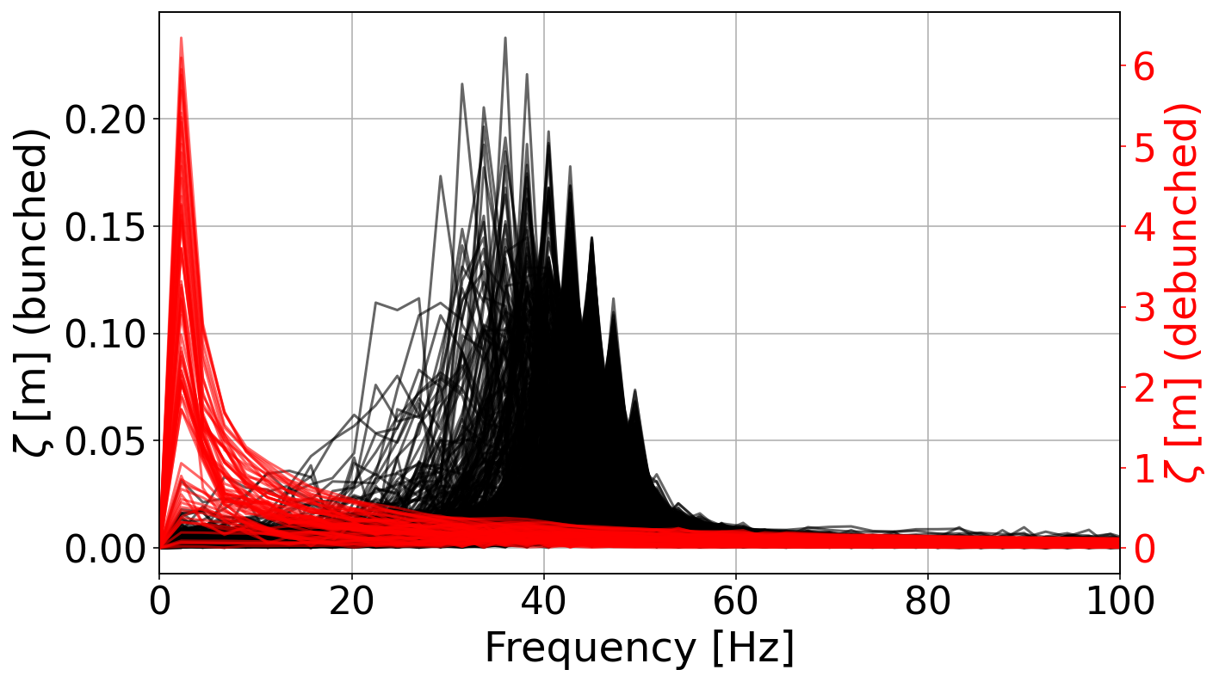
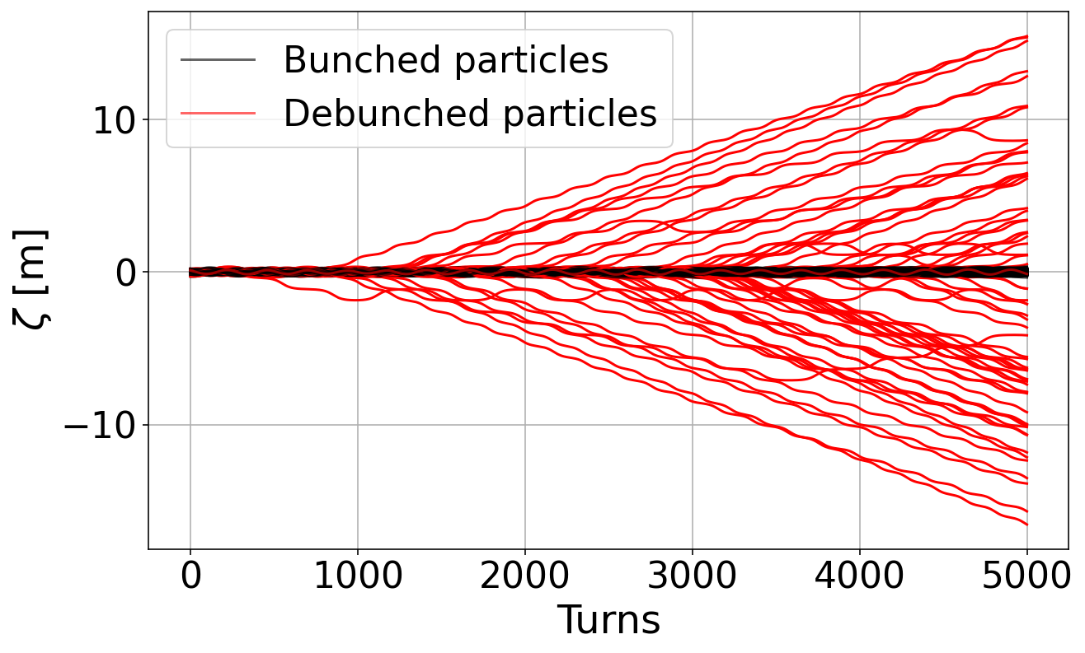
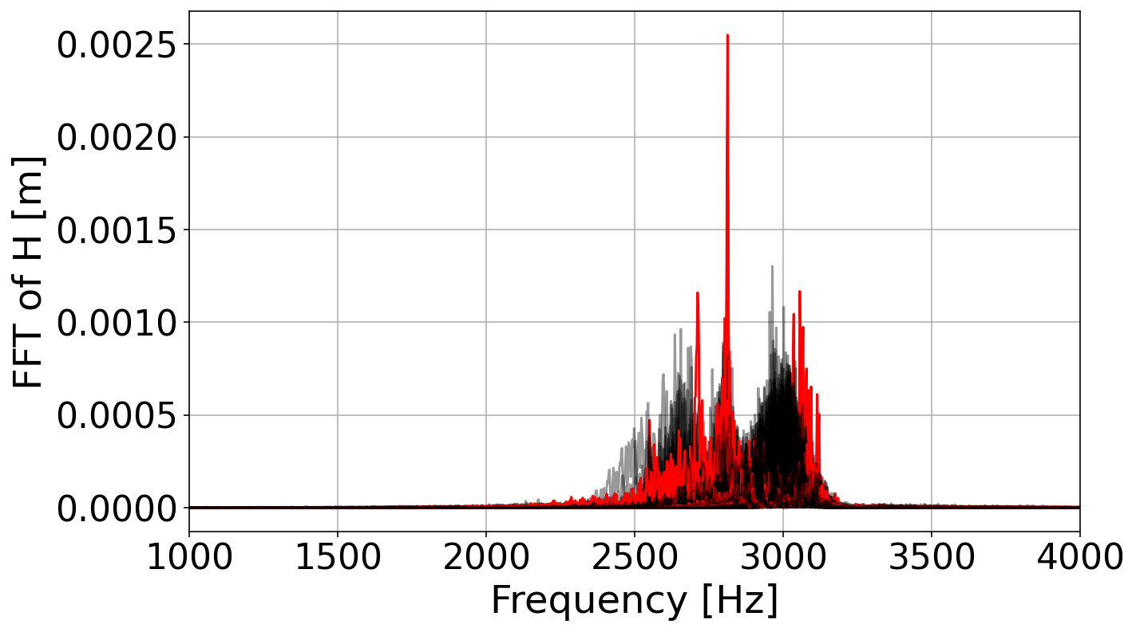
FFT of Bunched and Debunched Particles

Slide 5
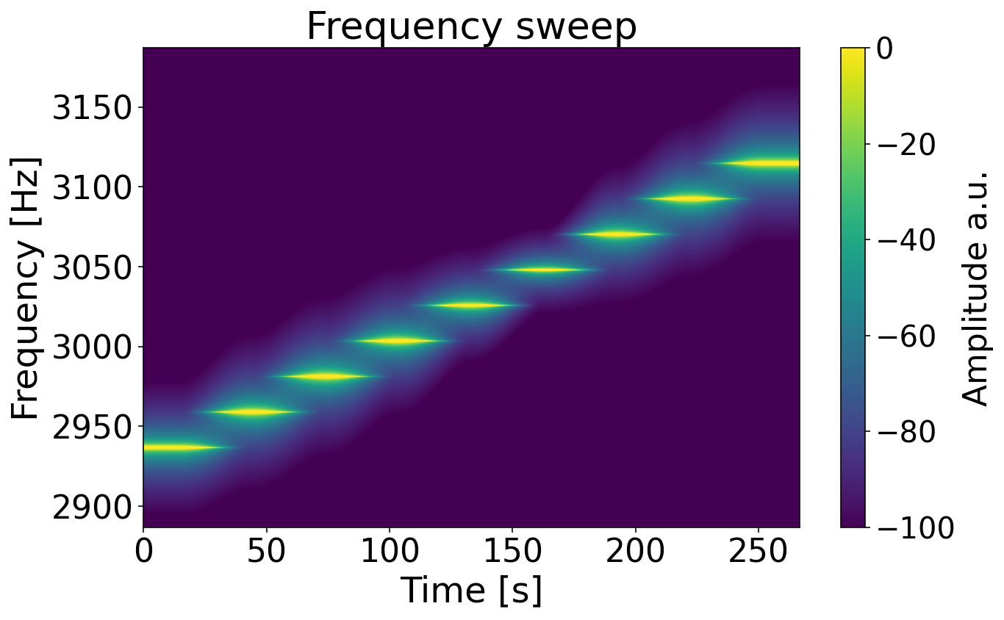
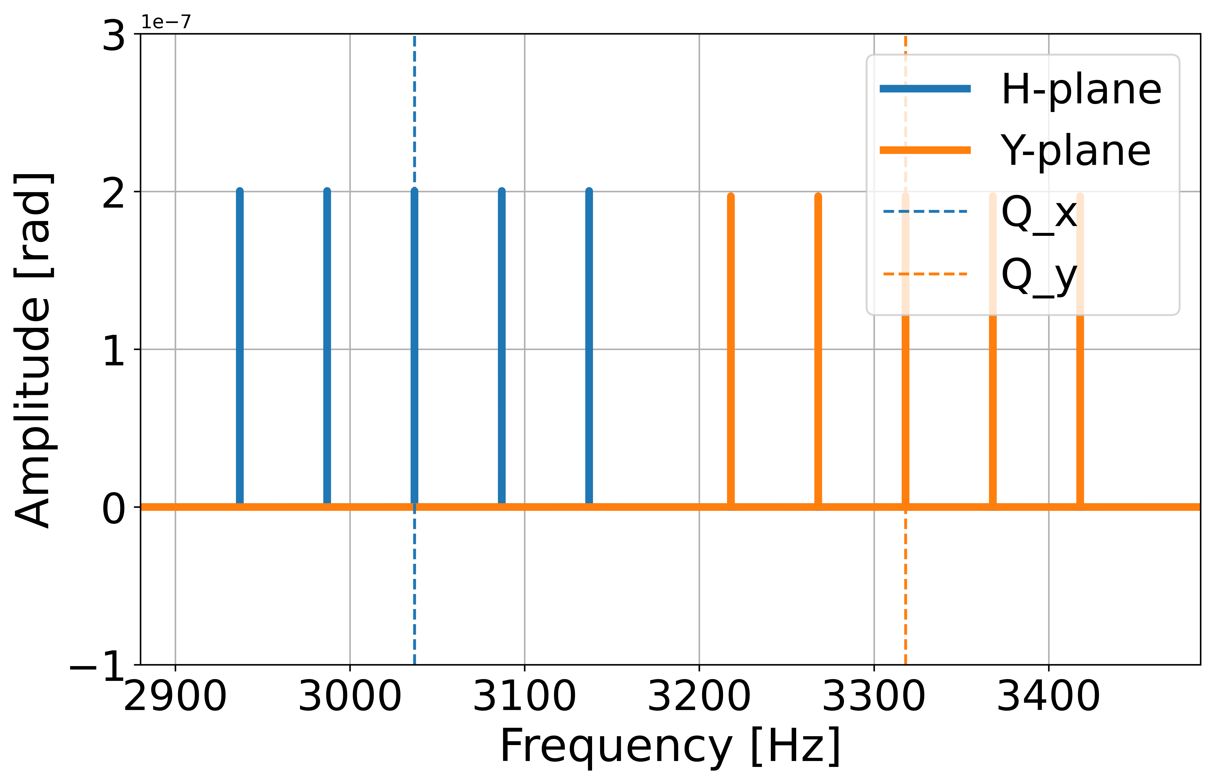
Types of noise
White noise – gaussian noise, sampled from a random distribution.
Frequency sweep – excitation of different frequencies sequencially for a given number of turns.
Rectangular excitation – excitation of different frequencies simulataniously.
Always excited around the tunes Qx, Qy in equal distances!
Using arbitraty number of turns for the excitation at each frequency
Using arbitraty number of excitation frequencies
Notes:
Put labels on top, 1st and 2nd plots: say that we are using arbitrary number of turns to stay at each frequency
Put the rectangular windows ins econd plot: say that we have 5 in this plot but that daniel managed to update the ADT firmware and now we can have at least 256 tones. As the clustering of debunched beam in the previous plot in the FFT is not clear in the previous plot we have to excite the fulll spread. The full spread is not very well reproduced in simulations so we have to test in operariton because in simulations there are effects that are not included (e.g. ecloud). So to find max min limits of rectangular excitation we need to test in operation
It will be the first time that we check the rectangular excitation in MD. The goal is to show that rectangular excitation is much more powerful than white noise and frequency sweep and that we need the minimum amount of excitation amplitude that would also lead to the minimum leakage.

Slide 6
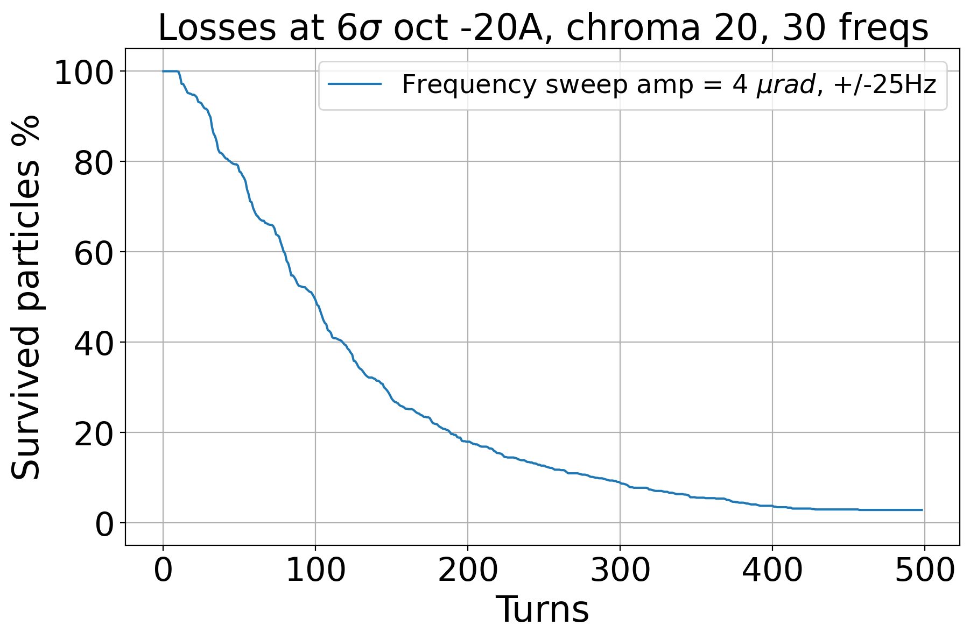
Frequency sweep: impact of f-range
Comparison between different excitation windows.
Due to the tune spread we need to kick around the tunes using different frequency windows.

Slide 7
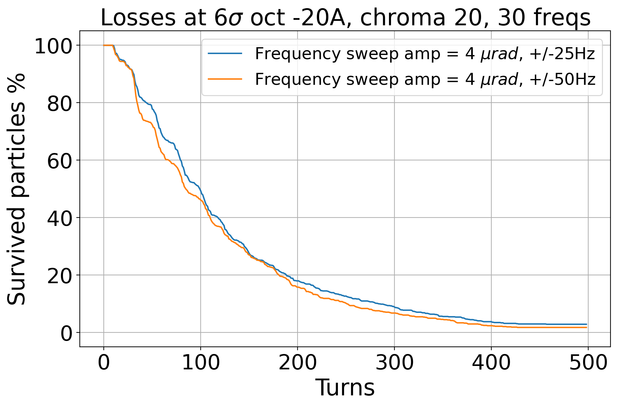
Frequency sweep: impact of f-range
Comparison between different excitation windows.
Due to the tune spread we need to kick around the tunes using different frequency windows.

Slide 8
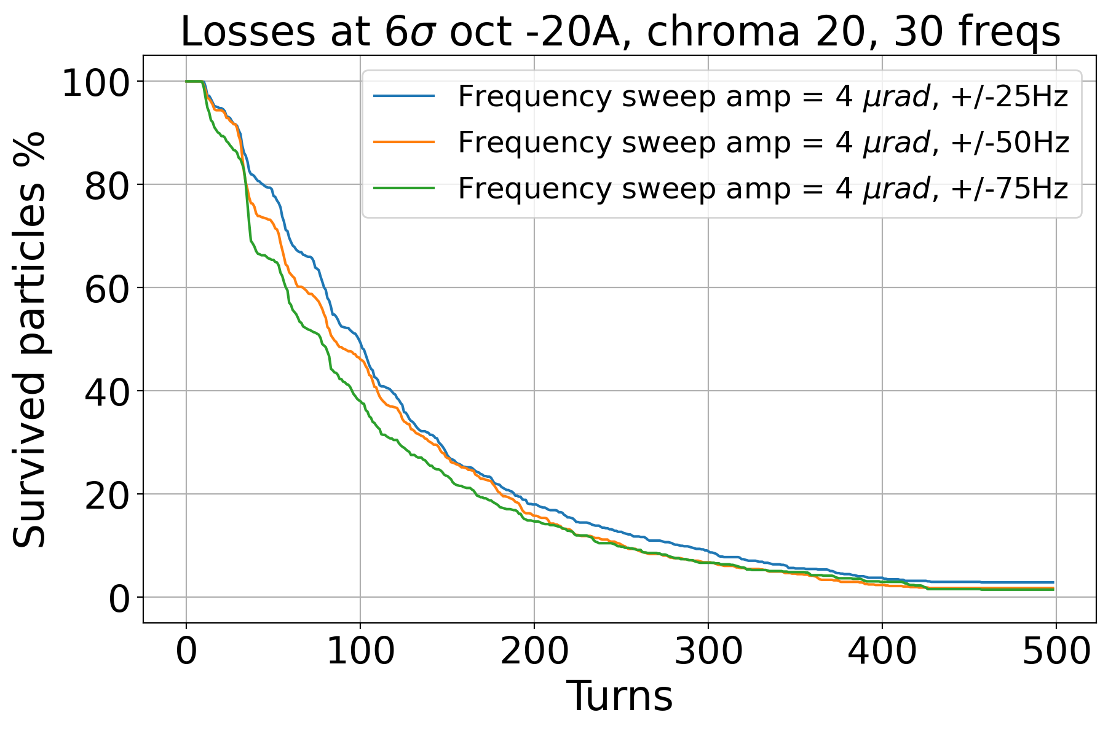
Frequency sweep: impact of f-range
Comparison between different excitation windows.
Due to the tune spread we need to kick around the tunes using different frequency windows.

Slide 9
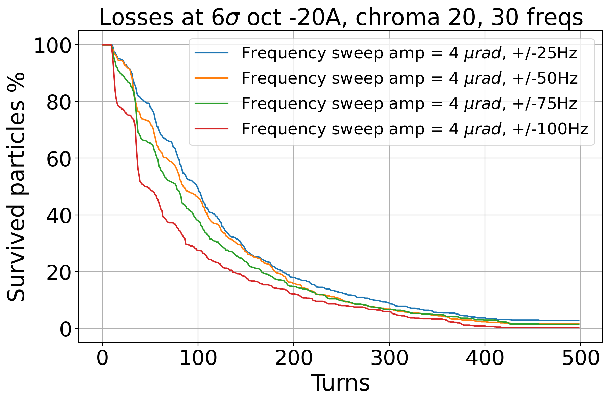
Frequency sweep: impact of f-range
Comparison between different excitation windows.
Due to the tune spread we need to kick around the tunes using different frequency windows.

Slide 10
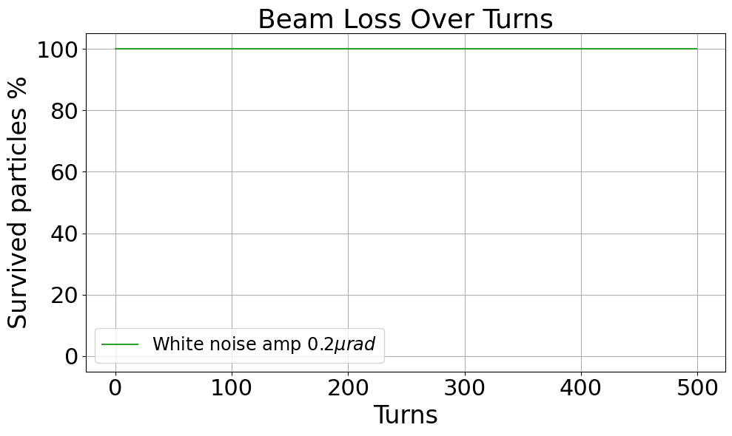
Simulations – comparison between the different noise types
The white noise and the sliding window are not as effective as the rectangular window.
We need way higher amplitude of excitation.

Slide 11
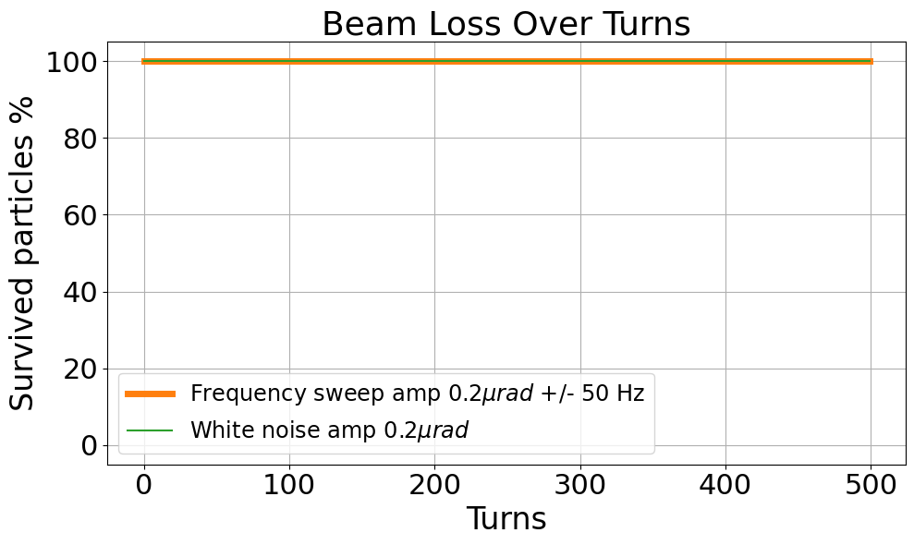
Simulations – comparison between the different noise types
The white noise and the sliding window are not as effective as the rectangular window.
We need way higher amplitude of excitation.

Slide 12
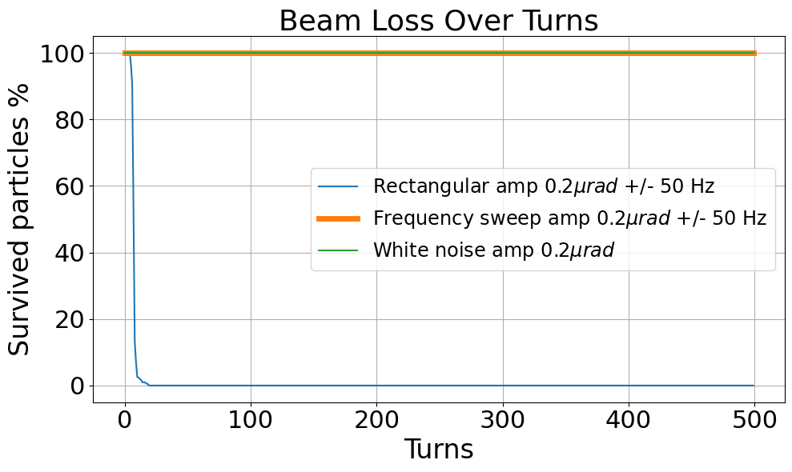
Simulations – comparison between the different noise types
The white noise and the sliding window are not as effective as the rectangular window.
We need way higher amplitude of excitation.

Slide 13
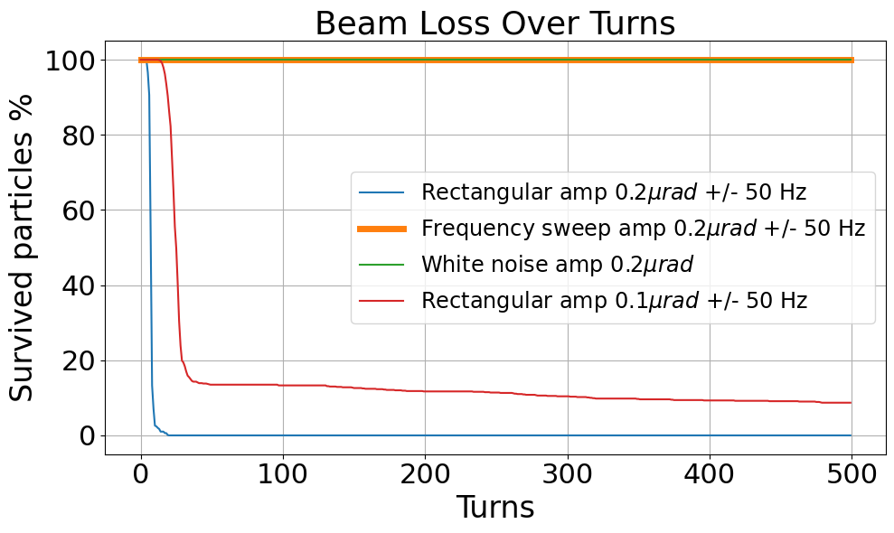
Simulations – comparison between the different noise types
The white noise and the sliding window are not as effective as the rectangular window.
We need way higher amplitude of excitation.

Slide 14
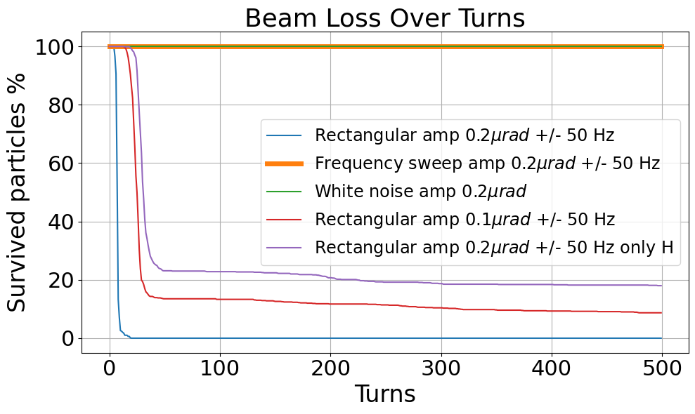
Simulations – comparison between the different noise types
The white noise and the sliding window are not as effective as the rectangular window.
We need way higher amplitude of excitation.

Slide 15
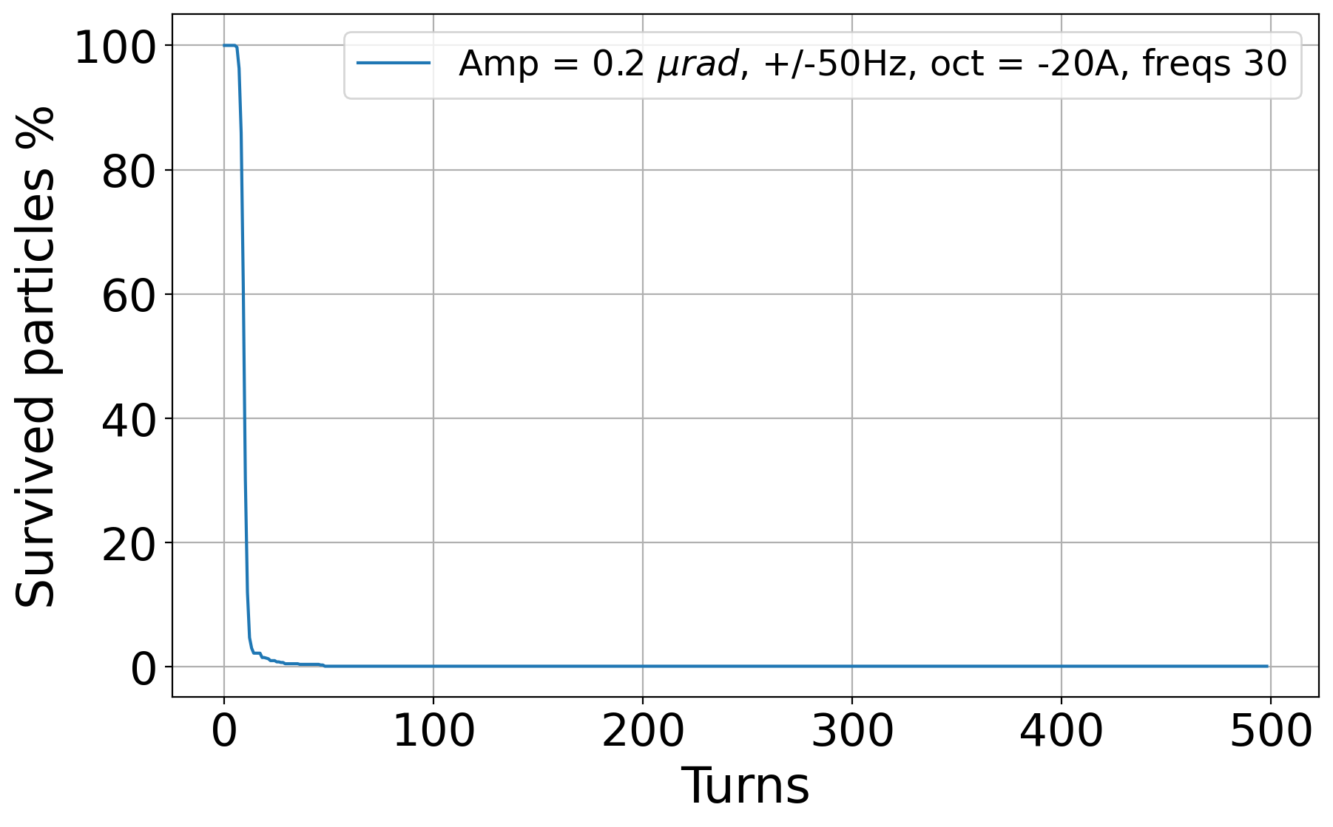
Rectangular excitation: impact of tune spread & number of tones
Comparison between different settings.
The best option is to have as many as possible excitation frequencies in a given window around the tunes.

Slide 16
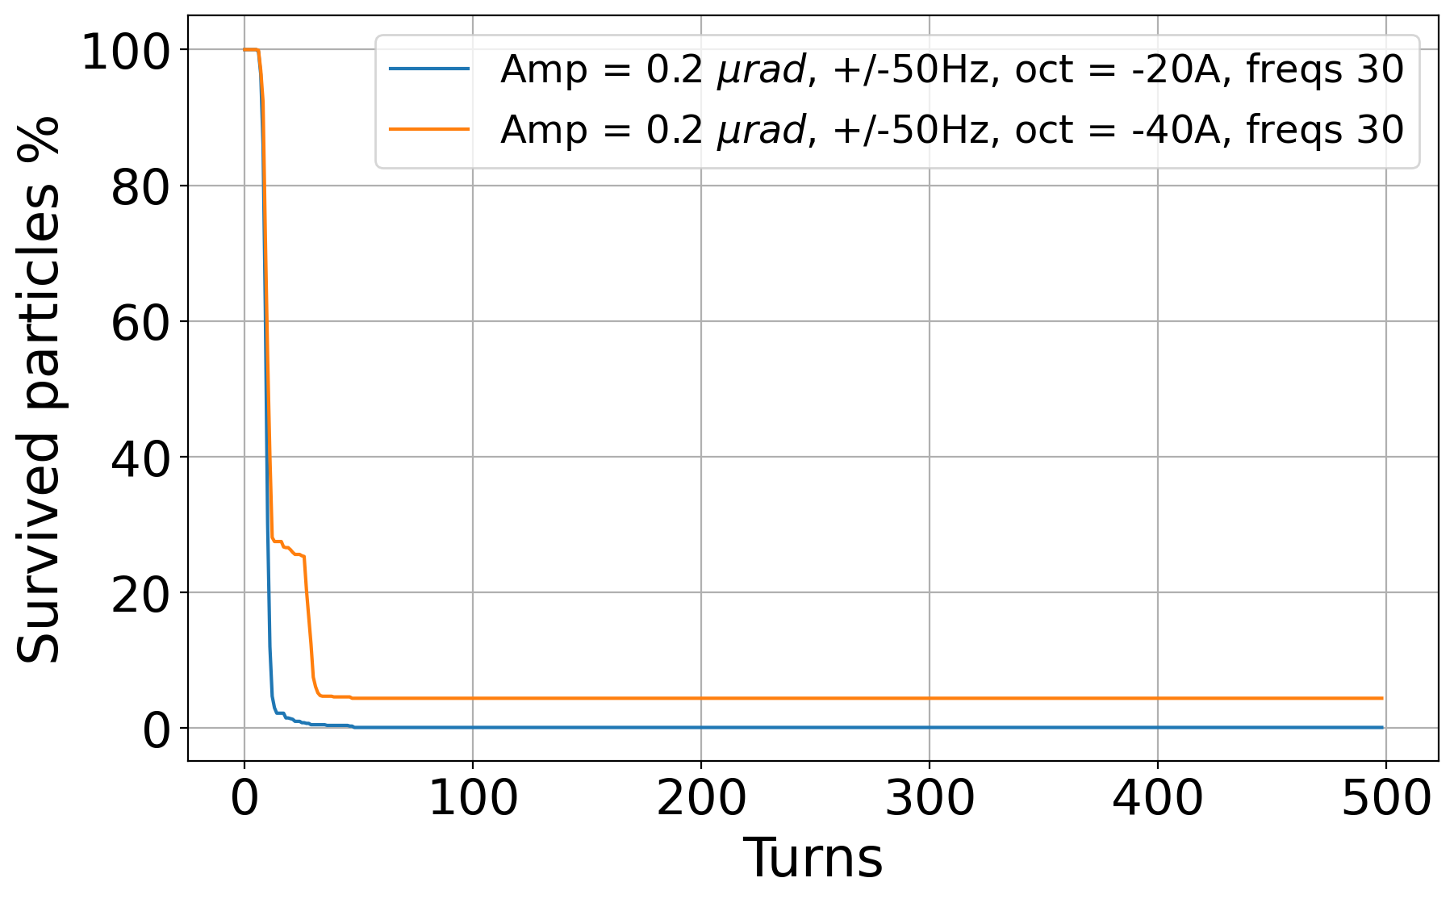
Rectangular excitation: impact of tune spread & number of tones
Comparison between different settings.
The best option is to have as many as possible excitation frequencies in a given window around the tunes.

Slide 17
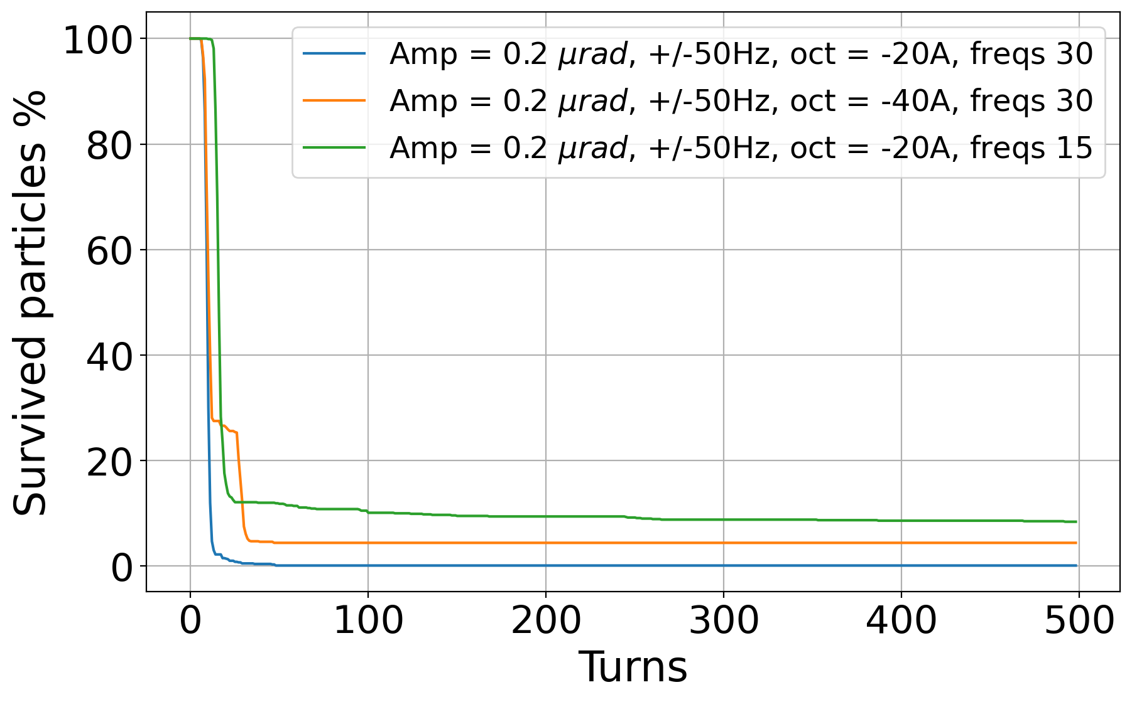
Rectangular excitation: impact of tune spread & number of tones
Comparison between different settings.
The best option is to have as many as possible excitation frequencies in a given window around the tunes.

Slide 18
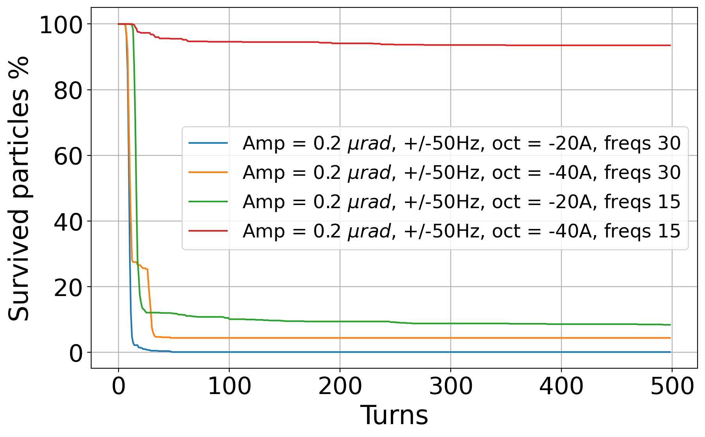
Rectangular excitation: impact of tune spread & number of tones
Comparison between different settings.
The best option is to have as many as possible excitation frequencies in a given window around the tunes.

Slide 19
Conclusions
A comparison study has been carried out between three different types of excitations.
In order not to cause any perturbations to the neighboring buckets, the most efficient excitation is to be found.
The white noise is proven to be the least effective approach.
The frequency sweep is better, but still not good enough.
The rectangular type excitation is the best for our purposes – since the strength needed to lose the unwanted particles is minimal. Best to combine both H & V excitation.
Exact settings of excitation (f-range) & number of tones will be defined in RF MD with 4x72b@2.3e11 in MD2.
We can also simulate multi-bunch & impact of realistic leakage.

Slide 20
Thank you for your attention!

Slide 21
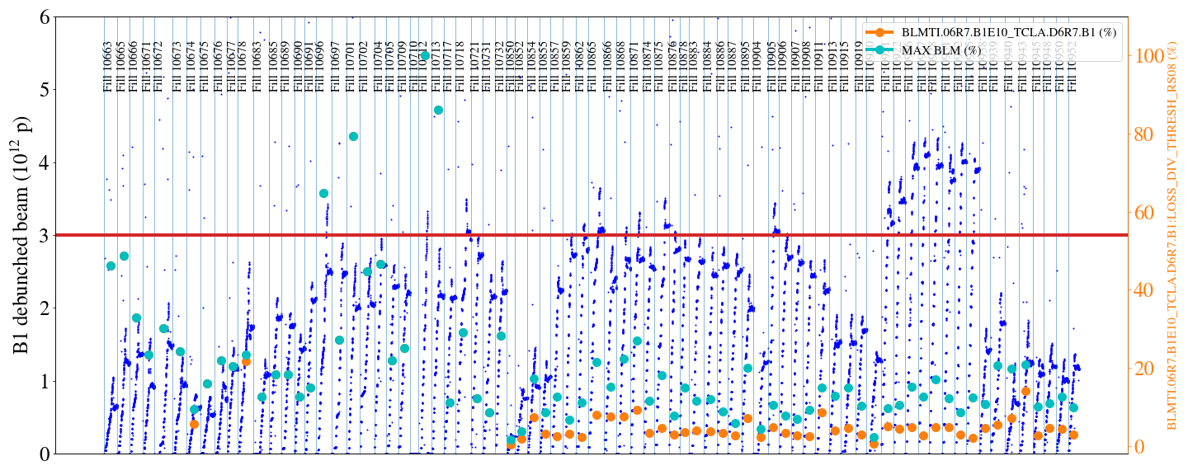
Sofia Kostoglou

Slide 22
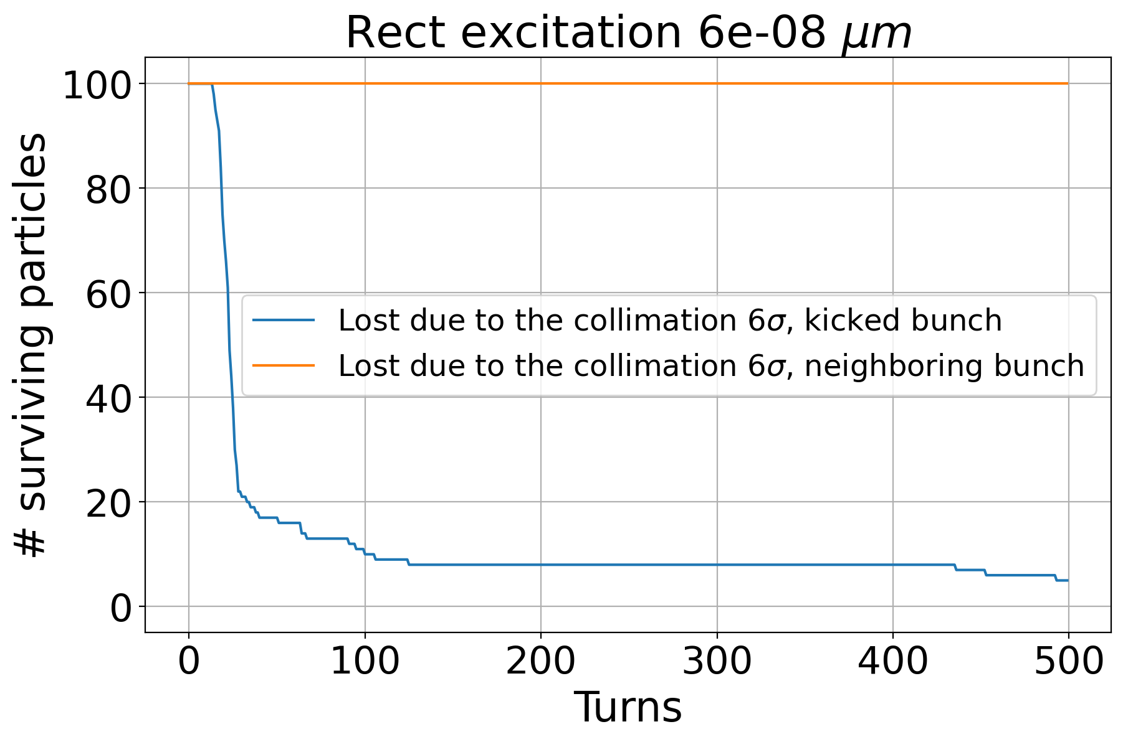
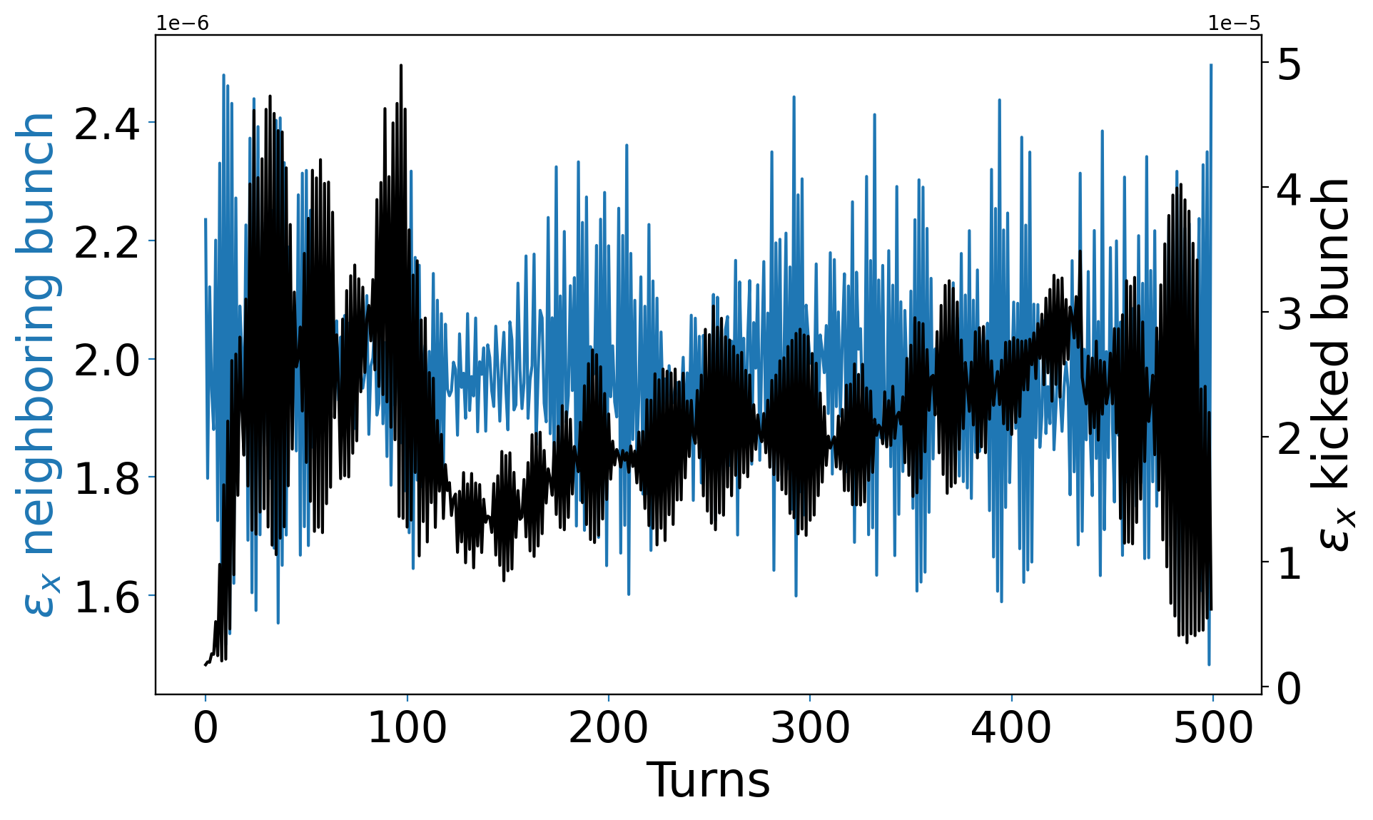
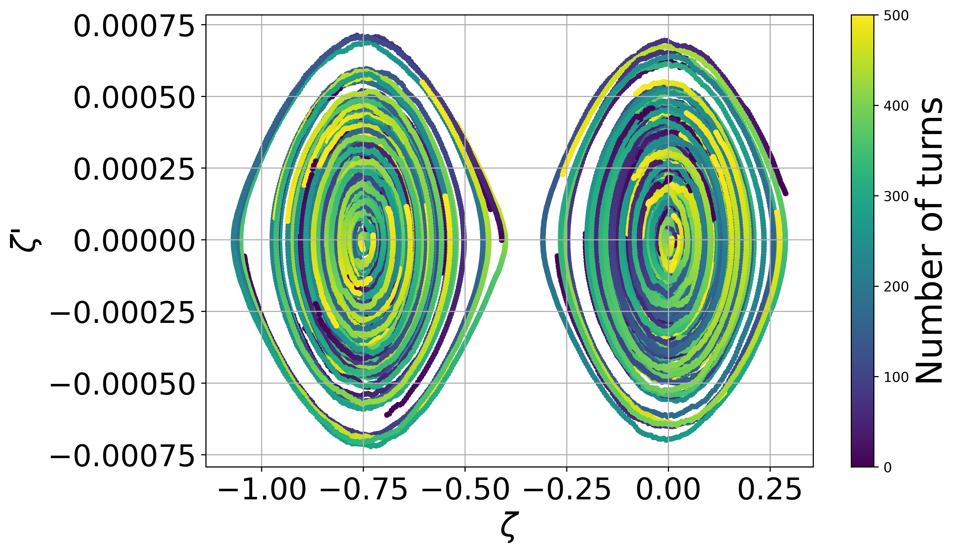
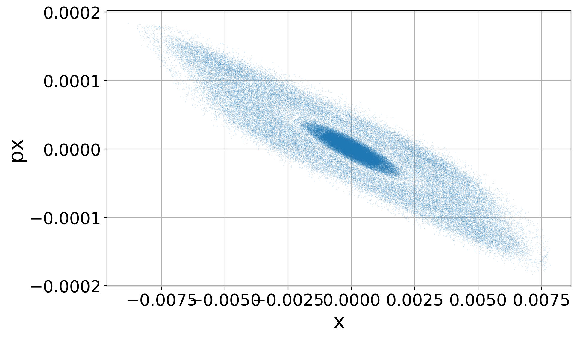
Appendix

Slide 23
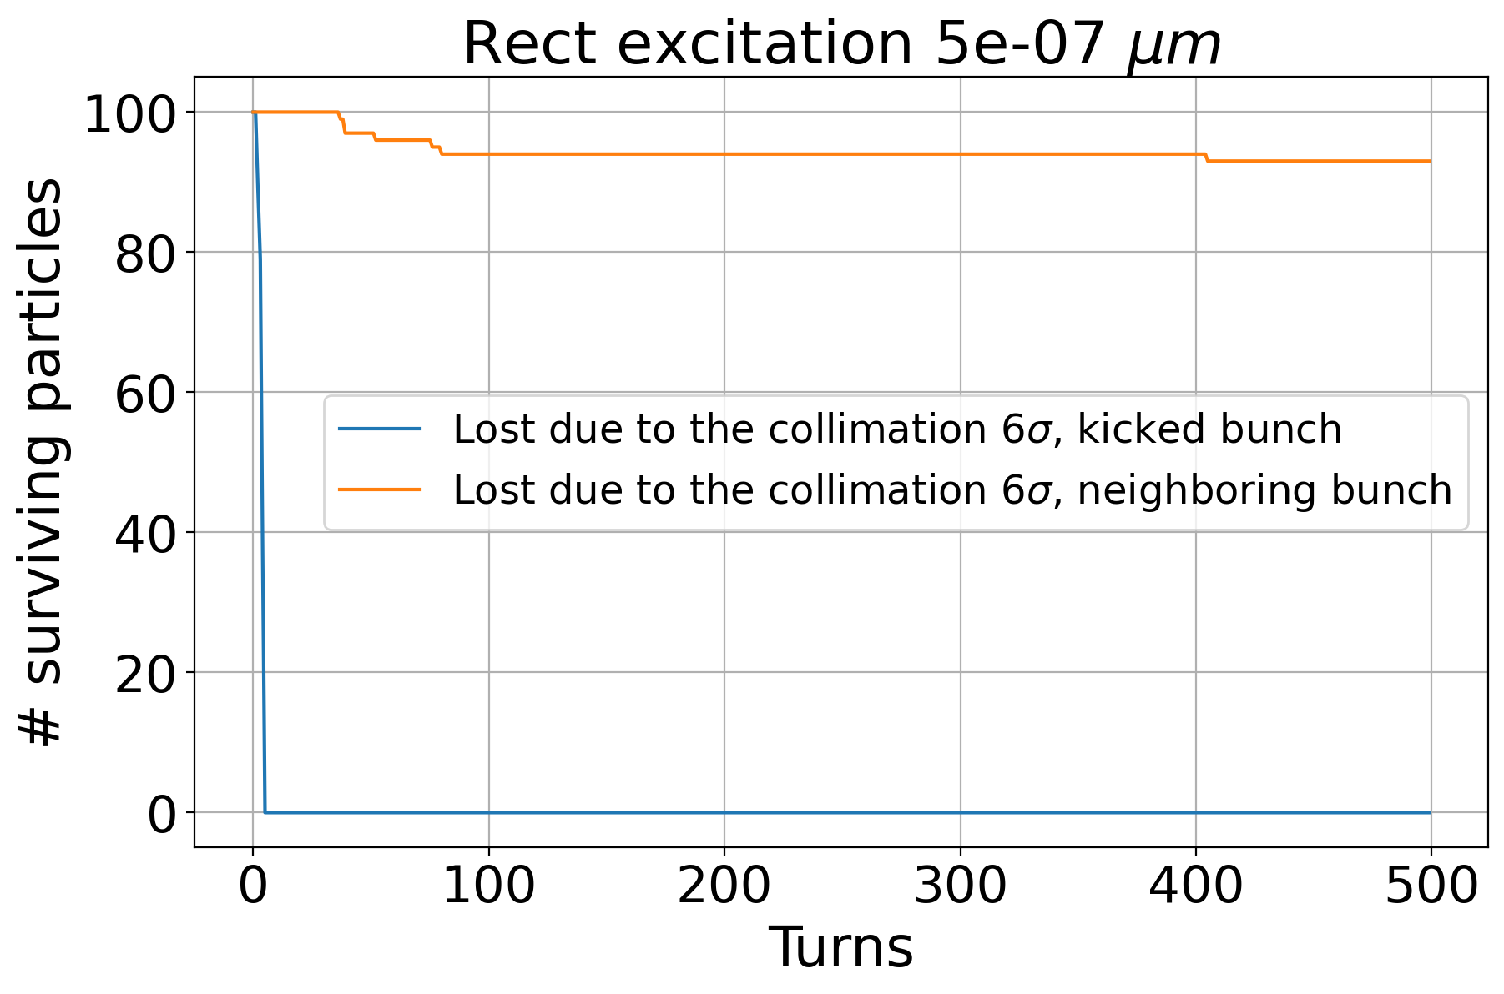
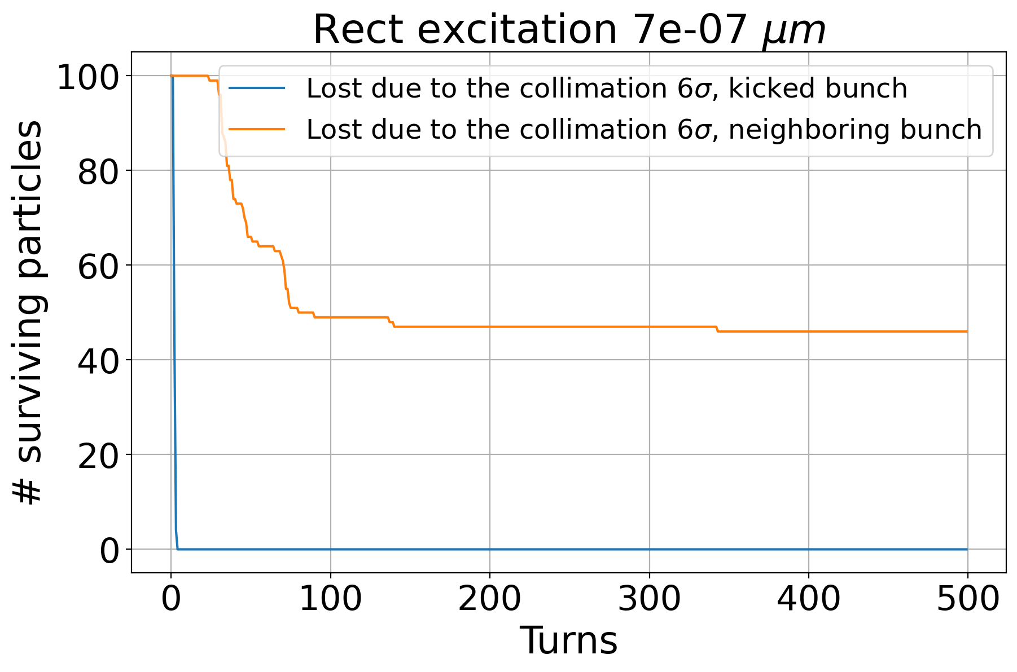
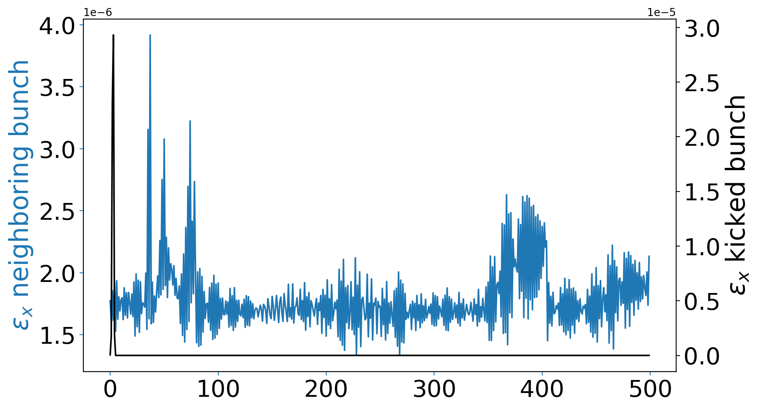

Slide 24
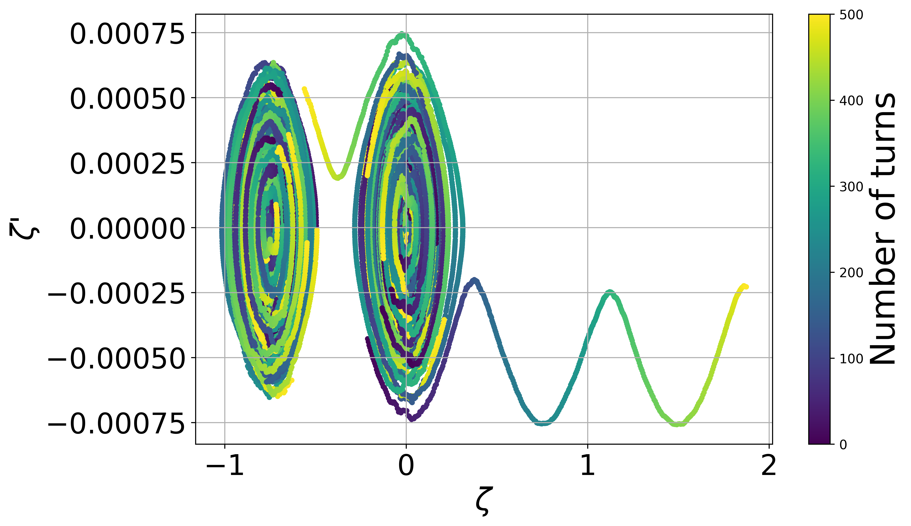
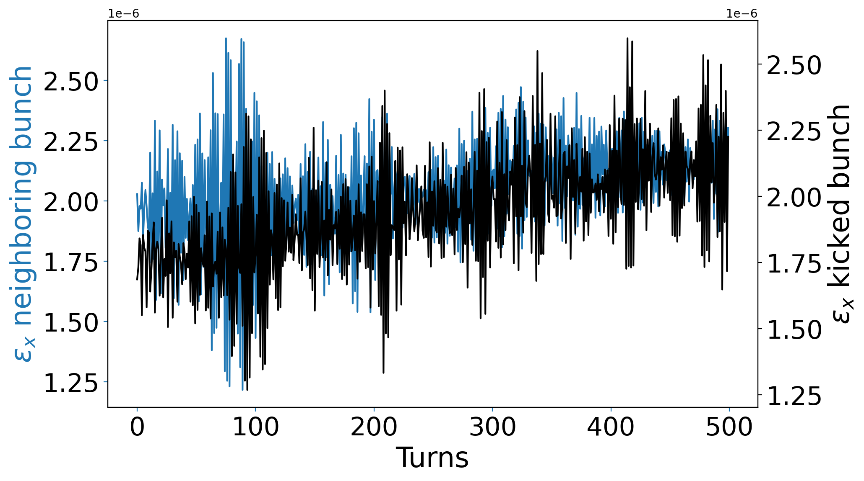
No excitation

Slide 25
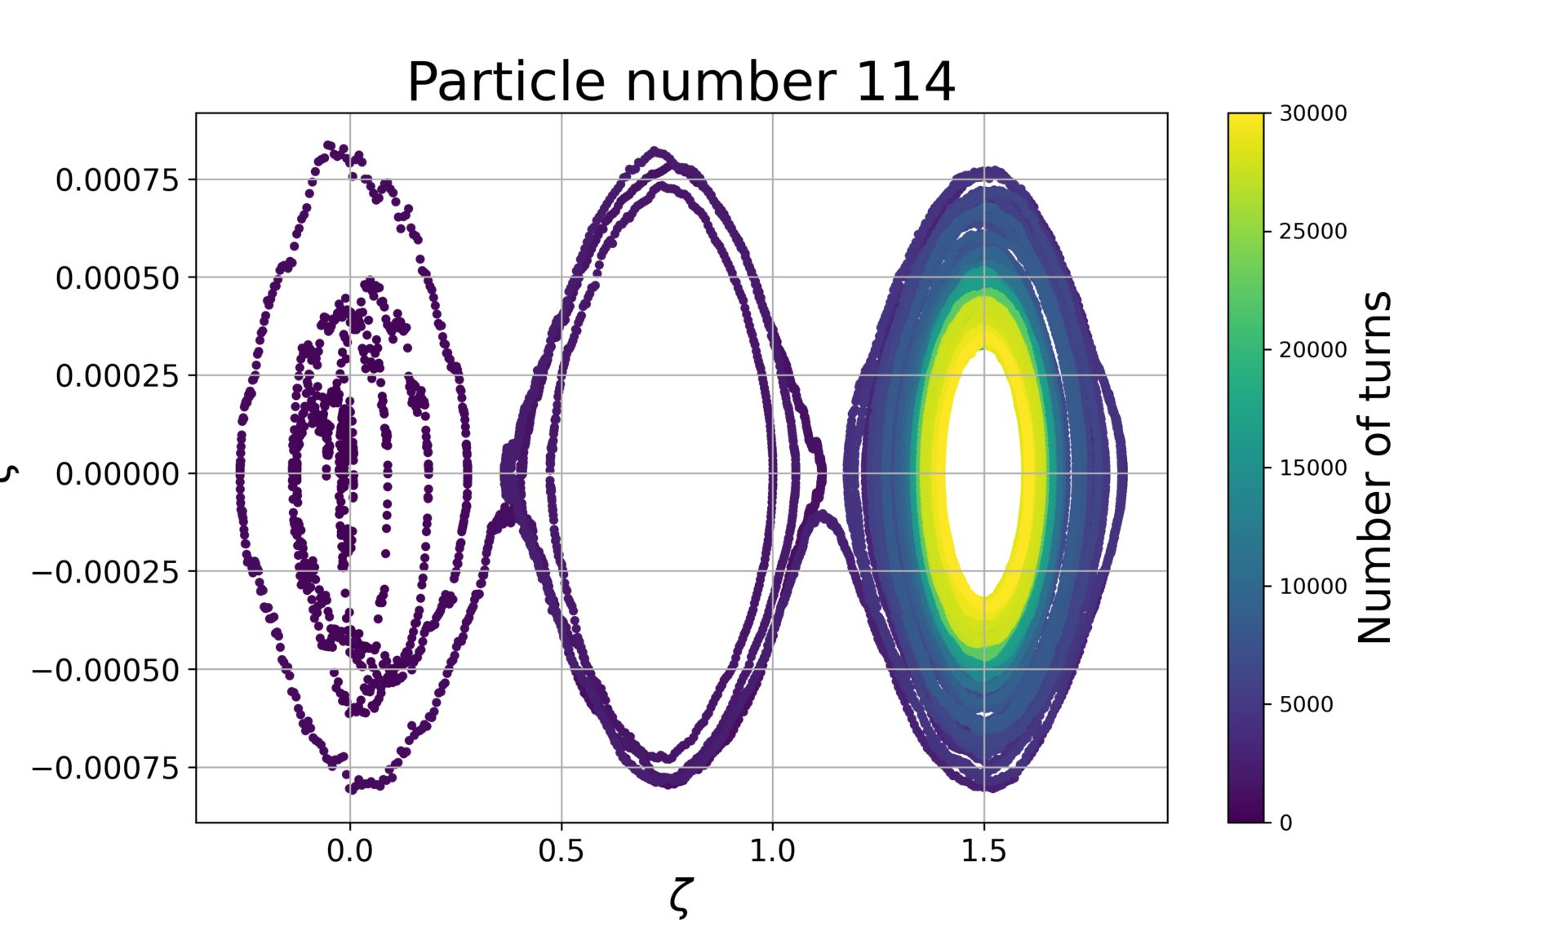

Slide 26
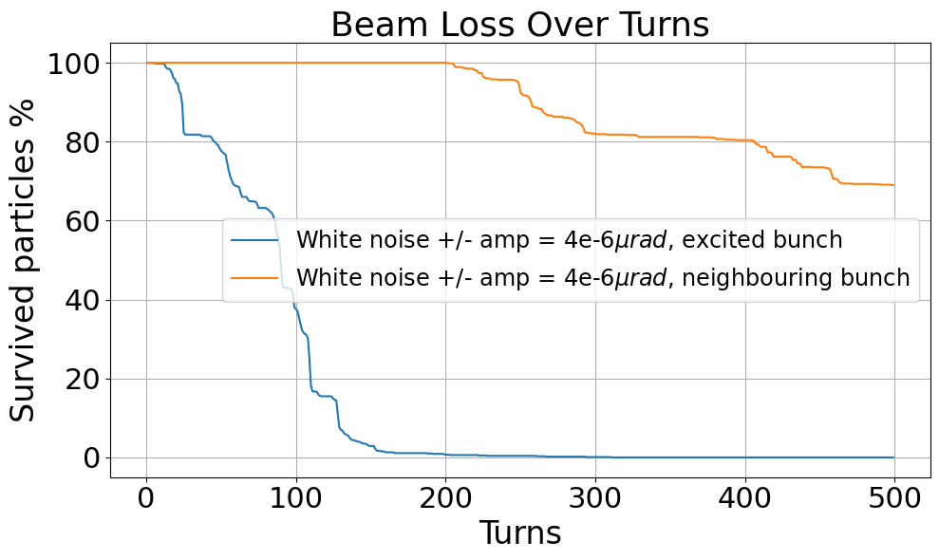
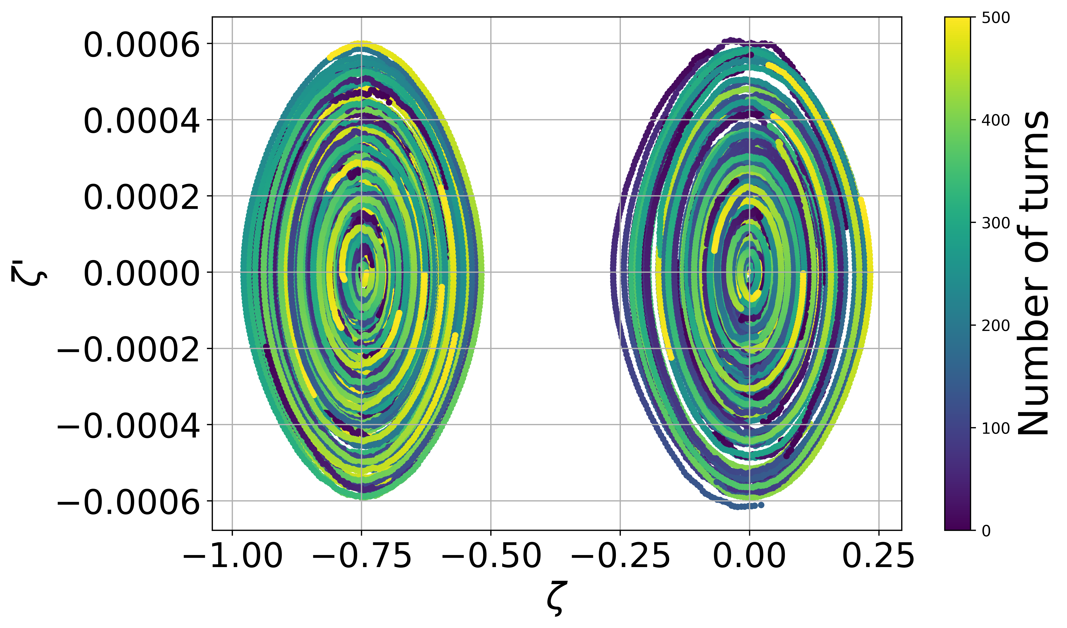
White noise - multibunch
If we use an excitation strong enough in order to clean the debunched beam, the particles in the neighboring bunch are also lost -> seen in the LHC already!

Slide 27
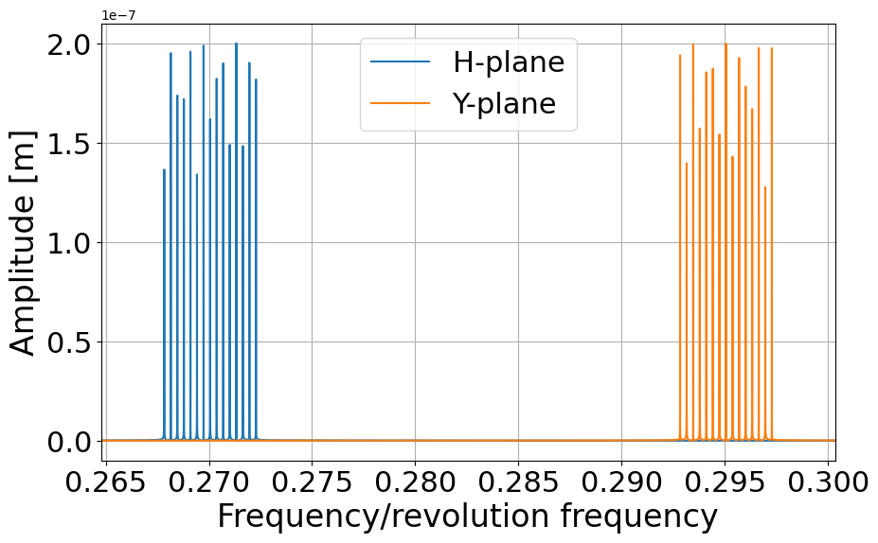
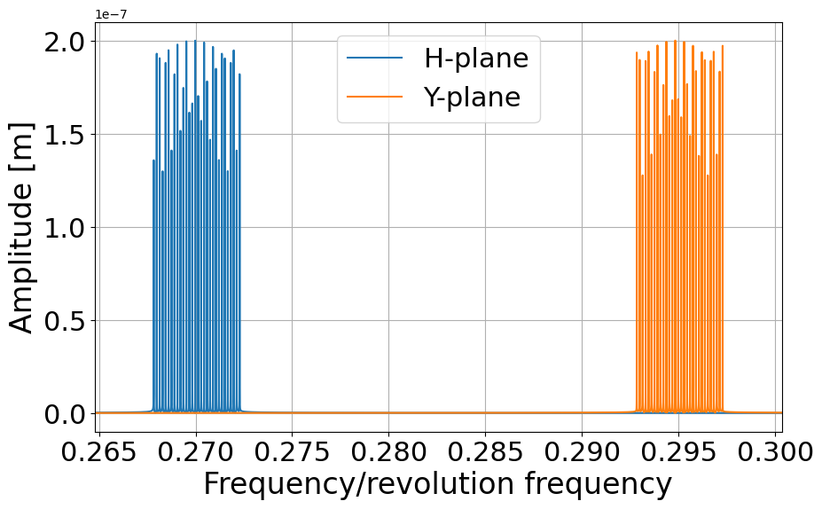

Slide 28
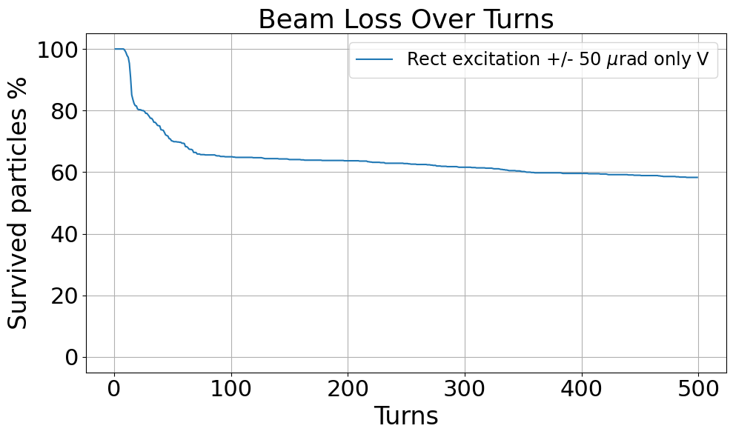
Rectangular excitation only V

Slide 29
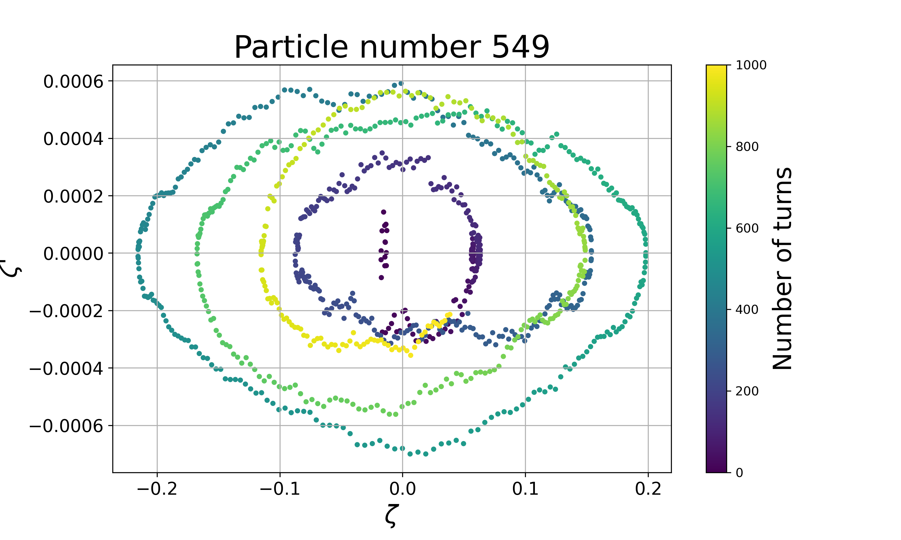
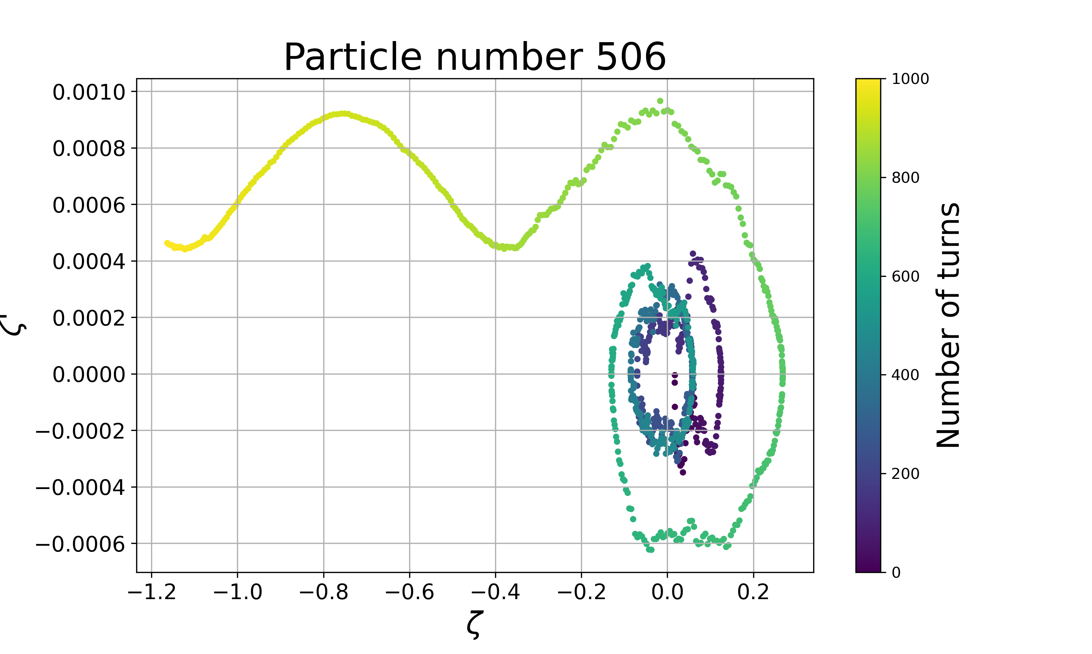
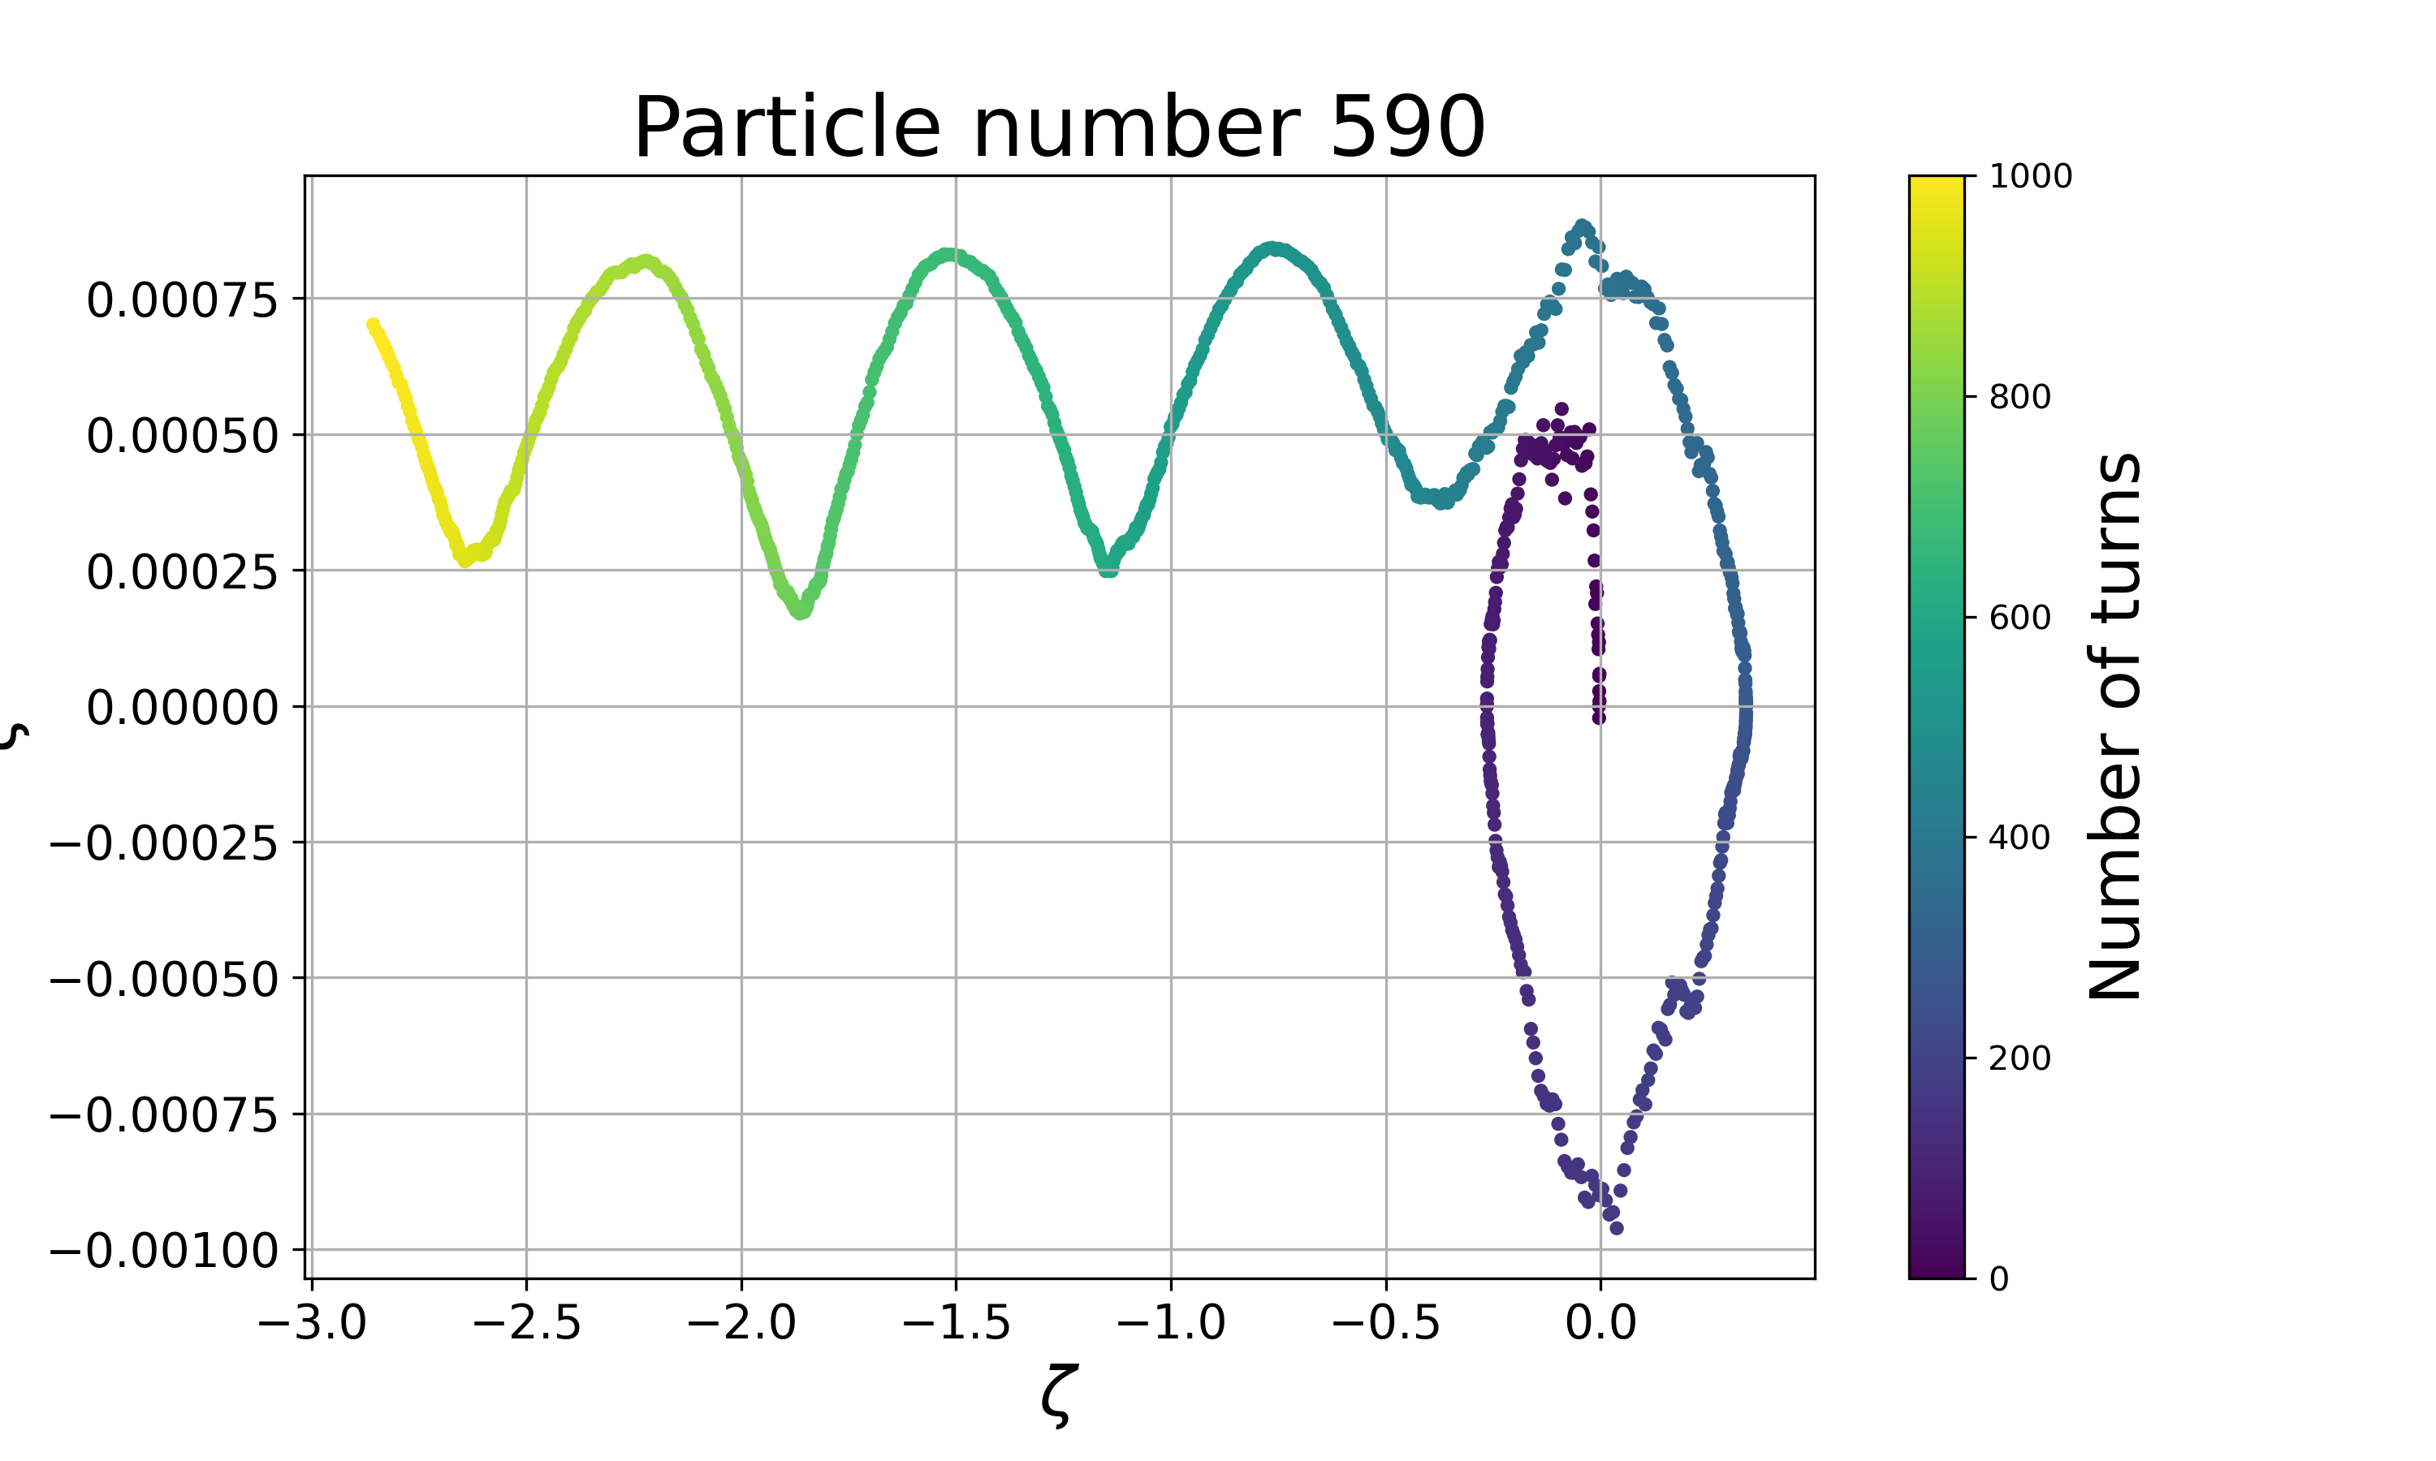
Simulations of debunched beam: LHC injection + IBS kicks

Slide 30
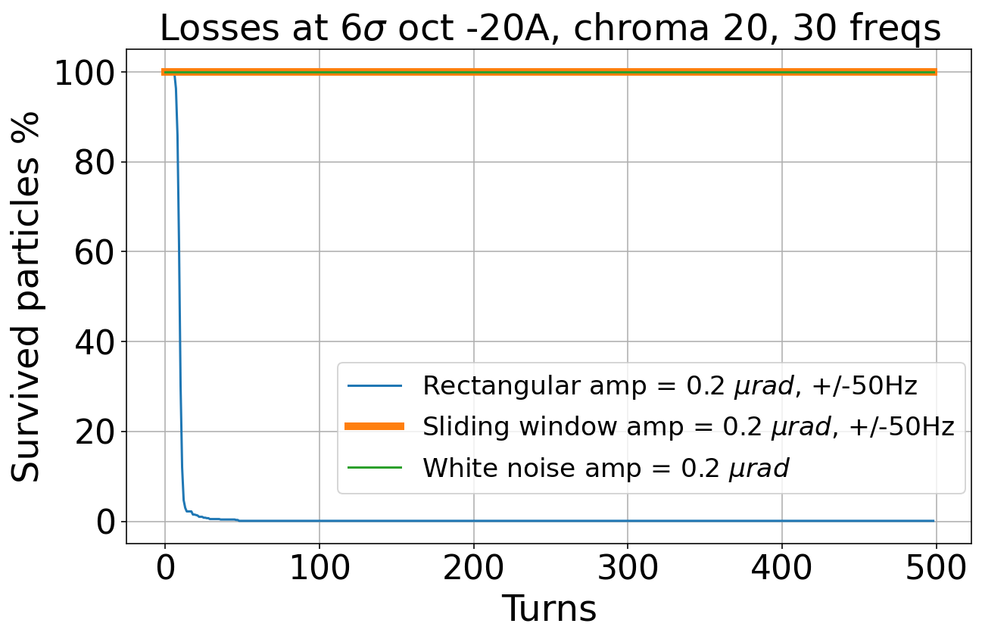
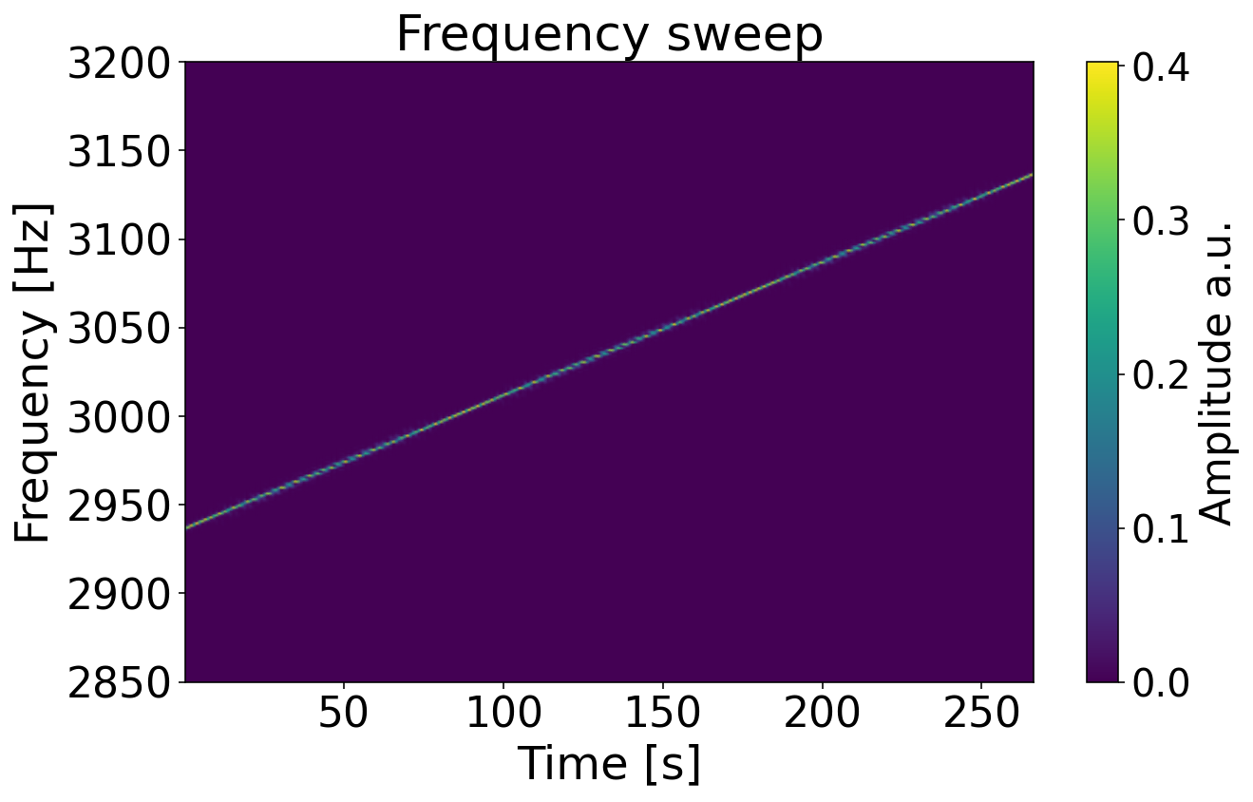

Slide 31
