Slide 1
Impact of measured crab‑cavity HOMs
C. Antuono, N. Mounet
Thanks to: A. V. Edwards, X. Buffat, R. Calaga, J. Mitchell

Slide 2
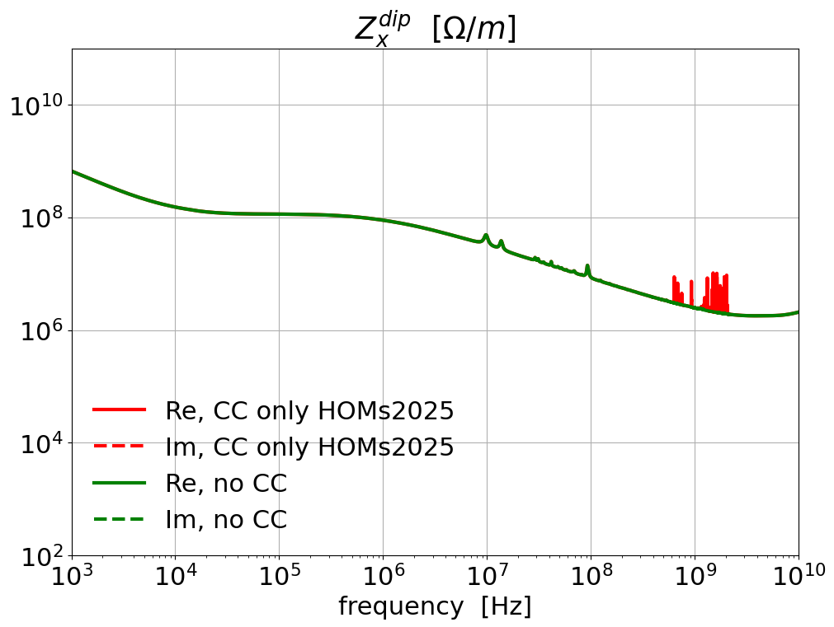
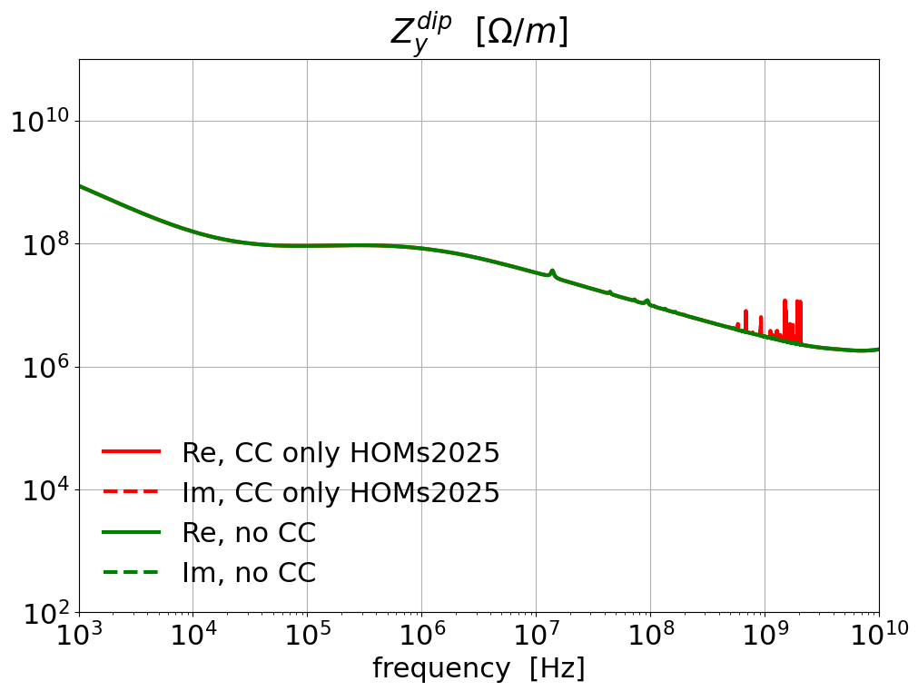
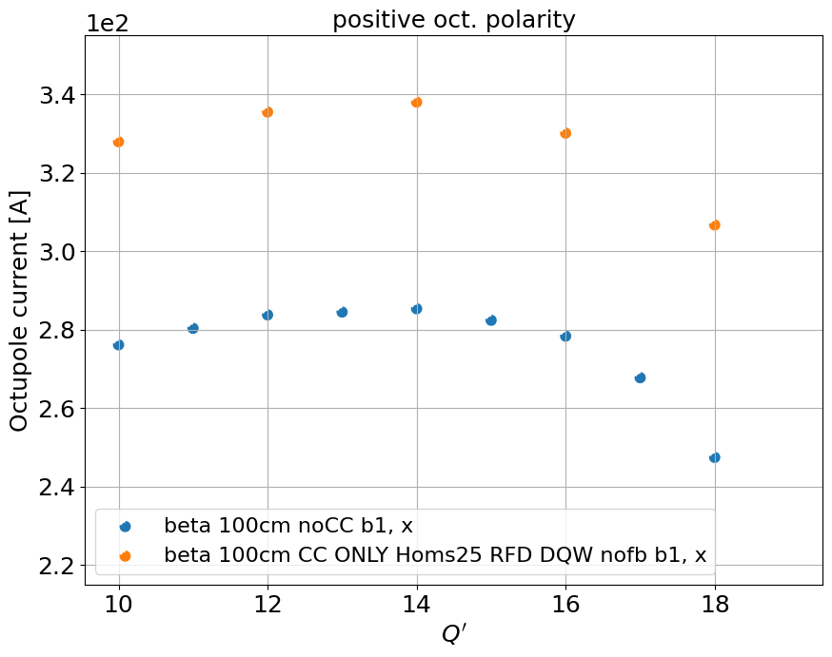
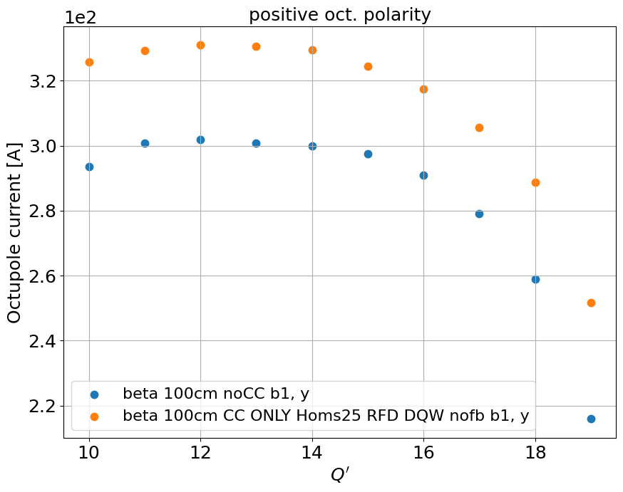

Impedance model with measured DQW HOMs
In this case we have, for each beam, 4 DQW and 4 RFD crab cavities (CC)
The HOMs of RFD CCs are computed from simulations (J. Mitchell, Nov. 2019)
The HOMs of DQW CCs are from A. Edwards measurements (more info in her talk)
Impact on stability
Flat top case, before collapse $β^{∗}=1 m$, round optics
Comparison between model without CC and model with only DQW and RFD HOMs
The maximum octupolar current increase is 59 Amps

Slide 3
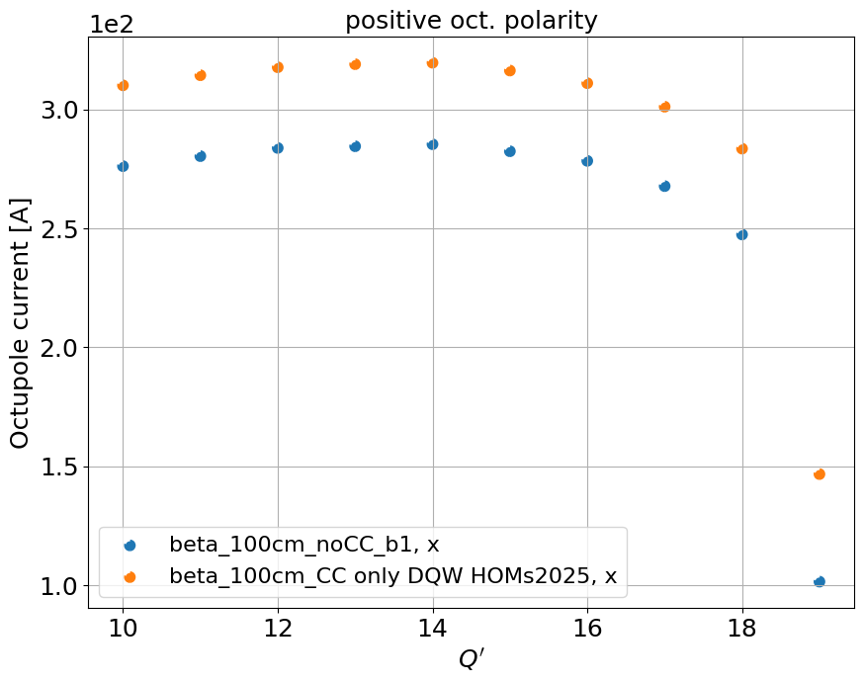

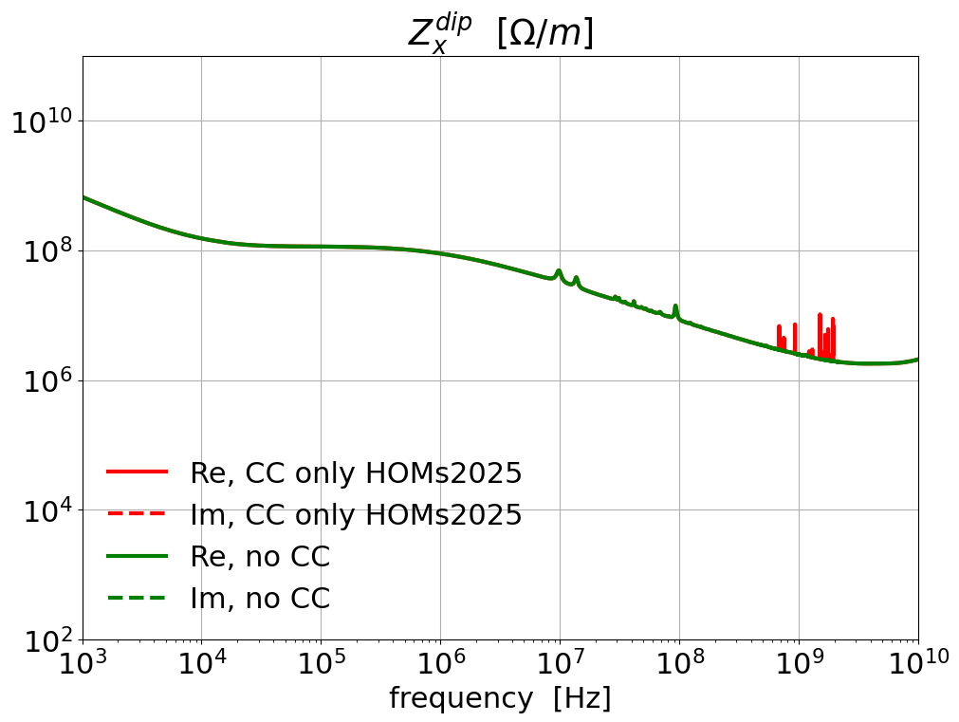
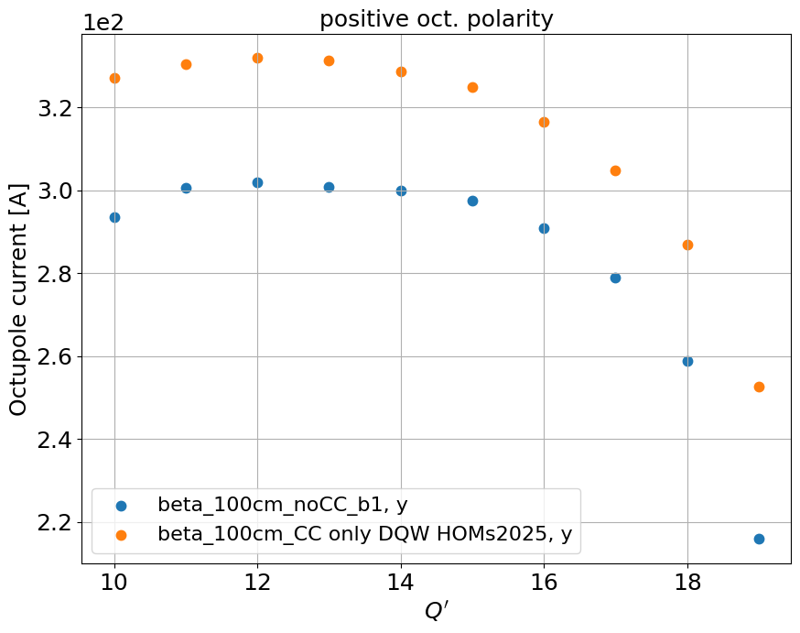
Impedance model with measured DQW HOMs: impact of only DQW
In this case we have, for each beam, 4 DQW and 0 RFD crab cavities (CC)
The HOMs of DQW CCs are from A. Edwards measurements (more info in her talk)
Impact on stability
Flat top case, before collapse $β^{∗}=1 m$, round optics
Comparison between model without CC and model with only DQW HOMs
The maximum octupolar current increase is 45 Amps

Slide 4
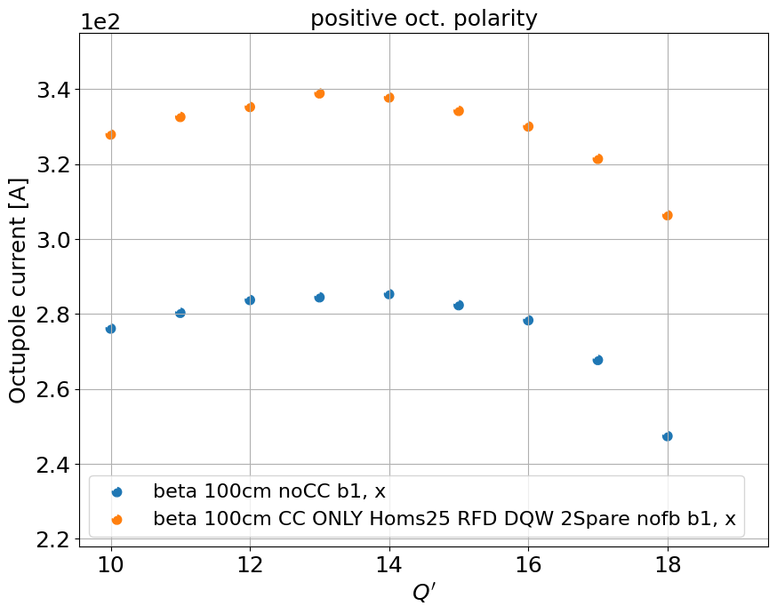
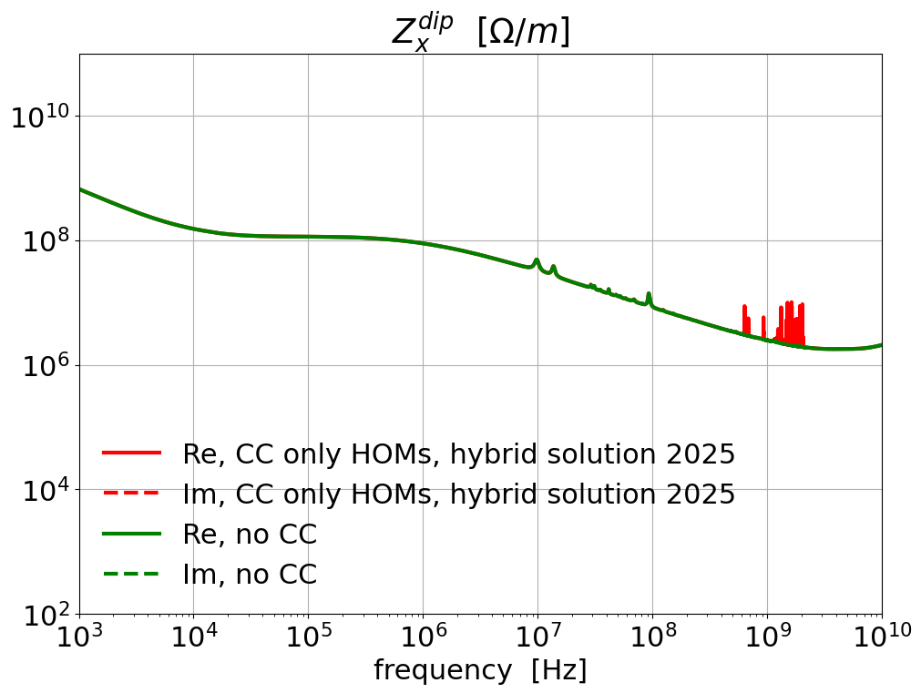
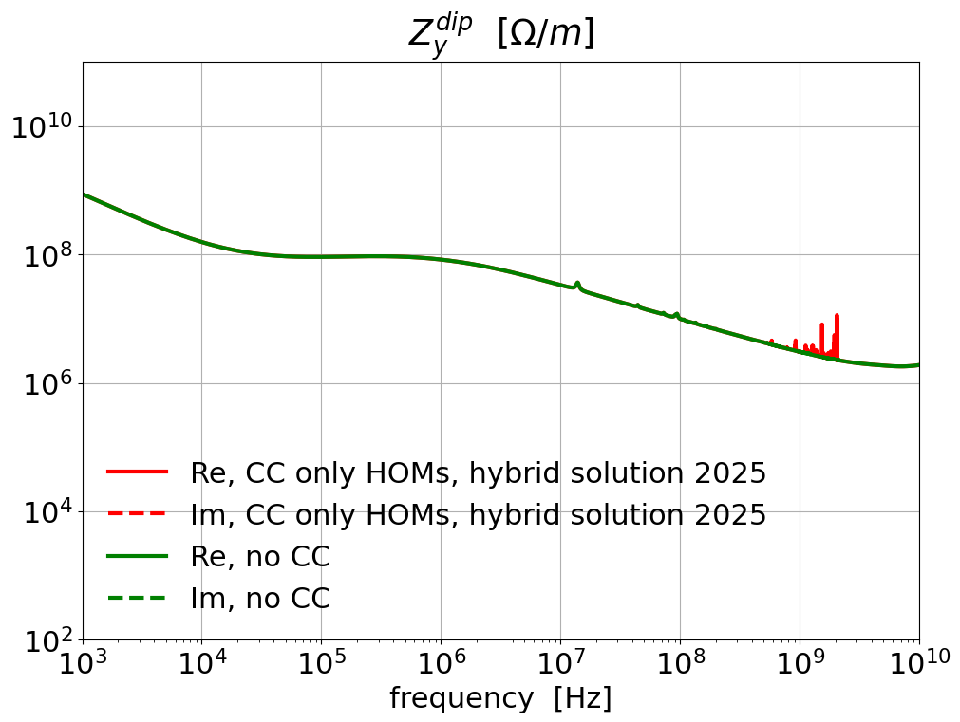
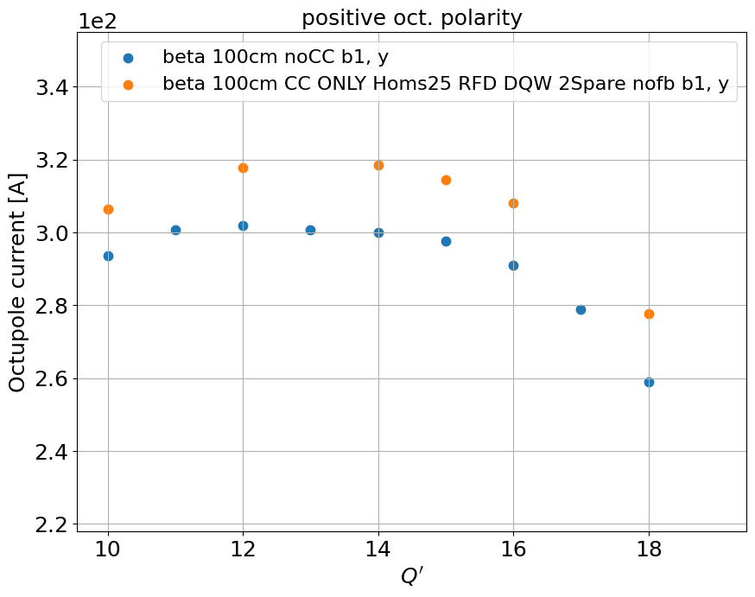

Impedance model of the “hybrid solution”
In this case we have, for each beam, 4 DQW and 4 RFD crab cavities (CC)
The HOMs of RFD CCs are the same as before (from J. Mitchell’s simulations)
The HOMs of DQW CCs are:
2 SPS spare DQW (HOMs from simulations)
The 2 worst measured DQW
Impact on stability
Flat top case, before collapse $β^{∗}=1 m$, round optics
Comparison between model without CC and model with hybrid solution
The maximum octupolar current increase is also 59 Amps

Slide 5
Conclusions
4 DQWs + 4 RFDs requires 59 A more octupole current at flat top, before collapse (positive polarity)
⟹ quite strong, detrimental impact (it would be slightly less with negative polarity – to be computed)
Most of it comes from the 4 DQWs (using measured HOM values)
Mitigations:
Can we reduce the HOMs?
Flat optics at flat top?

Slide 6
Backup

Slide 7
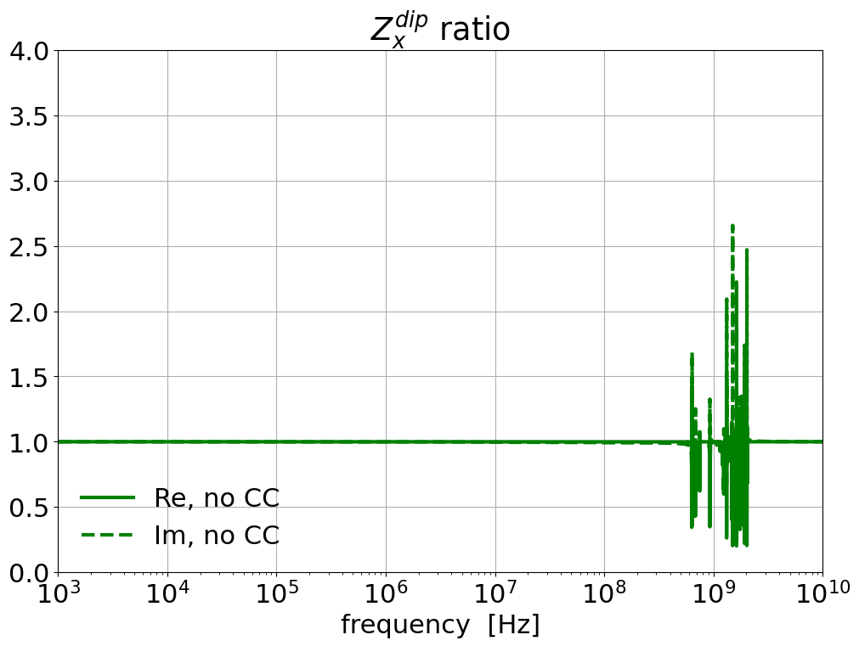
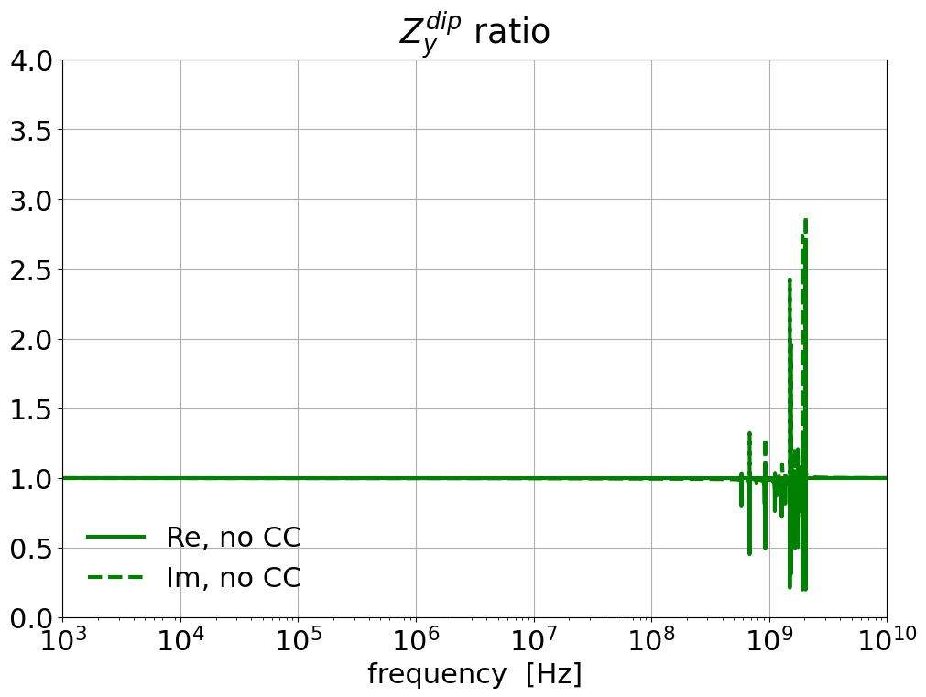
Impedance model with measured DQW HOMs
In this case we have, for each beam, 4 DQW and 4 RFD crab cavities (CC)
The HOMs of RFD CCs are from simulations (J. Mitchell, Nov. 2019)
The HOMs of DQW CCs are from A. Edwards measurements (more info on her talk)
Ratio between model without CC and model with only DQW and RFD HOMs

Slide 8
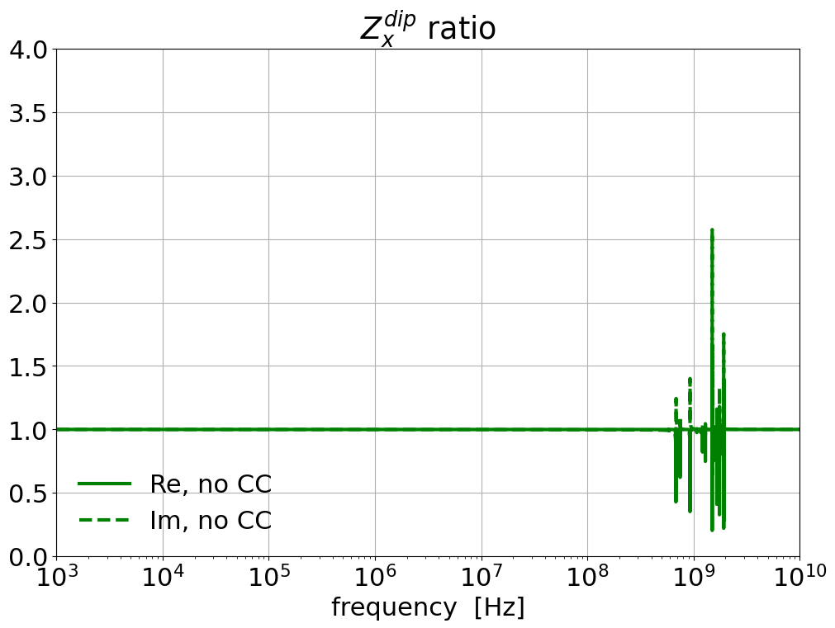
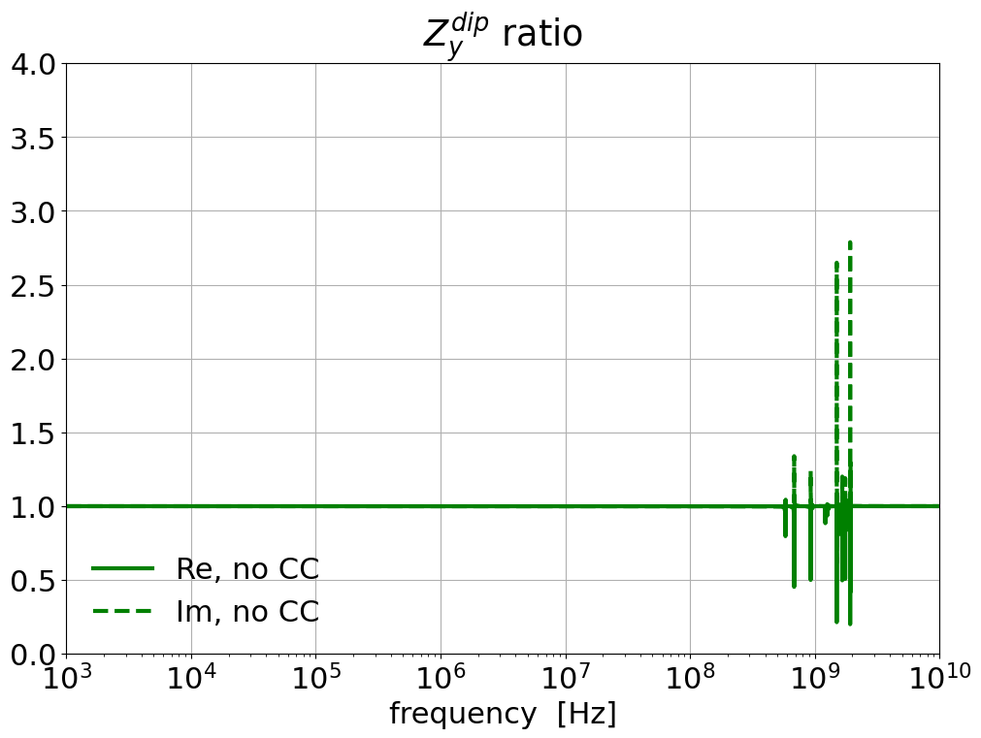
Impedance model with measured DQW HOMs: impact of only DQW
In this case we have, for each beam, 4 DQW and 0 RFD crab cavities (CC)
The HOMs of DQW CCs are from A. Edwards measurements (more info on her talk)
Ratio between model without CC and model with only DQW HOMs

Slide 9
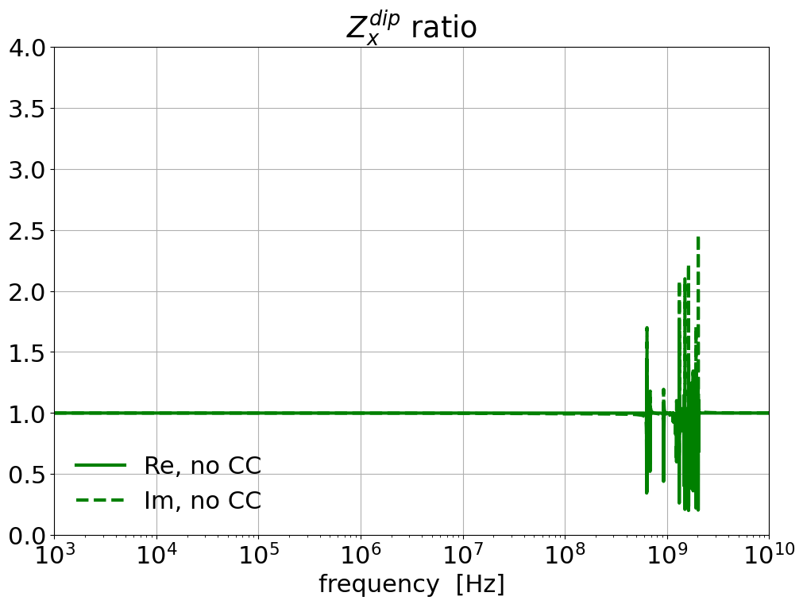
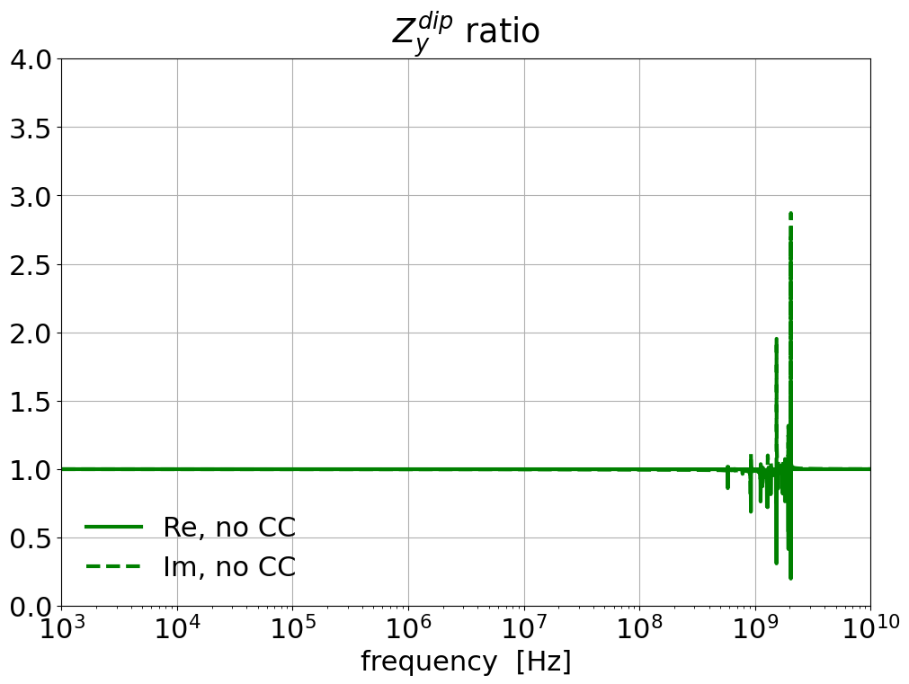
Impedance model of the “hybrid solution”
In this case we have, for each beam, 4 DQW and 4 RFD crab cavities (CC)
The HOMs of RFD CCs are computed from simulations (J. Mitchell, Nov. 2019)
The HOMs of DQW CCs are:
2 SPS spare DQW (HOMs from simulations)
The 2 worst measured DQW (A. Edwards)
Ratio between model without CC and model hybrid solution

