Slide 1
PyECLOUD Development and Studies
ABP-CEI Section Meeting | 9 October 2025
Evangelos Katralis, Lotta Mether

Slide 2
Presentation layout
Physics: Simulation studies
  Heat Load study
  Dipole Instability study
Software Development: PyECLOUD and GPU experiments
  Code profiling
  GPU acceleration potential
  Experiments
  Future prospects

Slide 3
Physics
Electron Cloud Heat Load and Beam Stability

Slide 4
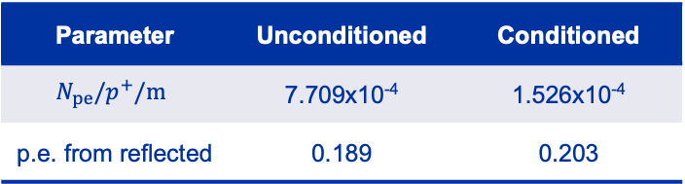
LHC Electron Cloud Buildup studies
Investigated the impact of surface material and photoemission for electron cloud buildup in Arc Dipoles, Quadrupoles and Drifts
Beam setup:
  4x36b with 25ns bunch spacing, collision energy
SEY Curves for surfaces:
  CuO
  Cu2O
Photoemission parameters:
  Unconditioned Photoemission (High)
  Conditioned Photoemission (Low)
Scanned parameters:
  SEY: 1.0-1.6
  Intensity: 0.2-1.8x10¹¹ ppb
Parameter | Unconditioned | Conditioned
$$N_{pe}/p^{+}/m$$ | 7.709x10⁻⁴ | 1.526x10⁻⁴
p.e. from reflected | 0.189 | 0.203

Slide 5
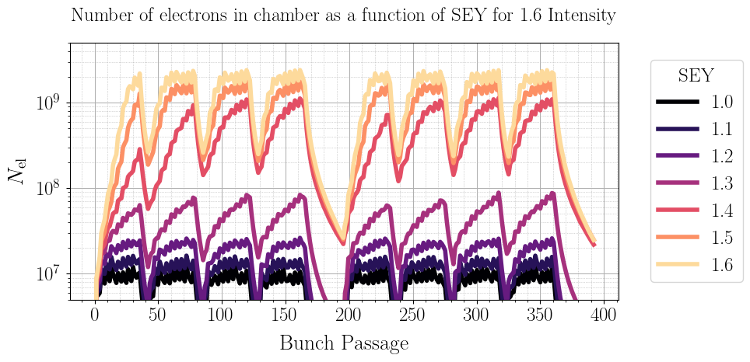
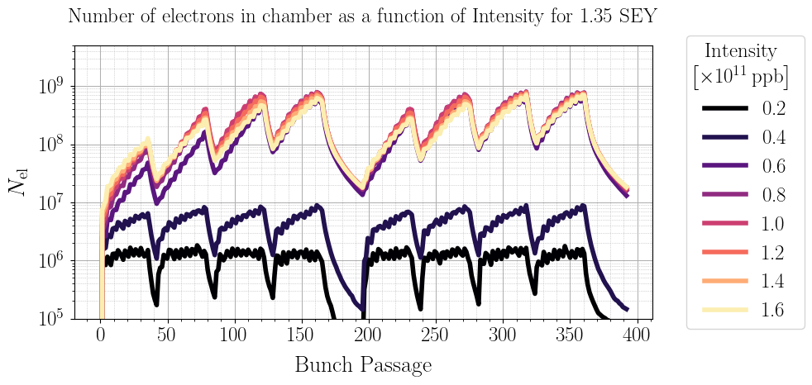
Electron Cloud Buildup
For low SEY and/or Intensity there is little to no electron cloud buildup
Plots shown are specifically for a Cu2O surface in the Dipoles, but this behavior generalizes

Slide 6
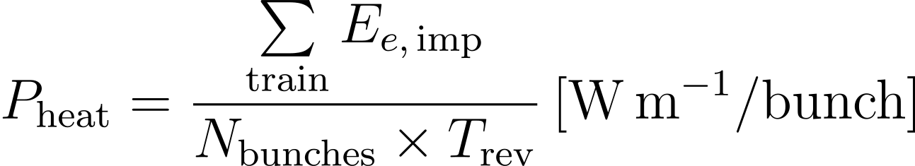
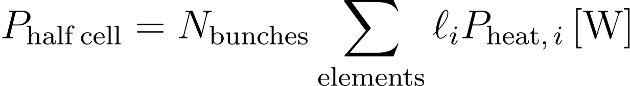
Heat load
We cannot directly measure electron buildup in the machine → We can calculate and measure the Heat Load
The per bunch heat load can be calculated as follows:
Since we know the length of each element in a Half Cell, we easily calculate the Half Cell heat load:
We can compare the above with the cooling capacity of the cryo system to make predictions

Slide 7
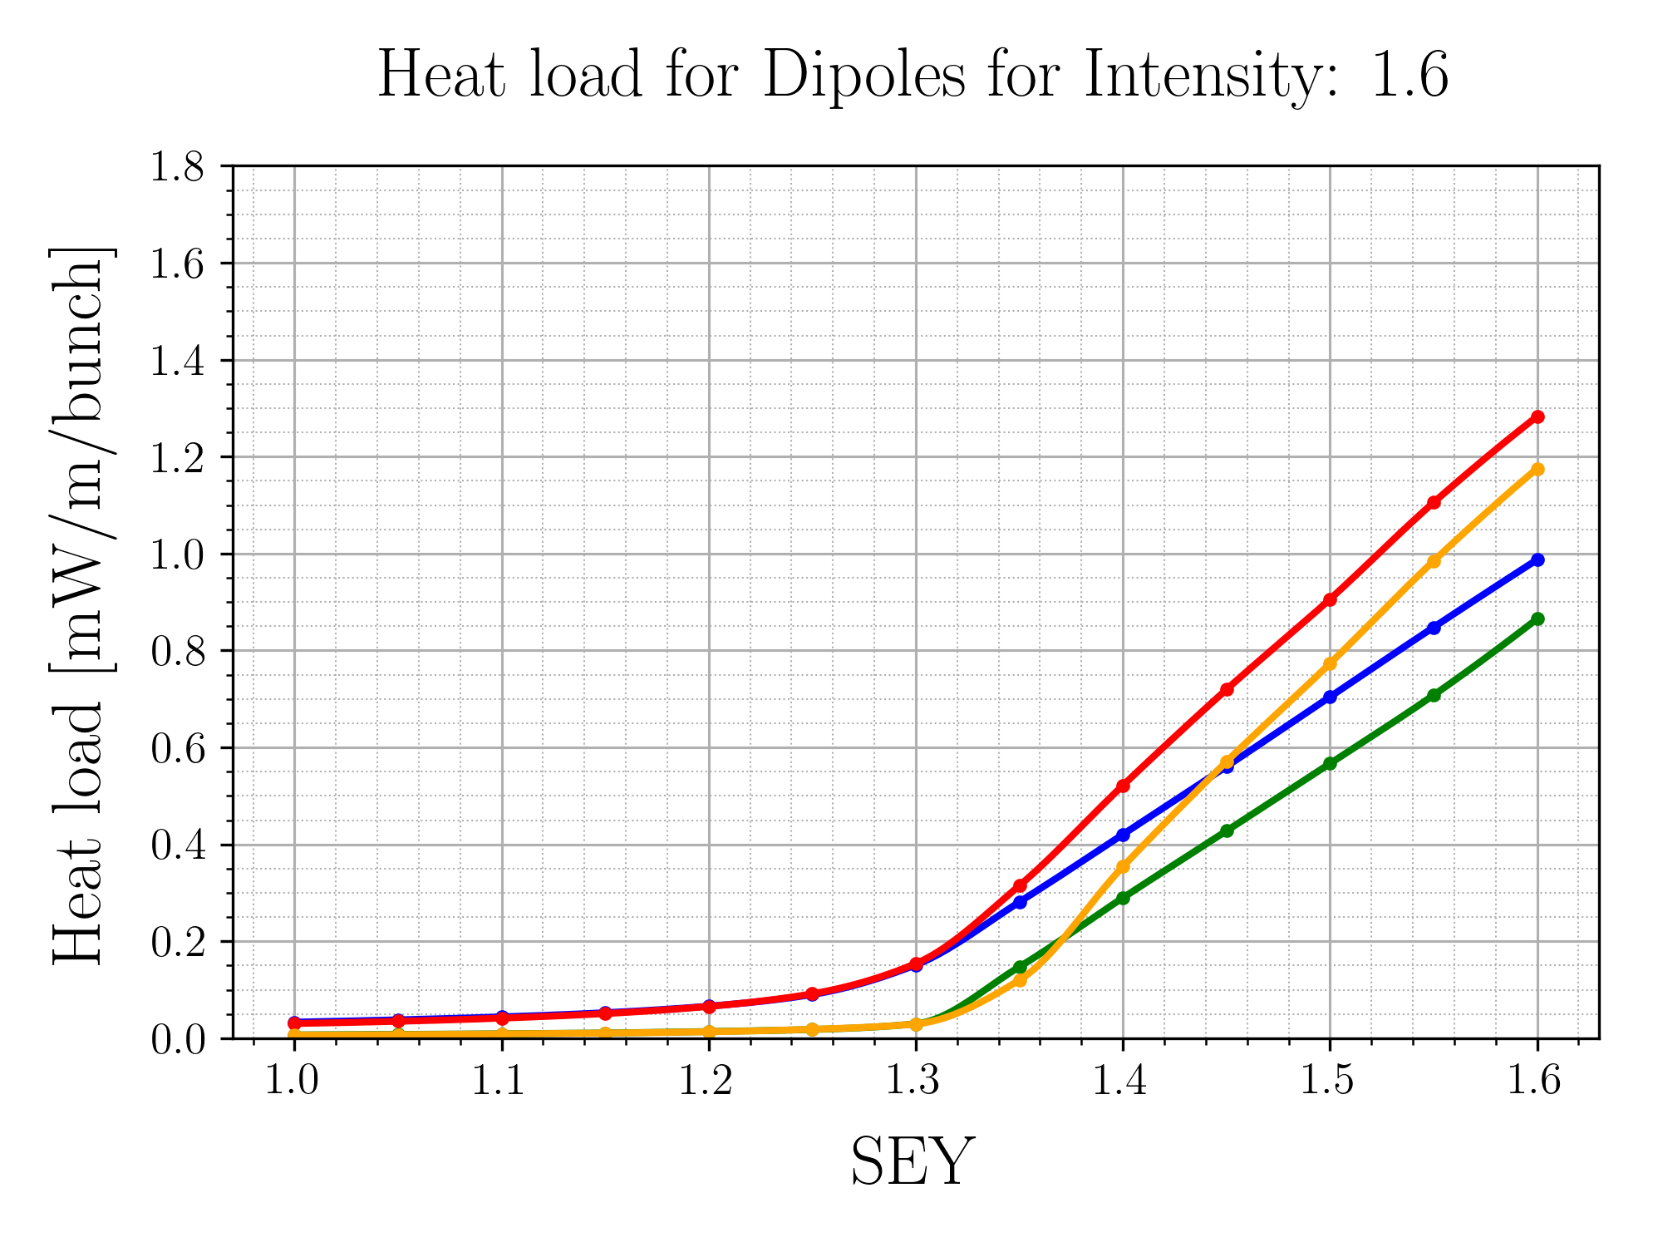
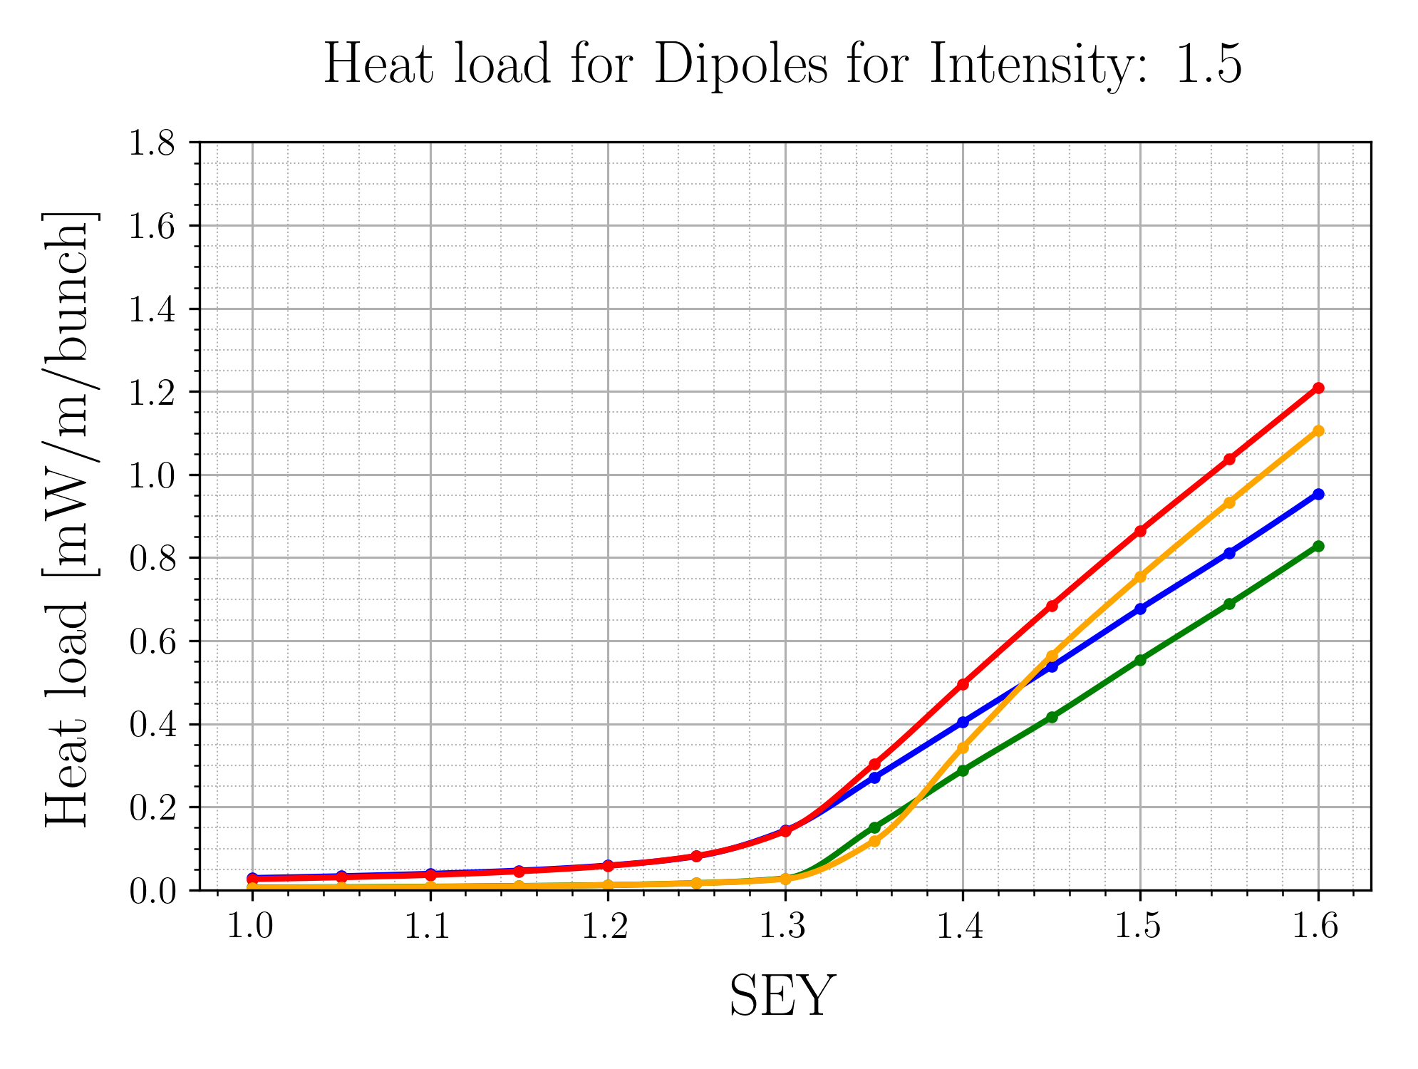
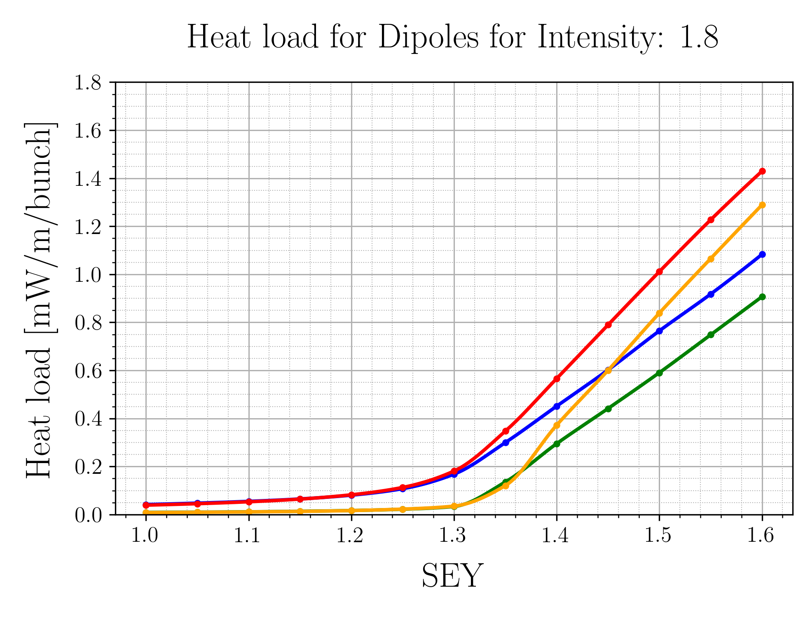

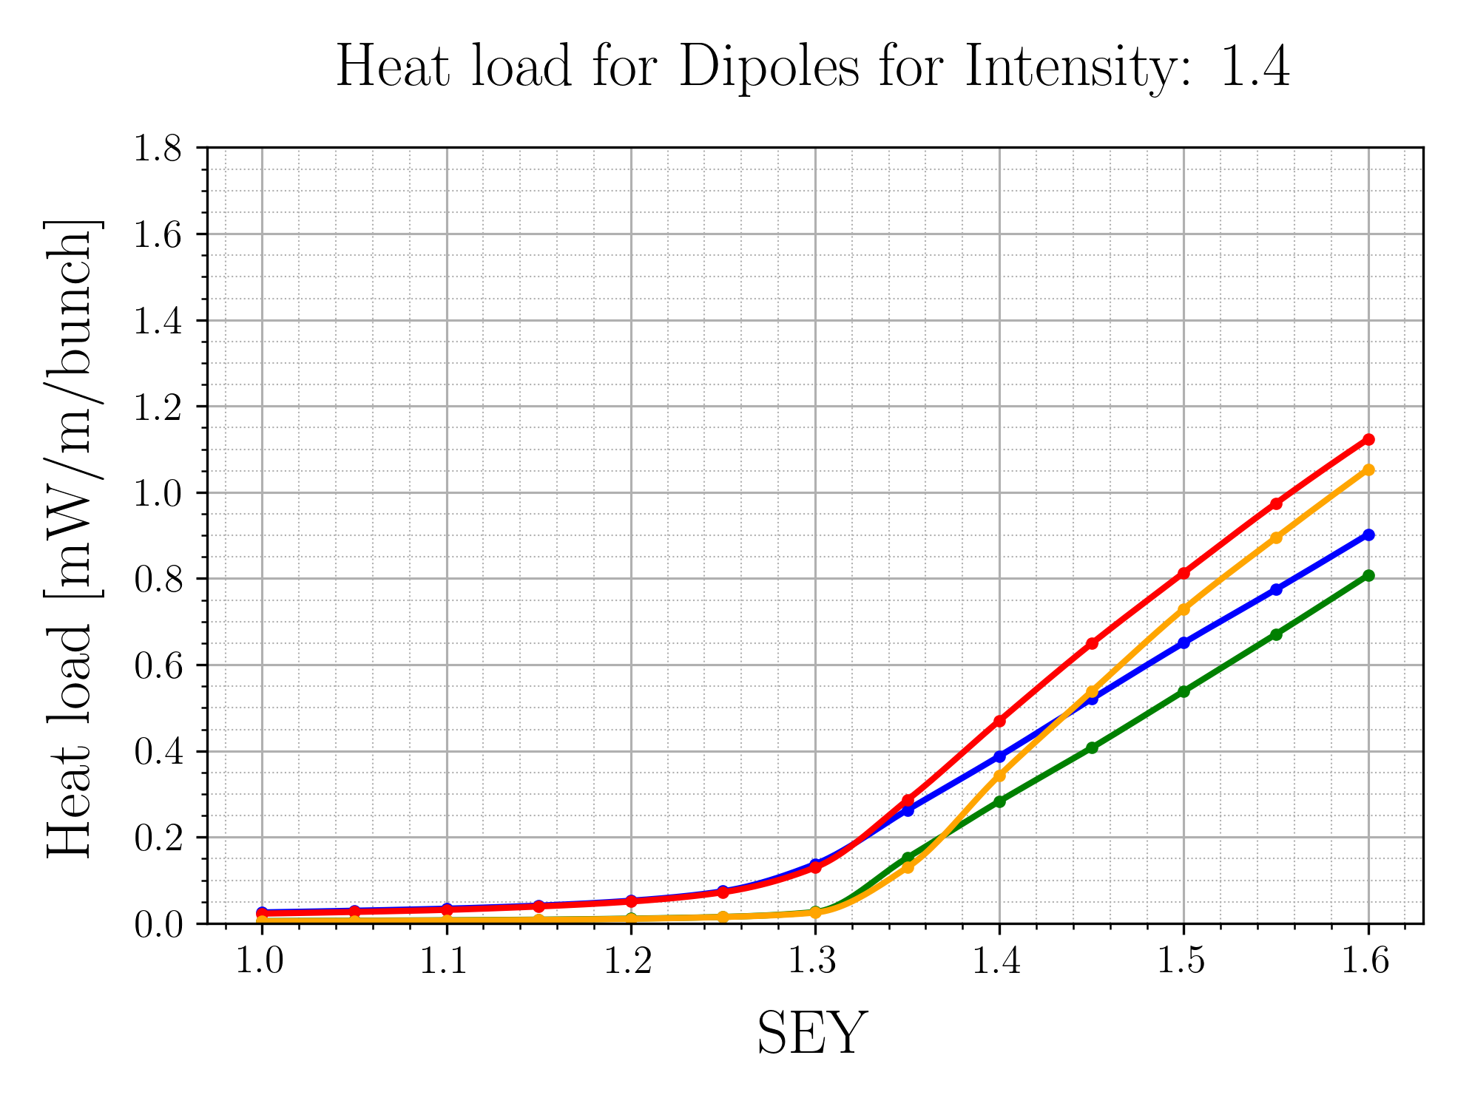
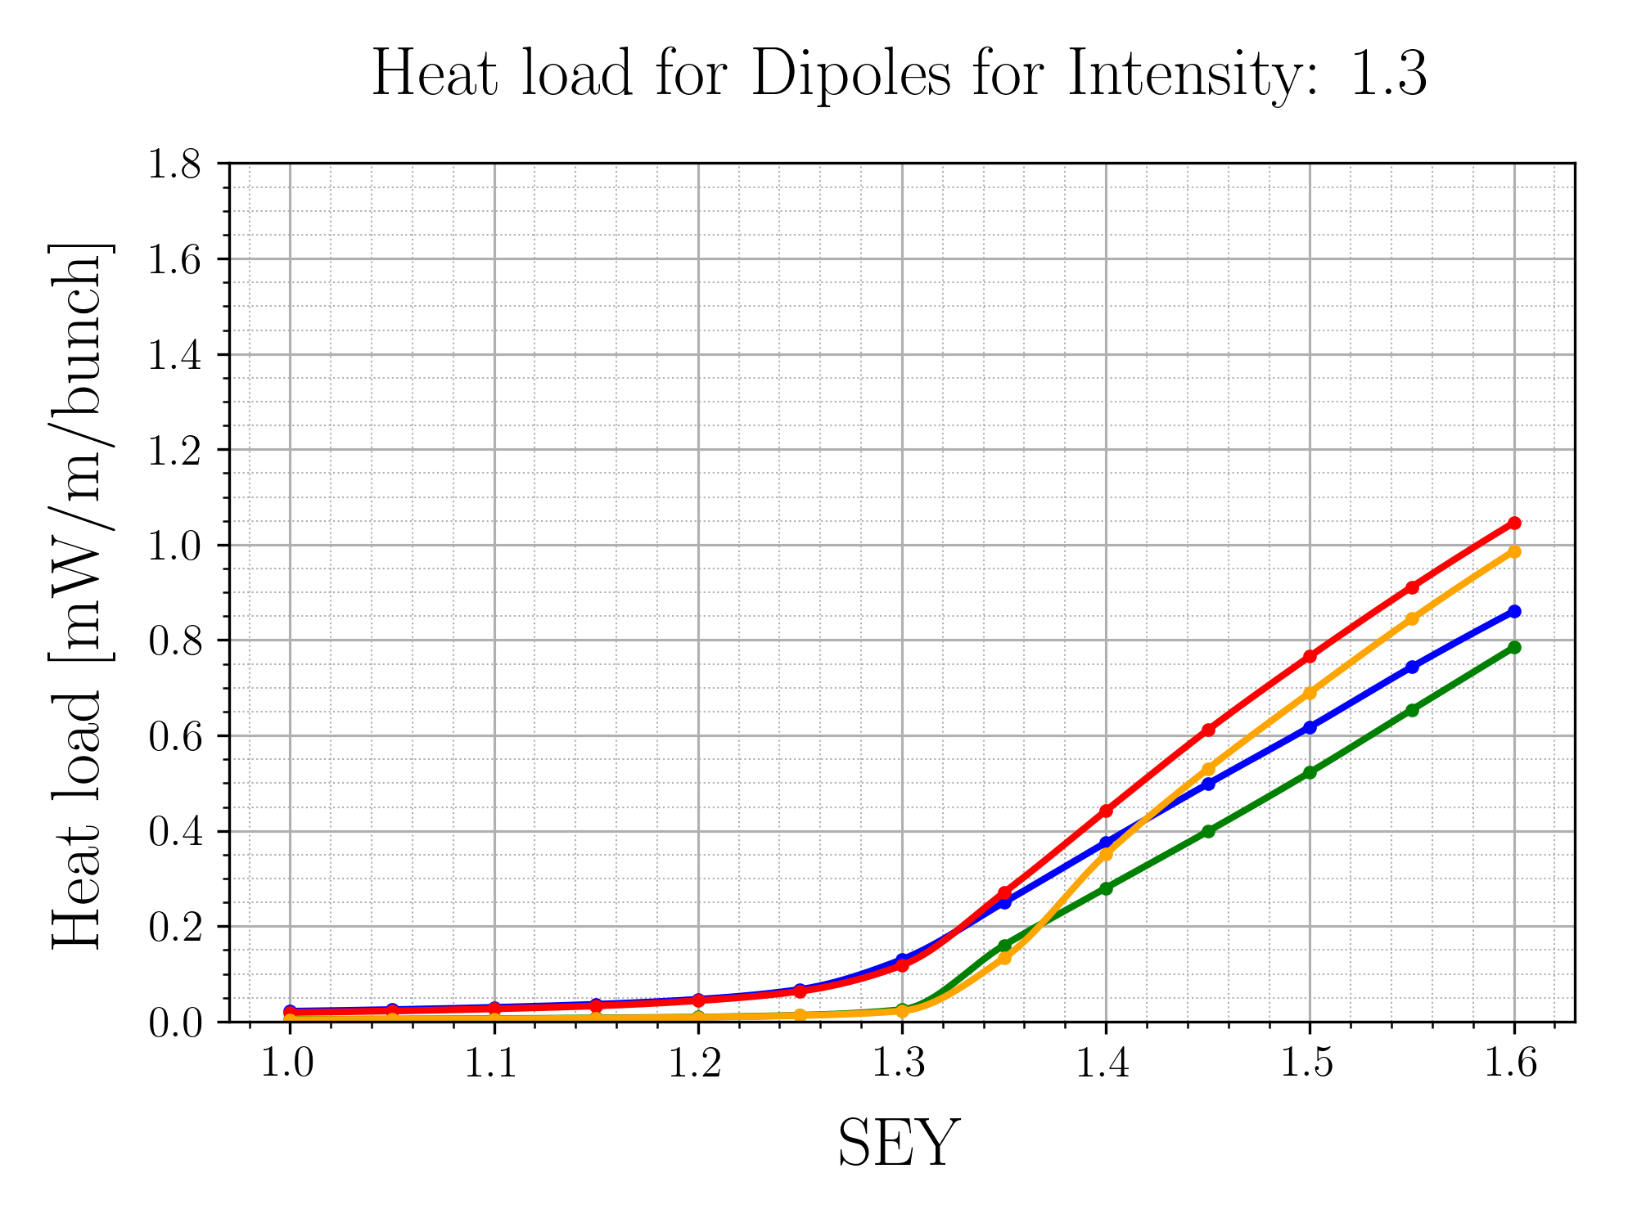
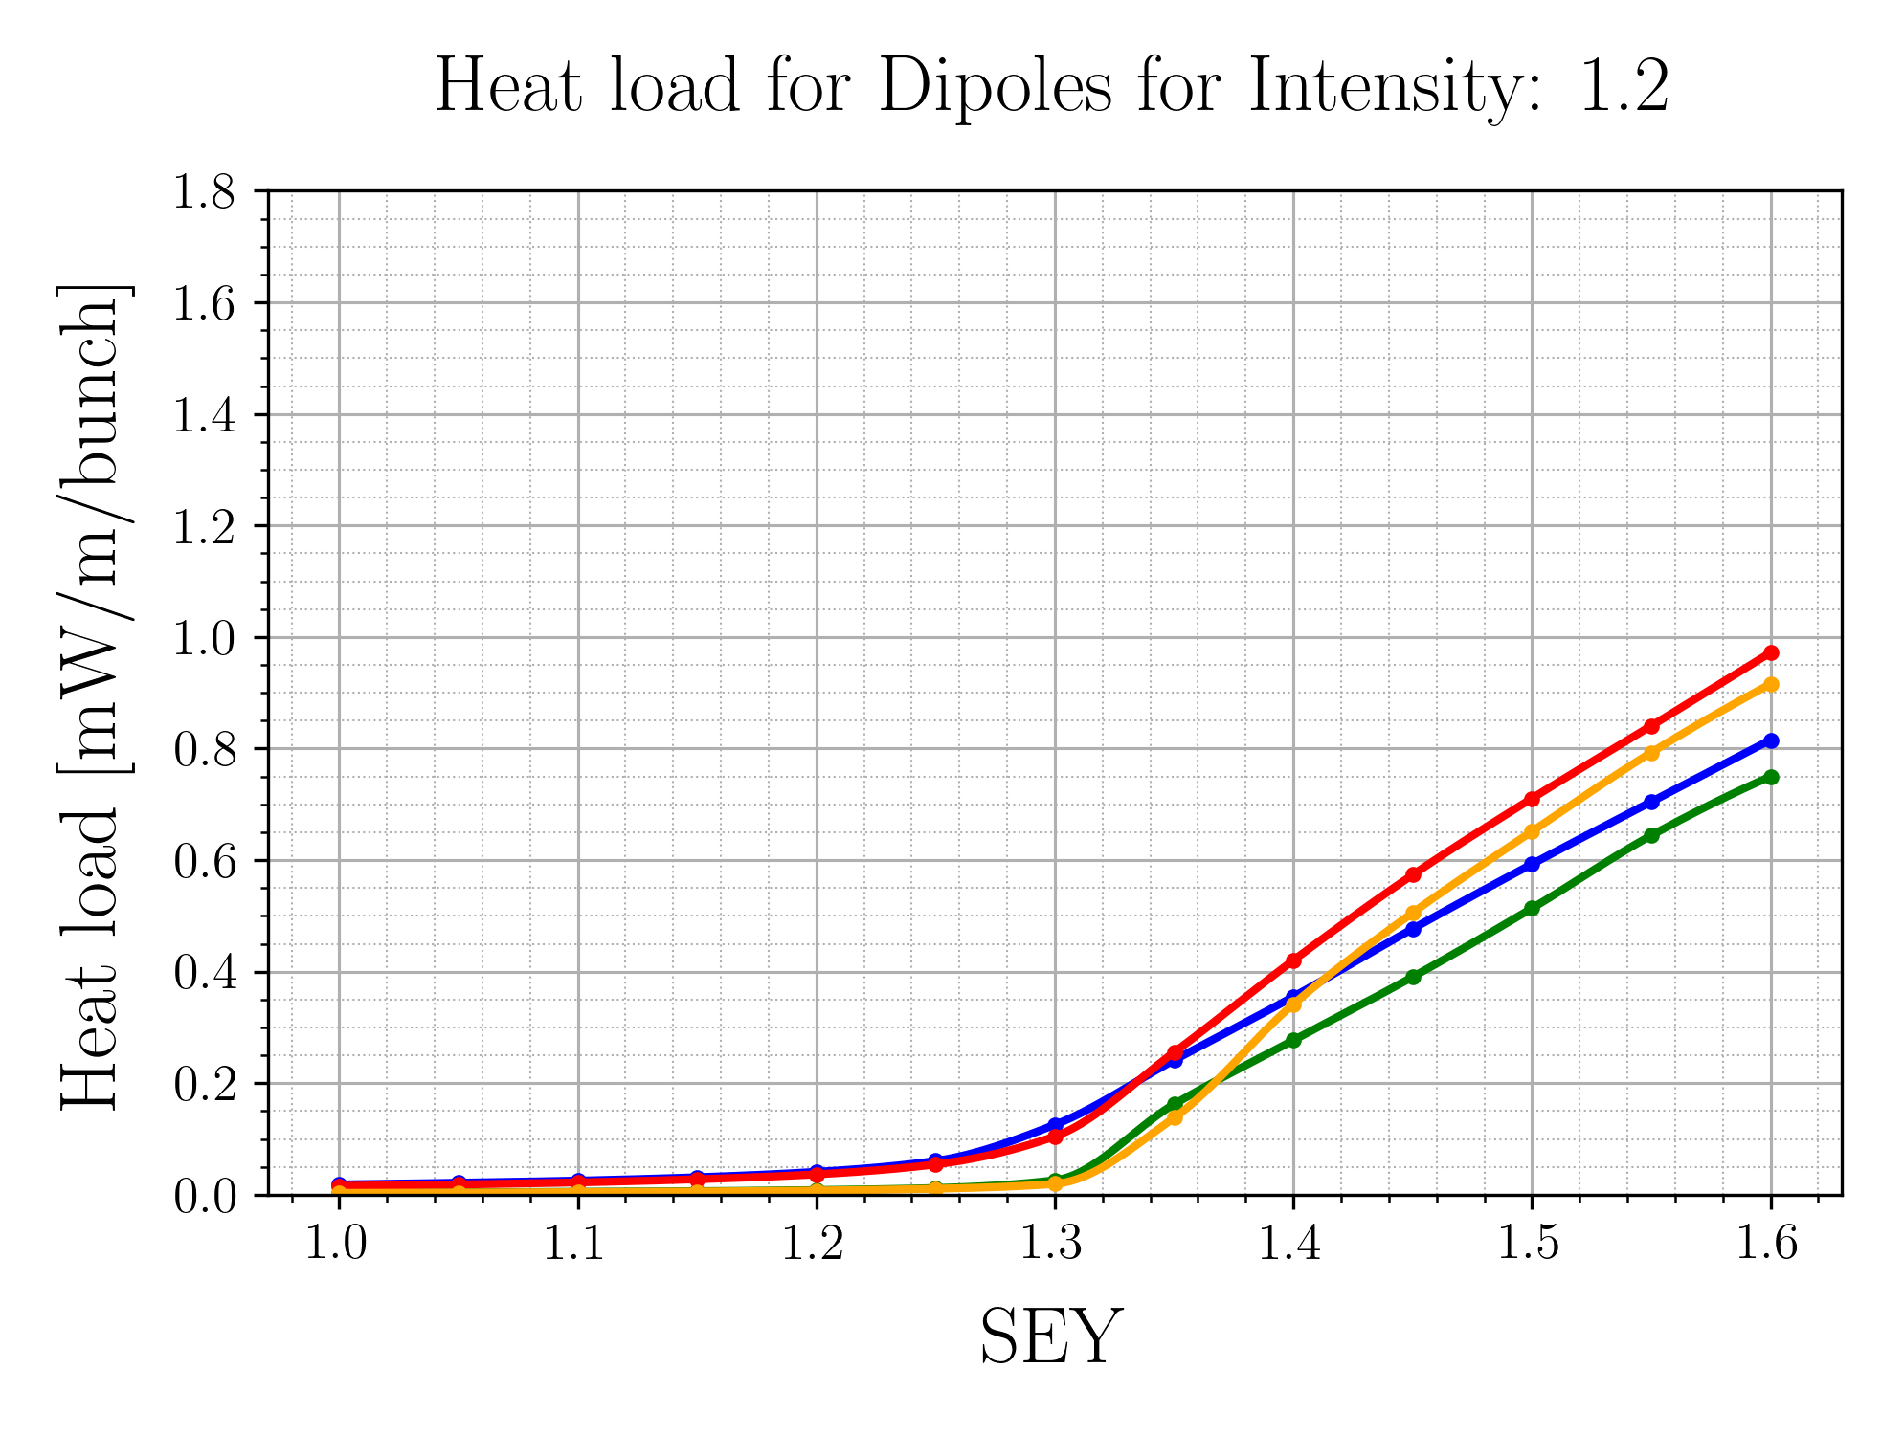
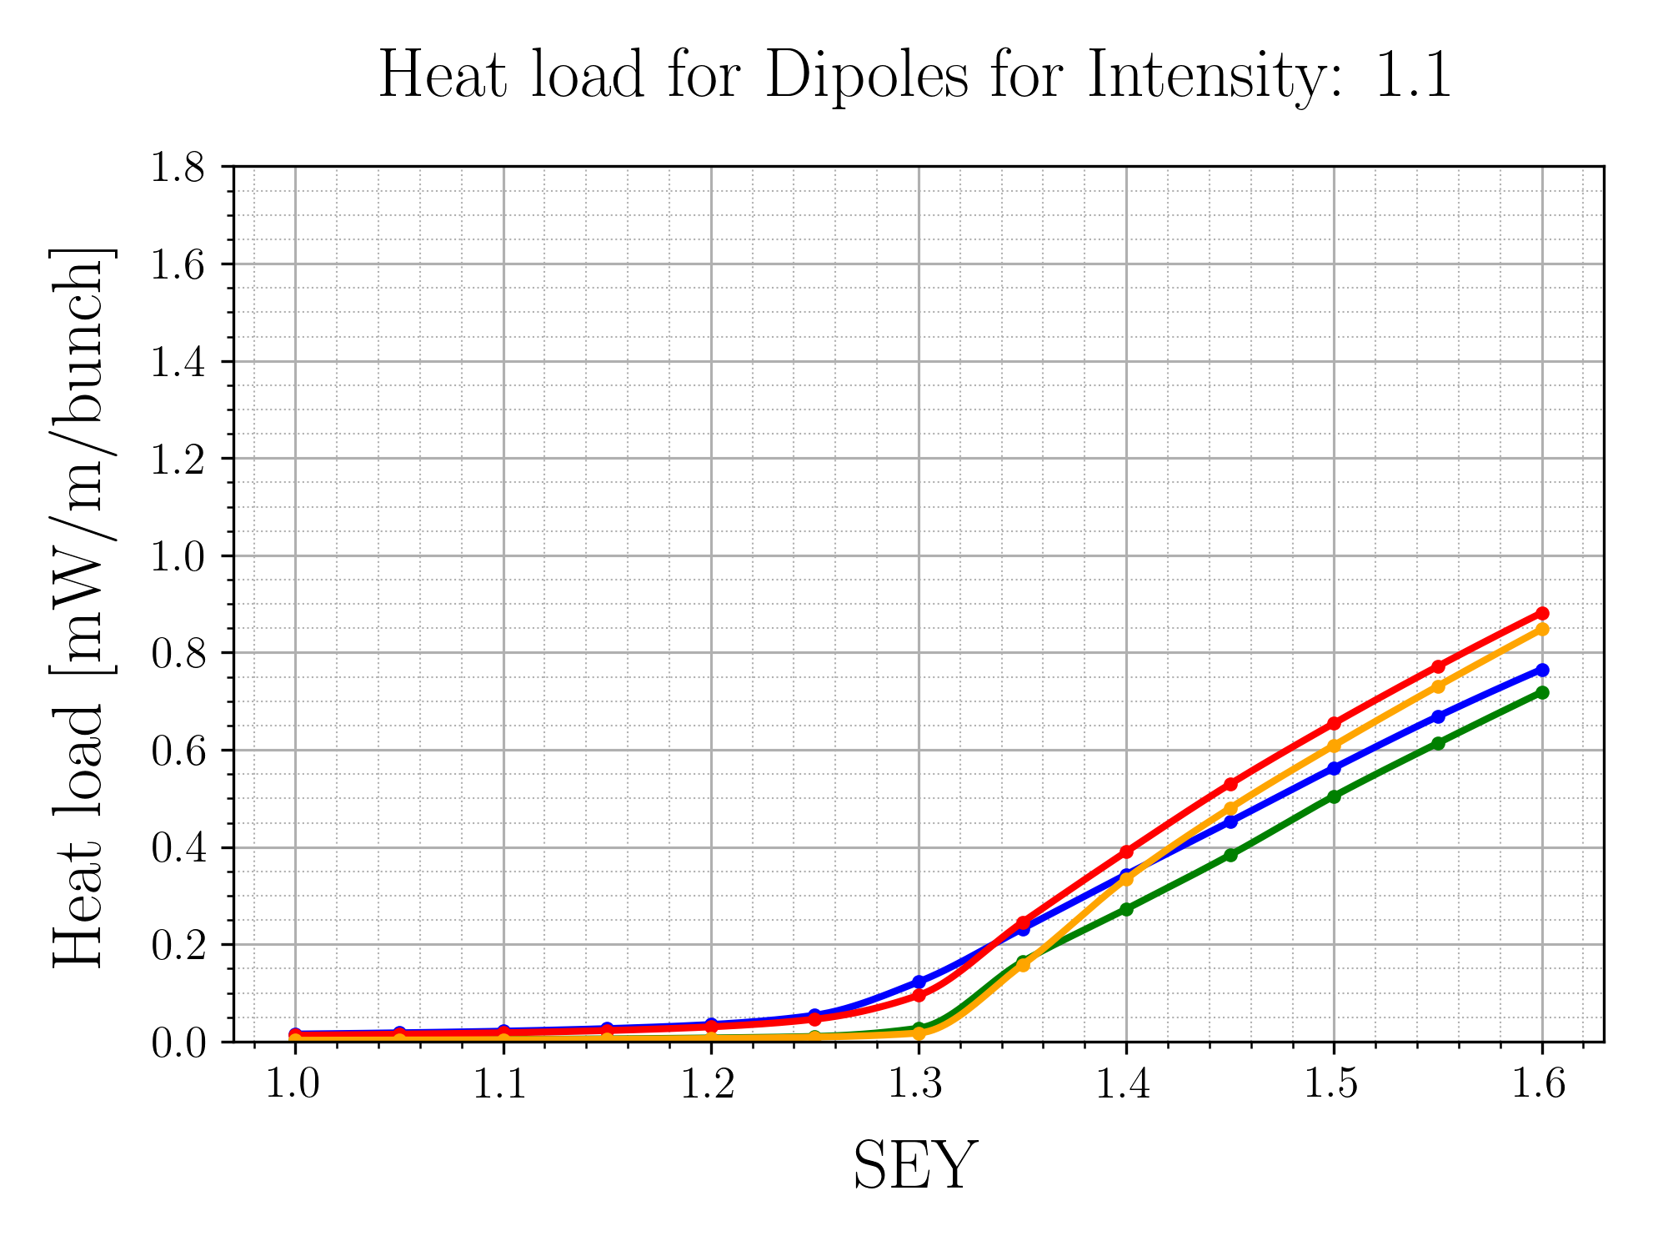
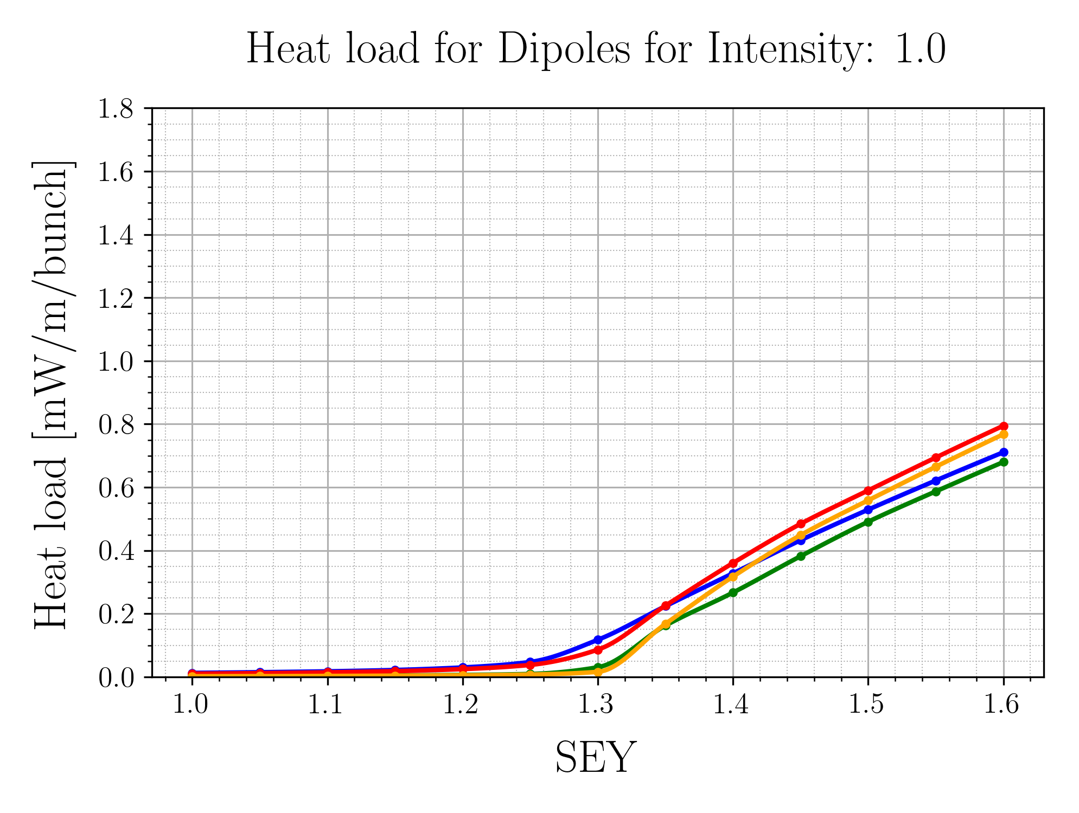
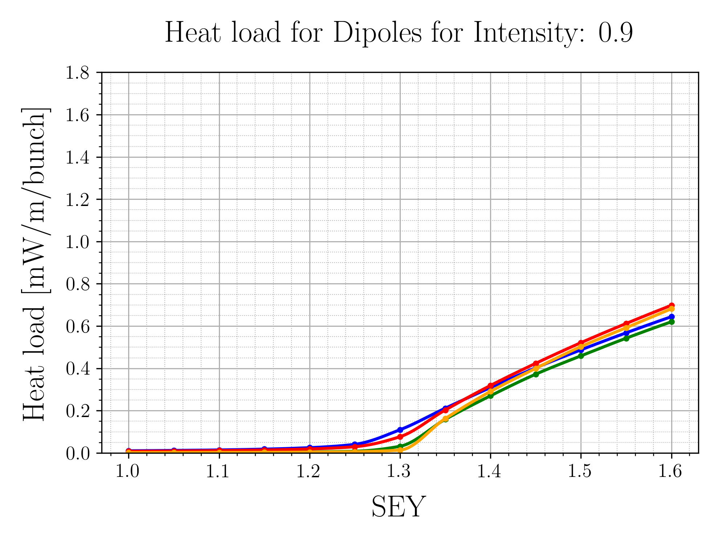
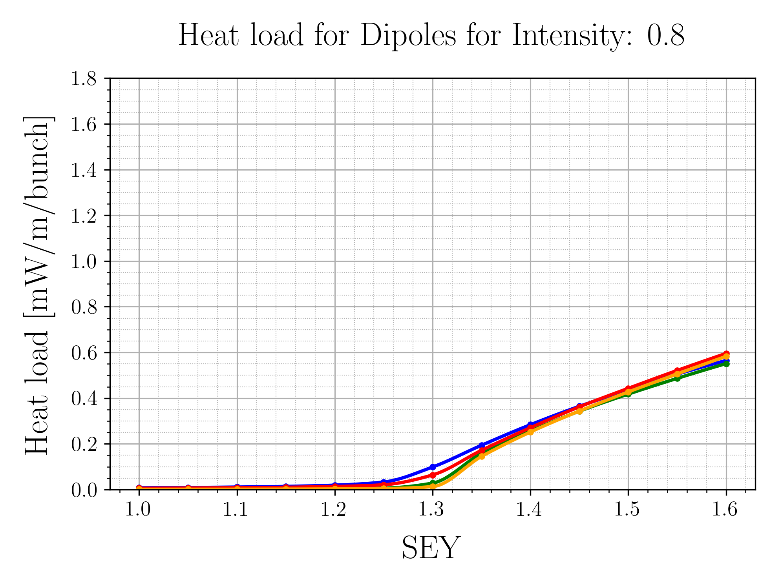
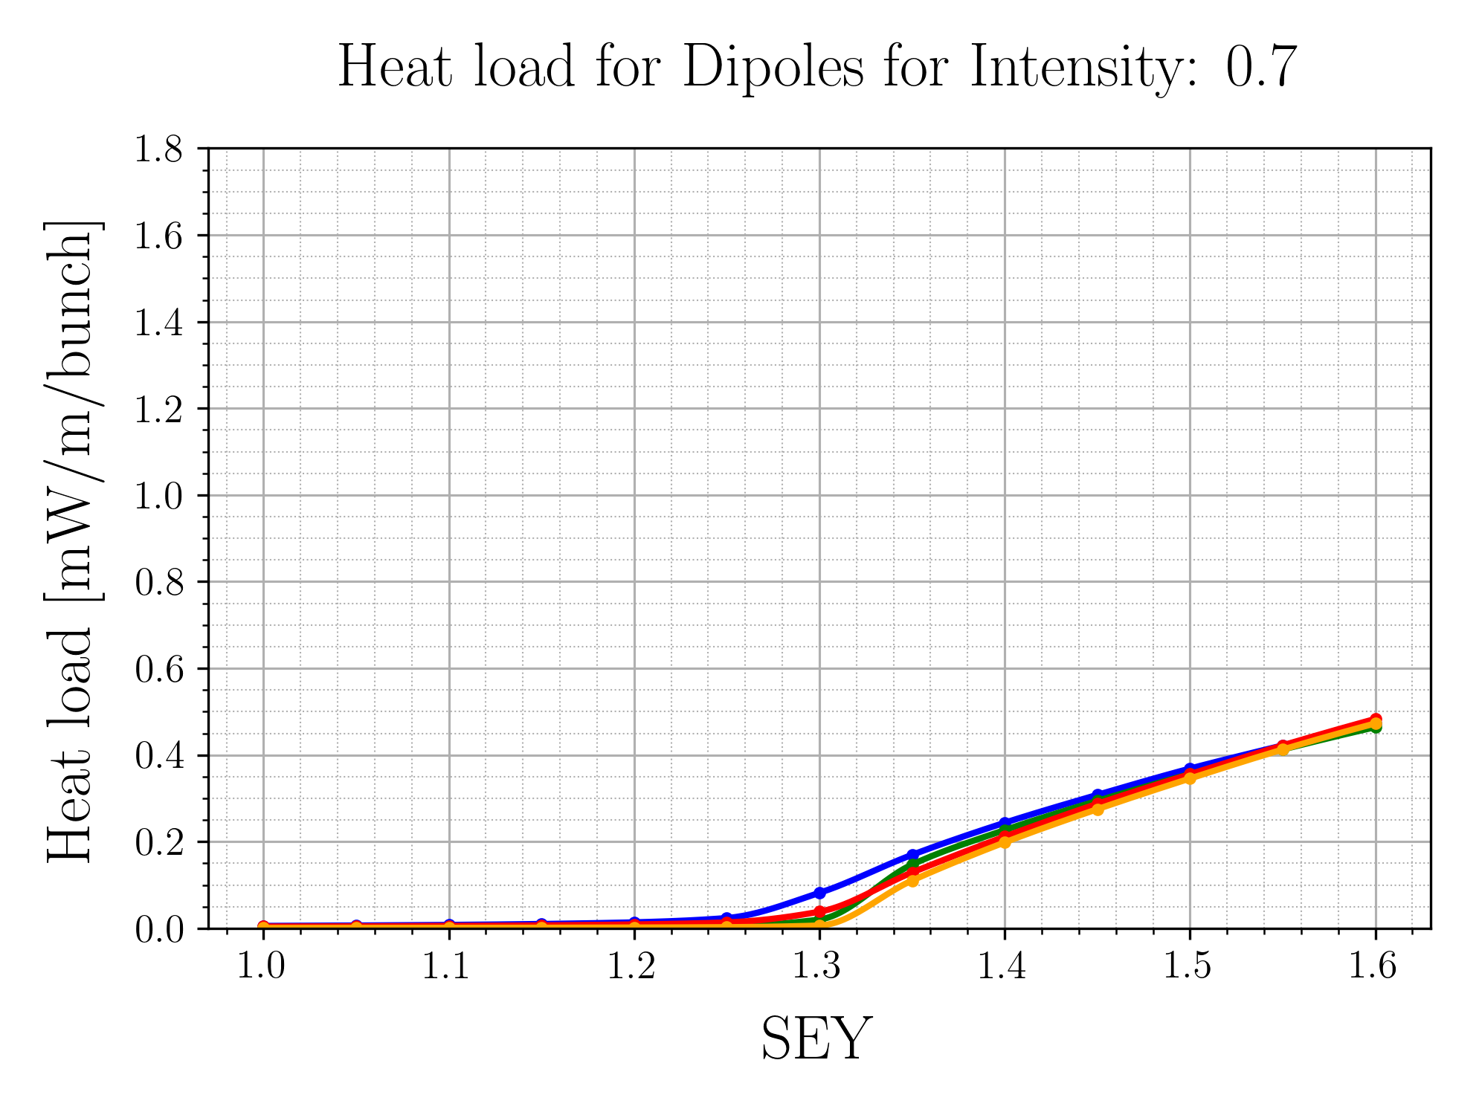
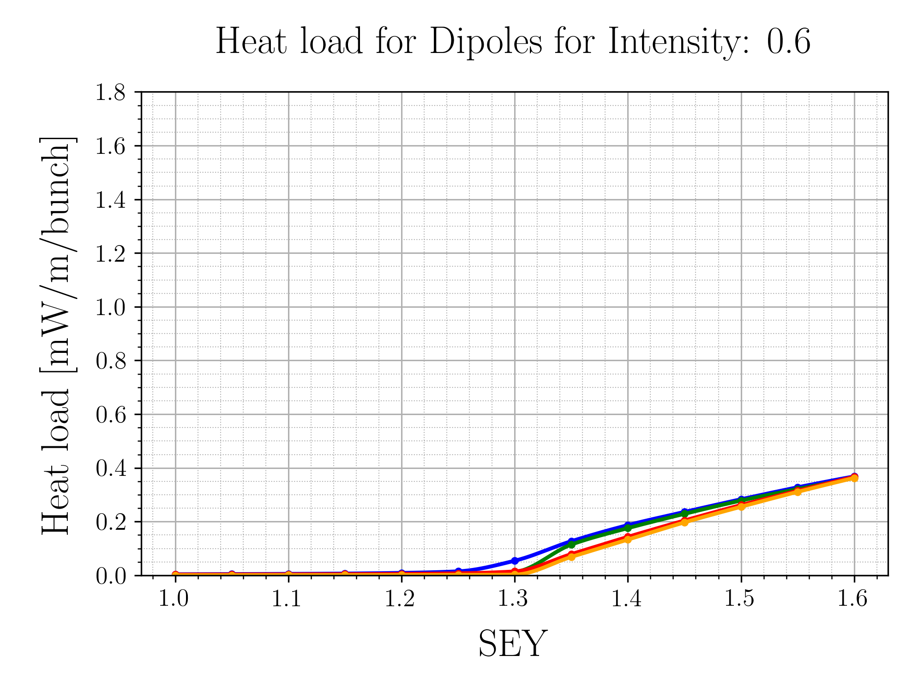
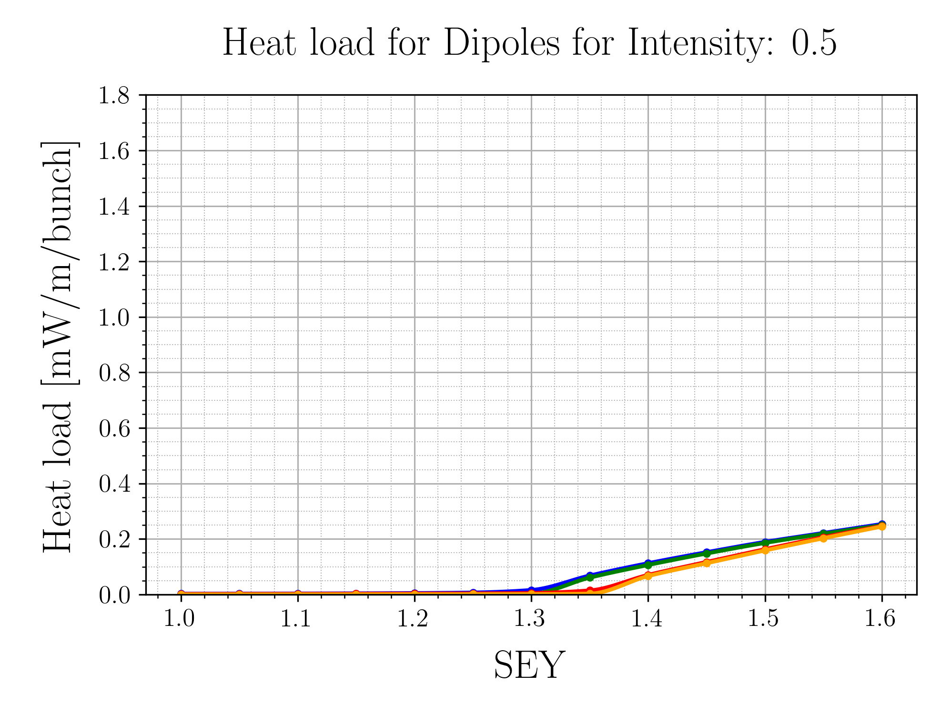
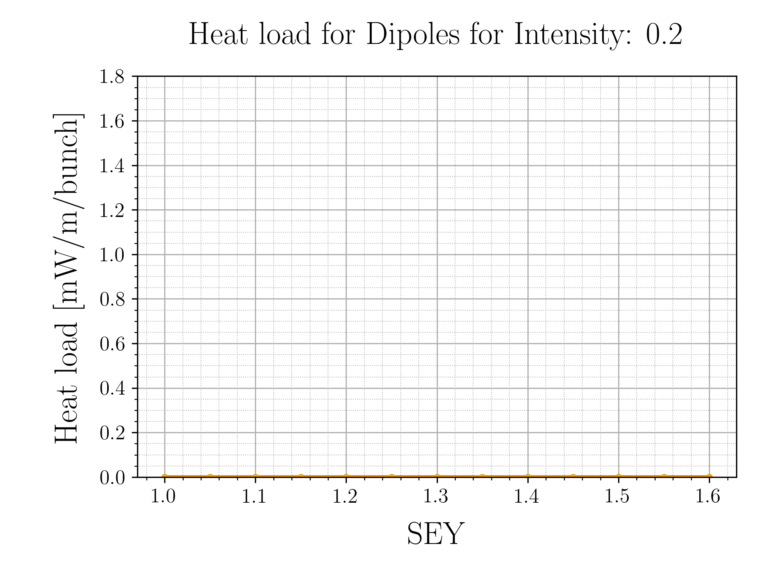
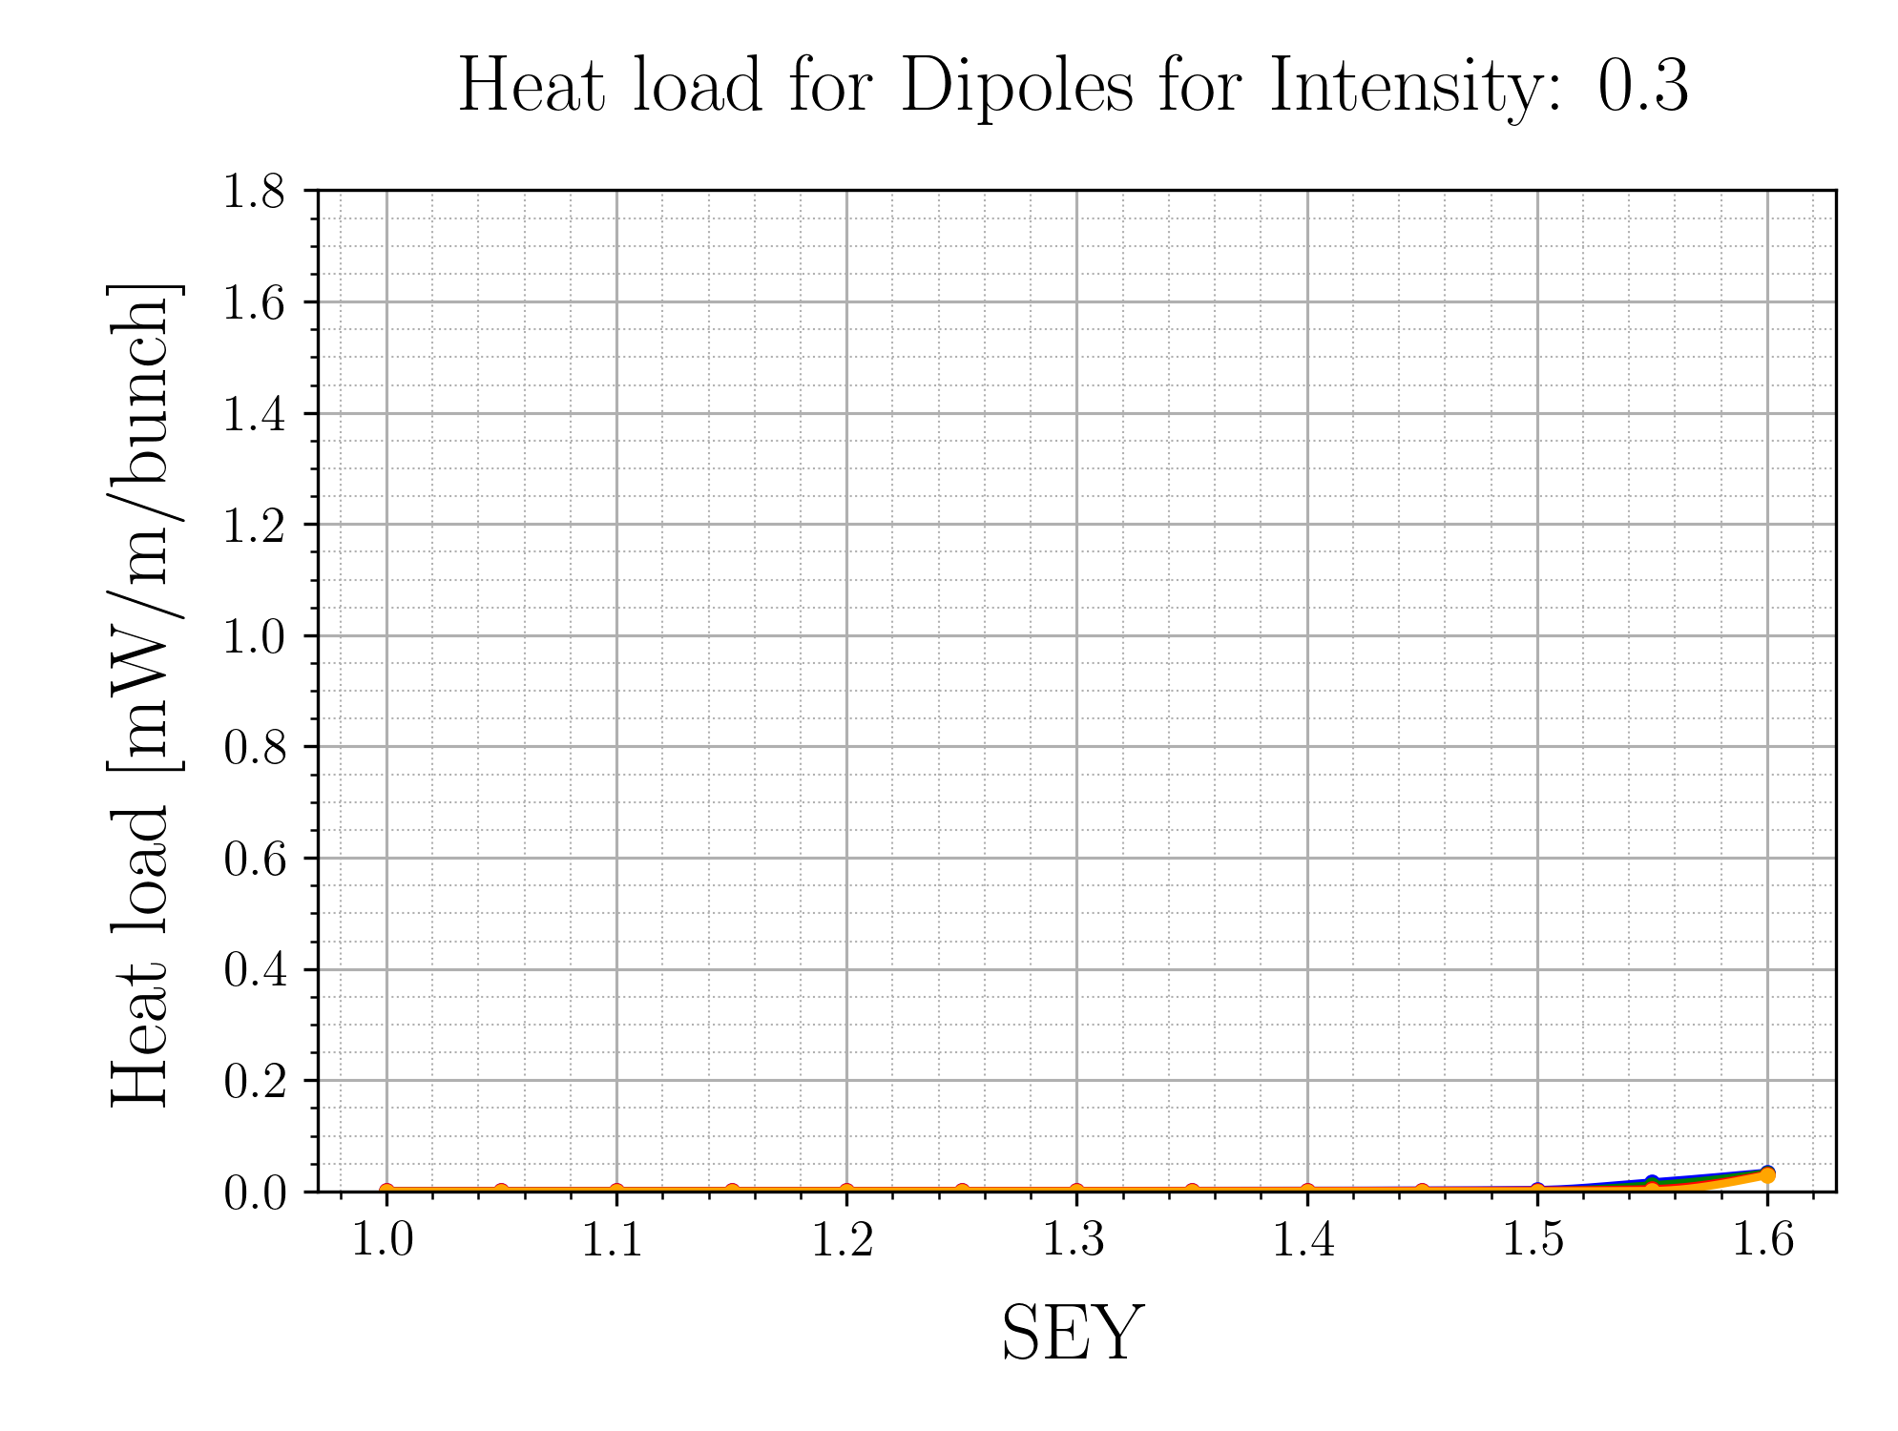
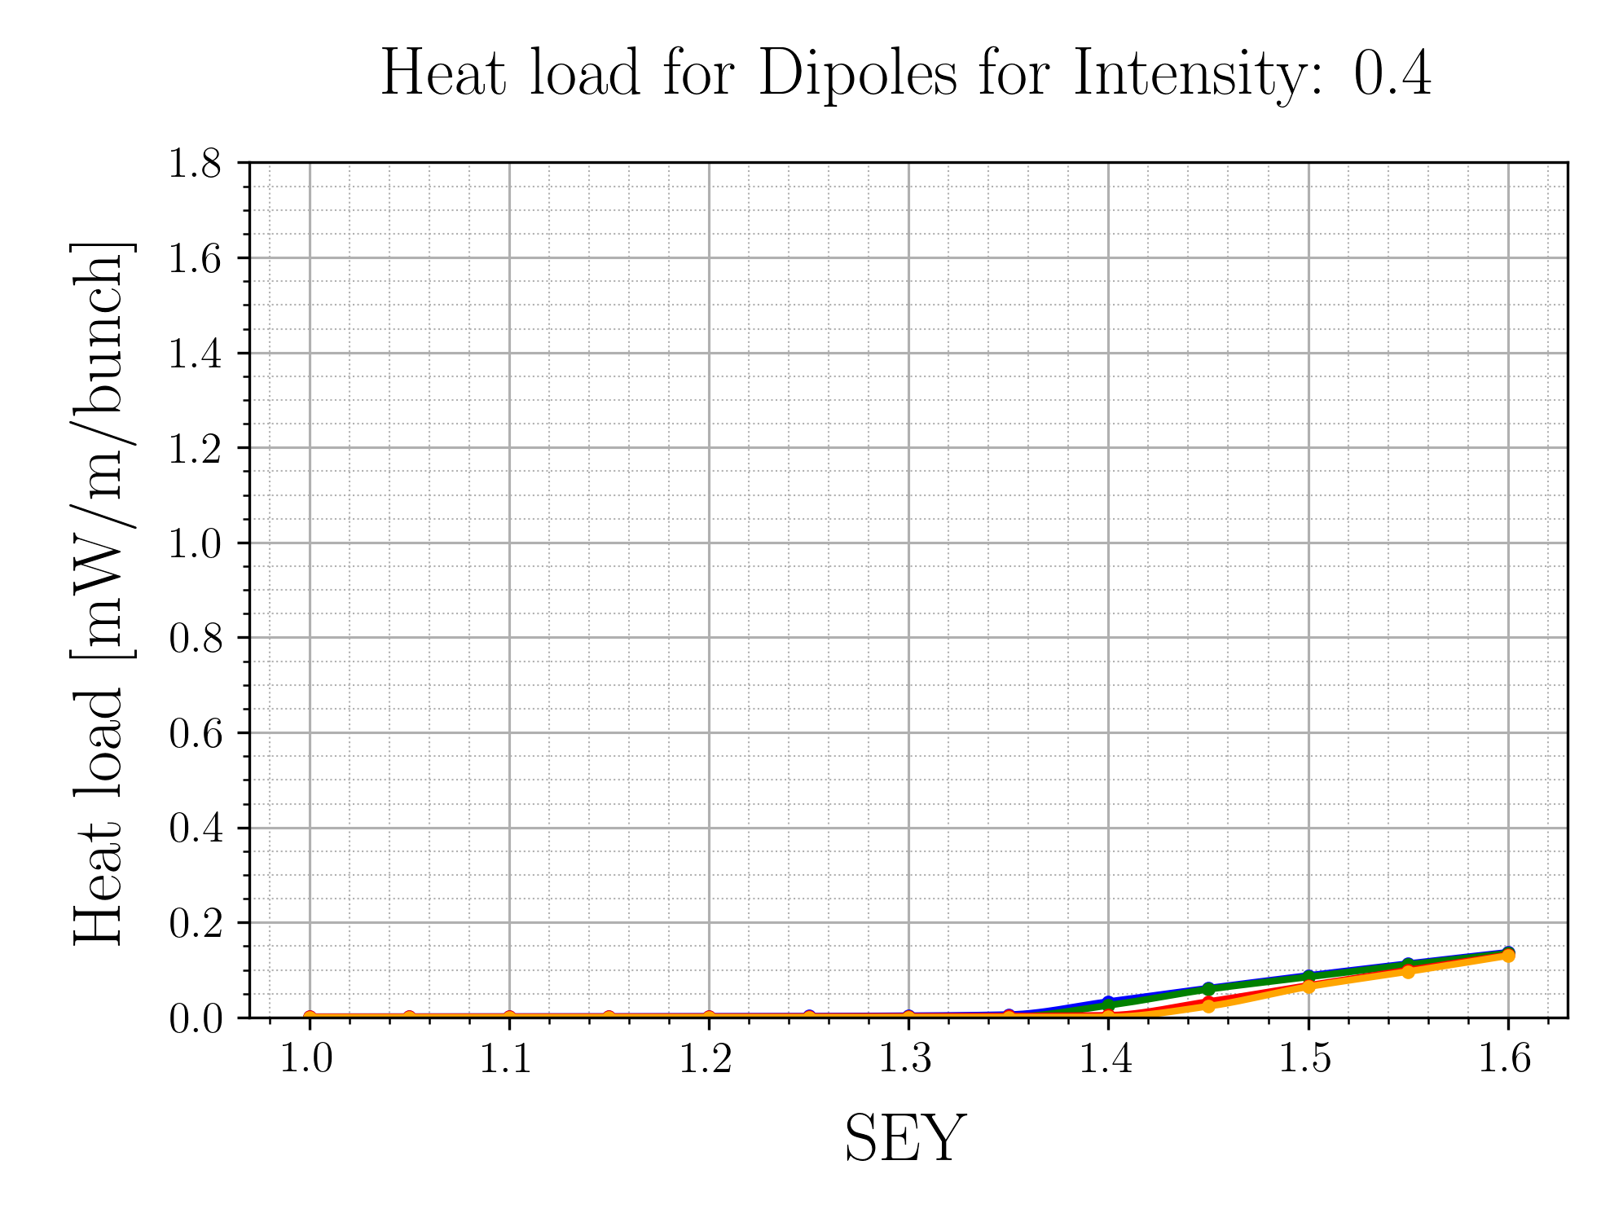
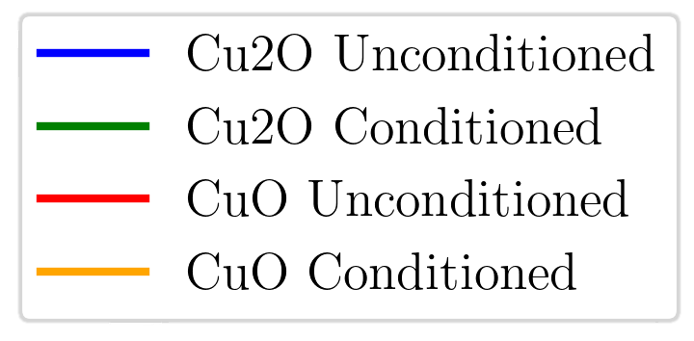
Dipole Heat Load
For higher intensities, the surface SEY curve makes the most difference
The higher the intensity, the bigger the difference photoemission makes

Slide 8
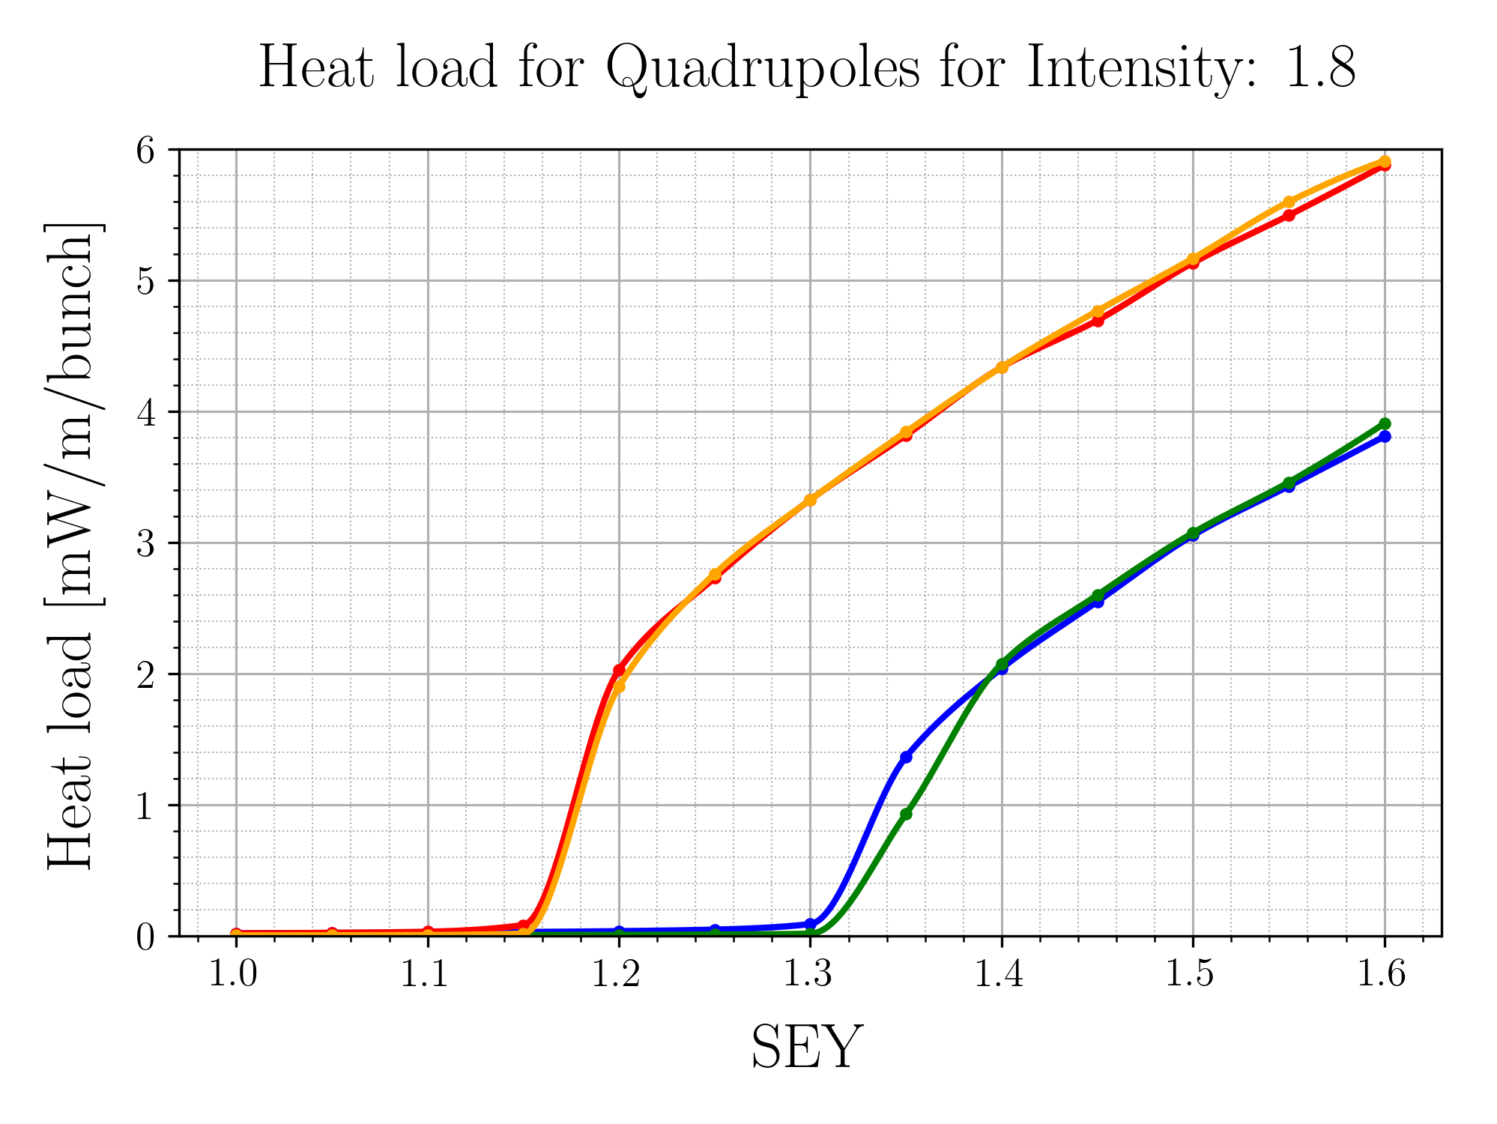
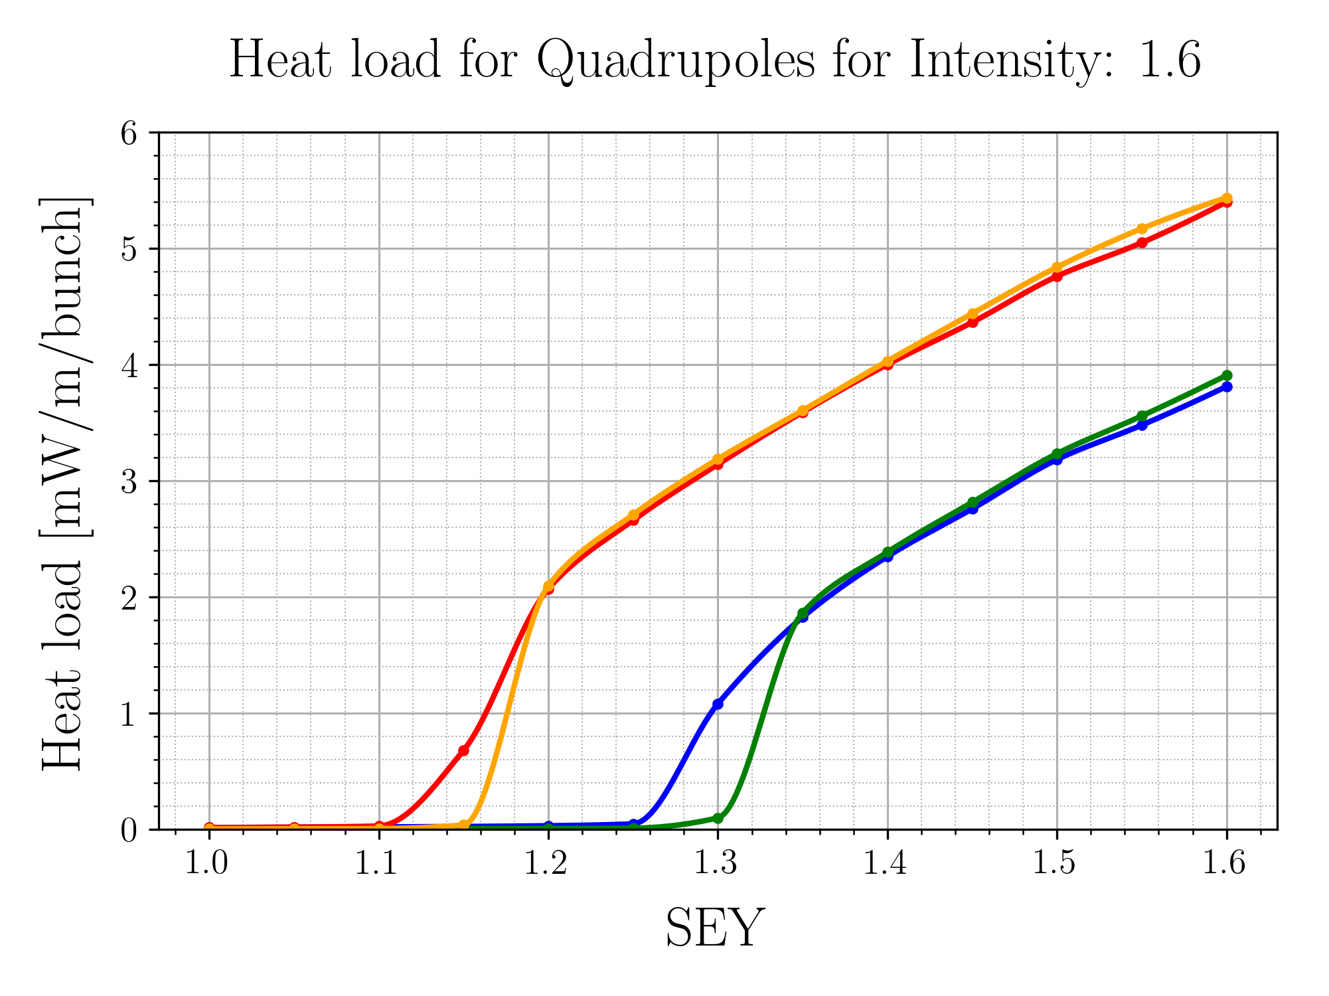
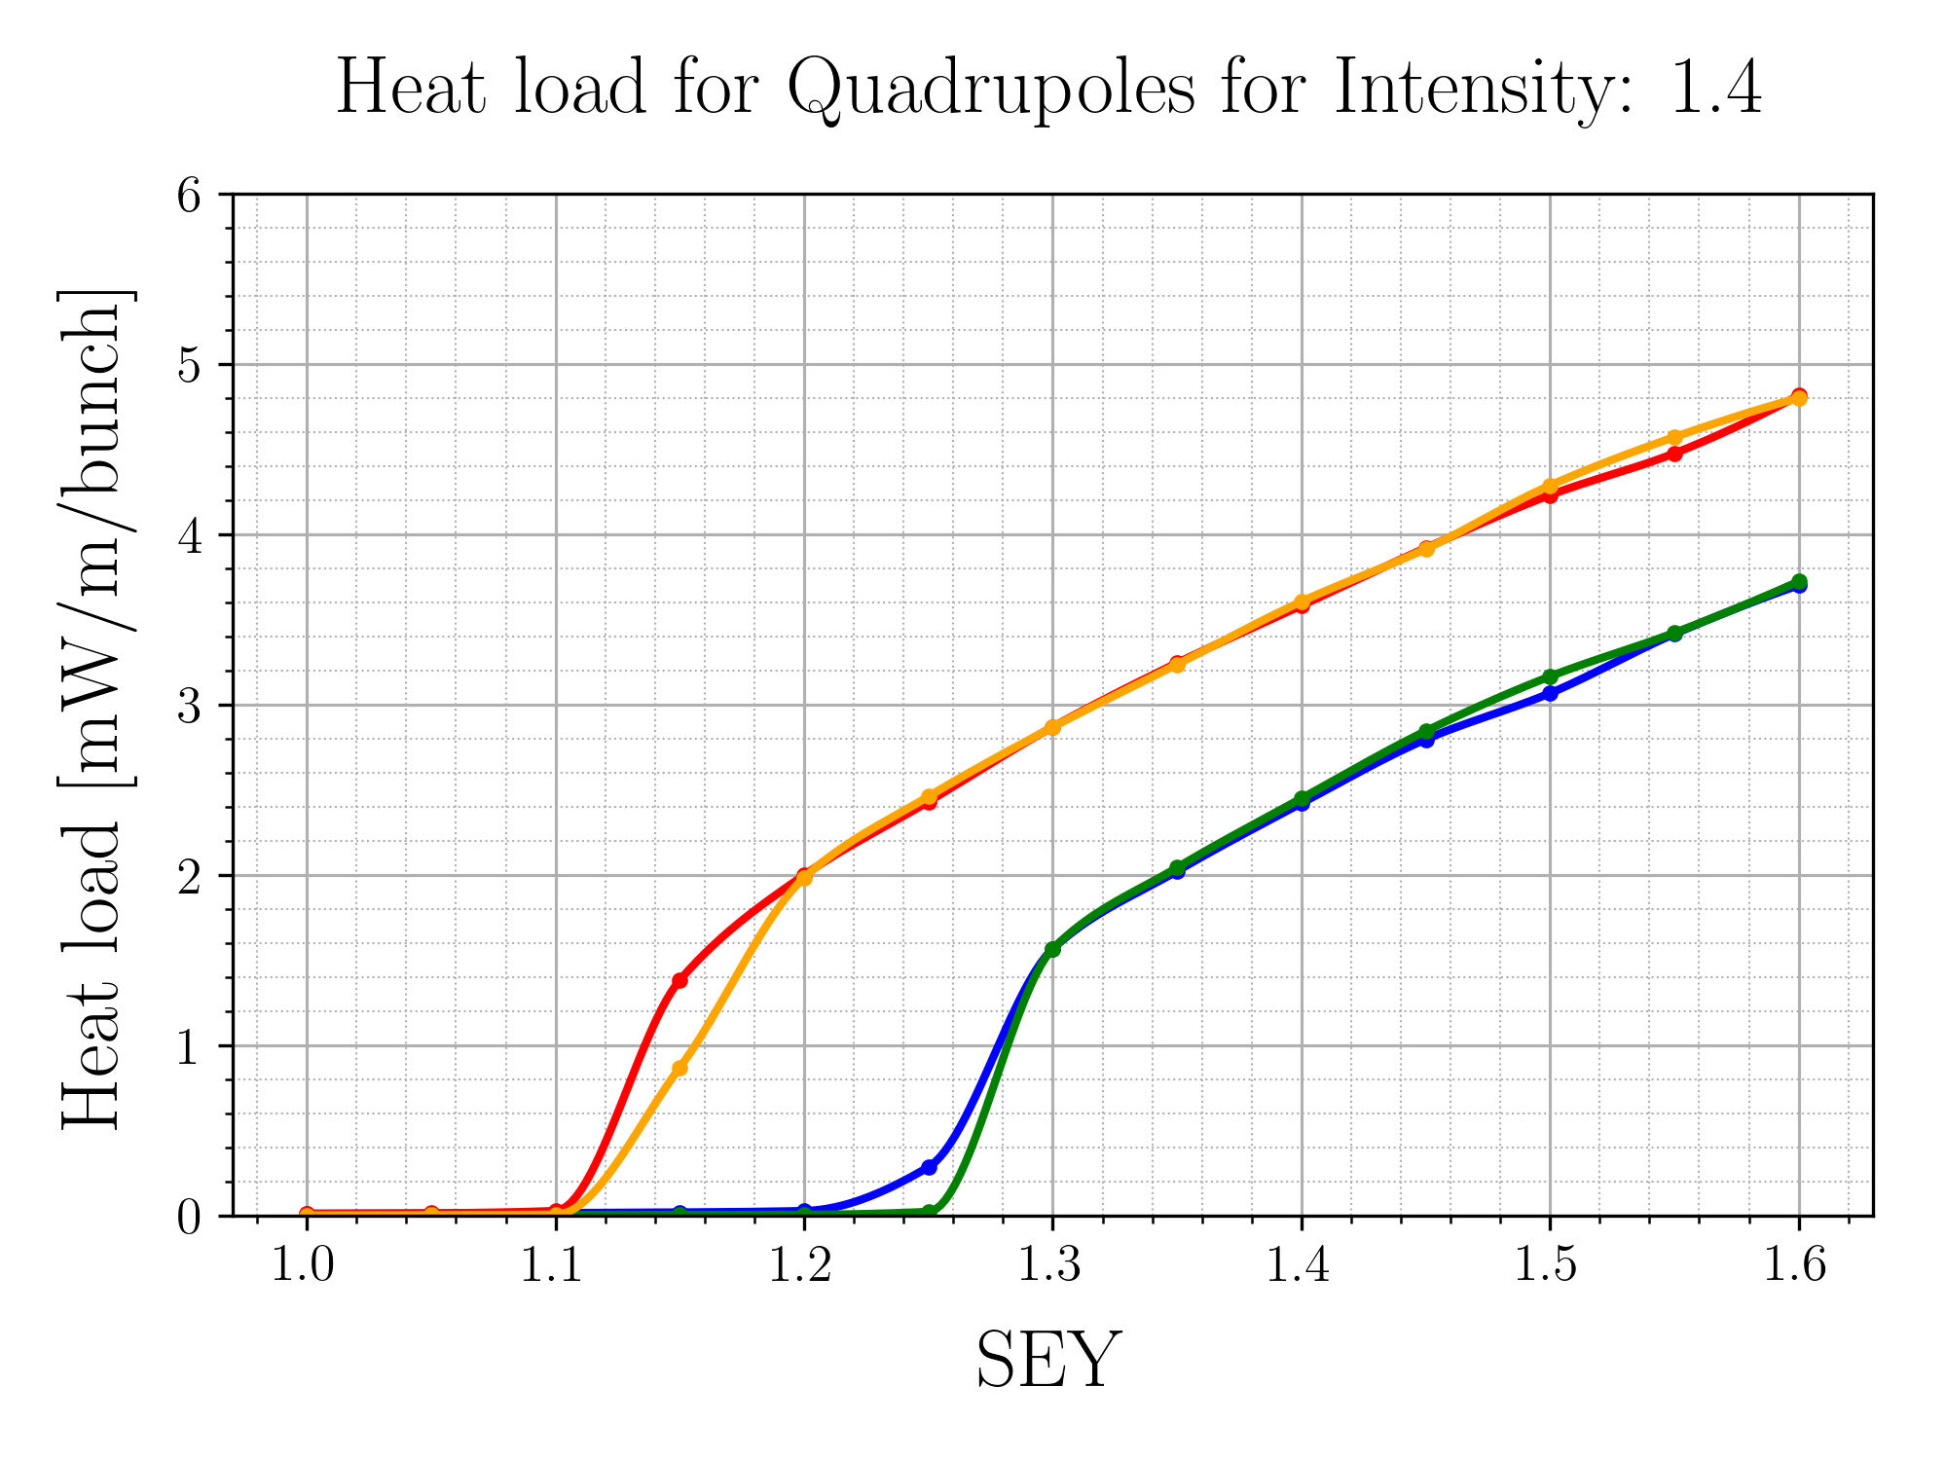
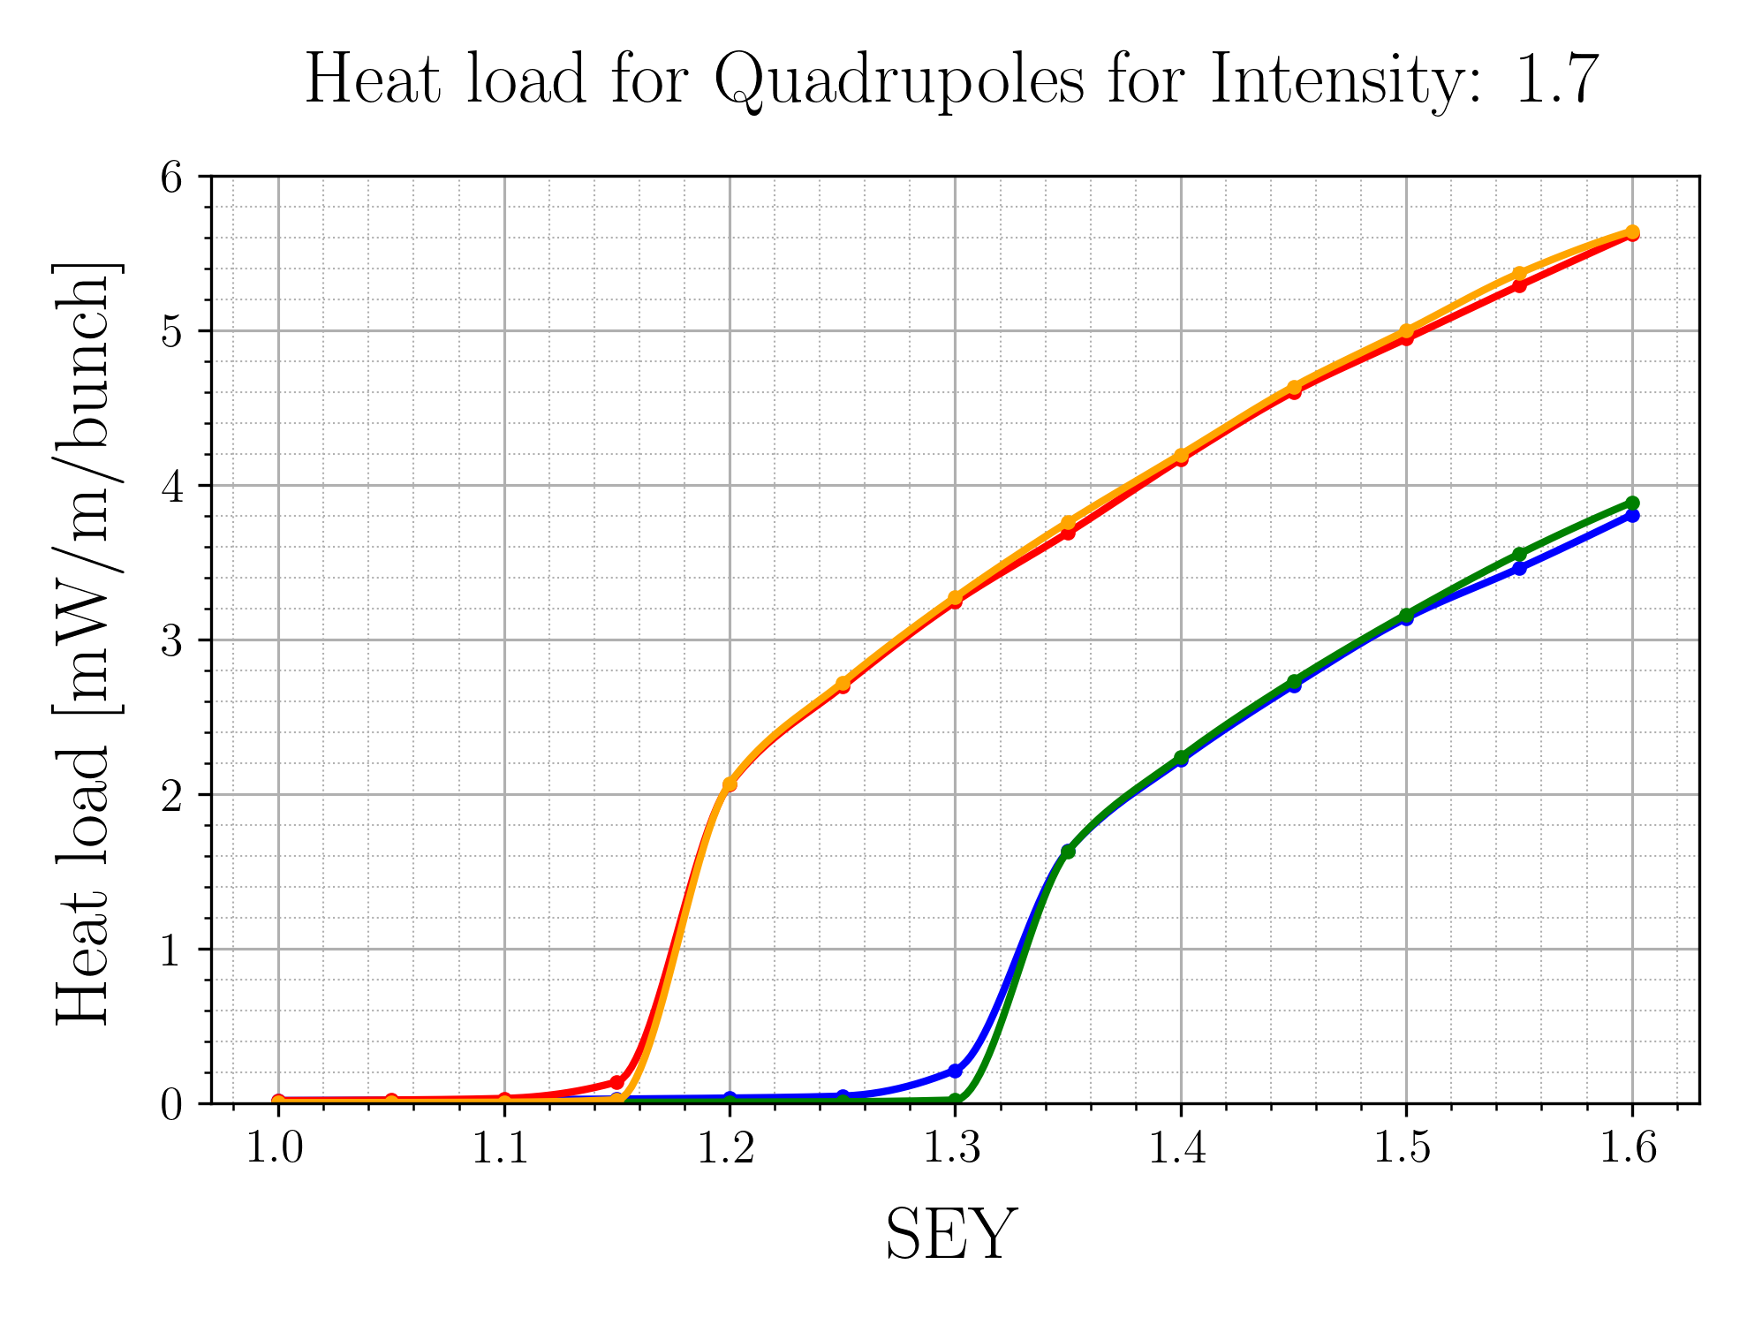
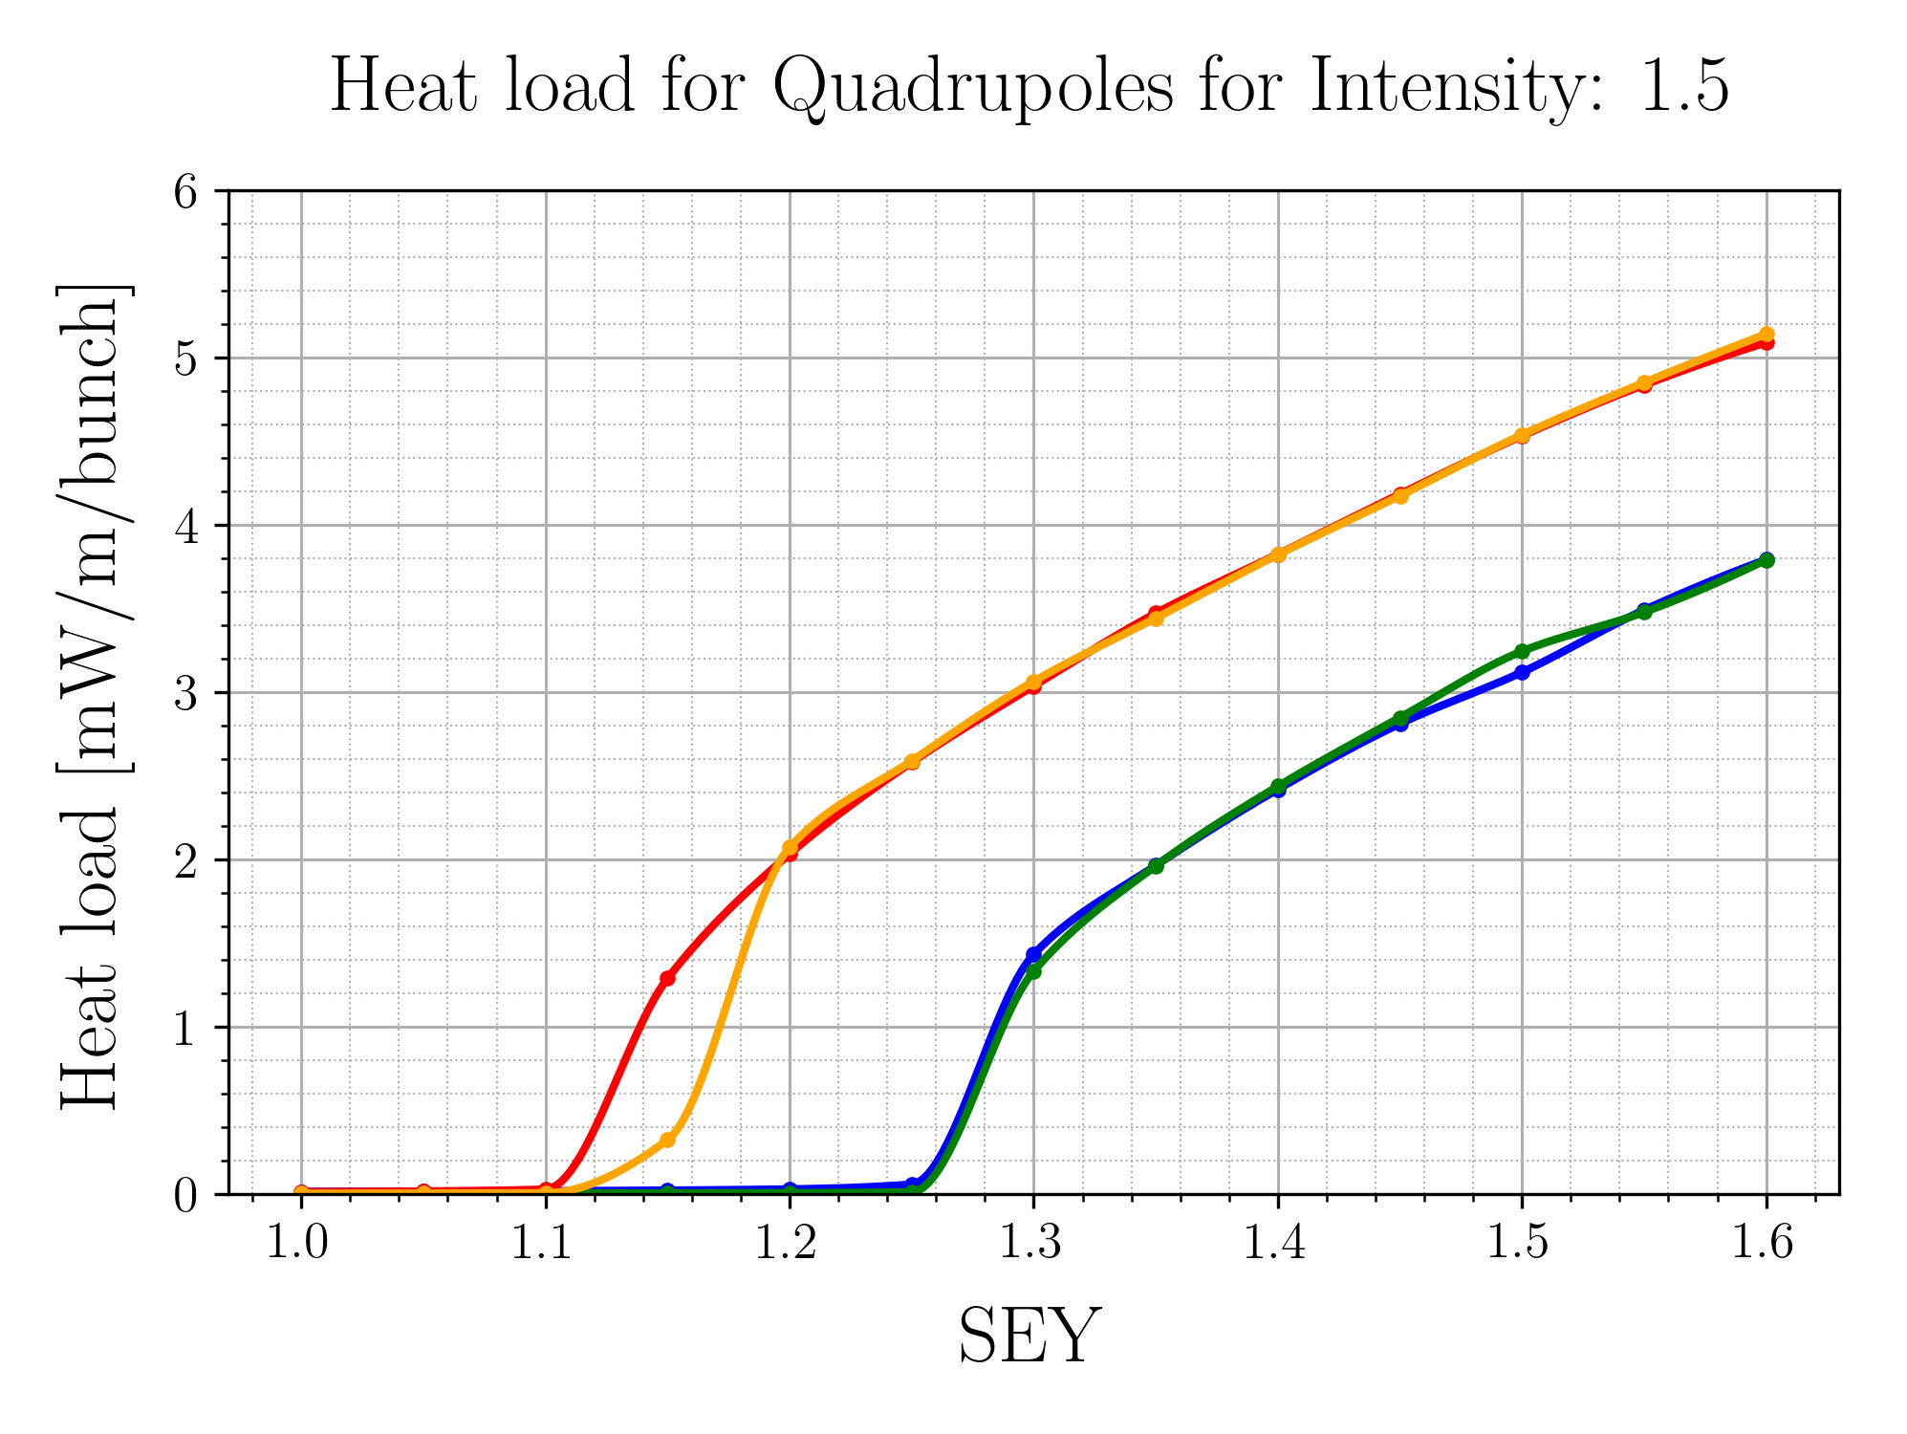
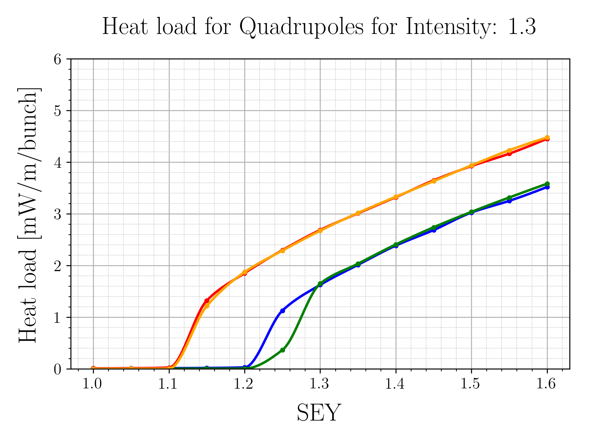
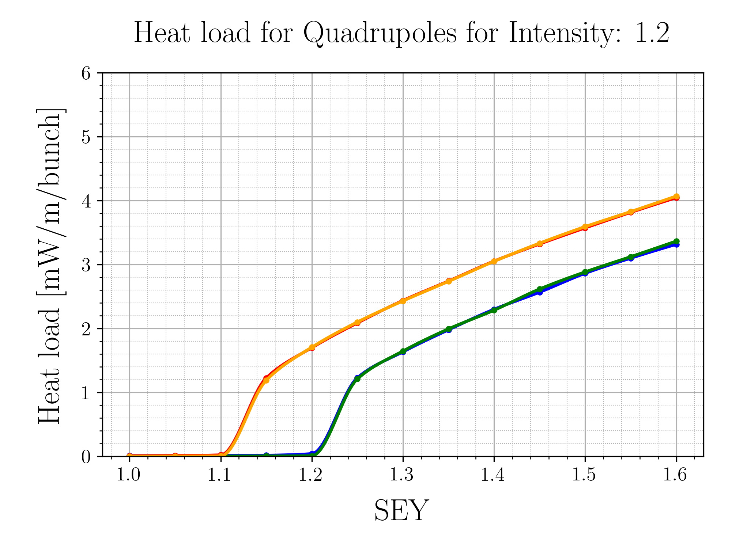
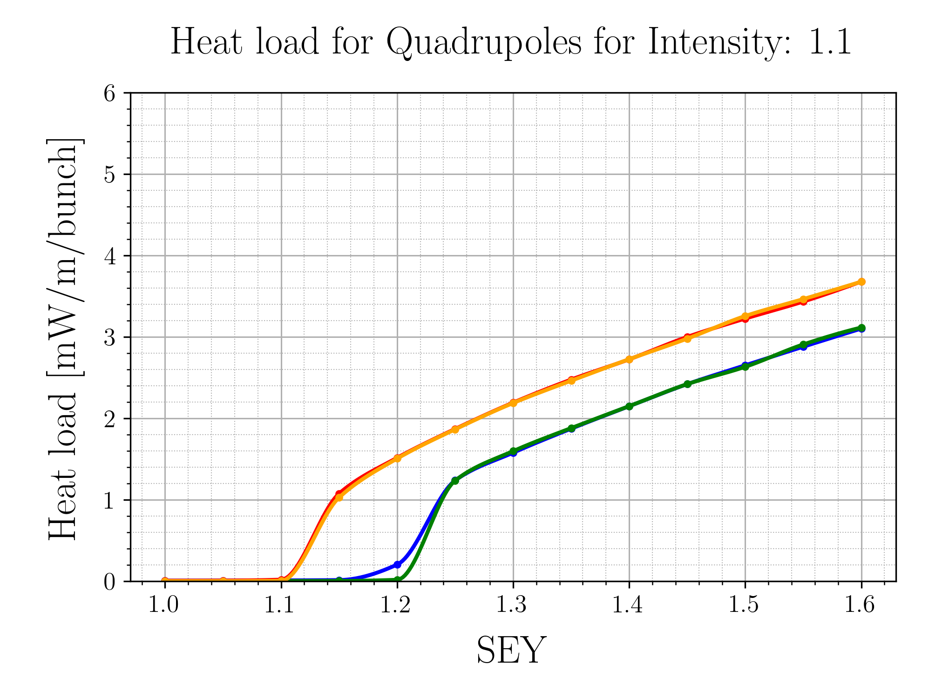
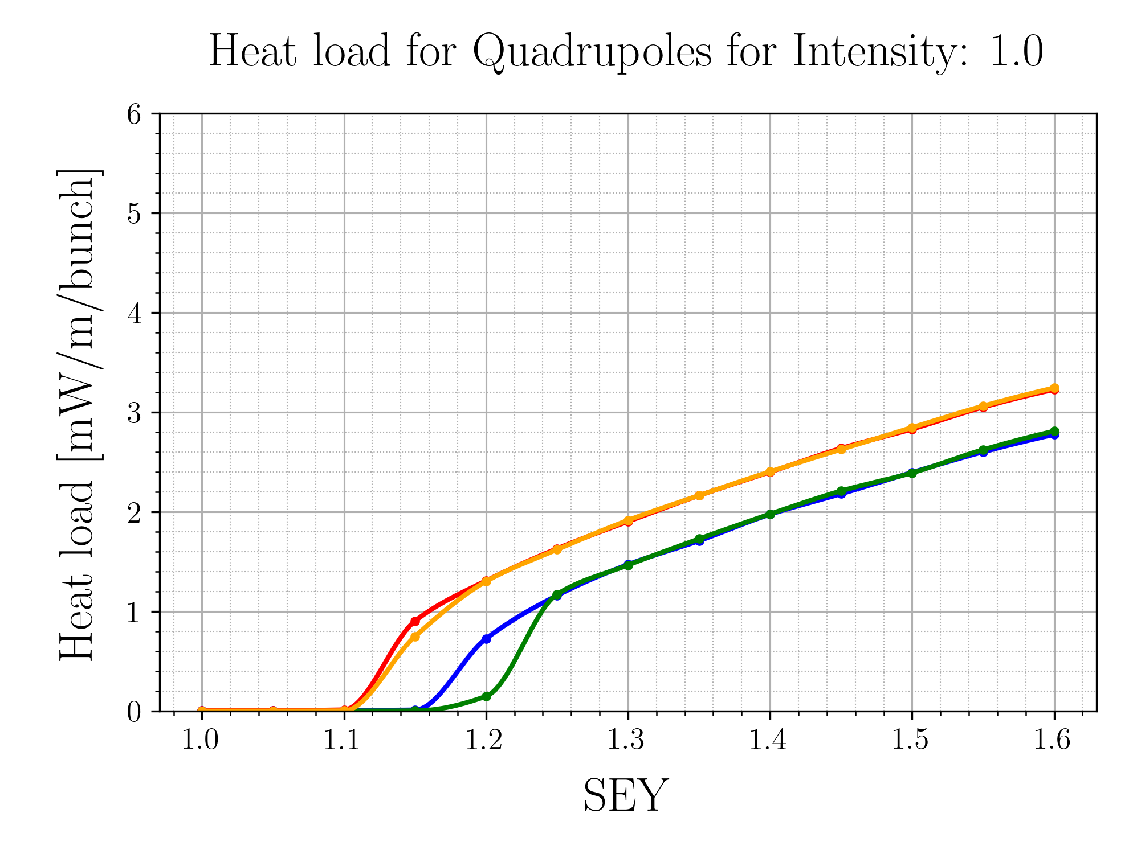
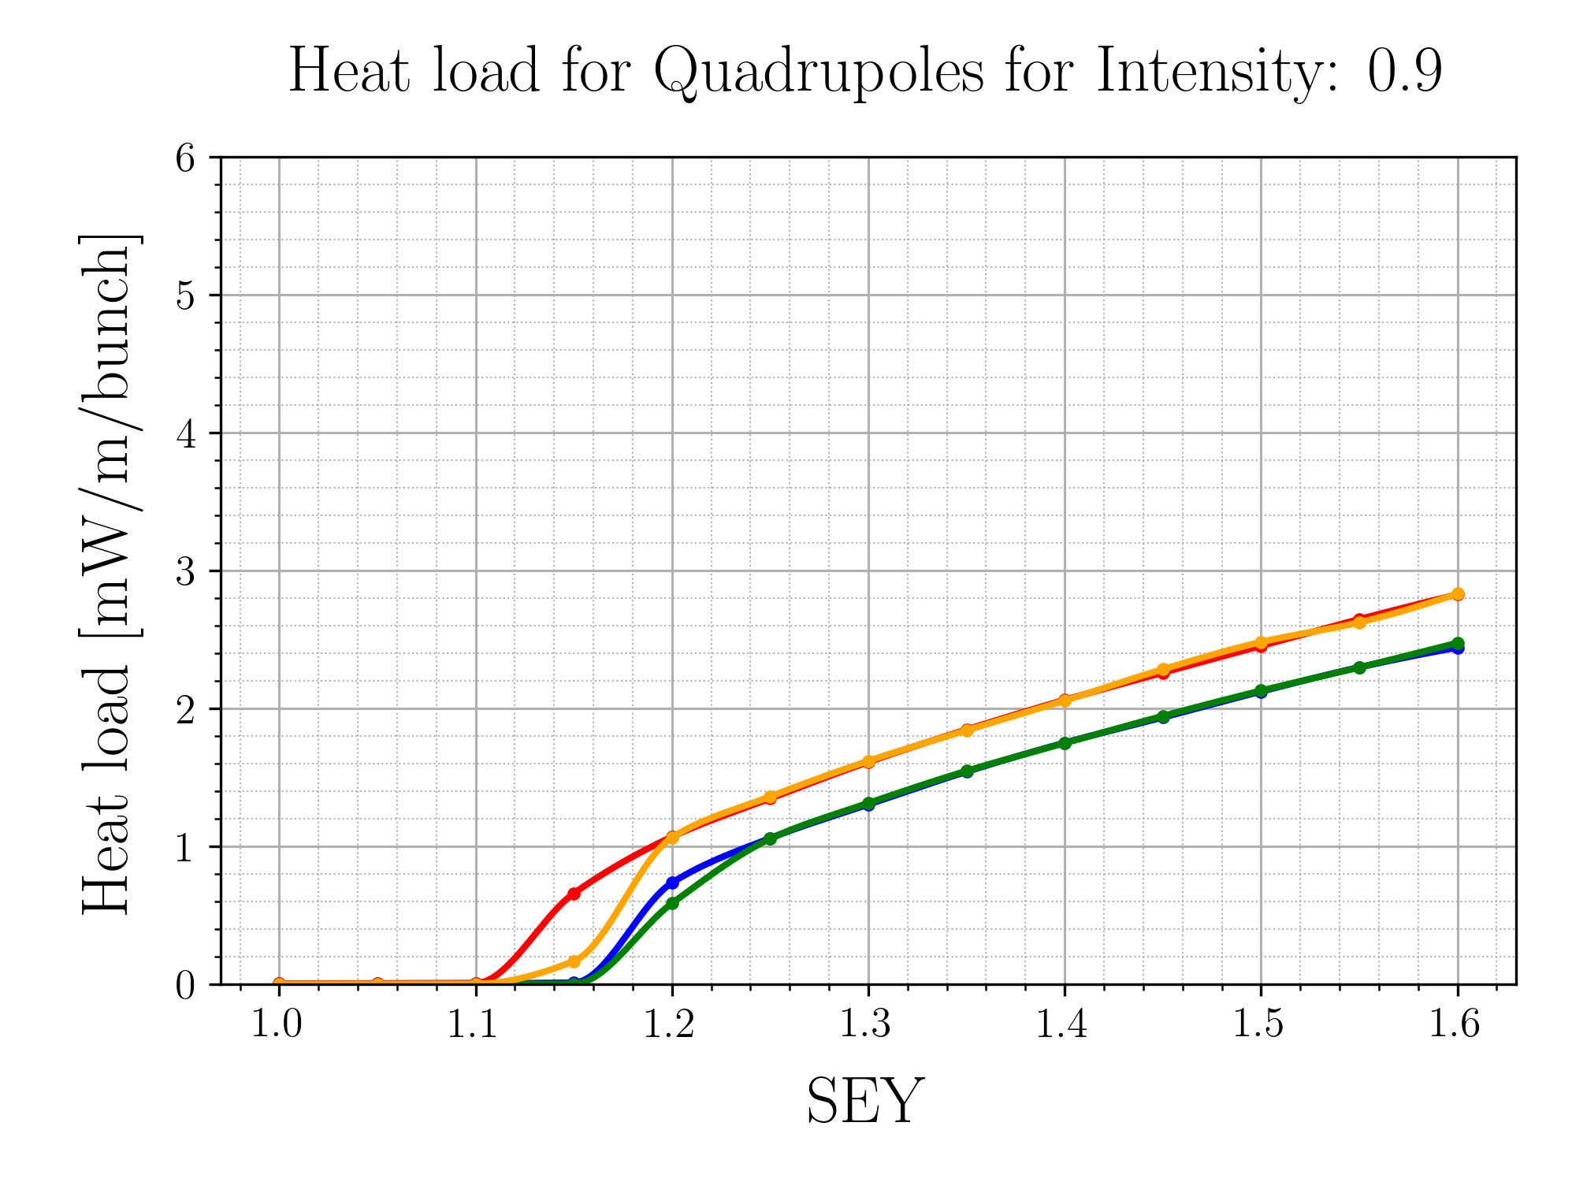
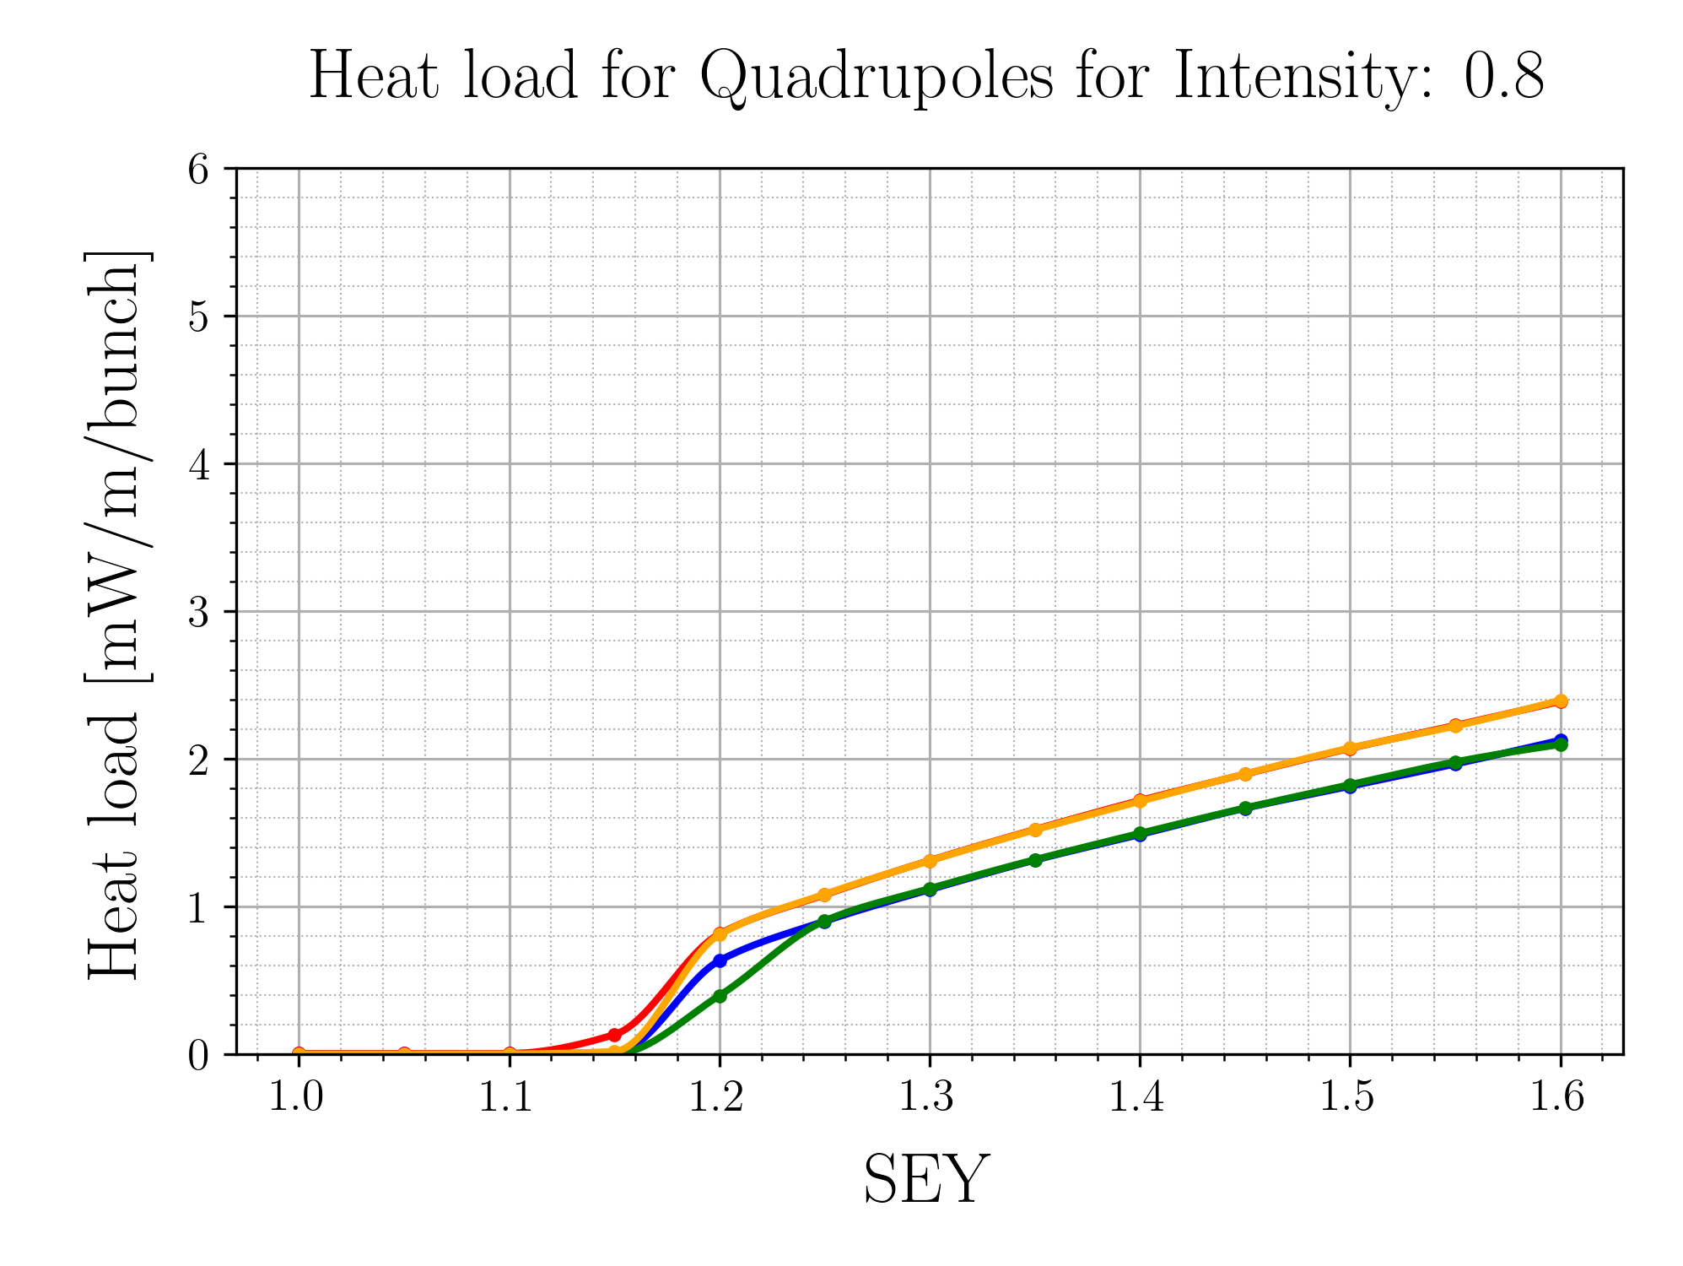
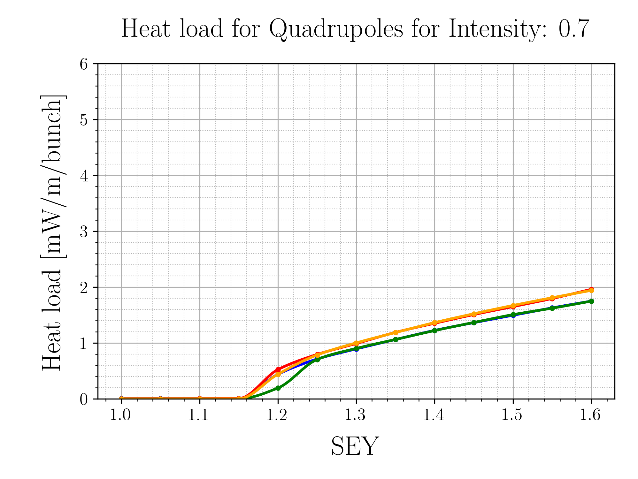
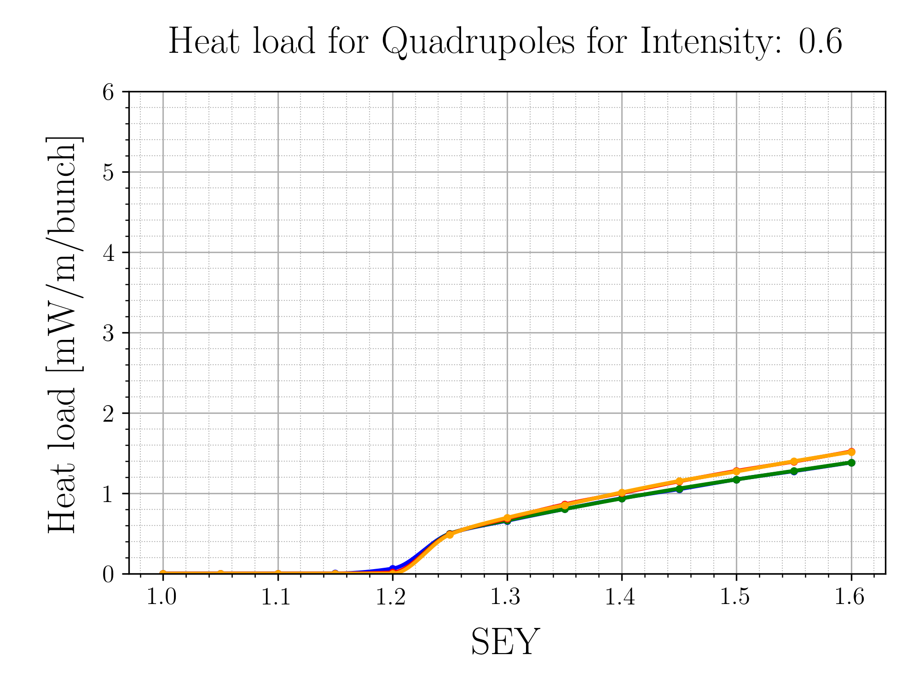
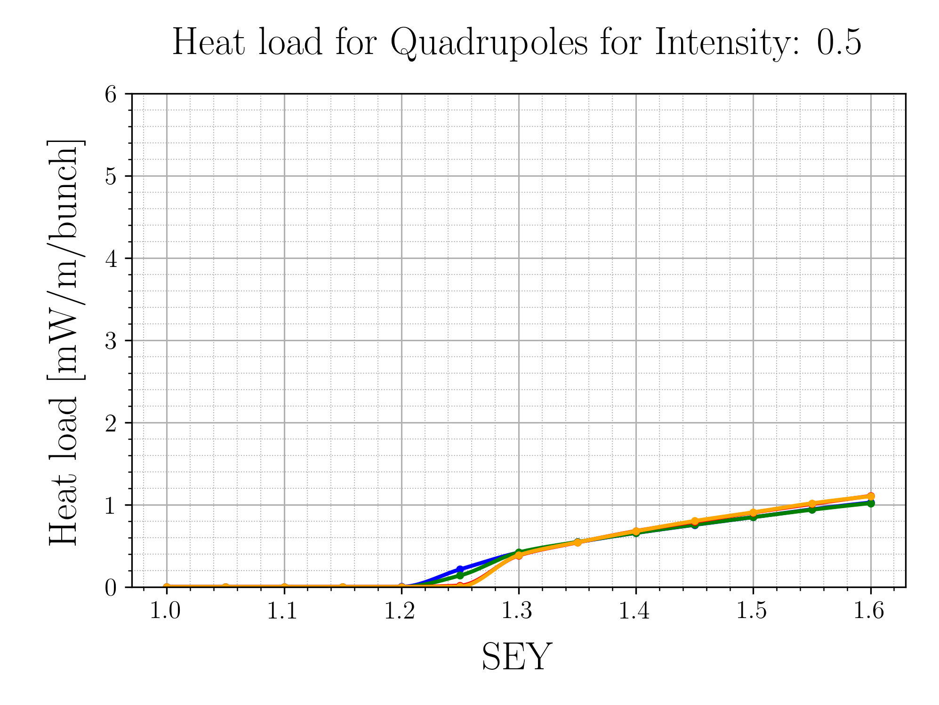
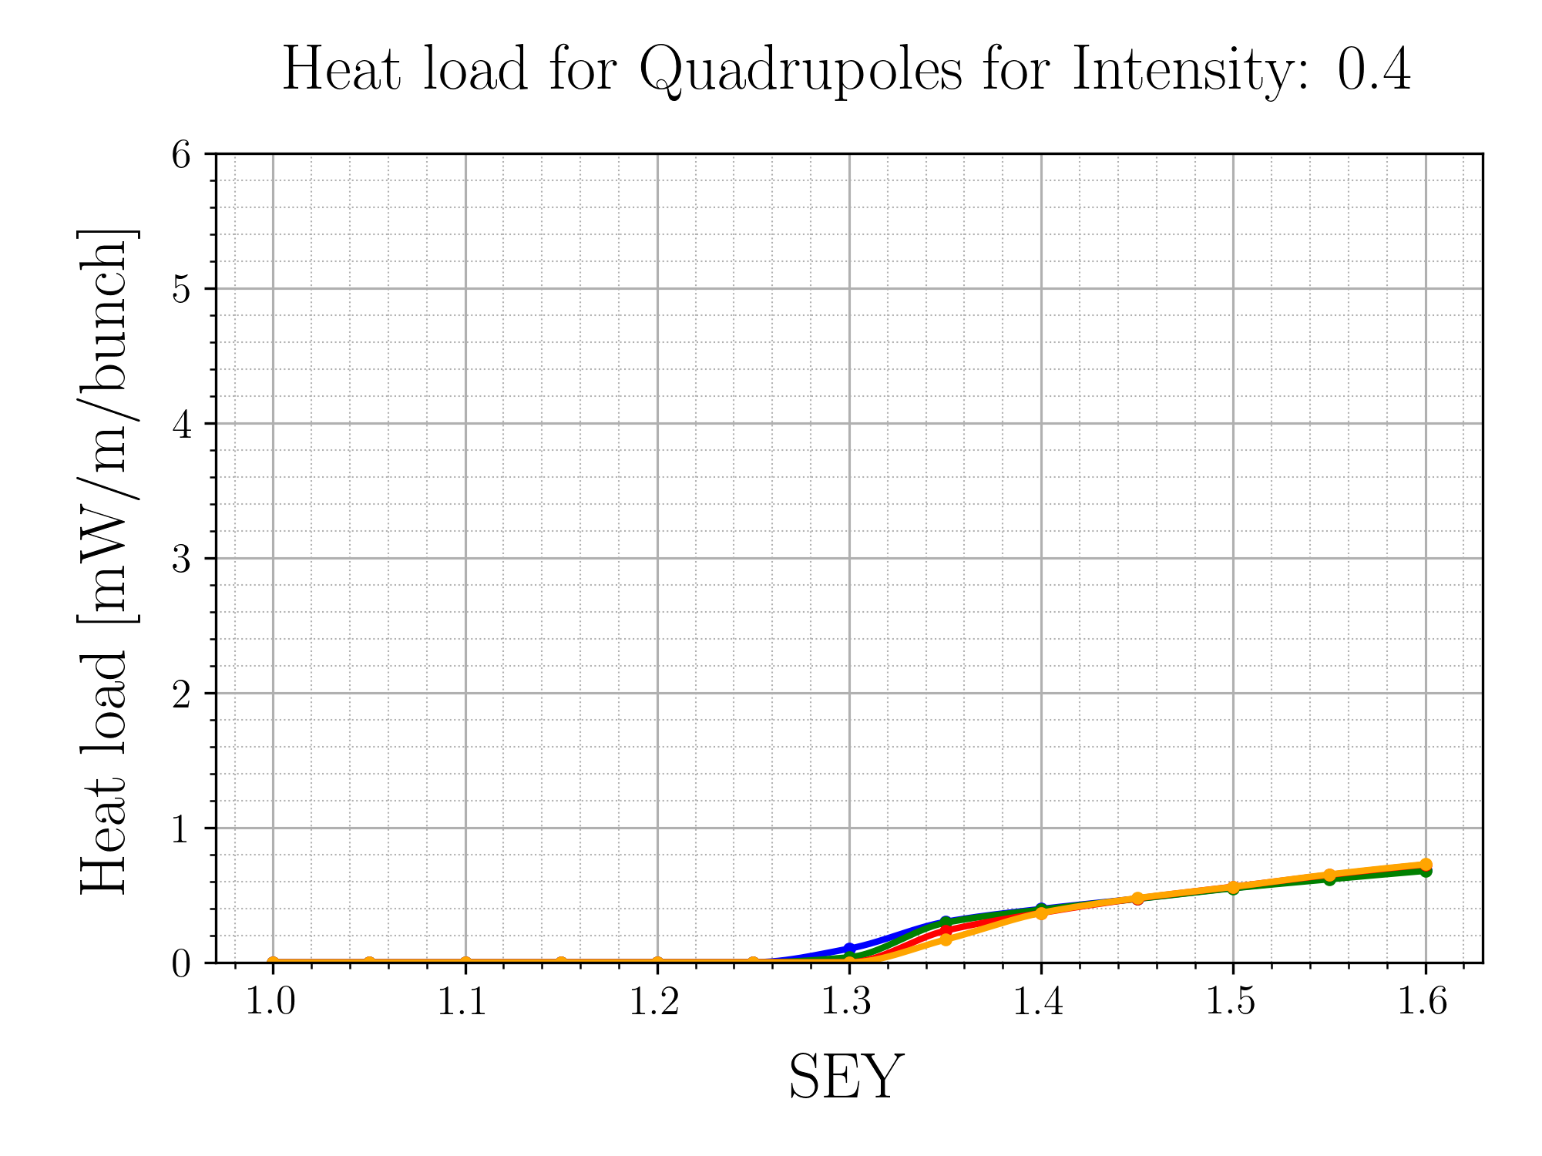
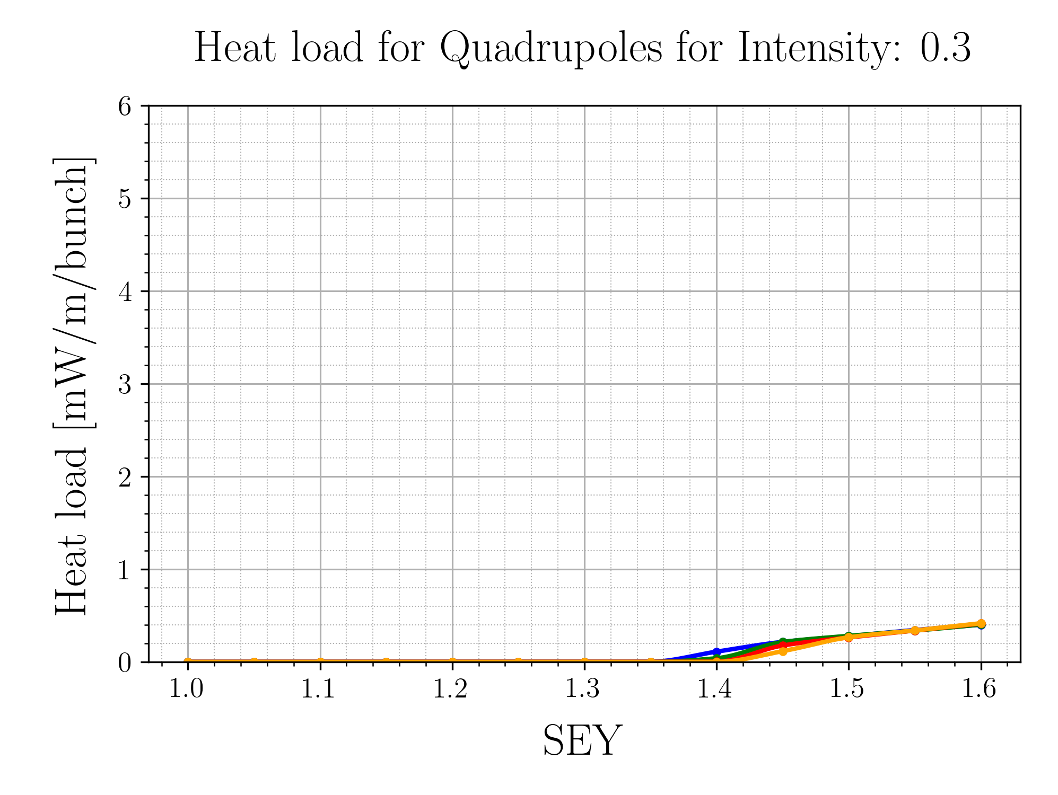
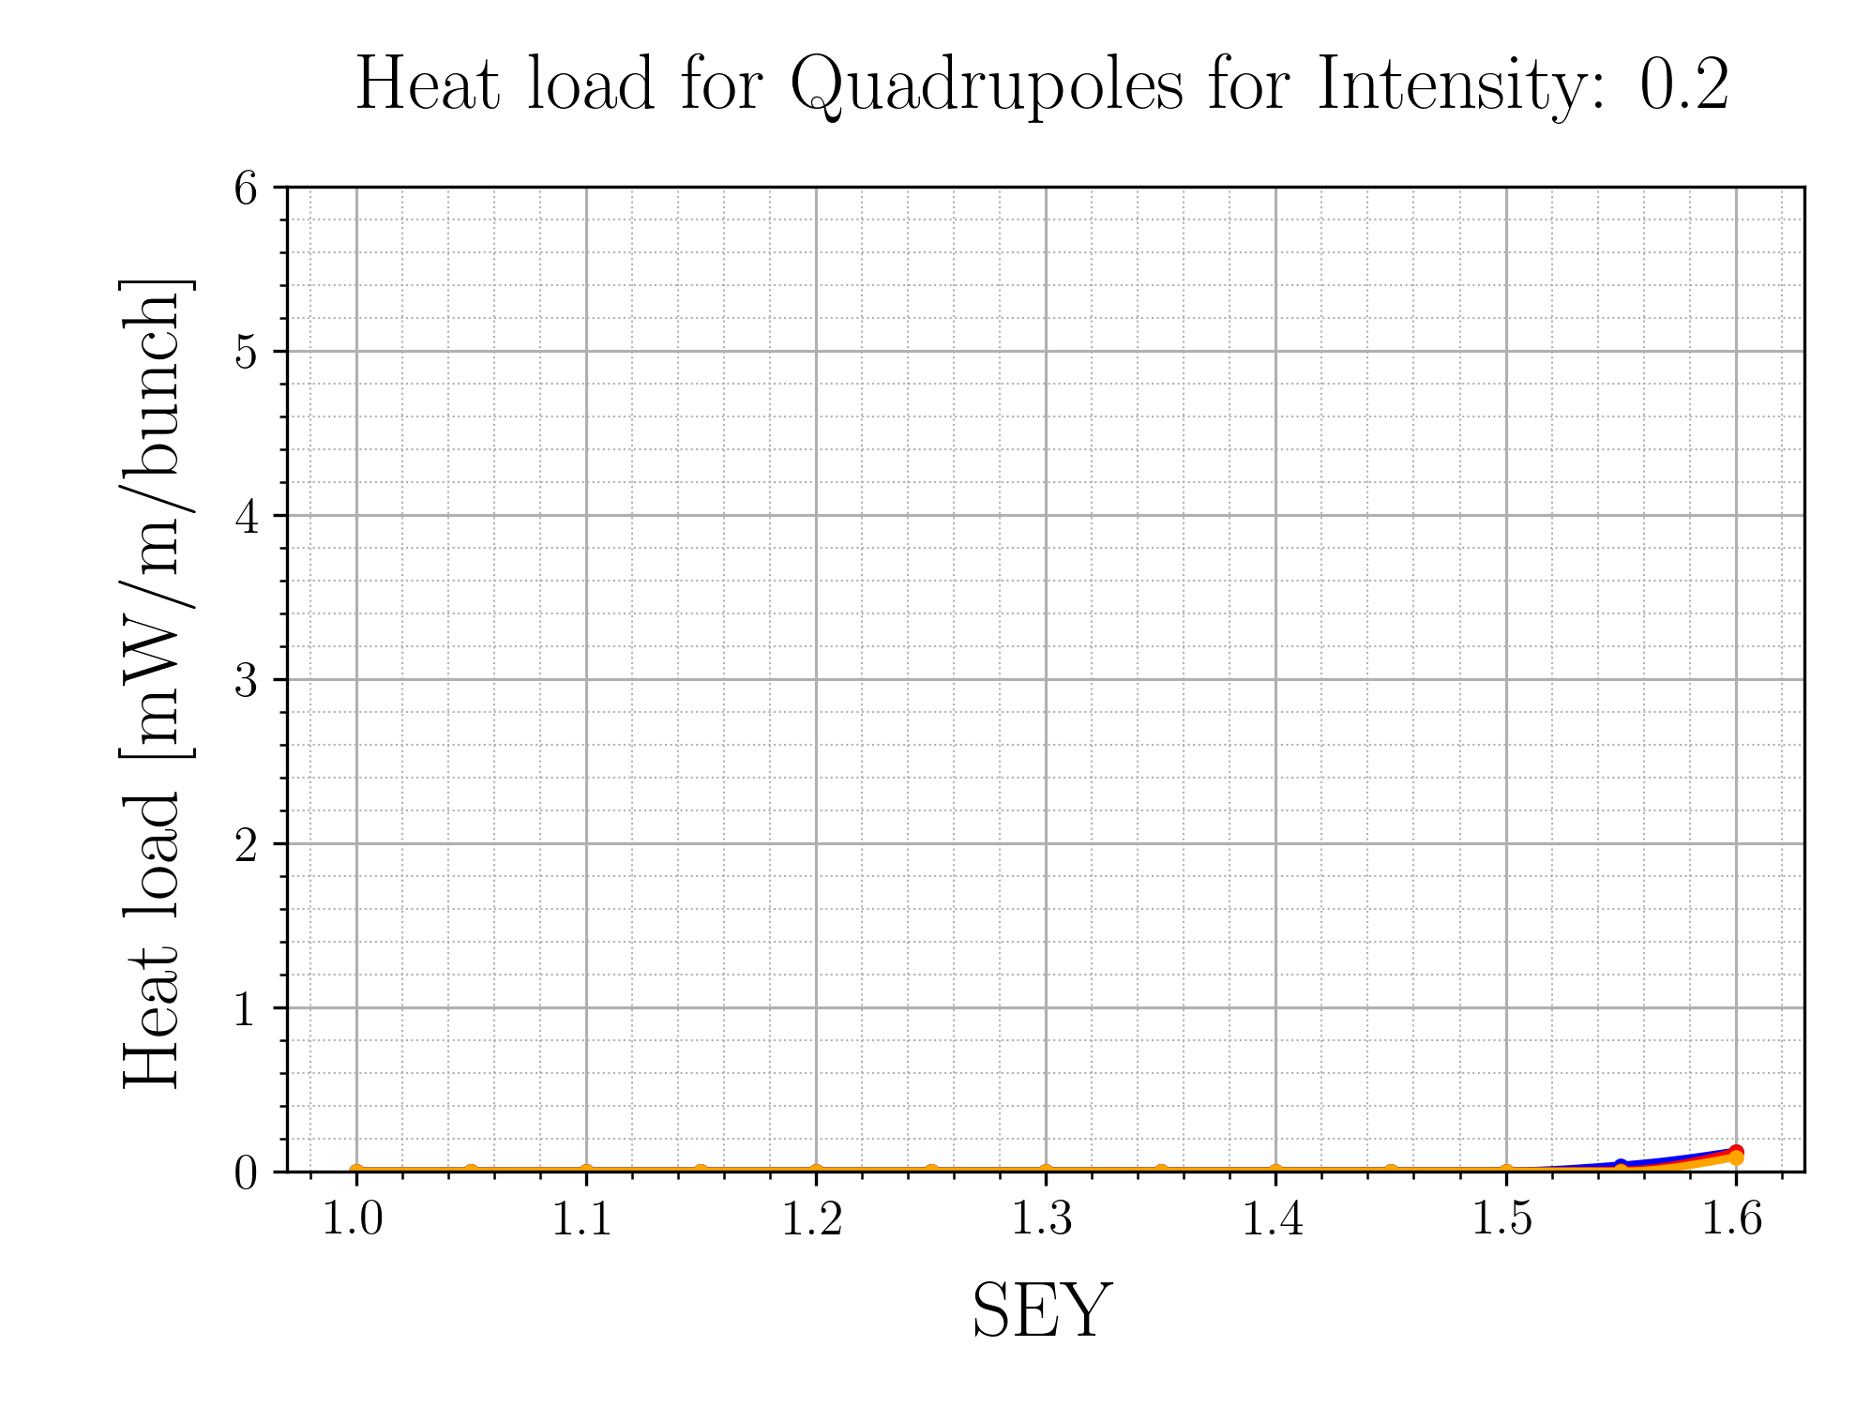
Quadrupole Heat Load
For higher intensities, the surface SEY curve defines the heat load
Photoemission parameters make little to no difference in Quadrupoles

Slide 9
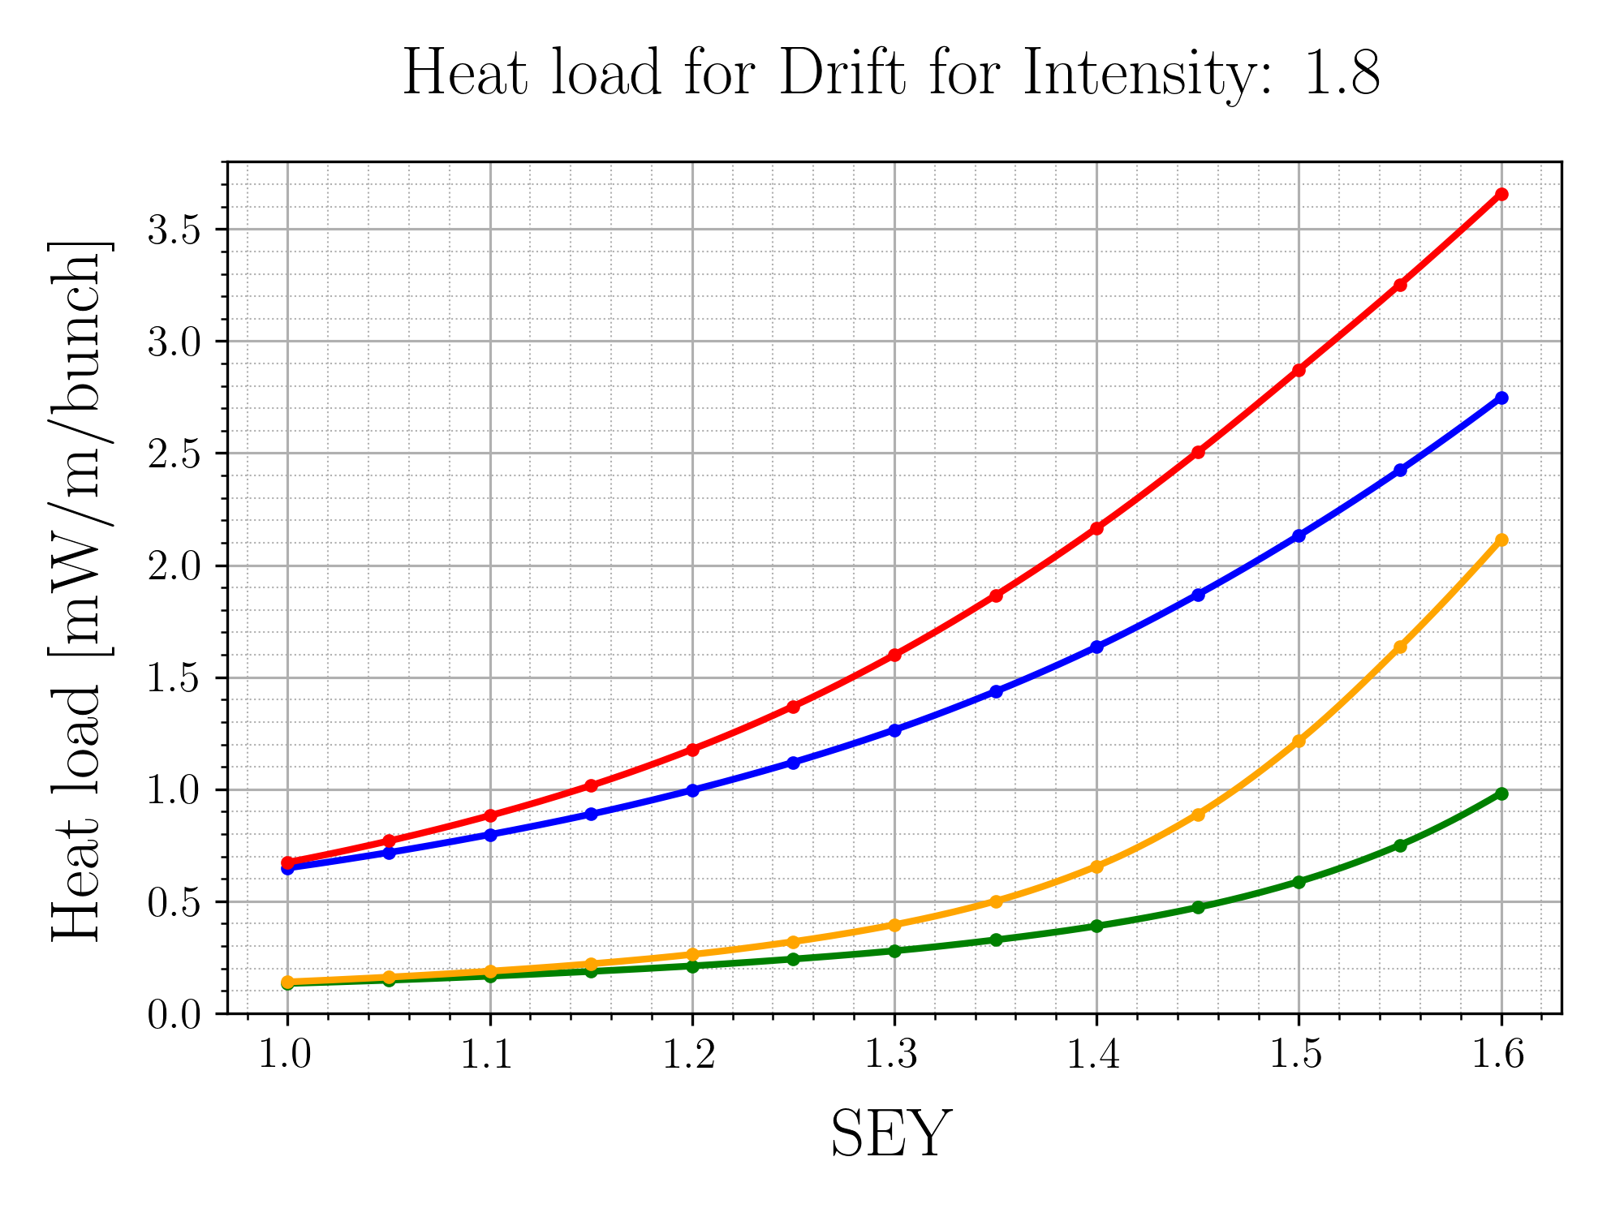
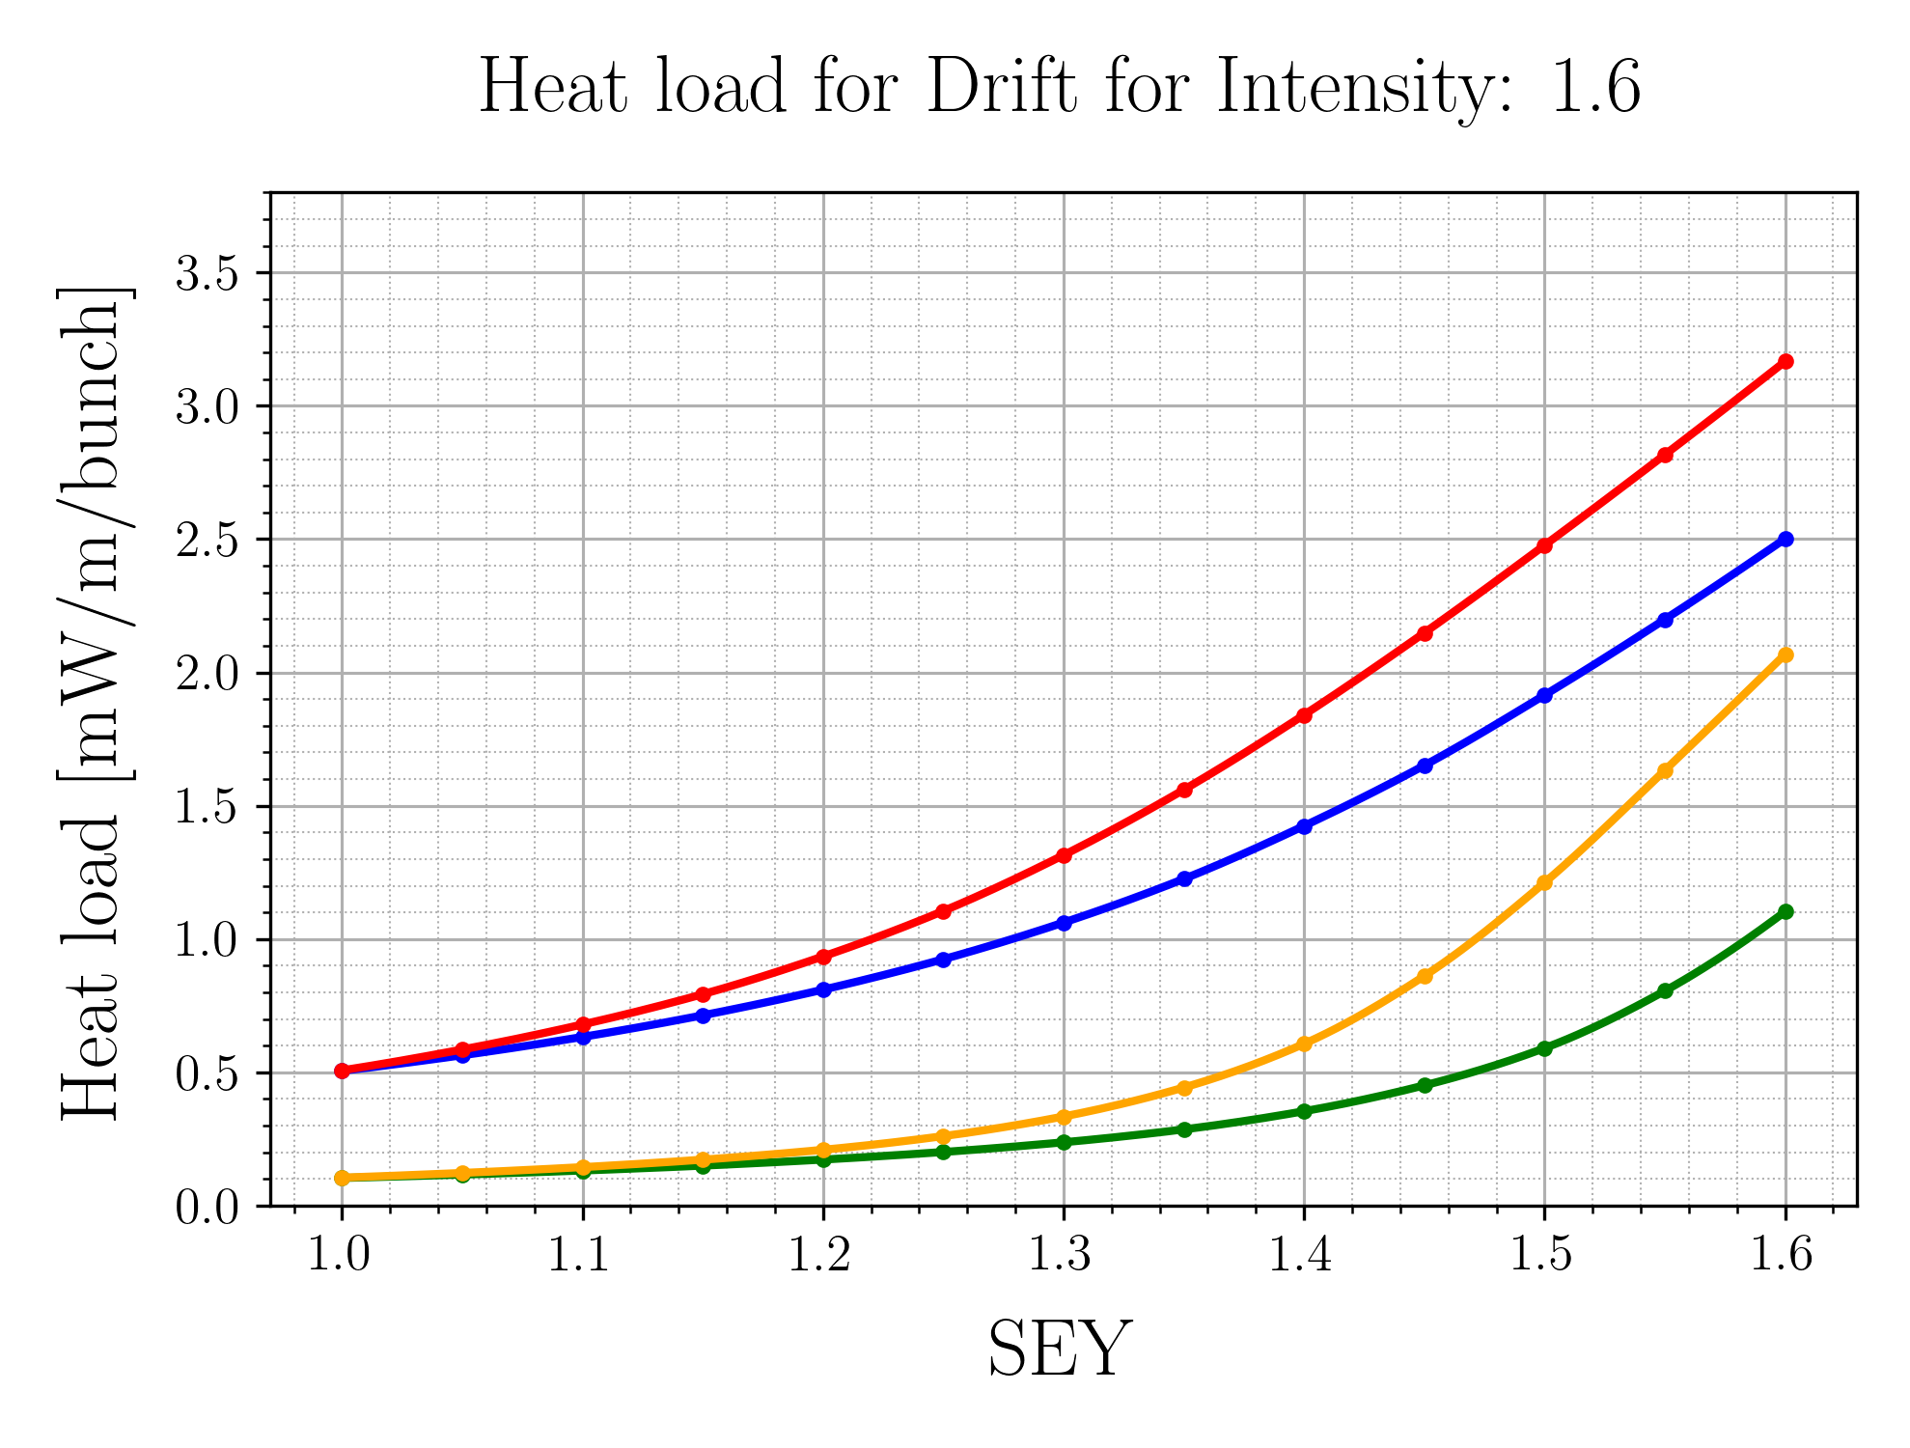
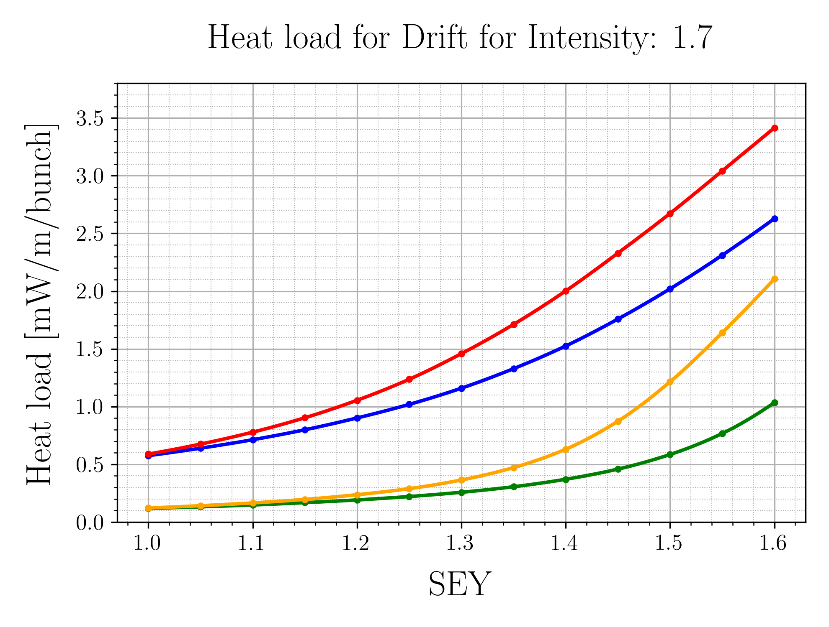
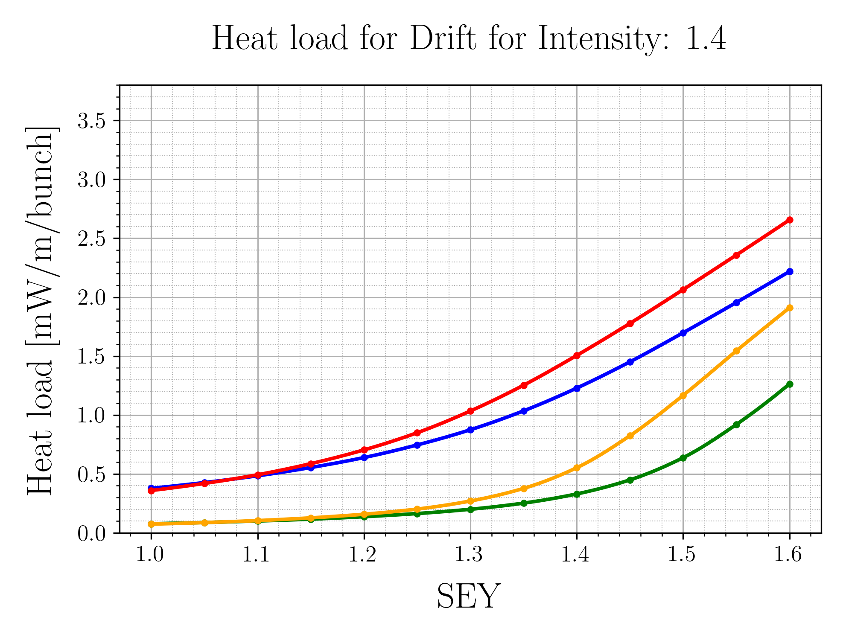
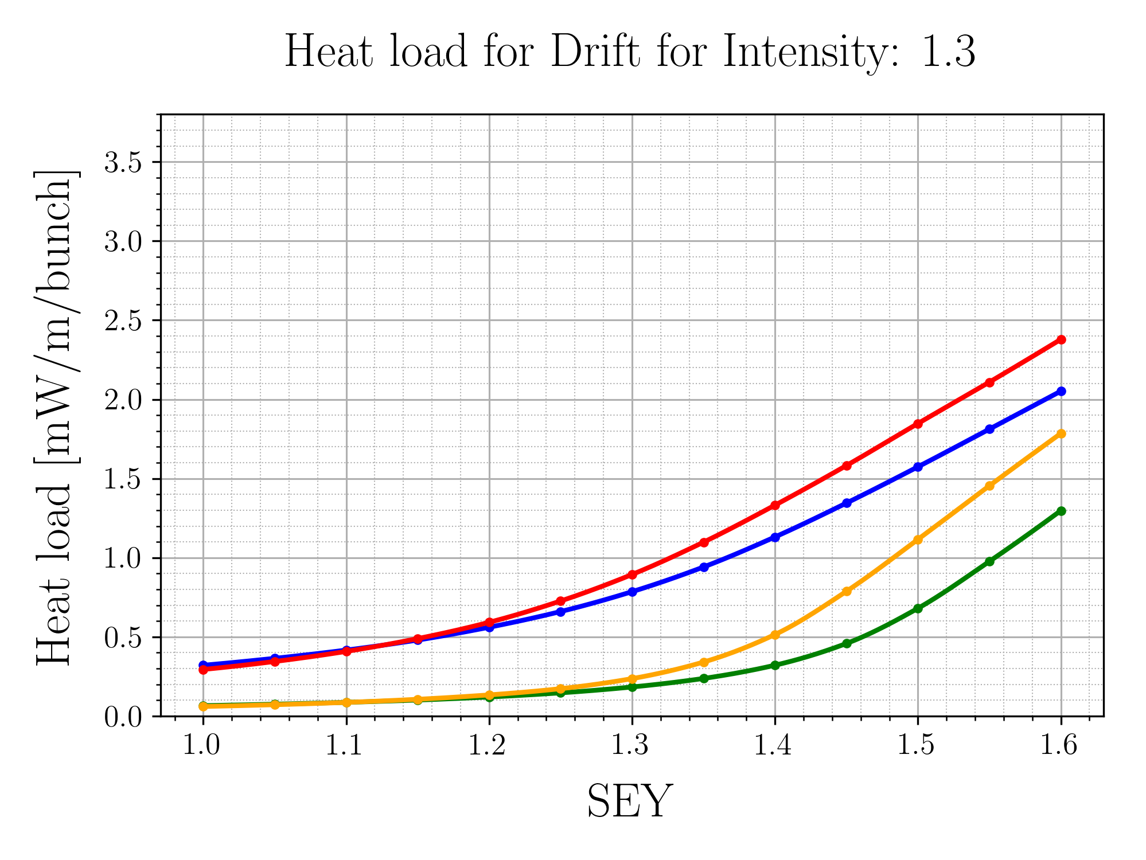
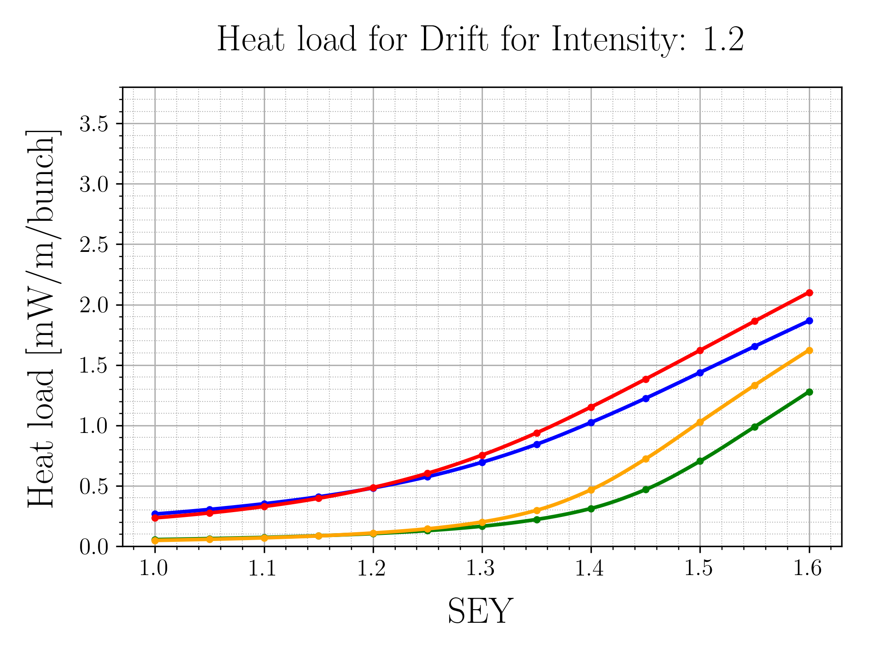
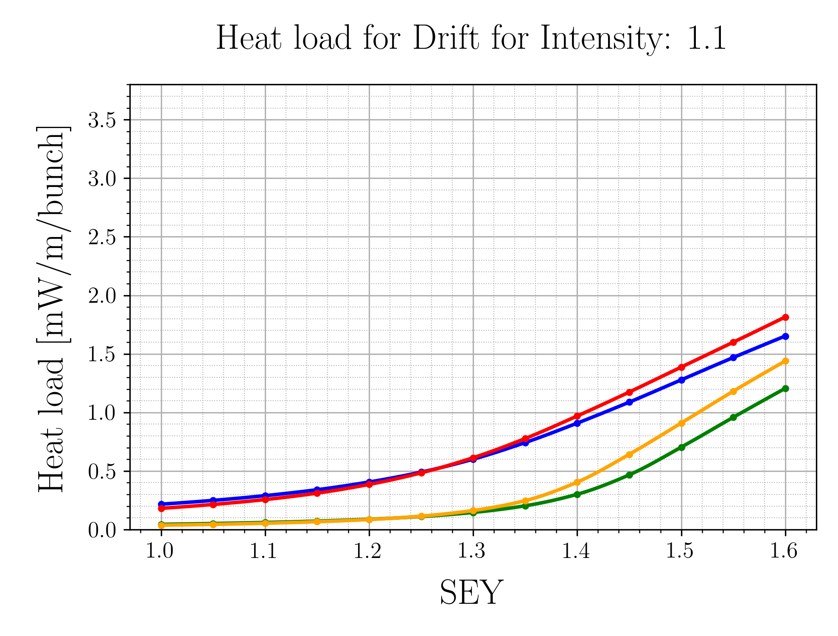
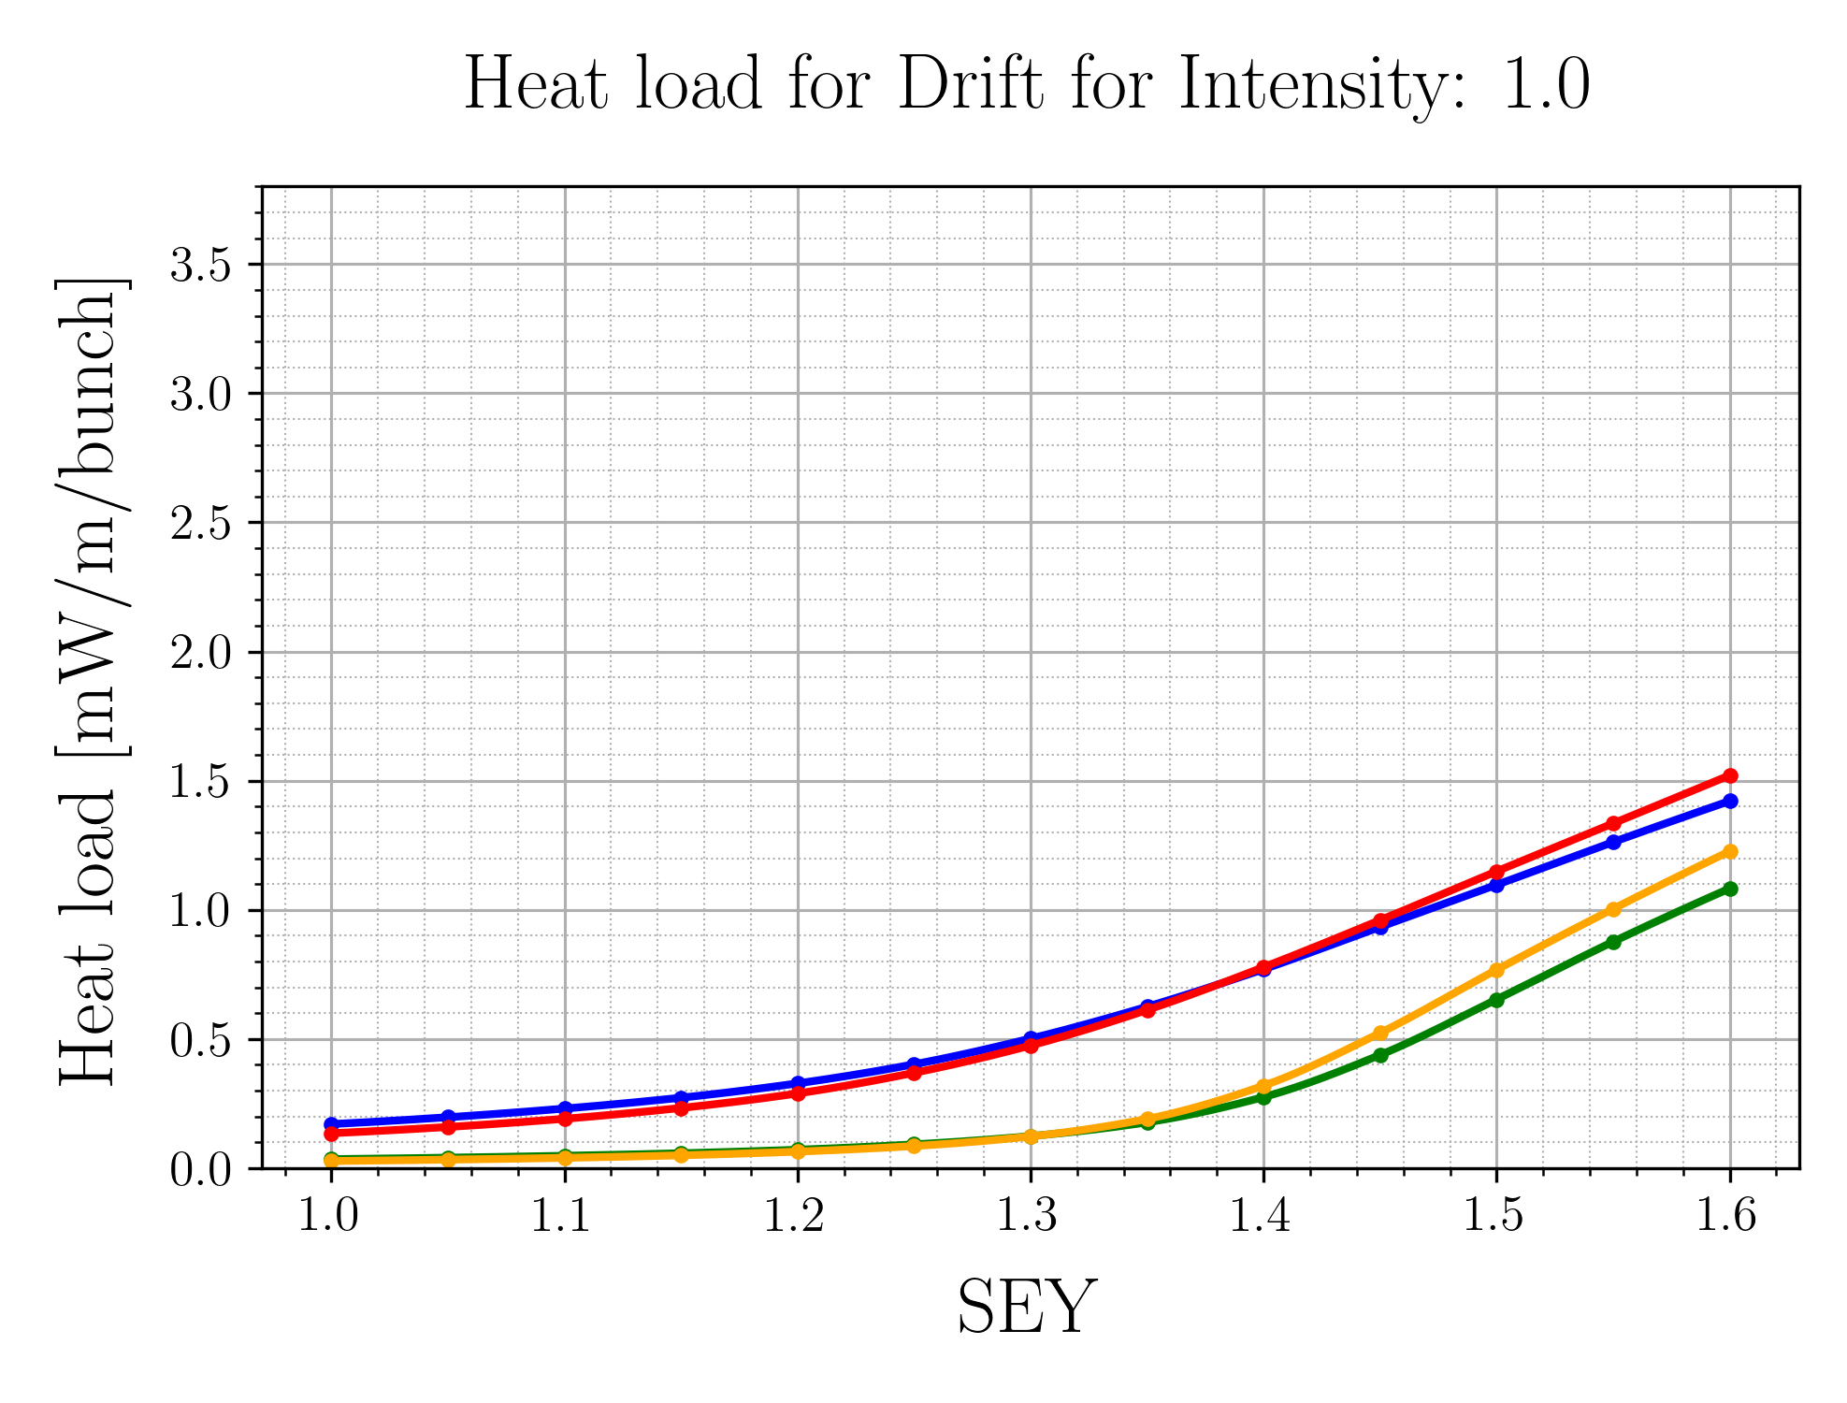
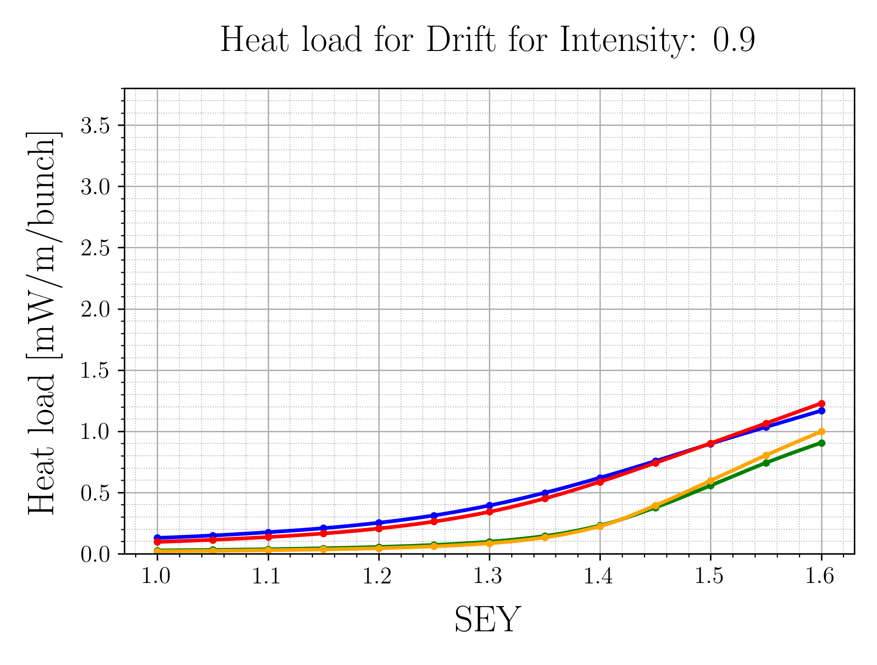
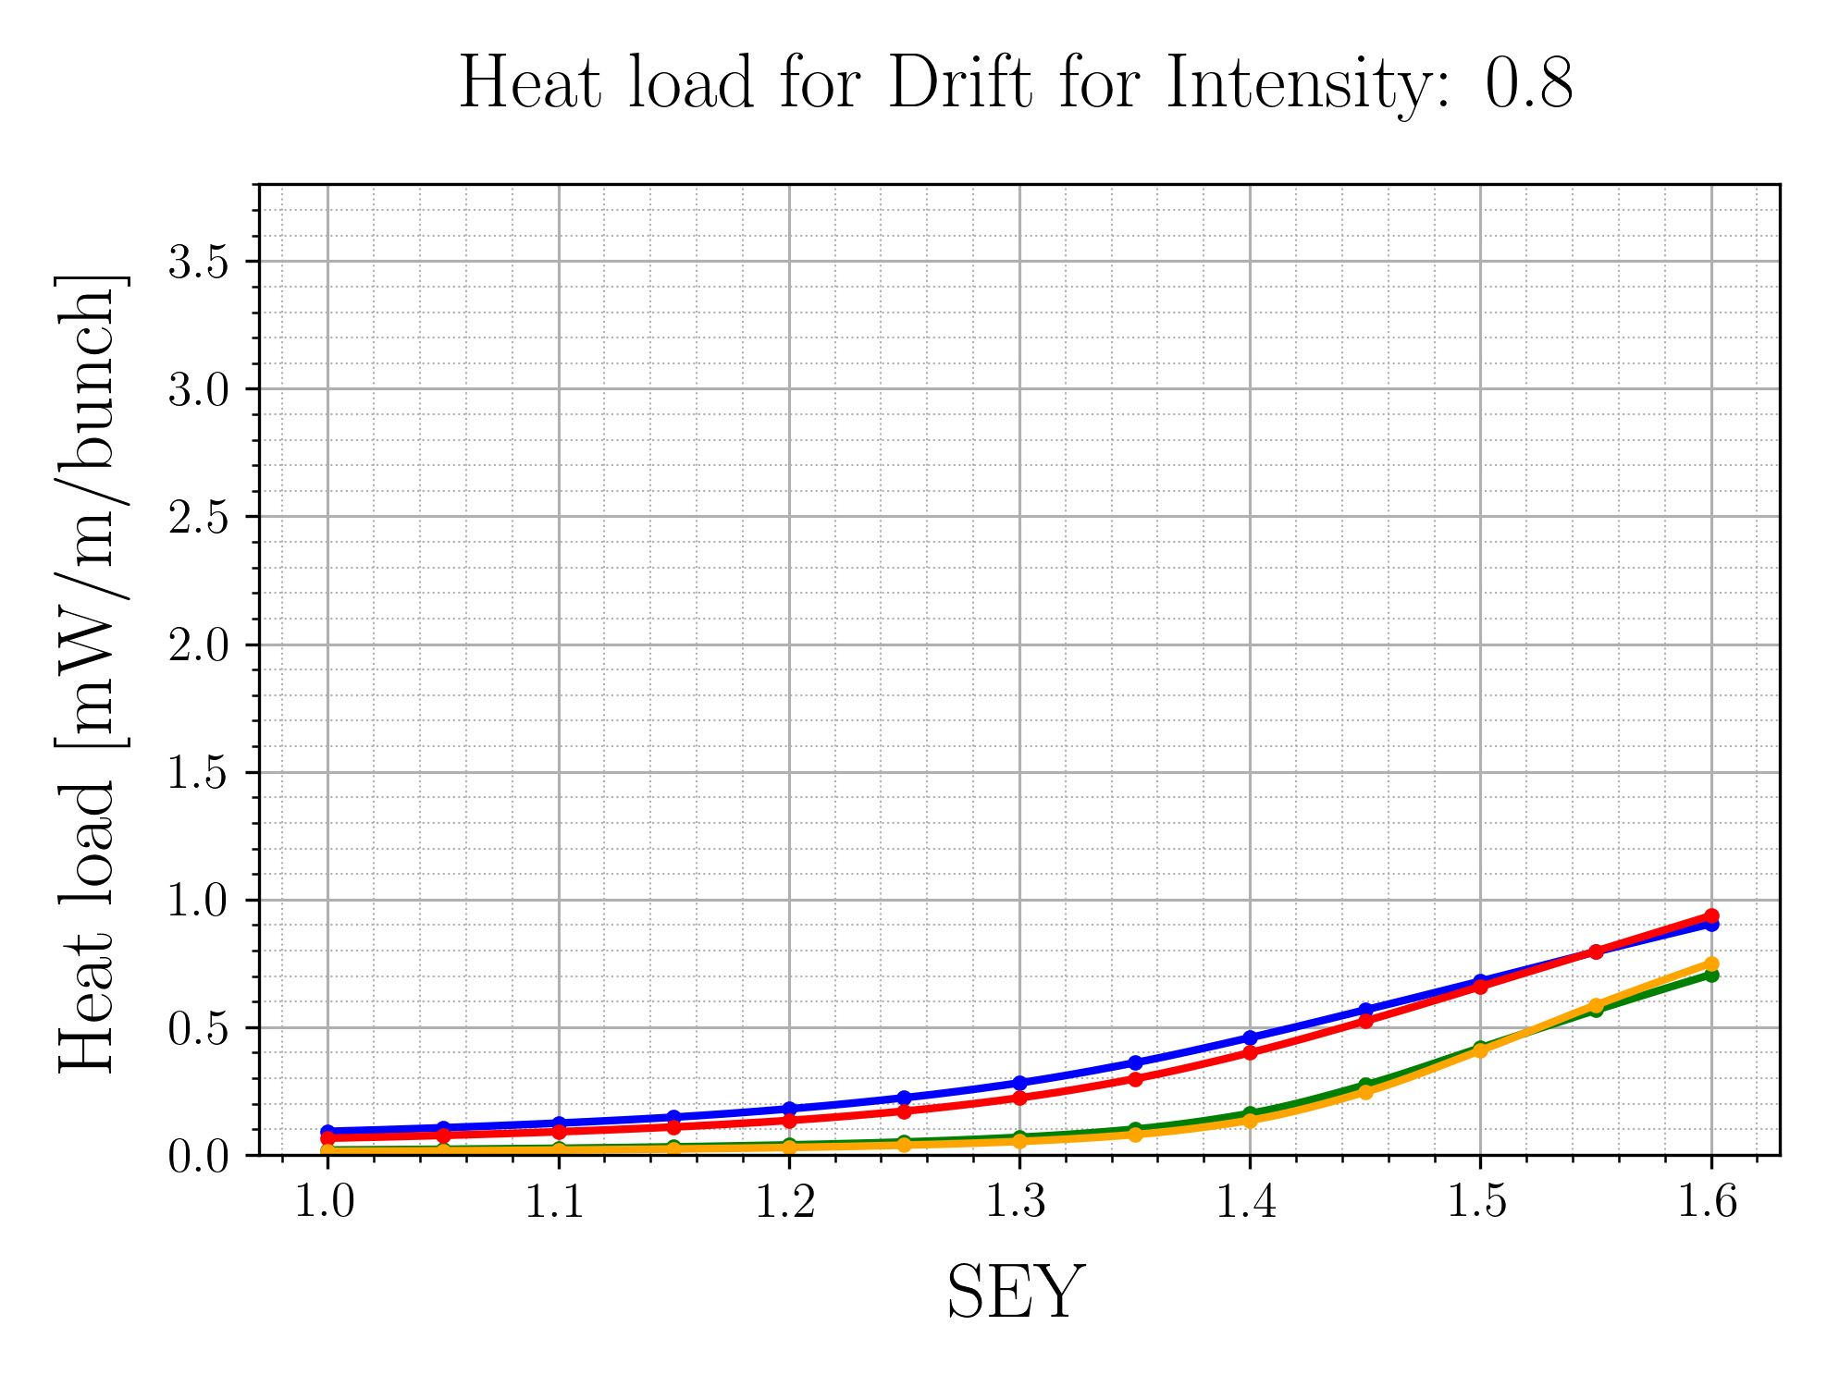
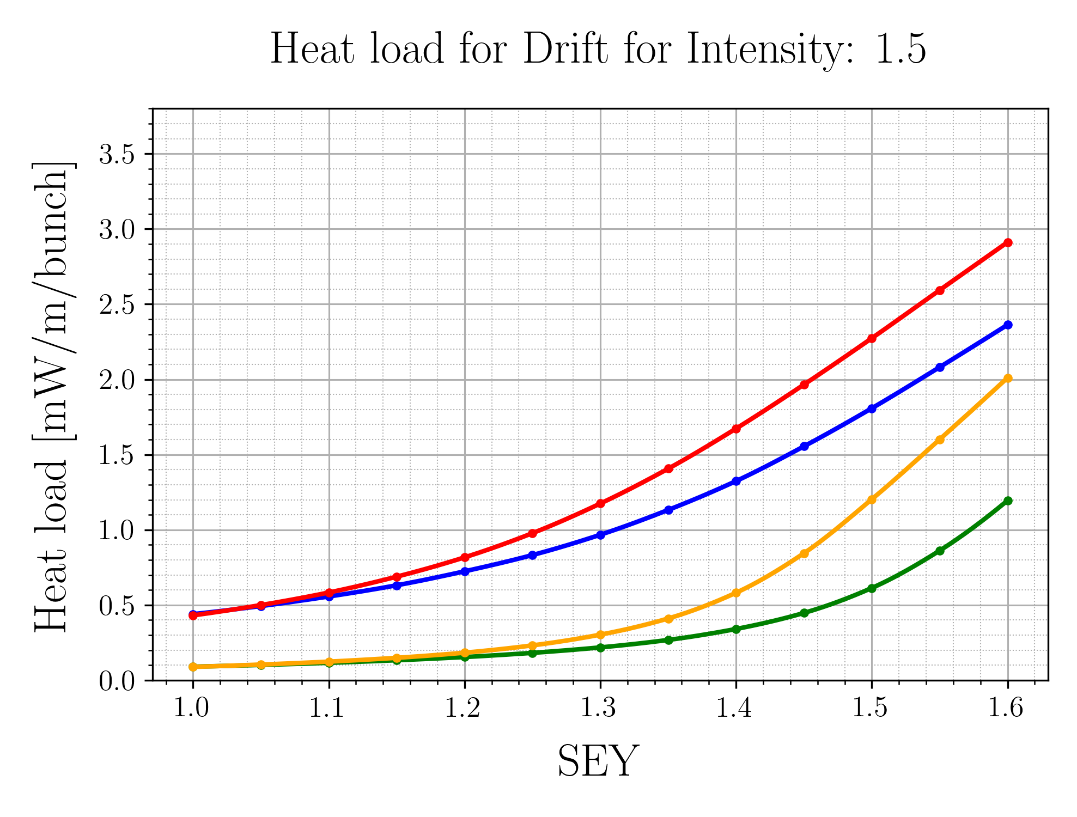






Drift Heat Load
For low intensities, the heat load is mainly defined by the photoemission
As intensity grows, the difference between the surface SEY curve becomes more evident
At all intensities, heat load is strongly dependent on the photoemission

Slide 10


Total Half Cell Heat Load
Heat load for Operational Configuration
  2460 bunches
  2 beams
  1.6x10¹¹ ppb
Red shaded area is above the cooling capacity of the cryo system in Sector 78 (~170W)
For expected SEY values for degraded surfaces (1.3-1.35) we are within the cooling capacity
  Except for high photoemission with CuO

Slide 11
Dipole single bunch instability
Investigate impact of surface parameters on beam stability
Methodology: Perform stability simulations for the dipoles:
Single bunch simulations
Initialize uniform electron density before bunch passage
Scan initial electron density parameter
Establish instability threshold
Match instability threshold with central density data from buildup simulations
Configuration:
Simulate 10k turns
Repeat for 3 intensity values: 0.8, 1.2, 1.6 (x10¹¹ ppb)
Instability simulations were performed at wrong energy → Waiting on results ☹

Slide 12
Software Development
PyECLOUD, GPUs and Xsuite

Slide 13
Introduction
PyECLOUD:
GPUs:
  2D Macroparticle code for simulating electron cloud buildup in chamber
  Can be added as a beam element in PyHEADTAIL for instability simulations
  Code was originally developed by Gianni in 2013 in Python 2
    Lots of room for improvement and modernization
  Increasing usage in recent years in physics applications
  Under the right circumstances, they provide massive speedups
Is it possible to leverage GPU tech in the context of electron cloud simulations?

Slide 14
Code profiling
Where do the bottlenecks lie in my code?
  Code profiling answers that question
Different types of profilers exist:
  Time each function call in the call stack
  Time each line of code inside a function
  Count memory allocations/transfers
Each type can provide useful insight into different types of bottlenecks that can exist

Slide 15
Profiling a buildup simulation
Profiling a buildup simulation showed the following:
  Most of the computation time is spent inside two functions:
    The particle pusher
    The function that checks the position of the particles with respect to the chamber
  Found some inefficiencies in these functions
    Fixed: Sped up buildup by ~30% ☺
Buildup is plenty fast and efficient for current use (parameter scans)
  GPU acceleration is not strictly necessary
Stability simulations are currently the slowest and least efficient to perform
  Different parameters → Different bottlenecks
We must profile a stability simulation and assess

Slide 16
Profiling stability simulations
GOAL:
  Identify bottlenecks in instability simulations and assess whether these are GPU friendly
SETUP:
  Use a realistic simulation: LHC stability simulation for dipoles
  Run simulation in single threaded mode
    Multithreaded mode can lead to issues
  System used:
    14c (10p+4e) M4 Pro
    24GB RAM

Slide 17


Profiling stability simulations: Results
PyECLOUD MP handling: ~20%
Boris pusher:
~10%
is_outside: ~10%
Scatter: 13.83%
Gather: 43.53%
MultiGrid (PyPIC) : ~60%
These 4 functions can account for ~80% of the computation time when performing a stability simulation!

Slide 18
GPU Feasibility
Is GPU acceleration possible for a stability simulation with electron clouds?
or (equivalently)
Can we parallelize these 4 functions?
The answer:
Yes!
(at least in theory)
Quick look at the code suggests that:
Gather and scatter perform grid-particle interactions in a way that is parallelizable (per particle operations)
  There will be some branching, but should be OK for some initial tests
The Boris Particle Pusher is easily parallelizable:
  Simple loop over particles and update coordinates
The is_outside function is also parallelizable:
  Evidenced by comments in the cython code
GPUs are at least worth a shot!

Slide 19
PyECLOUD on GPU
Target GPU platform: Nvidia. Why?
  Development is more simplified via CUDA and integration with python is very easy via CuPy
  PyECLOUD already heavily uses numpy and scipy functions, which often have drop-in CuPy equivalents
Back-and-forth data transfer between CPU and GPU is costly
  Often costly enough to outweight the speedup offered by running on the GPU (as will be shown later)
  Goal → Keep all the data on the GPU and only transfer when absolutely necessary
Strategy
Start small: Get a buildup simulation to run on the GPU

Slide 20

Initial attempt
Swap out NumPy for CuPy for rapid prototyping
  Should be simple, right?
CuPy is usually a drop-in replacement for NumPy, but not always
  Some functions that exist in NumPy/SciPy don’t exist in CuPy or they don’t behave identically
    Such functions are used in PyECLOUD/PyPIC
PyECLOUD and PyPIC often use custom functions implemented in C/Cython/Fortran, which will have to be rewritten and can often not be implemented using ready-made CuPy functions
Outlook
Getting a full buildup simulation running on the GPU requires more development time. We can change our approach for a simple proof of concept

Slide 21
Attempt #2: Proof of Concept
Start by porting only the most computationally heavy functions on the GPU
Run GPU functions alongside the CPU functions over the course of a simulation
Focus on only one part of the code at a time → Less Errors
Time GPU functions alongside CPU functions using line_profiler
Verify functions using realistic data generated during a simulation
Estimate cost of the data transfers required

Slide 22
Current development/testing platform
Test setup (old gaming laptop):
  Intel Core i5-8300H
  8GB RAM
  Nvidia GeForce GTX1060 3GB
Hardware is admittedly sub-optimal, but should give us an indication of the expected speed-up
  Single-threaded CPU performance should be on par (or even better) than the low-clock Xeon/EPYC CPUs used in many clusters where simulations are currently being deployed
More on that later

Slide 23

Translating from CPU to GPU
First attempt: boris_c_function
  Performs per particle operations to update position and momentum of all macroparticles in ecloud simulation
    Very easy to parallelize!
Initial attempt: Vectorize the function and use ready-made CuPy functions
  Result: Not good, very slow (over 3x slower than running on CPU) ☹
What went wrong?
  Using ready made CuPy functions means that we have many intermediate kernel launches for each operation we perform
  This approach also requires many intermediate array allocations in global memory → SLOW
Solution?
  Write a custom CUDA function and interface with CuPy via RawModule and RawKernel

Slide 24
Custom Boris Tracker CUDA Kernel
Expectation: This approach should yield the expected performance benefits. Why?
  We can optimize further: Launch one kernel per MP and perform the operations we need
  Keep relevant data in registers and only access global memory when absolutely necessary
Reality: It works! ☺
  Wrote a custom kernel and built a python wrapper around it
  The result was an over 40x speedup compared to the CPU version
Bonus:
  This gave us an idea of the data transfer cost between the CPU and GPU
    The CPU function takes ~2000 seconds
    The GPU function takes ~40 seconds
    Transfers take ~400 in each direction (~800 total)
Numbers based on a buildup simulation and represent total amount of computation time
This confirms that the gain in speed is offset by the cost of the data transfers

Slide 25
More Custom Kernels
Motivated by the success of the initial test, I looked into porting more computationally heavy or frequently used functions to custom GPU Kernels:
  int_field_for function in PyPIC-Gather:
    Interpolates the field at MP-locations. Simple for loop with some branching
  compute_rho function in PyPIC-Scatter:
    Scatters MPs onto the grid by distributing their charge
  compute_hist function:
    Distributes different MP properties in different bins of a histogram
  is_outside function in PyECLOUD:
    Calclulates whether each macroparticle is inside or outside the chamber
Originally Fortran77
Originally Cython

Slide 26
Custom Kernel results
Benchmarked CUDA implementations using LHC Ecloud stability simulation for 10 turns
boris_c_function: 93x speedup
int_field_for: 17x speedup
is_outside: 70x speedup (needs debugging though)
compute_rho: 108x speedup
compute_hist: 5x slowdown in stability simulation ☹ (albeit 2x speedup in buildup)
  Admittedly naïve implementation
    Simply use atomic operations to add values to histogram → Can be sped up with faster algorithms
  Consideration: This function is often used for output data that needs to be saved.
    We can reconsider whether that data is needed or not
    We can experiment with concurrent streams or offloading such tasks to a thread on CPU.

Slide 27
Outlook
All the key functions that make up ~80% of the computation time were sped up significantly by porting to GPU
  Room for further optimization
Proof of concept accomplished ☺

Slide 28
Areas that need more attention
Speedups are currently bottlenecked by CPU performance/data transfers
  Repeated tests on better PC (24c Threadripper/Titan V) → No further speedup
    GPUs under-utilized (<20% usage)
  Full speedups can only be realized through a more complete GPU pipeline
PIC solver requires more research to be ported to GPU
Important to ensure cross-platform compatibility
  We must not create a separate version of PyECLOUD that only runs on GPU
    Nightmare for long-term maintenance

Slide 29
Oh and one more thing…

Slide 30

Xsuite-PyECLOUD interface
Current status: Implemented and Functional
  Coordinates/particle attributes have been updated to work with Xsuite conventions
  Simple test case: Identical bunch is passed 10 times through a 10m long electron cloud (high electron density)
    Compared kicks in $x’$ and $y’$ after each passage using both the PyHT and Xsuite interface
    Less than 0.3% difference between the two interfaces → Interface looks to be working ☺
| | | | |
Xsuite bunch
PyECLOUD
Xsuite bunch
Xfields Slicer
Update MP coordinates
Sliced bunch
Pass through Ecloud Head → Tail

Slide 31
Next steps (Software & Physics)
GPU port and optimization:
Start re-factoring PyECLOUD inside the Xsuite framework
  Allows re-use of code that has already been developed and optimized
  Xobjects provides a natural way to ensure cross-platform support
  Starting point will be deprecating PyPIC in favor of xfields
Xsuite interface:
Add proper compatibility with multibunch beams
Port over other functionality currently present in the PyHT interface
Develop parallelization layer for Xsuite interface
  Repeat simulations performed with PyHT to ensure consistency in results
  Perform complex simulations which are currently not possible with PyHT
Simulation Studies:
Wait for and analyze results for the correct energy
Scan chromaticity

Slide 32
Thank you for your attention

Slide 33








CPU Performance Comparison (PassMark)

Slide 34

Xsuite-PyHT interface comparisons

Slide 35

Xsuite vs PyECLOUD interface: Electron + Beam Potential

