Slide 1
Coherent Effects and Impedances section (CEI) – general information
BE-ABP-CEI
Coherent Effects and Impedance
Giovanni RUMOLO
David AMORIM
Chiara ANTUONO
Miltiadis BOZATZIS
Xavier BUFFAT
Elena DE LA FUENTE GARCIA
Adam FURMAN
Dora GIBELLIERI
Fredrik GRØNVOLD
Antonia HUBER
Evangelos KATRALIS
Erik KVIKNE
Elena MACCHIA
Lotta METHER
Elias MÉTRAL
Nicolas MOUNET
Luca SABATO
Daniel SCHULTE
Leonardo SITO
Julian SONPAR
Roxana SOÓS
R TAYLOR
Carlo ZANNINI
Giovanni Rumolo
CEI Section Meeting, 09/10/2025
Scientific secretary: Chiara Antuono
https://indico.cern.ch/event/1569603/

Slide 2
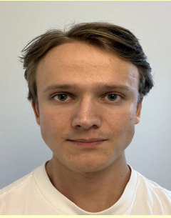
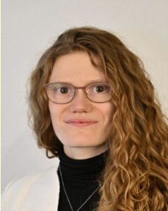
New arrivals
Erik Kvikne (not so new … ☺ )
  Former Technical Student and now back as PhD student under Elias’
  supervision, affiliated to University of Oslo
  Will work on collective effects during the ionisation cooling for muon
  colliders.
Antonia Huber
  Technical student under Elena’s and Carlo’s supervision, affiliated with
  Frankfurt university
  Will work on the model validation of the transverse SPS impedance using
  in-house electromagnetic solver Wakis

Slide 3
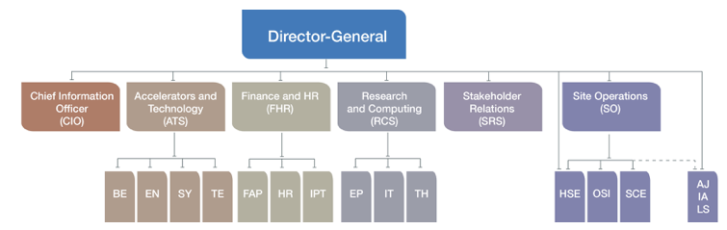
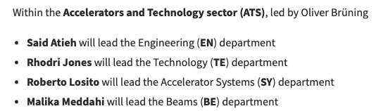
Arising matters
New department heads announced here
Enrica Porcari
Oliver Brüning
Jan-Paul Brouwer
Gautier Hamel de Monchenault
Ursula Bassler
Mar Capeáns

Slide 4
Arising matters
New department heads announced here
The call for expressions of interest for group leadership took place between 29 September until 5 October
Enrica Porcari
Oliver Brüning
Jan-Paul Brouwer
Gautier Hamel de Monchenault
Ursula Bassler
Mar Capeáns

Slide 5
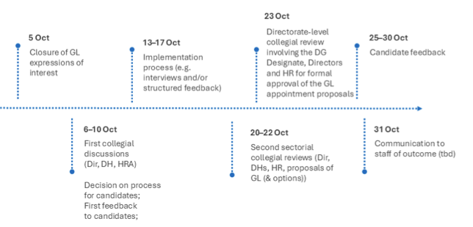
Arising matters
Timeline for appointment of the Group Leaders

Slide 6
Arising matters
MERIT 2025: Tool being updated to reflect changes in structure, please do not create your MERIT forms before the end of the year
CVI for 2025 has been calculated to be 1%, reflecting to 0.4% on salaries
BE training
  All training requests above 500 CHF require a small justification from the supervisor or GL inside the EDH request
  First language course of French is automatically validated, but for following language courses, need for professional purpose must be proven and a target level is mandatory in the request.
  For GRADs, the first French course is paid by HR under BC 10208.
  15% of classes are unattended without justification, group managements will receive the list to check with supervisors

Slide 7
Arising matters
Upcoming events, some dates to be marked in your agendas
  21/11/2025: BE seminar on metamaterials by Leonardo
  02/12/2025: BE end-of-year meeting
  04/12/2025: ABP Christmas party
  05/12/2025: BE seminar on WAKIS by Elena dlF (tbc)
  09-12/12/2025: MD days, CERN
  29-30/01/2026: ABP Chamonix 2026 dry-run
  02-05/02/2026: Chamonix Workshop 2026

Slide 8
LHC schedule
Efficient physics production since last CEI meeting
Currently at the end of MD3 block, with physics restarted as of tomorrow.

Slide 9
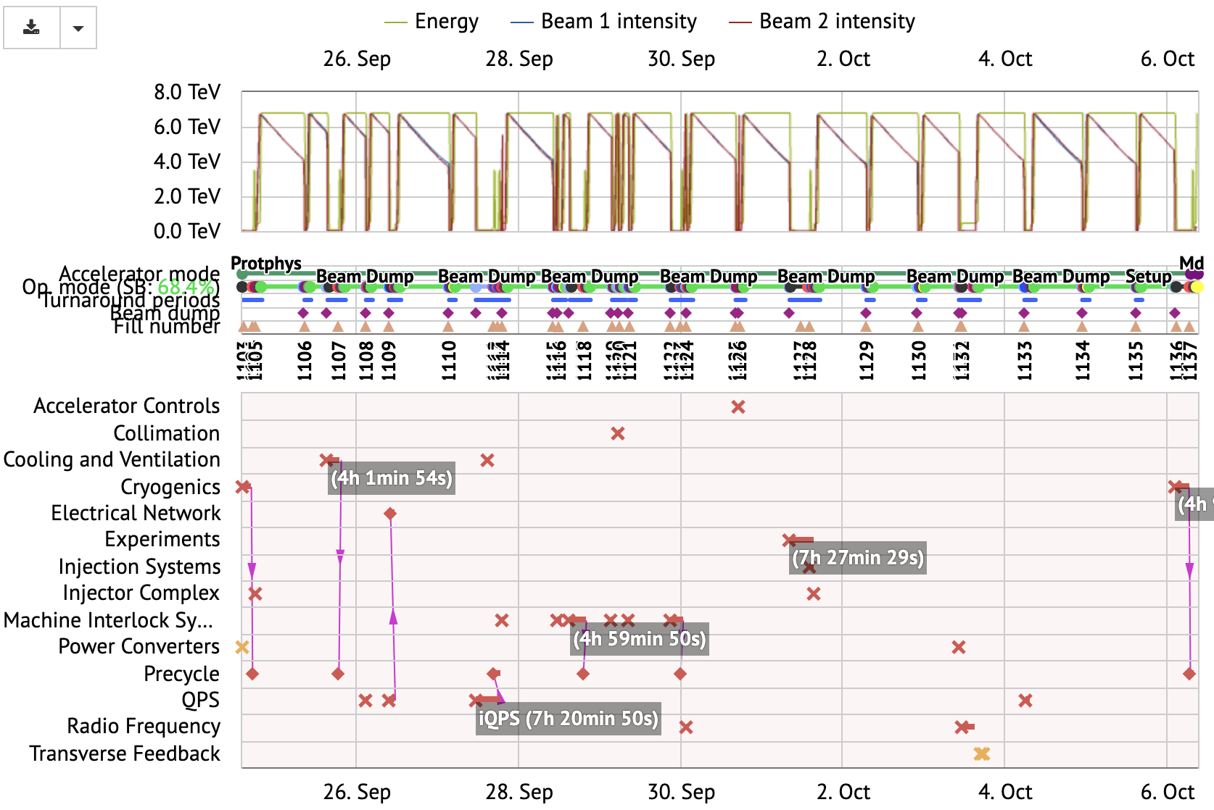
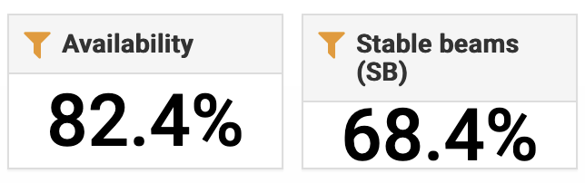
LHC luminosity production
Very efficient last week operation

Slide 10

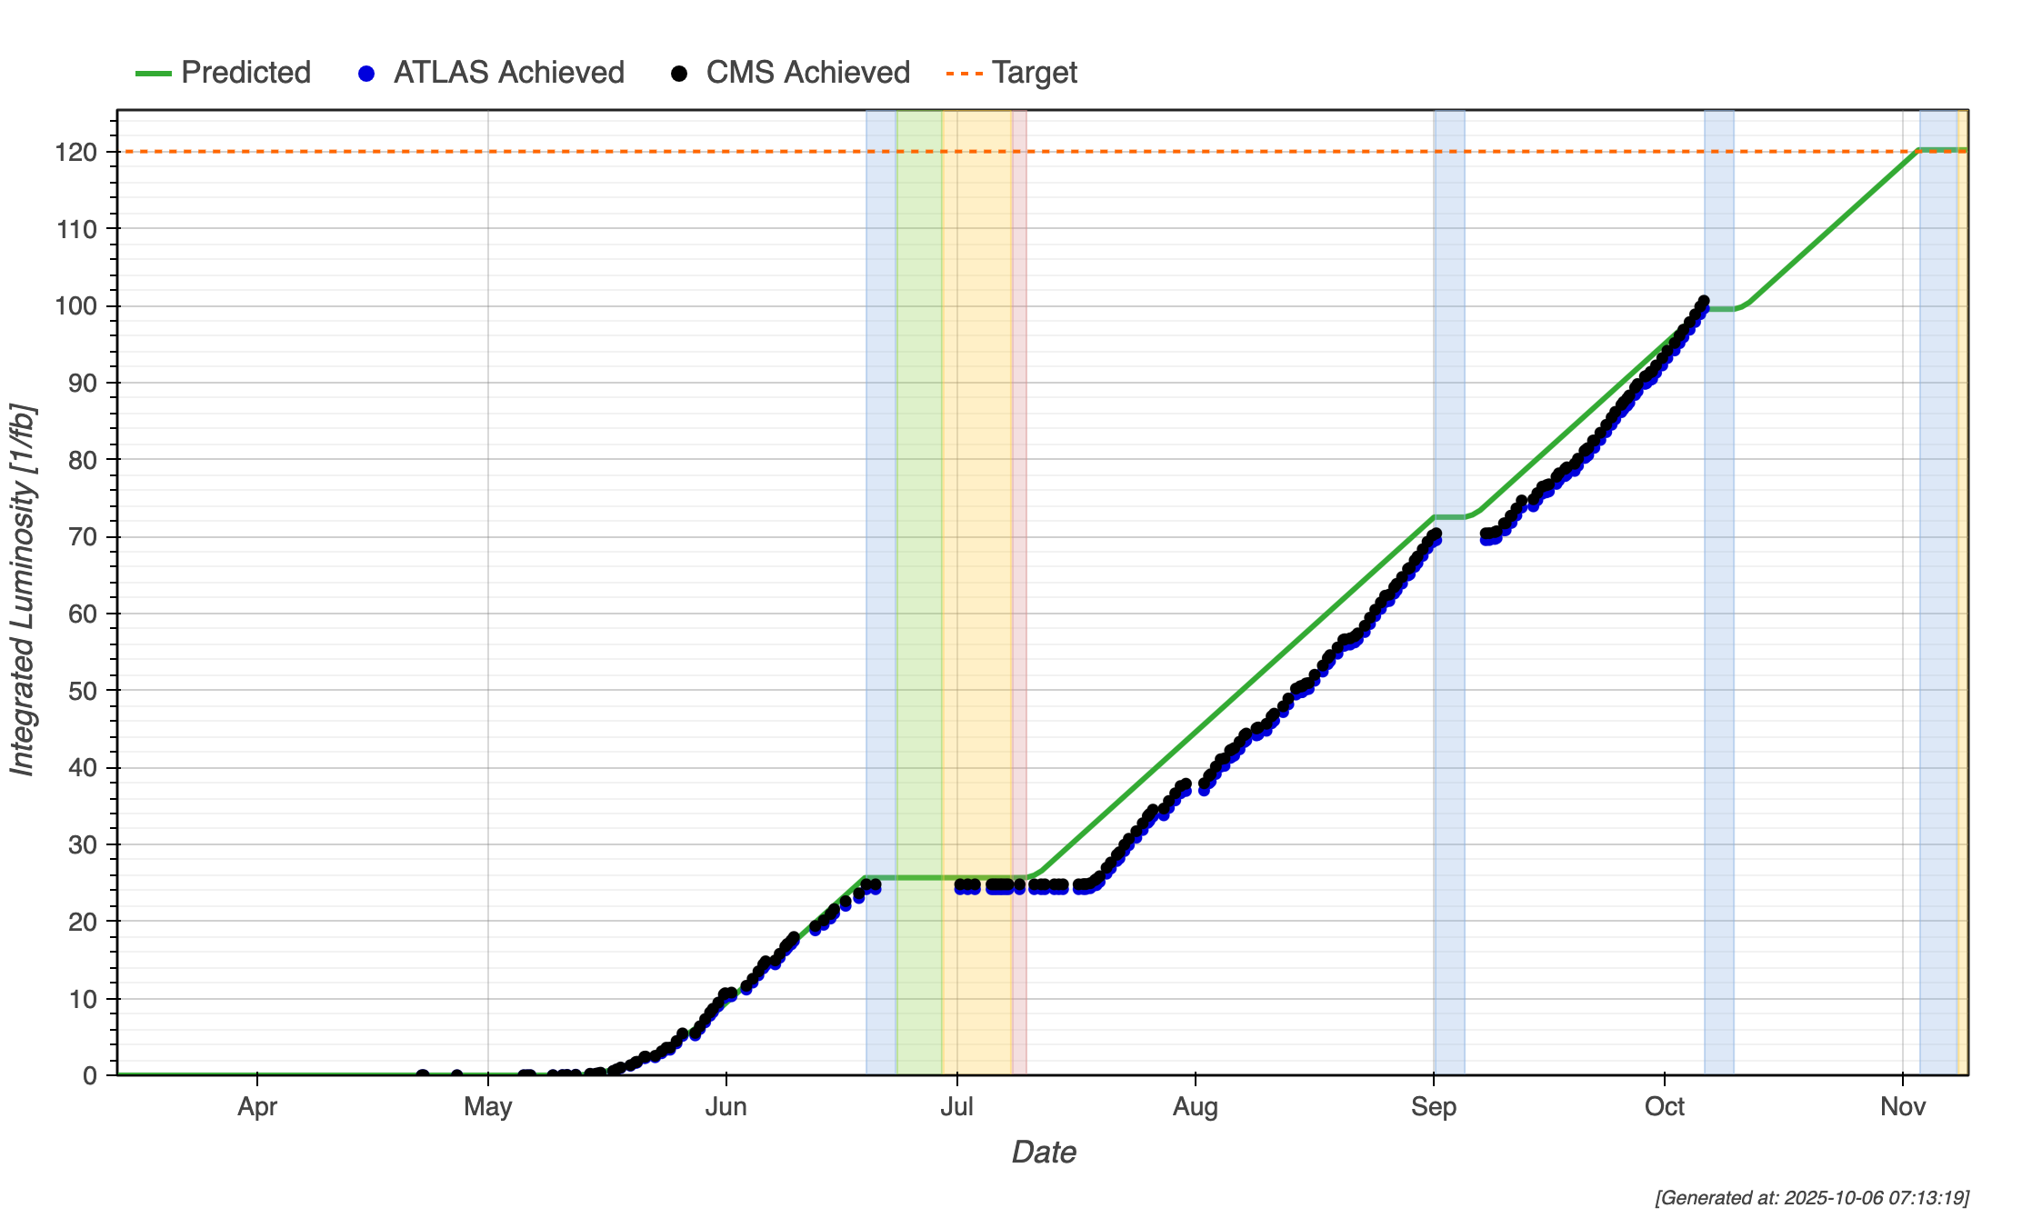
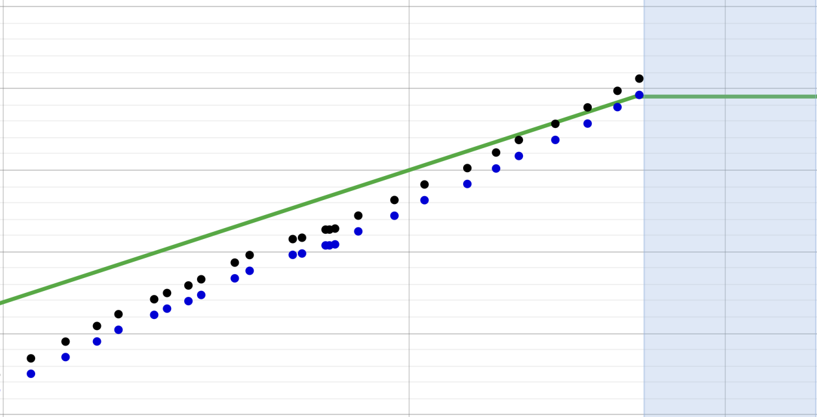
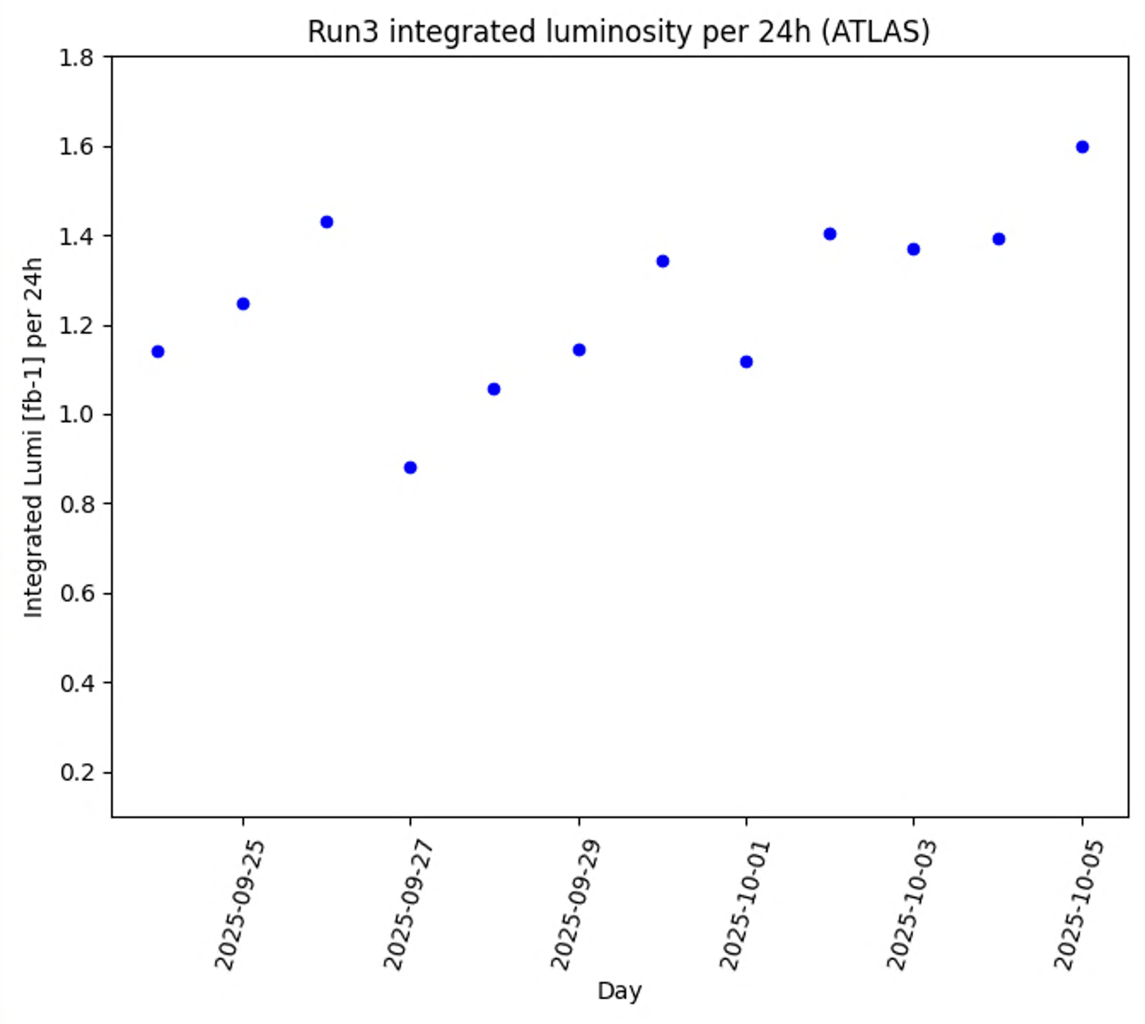
LHC luminosity production
Luminosity production has finally caught up on the original projection and ATLAS/CMS have marked the 100 fb-1
Average production
1.26 fb⁻¹ / 24 h
Original
Original

Slide 11
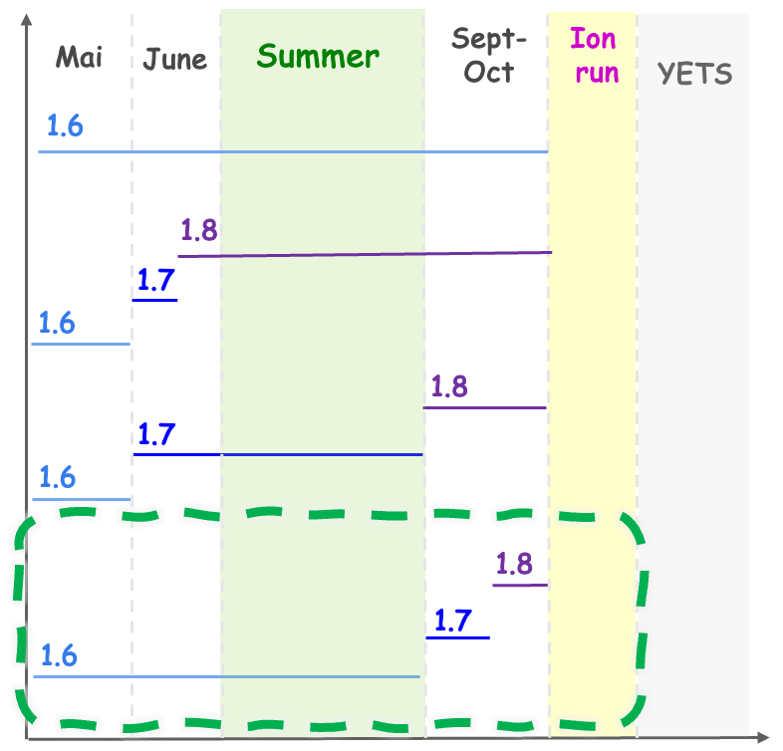
Proposal for operational intensity increase post-MD3
Plan for operational intensity increase to 1.8 ⋅ 10¹¹ p/b has been updated in the course of 2025
LMC#513
(10.09.2025)
“A compromise was suggested to balance the priorities of luminosity production and future preparation. The step to 1.7 × 10¹¹ ppb should take place after MD3, by which time integrated luminosity is expected to have reached about 100fb⁻¹ for ATLAS/CMS and 10fb⁻¹ for LHCb. This would leave approximately three and a half weeks for exploration at higher intensity.
….
A return to 1.6 × 10¹¹ ppb before MD4 could be envisaged as a safeguard.”
Chosen scenario at Chamonix 2025:
Stable run at 1.6x10¹¹ ppb until september
Increase bunch intensity to 1.8x10¹¹ ppb, before ION run

Slide 12
Proposal for operational intensity increase post-MD3
Currently running at ~1.63 ⋅ 10¹¹ p/b, go to 1.7 ⋅ 10¹¹ p/b after MD#3
  First fill this Friday at ~1.67/68 ⋅ 10¹¹ p/b
  As of second fill intensity ramped to 1.7 ⋅ 10¹¹ p/b
Operate at 1.7 ⋅ 10¹¹ p/b for about 10 days (i.e., until beginning of W43)
Adiabatically explore intensity towards 1.75 ⋅ 10¹¹ p/b, leaving operational margin to heat load, then operate at the reached level for ~10 days
  No change of filling scheme
  Limit with present filling scheme expected around 1.76 ⋅ 10¹¹ p/b (Lotta?)
No need to return to ~1.63 ⋅ 10¹¹ p/b?
Strategy endorsed, however possible review in case of poor availability!

Slide 13
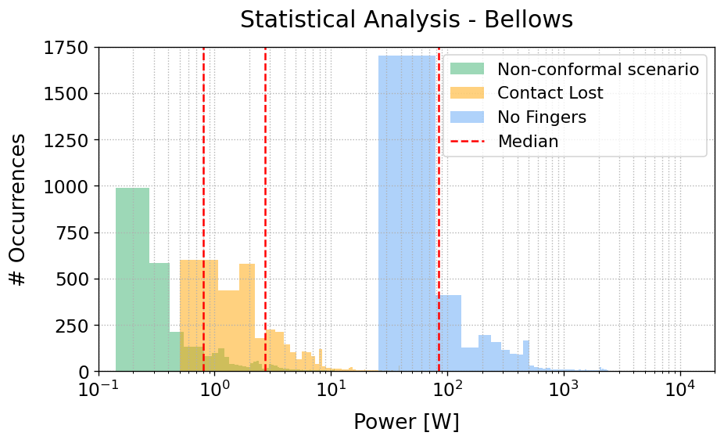
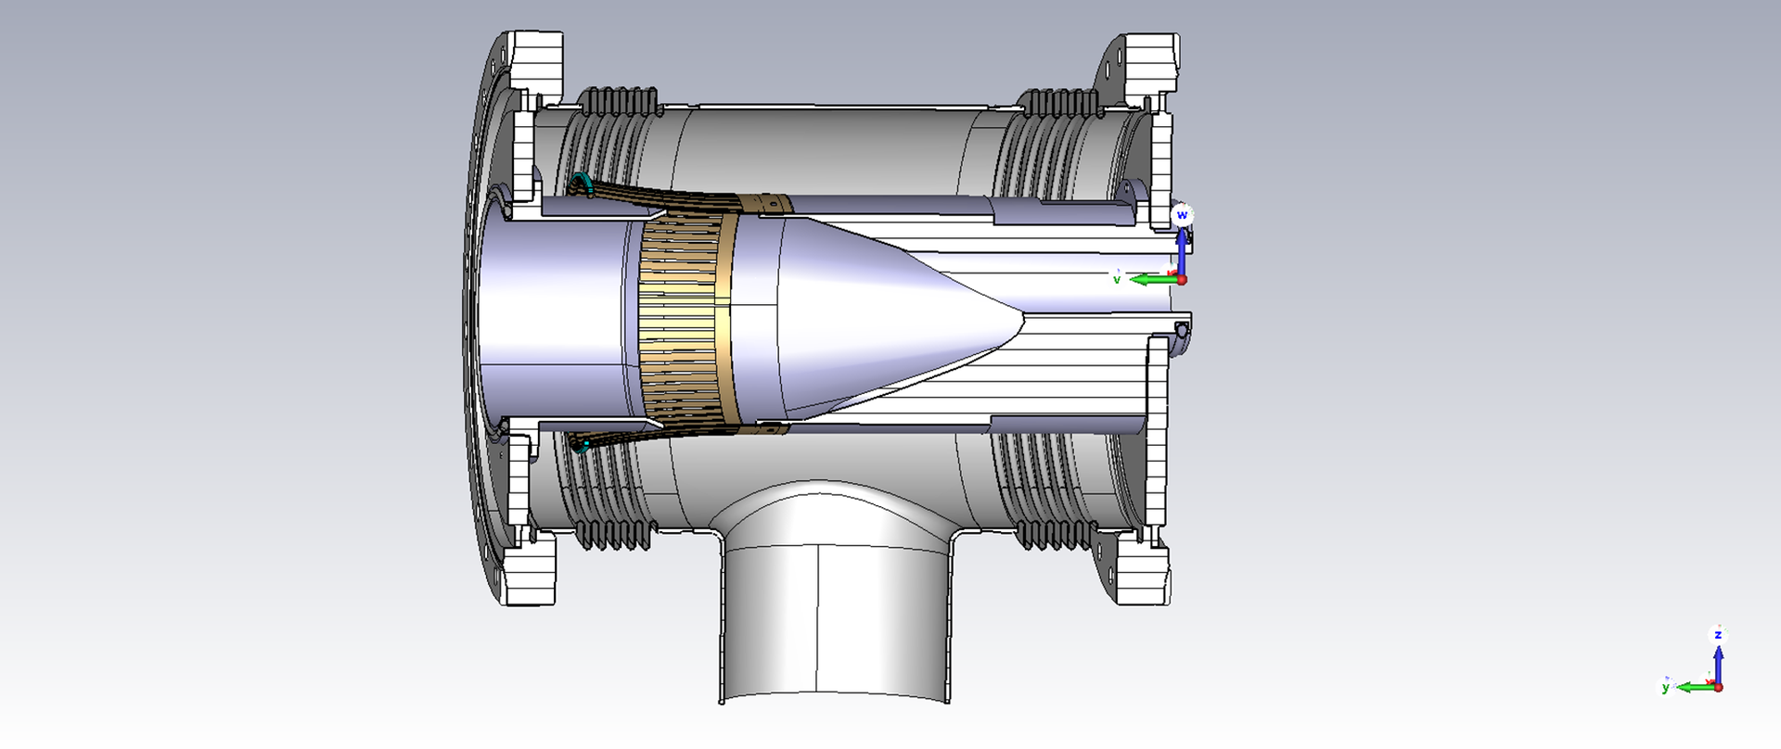
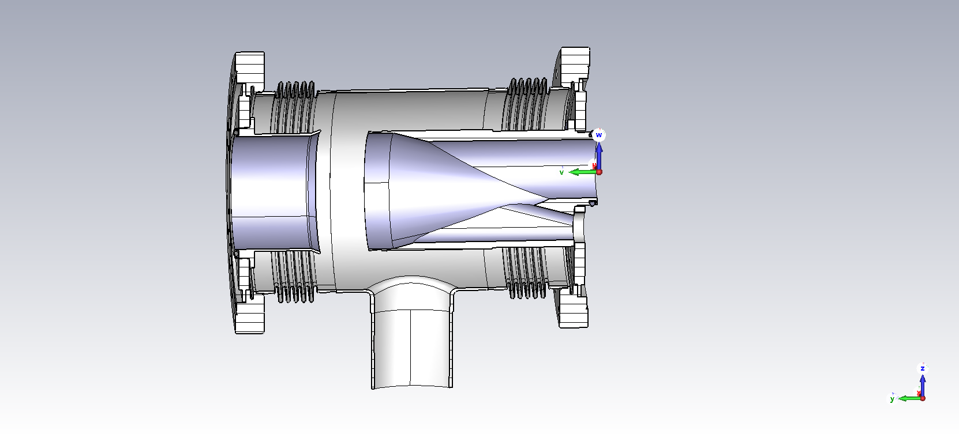
Carlo’s talk at LMC yesterday on 6L2
Carlo discussed the impedance implications of not changing VMISO.6L2 during YETS, but just removing the RF fingers
Large power loss expected on
bellows, one should study if this
is tolerable as well as impact on
(longitudinal) stability
LMC decided to proceed to
exchange the damaged module
with spare during YETS

Slide 14
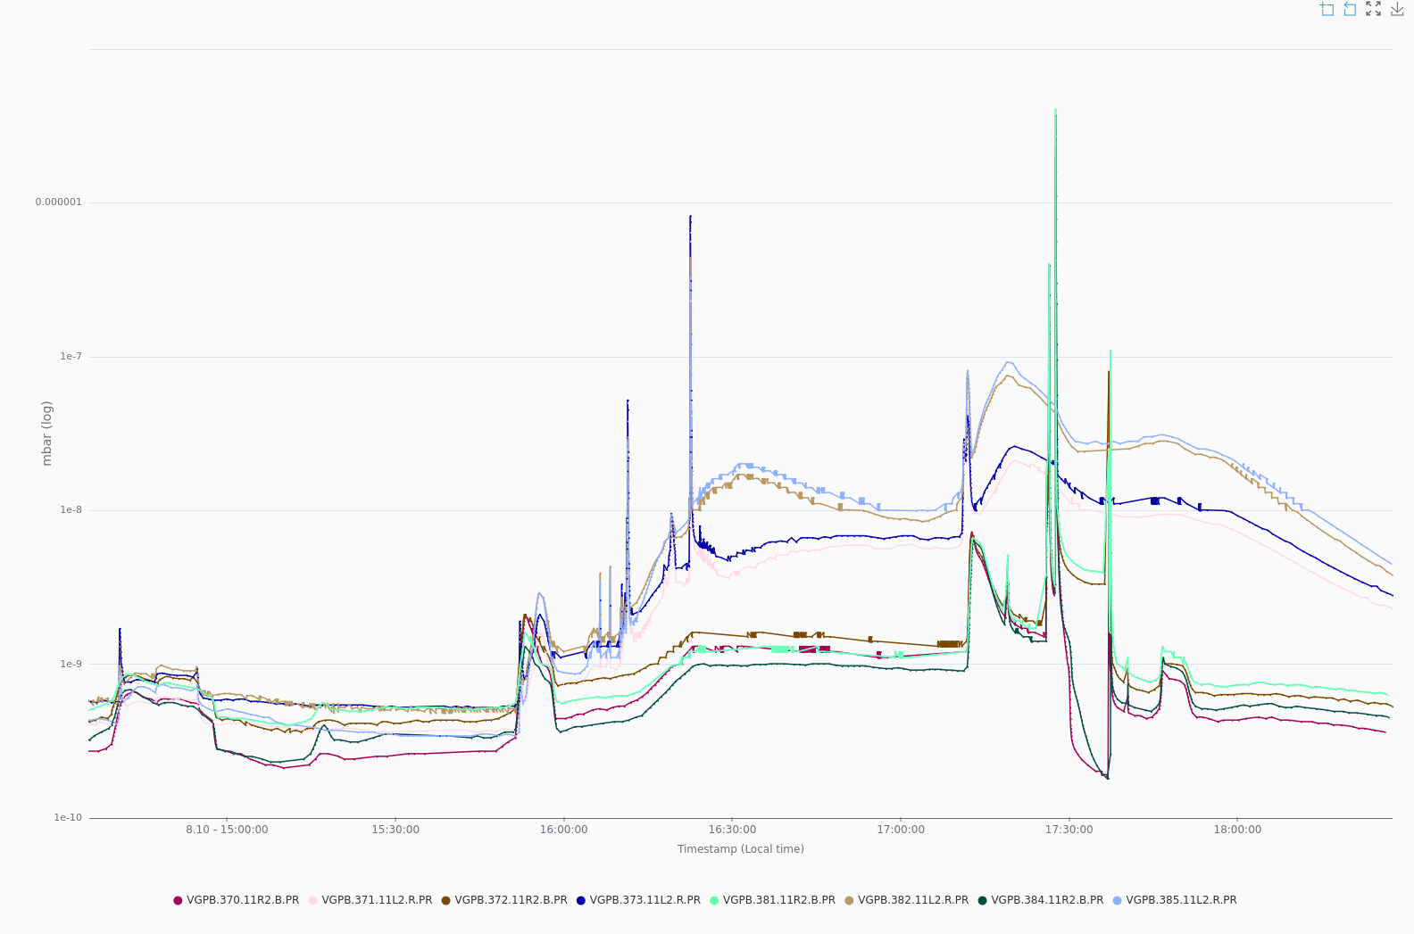
Vacuum spike in 11L7
High intensity 8b4e MD with ~600 bunches took place yesterday afternoon
  Losses at start of ramp <2% of thresholds
  Went to SB without problems
  Lifetime in collisions ~20h without any tune optimization
Beams got dumped by a vacuum spike in 11R2
on the TCLD. (TE-VSC reported activity on both
TCLD 11L2 in the RAMP and 11R2 at top
energy)

Slide 15
Injectors schedule
Since our last meeting, there were several long parallel MD blocks in the SPS
LIU reliability run started in the PS complex, already great results
Plans for LIU reliability run in 2026 were discussed at the IPP, then presented at the IEFC and finally endorsed

Slide 16
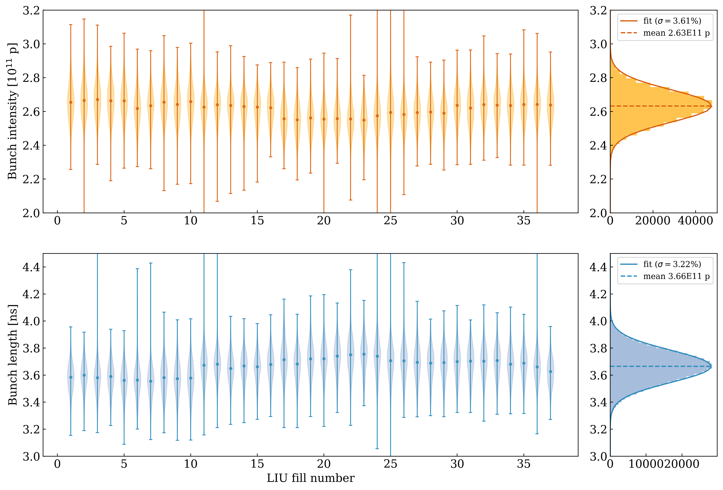
CPS reliability run
For lack of time in 2026, it was decided to advance the LIU reliability run (LIURR) in the PSB-PS to the last few months of 2025
  Decision presented at the FOM on 16 September and LIURR immediately started right thereafter with single batch (several batches to be taken only during SPS long parallel slots)
LIURR fills are fully monitored
  There is a set-up time followed by a short
  run in stable conditions
  Pretty good intensity and bunch length
  stability over time
Effort already seen in the close to 100%
availability of the SPS MDs since

Slide 17
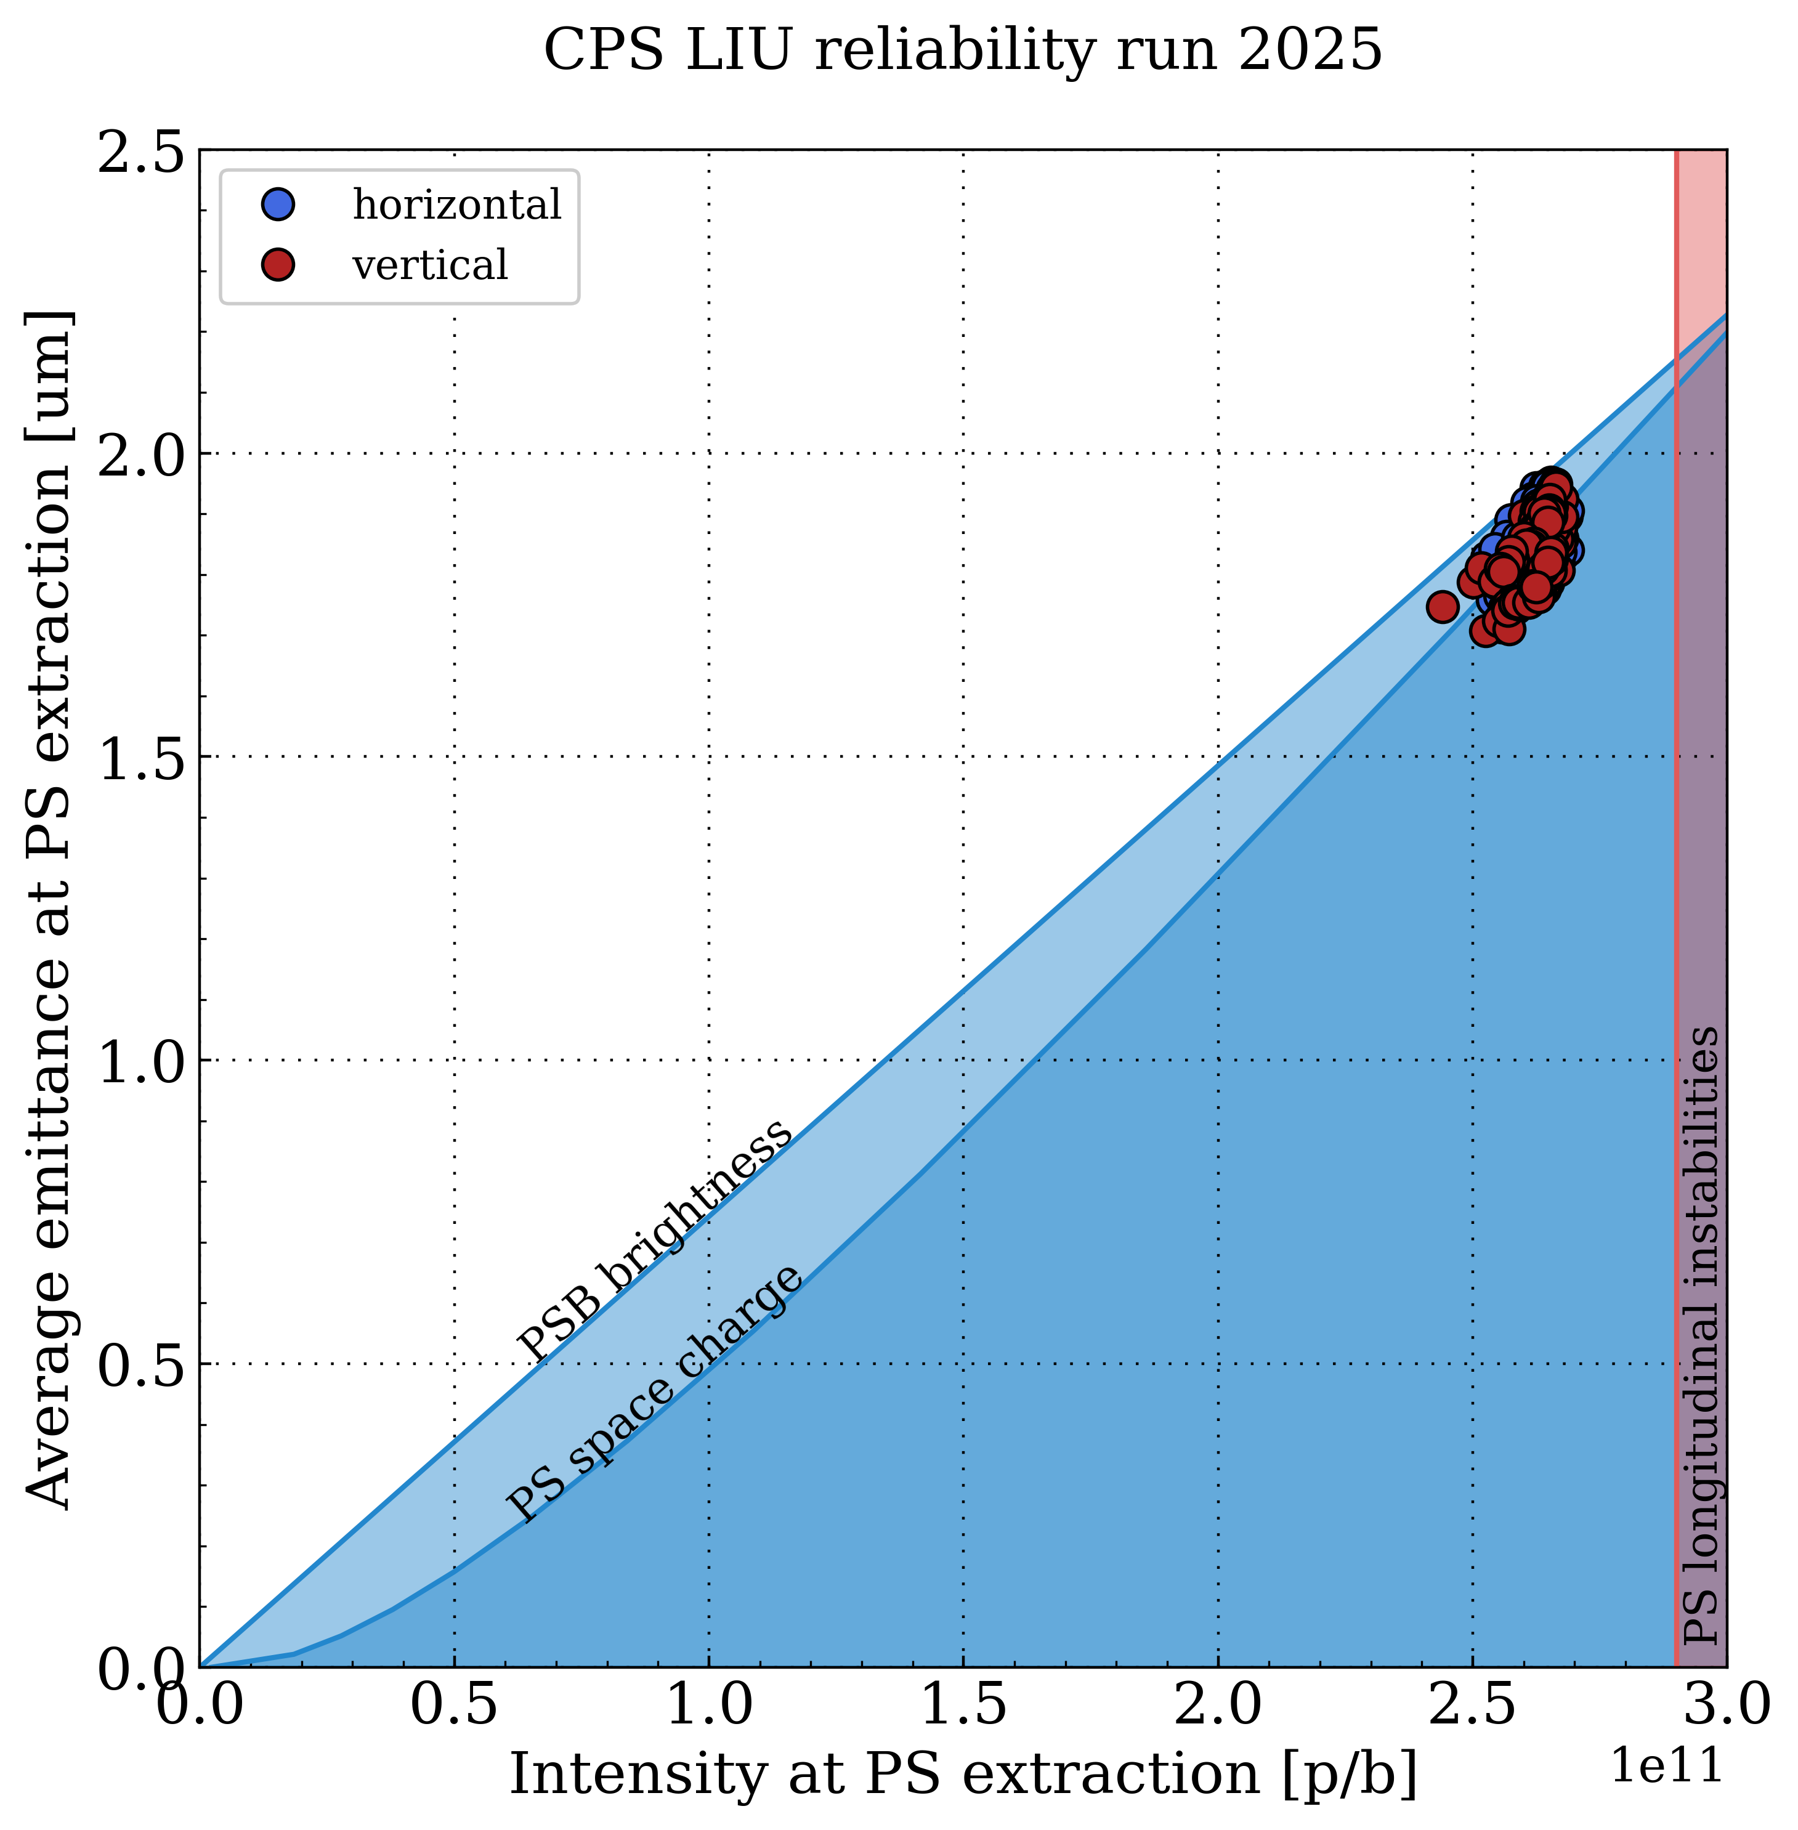
CPS reliability run
Perfectly on target also in terms of brightness!

Slide 18
LIU or HL-LHC reliability run in the SPS in 2026
Modus operandi
  Nominal beam 4 batches of 72 bunches, 2.3 ∙ 10¹¹ p/b
  Checklists, BQM, etc.
  Check after each LHC filling → aim at <30 min, at max 1 h
  Start during workdays only (expert support), extend to weekends during second half
  Avoid HiRadMat, dedicated MDs and LHC-MD blocks
  Possible periods: weeks 12, 14, 15, 16, 19, 20, 21
Duty cycle reduction for physics during about 60h, which means only <2% fewer spills to NA
In case of problems to reach desired beam quality, do not invest too much time and plan floating MD block to investigate the issue(s)

Slide 19
LIU or HL-LHC reliability run in the SPS in 2026
During coordinated discussions with LHC by then end of 2025, we need to define any possible requirement coming from the LHC high intensity run at the end of June 2026
  Probably MD days in December could be the right forum to address this

Slide 20
News from projects?
HL-LHC
Muon collider
FCC

