Slide 1

DQW CM series
STFC- Update
CERN WP4
Zoom Meeting – 28/07/2024 – CERN/STFC

Slide 2
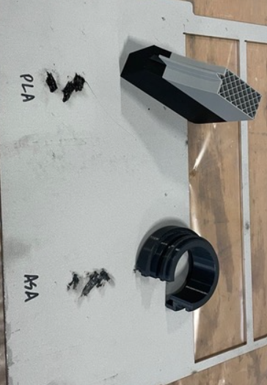
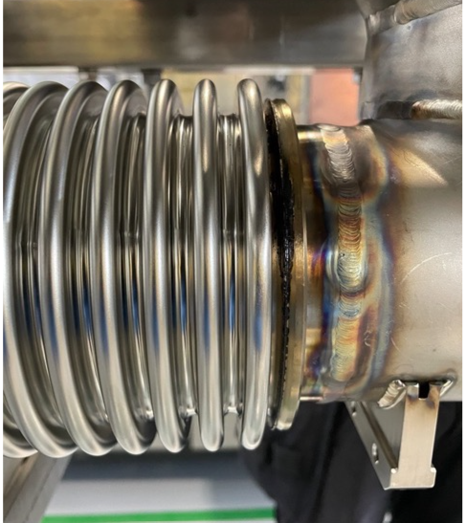
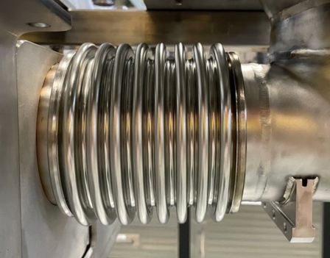
Update
Before site visit → problems with the bellows of the biphase line
  HyDE left the bellow protection while welding
  Bellows protections (3D printed PLA and ASA) were melted and had to be cleaned
  Rosas recommended dichloroethylene for cleaning. Test on SS 1.4429 was done before bellows
After cleaning, biphase line passed the final leak test on July 22nd

Slide 3
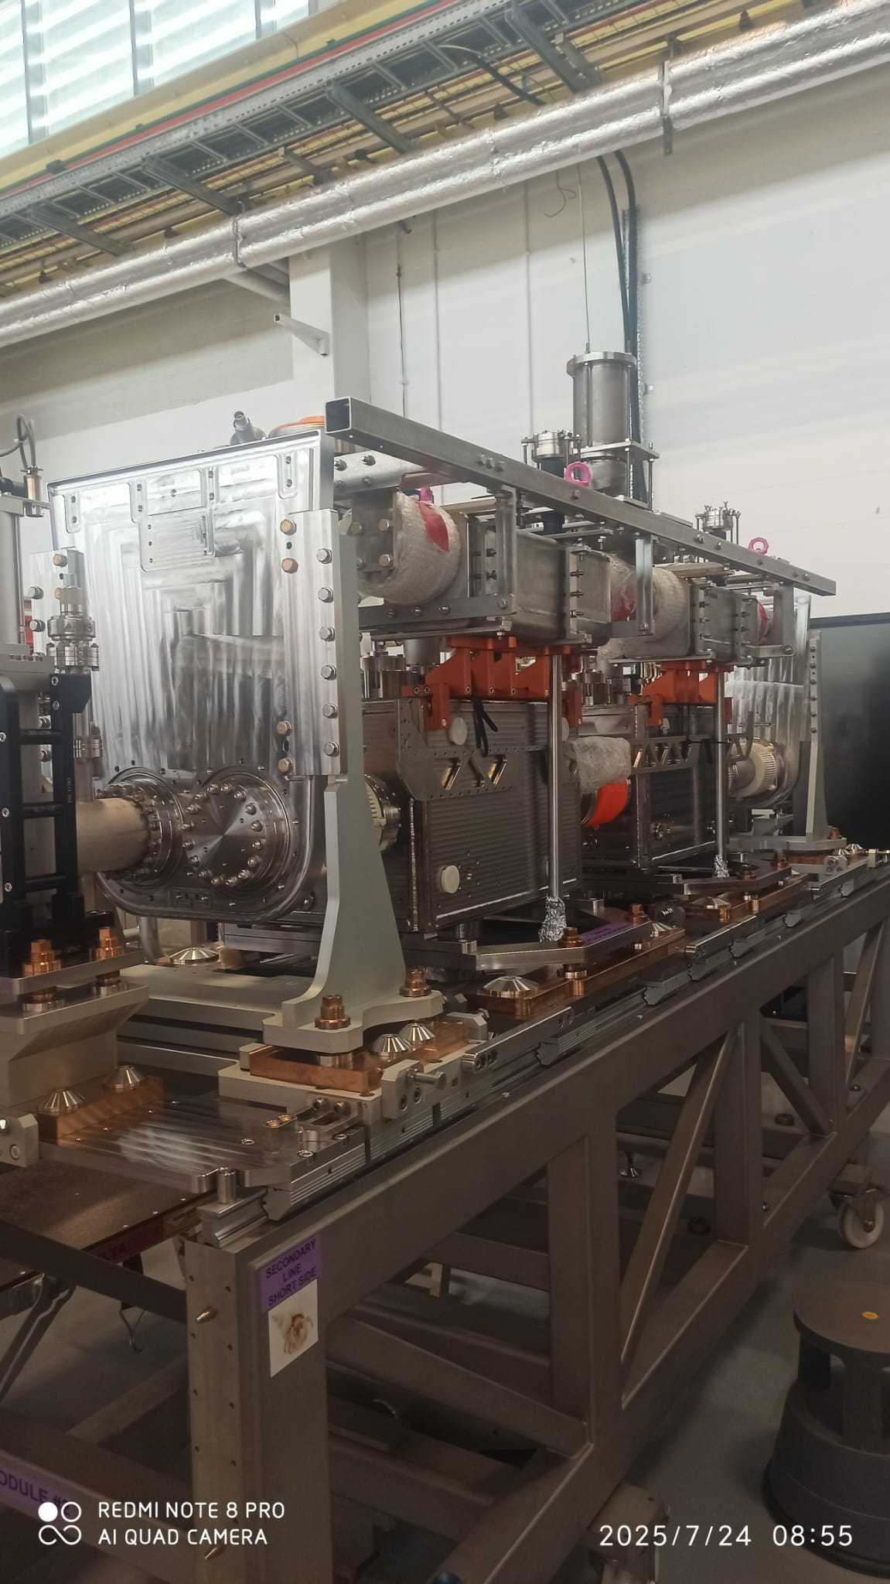
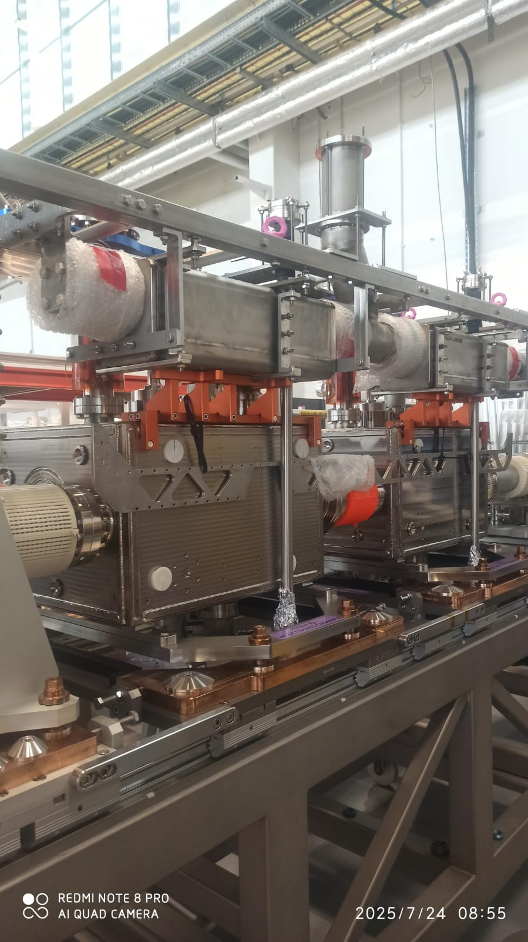
Vacuum Equipment
Site visit 23-25th → alignment of the biphase line with respect to cavities. All correct (took a whole day)

