Slide 1


The discovery of the neutrino and an introduction to oscillations
Stephen Dolan
stephen.joseph.dolan@cern.ch

Slide 2
The discovery of the neutrino

Slide 3
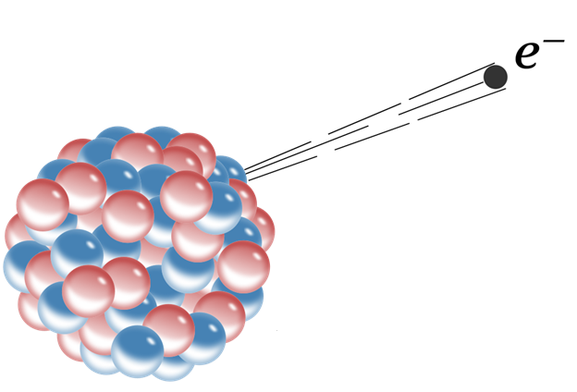
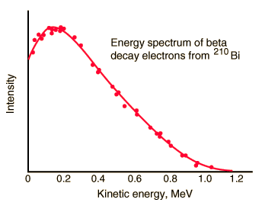
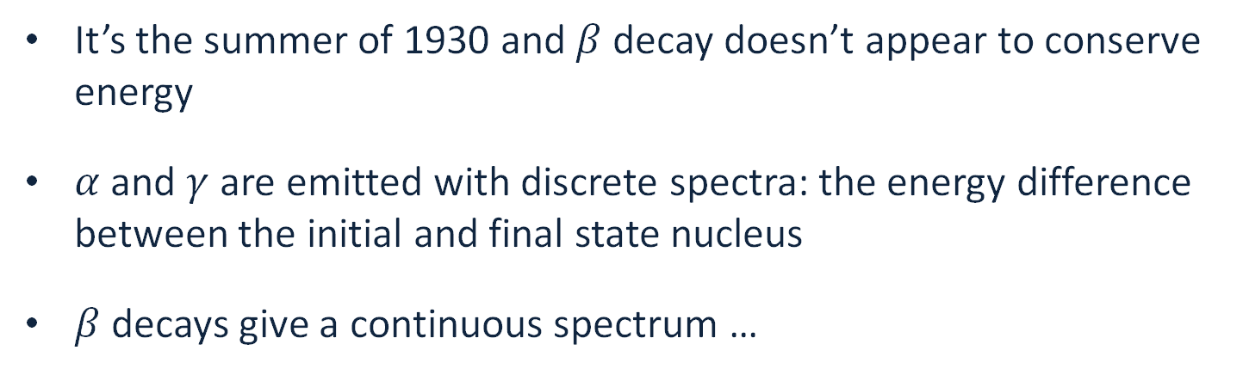
Neutrinos: a desperate remedy
It’s the summer of 1930 and $β$ decay doesn’t appear to conserve energy
$α$ and $γ$ are emitted with discrete spectra: the energy difference between the initial and final state nucleus
$β$ decays give a continuous spectrum …

Slide 4
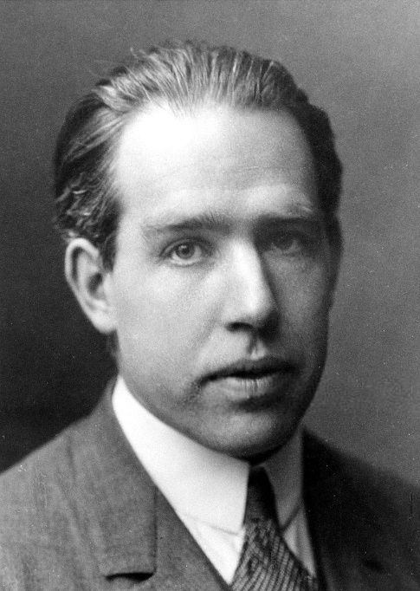

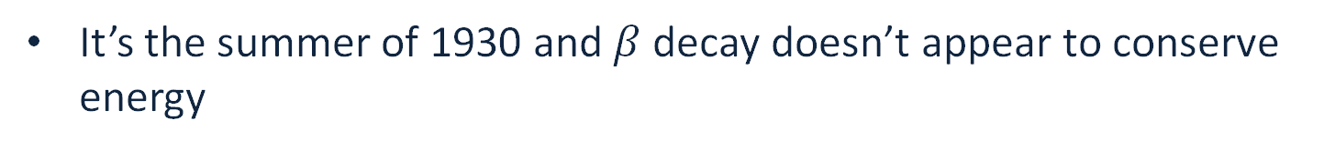
Neutrinos: a desperate remedy
It’s the summer of 1930 and $β$ decay doesn’t appear to conserve energy
“At the present stage of atomic theory, however, we may say that we have no argument, either empirical or theoretical, for upholding the energy principle in the case of β-ray disintegrations”. Niels Bohr
Bohr was close to giving up the conservation of energy!

Slide 5

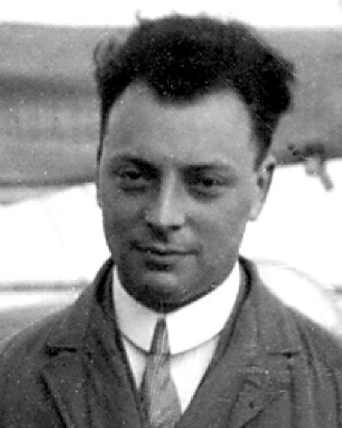
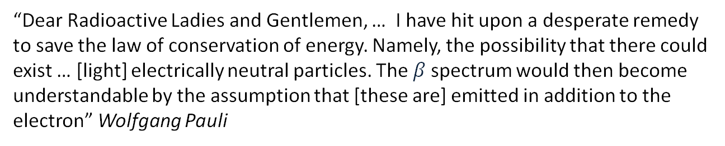
Neutrinos: a desperate remedy
Pauli writes a letter to colleagues attending a conference in Tübingen proposing a “solution”:
“Dear Radioactive Ladies and Gentlemen, … I have hit upon a desperate remedy to save the law of conservation of energy. Namely, the possibility that there could exist … [light] electrically neutral particles. The $β$spectrum would then become understandable by the assumption that [these are] emitted in addition to the electron” Wolfgang Pauli

Slide 6
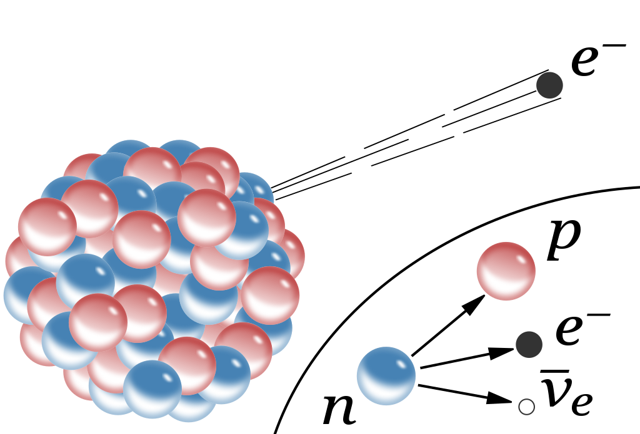
Neutrinos: a desperate remedy
Pauli writes a letter to colleagues attending a conference in Tübingen proposing a “solution”:
“Dear Radioactive Ladies and Gentlemen, … I have hit upon a desperate remedy to save the law of conservation of energy. Namely, the possibility that there could exist … [light] electrically neutral particles. The $β$spectrum would then become understandable by the assumption that [these are] emitted in addition to the electron” Wolfgang Pauli

Slide 7
Neutrinos: a desperate remedy
He’s not proud of it …
“I have done something very bad today by proposing a particle that cannot be detected; it is something no theorist should ever do.”

Slide 8

Neutrinos: a desperate remedy
He’s not proud of it …
“I have done something very bad today by proposing a particle that cannot be detected; it is something no theorist should ever do.”
He’s got other things to do
“Unfortunately, I cannot personally appear in Tübingen since I am indispensable here in Zürich because of a ball.”

Slide 9

Neutrinos: a desperate remedy
He’s not proud of it …
“I have done something very bad today by proposing a particle that cannot be detected; it is something no theorist should ever do.”
He’s got other things to do
“Unfortunately, I cannot personally appear in Tübingen since I am indispensable here in Zürich because of a ball.”
He wagers a case of champagne that no one would ever detect his elusive postulated particle

Slide 10
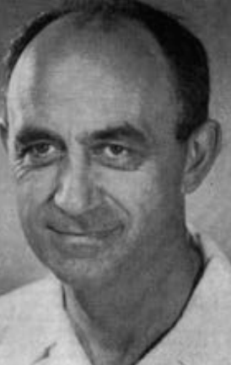
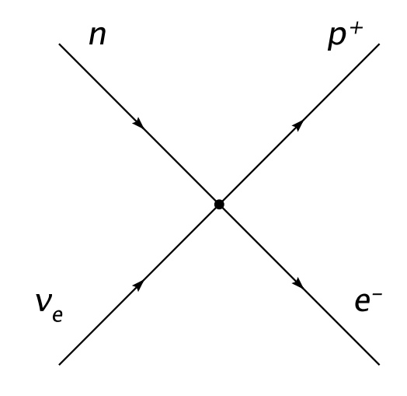
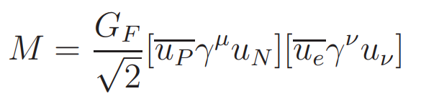
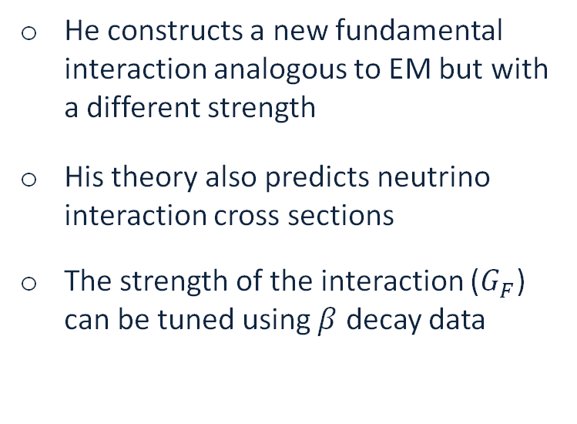
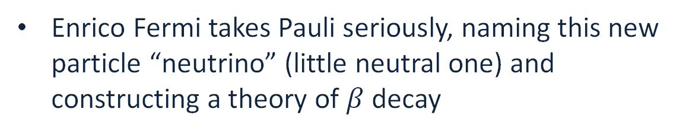
The Weak Interaction (1932)
Enrico Fermi takes Pauli seriously, naming this new particle “neutrino” (little neutral one) and constructing a theory of $β$ decay
Z. Physik, 88, 161 (1934)
He constructs a new fundamental interaction analogous to EM but with a different strength
His theory also predicts neutrino interaction cross sections
The strength of the interaction ($G_{F}$) can be tuned using $β$ decay data

Slide 11


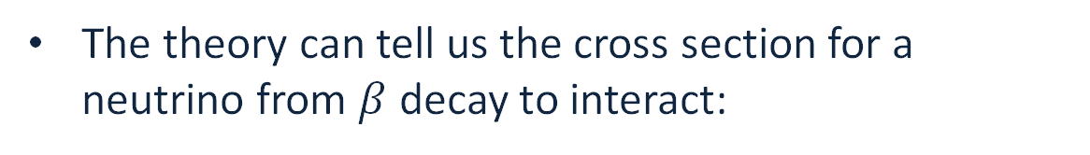
The Weak Interaction (1932)
The theory can tell us the cross section for a neutrino from $β$ decay to interact:
$$σ_{\overline{ν}p} \left(E_{\overline{ν}}\sim 1 MeV\right) \sim 5×{10}^{−44}cm^{2}$$
Compared to EM interactions of similar energies:
$$σ_{γp} \sim {10}^{−25}cm^{2}$$
Suggests a ~MeV neutrino’s mean free path in steel to be around 10 light years …
Fermi submitted his paper to Nature. The response:

Slide 12
The Weak Interaction (1932)
The theory can tell us the cross section for a neutrino from $β$ decay to interact:
$$σ_{\overline{ν}p} \left(E_{\overline{ν}}\sim 1 MeV\right) \sim 5×{10}^{−44}cm^{2}$$
Compared to EM interactions of similar energies:
$$σ_{γp} \sim {10}^{−25}cm^{2}$$
Suggests a ~MeV neutrino’s mean free path in steel to be around 10 light years …
Fermi submitted his paper to Nature. The response:
“it contains speculations too remote from reality to be of interest to the reader”

Slide 13
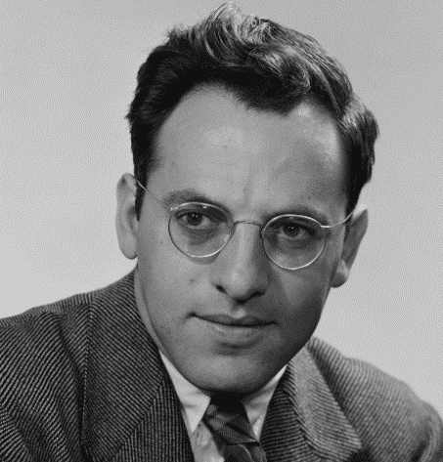
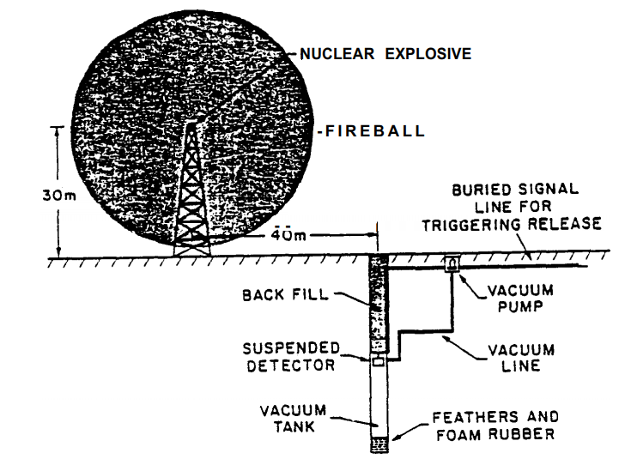
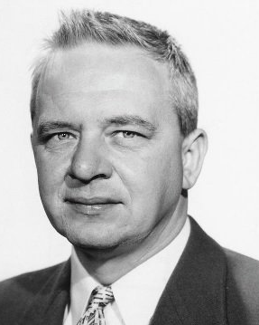

Where can I get a lot of $ν$s …
Frederick Reines
Clyde Cowan
Notes:
Frederick Reines, Clyde Cowan

Slide 14
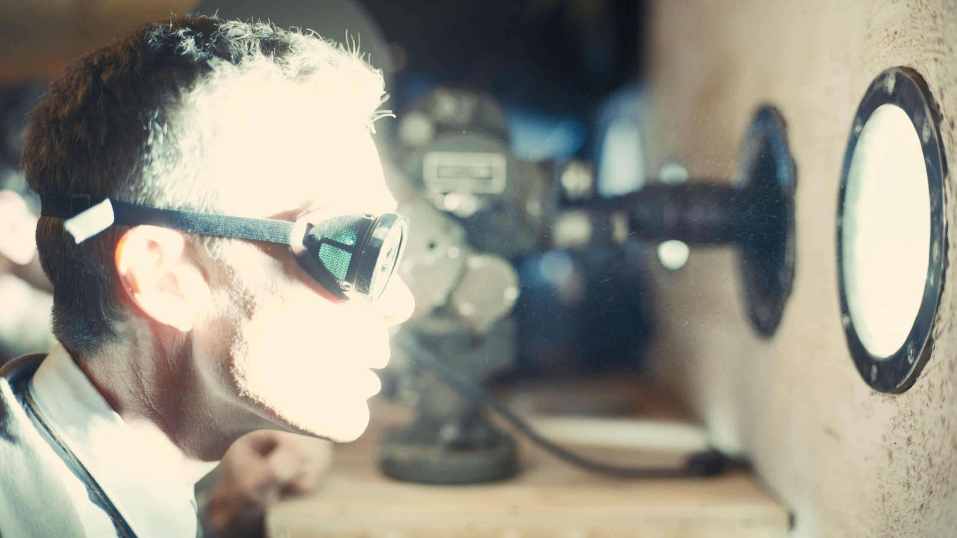
Where can I get a lot of $ν$s …
Frederick Reines
Any neutrinos out there?
“The idea that such a sensitive detector could be operated in the close proximity (within a hundred meters) of the most violent explosion produced by man was somewhat bizarre”
Frederick Reines, Nobel Lecture

Slide 15
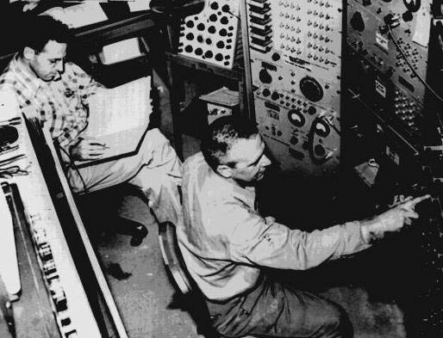
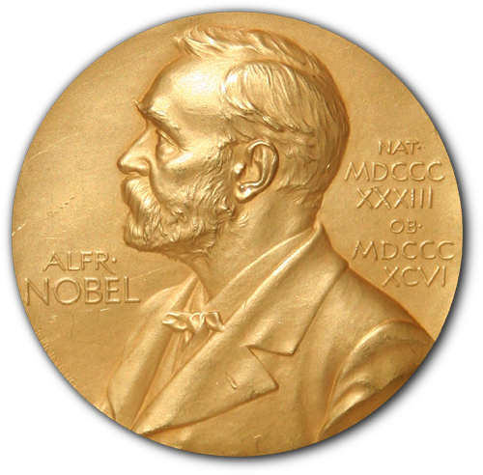
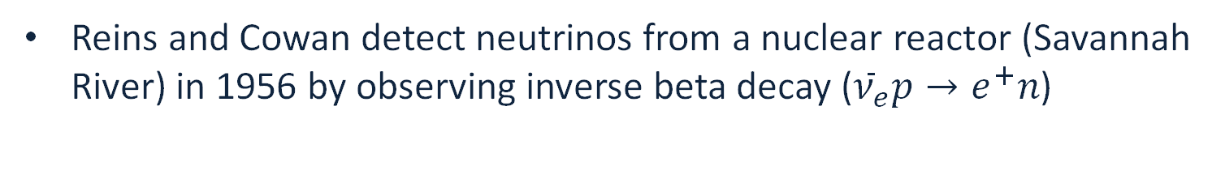
Discovery of the neutrino
Reins and Cowan detect neutrinos from a nuclear reactor (Savannah River) in 1956 by observing inverse beta decay (${\overline{ν}}_{e}p→e^{+}n$)
Letter to Pauli:
”We are happy to inform you that we have definitely detected neutrinos…”
1995 Nobel Prize

Slide 16
Discovery of the neutrino
Reins and Cowan detect neutrinos from a nuclear reactor (Savannah River) in 1956 by observing inverse beta decay (${\overline{ν}}_{e}p→e^{+}n$)
Letter to Pauli:
”We are happy to inform you that we have definitely detected neutrinos…”
1995 Nobel Prize
And a case of champagne !

Slide 17
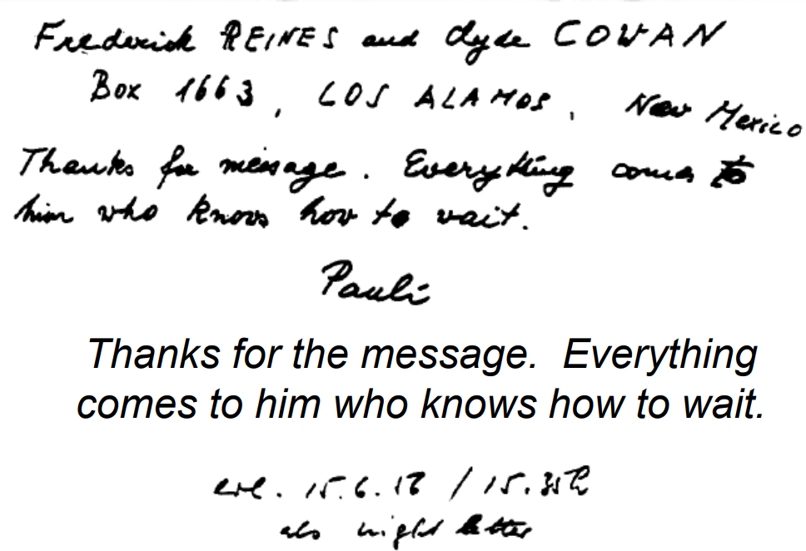
Discovery of the neutrino
Borrowed from K. McFarland’s INSS 2015 lectures

Slide 18
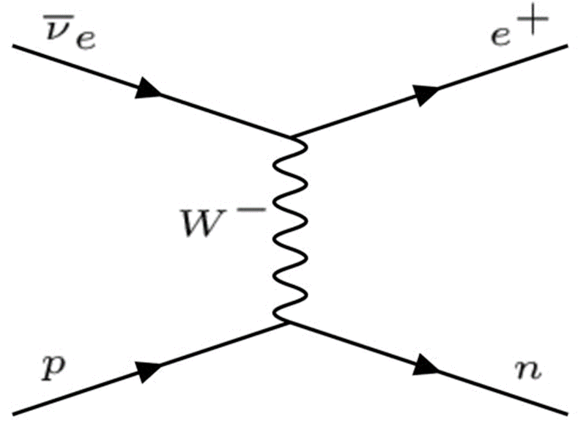

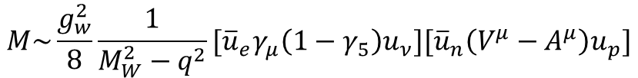
Back to the Weak Interaction
Fermi’s interaction works remarkably well, but the cross-section rises linearly with energy forever!
The modern standard model theory of weak interactions is a little different:
Fermi
Standard Model
$$M\sim \frac{G_{F}}{\sqrt{2}}{[\overline{u}}_{e}γ_{μ}u_{ν}][{\overline{u}}_{n}V^{μ}u_{p}]$$
$$M\sim \frac{g_{w}^{2}}{8}\frac{1}{M_{W}^{2}−q^{2}}{[\overline{u}}_{e}γ_{μ}\left(1−γ_{5}\right)u_{ν}][{\overline{u}}_{n}\left(V^{μ}−A^{μ}\right)u_{p}]$$

Slide 19
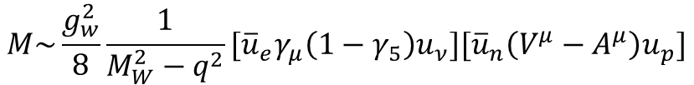
Standard Model Weak Interactions
Standard Model
$$M\sim \frac{g_{w}^{2}}{8}\frac{1}{M_{W}^{2}−q^{2}}{[\overline{u}}_{e}γ_{μ}\left(1−γ_{5}\right)u_{ν}][{\overline{u}}_{n}\left(V^{μ}−A^{μ}\right)u_{p}]$$
Fudges to deal with the fact we’re interacting with an extended (not point-like) object
… we’ll come back to this later!
Massive propagator
Parity violation

Slide 20
Neutrino oscillations

Slide 21
Discovery of Neutrino Oscillations
In one page …
Caveat: this is one page overview of a long story. Expect many more details in Animesh’s lectures

Slide 22
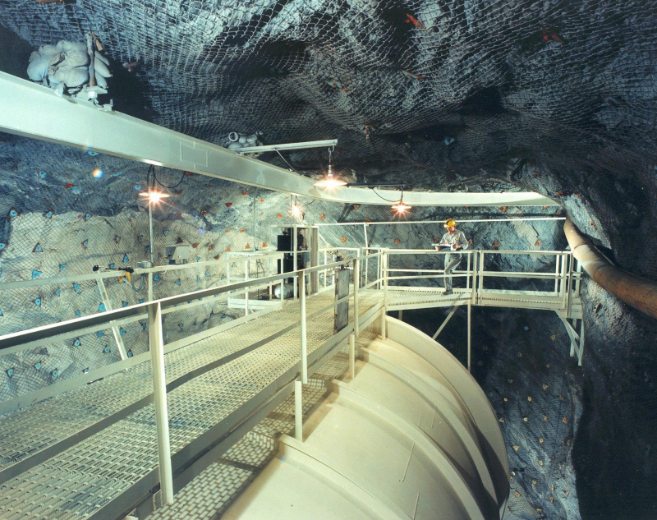
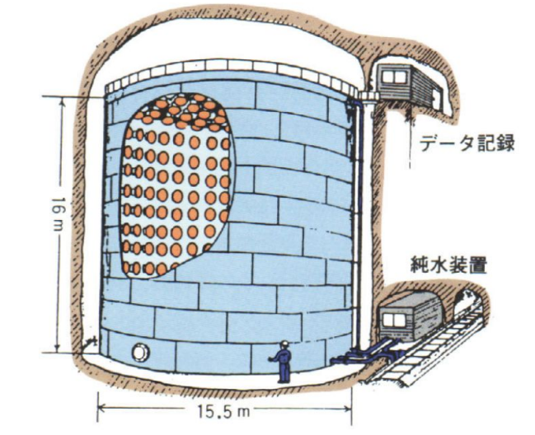
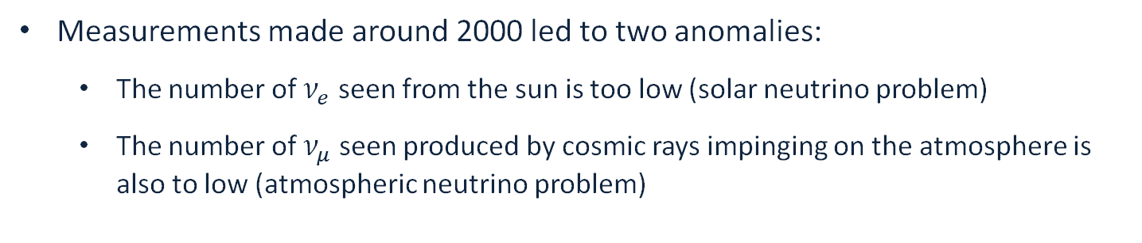
Discovery of Neutrino Oscillations
Measurements made around 2000 led to two anomalies:
  The number of $ν_{e}$ seen from the sun is too low (solar neutrino problem)
  The number of $ν_{μ}$ seen produced by cosmic rays impinging on the atmosphere is also to low (atmospheric neutrino problem)

Slide 23
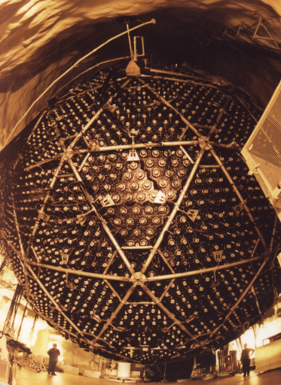
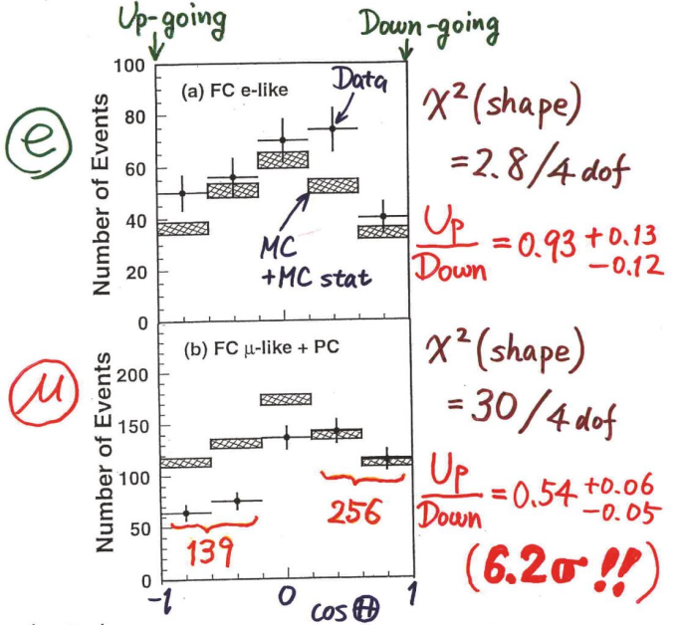
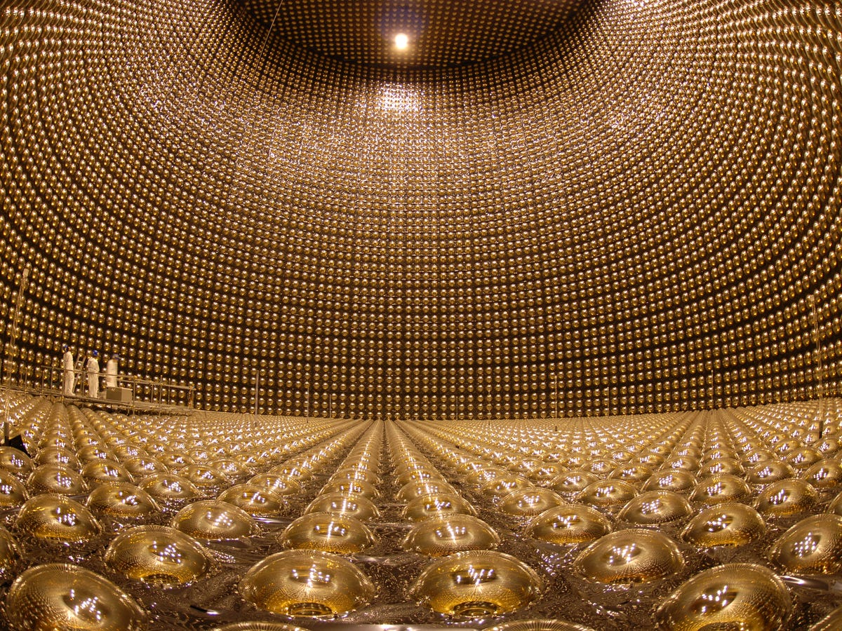
Discovery of Neutrino Oscillations
Measurements made around 2000 led to two anomalies:
  The number of $ν_{e}$ seen from the sun is too low (solar neutrino problem)
  The number of $ν_{μ}$ seen produced by cosmic rays impinging on the atmosphere is also to low (atmospheric neutrino problem)
Analyses from the SNO and Super-Kamiokande collaborations showed the flavour oscillation of neutrinos could explain the data

Slide 24
Discovery of Neutrino Oscillations
Measurements made around 2000 led to two anomalies:
  The number of $ν_{e}$ seen from the sun is too low (solar neutrino problem)
  The number of $ν_{μ}$ seen produced by cosmic rays impinging on the atmosphere is also to low (atmospheric neutrino problem)
Analyses from the SNO and Super-Kamiokande collaborations showed the flavour oscillation of neutrinos could explain the data
Implies neutrinos have mass: sign of physics beyond the standard model!

Slide 25
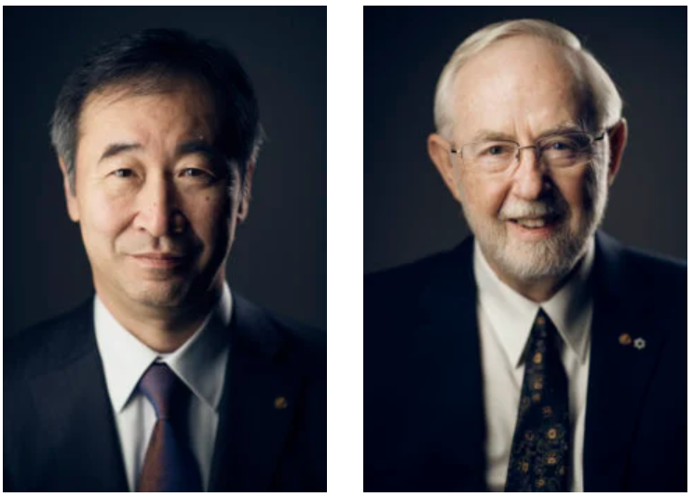
Discovery of Neutrino Oscillations
Measurements made around 2000 led to two anomalies:
  The number of $ν_{e}$ seen from the sun is too low (solar neutrino problem)
  The number of $ν_{μ}$ seen produced by cosmic rays impinging on the atmosphere is also to low (atmospheric neutrino problem)
Analyses from the SNO and Super-Kamiokande collaborations showed the flavour oscillation of neutrinos could explain the data
Implies neutrinos have mass: sign of physics beyond the standard model!
The collaboration spokespeople were awarded the 2015 Nobel prize

Slide 26
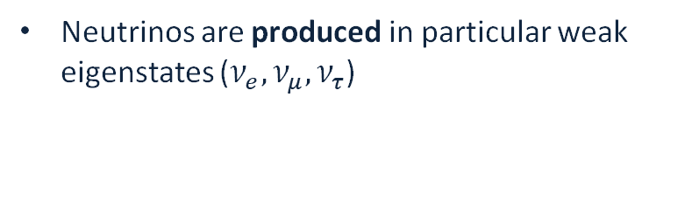
Neutrino Oscillations
Neutrinos are produced in particular weak eigenstates ($ν_{e}, ν_{μ}, ν_{τ}$)

Slide 27
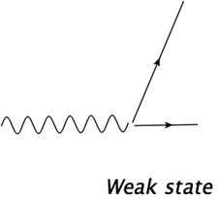
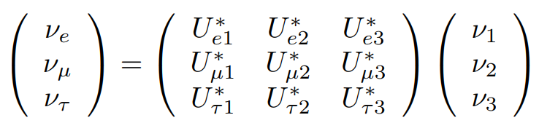



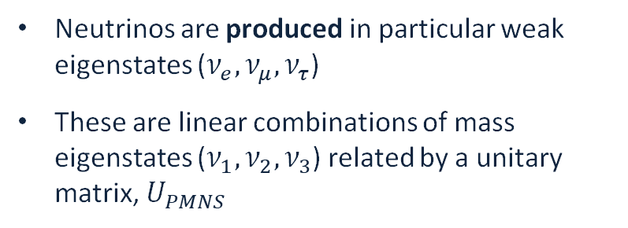
Neutrino Oscillations
$$μ^{+}$$
Neutrinos are produced in particular weak eigenstates ($ν_{e}, ν_{μ}, ν_{τ}$)
These are linear combinations of mass eigenstates ($ν_{1}, ν_{2}, ν_{3}$) related by a unitary matrix, $U_{PMNS}$
$$W^{+}$$
$$ν_{μ}$$
PMNS = Pontecorvo-Maki-Nakagawa-Sakata

Slide 28
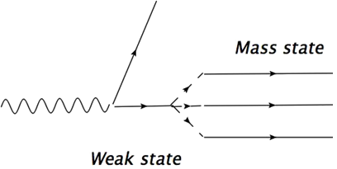
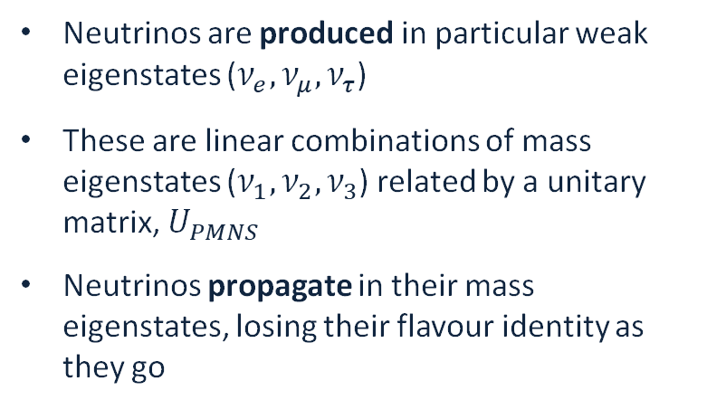
Neutrino Oscillations
$$μ^{+}$$
Neutrinos are produced in particular weak eigenstates ($ν_{e}, ν_{μ}, ν_{τ}$)
These are linear combinations of mass eigenstates ($ν_{1}, ν_{2}, ν_{3}$) related by a unitary matrix, $U_{PMNS}$
Neutrinos propagate in their mass eigenstates, losing their flavour identity as they go
$$W^{+}$$
$$ν_{μ}$$
PMNS = Pontecorvo-Maki-Nakagawa-Sakata

Slide 29
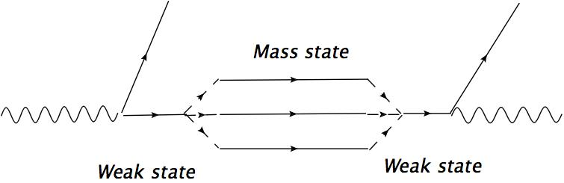


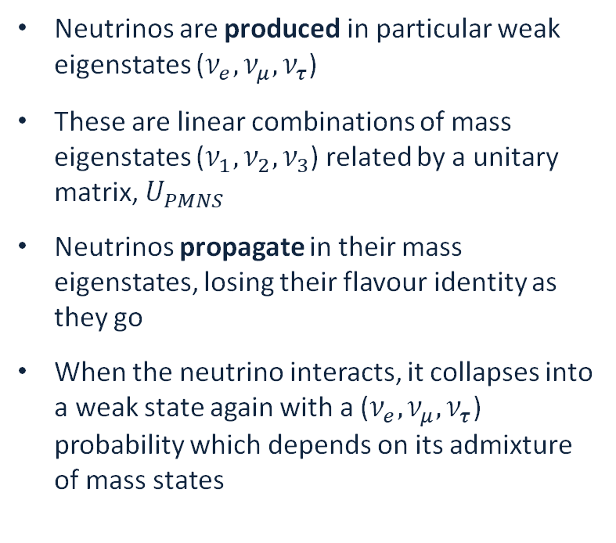
Neutrino Oscillations
$$μ^{+}$$
$$e^{+}$$
Neutrinos are produced in particular weak eigenstates ($ν_{e}, ν_{μ}, ν_{τ}$)
These are linear combinations of mass eigenstates ($ν_{1}, ν_{2}, ν_{3}$) related by a unitary matrix, $U_{PMNS}$
Neutrinos propagate in their mass eigenstates, losing their flavour identity as they go
When the neutrino interacts, it collapses into a weak state again with a ($ν_{e}, ν_{μ}, ν_{τ}$) probability which depends on its admixture of mass states
$$W^{+}$$
$$W^{+}$$
$$ν_{μ}$$
$$ν_{e}$$
PMNS = Pontecorvo-Maki-Nakagawa-Sakata

Slide 30
Neutrino Oscillations
$$μ^{+}$$
$$e^{+}$$
Neutrinos are produced in particular weak eigenstates ($ν_{e}, ν_{μ}, ν_{τ}$)
These are linear combinations of mass eigenstates ($ν_{1}, ν_{2}, ν_{3}$) related by a unitary matrix, $U_{PMNS}$
Neutrinos propagate in their mass eigenstates, losing their flavour identity as they go
When the neutrino interacts, it collapses into a weak state again with a ($ν_{e}, ν_{μ}, ν_{τ}$) probability which depends on its admixture of mass states
$$W^{+}$$
$$W^{+}$$
$$ν_{μ}$$
$$ν_{e}$$
PMNS = Pontecorvo-Maki-Nakagawa-Sakata
The probability of finding a neutrino as a particular flavour “oscillates” as its mass states evolve
Notes:
CERN talk: go through all of this, but obviously no full matrix.
Two flavour osc formula to give an idea

Slide 31
Neutrino Oscillations
$$μ^{+}$$
$$e^{+}$$
Neutrinos are produced in particular weak eigenstates ($ν_{e}, ν_{μ}, ν_{τ}$)
These are linear combinations of mass eigenstates ($ν_{1}, ν_{2}, ν_{3}$) related by a unitary matrix, $U_{PMNS}$
Neutrinos propagate in their mass eigenstates, losing their flavour identity as they go
When the neutrino interacts, it collapses into a weak state again with a ($ν_{e}, ν_{μ}, ν_{τ}$) probability which depends on its admixture of mass states
$$W^{+}$$
$$W^{+}$$
$$ν_{μ}$$
$$ν_{e}$$
See Animesh’s lecture for more details
PMNS = Pontecorvo-Maki-Nakagawa-Sakata
The probability of finding a neutrino as a particular flavour “oscillates” as its mass states evolve
Notes:
CERN talk: go through all of this, but obviously no full matrix.
Two flavour osc formula to give an idea

Slide 32
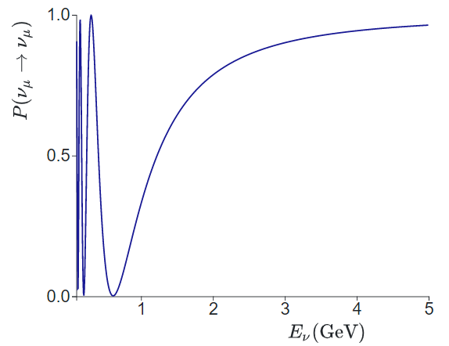

Neutrino Oscillations
L=295 km (~T2K)
The oscillation probability depends on:
  The neutrino energy
  The travelled distance (“baseline”)
Two-flavour mixing
$$p_{ν_{α}→ν_{α}}=1−{\sin^{2}(2θ)sin}^{2}\left(1.27\frac{Δm^{2}L}{E_{ν}}\frac{\left[eV^{2}\right]\left[km\right]}{\left[GeV\right]}\right)$$

Slide 33
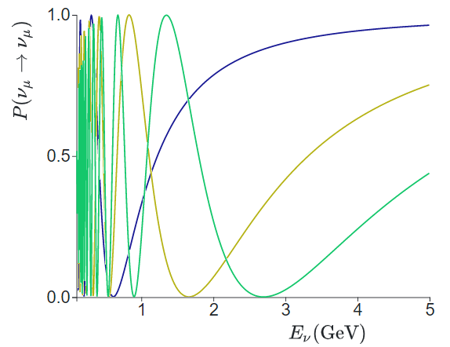
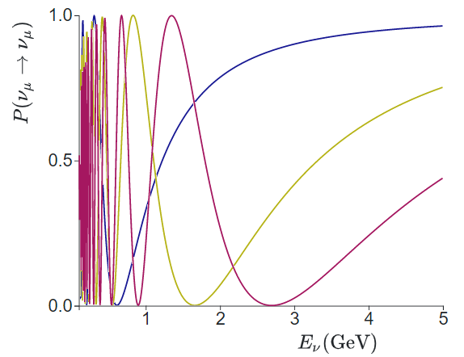
Neutrino Oscillations
L=295 km (~T2K)
The oscillation probability depends on:
  The neutrino energy
  The travelled distance (“baseline”)
L=800 km (~NOvA)
L=1300 km (~DUNE)
Two-flavour mixing
$$p_{ν_{α}→ν_{α}}=1−{\sin^{2}(2θ)sin}^{2}\left(1.27\frac{Δm^{2}L}{E_{ν}}\frac{\left[eV^{2}\right]\left[km\right]}{\left[GeV\right]}\right)$$
Notes:
Draw one extra case, not three

Slide 34
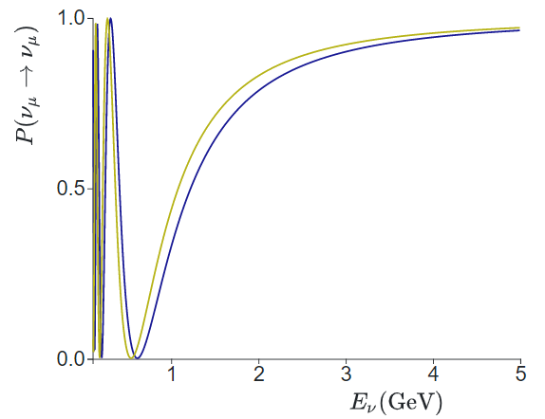


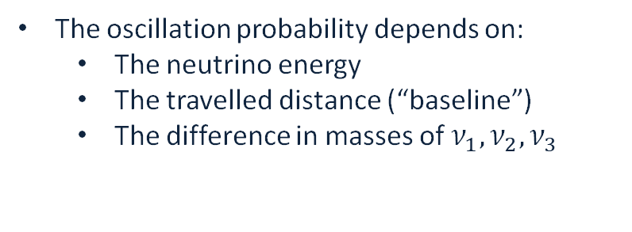
Neutrino Oscillations
$$Δm_{32}^{2}=2.24×10^{−3}eV$$
The oscillation probability depends on:
  The neutrino energy
  The travelled distance (“baseline”)
  The difference in masses of $ν_{1}, ν_{2}, ν_{3}$
$$Δm_{32}^{2}=2.54×10^{−3}eV$$
Measurements of mass splitting typically require good energy resolution!
Two-flavour mixing
$$p_{ν_{α}→ν_{α}}=1−{\sin^{2}(2θ)sin}^{2}\left(1.27\frac{Δm^{2}L}{E_{ν}}\frac{\left[eV^{2}\right]\left[km\right]}{\left[GeV\right]}\right)$$
Notes:
Just show arrows for Delta m^2, do show ordering but keep it short
If I need more time, can drop these explanations and swap to just leaning on the 2 flavour formula.

Slide 35
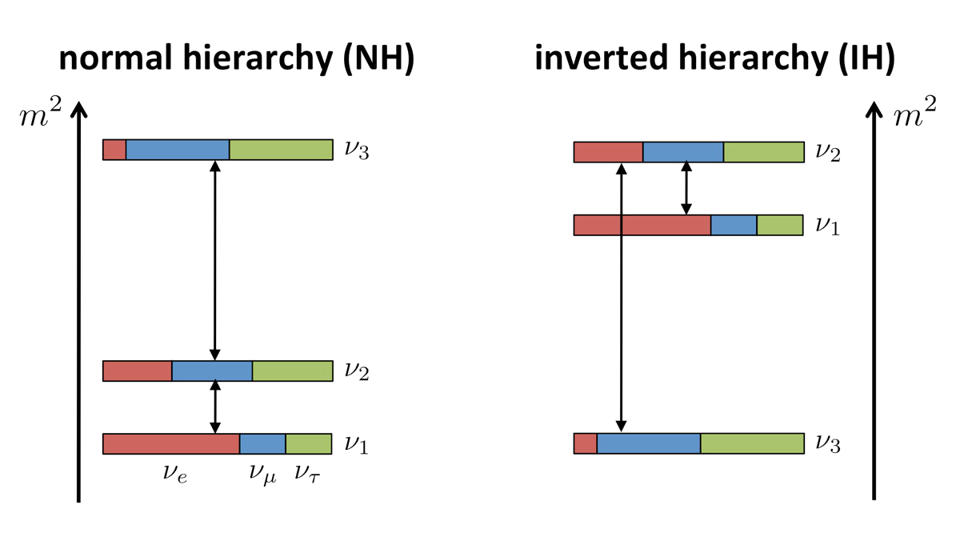




Neutrino Oscillations
$$Δm_{32}^{2}=2.24×10^{−3}eV$$
The oscillation probability depends on:
  The neutrino energy
  The travelled distance (“baseline”)
  The difference in masses of $ν_{1}, ν_{2}, ν_{3}$
$$Δm_{32}^{2}=2.54×10^{−3}eV$$
Measurements of mass splitting typically require good energy resolution!
Two-flavour mixing
$$p_{ν_{α}→ν_{α}}=1−{\sin^{2}(2θ)sin}^{2}\left(1.27\frac{Δm^{2}L}{E_{ν}}\frac{\left[eV^{2}\right]\left[km\right]}{\left[GeV\right]}\right)$$
Normal Ordering (NO)
Inverted Ordering (NO)
Neutrino oscillations in a vacuum are, to first order, sensitive only to the square of the mass splittings.
We don’t yet know the right “ordering”
$$Δm_{12}^{2}$$
$$Δm_{32}^{2}$$
$$Δm_{32}^{2}$$
$$Δm_{12}^{2}$$
Notes:
Just show arrows for Delta m^2, do show ordering but keep it short
If I need more time, can drop these explanations and swap to just leaning on the 2 flavour formula.

Slide 36
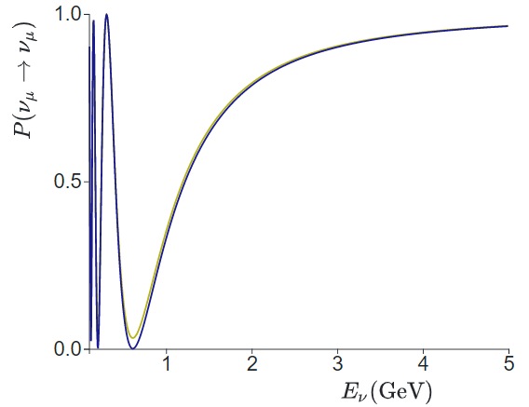



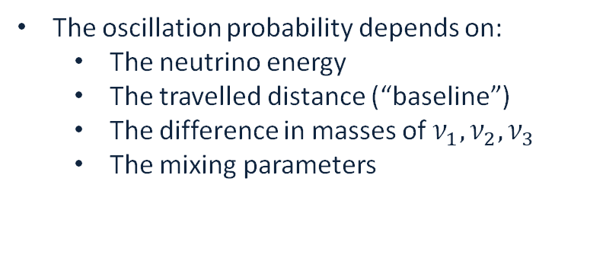
Neutrino Oscillations
$$sin^{2}\left(θ_{23}\right)=0.\text{42}$$
The oscillation probability depends on:
  The neutrino energy
  The travelled distance (“baseline”)
  The difference in masses of $ν_{1}, ν_{2}, ν_{3}$
  The mixing parameters
$sin^{2}\left(θ_{23}\right)=0.5$ (max mixing)
Measurements of mixing angles typically require good normalisation determination!
Two-flavour mixing
$$p_{ν_{α}→ν_{α}}=1−{\sin^{2}(2θ)sin}^{2}\left(1.27\frac{Δm^{2}L}{E_{ν}}\frac{\left[eV^{2}\right]\left[km\right]}{\left[GeV\right]}\right)$$
$$U=\left(\begin{matrix}cos⁡θ & \sin{θ} \\ −\sin{θ} & cos⁡θ\end{matrix}\right)$$
Notes:
Just show arrows for mixing angle
DO summarise parameters but don’t write matrix.

Slide 37
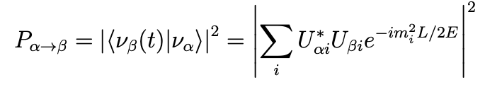
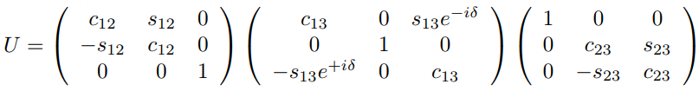


Neutrino Oscillations
$$sin^{2}\left(θ_{23}\right)=0.\text{42}$$
The oscillation probability depends on:
  The neutrino energy
  The travelled distance (“baseline”)
  The difference in masses of $ν_{1}, ν_{2}, ν_{3}$
  The mixing parameters
$sin^{2}\left(θ_{23}\right)=0.5$ (max mixing)
Measurements of mixing angles typically require good normalisation determination!
Three-flavour mixing
  Three mixing angles: $θ_{12},θ_{13},θ_{23}$
Notes:
Just show arrows for mixing angle
DO summarise parameters but don’t write matrix.

Slide 38


Neutrino Oscillations
$$sin^{2}\left(θ_{23}\right)=0.\text{42}$$
The oscillation probability depends on:
  The neutrino energy
  The travelled distance (“baseline”)
  The difference in masses of $ν_{1}, ν_{2}, ν_{3}$
  The mixing parameters
$sin^{2}\left(θ_{23}\right)=0.5$ (max mixing)
Measurements of mixing angles typically require good normalisation determination!
Three-flavour mixing
  Three mixing angles: $θ_{12},θ_{13},θ_{23}$
Predominantly from KamLAND reactor neutrino experiment
From reactor experiments (e.g. Daya Bay) and from measuring $P(ν_{μ}→ν_{e})$
Measuring $P(ν_{μ}→ν_{μ})$
Notes:
Just show arrows for mixing angle
DO summarise parameters but don’t write matrix.

Slide 39


Neutrino Oscillations
The oscillation probability depends on:
  The neutrino energy
  The travelled distance (“baseline”)
  The difference in masses of $ν_{1}, ν_{2}, ν_{3}$
  The mixing parameters
No CP-Violation
Max CP-Violation
Three-flavour mixing
Plot from L. Pickering
  Three mixing angles: $θ_{12},θ_{13},θ_{23}$
  One CP-Violating phase: $δ_{CP}$
    Required to have a difference between neutrino and anti-neutrino vacuum oscillations

Slide 40
Neutrino oscillation experiments
(Using accelerators)

Slide 41

Accelerator-Based Experiments
Near Detector
Far Detector
Many 100s of km
Particle Accelerator

Slide 42





Accelerator-Based Experiments
Near Detector
Far Detector
Many 100s of km
Particle Accelerator
$$Φ_{ν}$$
$$ν_{μ}$$
$$E_{ν}$$

Slide 43




Accelerator-Based Experiments
Near Detector
Far Detector
Many 100s of km
Particle Accelerator
$$Φ_{ν}$$
$$ν_{μ}$$
$$E_{ν}$$
At the near detector
$$N_{μ}\left(E_{ν}\right)=σ\left(E_{ν}\right)Φ_{ν}\left(E_{ν}\right)ε(E_{ν})$$
Interaction cross section
Detector effects
Neutrino flux

Slide 44

Accelerator-Based Experiments
Near Detector
Far Detector
Many 100s of km
Particle Accelerator
L=295 km (~T2K)
$$Φ_{ν}$$
$$ν_{μ}$$
L=800 km (~NOvA)
L=1300 km (~DUNE)
$$E_{ν}$$
At the near detector
$$N_{μ}\left(E_{ν}\right)=σ\left(E_{ν}\right)Φ_{ν}\left(E_{ν}\right)ε(E_{ν})$$
Interaction cross section
Detector effects
Neutrino flux

Slide 45




Accelerator-Based Experiments
Near Detector
Far Detector
Many 100s of km
Particle Accelerator
$$Φ_{ν}$$
$$ν_{μ}$$
$$E_{ν}$$
At the near detector
$$N_{μ}\left(E_{ν}\right)=σ\left(E_{ν}\right)Φ_{ν}\left(E_{ν}\right)ε(E_{ν})$$
Interaction cross section
Detector effects
Neutrino flux

Slide 46



Accelerator-Based Experiments
Near Detector
Far Detector
Many 100s of km
Particle Accelerator
$$Φ_{ν}$$
$$ν_{μ}$$
$$ν_{e}$$
$$ν_{τ}$$
$$E_{ν}$$
$$E_{ν}$$
At the near detector
$$N_{μ}\left(E_{ν}\right)=σ\left(E_{ν}\right)Φ_{ν}\left(E_{ν}\right)ε(E_{ν})$$
Interaction cross section
Detector effects
Neutrino flux

Slide 47
Accelerator-Based Experiments
Near Detector
Far Detector
Many 100s of km
Particle Accelerator
$$Φ_{ν}$$
$$ν_{μ}$$
$$ν_{e}$$
$$ν_{τ}$$
$$E_{ν}$$
$$E_{ν}$$
At the near detector
At the far detector
$$N_{μ}\left(E_{ν}\right)=σ\left(E_{ν}\right)Φ_{ν}\left(E_{ν}\right)ε(E_{ν})$$
$$N_{μ}\left(E_{ν}\right)=P(ν_{μ}→ν_{μ})σ\left(E_{ν}\right)Φ_{ν}\left(E_{ν}\right)ε(E_{ν})$$
Interaction cross section
Detector effects
$$N_{e}\left(E_{ν}\right)=P(ν_{μ}→ν_{e})σ\left(E_{ν}\right)Φ_{ν}\left(E_{ν}\right)ε(E_{ν})$$
Neutrino flux
Oscillation probability
Notes:
Build the diagram as we build the spectra and formulae

Slide 48









Accelerator-Based Experiments
$$ν_{μ}→ν_{μ}$$
Near Detector
$$N_{μ}$$
$$θ_{23}$$
Far Detector
$$N_{e}$$
L = 295 km
$$θ_{13}$$
Many 100s of km
$$Δm_{32}^{2}$$
Particle Accelerator
$$Φ_{ν}$$
$$ν_{μ}$$
$$ν_{e}$$
$$ν_{τ}$$
$$E_{ν}$$
$$E_{ν}$$
At the near detector
At the far detector
$$N_{μ}\left(E_{ν}\right)=σ\left(E_{ν}\right)Φ_{ν}\left(E_{ν}\right)ε(E_{ν})$$
$$N_{μ}\left(E_{ν}\right)=P(ν_{μ}→ν_{μ})σ\left(E_{ν}\right)Φ_{ν}\left(E_{ν}\right)ε(E_{ν})$$
Interaction cross section
Detector effects
$$N_{e}\left(E_{ν}\right)=P(ν_{μ}→ν_{e})σ\left(E_{ν}\right)Φ_{ν}\left(E_{ν}\right)ε(E_{ν})$$
Neutrino flux
Oscillation probability
Notes:
Build the diagram as we build the spectra and formulae

Slide 49





Accelerator-Based Experiments
$$ν_{μ}→ν_{μ}$$
Near Detector
$$N_{μ}$$
$$N_{e}$$
Far Detector
L = 800 km
Many 100s of km
Particle Accelerator
$$Φ_{ν}$$
$$ν_{μ}$$
$$ν_{e}$$
$$ν_{τ}$$
$$E_{ν}$$
$$E_{ν}$$
At the near detector
At the far detector
$$N_{μ}\left(E_{ν}\right)=σ\left(E_{ν}\right)Φ_{ν}\left(E_{ν}\right)ε(E_{ν})$$
$$N_{μ}\left(E_{ν}\right)=P(ν_{μ}→ν_{μ})σ\left(E_{ν}\right)Φ_{ν}\left(E_{ν}\right)ε(E_{ν})$$
Interaction cross section
Detector effects
$$N_{e}\left(E_{ν}\right)=P(ν_{μ}→ν_{e})σ\left(E_{ν}\right)Φ_{ν}\left(E_{ν}\right)ε(E_{ν})$$
Neutrino flux
Oscillation probability
Notes:
Build the diagram as we build the spectra and formulae

Slide 50


How’re we doing?
Parameter | Bestfit ±1σ | 2016
$$\sin^{2}{θ_{12}}$$ | $${0.307}_{−0.012}^{+0.013}$$ | $$\sim 4\%$$
$$\sin^{2}{θ_{23}}$$ | $${0.574}_{−0.144}^{+0.026}$$ | $$\sim 25\%$$
$$\sin^{2}{θ_{13}}$$ | $${0.02217}_{−0.0010}^{+0.0013}$$ | $$\sim 6\%$$
$$δ_{CP} [°]$$ | $${272}_{−64}^{+61}$$ | $$\sim 63°$$
$$Δm_{21}^{2} [{10}^{−5} eV^{2}]$$ | $${7.49}_{−0.17}^{+0.19}$$ | $$\sim 3\%$$
$$Δm_{3ℓ}^{2} [{10}^{−3} eV^{2}]$$ | $${2.484}_{−0.048}^{+0.045}$$ | $$\sim 2\%$$

Slide 51

How’re we doing?
Parameter | Bestfit ±1σ | 2016 | 2018
$$\sin^{2}{θ_{12}}$$ | $${0.307}_{−0.012}^{+0.013}$$ | $$\sim 4\%$$ | $$\sim 4\%$$
$$\sin^{2}{θ_{23}}$$ | $${0.538}_{−0.069}^{+0.033}$$ | $$\sim 25\%$$ | $$\sim 13\%$$
$$\sin^{2}{θ_{13}}$$ | $${0.02206}_{−0.00075}^{+0.00075}$$ | $$\sim 6\%$$ | $$\sim 3\%$$
$$δ_{CP} [°]$$ | $${234}_{−31}^{+43}$$ | $$\sim 63°$$ | $$\sim 37°$$
$$Δm_{21}^{2} [{10}^{−5} eV^{2}]$$ | $${7.40}_{−0.20}^{+0.21}$$ | $$\sim 3\%$$ | $$\sim 3\%$$
$$Δm_{3ℓ}^{2} [{10}^{−3} eV^{2}]$$ | $${2.494}_{−0.031}^{+0.033}$$ | $$\sim 2\%$$ | $$\sim 1\%$$

Slide 52


How’re we doing?
Parameter | Bestfit ±1σ | 2016 | 2018 | 2022
$$\sin^{2}{θ_{12}}$$ | $${0.303}_{−0.012}^{+0.012}$$ | $$\sim 4\%$$ | $$\sim 4\%$$ | $$\sim 4\%$$
$$\sin^{2}{θ_{23}}$$ | $${0.572}_{−0.023}^{+0.018}$$ | $$\sim 25\%$$ | $$\sim 13\%$$ | $$\sim 3\%$$
$$\sin^{2}{θ_{13}}$$ | $${0.02203}_{−0.00059}^{+0.00056}$$ | $$\sim 6\%$$ | $$\sim 3\%$$ | $$\sim 3\%$$
$$δ_{CP} [°]$$ | $${197}_{−25}^{+42}$$ | $$\sim 63°$$ | $$\sim 37°$$ | $$\sim 34°$$
$$Δm_{21}^{2} [{10}^{−5} eV^{2}]$$ | $${7.41}_{−0.20}^{+0.21}$$ | $$\sim 3\%$$ | $$\sim 3\%$$ | $$\sim 3\%$$
$$Δm_{3ℓ}^{2} [{10}^{−3} eV^{2}]$$ | $${2.511}_{−0.027}^{+0.028}$$ | $$\sim 2\%$$ | $$\sim 1\%$$ | $$\sim 1\%$$
Precision neutrino-oscillation physics!
Nature 580, 339-344

Slide 53

Precision oscillation physics
Parameter | Bestfit ±1σ | 2016 | 2018 | 2022
$$\sin^{2}{θ_{12}}$$ | $${0.303}_{−0.012}^{+0.012}$$ | $$\sim 4\%$$ | $$\sim 4\%$$ | $$\sim 4\%$$
$$\sin^{2}{θ_{23}}$$ | $${0.572}_{−0.023}^{+0.018}$$ | $$\sim 25\%$$ | $$\sim 13\%$$ | $$\sim 3\%$$
$$\sin^{2}{θ_{13}}$$ | $${0.02203}_{−0.00059}^{+0.00056}$$ | $$\sim 6\%$$ | $$\sim 3\%$$ | $$\sim 3\%$$
$$δ_{CP} [°]$$ | $${197}_{−25}^{+42}$$ | $$\sim 63°$$ | $$\sim 37°$$ | $$\sim 34°$$
$$Δm_{21}^{2} [{10}^{−5} eV^{2}]$$ | $${7.41}_{−0.20}^{+0.21}$$ | $$\sim 3\%$$ | $$\sim 3\%$$ | $$\sim 3\%$$
$$Δm_{3ℓ}^{2} [{10}^{−3} eV^{2}]$$ | $${2.511}_{−0.027}^{+0.028}$$ | $$\sim 2\%$$ | $$\sim 1\%$$ | $$\sim 1\%$$
But still plenty more to find out:
Maximal $θ_{23}$ mixing? (flavour symmetries?)

Slide 54

Precision oscillation physics
Parameter | Bestfit ±1σ | 2016 | 2018 | 2022
$$\sin^{2}{θ_{12}}$$ | $${0.303}_{−0.012}^{+0.012}$$ | $$\sim 4\%$$ | $$\sim 4\%$$ | $$\sim 4\%$$
$$\sin^{2}{θ_{23}}$$ | $${0.572}_{−0.023}^{+0.018}$$ | $$\sim 25\%$$ | $$\sim 13\%$$ | $$\sim 3\%$$
$$\sin^{2}{θ_{13}}$$ | $${0.02203}_{−0.00059}^{+0.00056}$$ | $$\sim 6\%$$ | $$\sim 3\%$$ | $$\sim 3\%$$
$$δ_{CP} [°]$$ | $${197}_{−25}^{+42}$$ | $$\sim 63°$$ | $$\sim 37°$$ | $$\sim 34°$$
$$Δm_{21}^{2} [{10}^{−5} eV^{2}]$$ | $${7.41}_{−0.20}^{+0.21}$$ | $$\sim 3\%$$ | $$\sim 3\%$$ | $$\sim 3\%$$
$$Δm_{3ℓ}^{2} [{10}^{−3} eV^{2}]$$ | $${2.511}_{−0.027}^{+0.028}$$ | $$\sim 2\%$$ | $$\sim 1\%$$ | $$\sim 1\%$$
But still plenty more to find out:
Maximal $θ_{23}$ mixing?
A new source of CP-violation? (implications for cosmology and leptogensis)

Slide 55

Precision oscillation physics
Parameter | Bestfit ±1σ | 2016 | 2018 | 2022
$$\sin^{2}{θ_{12}}$$ | $${0.303}_{−0.012}^{+0.012}$$ | $$\sim 4\%$$ | $$\sim 4\%$$ | $$\sim 4\%$$
$$\sin^{2}{θ_{23}}$$ | $${0.572}_{−0.023}^{+0.018}$$ | $$\sim 25\%$$ | $$\sim 13\%$$ | $$\sim 3\%$$
$$\sin^{2}{θ_{13}}$$ | $${0.02203}_{−0.00059}^{+0.00056}$$ | $$\sim 6\%$$ | $$\sim 3\%$$ | $$\sim 3\%$$
$$δ_{CP} [°]$$ | $${197}_{−25}^{+42}$$ | $$\sim 63°$$ | $$\sim 37°$$ | $$\sim 34°$$
$$Δm_{21}^{2} [{10}^{−5} eV^{2}]$$ | $${7.41}_{−0.20}^{+0.21}$$ | $$\sim 3\%$$ | $$\sim 3\%$$ | $$\sim 3\%$$
$$Δm_{3ℓ}^{2} [{10}^{−3} eV^{2}]$$ | $${2.511}_{−0.027}^{+0.028}$$ | $$\sim 2\%$$ | $$\sim 1\%$$ | $$\sim 1\%$$
Normal Ordering (NO)
Inverted Ordering (NO)
But still plenty more to find out:
Maximal $θ_{23}$ mixing?
A new source of CP-violation?
What’s the neutrino mass ordering?
$$Δm_{12}^{2}$$
$$Δm_{32}^{2}$$
$$Δm_{32}^{2}$$
$$Δm_{12}^{2}$$
Notes:
Only write what we want to know.
But stress how far we’ve come since 2016 (maybe one example)

Slide 56


Precision oscillation physics
arXiv: 1802.05781
But still plenty more to find out:
Maximal $θ_{23}$ mixing?
A new source of CP-violation?
What’s the neutrino mass ordering?
Physics beyond PMNS?

Slide 57




What’s Next?
Baseline: 295 km
Beam: Narrow band, ~0.6 GeV
Far detector: Water Cherenkov
Far detector mass (FV): 187 kt
Expected $N_{e}$: ~3500
Baseline: 1200 km
Beam: Wide band, ~3 GeV
Far detector: Liquid Argon TPC
Far detector mass (FV): 68 kt
Expected $N_{e}$: ~2500
But still plenty more to find out:
Maximal $θ_{23}$ mixing?
A new source of CP-violation?
What’s the neutrino mass ordering?
Physics beyond PMNS?

Slide 58





Beyond beyond the SM
Present
Future
$$ν_{μ}→ν_{μ}$$
$$ν_{μ}→ν_{e}$$
$$ν_{μ}→ν_{μ}$$
$$ν_{μ}→ν_{e}$$

Slide 59
Beyond beyond the SM
Present
Future
$$ν_{μ}→ν_{μ}$$
$$ν_{μ}→ν_{e}$$
$$ν_{μ}→ν_{μ}$$
$$ν_{μ}→ν_{e}$$
Facilities for exploring physics beyond the standard model + PMNS
DUNE and Hyper-K will offer a characterisation of neutrino oscillations with unprecedented precision (10-50 times more statistics)
Opportunities to see new physics feeding down to create deviations from PMNS behaviour (e.g. “NSIs”)
A complementary approach to pushing back the frontiers of particle physics

Slide 60
Beyond beyond the SM
Present
Future
$$ν_{μ}→ν_{μ}$$
$$ν_{μ}→ν_{e}$$
$$ν_{μ}→ν_{μ}$$
$$ν_{μ}→ν_{e}$$
Facilities for exploring physics beyond the standard model + PMNS
DUNE and Hyper-K will offer a characterisation of neutrino oscillations with unprecedented precision (10-50 times more statistics)
Opportunities to see new physics feeding down to create deviations from PMNS behaviour (e.g. “NSIs”)
A complementary approach to pushing back the frontiers of particle physics
Notes:
Find a quick way of making this point on the board

Slide 61

Beyond beyond the SM
Talk from João Coelho
Facilities for exploring physics beyond the standard model + PMNS
DUNE and Hyper-K will offer a characterisation of neutrino oscillations with unprecedented precision (10-50 times more statistics)
Opportunities to see new physics feeding down to create deviations from PMNS behaviour (e.g. “NSIs”)
Physics Beyond PMNS: a complementary approach to pushing back the frontiers of particle physics
Notes:
Find a quick way of making this point on the board

Slide 62

Beyond beyond the SM
Talk from João Coelho
JHEP12 (2020) 068
Facilities for exploring physics beyond the standard model + PMNS
DUNE and Hyper-K will offer a characterisation of neutrino oscillations with unprecedented precision (10-50 times more statistics)
Opportunities to see new physics feeding down to create deviations from PMNS behaviour (e.g. “NSIs”)
Physics Beyond PMNS: a complementary approach to pushing back the frontiers of particle physics
Notes:
Find a quick way of making this point on the board

Slide 63

Beyond beyond the SM
Talk from João Coelho
JHEP12 (2020) 068
JHEP12 (2020) 068
Facilities for exploring physics beyond the standard model + PMNS
DUNE and Hyper-K will offer a characterisation of neutrino oscillations with unprecedented precision (10-50 times more statistics)
Opportunities to see new physics feeding down to create deviations from PMNS behaviour (e.g. “NSIs”)
Physics Beyond PMNS: a complementary approach to pushing back the frontiers of particle physics
Notes:
Find a quick way of making this point on the board

Slide 64





Current uncertainties
Current long-baseline experiments
Current systematic uncertainties
Source ( ) | $$N(ν_{e})$$
Total Syst. | 5.2%
Baseline
$N_{μ}^{rec}$ ($ν$-mode)
$$N_{e}^{rec} \text{(}ν\text{−}\text{mode}\text{)}$$
295 km
318
94
800 km
211
82
At the far detector
Reconstructed events in samples at the experiment’s far detectors
$$N_{μ}\left(E_{ν}\right)=P(ν_{μ}→ν_{μ})σ\left(E_{ν}\right)Φ_{ν}\left(E_{ν}\right)ε(E_{ν})$$
$$N_{e}\left(E_{ν}\right)=P(ν_{μ}→ν_{e})σ\left(E_{ν}\right)Φ_{ν}\left(E_{ν}\right)ε(E_{ν})$$

Slide 65


Future uncertainties
Future long-baseline experiments
Current systematic uncertainties
Coming 2027-2032
Source ( ) | $$N(ν_{e})$$
Total Syst. | 5.2%
arXiv:1805.04163
arXiv:2002.03005
Baseline
$N_{μ}^{rec}$ ($ν$-mode)
$$N_{e}^{rec} \text{(}ν\text{−}\text{mode}\text{)}$$
295 km
~9000
~2500
1300 km
~15000
~3500
At the far detector
Approximate 10-year projections for reconstructed events in samples at the experiment’s far detectors
$$N_{μ}\left(E_{ν}\right)=P(ν_{μ}→ν_{μ})σ\left(E_{ν}\right)Φ_{ν}\left(E_{ν}\right)ε(E_{ν})$$
$$N_{e}\left(E_{ν}\right)=P(ν_{μ}→ν_{e})σ\left(E_{ν}\right)Φ_{ν}\left(E_{ν}\right)ε(E_{ν})$$
Notes:
Just do numu and nue (no anu), just do approx. Just show total syst under current and future.

Slide 66


Future uncertainties
Future long-baseline experiments
Current systematic uncertainties
Coming 2027-2032
Source ( ) | $$N(ν_{e})$$
Cross-section models | 3.8%
Total Syst. | 5.2%
arXiv:1805.04163
arXiv:2002.03005
Baseline
$N_{μ}^{rec}$ ($ν$-mode)
$$N_{e}^{rec} \text{(}ν\text{−}\text{mode}\text{)}$$
295 km
~9000
~2500
1300 km
~15000
~3500
At the far detector
Approximate 10-year projections for reconstructed events in samples at the experiment’s far detectors
$$N_{μ}\left(E_{ν}\right)=P(ν_{μ}→ν_{μ})σ\left(E_{ν}\right)Φ_{ν}\left(E_{ν}\right)ε(E_{ν})$$
$$N_{e}\left(E_{ν}\right)=P(ν_{μ}→ν_{e})σ\left(E_{ν}\right)Φ_{ν}\left(E_{ν}\right)ε(E_{ν})$$
Notes:
Just do numu and nue (no anu), just do approx. Just show total syst under current and future.

Slide 67
Future uncertainties
Future long-baseline experiments
Current systematic uncertainties
Coming 2027-2032
Source ( ) | $$N(ν_{e})$$
Cross-section models | 3.8%
Total Syst. | 5.2%
arXiv:1805.04163
arXiv:2002.03005
Crucial to reduce uncertainties related to neutrino interaction cross sections
(See Laura’s lecture)
Baseline
$N_{μ}^{rec}$ ($ν$-mode)
$$N_{e}^{rec} \text{(}ν\text{−}\text{mode}\text{)}$$
295 km
~9000
~2500
1300 km
~15000
~3500
At the far detector
Approximate 10-year projections for reconstructed events in samples at the experiment’s far detectors
$$N_{μ}\left(E_{ν}\right)=P(ν_{μ}→ν_{μ})σ\left(E_{ν}\right)Φ_{ν}\left(E_{ν}\right)ε(E_{ν})$$
$$N_{e}\left(E_{ν}\right)=P(ν_{μ}→ν_{e})σ\left(E_{ν}\right)Φ_{ν}\left(E_{ν}\right)ε(E_{ν})$$
Notes:
Mention link to 0nubb

Slide 68
Summary
The discovery of the neutrino in 1956 solved an apparent lack of energy conservation in beta decay
Neutrinos have tiny interaction probabilities; their study requires dedicated experiments with massive detectors
The discovery of neutrino oscillations shows us that neutrinos have mass and opens the door for new physics searches
  Potential new source of CP-violation!
Long baseline neutrino oscillation experiments are allowing precision measurements of neutrino oscillations
  Next-generation experiments start in the next few years
  Exciting time for neutrino physics
Notes:
Mention link to 0nubb

Slide 69

Thanks for listening!
c. 1930
2020
“[Fermi’s theory of weak interactions] contains speculations too remote from reality to be of interest to the reader”

Slide 70
Backups
Notes:
Mention link to 0nubb

Slide 71
Standard Model Weak Interactions
Standard Model
$$M\sim \frac{g_{w}^{2}}{8}\frac{1}{M_{W}^{2}−q^{2}}{[\overline{u}}_{e}γ_{μ}\left(1−γ_{5}\right)u_{ν}][{\overline{u}}_{n}\left(V^{μ}−A^{μ}\right)u_{p}]$$
Fudges to deal with the fact we’re interacting with an extended (not point-like) object
… we’ll come back to this later!
Massive propagator
Parity violation

Slide 72


Parity, Helicity and Chirality
The parity operation is defined as spatial inversion around the origin
axial-vector operator
The “V-A” (Vector-Axial) current in the weak interaction was first constructed to accommodate experimental observations that the weak interaction does not conserve parity
$$j_{weak}^{CC}\sim {[\overline{u}}_{e}γ_{μ}\left(1−γ_{5}\right)u_{ν}]$$
vector operator
Chien-Shiung Wu: discovered Parity violation in weak interactions

Slide 73


Parity, Helicity and Chirality
The parity operation is defined as spatial inversion around the origin
axial-vector operator
The “V-A” (Vector-Axial) current in the weak interaction was first constructed to accommodate experimental observations that the weak interaction does not conserve parity
$$j_{weak}^{CC}\sim {[\overline{u}}_{e}γ_{μ}\left(1−γ_{5}\right)u_{ν}]$$
vector operator
Vector contributions flip under a Parity transformation, axial vectors do not
The golden rule tells us observables relate to the squared matrix element:
The 2AV cross term gives us the Parity violation

Slide 74


Parity, Helicity and Chirality
The ($1−γ^{5}$) part of the weak current is also the left handed chiral projection operator
Only left (right) handed chiral (anti)leptons can participate in charged current weak interactions
axial-vector operator
$$j_{weak}^{CC}\sim {[\overline{u}}_{e}γ_{μ}\left(1−γ_{5}\right)u_{ν}]$$
Helicity
vector operator
The projection of spin along a particles momentum
Frame dependent!
Chirality
Lorentz independent version of helicity
For massless particles, helicity=chirality
All neutrinos are left-handed chiral (and virtually all have left handed helicity)
Figure from G. Perdue’s 2012 INSS lecture

Slide 75






Parity, Helicity and Chirality
The chiral properties of the weak interaction leads to differences in neutrino and antineutrino cross sections.
Neutrino-electron Scattering
COM Frame
$$ν_{e}+e^{−}→e^{−}+ν_{e}$$
$$ν_{e}$$
Assume massless leptons
$$θ$$
$$ν_{e}$$
$$e^{−}$$
$$e^{−}$$

Slide 76

Parity, Helicity and Chirality
The chiral properties of the weak interaction leads to differences in neutrino and antineutrino cross sections.
Neutrino-electron Scattering
COM Frame
$$ν_{e}+e^{−}→e^{−}+ν_{e}$$
$$ν_{e}$$
Assume massless leptons
$$θ$$
$$ν_{e}$$
$$e^{−}$$
$$e^{−}$$
The initial state neutrino and electron must be left handed (LH)
The initial state spin $J_{z}=0$

Slide 77

Parity, Helicity and Chirality
The chiral properties of the weak interaction leads to differences in neutrino and antineutrino cross sections.
Neutrino-electron Scattering
COM Frame
$$ν_{e}+e^{−}→e^{−}+ν_{e}$$
$$ν_{e}$$
Assume massless leptons
$$θ$$
$$ν_{e}$$
$$e^{−}$$
$$e^{−}$$
The initial state neutrino and electron must be left handed (LH)
The initial state spin $J_{z}=0$
The final state electron and neutrino must also be LH
If $θ=π$ the final state spin $J_{z}=0$

Slide 78






Parity, Helicity and Chirality
The chiral properties of the weak interaction leads to differences in neutrino and antineutrino cross sections.
Neutrino-electron Scattering
Antineutrino-electron Scattering
COM Frame
$$ν_{e}+e^{−}→e^{−}+ν_{e}$$
$${\overline{ν}}_{e}+e^{−}→e^{−}+{\overline{ν}}_{e}$$
$$ν_{e}$$
$${\overline{ν}}_{e}$$
Assume massless leptons
$$θ$$
$$θ$$
$$ν_{e}$$
$$e^{−}$$
$${\overline{ν}}_{e}$$
$$e^{−}$$
$$e^{−}$$
$$e^{−}$$
The initial state neutrino and electron must be left handed (LH)
The initial state spin $J_{z}=0$
The final state electron and neutrino must also be LH
If $θ=π$ the final state spin $J_{z}=0$
The initial state electron must be LH but the anti-neutrino is RH
The initial state spin $J_{z}=1$

Slide 79

Parity, Helicity and Chirality
The chiral properties of the weak interaction leads to differences in neutrino and antineutrino cross sections.
Neutrino-electron Scattering
Antineutrino-electron Scattering
COM Frame
$$ν_{e}+e^{−}→e^{−}+ν_{e}$$
$${\overline{ν}}_{e}+e^{−}→e^{−}+{\overline{ν}}_{e}$$
$$ν_{e}$$
$${\overline{ν}}_{e}$$
Assume massless leptons
$$θ$$
$$θ$$
$$ν_{e}$$
$$e^{−}$$
$${\overline{ν}}_{e}$$
$$e^{−}$$
$$e^{−}$$
$$e^{−}$$
The initial state neutrino and electron must be left handed (LH)
The initial state spin $J_{z}=0$
The final state electron and neutrino must also be LH
If $θ=π$ the final state spin $J_{z}=0$
The initial state electron must be LH but the anti-neutrino is RH
The initial state spin $J_{z}=1$
Equally, the final state electron must be LH and the anti-neutrino RH
If $θ=π$ the final state spin $J_{z}=−1$
  Not possible!

Slide 80




Parity, Helicity and Chirality
The chiral properties of the weak interaction leads to differences in neutrino and antineutrino cross sections.
Neutrino-electron Scattering
$$ν_{e}+e^{−}→e^{−}+ν_{e}$$
Assume massless leptons
See Ch. 10 of Griffiths Introduction to Elementary Particles for the nitty gritty details
$$\frac{dσ_{νe}}{dΩ}=\frac{G_{F}^{2}s}{4π^{2}}$$
$$σ_{νe}=\frac{G_{F}^{2}s}{π}$$

Slide 81




Parity, Helicity and Chirality
The chiral properties of the weak interaction leads to differences in neutrino and antineutrino cross sections.
Neutrino-electron Scattering
Antineutrino-electron Scattering
$$ν_{e}+e^{−}→e^{−}+ν_{e}$$
$${\overline{ν}}_{e}+e^{−}→e^{−}+{\overline{ν}}_{e}$$
Assume massless leptons
$$\frac{dσ_{νe}}{dΩ}=\frac{G_{F}^{2}s}{4π^{2}}$$
$$\frac{dσ_{\overline{ν}e}}{dΩ}=\frac{G_{F}^{2}s}{16π^{2}}{\left(1−\cos{θ}\right)}^{2}$$
$$σ_{\overline{ν}e}=\frac{G_{F}^{2}s}{3π}$$
$$σ_{νe}=\frac{G_{F}^{2}s}{π}$$
$$\frac{σ_{νe}}{σ_{\overline{ν}e}}=3$$

