Slide 1
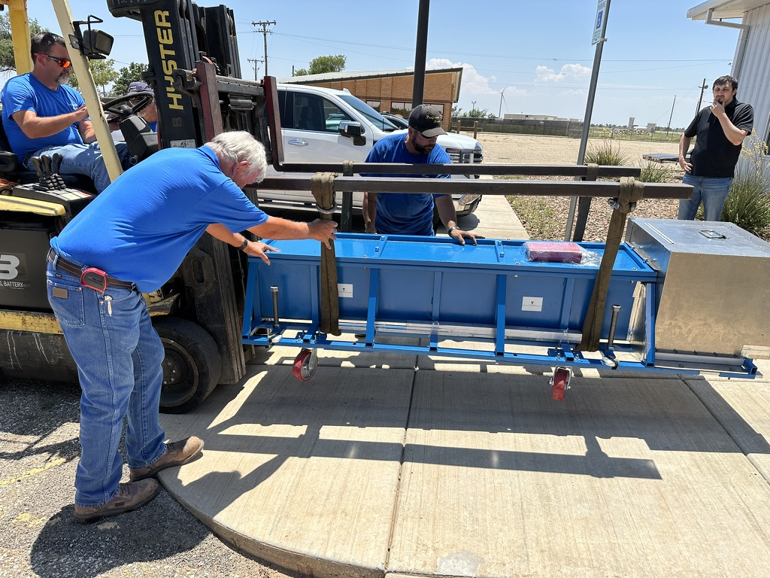
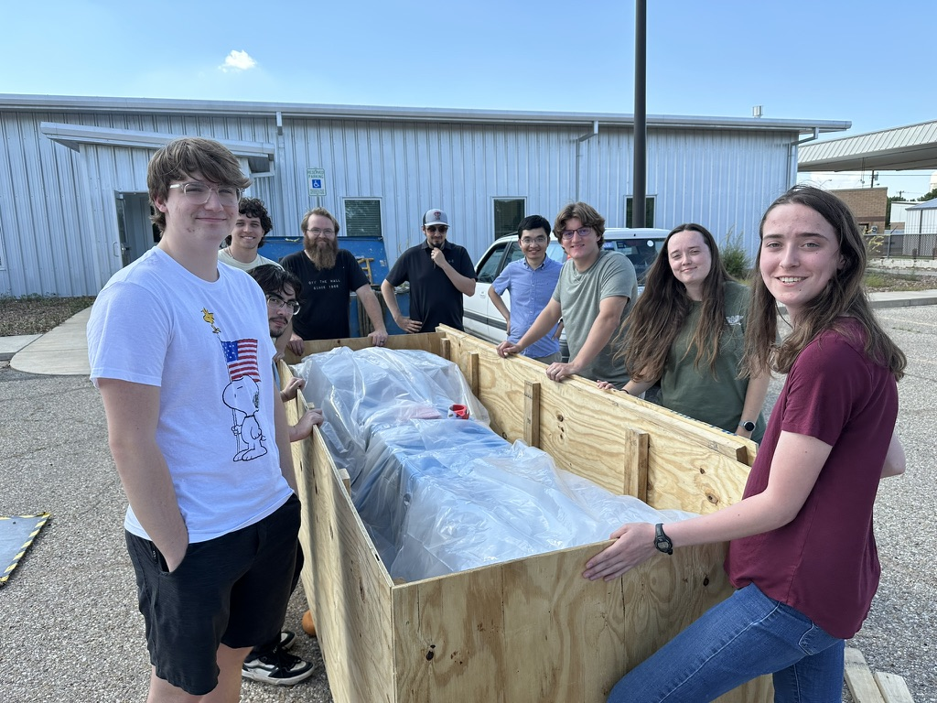
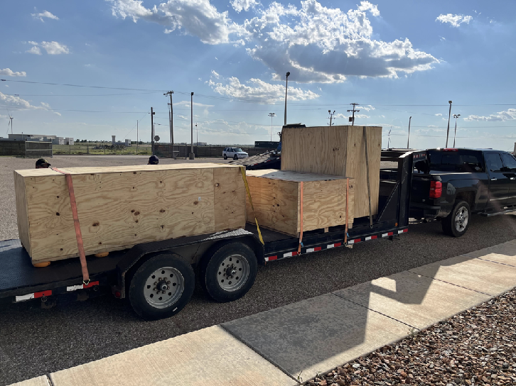
TTU Status Update
HG-DREAM is crated and shipped to CERN on July 9. There are two additional crates with misc hardware as well
We performed lots of cosmic runs (~160 GB, ~550K events) and data being analyzed
Arriving in early August 5/7 and departing on August 21 for the first test beam period (Aug 13-20): 12 TTU and 3 SLAC
Two step-down transformers for US 110 VAC power near sapphire table (Thanks to Giulia) are to be shipped

Slide 2
Sample Cosmic Events - DRS

