Slide 1



Adapting the Coffea Framework for FCC
Eglė Lenkaitytė
Mentors: David Lange, Prayag Yadav

Slide 2
Background
Bachelor’s in Physics – Vilnius University
Starting Master’s in Particle Physics and Astronomy this September – Vilnius University
Previously worked on a Drell-Yan study using CERN CMS Open Data
Mentors:
David Lange
Prayag Yadav

Slide 3
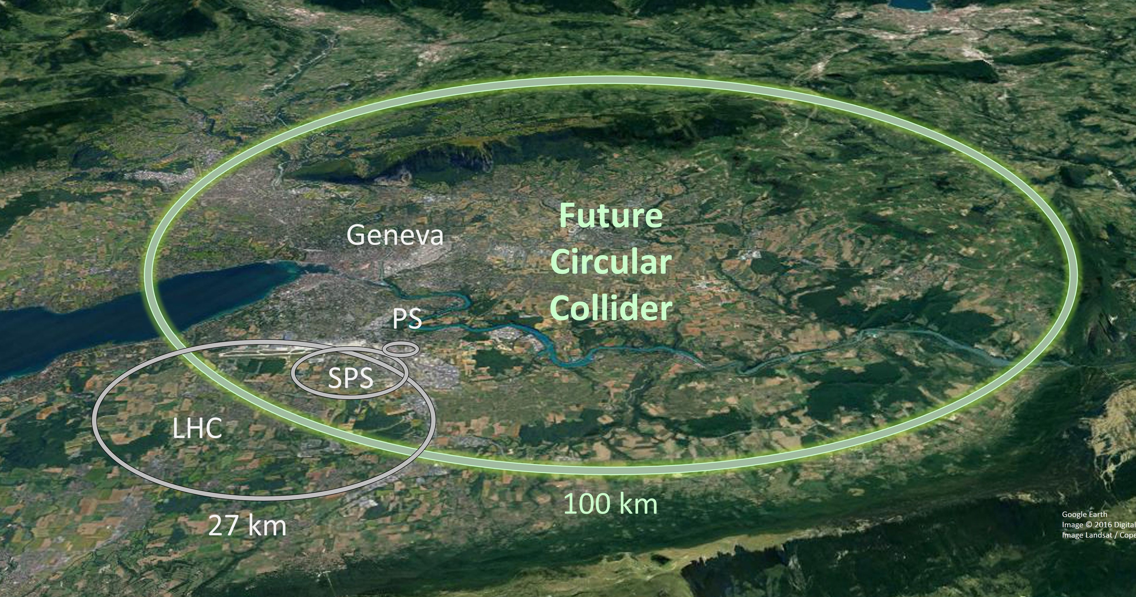
What is FCC
The Future Circular Collider (FCC) is a planned next-generation particle accelerator at CERN. With a potential to reach 100 TeV collision energies, increased data rates and more precision, FCC will open the way to greater understanding of fundamentals and the search for new physics beyond the Standard Model.

Slide 4
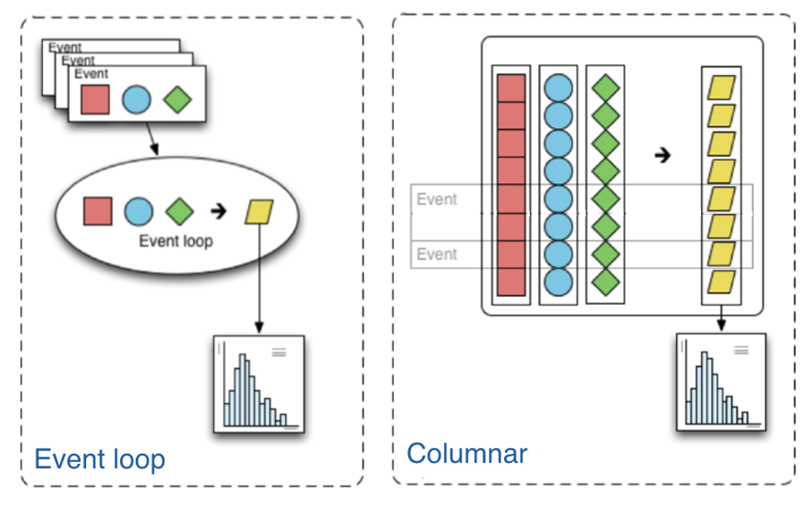
What is Coffea
The Columnar Object Framework For Effective Analysis (COFFEA) is a Python-based unified analysis toolkit for High Energy Physics (HEP) data. Coffea provides tools and components that simplify data analysis, enabling streamlined and reproducible HEP workflows.

Slide 5
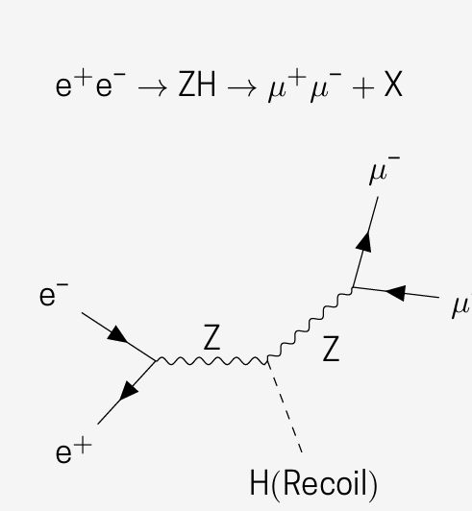
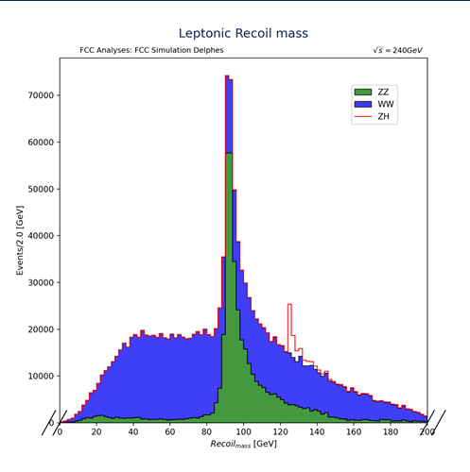
FCC ZH analysis using 4 lepton channel implemented in Coffea

Slide 6
Goal, progress and plans
Goal: create documented examples of using the Coffea analysis framework with FCC simulated data. This includes ensuring compatibility with the FCC software ecosystem (Key4hep and FCCSW) via the recently developed FCC schemas.
Progress: spent time learning NumPy, Awkward Array and Coffea, reviewed and analysed previous Coffea-based FCC analysis codes, successfully ran the analysis codes after setup, fixed errors encountered during execution.
Plans for now: start creating my own Coffea based FCC analysis code examples.

