Slide 1

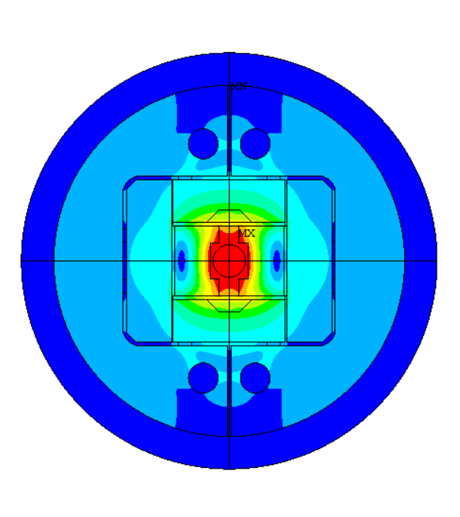
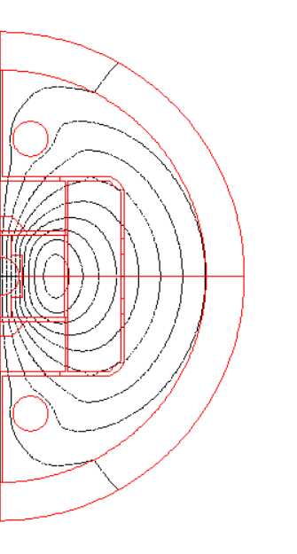
14T - Update on design
J. Ferradas Troitino, A. Haziot, E. Fernandez Mora, S. Izquierdo Bermudez,
E. Todesco and J.C. Perez
TE-MSC-SMT
July 2025

Slide 2
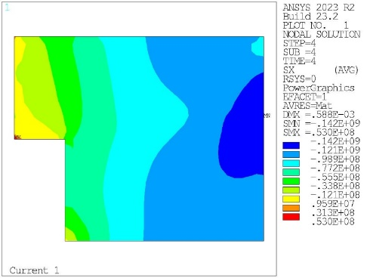
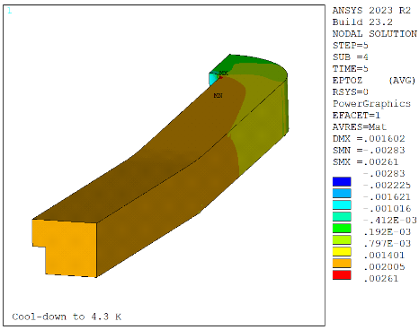
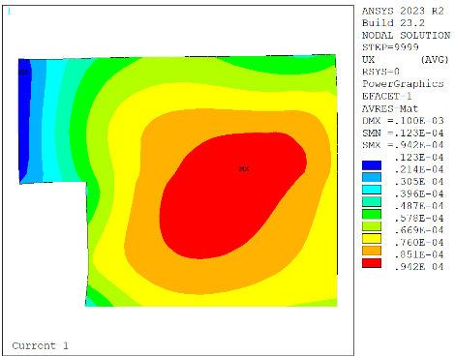
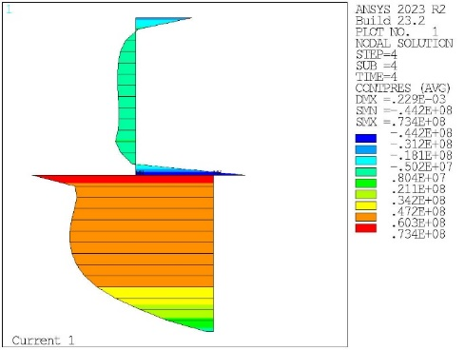
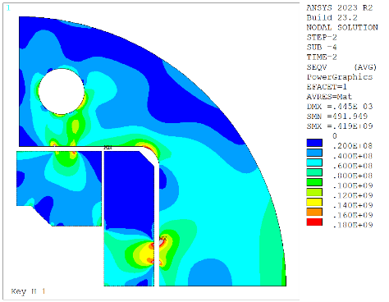
Intro - Mechanical analysis
Figures of merit
Coil stresses
Coil strain
Coil displacements
Coil contact pressure
Stress limits in the structure
Roughly:
Roughly:
Check the coil displacements during powering
Try to maintain an average contact pressure > 5 MPa while respecting the stress limits
All components below yield limits. We check S1 for brittle materials in first order
σ_{VM} < 120 MPa at RT
ε_{z} < 2000 µstr
σ_{VM} < 150 MPa at cold

Slide 3

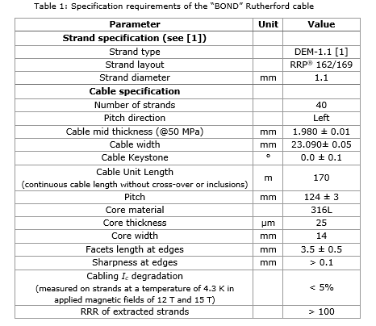

14 T Magnet design
Conductor parameters - UPDATED
40 strands x 1.1 mm
14 T Conductor

Slide 4
2D Mechanical analysis – Mat. Props.
MQXF Model
Coil |  |  |  | Stainless Steel |  |  |  | AlBr |  |  |  | Iron |  |  |  | Aluminum |  |  |  | G10 |  |  |  | Nitronic |  |  |  | Ti |  |  |  | HiMn Steel
 | 4.3 | 293 |  |  | 4.3 | 293 |  |  | 4.3 | 293 |  |  | 4.3 | 293 |  |  | 4.3 | 293 |  |  | 4.3 | 293 |  |  | 4.3 | 293 |  |  | 4.3 | 293 |  |  | 4.3 | 293
Ex | 20 | 20 |  | Ex | 210 | 193 |  | Ex | 120 | 110 |  | Ex | 224 | 213 |  | Ex | 79 | 70 |  | Ex | 30 | 30 |  | Ex | 225 | 210 |  | Ex | 130 | 130 |  | Ex | 210 | 193
Pr | 0.3 | 0.3 |  | Pr | 0.28 | 0.28 |  | Pr | 0.3 | 0.3 |  | Pr | 0.28 | 0.28 |  | Pr | 0.34 | 0.34 |  | Pr | 0.3 | 0.3 |  | Pr | 0.28 | 0.28 |  | Pr | 0.3 | 0.3 |  | Pr | 0.28 | 0.28
Alpx | 1.35E-05 |  |  | Alpx | 9.83E-06 |  |  | Alpx | 1.08E-05 |  |  | Alpx | 6.82E-06 |  |  | Alpx | 1.45E-05 |  |  | Alpx | 2.44E-05 |  |  | Alpx | 9.00E-06 |  |  | Alpx | 6.03E-06 |  |  | Alpx | 5.55E-06
Th. Strain | 3.89E-03 |  |  | Th. Strain | 2.84E-03 |  |  | Th. Strain | 3.12E-03 |  |  | Th. Strain | 1.97E-03 |  |  | Th. Strain | 4.18E-03 |  |  | Alpy | 2.44E-05 |  |  | Th. Strain | 2.60E-03 |  |  | Th. Strain | 1.74E-03 |  |  | Th. Strain | 1.60E-03
 |  |  |  |  |  |  |  |  |  |  |  |  |  |  |  |  |  |  |  | Alpz | 8.34E-06
 |  |  |  |  |  |  |  |  |  |  |  |  |  |  |  |  |  |  |  | Th. Strain | 7.04E-03
 |  |  |  |  |  |  |  |  |  |  |  |  |  |  |  |  |  |  |  | Th. Strain | 7.04E-03
 |  |  |  |  |  |  |  |  |  |  |  |  |  |  |  |  |  |  |  | Th. Strain | 2.41E-03

Slide 5
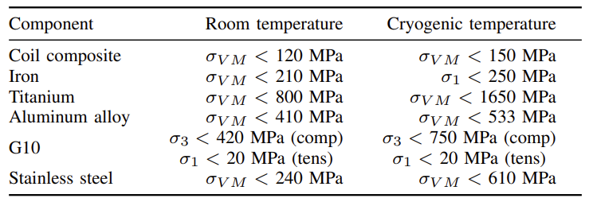
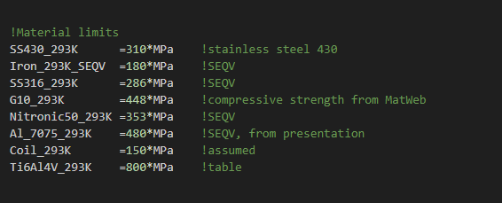
2D Mechanical analysis – Stress criteria
RMM

Slide 6
Outline
Conceptual design

Slide 7
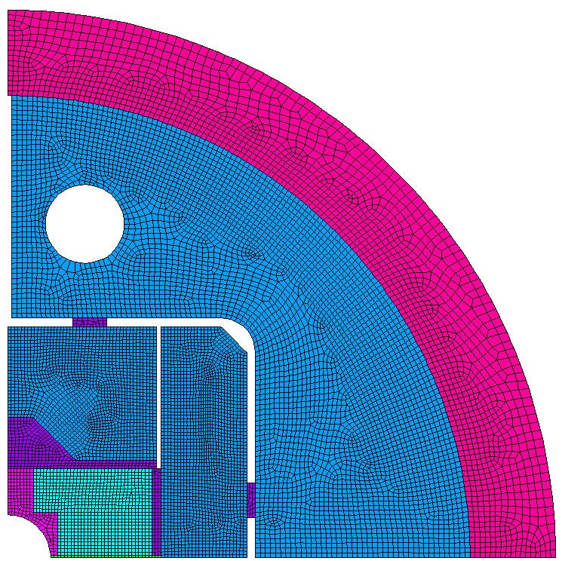
2D Mechanical analysis
Simplified geometry accounting for main features
Criteria
Use same modelling assumptions as MQXF, which we know well
Target similar coil peak stress limits at warm/cold as MQXF:
RT below 110 - 120 MPa
CD below 150 MPa
For reference, our MQXF reference preload gives in the model:
RT peak azimuthal stress = 80 MPa
CD peak azimuthal stress = 110 MPa
Gap = 100 µm

Slide 8
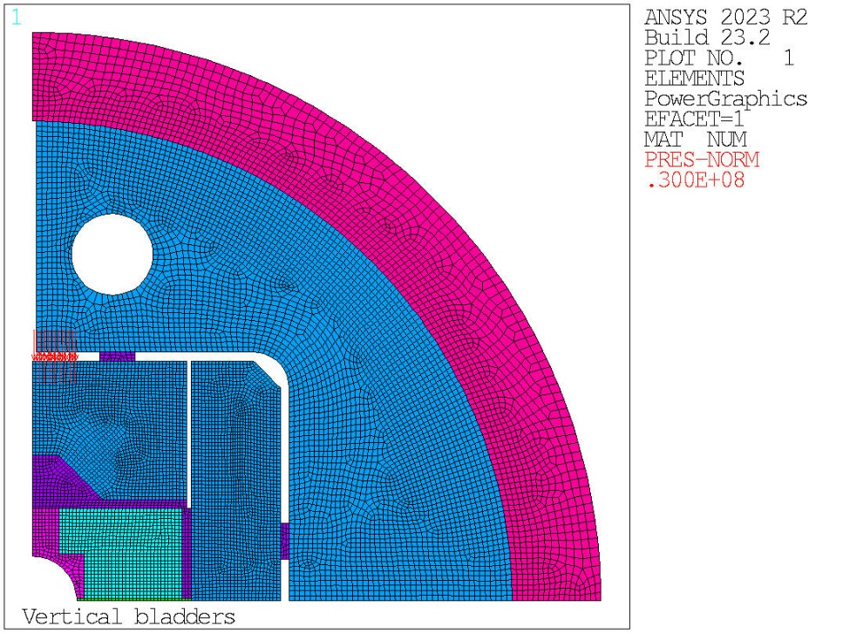
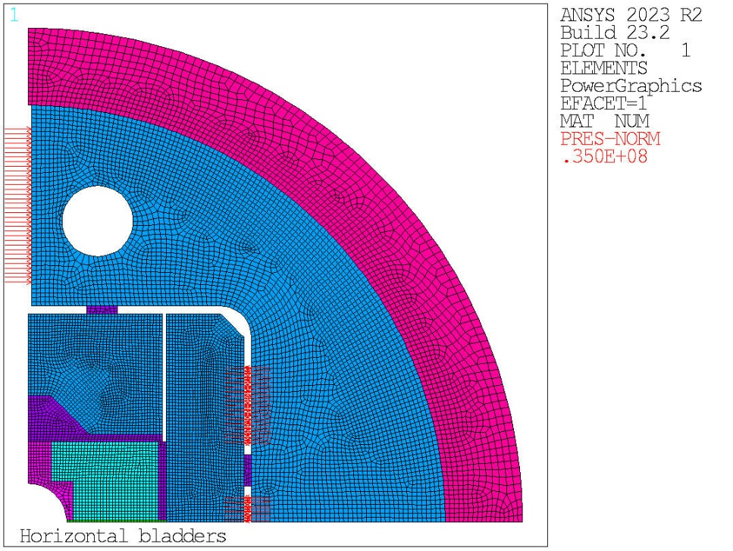
2D Mechanical analysis
Bladder positioning:
3 short bladders in the split yoke (horizontally)
One long and half short bladders in the Hpad (per quadrant)
Half long bladder in the vertical pad
Short bladders = 37 mm (34 mm active)
Long bladders = 54 mm (51 mm active)

Slide 9
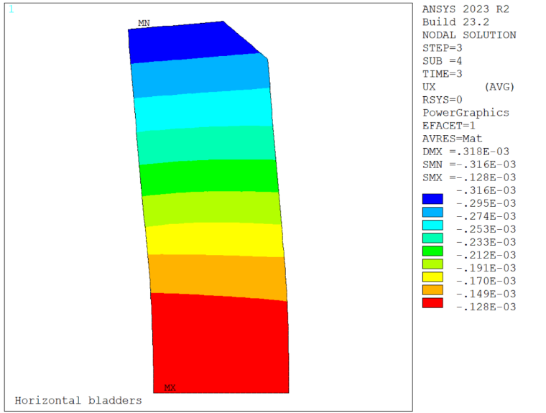
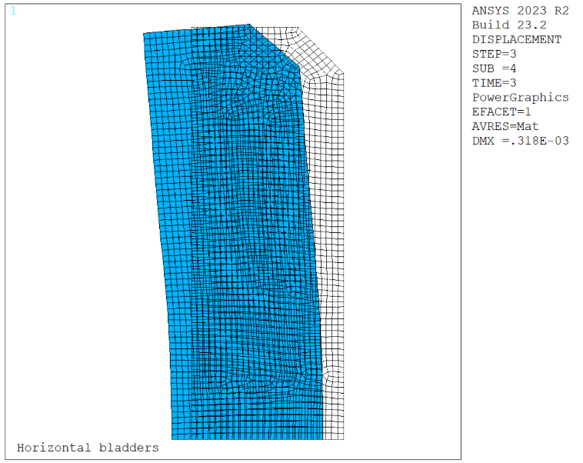
2D Mechanical analysis
The top bladder in the pad helps to open a larger clearance, we increase the bladder surface.
However it pushes in the non-supported part of the pad and creates a large bending. That’s why we’re obliged to have a very thick pad.

Slide 10
Outline
Engineering design version of the structure

Slide 11
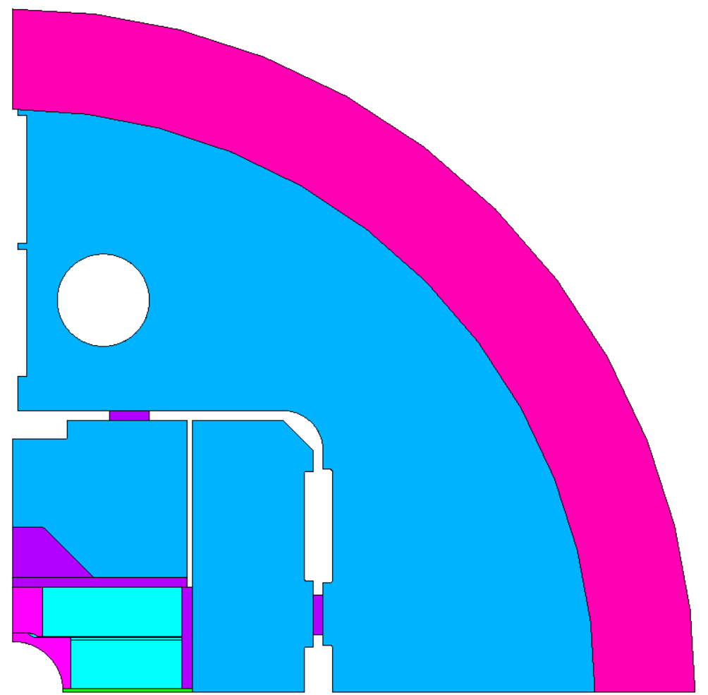
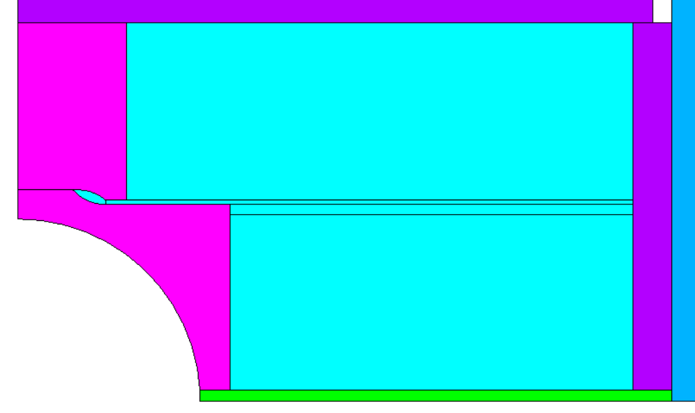
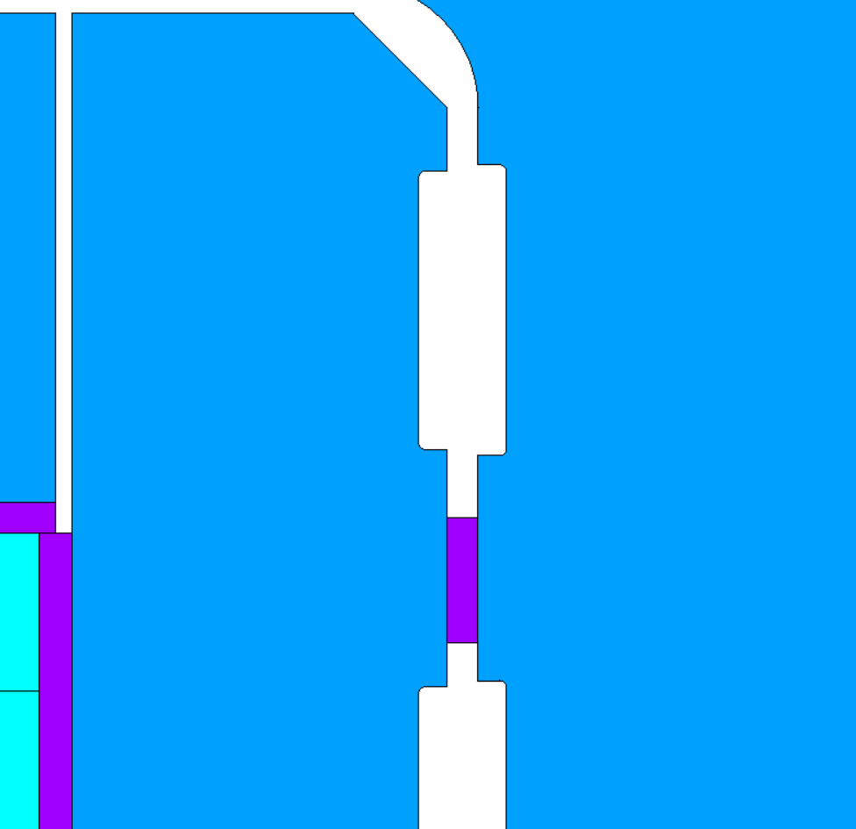
2D Mechanical analysis
New model accounts for:
New cable specification
Encapsulated bladders
Split pole

Slide 12
Figures of merit
Yoke OR = 290 mm
Shell thickness = 50 mm
Magnet OD = 680 mm
Hpad thickness = 60 mm
Bladder sizes as in the picture.
We have more shell thickness, so we gain more during CD.
We need less interference at warm and thus we need to open less clearance.
We come back to a small bladder at the midplane, which allows us to bring the interference key down.
3 large bladders
57 mm
Intermediate
47 mm
Small
37 mm

Slide 13
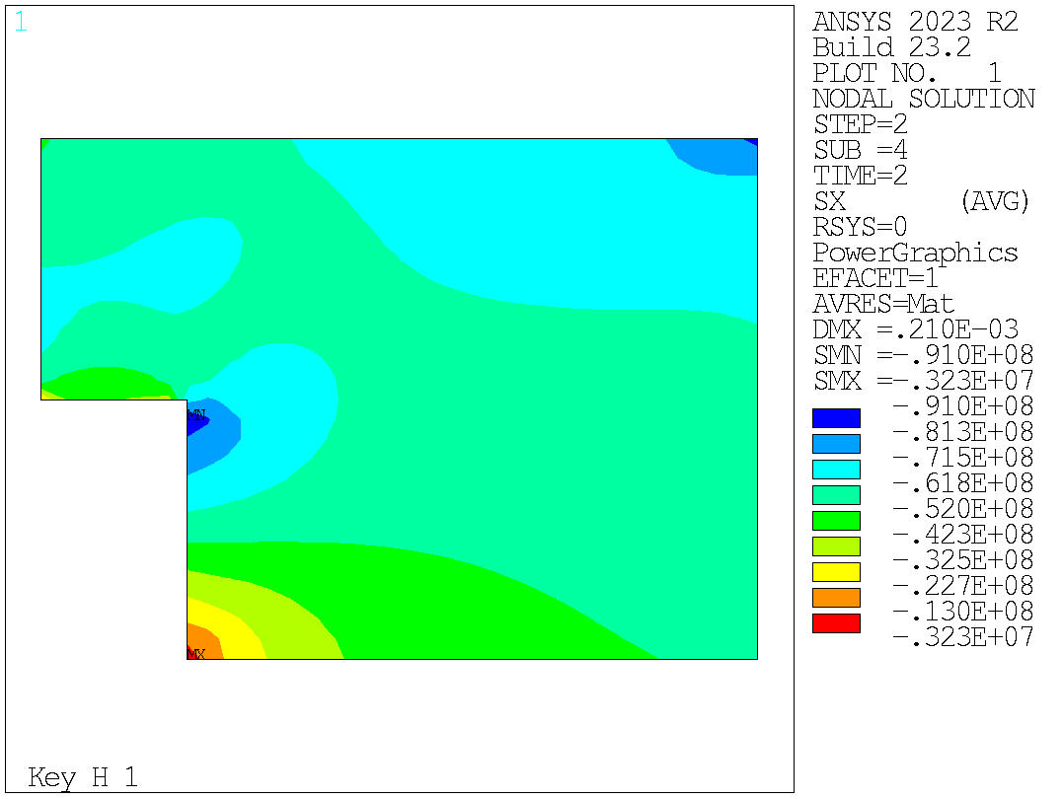
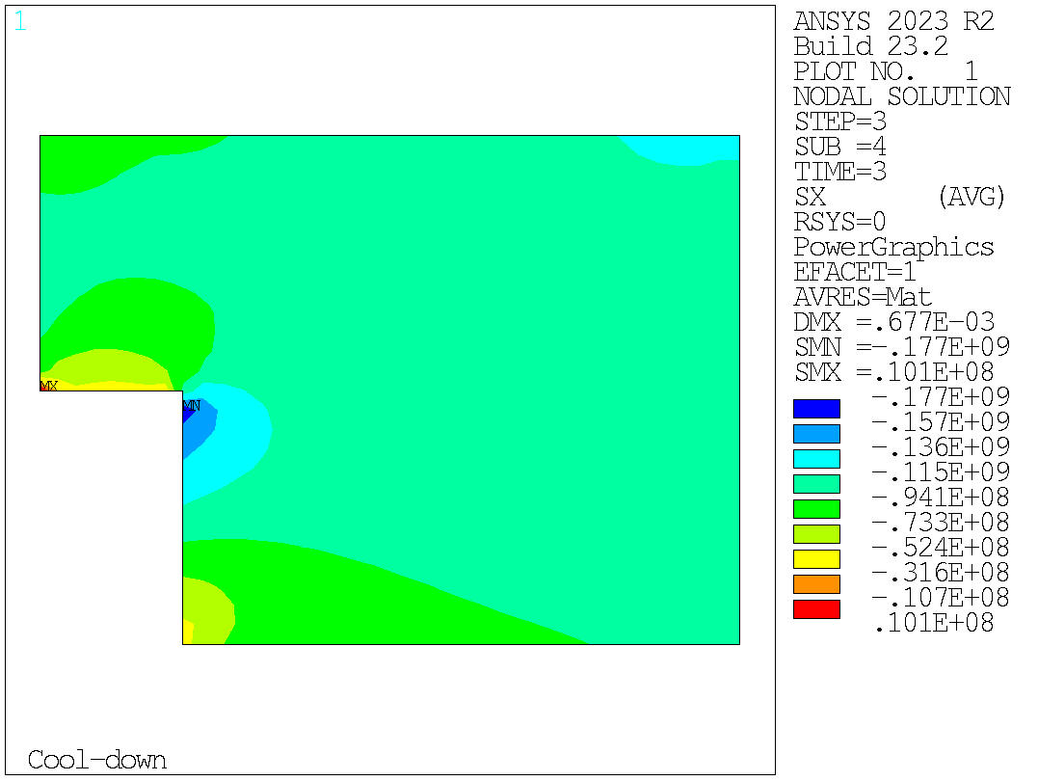
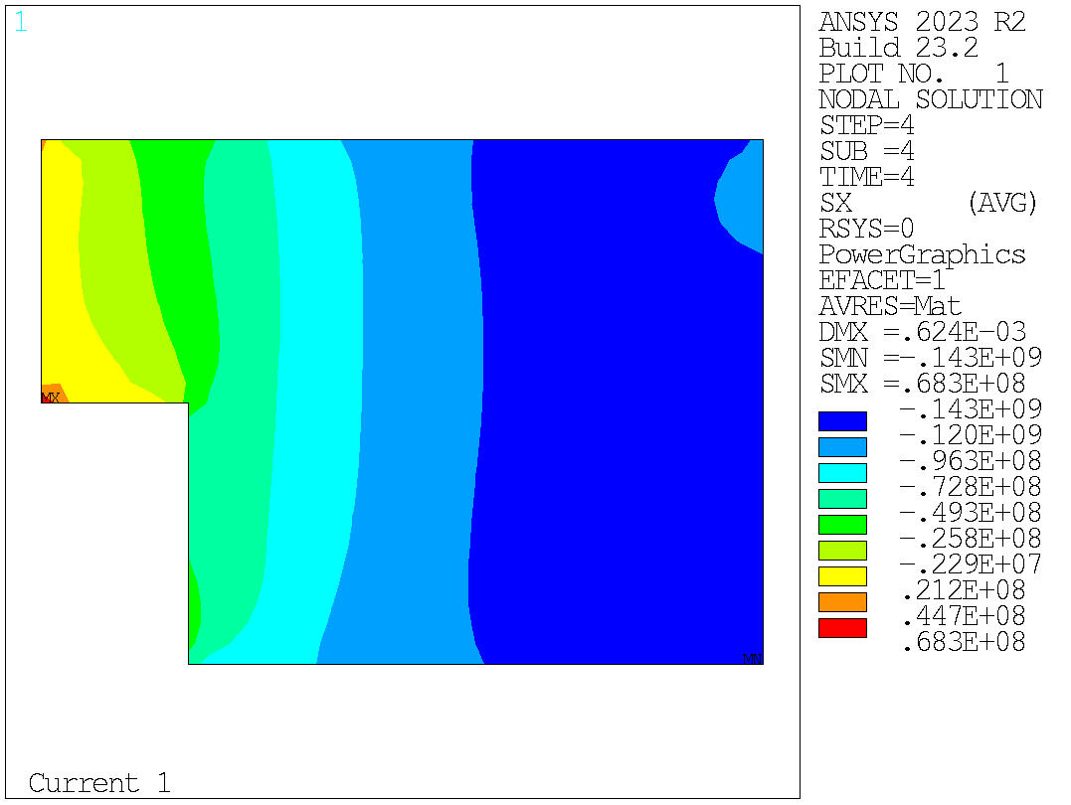
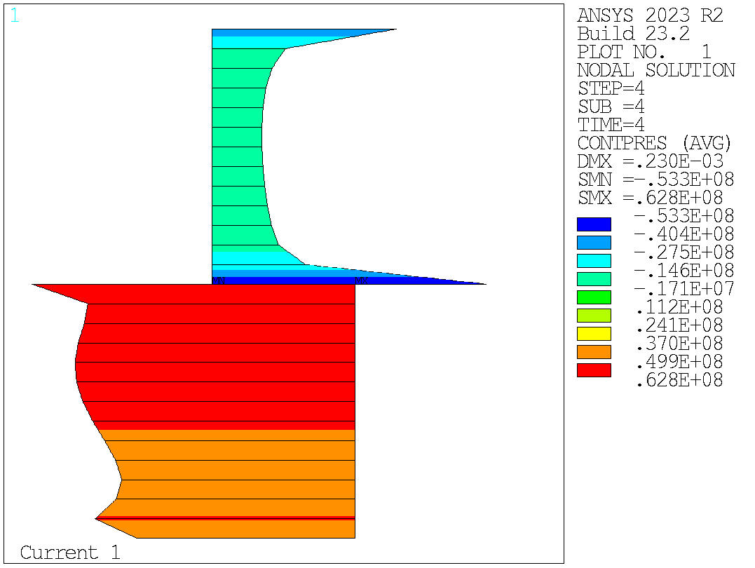
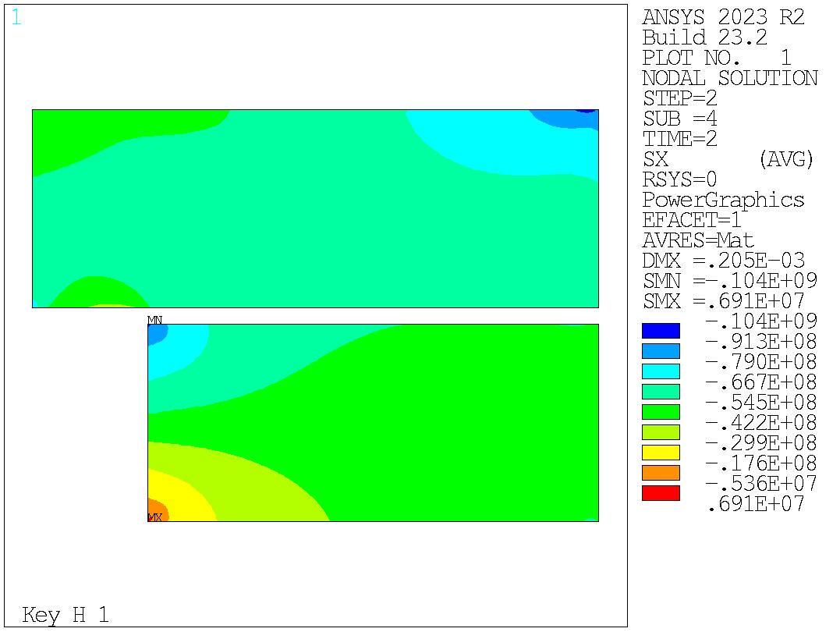
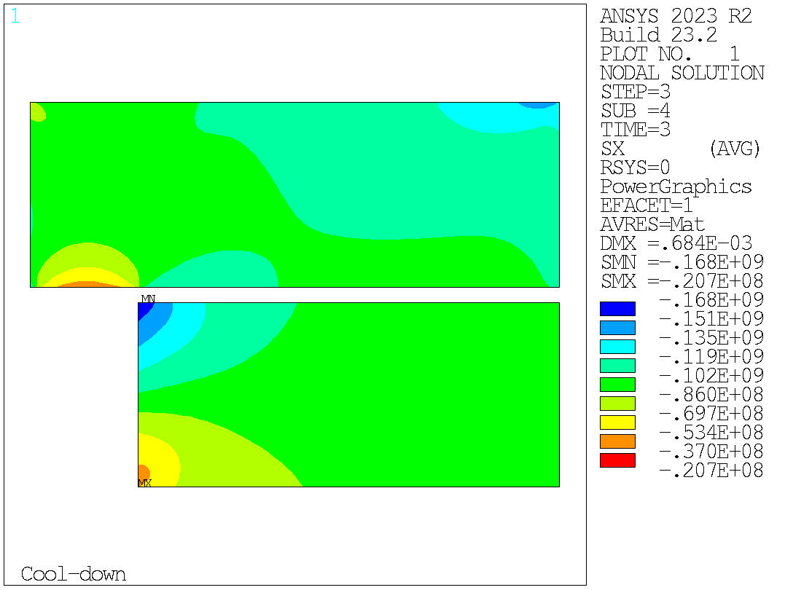
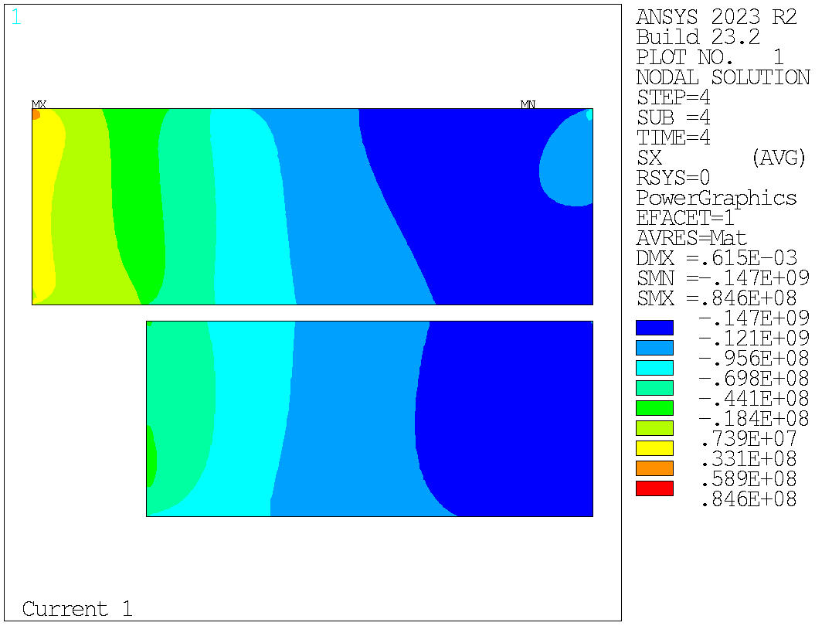
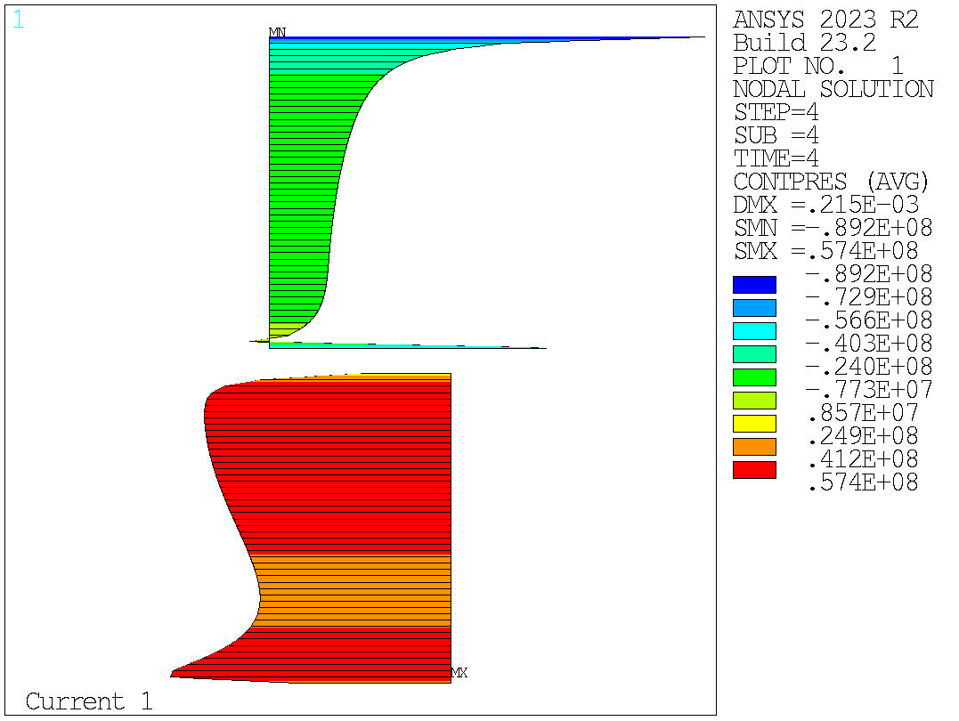
2D Mechanical analysis
Transverse stress (Horizontal)
Contact pressure at 14 T
Conceptual
Peak at RT = 91 MPa
Peak at CD = 177 MPa
Peak at 14 T = 143 MPa
Engineering design
Peak at RT = 104 MPa
Peak at CD = 168 MPa
Peak at 14 T = 147 MPa

Slide 14
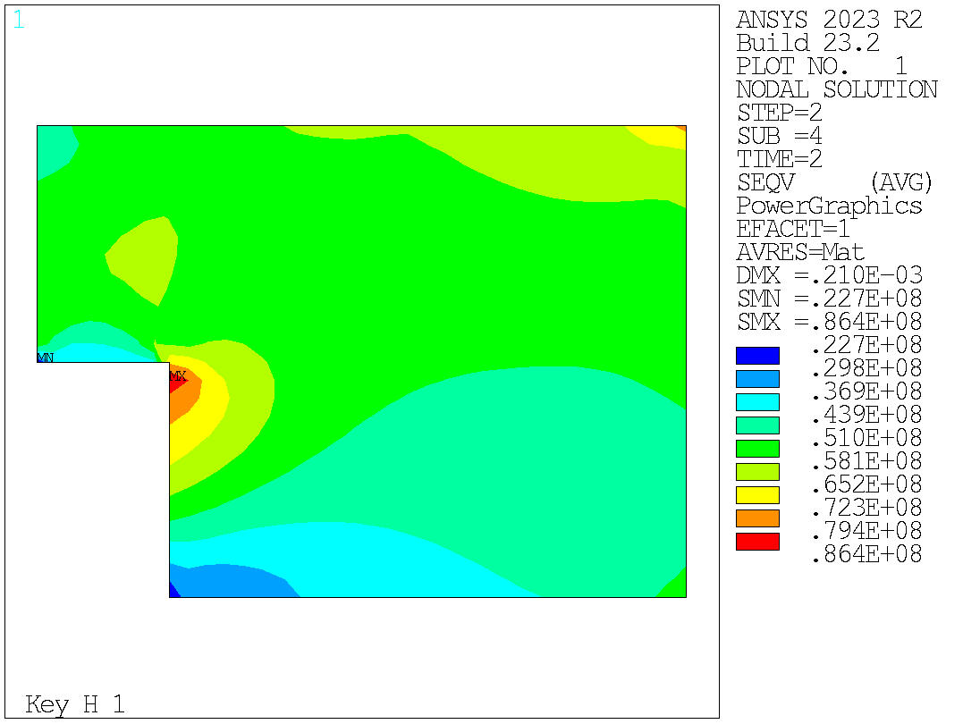
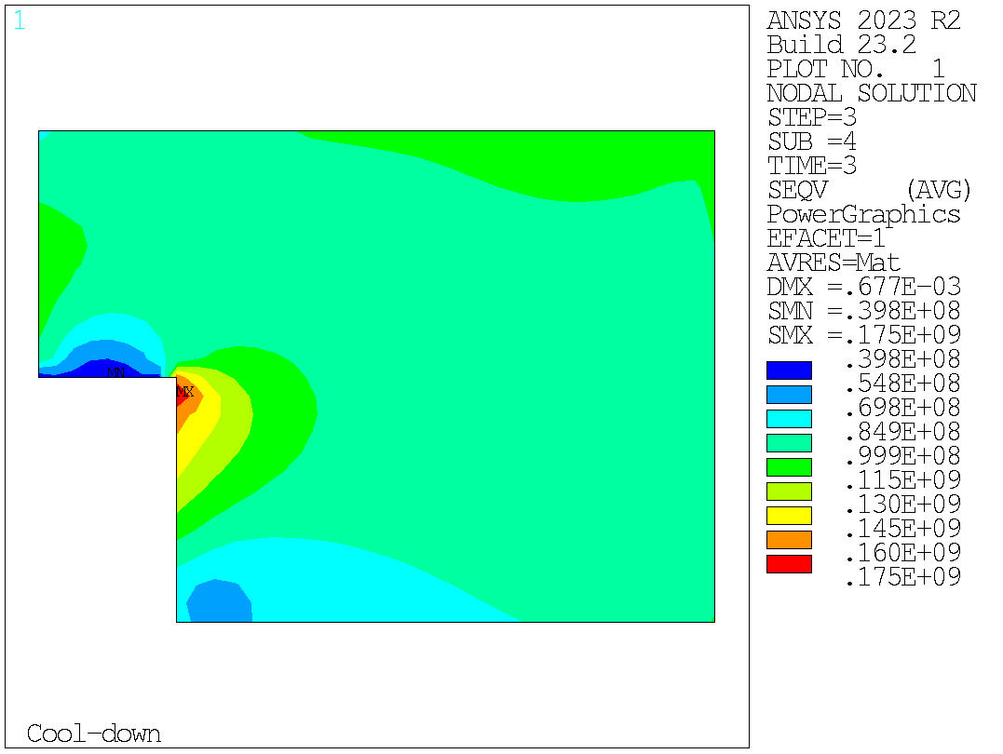
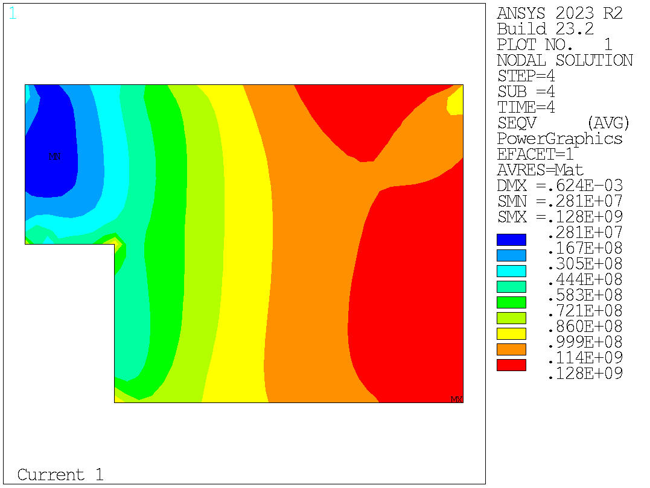
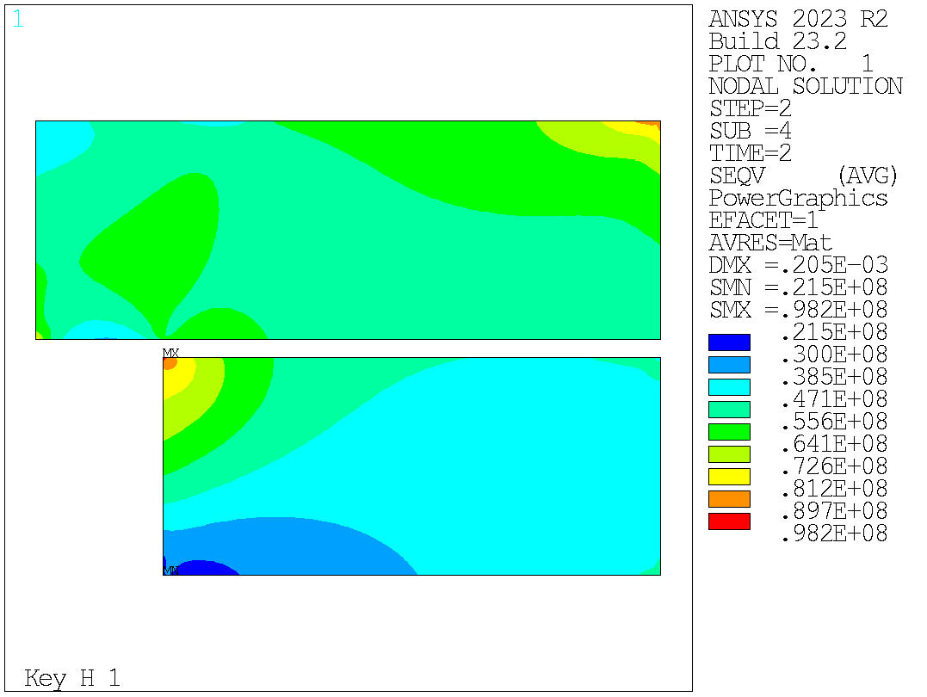
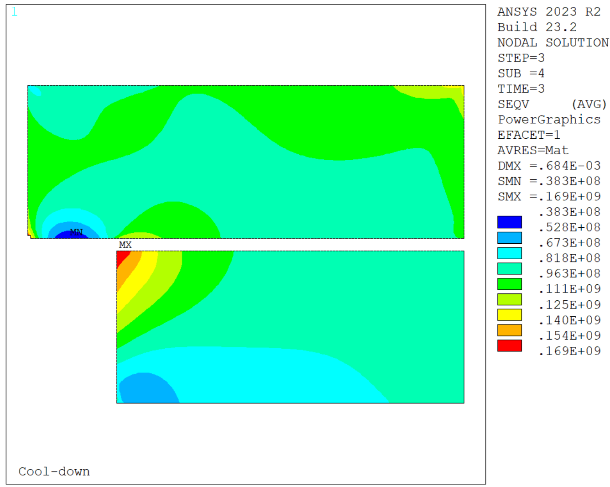
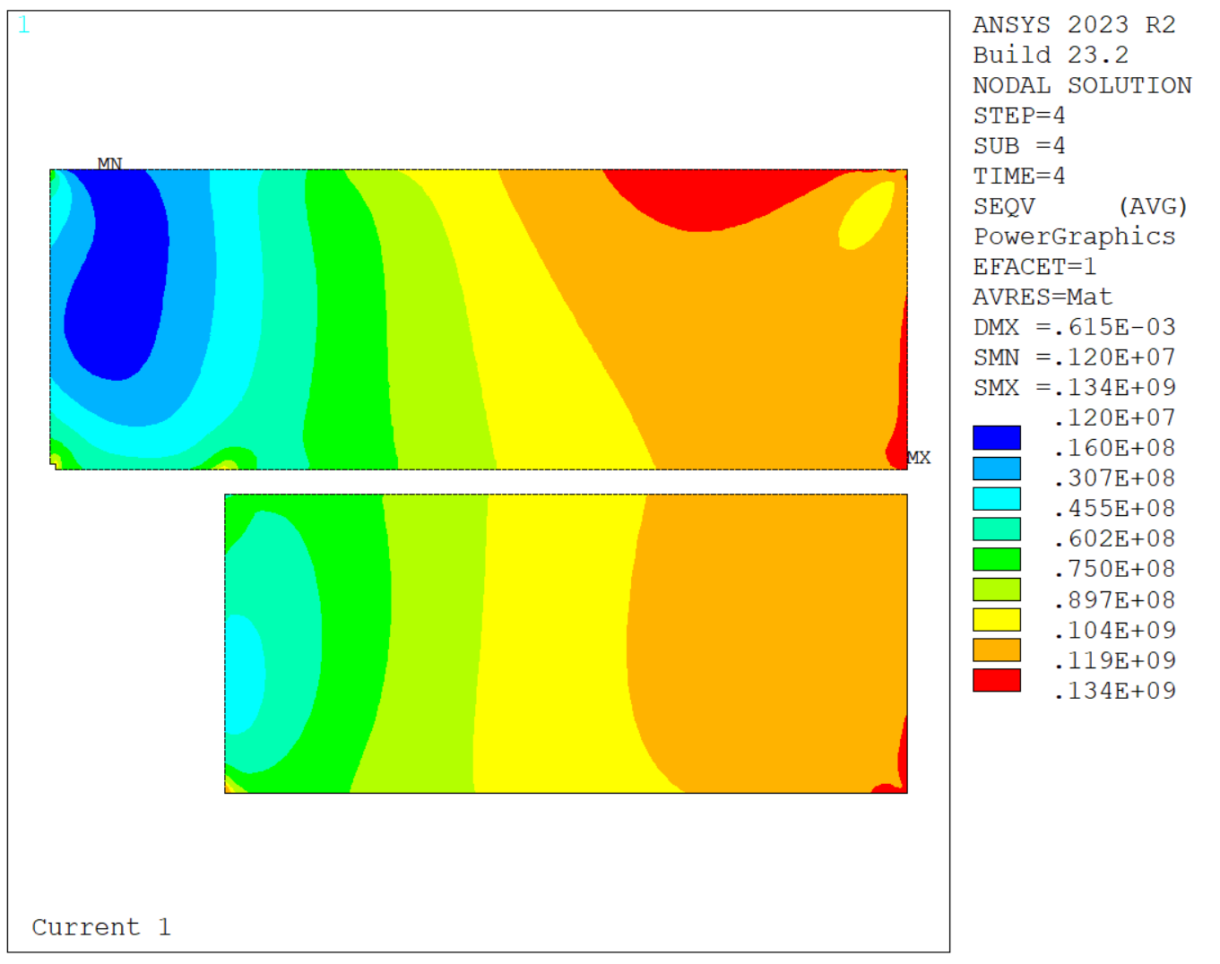
2D Mechanical analysis
VM Equivalent stress
Contact pressure at 14 T
Conceptual
Peak at RT = 86 MPa
Peak at CD = 175 MPa
Peak at 14 T = 128 MPa
Bladder
Peak at RT = 98 MPa
Peak at CD = 169 MPa
Peak at 14 T = 134 MPa

Slide 15
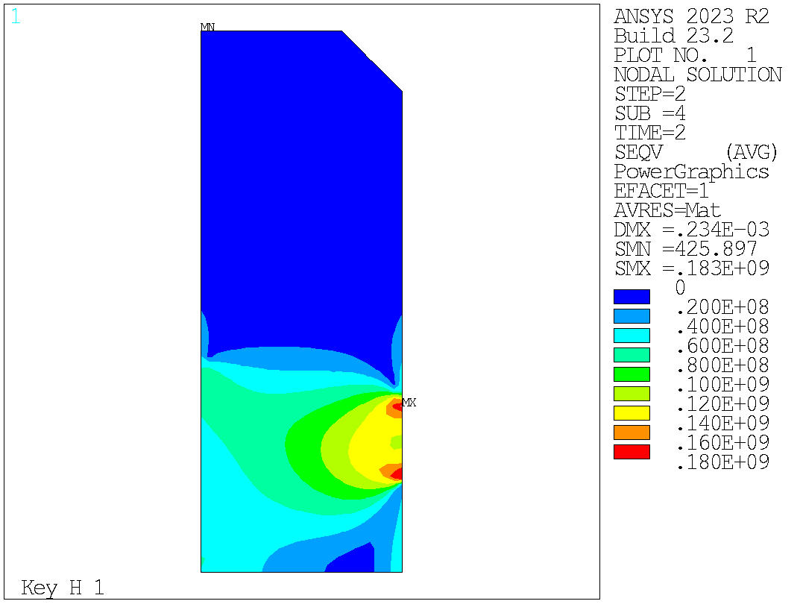
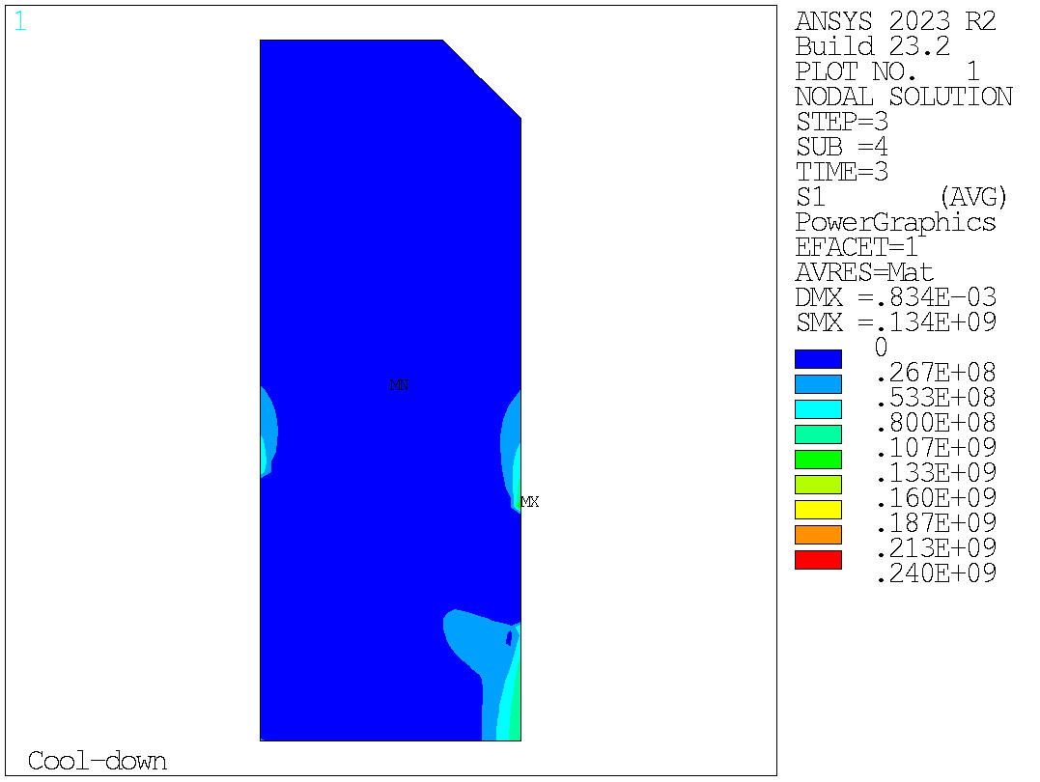
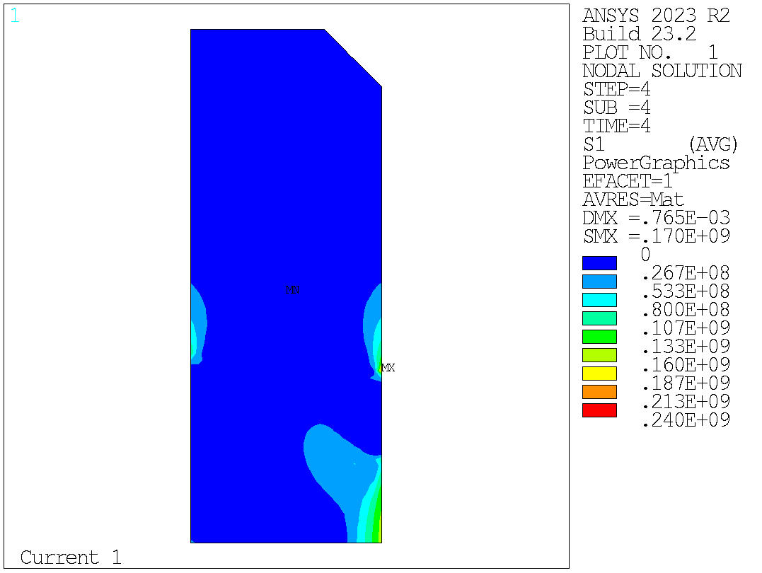
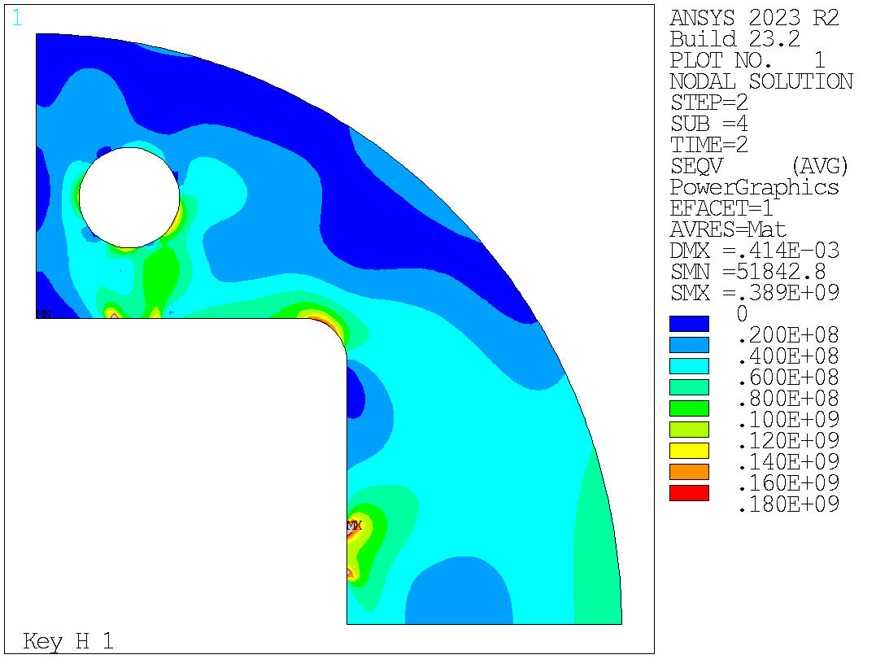
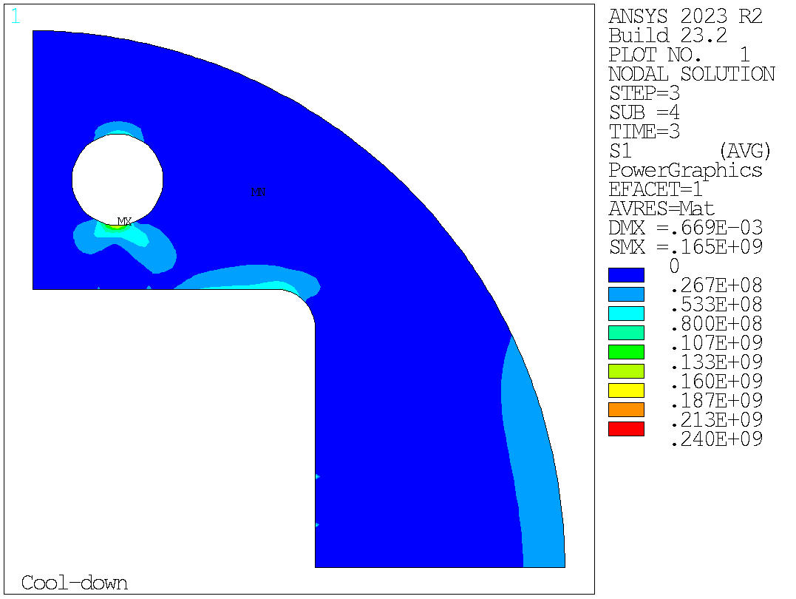
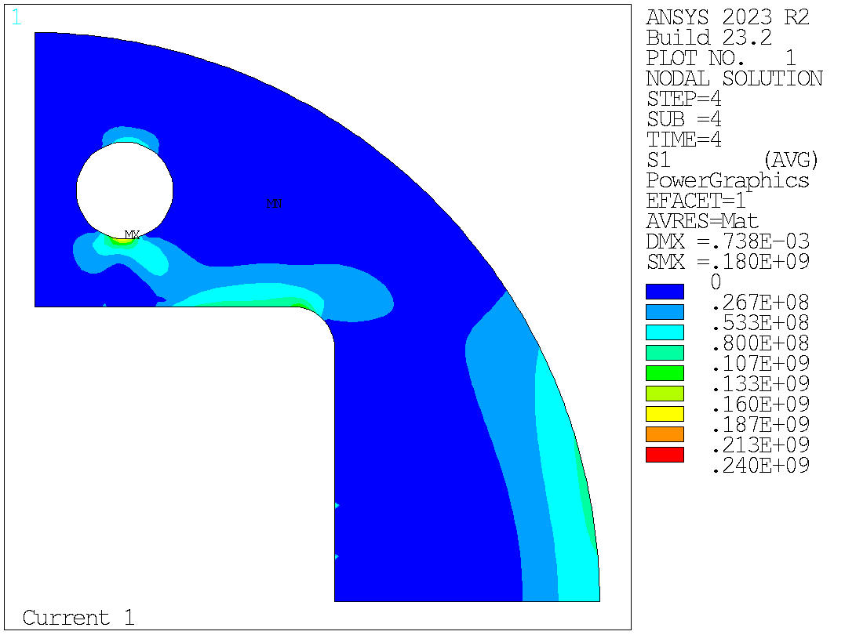
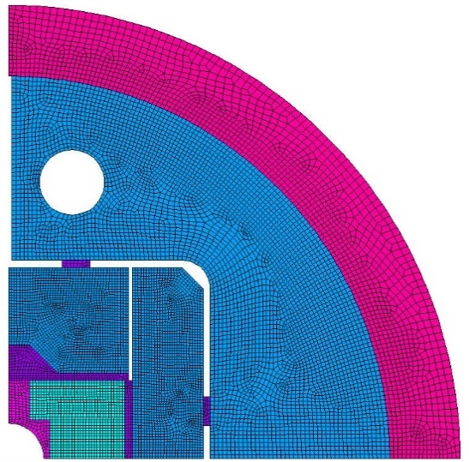
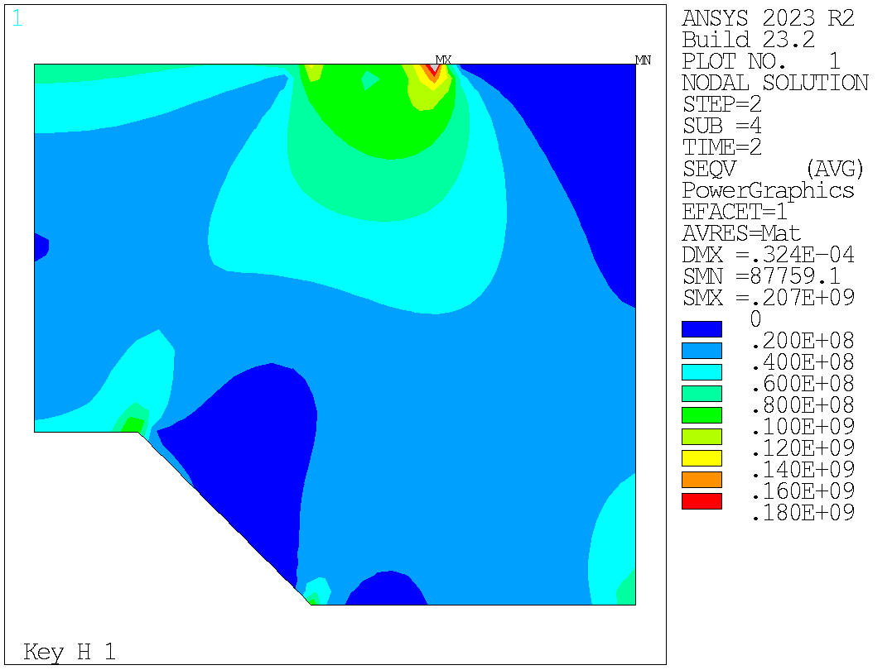
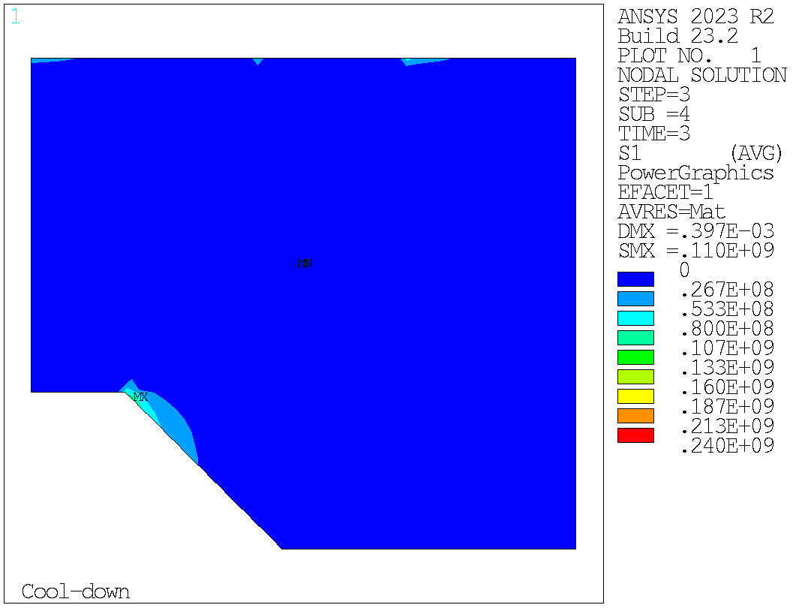
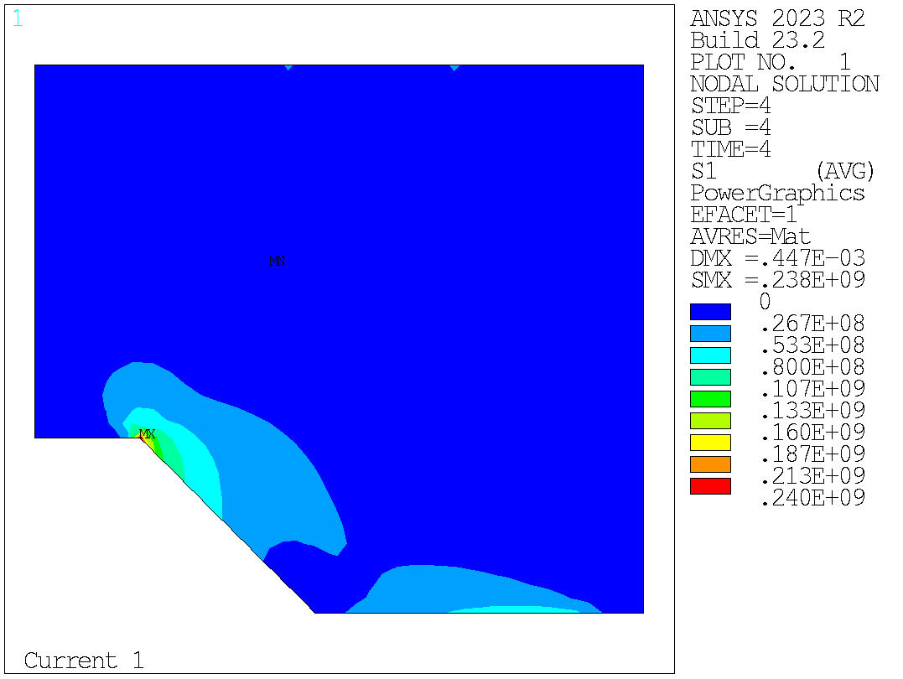
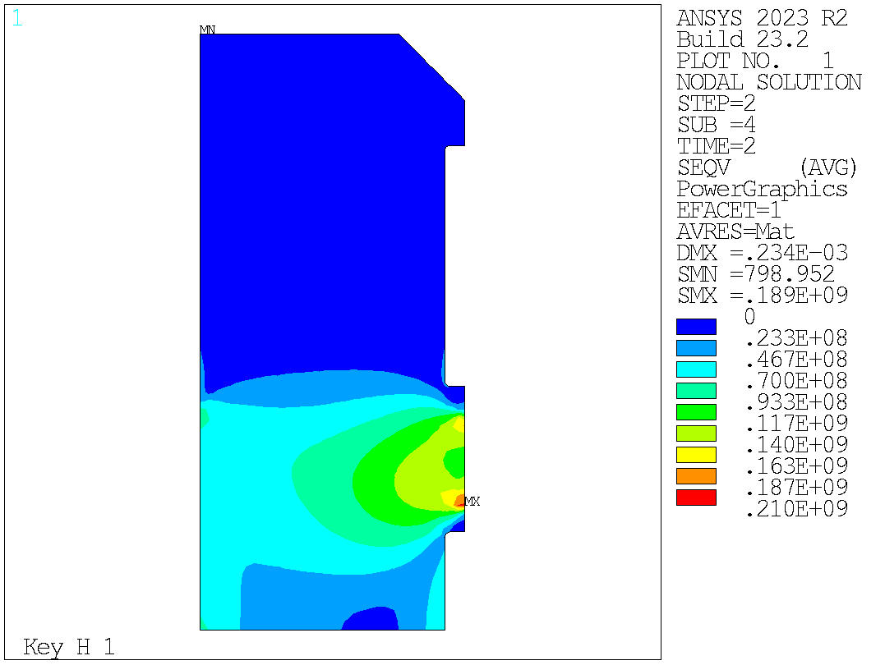
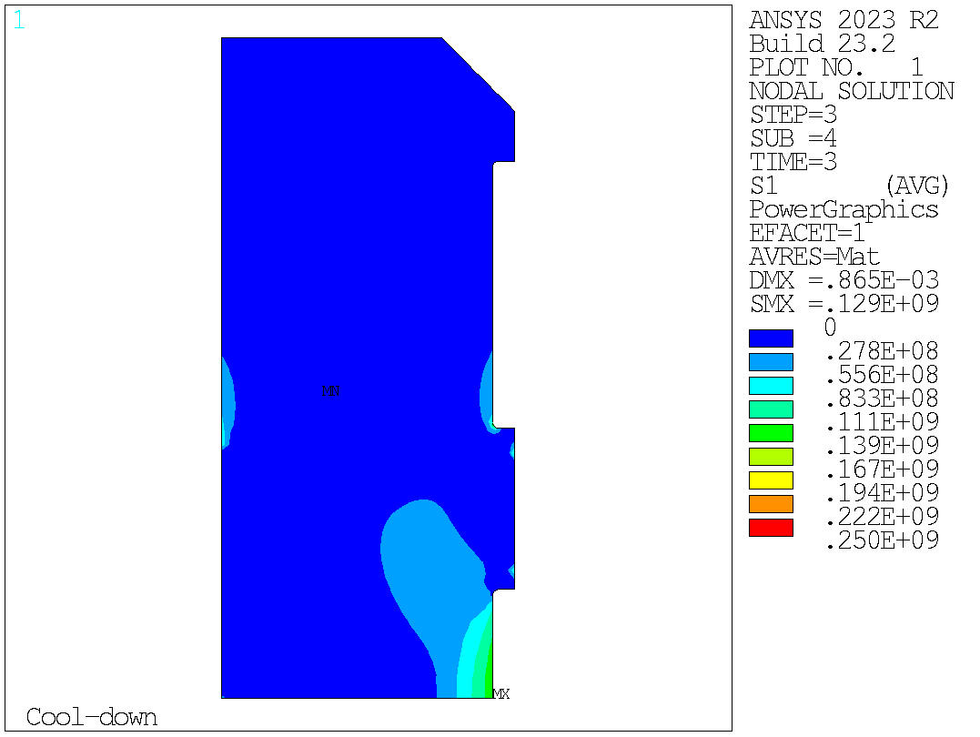
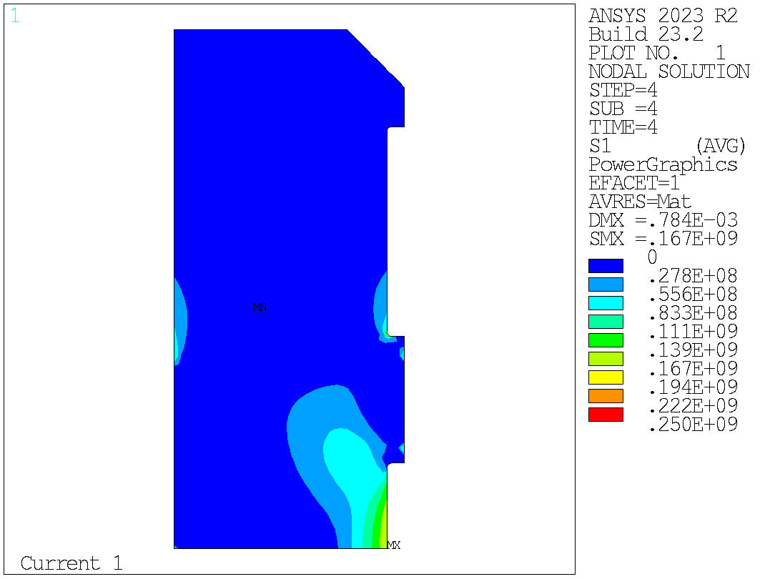
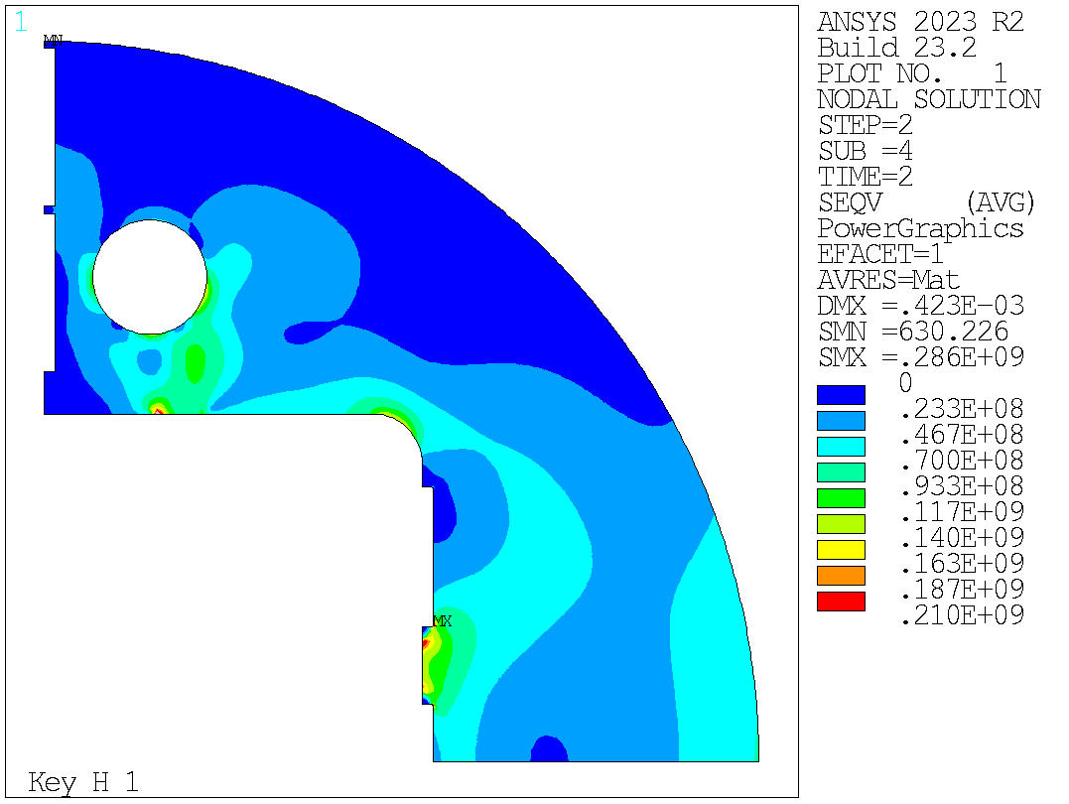
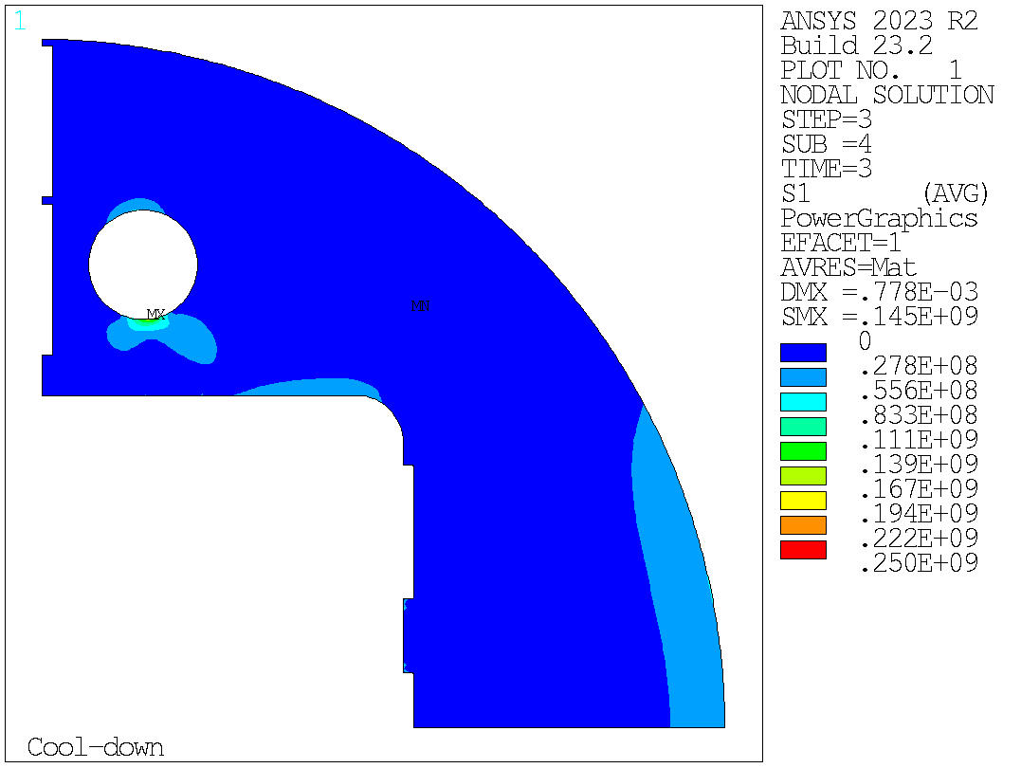
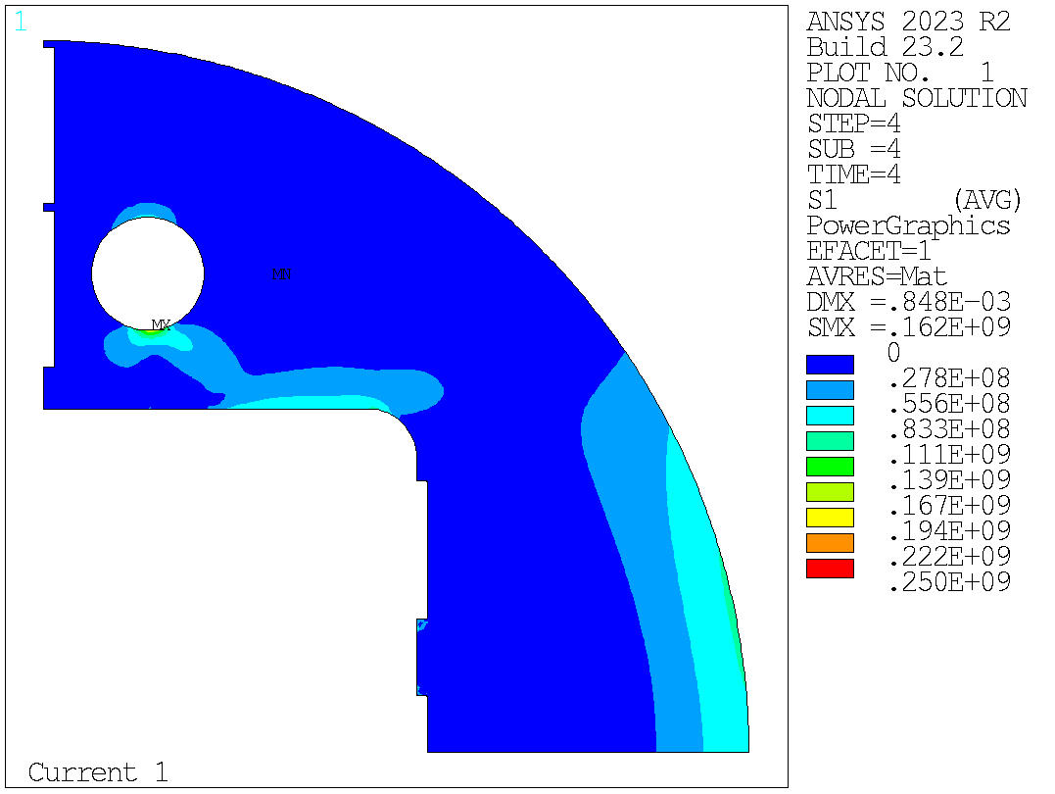
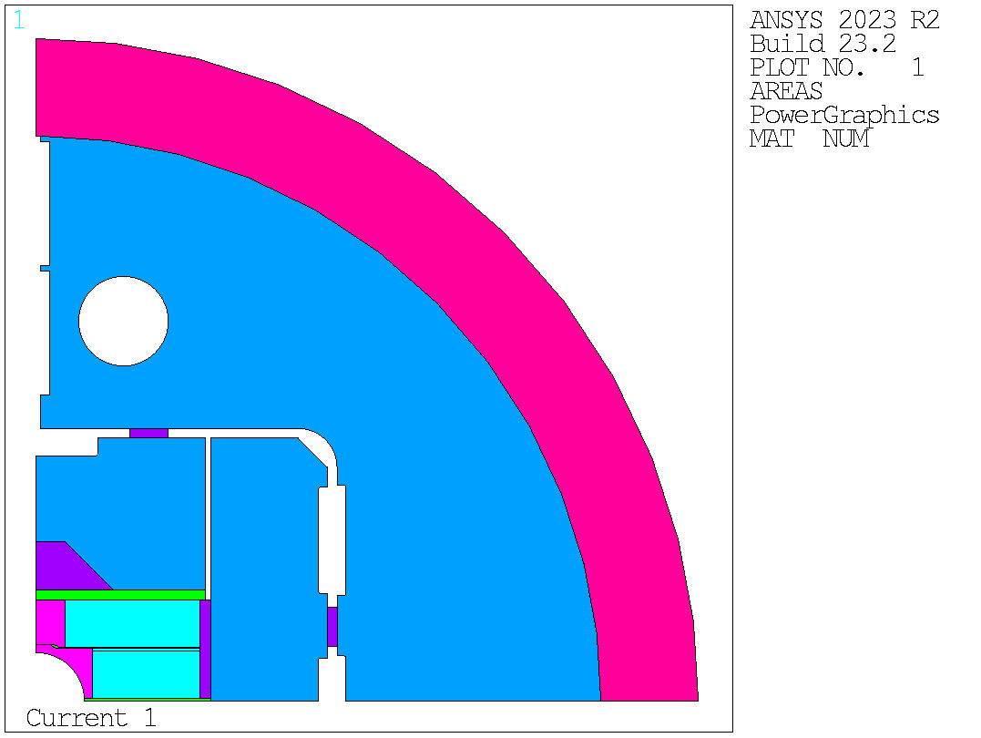
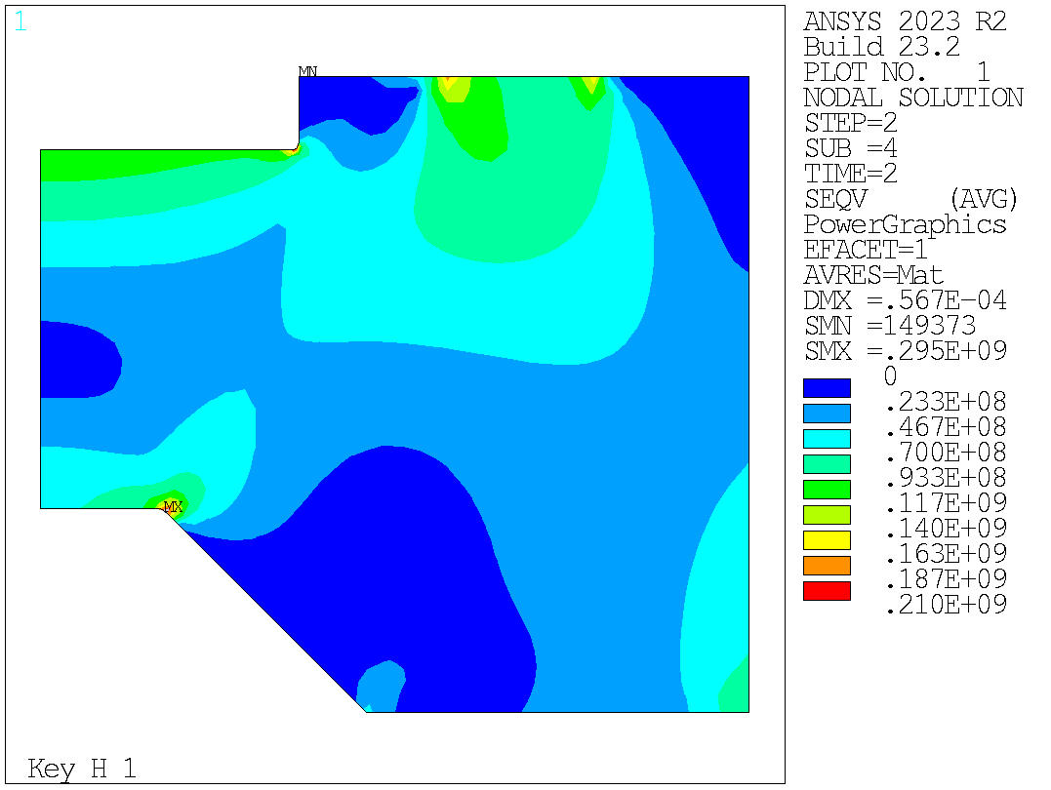


2D Mechanical analysis
VM Equivalent stress
Without bladder simulation

Slide 16
















2D Mechanical analysis
VM Equivalent stress
Step DisplcY DisplcX
1 153.1 -2.1
2 51.8 -0.7
3 42.3 837.5
4 45.3 636.7
Step DisplcY DisplcX
1 202.3 7.2
2 50.1 9.2
3 36.8 866.0
4 41.0 635.4
With bladder simulation

Slide 17




2D Mechanical analysis
VM Equivalent stress

Slide 18




2D Mechanical analysis
Conceptual:
Engineering design
Current = 20005 A.
Bore field = -13.9996405 T.
Peak field layer 2 = 14.7270832 T.
Peak field layer 1 = 14.1192093 T.
Current density = 330.725494 A/mm^2.
Current = 20005 A. Bore field = -14.0065861 T. Peak field layer 2 = 14.7078485 T. Peak field layer 1 = 14.2343845 T. Current density = 343.277084 A/mm^2.
F shell ratio (CD/Warm) = 2.22
Shell th. = 50 mm / Yoke OR = 270 mm
Interference = 0.65 mm
F shell ratio (CD/Warm) = 2.28
Shell th. = 50 mm / Yoke OR = 290 mm
Interference = 0.65 mm

Slide 19
2D Mechanical analysis
Conceptual:
Engineering design
Current = 20005 A.
Bore field = -13.9996405 T.
Peak field layer 2 = 14.7270832 T.
Peak field layer 1 = 14.1192093 T.
Current density = 330.725494 A/mm^2.
Current = 20005 A. Bore field = -14.0065861 T. Peak field layer 2 = 14.7078485 T. Peak field layer 1 = 14.2343845 T. Current density = 343.277084 A/mm^2.
F shell ratio (CD/Warm) = 2.22
Shell th. = 50 mm / Yoke OR = 270 mm
Interference = 0.65 mm
F shell ratio (CD/Warm) = 2.28
Shell th. = 50 mm / Yoke OR = 290 mm
Interference = 0.65 mm

Slide 20

2D Mechanical analysis
Conceptual:
Engineering design
Current = 20005 A.
Bore field = -13.9996405 T.
Peak field layer 2 = 14.7270832 T.
Peak field layer 1 = 14.1192093 T.
Current density = 330.725494 A/mm^2.
Current = 20005 A. Bore field = -14.0065861 T. Peak field layer 2 = 14.7078485 T. Peak field layer 1 = 14.2343845 T. Current density = 343.277084 A/mm^2.
Normalizing both with the same Fem
F shell ratio (CD/Warm) = 2.22
Shell th. = 50 mm / Yoke OR = 270 mm
Interference = 0.65 mm
F shell ratio (CD/Warm) = 2.28
Shell th. = 50 mm / Yoke OR = 290 mm
Interference = 0.65 mm

Slide 21
Outline
Structure limit

Slide 22




2D Mechanical analysis
15.5 T
1 mm interference
RT Assy:
Peak = 150 MPa
CD:
Peak = 206 MPa
14 T:
Peak = 190 MPa

Slide 23









2D Mechanical analysis
1 mm interference
RT Assy:
Peak = 204 MPa
RT Assy:
Peak = 200 MPa
Results without bladder simulation

Slide 24








2D Mechanical analysis
Step DisplcY DisplcX
1 305.2 6.0
2 50.0 9.2
3 31.6 1221.9
4 35.6 979.2
Peak = 220 MPa
With bladder simulation

Slide 25



2D Mechanical analysis
1 mm interference
Results without bladder simulation

Slide 26


2D Mechanical analysis
1 mm interference
Peak stress during bladders = 310 MPa
With bladder simulation

Slide 27



2D Mechanical analysis
VM Equivalent stress

