Slide 1
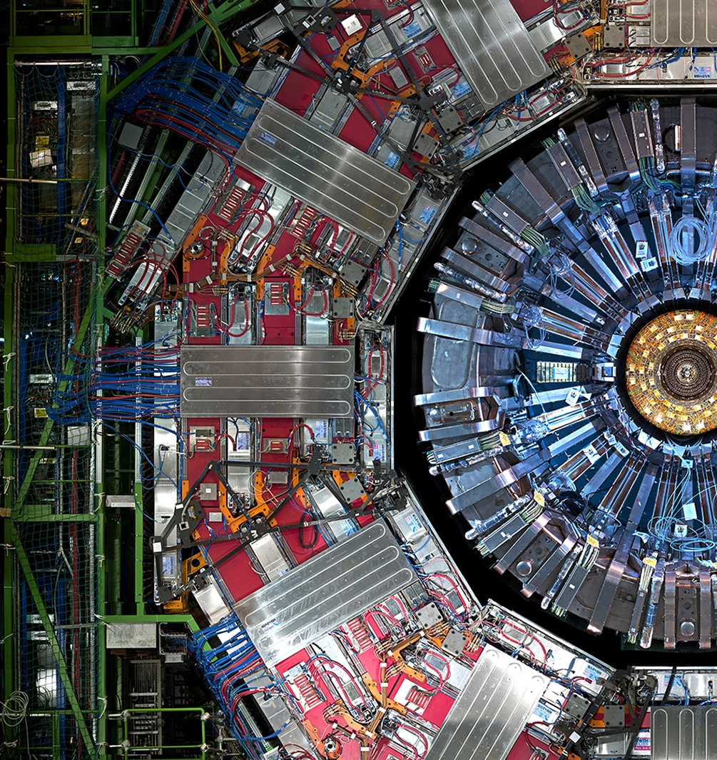
CMS – FGR DISTILLATION:
Costs, Status and Documentation
Damiano & Amin (17/07/2025)

Slide 2
INDEX
1. Recall of the simulation results
2. Project proposal (P&ID, 3D Model)
3. Material list and cost estimation
4. Status Update

Slide 3
PART 1: SIMULATION RESULTS
1. SIMULATION PURPOSE..
- For the mixture R134a, iC4H10, SF6, N2 (94.7%/4.5%/0.3%/0.5%) we want to build a plant for the recuperation of R134a.
- A comparison between the classic buffer config. and the distillation column will be simulated with ASPEN Plus.
2. SIMULATION STEPS
- Search of the most proper thermodynamic model
- Perform sensitivity analysis to find best purity and recovery for each system
- Provide accurate results

Slide 4
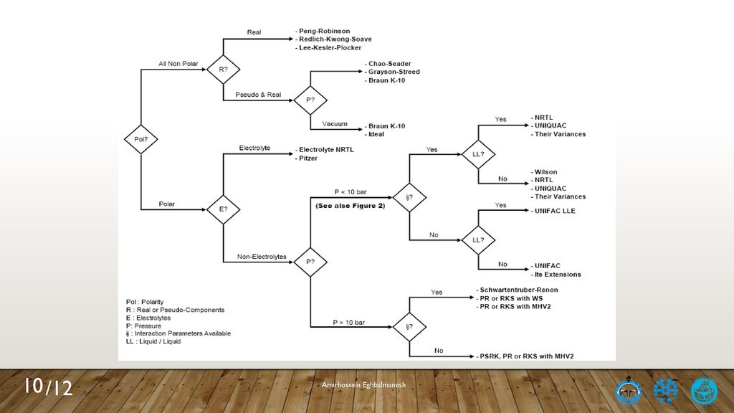
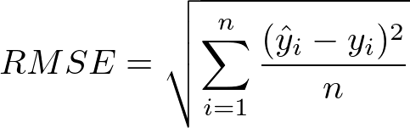
SELECTION OF THERMODYNAMIC MODEL
will focus on evaluating several candidate models: REFPROP, NRTL, NRTL-HOC, and NRTL-RK,
- Unfortunately, we only found three experimental datasets for the couple R134a/iC4H10 corresponding to three different temperatures: 293 K, 303 K, and 323 K.
- For each of these datasets, we will calculate the RMSE between the predicted pressures from each thermodynamic model and the corresponding experimental pressures.
-The model that presents the lowest RMSE across these temperature conditions will be chosen as the most suitable for our research.

Slide 5
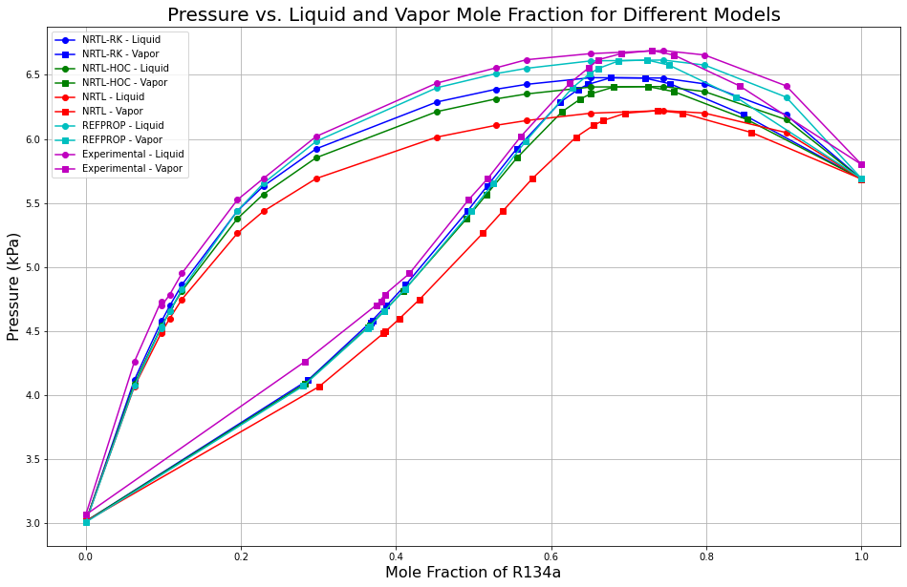
THERMODYNAMIC MODELS CONFRONT
- Five thermodynamic models have been compared to understand which of them has the best fitting with the experimental data of the binary mixture R134a/iC4H10 --> NRTL, NRTL-HOC, NRTL-RK, REFPROP.
In this picture, only dataset at 293 k is reported.
- The best model is the one that has the minimum RMSE which, in this case, is REFPROP
RMSE NRTL-RK = 0.15
RMSE NRTL-HOC = 0.20
RMSE NRTL = 0.330
RMSE REFPROP = 0.11

Slide 6
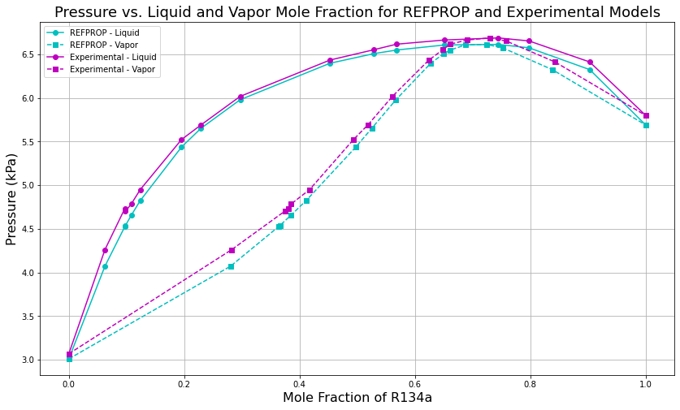
Pxy confront REFPROP and Experimental data
- REFPROP seems to be the most appropriate one for the couple R134a/iC4H10.
- For this configuration the RMSE of REFPROP is the lowest for the couple R134a/iC4H10.

Slide 7
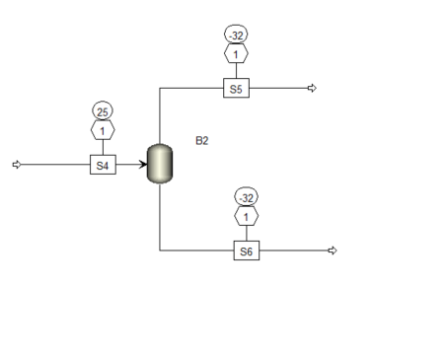
SINGLE BUFFER SIMULATION
Distillate flowrate: 190l/h
R134A : 74%
IC4H10 : 13%
SF6: 2%
N2: 11%
- Temperature of the Buffer : -32 °C
- Pressure inside the Buffer : 1 bar
- Purity achieved : 96 % of R134a
- Molar recovery of R134a :80%
- Thermal duty : -0,177 KW
- Bottom/Feed Ratio : 95%
- Distillate/Feed Ratio : 5%
Inlet flowrate : 600 l/h
R134A : 94.7%
IC4H10 : 4,5%
SF6: 0, 3%
N2: 0.5%
Bottom flowrate : 410 l/h
R134A : 95.7%
IC4H10 : 4.1%
SF6: 0.2%
N2: negligible (10e-11)
Why this temperature was chosen?

Slide 8
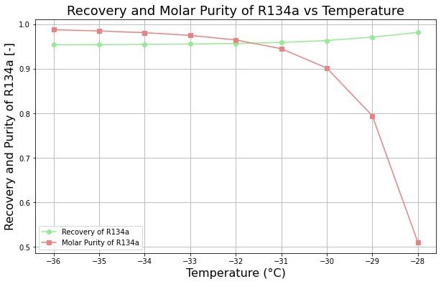
TEMPERATURE VARIATION IN THE BUFFER
A sensitivity analysis reveals that as the temperature increases, the molar recovery of R134a in the bottom stream (S6) improves from (95% to 98 %) , while the molar purity of R134a correspondingly decreases from (98.7% to 50%).
-As long as the best trade off between molar purity and recovery is reached at a temperature of -32 °C, this temperature is chosen as operative temperature.

Slide 9
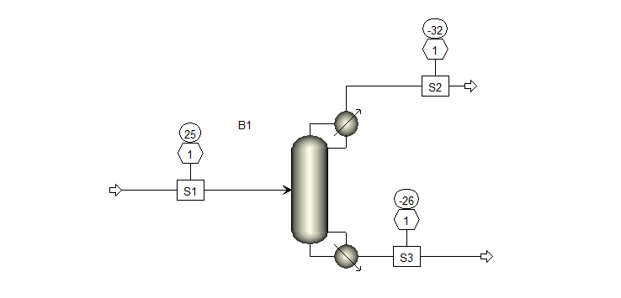
SINGLE DISTILLATION COLUMN
Distillate flowrate: 100 l/h
R134A : 70%
IC4H10 : 25%
SF6: 2%
N2: 3%
Distillation column optimized performances for R134a system
Condenser duty : -0,258 KW
Reboiler duty : 0,115 KW
Reflux ratio : 10
Boilup ratio : 0,9
Feed stage : 4 (above stage )
N stage : 5
Purity of R134a in the bottom stream 99.6%
Recovery of R134a in the bottom stream87.5 %
Inlet flowrate : 600 l/h
R134A : 94.7%
IC4H10 : 4,5%
SF6: 0, 3%
N2: 0.5%
Liquid Flowrate: 500 l/h
R134A : 99,6%
IC4H10 : 0,4%
SF6: negligible ( 10 e-10)
N2: negligible (10 e-11)

Slide 10
PERFORMANCES OF THE SET-UPs
 | SINGLE BUFFER | DISTILLATION COLUMN
Molar Purity of R134a | 96 % | 99.7%
Molar Recovery of R134a | 80% | 87.5%
Thermal Duty required [KW] | -0,177 | -0,258

Slide 11
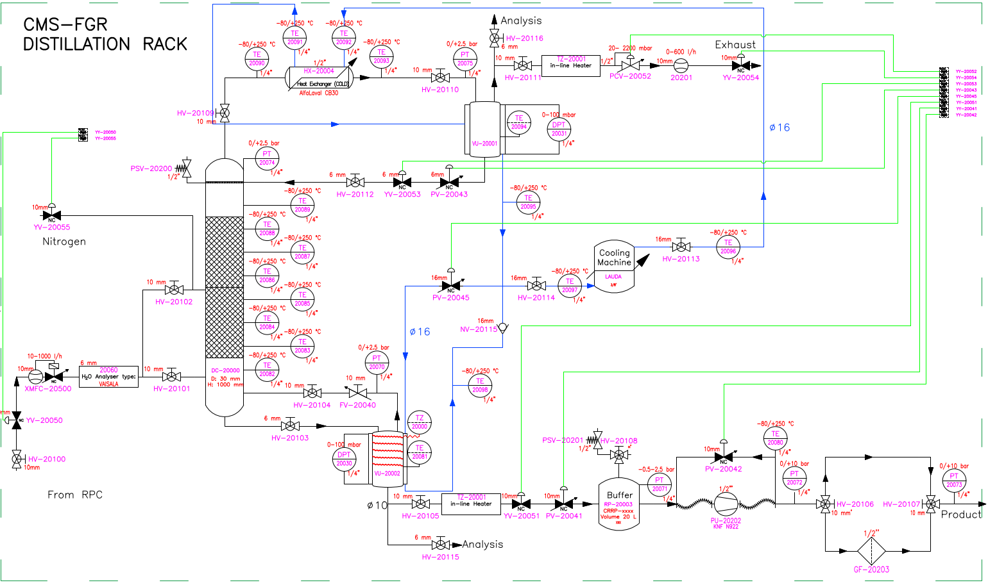
PART 2: P&ID

Slide 12
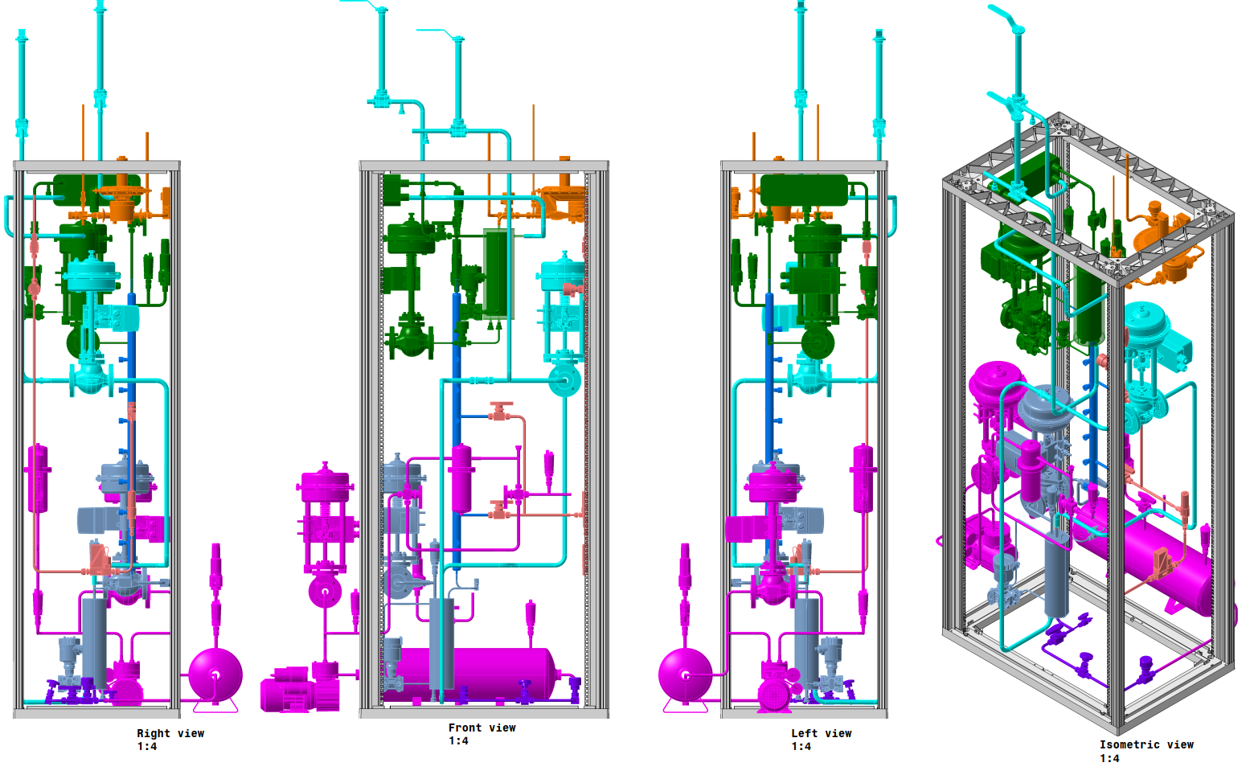
PART 2: 3D Models

Slide 13
PART 3: ESTIMATION (07/11/2024) vs REALITY
The estimation was done using the prices of material bought for the R134a and C4F10 recovery, thus:
Prices have been rounded up (around 5-10% increase due to last years inflation)
The final cost does not include the cost of the cooling machines, the isolation, and the electric system
Compared to the estimation we spent about 10k extra, but back then we did not take into account pneumatic regulation valves which are 20k in total
For more: \\eosproject-smb\eos\project\g\gas-systems\projects\R134a distillation\material_list_and_more.xlsx

Slide 14
PART 4: STATUS
SO?
MECHANICAL
FSU Estimation: 25/30 days
Material: arrived (only Von Rorh Valves Missing)
Status: started the rack last week with Hervè, from next week we have some days with Abdel and Fabio
ELECTRICAL
FSU Estimation: 15 days (?)
Material:
Status:
The data for the tests have been merged (vertical concatenation) to visualize the behavior of different columns and column combinations.
WELDING
FSU Estimation: 15 days
Material: arrived
Status: we only welded one buffer at this point

Slide 15
The presentation contains
SO?
1. Cost Estimation of…
- Building a two Buffers System (TBS)
- Building a Distillation Column system (DCS)
- Building a Distillation Column and two Buffers System (DCTBS)
- Building a Distillation Column and one Buffer System (DCBS)
The data for the tests have been merged (vertical concatenation) to visualize the behavior of different columns and column combinations.
2. Performance Comparison
- Between the Buffer and the Distillation Column approaches in terms of…
- Purity of R134a (molar fraction of R134a in the product stream)
- Recovery of R134a (moles of R134a recovered in the product line normalized by the quantity injected into the recovery system)

Slide 16
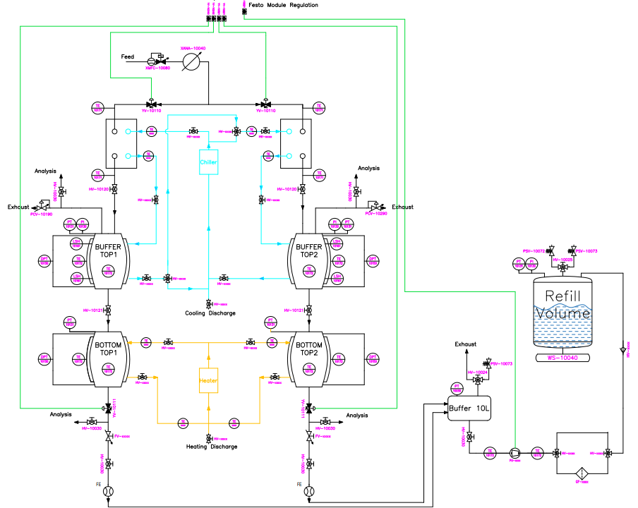
Two Buffers Rack
SO?
The main difference between the old racks and the new design (see drawing on the right) is the implementation of little changes which can increase the flexibility of the system and the comprehension of the separating phenomena.
- Higher flexibility? Yes, as the cooling system has been changed to have the chance to remove calories both in a series (as it happens now) and in parallel (see the light blue cooling lines)
- Deeper Understanding? Yes, we are facing some issues finding out if the sensors are correctly placed (sometimes also where… are placed). The new proposal will have at least twice as many temperature sensors to comprehend better the heat exchange phenomena and their influence on product purity
The data for the tests have been merged (vertical concatenation) to visualize the behavior of different columns and column combinations.

Slide 17
Cost Estimation TBS
TYPE | SUPPLIER | PRODUCT NAME | PRICE X UNIT | NUMBER OF UNITS | PRICE (CHF) | NOTES
HV | Swagelock | SS-42GS6MM-1466 | 150 | 12 | 1800 | apparatuses separation and analysis points
FV | Swagelock | SS-1RS6MM-SC11 | 130 | 2 | 260 | flow regulation bottom buffers
3WV | Swagelock | SS42GX6MM-1466 | 190 | 6 | 1140 | cmp injection filter by-pass, cmp extraction filter by-pass, cooling series2parallel
PT | Vega | VEGABAR 29 | 370 | 8 | 2960 | top buffers, bottom buffers, in-out cmp injection, in-out cmp extraction
TE | Radiospare | CAPTEUR RTD PT100 RS PRO | 40 | 25 | 1000 | top buffers, bottom buffers, heating, cooling, heat ex, jackets
LSH | Vega | VEGASWING 61 | 650 | 4 | 2600 | level sensors buffers
DPT | Vega | VEGADIF 85 | 1700 | 2 | 3400
HEATX | Fisher Kaelthe Klima | DEPENDS | 700 | 2 | 1400 | condenser
YV | Swagelock | SS-6BK-MM-1C | 350 | 4 | 1400 | input top columns and discharge bottom columns
PICV | Tescom | DEPENDS | 500 | 1 | 500 | pressure regulation injection
XMFC | Bronkhorst | DEPENDS | 3000 | 1 | 3000 | injection
PMP | Interfluid/KNF | DEPENDS | 3000 | 1 | 3000 | extraction pump
XANA | Vaisala | DEPENDS | 1500 | 1 | 1500 | injection humidity sensor
CMP | Haug | DEPENDS | 10000 | 1 | 10000 | injection compressor
PCV | Zimmerli | DEPENDS | 2000 | 2 | 4000 | condenser pressurer regulation
GF | Donaldson | DEPENDS | 1500 | 2 | 3000 | output injection pump, output extraction pump
PSV | Les Automatisme Appliques | DEPENDS | 400 | 1 | 400 | pressure relief valve column head
CONN | Swagelock/Cern Store | DEPENDS | 100 | 70 | 7000 | connectors (vebeo/swagelock/extras)
FE | Cern Store | Omron | 200 | 2 | 400 | exhaust and product line
FSU | X | X | 50 | 200 | 10000 | FSU for construction
EXTRA | Extra Material | DEPENDS | 3000 | 1 | 3000 | inox for welding
 |  |  |  | TOTAL | 61760

Slide 18
Cost Estimation DCS
TYPE | SUPPLIER | PRODUCT NAME | PRICE X UNIT | NUMBER OF UNITS | PRICE (CHF) | NOTES
HV | Swagelock | SS-42GS6MM-1466 | 150 | 30 | 4500 | apparatuses separation, analysis points, cooling circuits
FV | Swagelock | SS-1RS6MM-SC11 | 130 | 3 | 390 | flow regulation of reflux, boilup, extraction pump
3WV | Swagelock | SS42GX6MM-1466 | 190 | 4 | 760 | cmp injection filter by-pass, cmp extraction filter by-pass
PT | Vega | VEGABAR 29 | 370 | 8 | 2960 | condenser, reboiler, column head, in-out cmp injection, in-out cmp extraction, equaliz. Pump buffer
TE | Radiospare | CAPTEUR RTD PT100 RS PRO | 40 | 25 | 1000 | condenser, reboiler, 6 in column, 2 in-out cmp injection, 2 in-out cmp extraction, heat ex, cooling circuit
LSH | Vega | VEGAFLEX 81 | 1900 | 2 | 3800 | level sensor condenser and reboiler
HEATX | Fisher Kaelthe Klima | DEPENDS | 700 | 1 | 700 | condenser
YV | Swagelock | SS-6BK-MM-1C | 350 | 2 | 700 | flow regulation reflux, boilup
PICV | Tescom | DEPENDS | 500 | 1 | 500 | pressure regulation injection
XMFC | Bronkhorst | DEPENDS | 3000 | 1 | 3000 | injection
PMP | Interfluid/KNF | DEPENDS | 3000 | 1 | 3000 | extraction pump
XANA | Vaisala | DEPENDS | 1500 | 1 | 1500 | injection humidity sensor
CMP | Haug | DEPENDS | 10000 | 1 | 10000 | injection compressor
PCV | Zimmerli | DEPENDS | 2000 | 1 | 2000 | condenser pressurer regulation
GF | Donaldson | DEPENDS | 1500 | 2 | 3000 | output injection pump, output extraction pump
PSV | Les Automatisme Appliques | DEPENDS | 400 | 1 | 400 | pressure relief valve column head
CONN | Swagelock/Cern Store | DEPENDS | 100 | 70 | 7000 | connectors (vebeo/swagelock/extras)
FE | Cern Store | Omron | 200 | 2 | 400 | exhaust and product line
EXTRA | Extra Material | DEPENDS | 5000 | 1 | 5000 | inox for welding + packing material
FSU | X | X | 50 | 250 | 12500 | FSU for construction
 |  |  |  | TOTAL | 63110

Slide 19
Cost Estimation DCBS
TYPE | SUPPLIER | PRODUCT NAME | PRICE X UNIT | NUMBER OF UNITS | PRICE (CHF)
HV | Swagelock | SS-42GS6MM-1466 | 150 | 36 | 5400
FV | Swagelock | SS-1RS6MM-SC11 | 130 | 4 | 520
3WV | Swagelock | SS42GX6MM-1466 | 190 | 8 | 1520
PT | Vega | VEGABAR 29 | 370 | 12 | 4440
TE | Radiospare | CAPTEUR RTD PT100 RS PRO | 40 | 35 | 1400
LSH | Vega | VEGASWING 61 | 650 | 2 | 1300
LSH | Vega | VEGAFLEX 81 | 1900 | 2 | 3800
HEATX | Fisher Kaelthe Klima | DEPENDS | 700 | 2 | 1400
YV | Swagelock | SS-6BK-MM-1C | 350 | 4 | 1400
PICV | Tescom | DEPENDS | 500 | 1 | 500
XMFC | Bronkhorst | DEPENDS | 3000 | 1 | 3000
PMP | Interfluid/KNF | DEPENDS | 3000 | 1 | 3000
XANA | Vaisala | DEPENDS | 1500 | 1 | 1500
CMP | Haug | DEPENDS | 10000 | 1 | 10000
PCV | Zimmerli | DEPENDS | 2000 | 2 | 4000
GF | Donaldson | DEPENDS | 1500 | 2 | 3000
PSV | Les Automatisme Appliques | DEPENDS | 400 | 2 | 800
CONN | Swagelock/Cern Store | DEPENDS | 150 | 88.2 | 13230
FE | Cern Store | Omron | 200 | 2 | 400
EXTRA | Extra Material | DEPENDS | 3000 | 1.8 | 5400
FSU | X | X | 50 | 312 | 15600
 |  |  |  | TOTAL | 81610

Slide 20
Cost Estimation DCTBS
TYPE | SUPPLIER | PRODUCT NAME | PRICE X UNIT | NUMBER OF UNITS | PRICE (CHF)
HV | Swagelock | SS-42GS6MM-1466 | 150 | 42 | 6300
FV | Swagelock | SS-1RS6MM-SC11 | 130 | 5 | 650
3WV | Swagelock | SS42GX6MM-1466 | 190 | 8 | 1520
PT | Vega | VEGABAR 29 | 370 | 14 | 5180
TE | Radiospare | CAPTEUR RTD PT100 RS PRO | 40 | 40 | 1600
LSH | Vega | VEGASWING 61 | 650 | 4 | 2600
LSH | Vega | VEGAFLEX 81 | 1900 | 2 | 3800
HEATX | Fisher Kaelthe Klima | DEPENDS | 700 | 2 | 1400
YV | Swagelock | SS-6BK-MM-1C | 350 | 6 | 2100
PICV | Tescom | DEPENDS | 500 | 1 | 500
XMFC | Bronkhorst | DEPENDS | 3000 | 1 | 3000
PMP | Interfluid/KNF | DEPENDS | 3000 | 1 | 3000
XANA | Vaisala | DEPENDS | 1500 | 1 | 1500
CMP | Haug | DEPENDS | 10000 | 1 | 10000
PCV | Zimmerli | DEPENDS | 2000 | 3 | 6000
GF | Donaldson | DEPENDS | 1500 | 2 | 3000
PSV | Les Automatisme Appliques | DEPENDS | 400 | 2 | 800
CONN | Swagelock/Cern Store | DEPENDS | 150 | 98 | 14700
FE | Cern Store | Omron | 200 | 2 | 400
EXTRA | Extra Material | DEPENDS | 3000 | 2 | 6000
FSU | X | X | 50 | 360 | 18000
 |  |  |  | TOTAL | 92050

Slide 21
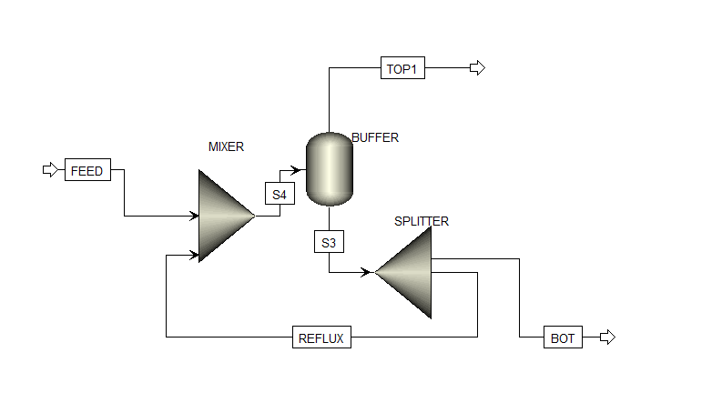
SINGLE BUFFER WITH SPLIT FRACTION
Distillate flowrate: 150 l/h
R134A : 78%
IC4H10 : 11%
SF6: 2%
N2: 9%
- Temperature of the Buffer : -32 °C
- Pressure inside the Buffer : 1 bar
- Split Fraction : 0.8 (it means that 80% of the S3 stream is reinjected in the buffer)
- Purity achieved : 99 % of R134a
- Molar recovery of R134a : 90%
- Thermal duty : -0,0377 KW
ADVANTAGE:
Purity of the recovered R134a is increased from 94.7% to 99 %
DISADVANTAGE:
In contrary, recovery is lower than the single buffer configuration ( only 90% vs 96% of previous configuration)
Inlet flowrate : 600 l/h
R134A : 94.7%
IC4H10 : 4,5%
SF6: 0, 3%
N2: 0.5%
Bottom flowrate : 450 l/h
R134A : 99%
IC4H10 : 1%
SF6: negligible (10 e-10)
N2: negligible (10e-11)

