Slide 1
Shielding Updates for FLUKA
Gemma Humphreys
15/07/2025

Slide 2
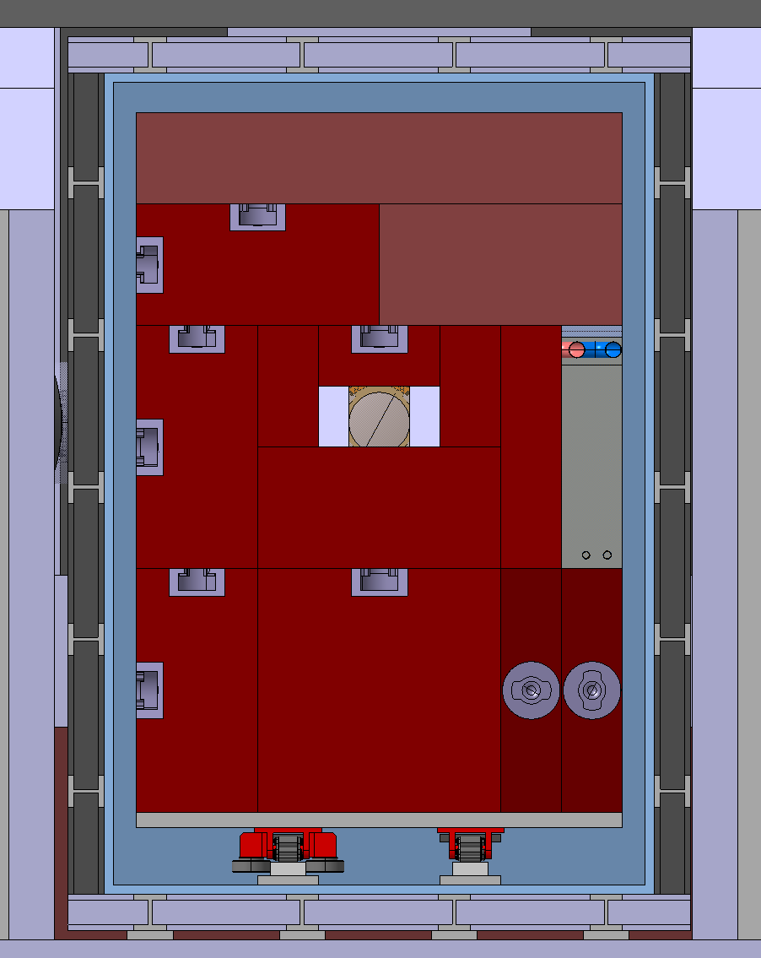
Vacuum Vessel Dimensions
1750mm usable space
2641mm usable space
50mm trolley thickness
240mm – base of vessel to start of shielding
190mm – height from base of vessel to underside of trolley
30mm vessel thickness
Floor Level
150mm from floor to outer vacuum vessel

Slide 3
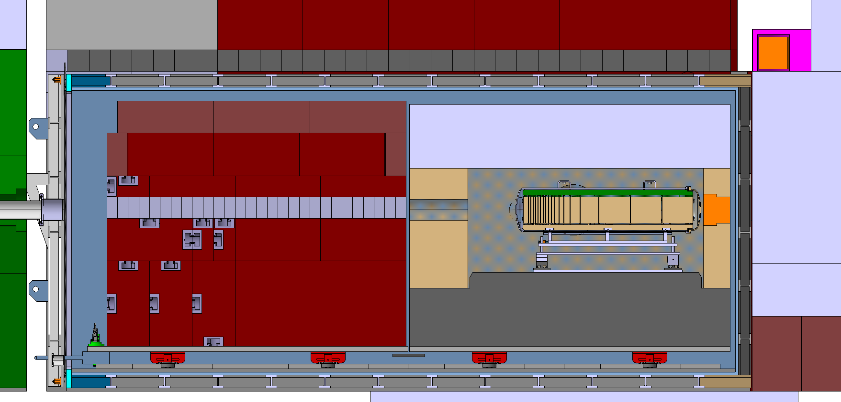
Vacuum Vessel Dimensions
149mm top of vacuum vessel to bottom of shielding
127.5mm outer vacuum vessel to MHS
6210mm usable space

Slide 4
Shielding To Add
Red internal shielding can be made 70mm taller
Proximity shielding can be made 100mm taller
Area under trolly can be filled with shielding
Hole on right side of internal shielding can be decreased in size

Slide 5
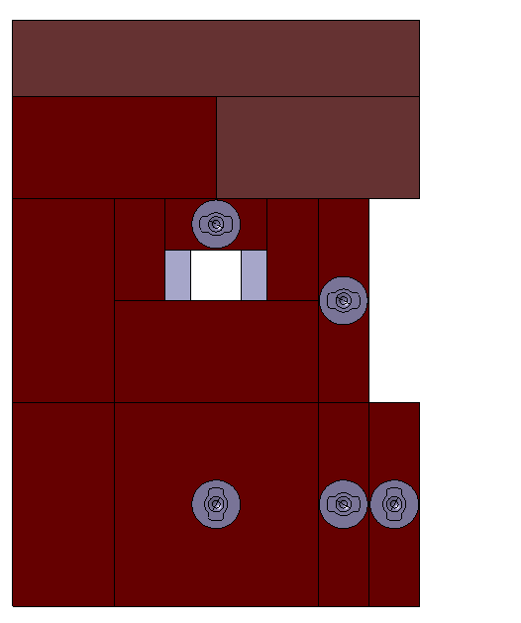
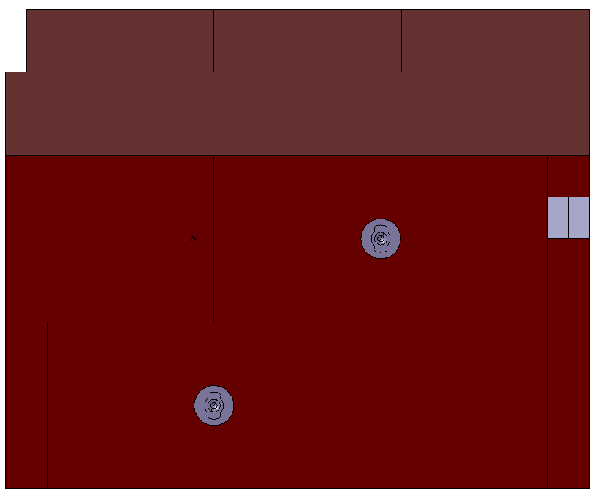
Internal Shielding New Dimensions
Front View
Right Side View
1600mm
200mm
2370mm
800mm
645mm
65mm
800mm
2800mm

Slide 6
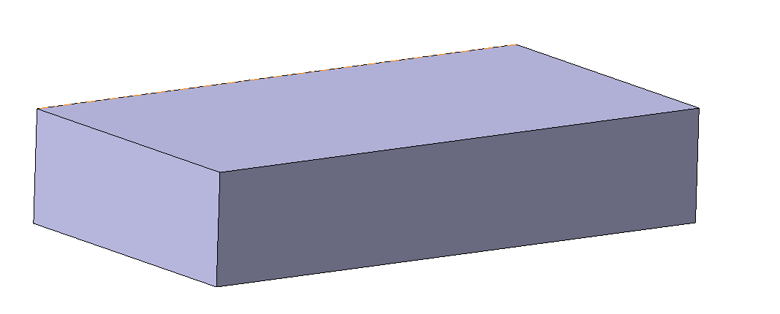
Upper Proximity Shielding Dimensions
3000mm
Total proximity shielding height:
2371mm
700mm
1600mm

Slide 7
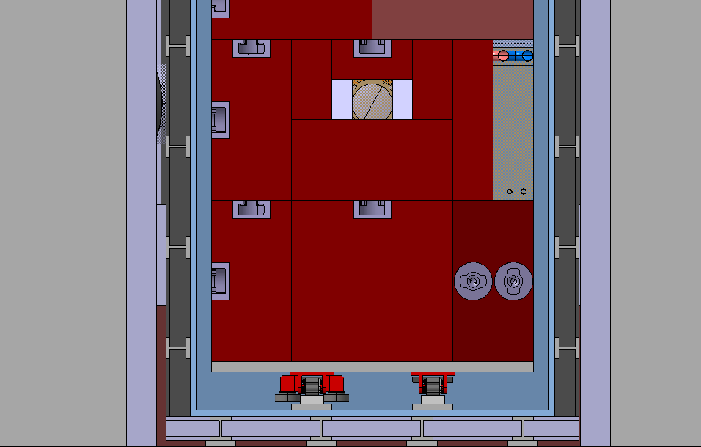
Shielding Under Trolley
Shielding sitting on the floor of the vacuum vessel
170mm
170mm
170mm
370mm
260mm
450mm
705mm
1750mm

Slide 8
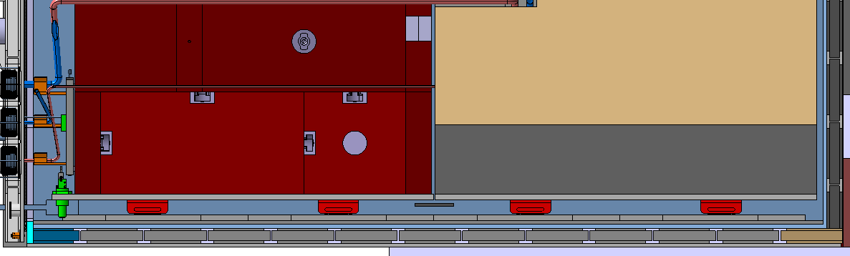
Shielding Under Trolley
All 3 Blocks the same length and positioned against the rear of the vacuum vessel
5840mm

Slide 9
Shielding Between Rollers
Height of each block: 90mm
Width of each block: 200mm
355mm
1150mm
1160mm
1150mm
570mm
Shielding on the vacuum vessel trolley
50mm
975mm
2475mm
3985mm
5485mm

Slide 10
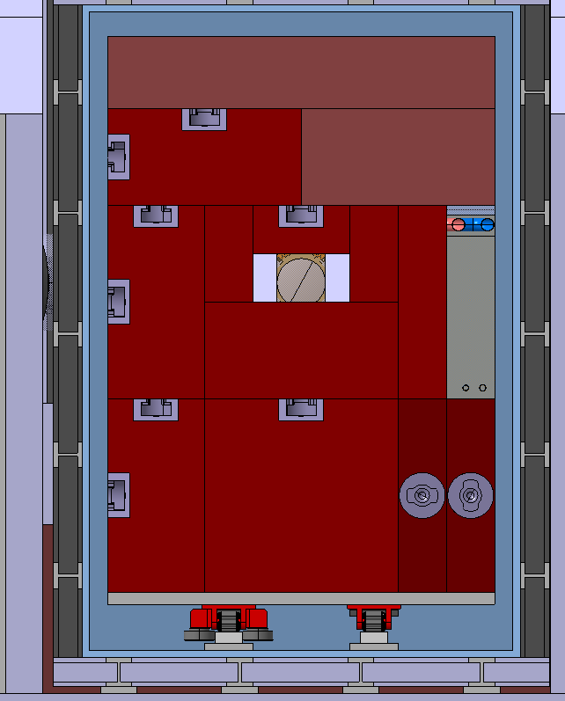
Shielding Between Rollers
90mm
475mm
200mm
200mm
475mm

Slide 12
Old/General Dimensions

Slide 13
Upper Proximity Shielding Dimensions
3000mm
600mm
1600mm

Slide 14
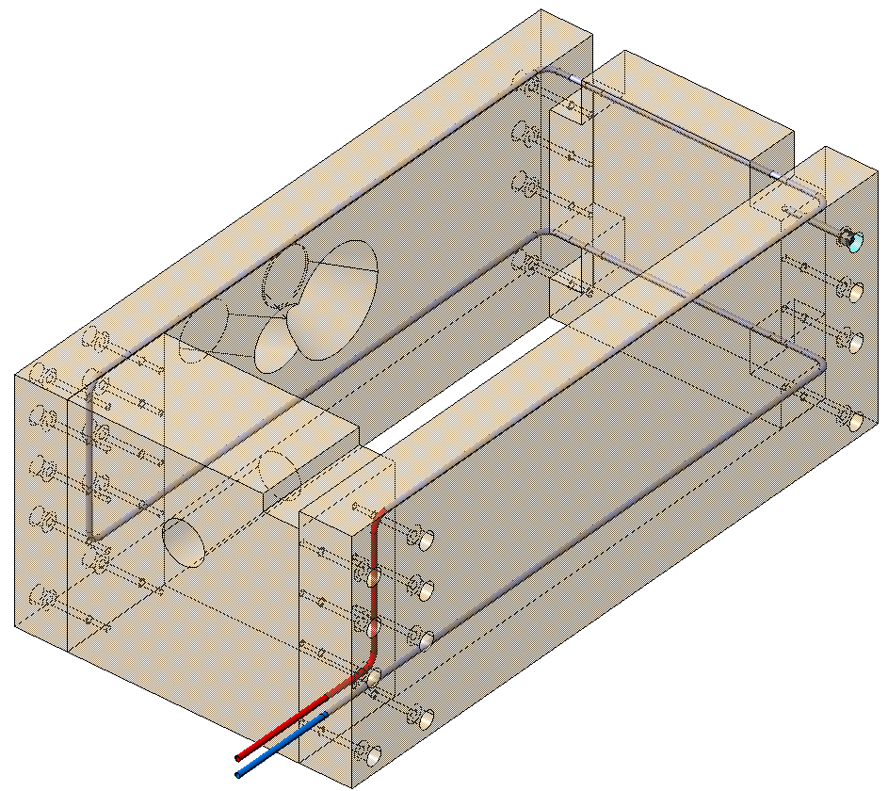
Middle Proximity Shielding
1126mm
Beam Direction
3000mm
1600mm

Slide 15
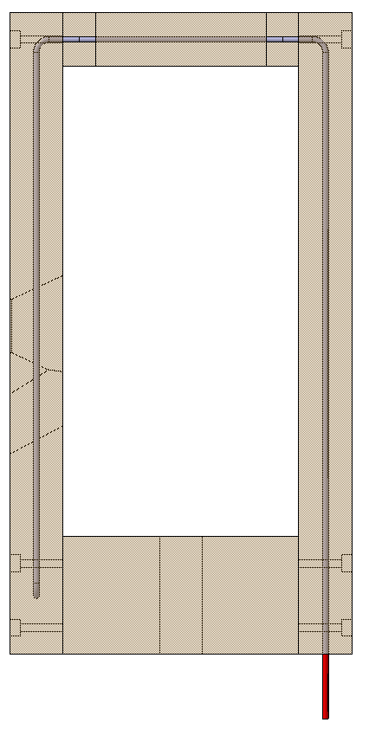
Overview
250mm
550mm
250mm
250mm

Slide 16
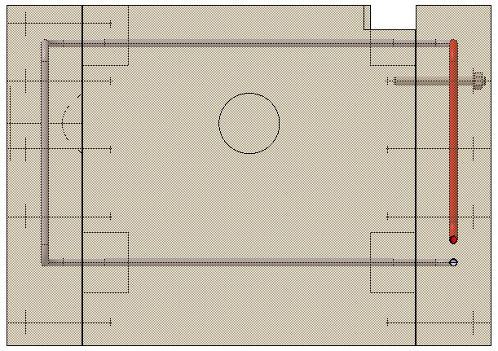
Overview
200mm ø
735mm
800mm

Slide 17
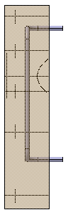
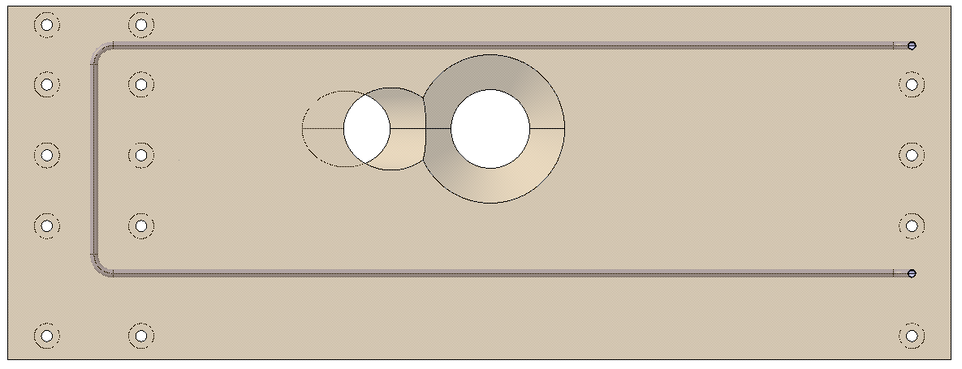
Left Side
3000mm
1484mm
458mm
1126mm
250mm
474mm ø
250mm ø

Slide 18
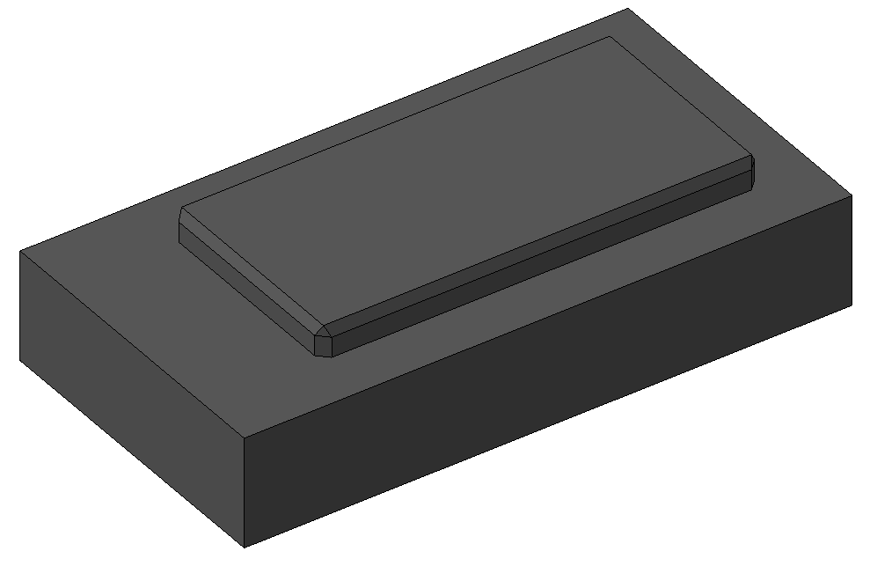
Lower Proximity Shielding
3000mm
1600mm
150mm
2170mm
545mm
1070mm

Slide 19
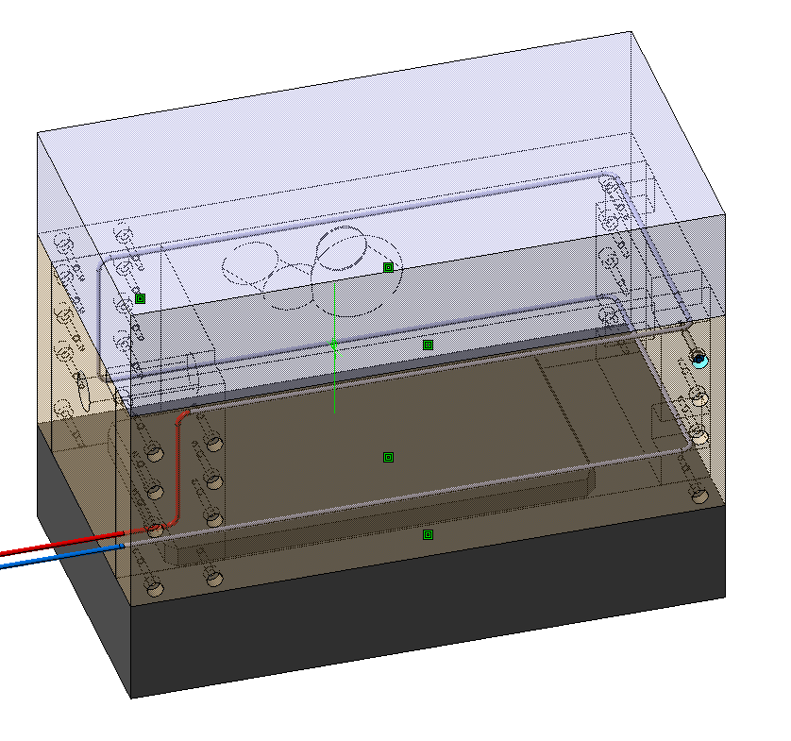
Proximity Shielding Assembly

Slide 20
Internal Shielding
Front View
Right Side View
1600mm
200mm
2300mm
800mm
2800mm

Slide 21
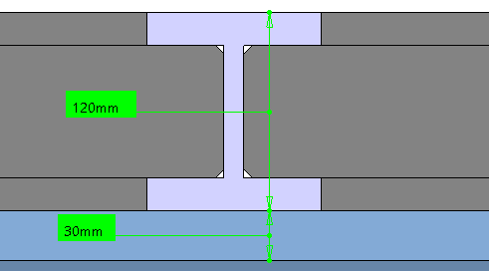
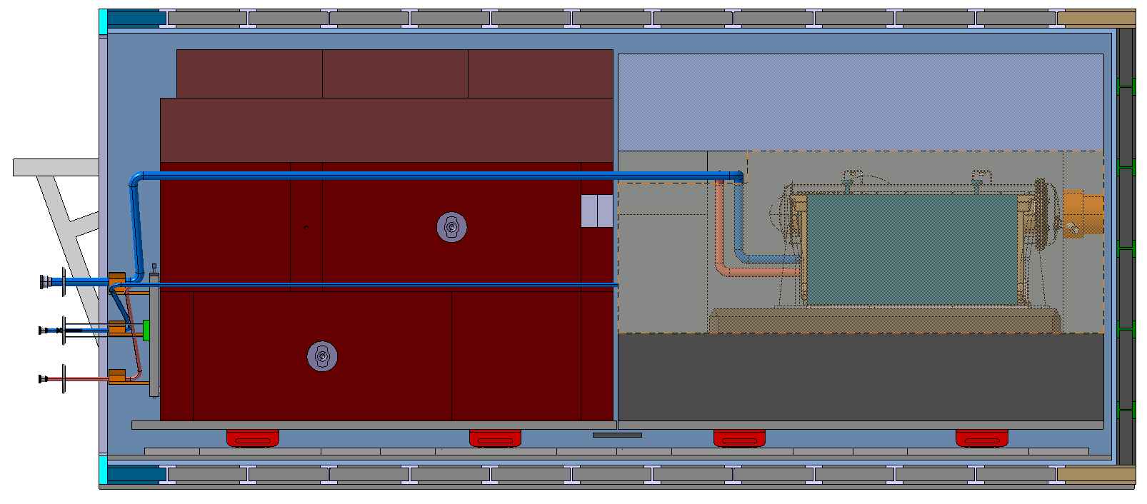
Internal Vacuum Vessel
Vessel Structure
Vessel Skin
280mm
30mm
200mm
380mm
420mm

Slide 22
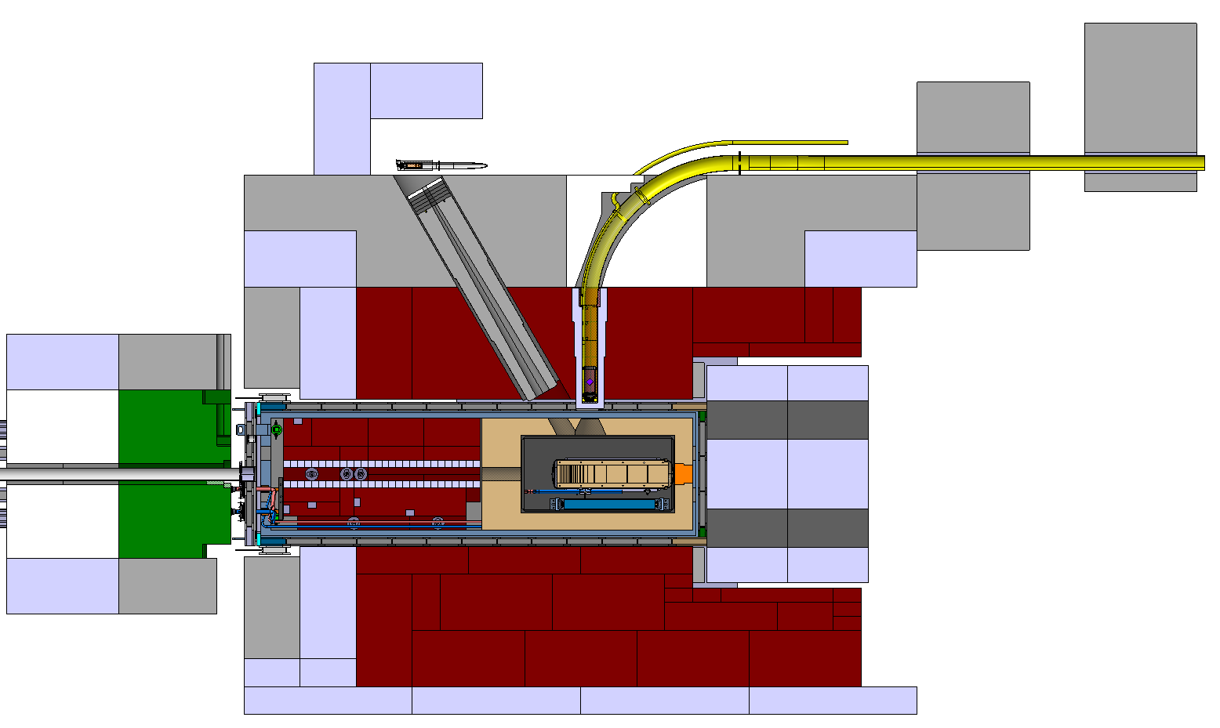
External Shielding
1600mm
2400mm
1600mm
785mm
800mm
2400mm
1000mm
800mm
2400mm
837mm
524mm
3200mm
4270mm
185mm
7700mm
4000mm
5700mm
4463mm
8800mm
9600mm

Slide 23
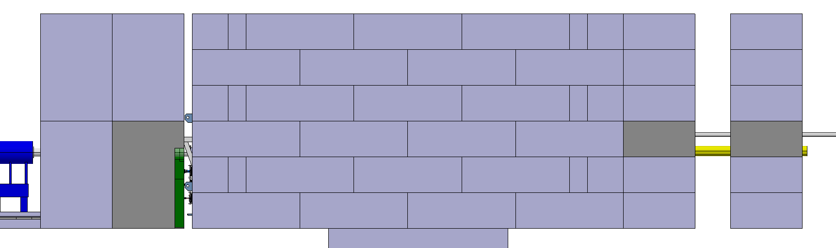
External Shielding
4800mm

