Slide 1
Optimization of physics objects for the ttbar threshold run at FCC-ee
Gino Daniels, Matteo Defranchis, Andrea Sciandra, Michele Selvaggi

Slide 2
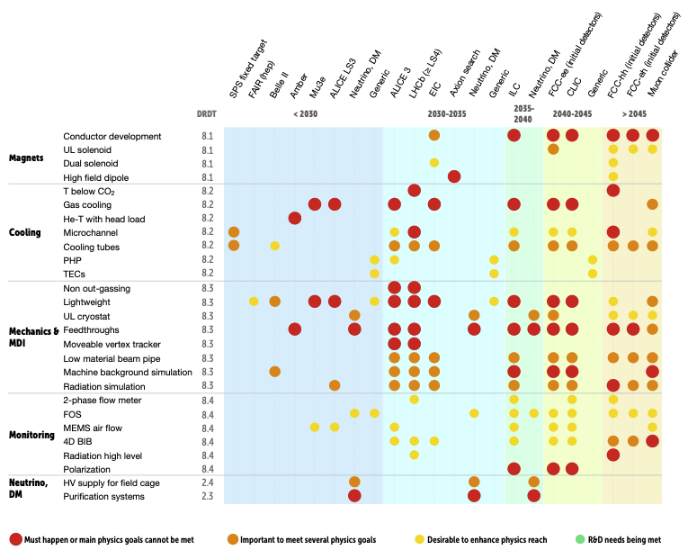
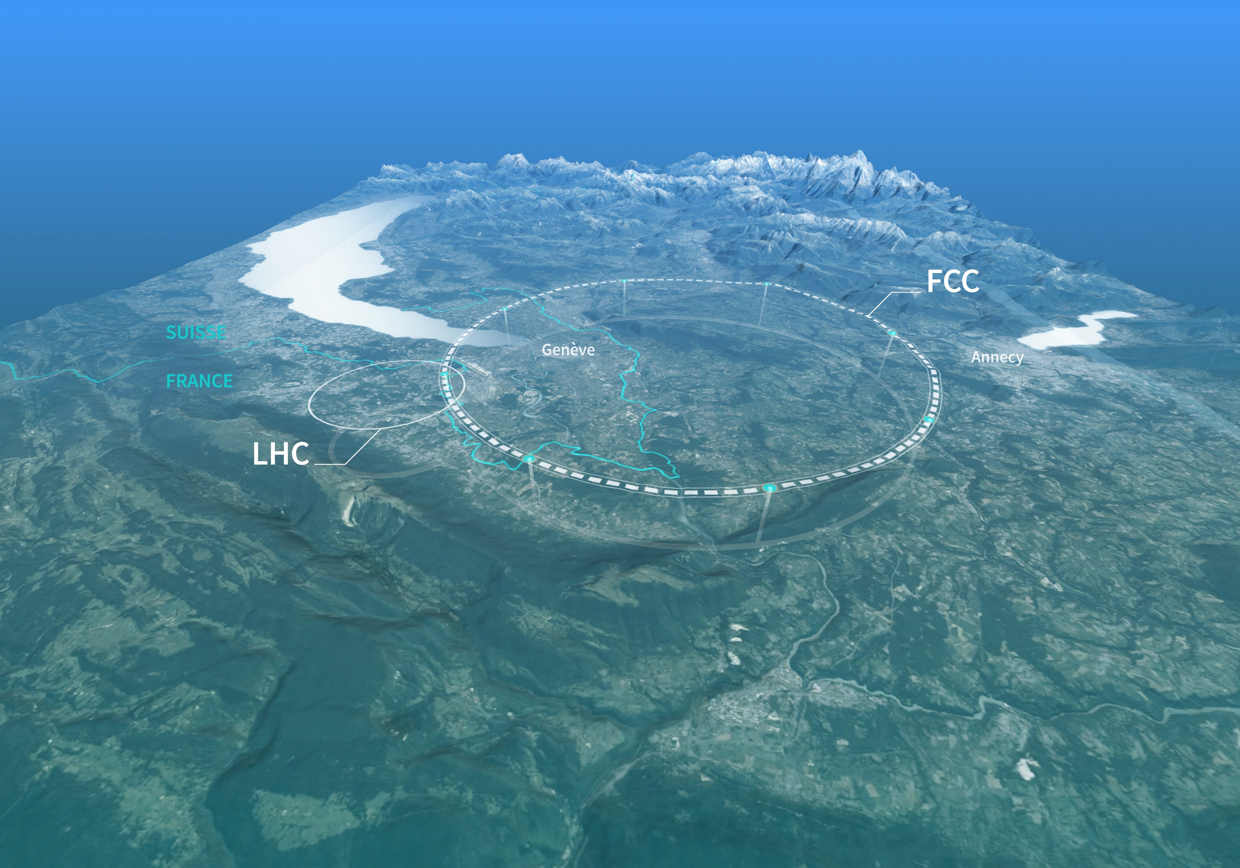
Future Colliders
European Committee for Future Accelerators (ECFA),
‘ECFA Detector R&D Roadmap’, CERN Document Server, CERN, November 2021.
(Lepton) Colliders
  FCC-ee
  EIC
  Muon
Higher luminosity
  Require radiation resistant detectors
  More background from Bremsstrahlung
R&D for future colliders needed now
Affolder et al., ’Solid State Detectors and Tracking for Snowmass’, arXiv:2209.03607, 2022.
E. Anderssen, A.W. Jung, S. Karmarkar, A.M. Koshy, et al.,
‘Light-weight and highly thermally conductive support structures for future tracking detectors’,
arXiv preprint arXiv:2203.14347 [physics.ins-det], Mar 2022.

Slide 3
R&D for Carbon-Fiber Wire Drift Chamber
Developing CF wire drift chamber for IDEA detector
  Replace W-Au sense wires with CF-Au to reduce material budget
  Prototyping lab setup to further test mechanical feasibility
Working on Geant4 Material budget plots and p_{T} resolution plots
Developed IDEA Delphes Card with CF Drift Chamber
  Noticed existing drift chamber in IDEA Delphes card has X0 of only gas
  X₀ = 1400 m whereas new corrected W-Au DCH has X₀ = 579 m

Slide 4
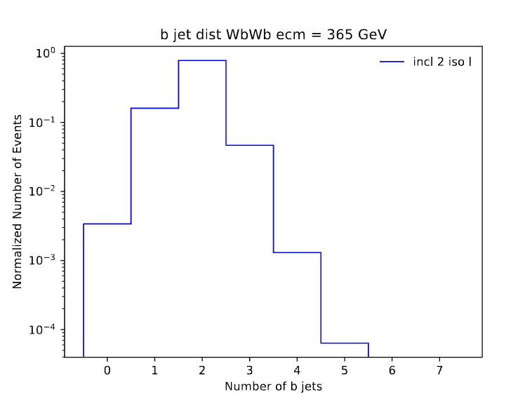
Motivation
First studies for ECFA (Paris 2024)
Unexpected b jet distribution needs to be understood
Event topologies change at ecm = 365 GeV tagger trained on exclusive njets = 2 HH→nunuqq
  Understand performance wrt inclusive/exclusive clustering wrt which clustering method
Retrain tagger if found to be necessary
b jet distribution for WbWb at ecm = 365 GeV for inclusive clustering with 2 iso leps per event

Slide 5
Lepton Isolation
Isolated leptons remaining in clustering collection can be misidentified as b-jets
  Removed jets that have isolated leptons within jet radius
e+e- →WbWb
  Prompt leps from W and non-prompts from everything else
Optimize selection
  ROC Curves on gen-matched prompt/non-prompt leptons

Slide 6
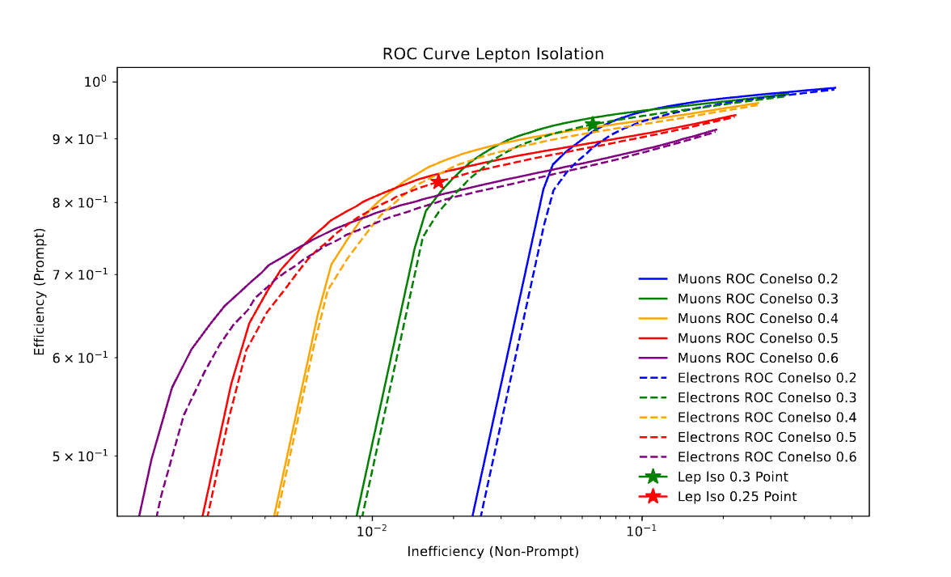
ROC Curve Prompt vs Non-Prompt e, μ
Focus on improving b-tagging efficiency
Prompt leps allowed into clustering can fake b jets
Remove more prompts, but allow more non-prompt
9.4%(9.35%) selection efficiency increase for e(μ)
Inefficiency vs Efficiency for D Iso [0,1] & ConeIso upper bounds [0.2,0.6] for e, μ

Slide 7
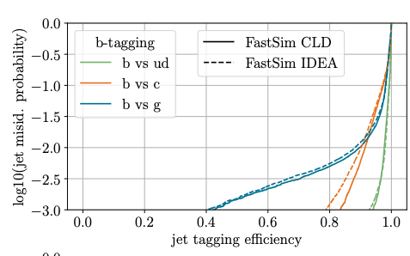
ParT FCCee
Sara Aumiller, Dolores Garcia, Michele Selvaggi, ”Jet-Flavor Tagging Performance at FCC-ee”
Transformer-based jet tagger
  Attention mechanism adds new term characterizing pairwise particle interactions
  Expected performance of tagger does not explain observed b-jet distribution in WbWb
Current Tagger Training:
  HH→nunuqq at ecm = 240 GeV
  Exclusive clustering & kt algorithm
  njets = 2
ROC curves for b vs c, ud, g at 240 GeV

Slide 8
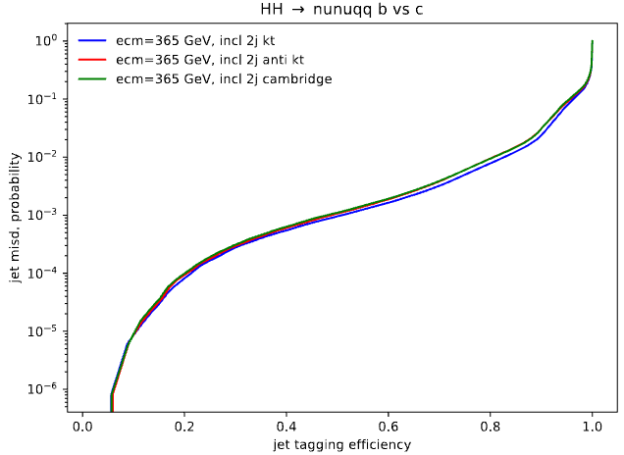
b-tagging
Inclusive is more convenient for WbWb due to variable jet multiplicity
Evaluate best clustering algorithm & inclusive vs exclusive
  Benchmark processes WbWb, ZZ, and HH→nunuqq
  Concluded kt performs slightly better
  Inclusive njets = X means expect X number of jets based of # of isolated leps per event
b vs c ROC Curve comparing clustering algorithms for HH→nunuqq, ecm = 365 GeV, inclusive clustering

Slide 9
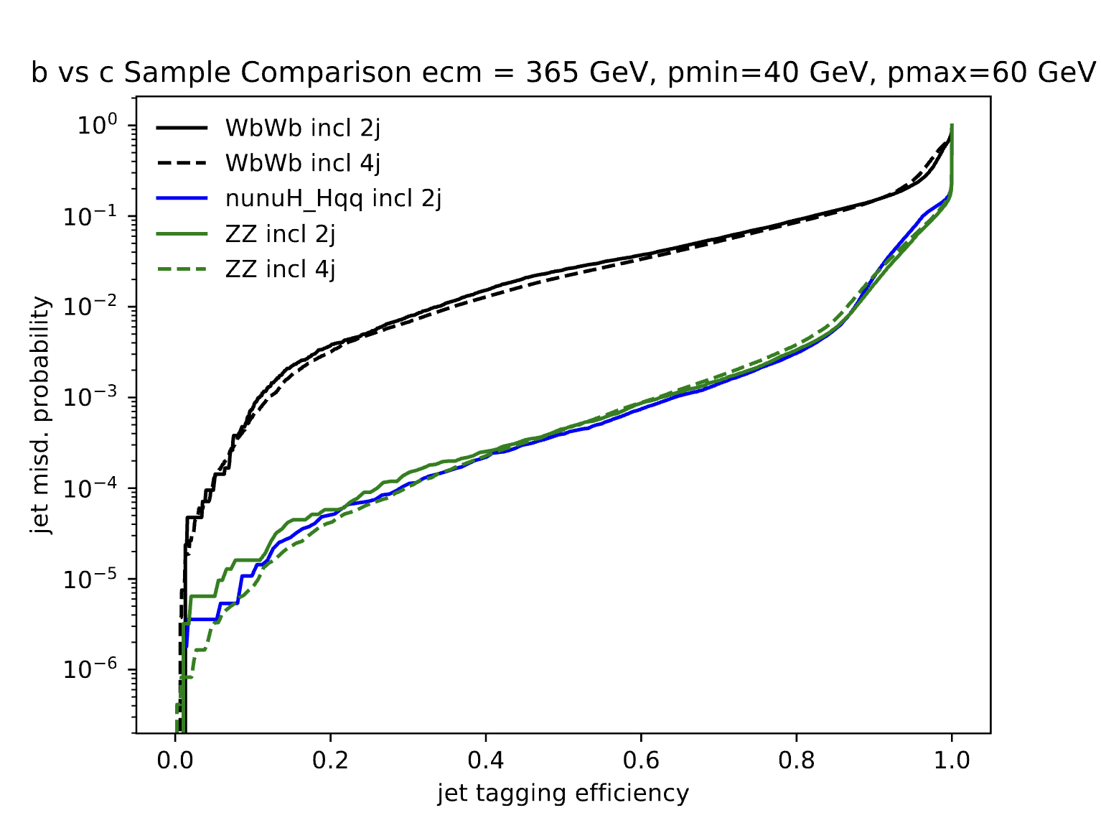
WbWb Sample Comparison
Low WbWb b-tagging performance
Compared various samples to WbWb in p bins
Saw same trend in all p bins across all samples
Investigated if there was an issue with the sample
b vs c ROC Curve comparing WbWb to HH→nunuqq & ZZ at ecm = 365 GeV, njets = 2, pmin = 40 GeV & pmax = 60 GeV

Slide 10
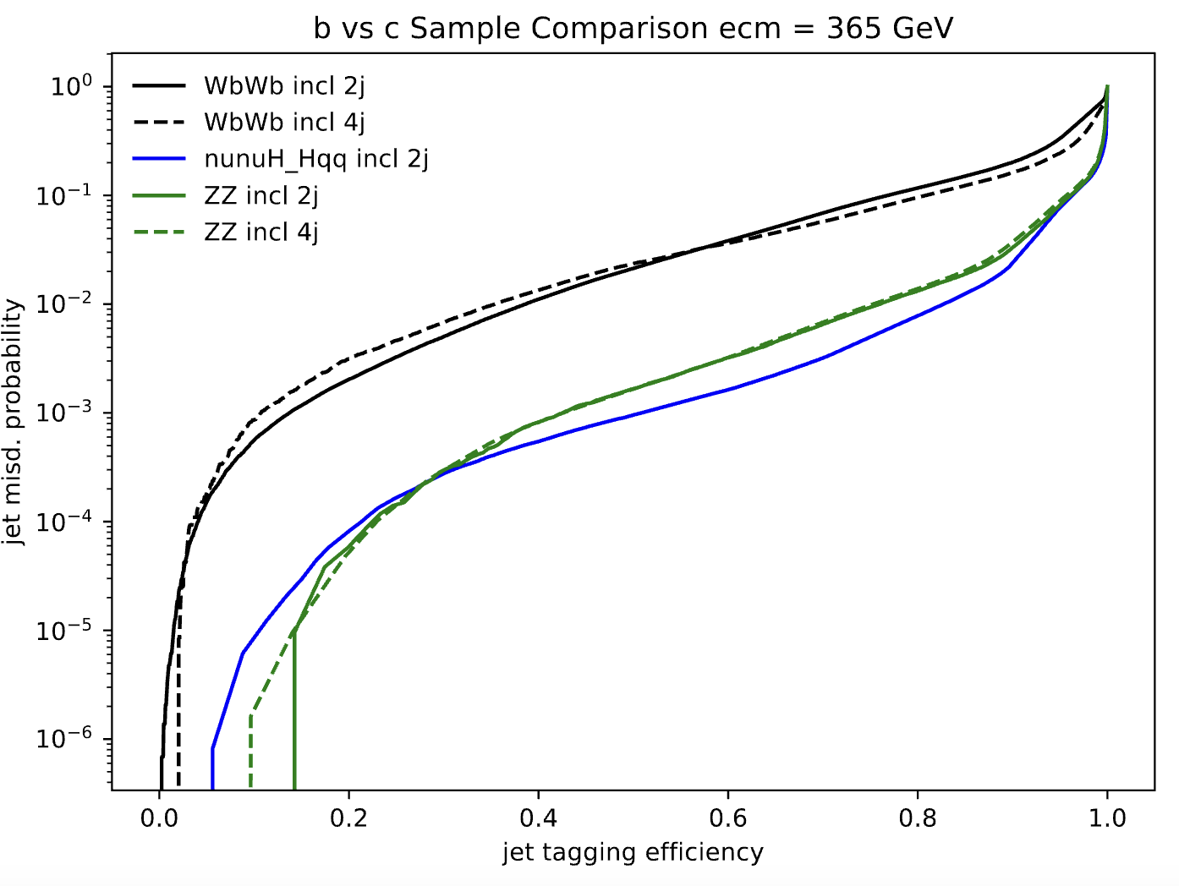
WbWb Sample Issue
WbWb compared to HH→nunuqq, ZZ
Steering card issue
  Volume in which decays are allowed in PYTHIA 6 was too small
  Reduced b tagging performance at n = X jets
b vs c ROC Curve comparison for ecm = 365 GeV, njets = 2

Slide 11
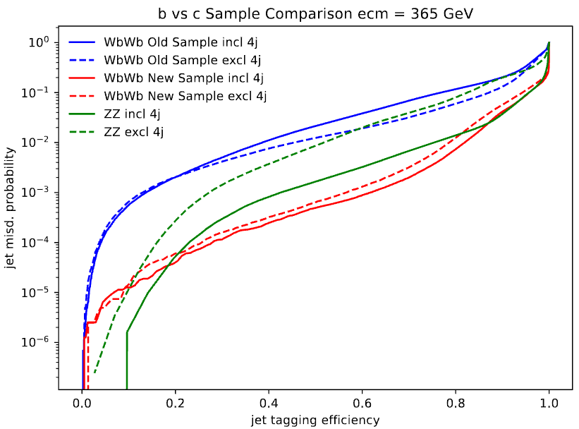
WbWb New Sample
Reproduced WbWb sample via help of Louis Portales
New sample shows drastic difference in b-tagging performance
b vs c ROC Curve WbWb, ZZ sample comparison for ecm = 365 GeV, njets = 4

Slide 12
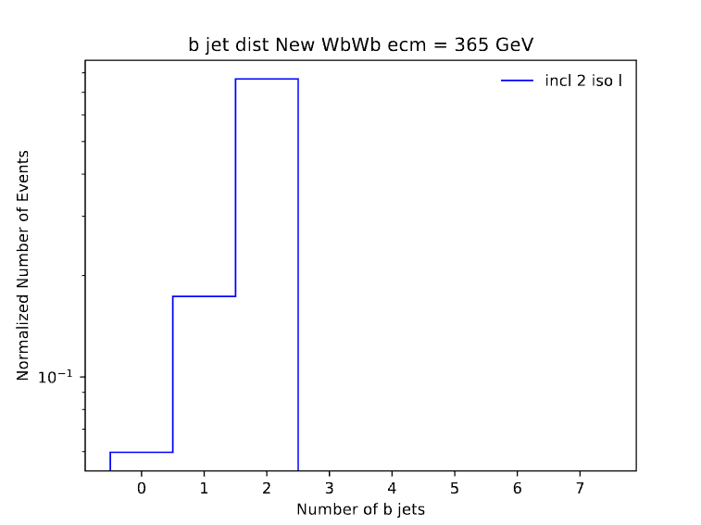
b-jet distribution after sample fix
b jet distribution for WbWb at ecm = 365 GeV for inclusive clustering with 2 iso leps per event
b jet distribution for New WbWb sample at ecm = 365 GeV for inclusive clustering with 2 iso leps per event

Slide 13
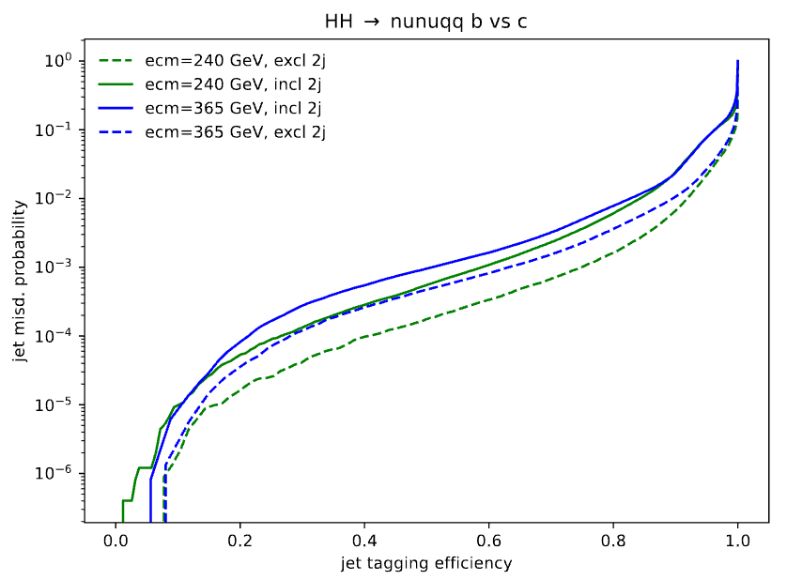
b vs c ROC Curves HH → nunuqq
Trained on exclusive njets = 2 HH→nunuqq
Performance dependence on clustering type and ecm
Dedicated ecm = 365 GeV tagger is needed!
b vs c ROC for HH→nunuqq at ecm = 240, 365 GeV

Slide 14
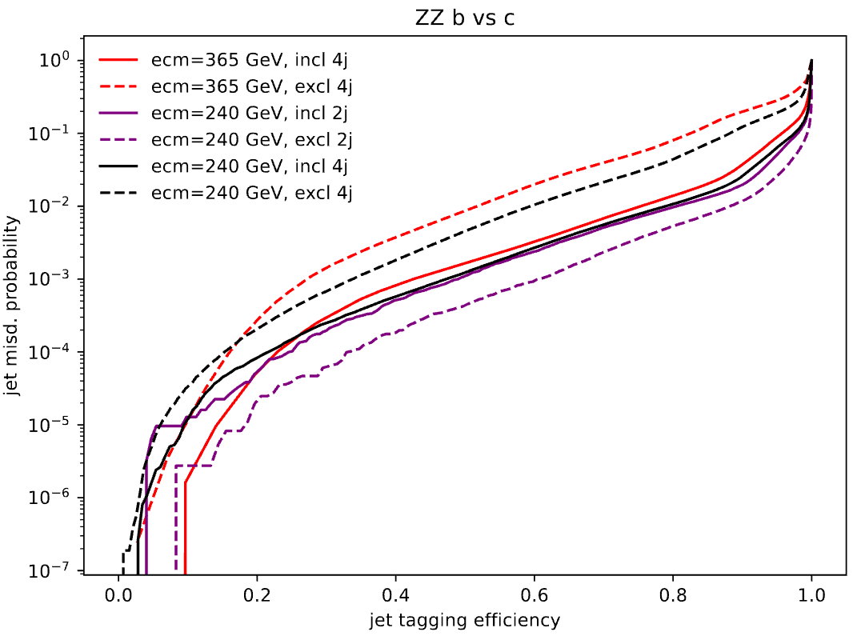
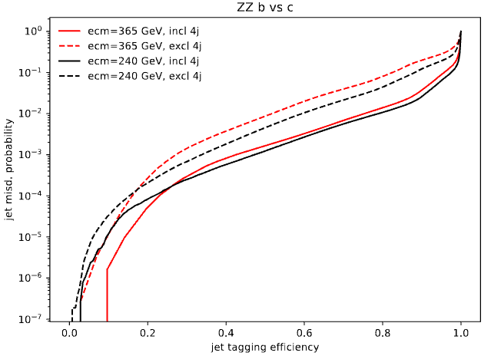
b vs c ROC Curves ZZ
Performance decreases at ecm = 365 GeV
Exclusive clustering performs worse at njets > 2
Want tagger that works well at higher jet multiplicity, which seems to be the case for inclusive clustering
b vs c ROC for ZZ at ecm = 240, 365 GeV njets = 2, 4

Slide 15
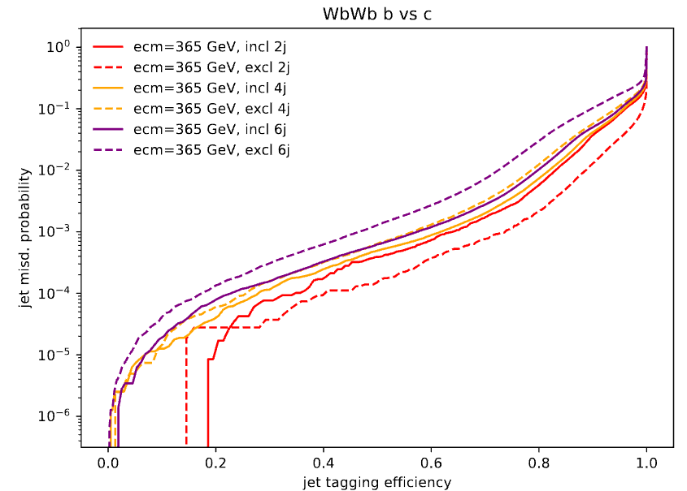
b vs c ROC Curves WbWb
Inclusive clustering outperforms exclusive when njets > 2
Tagger trained on ecm = 240 GeV, therefore a 365 GeV training would likely see a performance increase
b vs c ROC for new WbWb sample at ecm = 365 GeV

Slide 16
ParT Training plan
Performance heavily relies on number of jets used in training, inclusive vs exclusive, & ecm of samples
Goal:
  Train on ecm = 365 GeV samples with inclusive clustering, kt algorithm, & njets ≥ 2
  Reevaluate performance on samples at ttbar threshold

Slide 17
Conclusion
WbWb samples and other heavy flavor samples need to be redone
Need a dedicated tagger for 365 GeV due to different event topologies
Exclusive clustering performance suffers at njets > 2
  Inclusive clustering shows promise to handle any number of jets
Efforts to retrain and evaluate performance difference are a few weeks away

Slide 18
Acknowledgements
I would like to thank Andreas Jung for helping set up this research opportunity, Matteo Defranchis for guiding me through this project and being a great mentor to me, Andrea Sciandra, & Michele Selvaggi

Slide 19
Questions?

Slide 20
Backup Slides

