Slide 1
HL-LHC Signal Cabling
Patch Panel Study
Status #2
D. Gameiro (EN-EL-CS), G. Girardot (EN-EL-CS)
Thanks to R. Roche (EN-EL-DDO)
2025-07-18
EDMS 3314730
Indico 1570308

Slide 2
Contents
Patch-Suitable Cables & Patching Solutions
BE-GM Cabling Topology – US vs. UR
EMC Forum Feedback
Design & Integration
Prototyping
Cost Estimation
Schedule
Next Actions
AoB

Slide 3
Patch-Suitable Cables & Patching Solutions
Group | Total No. of Cables | No. of Patchable Cables | Proposed Patching Solution
BE-CEM | 4 (0.1%) | 4 | FIP box
BE-GM | 648 (17.7%) | 442 | Burndy
EN-AA | 8 (0.2%) | 0 | –
EP-CMT | 28 (0.8%) | 12 | Burndy
SY-BI / SY-RF | 552 (15.1%) | 0⁽¹⁾ | –
TE-CRG | 908 (24.8%) | 388 | Burndy (228) Standard & high-EMC Harting(144) BNC-50 (16)
TE-MPE | 444 (12.1%) | 278 | Resin junction (38) PCB based OR high-EMC Harting (240)
TE-VSC | 1070 (29.2%) | 1062 | Burndy (540) Harting (4) BNC-50 (4) FIP box (8) Special crates (506)
Total | 3662 | 2186 (59.7%)
Discussions with WP07 lead to the pre-validation of the use of high-EMC Harting connectors for all cables.
  Supplied and installed by EN-EL-CS
All proposed patching solutions are now pre-validated by all impacted Groups.
Connector assembly and cable test procedures will be proposed and subject to validation.
Thank you all for the discussions!
⁽¹⁾Cables disregarded for technical reasons.

Slide 4
BE-GM Cabling Topology – US vs. UR
BE-GM has racks in both US15/USC55 and UR15/UR55.
Recent modification on the cabling topology highly impacts the:
  Patch panel study and consequent LS3 schedule gains.
  Cable tray integration.
Meeting between EN-EL and BE-GM clarified the situation.
BE-GM updated the DIC taking into account the mentioned impact.
Cables will be centralized in UR15/UR55 whenever possible.
In point 5, PPS2 takes rack space and 44 cables connecting to the LSS are left in UL557 racks.
Opportunity to add 2 racks in UR55 (1 per ½) for PPS2*
and increase even further LS3 schedule optimization!
*and future LS4 BBLR project

Slide 5
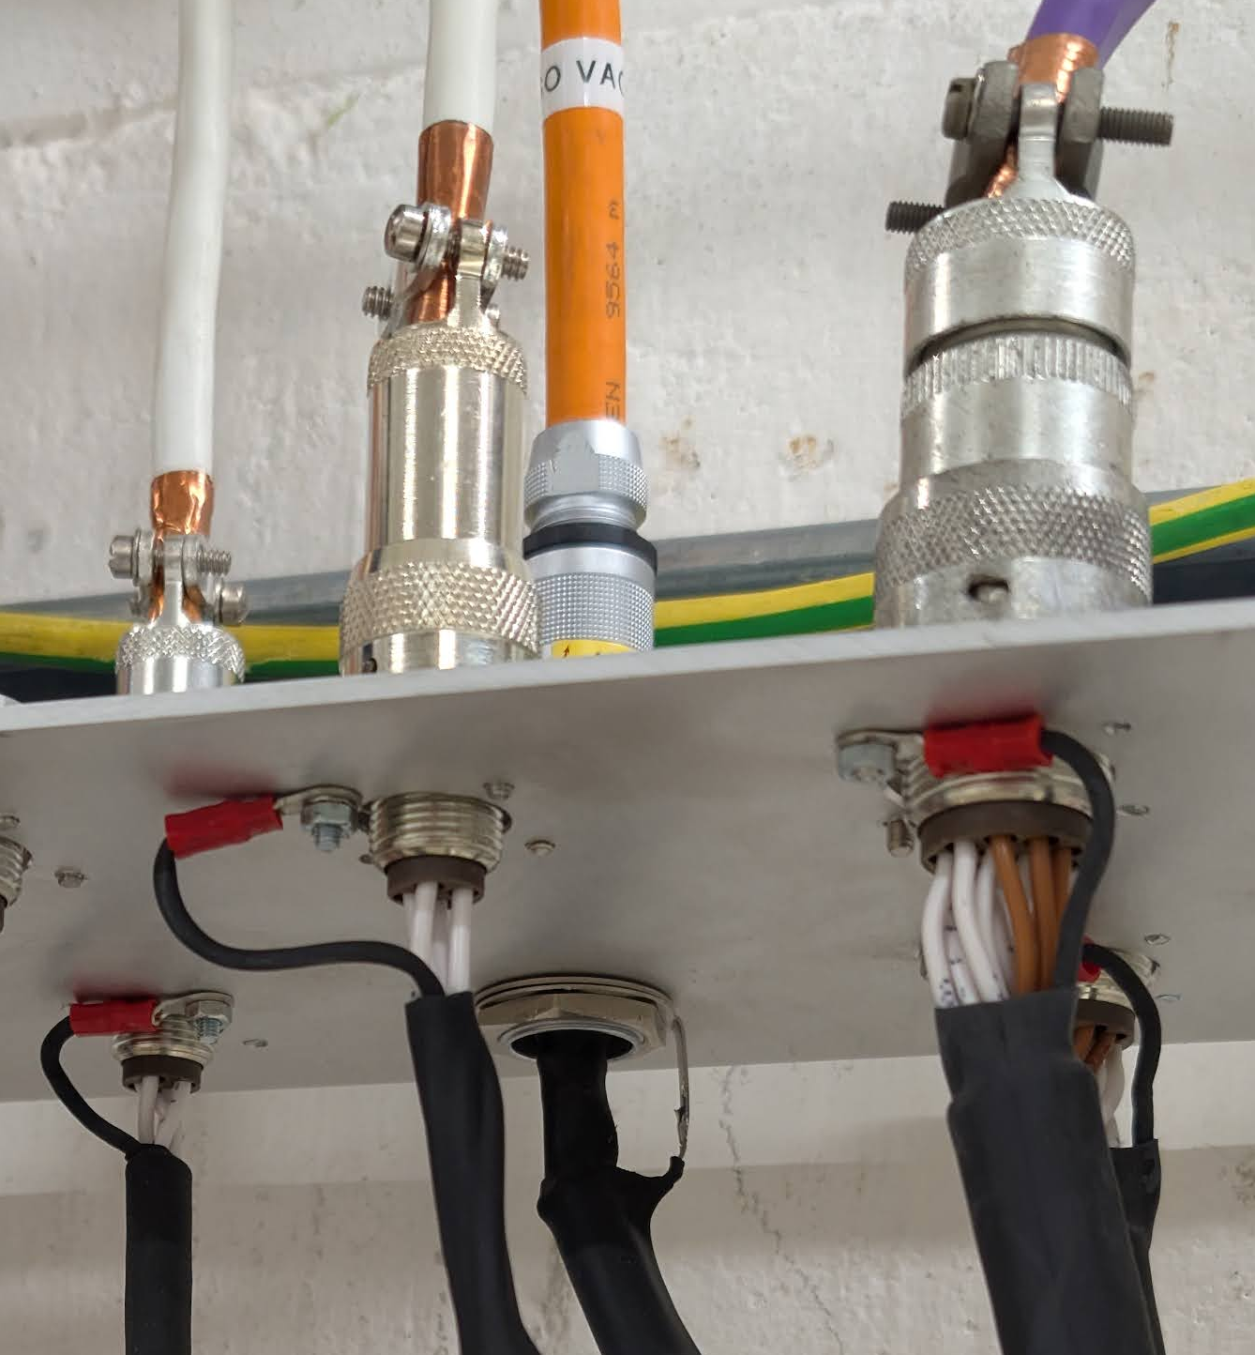
EMC Forum Feedback
Meeting with Daniel Valuch on 27/06.
Harting-based solution pre-validated as EMC conform.
Burndy-based chassis solution identified as non-EMC conform.
  Feasibility of the introduction of a backshell termination to be evaluated.
Patch panel material selection discussed:
  Grounded conductive plates identified as the go-to approach according to EMC standards.
    However, there is the risk of ground loops if the grounding system is poorly bonded or if the cable screen is then connected to multiple grounding references.
  Non-conductive (insulator) plates identified as the best approach for a seamless patching ensuring EMC.
    Require more study on material selection for mechanical robustness and durability.
Open possibility of testing prototypes at the EMC lab.

Slide 6
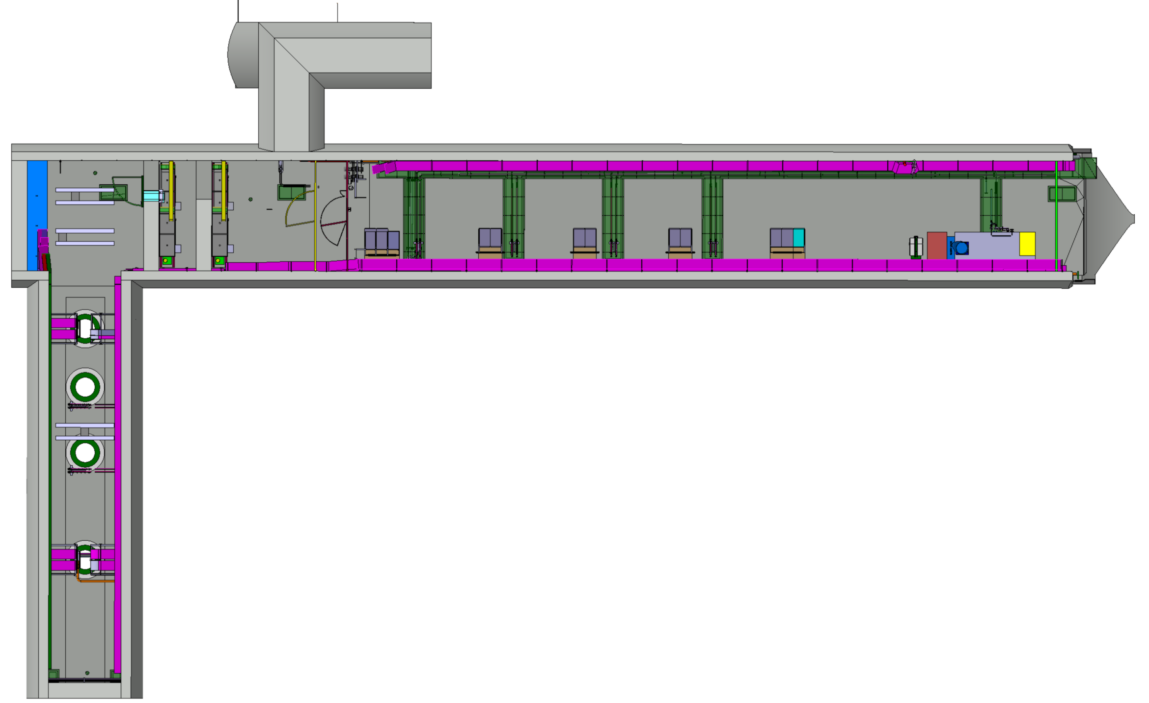
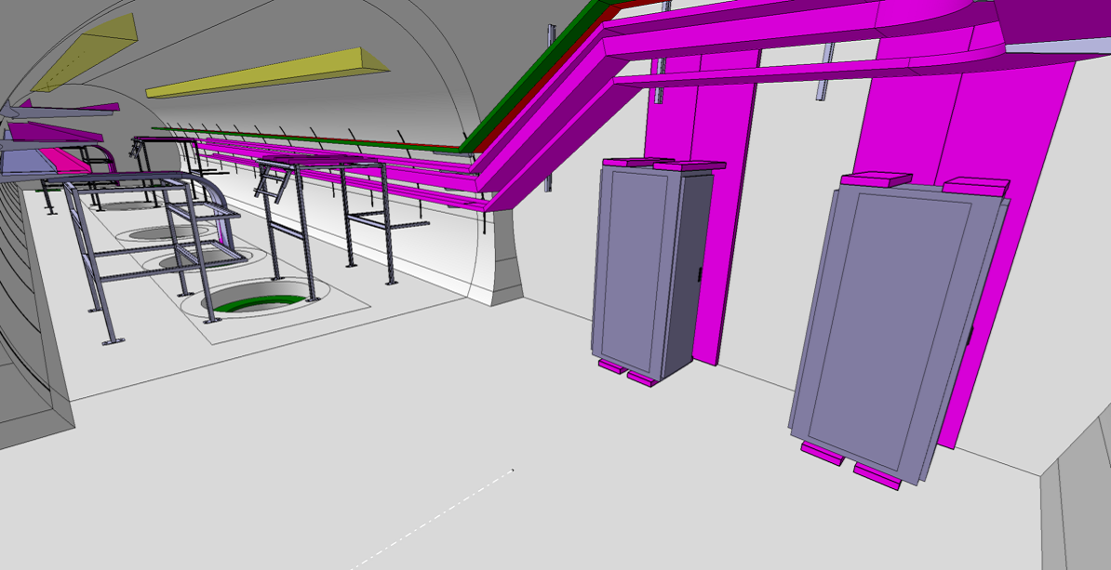
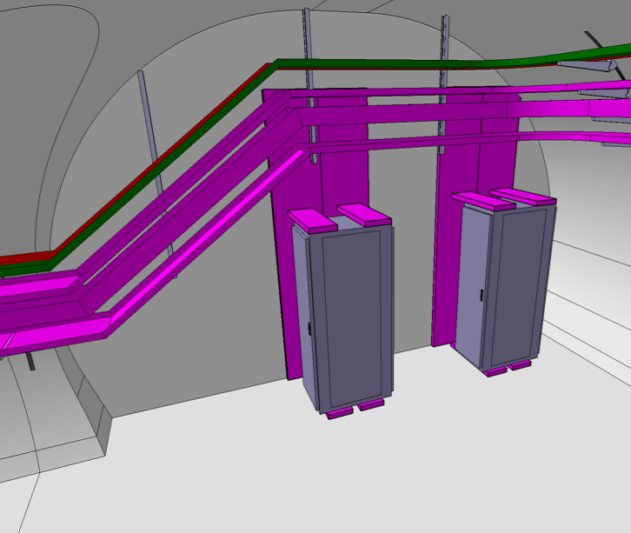
Design & Integration – UAs
Study on-going for worst-case UA – UA53 (242 cables).
Volume available for 2 standard LHC 45U 19” racks:
  1 rack exclusively for TE-VSC with total allocation of 45U:
    Patch panel – 15U (can be moved to other rack if requirement for max. rack allocation <45U)
    Special crates 19” – 30U.
  1 rack for patch panels with total allocation of 17U:
    BE-GM + EP-CMT – 8U.
    TE-CRG – 9U.
Patch panels:
  with standard 19” width
  installed in the centre support frame parallelly to rack doors plane.
FIP boxes & resin-junctions attached to wall / cable tray.
System impacted: EC (“normal” signal cables).

Slide 7
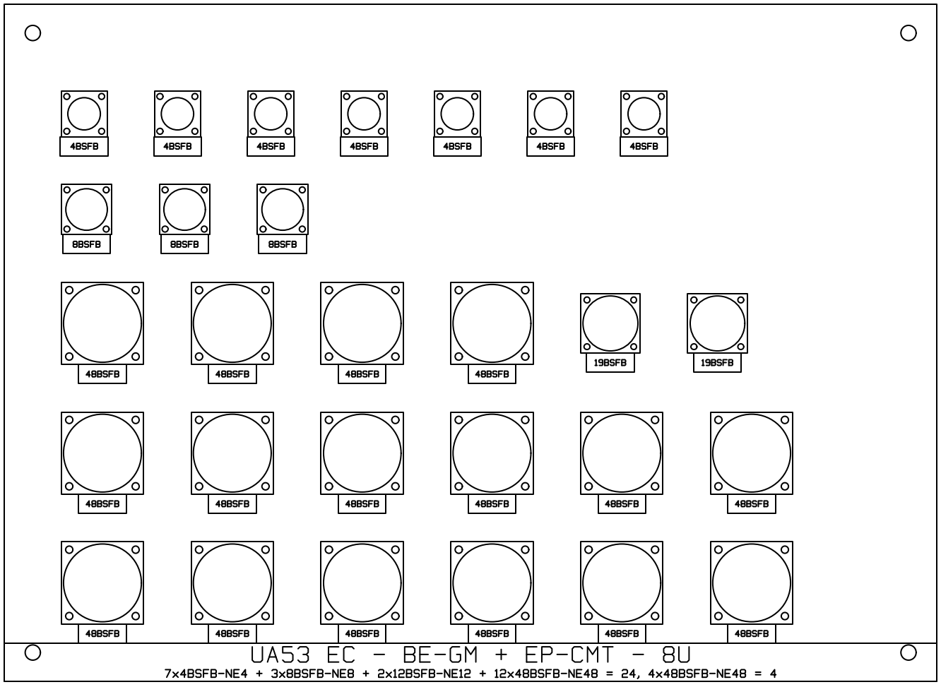

Slide 8
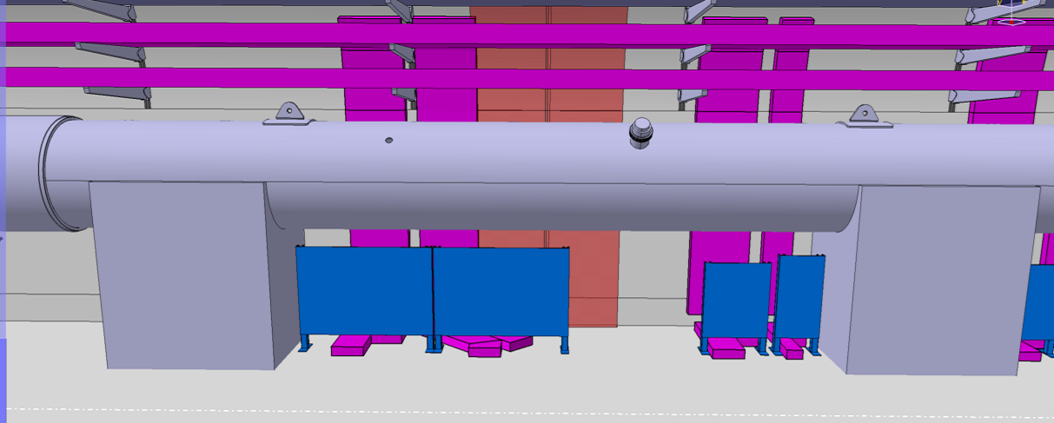
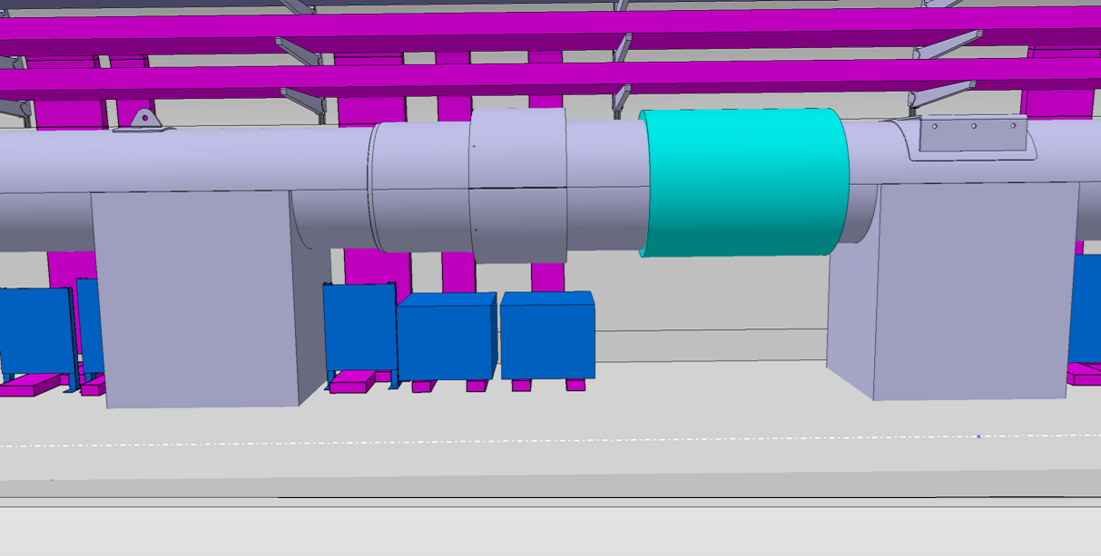
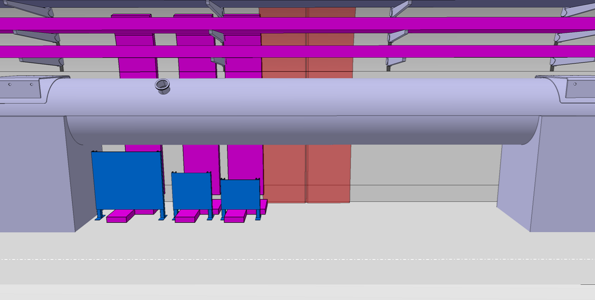
Design & Integration – ULs
R1
R2
R3
Study on-going for worst-case UL – UL13 (329 cables).
Volume available under QXL with W600mm x H850mm in sections of L3m~4m (between QXL supports).
Patch panels:
  Installed In vertical rails fixed to the floor parallelly to the wall.
  With handles and supports to be put in “work” position for access and connector installation on the rear side.
  Positioned to keep a minimum of L600mm passage to the wall under the QXL and avoiding the QXL interconnection sections.
Uncertainty on QXL integration is a major blocking point!
FIP boxes & resin-junctions attached to wall / cable tray.
R1 – EC for BE-GM, TE-CRG, and TE-MPE
R2 – EC for TE-VSC
R3 – ECP for BE-GM, TE-CRG, and TE-VSC
Systems impacted: EC (“normal” signal cables) and ECP (potential EMC-offender cables).

Slide 9
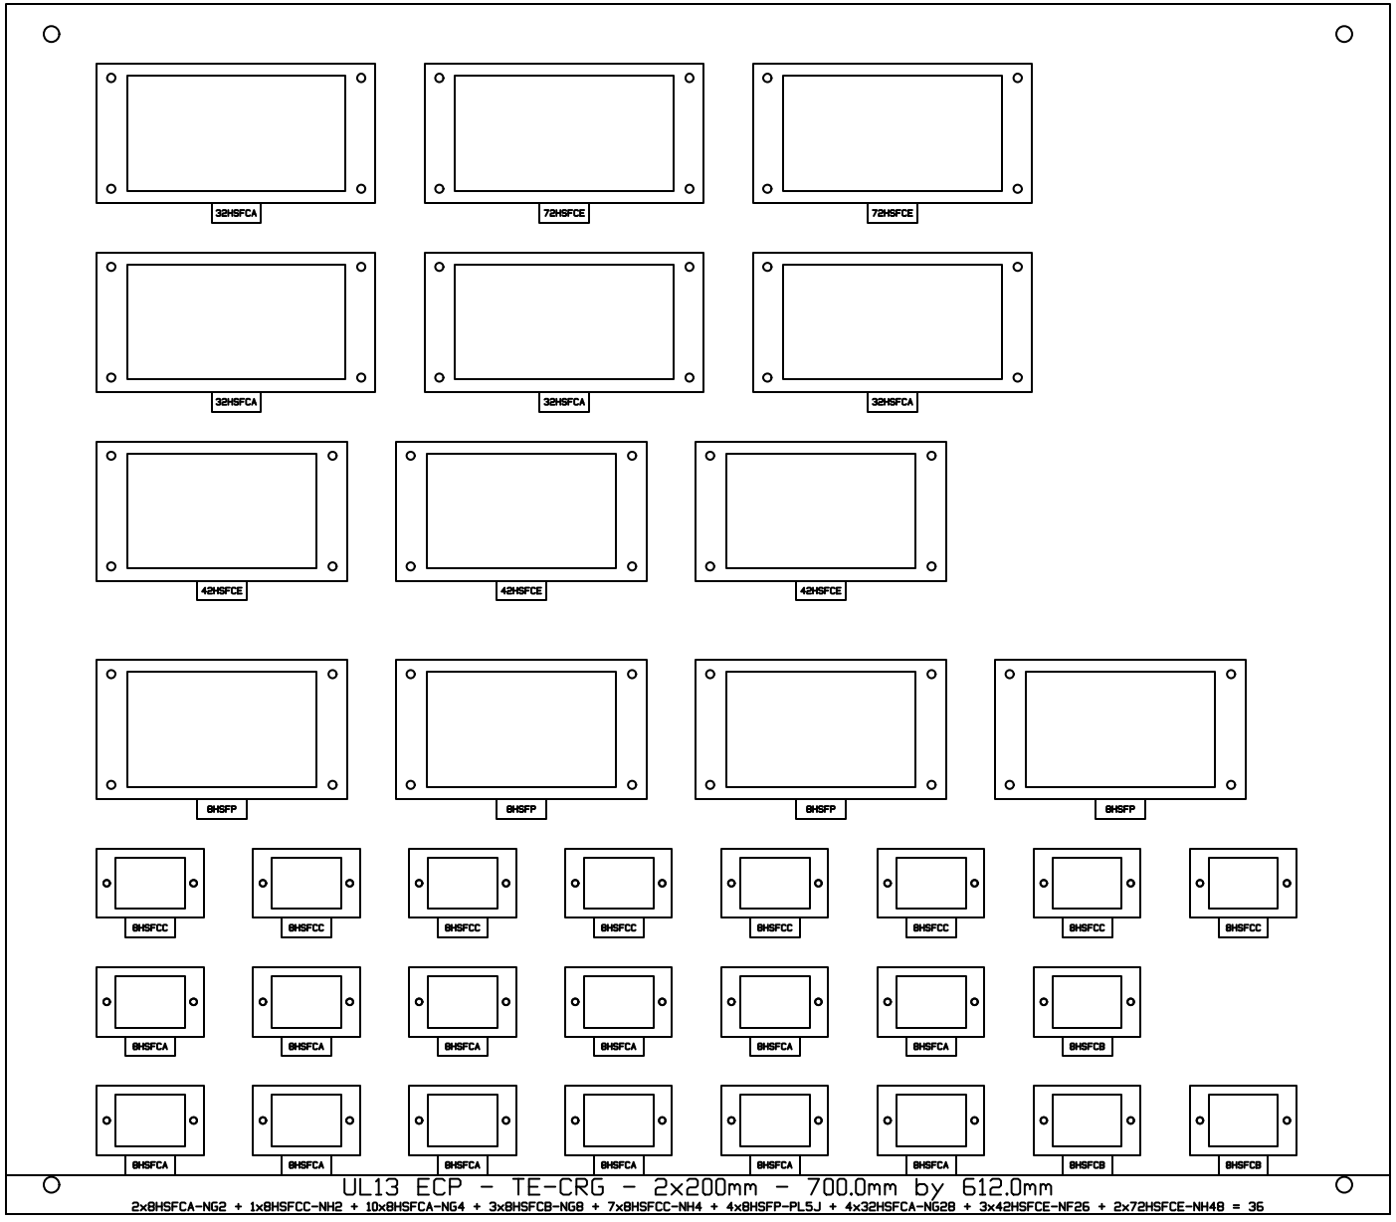

Slide 10
Prototyping
2 prototypes with 16 connections (32 connectors) each:
  Rack assembled with Burndy + BNC.
  Rails assembled with Harting (standard & high-EMC).
Includes examples of all patch panel connections with the 2 installation topologies (rack + rails).
Objective:
  Validate:
    Design choices.
    Connector parts and assemblies.
  Anticipate issues on:
    Connector installation.
    Patch panel production, assembly, installation, and operation.
Risk on connector procurement delay for Harting connectors.

Slide 11
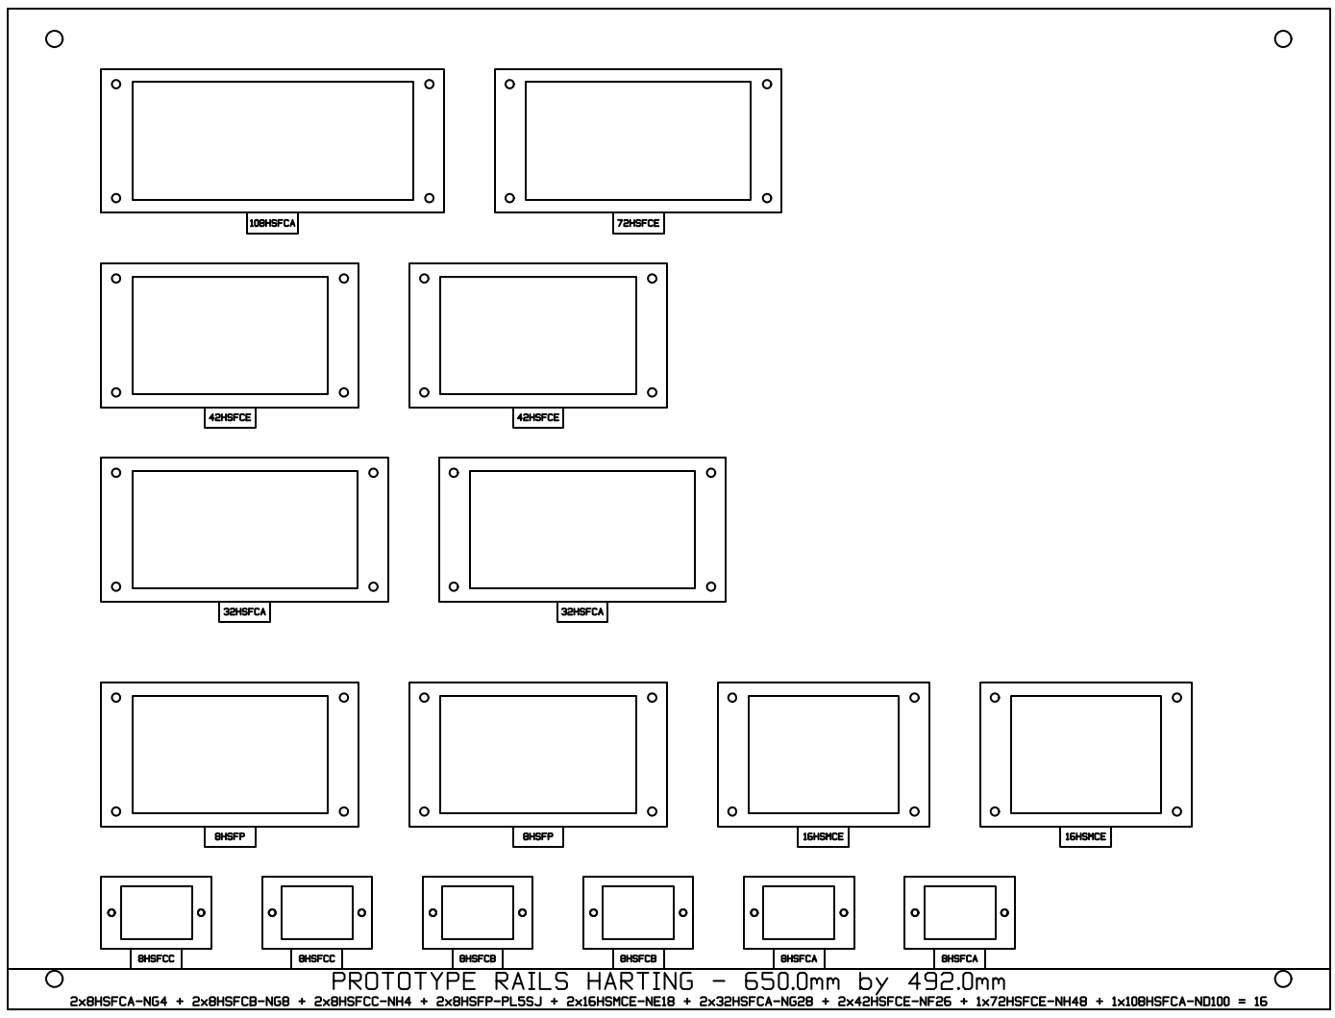
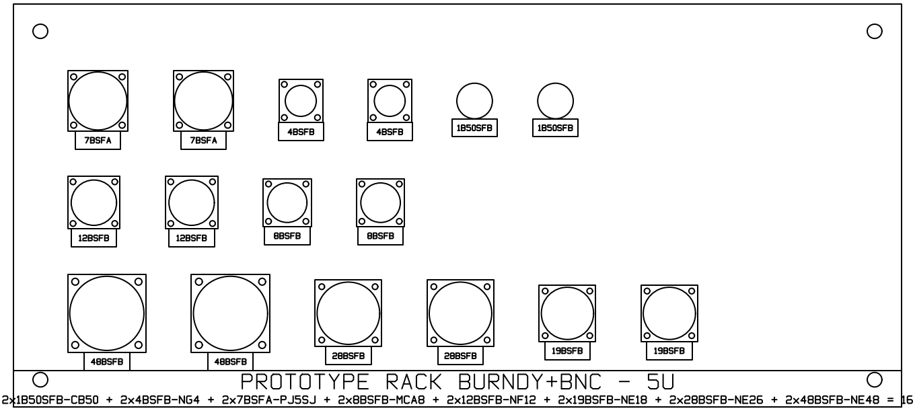

Slide 12
Cost Estimation
Cost Estimation | Material (CHF) | Manpower (€) | Total Cost* (CHF)
Mechanical Works | 12 168 | 11 931 | 23 344
Connectors | 94 594 | 314 709 | 389 382
Cable tests | 0 | 76 318 | 71 487
Additional Cable Lengths | 33 927 | 65 062 | 94 871
Prototyping⁽¹⁾ | 4 687 | 6 850 | 11 103
Pulling 1-shift vs. 2-shift | 0 | – 85 057 | – 79 673
Total | 145 376 | 389 813 | 510 514
N.B. With today’s prices, the cost of a future HL-LHC RIAC campaigns can be reduced by up to 2.2 MCHF, since the section of cables upstream of patch panels will not be irradiated.
⁽¹⁾Corresponding to 2% of the total cost.
*CHF/€ = 0.9367 (EDH rate as of 10/06/2025).

Slide 13
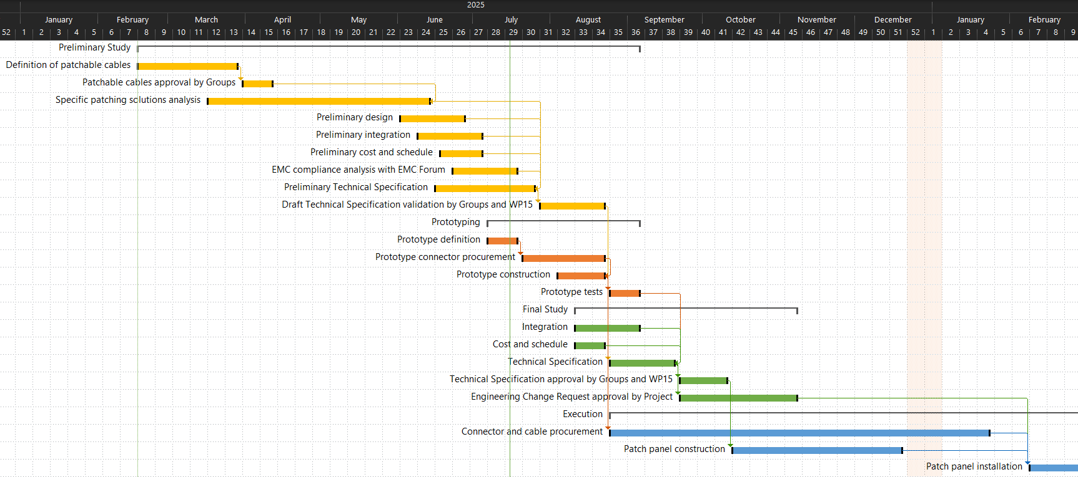
Schedule

Slide 14
Next Actions
Investigate Burndy-based chassis backshell solutions.
Submit Draft of Technical Specification in EDH as “Draft For Discussion” for Groups and WP15.
Prototyping:
  Finalize definition.
  Launch connector procurement order.
  Start construction.
Launch connector procurement order once:
  Draft of Technical Specification is validated.
  Prototypes construction is finalized.
Finalize integration.

Slide 15
AoB
DICs for cabling campaigns in September are still not mature enough for Technical File finalization:
  Functional Positions.
  Cable types.
  Connectors + conventions.
Group | Wrong / outdated Functional Positions | Undefined / non-standard Cable Types | Undefined / non-standard Connectors | Undefined Connecting Conventions
BE-CO RESET | X |  |  | X
SY-BI BPW TRIGGERS |  |  |  | X
SY-BI IT BPM |  |  |  | X
SY-EPC ETHERNET | X
SY-EPC INTERLOCK | X |  |  | X
SY-RF RF POWER | X |  | X | X
SY-RF-CS RF CONTROL | X
SY-RF-FB RF CC FC IPR |  |  | X
TE-CRG | X | X | X | X
TE-MPE |  | X | X | X
TE-VSC BV+IV UR | X
We risk considerable delay if DICs are not corrected by the end of July!

