Slide 1
A short introduction to the Worldwide LHC Computing Grid
Maarten Litmaath
CERN IT
September, 2025

Slide 2

The LHC challenge
300+ PetaByte / year
Current total 2.5+ ExaByte
Data analysis requires at least ~1M typical PC processor cores
Scientists in tens of countries worldwide
CERN can provide up to 20-30% of the storage and CPU
We need a GRID !

Slide 3
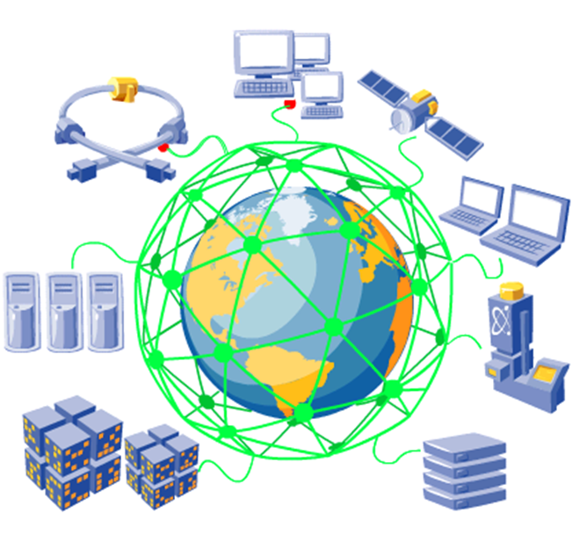
What is a grid?
Relation to WWW?
Uniform easy access to shared information
Relation to distributed computing?
Local clusters
WAN clusters
Relation to distributed file systems?
NFS, AFS, DFS, …
A grid gives selected user communities uniform access to distributed resources with independent administrations
Computing, data storage, devices, …

Slide 4
Why is it called grid?
Analogy to power grid
You do not need to know where your electricity comes from
Just plug in your devices
You should not need to know where your computing is done
Just plug into the grid for your computing needs
You should not need to know where your data is stored
Just plug into the grid for your storage needs

Slide 5
What is cloud computing?
Transparent use of generic computing resources off-site
Dynamically provisioned
Metered
Neutral to applications
Rent-a-center
Computer or data center
Internet
Amazon EC2, S3
Microsoft Azure
Google
IBM
Alibaba
Oracle
…
Site

Slide 6
What is grid computing?
Site
Site
Site
Internet
Site
Site
Site
Site
Site
Site
Site
Site

Slide 7
What is grid computing about?
A grid facilitates collaboration between members of a supported distributed community
They can form a Virtual Organization within that grid
A grid allows distributed resources to be shared uniformly and securely for common goals
Computing
Data storage
A grid can support multiple Virtual Organizations in parallel
Sites, computer and data centers make selections according to the projects in which they participate
The quality of service may differ per VO

Slide 8
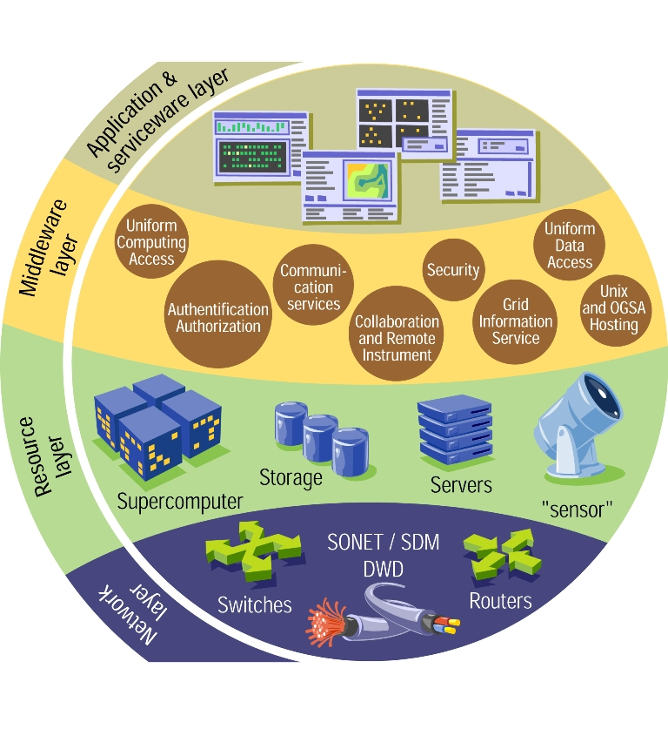
How does a grid work?
Middleware makes multiple computer and data centers look like a single system to the user
Security
Information system
Data management
Job management
Monitoring
Accounting
Not easy!
Independent sites
Different systems
Local policies/priorities
Other users

Slide 9
Where can we use grids?
Scientific collaborations!
Can also serve in spreading know-how to developing countries
Industry? Commerce?
Mostly cloud computing
Homes? Schools?
Internet Service Providers → cloud computing
Secure data sharing technologies?
E-learning
Social media
Government? Hospitals? Other public services?
Beware of sensitive/private data

Slide 10
Many grids can coexist
EGI – European Grid Infrastructure
Successor of EGEE – Enabling Grids for E-sciencE ← led by CERN
OSG – Open Science Grid
USA and beyond
National
IGI (It), GridPP (UK), DFN (De), France Grilles, …
Regional
NorduGrid (Nordic countries), BalticGrid (Baltic region), SEEGrid (South-East Europe), EUMedGrid (Mediterranean), …
Interregional
EELA (Europe + Latin America), EUIndiaGrid, EUAsiaGrid, …
WLCG – Worldwide LHC Computing Grid
Federation of EGI, OSG, Nordic Data Grid Facility, …

Slide 11
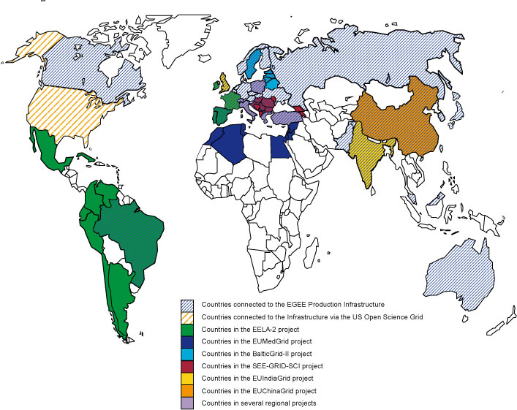

Projects that collaborated with EGEE

Slide 12
Many communities can coexist
High-energy physics
Astrophysics
Astronomy
Fusion
Computational chemistry
Biomed – biological and medical research
Statistical analysis of anonymized data
“In silico” discovery of new drugs and vaccines
…
Earth sciences
…

Slide 13
The LHC challenge
300+ PetaByte / year
Current total 2.5+ ExaByte
Data analysis requires at least ~1M typical PC processor cores
Scientists in tens of countries worldwide
CERN can provide up to 20-30% of the storage and CPU
70-80% are provided by WLCG partners

Slide 14
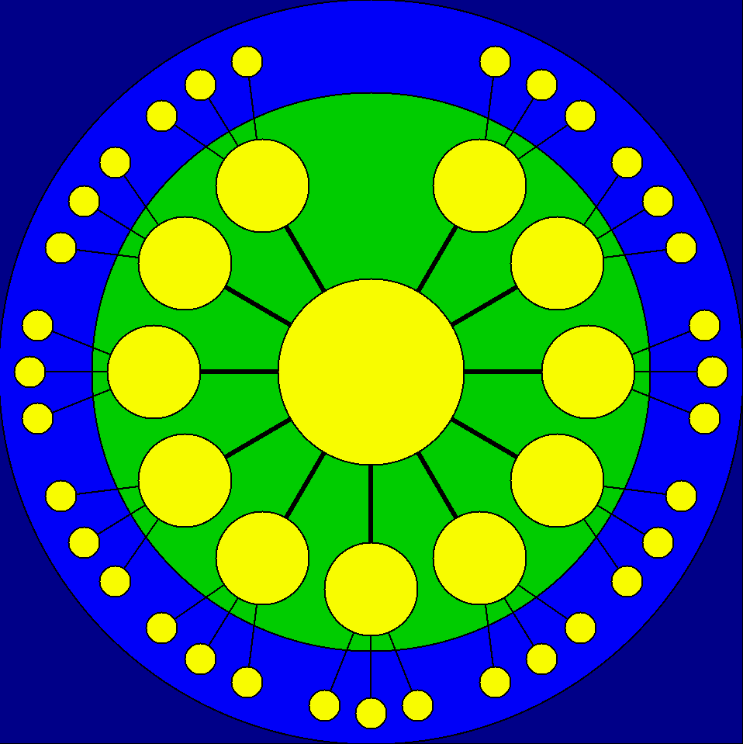
The WLCG answer
140+ computing centers
40+ countries
Hierarchical and regional organization
15 large centers for long-term data management
CERN = Tier-0
10 initial + 4 additional Tier-1 sites
South Korea: KISTI
Russia: JINR
Poland: NCBJ
China: IHEP
Dedicated network links
60+ federations of 130+ smaller Tier-2 centers
Tens of Tier-3 sites
Resources outside of WLCG policies
Tier-2
sites
Initial
Tier-1
centers
Canada
TRIUMF
(Taipei
ASGC)
NL
SURF-
NIKHEF
USA
BNL
UK
RAL
Tier-0
CERN
France
CCIN2P3
Spain
PIC
Italy
CNAF
Nordic
countries
NDGF
USA
FNAL
Germany
KIT

Slide 15
The WLCG evolution
Fast networks allow for direct transfers between:
Tier-1 sites
Also providing backup routes since many years
T2 sites in the same region
T2 and T2/T1/T0 in different regions
A Layer 3 Virtual Private Network connects most sites to each other
LHCONE = LHC Open Network Environment
T1 and T2 sites keep their different responsibilities
Tier-2
sites
Tier-1
centers
Tier-0
CERN

Slide 16
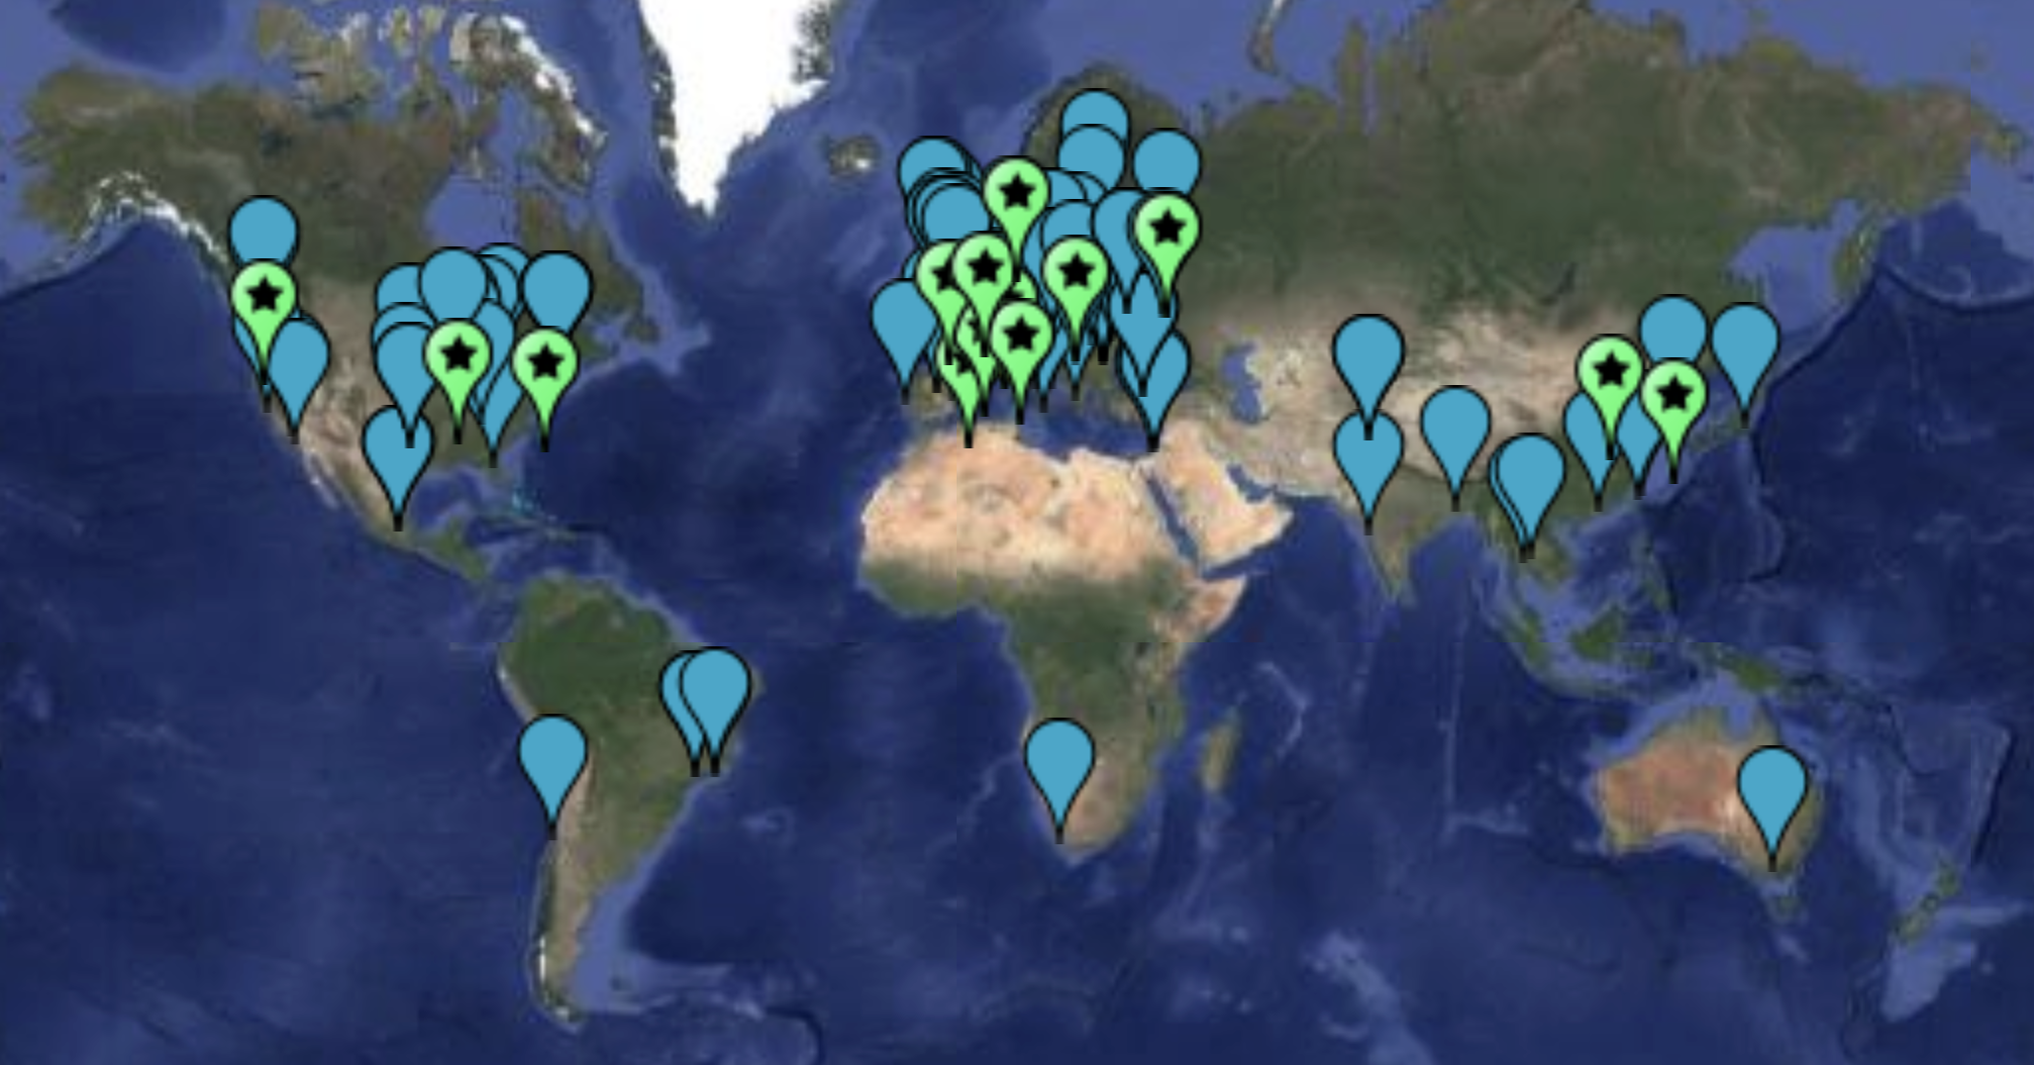
Locations of the WLCG sites

Slide 17
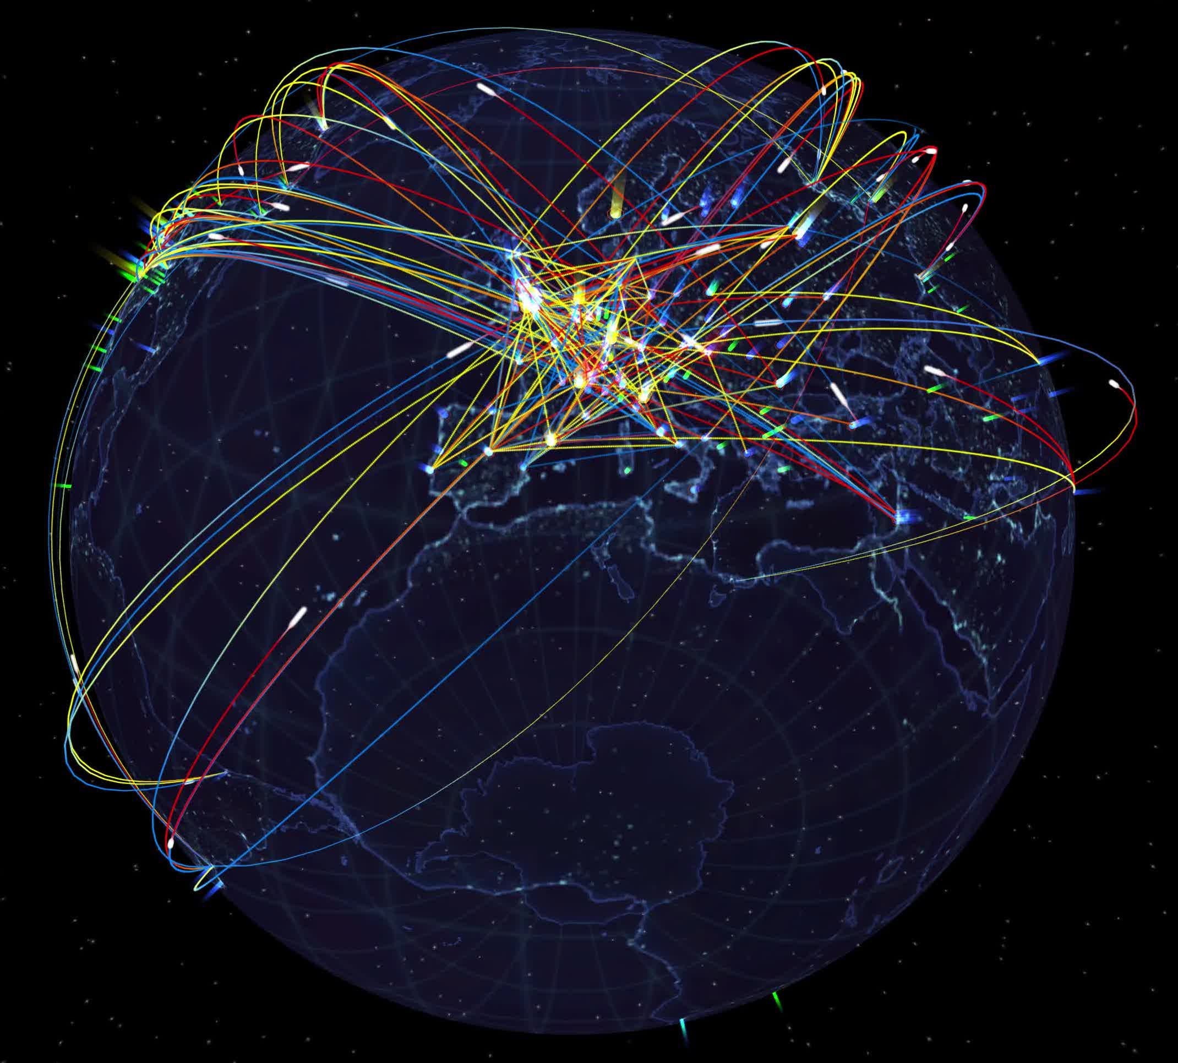
WLCG in action

Slide 18
Conclusions
Grids facilitate collaboration between members of supported distributed communities
Grids allow distributed resources to be shared uniformly and securely for common goals
Grids may have complex infrastructures
Grids are useful for many scientific disciplines and projects
The Worldwide LHC Computing Grid is vital
for the success of the LHC experiments !

Slide 19




More information
wlcg-public.web.cern.ch
www.egi.eu
osg-htc.org
www.ndgf.org

