Slide 1
Current Progress (02/07/25)
Overview of existing functionality
(We will not copy this 1 for 1, we will only implement things that are necessary).
BIPXL CTL FESA Class (C++)
bipxl_gateware_info (very very small)
data_controller
detector_controller
event_assembler
fast_bus
gbt_fpga
gbt_sc
shutter_controller
system_controller
trigger_controller
zcu102_peripherals
4/11 blocks = ~36%
BIPXL Core Library (C++)
EDGE Extender (Semi-Auto)
EDGE Wrapper (Auto-generated)
EDGE Driver (Auto-generated)
FEC

Slide 2
Current Progress (17/07/25)
Overview of existing functionality
(We will not copy this 1 for 1, we will only implement things that are necessary).
BIPXL CTL FESA Class (C++)
bipxl_gateware_info (very very small)
data_controller
detector_controller
event_assembler
fast_bus ← not needed (IP Bus)
gbt_fpga
gbt_sc
shutter_controller
system_controller
trigger_controller ← cant test yet
zcu102_peripherals
9/11 blocks = ~63%
BIPXL Core Library (C++)
EDGE Extender (Semi-Auto)
EDGE Wrapper (Auto-generated)
EDGE Driver (Auto-generated)
FEC

Slide 3
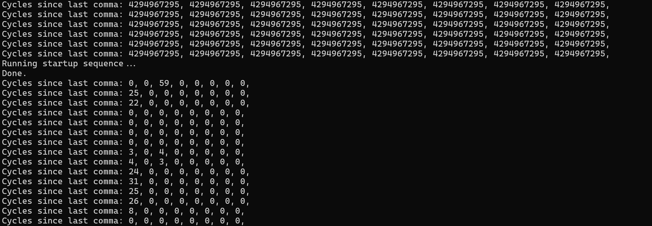
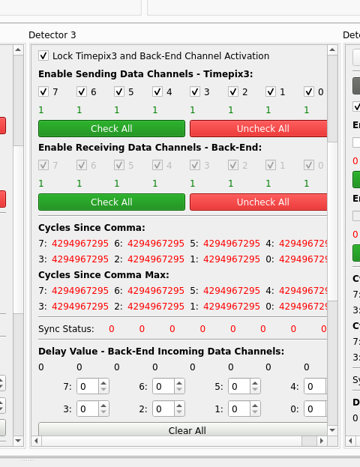
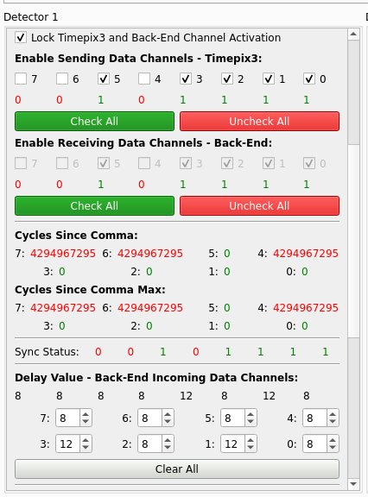
Can sync detectors in V5!
(Gabriela’s work)

Slide 4
Next steps:
Finish extender (data controller needed, trigger controller should follow closely)
Expand the core to handle more complex things (i.e. opening shutter and reading data, full acquisition)
Further expansion of EPA benchmarking we did? (to give some numbers to OP)
Related:
DMA discussions / benchmarks ongoing

Slide 5
Timeline, Q1
Week 11-12
  Finish the specification document(s) (Jüri, everybody else as well)
    Also, benchmarking if needed to motivate choice of architecture (Lukas)
  Explore DMA options together with David (Gabriela, Jüri)
  Generate Wrapper and start implementing Extender (Lukas, Jüri)
  Start a fresh GUI project, reuse UI elements (Lukas)
  Explore HDF5 capabilities in more detail (Lukas, Jüri, Justus)
  Brainstorm middle layer design (Jüri, Lukas, Steen)
  Gateware: adapting clocks, PCIe IP integration (Gabriela)
Week 13-14
  Distribute, edit, and approve the specification(s)? (James)
  If needed, implementation for DMA integration (Gabriela, Jüri)
  Finish and test Extender layer (Lukas, Jüri)
  Implement HDF5-based file writing (Jüri, Justus)
  Start extracting and fixing EPA algorithms (Lukas)
  Gateware: divide DDR between different event types (Gabriela)

Slide 6
Timeline, Q2
Week 15-18 (April)
  Finalise architecture of FESA class(es), start implementation (Steen, Jüri, Lukas, Justus)
    Also, fix/freeze the BIPXL API for FESA based on specifications
    In parallel, continue developing the new GUI (Lukas)
  Start reorganising Internal Driver, merge with BIPXL API (Jüri, Lukas)
  Finalise decision on architecture: traditional vs. hosted SoC (everybody)
    Also, make a decision and start implementing raw data offloading (Jüri, Lukas, Justus, Manuel)
  Gateware: continue integration, FMC-related GBTx modifications, refactoring (Gabriela)
Week 19-22 (May)
  MVP of BIPXL API + all layers below (Jüri, Lukas, Gabriela)
    Core functionality using real hardware
  Integrate BIPXL with FESA, and FESA with GUI
  Work on raw data offloading and event processing (Lukas, Jüri, Justus, Manuel)
  Knowledge sharing effort (everybody, aimed for the new hire but also for ourselves)
  Gateware: trigger and timing signal related modifications (Gabriela)
Week 23-26 (June)
  Start expanding software functionality (Jüri, Lukas, Steen)
  Perform more end-to-end testing (Jüri, Lukas, Gabriela, Steen)
  Gateware: verification and validation, CI/CD (Gabriela + new person?)

Slide 7
Timeline, rest of the year
We are here!
July-August (unproductive period)
  Solve integration issues between layers (everybody)
  Continue adding needed functionality in all layers (everybody)
September-October
  Continue solving previous and new issues (everybody)
  Move towards a wider testing campaign, automate everything (if not yet done) using CI/CD (everybody)
November (target!)
  Test out the new system with beam (everybody)
  Implement quick fixes for minor issues (everybody)

