Slide 1

Site and Civil Engineering Department
– Staff Association presentation
I. Fernandez, V. Sogno
CERN, 17.07.2025

Slide 2

Service Hub – What?
The Service Hub is a shared and flexible space located on the CERN Meyrin site, designed to bring support services physically closer to the CERN community.
It hosts key frontline teams such as IT-SOS (Support On Site), the Service Desk and UNIQA, and complements the assistance provided by the CERN Community Support Centre (CCSC).
The space is adaptable and can accommodate temporary activities, encouraging collaboration, operational efficiency, and direct contact with users who are already registered and working on site.
References

Slide 3
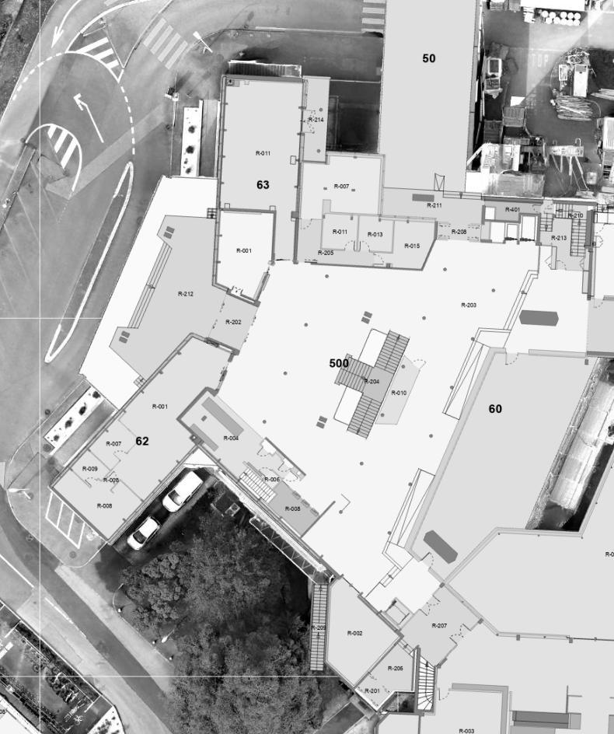
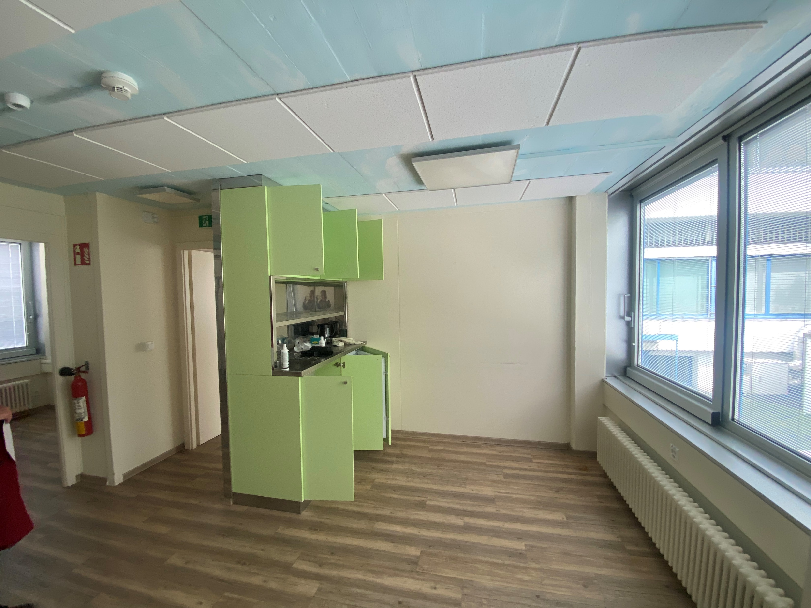
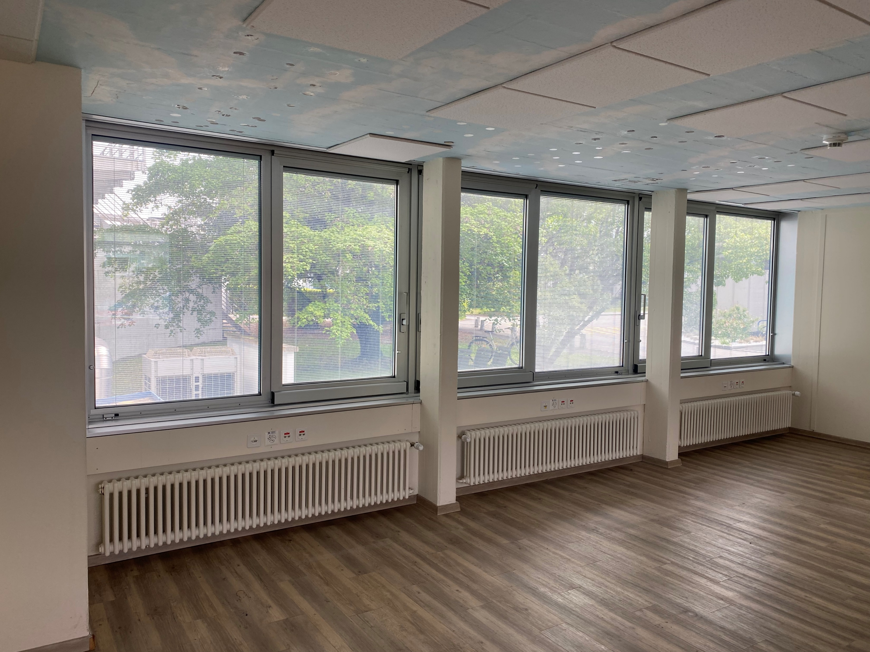
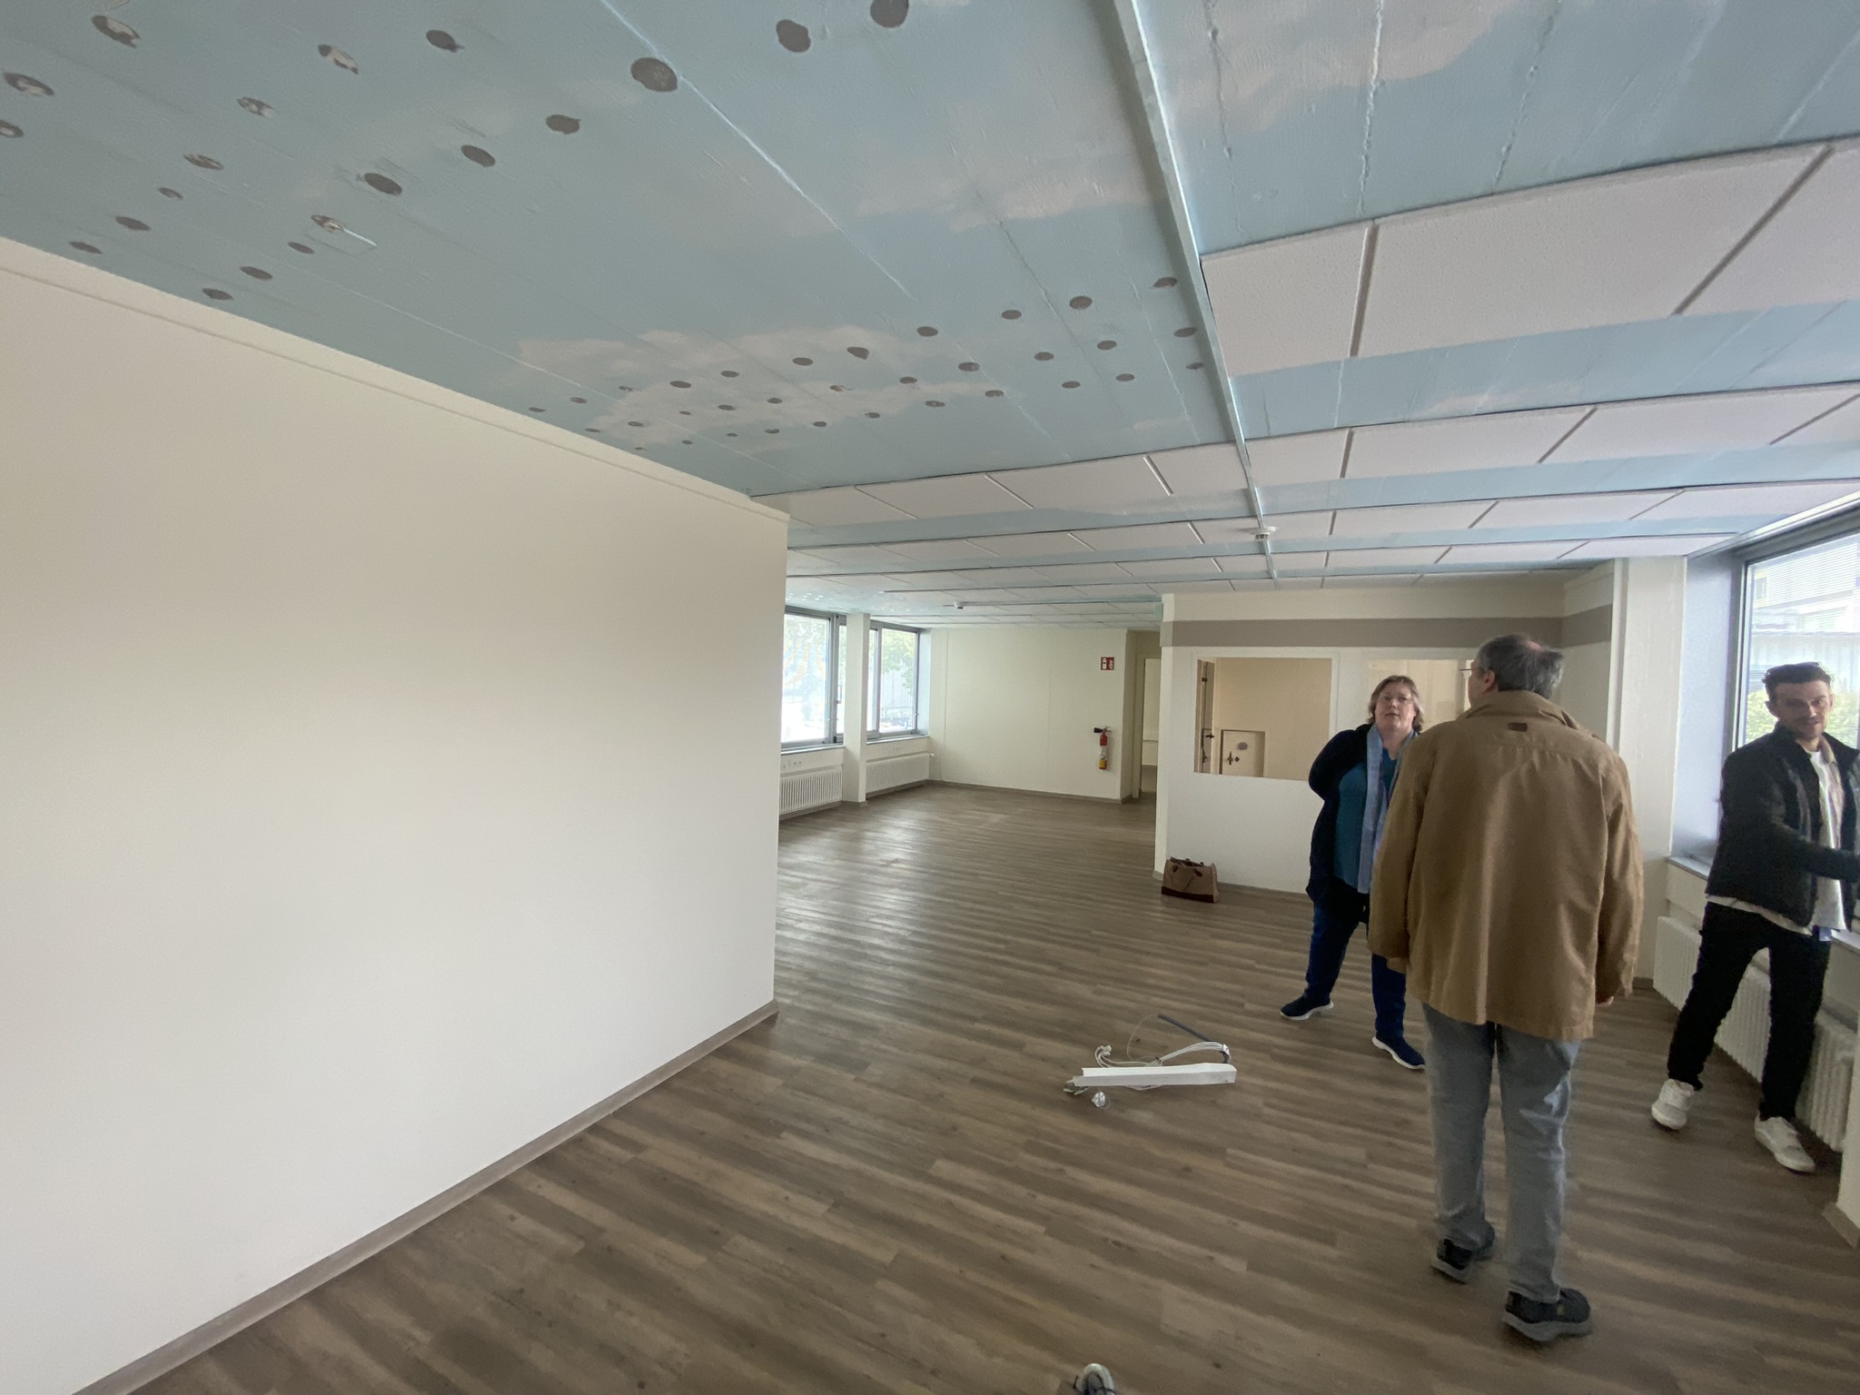
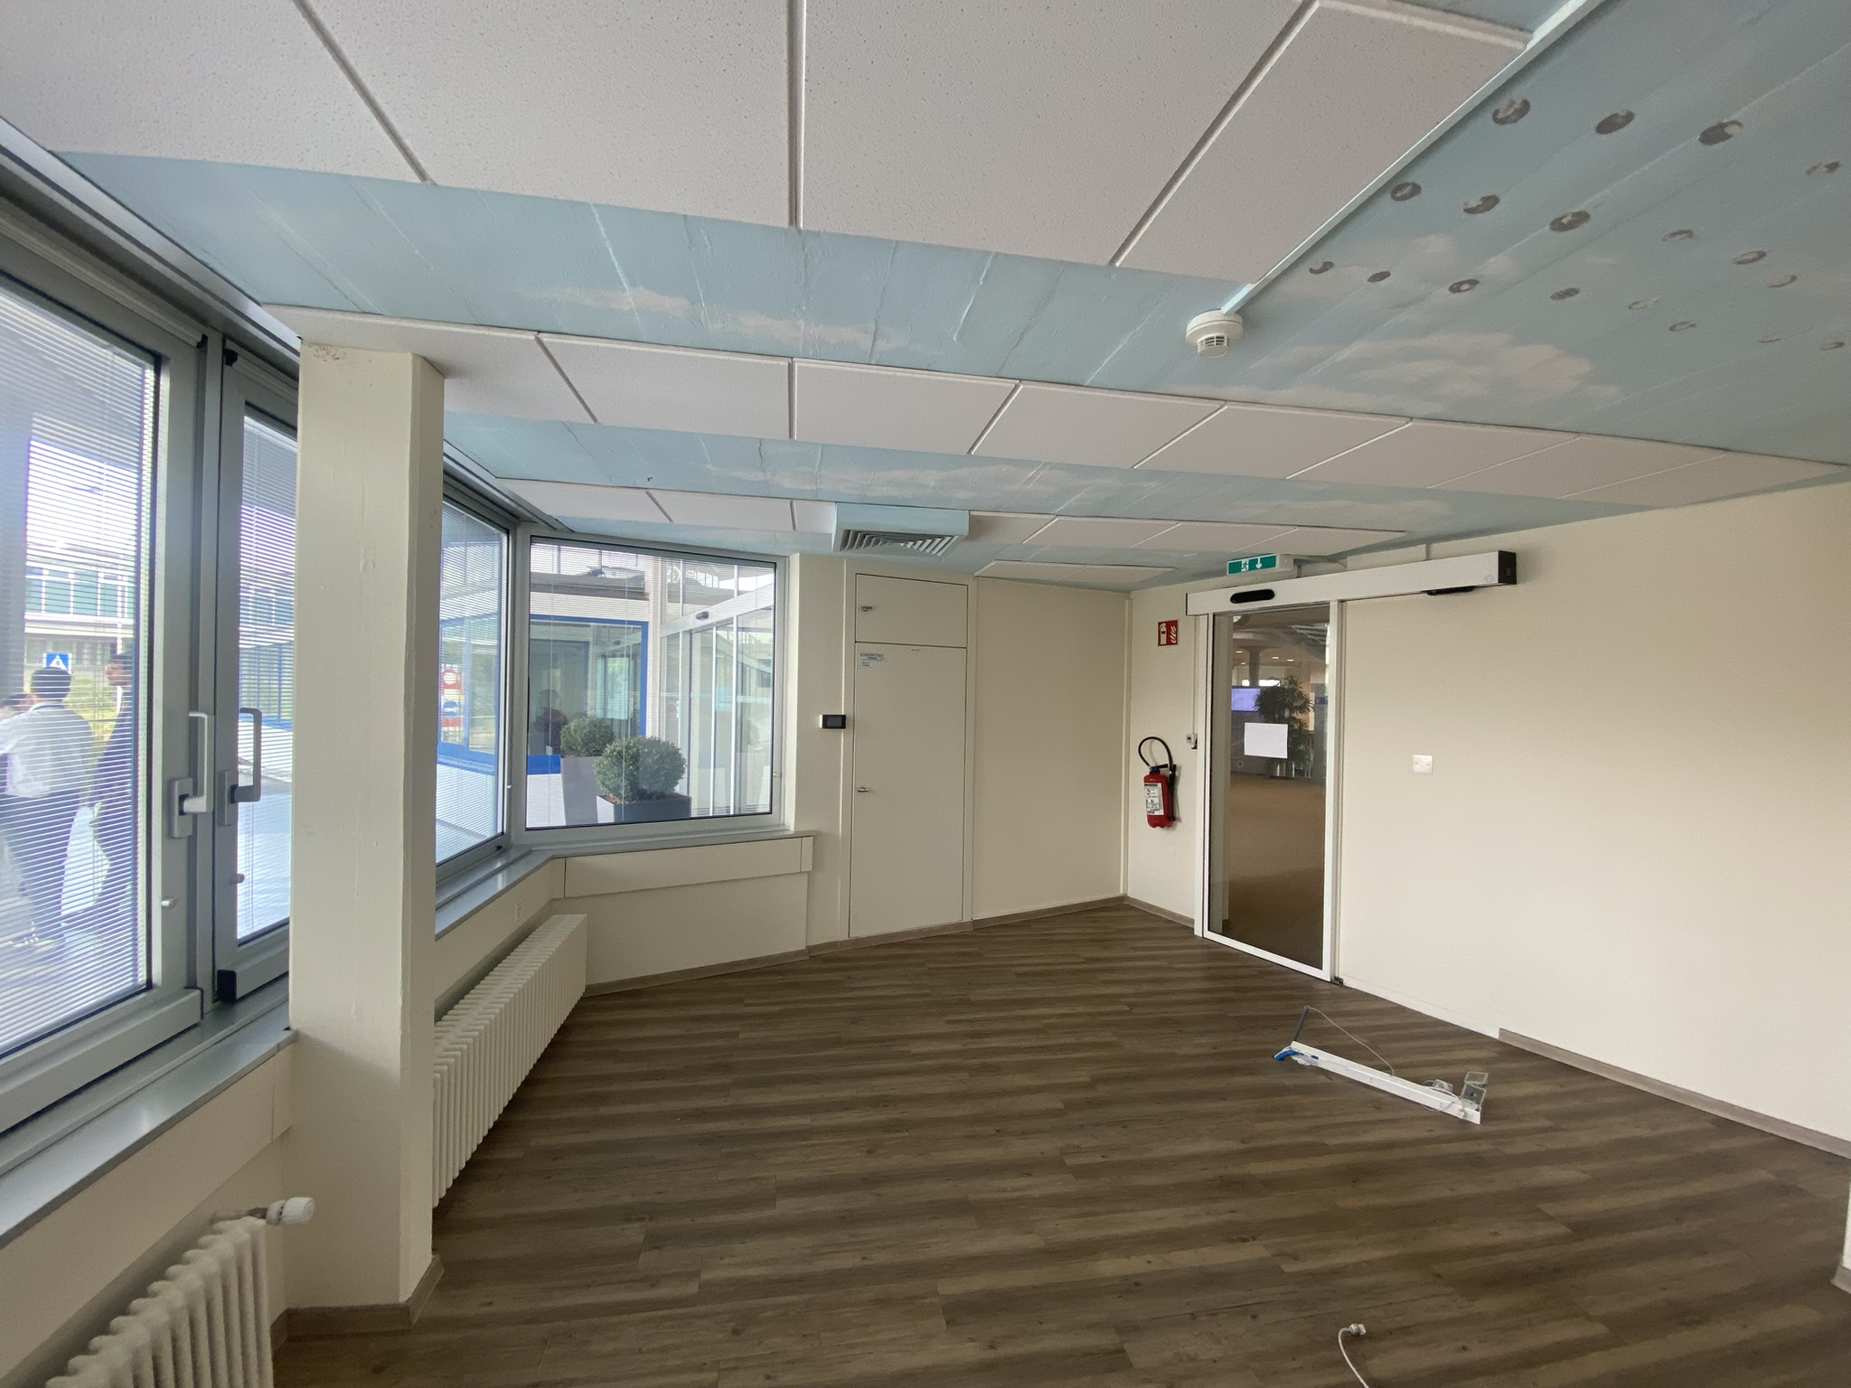
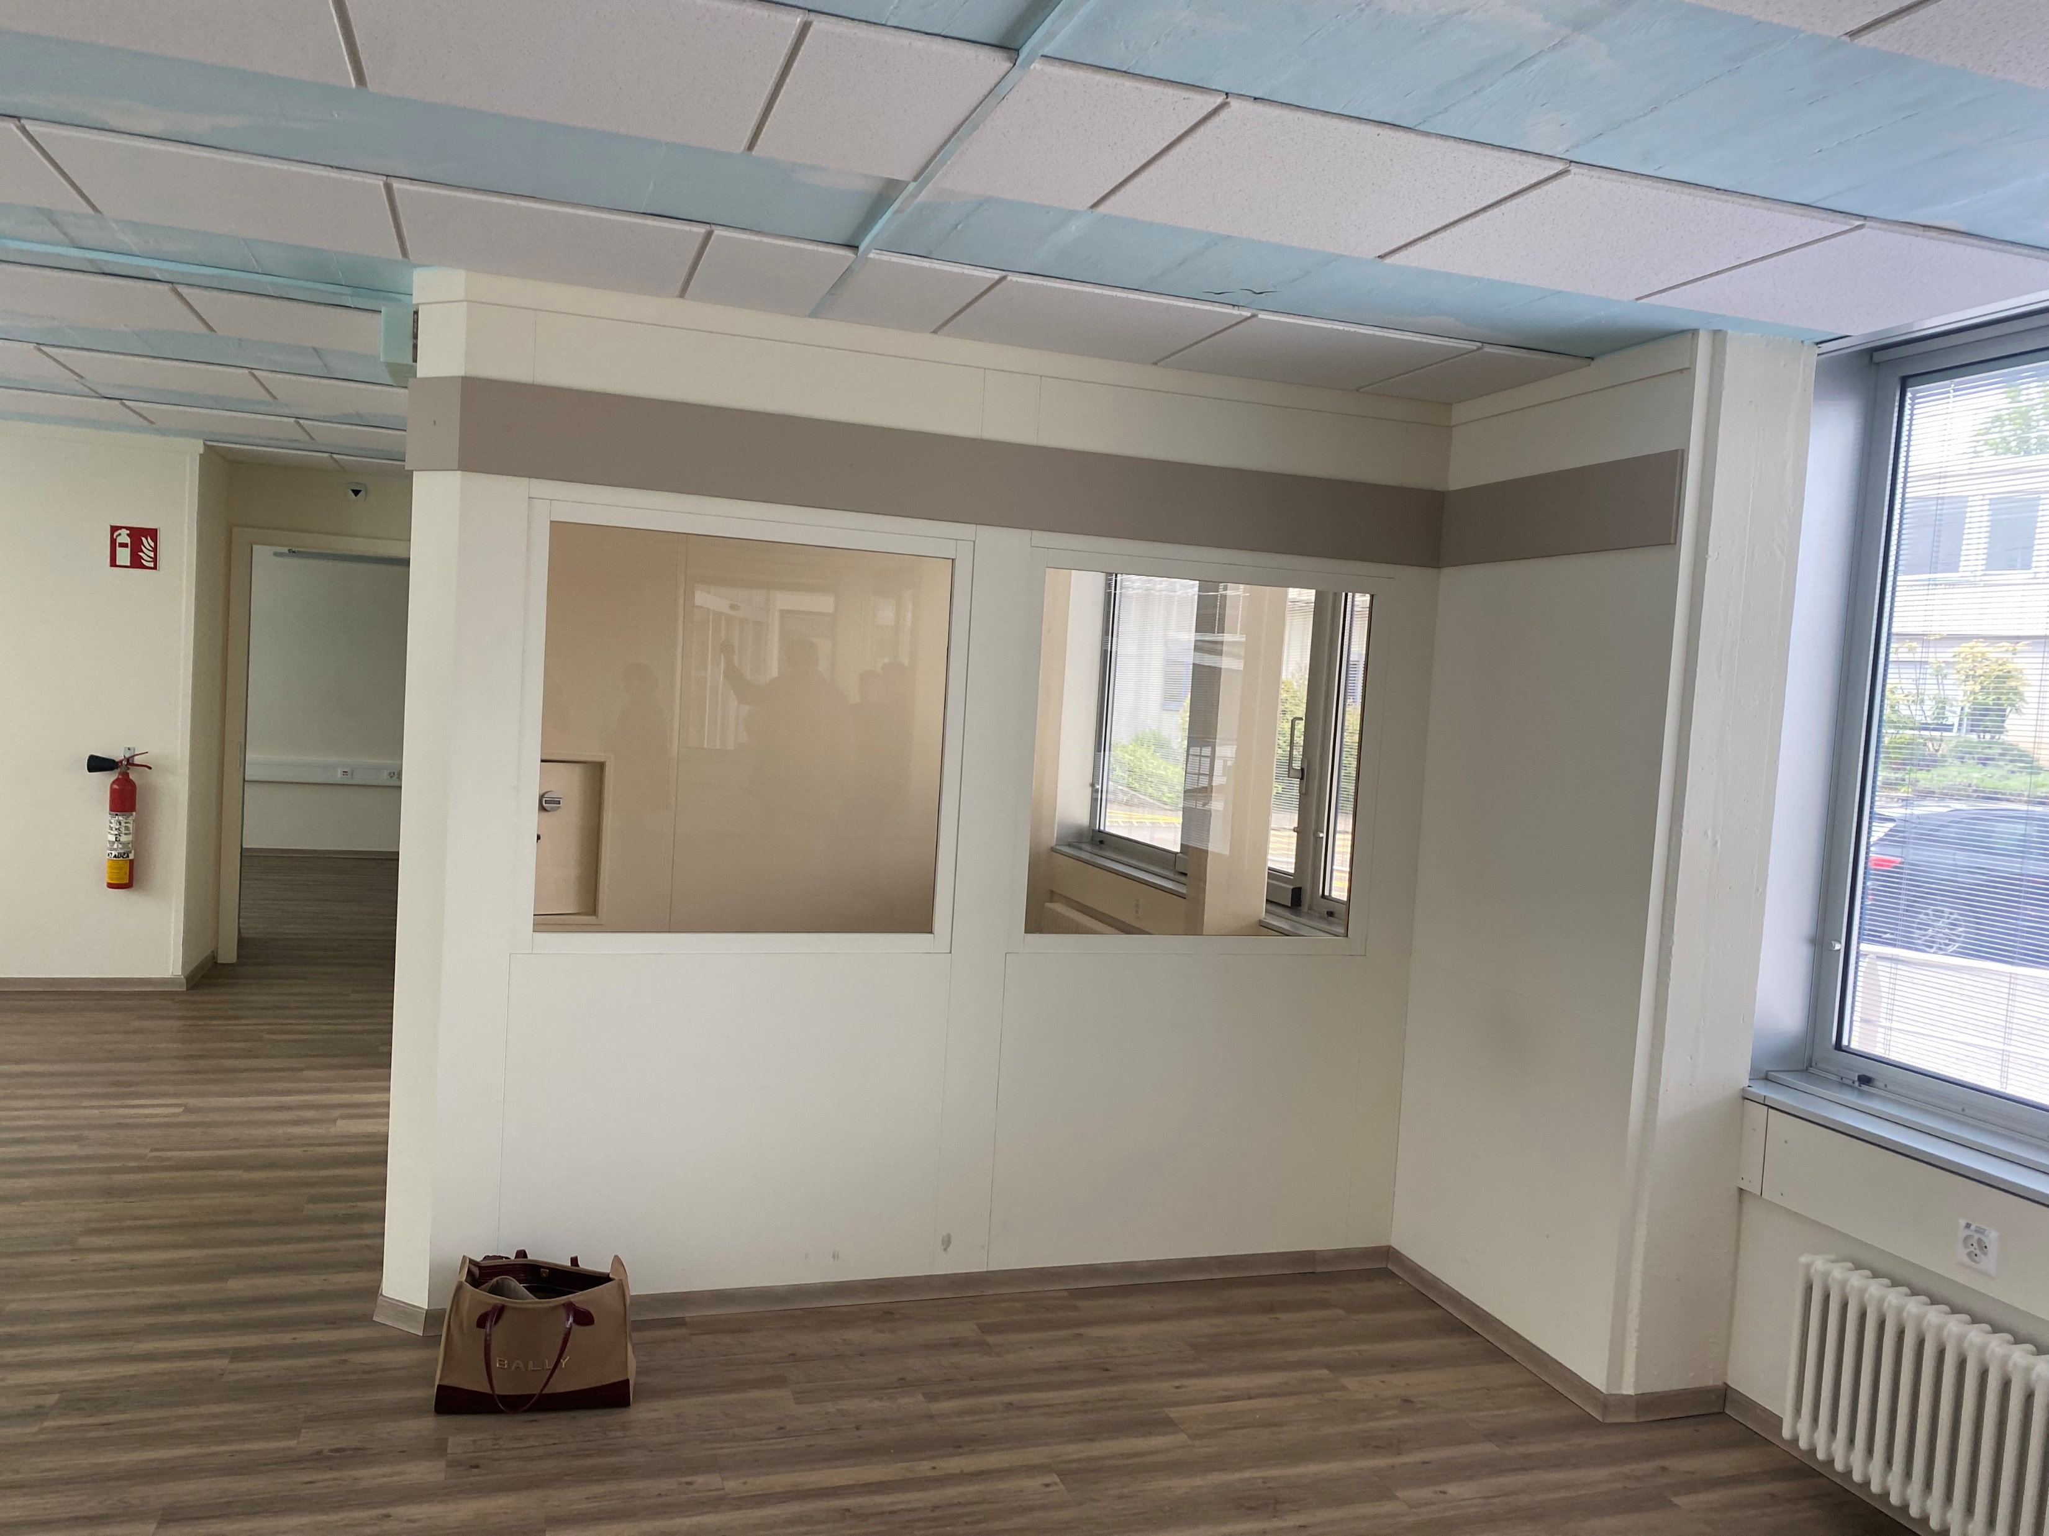
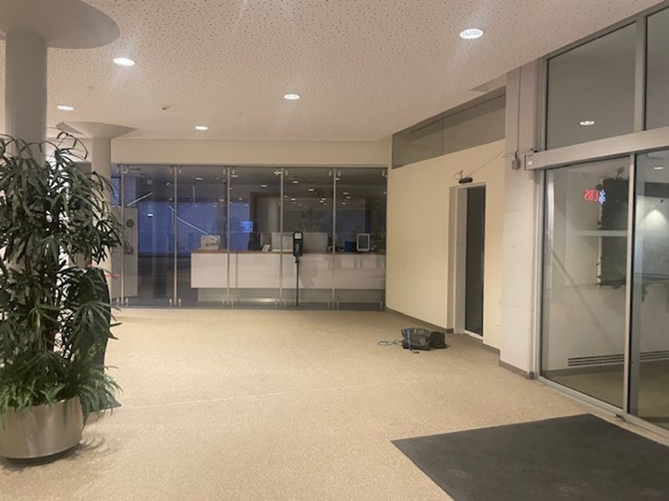
Service Hub– Where?
There is no alternative allowing these services to be in a central location, around the Main Building, which is key to be as accessible and visible as possible for CERN’s community.
UNIQA moved temporarily from B63 to B55 to allow the Minimarket project to be in that building from April to October 2025 during the works.
There is the possibility of locating the Service Desk back office in B55 but this would mean having that service split into three different locations (B33, B62 and B55) which would not allow to operate efficiently.
IT-SOS aim is to be as accessible as possible to the CERN’s community during the most popular time frame, which their figures show to be around lunchtime.

Slide 4
Service Hub– works
Safety & energy
New finishings
Recovery of existing ventilation system (*)
Update of electrical installation & electrical cupboards
Update of IT, DI and AC installations
Operational/space efficiency
Mutualisation
Flexibility (other future uses)
Collaboration
User friendly
New visible entrance
Ticket system for waiting
References

Slide 5
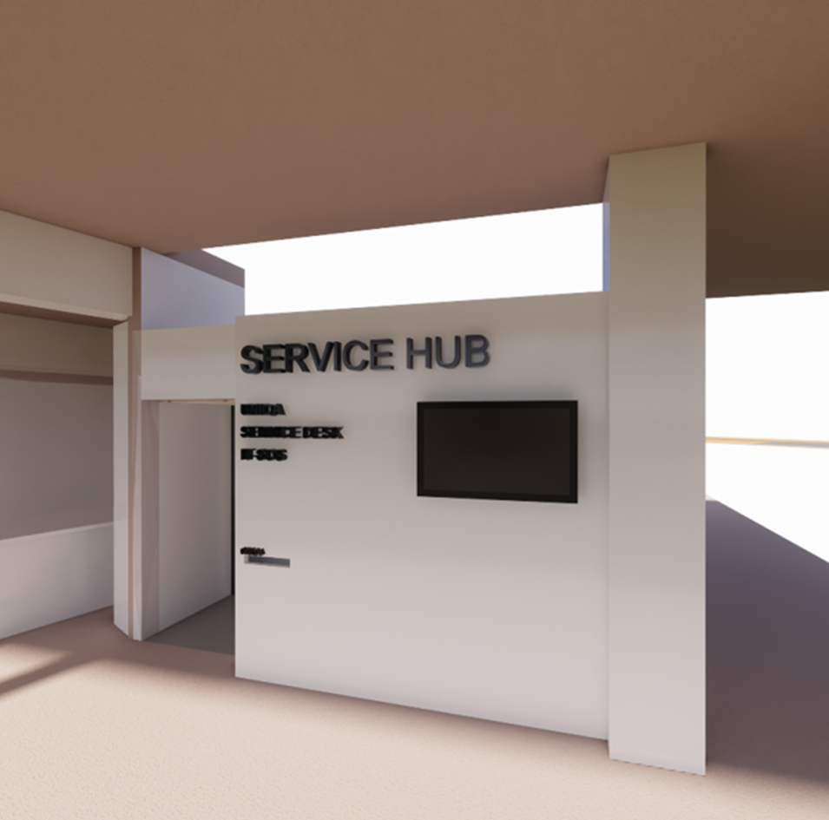
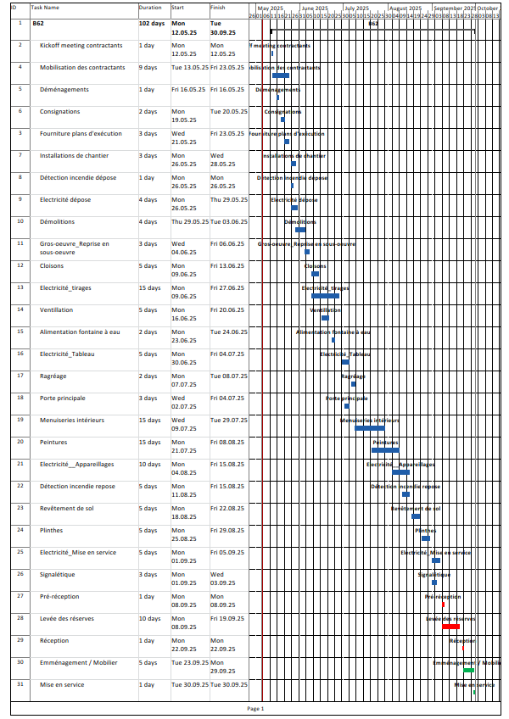
Service Hub– When?
TIME LINE
The Service Hub is planned to open on 1st October 2025:
Works: 4 months (06 – 09/2025)

Slide 6
What does the Service Hub offer?
Front Desk Opened from 08:00 am to 05:00 pm
IT-SOS
IT support
Telecom services
Service Desk
Access cards,
Computing account management
First-line support for all services
Temporary presence of other services
Enabling them to establish a physical presence during specific periods as needed.
Every morning from Monday to Friday 9am-1pm Tuesday and Thursday 2pm-4pm
UNIQA office
providing access to insurance-related services (currently located at B.63/R-001, this space will be freed for the mini market).
Back office space
Service Desk back office
IT-SOS repair area

Slide 7
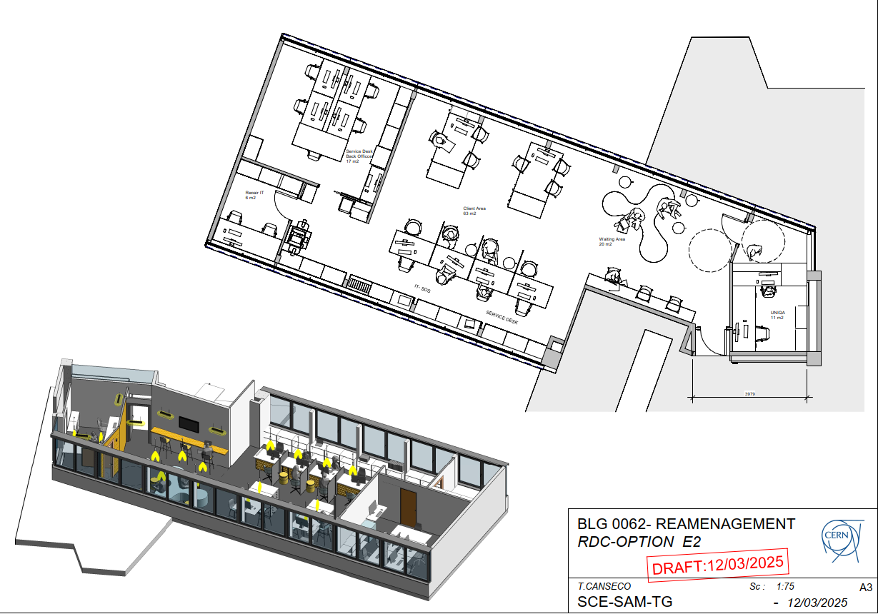
Service Hub– How?

Slide 8
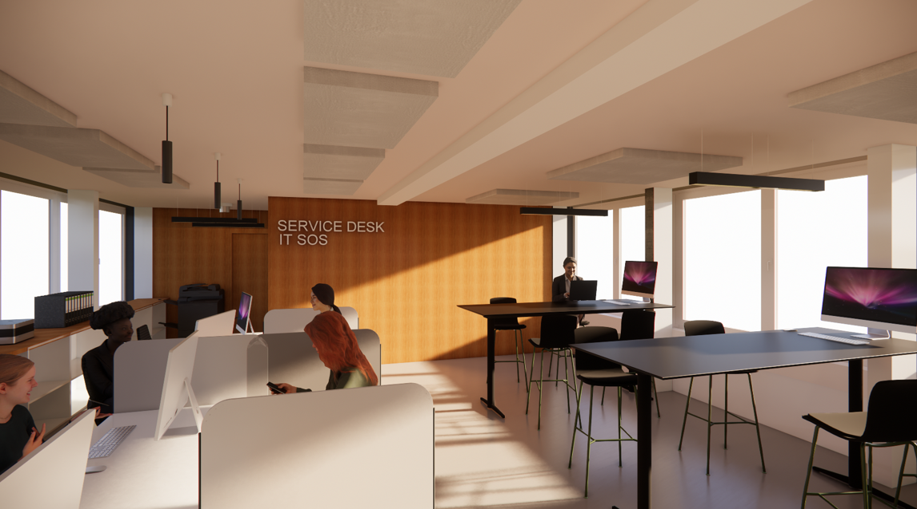
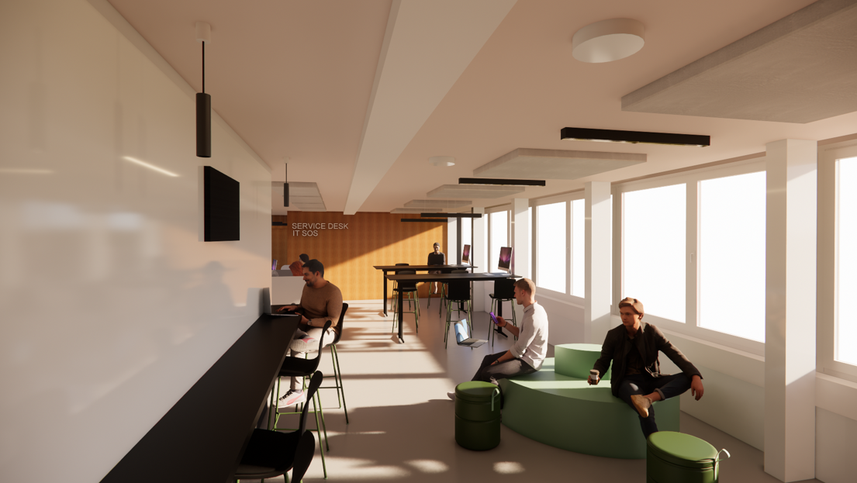
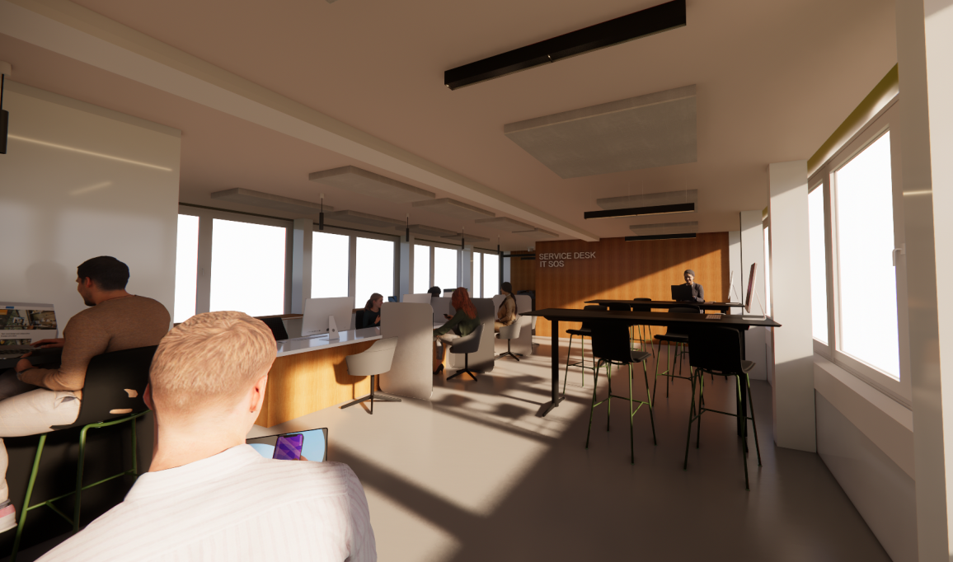
Service Hub – How?
Interior 3D views

Slide 9





