Slide 1

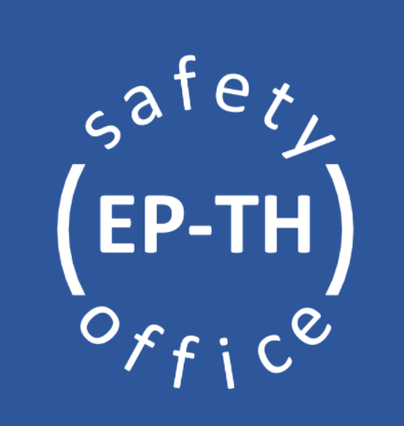

Safety for BL4S in East Hall

Slide 2

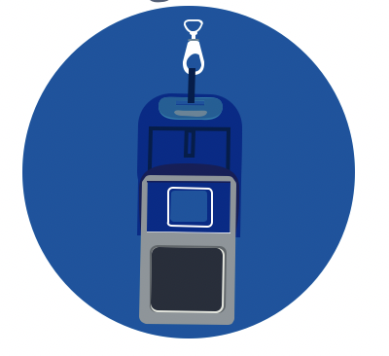
General Safety in East Hall
Necessary PPE (Personal Protective Equipment) to enter the building are: helmet, safety shoes and personal dosimeter. Shorts, skirts or sandals are forbidden.
The T10 Experimental Area is equipped with safety installations, including fire extinguisher at the entry of the area and AUG (Arret Urgence General) in the area. Please, take some time to familiarise yourself with their position!
Additional PPE might be required, depending on the activities to be performed.

Slide 3
B.157 : 1 Assembly Point, located on the Salève Side
Please familiarise yourself with its location.
Jura Side
In case of evacuation alarm, you must immediately evacuate calmly and join the assembly point
EHN1
Salève Side
Satigny Side

Slide 4
Additionnal Safety Information
It is forbidden to eat / drink in classified areas, this is the case in B.157.
Call the Fire Brigade immediately in case of emergency (74444 or +41 227674444) and stay online with them as long as necessary.
Any accidents or incidents shall be declared via: https://edh.cern.ch/Document/General/IncidentDeclaration
In case of any safety related questions, different safety actors are available :
TSO – Territorial Safety Officer
Contact: aboubakr.ebn.rahmoun@cern.ch
DSO – Department Safety Officer
Contact: ep-th-safety@cern.ch

