Slide 1
Beam Interlock System Ext. sextupoles and bumpers – follow-up 2

Slide 2
Status regarding extraction sext. + bumpers
OP:
don’t want to specify functions for extraction bumpers and sextupoles for non-North Area users (risk of making a mistake)
EPC:
if no LSA settings provided + PPM regulation + non-PPM threshold: the PC regulates at the last known value. In that case, if the PC regulates correctly, the user permit is TRUE
Can provide single non-PPM tolerance for these elements
ABT:
might be ok to have a fixed tolerance for extraction sextupoles
for bumpers, need stricter tolerance, so a single non-PPM tolerance would likely not work (to be confirmed)
need windowed tolerance along the cycle
MPE
can these interlocks be connected to the ring BIS, or should all of them only be considered for slow extraction cycles, and ignored otherwise
First meeting: https://indico.cern.ch/event/1531086/
Second meeting: https://indico.cern.ch/event/1546738/

Slide 3
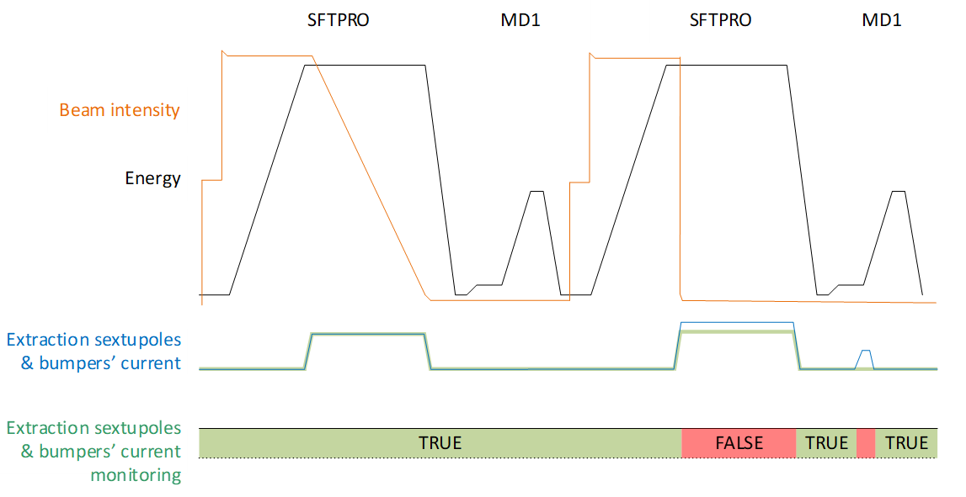


If no LSA settings provided + PPM regulation + non-PPM threshold, the interlocks above can be achieved
-> but is it ok to have a single non-ppm threshold?

Slide 4
Questions
Will all extraction sextupoles + bumpers be renovated with FGC3 controls in LS3?
Required maximum regulation errors for all extraction sextupoles, LSS2 bumpers and LSS4 bumpers at flat top?
What is the regulation error for these elements during ramp?
As the tolerance is larger on extraction sextupoles, can these have a non-ppm tolerance, and be interlocked regardless of the cycle? (as opposed to bumpers)
Kevin’s question: If we have windowed tolerances along the cycle and the PC regulates at the last known value, could it also take the last known tolerance if a user is not defined?
Multiple thresholds along the cycle: how would a non-PPM thresholds work in these conditions? (different cycle lengths)
For Ext. Sext., 4 are used and 5 are spares. Should all of them be interlocked? Or these interlocks left disabled?
LSS4 bumpers are also interlocked with the SPS extraction BIS? Is that a problem to have two interlock channels to 2 different BICs? (with potentially different conditions based on the user)

Slide 5
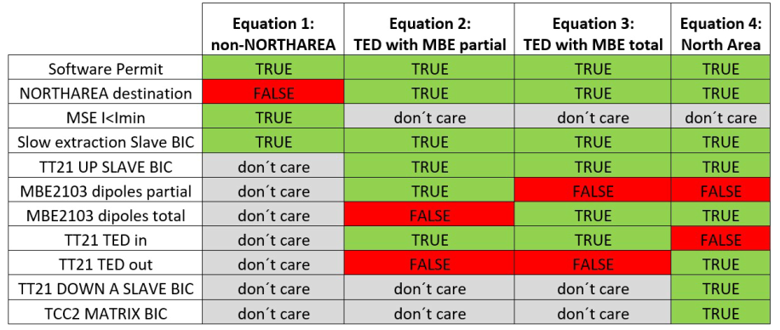
Questions
‘Don’t care’ for
Non-NORTHAREA
destinations?

Slide 6
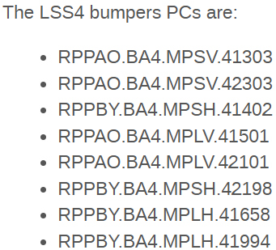

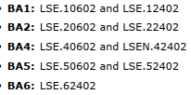
List of elements:
LSS2 bumpers:
Extraction sextupoles:

