Slide 1
Enabling AI for HEP Experiment and Theory
CMS Run 3 event with 55 vertices
CCP-TEPP meeting, 16/9/2025
FASER neutrinos
*Theory is the talk after this ☺
Monica D’Onofrio, University of Liverpool

Slide 2
Introduction
https://cds.cern.ch/record/2927605
Preamble:
  AI/ML has been key for HEP since decades, but it is now really reshaping methodologies and capabilities.
Already a couple of years back, the UK community started to think about getting organized to maximize capabilities and impact, identifying challenges and opportunities.
Embedding AI in the “SoftWare and InFrastructure Technology for High Energy Physics” (SWIFT-HEP) project was planned but did not go ahead due to lack of funding
A workshop was held in October 2024 to discuss status, challenges and needs
In the following months, a document was prepared with findings and recommendations to enable AI for both experimental and theoretical PP in UK. A set of use cases are presented to illustrate various areas of deployment and exploitation

Slide 3
Timeline
https://cds.cern.ch/record/2927605
  October 2024: workshop (1.10.2024)
  March 2025: publication of v1.0 of the document
  April 2025: informed and discussed by PPAP
  May 2025: information to STFC through Science Board PPAN and ‘endorsement’ of the planning, also communicated to the whole community
    European Strategy for Particle Physics in between:
      AI and computing part of the UK submission
      Documents produced concerning needs, strategy etc which align well with ours
  September 2025: follow up workshop (17.9.2025)
    https://indico.cern.ch/event/1571300/

Slide 4
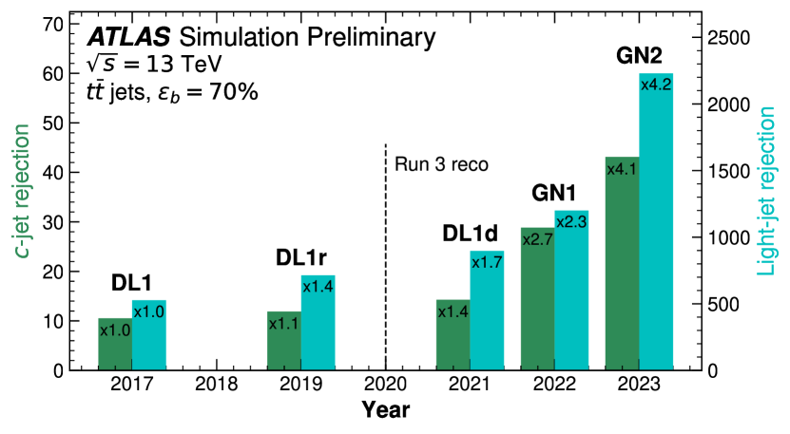
Finding 1: Importance of AI and use cases
Importance of AI: AI is crucial to HEP, with its impact expected to transform almost every area of the field and enable breakthroughs that would be impossible with traditional methods; without swift adaptation and a strategic focus on AI, the UK risks falling behind other nations in this rapidly evolving domain
  Appendix B presents a series of use-cases, showing exploitation of AI across all aspects of experiment, including: physics object reconstruction, identification and calibration; real-time event selection; uncertainty evaluation; event selection; background modelling; and documentation.
  ATLAS: (1) identification of jet flavour (b- and c-tagging) using GNN (GN2– paper submitted in May 2025), relevant for key areas such as Higgs physics (H→bb in VH and ttH, di-higgs production), precision measurements and charged particles reconstruction (2) searches for new physics such as long-lived particles decaying within the detector – reconstructed with unconventional signatures such as displaced jets (CNN, now also GNN).

Slide 5
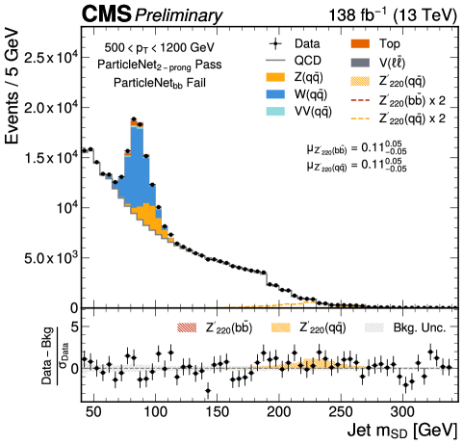
Use cases (2)
Importance of AI: AI is crucial to HEP, with its impact expected to transform almost every area of the field and enable breakthroughs that would be impossible with traditional methods; without swift adaptation and a strategic focus on AI, the UK risks falling behind other nations in this rapidly evolving domain
  Appendix B presents a series of use-cases, showing exploitation of AI across all aspects of experiment, including: physics object reconstruction, identification and calibration; real-time event selection; uncertainty evaluation; event selection; background modelling; and documentation.
    CMS: (1) data analysis (Higgs to bb, di-Higgs with photons and tau leptons, precision cross section measurements and more). (2) trigger (e.g. End-to-End Neural Network Approach to Phase-2 Level-1 Trigger Primary Vertex Reconstruction and Track to Vertex Association)

Slide 6
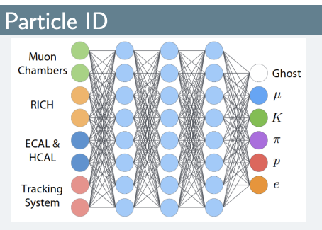
Use cases (3)
Importance of AI: AI is crucial to HEP, with its impact expected to transform almost every area of the field and enable breakthroughs that would be impossible with traditional methods; without swift adaptation and a strategic focus on AI, the UK risks falling behind other nations in this rapidly evolving domain
  Appendix B presents a series of use-cases, showing exploitation of AI across all aspects of experiment, including: physics object reconstruction, identification and calibration; real-time event selection; uncertainty evaluation; event selection; background modelling; and documentation.
    LHCb: trigger system relying on AI (with Boosted Decision Trees) → needed because the full detector is read-out at high rate (32 Tb/s).
    Other examples (physics) made; MLPs, BDTs and others for particle ID and physics analyses; GANs for simulation; Deep Sets for inclusive flavour tagging of B mesons; GNNs for track finding; DL based algorithm for full-event interpretation.
Notes:
(due to high-throughput requirement, limited to “simple” architectures such as fully-connected ANNs, BDTs in real-time processing R&D ongoing with more advanced approaches (GNNs, autoencoders).

Slide 7
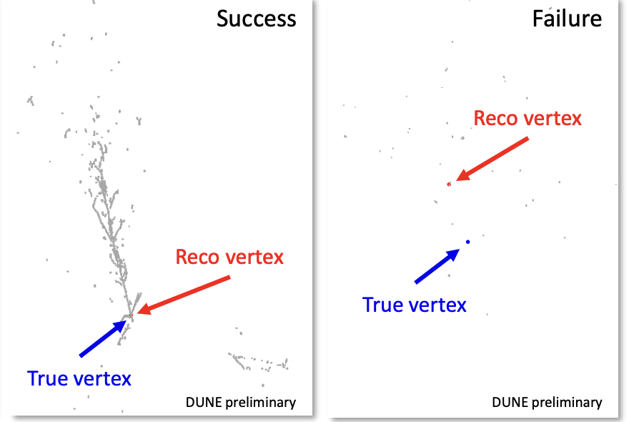
Use cases (4)
Importance of AI: AI is crucial to HEP, with its impact expected to transform almost every area of the field and enable breakthroughs that would be impossible with traditional methods; without swift adaptation and a strategic focus on AI, the UK risks falling behind other nations in this rapidly evolving domain
  Appendix B presents a series of use-cases, showing exploitation of AI across all aspects of experiment, including: physics object reconstruction, identification and calibration; real-time event selection; uncertainty evaluation; event selection; background modelling; and documentation.
DUNE/SBND: (1) flavour-tagging CNN, enhancing sensitivity to CP violation in the lepton sector and mass hierarchy determination; CNN-based tools for separating track and shower-like energy deposits in LArTPC (ProtoDUNE analyses). (2) AI-based neutrino vertex reconstruction in the Pandora package for MicroBooNE and DUNE using U-ResNet semantic segmentation. (3) SBND semantic segmentation for cosmic-ray background removal in neutrino interaction.

Slide 8
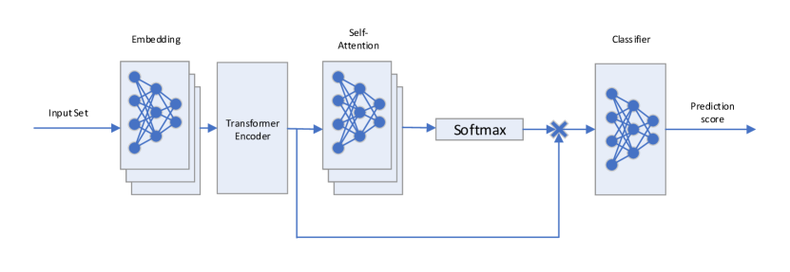
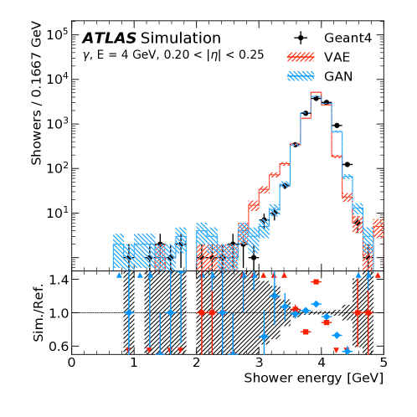
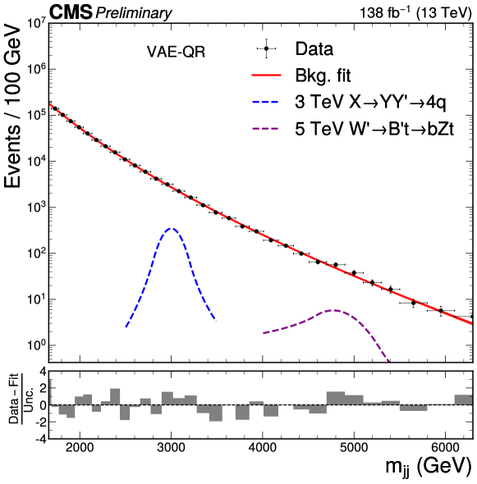
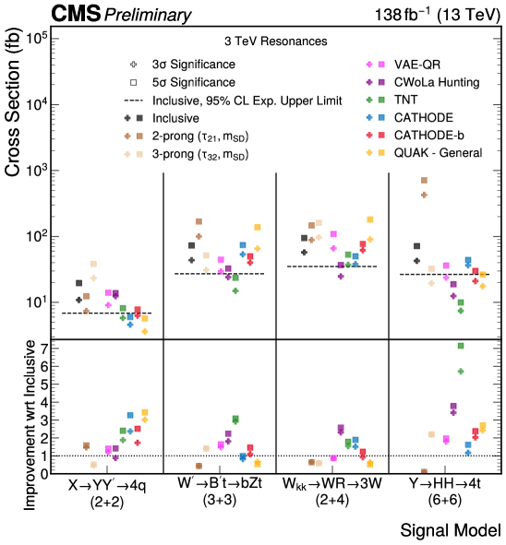
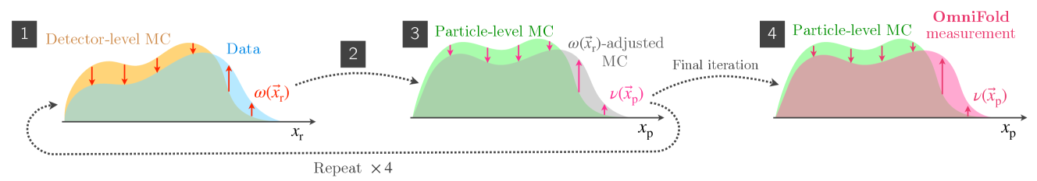
Much more around..
From Nuclear Physics (but relevant for particle as well..): in the ALICE experiment, transformers have been used for particle ID → higher purity and efficiency, even for data with missing values due to limited detector efficiency and acceptance
Fast simulation work: i.e. model the response of the ATLAS electromagnetic calorimeter to photons of various energies
Anomaly detection for searches of NP
AI-driven Unfolding - enable high-dimensional, un-binned parameter estimation and robust multidimensional corrections (precision, speed)
VAEs and GANs are found to be capable of quickly simulating electromagnetic showers

Slide 9
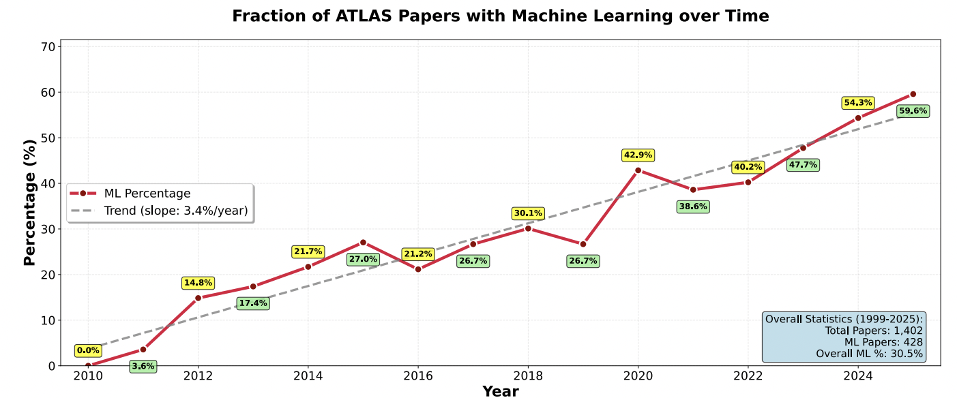
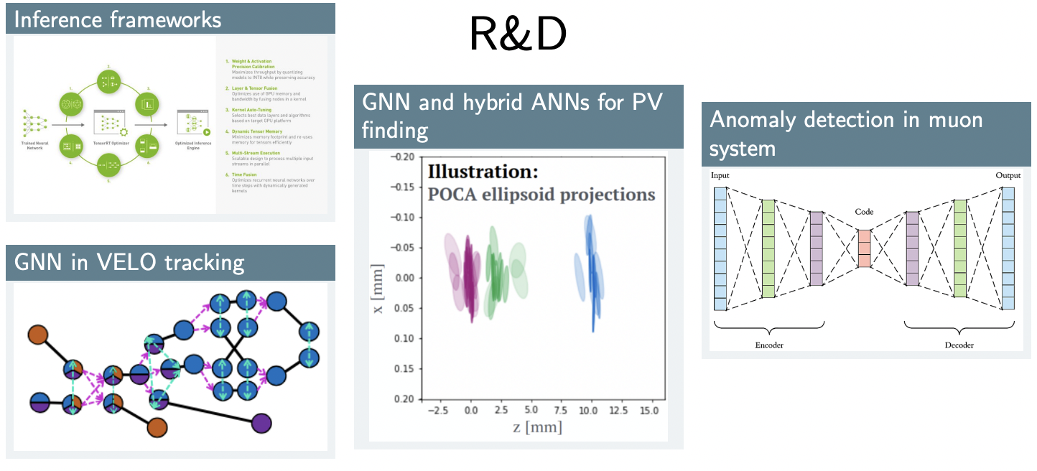
Directions/updates in offline since last UK workshop..
GNN->transformers for reco/object ID (b- and c-jets but also tau leptons, working towards a global reconstruction approach for all complex physics objects)
MLP/BDT still used widely for event categorization
Anomaly detection analyses
AI applied to detector design and development
further work on FastML, ML-Ops
General use of frameworks from industry…
Number of physics papers using ML growing…
From these slides (ML at ATLAS)
Example from EPS2025 LHCb slides
  Lot of work in progress and improvements planned
Also clear from talks presented in recent conferences and workshops organized internationally

Slide 10
..with ”diverse” possibilities arising
chATLAS (UK contributions from UCL):
  the official AI assistant and search system for the ATLAS Collaboration at CERN
  In the words of AI google – “it provide an easy entry point to the large and intimidating corpus of documentation, code, and project data within the ATLAS Collaboration”.
sources
Plans

Slide 11


AI and computing in international landscape
For computing needs (and AI) → JENAA: Joint ECFA-NuPECC-APPEC Activities
  Started in 2022, JENA computing workshops held yearly
  https://indico.scc.kit.edu/event/3813/
More specific for AI: EuCAIF → European AI for Fundamental Physics → Conference in 2024 and 2025 (with some UK representation)
Rationale:
  European initiative for advancing the use of Artificial Intelligence (AI) in Fundamental Physics.
  Members are working on particle physics, astroparticle physics, nuclear physics, gravitational wave physics, cosmology, theoretical physics as well as simulation and computational infrastructure.
5 Working groups organised around specific themes
Aim of the events:
provide a platform for establishing new connections between AI activities across various branches of fundamental physics, by bringing together researchers that face similar challenges and/or use similar AI solutions.

Slide 12
EUCAIF: Working group structure and mission
WG1: Foundation models.
  Mission: Facilitate research on large-scale foundation models for fundamental physics
  Provide infrastructure, resources, data and models, connect researchers, define problems & metrics
WG2: AI-assisted co-design for detectors
  AI-assisted co-design of future ground- and space-based detectors - Related to the work of the MODE Collaboration
WG3: FAIR-ness and sustainability
  FAIR: findable, accessible, interoperable, and reusable data principles. Example (from UK) also here
WG4: ML and AI infrastructure – Mission: understand status, guide funding and development efforts
  Scalability and access to HPC Resources, Data Infrastructure and Infrastructure for Distribution, Integration of AI/ML into Existing Experimental Workflows, Large and Small Scale Models, Benchmarking and Standards
WG5: Building-bridges - community, connection
  Establish EuCAIF as a new brand for AI in physics (independent of CERN), eventually bringing in new grants
  Aggregate and provide an overview of already existing structures and networks, put this on professional website
Overall, some engagement from UK community

Slide 13
Inputs for European Strategy PP update
2 main inputs submitted and considered for the Briefing Book
  AI-RDs: A EuCAIF proposal to structure AI research in Particle Physics
  EuCAIF Recommendations for Scaling AI Capabilities in Particle Physics (mirror closely UK ones.. See later)

Slide 14
Back to our document → Many more findings…
2. Dangers of falling behind: If UK HEP does not embrace AI, it risks losing global competitiveness, missing key scientific opportunities, struggling to attract top talent, inefficiently utilising resources, weakening its role in international collaborations, and limiting its wider socio-economic impact. Adopting AI is essential to maintain leadership and capitalize on emerging opportunities in the field.
3. Funding: Dedicated funding for AI in HEP is infrequent, difficult to access, and lacks the stability needed for sustained research and implementation. Similar issues exist in the wider software and computing realm, with long-term support essential to fully exploit opportunities, as demonstrated by effective initiatives like Swift-HEP
4. UK AI Forum: There is a lack of a regular UK forum to discuss common barriers, challenges, and opportunities in AI across HEP.
5. International Initiatives: There are several international initiatives (for instance EuCAIF, FAIR for AI) also developing AI strategies, which are not widely known in the UK HEP community and sometimes lack sufficient UK engagement.
6. Hardware, Software, and AI-Ops:
  a. Access to GPU resources varies widely across institutes and users are often unaware of how they can access such resources, especially at the national and international level.
  b. Different experiments experience very similar technical issues, for instance those related to training, inference, and model stability against changing versions of AI software tools, but lack mechanisms to exchange expertise.

Slide 15
.. and related Recommendations
First set of recommendations on funding and initiatives

Slide 16
More findings: skills/training
7. Skills/Training, Capacity Building, and Knowledge Transfer:
  a. Although there have been some very successful AI-training initiatives in the UK, for instance, STFC’s/UKRI’s Centres for Doctoral Training (CDTs) which have been hugely successful in imbedding expert AI practitioners into the field with revolutionary outcomes, there is a lack of a coherent and concrete approach to such training across the UK. More can be done to expand the benefits of and learn from successful programmes, and to make a more enriched training offering across the field.
  b. An increasing number of physics PhD applicants are seeking research opportunities that incorporate AI, with the intention of applying these skills in either other research areas or industry throughout their careers. As such, a greater focus on AI training, challenges and opportunities, can significantly enhance PhD recruitment outcomes, attracting more talent to the field. This also helps embed expert practitioners of AI, with HEP domain expertise, into the field, which is also very effective for transferring foundational AI knowledge. The strong recruitment evident in the CDTs, which bring complementary new talent into the field, are a good example of the effectiveness of this approach.
  c. Some areas of HEP are enriched with AI expertise, both foundational (Hartree, SciML) and applied (various experiments), while others would benefit from more dedicated expertise. The field stands to gain significantly from ensuring more effective knowledge transfer within the field. There are also gains to be realised from engaging with foundational AI experts, especially for innovative and non-standard approaches.
  d. There is strong competition across sectors for AI experts, particularly those with the skill set developed in HEP. New initiatives, such as joint roles between industry and HEP, have proven successful in attracting these researchers and encouraging longer-term retention in the field.

Slide 17
Recommendations related to skills et al.

Slide 18
Many more findings: Industry, wider engagement, fast ML
8. Industry and Wider Engagement:
  a. Industry plays a leading role in the development of cutting-edge AI tools and techniques. The HEP community can benefit from aligning with industry tools to leverage developments and lower the threshold for expertise exchange.
  b. In some programmes there has been a successful track record of industry partnerships and placements, undertaken in a wide array of sectors, focussing on skills, techniques and hardware. This has created extra knowledge exchange opportunities and access to additional funding streams. However, this is not widespread across the field and there is the potential for significant gains from enhancing the way we work, improving our effectiveness and delivery of outputs.
  c. There is a strong demand in industry for the development of talent within HEP, which has enabled the wider socioeconomic impact of HEP to be enhanced, providing another strong narrative for funding of HEP research.
9. Fast-ML: applications in which AI inference is required on microsecond timescales or below […] with work together with leading FPGA vendors, the UK HEP community can be influential in spreading the benefits of microsecond-scale AI to applications in industry where it is currently generally not widely developed/supported.

Slide 19
Recommendation: industry and engagement

Slide 20
EUCAIF recommendations
Very close to ours..

Slide 21
EUCAIF recommendations (2)

Slide 22
The next decades…
The Next 10 Years (2025–2035): AI is already mature but much more to be done:
  Classification and Tagging
  Offline Reconstruction algorithms
  Simulation and Generative Modelling
  Triggers and Real-Time Systems
  Inference and Unfolding
Beyond 2035 [according to the ES review] →AI for next-generation colliders/experiments:
  AI will be at the very heart of experimental design and operation → traditional workflows of collection, storage, and offline analysis no longer be viable → AI could be embedded directly into detectors and data pipelines
    Development of intelligent frontends (extractors integrated on ASICs, with early prototypes already demonstrated in CMOS technology)
    Foundation models
    Large language models → Large Physics models (LPMs)
    Differentiable programming → geometry and readout of detectors optimized through gradient descent, directly targeting physics performance – merging detector development and physics optimisation
  Is this perhaps even sooner that 2035?
The quantum frontier: quantum-AI or AI for quantum (or both)?
Mostly for collider physics but true across the board..

Slide 23
.. But how do we go there? [ brief summary]
Invest in both infrastructure and people
Establish a sound and solid software ecosystem, to ensure comparability and reproducibility, i.e. share benchmarking datasets and evaluation metrics, as well as fast pacing
Nurture the “human capital” → dedicated training programs, establish attractive career paths: prepare the next generation of particle physicists “fluent” in AI and ensure they have a future in the field
KE within HEP plus capacity building are key but also collaboration with industry
  might seem not tailored toward HEP at first, but collaborative initial work perhaps evolving in the right direction (i.e. CDTs with industry, applications to other fields such as healthcare)
  Of course, we must maintain the focus on fundamental science
Exploit the ‘sustainability route’ – can targeting efficient and sustainable software for our future experiments pass through AI? Certainly, responsible energy consumption for AI algorithms is a must
Identification of funding streams that can be used to support are key for a successful strategy – ie engagement with UKRI/STFC to shape and implement strategies (and show the potential of investing in HEP!) is key

Slide 24
Back up
Some slides from past meeting summary …

Slide 25
Purpose of the October 1-day workshop

Slide 26
SciML: AI for Science at STFC
Overview and opportunities presented by Jeyan Thiyagalingam

Slide 27
SciML: AI for Science at STFC (2)
Wide portfolio of activities, perhaps not sufficiently inclusive of experimental PP
There are funded programmes: AI for Realistic Science(AIRS) by DSIT, Benchmarking for AI for Science (BASE-II) by EPSRC, etc.
Only starting to grasp the surface of possibilities such as National Strategic Platform for RTPs on AI for Science and Engineering – NPRAISE

Slide 28
Fast-ML/FPGA
What are the HEP use cases for fast-ML/FPGAs and what is the current
  Trigger/DAQ applications: O(us) latency – “traditional” use on custom hardware
  Wider use as accelerator for CPU based workloads – emerging – less UK involvement?
  Status
    First BDTs and NNs running in ATLAS and CMS hardware triggers deployed
    Large range of examples planned for HL-LHC upgrade
    Development pipelines for ML on FPGAs – established but further development needed
    Next Gen trigger project at CERN platform for development (within ATLAS UK) of ML pipelines for FPGA

Slide 29
Fast-ML/FPGA (2)
What are the challenges/barriers that we are facing in this area (e.g. software, training, skills-capacity, hardware, etc.)?
  Steep learning curve – albeit not as steep as VHDL
  Understanding and tools e.g. hls4ml, pruning, quantisation
  Bottleneck is (skilled, technical) effort – technical PhD funding, DRD funding ....
  Consolidate UK skills across experiments – currently quite siloed
  Evaluate industry directions e.g. Versal AI engines vs custom electronics (DRD7 etc.)
  Challenges with obsolescence and software tools support
  Explainability a key topic for confidence in tools and algorithms – in general but especially so in real time where data is lost
What are the opportunities in this area for HEP (e.g. enhanced outcomes, wider connections, funding, industry engagement, knowledge exchange etc.)?
  Highly trained people useful to science and UK generally – many people go on to data science and elsewhere e.g. CERN
  Niche in AI – not well covered or supported by industry in general
  Need to prepare case(s) to allow access to wider funding – examples from science & beyond
  Industry connections – good connections in this area to key players and UK SMEs
  Community tool hls4ml – UK contributes, plans driven by US towards formal basis

Slide 30
Skills/Training, Capacity building and KE
Skills/Training – Essentials:
  trained researchers in AI, expertise on latest developments, ability to identity and exploit latest developments
Currently lacking a coherent and concrete approach to AI training in HEP across the UK
Online courses and material
  → lack depth or necessary HEP focus, little (so far) from the HSF on AI
University courses and 1st year PhD courses
  → can lack depth or necessary HEP focus
STFC’s DIS Summer School (also international HEP-ML summer schools)
  → overall very useful
STFC’s Centres for Doctoral Training (CDT) in Data Intensive Science (DIS)
  → perhaps most successful way to train next generation of researchers
General consensus on the need to have a better AI training focused on HEP

Slide 31
Skills/Training, Capacity building and KE
Capacity building → Once trained, large fraction of experts leaves for industry
  Good and healthy, but need to ensure _some_ stay in HEP
    Need options for career progression and job security
    Training (interactions with industry/foundational-AI experts)
    Ability to stay at the cutting-edge (software/hardware)
    Ensuring interesting work environment
Questions and discussions around the following
Ideas shared, some more difficult to realise than others

Slide 32
Skills/Training, Capacity building and KE
Knowledge exchange → several layers to be considered
Perhaps there isn’t a preferred options but all ways should be explored
Training comes back as very important
Effective sharing
Still some open questions:
Can we effectively and consistently engage with AI foundational experts?
How do we make this happen in practice, at the least cost?

Slide 33
Industry and other engagements
Related to the previous KE aspect
Current status of engagement healthy, but also reliant on hit&miss programmes (e.g. studentships, projects)
Industry leads, we follow … perhaps not the best and most effective way
Questions we should try to answer:
Examples made:
Projects through CDTs
Undergraduate projects
Placements at industry
Very good feedback on contributions from us overall, but is that enough?

Slide 34
Industry and other engagements (2)
My two cents: It is clearly a challenge to find sustained pattern of collaborations with obvious return from industry to research,…

Slide 35
Software, hardware and ML-Ops
Good collection of information from large part of the community – LHC experiments, DUNE, LZ, Mu3e. Perhaps more aspects to be considered
Hardware Trends, utilization models, software evolution (PyTorch), and Practices

Slide 36
Challenges and barriers

Slide 37
Challenges and barriers (2)

Slide 38
But also opportunities ..
Many of these resonating also with other discussion presented before

