Slide 1
Report from Council and News from CERN
James Gillies 03.11.2011
Report to Council and feedback
Selected highlights of 2011
LEP cavities
Press release procedures

Slide 2
Report from EPPCN
James Gillies, SPC 13.09.2011, European Strategy Session of Council, 16.09.2011

Slide 3
Key points:
Stakeholder survey
Schools cosmics workshop
EPPCN MoU
Brussels Council meeting
Network membership

Slide 4
Stakeholder Survey
Conducted by independent agency for anonymity
Interviewed Extended Directorate, Council Delegates, Journalists, Neighbours, members of communicaiton networks like EPPCN.
Objective: to inform new communication strategy for CERN

Slide 5
Stakeholder Survey
Associations…
High class research Basic research Ground breaking research Top level research First class research facilities
Most forward looking research laboratory in the world Scientific organisation The mecca of physics Particle physics Interesting science Far Away Powerful science Cutting edge science Expensive Centre of world class science Leader of the world science WWW Closed area Big science Nobel Prize Complex Huge Waste of money Wow factor Tolerance

Slide 6
Visibility increased in the last five years? 5= very much / 4=somewhat / 3=no change / 2=decreased somewhat / 1=decreased very much
Total | ExtDir | CouncDel | NetWork | InterMedia | Neighbours
4.81 | 5.0 | 4.78 | 4.85 | 4.67 | 4.50
n=52 | n=15 | n=9 | n=13 | n=9 | n= 6
Current international reputation 5= very positive / 4= positive/ 3= no neutral / 2= negative / 1= very negative
Total | ExtDir | CounDel | NetWork | InterMed | Neighbours
4.43 | 4.47 | 4.56 | 4.46 | 4.25 | 4.33
n=51 | n=15 | n=9 | n=13 | n=8 / 1 na | n= 6

Slide 7
Rating of communication activities – Speed of response 5= Excellent / 4=Good / 3=average / 2= Quite low/ 1=very low
Total | ExtDir | CounDel | NetWork | InterMed | Neighbours
4.39 | 4.30 | 4.17 | 4.27 | 4.56 | 4.83
n=47 | n=15 | n=6 / 3 na | n=11 / 2 na | n=9 | n= 6
Rating of communications activities – Social media 5= Excellent / 4=Good / 3=average / 2= Quite low/ 1=very low
Total | ExtDir | CounDel | NetWork | InterMed | Neighbours
3.79 | 3.69 | 4.5 | 3.43 | 4.14 | Not asked
n=29 | n=13 / 2 na | N=2 / 7 na | N=7 / 6 na | N=7/ 2 na
Rating of communications activities – Website 5= Excellent / 4=Good / 3=average / 2= Quite low/ 1=very low
Total | ExtDir | CounDel | NetWork | InterMed | Neighbours
3.48 | 3.07 | 3.89 | 3.42 | 3.83 | 3.5
n=47 | n=15 | N=9 | n=12 / 1 na | N=9 | n= 2 / 4 na

Slide 8
Rating of communication activities – CERN Visits / (press) briefings 5= Excellent / 4=Good / 3=average / 2= Quite low/ 1=very low
Total | ExtDir | CounDel | NetWork | InterMed
4.29 | 4.10 | 4.39 | 4.18 | 4.67
n=45 | n=15 | n=9 | n=11 / 2 na | n=9
Rating of communications activities – Brochures & annual reports 5= Excellent / 4=Good / 3=average / 2= Quite low/ 1=very low
Total | ExtDir | CouncDel | Networks | InterMed
3.65 | 3.5 | 3.9 | 3.5 | 3.9
N=41 | n=14/ 1 na | n= 8 / 1 na | n=11/2 na | n= 8 /1na
Rating of communications activities – Quality of other material 5= Excellent / 4=Good / 3=average / 2= Quite low/ 1=very low
Total | ExtDir | CouncDel | Network | InterMed
4.10 | 3.7 | 4.1 | 4.0 | 4.4
n=41 | n=15 | n=7 / 1 na | n=11 / 2 na | N=8 / 1 na

Slide 9
Is CERN reaching its target audiences?
 | Yes | No | N / A
Extended Directorate | 93 % | 7 % | --------
Council Delegates | 78 % | 11 % | 11 %
Information Networks | 92 % | ------ | 8 %
International Media | 100 % | ------ | -------
Neighbourhood | 100 % *

Slide 10
Conclusions – call to action

Slide 11
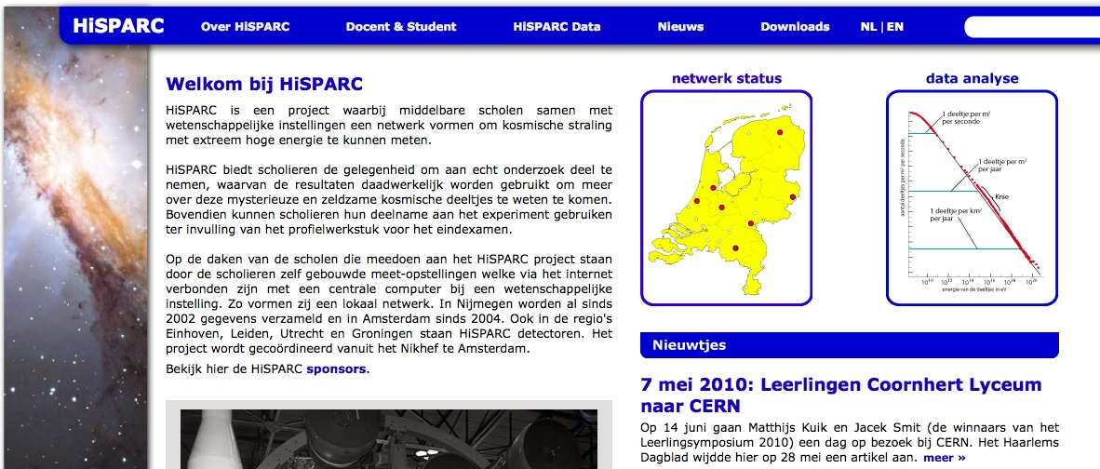
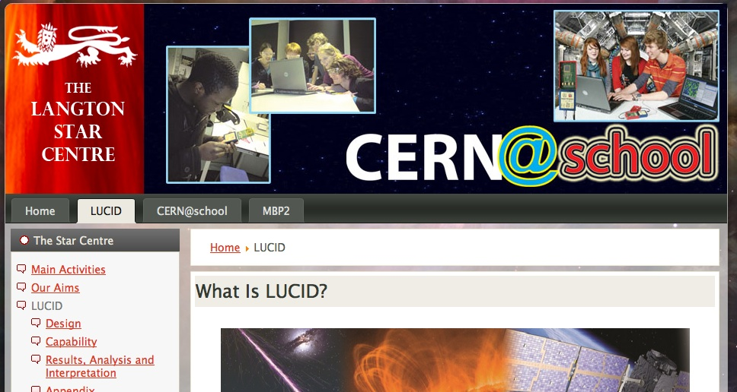
Schools Cosmics Workshop
Organized by ASPERA, EPPCN, EPPOG
Aim: to catalyze networking between existing schools projects in CERN Member States
Date: 15 October 2010
Appropriate call open: closes 22 February 2012

Slide 12
EPPCN MoU
Looked at ESO, ESA
Recognises that EPPCN brings extra work
Defines roles and responsibilities
Requires a budget

Slide 13
Brussels Council meeting
Valuable communication opportunity
Grass-roots exhibition
Press conference
Networking event
Brochure
Full details to be defined at next EPPCN meeting

Slide 14
Network membership
Active members bring clear benefits
Still no members from observers
Not all Member States active

Slide 15
Selected highlights from 2011

Slide 16
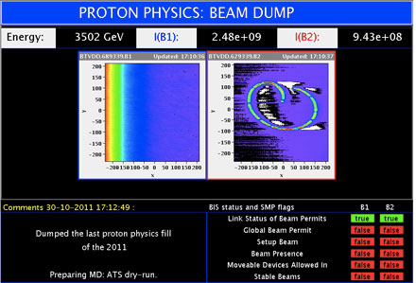
LHC
Excellent performance
Almost 6fb⁻¹ for ATLAS and CMS

Slide 17
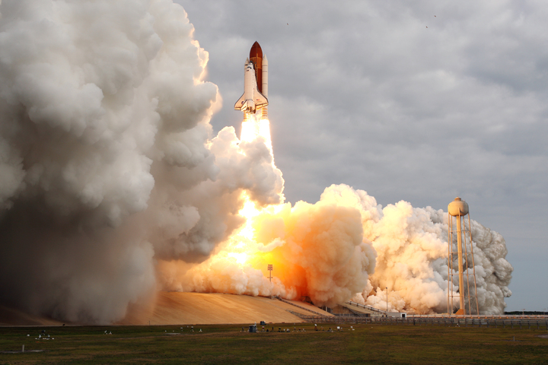
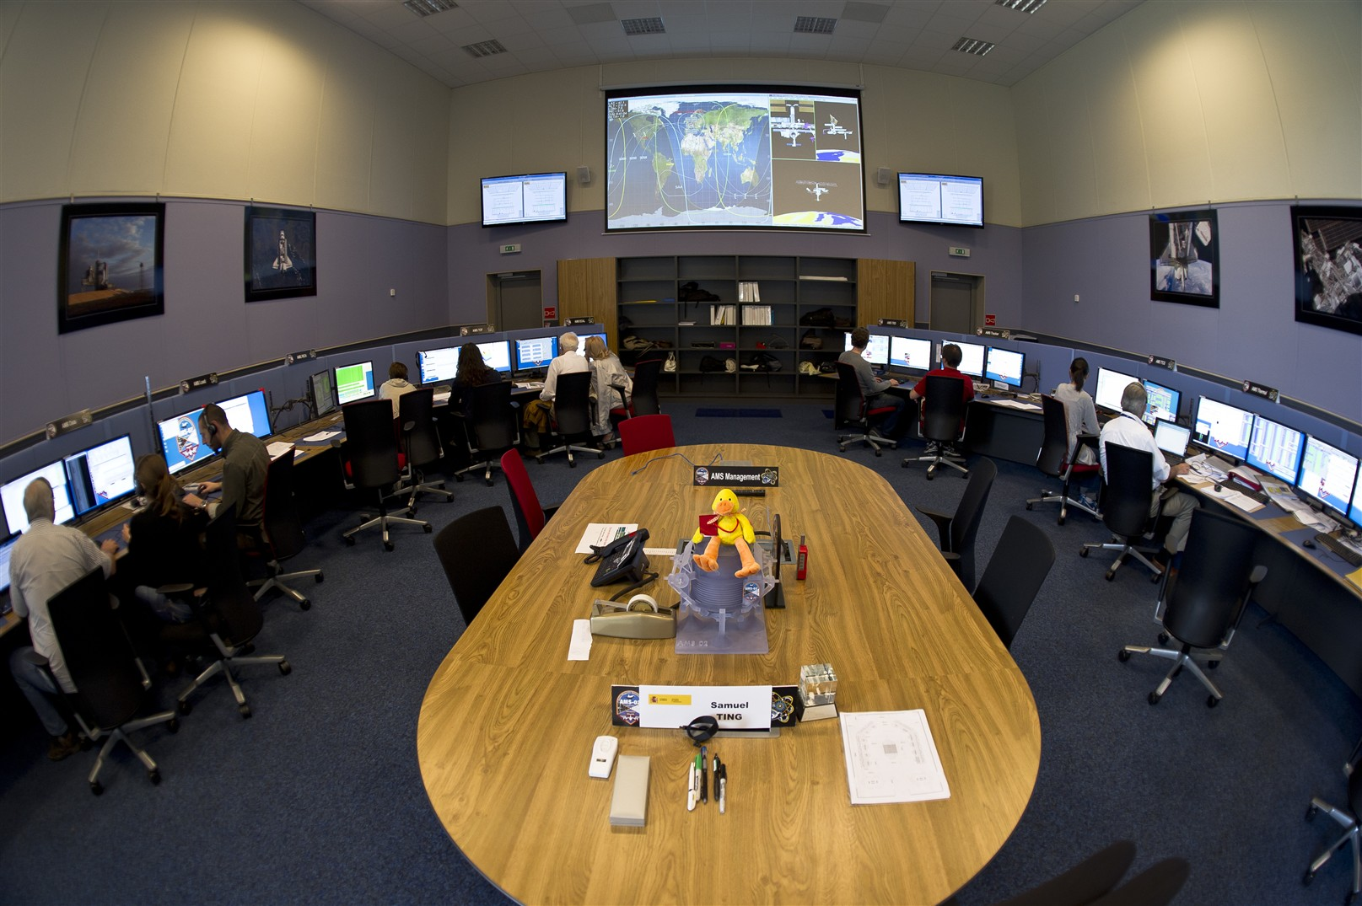
AMS
16 May: AMS detector launched onboard shuttle Endeavour
23 June: AMS centre operational

Slide 18

Open Hardware Initiative
Launched in July
Open source for electronics

Slide 19
Antimatter
5 June: ALPHA reports trapping of antihydrogen for 1000s
28 July: ASACUSA reports part per billion antiproton mass measurement
28 September: ELENA launch

Slide 20
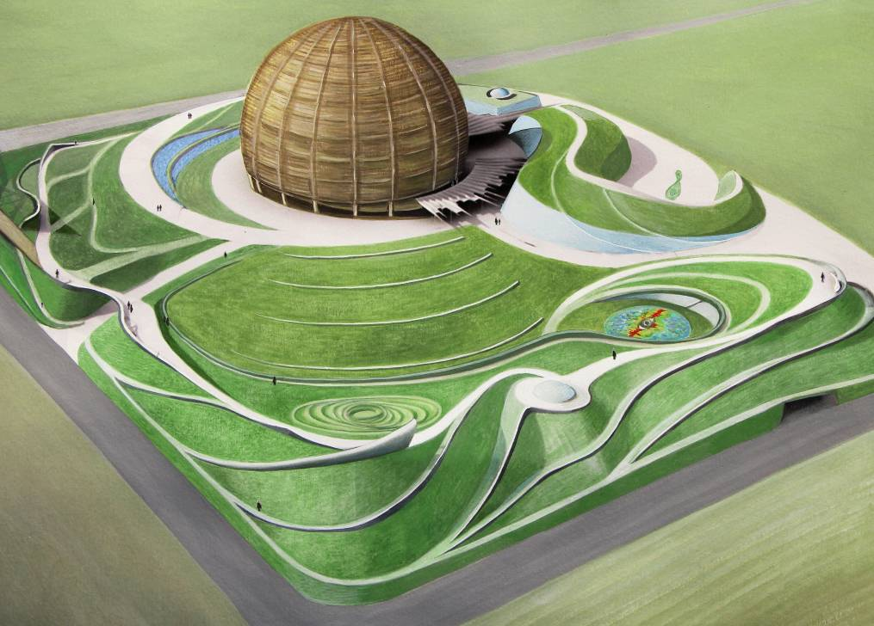

Cultural engagement
2 September, Collide@CERN launch
4 November, Collide@CERN Genève launch
Cosmic Rings of CERN

Slide 21
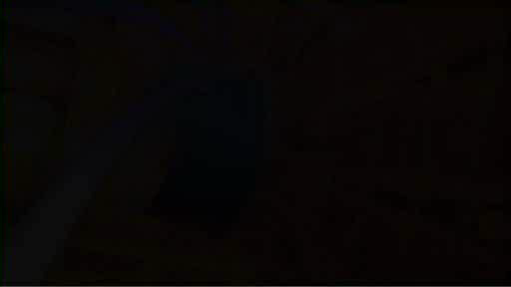
CLOUD
25 August. CLOUD’s first paper published

Slide 22
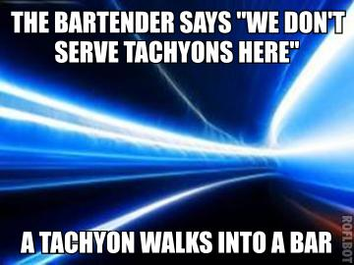
OPERA neutrinos

Slide 23
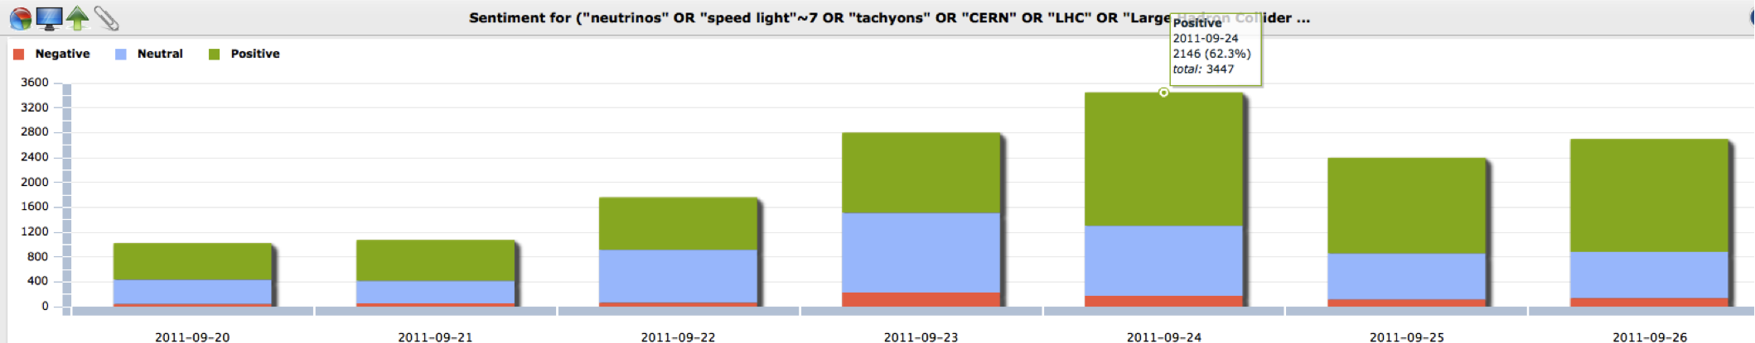
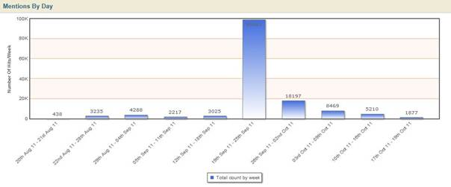
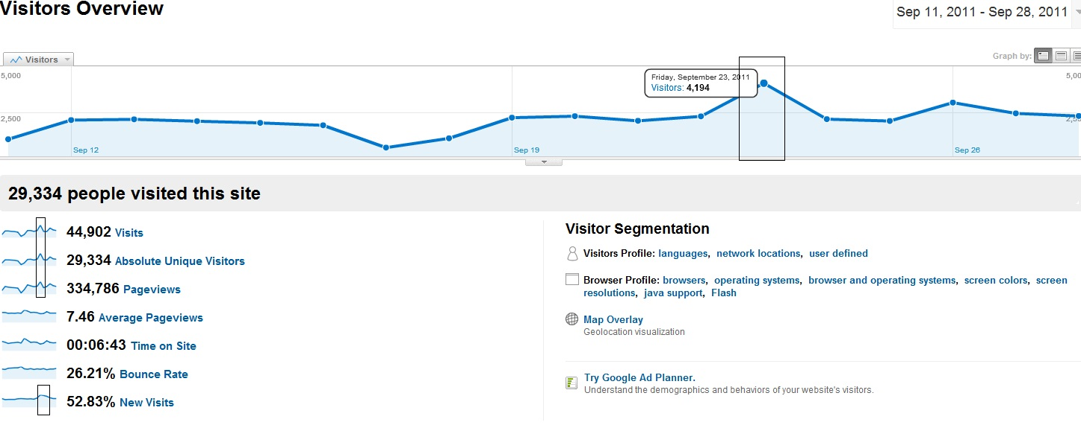
OPERA neutrinos

Slide 24
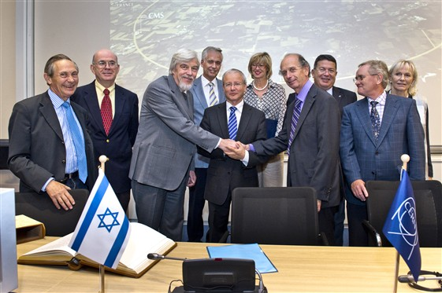
Enlargement

Slide 25


Slide 26
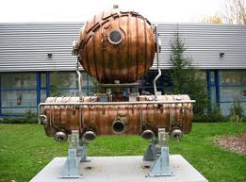


LEP cavities status
3.0m 2 tonnes
12.0m 8 tonnes
Individual cavities
Legal agreement written. Cavities in the process of declassification.

Slide 27
Press release procedures
Please respect the press release protocol…

Slide 28
Conclusions
Council appreciative.
CERN makes headlines.
Making progress towards tapping story potential.

Slide 29
Communications Strategy 2012 – 2016
Enlarged Directorate
25 October 2011

Slide 30
Solid foundation: research & workshops

Slide 31

Key findings

Slide 32

The Purpose

Slide 33
The Role of Communications

Slide 34

Risk I
Risk II
Risk III
Risk VI

Slide 35

TAGLINE
CERN – Exploring the frontiers of knowledge

Slide 38

CERN Messaging

Slide 39

CERN messaging architecture 2011/12

Slide 40
CERN messaging architecture 2011/12

Slide 41
CERN messaging architecture 2011/12
Risk I
Risk II
Risk III
Risk VI

Slide 42
Target audiences – stakeholder groups
Group | Definition | Objective | Messages | KPIs
Member States plus Collaborating nations | Governments & their advisors Research councils Funding agencies S&T opinion leaders | Maintain financial support for CERN by providing timely, open and accurate Increase knowledge and understanding through ongoing, targeted dialogue and engagement | CERN is a world leader in fundamental research Fundamental science is a driving force for technical innovation CERN´s research has the capacity to attract young people into science | Positive opinion expressed in regular surveys Reports and (public) statements from officials/civil servants at national level Feedback from decision makers on an individual level Budget decisions
High energy physics community | Physicists and institutes that have an interest in research at CERN | To promote contacts and interchange between scientists and institutes To foster understanding of CERN´s position and importance in the high energy physics landscape | CERN is a world leader in fundamental research LHC is launching a new era of discovery and understanding of fundamental questions about the universe CERN physics has the capacity to attract young people into science | Level of understanding of CERN´s role through CERN Courier readership survey Level of engagement, initiatives and (positive) comments Number of positive comments/mentions in public

Slide 43
Target audiences – stakeholder groups
Group | Definition
The CERN community | Staff Users Contractors
Alumni | Anyone who has spent time at CERN. Institutions/companies that have a relationship with CERN Friends of CERN
Industry | Companies CERN does – or wishes to do – business with
Potential sponsors | Private donors (individuals) Institutional donors (foundations) Sponsor partners (corporations)
Media | Media professionals from all sectors: print, TV, radio, online/www, blogs
Cultural and artistic community | Artists drawing inspiration from CERN´s activities Artists using CERN´s facilities or content Artists contributing works to CERN Cultural entities/organizations collaborating with CERN
General public | Voting and tax paying citizens at all levels with a focus on the science aware
The local community | Voting/tax paying residents in Geneva, Vaud and neighbouring France Local authorities and community associations Local tourist offices
Educational systems | Schools/systems catering to the 13-18 age group with emphasis on the high school level
Younger children | Children aged 8-12
Job seekers | Exceptional talent in CERN´s core activity areas

Slide 44
Generally accepted practice study*
*University of Southern California
Annenberg School of Communications
and Journalism, 2010

Slide 45
CERN´s risks
Risk I
Risk II
Risk III
Risk VI

Slide 46
Chief Communications
Officer
Chief Information
Officer
Information
policy
&
Synergies
=
Output
increase

Slide 47
Current communications structures

Slide 48
Proposed new communications structures
International relations
Outreach
Chief Communications Officer
<
LHC outreach group
Spokesperson
Content manager
Audience engagement manager
EPPCN
Press office
Content production
Audience engagement
IPPOG
Interactions

Slide 49
Resourcing
Budget for DG-CO (M&P): from 0.25% to 0.5%
Much exists already at CERN
Some new recruitment would be necessary - we estimate 5-6 new posts, one senior

Slide 50
Summary
Effective, managed communications are core to CERN's continuing success.
Failure to restructure communications at CERN creates risk to the Organization's reputation, an inability to manage opinion forming processes, and excess expenditure.
This strategy addresses key issues in the way that CERN's communications function is managed and resourced. It proposes:
  the creation of two new senior-level functions: CCO and CIO
  a reorganization of the Communications Group to enable communications around a new, focussed messaging architecture.
  bringing CERN’s resourcing for communications closer to benchmarked levels.

Slide 51
Status of MoU
Council agreed to MoU
Legal service to validate
There will be a budget in 2012

