Slide 1
Measurement and alignment needs for the BDF Target
A. Huncikova, C. Vendeuvre
23.07.2025

Slide 2
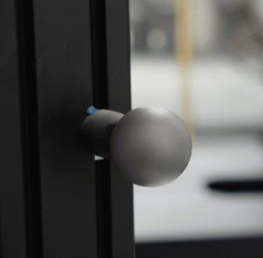
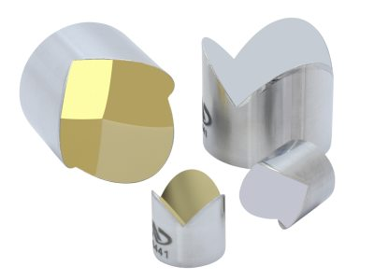
Measurement methods study – BDF Target
Laser Tracker Leica ATS800 with full 1,5 inch spheres
Laser Tracker Leica ATS800/ATXXX with Newport retroreflectors

Slide 3
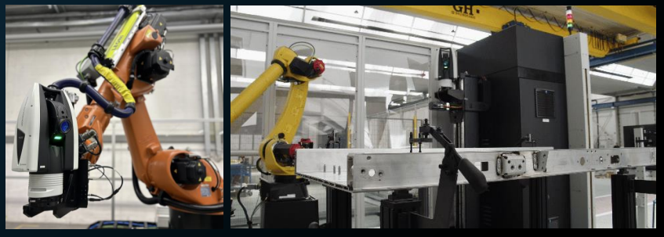
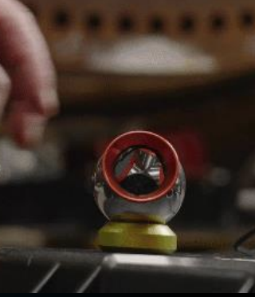
Measurement methods study – BDF Target
Question:
Robotic solutions for the installing of the removable retroreflective targets/laser tracker – accessibility?

Slide 4
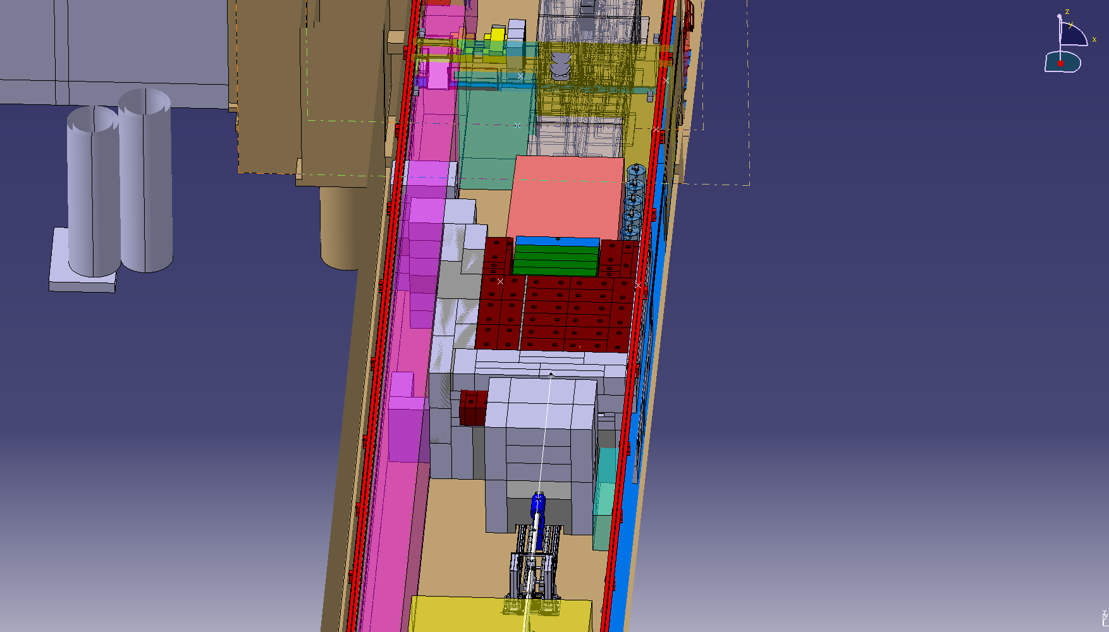
Spatial Requirements - Survey network
Link between TCC8 and ECN3 preferably on both sides
Position and number of the fire doors and confinement walls and the time of installation
Jura
Opening through the chicane (installation of brackets on the wall up to 15 m up- and downstream)
Salève
Link on the floor level/
In height? Is there space along the wall?

Slide 5
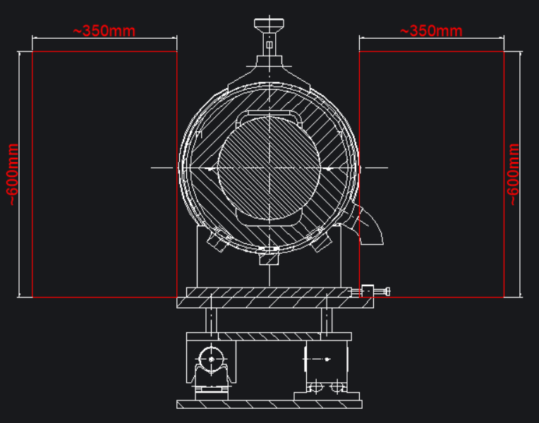
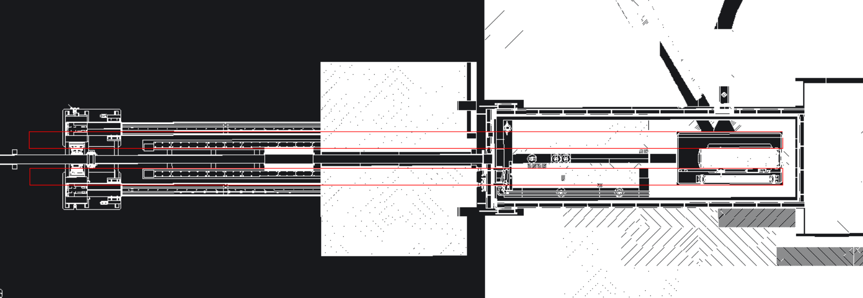
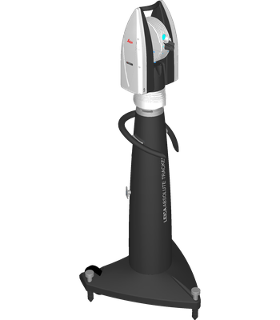
Spatial Requirements - Vacuum Vessel
Spots for the positioning of the instrument with a permanent pillar – possible collision with the conveyor and shielding manipulation
BDF Target – openings in the shielding on both sides and enough margin
Clear line of sight

Slide 6
Environmental conditions inside the vacuum vessel
Radiation dose – gross estimate 10 MGy/yr for materials with density of 7,85 g/cm³
Temperature – up to 100°C for the Au and Al coated retroreflective prisms by manufacturer
Vacuum – conditions inside the vessel for the tests
Radiation tests for retroreflective targets

Slide 7
Error Budget
Measurement |  | mm
Network | Network simulations (geometry+instrument) | 0.19 | R 0.250 L 0.050 Z 0.050 mm - simulation part. masked ST20 REF10 M40 ECN3+TCC8 - WORST CASE
 | Stability of the network overtime (mainly building sitting) | ? | Re-measuring the network, measuring the network before and after the installation
Instrument | ATS800 | 0.03 | 2cc 5 μm + 2 ppm for ATS800 - distance cca 5 m from the target ca. 0.015 d, 0.024 for angl.,
Survey target | Single station - single point | 0.06 | OPTIMISTIC
 | Radiation/heat damage | ? | Full spherical targets, radiation tests on retroreflective prisms
Target
Fiducialisation of the target | Configuration of the fiducials within the target | ? | To be simulated according to the possible geometry within the vacuum vessel
 | Fiducialisation | 0.05 | standard empirical value
 | Deformation of the target during operation | ? | What is the expected range? Better observation from two stations
Precision of the alignment system | Capability of the alignment system | ? | Ability to align with respect to the nominal
 | Precision of the repeatability of the position | ? | Compensated by measurement of the target inside the vacuum vessel
External
 | Refraction caused by heat instability after opening the vacuum vessel | ? | What is the air temperature after opening and during the measurement?
 | Mechanical vibrations | ? | Cooling, ventilation, machinery...?
 | Installation and desinstalation of the shielding | ? | We do not know
 | Vacuum vessel deformations | ? | Movement of the target caused by the vacuum vessel movements

