Slide 1
TCC8 Floor Evaluation and Misalignment
Gemma Humphreys
23/07/2025

Slide 2
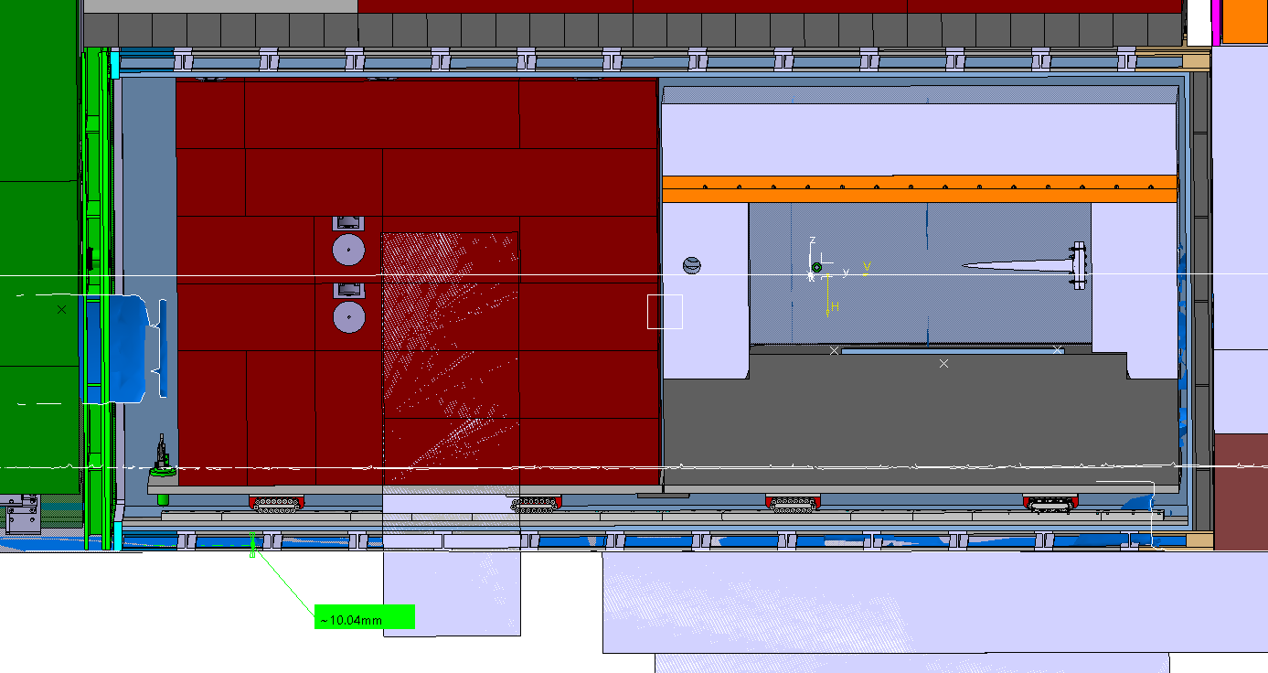
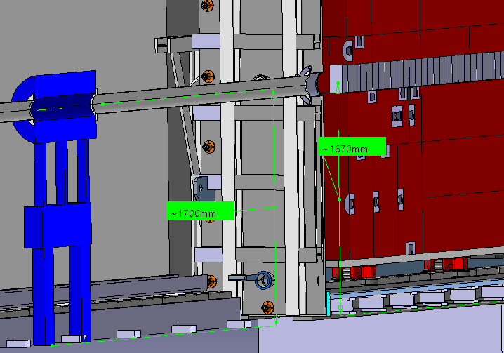
TCC8 Floor Scans
Discrepancy between TCC8 floor scan and civil engineering model on CAD ranging from 0-12mm.
Accuracy of floor scan is between 1-5mm.
Should allow for a tolerance on vacuum vessel production of 5mm.
Vessel was raised from 6mm above floor to 30mm to provide a safe margin. Shims have been implemented within this gap.
Target position was moved down 30mm to maintain alignment with beam.
No need for in-ground shielding

Slide 3
Vacuum Vessel
Size of vacuum vessel was reduced by 30mm to compensate and prevent the need of purchasing more custom shielding blocks
Design study will result in a change of dimensions and structural thickness of the vessel.

Slide 4
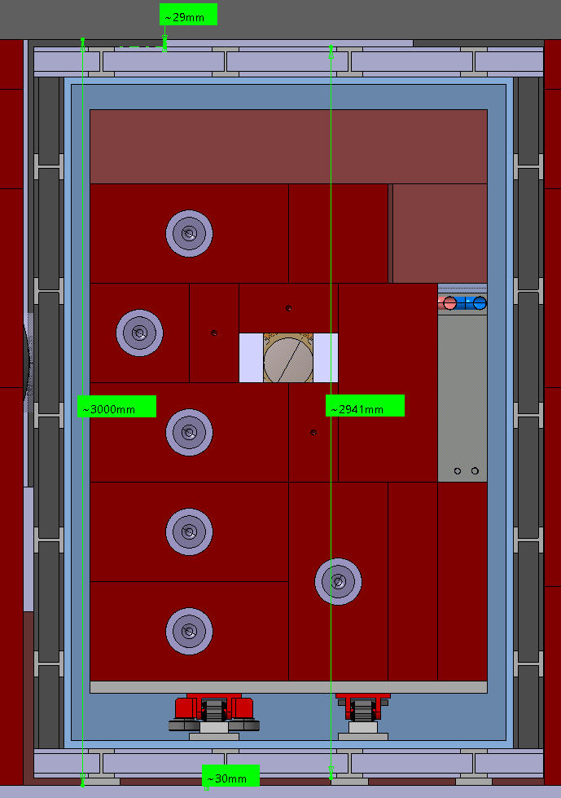
Repositioning of Vacuum Vessel
Parameter | Dimension
Gap from top of vessel to above shielding | 29mm
Tolerance of shielding blocks | 2-3mm x 5 blocks = ± 15mm
Shielding height range | 2985 – 3015mm
Vessel height | 2936 – 2946mm (including ± 5mm)
Max vessel height with 30mm floor offset | 2976mm
Even if the vessel is at maximum height and all shielding blocks are at minimum tolerance, there won’t be any interaction.

Slide 5
Complex Total Floor Load 2.3m MHS
9.6m
~ 1827 tonnes total
~70 m2
~ 26 tonnes/m2
7.7m

Slide 6
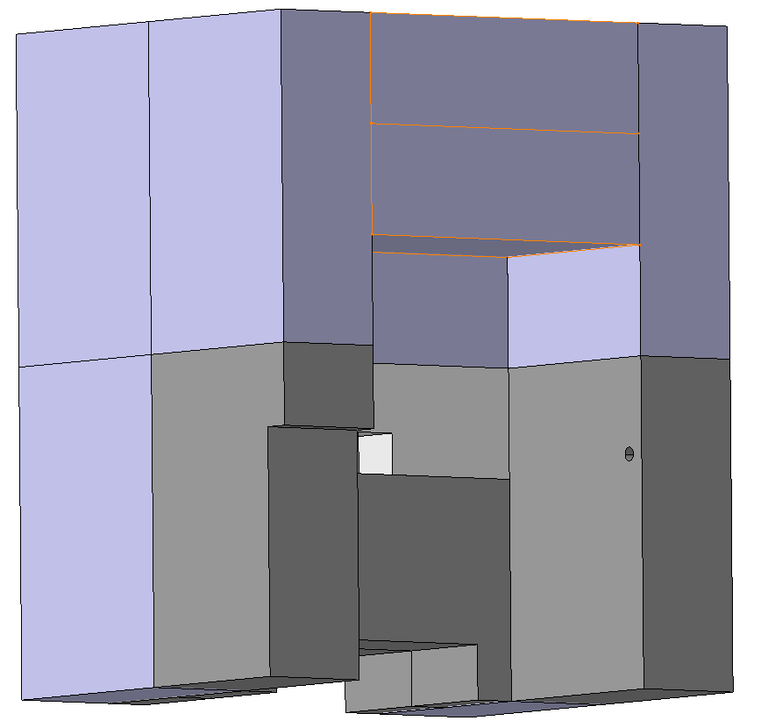
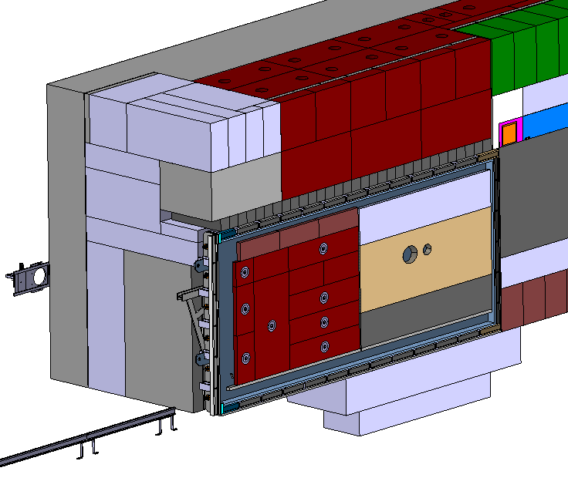
Weight Distributions
The weight of the shielding above the vacuum vessel is distributed onto the steel beams which transfer the load to the shielding either side of the vacuum vessel
These 2 concrete blocks currently sit upon the collimator
Steel beams
Collimator Shielding

Slide 7
Station Floor Load 2.3m MHS
40 tonnes
3.84m2
11 tonnes/m2
40 tonnes
3.84m2
11 tonnes/m2
Concrete Shielding: 145 tonnes, 14.08m2, 10.3 tonnes/m2
Concrete Shielding:
42 tonnes
3.4m2
12 tonnes/m2
Cast Iron Shielding:
465 tonnes, 10.36m2, 45 tonnes/m2
Concrete Shielding:
105 tonnes
5.92m2
18 tonnes/m2
Collimator (including concrete on top):
104 tonnes
3.84m2
27 tonnes/m2
Vacuum Vessel: 190 tonnes
13.14m2
15 tonnes/m2
MHS:
275 tonnes
7.13m2
39 tonnes/m2
Concrete Shielding:
42 tonnes
3.4m2
12 tonnes/m2
Cast Iron Shielding:
547 tonnes, 13.24 m2, 42 tonnes/m2
Calculations performed with assumed densities:
Steel – 7.9kg/m3
Cast iron – 7.8 kg/m3
Concrete – 2.2 kg/m3
Concrete Shielding: 41 tonnes, 3.84m2, 10.5 tonnes/m2

Slide 8
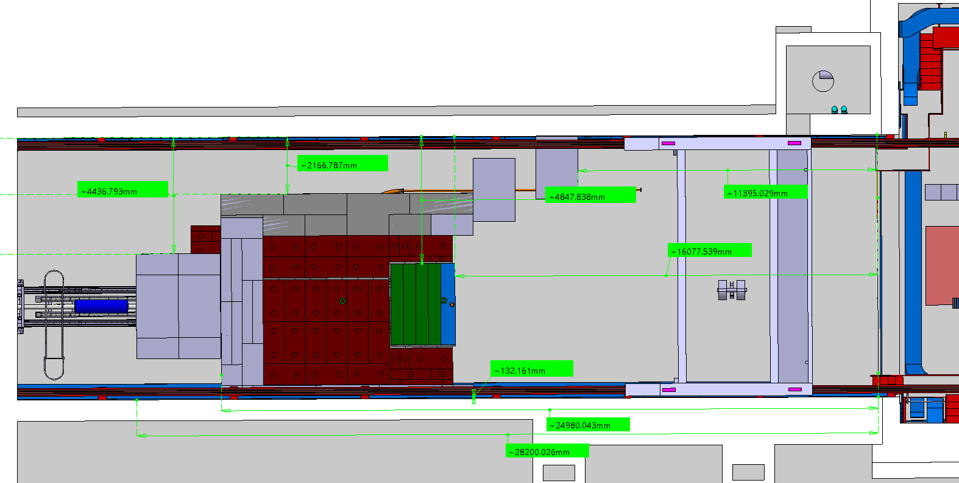

Location of Load 2.3m MHS
TCC8 Wall
All measurements in the y direction are taken from barrier at the end of TCC8

Slide 9
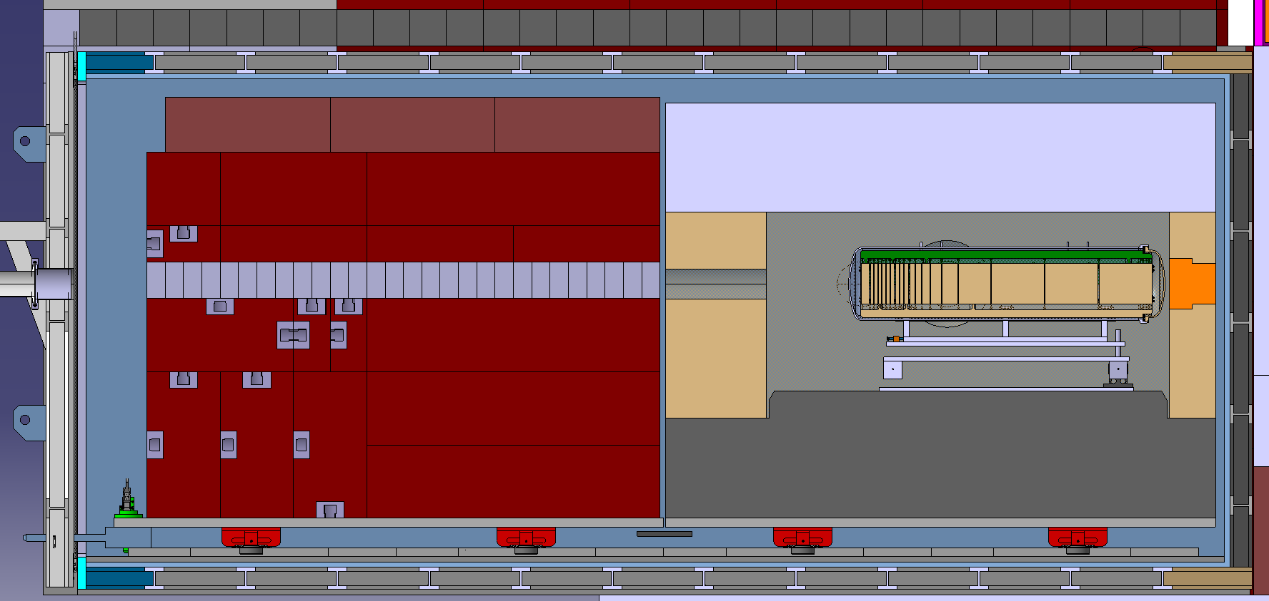
Misalignment
1. Support
2. Proximity Shielding
3. Trolley
4. Rollers
5. Rails
6. Vacuum Vessel
7. Shims

Slide 10
Interactions
7 Interactions from the shims to the target
Interaction | Tolerance
1. Support Structure | ± 0.1
2. Proximity Shielding | ± 0.1
3. Trolley | ± 0.1
4. Rollers | ± 0.1
5. Rails | ± 0.1
6. Vacuum Vessel | ± 5mm
7. Shims | ± 0.1
Possible tolerance accumulation: 5.6mm

