Slide 1
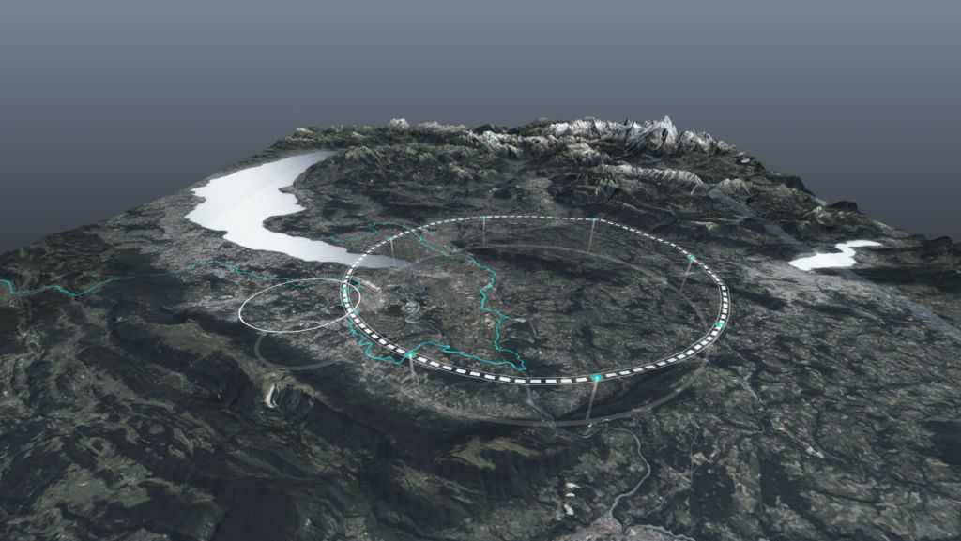
CERN status and FCC/accelerator collaboration with Mexico
"Carlos Hernandez Garcia” Prize 2025
- Award Ceremony, 22 July 2025
Frank Zimmermann, CERN

Slide 2
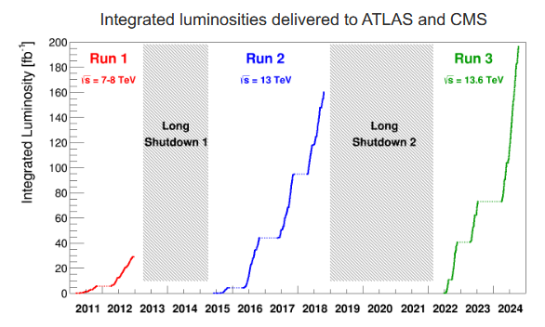
CERN status – LHC

Slide 3
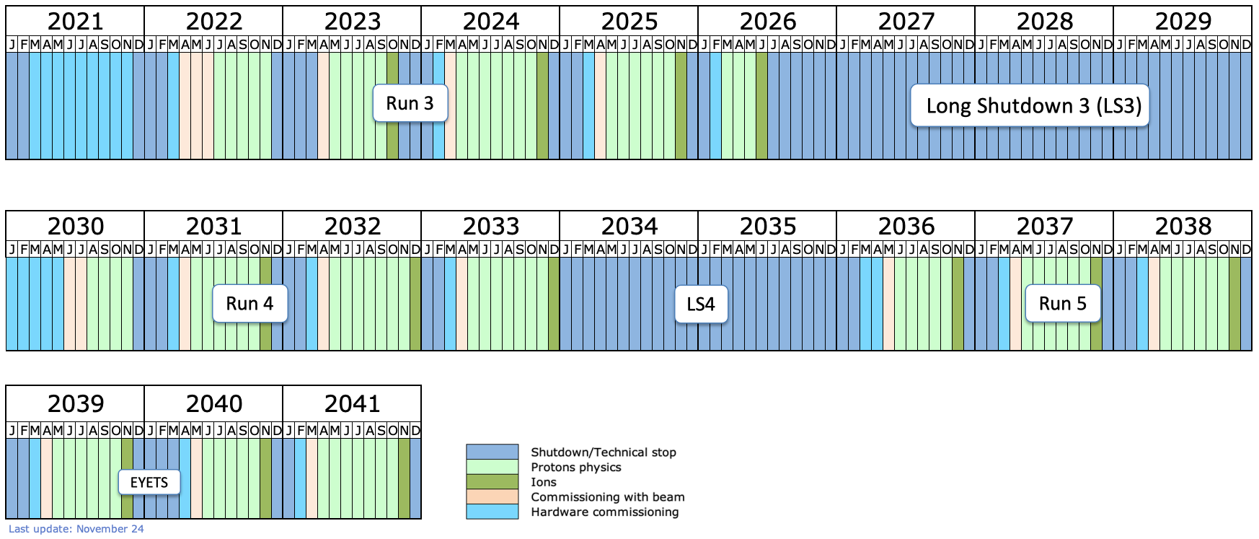
CERN status – long-term LHC schedule

Slide 4
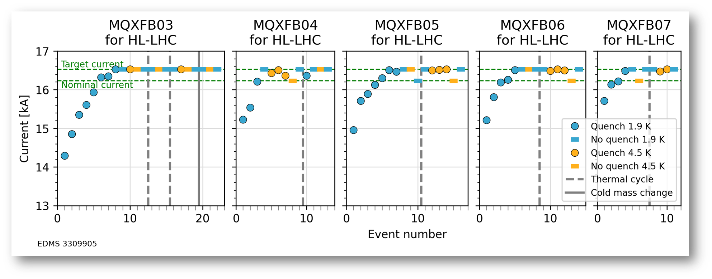
CERN status – HL-LHC, “11.3 T”Nb₃Sn Q2 quadrupoles
50% of MQXFB tested in final configuration for HL-LHC; so far, all Q2 cryo-assemblies for HL-LHC passed the acceptance criteria

Slide 5
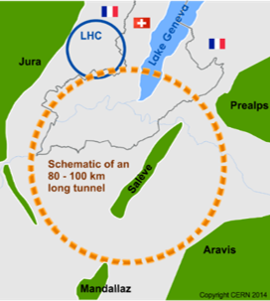
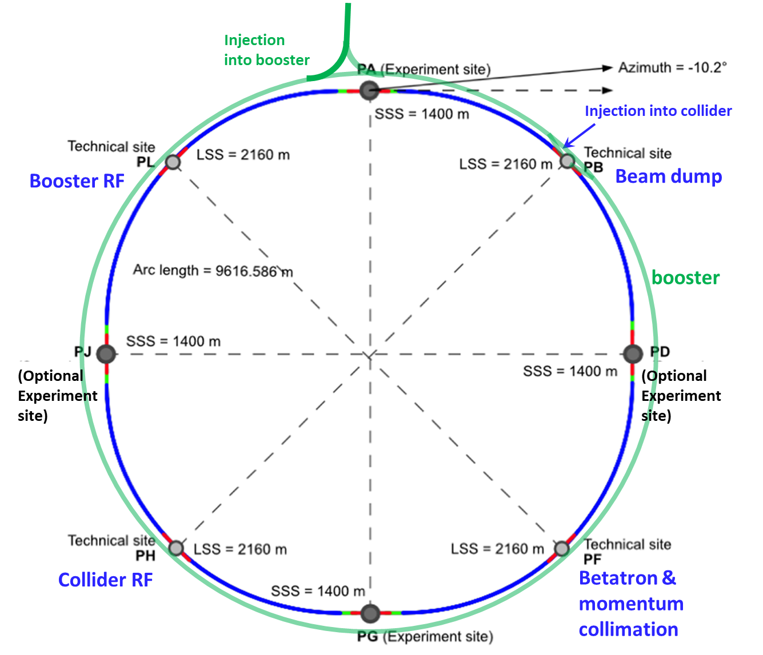
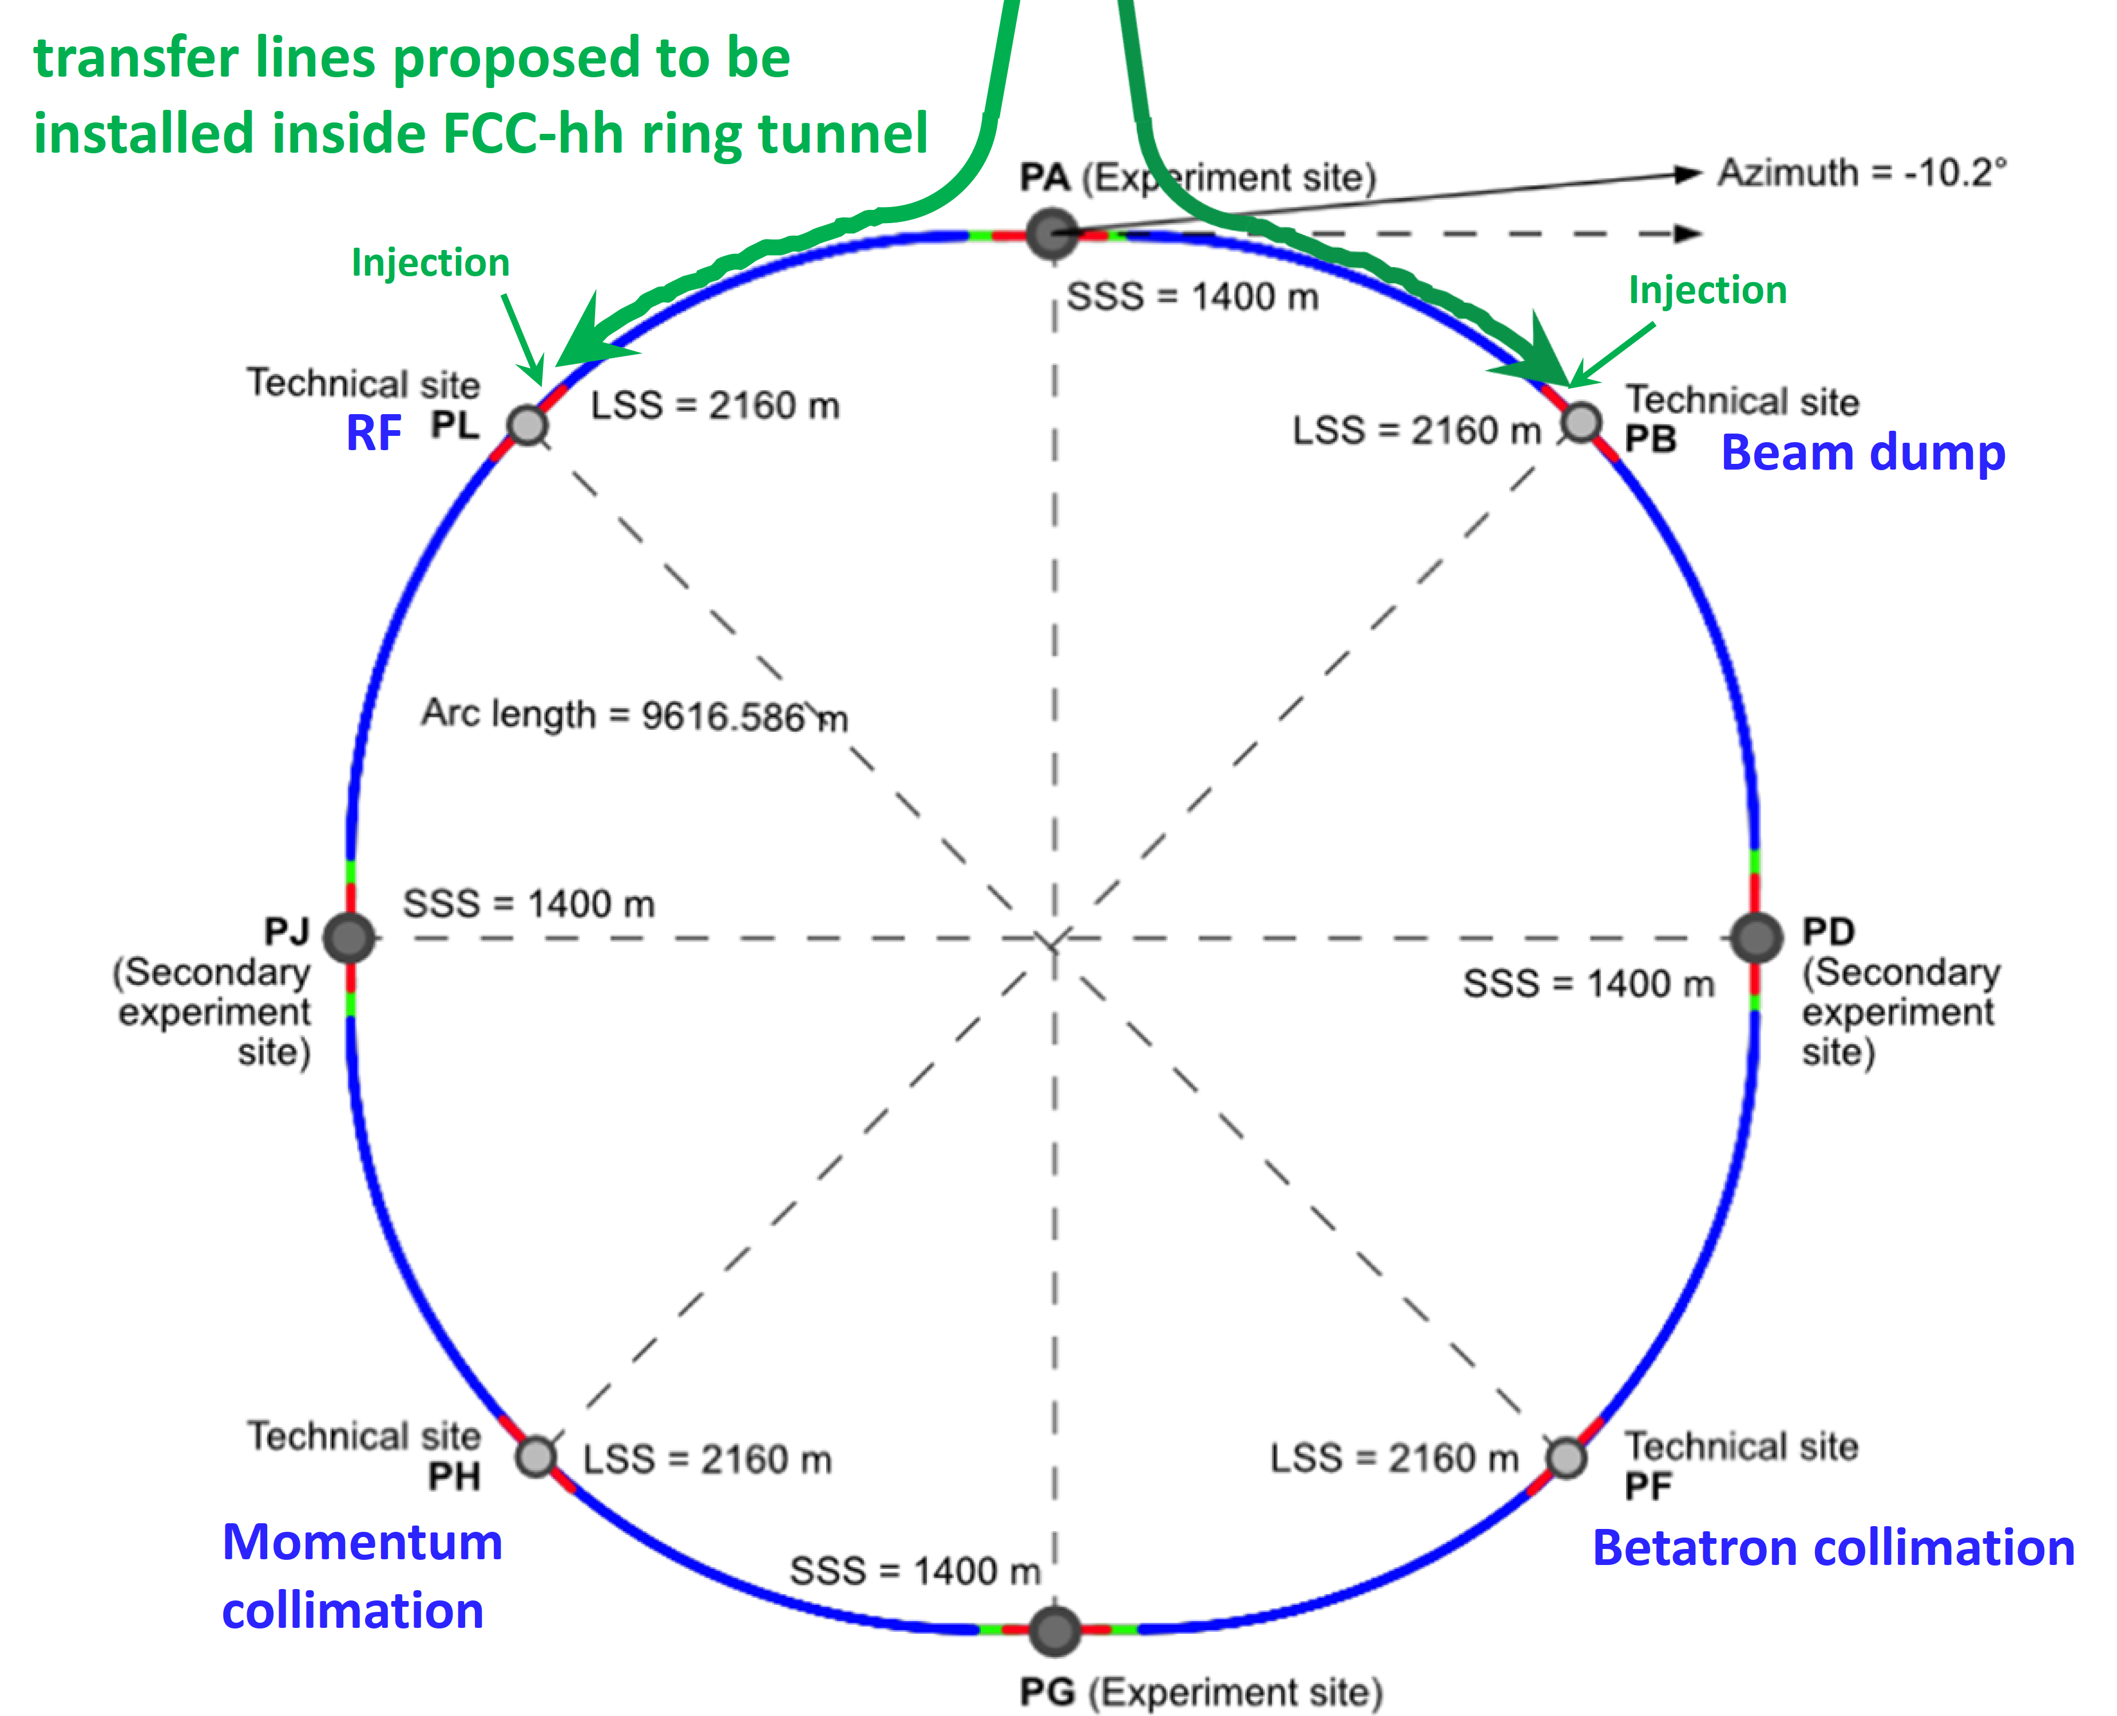
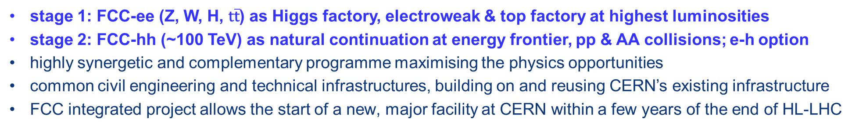
FCC integrated program
stage 1: FCC-ee (Z, W, H, $\text{t}\overline{\text{t}}$) as Higgs factory, electroweak & top factory at highest luminosities
stage 2: FCC-hh (~100 TeV) as natural continuation at energy frontier, pp & AA collisions; e-h option
highly synergetic and complementary programme maximising the physics opportunities
common civil engineering and technical infrastructures, building on and reusing CERN’s existing infrastructure
FCC integrated project allows the start of a new, major facility at CERN within a few years of the end of HL-LHC
FCC-ee
FCC-hh
2020 - 2045
2045 - 2065
2070 -

Slide 6
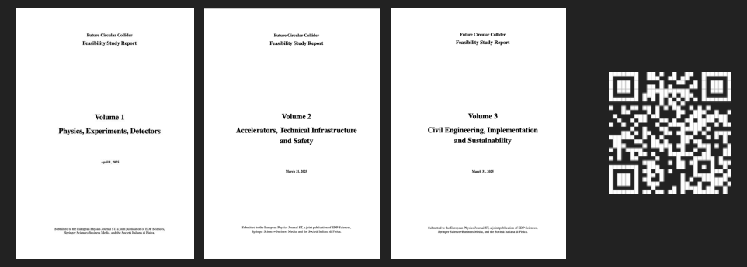




FCC Feasibility Study Report (FSR) delivered on 31 March 2025
Structure: three volumes
Vol. 1: Physics, Experiments & Detectors
Vol. 2: Accelerators,Technical Infrastructures, Safety Concepts
Vol. 3: Civil Engineering, Implementation & Sustainability
These & other FCC input to 2025/26 ESPPU posted at https://indico.cern.ch/event/1534205/
Input for 2025/26 Update of European Strategy for Particle Physics
prepared with Overleaf & to be published by EPJ (Springer-Nature) – FCCIS members

Slide 7
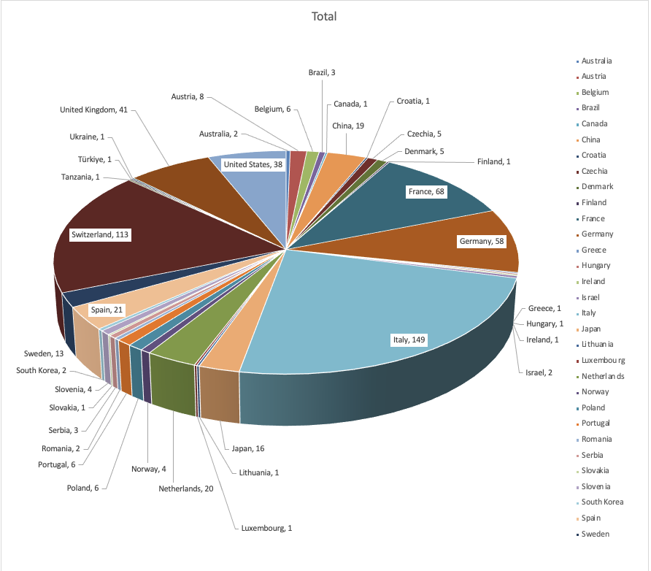
ESPP Open Symposium, Venice, June 23-28
~ 630 in-person participants and ~ 720 remote participants per day
Many thanks to INFN and the Local Organizing Committee chaired by Sandra Malvezzi

Slide 8
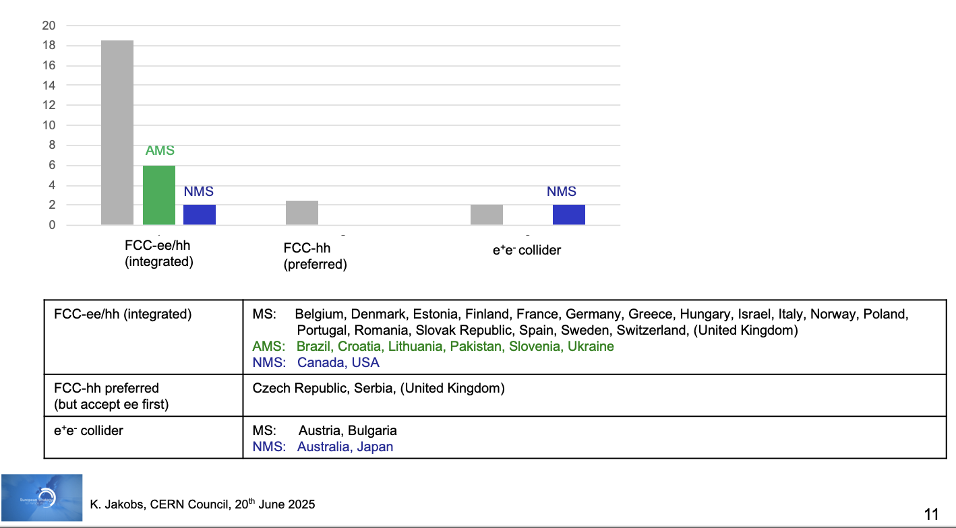
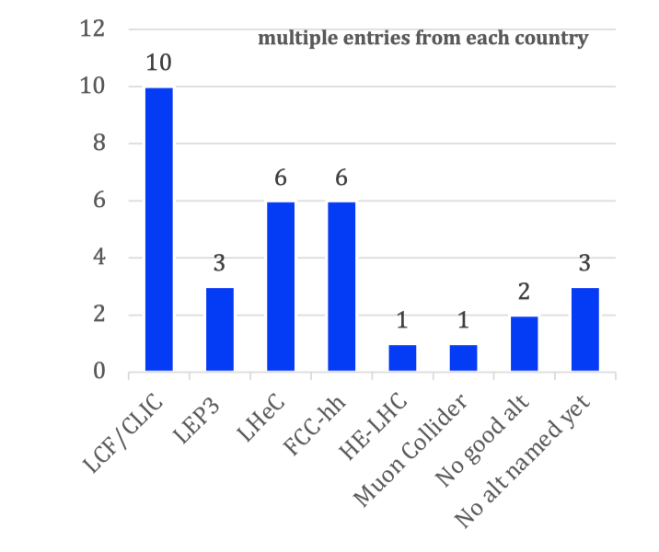
National Inputs to European Strategy for Particle Physics Update
Preferred option
Alternative if preferred option not feasible
MS
Publicly available at: https://indico.cern.ch/event/1439855/contributions/
Summary compiled by European Strategy Group

Slide 9
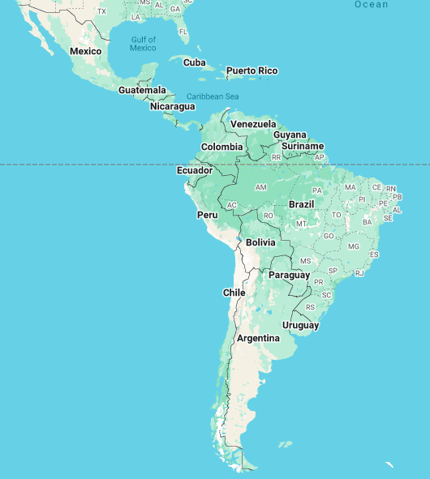
Latin American members (& friends) of FCC collaboration
Brasil:
Centro Brasileiro de Pesquisas Físicas (CBPF), Rio de Janeiro
Federal University of Rio Grande do Norte (UFRN), Natal
Colombia:
Universidad Nacional de Colombia, Bogotá
Chile:
Pontificia Universidad Católica de Chile, Santiago
Millenium Institute SAPHIR, Las Condes
Mexico:
Universidad Autónoma de Sinaloa, Culiacán
BUAP, Puebla
Universidad de Guanajuato, Guanajuato
Universidad de Colima, Colima
Universidad Autonoma de Yucatán, Merida
CINVESTAV, Mexico City

Slide 10




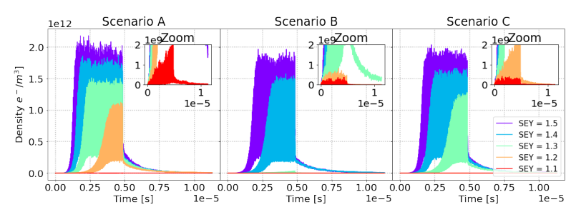
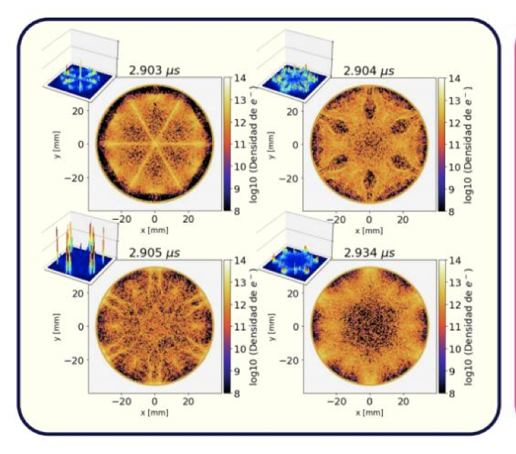
FCC-ee beam dynamics: electron cloud build up
synchrotron radiation photon interception & electron-cloud mitigation
Electron density at the center of an arc sextupole chamber with winglets. Parameters: 𝑛_{𝛾} = 10⁻⁶, 32.25 bunch spacing
Electron cloud inside a sextupole magnets
Electron Cloud Build-Up for the Arc Sextupole Sections of the FCC-ee, https://jacow.org/ipac2022/papers/mopost049.pdf
Humberto Maury Cuna, Karla Cantun Avila, Gerardo Guillermo Contreras Nuno,
Jaime Eduardo Rocha Muñoz, …

Slide 11
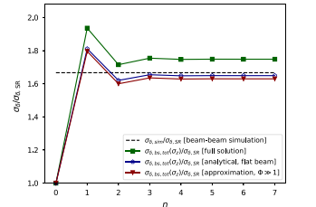
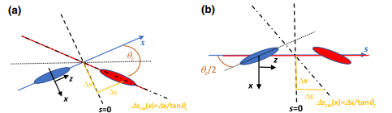
beam dynamics: effect of beamstrahlung
iterative self-consistent equilibrium distribution and parameter optimisation
Bunch orientation and coordinates in the laboratory frame (a) and in the boosted frame (b). Locations of the vertical focusing plane without and with crab waist are also indicated
Relative rms momentum spread increase versus the number of iterations n for the FCC-ee ZH production mode at 240 GeV centre-of-mass energy; shown are results for the full analytical solution, [green markers], for the analytical solution for extremely flat beams [blue markers] and for asymptotic analytical approximation in the case of large Piwinski angle [red markers]. For comparison, the black line is the rms momentum spread increase from a many-turn (quasi-)strong-strong beam-beam simulation with the code LIFETRAC, as obtained by D. Shatilov for the FCC-ee Conceptual Design Report.
Marco Alan Valdivia Garcia, F.Z.

Slide 12
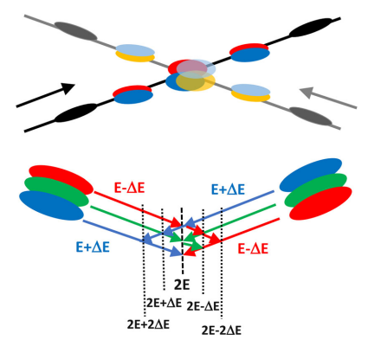
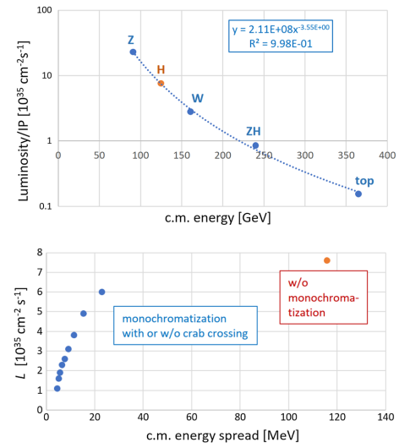
FCC-ee monochromatised s-channel Higgs production
FCC-ee monochromatisation scheme featuring interaction-point dispersion of opposite sign for the two colliding beams, with (top), or without crab crossing and integrated resonance scan (bottom). Different colors schematically indicate bunch portions withslightly different energies
FCC-ee luminosity per interaction point as a function of c.m. energy at its four different baseline operating points, fitted curve, and extrapolated luminosity at 125 GeV [red-orange marker] (top) and luminosity as a function of c.m. energy spread for either monochromatisation scheme (bottom). Two IPs are assumed.
Marco Alan Valdivia Garcia, A. Faus-Golfe, F.Z.

Slide 13

FCC accelerator opportunities for Mexico
ongoing collaborations
FCC-ee beam instabilities: e⁻ cloud build up (UADY Merida, Guanajuato)
FCC-ee beam-beam dynamics & collider optimization: beamstrahlung, monochromatization etc. (U Guanajuato,…)
FCC-hh injector: hadron sources & linacs (UA Sinaloa, U Guanajuato)
potential further contributions ?
FCC-ee vacuum system
FCC-beam diagnostics
FCC-ee injector
moderate & high field SC magnets

Slide 14
Summary & outlook
FCC Feasibility Study concluded; Feasibility Study Report submitted to the ESPP, as requested by CERN Council.
Coherent baseline design for FCC integrated programme, including well-advanced territorial implementation scenario, in line with CE construction start by 2032/33.
FCC-ee design level enables moving towards technical design and prototyping phase, aligned with overall schedule, and towards preparing input for potential project decision by 2027/28.
Long term goal: world-leading HEP infrastructure for 21st century to push the particle-physics precision and energy frontiers far beyond present limits.
Success of FCC relies on global participation
Strong participation from Mexico with many addt’l opportunities !

Slide 15
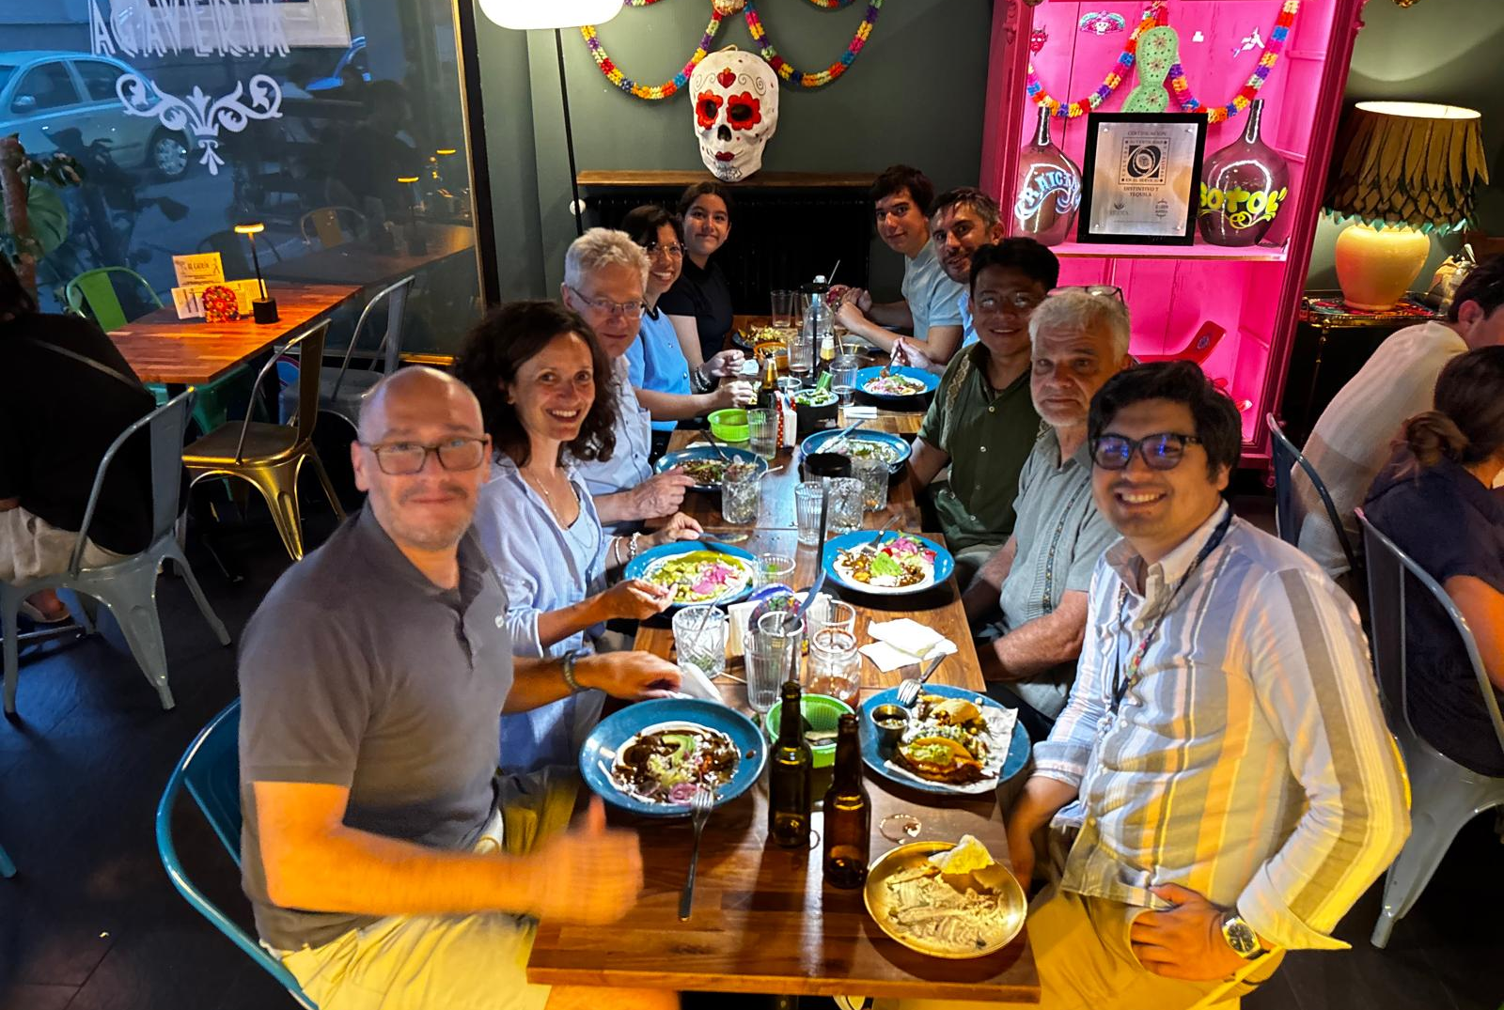
CERN-Mexico
topical FCC
Collaboration
Meeting,
18 July 2025

