Slide 1
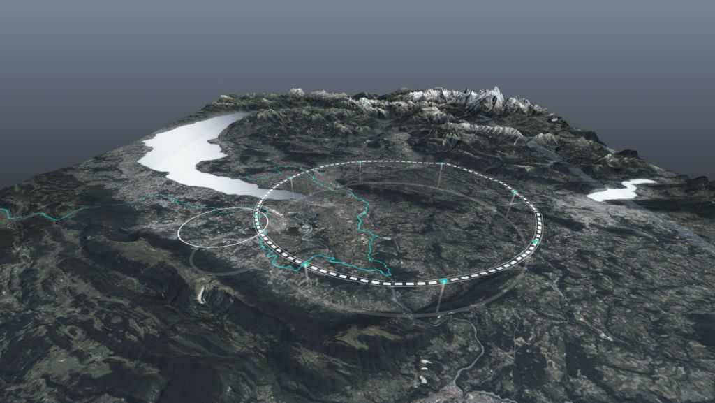
Mexican CERN “Beam” program
and Outlook
"Carlos Hernandez Garcia” Prize 2025
- Award Ceremony, 22 July 2025
Frank Zimmermann, CERN

Slide 2

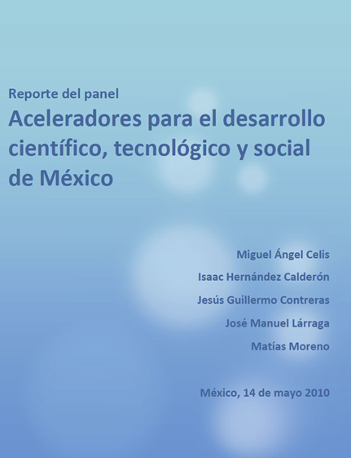
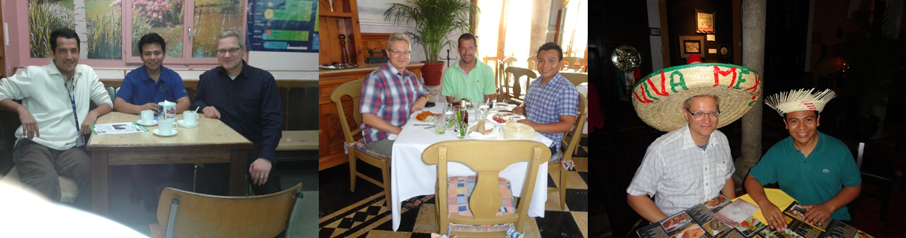
accelerator collaboration & training with Mexico
Director for Scientific Development of CONACyT, J. L. de la Peña, created ad-hoc committee to advise on feasibility of large-scale accelerator projects in Mexico;
panel stressed need for strong investment in the training of highly qualified human resources; from this committee and from other input by the RedFAE (CONACyT nat’l network on high-energy physics), Dr. de la Peña agreed to look for ways to fund prospective students in this area
first Mexican accelerator student at CERN
Humberto Maury Cuna, M. Sc. (2009) and Ph. D. (2013) under the direction of Frank Zimmermann working on electron cloud effects at the LHC ; Funding sources: EuCARD, HELEN, E-Planet from Europe ; CONACyT, RedFAE, CINVESTAV from Mexico

Slide 3
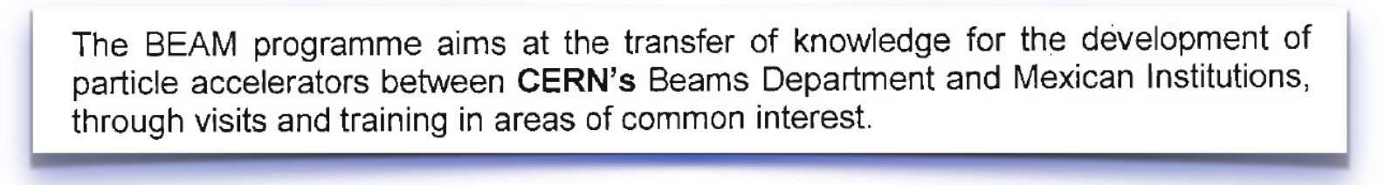
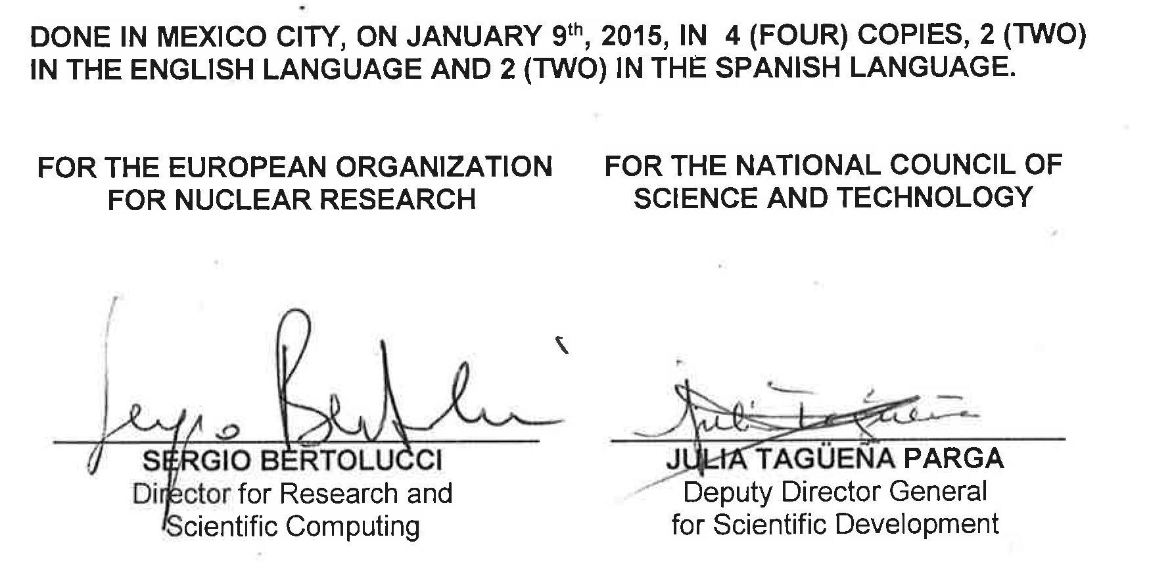
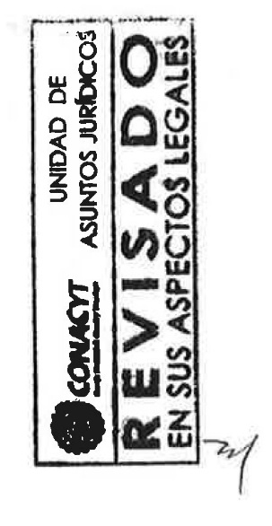
the BEAM programme
since 1998 there is a cooperation agreement between CONACyT and CERN ;
BEAM, an addendum to this agreement, was written to formalise the accelerator collaboration between Mexico and CERN
the formalities took a long time; finally on January 9, 2015 it was officially signed, but it was de facto operating before that date ;
BEAM helped in creating an official environment to ask for funding and several students benefitted from this

Slide 4
Mexican accelerator students & fellows at CERN
2009
2010
2011
2012
2013
2014
2015
2016
2017
2018
2019
2020
2021
2022
2023
Humberto Maury Cuna, CINVESTAV Merida
Bruce Yee Rendon, CINVESTAV D.F.
Cristhian Valerio, U. Sonora
then CERN fellow
Luis Medina, U. Guanajuato
Abrahan Pinedo, U. Guanajuato
Karim Hernandez, U. Guanajuato
Gerardo Guillermo, CINVESTAV Merida
the last one ?! ☹
Marco Alan Valdivia, U. Guanajuato
Ricardo Montoya Soto, U. Guanajuato
Other Mexican accelerator experts at CERN: Alejandro Castillo (former CERN fellow), Emilia Cruz Alaniz (former CERN fellow), Cristobal Garcia (present EPFL/CERN doctoral student), …

Slide 5
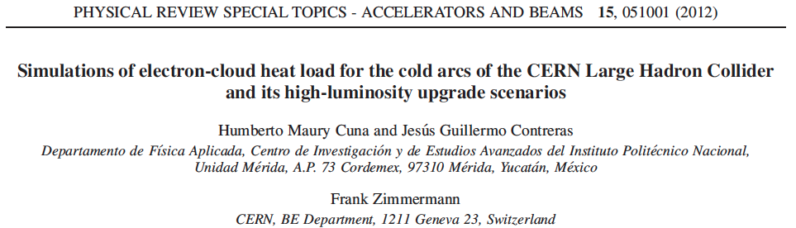
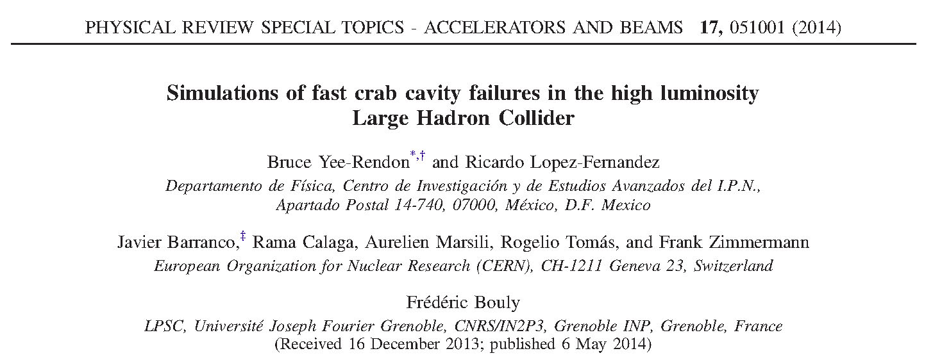
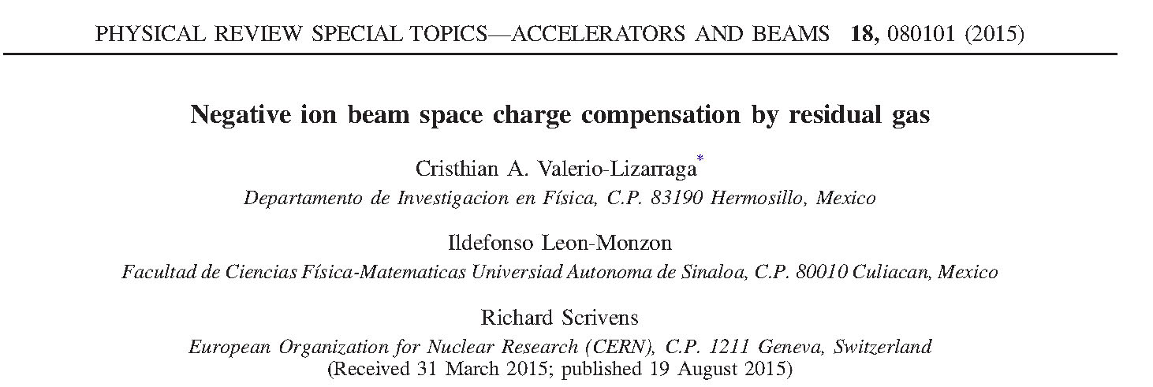
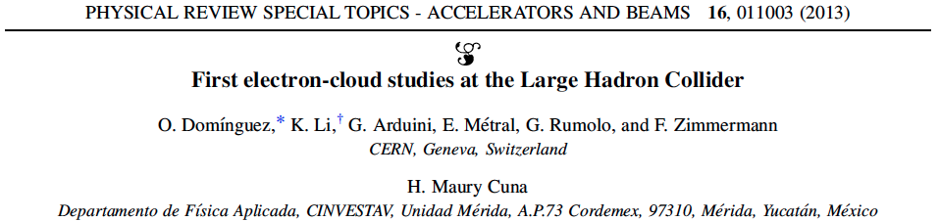
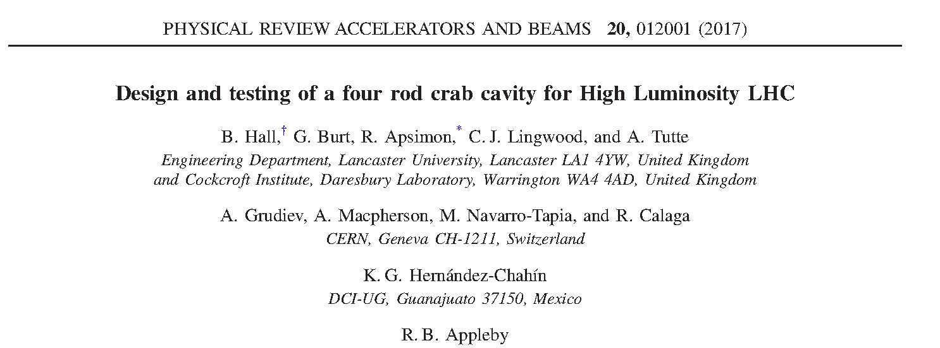
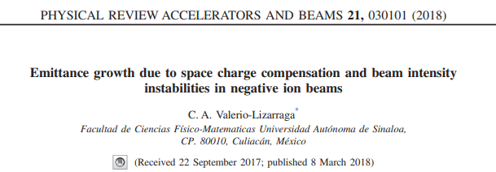
journal articles by Mexican “BEAM” students

Slide 6
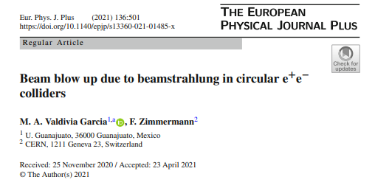
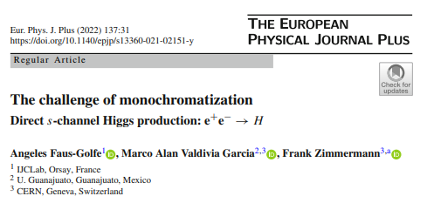
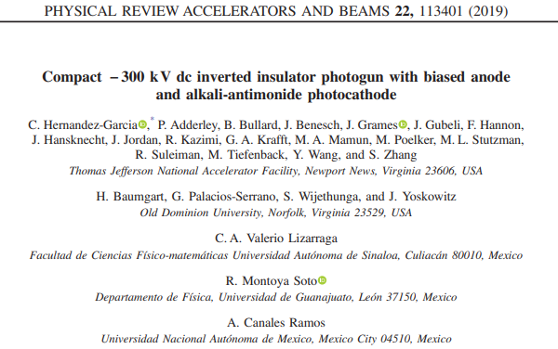
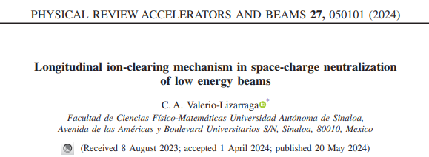
more journal articles by Mexican “BEAM” students

Slide 7
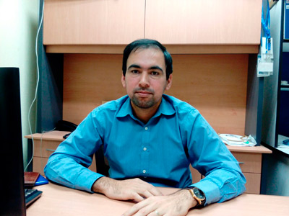
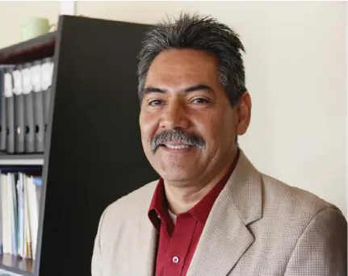
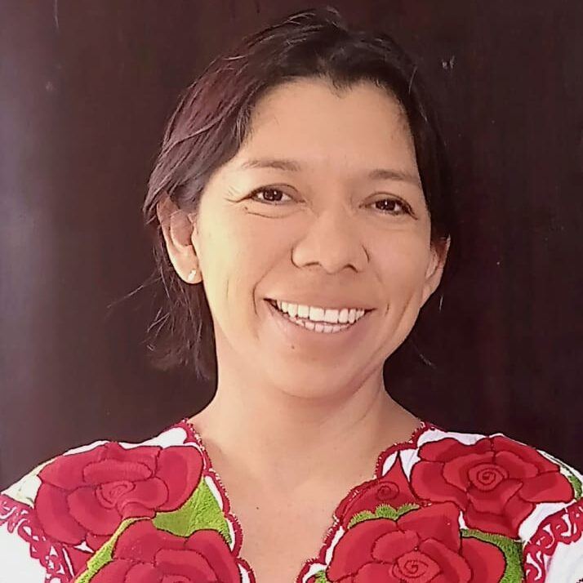
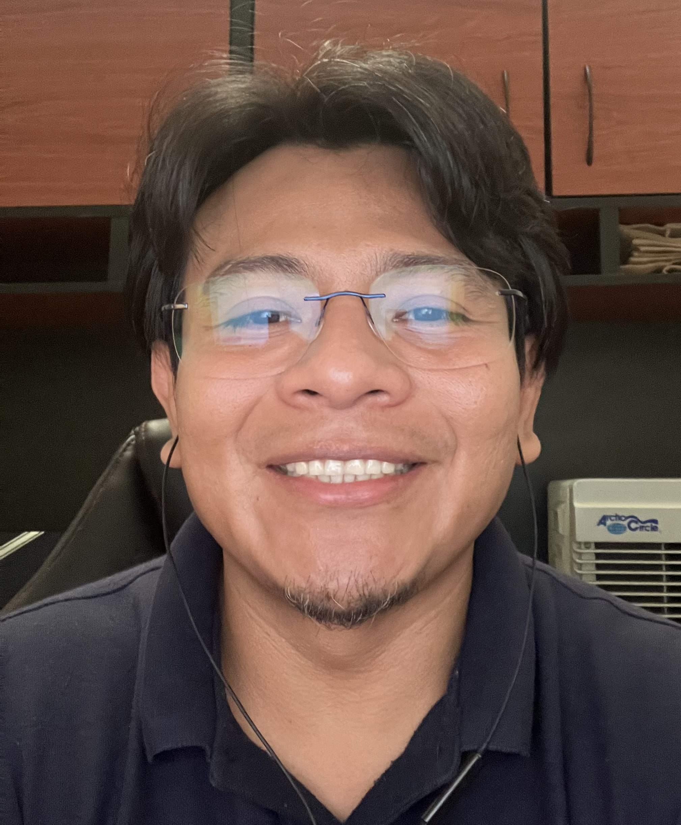


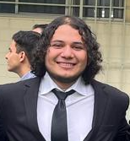
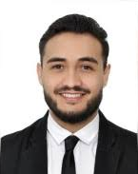
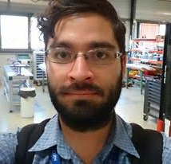
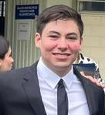
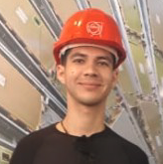
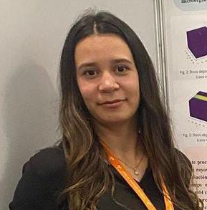
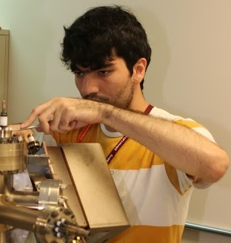
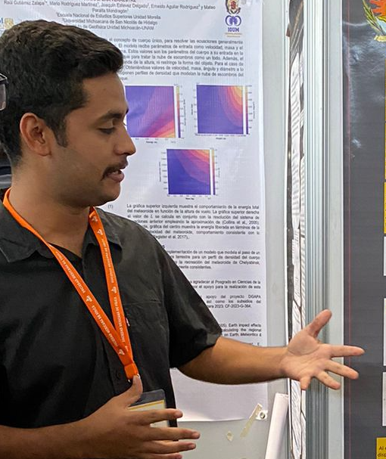
“BEAM” members working with CERN/FCC
Dr. Cristhian Valerio (UAS)
Dr. Mauro Napsuciale (UG)
Dra. Karla Cantún (UADY)
Dr. Humberto Maury (UG)
supported by Projects CONAHCYT 2042 through Nov 2024, and
CONAHCYT CF-2023-G-1286 through Nov 2026
Students involved:
Yair Villaseñor
Jaime Rocha
Marco Valdivia
Sergio Millán
Ricardo Montoya
Raquel Ríos
Víctor Lizárraga
Edgardo Leyva

Slide 8

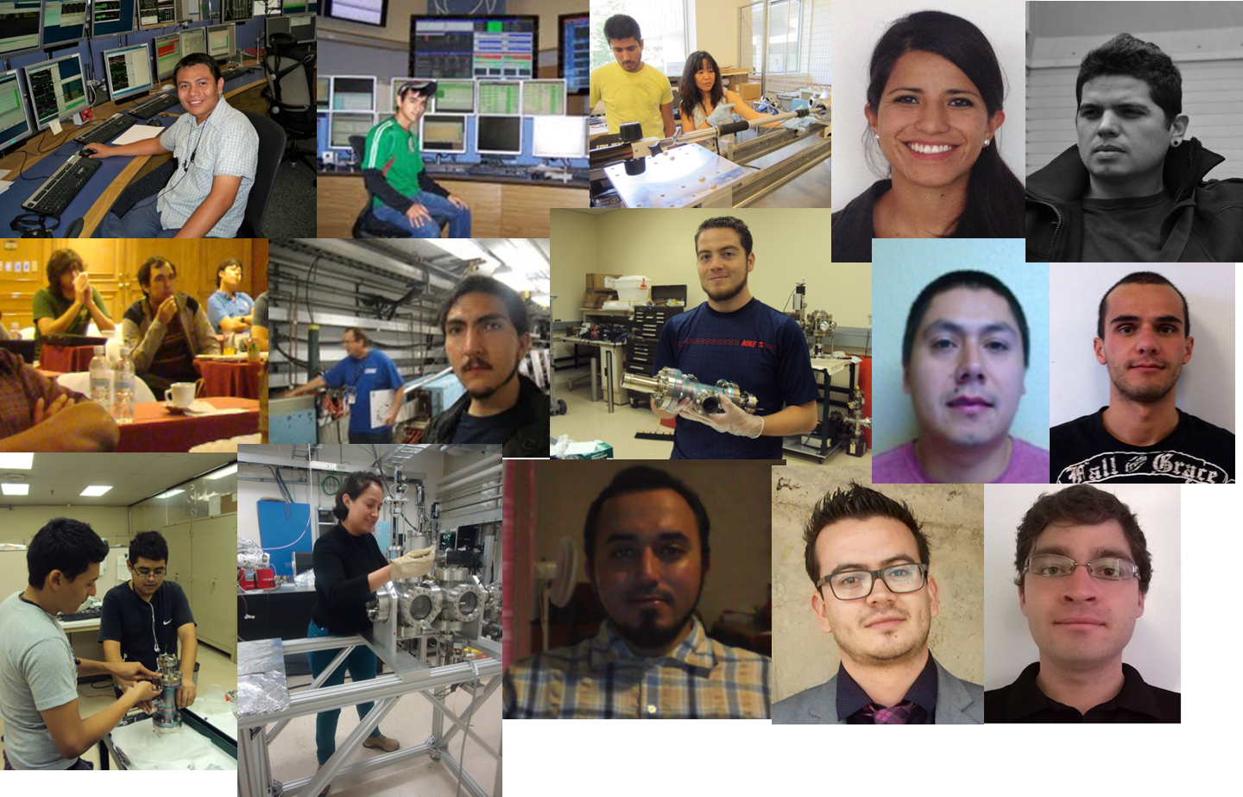
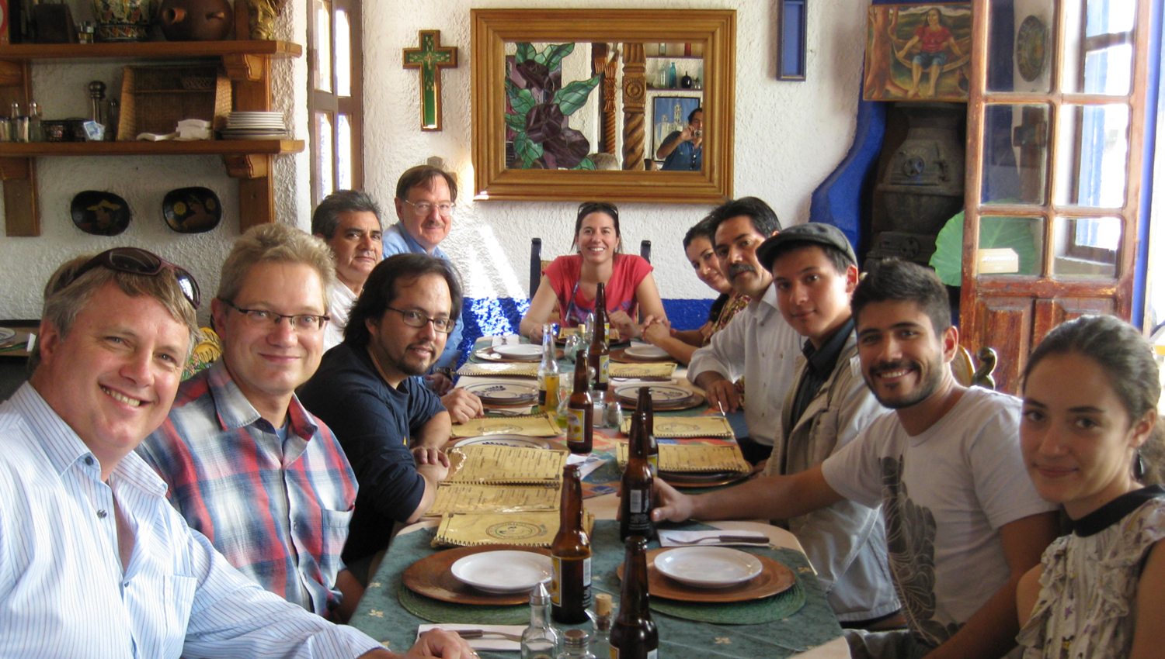
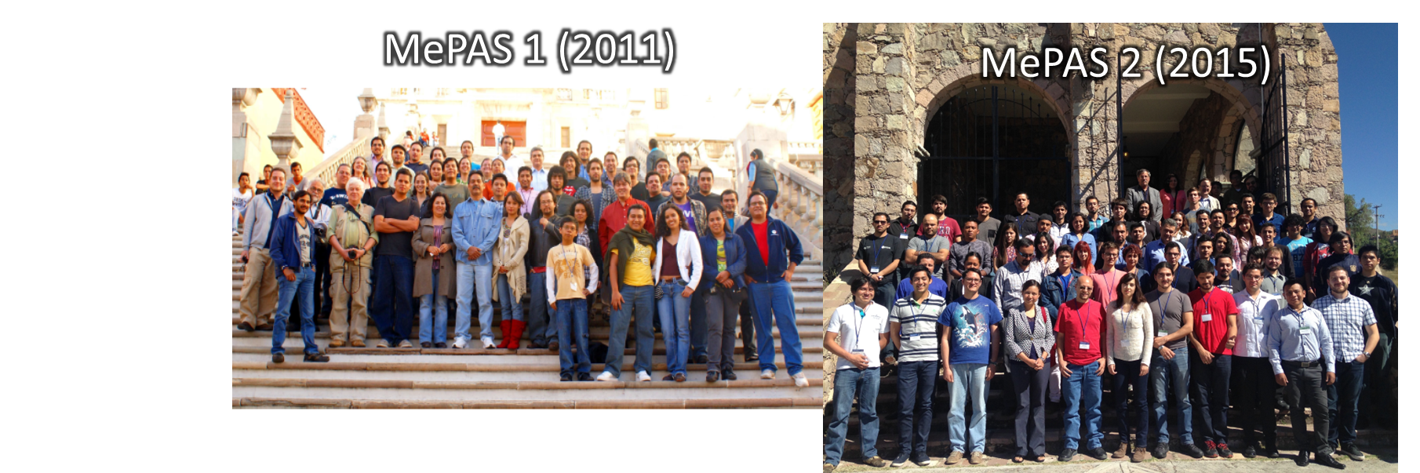
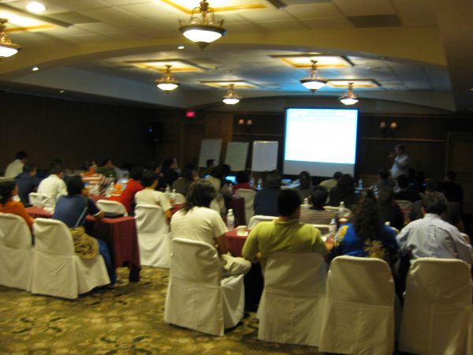

Mexican Particle Accelerator Community (CMAP)
MePAS 3 (2017)

Slide 9
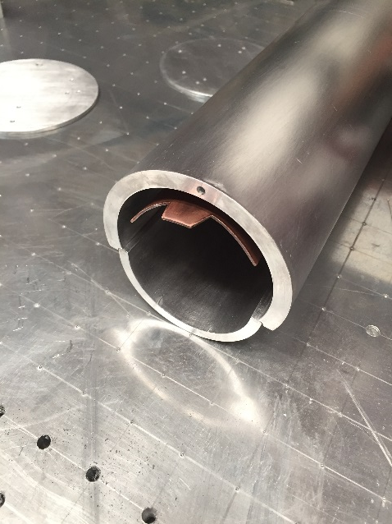
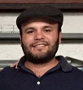
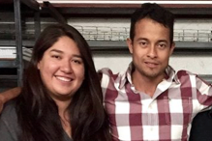
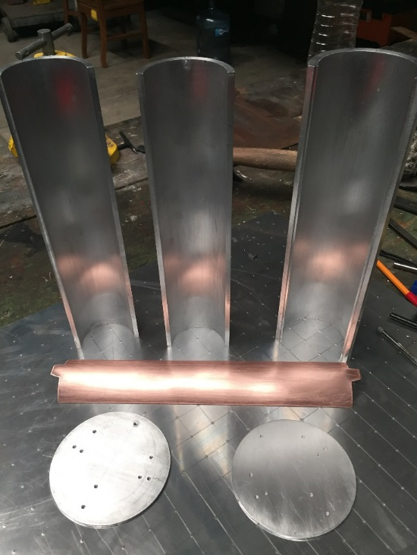
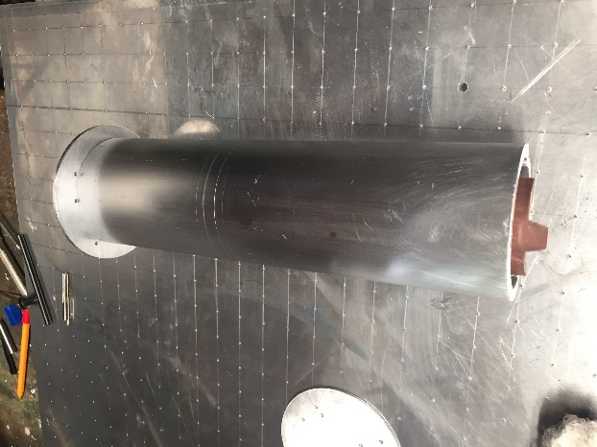
CMAP projects of interest to FCC-ee
Design and construction of a stripline beam kicker
Design and construction of a Beam Position Monitor
Fermín Pérez Suárez (Mechatronical engineer) UG – Master student
Design of electron gun
Veronica Bravo (Mechanical engineer) – Design –
Isaac López Jurado Ing. Mechatronical engineer) – Construction -
Ricardo Gaspar (Physicist)
UAS – Master student

Slide 10
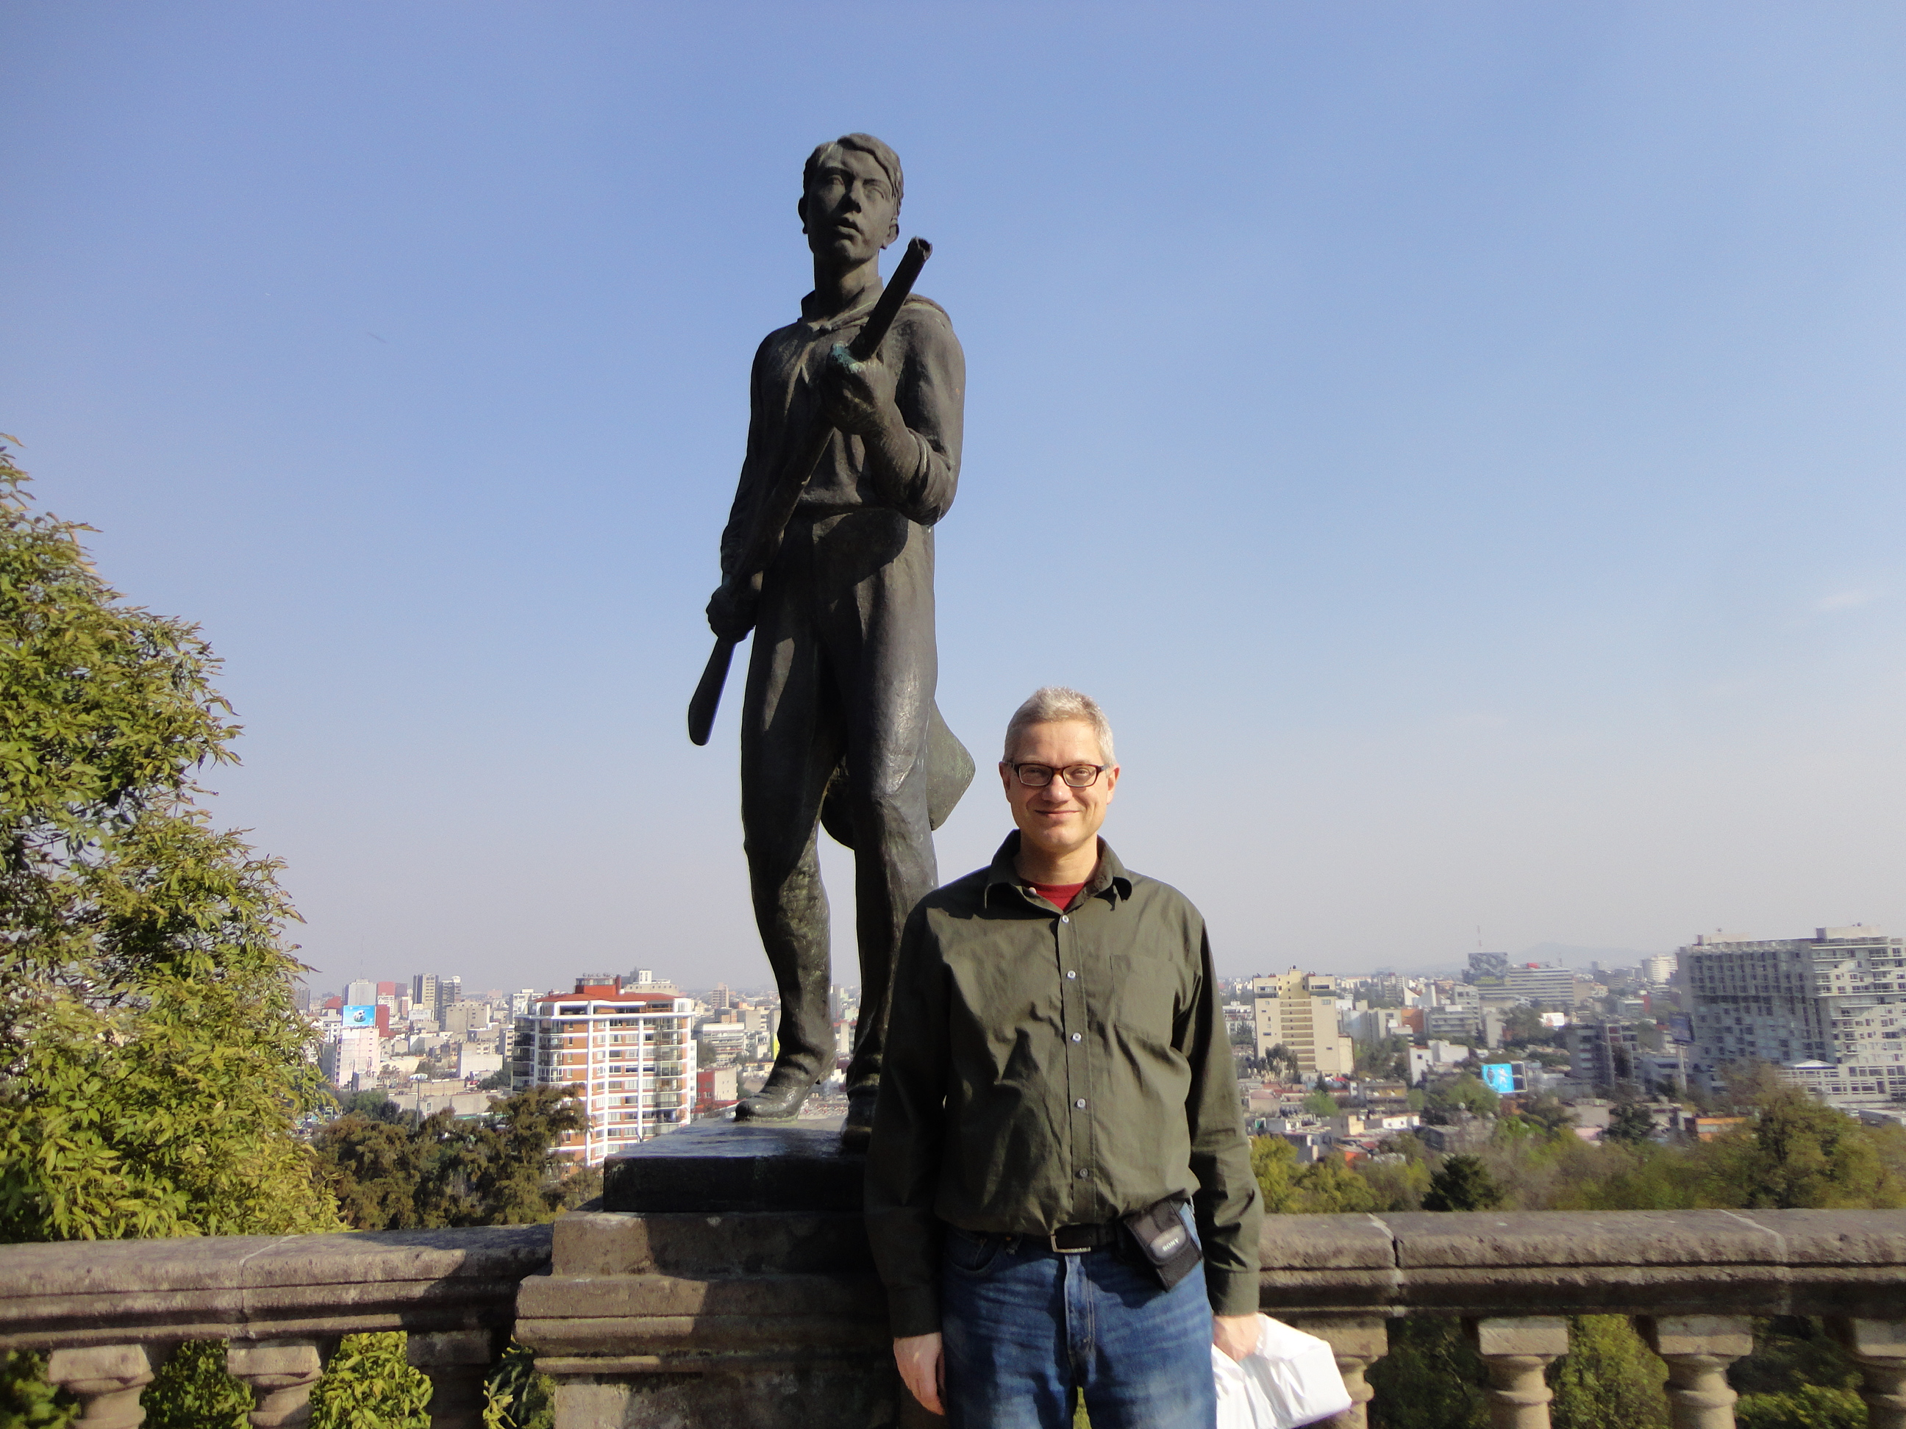
Mexico City
2014
Bruce Yee’s
thesis defence

Slide 11
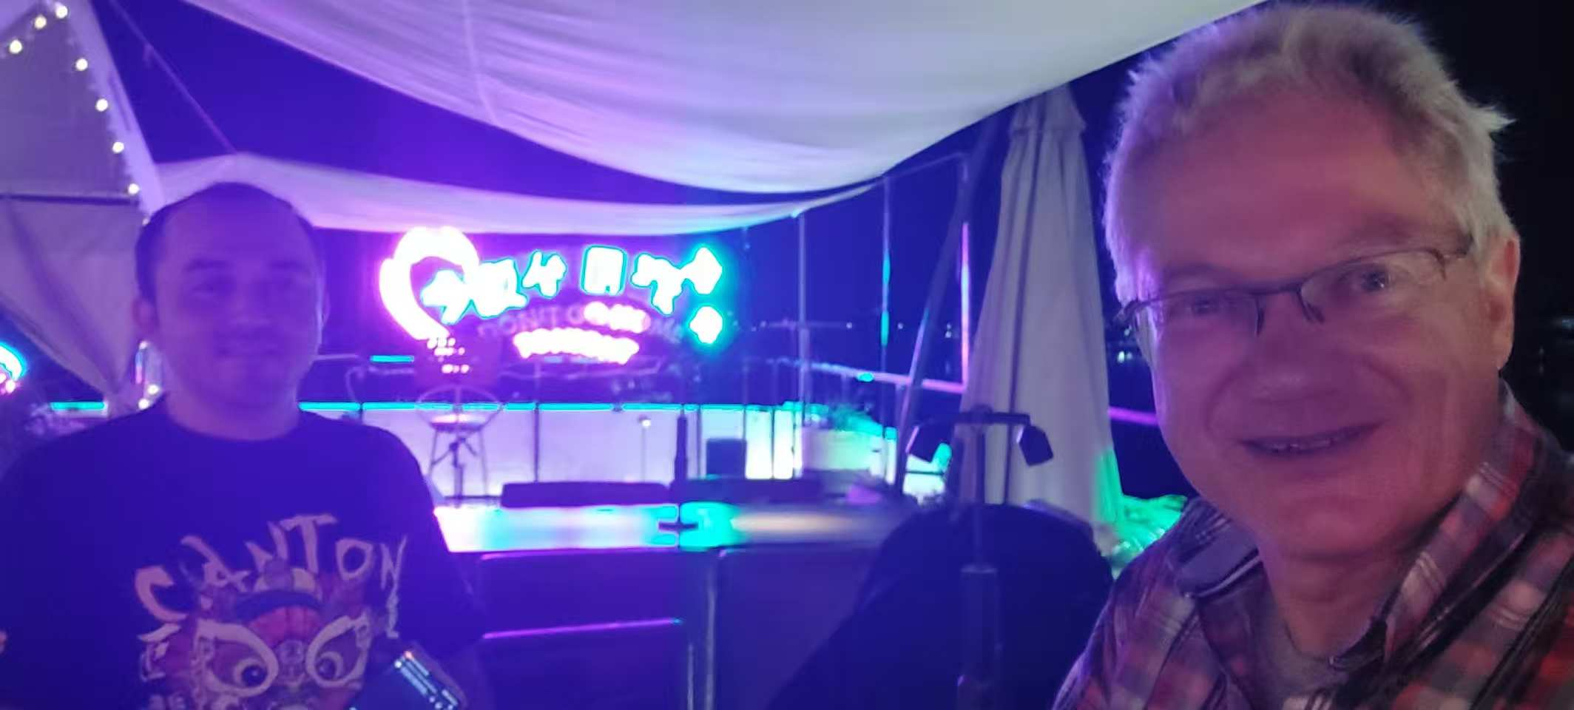
Kaiping, Jianmen 2023 - catching up with Gerardo Guillermo

Slide 12
Summary & perspective
A fantastic CERN-CONACyT Mexican student program “BEAM” started around 2008; it was fully formalized in 2015 – overall 9 students enrolled
“BEAM” students today:
  Luis Medina became CERN fellow
  Humberto Maury now is Vice President of MPS HEP Division
  Bruce Yee serves in key role at J-PARC
  Gerardo Guillermo was first at CSNS and then stayed in China
  …
  Unfortunately, BEAM program came to abrupt halt in ~2021/22
  It would be great to resume “BEAM” and/or even better if Mexico joined CERN as an Associate Member State

Slide 13
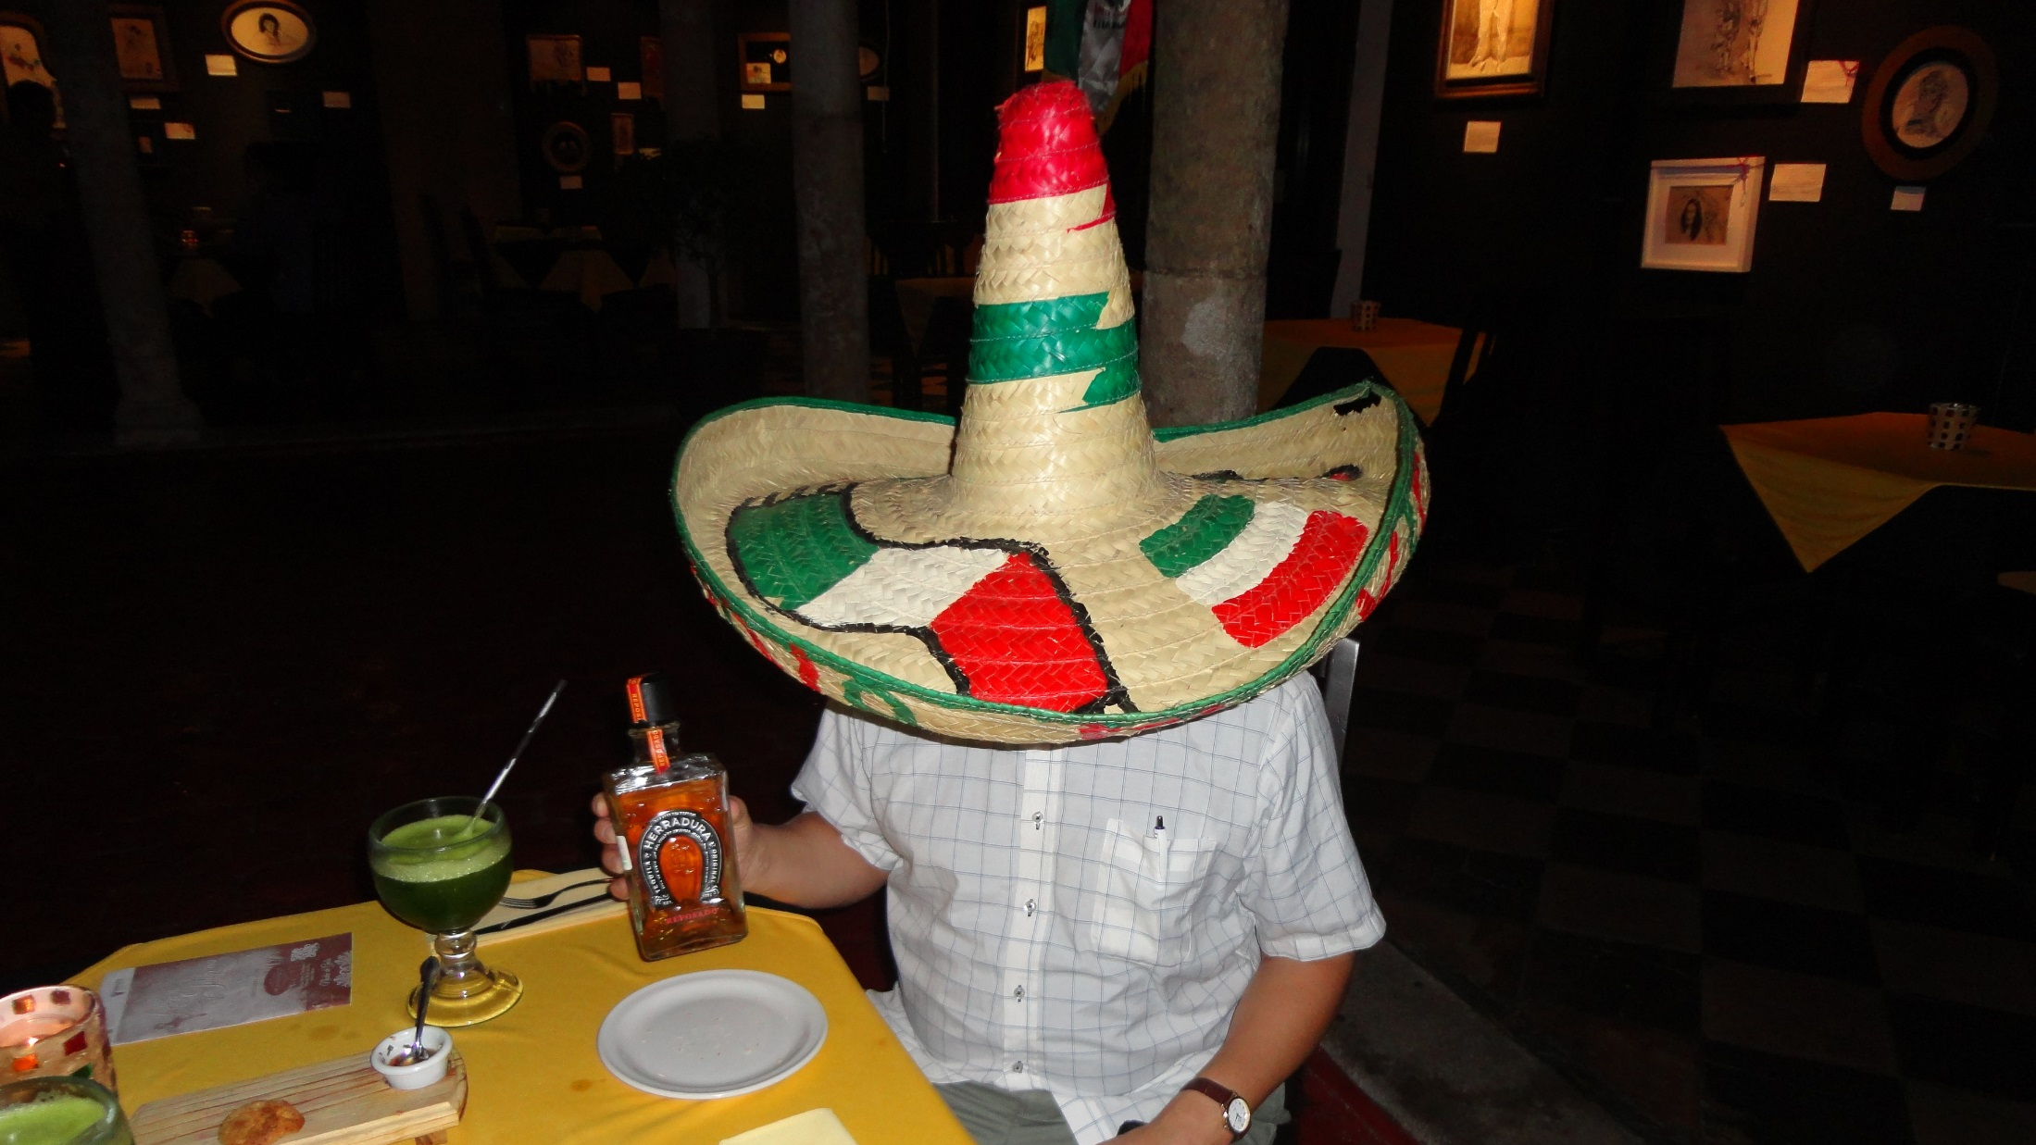
gracias!

