Slide 1
Target Station Changes
Gemma Humphreys
23/07/2025

Slide 2
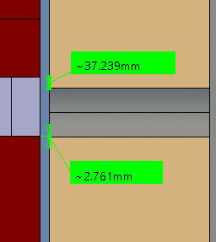
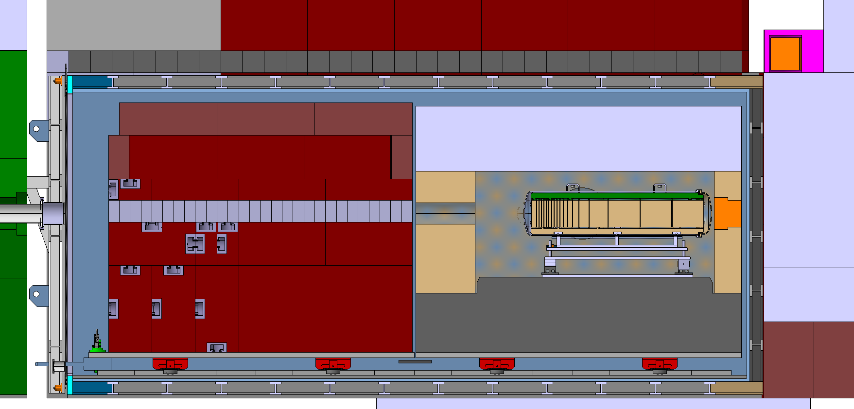
Hole Position Change
Move hole of internal shielding 20mm down

Slide 3
Steel Beam
Add additional steel beam at rear of vessel

Slide 4
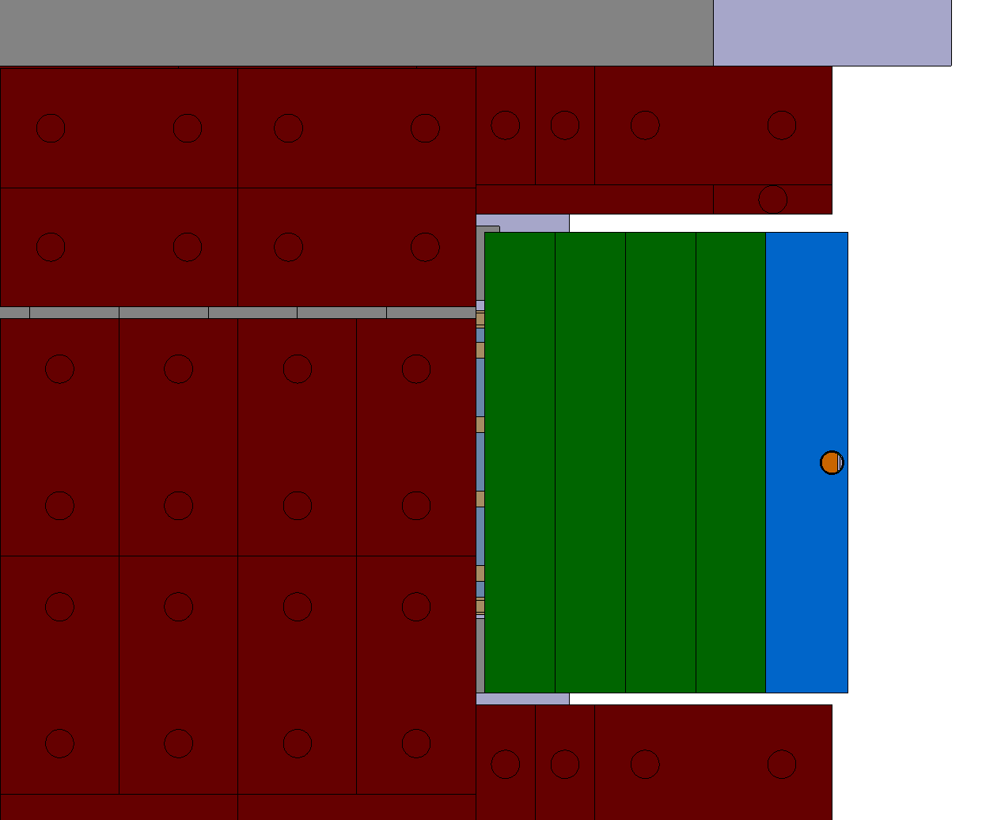
MHS Gap
Add/move shielding to remove the gap either side of MHS

Slide 5
Shielding To Add
Red internal shielding can be made 70mm taller
Proximity shielding can be made 100mm taller
Area under trolly can be filled with shielding
Hole on right side of internal shielding can be decreased in size

Slide 6
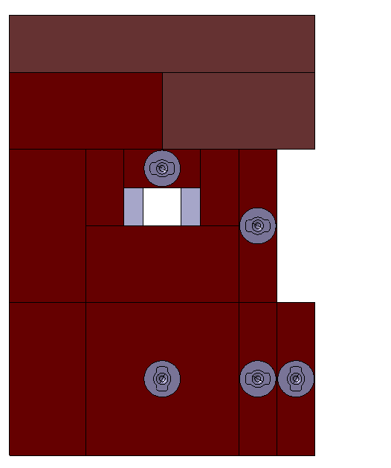
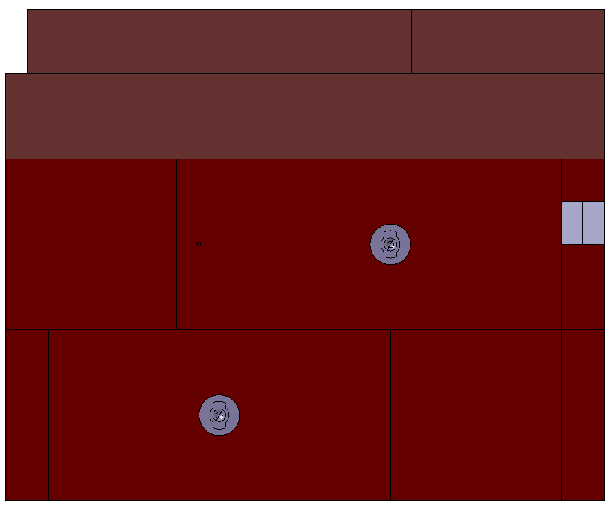
Internal Shielding New Dimensions
Front View
Right Side View
1600mm
Additional shielding block
200mm
2370mm
800mm
645mm
65mm
800mm
2800mm

Slide 7
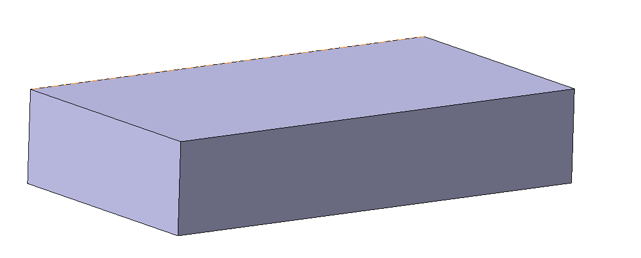
Upper Proximity Shielding Dimensions
3000mm
Total proximity shielding height:
2371mm
Increased from 600mm to 700mm
1600mm

Slide 8
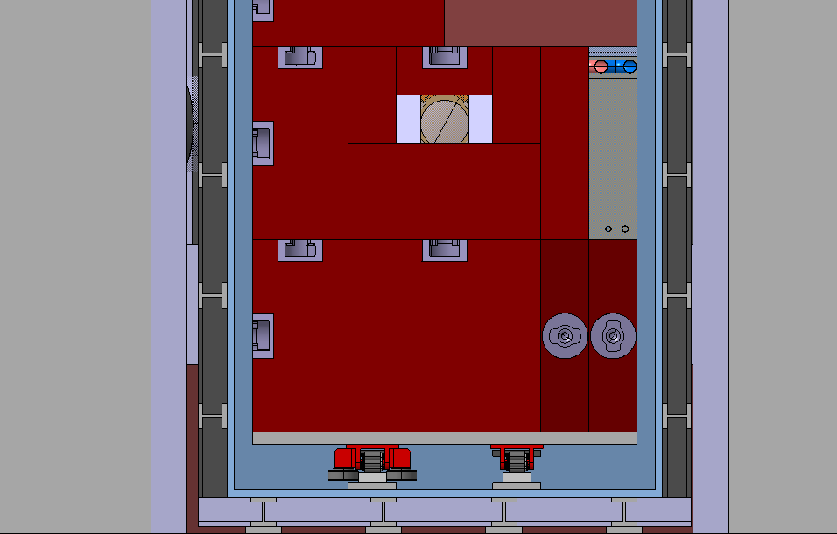
Shielding Under Trolley
Shielding sitting on the floor of the vacuum vessel
170mm
170mm
170mm
370mm
260mm
450mm
705mm
1750mm

Slide 9
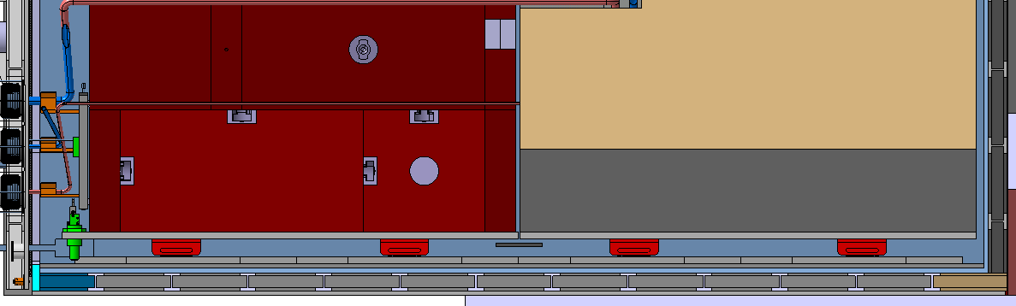
Shielding Under Trolley
All 3 Blocks the same length and positioned against the rear of the vacuum vessel
5840mm

Slide 10
Shielding Between Rollers
Height of each block: 90mm
Width of each block: 200mm
355mm
1150mm
1160mm
1150mm
570mm
Shielding on the vacuum vessel trolley
50mm
975mm
2475mm
3985mm
5485mm

Slide 11
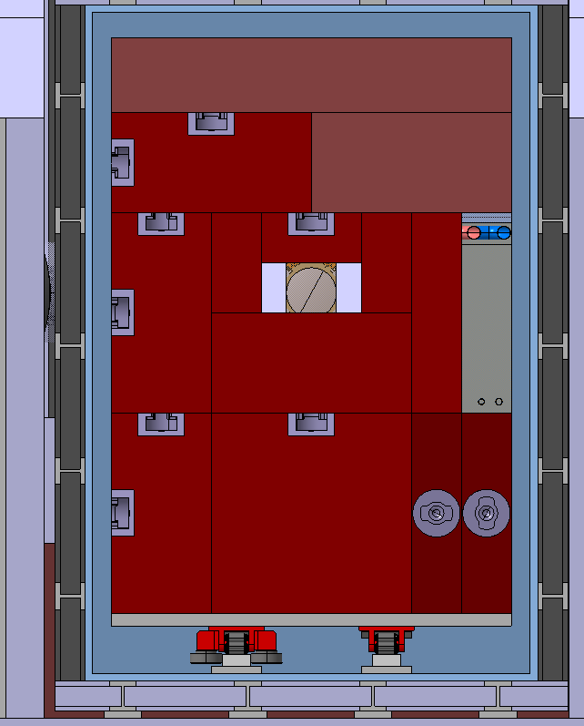
Shielding Between Rollers
90mm
475mm
200mm
200mm
475mm

Slide 12
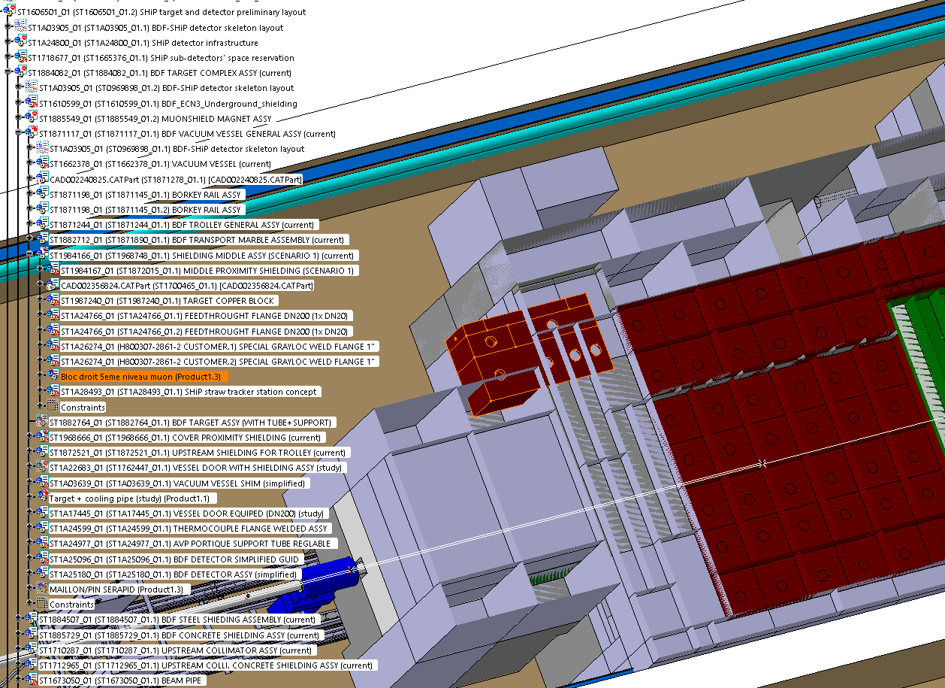
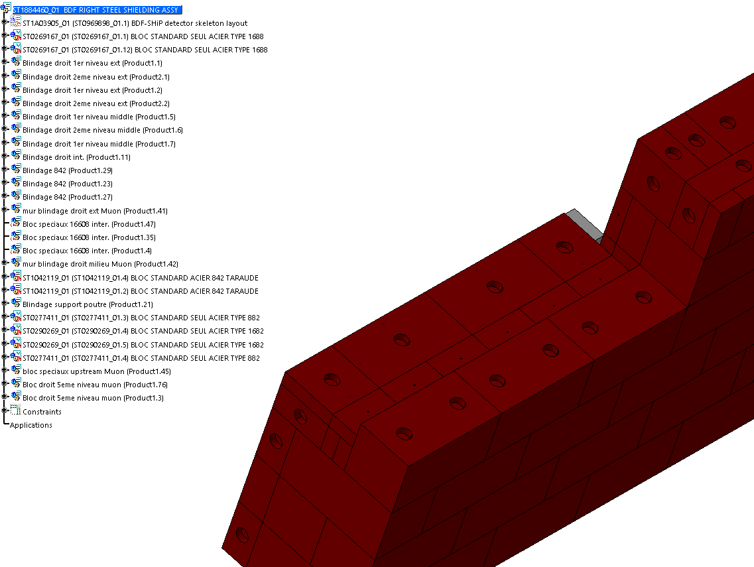
TCC8 ECN3 Integration Model

