Slide 1
Integration P42 line
BDF-SHiP
Target Integration #8
Beatriz Martinez Sutil (BE-EA-DC)
23/07/2025

Slide 2
INDEX
Overview of tasks
  Beam skeleton analysis
  P42 Layout implementation
  First Layout Integration
Beam Skeleton Study
  MADX files
  Skeletons overview
  Errors
  Conclusions
Layout
  P42 expected changes
  Changes overview
  Process

Slide 3
TASKS OVERVIEW

Slide 4
Tasks: P42 Layout
Last Week - 29/6/25 to 4/7/25: Study of the beam line skeletons provided
Checking the different version provided and its accuracy while implementing them in different C.S., or moving them with the macro in CATIA.
This week – 7/7/25 to 11/7/25: Implementing the Layout
The beam line skeletons have been inserted in each product (TT83+TDC8, TT85+TDC85, TCC8+ECN3)
Started with the zone TT85+TDC85. This time, I will insert the full beam line and no only the part that changes.

Slide 5
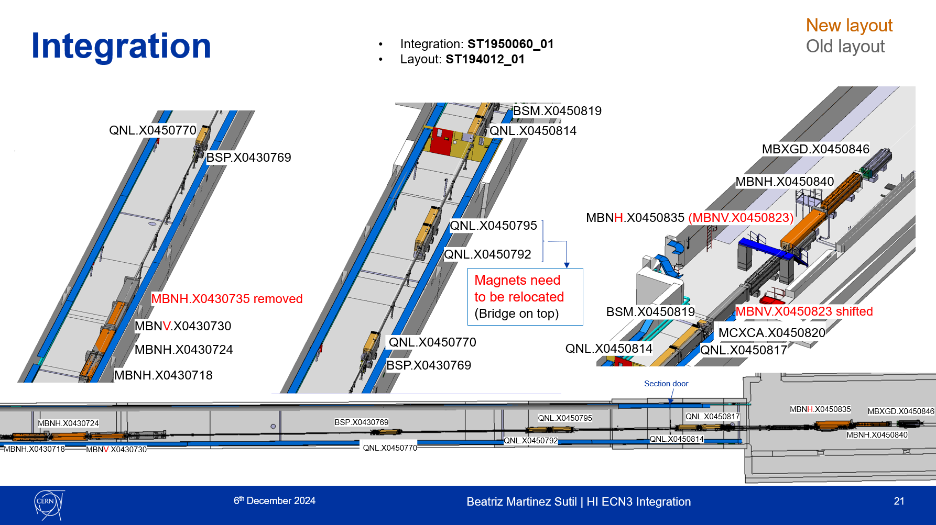
First Layout Integration

Slide 6
BEAM SKELETON

Slide 7
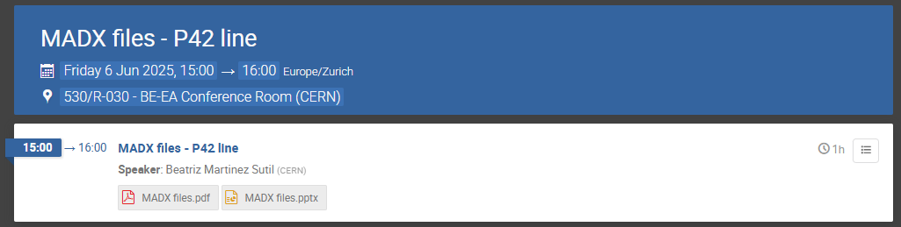
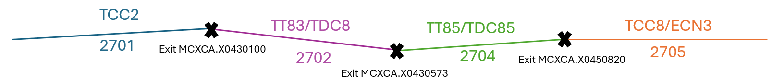
Beam Skeletons Study: MADX files
In this meeting it was agreed in several aspects about the P42 beam line:
https://indico.cern.ch/event/1556754/
The MADX files will be uploaded in the following folder created specifically for integration: https://gitlab.cern.ch/acc-models/acc-models-ea/-/tree/en-ea-le/P42/integration?ref_type=heads
2. The beam lines will be provided in each respective CAD coordinate system as follows:
Beam Skeleton implemented, divide in the 4 zones: https://gitlab.cern.ch/acc-models/acc-models-ea/-/blob/en-ea-le/P42/integration/p42-cern-coordinate-frame-survey-bdf-v6-catia.xlsx?ref_type=heads

Slide 8
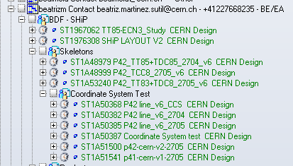
Beam Skeletons Study: Skeletons overview
Several problem were encountered in the implementation of the beam files:
List of the Skeletons studied:
V1: After checking with Fabian, it is the skeleton we think is currently applied (Nov. 2024)
V6: Last version (June 2024)
Current: Implemented with an extension until BDF start to compare the offset respect to the new beam line.
SHiP: straight line that joins MBXGD.X0450846 and ENDP42

Slide 9
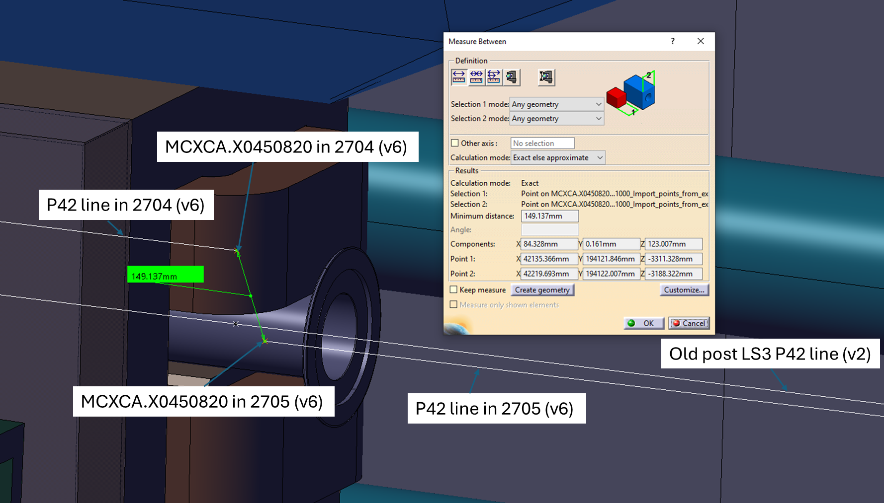
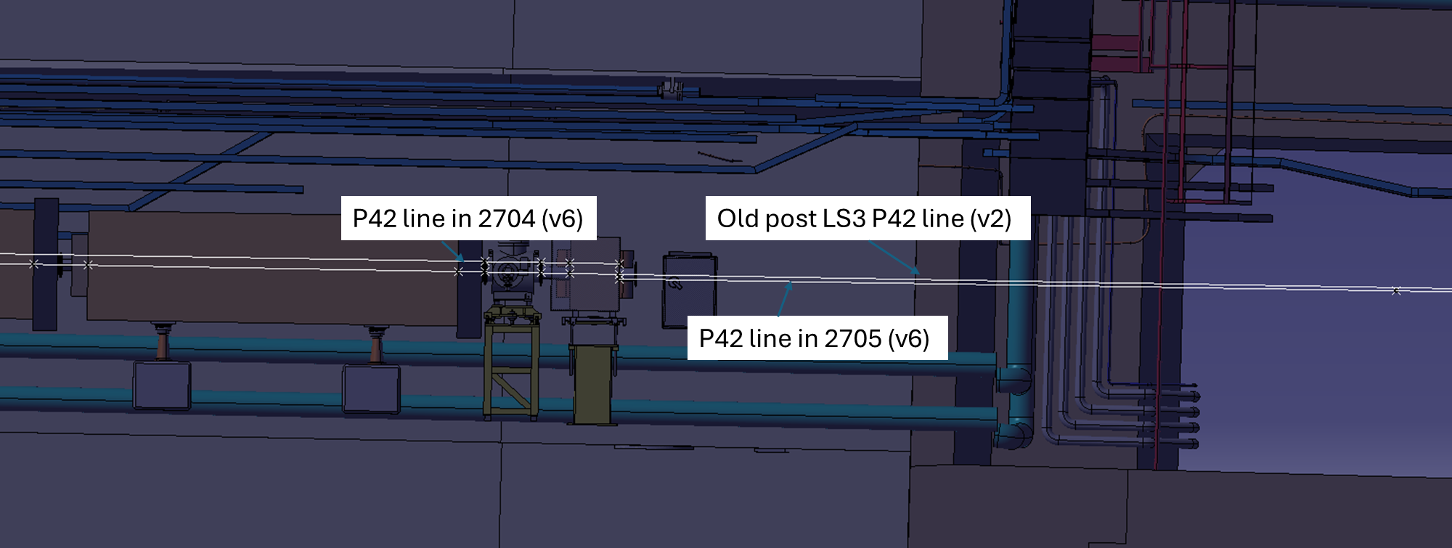
Beam Skeletons Study: Error 1
Several problem were encountered in the implementation of the beam files:
Offset during the superposition of TT85+TDC85 and TCC8+ECN3
Solved after making again the study.

Slide 10
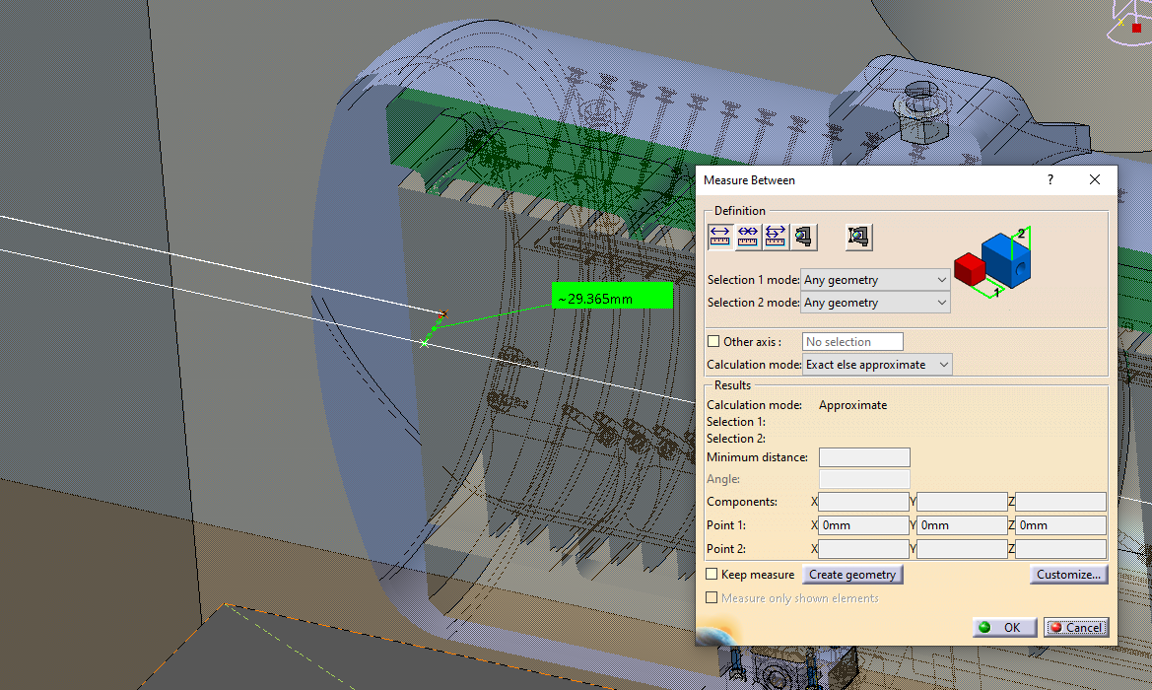
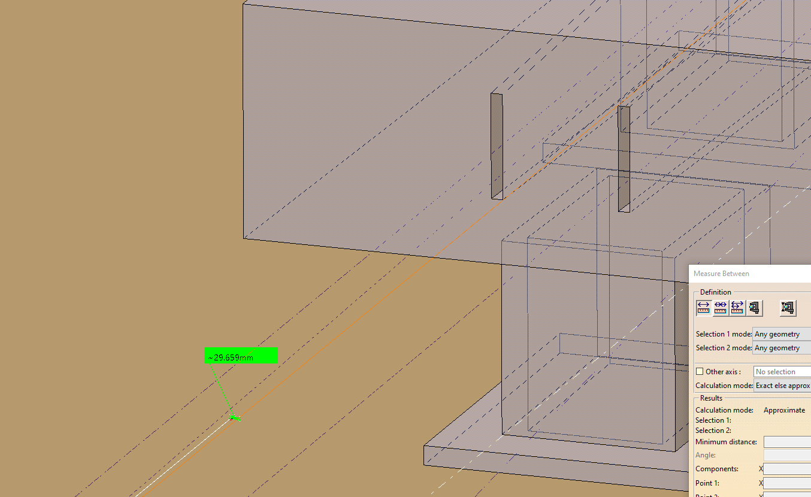
Beam Skeletons Study: Error 2
Offset between the beam line v1 and SHiP
- Problem: 3cm offset the v1 and the SHiP start.
- Cause: not founded. Possibly was because the problem with the TT85-ECN3 assembly model. Difficult to tell since the SHiP position was positioned with beam files in 2704, not in 205, and there is no record of all the beam lines applied.
- Solution: New way to implement the beam lines is more accurate, easy and allow its traceability.
Not solved yet. After the implementation of the Layout, a meeting will be held.

Slide 11
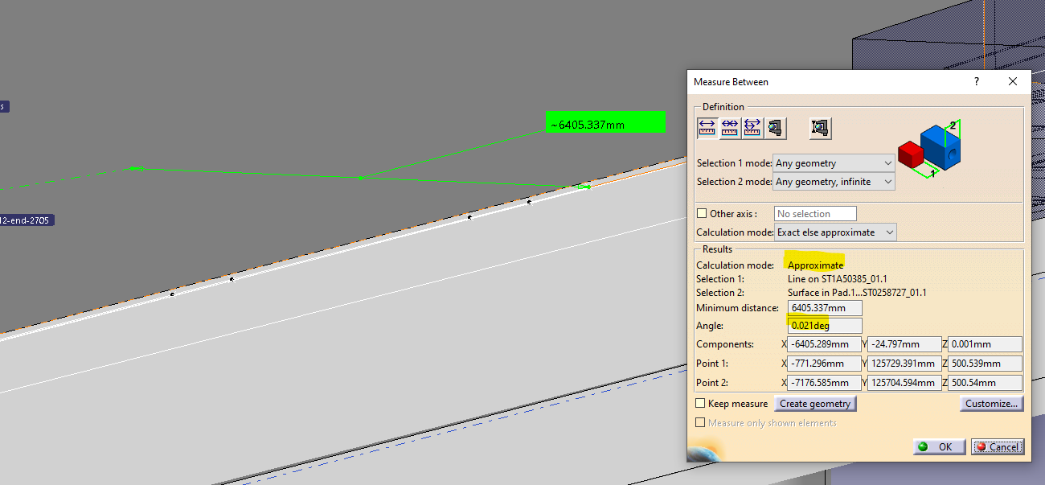
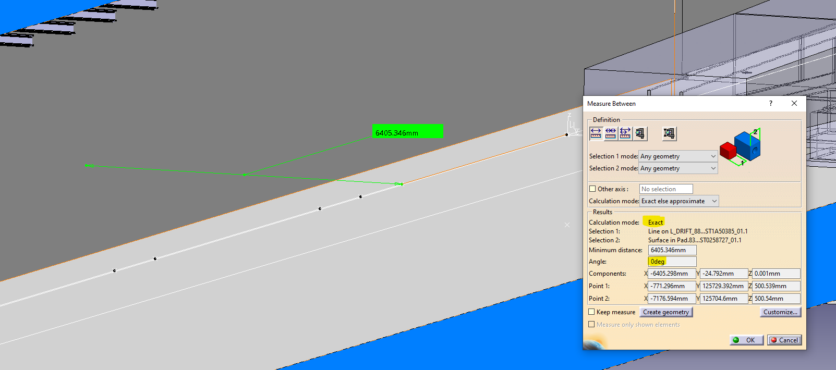
Beam Skeletons Study: Error 3
Angle between the last bend of P42 and the wall.
- Problem: Deviation of 0.021degrees respect to the wall.
- Cause: depends if CATIA measure in exact or approximate
- Solution: Check that while getting the measure, the measure is ‘exact’.
Problem solved after understand the mistake. Always be careful to check what is being measured

Slide 12
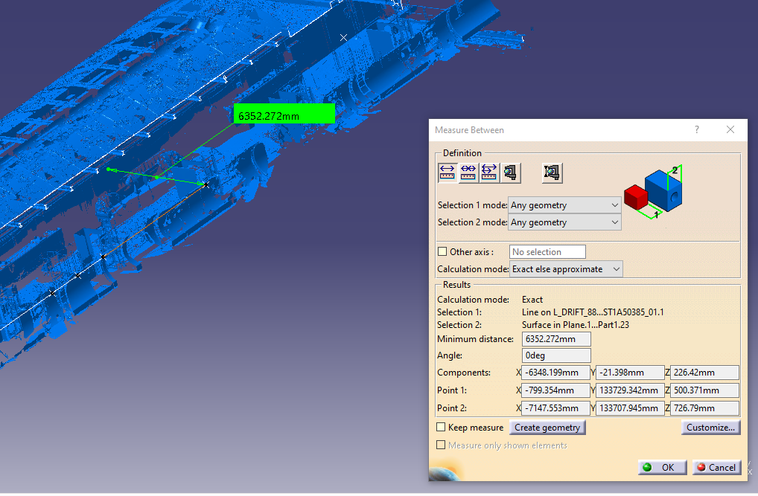
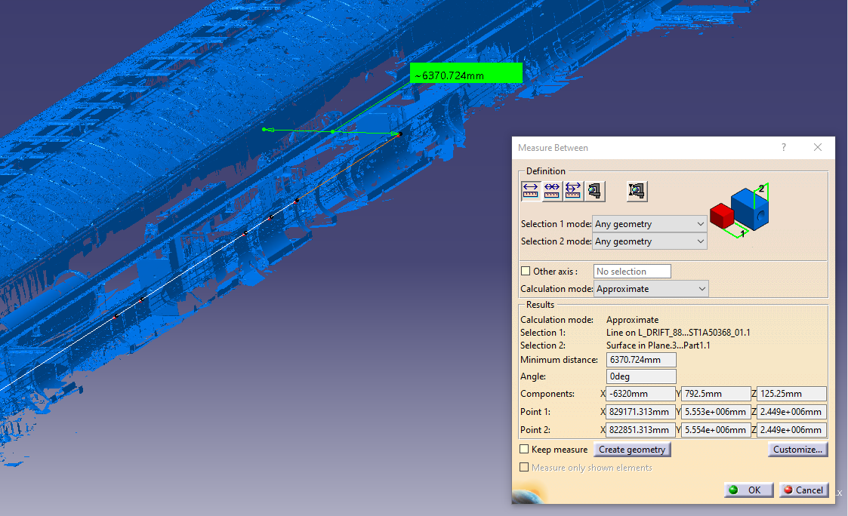
Beam Skeletons Study: Error 3
Angle between the last bend of P42 and the wall.
- As suggested by Camille, it has been checked with scans on the area
2705 C.S.
0 C.S.

Slide 13
Beam Skeletons Study: Conclusions
As suggested by Sylvain, is extremely important to apply the beam skeleton in its coordinate system.
After so many hours moving skeletons with the macro and applying the skeletons directly in its C.S., I have seen several precision errors.
This will also help to avoid error as the offset with the SHiP Layout (error 2).
After checking with Fabian and Camille, they have agreed on starting with the implementation of the P42 beam Layout.

Slide 14
P42 LAYOUT

Slide 15
P42 Layout expected changes
From the old table provided by Dipanwita, the expected changes were from MBNH.X0430718
However, there are some quadropoles and correctors removed before, but this doesn´t impact the geometry.
Some of the changes are:
  QNL.X0430714 is gone for now.
  QNL.X0430710 moved downstream by 35m.
  All the collimators are removed from the line
  QNL.X0450817 is removed for now
  QNL.X0450792 and QNL.X0450795 gone for now
  QNL.X0450814 moved downstream by 14m
All the quadrupoles will likely change position when we update the optics
  Need to make the beam as ship wants it. And for this, the quadrupoles are probably not placed optimally
Source: Mattermost chat with Fabian

Slide 16
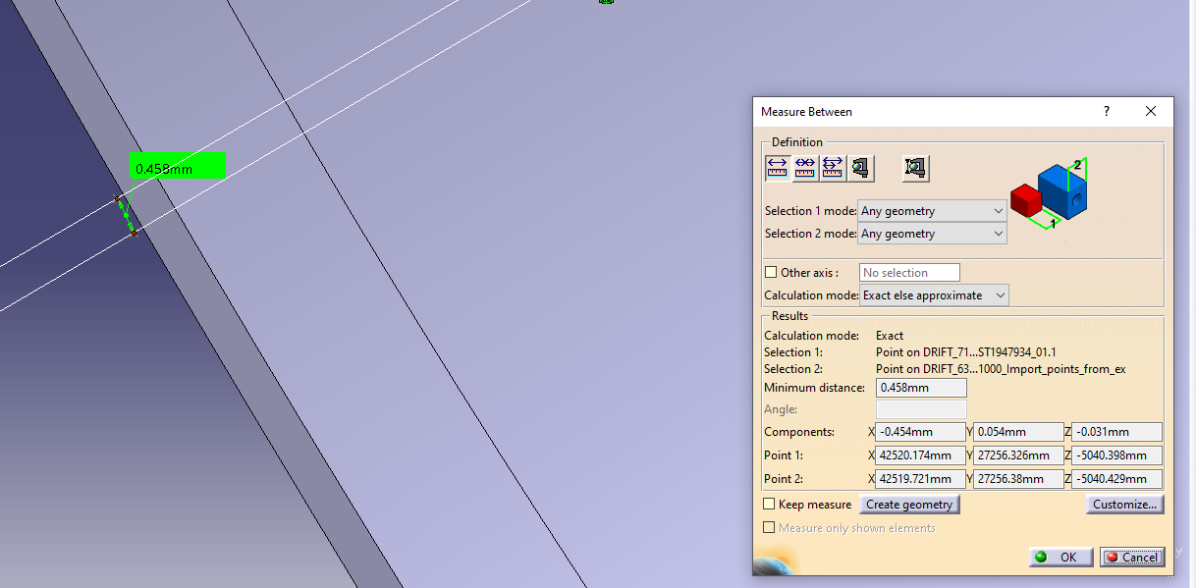
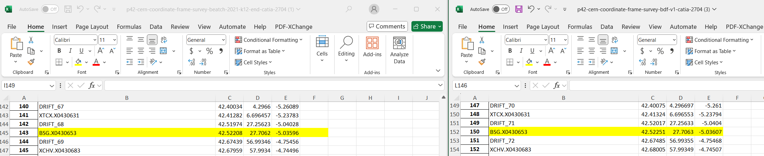
P42 Layout: Changes overview – TT85
In this overview I have included the changes I find while implementing the new beam line
Offset found in the beginning of TT85

Slide 17
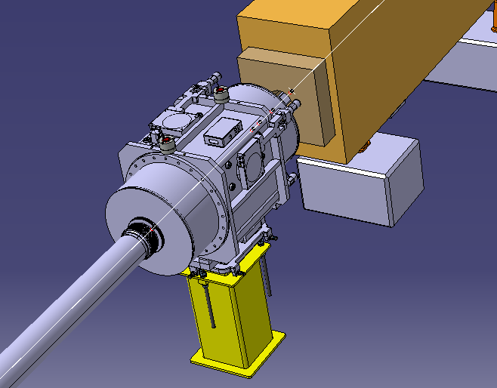

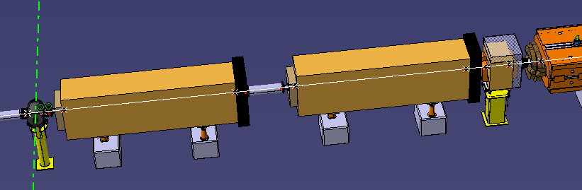
P42 Layout: Changes overview – TT85
XCHV removed respect to v1 and current (also in beginning of TT85)
714
715
710
708
QNL 710 and QNL 714 have been removed

Slide 18
P42 Layout: Changes overview – TT85
XCHV removed respect to v1 and current (also in beginning of TT85)
714
715
710
708
QNL 714 have been removed
QNL710 has been moved 35m

Slide 19
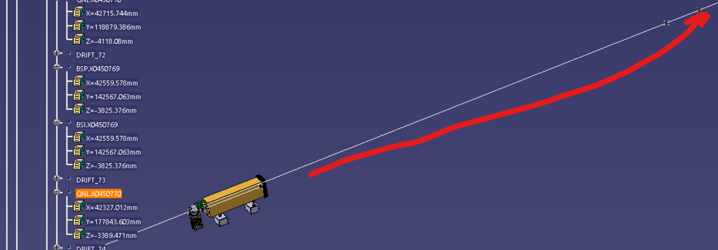

P42 Layout: Changes overview – TT85
QNL770 has been moved around 32m downstream

Slide 20
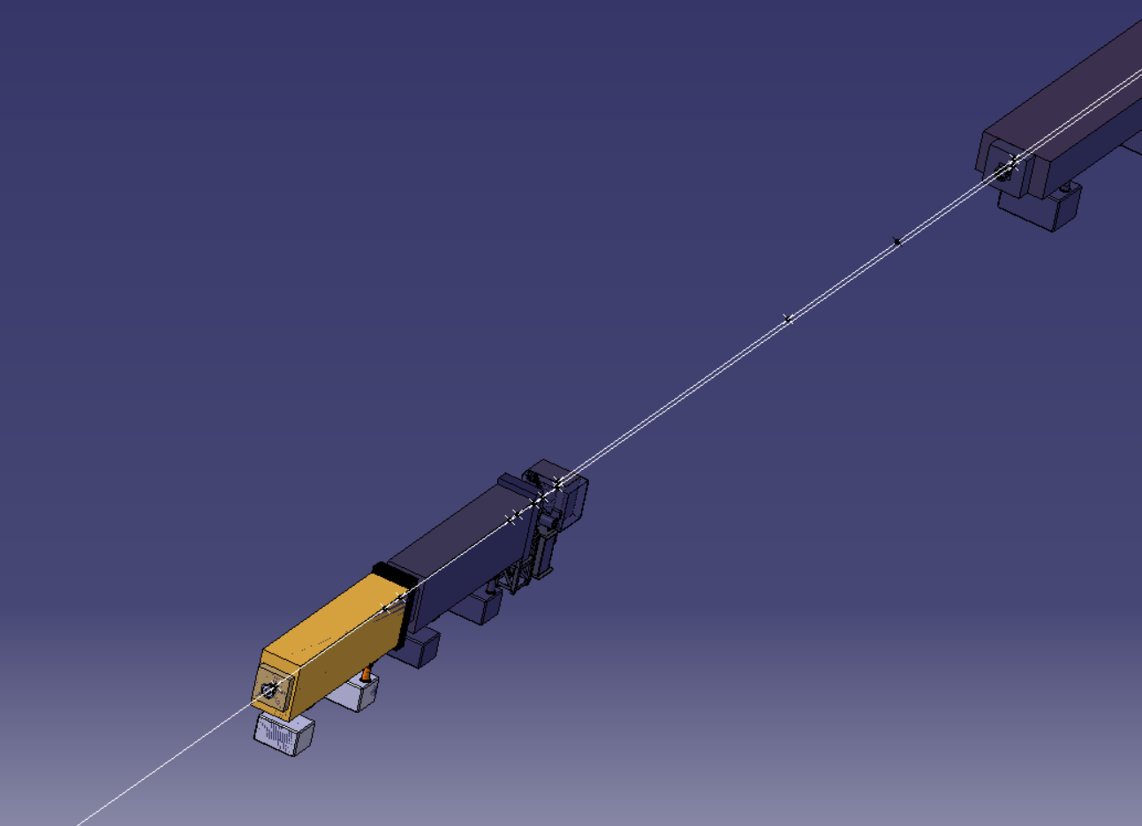
P42 Layout: Changes overview
QNL 814 moved downstream by 14m respect to the v1

Slide 21
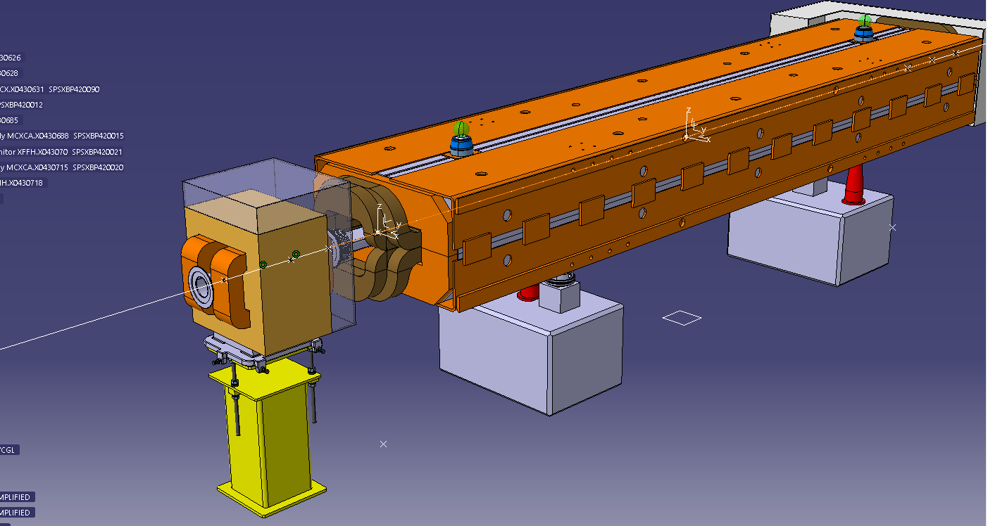
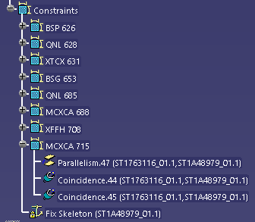
Last time the Layout was implemented in preliminary (with Snap tool + Fix)
Now I will implement the full beam line (no only from 718) and with the constraints
It will take longer but will be more robust solution.
P42 Layout: Process

Slide 22
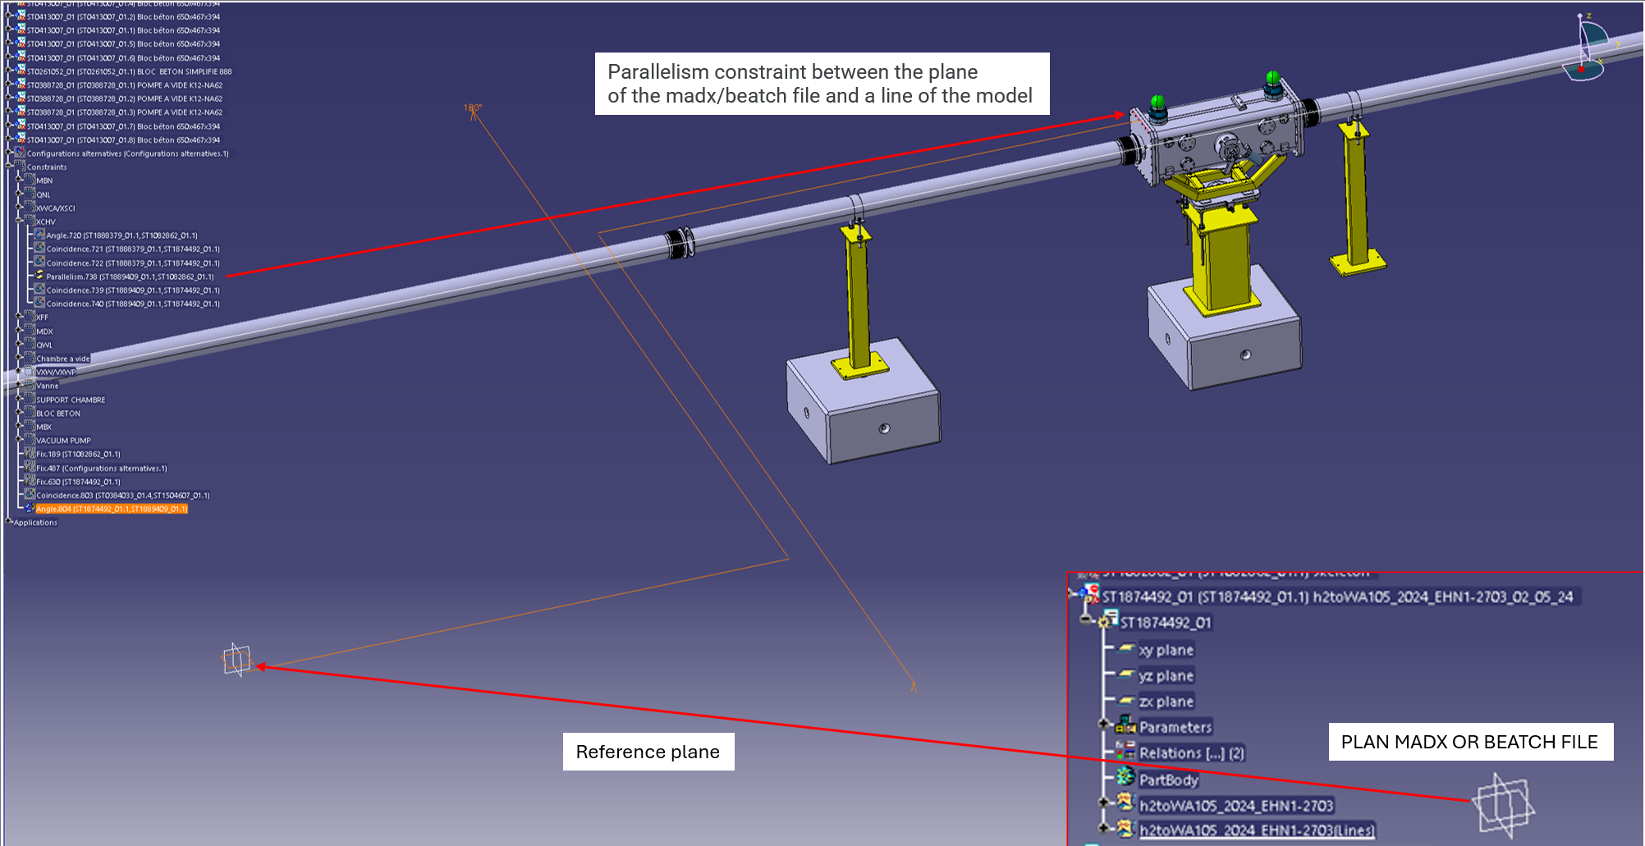
P42 Layout: Process
Contraints applied:
Coincident in the exit point (MADX files and element skeleton)
Coincident in the beam line (MADX files and element skeleton)
Parallelism between the XY plane of the MADX and one of te lines of the element (as shown in the photo of the right)

Slide 23
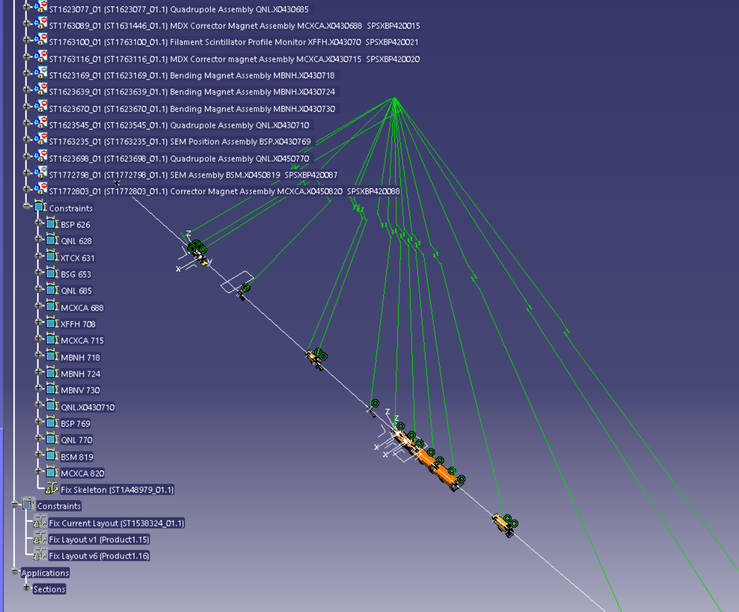
P42 Layout: Process
TT85 and TDC85 beam line after being fully constrained

Slide 24
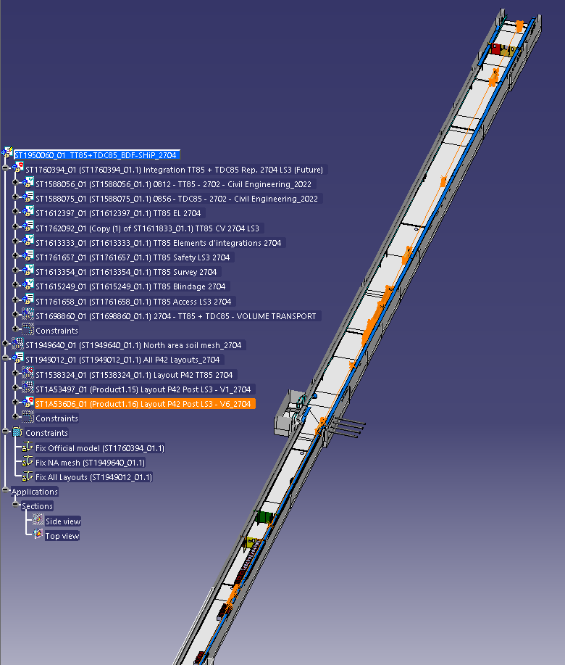
P42 Layout: Results
Implemented the new Layout with constraints as shown before
Change of the tree distribution

