Slide 1
Status of the LHC
Cédric Hernalsteens
on behalf of the LHC operation team
163rd LHCC OPEN Session
September 1st, 2025

Slide 2
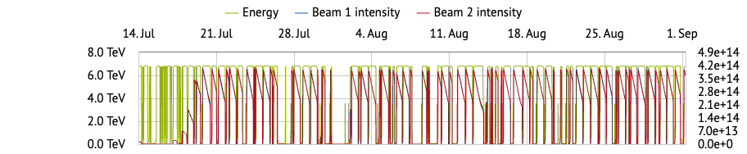
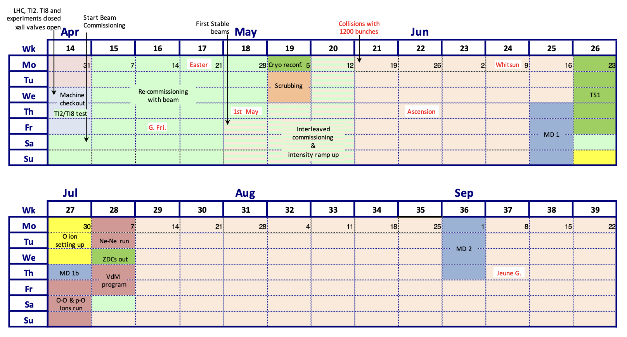
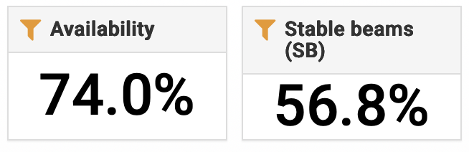

Slide 3
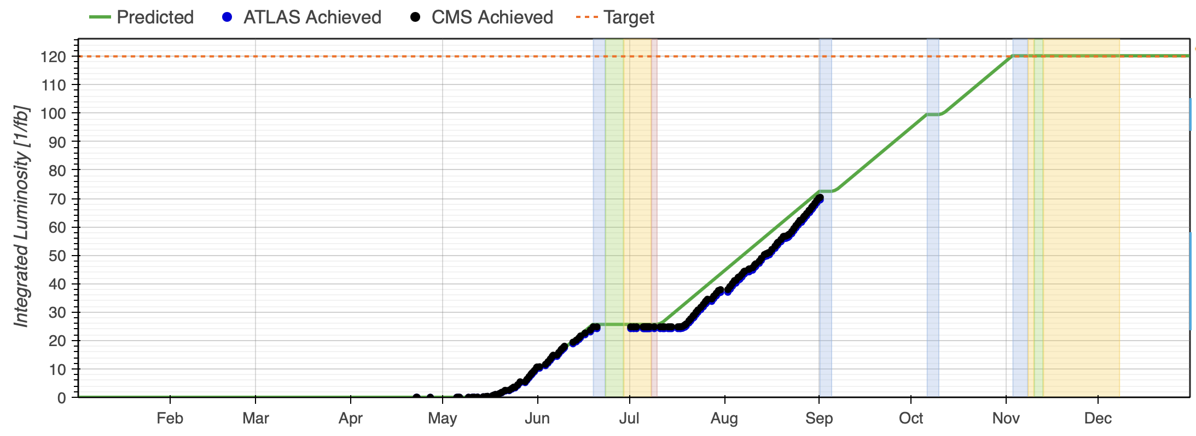
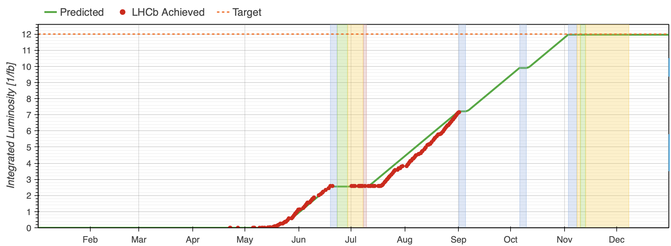
120 fb⁻¹
ATLAS
CMS
~ 70 fb⁻¹
12 fb⁻¹
LHCb
7.2 fb⁻¹

Slide 4
Outline
Proton run
  Luminosity production
  Machine performance
  Challenges and issues
Light ion run: p-O, O-O and Ne-Ne
Conclusion and outlook for the rest of the year

Slide 5
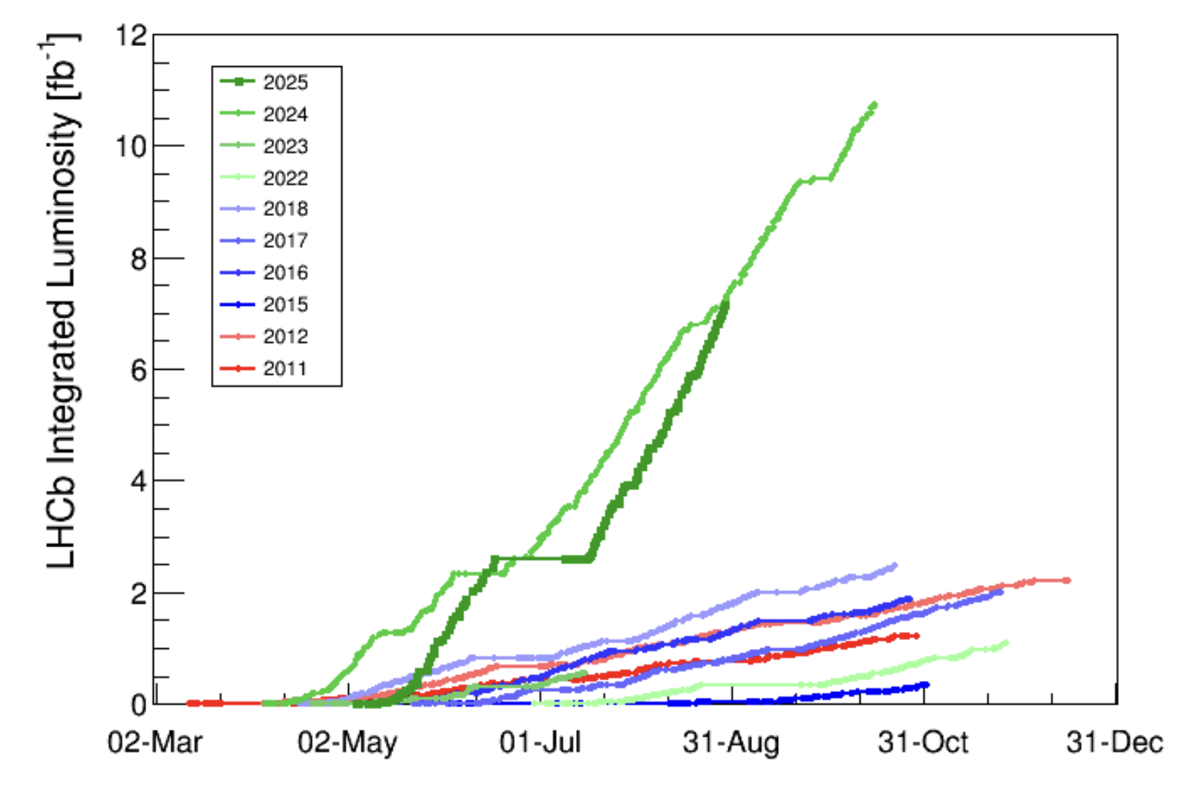
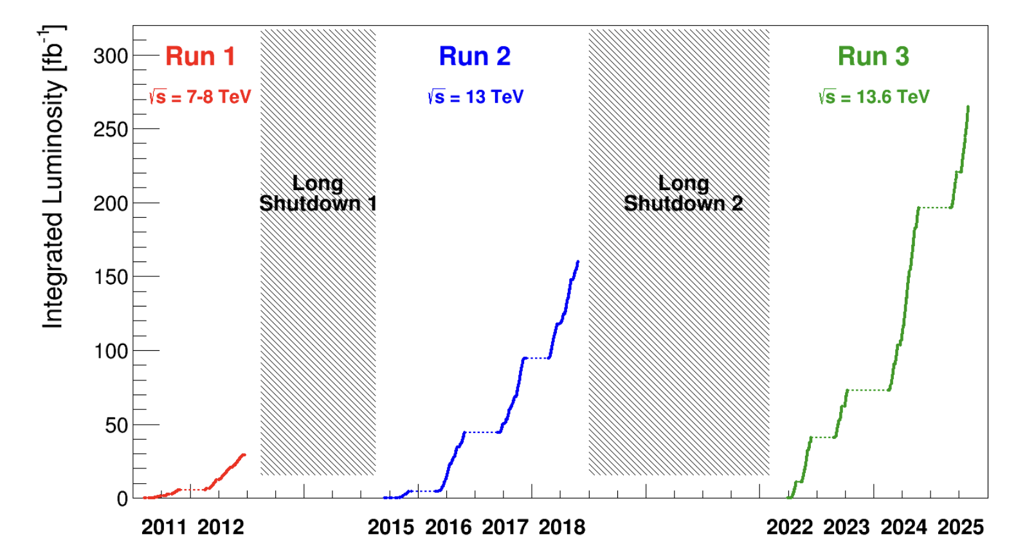
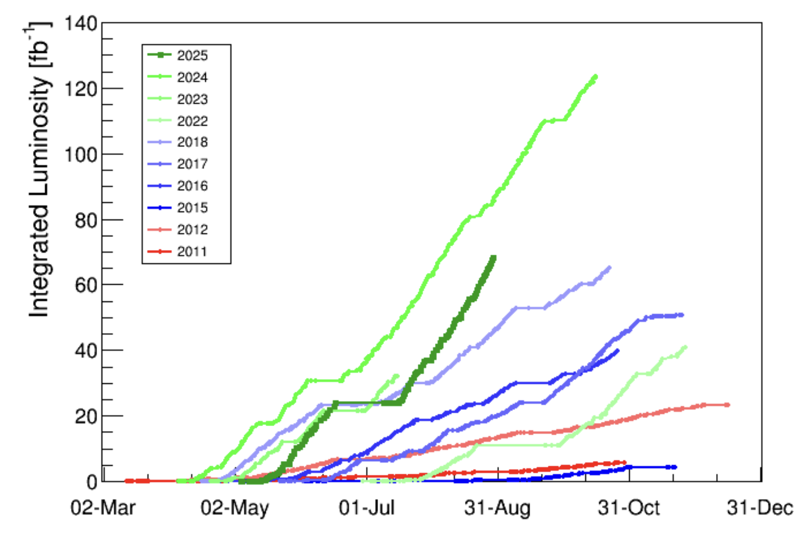
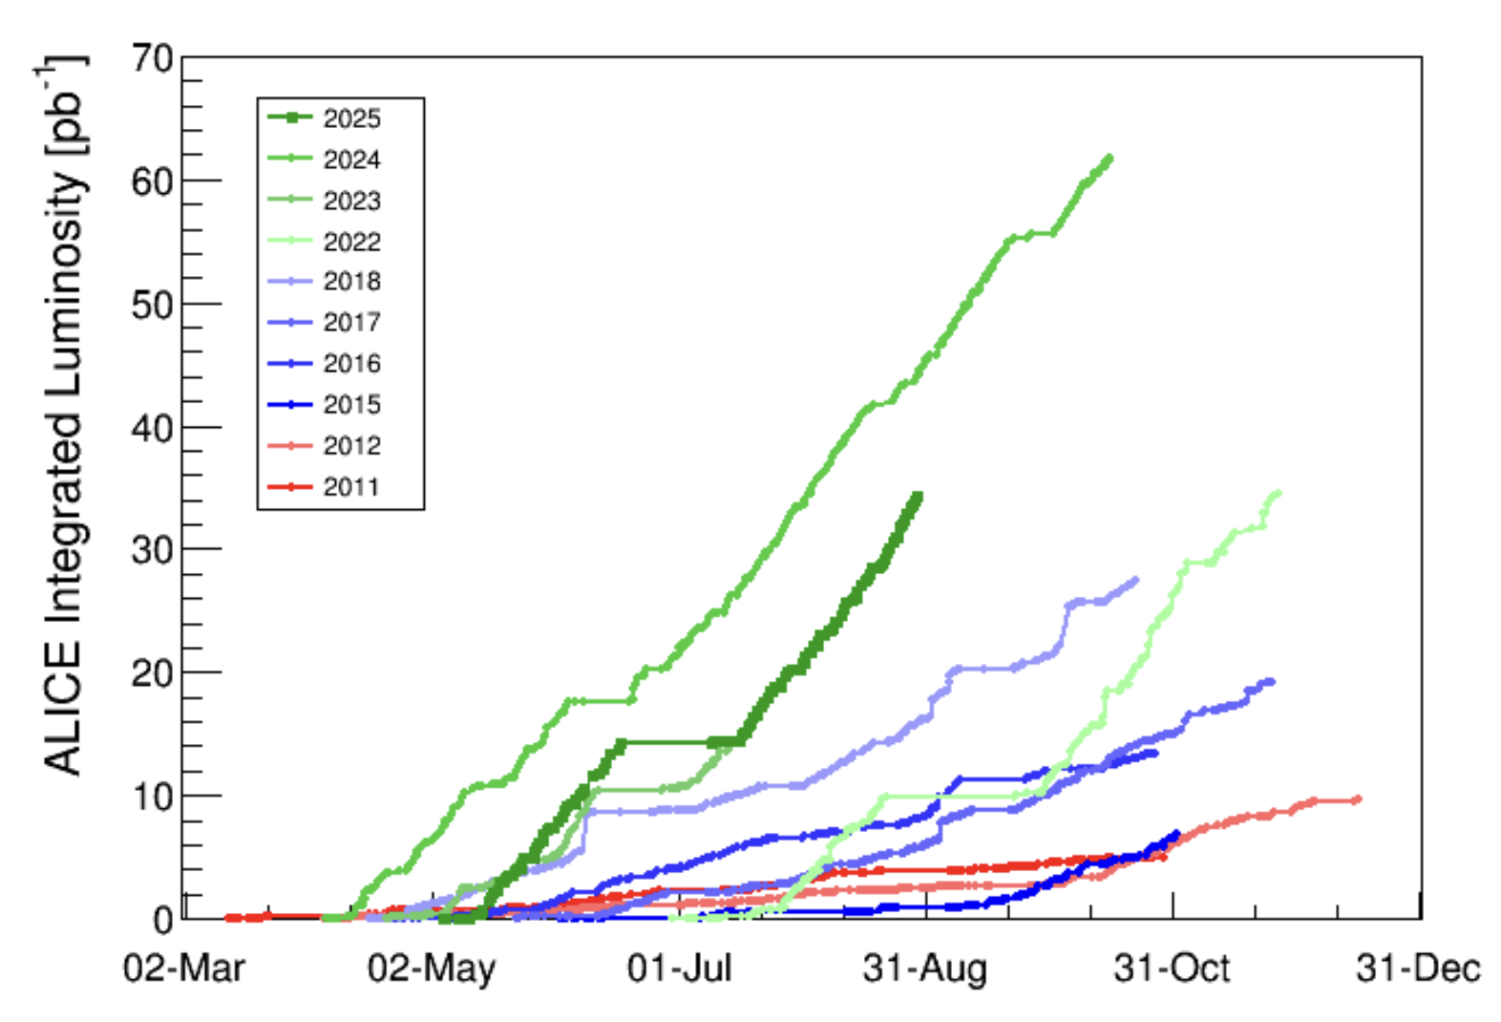
2025 so far…
LHCb
2024
~70 fb⁻¹ in ATLAS/CMS
7.2 fb⁻¹ in LHCb
~35 pb⁻¹ in ALICE
Full steam production on-going!
2025
ATLAS/CMS
2024
ALICE
2024
Record 24h rate = 1.7 fb⁻¹/24h
(midnight to midnight on August 30)
Record 7-day rate = 9.1 fb⁻¹ / 7d
(August 24 to 30)
2025
2025

Slide 6
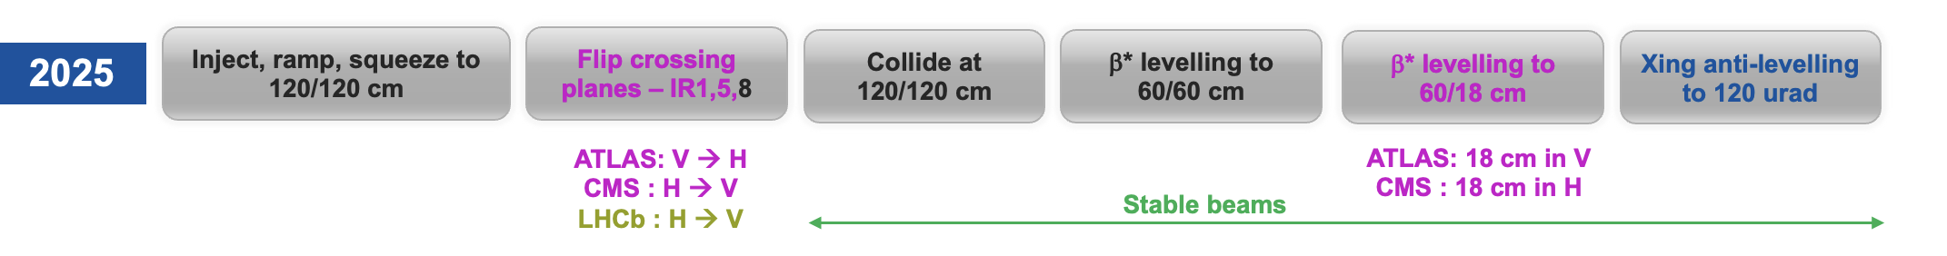
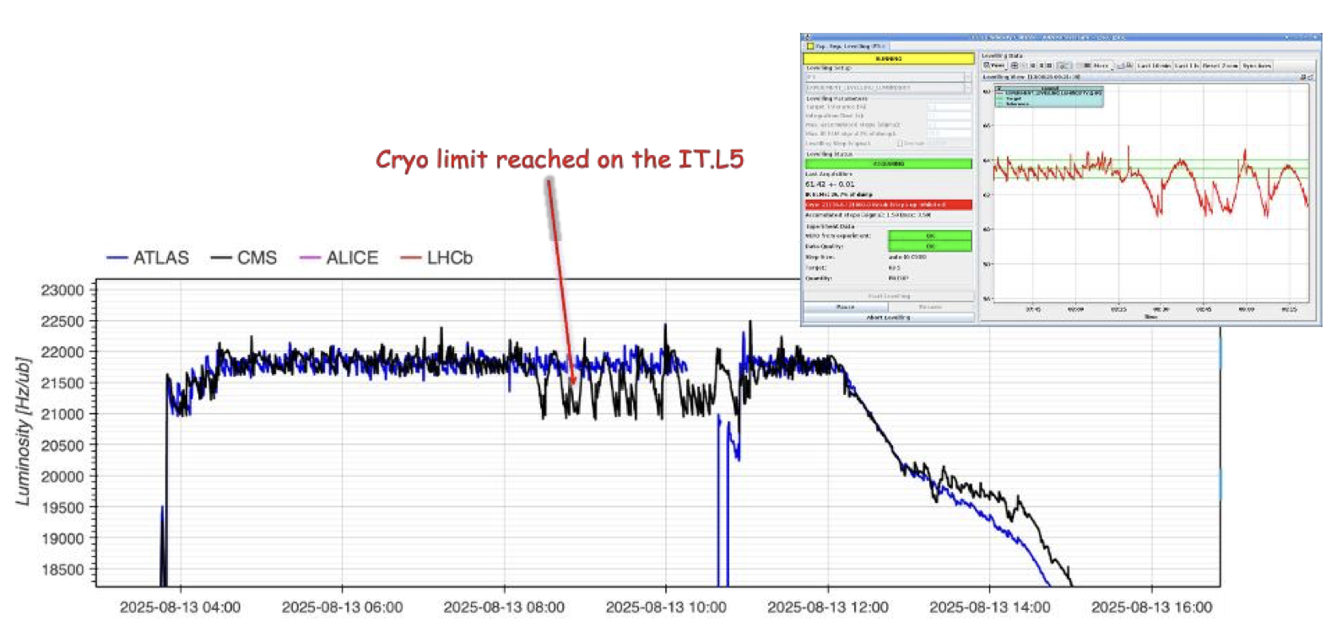
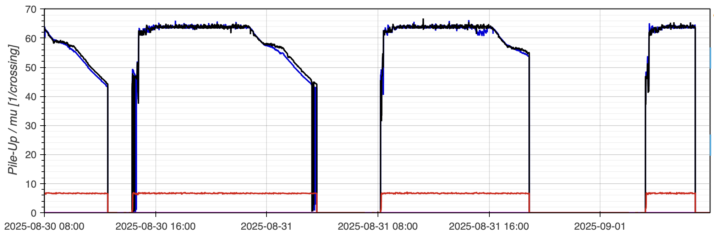
Levelling in physics
Combined (β* + separation) levelling allows for
  7 to 8 hours in levelling with high-brightness beams
  Additional crossing-angle levelling to slow-down the
  luminosity decay when reaching end of separation
  levelling (from 160 to 120 µrad)
Separation levelling tolerance reduced to 0.8 %
for ATLAS/CMS and to 2.5 % for LHCb
LHCb levelled through the entire fill (up to ~ 14h)
Target pile-up increased to 64 mid-August, allowed by good cryogenics performance and margin after fine tuning in ITL5
β* = 73 cm
β* = 60/18 cm
(flat beams)
β* = 120 cm
Crossing
angle
reduction

Slide 7
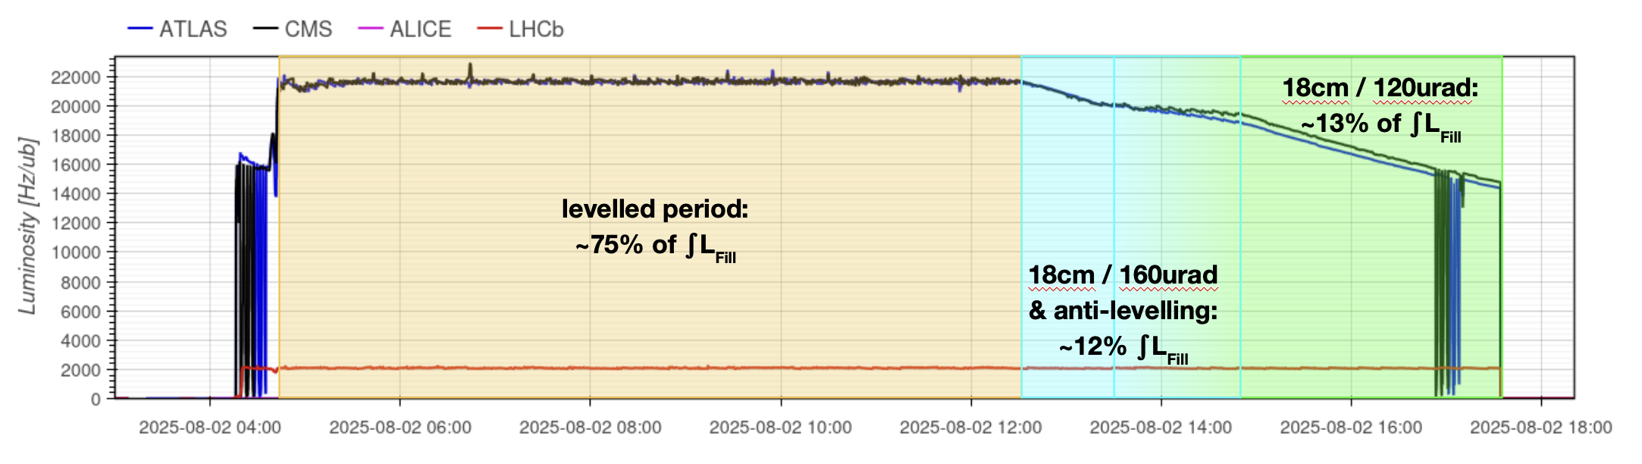
Luminosity imbalance between ATLAS and CMS
Systematic ATLAS/CMS luminosity imbalance observed during luminosity decay: a consistent 3% imbalance starts during crossing-angle levelling
Impact on integrated luminosity is small as it only affects the out-of-levelling period (estimated impact of lower than 1 % on the integrated luminosity)
Multi-ingredient effect, on-going investigations:
  Emittances asymetry too small to explain the 3% effect
  Beam-beam effect has a small contribution but can only explain 50% of the observed effect
  Luminometer non-linearity dependence on crossing angle has been excluded
  Latest tests of longitudinal beam spot displacement at 160 µrad revealed that waist shift is not main culprit to explain the imbalance evolution with crossing angle

Slide 8
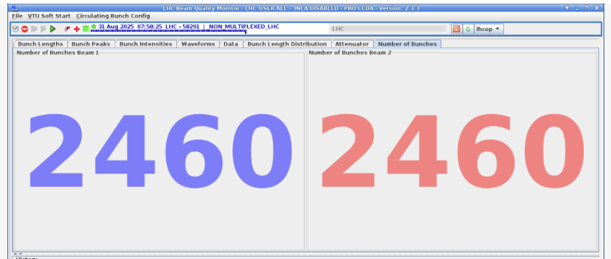
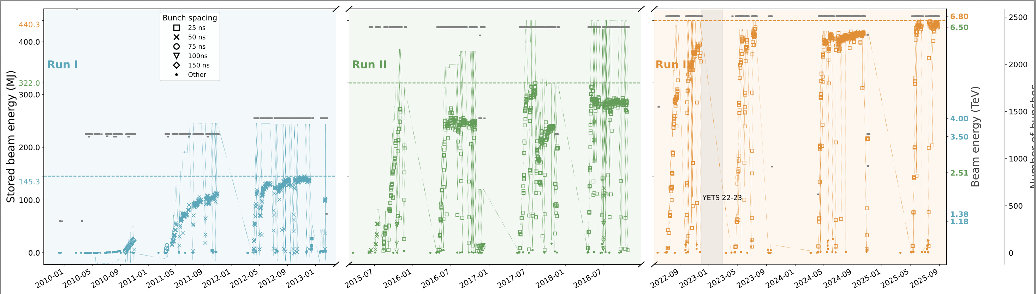
Performance - Beams brightness
Record stored beam energy reached this year, at 440 MJ per beam (average) at start of stable beams, corresponding to ~4 x 10¹⁴ protons
2025 filling scheme features 2460 bunches over
20 injections

Slide 9
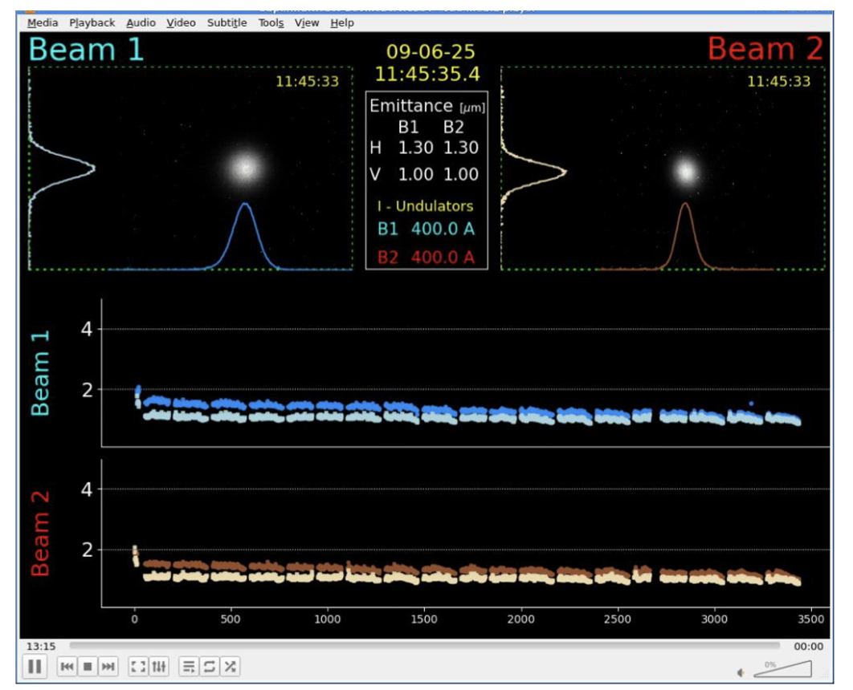
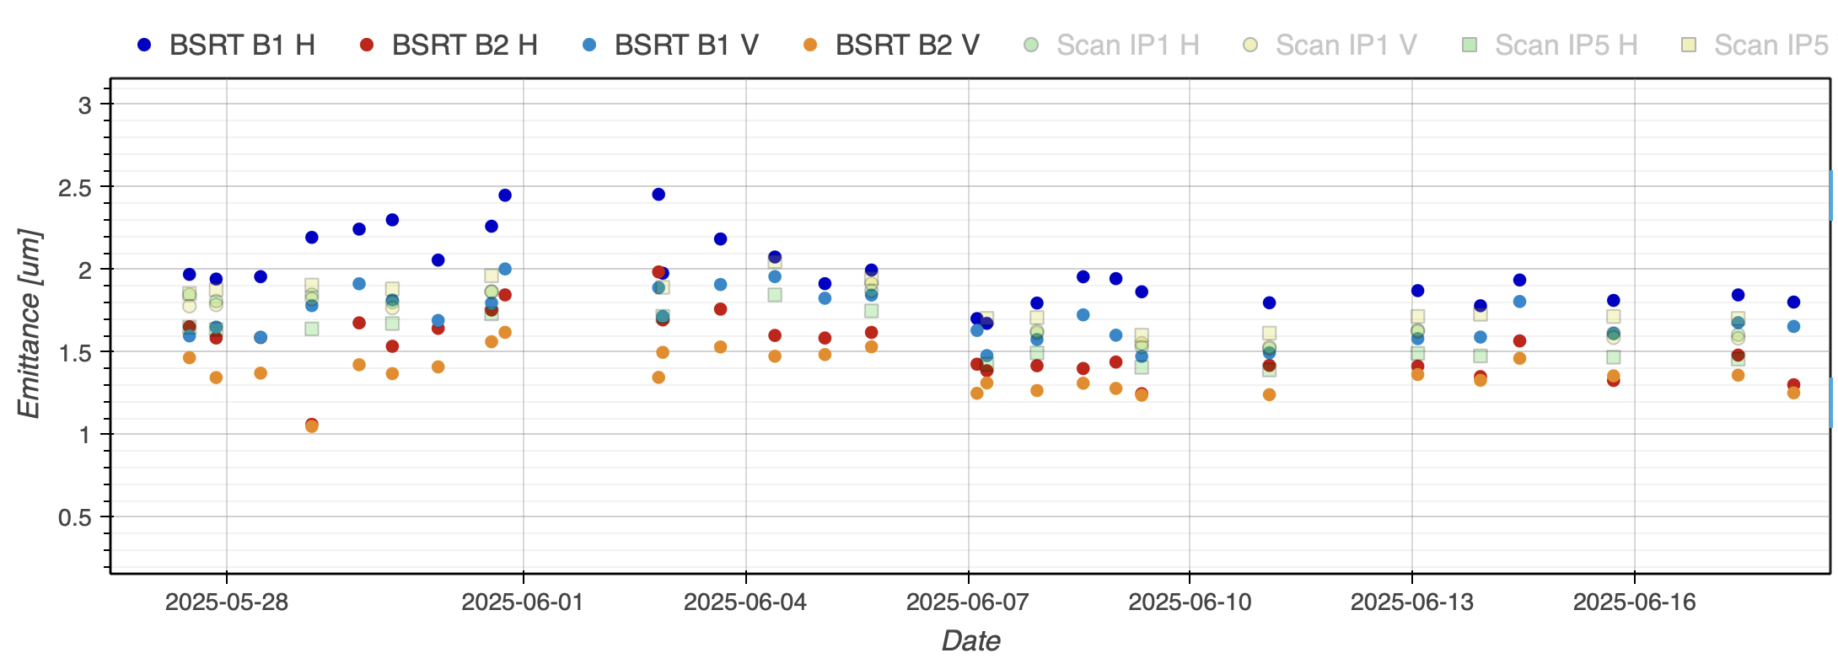
Performance - Beams brightness
Lower emittances, hence smaller beam sizes and longer levelling time, delivered by the injectors chain following an adjustment of the SPS tunes
Emittances at injection at 1.3 µm (H) / 1.0 µm (V) with the gains preserved up to flat-top and start of stable beams

Slide 10
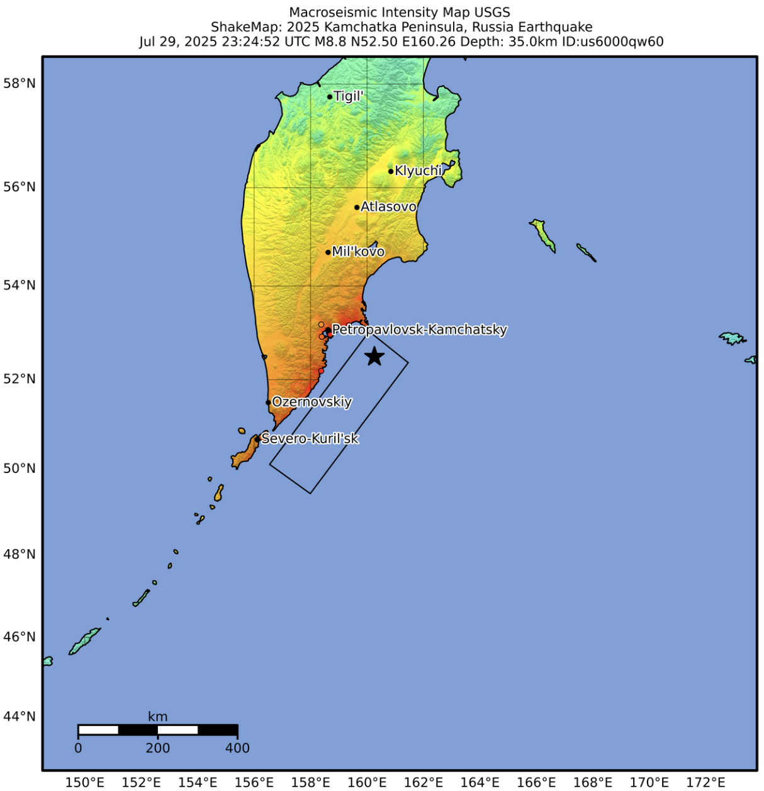
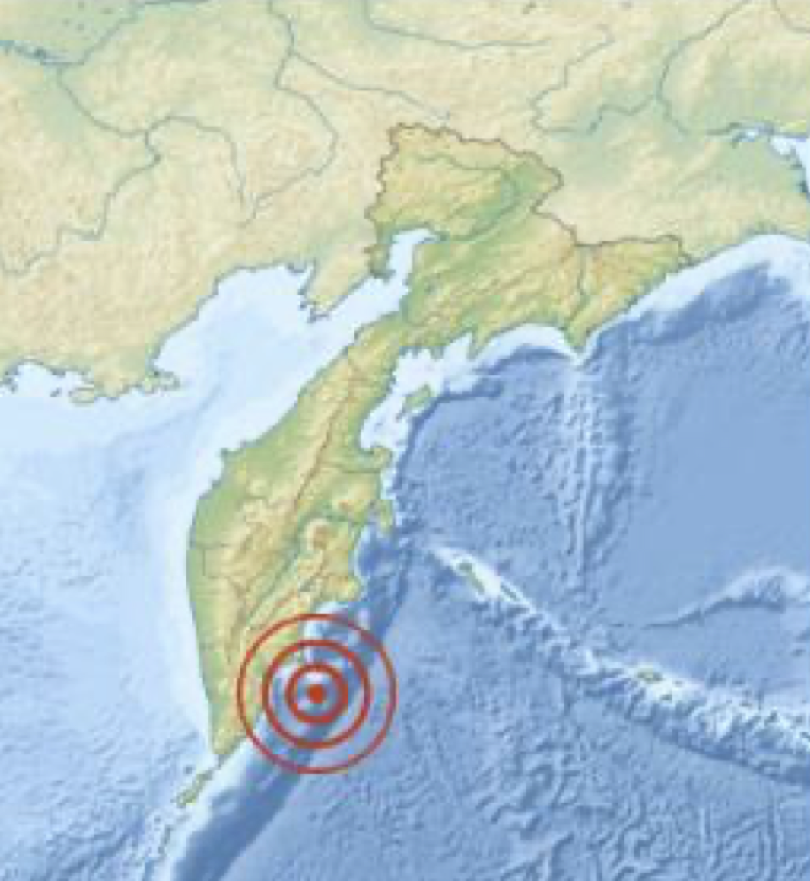
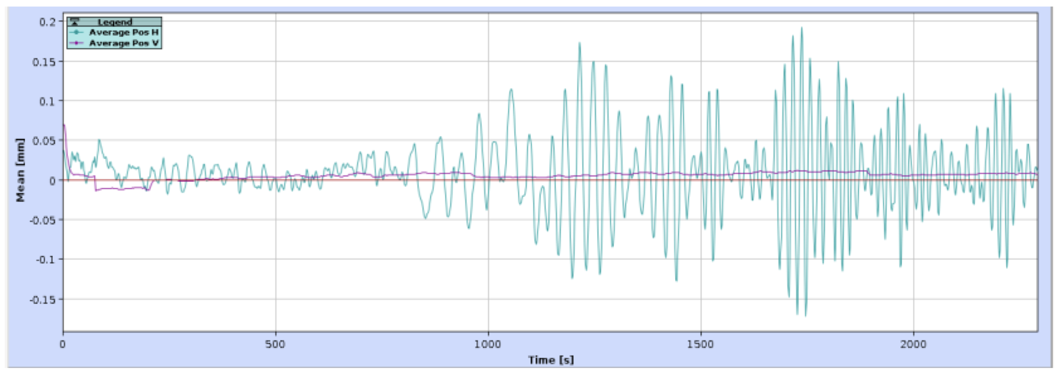
Interesting observation - Earthquake in fill #10888
On July 29, a magnitude 8.8 earthquake, the largest one worlwide since 2011, occurred in the Kamchatka Peninsula
Earthquake-related effects commonly observed in the LHC
Kamchatka Peninsula
Large orbit oscillations up to 250 um (rms) were observed in the LHC for approximately 25 minutes, and milder effects continued during ~4 hours

Slide 11
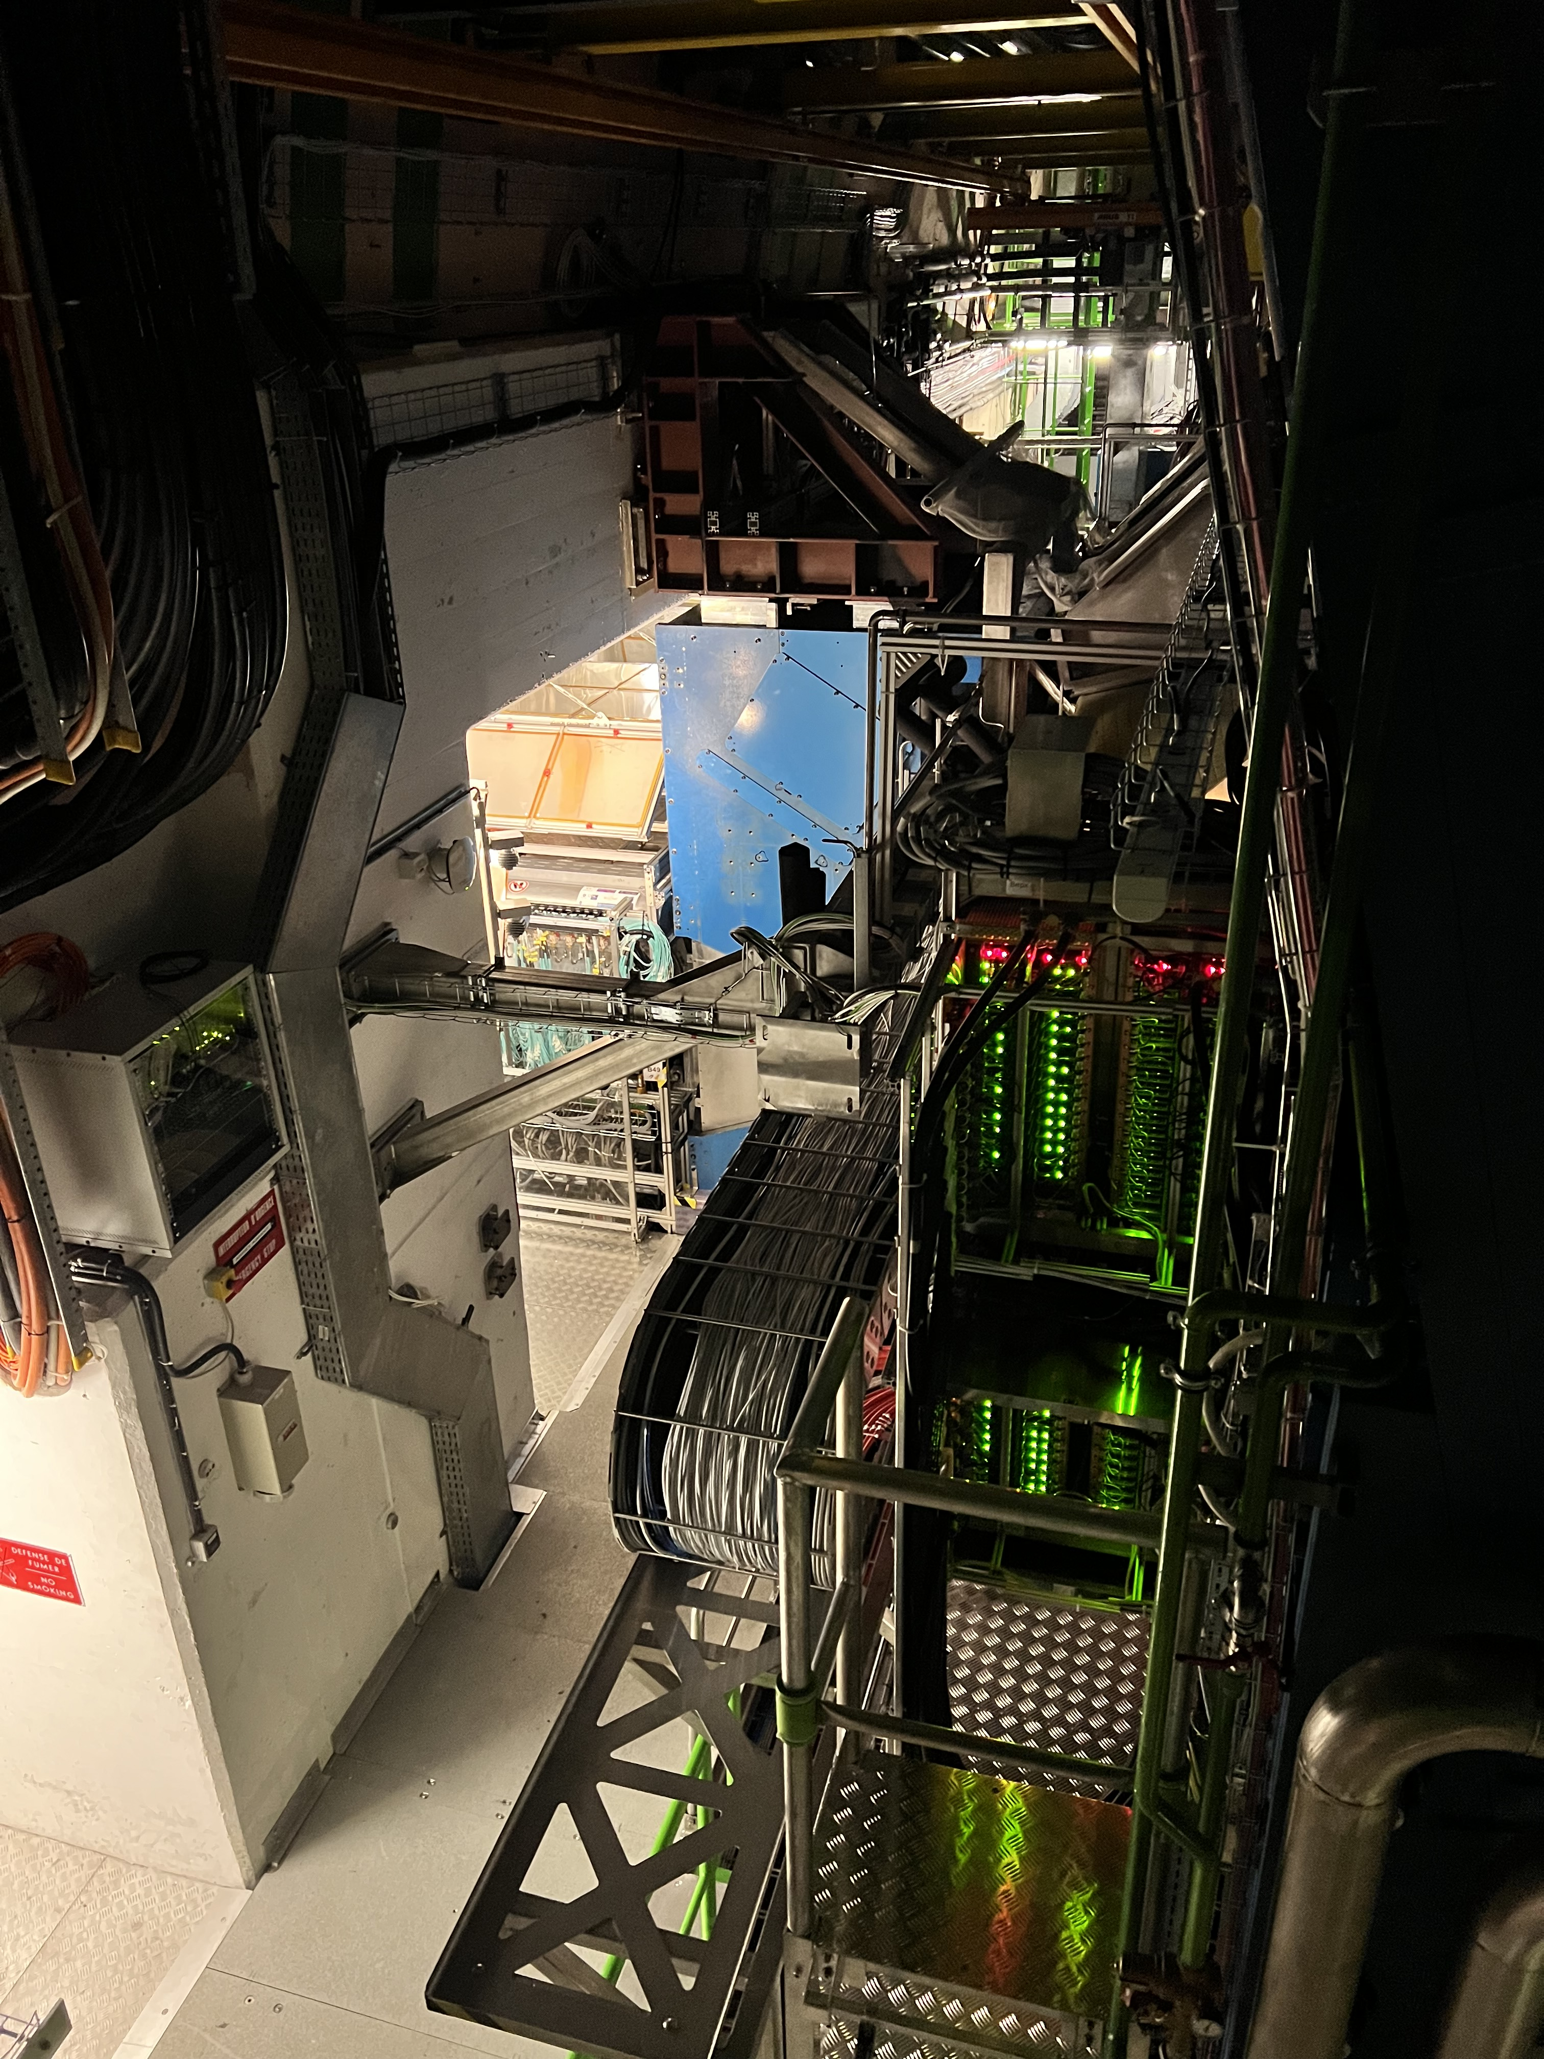
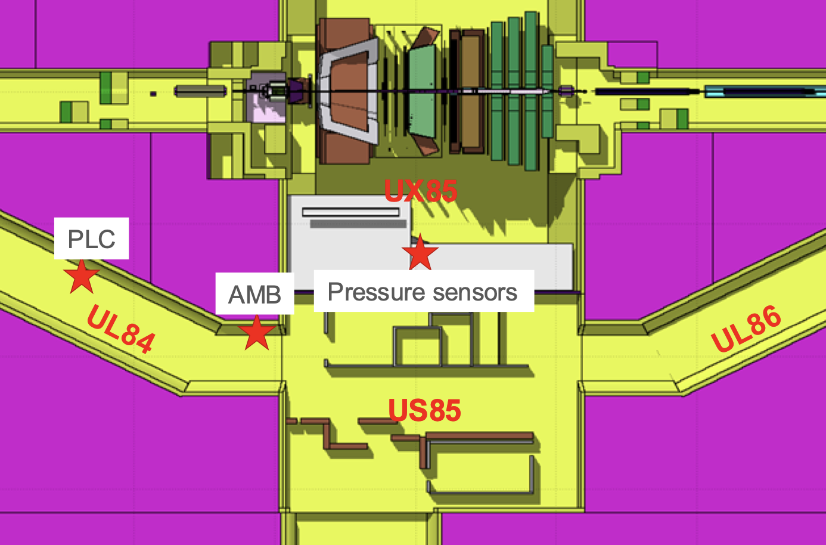
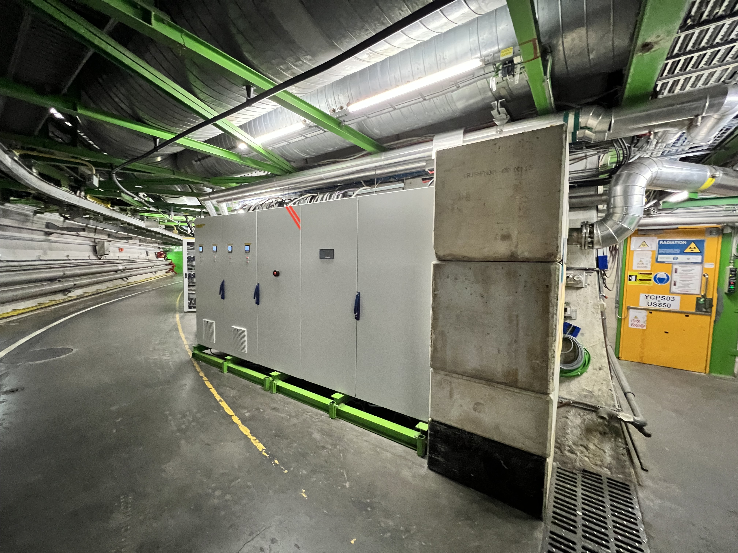
Challenges with cryogenics
LHCb VeLo seen from the UX85 cryogenics platform
Cryogenics faults in point 8 impacted availability in June, one event re-occurred in August
  Radiation-induced effects, faults are stochastic and proportional to integrated luminosity
  Some (but not all) pressure sensor faults are now mitigated by software fixes (which saved the day a couple of times already!)
  P8 is the only point where cryogenics equipment are located in the experimental cavern
Concrete shielding now replaced by steel shielding

Slide 12
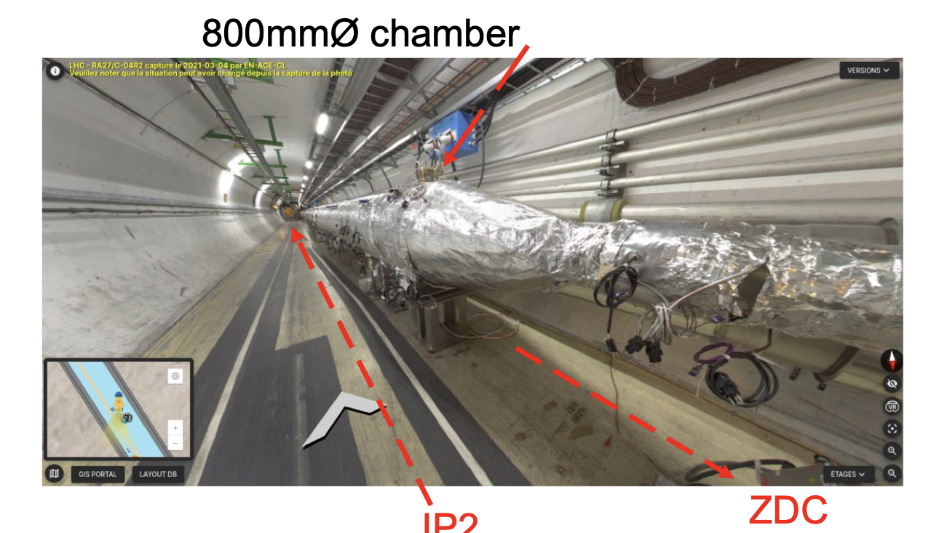
Vacuum spikes near IP2 and background to ALICE
Vacuum spikes were observed in some fills (4-8 August) in the wide common chamber around ALICE, shortly after start of stable beams
Increase of background and trip of ALICE detectors
Mitigation: reduced voltage on the ion pumps in 4L2 and 4R2, which is expected to help in case of pump degradation
No large spikes were observed since

Slide 13
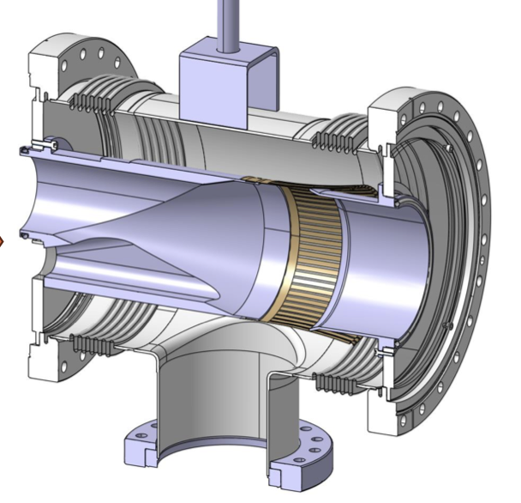
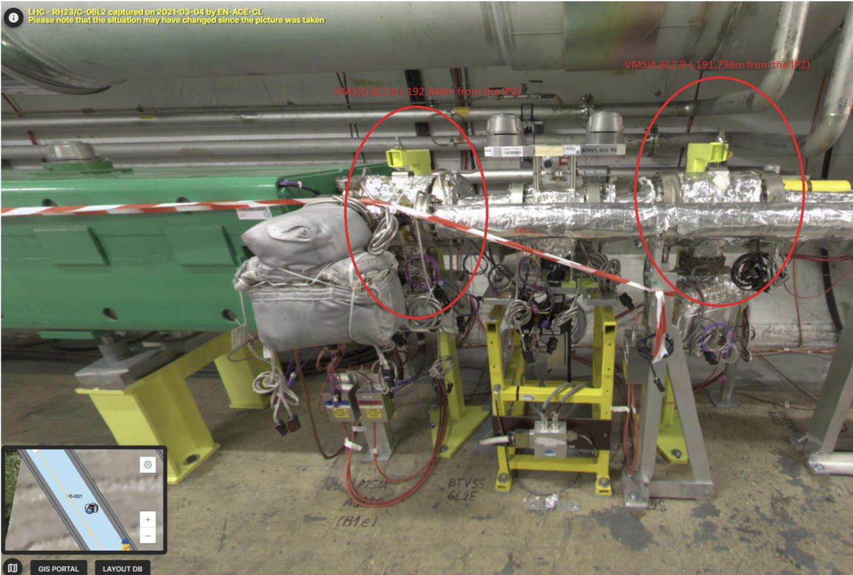
Vacuum issues with warm transition modules
Slow losses in LSS2 initially observed end of July and correlated with pressure spikes in sector A6L2
Two warm transition modules identified as potential sources, due to rf “fingers” issue
VMSIO module : design change took place during LS2, new design installed

Slide 14
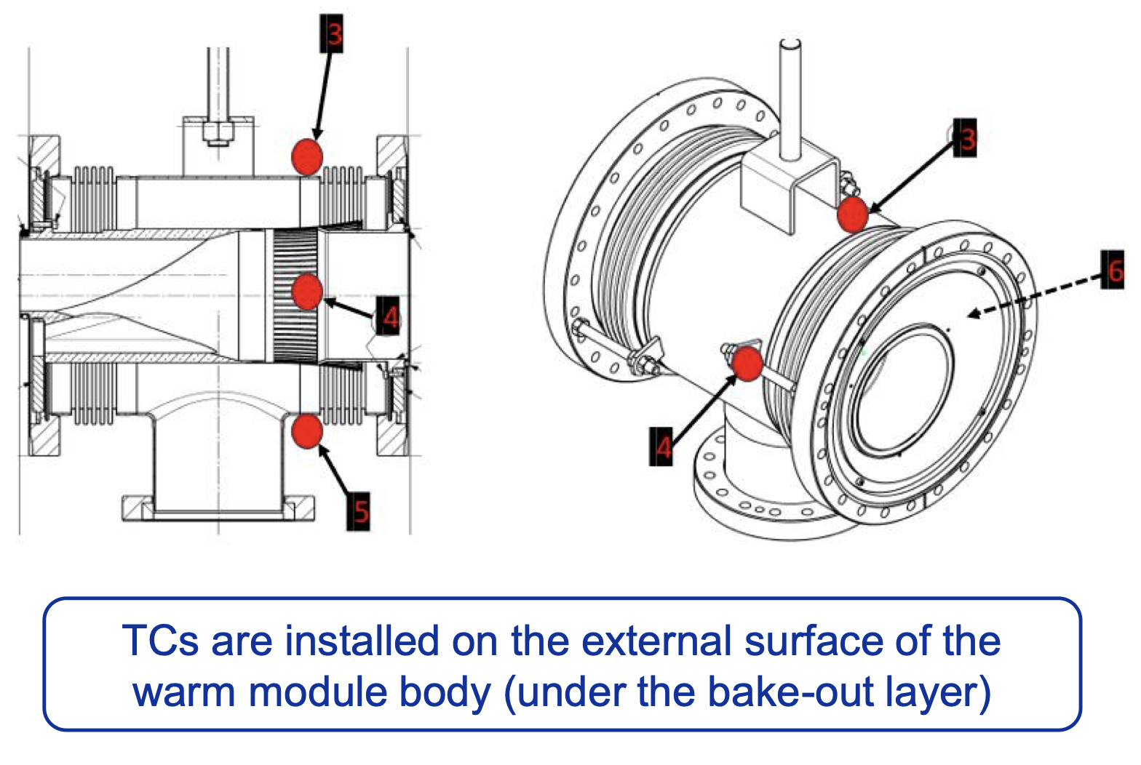
Vacuum issues with warm transition modules
High intensity operation was stopped and X-ray inspection was organized, a defect of the tension spring (holding the rf fingers in place) was found
Thermocouples have been put in place on the vacuum module body
Situation actively monitored since, no further deterioration of the rf contact observed since

Slide 15
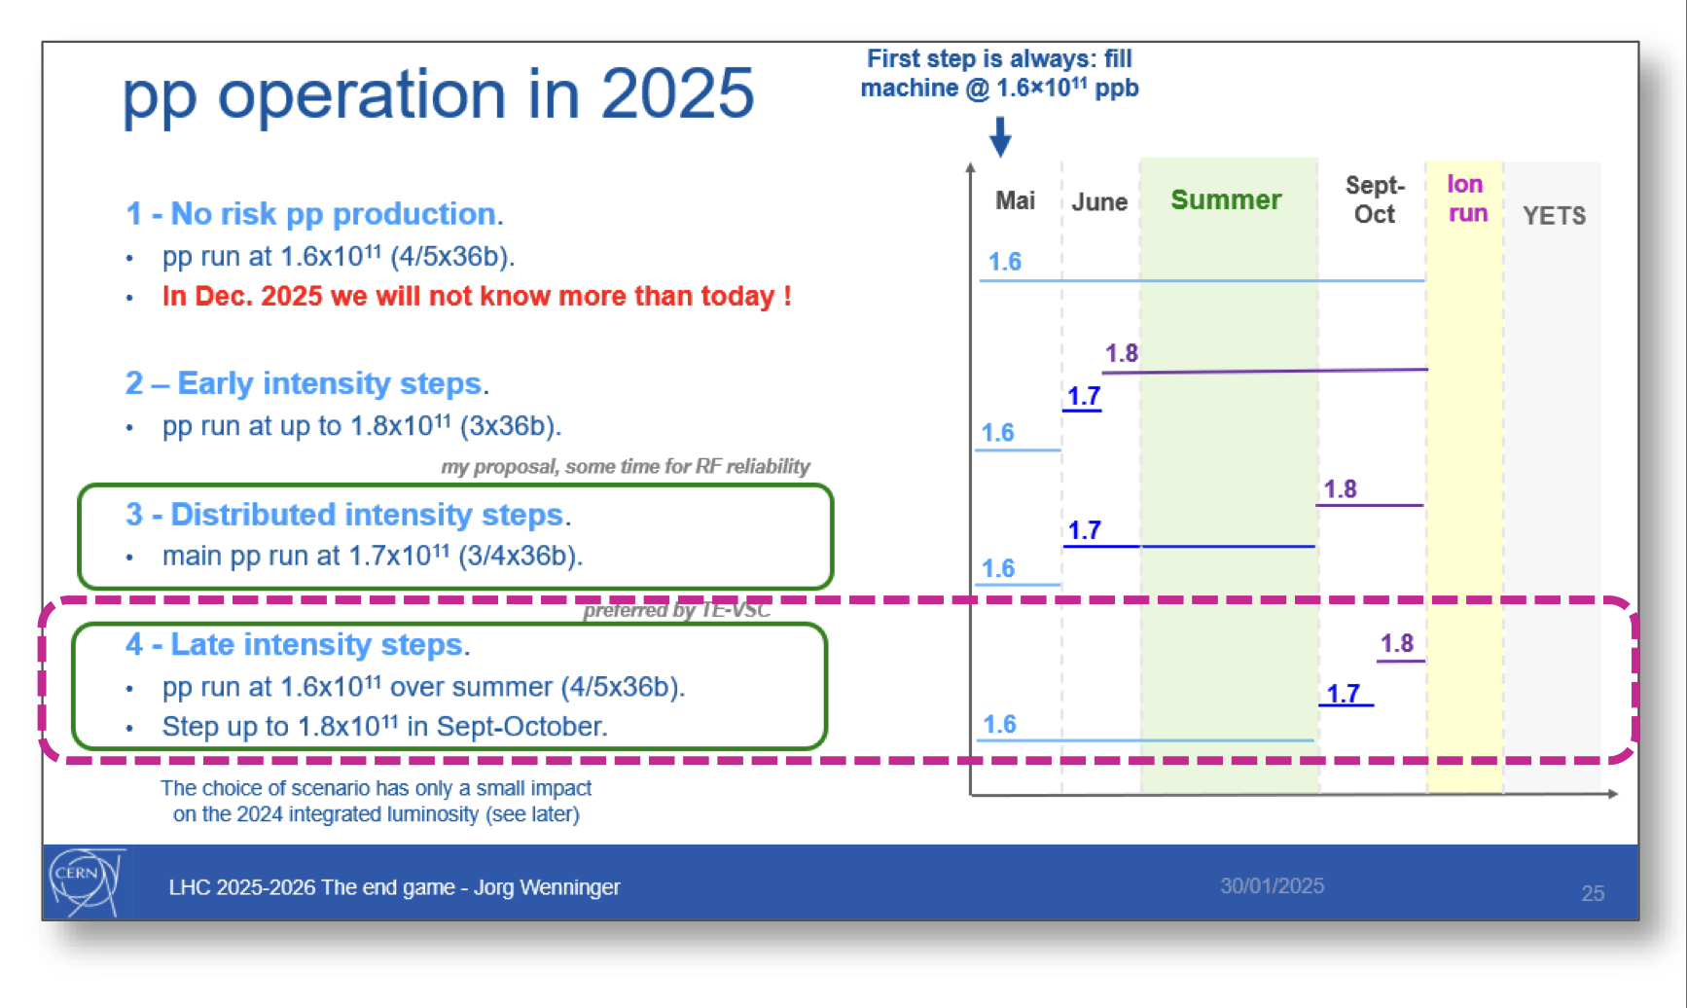
Plans for intensity increase
Initial plan foresees an step-by-step intensity increase, from 1.6 x 10¹¹ ppb to 1.8 x 10¹¹ ppb starting in September
The rf contacts of the warm elliptical transition modules near the D1 (IR 1-5, 24 modules in total) are known to be prone to fault and will be inspected prior to any intensity increase
X-rays are planned for this week and plans will be finalised based on these results and possible developments from further obversation of vacuum spikes in 6L2

Slide 16
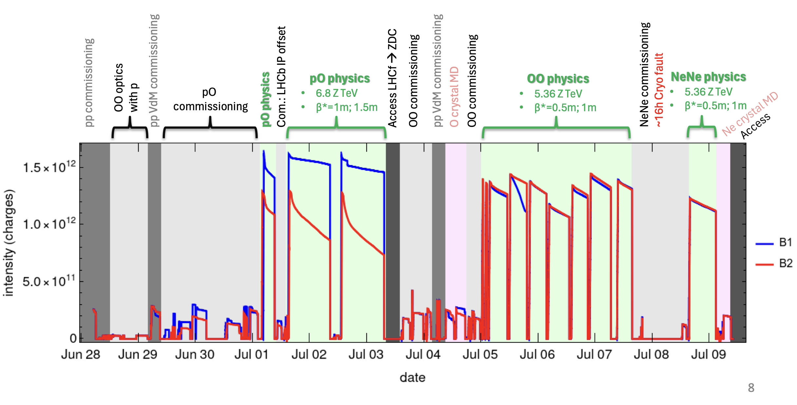
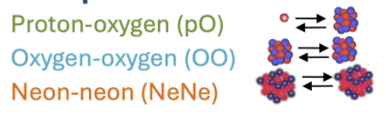
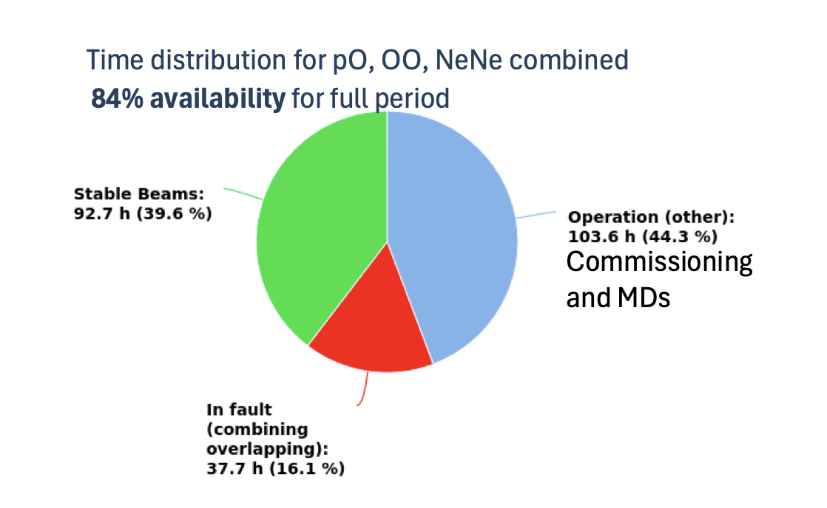
Light ion run
Excellent machine and beam availability, with ~40 % stable beam time
Rich and intense programme conducted over 12 days involving three non-standard LHC configuration and particle types

Slide 17
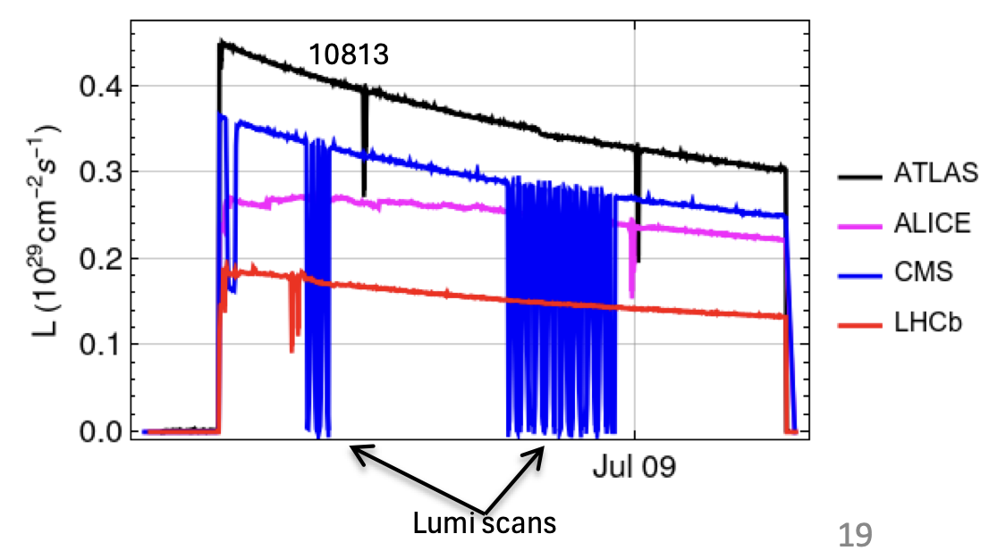
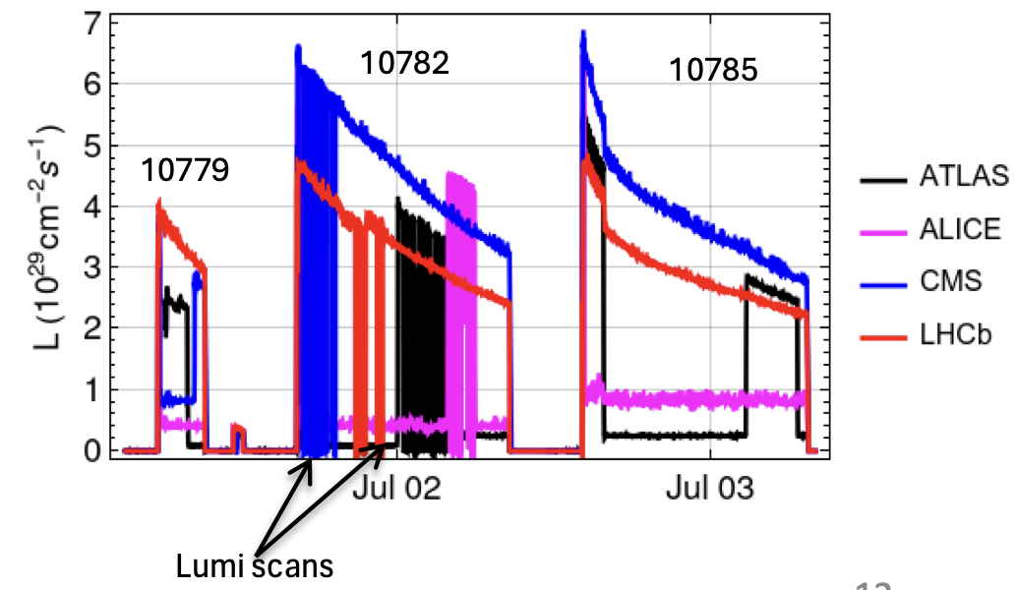
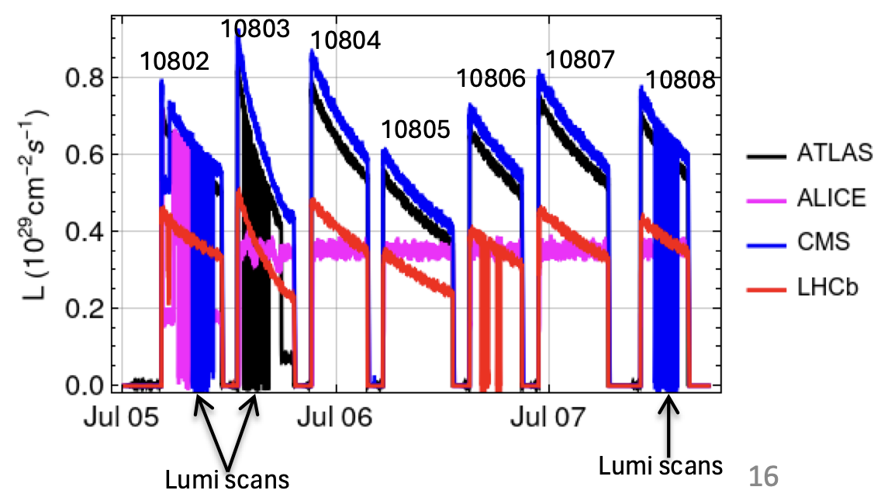
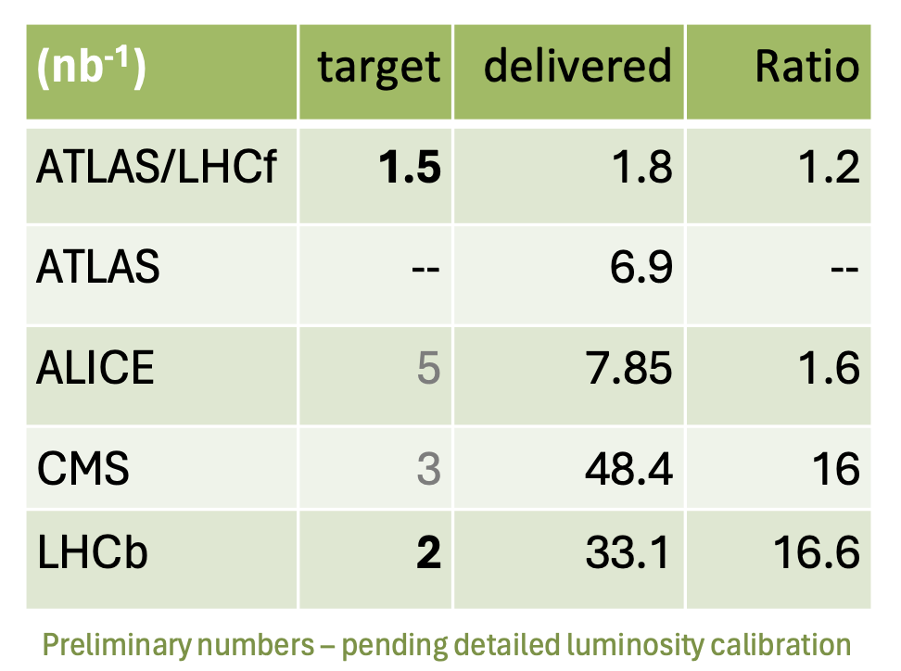
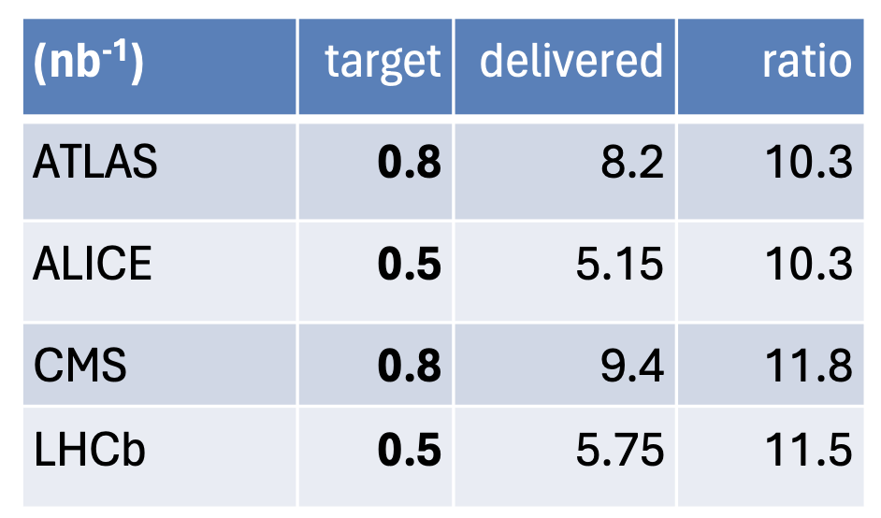
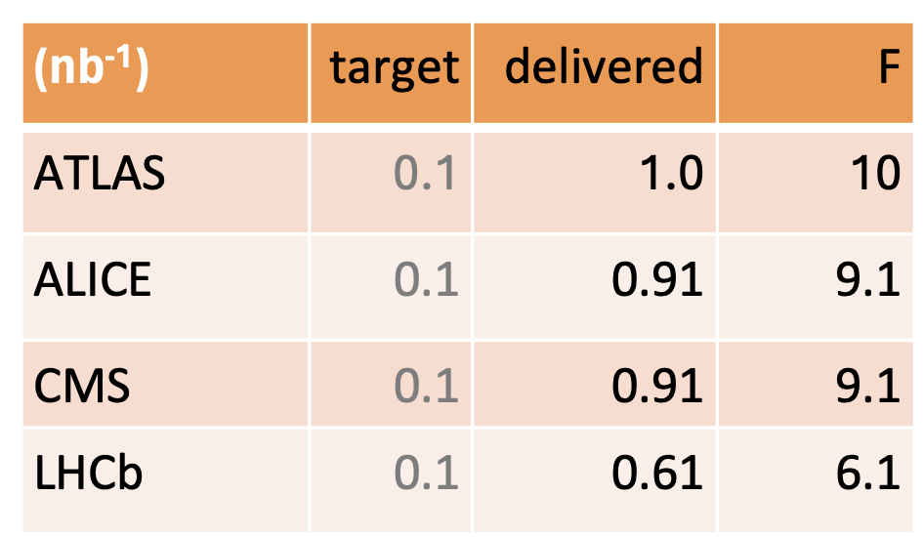
Luminosity targets reached and exceeded by large factors
Proton - Oxygen
Oxygen - Oxygen
Neon - Neon

Slide 18
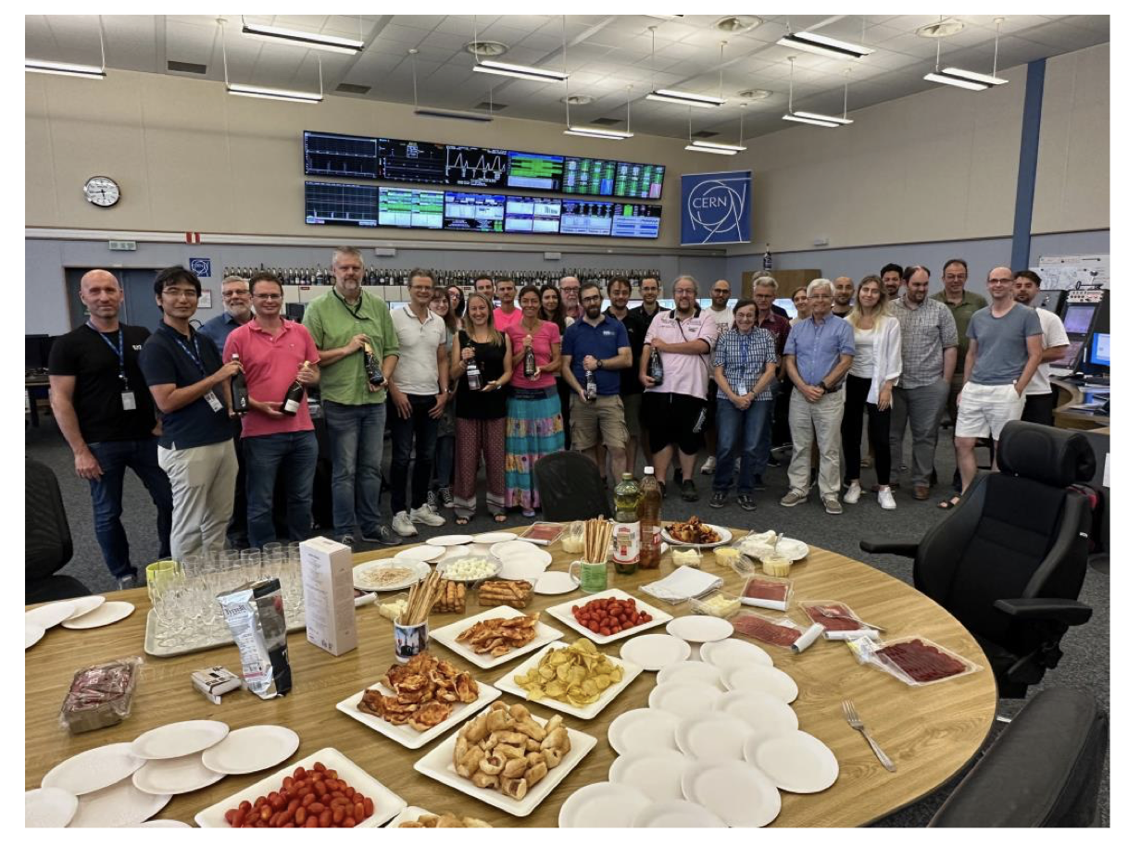
Light ion run
Keys to machine performance and overall success
  Going to maximum number of single bunches, while keeping commissioning and validation short
  Commissioning of the special cycles performed ahead of time
  Very good beam quality from injectors, higher intensities than expected
  Almost perfect availability (contingency became physics time)
  And …
... dedication and flexibility of all experts involved!

Slide 19
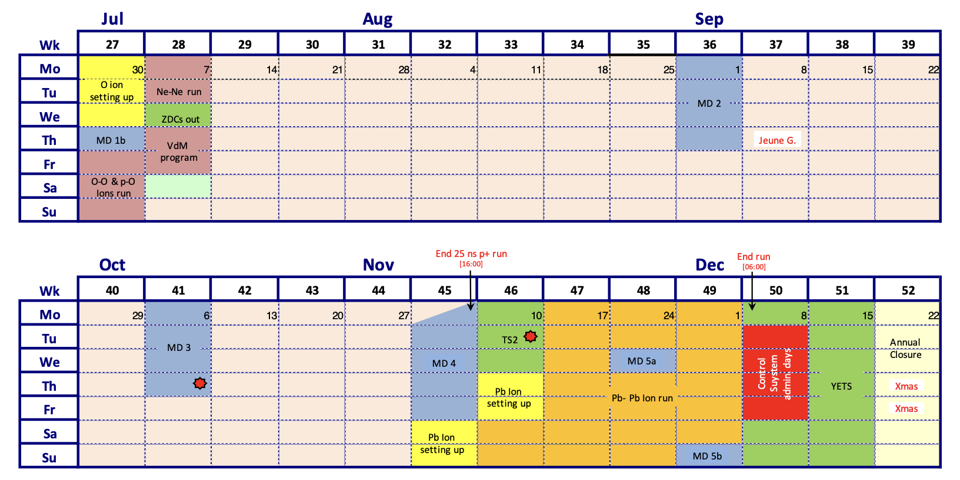
Conclusion
LHC is running well, no major issue affecting luminosity production
  Record-level luminosity production achieved through increased availability and efficiency, high beam brightness from the injectors and cryogenics margins
Under constant monitoring
  Vacuum in 6L2
  Elliptical modules in IR1-5
  SEU issues on P8 cryogenics
Looking forward to
  Continued luminosity production interleaved with MD blocks (MD2 on-going this week)
  Heavy ion run

