Slide 1
Combinations of SM Higgs searches at the LHC and Tevatron:
Information lost … but not forgotten
Ben Kilminster
Fermilab
Zurich 2012 Higgs confrontation workshop
January 9, 2012

Slide 2



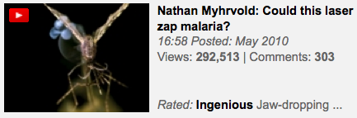

Organization with > 1000 Short online talks on ideas worth spreading

Slide 3
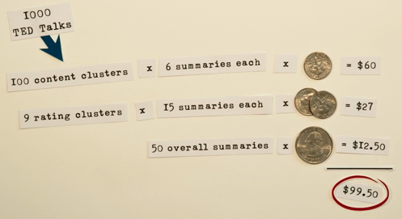
Ted x Zürich, Oct. 2011
Sebastian Wernicke
  Leader in field of bioinformatics
  Used Mechanical Turk website to hire people to do Human Intelligence Tasks for 10 cents each
  1000 Ted Talks, each ~2300 words, summarized to 6 words for $100

Slide 4

Ted x Zürich, Oct. 2011
Six of the fifty 6-word summaries of all 1000 Ted Talks

Slide 5

Ted x Zürich, Oct. 2011
Still not satisfied, he chose these 6 final words
Information is clearly lost ☺

Slide 6

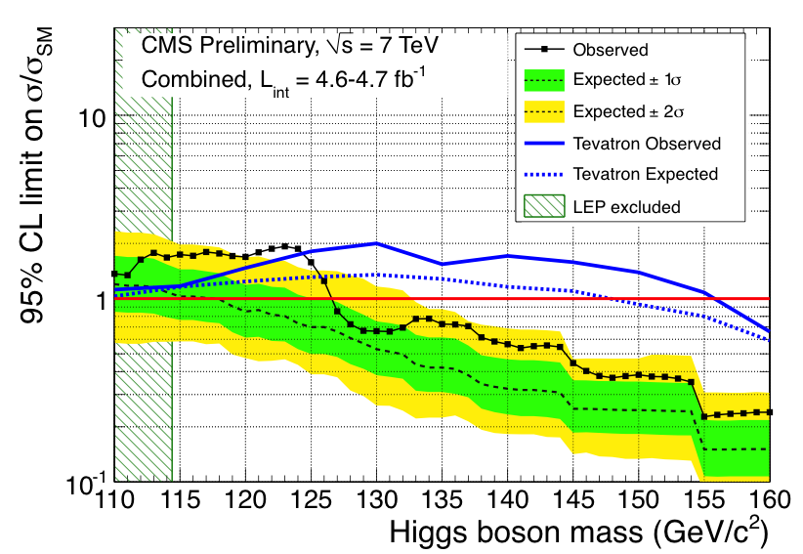
Physicists summarize with a picture
Exclusions above this :
Tevatron:
158 – 177 GeV
CMS:
127-600 GeV
ATLAS:
112.7-155.5
131-237
251-468
ATLAS
CMS
TEVATRON
Caveat : cost >> $100

Slide 7
Except …
A one-picture summary begs the question :
  What went into this ?
None of us here accept a single picture as the answer without considering its components

Slide 8
Specifically for our Higgs picture
What goes into TeV & LHC limits ?
What are all the pieces ?
How does it all fit together ?
What are the assumptions ?
  How important are they to the conclusion ?
How do we define excesses and deficits ?
  What do they tell us ?
To what degree is it a consistent picture ?

Slide 9
Or in 6 words …
How much information does picture lose ?
ATLAS
CMS
TEVATRON

Slide 10

Higgs production

Slide 11
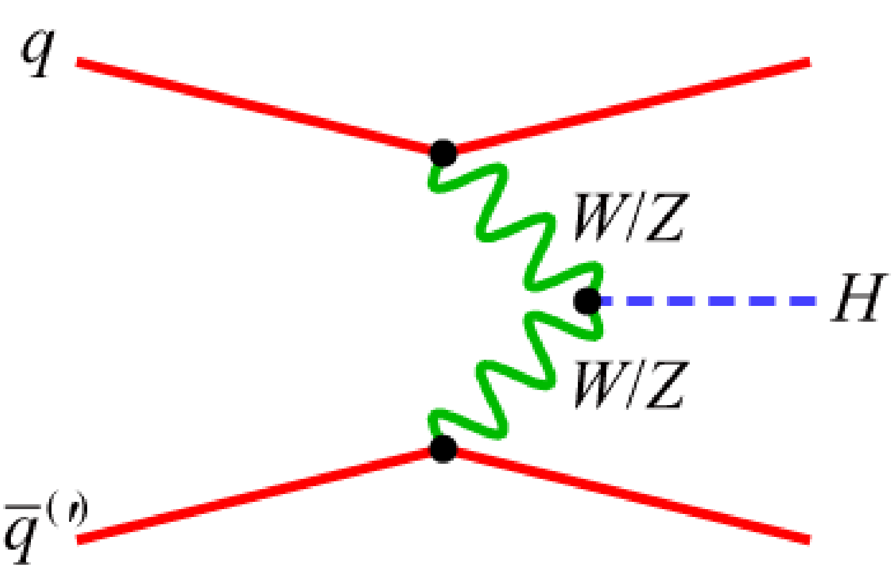
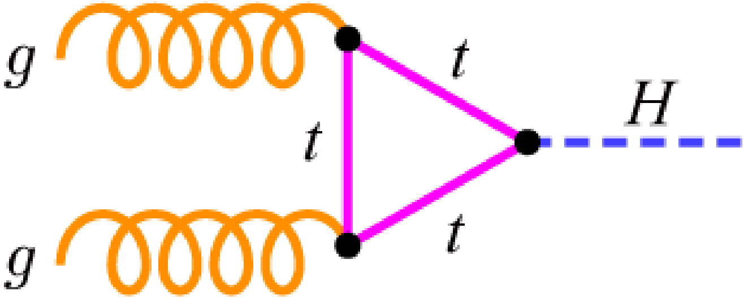
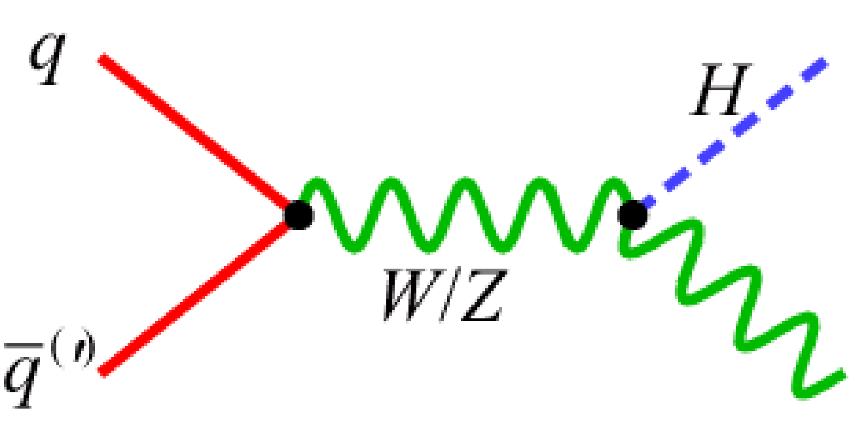
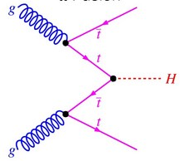
Actually searching for four production modes
Picture uses single multiplier μ of the SM cross-sections for four different Higgs productions

Slide 12
Higgs Production in combinations
Production | LEP | Tevatron | LHC
qq ➞ Z* ➞ ZH
qq ➞W* ➞ WH
gg ➞ H
qq ➞ WW/ZZ qq ➞ Hqq
gg ➞ tttt ➞ ttH

Slide 13
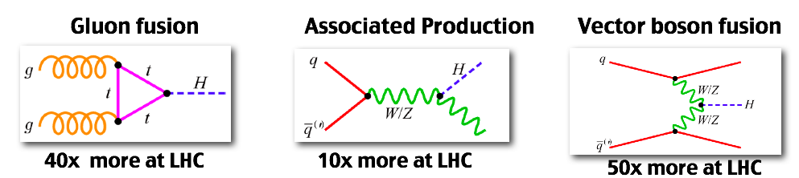
Tevatron vs. LHC
LHC has higher cross-sections for signal
  But scaling is not the same
  Different production cocktail between accelerators
Sensitivity
at 115 GeV :
LHC
Tevatron

Slide 14
Higgs production uncertainties

Slide 15
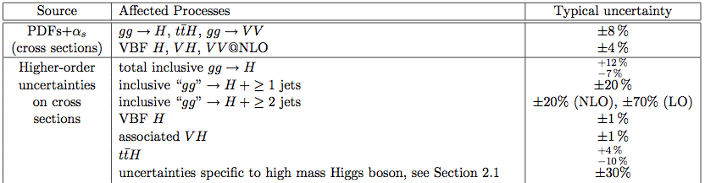
Each Higgs production also comes with different relative uncertainties
At LHC
Correlated between all
channels and each experiment
gg ➞ H uncertainties are largest despite tremendous set of calculations :
QCD radiative corrections at NLO
QCD corrections NNLO
QCD soft-gluon resummation NNLL
EWK corrections NLO
top and bottom loop corrections up NLO
above 400 GeV, line shape unknown
Details & references in CMS+ATLAS
combination note

Slide 16
Higgs exclusive production uncertainties

Slide 17
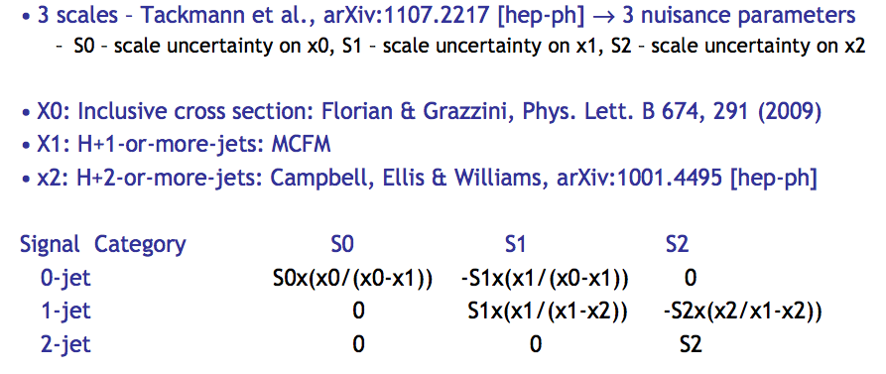
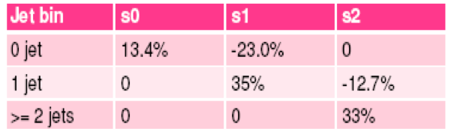
Production modes have exclusive uncertainties
Splitting H➞WW by number of jets
  Different PDF+α_{s} and scale errors for each jet-bin
    PDF errors from Anastasiou et al,. JHEP 0908, 099 (2009)
  Treat scale uncertainty of NNLO+NNLL inclusive, but NLO 1+ jet, 2+jet bins as uncorrelated
    Berger et al., arXiv:1012.4480, Stewart and Tackman, arXiv:1107:2217
At Tevatron

Slide 18
Higgs decays

Slide 19
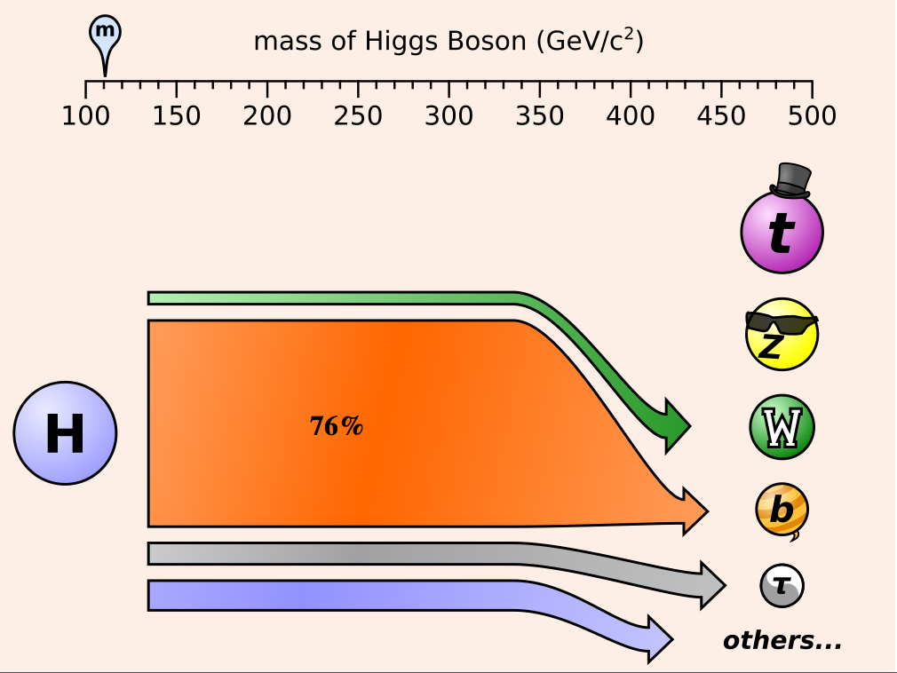
110 GeV
Comes from svg animation by Jim Pivasrksi

Slide 20
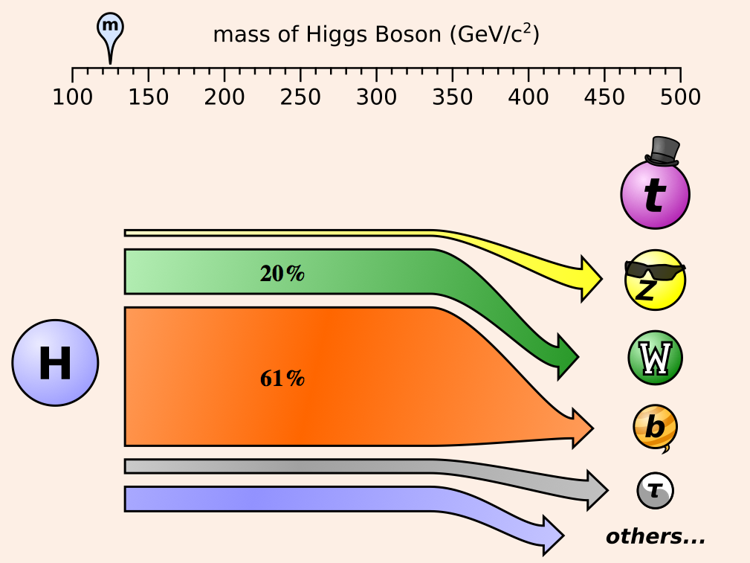
The infamous 125 GeV excess
NOTE:
Excess not
due to
dominant
Higgs decay

Slide 21
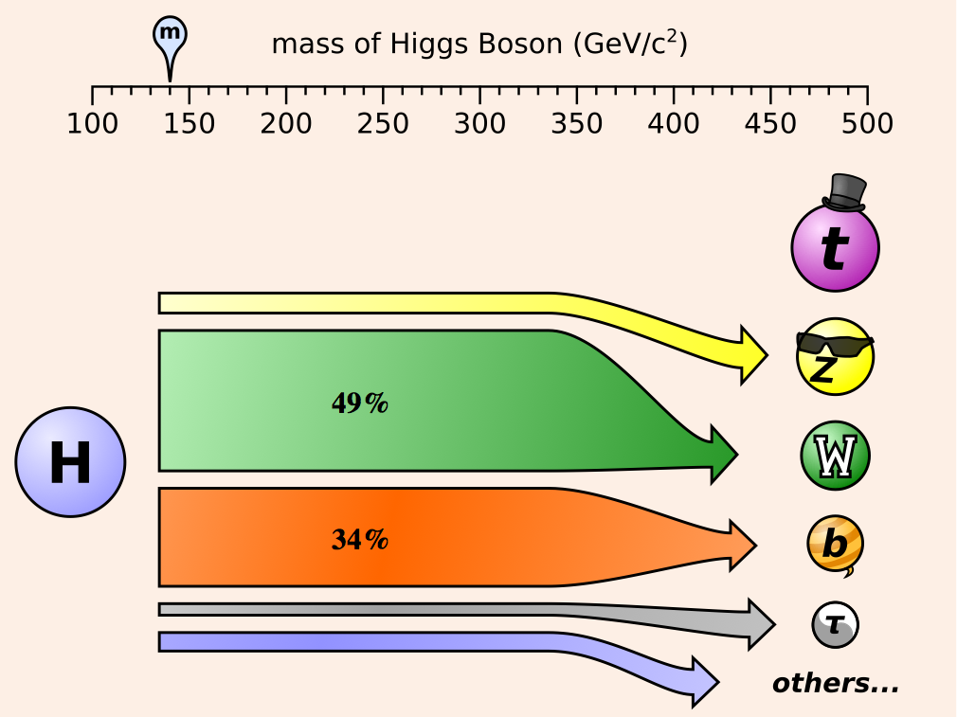
140 GeV

Slide 22
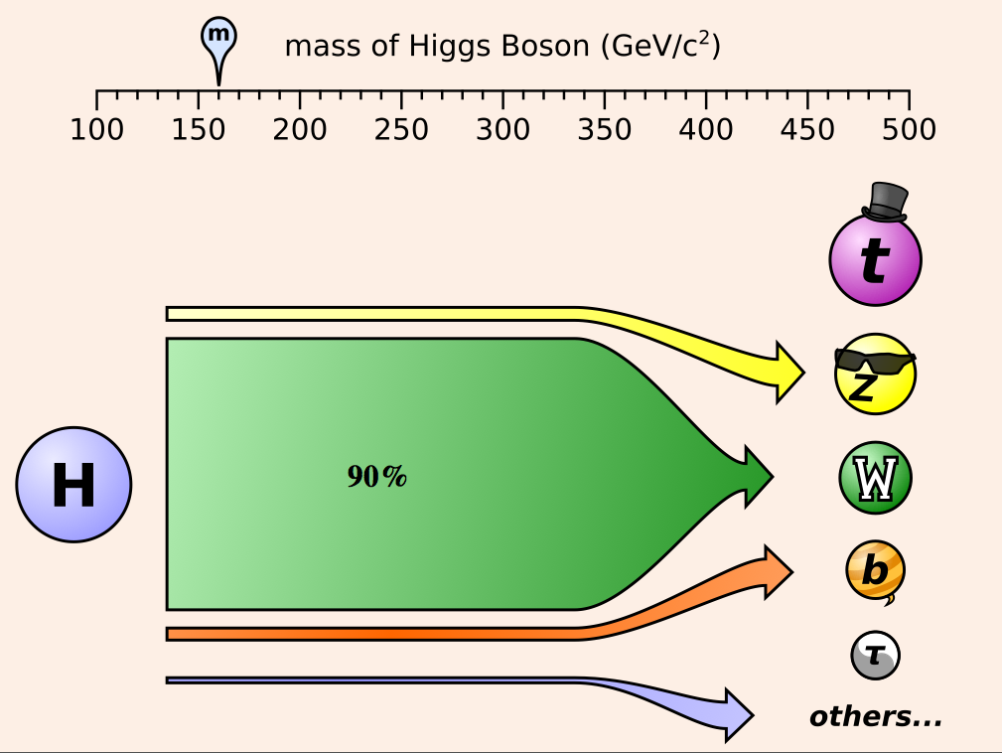
160 GeV

Slide 23
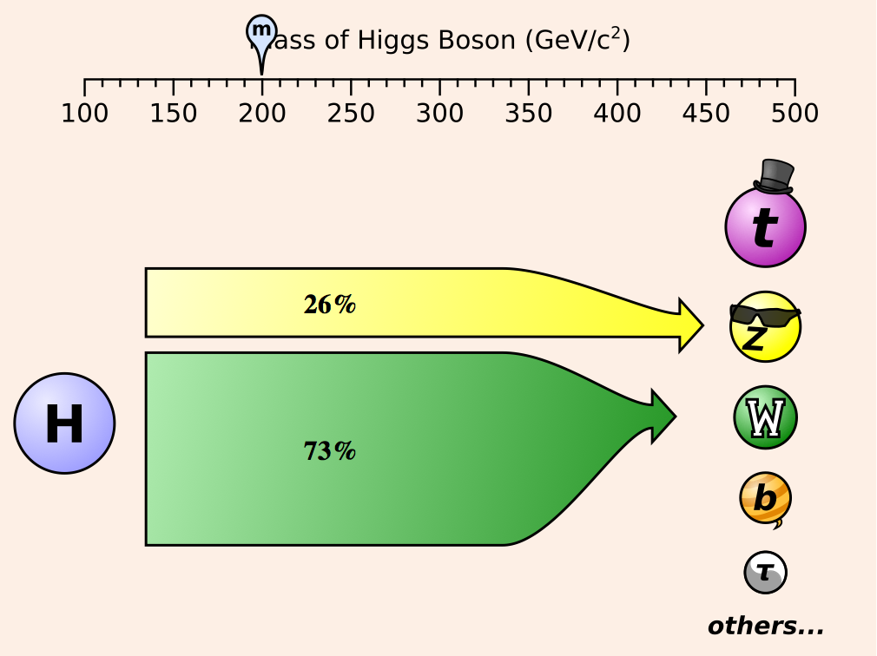
200 GeV

Slide 24
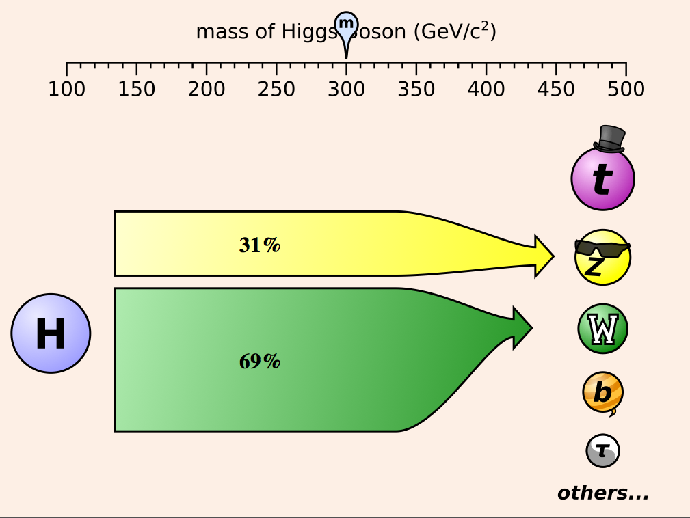
300 GeV

Slide 25
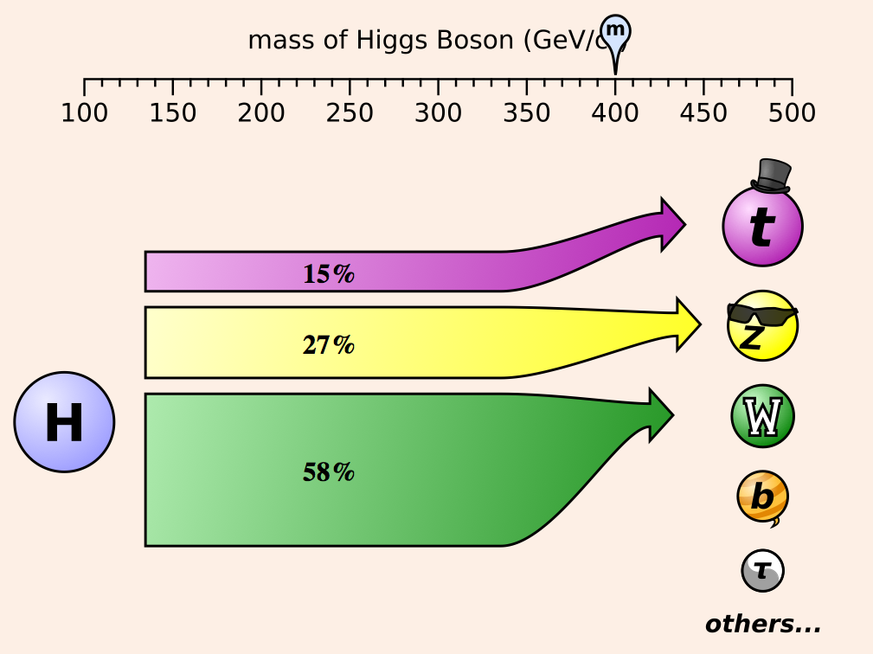
400 GeV

Slide 26
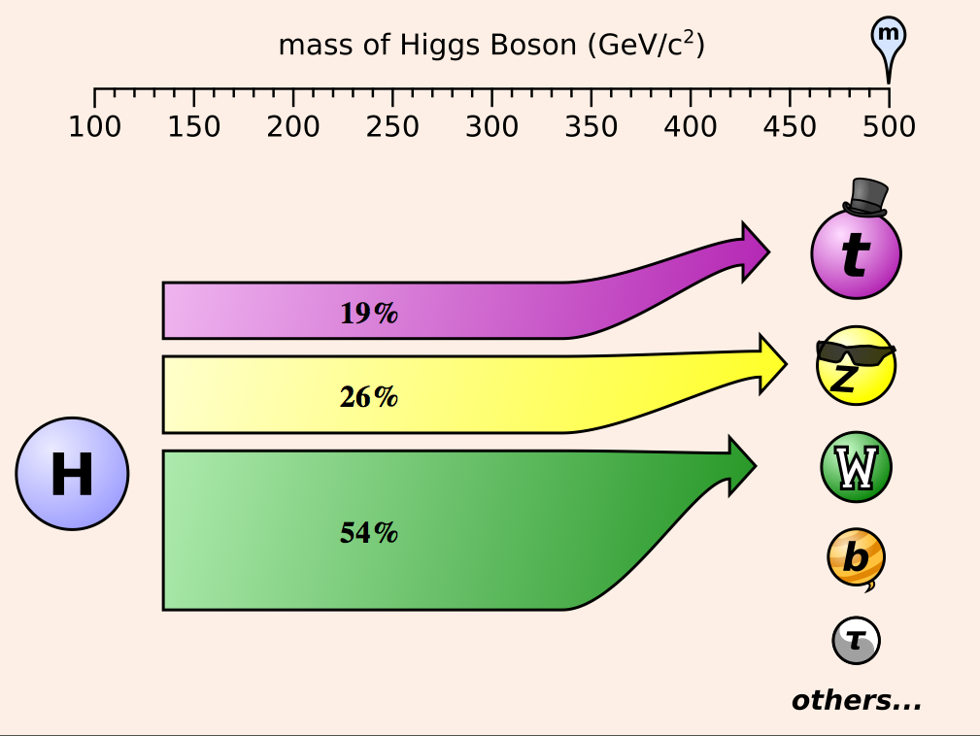
500 GeV
NOTE:
Exclusion at
525 GeV does not
consider H➞tt

Slide 27
Channels in picture
Associated Higgs modes
 | LEP | Tevatron | LHC
ZH➞vv(bb)
ZH➞qq(bb)
ZH➞ll(bb)
ZH➞ττ(bb)
ZH➞qq(ττ)
ZH➞ZWW➞lll
WH➞lv(bb)
WH➞qq(bb)
WH➞τv(bb)
WH➞WWW➞ll(l)

Slide 28
Channels in picture
Gluon fusion, VBF, ttH
 | Tevatron | LHC
H➞WW➞lvlv
H➞WW➞lvqq
H➞WW➞lvτv
H➞ZZ➞llll
H➞ZZ➞llvv
H➞ZZ➞llqq
H➞ZZ➞llττ
H➞ZZ➞vvqq
H➞ττ+ jets
H➞γγ
ttH ➞ lv+bb(b)
ttH ➞ MET+bb(b)
ttH ➞ qq+bb(b)

Slide 29
Higgs backgrounds

Slide 30
Different dominant SM backgrounds at each mass
γγ
WW
ZZ
At LHC:
At TeV:
bb
WW
125
200
600 GeV

Slide 31
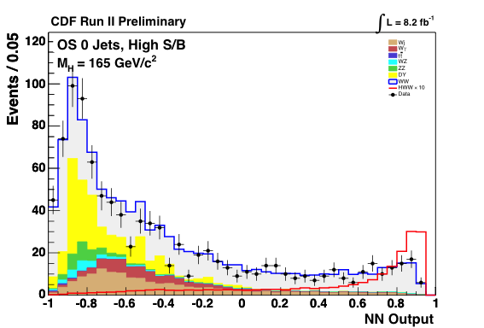
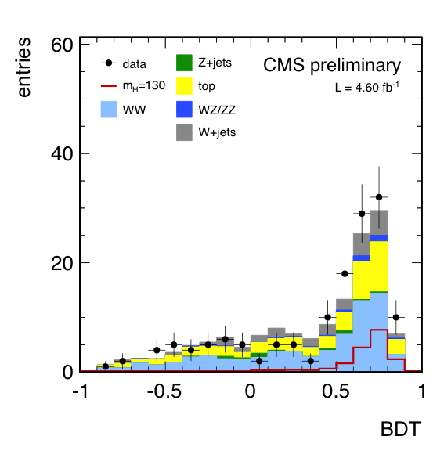
Higgs background composition at LHC vs. Tevatron
WW searches with 0 jets
Tevatron: larger Drell-Yan
LHC : larger tt
Consistent limits between Tevatron and LHC make background mis-modeling less likely

Slide 32
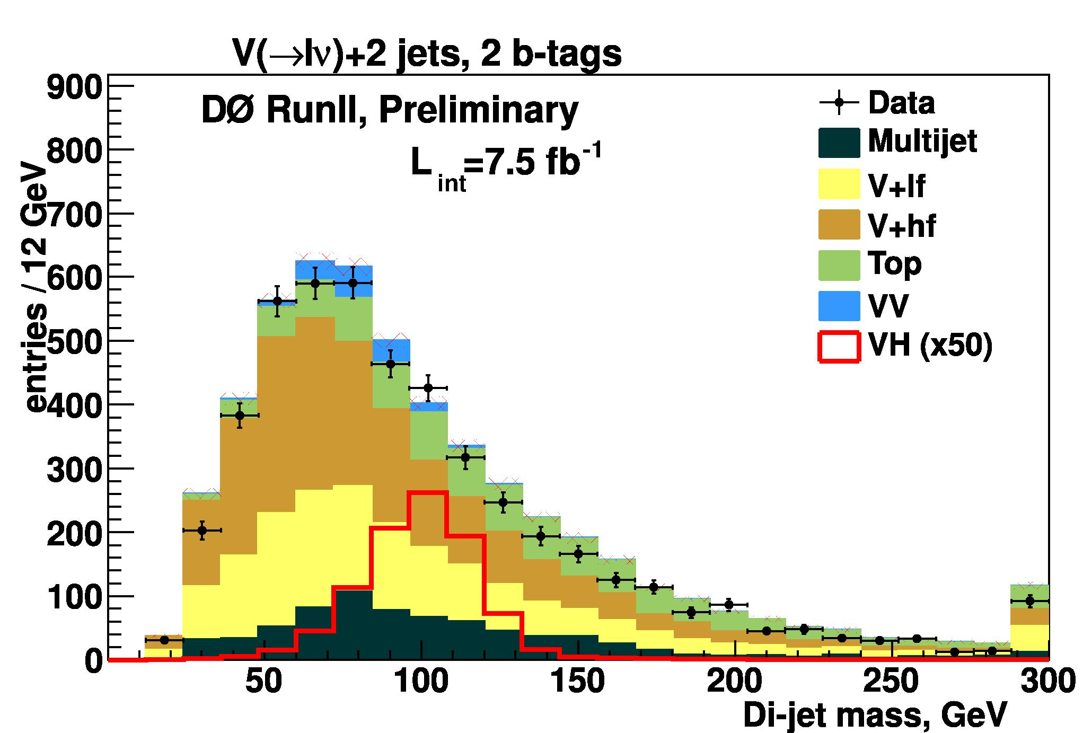
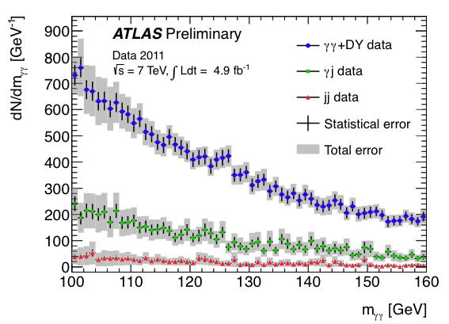
Higgs background composition at LHC vs. Tevatron
Low mass range
Tevatron: W+jets dominant in H➞bb
LHC : γγ dominant in H➞γγ
Consistent excesses between Tevatron and LHC would make background mis-modeling less likely

Slide 33
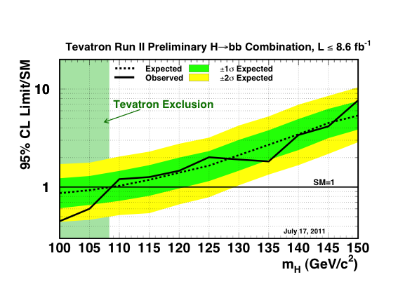
Tevatron H➞bb
NOTE: H➞bb excess has not developed but, if there,
should be expected across this mass range with full dataset

Slide 34
Statistical techniques

Slide 35
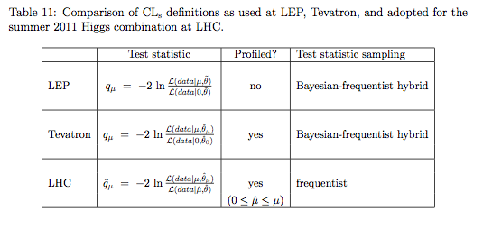
Different test statistics used in picture
* Tevatron quotes limits with Bayesian technique;
CL_{S} is a cross-check
*
From CMS+ATLAS combination procedure note
μ : scaling of signal cross-section where SM=1
θ : nuisance parameters
q_{μ} : test statistic of the signal + background model

Slide 36

CL_{s} technique
Confidence levels are evaluated by integrating corresponding log likelihood ratio distributions populated by simulating outcomes via Poisson statistics
LHC: Pseudo-data is generated using best fit of nuisance parameters to the observed data
  For both background-only and signal+background hypothesis in LLR
Tevatron: Pseudo-data is generated using expected values of nuisance parameters
CL_{s} is computationally expensive
  LHC CL_{s} has asymptotic properties so that limits can be evaluated with a simple formula – no pseudo-data needed :

Slide 37
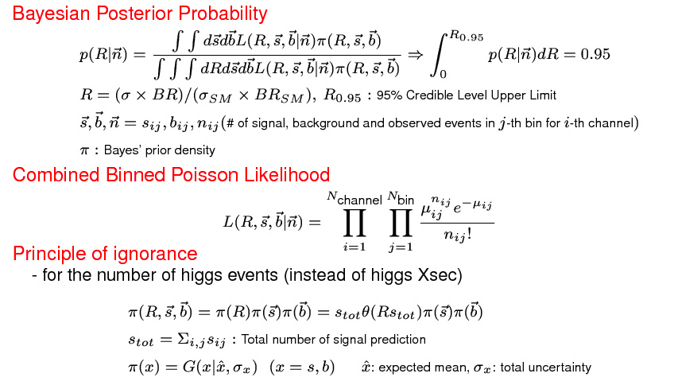
Bayesian technique used by Tevatron
The integrals over the uncertain parameters with their correlated priors from external constraints are done with a Markov Chain Monte Carlo integration method, using the Metropolis-Hastings algorithm.

Slide 38
Do we need to care what is used ?
CLs vs Bayesian ?
Different flavors of CL_{s} (LEP, Tevatron, LHC)
Asymptotic approximation of CL_{s} without toys
Not obvious from get-go, but the answer is “NO”

Slide 39
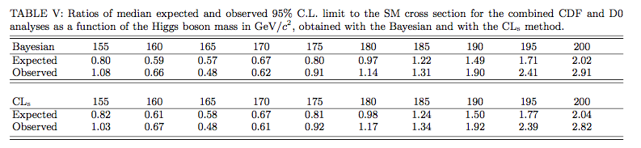
CL_{s} vs. Bayesian
Tevatron limits from summer 2011
Expected agree to 1-2% on average
Observed agree to 1-3 % or so on average
Max disagreement is 2.23 -> 2.38 (10%)
Two philosophies draw same conclusions

Slide 40
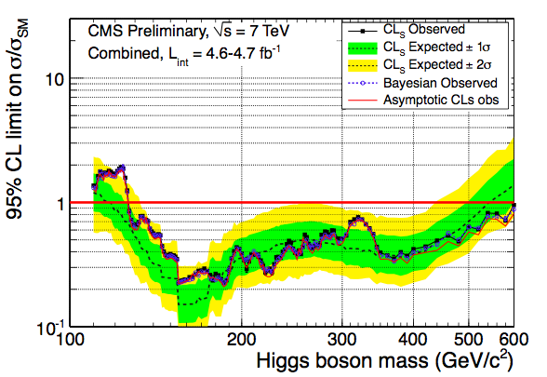
Asymptotic vs. CL_{s} vs. Bayesian
CMS Dec. 2011 combination
Strong agreement – asymptotic agrees better when high statistics

Slide 41
Treatment of nuisance parameters

Slide 42
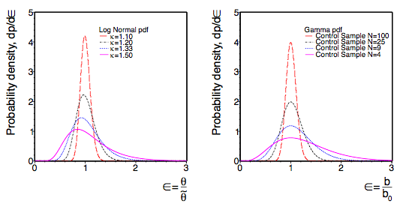
Choice of PDFs for nuisance parameters
Flat or uniform priors
  Ie, constrained by data measurement, such as signal cross-section
Poisson
  Ie, constrained from event counts in control regions or MC statistics
Normal
  Gaussian
  If uncertainties can assume only positive values
    Log-normal - LHC
    Truncated - Tevatron (less elegant, but found to be same as log-normal)
For small uncertainties,
or large statistics, log-normal and Gamma distribution equivalent to Gaussian

Slide 43
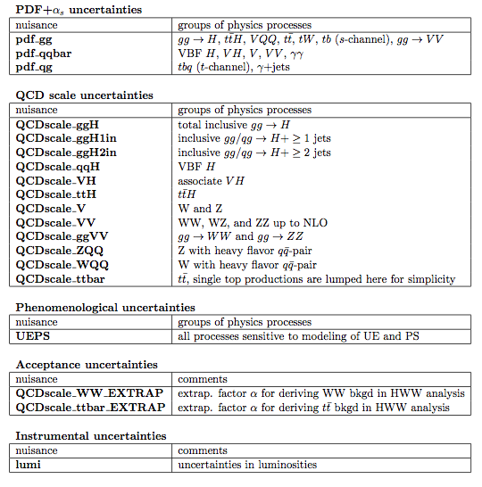
Correlated between analyses and experiments
Instrumental uncertainties not correlated between experiments
Sometimes correlated between analyses within an experiment depending on measurement technique
Similar for Tevatron

Slide 44
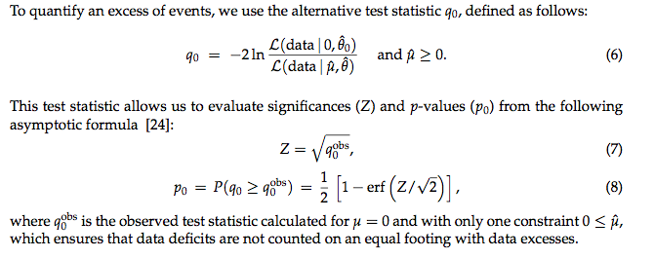
What if there is an excess ?

Slide 45
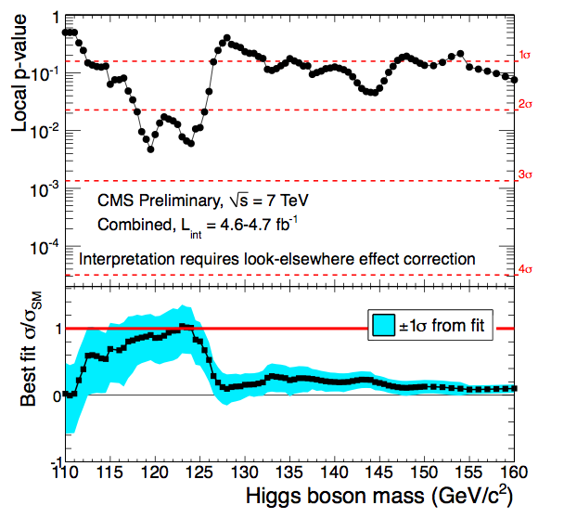
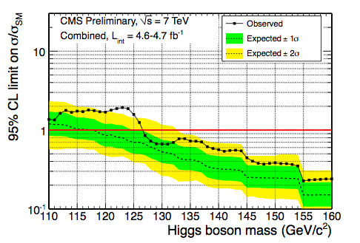
Need complete picture to understand excess
Tells us where the excesses are respect to background
Tells us if excess is consistent with signal
Tells us if we should have sensitivity to it

Slide 46
What is the true probability of a local excess ?

Slide 47
Trials factors estimations
Number of independent searches being performed
  Range of search in mass / Mass resolution
Pseudo-data
  Using toy MC to determine how often an excess as large can happen
Approximation
  For small P-values, in asymptotic regime, can count up-crossings of signal stength = 0, and determine global P-value from test statistic
    In observed data

Slide 48
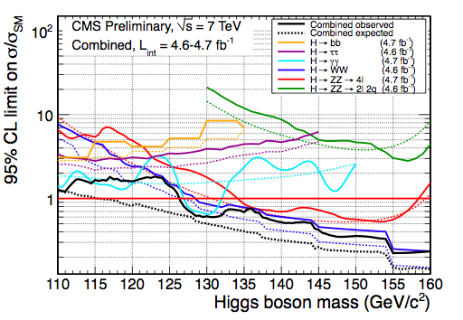
Approx: Trials factor = Range / resolution
Problem:
Concept of mass resolution
not clear in an MVA
Also MVAs trained separately at each mass point !
(Mass points are correlated)
Not used by LHC
(At around 120 GeV)
H➞γγ (1-3%)
H➞ZZ➞4l (1-2%)
H➞WW (20%)
H➞ττ (20%)
H➞bb (10%)

Slide 49
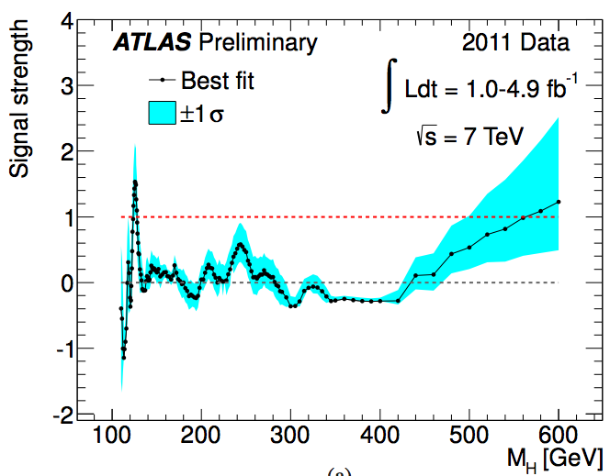
Trials factor: Up-crossings
At 0:
ATLAS: 6 up-crossings
CMS: 8 up-crossings
Trials factor not that sensitive to statistical
Fluctuations
Cross-checked using different signal strengths and with statistical uncertainties

Slide 50
Significances of excesses
ATLAS: 126 GeV
  3.6 Sigma local P-value
  2.2 Sigma with trials factor
CMS: 119 GeV
  2.6 Sigma local P-value
  0.6 Sigma with trials factor

Slide 51
But what is the right Look Elsewhere Effect ?
CMS & ATLAS search 110 – 600 GeV
  Decided a priori based on experimental reach
  Generates a large Look Elsewhere Effect
  Do we really expect a SM Higgs boson to be 600 GeV ?
Could use previous experimental exclusions for prior
  ATLAS uses 2fb⁻¹ LHC combination to motivate restricted window
    110 – 146 GeV :
    3.6 σ local ➞ 2.2 σ (full mass range) ➞ 2.5 σ (restricted)
  But unfair to use subset of data both to define search window and perform search

Slide 52
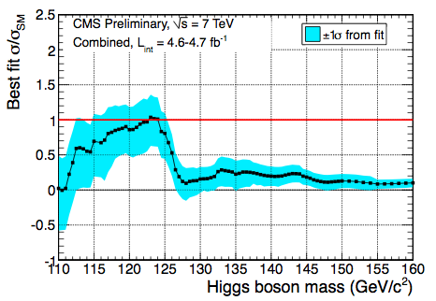
Restricted mass range
CMS restricted mass range
    Statistical uncertainty of up-crossing technique in observed data is limited
      CMS finds 1 up-crossing in this mass range
If this were to be used,
Global significance = local significance:
Instead, use pseudo-experiments instead of up-crossings
Problem: H➞WW uses mass-dependent MVAs
(correlations between mass points because
backgrounds not the same at each search mass)
Generate pseudo-data from background model at m_{H} ~ 125 GeV
Safe assumption for 110 – 145 GeV due to M_{WW} resol.
So 110 – 145 GeV is used by CMS (~ same as ATLAS)
2.6 σ (local) ➞ 0.6 σ (full mass range) ➞ 1.9 σ (restricted)

Slide 53
What is the right restricted mass range ?
CMS could use ATLAS’ exclusion range for search window & vice versa
  Not very agreeable since there are correlations between nuisance parameters of CMS & ATLAS
Could split data into old data for exclusion, and new data for search window
  Lots of work, and would be self-defeating since not all data would be used, reducing significance at the expense of reducing trials factor
Instead … the SM Higgs boson is predicted by precision electroweak measurements (LEPEWWG)
  m_{H} < 161 GeV at 95% CL
So a more appropriate prior assumption for look elsewhere effect would be :
  110 – 161 GeV

Slide 54
Our picture of the Higgs boson
ATLAS
CMS
TEVATRON

Slide 55
Conclusions from Higgs picture
… but not forgotten
  Higgs signal
    Production at each mass
    Production at each accelerator
    Uncertainties
    Uncertainties of exclusive final states
  Higgs decays at each mass
  Backgrounds at each mass
  Backgrounds at each accelerator
  Different statistical methods
  Defining an excess

Slide 56
Higgs discovered
Higgs excluded
Rename
“God particle”
Rename
“Devil particle”
Newspaper Headline :
“Physicists prove God exists”
Newspaper Headline :
“Physicists prove Devil
does not exist”
Rake in the $$$
$$$

