Slide 1
Searches for new physics at the LHC outside the Higgs sector
Paris Sphicas
CERN & University of Athens
The Zurich phenomenology workshop: Higgs search confronts theory
Jan 09, 2012
Prelude
The foundations: a very quick tour of pp collisions at 7 TeV
  Strong interaction physics (jets, QCD); Electroweak signals (W/Z production & properties); The top quark (still there)
Searching for New Physics
  Bread-and-butter searchers + Tevatron checks
  Where is SUSY?
The 2012 run.
  More data (lumi?); higher energy?
Summary

Slide 2
In a nutshell (I)
At 95% CL:
  ZPW participants are aware of the fact that the LHC has had a spectacular year, breaking luminosity records and all expectations
  Most people are aware of the incredibly successful operation of ATLAS and CMS
  Standard model (SM) of particle physics reigns supreme in pp collisions at 7 TeV
  The mass of the SM Higgs boson is not in the ranges M_{H}<115 or M_{H}>128 GeV
  R_{P}-conserv: gluinos, 1st/2nd-gen squarks, not lighter than ~0.5TeV
  There exist no new resonances with mass <~2 TeV
  There are no spectacular signatures from objects of mass ~few TeV decaying “democratically” to lots of jets, MET, leptons....
  Most of the information in this talk is already well known
  Standard model of human behavior reigns supreme in pp collisions at 7 TeV (some level of worry has set in; still in control)

Slide 3
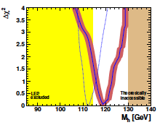
In a nutshell (II)
At 100% CL, all the reasons for building the LHC are still there, intact:
  The WW cross section regulator is still missing. (S)he must be there before we explore fully the 1 TeV.
    Old name: “LHC no-lose theorem”; new name: “not finding the Higgs is a major discovery”
  Any (reasonable) M_{H} unnatural; Higgs needs its own regulator
    Old name: SUSY; New name: SUSY; its main prediction is (so far) vindicated ☺
    Old CW: SUSY around the corner; New CW: she’s in the third generation (stop, sbottom)
  Other stuff:
    Extra-dimension physics, new gauge
    bosons, leptoquarks, fourth fermion
    Generation, quark substructure…
    Still huge space of unexplored physics
The best has yet to come – read on.
Mastercode

Slide 4
LHC(t₀):
Great expectations

Slide 5
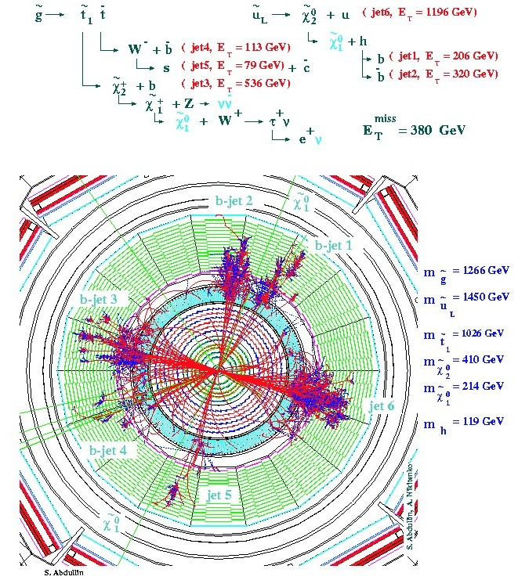
“Turn on the LHC and find Higgs & SUSY”
ATLAS and CMS were designed to do this; they were “guaranteed” to find the Higgs – period; right away
  In fact: SUSY is strongly produced, so will be observed first
    For the “impatient”: join SUSY physics group
Many hard Jets
Large missing energy
  2 LSPs
  Many neutrinos
Many leptons
In a word Spectacular!
Text & simu from 1999

Slide 6
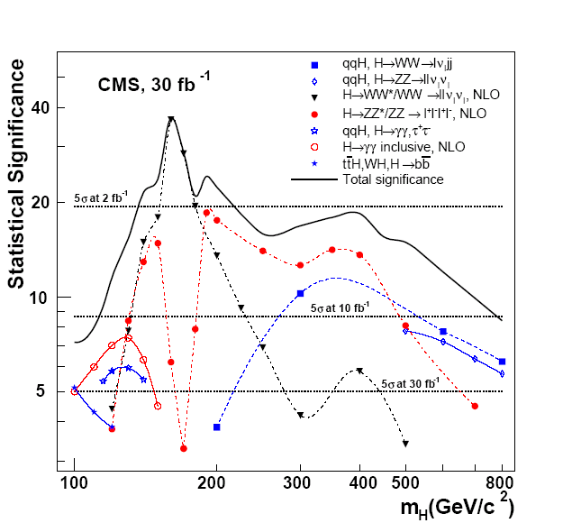
“Turn on the LHC and find Higgs & SUSY”
ATLAS and CMS were designed to do this; they were “guaranteed” to find the Higgs – period; right away
  In fact: SUSY is strongly produced, so will be observed first
    For the “impatient”: join SUSY physics group
    For the “patient” ones: join the Higgs group
The LHC can probe the entire set of “allowed” Higgs mass values;
  in most cases a few months at 10³³cm⁻²s⁻¹ are adequate for a 5σ observation
Text & simu from 2006

Slide 7
Turn on the LHC and find Higgs & SUSY
ATLAS and CMS were designed to do this; they were “guaranteed” to find the Higgs – period; right away
  In fact: SUSY is strongly produced, so will be observed first
    For the “impatient”: join SUSY physics group
    For the “patient” ones: join the Higgs group
  For all others:
    For those who like smaller analyses: join the Exotica group
    For those who like finding something:
      QCD, EWK, B physics, …

Slide 8
LHC(t₀+Δt=2yrs):
Foundations established a “tour de force” of SM measurements

Slide 9
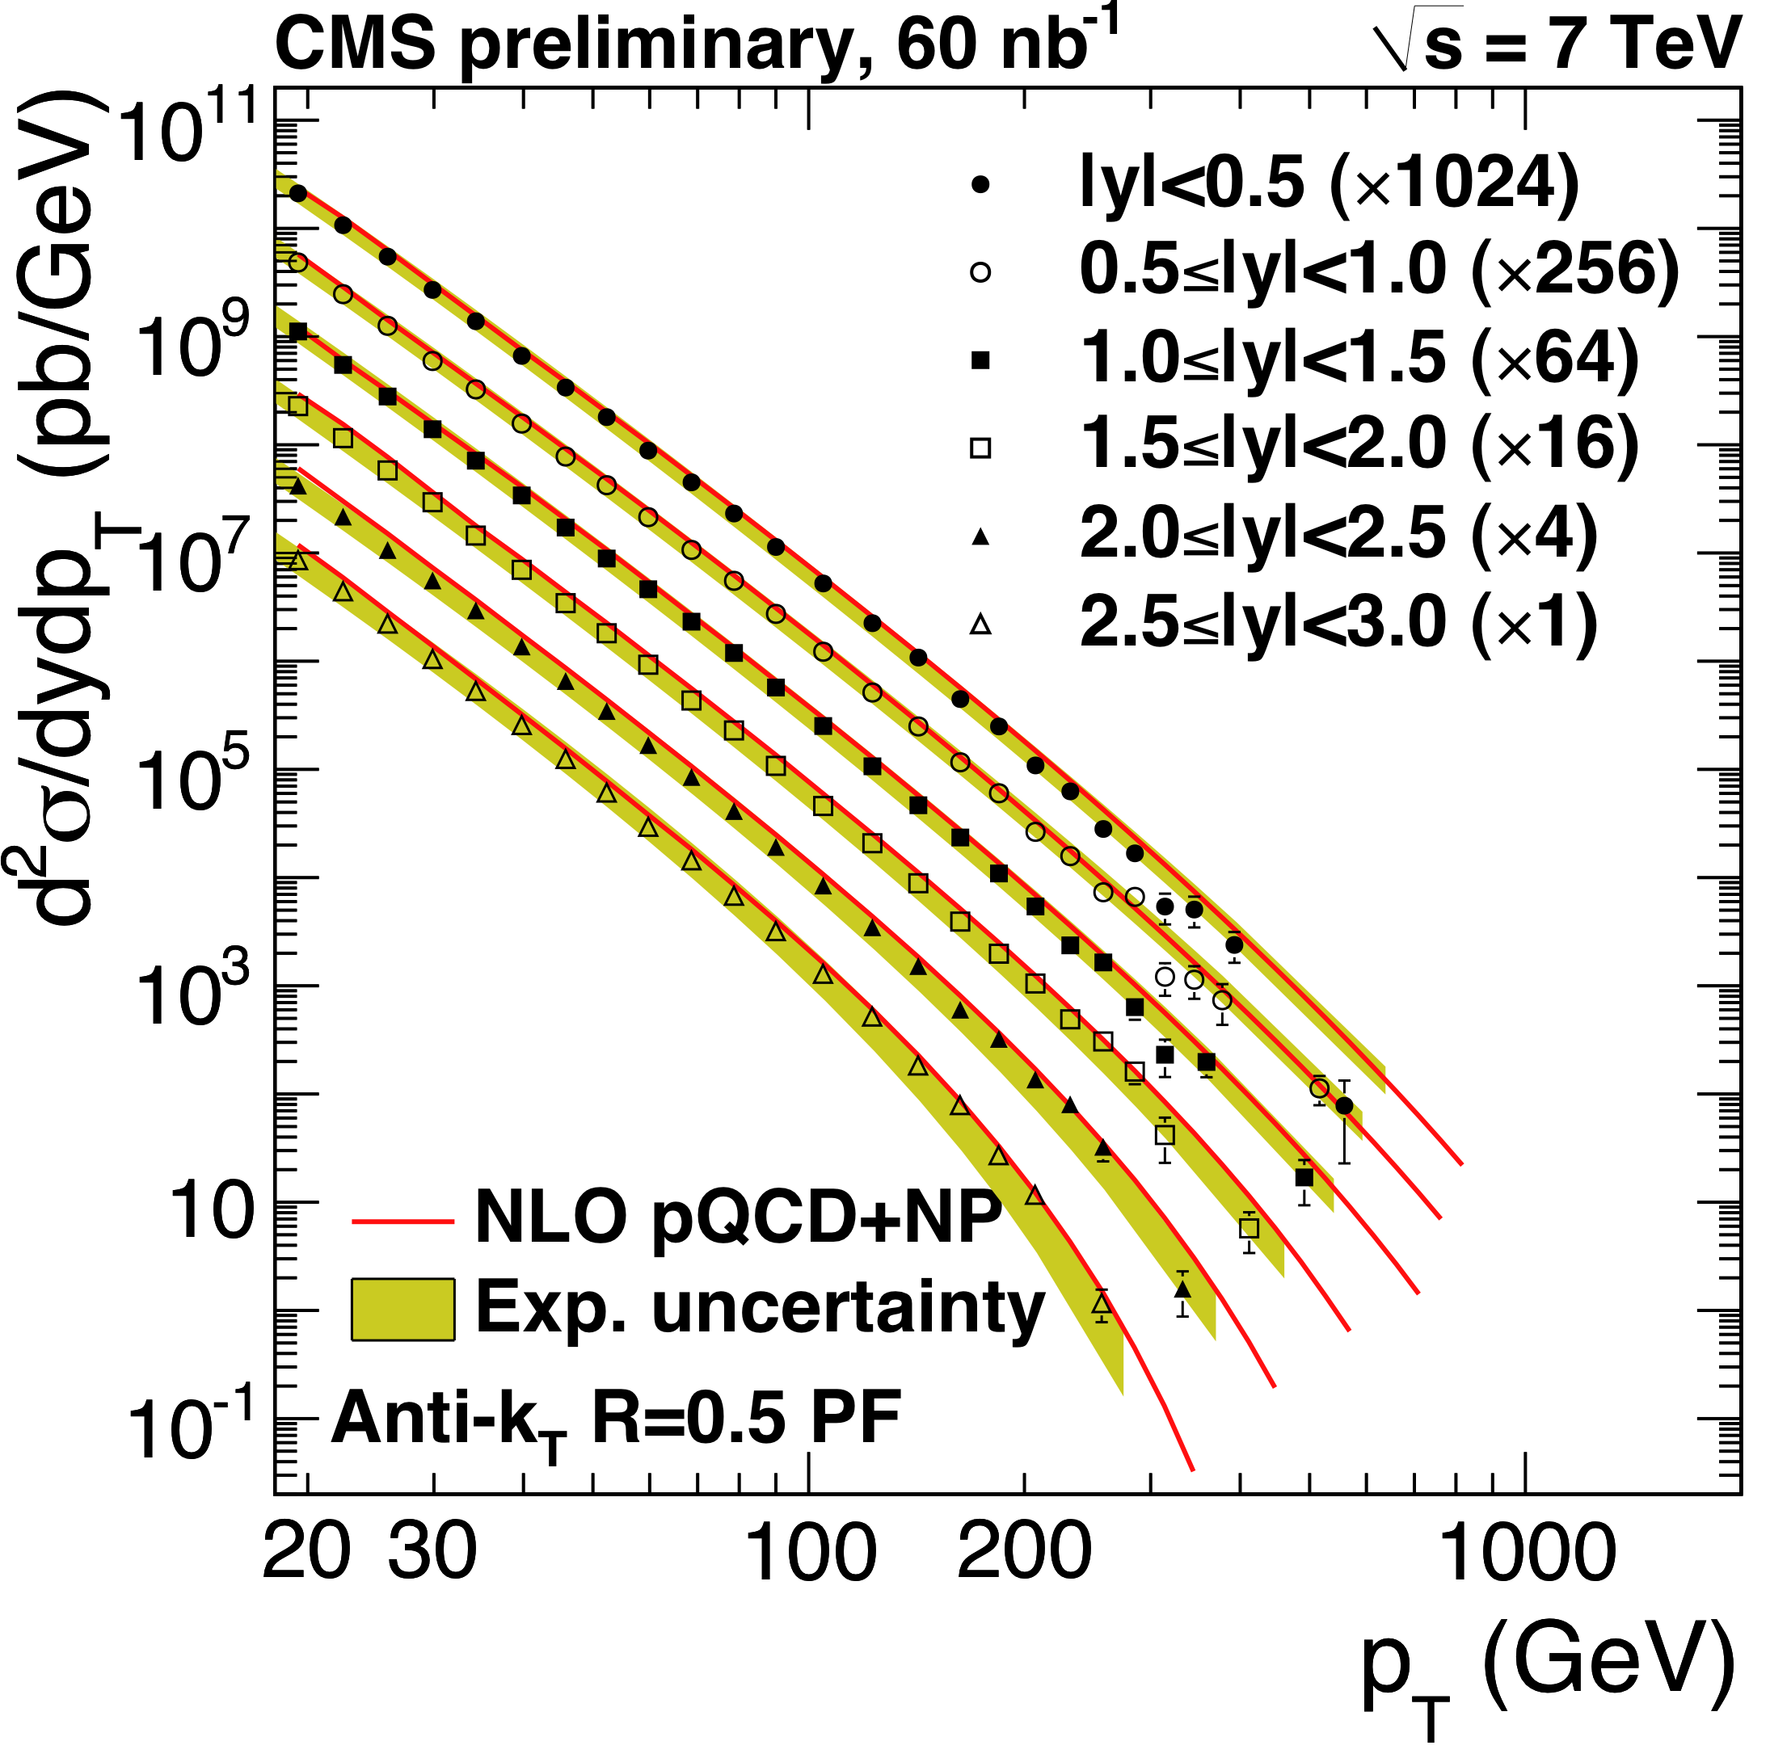
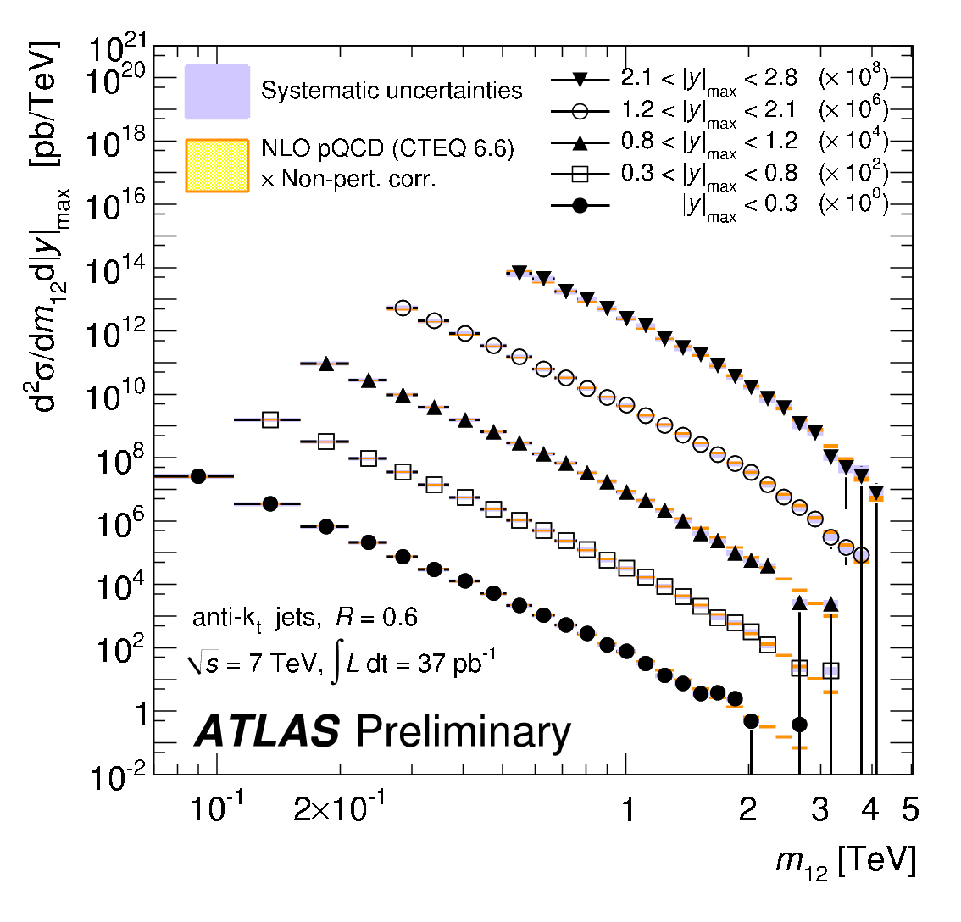
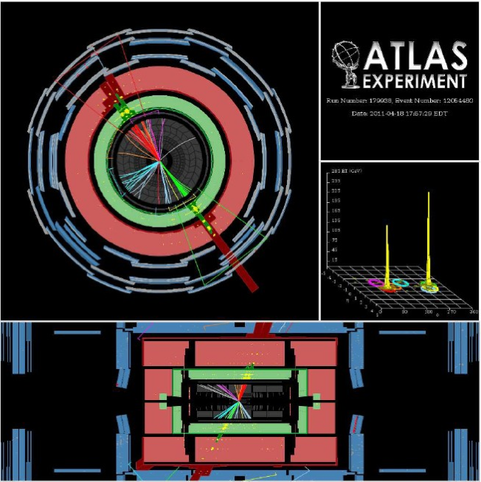
Jets
  M_{jj} = 4.04 TeV
  P_{T}¹ = 1850 GeV, η= 0.32
  P_{T}² =1840 GeV, η=-0.53
To probe the hard scatter:
  The hard scatter: jet P_{T} and η, dijet correlations, dijet mass,…
Excellent agreement with QCD

Slide 10
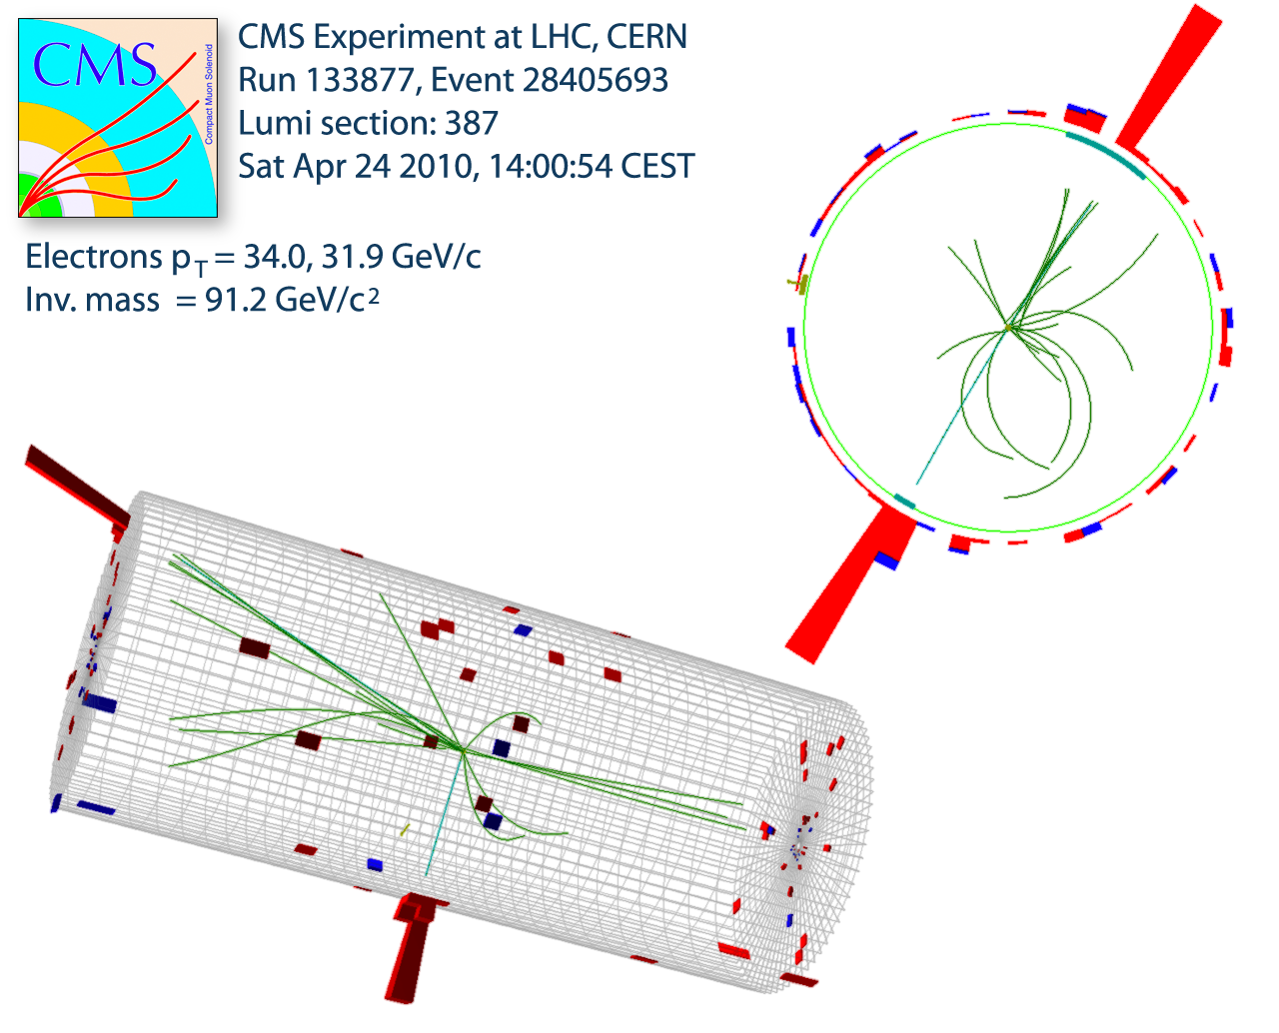
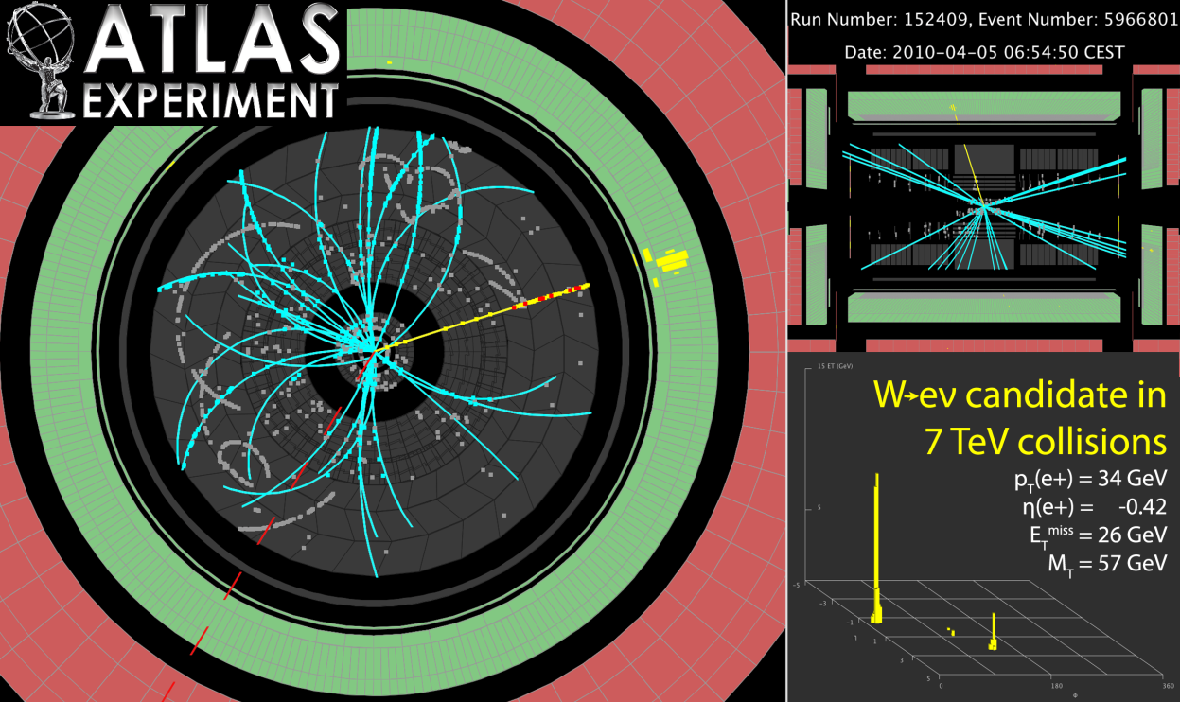
W/Z at 7 TeV: (still) clean & beautiful
Z → electron + positron
W → electron + neutrino

Slide 11
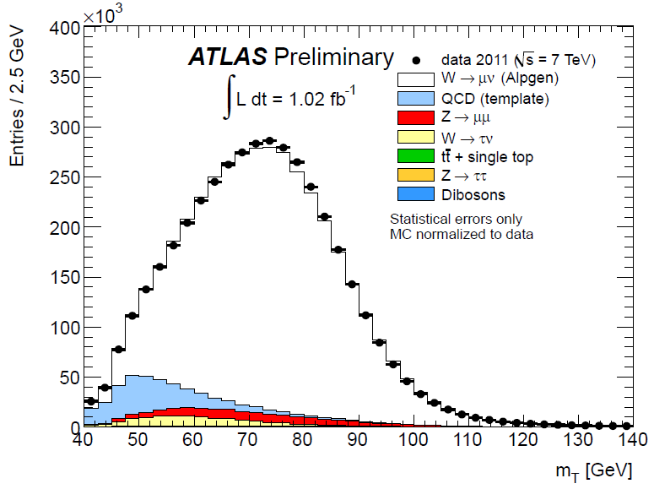
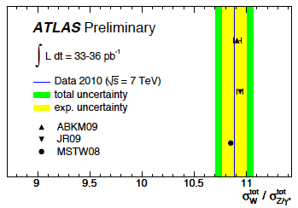
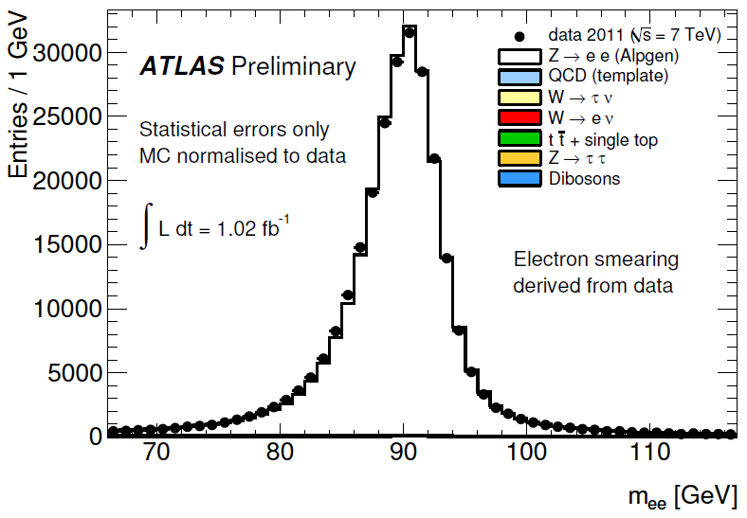
W/Z production (+LHC-specific obs)
Excellent agreement between data and simulation
Good agreement with NNLO+PDF theory predictions
Move to “new environment”:
  σ(W⁺)≠σ(W–) (~1.4)
  W polarization
W→μν
~4.3 M W→μν
Z→ee
264k Z→ee

Slide 12
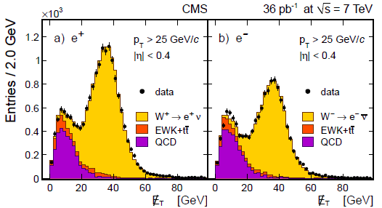
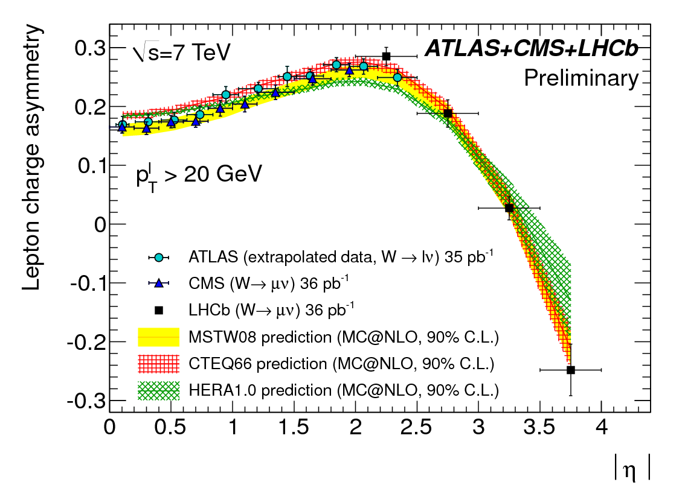
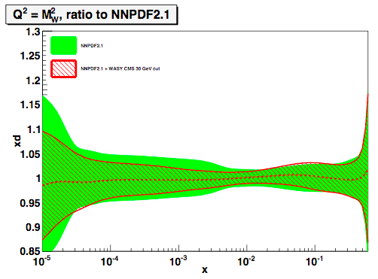
W production: charge asymmetry
Split samples in η; fit W⁺, W–.
In 10^{–3} < x < 10^{–2}:
measurement already improves d,u,q-bar PDFs by >40%
ATLAS-CONF-2011-129
LHCb-CONF-2011-039
CMS-EWK-10-006 (aXiv:1103.3407)

Slide 13
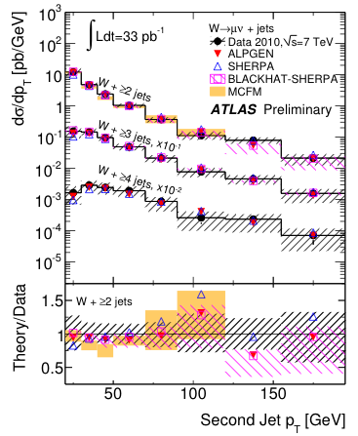
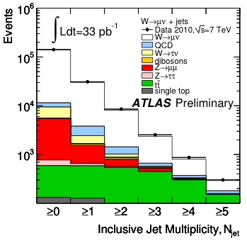
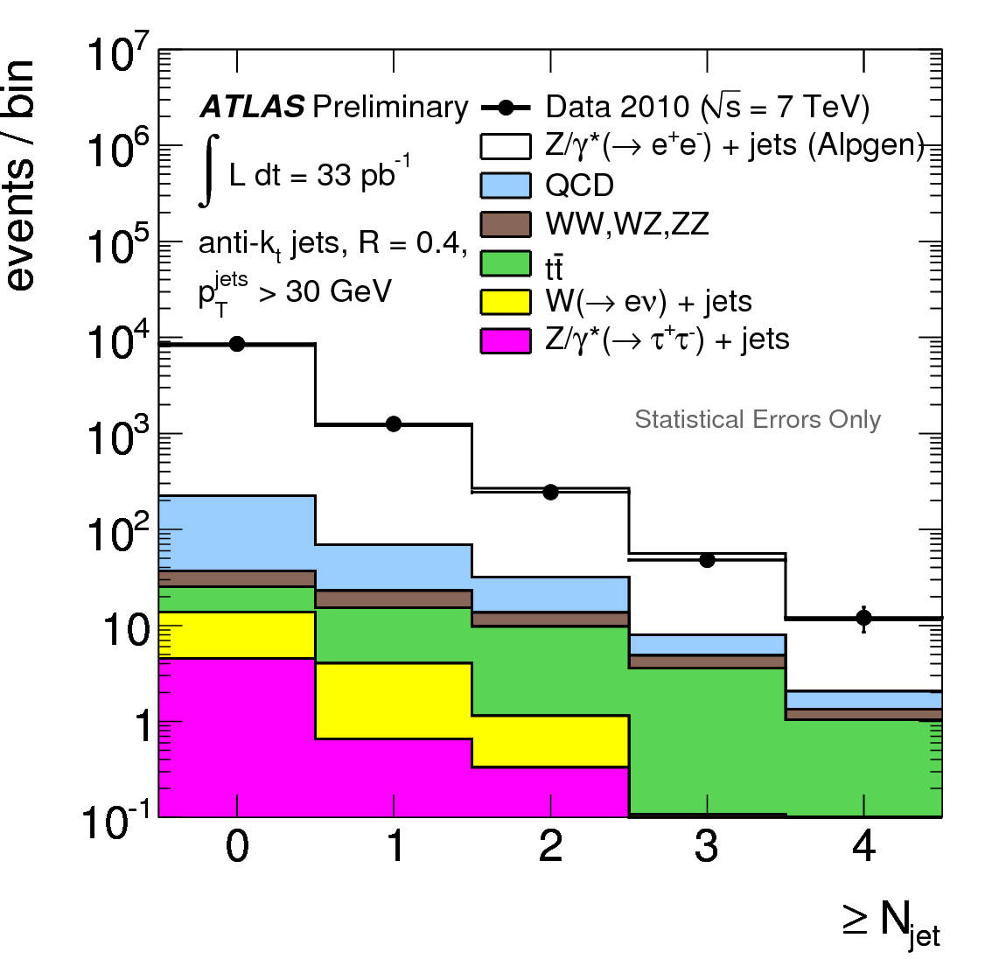
W/Z + jets
Background for top and new physics; especially at high p_{T}(W/Z); each jet “costs” ~α_{s}
Jet multiplicity and p_{T} distributions
  Good description by state-of-the art QCD NLO calculations and LO multi-parton generators
W+jets
Z+jets

Slide 14
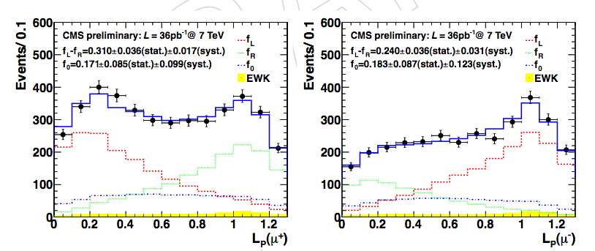
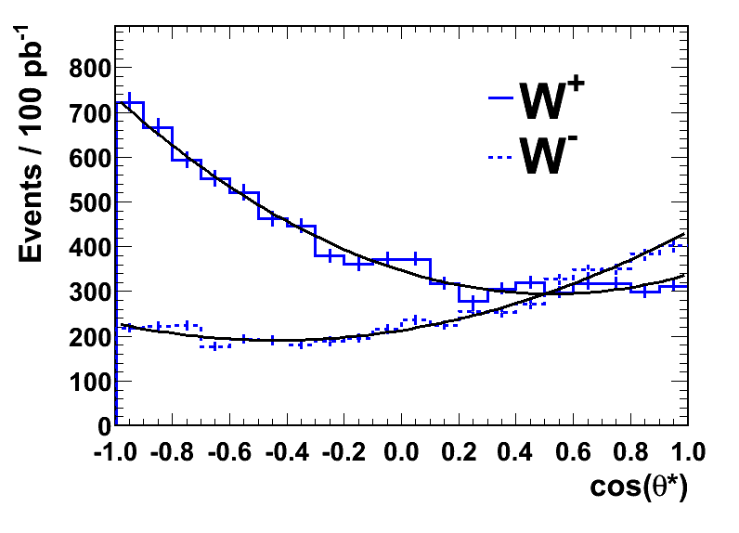
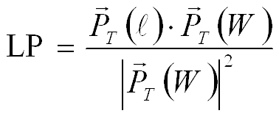
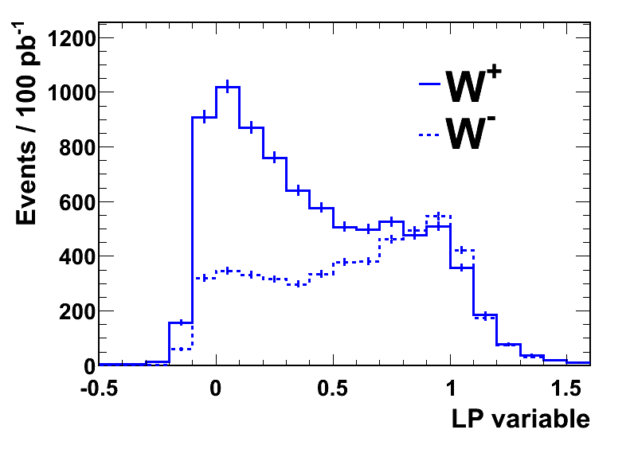
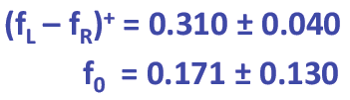
LHC-specific: W polarisation in pp
Production of high P_{T} (>50 GeV) W bosons:
  Valence quark – gluon (q_{v}-g) dominates. Strong polarisation effects in transverse plane at LHC expected.
  Initial states and CP counterparts not present in equal amounts at pp collider in contrast to pp-bar (Tevatron)
  → W’s produced in pp are mainly left-handed.
CMS z-dir
W⁺
W–
helicity
helicity
Preferred W spin directions
W+1jet dominant production mechanism at LHC (not a Feynman diagram)
However: cannot measure cosθ* (missing neutrino)
14
Notes:
14

Slide 15
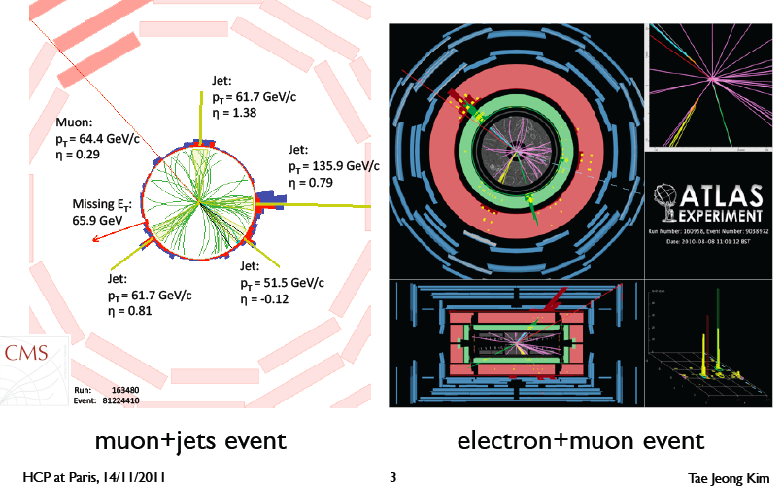
The most complex SM signal: the top

Slide 16
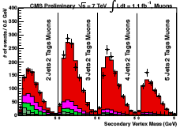
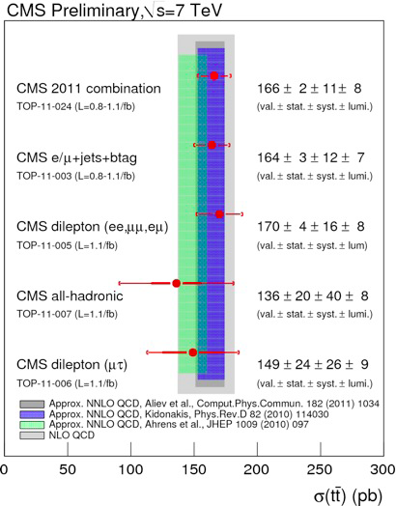
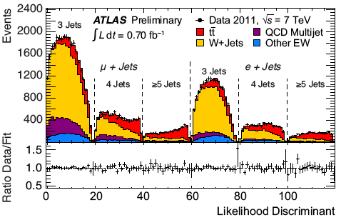
Top physics @ 7 TeV

Slide 17
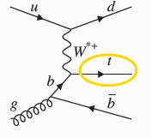
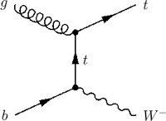
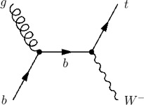
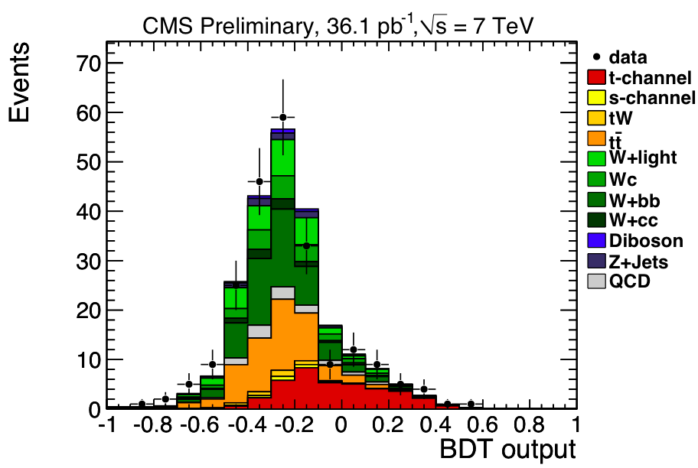
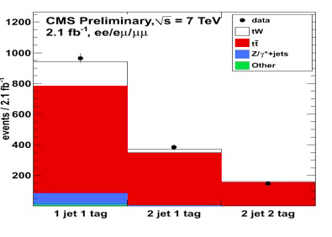
Small, tricky signals as well
Single-top production
t channel: 63 pb
Wt channel: 10 pb

Slide 18
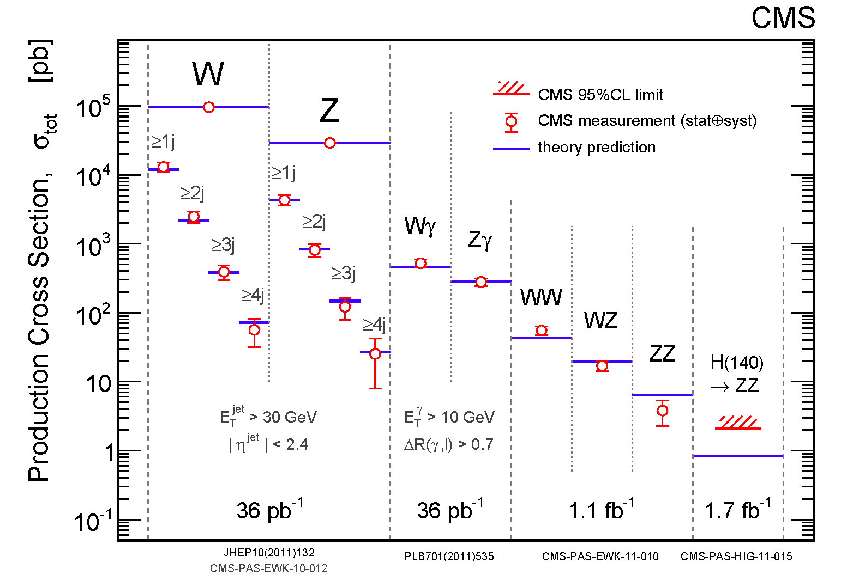
Standard model in pp collisions @ 7 TeV
Understanding of SM processes at level of Tevatron experiments.
  Let the search begin.

Slide 19
LHC(t₀+Δt=2yrs):
What about new physics?
Good news from the Higgs
“Bad” news from the searches

Slide 20
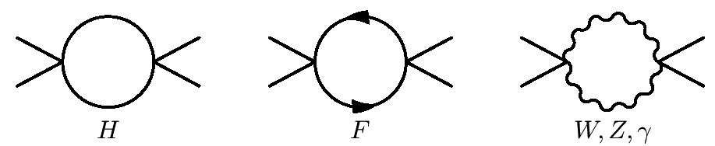

Scale of New Physics = F(M_{H})
V(φ)
Q²→∞, λ →∞!
φ
+
≠
V(φ)
φ

Slide 21
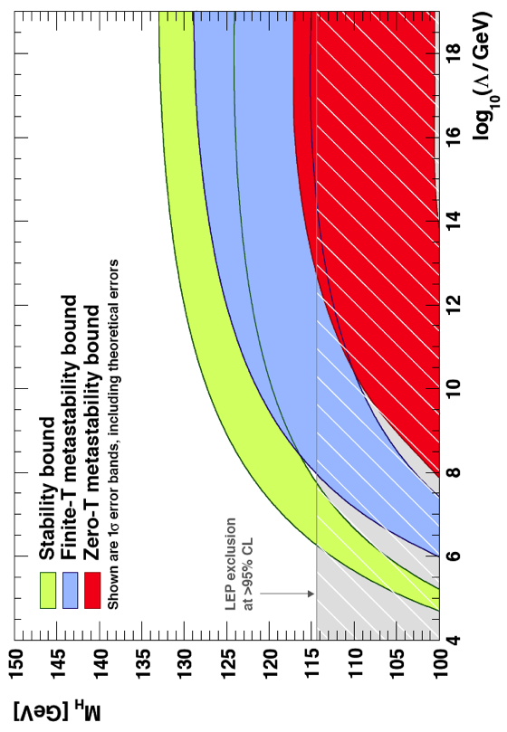
Zooming in: some good news
At 95% CL: there Is new physics at a scale below the GUT scale ☺
10¹⁸
10¹⁶
10¹⁴
10¹²
10¹⁰
10⁸
10⁶
10⁴
Excluded at 95% CL
☺
allowed region
100 110 120 130 140 150
M_{H} (GeV)

Slide 22
Where is the new physics?
Searches for signs of exotic New Physics

Slide 23
Many (many) possibilities
Compositeness; new contact interaction(s)
Exotica:
  Leptoquarks
  New gauge bosons (W’, Z’) – or resonances
  Fourth generation (b’)
  TeV-scale gravity: Black Holes; mono-jets; mono-photons; UED
    Universal Extra dimensions (diphotons)
Supersymmetry
  Squarks and gluinos
    Decays into jets and MET plus 0, 1 or 2 leptons
    Decays into photons (GMSB)
SUSY-based exotica
  Long-lived particles
The totally unexpected

Slide 24
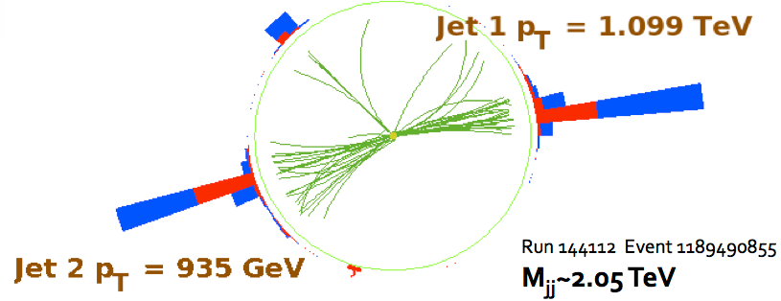
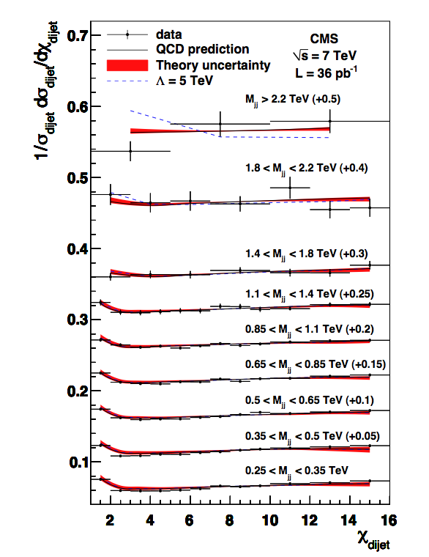
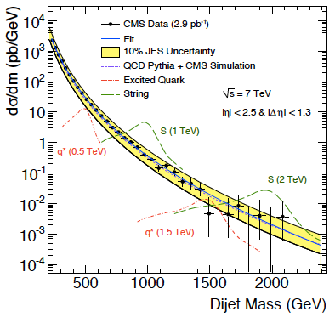
Jet searches (resonances, contact intrctn)
36pb⁻¹
Scale of contact interaction Λ>5.6 TeV (95% CL)

Slide 25
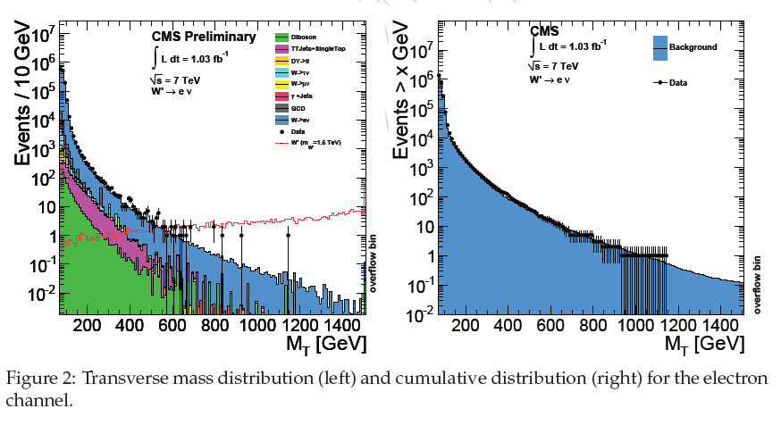
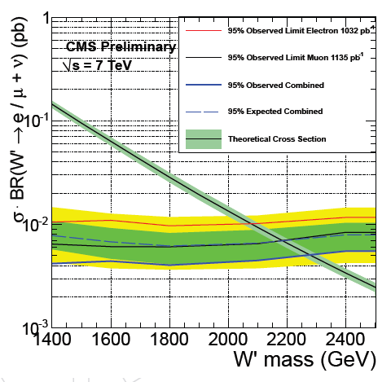
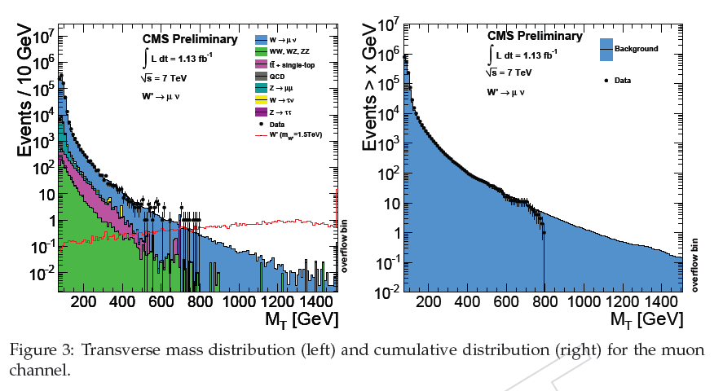
(Null) search for W′
2011 update:
1.03 fb⁻¹
Combined (SSM) limit:
M(W’)>2.20 TeV obs
M(W’)>2.27 TeV exp
2011 update:
1.13 fb⁻¹

Slide 26
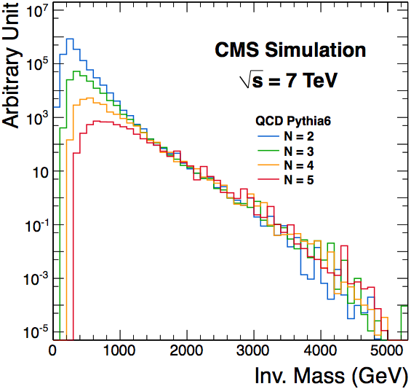
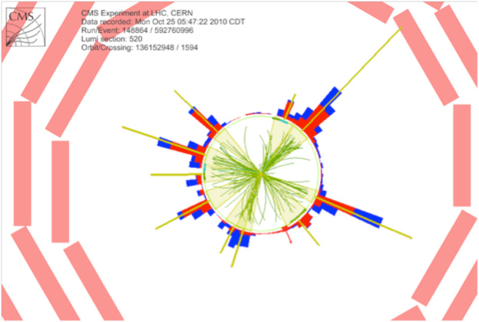
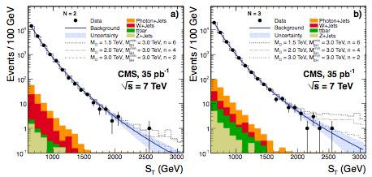
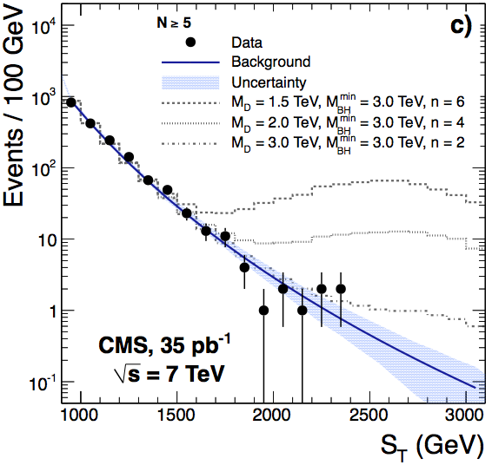
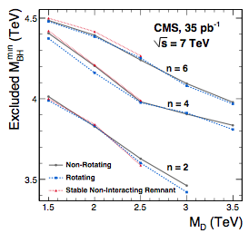
(Null) search for BHs
arXiv:1012.3375
Expect lots of activity in the event, so
  Use S_{T} = Sum E_{T} of all objects (including ME_{T}) with E_{T}>50 GeV.
    Great against pileup (in the future as well)
Key for search: S_{T}-invariance of final state multiplicity
  A posteriori wisdom: FSR/ISR collinear do not affect S_{T} a lot
Use N=2 shape (with uncertainties) to fit higher multiplicities – where signal more prominent
A candidate event with 10 jets and S_{T} = 1.3 TeV
M_{BH}> 3.5-4.5 TeV
(semi-classical
approximation)
No excess, so set limits on minimum M_{BH}

Slide 27
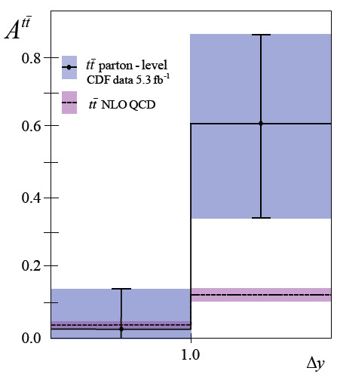
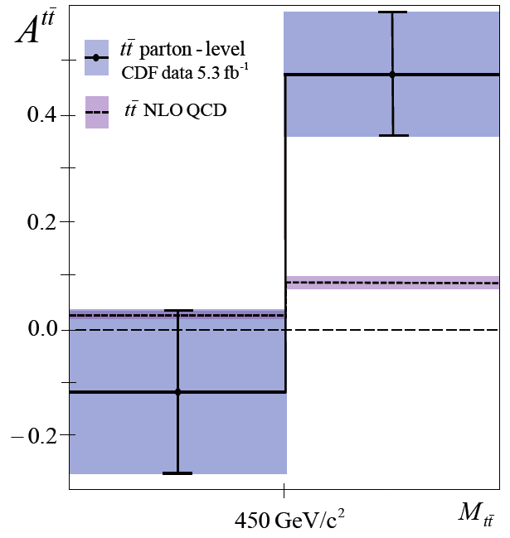
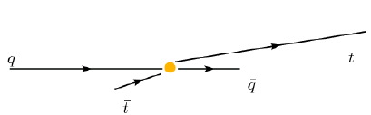
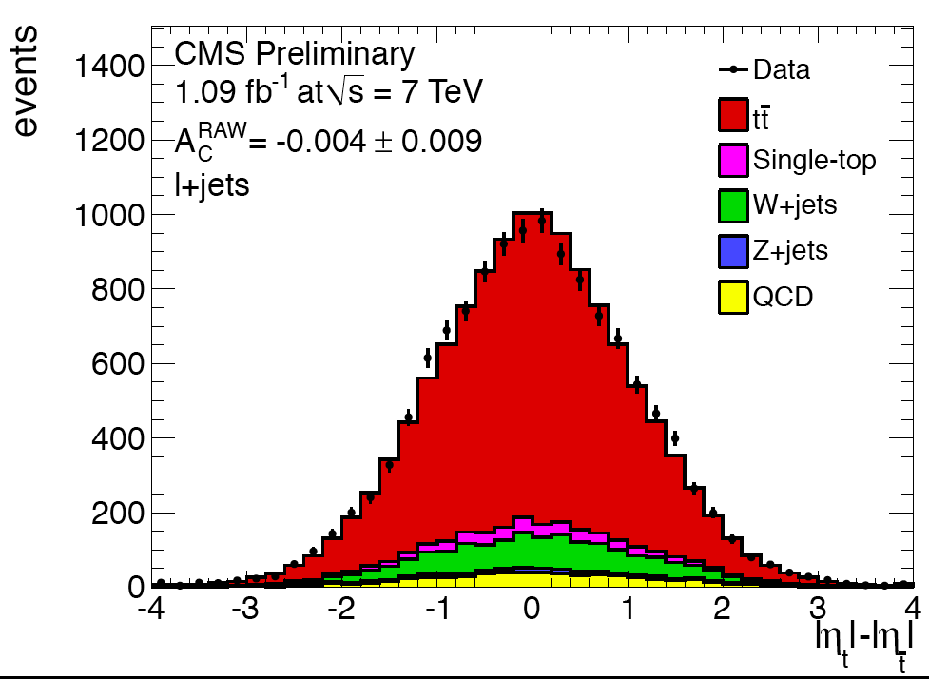
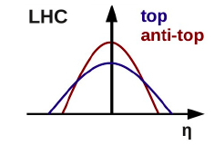


Top-antitop production
CDF/D0 measurement of forward‐backward asymmetry : ~3σ deviation from SM expectation
At the LHC:
No asymmetry
beyond SM observed

Slide 28
Supersymmetry

Slide 29

Supersymmetry: TO“E” at the Weak Scale
spin
The beautiful part: minimal price (one new principle plus an unknown SB mechanism)

Slide 30



Supersymmetry: TO“E” at the Weak Scale
spin
The beautiful part: minimal price (one new principle plus an unknown SB mechanism) yet it achieves quite a lot:
  No fine-tuning (large radiative corrections cancel)
  If Lightest SUSY Particle stable: offers “natural” dark-matter
  Equality of Strong, Weak and EM couplings at ~10¹⁶ GeV
boson
fermion
+
= 0
λ²
λ
λ
gauge boson
gaugino
= 0
+
g²
g
g

Slide 31

Supersymmetry: TO“E” at the Weak Scale
spin
The facts: despite conventional wisdom, SUSY is quite predictive: it specifies spins & couplings of superpartners
  At least as predictive as the SM (if one does not measure the CKM)
The ugly part: one unknown SB but 500% increase in number of parameters (MSSM). Unfortunately, nothing about the masses
  End result: large space of signatures, dependent on models
Even MSSM-124 is tough. Hard work to study particular scenario. Reduce complexity: use model of dynamical SYSY breaking
  mSUGRA (gravity-mediated)
  GMSB (gauge-mediated)
  AMSB (anomaly-mediated; studied in less detail)

Slide 32
SUSY: what we do not know
Agnostic approach: consider all possible mass hierarchies: there are 9! = 362880 of them
  ME_{T}: 4x8! (161,280) cases, LSP=weakly-interacting, neutral particle; phenomenology depends crucially on mass hierarchy
  CHAMPs: 8! (40,320) cases, LSP=e_{R} (charged, color-neutral); signature: CHAMP (independently of hierarchy)
  R-hadrons: 4x8! (161,280) cases, LSP=colored object; again, independent of hierarchy
arXiv:1008.2483: “How to look for supersymmetry under the lamppost at the LHC”; P.Konar, K.Matchev, M.Park, G.Sarangi

Slide 33
SUSY search with ME_{T}: summary of 2010
No signs yet. But all analysis methods in place; now need more data (2011!)
Corner around which SUSY would lie
Transp from
March 2011

Slide 34


In brief: SUSY moving further out
Simplified model: two squark (q) generations, m(χ₁⁰)~0
m_{g}>800 GeV m_{q}>850 GeV
Equal mass case: m_{g}=m_{q}>1.075 TeV
MSUGRA/CMSSM:
tanβ=10, A₀=0, μ>0
Equal mass case:
m_{q}=m_{g} > 980 GeV
2010→2011
2010→2011

Slide 35

Constrained MSSM
Corner around which SUSY used to lie

Slide 36
Then again…
A bit of a self-fulfilling prophecy; very early searches were guided by combination of “probability of success” and “obeying the rules”:
  Go after high cross section processes (i.e. accessible already with small integrated luminosity ~10-50 pb⁻¹)
  Do not rely on a perfectly working detector: seek robust signatures with good experimental control of “things”
  Do not rely on Monte Carlo; “thou shall use the data” (well, ok, and some Monte Carlo)
  Beat the competition: go after the simplest signatures
We have followed these four guidelines extremely well
  (another reason to rejoice – when we set to do sthng, we do)
  (another reason to think that there is much, much more)

Slide 37


What the LHC has done to/for the CMSSM
With 1fb⁻¹ of data the amount of naturalness need has diminished to “unnaturally” small values [?!?!]
  CMSSM being cornered. Not excluded [yet] but looking unlikely [e.g. “high fine-tuning price of the LHC” hep.ph/1101.2195]
But: (a) effect of g-2 ?! (b) SUSY >> CMSSM
CMSSM
68% CL
95% CL
NUHM1
….. pre-LHC
___ LHC@1fb⁻¹
without
g-2
MasterCode Project (Oliver Buchmüller et al)

Slide 38

SUSY is far from excluded (let alone dead)
Simple models (e.g. universal soft masses) being squeezed
Numerous other scenarii still very much unprobed [thus very unconstrained]. Two examples:
  Large flavor splitting: very heavy squarks [1st, 2nd gen], light 3rd gen (plus gluino at ~1-1.5 TeV)
  Low ME_{T}: not only within R_{p}-violation; small mass splittings (would be equally lethal to ME_{T} signature)
    Could even have all sparticles with mass < ~0.5 TeV…
Cohen et al (96)
Barbieri et al (07)

Slide 39




SUSY: we will always have the stop
Only the stop (+sb) need be light [e.g. Barbieri @ HCP 2011]
Some incredible signatures…

Slide 40




First stop searches (ATLAS)
SUSY will be unnatural if m_{stop}>1 TeV: this is a real challenge for the LHC experiments!

Slide 41






First sbottom searches
ATLAS, 2 b tags, MET 2fb⁻¹.
  Uses co-transverse mass
  End-point at
Notes:
41

Slide 42


Recently: use of simplified models
CMSSM
What we see:
much simpler…
Simplified Model Spectrum (SMS)
with 3 particles, 2 decay modes

Slide 43



Simplified models
Effect of varying MLSP:
  RED: M_{LSP}=0
  Green: M_{LSP}=195 GeV
  Blue: M_{LSP}=395 GeV
Gluinos
Squarks

Slide 44




Simplified Model Spectra
Started with squark and gluino pair-production topologies
Limits are “best of N” searches (usually not a combination)
Black lines are QCD-like cross sections
Theoretical uncertainties like ISR simulation important (under study)
Theoretical uncertainties not included
Caution: usage of SMs is the sole responsibility of the user. SUSY and all its incarnations bear no obligation for any and all hasty conclusions (from SMS’s).
M(gluino)>0.4-0.5 TeV

Slide 45











LHCb+CMS: B_{s}→μμ
Power of the loop; + double ratio
hep-ph:1108.3018
tanβ=30
tanβ=50

Slide 46
Heavy Stable Charged Particles
Both in SUSY and other SM extensions:
  SUSY (split SUSY: M(gluino)<<M(squark) → long lifetime; GMSB models: stau NLSP, decaying via gravitational coupling only…)
  Other: hidden valleys; GUTs; …
Two types of signatures: MIP & strongly-interacting
MIP: HSCP passes through tracker & muon chambers
R-hadrons traversing material can flip Q or become neutral
dE/dx: Massive, charged particles traversing detector: highly ionizing tracks (tracker, possibly muon dets)
(Out-of-time) Jet: particles stopping in the detector and decaying – possibly out-of-time with the collisions

Slide 47




Heavily ionizing tracks
Mass estimate from approximate Bethe-Bloch:
  K and C determined from proton data
    Mass resolution: 12% at 300 GeV
Cut on I_{AS} (MIP compatibility) & p_{T} (I_{AS}, p_{T}: uncorrelated)
  Bkg
K=2.58 MeV c²/cm
C=2.56 MeV/cm
600

Slide 48







Stopped gluinos
Slow (β < 0.4) long-lived gluinos hadronize into and then stop in the dense material of the CMS detector
  Their number builds up with luminosity:
They then decay μs, s or day(s) later. Their decay:
Spectacular jets in the absence of beam

Slide 49

A dizzying array of (null) searches

Slide 50
2012

Slide 51

LHC running in 2012: 8 TeV [?]
Enhances physics reach in two ways:
  Higher cross sections for new physics over full mass range
  More integrated luminosity
    @ 8 TeV: 10-16 fb⁻¹ expected (25/50 ns bunch-crossing)
Higgs: pp → H, H→ WW, ZZ & γγ
mainly gg: Factor ~1.2
SUSY: 3rd Gen Mass ~ 0.5 TeV
qq and gg: Factor ~1.5
SUSY: Squarks/Gluino M~1.5TeV
qq,gg,qg: Factor ~4.0
Z’ : Mass ~ 3.0 TeV
qq: Factor ~3.5
SUSY
squarks/Gluino
~1.5 TeV
or
Z’
~3.0 TeV
SUSY
3rd Gen
~500 GeV
Higgs
~ 100 GeV

Slide 52
Summary

Slide 53
Summary and Outlook
LHC and experiments’ run at 7 TeV truly impressive
  By now the detectors are fully functioning scientific instruments: physics-producing engines
With ~40pb⁻¹ the LHC observed all particles of the standard model (indirectly, even neutrinos)
  Solid basis for understanding the “background” to searches at higher mass and transverse energy scales
With 5 fb⁻¹ we entered a true discovery era. With 10-15 fb⁻¹: discovery [no matter what]
  “SUSY” explorable over very large area with 1 fb⁻¹; possible new resonances. Very large reach for other new physics.
  But nobody said it would be easy. We have to start looking hard for the more complicated scenarios.
  Perhaps unification should start in the physics [search] groups
Thankfully, there is also always the anthropic principle.
  Anthropically, history repeats itself ☺ → we should find something unexpected!
The journey has only just started!

