Slide 1


Parton Distributions and
Higgs Production at the LHC
James Stirling
Cambridge University
introduction: overview and
    recent developments
LHC Higgs cross sections
and correlations
summary
Higgs at the LHC, ETH Zürich, January 2012

Slide 2
1
Introduction: overview and recent developments

Slide 3
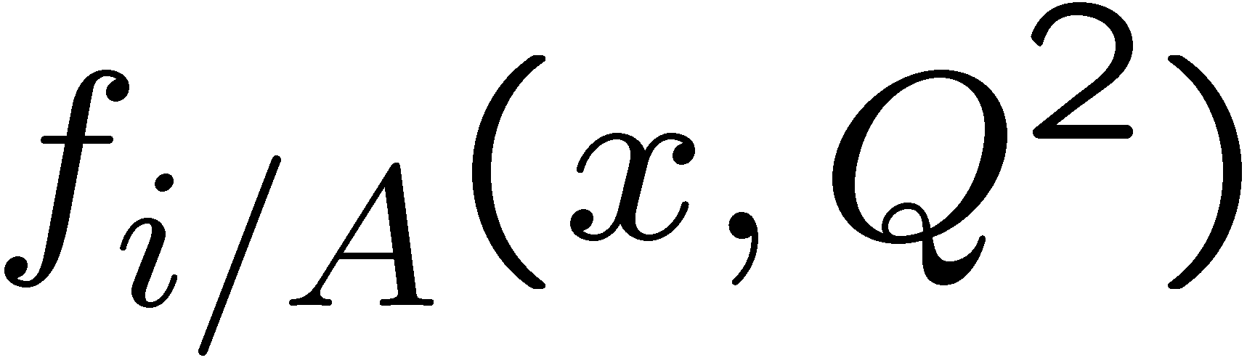
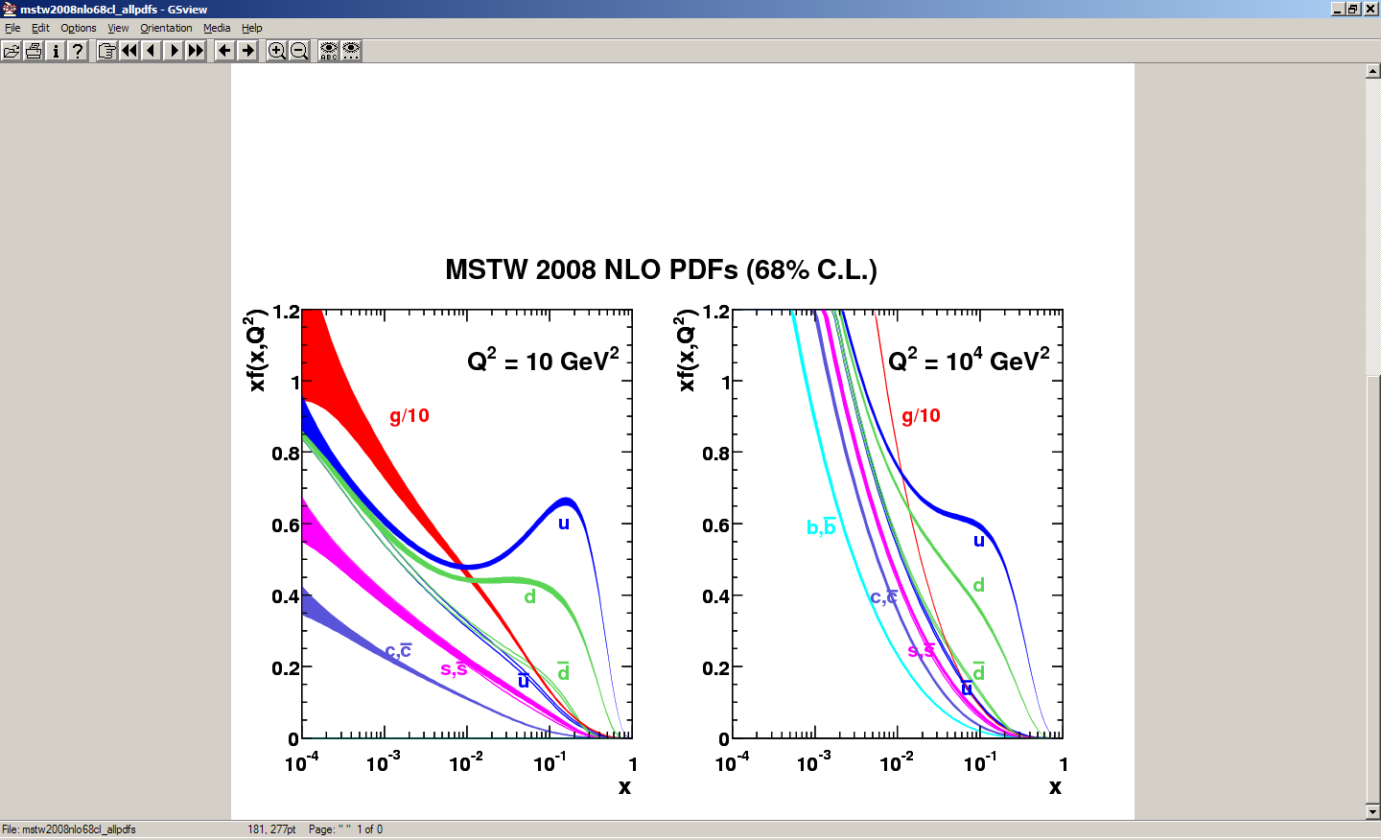
parton distribution functions
introduced by Feynman (1969) in the parton model, to explain Bjorken scaling in deep inelastic scattering data; interpretation as probability distributions
obtained by fitting a wide variety of high-precision deep inelastic and other hadron collider data (‘global PDF fits’)
key ingredients for LHC phenomenology
according to the QCD factorisation theorem for inclusive hard scattering processes, universal distributions containing long-distance structure of hadrons; related to parton model distributions at leading order, but with logarithmic scaling violations (DGLAP)

Slide 4
precision phenomenology at LHC
Benchmarking → precision predictions
  inclusive SM quantities (V=(γ*,W,Z), jets, top,… ), calculated to the highest precision available (e.g. NNLO, NNLL, etc) and compared with exptl. measurements
  tools needed: robust jet algorithms, kinematics, decays included, PDFs, …
  theory uncertainty in predictions:
  such comparisons give confidence in the calculation of SM backgrounds, e.g. {V,VV,bb,tt,H,…} + jets
δσ_{th} = δσ_{UHO} ⊕ δσ_{PDF} ⊕ δσ_{param} ⊕ …

Slide 5
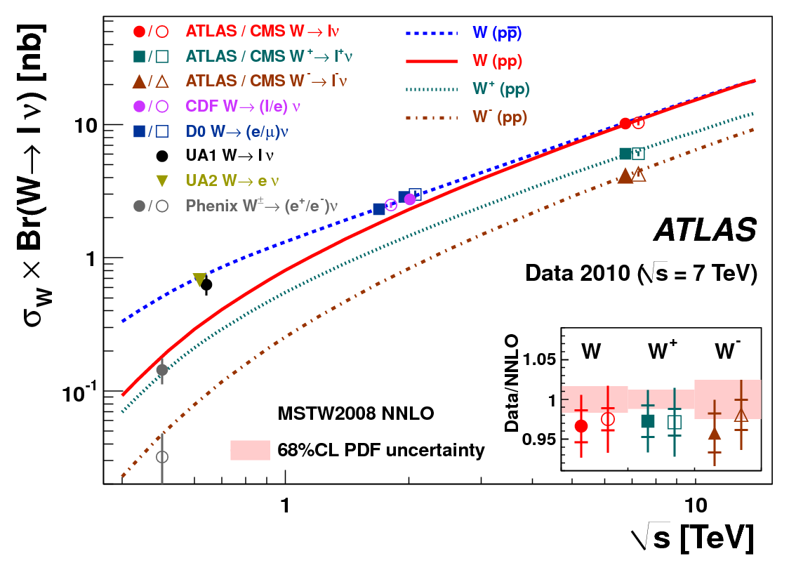
W cross section measurements
δ_{theory} ~ ± 1-2%
ATLAS-CONF-2011-041

Slide 6
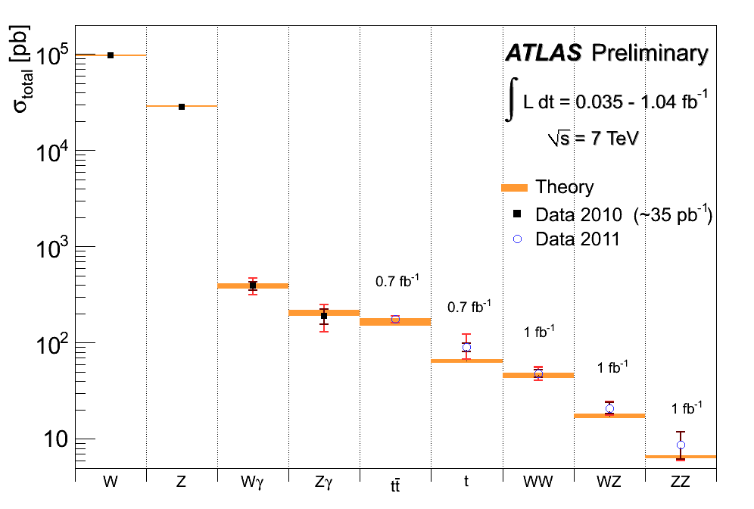

Slide 7
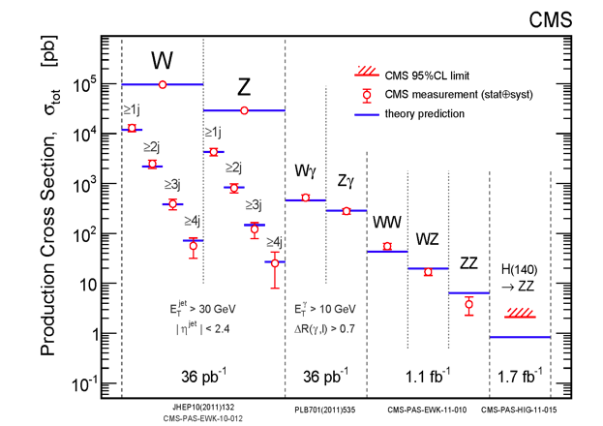

Slide 8
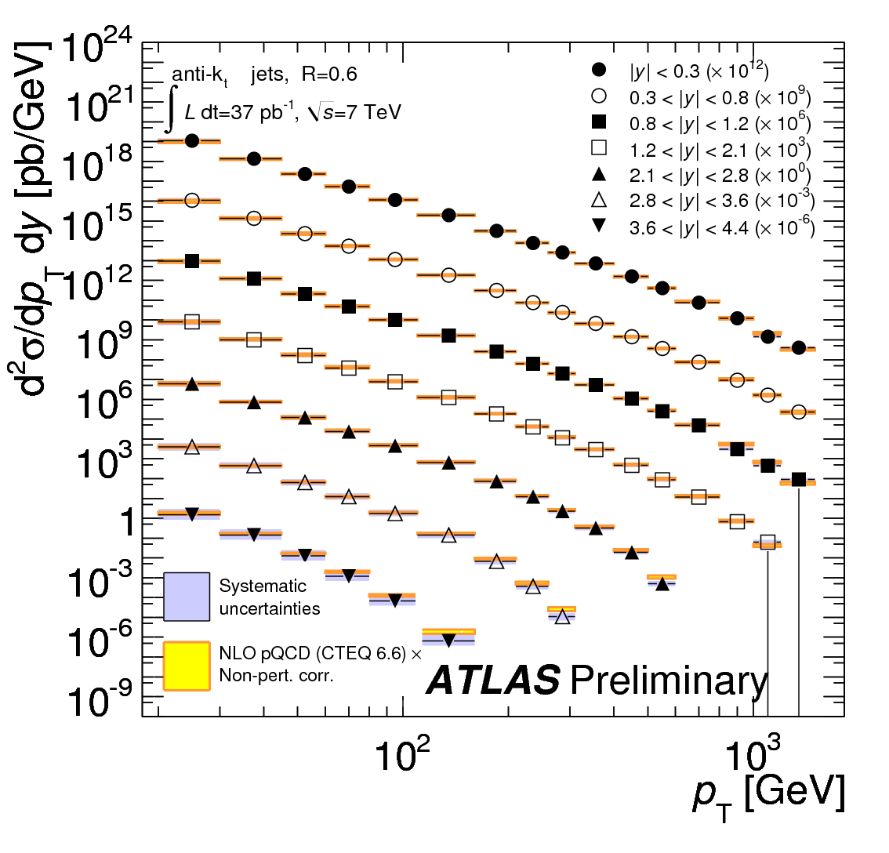
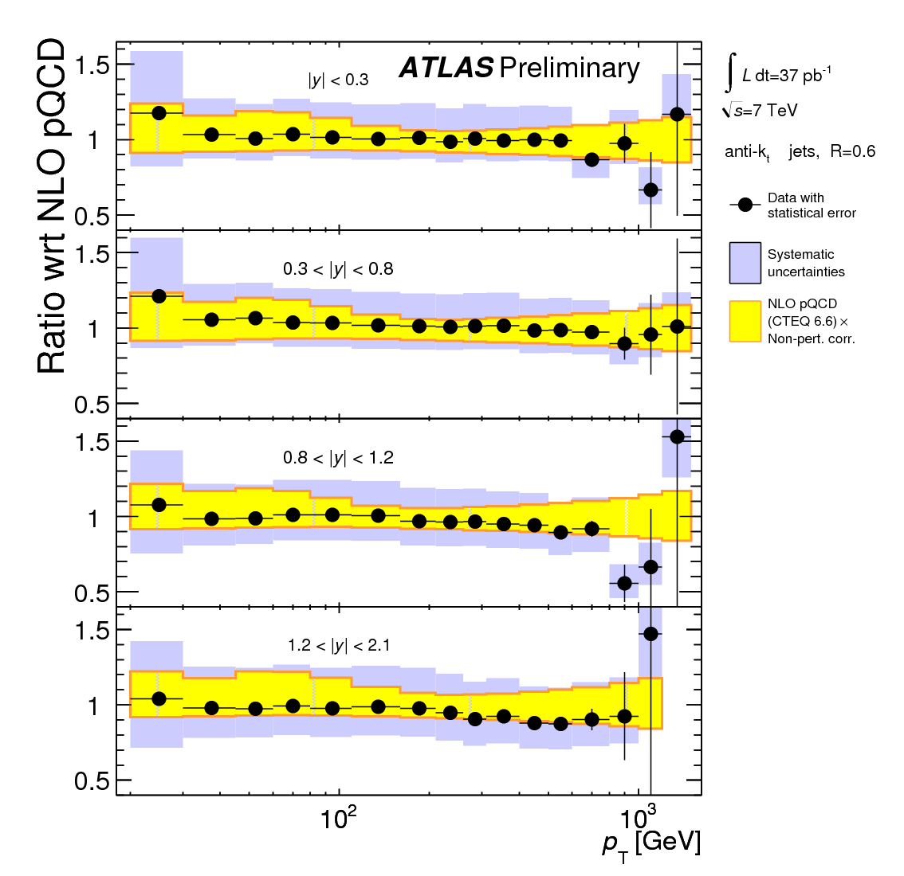
inclusive jet cross section

Slide 9
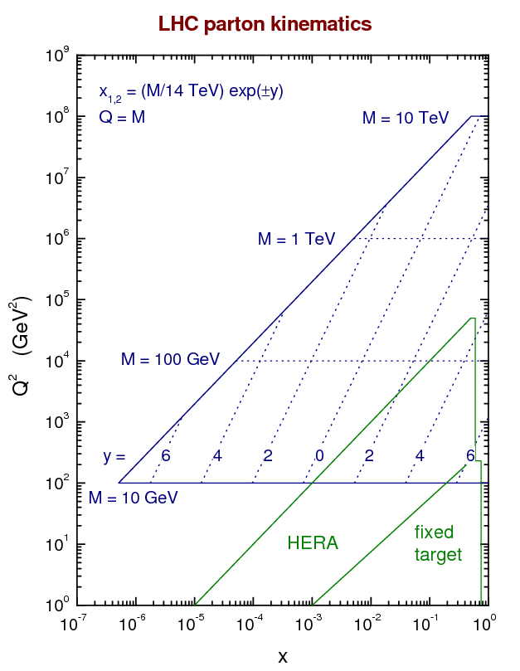
PDF fitting
  LHC can in principle provide complementary (and new?) information on PDFs, particularly from well measured, generally inclusive, Standard Candle cross sections (W,Z,jets,tt,…)
  the process has already started...
SUSY,
Higgs,
top, W,Z,
…
γ* ?
proton
X
proton
x₁P
x₂P

Slide 10
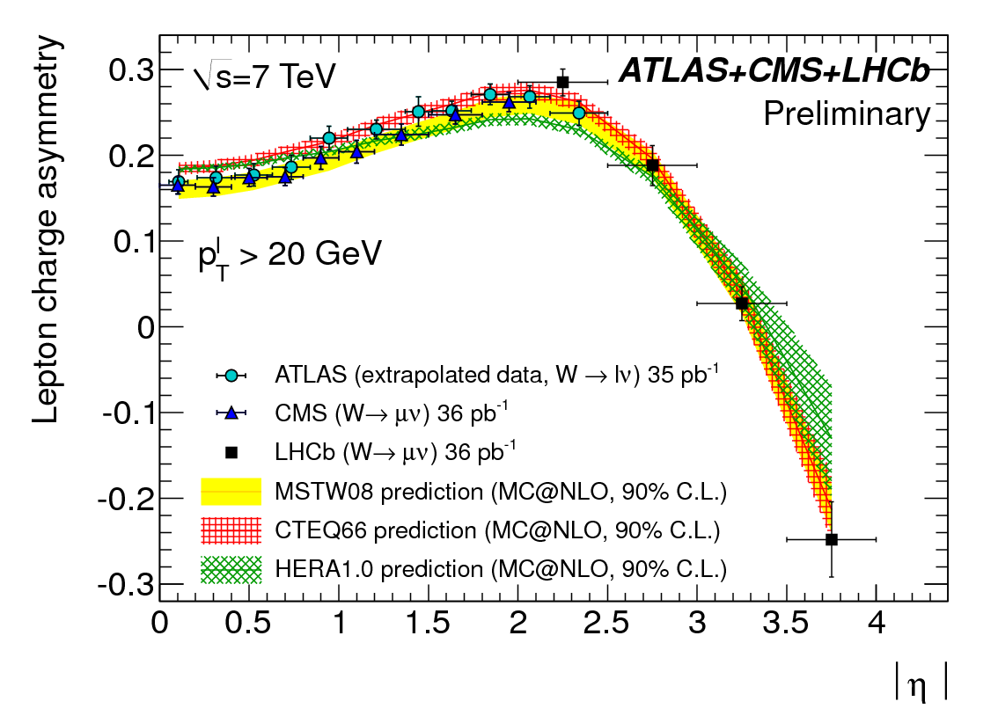
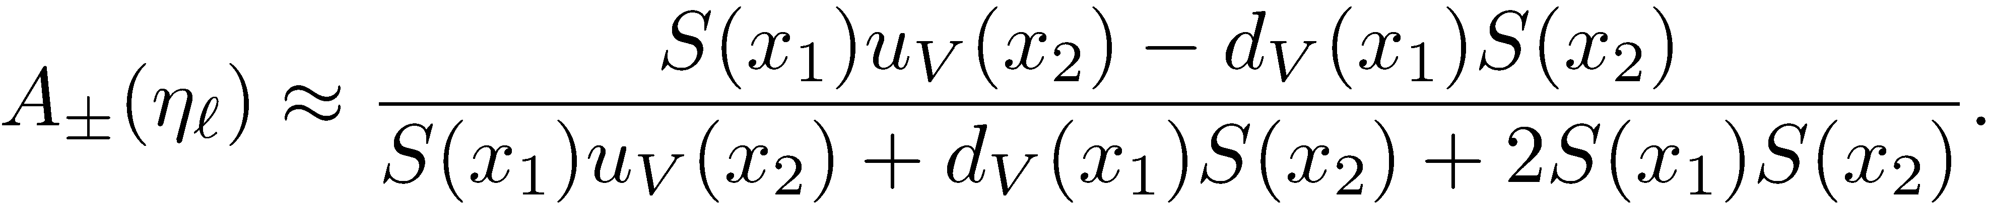
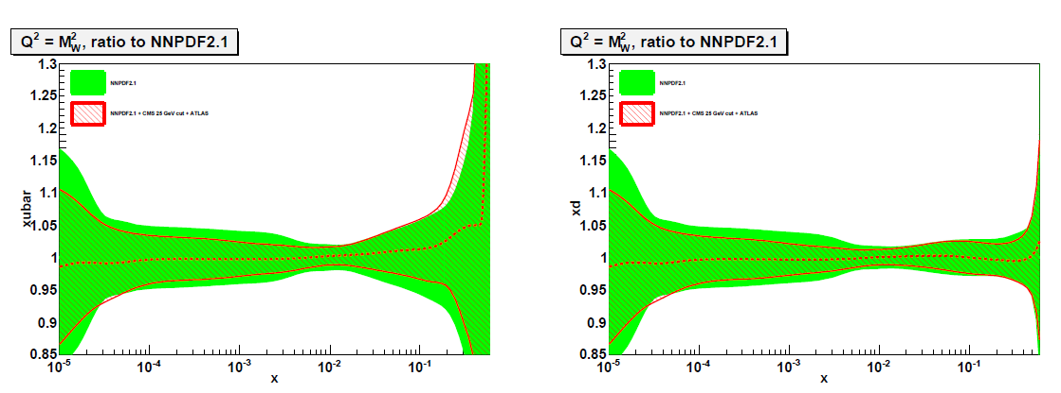
W rapidity asymmetry
l±
W
impact of LHC W asymmetry on NNPDF ubar and d PDFs

Slide 11
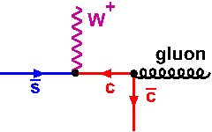
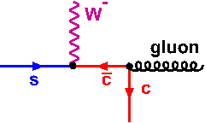


probing heavy quark pdfs
take advantage of (a) qg dominates W,Z + jet production, (b) heavy quark suppression becomes weaker at high Q², small x, (c) ability to tag c,b jets
CMS: “W production in association with c jets” (CMS-PAS-EWK-11-013)
sbar / s
sbar + s
Z
differences at level of exptl.
systematic error!
Also: Z + c as a measure of charm pdf

Slide 12
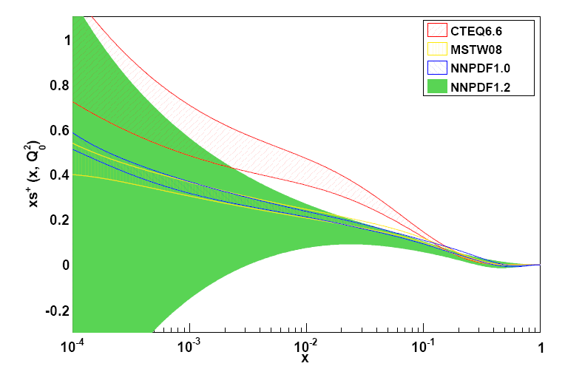
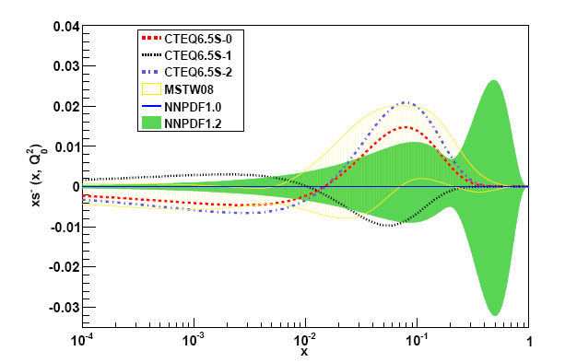
strange quarks in NNPDF, MSTW, CTEQ
s + sbar
s - sbar
Note:
MSTW: assume u,d,s quarks have same x^{δ} behaviour as x → 0

Slide 13
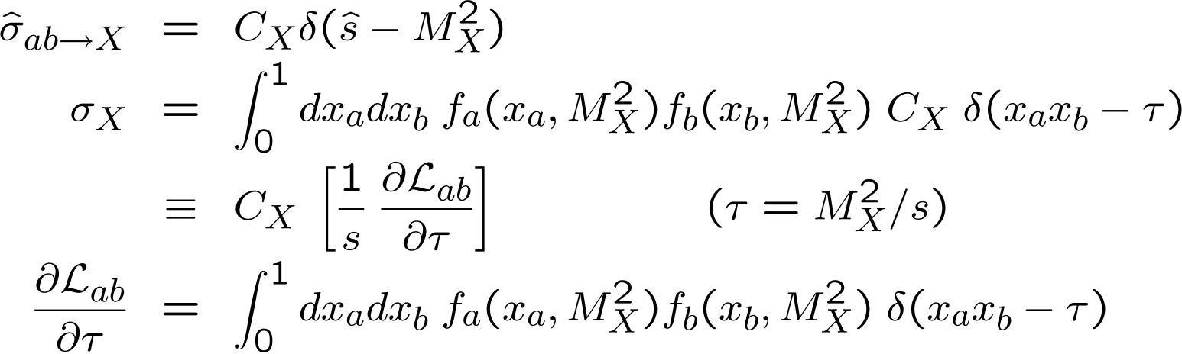

parton luminosity functions
a quick and easy way to assess the mass and collider energy dependence of production cross sections, and to compare different PDF sets
a
√s X
b
i.e. all the mass and energy dependence is contained in the X-independent parton luminosity function in [ ]
useful combinations are
and also useful for assessing the uncertainty on cross sections due to uncertainties in the PDFs

Slide 14
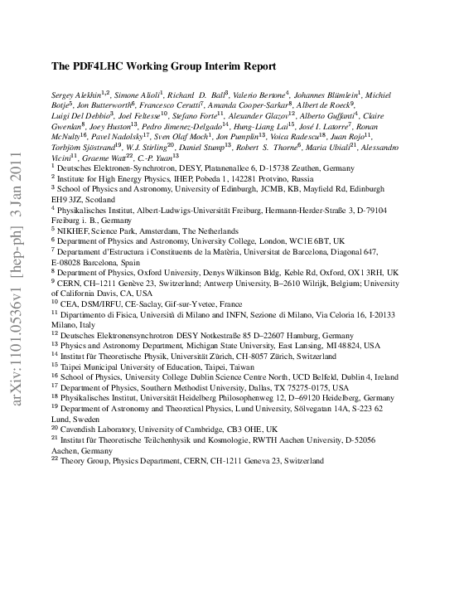
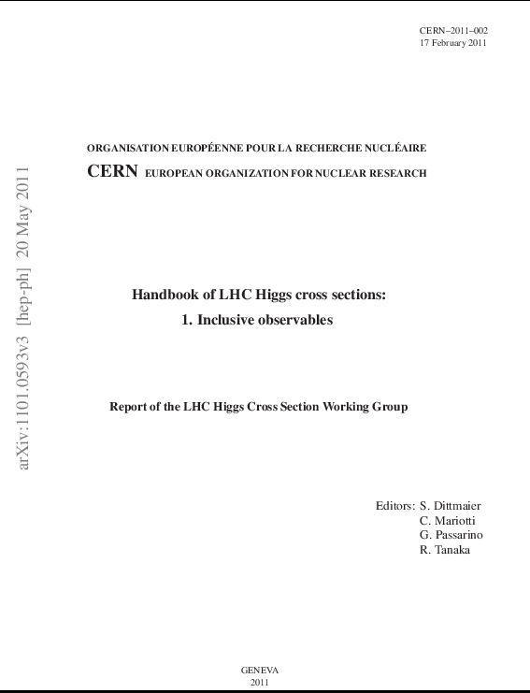
benchmark cross sections at 7 TeV from 6 fitting groups
Chapter 8: Parton Distribution Functions (S. Forte et al.)

Slide 15
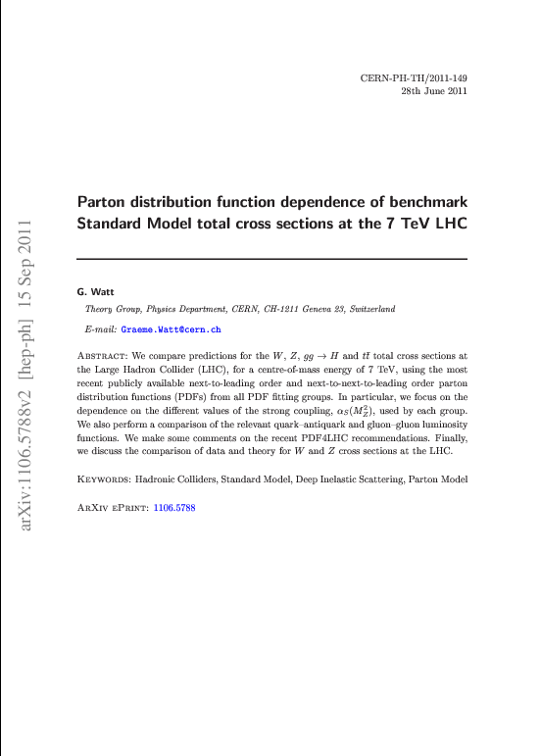
See also ....
and many plots at ...
http://projects.hepforge.org/mstwpdf/pdf4lhc/

Slide 16
recent global or quasi-global PDF fits
PDFs | authors | arXiv
ABKM | S. Alekhin, J. Blümlein, S. Klein, S. Moch, and others | 1105.5349, 1007.3657, 0908.3128, 0908.2766, …
CTEQ | H.-L. Lai, M. Guzzi, J. Huston, Z. Li, P. Nadolsky, J. Pumplin, C.-P. Yuan, and others | 1007.2241, 1004.4624, 0910.4183, 0904.2424, 0802.0007, …
GJR | M. Glück, P. Jimenez-Delgado, E. Reya, and others | 1006.5890, 0909.1711, 0810.4274, …
HERAPDF | H1 and ZEUS collaborations | 1012.1438,1006.4471, 0906.1108, …
MSTW | A.D. Martin, W.J. Stirling, R.S. Thorne, G. Watt | 1007.2624, 1006.2753, 0905.3531, 0901.0002, …
NNPDF | R. Ball, L. Del Debbio, S. Forte, A. Guffanti, J. Latorre, J. Rojo, M. Ubiali, and others | 1108.1758, 1107.2652, 1102.3182, 1101.1300, 1012.0836, 1005.0397, 1002.4407, …

Slide 17
2010 (shown at the January 2011 Heavy Quarks meeting)
 | MSTW08 | CTEQ6.6 | NNPDF2.0 | HERAPDF1.0 | ABKM09 | GJR08/JR09
HERA DIS | ✓ | ✓ | ✓ | ✓ | ✓ | ✓
F-T DIS | ✓ | ✓ | ✓ | ✗ | ✓ | ✓
F-T DY | ✓ | ✓ | ✓ | ✗ | ✓ | ✓
TEV W,Z | ✓ | ✓ | ✓ | ✗ | ✗ | ✗
TEV jets | ✓ | ✓ | ✓ | ✗ | ✗ | ✓/✗
GM-VFNS | ✓ | ✓ | ✗ | ✓ | ✗ | ✗
NNLO | ✓ | ✗ | ✗ | ✗ | ✓ | ✓

Slide 18
January 2012
 | MSTW08 | CT10 | NNPDF2.1 | HERAPDF1.5 | ABKM09 | GJR08/JR09
HERA DIS | ✓ | ✓ | ✓ | ✓ | ✓ | ✓
F-T DIS | ✓ | ✓ | ✓ | ✗ | ✓ | ✓
F-T DY | ✓ | ✓ | ✓ | ✗ | ✓ | ✓
TEV W,Z | ✓ | ✓ | ✓ | ✗ | ✗ | ✗
TEV jets | ✓ | ✓ | ✓ | ✗ | ✗ | ✓/✗
GM-VFNS | ✓ | ✓ | ✓ | ✓ | ✗ | ✗
NNLO | ✓ | ✗ | ✓ | ✓ | ✓ | ✓
– all available in LHAPDF V5.8.6 (August 2011)

Slide 19
Note:
not ‘true’ NNLO fits when collider inclusive jet data are included, since NNLO pQCD corrections not yet known
all except CTEQ/CT now have publicly available NNLO sets
PDF groups may also have ‘internal’ unpublished sets (e.g. CT-NNLO, HERAPDF1.6/7, ABM10, ...)
convergence and broad agreement (see below), but still differences for example due to
  choice of data sets (including cuts, corrections and weighting) and treatment of data errors
  definition of ‘PDF uncertainties’
  treatment of heavy quarks (s,c,b), FFNS, ZM-VFNS, GM-VFNS,
  treatment of α_{S} (fitted or fixed)
  parametric form at Q₀
  (hidden) theoretical assumptions (if any) about flavour symmetries, x→0,1 behaviour, etc.
  ...

Slide 20
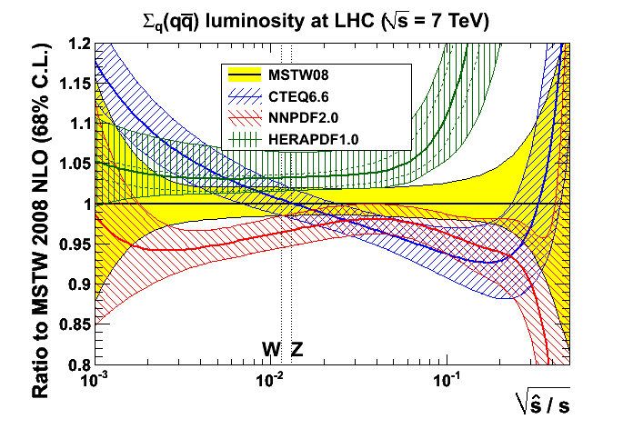
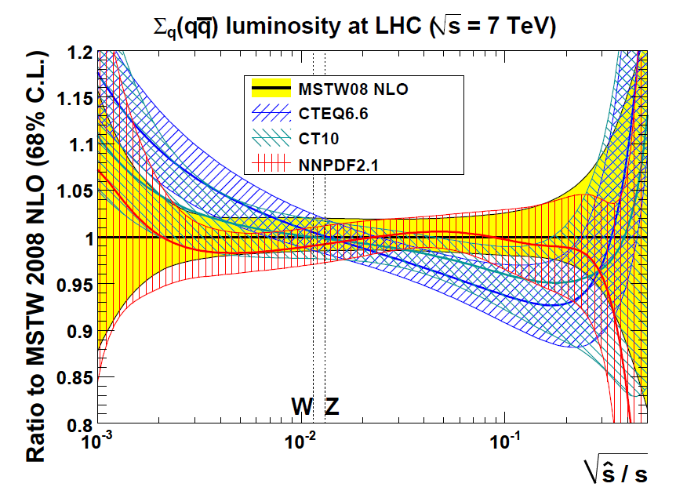
convergence of pdfs!
plots from Graeme Watt
2010
2011
... although still some differences with ABKM, GJR, HERAPDF
Note: NPDF2.0→2.1: ZM-VFNS → GM-VFNS (FONLL) → larger PDFs at small x
CTEQ6.6→CT10: Tevatron Run II jets + extended parametrisation + ...

Slide 21
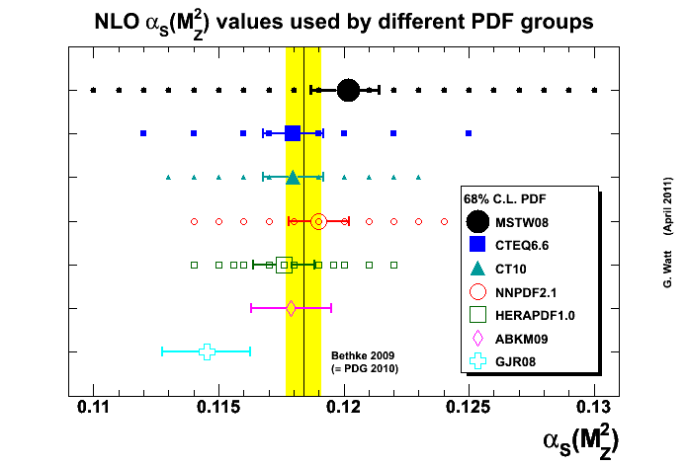
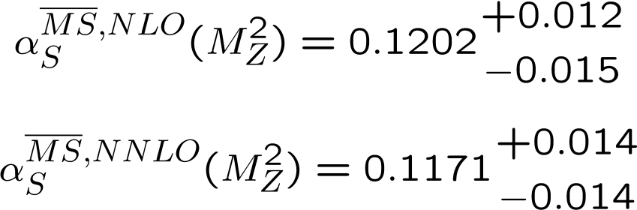

PDFs and α_{S}(M_{Z}²)
MSTW08, ABKM09 and GJR08: α_{S}(M_{Z}²) values and uncertainty determined by global fit
NNLO value about 0.003 − 0.004 lower than NLO value, e.g. for MSTW08
CTEQ/CT10, NNPDF, HERAPDF choose standard values and uncertainties
world average (Bethke 2009)
note that the PDFs and α_{S} are correlated!
e.g. gluon – α_{S} anticorrelation at small x and quark – α_{S} anticorrelation at large x

Slide 22
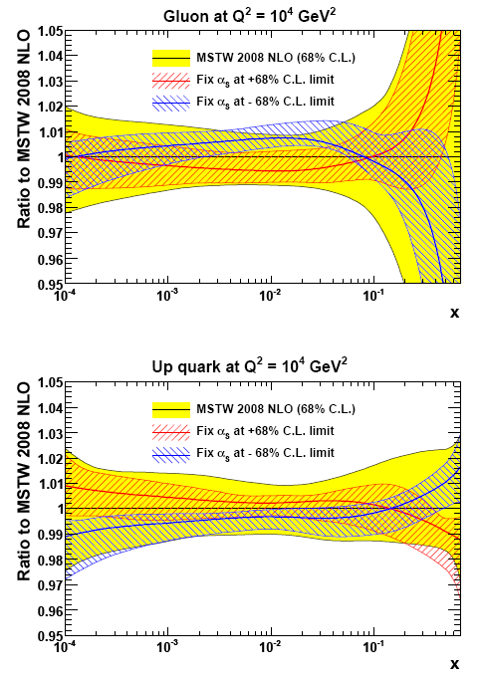
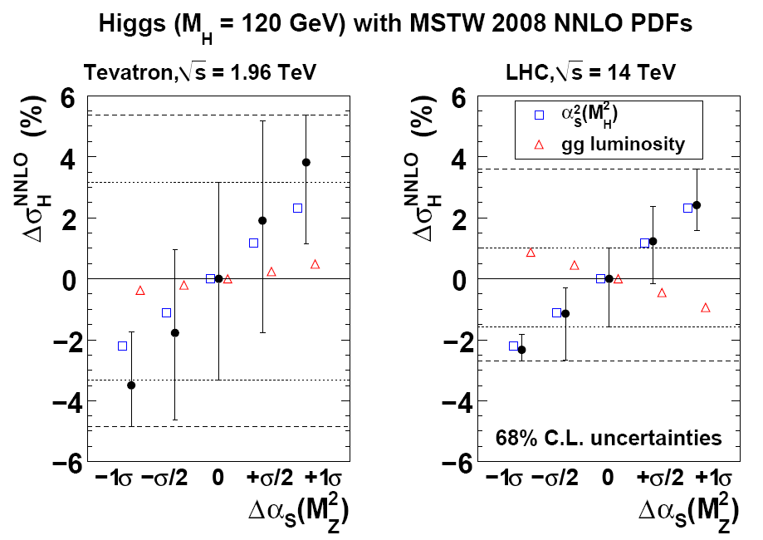
α_{S} - PDF correlations
care needed when assessing impact of varying α_{S} on cross sections ~ (α_{S} )^{n} (e.g. top, Higgs)
MSTW: arXiv:0905.3531

Slide 23
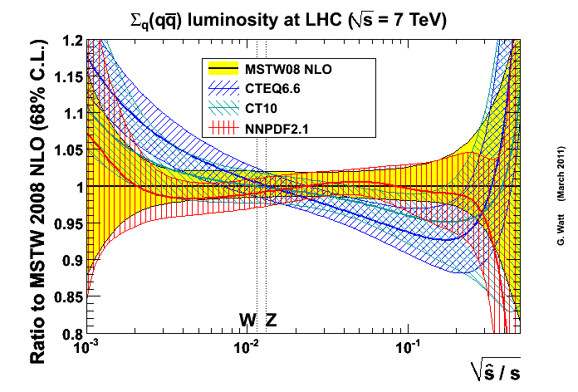
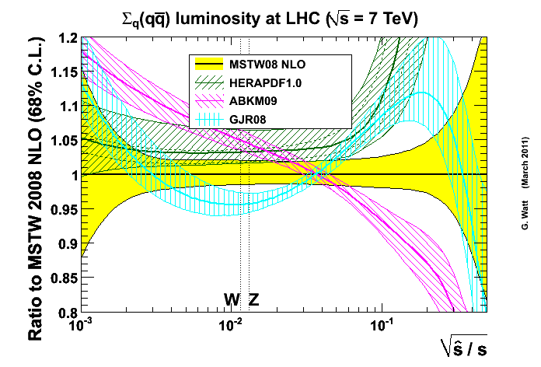
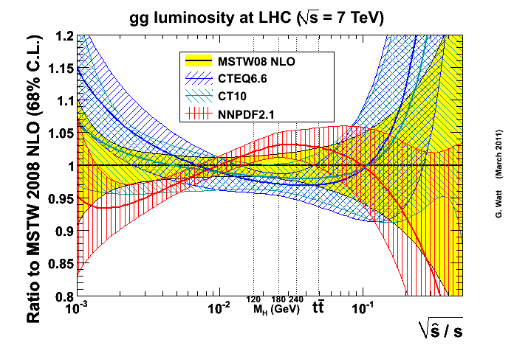
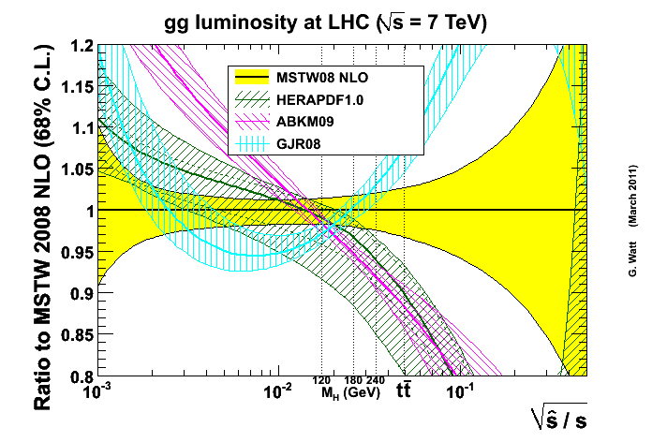
comparison of NLO parton luminosity functions at 7 TeV LHC

Slide 24
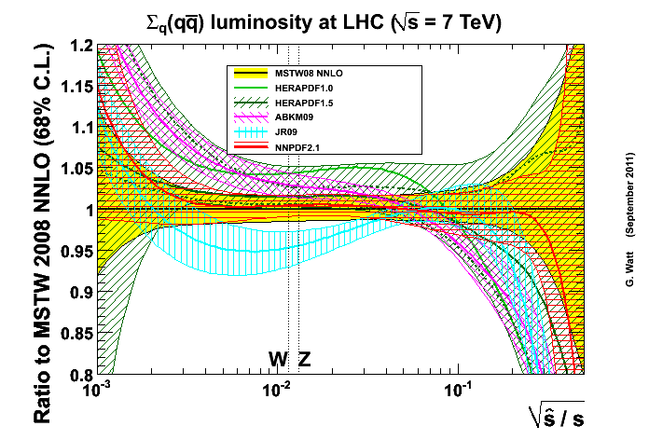
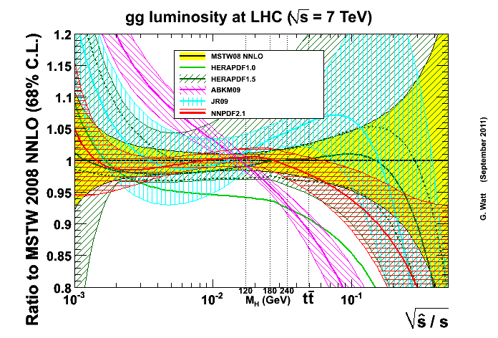
comparison of NNLO parton luminosity functions at 7 TeV LHC

Slide 25
The ‘PDF4LHC recommendation’* for combining best fits and uncertainties from different PDF sets into a single prediction
NLO
NNLO
“For the calculation of uncertainties at the LHC, use the envelope provided by the central values and PDF+α_{s} errors from the MSTW08, CTEQ6.6, and NNPDF2.0 PDFs, using each group’s prescriptions for combining the two types of errors. We propose this definition of an envelope because the deviations between the predictions can sometimes be as large as their uncertainties. As a central value, use the midpoint of this envelope. We follow the PDF4LHC prescription and recommend that a 68% CL uncertainty envelope be calculated and the α_{s} variation suggested is consistent with this. Note that the CTEQ6.6 set has uncertainties and α_{s} variations provided only at 90% CL and thus their uncertainties should be reduced by a factor of 1.645 for 68% CL. Within the quadratic approximation, this procedure is exact.”
“As a central value, use the MSTW08 prediction. As an uncertainty, take the same percentage
uncertainty on this NNLO prediction as found using the NLO uncertainty prescription given above.”
2011 update: CTEQ6.6 → CT10, NNPDF2.0 → NNPDF2.1
*S. Forte, J. Huston, K. Mazumdar, R.S. Thorne and A. Vicini, Section 8, in Report of the LHC Higgs Cross Section Working Group, arXiv:1101.0593

Slide 26
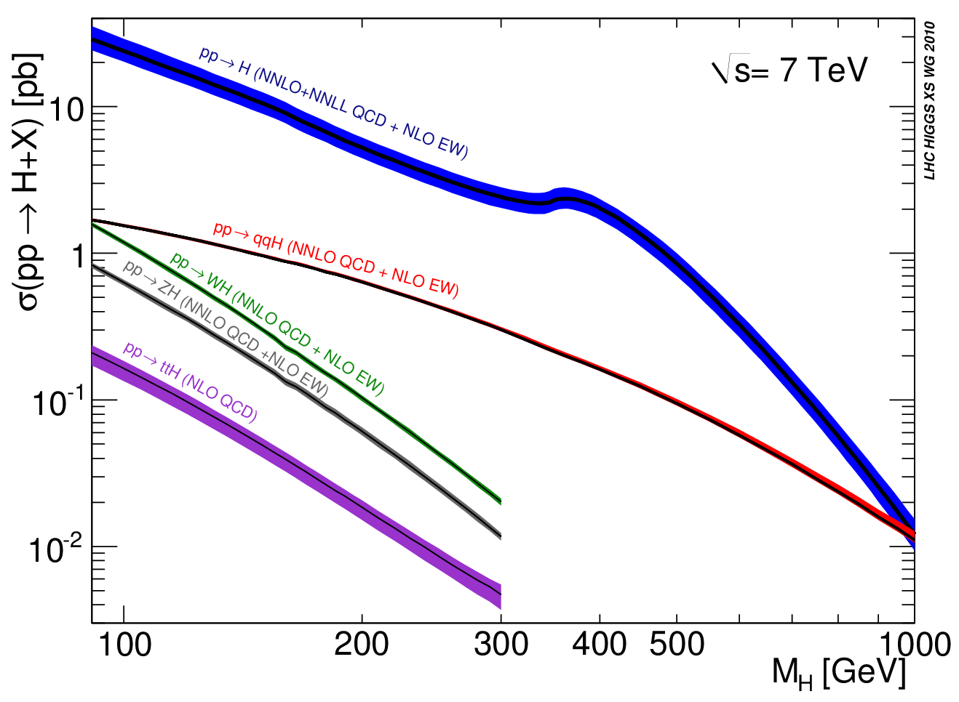
2
Higgs cross sections

Slide 27
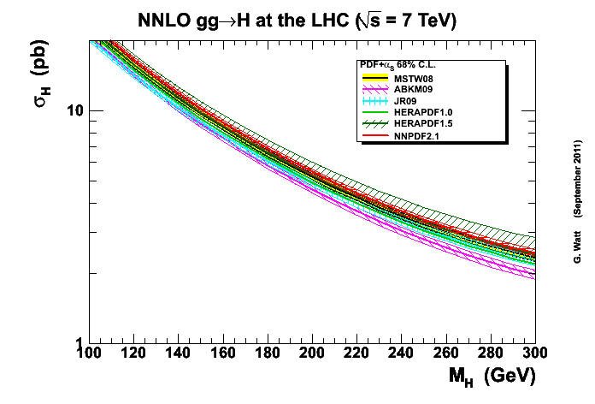
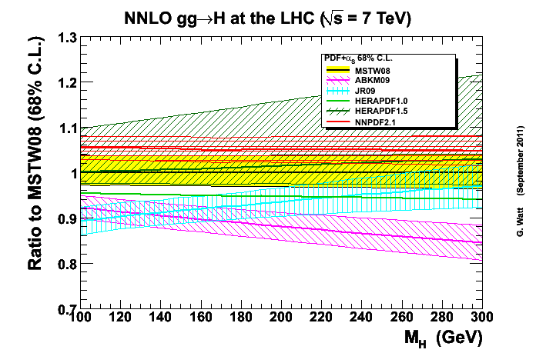

Slide 28
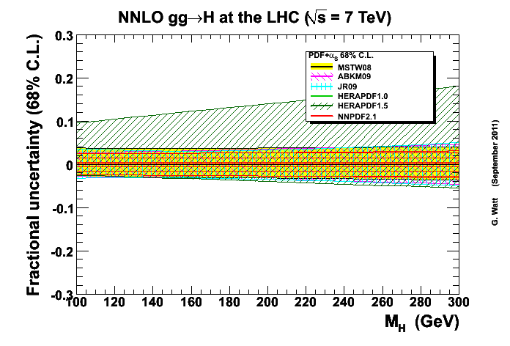
- with the exception of HERAPDF1.5, the uncertainties are very similar, in the ±3-4% range for light M_{H}

Slide 29
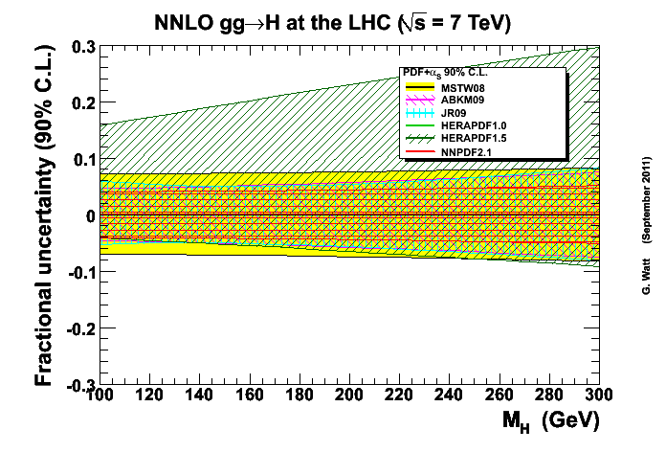
- the same but with 90% C.L.

Slide 30
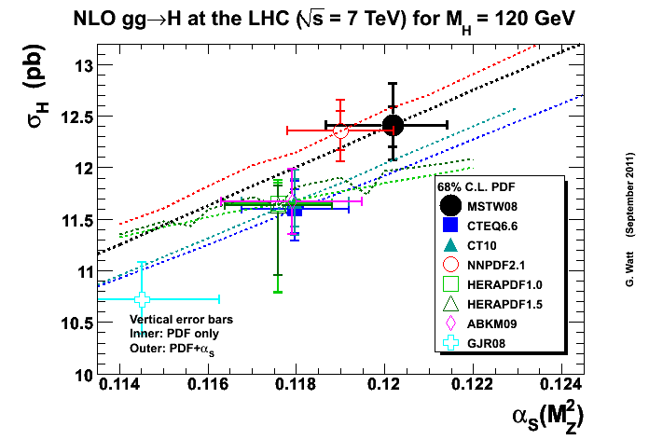
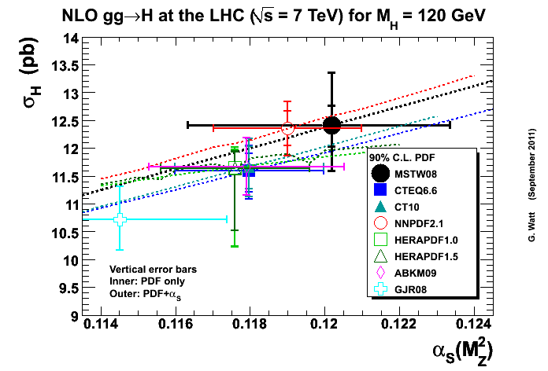
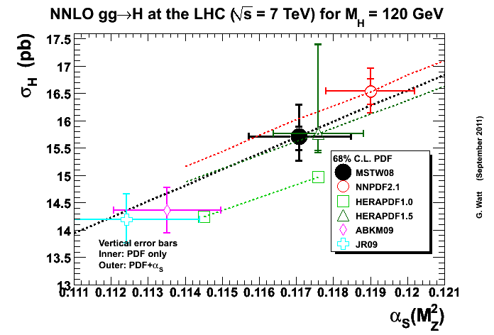
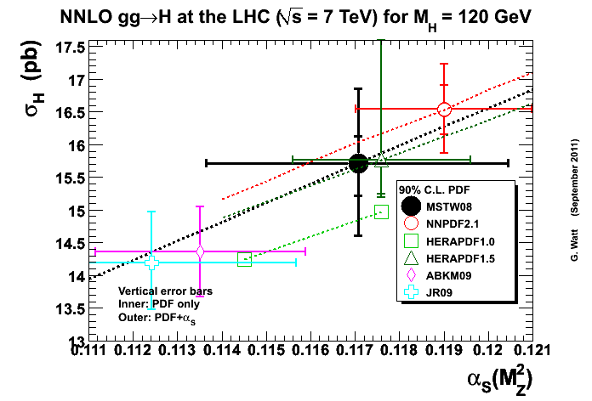

Slide 31
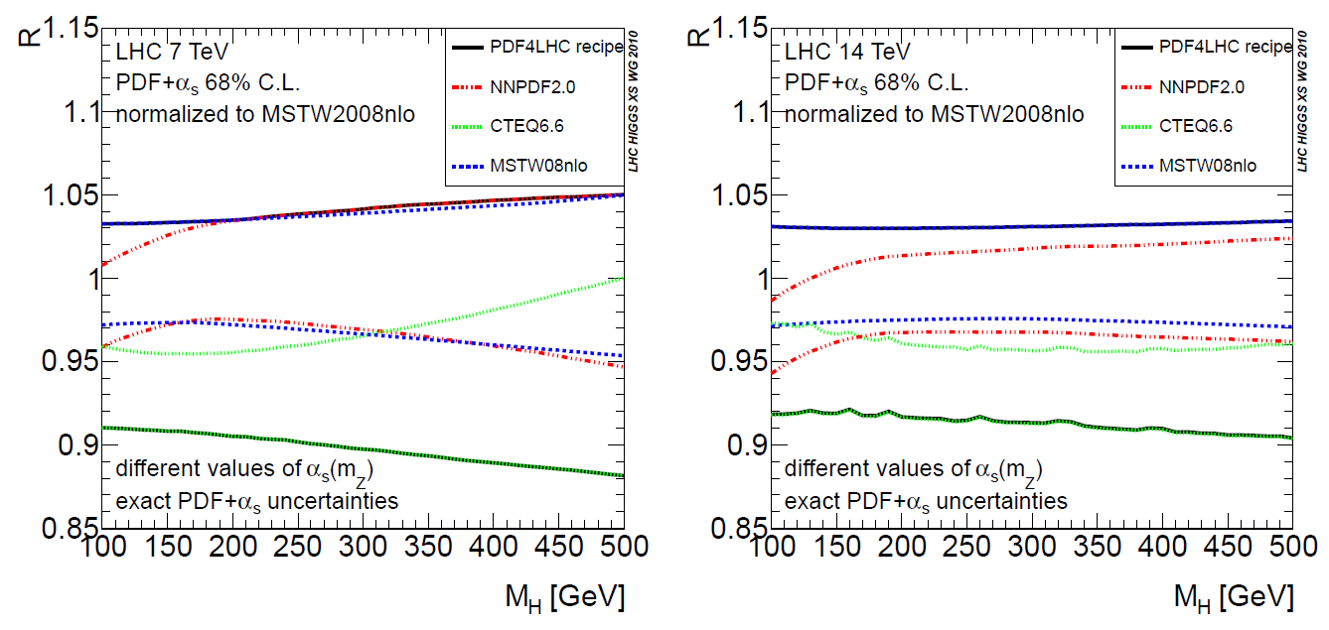
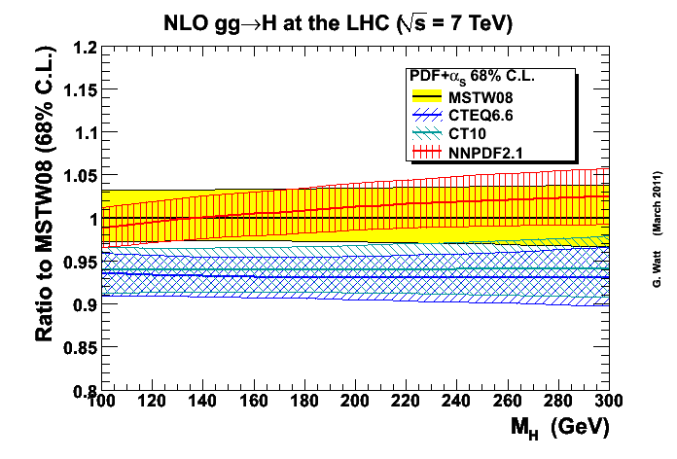
±9%
±7%
largely unchanged by NNPDF2.0→2.1 and CTEQ6.6→CT10

Slide 32
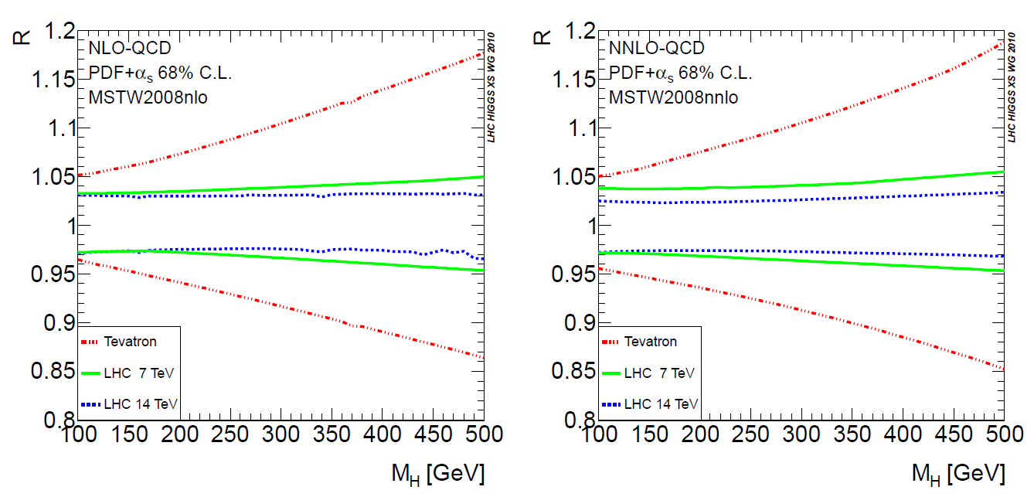
PDF + α_{S} uncertainties: Tevatron vs. LHC

Slide 33
recall

Slide 34
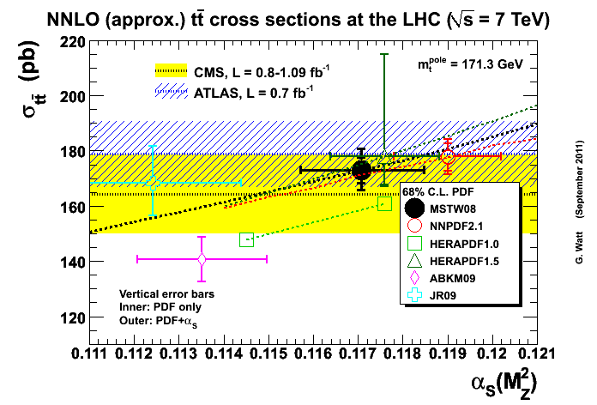
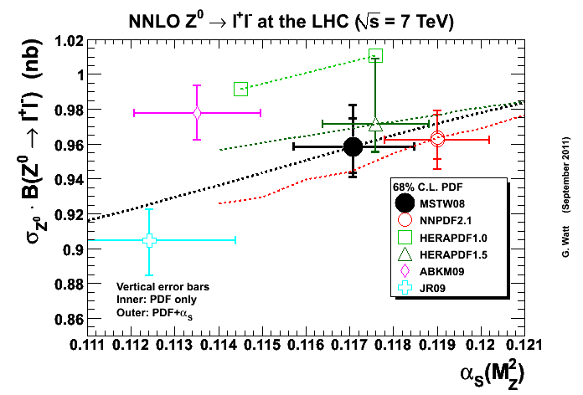
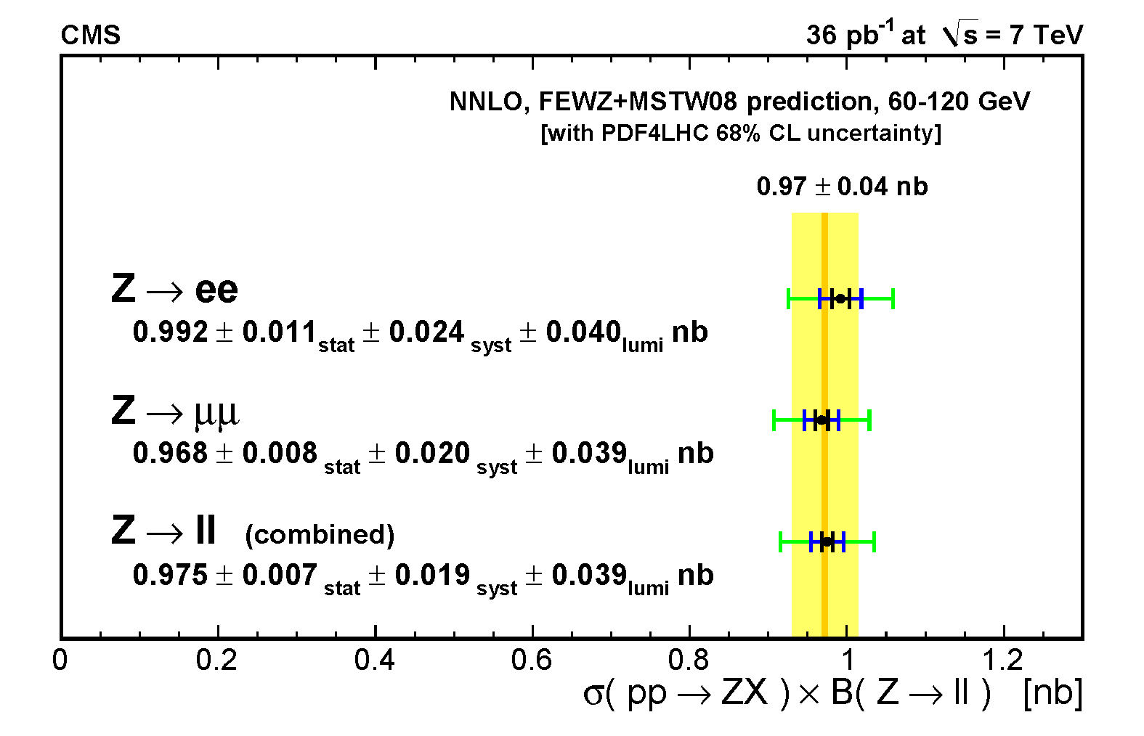
- the relatively high upper limit of the HERAPDF1.5 prediction is visible in other SM cross sections
Note:
– these are calculated for m_{t} = 171.3 GeV (PDG2010); the PDG2011 value is 172.9±0.6±0.9 GeV
– δσ_{top} (pb) ≈ -5 δm_{top} (GeV)

Slide 35
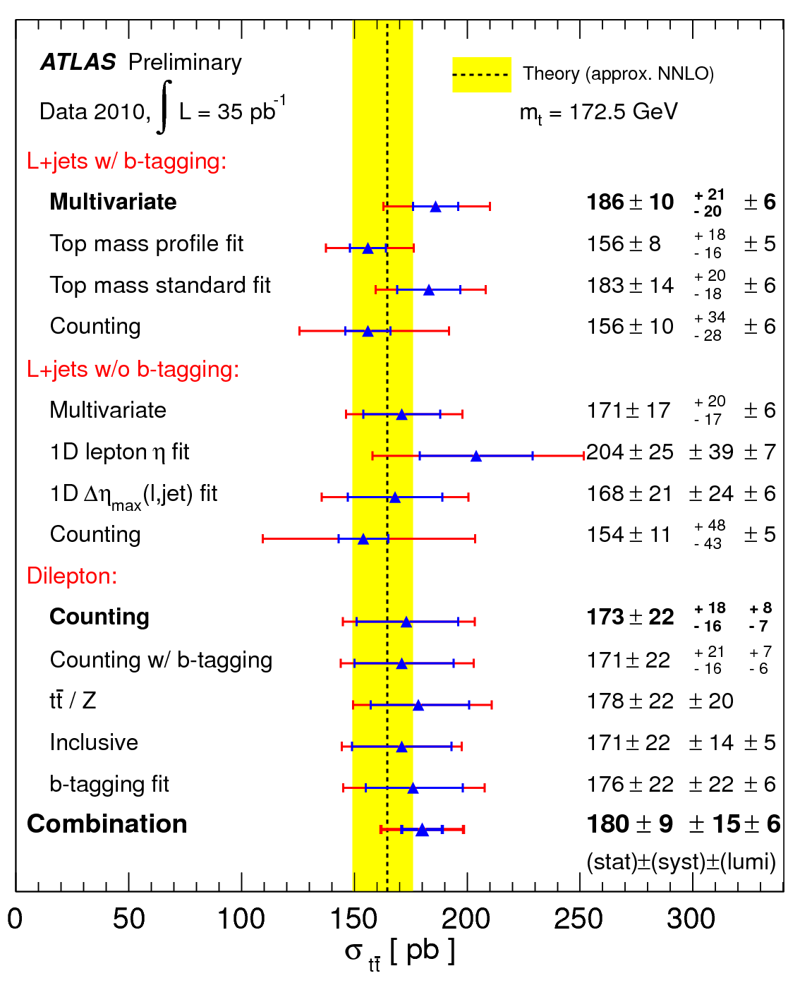
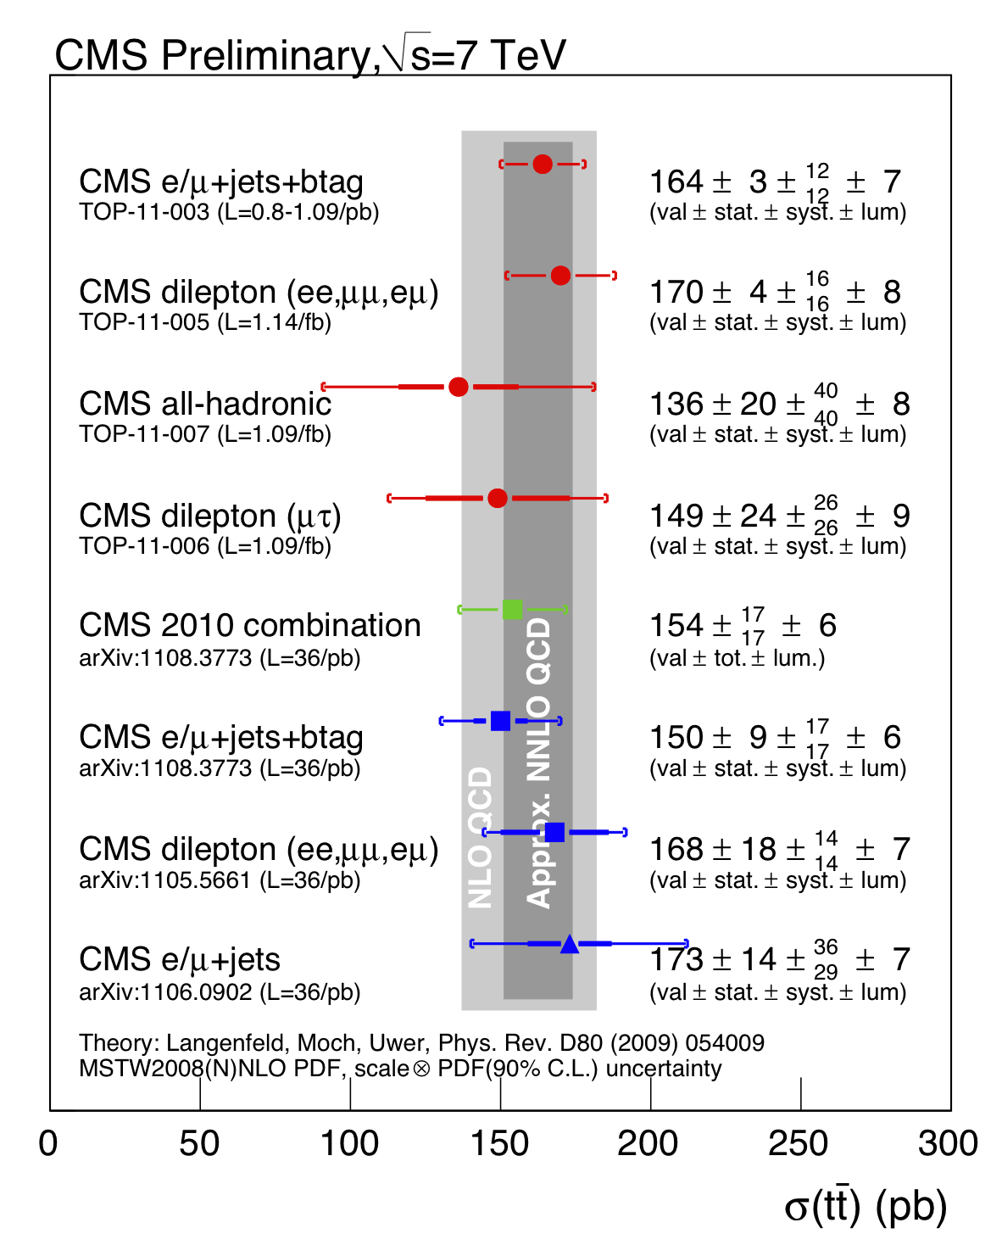

Slide 36
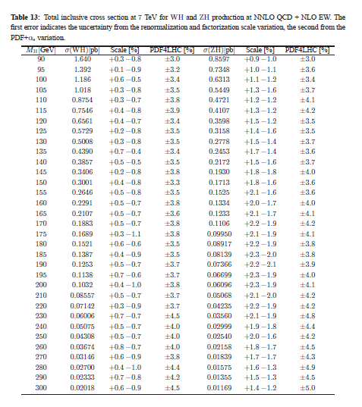
from “Handbook of LHC Higgs cross sections: 1. Inclusive observables”
NNLO WH, ZH
7 TeV LHC
±3-4%

Slide 37
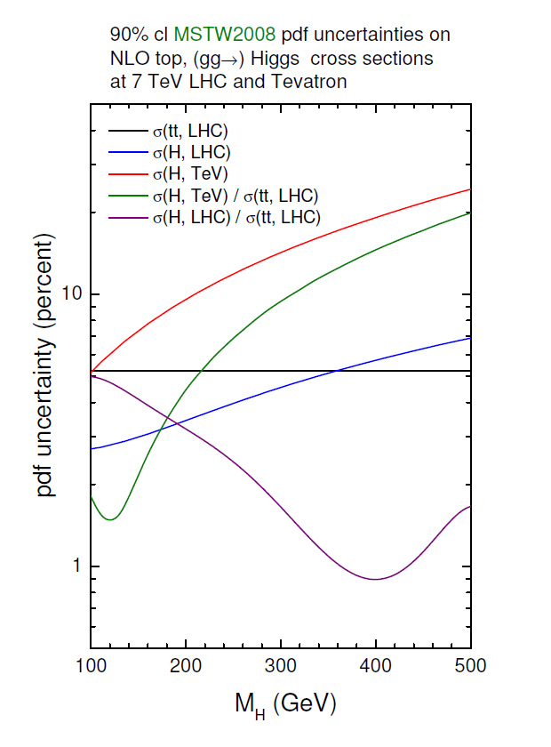

correlations between Higgs and other cross sections at 7 TeV LHC
a simple example: σ_{gg→H} vs. σ_{top}
a more detailed study will appear (this week?) in the second LHC-Higgs working group Yellow Report
Define the degree of correlation:
for two (e.g. cross section) quantities X and Y, using a particular PDF set “0” with its uncertainty sets “i”:
ρ = 0, +1(-1) for uncorrelated, completely (anti-)correlated quantities

Slide 38
sets used: MSTW2008, CT10, GJR08, ABKM09, HERAPDF1.5*, NNPDF2.1*
four Higgs production mechanisms studied (ggH, VBF, WH, ttH) and many other SM (W, Z, t, b,...) processes
results presented for the individual PDF sets and for the PDF4LHC average (defined here with CT10, MSTW2008, NNPDF2.1)
α_{S} variation can be omitted or included (small changes in most cases)
* requires modified definition of ρ because of the way that the uncertainties are defined for these sets

Slide 39

PDF4LHC average correlations: Higgs vs. Higgs and Higgs vs. other SM
strong correlation:
tt vs. ggH_{heavy}, ttH_{light}
WZ vs. WH
tb vs. WH_{light}
- same PDFs, similar x
weak correlation:
ttH vs. WH
- different PDFs, different x
anticorrelation:
W, Wγ vs. ttH
- hi/lo x

Slide 40

Note!

Slide 41


Slide 42
summary
knowledge of PDFs continues to improve
the ‘global fit’ sets (MSTW, CT, NNPDF) are becoming more similar; origin of residual differences largely understood
sets fitted without Tevatron jets (HERAPDF, GJR, ABKM) tend to give smaller high-x gluons → visible differences in LHC cross section predictions (e.g. top)
PDF4LHC Workshops have provided an extremely valuable forum for understanding and comparing PDFs
PDF dependence of 7 TeV LHC cross sections and correlations has been studied; fitting to LHC data has already begun
for gg→H with M_{H}~125 GeV, combined PDF+α_{S} uncertainty is ~ ±7%; uncertainty increases with M_{H} and is similar for NLO and NNLO
for qqbar → WH,ZH with M_{H}~125 GeV, combined PDF+α_{S} uncertainty is ~ ±3.5%, slightly anticorrelated with gg→H (ρ = -0.2)

Slide 43

r_{gg}(8/7) = 1.28 for M_{X} = 125 GeV, cf. r_{Z}(8/7) = 1.17

Slide 44


Slide 45
extra slides

Slide 46


7 TeV LHC top cross section predictions
plots from G. Watt
Note: ~80% gg production

Slide 47


Slide 48


Slide 49
benchmark NLO top cross sections at 7 TeV LHC
 | σ (pb) | δσ (pb) | comment
ABKM09 | 139.55 | 7.96 | combined PDF and α_{s}
CTEQ6.6 | 156.2 | 8.06 | combined PDF and α_{s} *
GJR08 | 169 | 6 | PDF only
HERAPDF1.0 | 147.31 | +5.18 -13.76 | combined PDF and α_{s}**
MSTW08 | 168.1 | +7.2-6.0 | combined PDF and α_{s}***
NNPDF2.0 | 169 | 7 | combined PDF and α_{s} ****
m_{top}= 171.3 GeV*
zero width approximation,
no branching ratios
68% cl uncertainties
scales μ _{F} = μ _{R} = m_{top}
* ±6.63 (PDF) ±4.59 (α_{s})
** expt.+model+param.+α_{s} , see report for details
*** +4.7-5.6 (PDF) +3.8-4.6 (α_{s})
**** ±6 (PDF) ±4 (α_{s})
Note: δσ_{top} (pb) ≈ -5 δm_{top} (GeV)
*PDG2011 value is 172.9±0.6±0.9 GeV
PDF4LHC Working Group Interim Report, arXiv:1101.0536 (January 2011)

Slide 50



Slide 51

PDF + α_{S} uncertainties in jet cross sections

Slide 52

includes ttbar total production cross section with:
m_{top}= 171.3 GeV
zero width approximation, no branching ratios
scales μ _{F} = μ _{R} = m_{top}

Slide 53

data sets used in MSTW fit

Slide 54

MSTW input parametrisation
Note: 20 parameters allowed to go free for eigenvector PDF sets, cf. 15 for MRST sets

Slide 55

which data sets determine which partons?

Slide 56

LO vs NLO vs NNLO?
in the MSTW2008 fit
3066/2598 (LO)
χ² _{global} /dof = 2543/2699 (NLO)
2480/2615 (NNLO)
LO evolution too slow at small x; NNLO fit marginally better than NLO
Note:
an important ingredient missing in the full NNLO global PDF fit is the NNLO correction to the Tevatron high E_{T} jet cross section
LO can be improved (e.g. LO*) for MCs by adding K-factors, relaxing momentum conservation, etc.

