Slide 1


WP2 - Task 2.2 Highlights with TA activities
with radioactive ion beams
Gheorghe Iulian STEFAN
FAME - EURO-LABS Fourth Annual Meeting
29 September 2025 - 1 October 2025

Slide 2
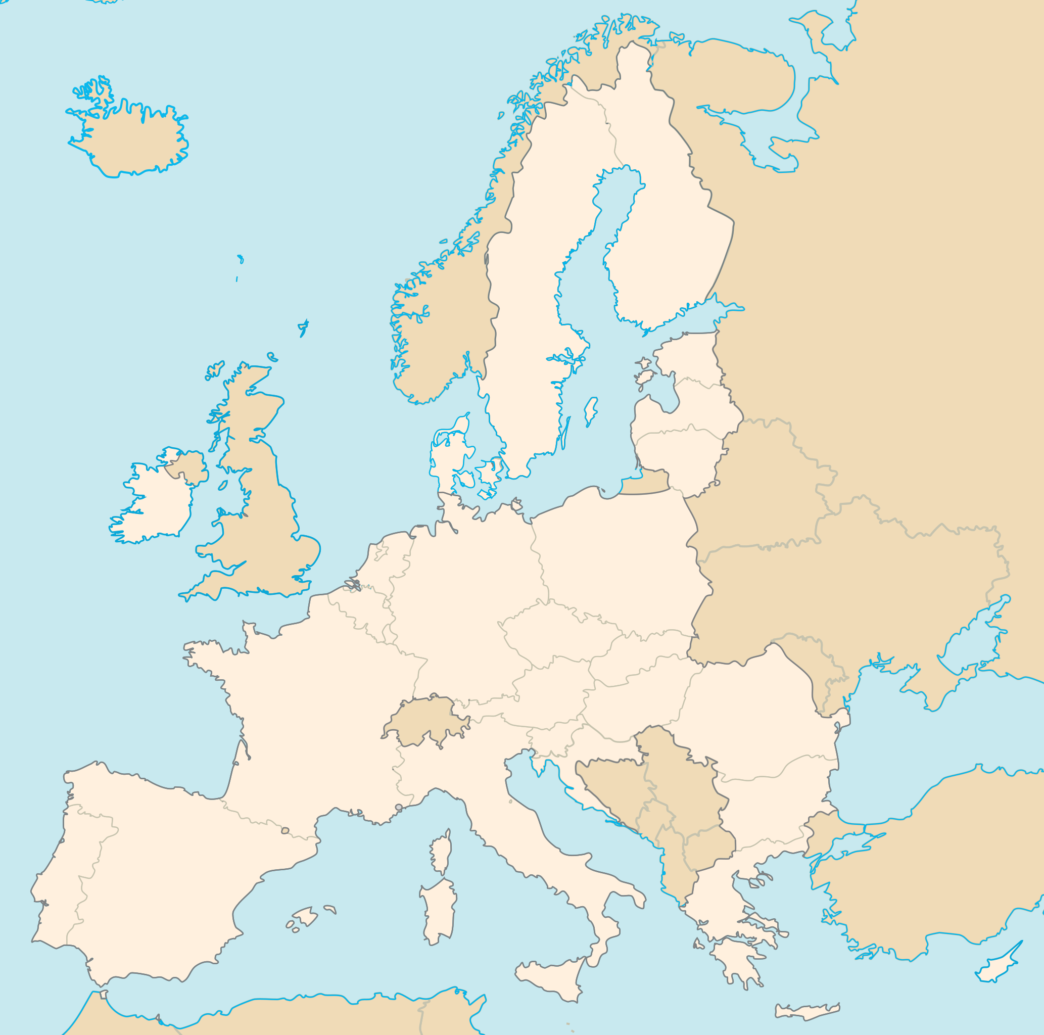
WP2 - Task 2.2 Radioactive Ion Beam Facilities
Institution | Infrastructure | Country | Facility Coordinator
INFN | LNL/LNS | Italy | Tommaso Marchi Alessia Di Pietro
GANIL | GANIL-SPIRAL2 | France | Emmanuel Clement
IJCLab | ALTO | France | Enrique Minaya
GSI | GSI/FAIR | Germany | Christoph Scheidenberger
CERN | ISOLDE | International Organisation | Sean Freeman Luis Mario Fraile
Univ. Jyväskylä | JYFL | Finland | Paul Greenlees
Thank to all the facility coordinators
FAME 2025 I. STEFAN
Notes:
Should be a publication even internal before the end of the project. (experiment repport is not sufficient)

Slide 3
WP2 - Task 2.2 Radioactive Ion Beam Facilities
Institution | Infrastructure | Country | Facility Coordinator
INFN | LNL/LNS | Italy | Tommaso Marchi Alessia Di Pietro
GANIL | GANIL-SPIRAL2 | France | Emmanuel Clement
IJCLab | ALTO | France | Enrique Minaya
GSI | GSI/FAIR | Germany | Christoph Scheidenberger
CERN | ISOLDE | International Organisation | Sean Freeman Luis Mario Fraile
Univ. Jyväskylä | JYFL | Finland | Paul Greenlees
GOAL:
Provide Transnational (TA) Access to various Research Infrastructures providing radioactive ions at various energies, combined with state-of-the-art equipment to explore nuclei under extreme conditions.
Thank to all the facility coordinators
FAME 2025 I. STEFAN
Notes:
Should be a publication even internal before the end of the project. (experiment repport is not sufficient)

Slide 4
WP2 - Task 2.2 Radioactive Ion Beam Facilities
Institution | Infrastructure | Country | Facility Coordinator
INFN | LNL/LNS | Italy | Tommaso Marchi Alessia Di Pietro
GANIL | GANIL-SPIRAL2 | France | Emmanuel Clement
IJCLab | ALTO | France | Enrique Minaya
GSI | GSI/FAIR | Germany | Christoph Scheidenberger
CERN | ISOLDE | International Organisation | Sean Freeman Luis Mario Fraile
Univ. Jyväskylä | JYFL | Finland | Paul Greenlees
Thank to all the facility coordinators
FAME 2025 I. STEFAN
Notes:
Should be a publication even internal before the end of the project. (experiment repport is not sufficient)

Slide 5

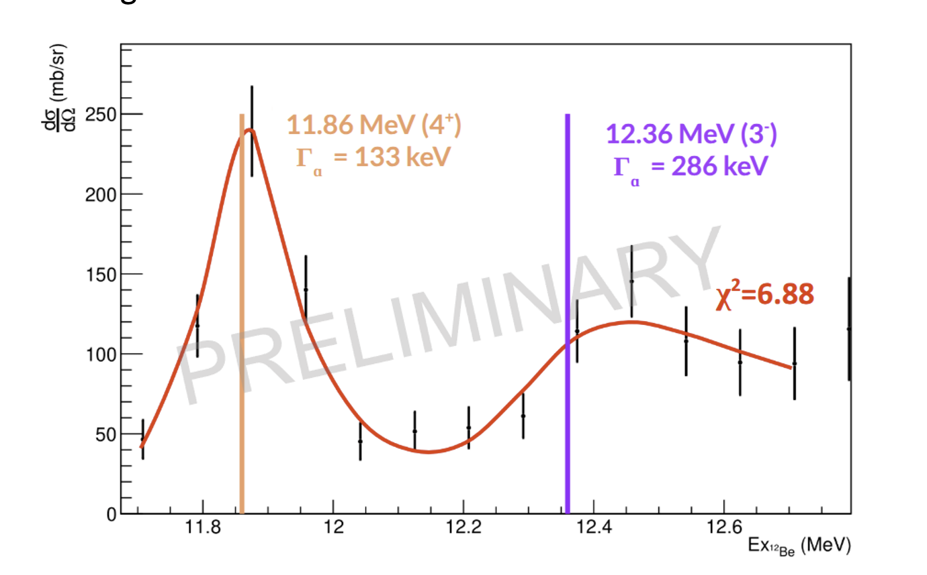
WP2 - Task 2.2 : GANIL-SPIRAL2
Means of production: fragmentation, fusion-evaporation (ISOL & In Flight)
ISOL: Low energy & Post-Accelerated up to 25 MeV/A
In the future, proton-rich nuclei up to SHE at Low-Energy
after fusion evaporation (LINAG)
1540 hours of beamtime receiving TA
Estimated AU provided in the full project - 90%
Stable + radioactive beams
Two projects received Transnational Access during EURO-LABS P2 focusing on Nuclear Physics investigations on light radioactive nuclei using ACTAR – TPC detector:
E837 Study of ¹²Be structure in the vicinity of different cluster thresholds vicinity, such as ⁴He, ⁷He, ⁸He by looking for narrow resonances
E864_22 Indirect study of ⁸Li(α, n)¹¹B reaction. This reaction is involved in the nucleosynthesis from the early evolutionary stage of our universe, till the starting of r-process nucleosynthesis in supernovae, collapsars and neutron star mergers. The compound nucleus ¹²B, has been investigated with the help of the resonant elastic scattering reaction ⁴He(⁸Li, α) ⁸Li.
Two alpha cluster structure observed in ¹²Be
FAME 2025 I. STEFAN

Slide 6

WP2 - Task 2.2 : GSI/FAIR phase 0
UNILAC: p to U, Energy <11.4 MeV/A
  facilities: SHIP/SHIPTRAP, TASCA, M-Branch, irradiation cave
SIS18: p to U, max. energy 1.0 (U)… 2.0 (¹²C) GeV/A, 4.2 GeV (p)
Fragmentation and fission
Experiments with the FRS: G-22-00160 (FRS Developments for APPA and NUSTAR)
G-22-00180 (Production Cross Sections in ²³⁸U+⁹Be)
Experiments at the ESR: G-22-00018 (Nuclear Two-Photon Decay and Bound-State Pair Conversion)
G-22-00028 (NECTAR – Nuclear Reactions at Storage Rings)
Experiments with the R3B Setup: G-22-00118/G-22-00091 (R3B Commissioning and Nucleon-Nucleon Correlations)
Experiments with the DESPEC Setup: G-22-00100 (Structure of Neutron-Rich Rare-Earth Nuclei)
G-22-00181 (Towards the N=126 r-Process Waiting Point)
Experiments with the FRS Ion Catcher: G-22-00117/G-22-00179 (Multi-Nucleon Transfer Reactions in the Ion Catcher)
G-22-00182 (Fission Isomer Studies with the FRS)
G-22-00056 (Mass Measurements at the N=Z Line)
Experiments with the EXPERT Detector: G-22-00111 (Exploring Nuclear Structure Limits with a ⁹C Beam)
FAME 2025 I. STEFAN

Slide 7
WP2 - Task 2.2 : GSI/FAIR phase 0
Nuclear two-photon decay
1±
1±
0⁺
2E1
2M1
0⁺
Only decay mode in bar ions
where first-excited 0⁺ state
is located below 2m_{e}
Very few cases
Stable: ⁷²Ge, ⁹⁸Mo
Unstable ⁹⁸Zr, ¹⁹⁴Pb, ⁷²Kr
Fundamental quantities accessible:
Transitional electric dipole polarizability
and magnetic dipole susceptibility
7
FAME 2025 I. STEFAN

Slide 8
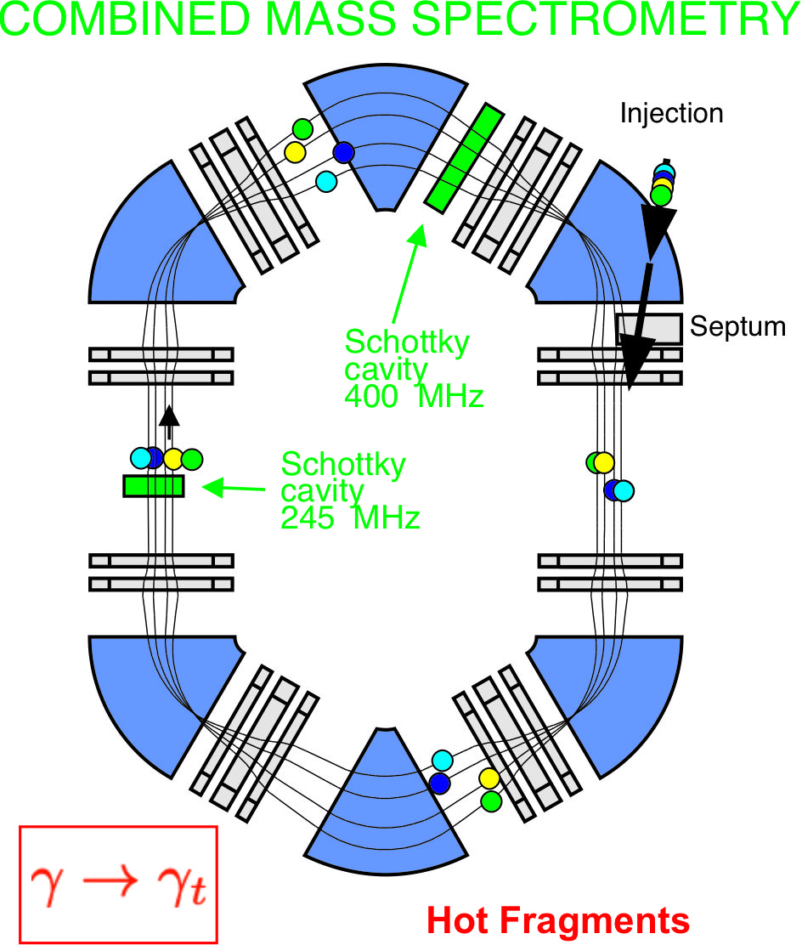
WP2 - Task 2.2 : GSI/FAIR phase 0
Nuclear two-photon decay
Combined Isochronous and Schottky
Mass Spectroscopy (ISMS)
1±
1±
0⁺
2E1
2M1
0⁺
Only decay mode in bar ions
where first-excited 0⁺ state
is located below 2m_{e}
Very few cases
Stable: ⁷²Ge, ⁹⁸Mo
Unstable ⁹⁸Zr, ¹⁹⁴Pb, ⁷²Kr
Fundamental quantities accessible:
Transitional electric dipole polarizability
and magnetic dipole susceptibility
8
FAME 2025 I. STEFAN

Slide 9
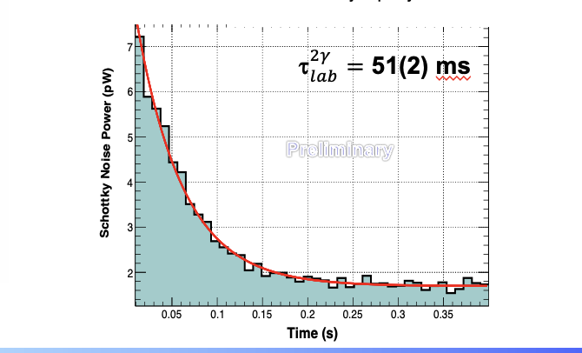
WP2 - Task 2.2 : GSI/FAIR phase 0
Nuclear two-photon decay
Combined Isochronous and Schottky
Mass Spectroscopy (ISMS)
Result from E143 in ⁷²Ge^{m}
1±
1±
0⁺
2E1
2M1
0⁺
Only decay mode in bar ions
where first-excited 0⁺ state
is located below 2m_{e}
“Schottky frequency”
Very few cases
Stable: ⁷²Ge, ⁹⁸Mo
Unstable ⁹⁸Zr, ¹⁹⁴Pb, ⁷²Kr
Fundamental quantities accessible:
Transitional electric dipole polarizability
and magnetic dipole susceptibility
9
FAME 2025 I. STEFAN

Slide 10
WP2 - Task 2.2 : GSI/FAIR phase 0
Nuclear two-photon decay
Combined Isochronous and Schottky
Mass Spectroscopy (ISMS)
Result from E143 in ⁷²Ge^{m}
1±
1±
0⁺
2E1
2M1
11 user project had EURO-LABS support.
(RI and stable beam ) 2150 total hours of beamtime (150% of AU beam time)
0⁺
Only decay mode in bar ions
where first-excited 0⁺ state
is located below 2m_{e}
“Schottky frequency”
Very few cases
Stable: ⁷²Ge, ⁹⁸Mo
Unstable ⁹⁸Zr, ¹⁹⁴Pb, ⁷²Kr
Fundamental quantities accessible:
Transitional electric dipole polarizability
and magnetic dipole susceptibility
10
FAME 2025 I. STEFAN

Slide 11

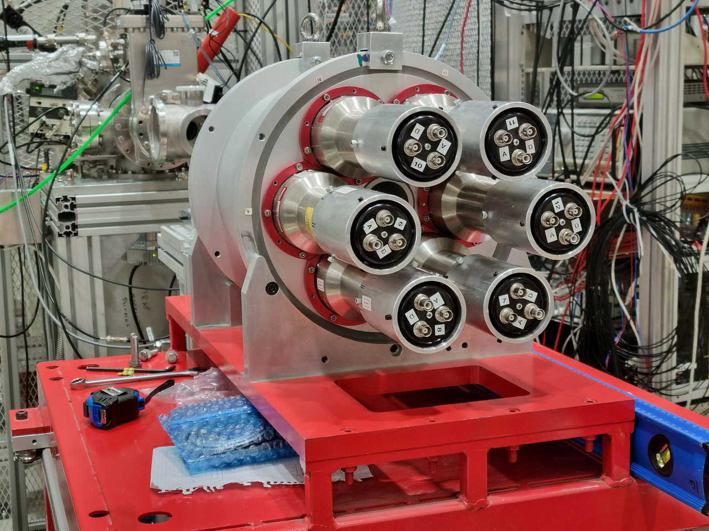
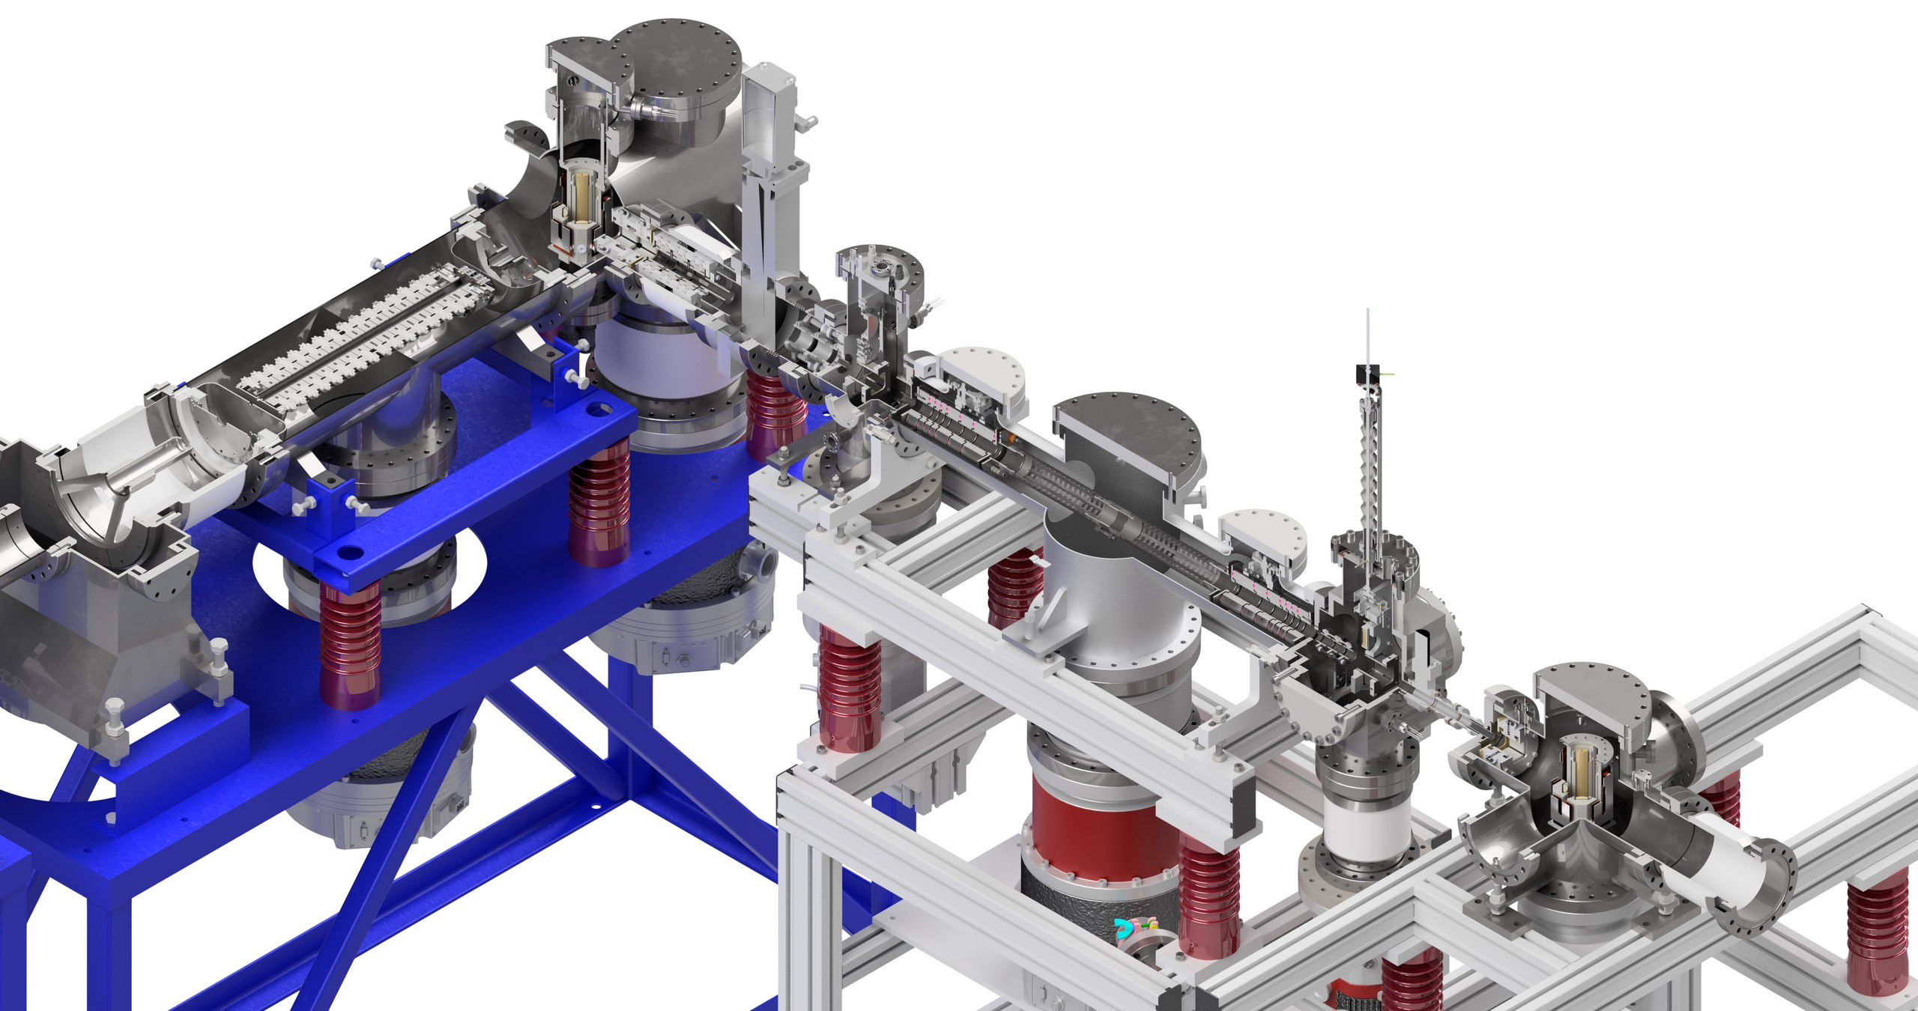
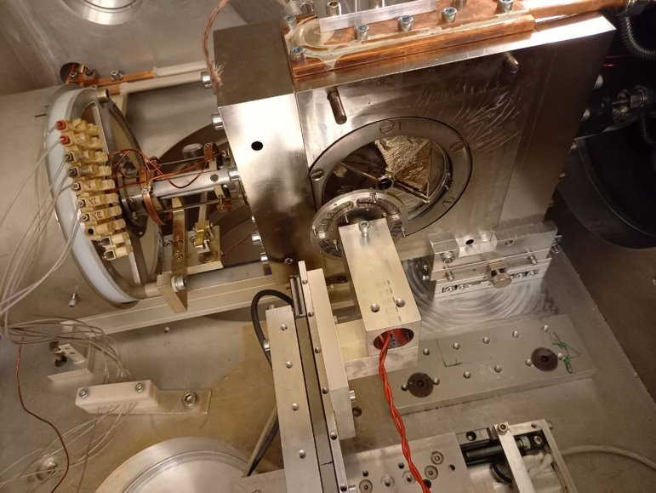
WP2 - Task 2.2 : JYU/JYFL ACCLAB
Low energy (keV) RIBs produced via
proton-induced fission, heavy-ion fusion, multi-nucleon transfer
Total Absorption Spectrometer
I300 Trap-assisted decay spectroscopy of very neutron-rich Rh and Pd isotopes around A=110 at IGISOL
I290 Fission isomer studies on ^{240,242}Am at IGISOL
I233 Study of beta shapes relevant for precise predictions of reactor neutrino spectra II
I291+I294 Trap-assisted decay spectroscopy of fission fragments
I306 Determining a reference quadrupole moment for Ag
MR-ToF
New gas cell for MNT
FAME 2025 I. STEFAN

Slide 12
WP2 - Task 2.2 : JYU/JYFL ACCLAB
Low energy (keV) RIBs produced via
proton-induced fission, heavy-ion fusion, multi-nucleon transfer
Total Absorption Spectrometer
I300 Trap-assisted decay spectroscopy of very neutron-rich Rh and Pd isotopes around A=110 at IGISOL
I290 Fission isomer studies on ^{240,242}Am at IGISOL
I233 Study of beta shapes relevant for precise predictions of reactor neutrino spectra II
I291+I294 Trap-assisted decay spectroscopy of fission fragments
I306 Determining a reference quadrupole moment for Ag
6 user project had EURO-LABS support.
(RI and stable beam ) 3500 total hours of beamtime (250% of AU beam time)
MR-ToF
New gas cell for MNT
FAME 2025 I. STEFAN

Slide 13
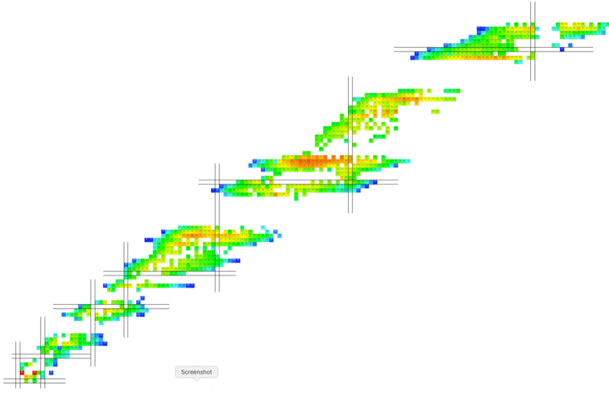


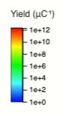
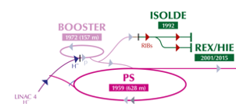
WP2 - Task 2.2 : ISOLDE
(ISOL facility)
Low energies: 30-60 keV
Post-acceleration up to 10 MeV/A (HIE-ISOLDE)
.
FAME 2025 I. STEFAN

Slide 14
WP2 - Task 2.2 : ISOLDE
(ISOL facility)
Low energies: 30-60 keV
Post-acceleration up to 10 MeV/A (HIE-ISOLDE)
.
Study around exotic double magic nucleus ¹³²Sn:
¹³²Sn(d,p) transfer reaction: Using I * 10, higher beam energy, much improved resolution revealed population of all the valence single-neutron orbitals for the first time and their single-particle content has been deduced, establishing them all as carrying “full” single-particle strength.
β-delayed neutron decay studies in ¹³⁴In: very impactful as they can be used in shell-model calculations of wide regions of medium-mass nuclei.
Coulomb-excitation of ^{130,134}Sn: Probe the collectivity of states in this by measurements in ¹³⁰Sn&¹³⁴Sn
FAME 2025 I. STEFAN

Slide 15
WP2 - Task 2.2 : ISOLDE
(ISOL facility)
Low energies: 30-60 keV
Post-acceleration up to 10 MeV/A (HIE-ISOLDE)
~50 counts, profited from 2.5 uA intensity
High precision mass measurements in ¹⁰⁰Sn region
.
2025
2025
Preliminary
Preliminary
FAME 2025 I. STEFAN

Slide 16
WP2 - Task 2.2 : ISOLDE
(ISOL facility)
Low energies: 30-60 keV
Post-acceleration up to 10 MeV/A (HIE-ISOLDE)
.
Nuclear techniques were employed to characterize a number of novel materials, which included perovskites that are potentially important for novel solar cells, vanadium-based materials that have important applications in batteries, indium- gallium nitride semi-conductors, quantum colour centers in diamond that may have application as q-bits, ferroic systems such as lithium niobate that is important in piezo-electrics, and other functional materials
FAME 2025 I. STEFAN

Slide 17
WP2 - Task 2.2 : ISOLDE
(ISOL facility)
Low energies: 30-60 keV
Post-acceleration up to 10 MeV/A (HIE-ISOLDE)
45 experiments and 5 LOI with EURO-LABS support.
4500 total hours of beamtime (200% of AU beam time)
.
Nuclear techniques were employed to characterize a number of novel materials, which included perovskites that are potentially important for novel solar cells, vanadium-based materials that have important applications in batteries, indium- gallium nitride semi-conductors, quantum colour centers in diamond that may have application as q-bits, ferroic systems such as lithium niobate that is important in piezo-electrics, and other functional materials
FAME 2025 I. STEFAN

Slide 18
WP2 - Task 2.2 Radioactive Ion Beam Facilities
4/6 facilities highly active
All active facilities delivering a high level of access units and performing leading-edge experiments
No problems within WP to exhaust budget and deliver much greater than promised number of access hours (possibly with some redistribution reflecting availability of beam time across WP facilities)
High impact results and publications to follow
Total number of projects supported for Task 2.2 (Radioactive Ion Beams) in P2: 69
Total access provided in WP2:
23000 access units, 194 TA projects, 28% of T&S, 836 visits
FAME 2025 I. STEFAN
Notes:
Should be a publication even internal before the end of the project. (experiment repport is not sufficient)

Slide 19
WP2 - Task 2.2 Radioactive Ion Beam Facilities
INFN LNL/LNS
GANIL
Access to state-of-the-art
instrumentation (many traveling detectors) and high variety of RIB for high precision and frontier physics
JYFL
ALTO
GSI/FAIR
ISOLDE
FAME 2025 I. STEFAN
Notes:
Should be a publication even internal before the end of the project. (experiment repport is not sufficient)

Slide 20
Thank you
FAME 2025 I. STEFAN

