Slide 1
WP3 – Task 3.2 Access to Technology Infrastructures for Accelerator R&D
HORIZON-INFRA-SERV-07-01
I. Efthymiopoulos – for the WP3 Task 3.2

Slide 2
WP3.2 – Technology Infrastructures
 | Facility | Location | Coordinator | Description | Expected Users
 | Task 2 : Technology Infrastructures
1 | FREIA/Univ. Uppsala | Uppsala, Sweden | Rocio Santiago Kern | Test stand for SC magnets and RF, vertical (GERSEMI) and horizontal (HNOSS) cryostat | ESS, CERN, MYRRHA/MINERVA, ITER/DONES, and PIP II at Fermilab, US)
2 | INFN-LASA | Milano Italy | Dario Giove | Test stand for SC magnets and RF cavities, complex UHV system for growing photocathodes, laser applications for cavities | LAL Orsay, Saclay
3 | INFN-THOR | Salerno, Italy | Antonella Chiuchiolo | Horizontal test stand for SC magnets | GSI
4 | IJCLab SUPRATECH | CNRS Orsay, France | David Longuevergne | Test stand for SC RF cavities | US teams from PIP-II
5 | LRFU-Synergium (MACHAFILM – CRYOMECH) | CEA Saclay, France | Thomas Proslier, Roser Vallcorba-Carbonell | Characterization of thin film SC layers for RF cavities and materials at low temperature | Teams from CERN, FermiLab, Jlab, Chicago Univ. possibly industrial firms
6 | XBOX | CERN | Roberto Corsini | Hgh-power RF testing

Slide 3
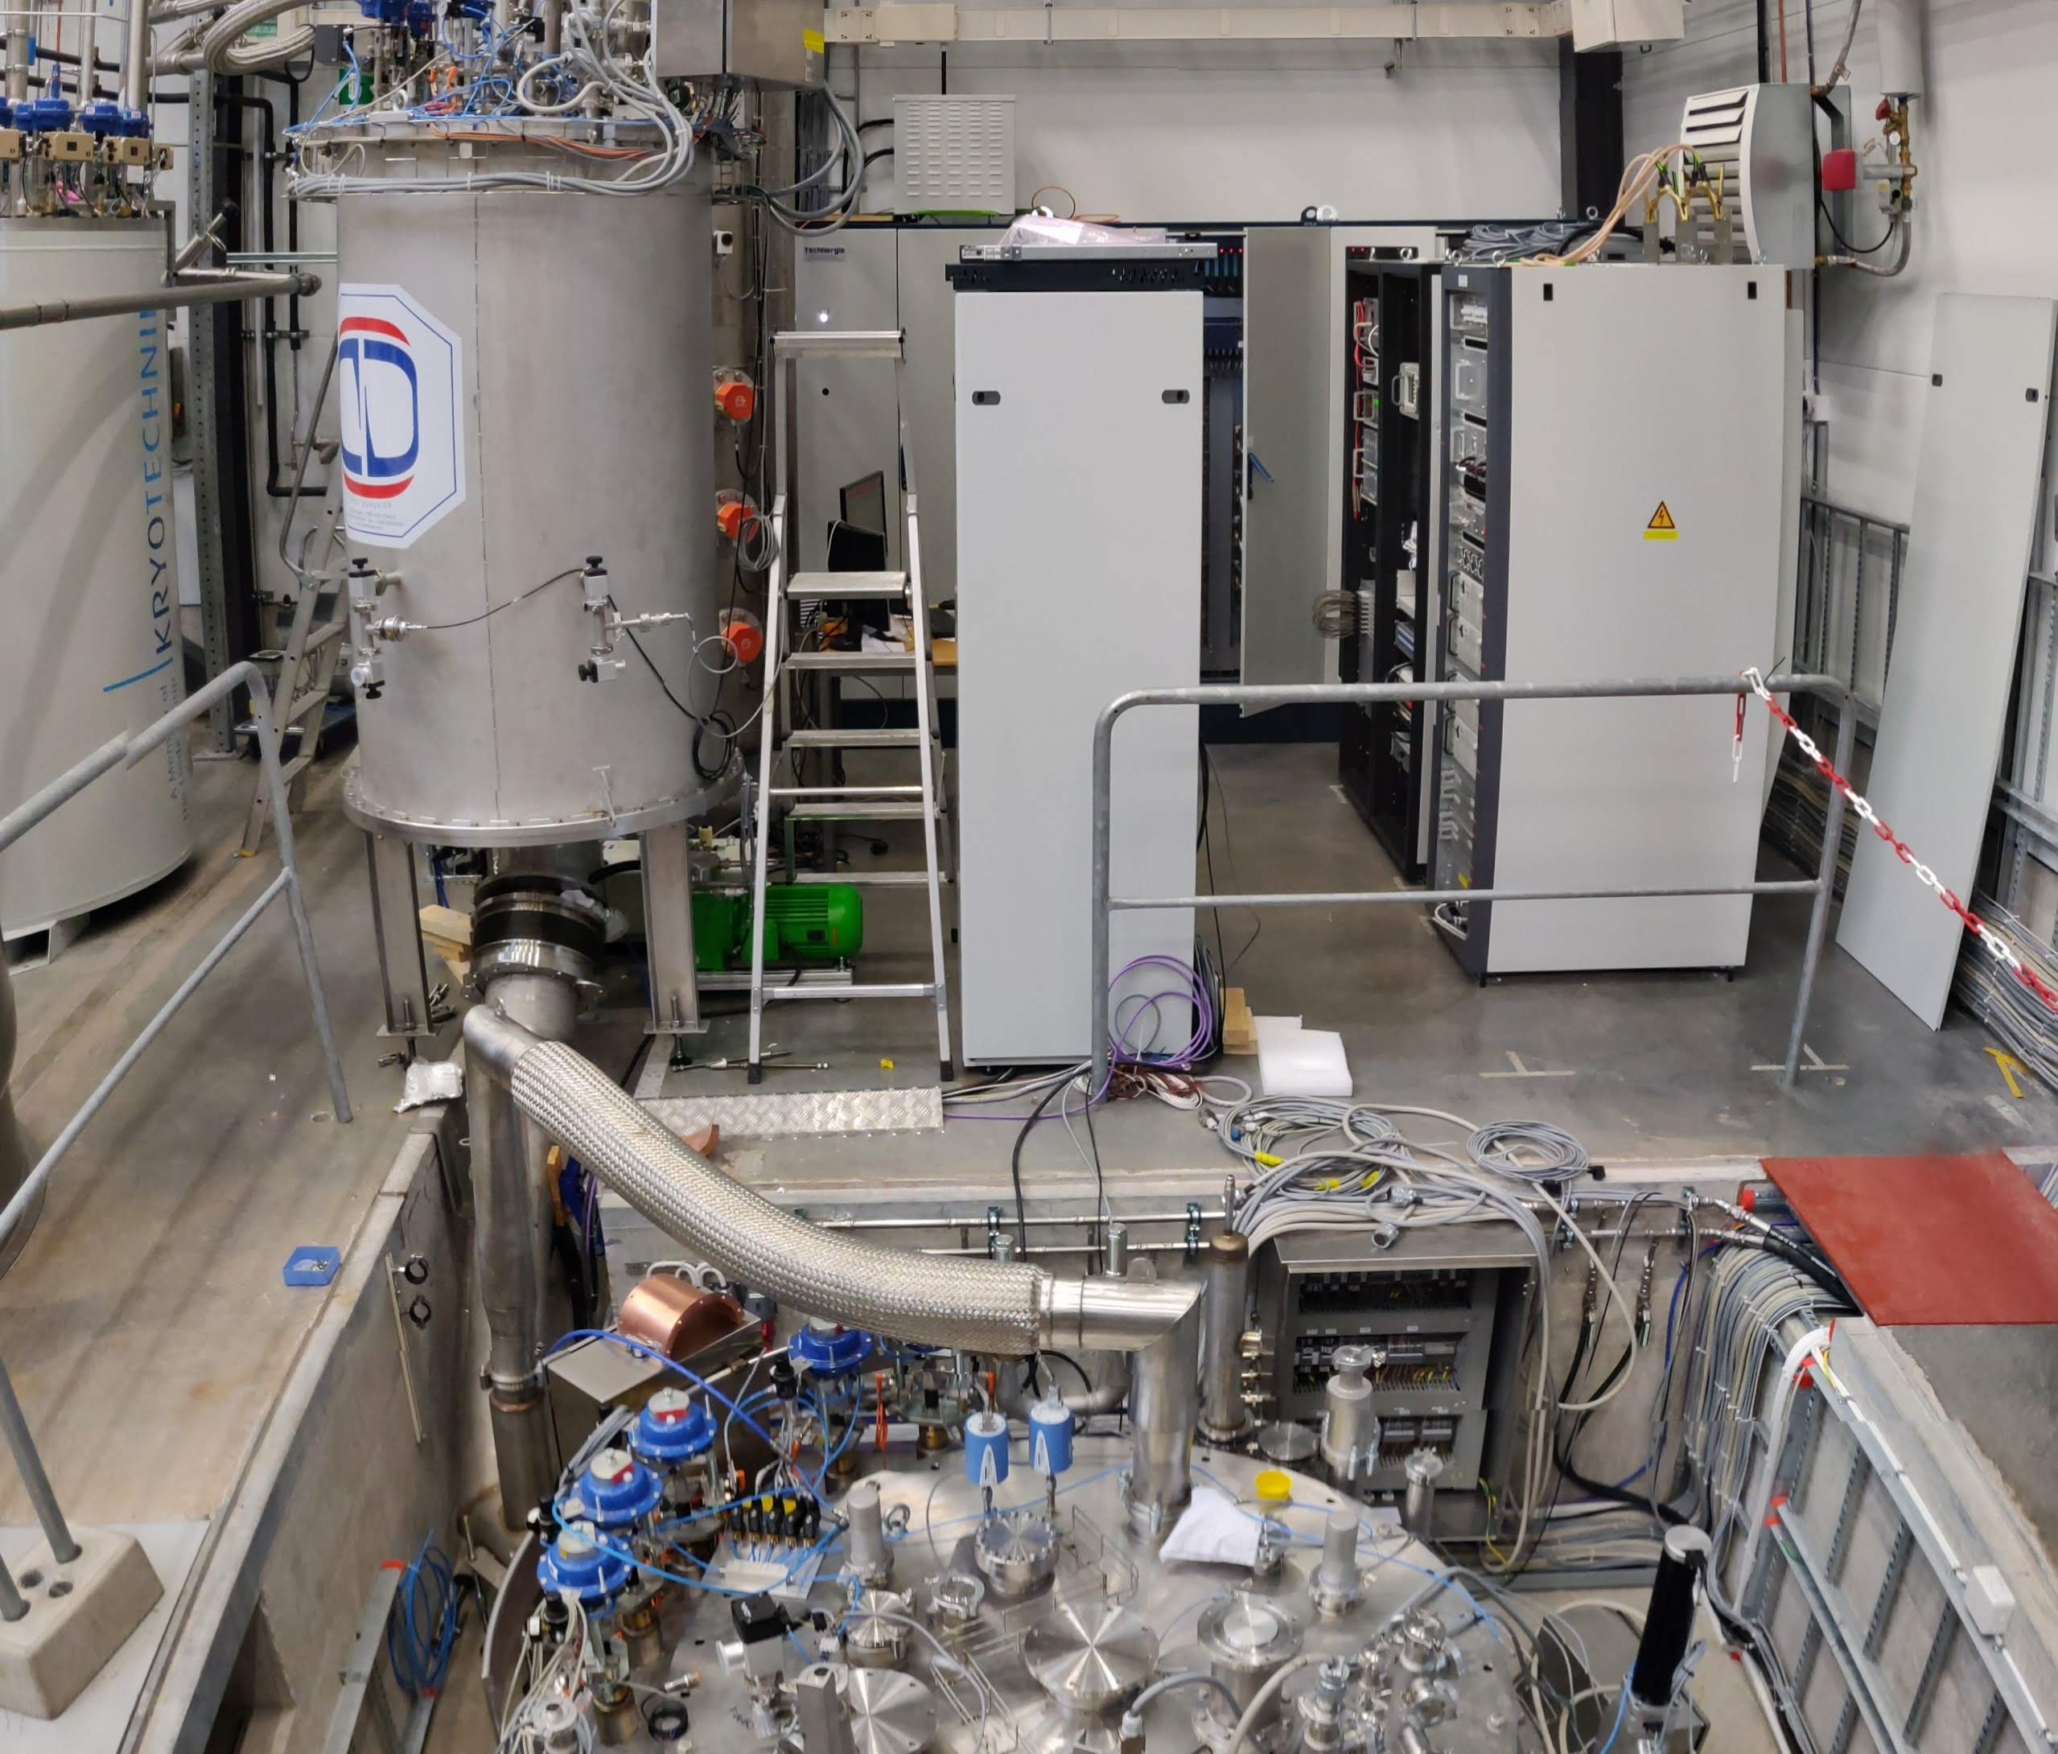
WP3.2 – FREIA – Univ. Uppsala
Rocio Santiago Kern
FREIA @ UU A facility for testing RF cavities and SC magnets, H & V cryostats (HNOSS – Gersemi)
The facility had a strong start in P1, successfully delivering approximately 50% of the planned projects and Access Units (AU)
Since then, no new Transnational Access (TA) projects have been requested.
The facility has signed a contract to test the series production of cryomodules for a new Research Infrastructure (RI), reducing the availability of the HNOSS cryostat for other users.
To date, no requests have been received for the use of the other cryostats

Slide 4
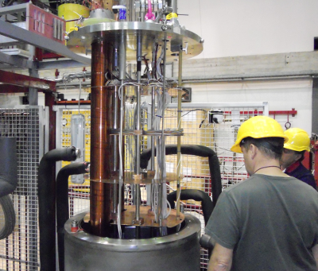
WP3.2 – LASA – INFN-MI
Dario Giove
LASA @ INFN-MI
A facility for testing RF cavities and SC magnets
V cryostats
Laser/Photocathode lab
Despite the high expectations at the time of the project proposal, no TA projects have been realised.
Infrastructure works planned for the extension of the Lab prohibited the use of the facilities for TA projects
Additionally, the recent incident involving the He liquefier (April 25) further limits the possibility of TA for the cryogenic infrastructures of the Lab
Expectation for new TA requests to the end of the project:
2 shifts of 7-9 days each (including travel) for measurements on high-voltage systems for copper cavities with 1-2 people - US laboratory present
3 shifts of 7 days each (including travel) for measurements on superconducting RF cavities with 1-2 people - French laboratory present.
If any of these tests are realized in 2025/2026, they could cover a sizeable fraction of the planned TA project/Access Units.
Notes:
PERLE : A High Power Energy Recovery Facility for Europe

Slide 5
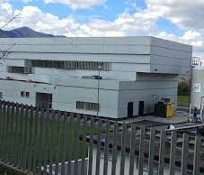
WP3.2 – THOR – Univ. Salerno
Antonella Chiuchiolo
THOR & INFN – USalerno
A facility for testing SC magnets
H cryostat
No TA projects accepted so far.
The facility has signed a contract for the series production testing of magnets for GSI/FAIR, significantly limiting availability for external users.
Additionally, access to THOR has been restricted due to upgrade and consolidation works

Slide 6
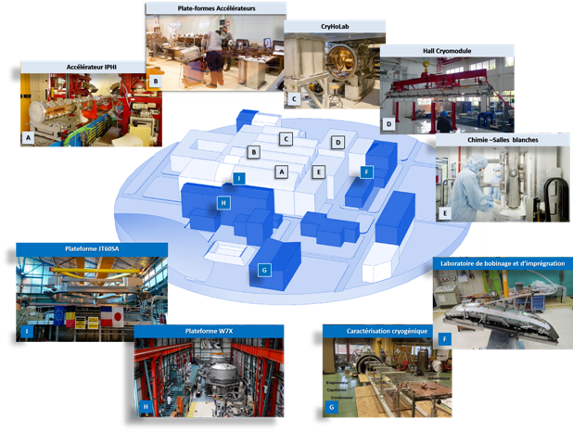
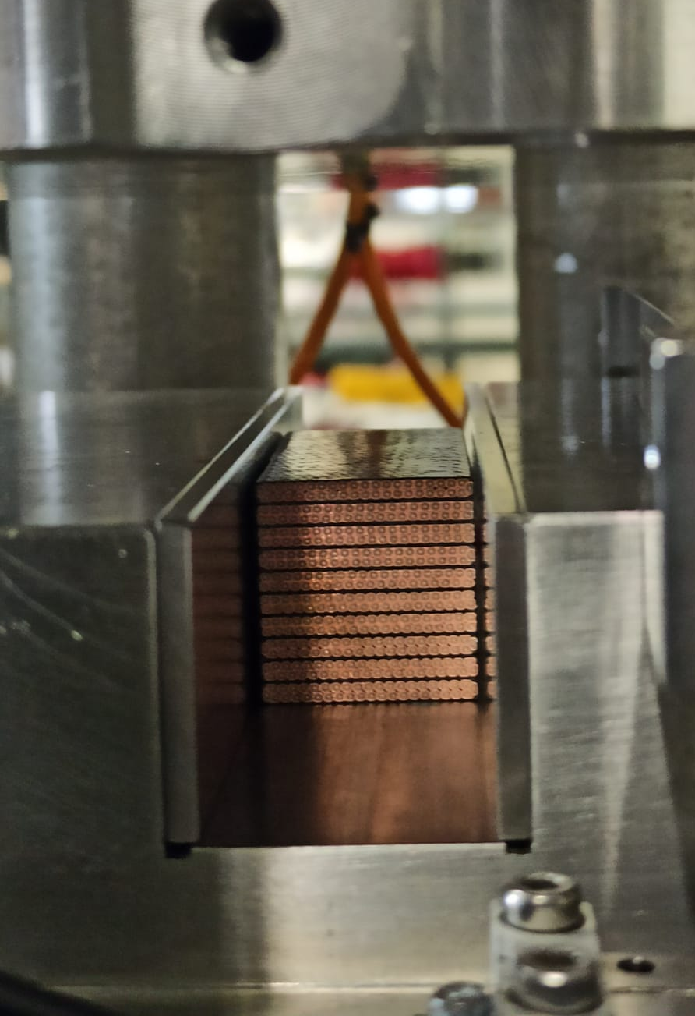
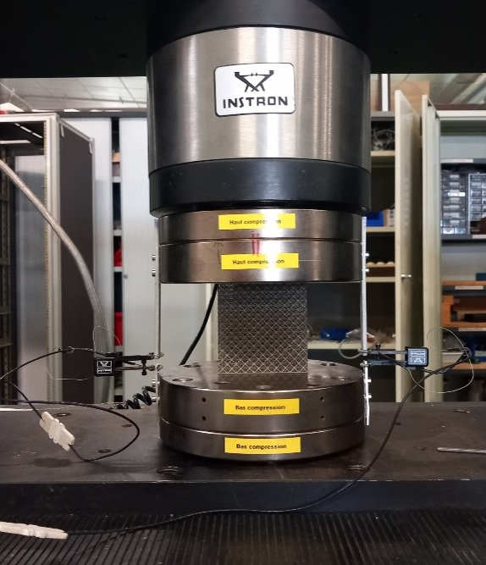
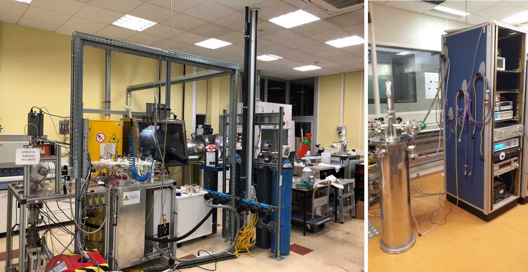
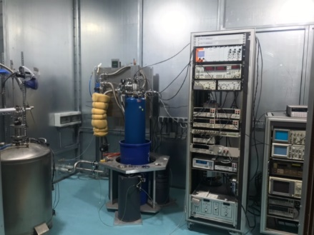
WP3.2 – IRFU-Synergium
Thomas Proslier
MACHAFILM – Platform for the manufacturing and characterization of thin film on radiofrequency cavities. Use of Synergium platform (Chemistry, clean room, high vacuum oven) for bulk Nb surface treatments.
CRYOMECH – Platform for the characterization, analysis and measurement of materials at low temperature
Both platforms are operational.
Synergium
Cryogenic mechanical tests
Atomic Layer Deposition
RRR
Tunneling spectroscopy
Mastery of the stringent operating conditions in the specific accelerator environment due to:
Ultra-high-vacuum
Cryogenic temperatures
High electromagnetic fields
Irradiations …
Scientific and technical challenges:
Innovate surface treatments (chemical, thermal, mechanical…)
New fabrication methods : Additive manufacturing…
New materials testing : Nb₃Sn conductor stacks, HTS tapes…
Improvement of the cryogenic cooling systems

Slide 7
WP3.2 – IRFU-Synergium
Thomas Proslier
List of projects:
Platform | Users/Institution | Title | Description | Status | Access | units
MACHAFILM | HZB-O. Kugeler | QPR sample rejuvenation | Electropolishing and thermal treatments on 2 QPR samples | Completed / report sent. 11/2024. | Remote | 48
MACHAFILM | INFN-C. Pira/JLAB- A-M. Valente | Tunneling spectroscopy measurements | Measure the surface superconducting properties of 6 Nb₃Sn and NbTiN samples | Completed/ report sent. 04/2025. | Remote | 240
MACHAFILM | STFC- R. Valizadeh | High Tc superconducting alloys characterization by tunneling spectroscopy and X-ray diffraction | Measure the superconducting and structural properties of 4 Nb₃Sn samples | Completed | Remote | 160
MACHAFILM | STFC - R. Valizadeh | 1.3 GHz Nb cavity surface treatments | Electropolishing, thermal treatments and clean room assembly on three Nb 1.3 GHz cavities. | 1 cavity treated and sent back. Waiting for final components from STFC for the last 2 cavities. | Remote | 143
MACHAFILM | HZB-O. Kugeler/University of Hamburg – M. Wenskat | QPR sample rejuvenation | Electropolishing and thermal treatments on 4 QPR samples. | 2 QPRs have been treated out of 4. Waiting for the last 2 from HZB | Remote | 104
MACHAFILM | University of Hamburg – LM. Wenskat | Tunneling spectroscopy measurements of bulk Nb | Measure the surface superconducting properties of a bulk Nb sample. | Under assessment by the Machafilm team | Remote | 65
Total |  |  |  |  |  | 760/640

Slide 8
WP3.2 – IRFU-Synergium
Thomas Proslier
Services improvements:
Purchase and use of program Instron@ and mechanical parts for the mechanical tests at cryogenic temperature. (40 k€)
Purchase and use of X-ray and TEM fitting program CrystalMaker@ to extract thin film structural properties. (2,1k€)
Purchase and use of Cernox temperature sensors for the low temperature material characterization platforms (Tunneling spectroscopy and magnetometry – 6,5 k€).
Supply (LHe) for Tunneling spectroscopy mesurements. (1,4 k€ )
Total: 50 k€ (spent) / 50 k€(asked).
Scientific informations:
1 Ph.D. thesis working on the tunneling spectroscopy.
1 Ph.D. thesis and 1 post doctorant working on the Atomic layer deposition.
4 articles published and 2 in redaction.
Presentation of results at 6 international conferences and workshops.

Slide 9
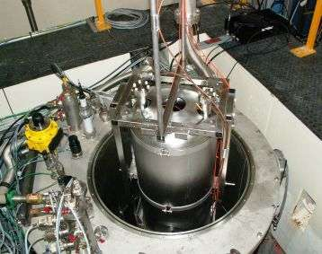
WP3.2 – SUPRATECH
David Longuevergne
IJCLab SUPRATECH @ CNRS Orsay
A facility for testing RF cavities, cryomodules,
V & H cryostats
The facility is in operation,
3 TA projects were accepted, all as Remote Access (RA)
SUPRATECH is strongly linked to IRFU-Synergium for offering combined surface processing of accelerator RF components for R&D activities

Slide 10
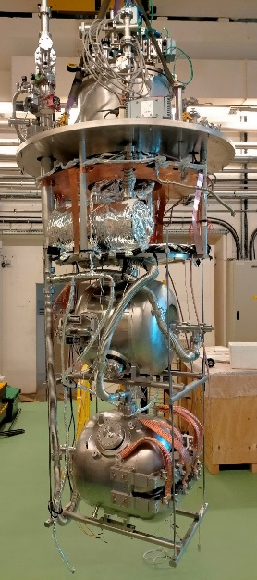
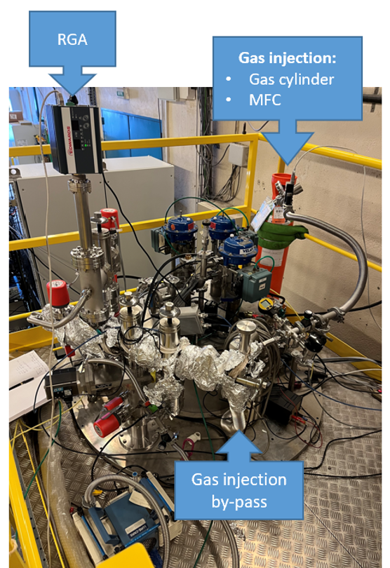
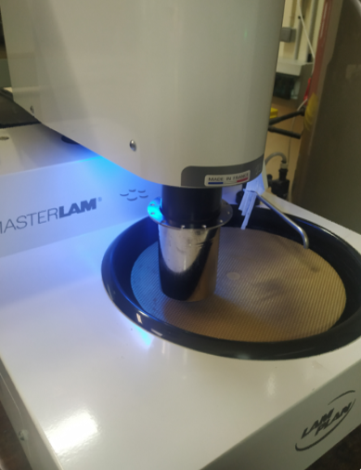
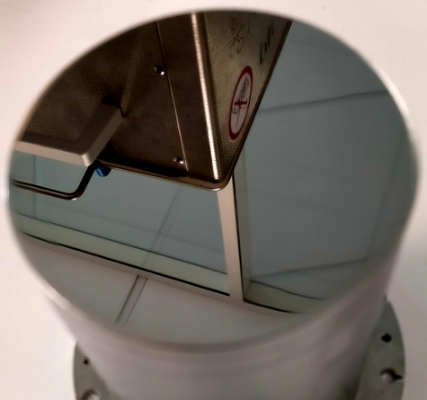
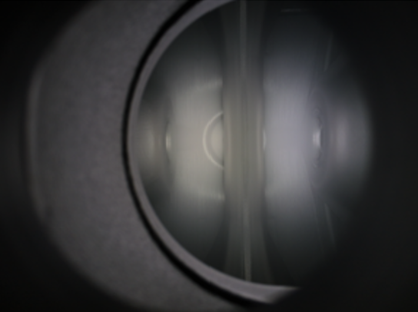
WP3.2 – SUPRATECH
David Longuevergne
In total, Supratech provided 3 remote access to users:
For HZB (Germany) : Surface treatment of Niobium sample by metallographic polishing
For Zanon company (Italy) : Testing at cryogenic temperature of 3 prototypes Spoke resonator (SSR2) for PIP2 project
For Fermilab (USA) : 2 cryogenic tests of 1 prototype Spoke resonator (SSR1) before/after plasma processing.
No further access foreseen
PIP-II Spoke resonators built by Zanon installed on insert
Polishing device
Polished Niobium sample
Plasma ignited inside cavity
Set-up for plasma cleaning
10

Slide 11
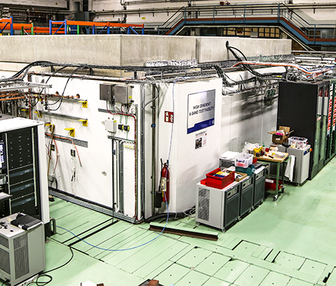
WP3.2 – XBOX - CERN
XBOX @ CERN
Klystron X-band test stands (11.994GHz – 50MW/1.5μs/50Hz and 6MW/5μs/400Hz)
No TA requests so far.
XBOX is a highly specialized facility that was developed for the CERN-CLIC project.
No requests received. Its use within the broader community and the ongoing R&D projects is of little interest or need.

