Slide 1
WP 5: Open, Diverse and Inclusive Science
Looking Ahead→
What's to be done until the end of the project?
What's the future after the project?
María José G. Borge
Instituto Estructura de la Materia, CSIC
Madrid, Spain

Slide 2

WP5
Open, Diverse and Inclusive Science
WP Coordinator Maria J G Borge
Task 1
Diversity and Dissemination
Enhancing diversity: Nacionality Gender Age Level of expertise Enhancing Dissemination Web site Videos of RI Newsletters,…
Task 2
Open Science & Data Management
Promoting Data Management Plan Creating a portal for Nuclear Physics data tools
Task 3
Machine learning
Machine Learning Beam control and Optimization & Control of the source of Laser driven Accelerator
Task 4
Training
Hands-on training on the facilities 4 events of Basic Training 4 events of Advanced training
Paolo.Giacomelli
paolo.giacomelli@bo.infn.it
Antoine Lemasson
lemasson@ganil.fr
Sabrina Appel.
s.appel@gsi.de
Livius Trache
livius.trache@nipne.ro

Slide 3
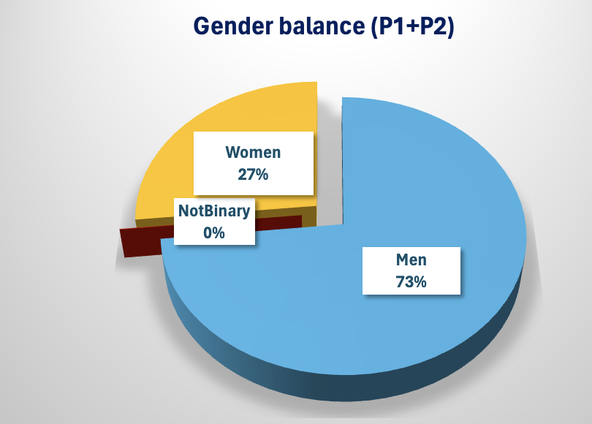
Task 1: Diversity & Dissemination
Diversity:
Within task 5.1 we will work to ensure the largest posible diversity of potential users
Engaging people of Different Nationality
Gender
Age
Level of profesional expertise
What's to be done until the end of the project?
Deliverable 5.2: User’s Diversity Final report ( December 23rd, 2025)
Statistics on Gender → to be compared with previous Projects ENSAR2, AIDA, check evolution in a decade
Deliverable: EURO-LABs user’s diversity final report M48
What's the future after the project?
The webpage contains a lot of documentation and videos it will be important to maintain it

Slide 4
Task 2 : Data Availability from the Facilities
Task 1:
Develop a Open NP Catalogue of Dataset and Tools
Definition of the catalogue perimeter, architecture, and standards.
Release of terms of reference (M 36).
Deliverable 5.6 Final Report in Open Science (M 46)
Task 2:
Prepare a Platform to integrate existing infrastructures in the EOSC environment
Milestone: Report on existing solution in EOSC ecosystem
Report on how to adapt and integrate existing solutions to NP Ecosystem
Release of the first functional version of the Open NP and data access tools (M36)
Deliverable 5.9 Data management Plan Final Release (M 48)
What's to be done until the end of the project? Look at Quentin Presentation
What's the future after the project? → GANIL will continue already discussed with the Management
What about the other facilities? How useful is for the community the work done @ GANIL?
It has been already indicated that a survey within EUROLABS will be done
It has been suggested to collaborate with CNA to see the similarities and possible help for improvements
Maria Jose Gª Borge, Coordinator WP5, IEM-CSIC, Madrid Spain

Slide 5
Task 3 : Machine Learning for accelerator and Plasma
Objetive:
Use Machine Learning (ML) methods to improve beam quality, transport efficiency and reproducibility.
Task 1: Beam control and optimization Applications
Milestone: The source code of the ML toolkit prototype has been made available on a shared platform (e.g. Gitlab at CERN) (M8). Deliverable : The new toolkit has been deployed at least two facilities (e.g. CERN and GSI) and has successfully been used for an optimitation task. (M24) .
The toolkit is established at the involved facilities and has been applied to at least one user beam line. (M36) Report on the different tested algorithms and reported results in applications beyond ion beam tuning optimitation. (M48)
Task 2: ML applied to the control of the source of the laser driven accelerator
Already started
In a final step, the optimizer kit may be apply to other fields, such as medical physics
What's to be done until the end of the project? See presentation of Penny Madysa and Proxy Kad
What's the future after the project?:--> opening to other facilities will take priority
GANIL is interested in getting Geoff. We think Penny should give a seminar in GANIL……
Maria Jose Gª Borge, Coordinator WP5, IEM-CSIC, Madrid Spain

Slide 6
Task 4 : Training
Objetives: In order to enhance competitiveness of our RI and its technical capabilities we will forge a coherent, stable, and predictable system of training, formation schools and events that uses the strengths and capabilities of all partners providing hands-on training
Plan: 2 set of schools
4 Basic Training (1/year) to take place at smaller accelerator facilities that allows hands-on activities: IFIN-HH,, HIL Warsaw, etc.
4 Advanced Training (1/year) at larger, state-of-the-art facilities: CERN ISOLDE (2023), GANIL (2024), GSI/FAIR (2025) and ELI-NP (2026). Two of these will be dedicated to the technical and engineering staff.
To coordinate the activities of this task we will select a Training Scientific Board (TSB) in the first 6 months of the Euro-Labs project
What's to be done until the end of the project?→ 1 basic School (IFIN-HH)and 2 advanced schools (CERN and GANIL)
Co-sponsor different schools ( see presentation of Livius Trache)
What's the future after the project? It is clear the need of hands-on Schools. So we would like to get at least CERN to support the ATSOA school and IFIN-HH is also consideirng the possibility of runing the basic school
Milestones and Deliverables
Milestone: Selection of the Training Scientific Board. M6 of Euro-Labs
Deliverable: Report on activities after 24 months, including follow-ups from participants. M24
Deliverable: Final report. M48
Maria Jose Gª Borge, Coordinator WP5, IEM-CSIC, Madrid Spain

Slide 7
WP5: Service Improvements → All accomplished
Provide and maintain the webpage
Provide regular exchanges by the newsletter
Provide videos of the 39 RI so the users can choose the best RI for their research
Foster diversity by engaging people of different nationalities, gender, age and level of expertise.
Develop a Data Management Plan
Develop an Open NP catalogue of data sets and tools and an associated Open Science Desk
Integrate the Nuclear Physics community to existing infrastructures and services of EOSC environment.
Provide a ML optimizer toolkit for beam control and optimization of friendly use and that it can be applied at different facilities to improve performances.
ML will also be used for the source of the laser-driven accelerators will the same spirit.
Enhance the competitiveness of our research infrastructure and its technical capabilities by training researcher and technical personnel both at the basic and advanced level providing hands-on courses in our facilities.
Maria Jose Gª Borge, Coordinator WP5, IEM-CSIC, Madrid Spain

Slide 8
Thanks for your attention !!

