Slide 1
PERLE / ERLs
in the European Strategy Update
Achille Stocchi
PERLE Collaboration meeting
13-14 October 2025

Slide 2
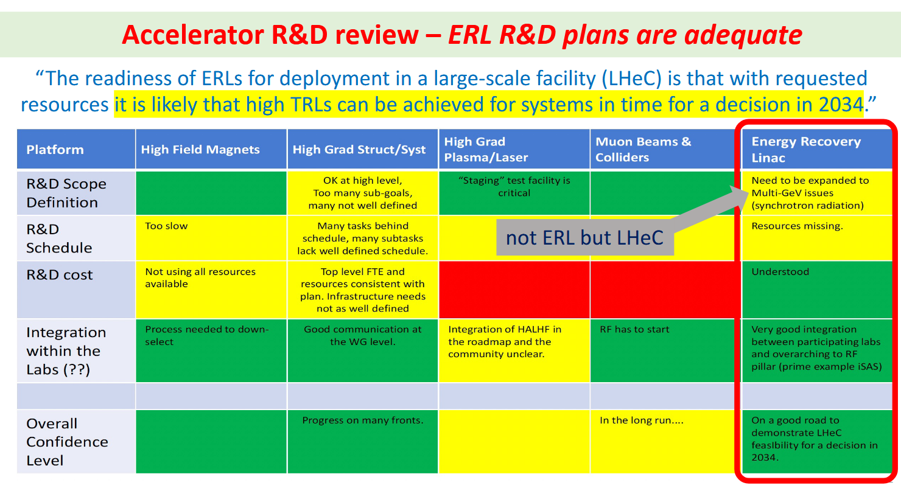
MARCH 2025

Slide 3
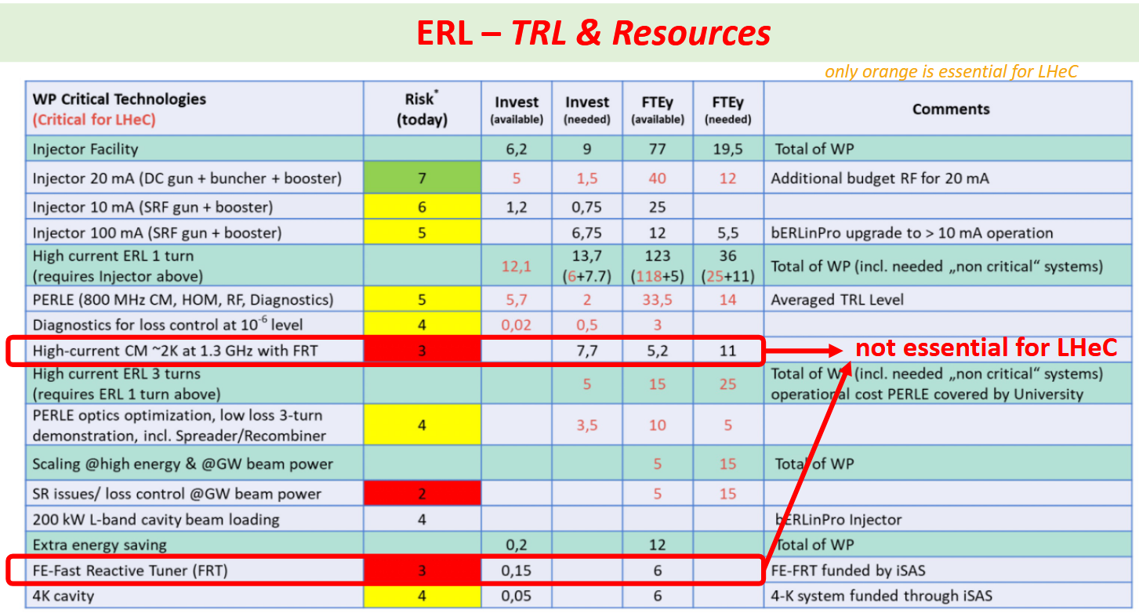
MARCH 2025

Slide 4
ERL R&D Roadmap – Key messages
MARCH 2025
Based on the review, the R&D program for PERLE and bERLinPro should be implemented and financed as presented. The plan is adequate and spans up to 20232, and will allow a timely informed decision for the ERL performance of the LHeC
bERLinPro – The particle gun is commissioned and is ready for an impactful R&D programme, but resource commitments are urgently expected from the particle community.
PERLE – The ERL1-turn is being installed and a phased approach for the 3-turns has been developed with additional opportunity, e.g. for testing cryomodules (e.g. FCC), for testing energy saving technologies and for involving more institutions
For the funding of R&D that is critical for LHeC 12M€ and TTFTEy are still missing
Recommendations
Secure sufficient funding and personnel for the realization of PERLE in multi-turn configuration latest 2032
Develop suitable concepts and technologies for dealing xith SR power loss and induced energy spread of LHeC within the Accelerator roadmap and secure funding
Since March things are very nicely evolving.
PERLE is a facility where we can host the first FCC-ee cryomodule and test other key components (FCC like mono-cell cavities in the booster, HOM, FCP..)

Slide 5
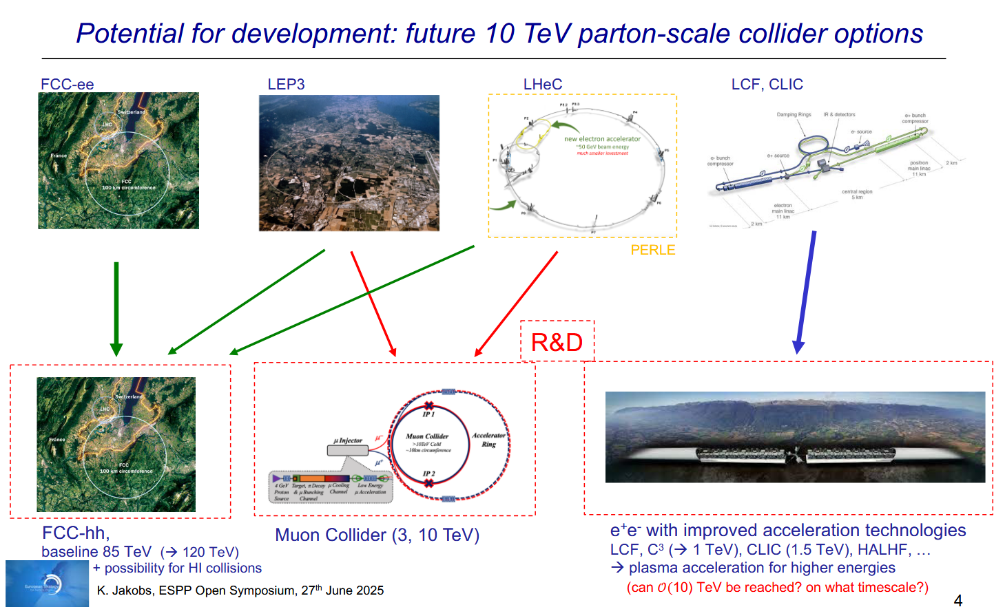
1-SLIDE of the Summary presented by Karl Jakobs at ESPP in Venice
JUNE 2025

Slide 6
As a summary : PERLE Facility in the FUTURE ACCELERATOR PLAN
EPPS2026
EPPS2032
2025 |  |  |  |  | 2030 |  |  |  |  | 2035 |  |  |  |  | 2040 |  |  |  |  | 2045 |  |  |  |  | 2050
Run 4
Run 5
FCC-ee Run
LHC/FCC
LS3
LS4
FAST²E
The 50GeV ERL for LheC
could be the injector of FCC
1 turn
Test facility
for Future Accelerators
PERLE
Installation
3 turns
ESS
upgrade
ERL performance
validation
Run
LHeC
bridge
Work towards TDR
Civil engineering
50 GeV ERL
commissioning
IR
preparation
PERLE performance validation for LHeC
PERLE can be seen as
FAST²E : Future Accelerator and System Test Facility for Energy Efficiency
A Test Facility for Future Accelerator and related systems aiming for Energy Efficiency. The Approach is guided by the Energy Efficiency, not only with ERL but with a system approach : developing and testing various systems that work together to make accelerator technology both cutting-edge and sustainable.
PERLE can/will host the first FCC-ee cryomodule as soon as it is ready (~2031-2032)

