Slide 1

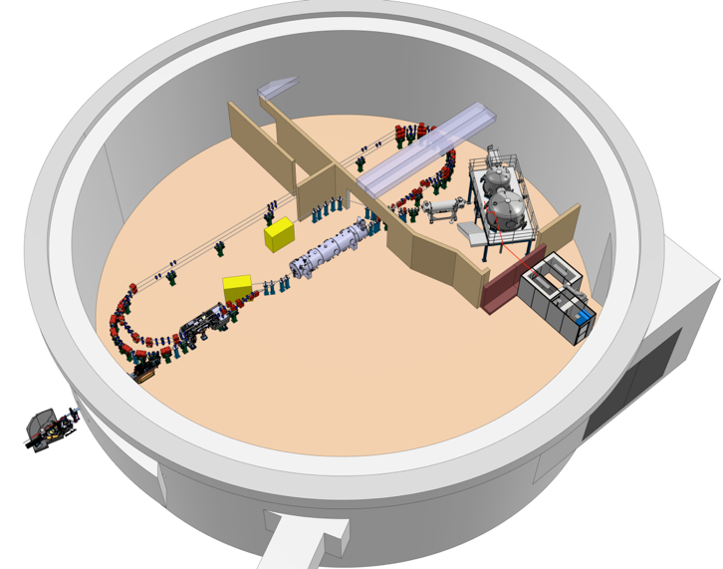
CERN Collaboration Meeting
DIAGNOSTICS choices for PERLE
M. Ben Abdillah (IJCLab)
October 14th 2025

Slide 2
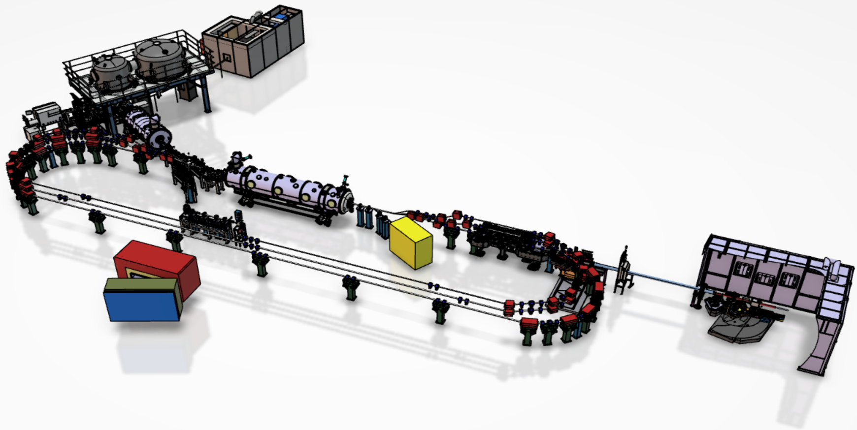
PERLE Diagnostics issues
Issues specific to diagnostics for the development and multi-turn ERL operation
6D measurements of the beam at the output of the injector: high load, low emittance, low to high current, pulsed to CW
Calibration of the phases of the cavities of the Linac
Beam path adjustment
Monitoring of several beams: measurement of the position of each beam individually
Measurement beams properties in the ring: emittance, halo, transverse profile.
Losses monitoring: interleaved beams increase the difficulty of tracking losses throughout the machine.
…
Target Parameter | Unit | Value
Injection energy | MeV | 7
Electron beam energy | MeV | 89/250/500
Normalised Emittance γε_{x,y} | mm mrad | 6
Average beam current | mA | 20
Bunch charge | pC | 500
Bunch length | mm | 3
Bunch spacing | ns | 25
RF frequency | MHz | 801.58
Duty factor |  | CW
Notes:
PERLE studies point out challenging issues for diagnostics, these issues are mentioned in this slide and will be addressed one by one in the following slides. For example, we would like diagnostics to cover a large brand of commissioning schemes and help in the monitoring of different beam properties

Slide 3
PERLE Global planning
Design
First electrons April 2026
Upgrade
Laser
Procurement/Construction/Installation
5 mA
20 mA
Commissioning
DC Gun @ 350 keV
Buncher installation
Booster installation
Booster
RF sources upgrade
20 mA
5 mA
Injector @ 7 MeV
Cryomodule installation
0.5 MW
2 MW
ERL 1-loop @ 89 Mev
Civil engineering work
5 MW
ERL 3-loop
TDR
2025
2026
2027
2028
2029
2030
2031

Slide 4





Collaborations in Diagnostics WorkPackage
BPM: Beam Position Monitors
BLM: Beam Loss Monitors
BCM: Beam Current Monitors
Profilers: transverse & longitudinal
Energy: nominal value & spread
Emittance:
Diagnostics based on Synchrotron Radiation: Emittance, Halo, Losses
BLM
Emittance
Diag SR
BPM
BLM
BCM
Profilers
Energy
We are still looking for new collaborations

Slide 5
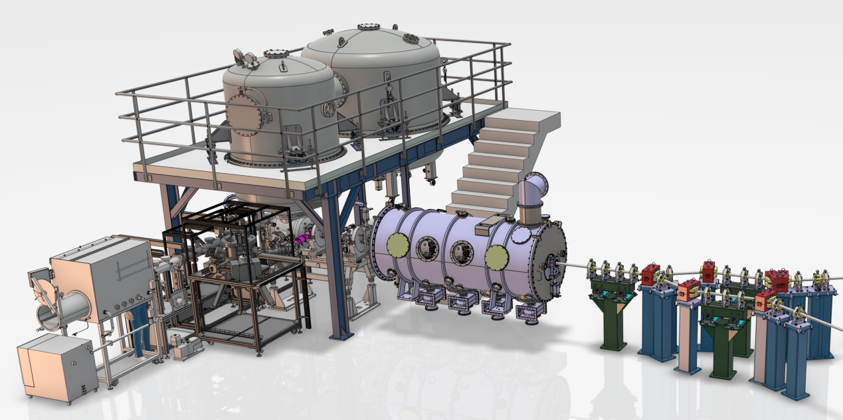
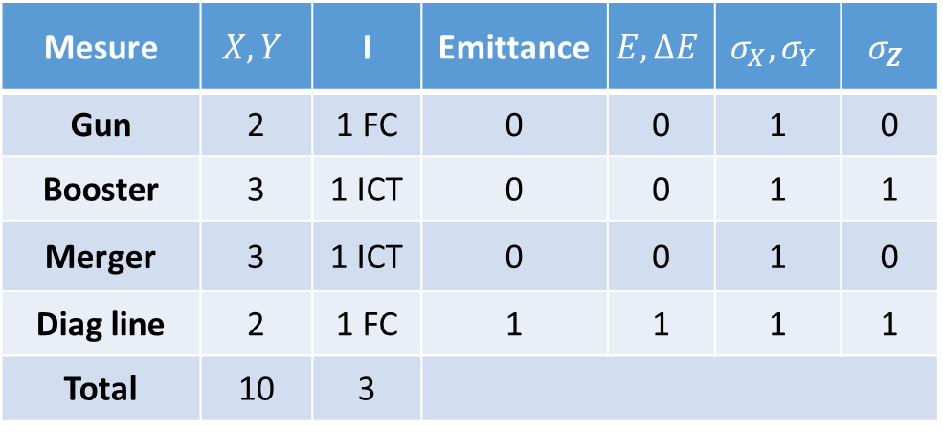

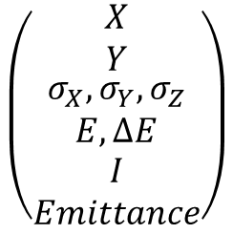

Diagnostics for PERLE injector
Funded by the national program RI2 (CNRS)
$$\left(\begin{matrix}\begin{matrix}X \\ Y\end{matrix} \\ \begin{matrix}σ_{X},σ_{Y},σ_{Z} \\ E,∆E\end{matrix} \\ \begin{matrix}I \\ Emittance\end{matrix}\end{matrix}\right)$$
Photogun
Merger
To the Linac
Cryomodule Booster
To diagnostics line
$$\left(\begin{matrix}X,Y \\ \begin{matrix}{σ_{X},σ}_{Y} \\ I\end{matrix}\end{matrix}\right)$$
$$\left(\begin{matrix}X,Y \\ \begin{matrix}{σ_{X},σ}_{Y} \\ I\end{matrix}\end{matrix}\right)$$
Mesure | $$X,Y$$ | I | Emittance | $$E,∆E$$ | $$σ_{X},σ_{Y}$$ | $$σ_{Z}$$
Gun | 2 | 1 FC | 0 | 0 | 1 | 0
Booster | 3 | 1 ICT | 0 | 0 | 1 | 1
Merger | 3 | 1 ICT | 0 | 0 | 1 | 0
Diag line | 2 | 1 FC | 1 | 1 | 1 | 1
Total | 10 | 3
Beam properties:
In operation: 500pC, 40MHz, 20mA,
During the commissioning:
125pC, 10MHz + macropulse
10pC, 10MHz ,100µA CW

Slide 6
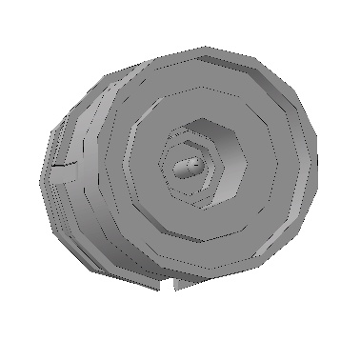
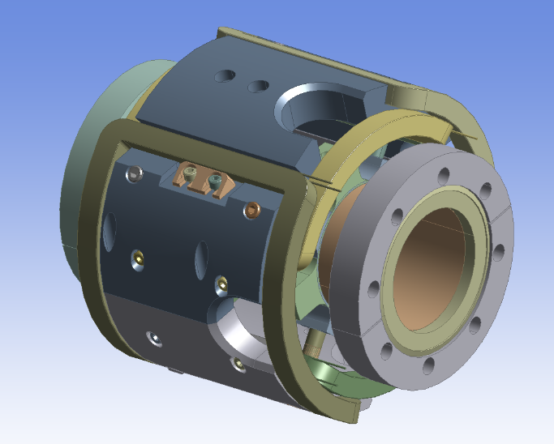
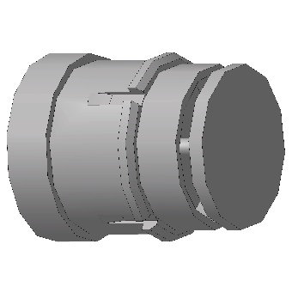
Diagnostics for PERLE injector: BPMs
Gun BPMs
Button diameter 11mm
BPM diameter 60mm
Position sensitivity 1dB/mm
BPM + steerer = 178mm along beam axis
Matching might be needed inside the merger
Optional measurement: BPM output level at 2 tones for beam longitudinal length measurement

Slide 7
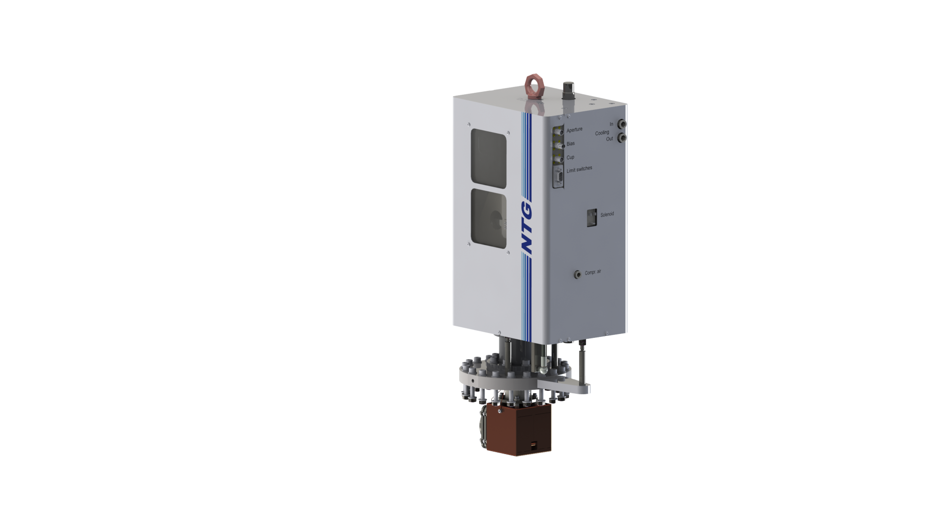
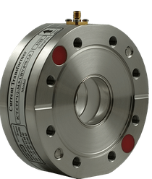
Diagnostics for PERLE injector: BCMs
Faraday cup for the Gun:
Delivery expected mid november 2025
Current measurement at the Gun exit (350KeV & up to 20mA)
Current measurement at the end of diagnostics line (7MeV, 1mA)
Non invasive current measurement:
Chosen solution: ICT with fast stable output (5 ns)

Slide 8
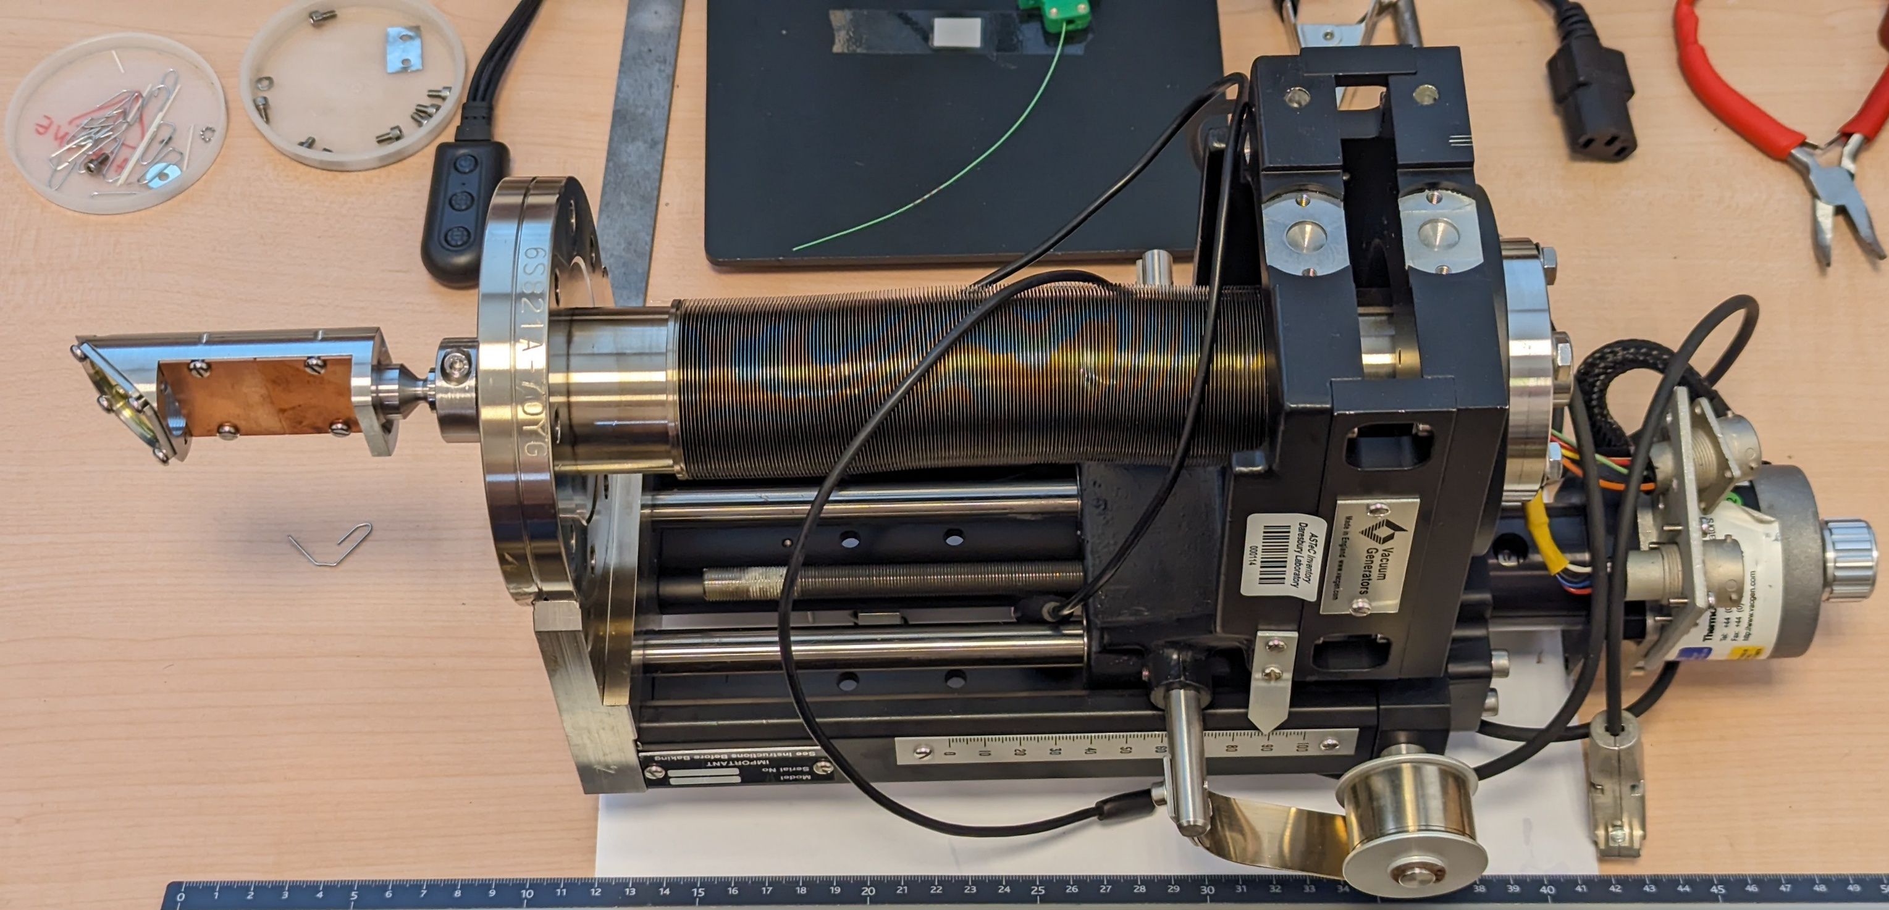
Diagnostics for PERLE injector: Diagnostics line
Gun screen to be reproduced for the measurement of:
Transverse profile
Emittance with a quad scan
Energy profile with a dipole ahead of the screen
Simulations to be run to optimize diagnostics line measurements

Slide 9
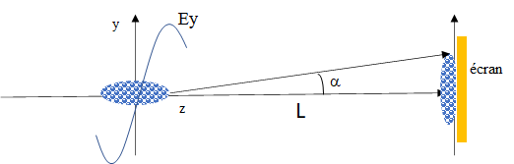
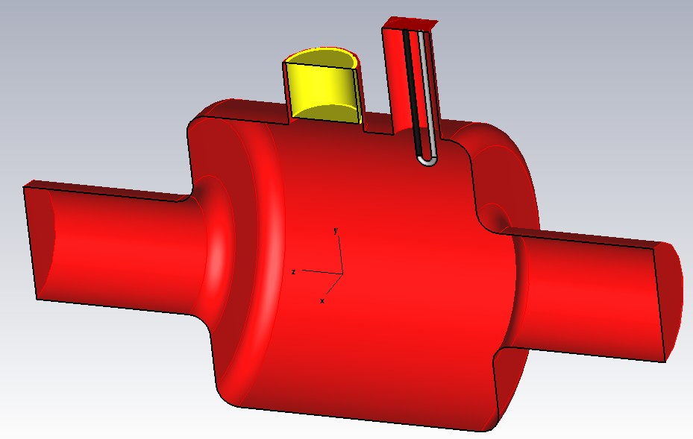
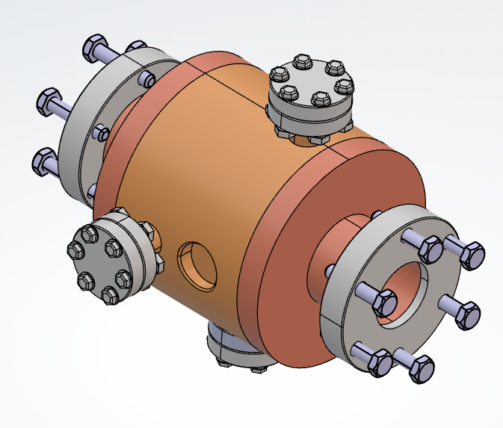
Diagnostics for PERLE injector: Diagnostics line
RF Cavity exciting TE11 mode at 3 GHz+ YAG screen
RF & mechanical design
Length L=2m
Electrical field peak value= 2,7 MV/m
Pulse duration=3µs
Pulse period=100ms
CH cavity
Needed RF power ~ 2 kW

Slide 10
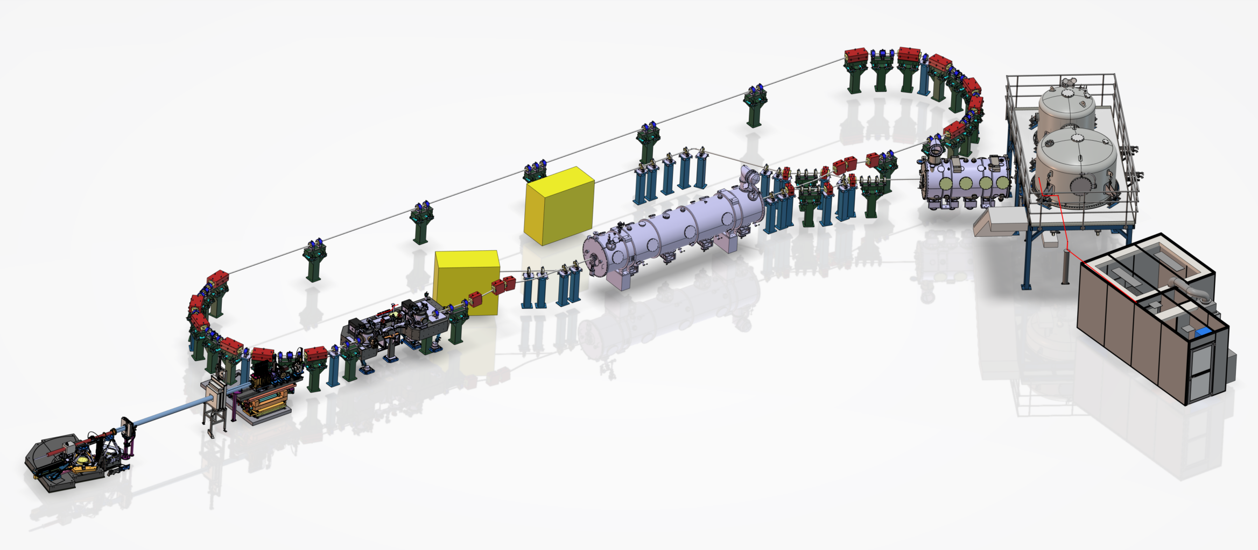
Diagnostics for PERLE 1 turn
Inverse compton source
Fabry-Perot cavity experiement @ 89 MeV
515 nm /200 kW
DESTIN
e- scattering / nuclear Porbe
Spectrometer and Ion trap
Diagnostics goals:
Calibration of cavities phases in the Linac
Measurement of Linac transmission coefficient
Distinguish and measure each beam position
Beams path adjustment
Measurement of beams losses
Non invasive measurements of beam properties (emittance, …)

Slide 11
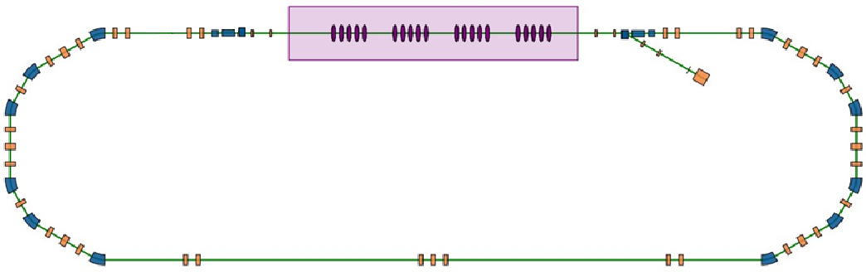
Diagnostics for PERLE 1 turn: Linac BPMs
LINAC
beam scheme for the calibration of Linac cavities: measure of the phase difference between the two BPMs for the same beam
Beam Dump line
BPM
BPM
Position (Single Bunch) | Phase (Single Bunch) | Position (Multiple Bunch)
14 | 2 | 2
For PERLE 3 turns, specific beam schemes for Linac commissioning will be defined

Slide 12
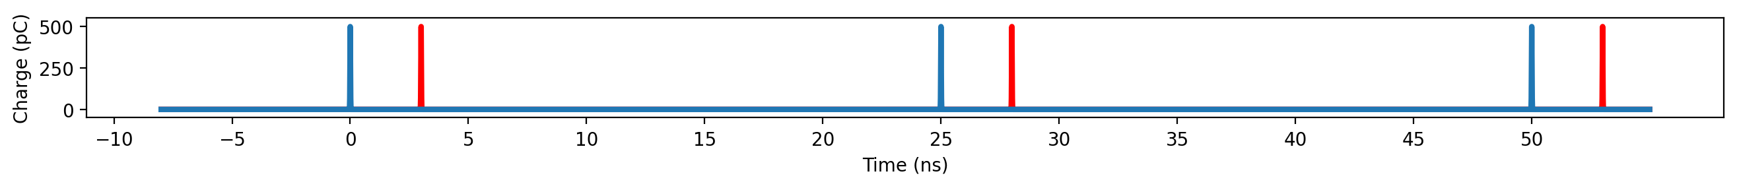
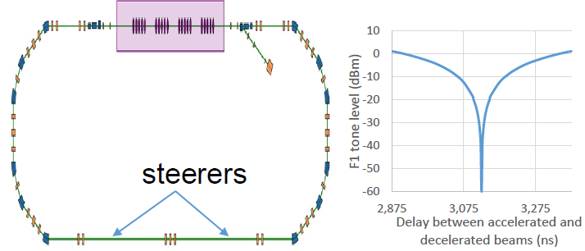
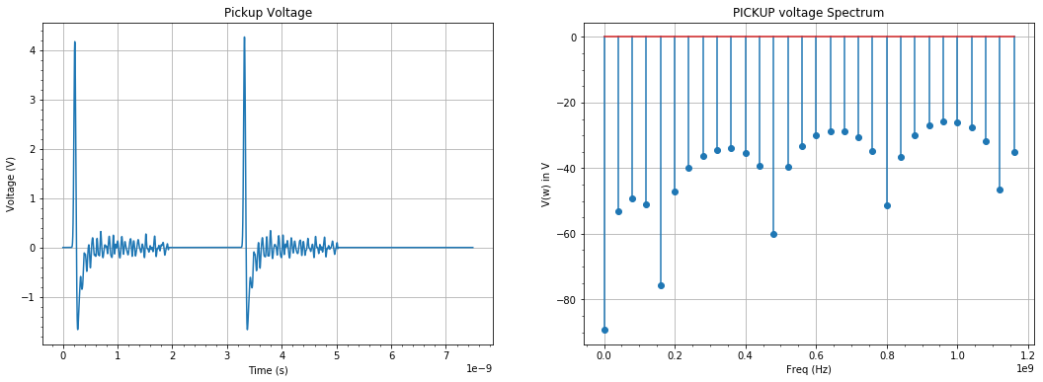
Diagnostics for PERLE 1 turn: Linac BPMs
Adjustment of the length traveled by the beam on a turn:
Goal: 2 beams (A & D) separated by 3.125ns
BPM output
J. Issa : Longitudinal matching of the PERLE accelerator
Chicane giving up to 10mm additional path length
Measure tone level with a powermeter
Measure phase shift between Linac BPMs for the same beam
Use Ultra-fast Comparator to compare BPM output signal to a predefined pattern over a given period
For PERLE 3 turns, a similar method will be applied for each turn

Slide 13
Diagnostics for PERLE 1 turn: Linac BPMs
Measure the position of each beam (blue & red)
CBETA solution: trigger ADC start at a given beam peak then trigger it on the peak of the other beam. Measure a beam at a time
Fast ADCs solution: Sample BPM output at 1GSPS rate or more allowing the distinction between the two beams
BPM output
For PERLE 3 turns, the chosen solution will be matched (particularly to the 6 beams seen by Linac BPMs)
« Over sampling » solution: reconstruct BPM output signal over some sampling periods

Slide 14
Diagnostics for PERLE 1 turn: BLMs
A lot of simulations to do
Definitions of needs to be refined
Interlock management and relation with MPS
Location of losses and reasons for losses
Challenges for electronics:
The ERL interlaced beams increase the difficulty of tracking losses throughout the complete journey through the machine.
The location of the beam(s) responsible for the losses is only more complicated

Slide 15
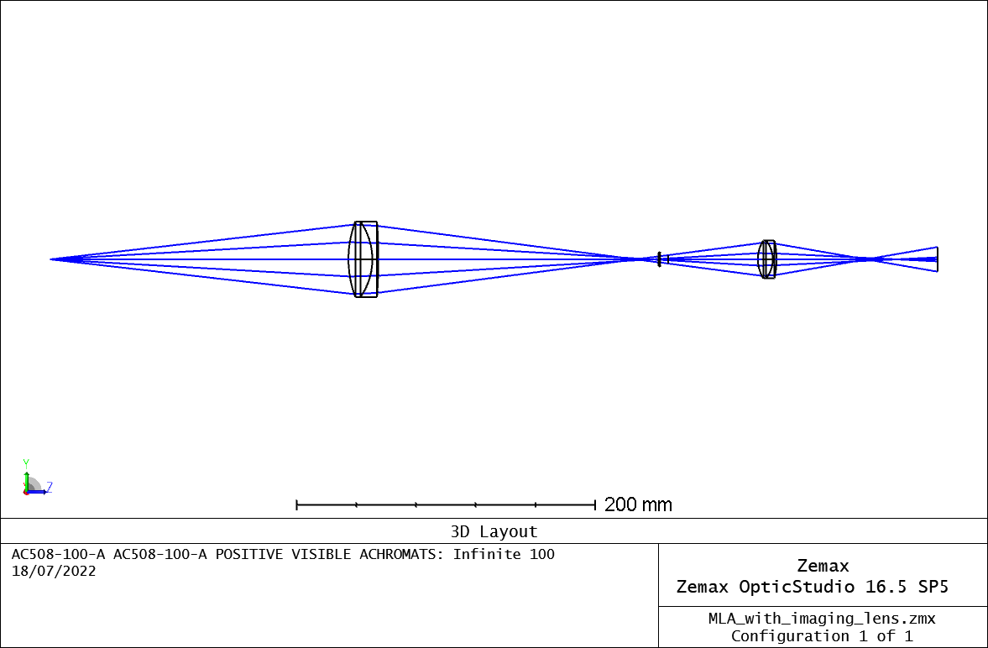
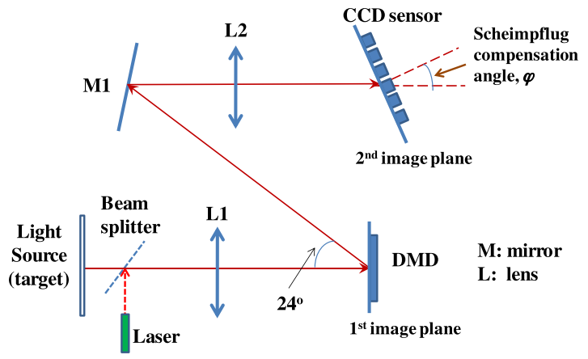
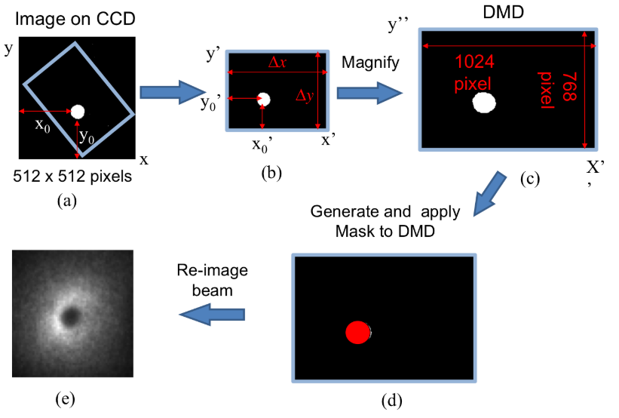
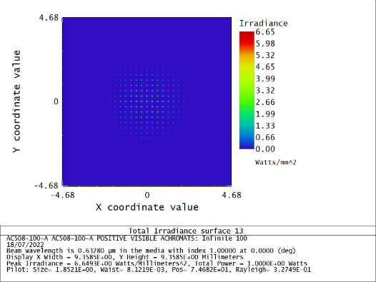
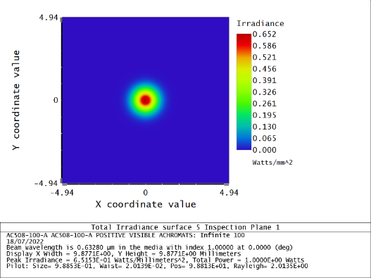
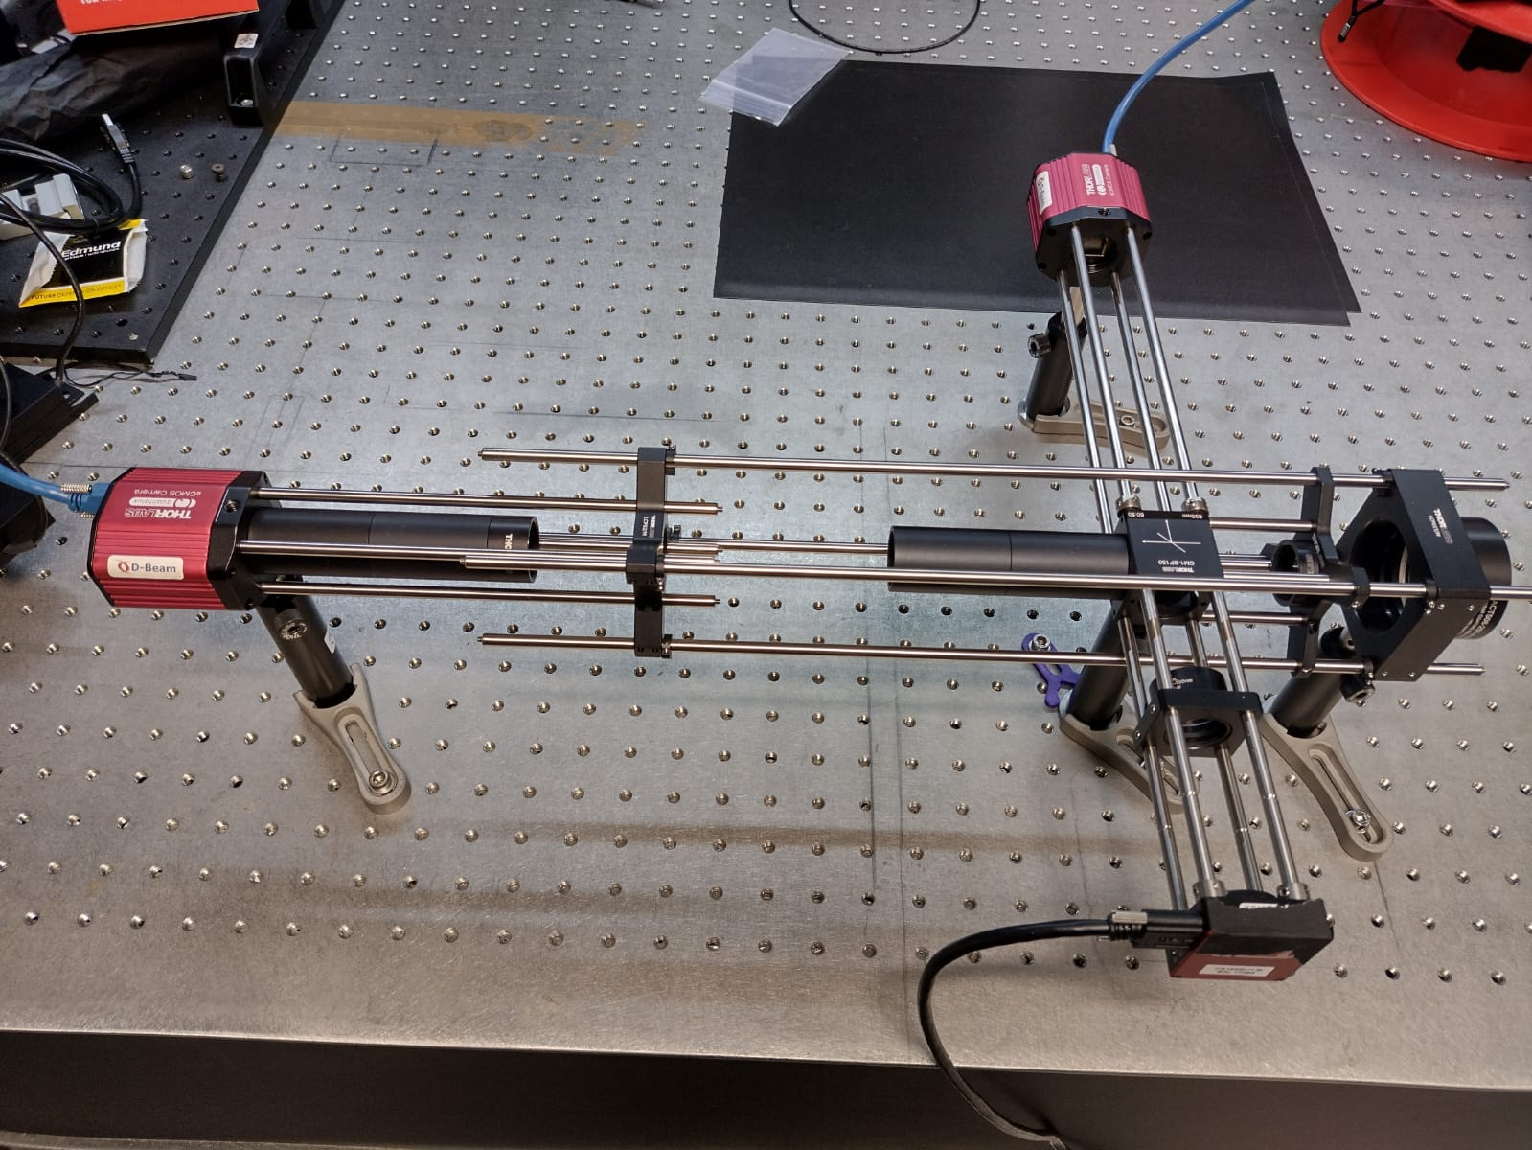
Diagnostics for PERLE 1 turn: Non Invasive Diags
L2
L1
I1
I2
Micro-Lens Array
I1
Halo imaging with DMD (Digital Micromirror Device)
L1
I2
L2
Pellicle Beamsplitter
Non-Invasive diagnostics development for ERLs Speaker: J. Wolfenden
Single Shot Emittance with MLA (MicroLens Array)

Slide 16
Conclusion
Design phase ends (TDR to come) start of construction and prototyping
Injector
Diagnostics for the gun already provided: commissioning in 2026
Well defined tasks: rather tight schedule and backup solutions identified
Integration challenges: reduced space for BPM, steerers and viewers in the merger,
Acquisition challenges: large dynamic range for BPM signal, Diag line measurements to be optimized
PERLE 1 turn
Stringent specifications for two BPMs at Linac entrance and exit
Acquisition challenges: new constraints required a particular processing of BPM output signals
BLM task requiring a lot of work
Possible interesting advances for non invasive diagnostics based on synchrotron radiation
Perle 1 turn diagnostics will mostly guide diagnostics for PERLE 3 turns

