Slide 1
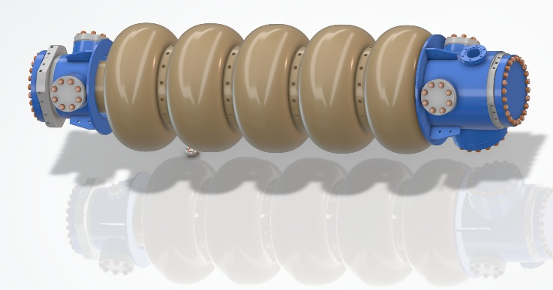
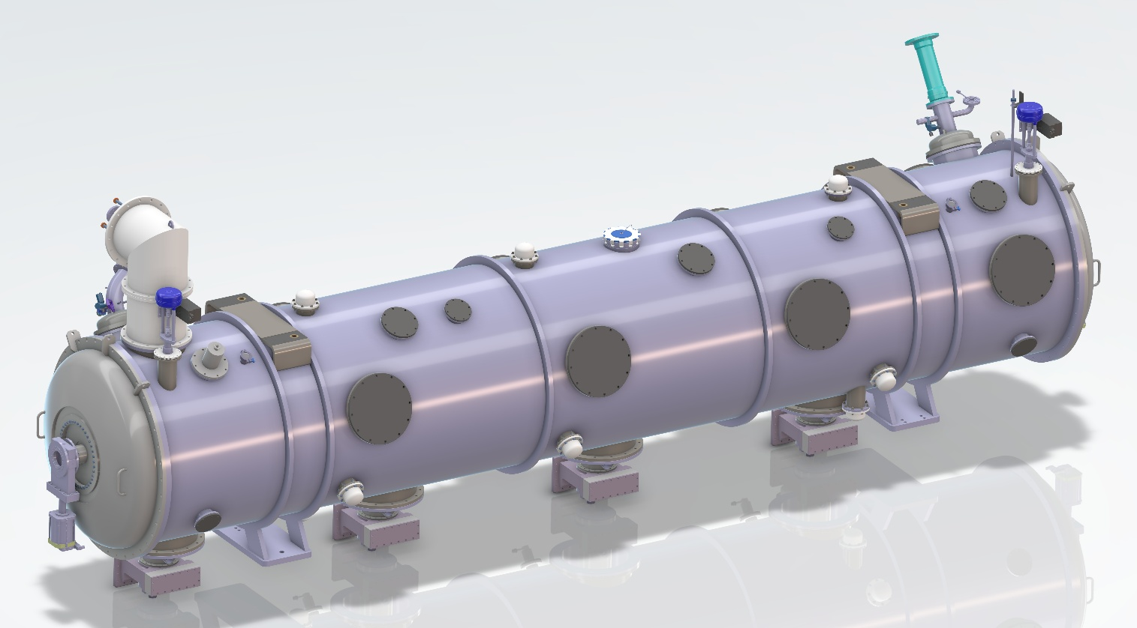







ERL cryomodule status and plan
Collaboration meeting
Guillaume Olry (CNRS/IN2P3/IJCLab)
on behalf of the PERLE partners
13-14 October 2025 - CERN

Slide 2
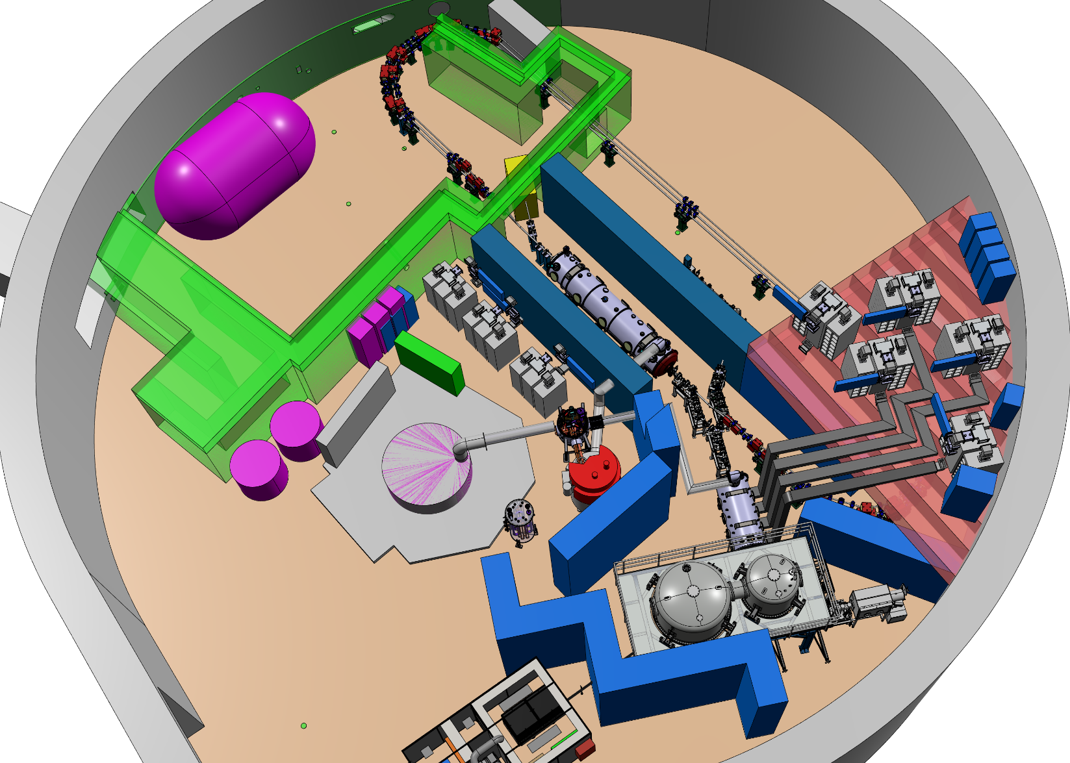
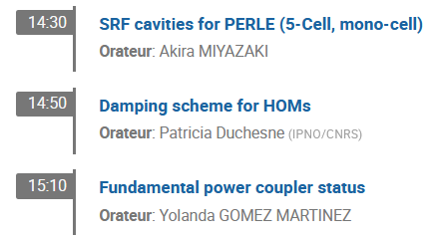
Outline
ERL Cryomodule in the igloo
Context/News
5cell cavities and more...
HOM / BLA
Power couplers
Magnetic shields
Cryomodule adaptations
  End-caps
  Cryogenic circuits
CO2 saving
Planning

Slide 3

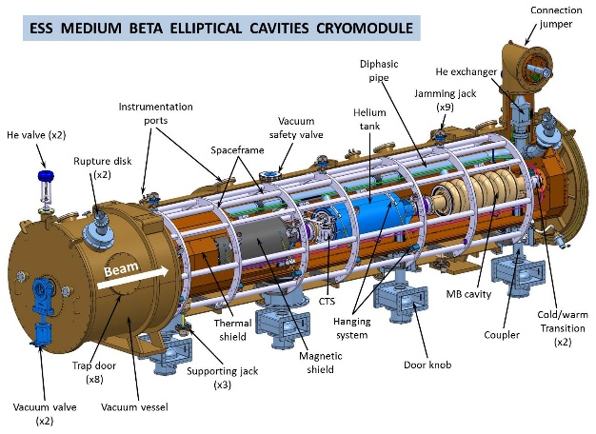
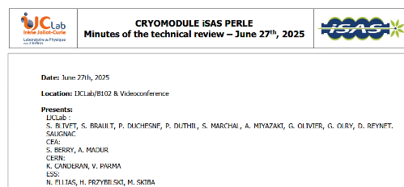
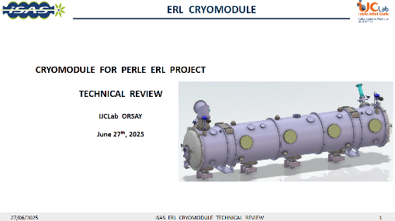
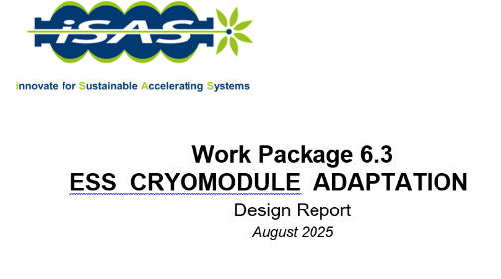
Context/News
Most of the work is done through the iSAS project:
Major in-kind from ESS (Medium beta cryomodule) : vacuum vessel, thermal shield, spaceframe, MLI
New components :
  Cavity string : 5cell cavities, HOM couplers and cold absorbers, power couplers, tuning systems
  Warm and cold magnetic shields
  Cryogenic circuits
We are about to complete the design and adaptation phase
Important and fruitful technical review in June to validate our choices
Writing of the technical report in August (iSAS milestone)
1 October 2025: New PhD student Axel Perez-Ruiz, on cryogenic absorbers (supervisor: Akira Myazaki)

Slide 4
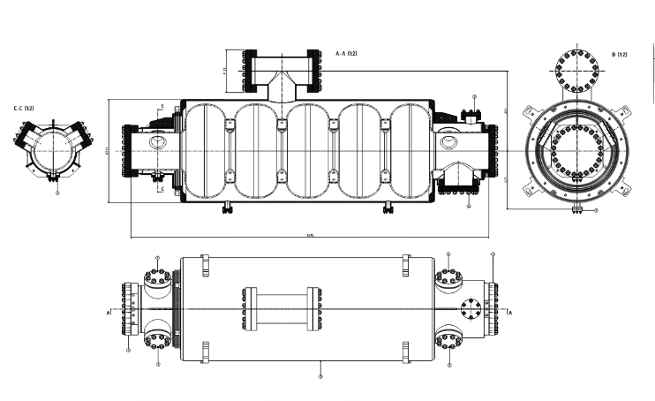
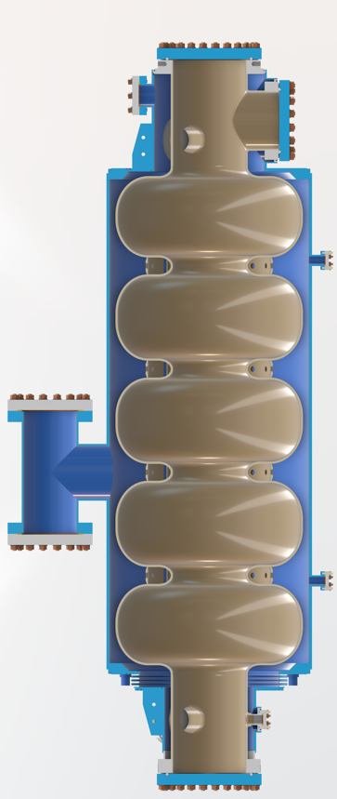
5cell cavities
Reminder: 1st call for tender has been cancelled due to
  Changes on preparation strategy (validation of mid-T bake in IJCLAB furnace → no need of single-cell prototype incl. in the call for tender)
  Mandatory technical changes on the cavity (HOM ports diameter, flanges material) and the helium vessel (bi-phase flanges type/material, He degassing ports for vertical testing...)
Preparation and testing
  Vertical EP to be done at CEA (1st try with ESS proto cavity) & Heat Treatment (650°C) + Mid-T bake at IJCLAB
  Field flatness tuning bench under development @IJCLAB → adaptation of the one used for the SPL 5 cell prototype of EuCARD project...
  Vertical test configuration @ INFN-LASA : possible with and without the helium jacket → CF 16 (inlet) and CF40 (outlet) have be added.
2nd call for tender : new offers received 2 weeks ago. Technical analysis is done → order is planned end of October. Cavities fabrication on the critical path.
CF 40
CF 16

Slide 5
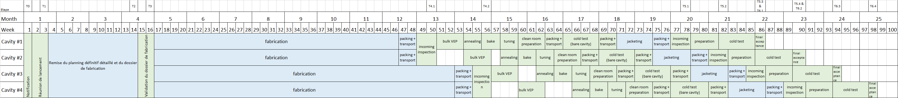
5cell cavities
  Expected planning: lead-time of about 2 years to get the 4 cavities ready for clean room assembly (NB: no spare cavity)
Delivery of cavities by pair
~12 months for cav #1 & #2
~14 months for cav #3 & #4
~12 months for cavity preparation and testing
Vertical EP @ CEA
Heat treatments + freq tuning + clean room preparation @ IJCLAB
Cavity tests @ INFN-LASA (+ backup @ IJCLAB)
Goal: High Qo > 3 10¹⁰ (at 2K) @ Eacc=22 MV/m

Slide 6

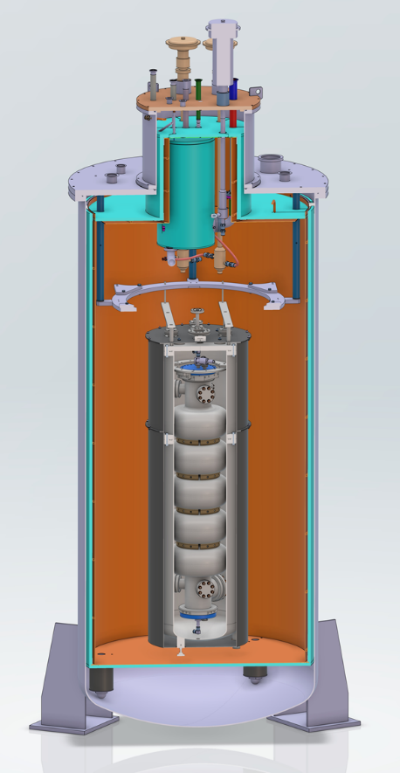
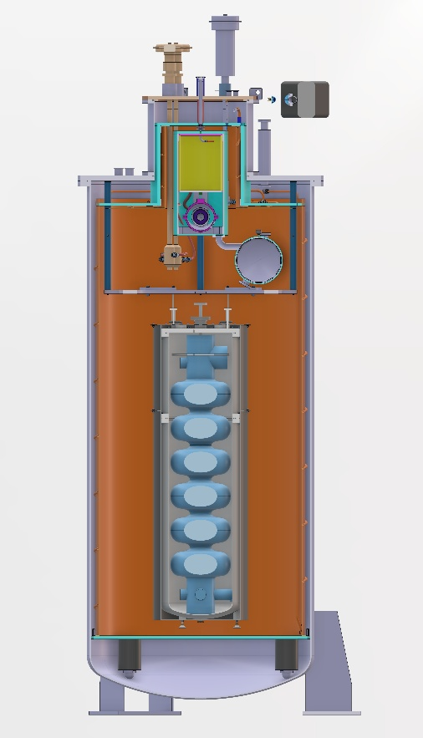
Testing 800MHz cavities @ IJCLab
Adaptation of the Vertical Cryostat to host monocell and multicell bare or jacketed cavities.
  New mechanical support and cryo piping
  New reservoir
  New magnetic shield (cryophy) to minimize the residual B field
→ Order of the reservoir and mechanical support : November 2025
Order of the magnetic shield: Jan 2026
Assembly in March.
1st test with the new FCC monocell cavity or the repaired PERLE monocell cavity.
Financial support from Université Paris/Saclay (awarded this summer).
5cell PERLE cavity
6cell FCC cavity

Slide 7

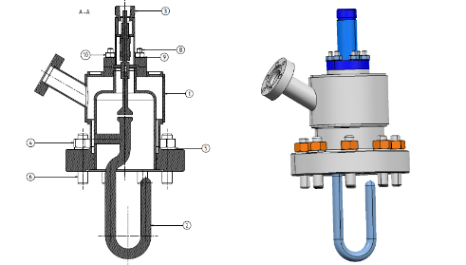
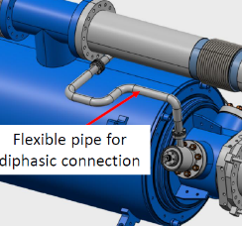
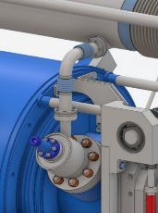
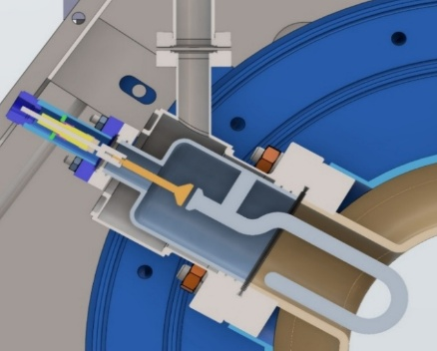
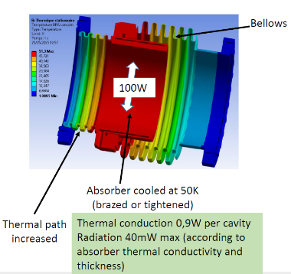
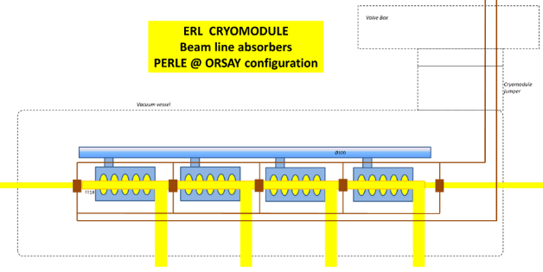
HOM couplers and Absorbers
Standard RF feedthrough on CF16 flange
HOM couplers : 2 hook type couplers per cavity (8 needed, 4 produced by CERN)
RF design has been optimised to integrate an off-the-shelf RF feedthrough (PHOM max 2W @ 2K)
Optimization of the cooling circuit (diam & length)
2 designs for the He jacket: SS or Ti
Start requesting quotation from industry to order 4 additional HOM couplers
Cold absorbers: study to be done →PhD thesis just started
Which material (SiC, AlN, other...)?
Number of cold BLAs? 2 options: 3 cold + 2 warm BLA or 5 cold
Cooled by GHe at 50K by a new dedicated cryo circuit
Preliminary design for 100W extracted PHOM: to be optimised
Helium jacket
Thermal mapping
Config with 5 cold BLAs

Slide 8

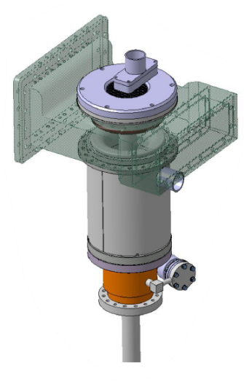
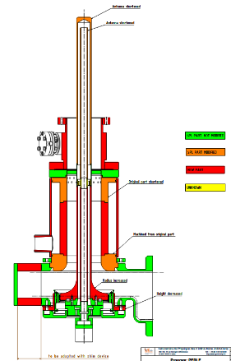
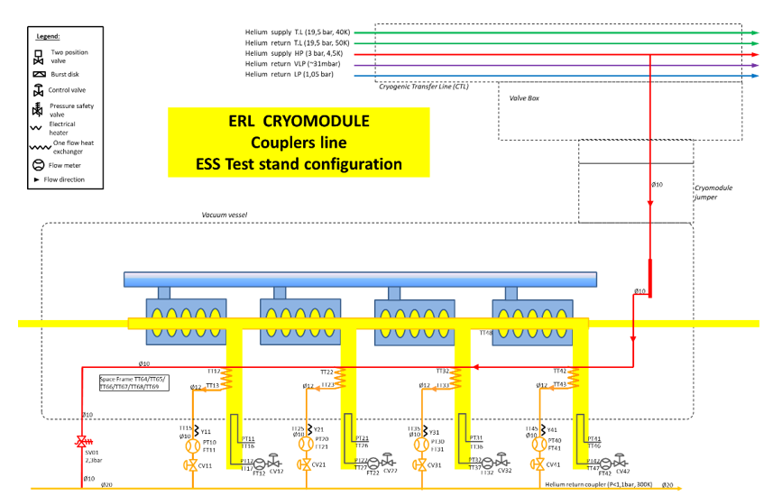
Power couplers
Power couplers
SPL is the baseline with some adaptations to cope with PERLE requirements
Design completed and validated (iSAS: technical review in June)
CERN will produce 4 of them by end of 2026
Same cooling configuration than the one of ESS: helium circulation from 4/5 K to 300 K through a double wall tube
Double-wall tube procurement was not included in ISAS: need to be ordered in 2026. We got 2 options:
  Take the ESS design (baseline) → need to sign an NDA with CEA.
  Mitigation: modify/adapt the DWT of the ESS double-spoke → Study about to start.

Slide 9
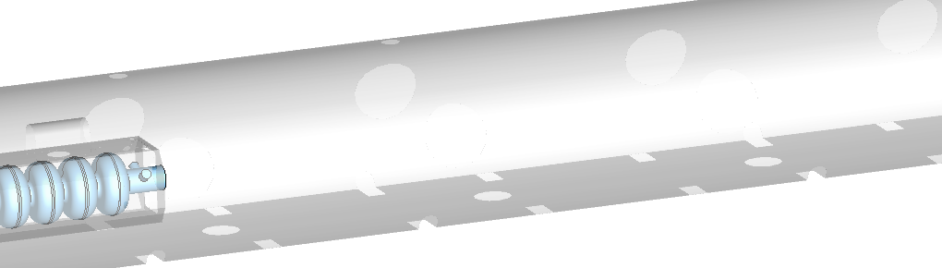
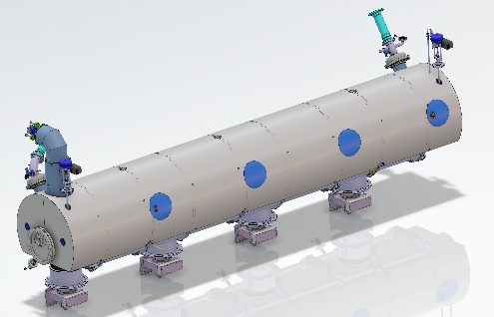
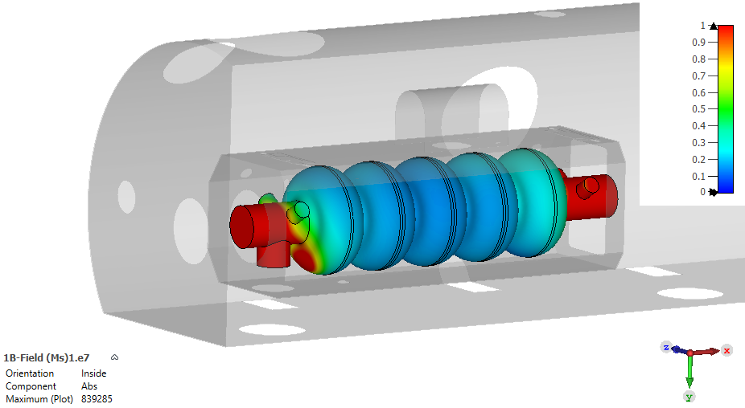
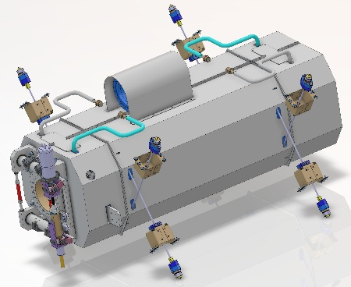
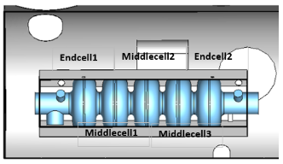
Magnetic shield
Reminder: we aim at a very low residual magnetic field (< 1mG!) to get 3E+10 @ 22MV/m.
Design finished: need a warm and cold magnetic shields to get less than 1mG onto the cavity inner surfaces
Raw material will be ordered this week. Order for the fabrication planned in 2026 (lead-time 3 months).
Warm magnetic shield
Both µmetal and Cryophy : 2mm thick, µr estimated ~ 30000
Values at the equator of each cell
 | B Min (mG) | B Max (mG)
Endcell1 | 0.15 | 0.24
Endcell2 | 0.15 | 0.35
Middlecell1 | 0.13 | 0.19
Middlecell2 | 0.13 | 0.19
Middlecell3 | 0.14 | 0.24
Cold magnetic shield
B > 1 mG

Slide 10
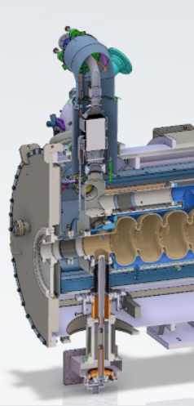
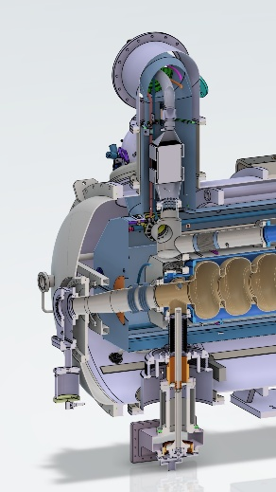
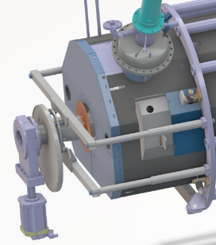
Main cryomodule adaptations
We have to deal with two different cryo configurations:
  At Lund (=qualification test within ISAS): heat exchanger needs to be inside the jumper.
  At Orsay: heat exchanger is inside the valve box
→ heat exchanger and JT valve need to be removed after qualification test
Cryo piping is modified to allow a fast cooling down between 50 K and 4 K with external dewars
The cooling circuit of the beam line absorbers will be connected to the 50K circuit for the nominal operation (even if BLAs are not assembled for the testing)
New design of the cryomodule end-cap to get more space for potential cold BLAs integration and ease removal operations of heat exchanger and JT valve. → Total cryomodule length increase by 400mm.
heat exchanger
New end-cap
design
New mechanical support for assembly

Slide 11
CO2 savings
Reuse of the main cryomodule components
Vacuum vessel made of stainless steel, 3850 kg
Spaceframe made of aluminium, 400 kg
Thermal shield made of aluminium, 120 kg
Miscellaneous (jacks, coupler bells…), mainly made of stainless steel, 285 kg
The CO2 emission for the fabrication of raw material is estimated at 17 kg CO2e/kg for aluminium and 2 kg CO2e/kg (ref: france stratégie 2020)
→ For what it’s worth, taking into account a very rough assessment of additional 17% for final fabrication (forming, machining…) and transportation, we can consider a global saving of about 20 tons CO2e by reusing many components of the ESS cryomodule

Slide 12
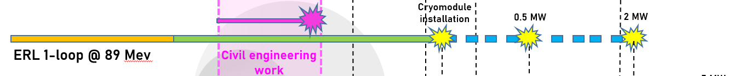
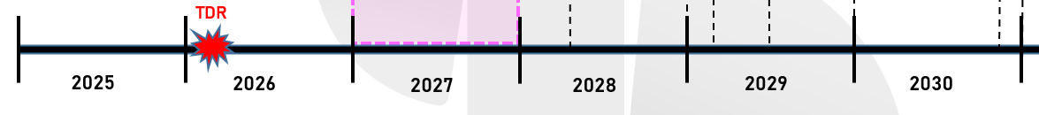
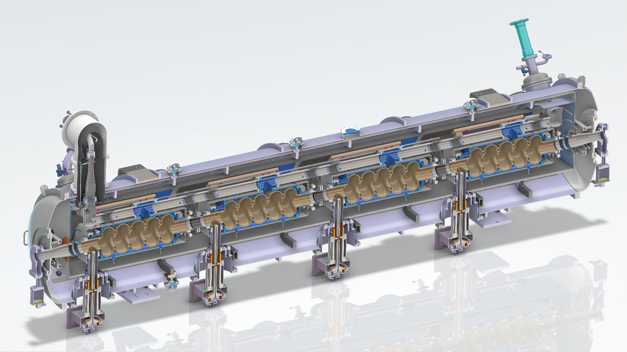
Planning: next steps for critical components...
Goal: be ready by end of T1 2029
→ Intensive ordering phase is coming in 2026...
Components available in 2026 provided by CERN through iSAS
  4 Hook type HOM couplers
  4 Fundamental Power Couplers (modified SPL type)
Components ordered in 2026 and available in 2027
5-cell cavities → to be ordered now (but already on the critical path)
warm and cold magnetic shields
Cryogenic circuit
gate valves
new dished end-caps
Components ordered in 2027 and available in 2027
tuning systems
MLI, bellows, mechanical support
Instrumentation, cables
Excellent job everyone up to now!
Keep the good momentum!

Slide 13
Thank you for your attention

