Slide 1




PERLE fundamental power coupler status
Yolanda Gómez Martínez ( LPSC) on behalf of :
Karin Canderan, Marco Garlasche, Sebastien Jerome, Vittorio Parma, Calum Sharp, Shahnam Gorgi Zadeh, (CERN)
Patricia Duchesne, Sébastien Blivet, Gilles Olivier, Guillaume Olry (IJCLab)
Julien Angot, Adrien Plaçais (LPSC)
PERLE collaboration meeting, 13- 14 Oct 2025

Slide 2
Table of content
Introduction
PERLE FPC status
Planning and conclusion

Slide 3
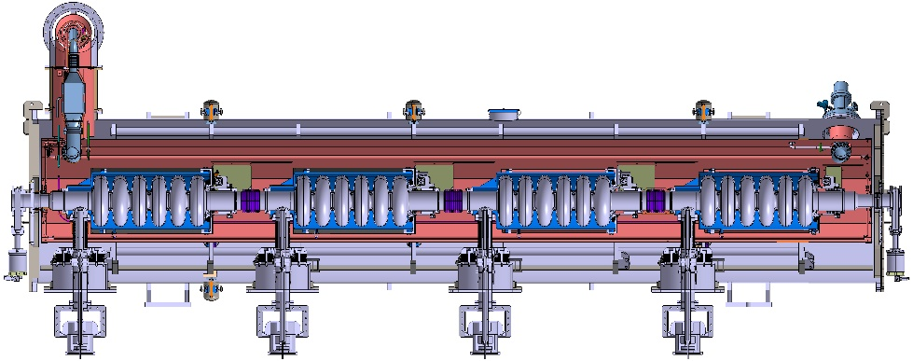
Introduction (1/3)
The fundamental power couplers (FPC) transmit the RadioFrequency (RF) power from the RF amplifiers to the cavity, achieve the vacuum tightness of the accelerator and realize the thermal interface 4 K – 300 K.
There are 4 FPC in the PERLE ERL cryomodule.
Their design, manufacture and the test are realized in the iSAS project.
The CERN ( C. Sharp) is in charge of these tasks. The work is done in collaboration with the CNRS.
‘iSAS (Innovate for Sustainable Accelerating Systems) is an EU project with the overall ambition to expedite the development and deployment of energy-saving technologies that are at the core of the superconducting RF accelerating systems for many accelerator-driven Research Infrastructures and to enable a broad portfolio of future industrial applications’.
Courtesy of G. Olivier ( IJCLab)
1

Slide 4
Introduction (2/3)
The FPC includes:
  the disc window with TiO coating on vacuum side
  the antenna,
  the coupler sleeve with 1 gauge
  the transition to the RF connection a WR 1150 and with a HV DC biasing capacitor
Antenna
Copper sleeve
PERLE FPC RF characteristics
Window
Parameter | Specification
Frequency | 801,58 MHz
Traveling wave (TW) maximal power | 50 kW CW
Standing wave (SW) maximal power | 50 kW CW
Max. reflection S₁₁ @ 801,58 | <- 30 dB
S₁₁ bandwidth at -20dB | > 10 MHz
Qext range ( at cold temperature) | 7×10⁶ < Qext < 1×10⁷
Transition
Courtesy of S. Blivet ( IJCLab)
2

Slide 5
Introduction (3/3)
PERLE FPC is based on the CERN Superconducting Proton Linac (SPL) FPC
  Fixed coupler
  Air cooled
  Disc ceramic with TiOx coating on vacuum side
  With a HV DC biasing capacitor
  Connections :
    Cavity flange Ø : 100 / 43.5 mm (50 Ω)
    WR 1150
Why SPL FPC?
SPL FPC works at 704 MHz, frequency close to PERLE FPC 801,58 MHz
The original SPL design was previously produced and tested at power higher than PERLE specification ( 50 kW CW TW and SW):
  TW and SW up to 1 MW
  100 kW average power : 1 MW 10 % duty cycle ( 2 ms / 20 ms)
SPL FPC courtesy of C. Sharp ( CERN)
3

Slide 6
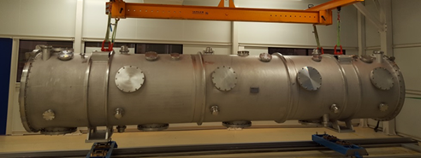
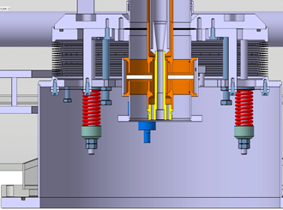
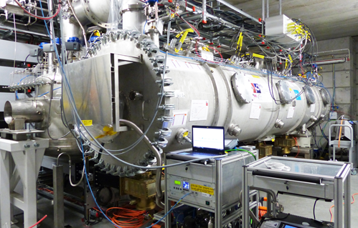
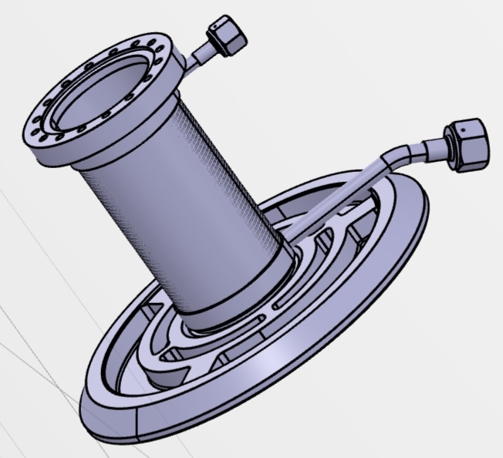
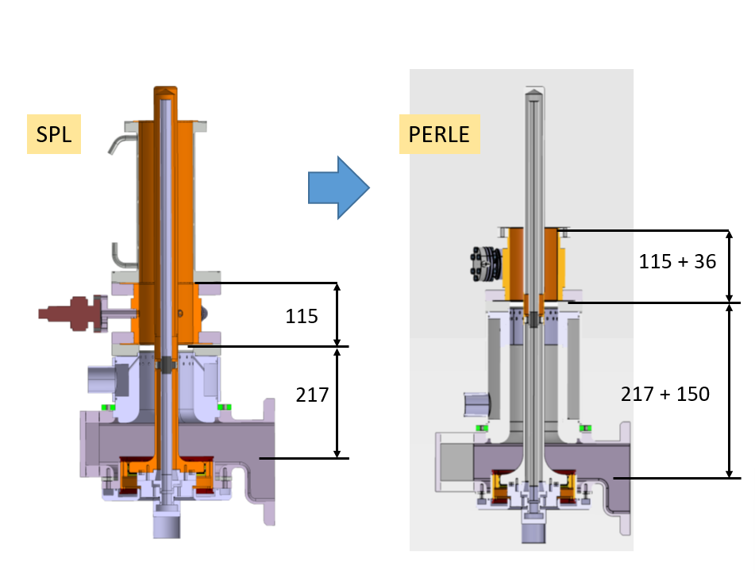
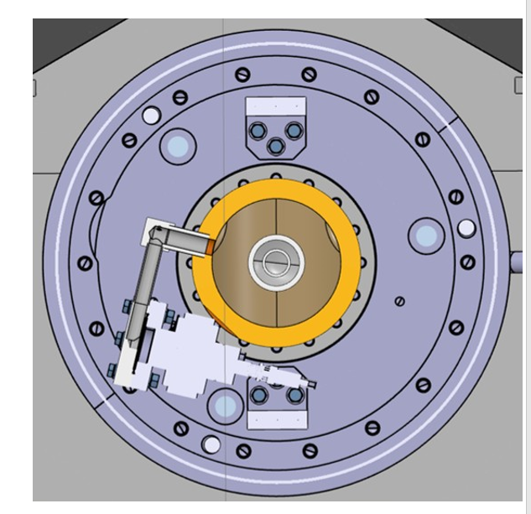
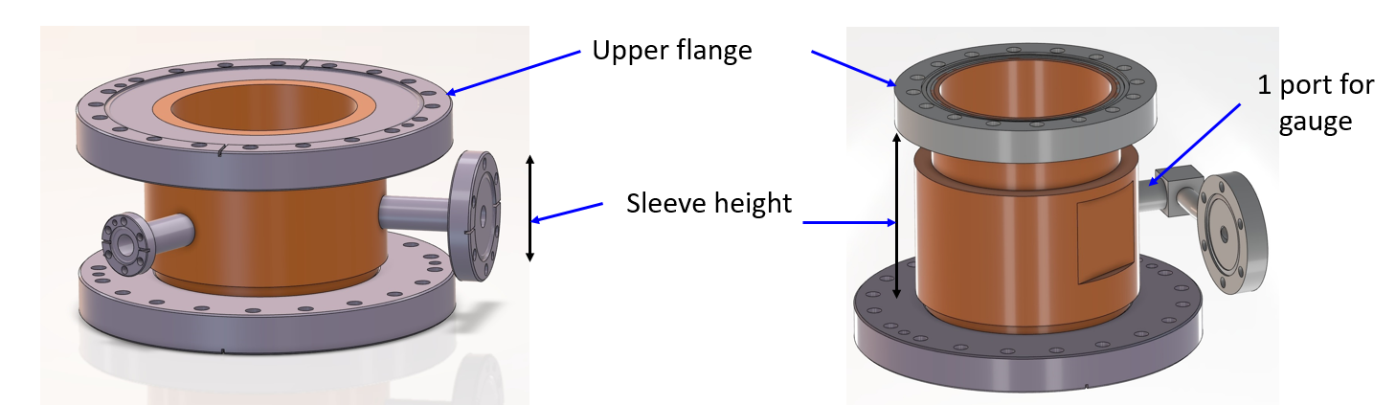
FPC status: done ( 1/11)
1 / Mechanical interface studies:
  To re-use some components from the ESS prototype cryomodule for elliptical cavities
  To be able to use the test stand at ESS LUND
ESS vacuum vessel
Atmospheric pressure compensation
Main mechanical design modifications for the SPL FPC
  Gauge horizontal position
  Coupler sleeve lengthened of 36mm and CF flange from 160 to 100 mm
  Lengthening of the transition of 150mm
Test stand at ESS
ESS DWT double wall tube
4
Courtesy of G. Olivier( IJCLab)

Slide 7
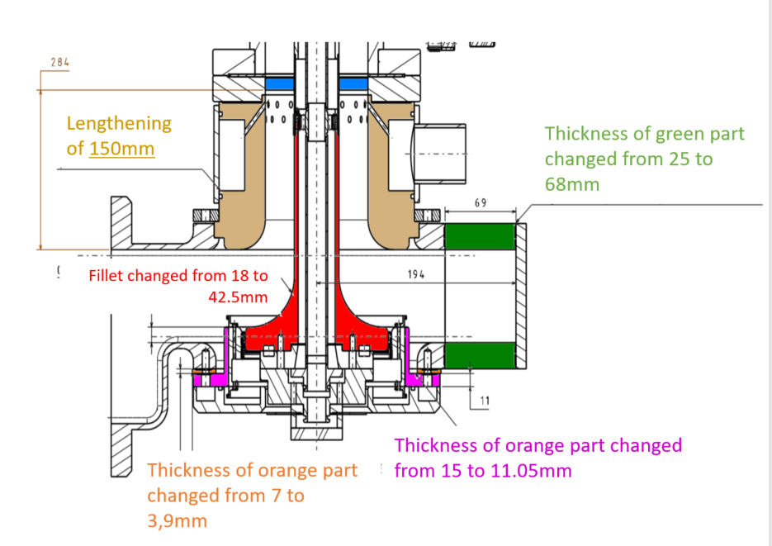
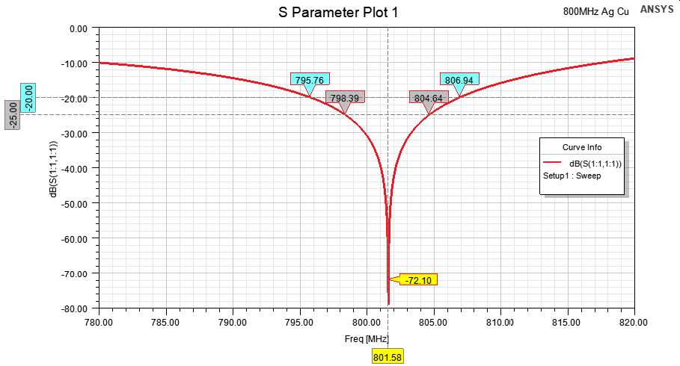
FPC status: done ( 2/11)
2/ Frequency adaptation from 704 MHz to 801,58 MHz ( IJC Lab & LPSC)
  Max. reflection S₁₁ @ 801,58 <- 30 dB & S₁₁ bandwidth at -20dB > 10 MHz
  Taken into account the lengthening of the transition of 150mm
  To reuse as many parts as possible from SPL FPC
S₁₁ bandwidth at -20dB =11,18 dB> 10 dB
S₁₁ @801,58 MHz = -72,10 dB <-30 dB
PERLE FPC versus SPL FPC
S11 (dB) versus the frequency
Test stand in ESS LUND
Courtesy of J. Angot ( LPSC)
5

Slide 8
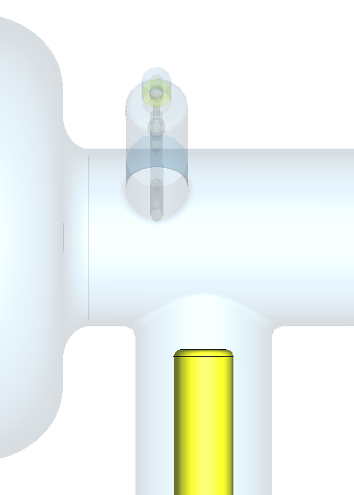
FPC status: done ( 3/11)
3/ Study of the penetration length of the antenna ( IJCLab)
→ To ensure the range of Qext required (7×10⁶ < Qext < 1×10⁷) the antenna penetration range is ( -18,5 mm and 15,5 mm)
Penetration length
Courtesy of P. Duchesne ( IJC Lab)
6

Slide 9
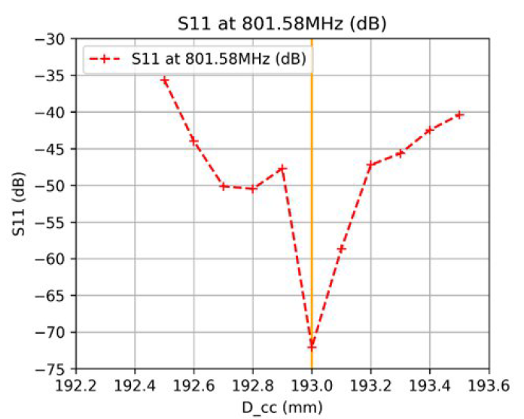
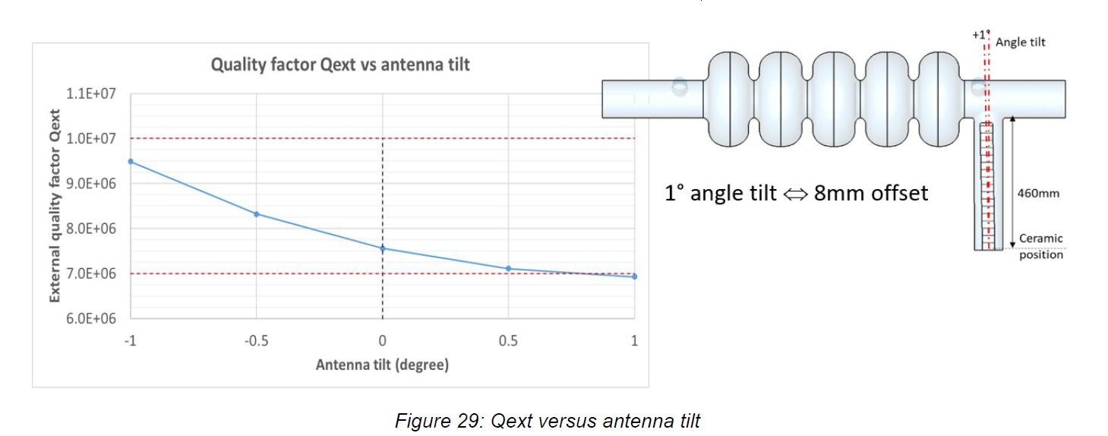
FPC status: done ( 4/11)
4/ Sensitivity studies on Qext and S11 ( IJCLab & LPSC)
to check the sensitivity of the coupling and S11 with respect to the mechanical tolerances
S11
Qext
versus Impact of the ceramic position, Impact of the dielectric constant of the ceramic, Impact of the antenna tilt
Parameters studied for S11
Mechanical tolerance: 0,5 mm
Courtesy of J. Angot ( LPSC)
Courtesy of P. Duchesne ( IJC Lab)
→ Values found for tolerances are acceptable.
7

Slide 10
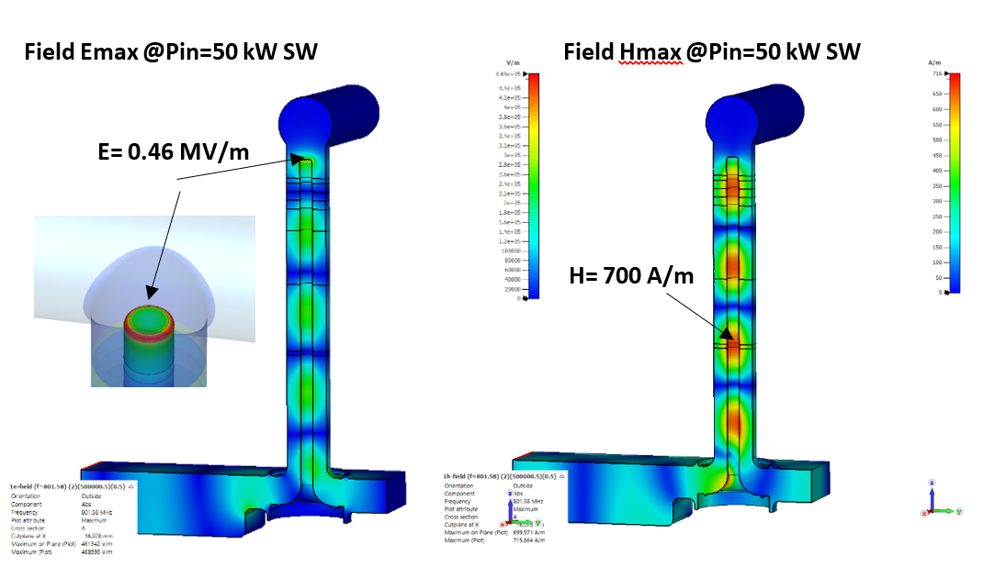
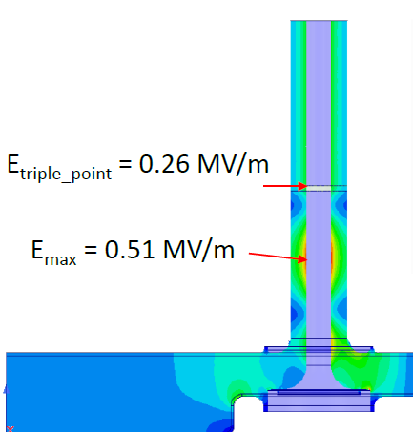
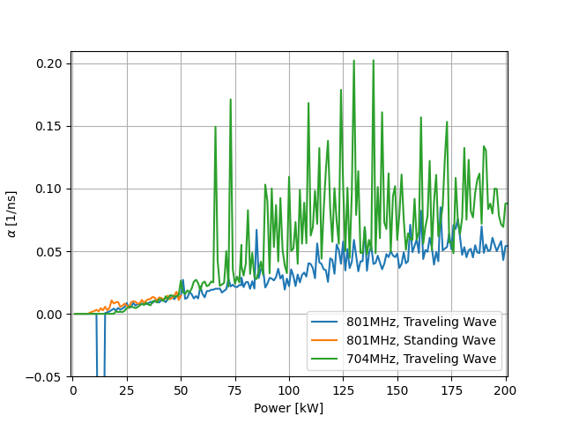
FPC status: done ( 5/11)
5/ Study the good operation of the FPC up to 50 kW CW ( Traveling wave and standing wave) ( IJC Lab & LPSC)
5.1 Electrical field studies
→ E_{max} ≤ 1MV/m and E_{triple_point} ≤ 0.3 MV/m
5.2 Preliminary multipacting studies
→Similar to SPL FPC that has been tested without multipactor problem
4 * 50 kW TW
E field
Courtesy of J. Angot ( LPSC)
Courtesy of A. Placais ( LPSC)
8

Slide 11
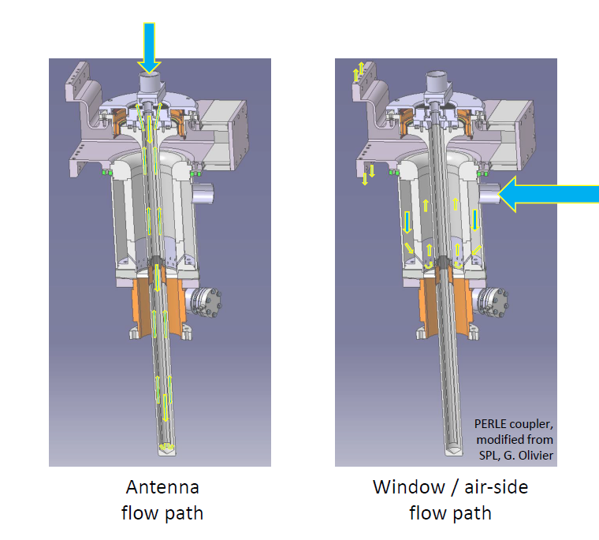
FPC status: done ( 6/11)
6/ Studies thermo-mechanics to define the antenna and the window air cooling (CERN)
  To maintain temperatures everywhere in an acceptable range, minimize antenna deformation, avoid condensation on the window, avoid induced stresses in the window and minimize radiation heat loads to the cavity
  3 air flow rates studied :
    Laminar ( <200 l/min),
    Just turbulent ( 200 l/min),
    Turbulent ( 400 l/min)
  5 cases studied:
    50 kW TW
    50 kW SW with max H field at the antenna tip
    50 kW SW with max H field at λ/ 4 from antenna tip
    without RF w/o air cooling
  → Air flow of at least 400 l/min is required
  0,5 W power radiation to the cavity
  → Electrical heaters on outer conductor of the window (risk of water condensation if there is no RF and the air supply is interrupted)
Courtesy of C. Sharp (CERN)
9

Slide 12
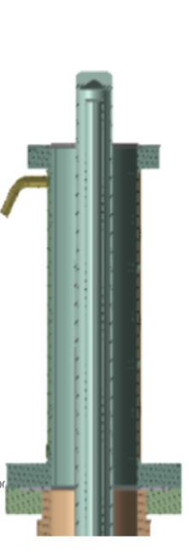
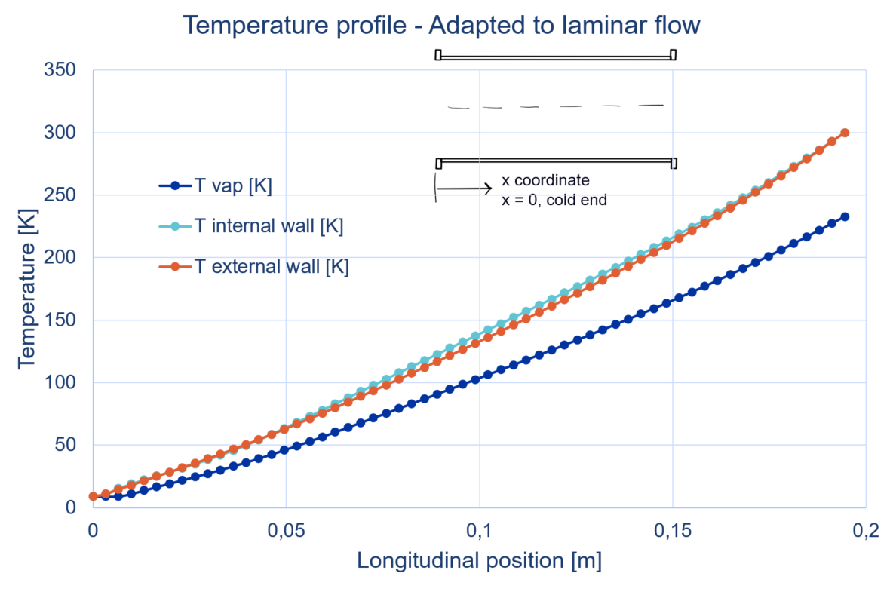
FPC status: done ( 7/11)
7/ Studies of the double walled tube ( DWT) active He cooling (CERN)
Re-use of ESS DWT, FPC outer conductor
Calculation of the heat loads in the outer conductor (conduction, convection, radiation and RF dissipation as position of the Max H_{field}) , the equivalent cost to the cryogenic plant in operation and the helium mass flowrate which minimize the heat leaking to the cavity helium bath at 2K.
Parameter | Values
Liquefaction capacity | 23.1 mg/s
Max RF power dissipated in the DWT@MaxH_{field} position | 6.25 W
Heat released to the He bath @2K from DWT | 0.5 W (inlet 5.1K) &1,8 W (inlet 9K)
Total cryogenic cost [W_{el}] (15% of the Carnot efficiency) | 0.96 kW( inlet 5,1K) & 2,2 kW (inlet 9K)
247 mm
ESS DWT
Courtesy of K. Candera (CERN)
  →The He inlet temperature has an important impact in cryogenic cost.
  →Electrical heaters to ensure that the warm flange (30 - 50W) and outlet helium pipe (10W) temperature don’t drop below the dew point.
10

Slide 13
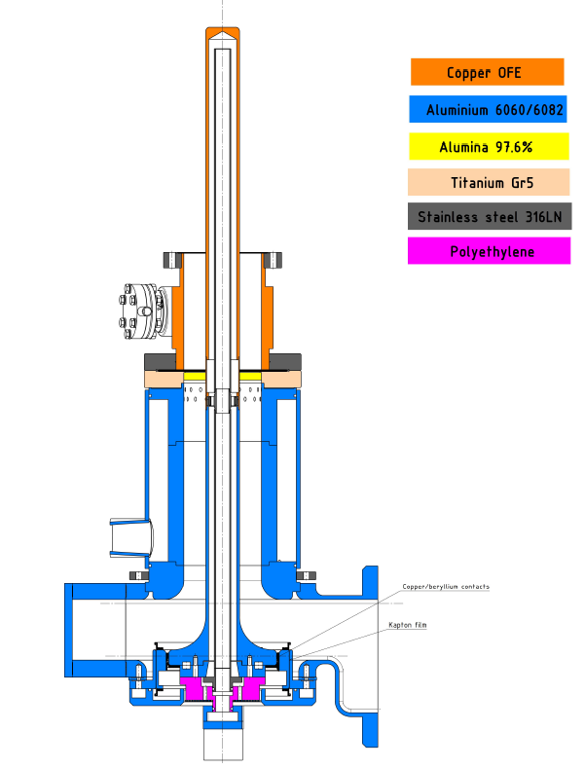
FPC status: done ( 8/11)
8/ FPC materials have been assigned and validated ( CERN, CNRS).
Courtesy of S. Blivet ( IJCLab)
11

Slide 14
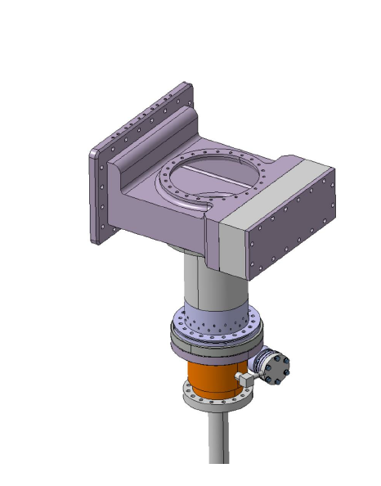
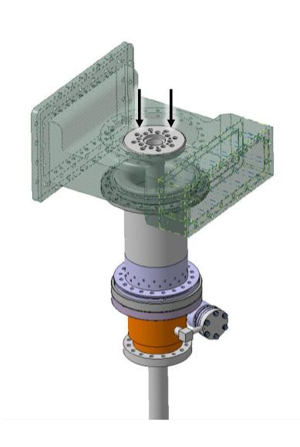
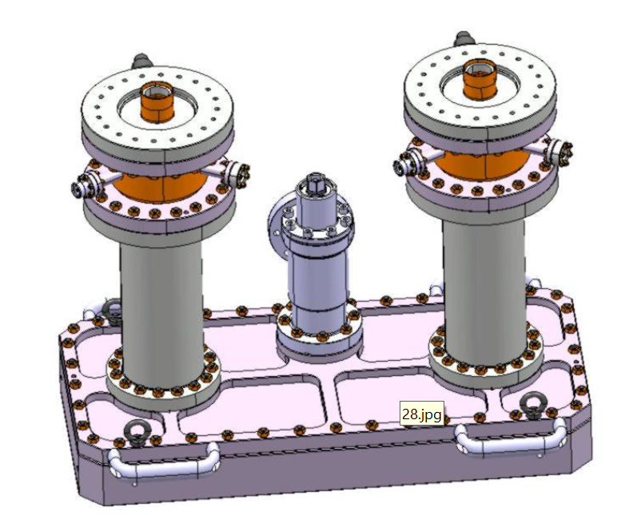
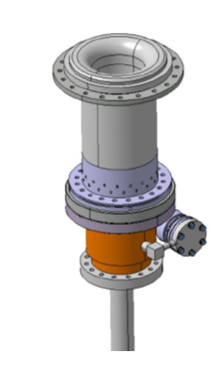
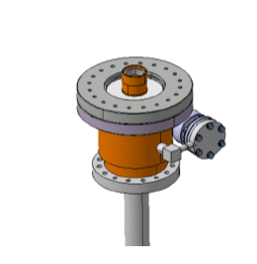
FPC status: done ( 9/11)
9/ The FPC assembly was detailed ( CERN)
On test box assembly in clean room
And removed from test box, and installed on PERLE double-walled tube and cavity string, inserted in cryomodule. Then, air side assembly.
Air side
Courtesy of S. Calvo ( CERN)
12

Slide 15
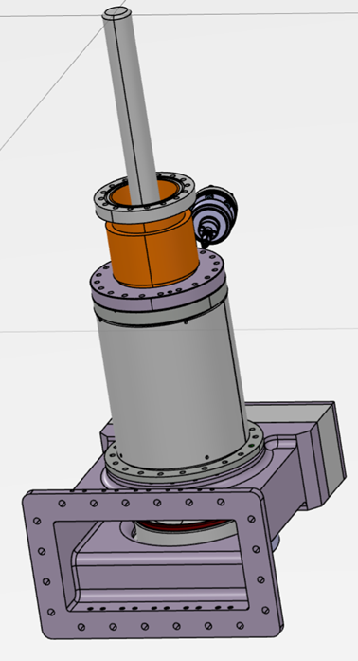
FPC status: done ( 10/11)
10/ Technical review ( CERN, CNRS)
  Validation of the design
  Decide to do RF conditioning at 801.58 MHz up to 50 kW CW
11/ FPC design report ( CERN, CNRS)
12/ 3D step file ( CNRS)
Courtesy of S. Blivet ( IJCLab)
13

Slide 16
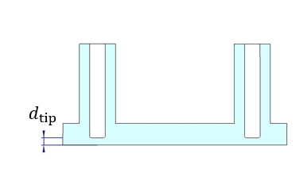
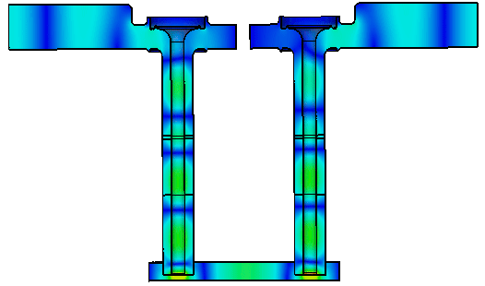
FPC status: done ( 11/11)
13/ RF studies to use the 704 MHz test box at 801,58 MHz (CERN)
→ With $d_{tip}=18.5 mm$and a maximum tolerance of $±$1.5 mm the S1,1 reflection remains below -20 dB
For 0.5 W input power
$$f=801 MHz, d_{tip}=18.5 mm$$
Courtesy of S. Gorgi Zadeh ( CERN)
14

Slide 17
FPC status: in progress
1/ The 2D plans ( CERN)
2/ The raw orders (CERN)
3/ The task list to have the operational test bench (CERN)
15

Slide 18
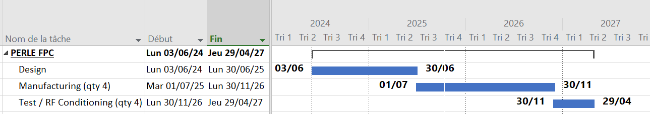
Planning and conclusion
The FPC design is finished and the manufacturing phase is in progress.
The 4 FPC manufactured and tested are expected by April 2027
16

Slide 19
Thank you for your attention

