Slide 1



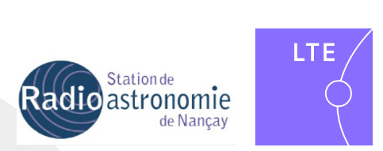
LLRF and RF power prospects for PERLE
Christophe Joly (CNRS/IN2P3/IJCLab)
On behalf of the PERLE collaboration
N. Belouchrani*, X. Lafay, S. Berthelot, J-F. Yaniche, O. Frossard, A. Martens, F. Bouly, A. Buthod, C. Guérin with a strong interaction with the IDROGEN Team :
D. Charlet, A. Back, C. Esnault, M. Taurigna, C. Cheik-ali , C. Soulet, Gaetan Seuillot, Mathias Vecchio, Sid Ali Cherrati in collaboration with P-E. Potty , Michel Lours( LTE lab) , Cédric Viou (ORN lab).
PhD student CIFRE IJCLab & ASC

Slide 2
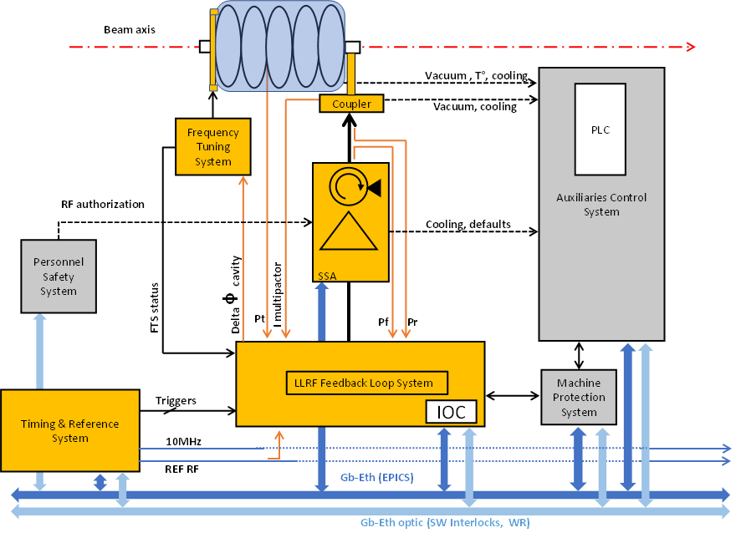
RF system overview
Master Oscillator (MO)
Accelerator Phase Reference Distribution system ( PRDS)
LLRF feedback system (LLRF)
Frequency Tuning System (FTS)
Timing system (LLRF, Diagnostics,…)
RF powers Sources and RF power distribution
Linked to C&C, MPS and PSS
Using a ultra low noise version of the WR system
(same protocol but with HW and SW improvements)
More details : see presentation A. Back (WR workshop 2025)

Slide 3
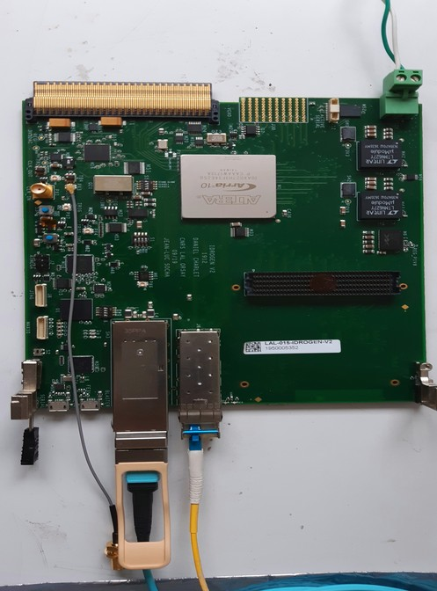

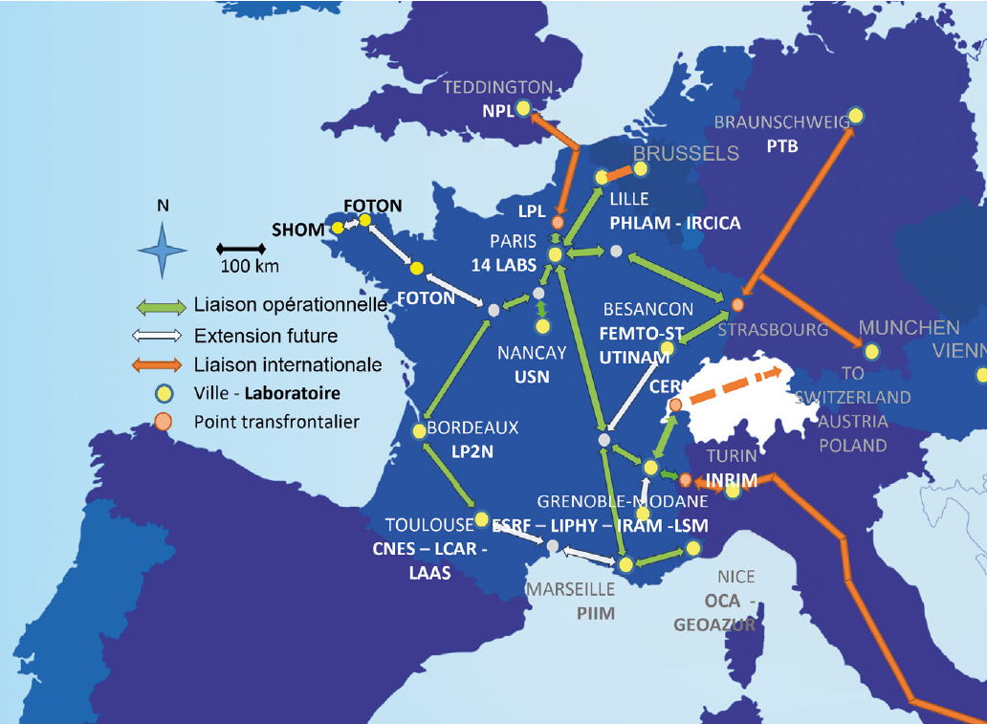

Distributed Master Oscillator (DMO)
Requirements in progress from beam dynamics
IDROGEN board
Base line (rms) : +/-0.1% and +/-0.1°
to distribute between MO, PRDS and LLRF
Rubidium
10MHz + PPS
To diagnostics,
…
Buncher
Aim : to develop an architecture of one Distributed Master Oscillator with ultra low phase noise @[1Hz to 1MHz)] using WR thanks to the IDROGEN boards and the REFIMEVE infrastructure, for PERLE, waiting a new solution, White Fox project (jitter < 100fs) for future applications.
Crate
MTCA
IDROGEN board
IDROGEN board
Booster
Mode Master
Crate
MTCA
Time and frequency
IDROGEN board
IDROGEN board
ERL
Mode switch LN
Crate
MTCA
Atomic Clock
LTE
PARIS
IJCLab
PARIS
Mode Slave

Slide 4
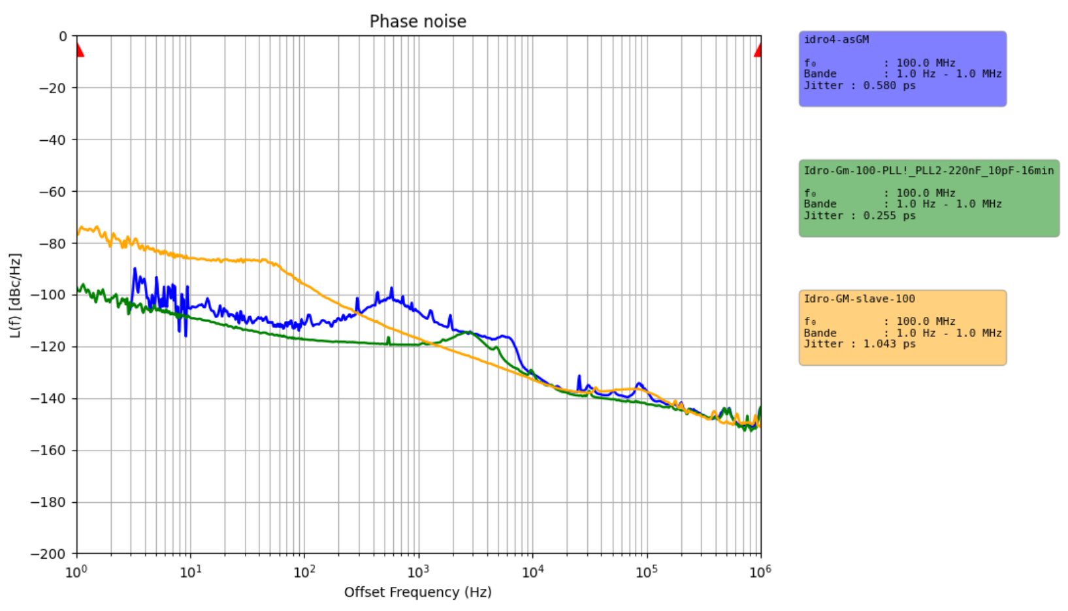
Distributed Master Oscillator (DMO)
Rubidium
10MHz + PPS
Frequency distribution Amplifier
IDROGEN board
Master Mode
IDROGEN board
Courtesy : Nawal Belouchrani
Improvements of the Master’s jitter 100MHz@offset range [1Hz-1MHz] : 260 fs
Thanks to PLL simulation
Crate
MTCA
100MHz@offset range [1Hz-1MHz] at the end point (Slave) : 1.04 ps
Slave Mode
Today best result obtained by D. Charlet : 866fs

Slide 5
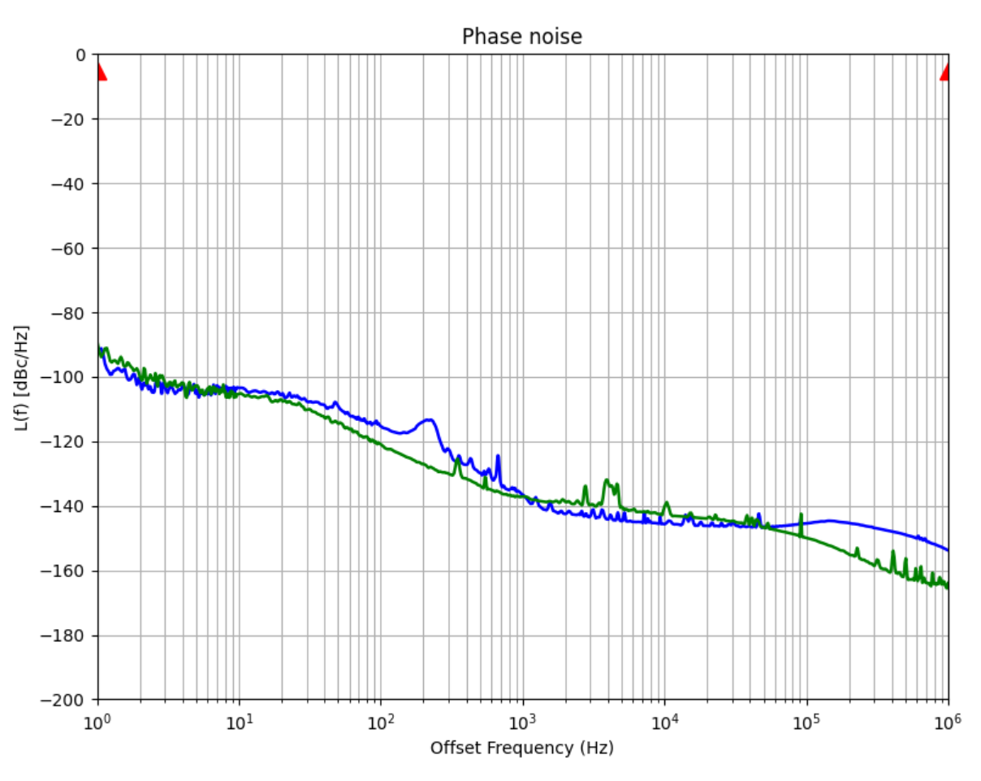
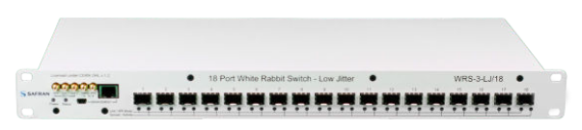
Distributed Master Oscillator (DMO)
Rubidium
10MHz + PPS
WR switch Low noise references
Jitter (rms) 10MHz@offset range [1Hzto 1MHz] =1380fs Manufacturer 1
Jitter (rms) 10MHz@offset range [1Hzto 1MHz] =968fs Manufacturer 2
Frequency distribution Amplifier
Master Mode
Courtesy : Nawal Belouchrani
IDROGEN Switch version
in mode GM ?
Very interesting !!

Slide 6
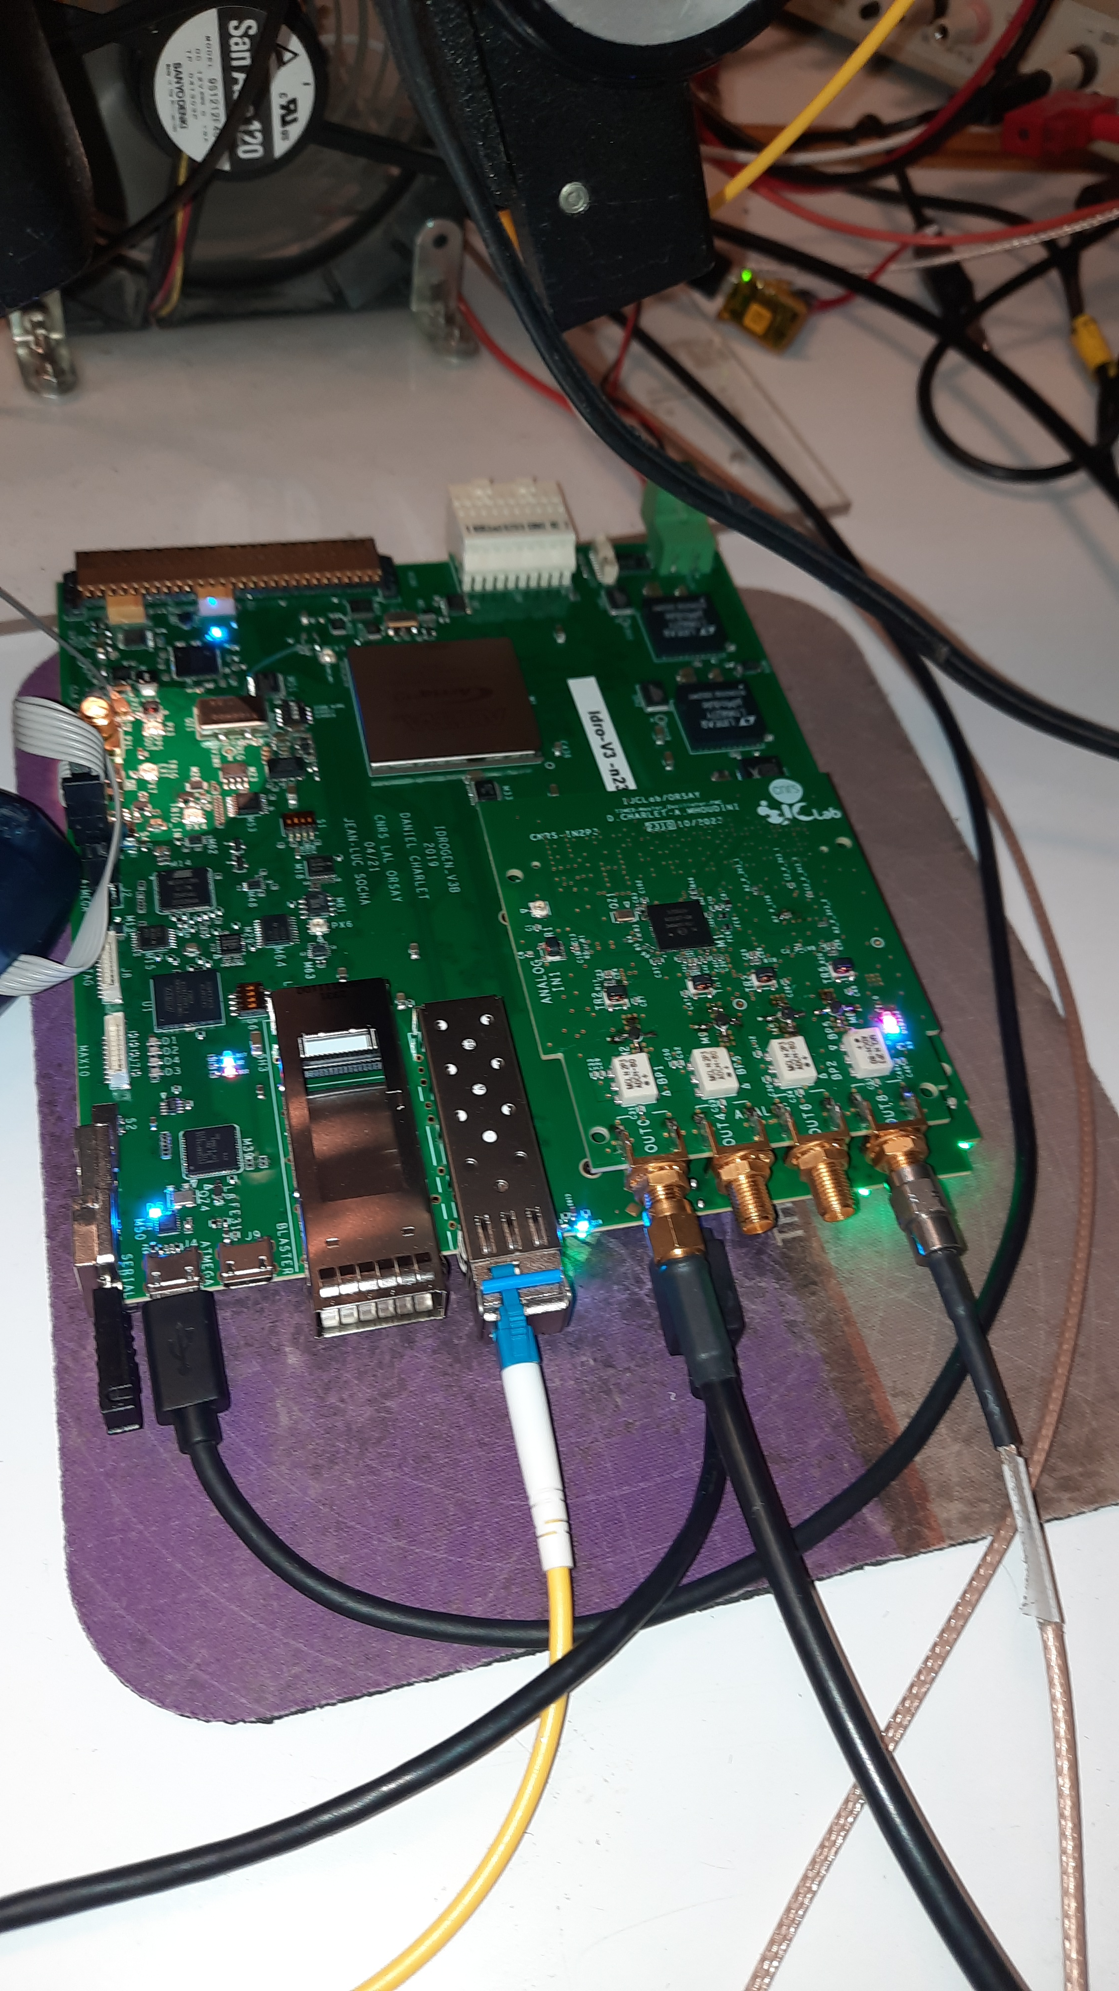
Distributed Master Oscillator (DMO)
Rubidium
10MHz + PPS
Next step : To measure this configuration
Frequency distribution Amplifier
REFGEN FMC board
With a SI5362
IDROGEN board
10 MHz (synchronization of Scopes, …)
Master Mode
200.395 MHz (LLRF reference)
IDROGEN board
400.79 MHz (Laser reference)
801.58 MHz (Accelerator reference)
Crate
MTCA
Or others frequencies in function of need
for diagnostics
Switch Mode
Mode Slave

Slide 7
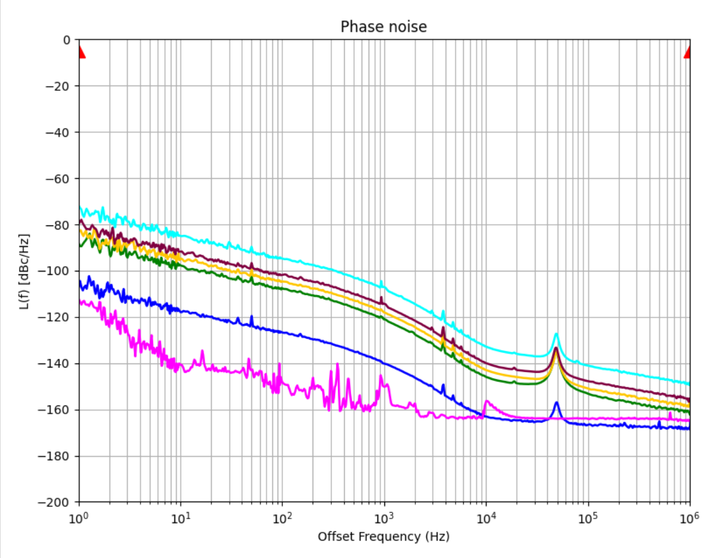
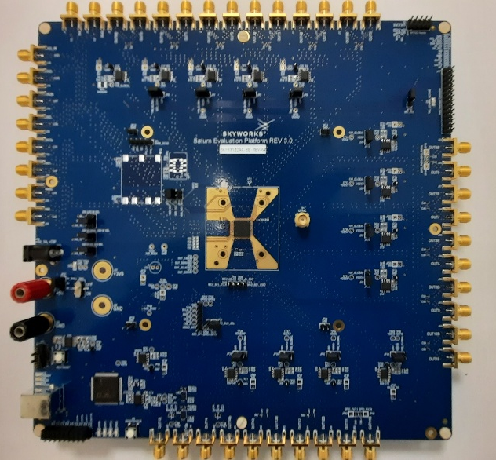
New PLL : preliminary results
SKY 63102
Jitter (rms) 400.79MHz@offset range [1Hzto 1MHz] =282fs
Jitter (rms) 176.1MHz@offset range [1Hzto 1MHz] =282fs
Jitter (rms) 125MHz@offset range [1Hzto 1MHz] =285fs
Jitter (rms) 88MHz@offset range [1Hzto 1MHz] =284fs
Jitter (rms) 10MHz@offset range [1Hzto 1MHz] =249fs (Rubidium)
Morion
10MHz
Jitter (rms) 10MHz@offset range [1Hzto 1MHz] =150fs (Morion) from LTE
Jitter (rms) 10MHz
@offset range [1Hzto 1MHz]
=150fs
Courtesy : Nawal Belouchrani
-10fs better than Si5362 used on FMC REFGEN board in offset range [12kHz to 1MHz] → validated
- Need characterization in the offset range [1Hz to 1MHz]

Slide 8
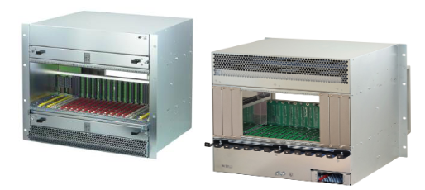
LLRF MTCA-based architecture

Slide 9
Timing Distribution
New IDROGEN version in progress due to obsolete components and some improvements
REFGEN FMC is realized and tests in progress but already improvements planned.

Slide 10
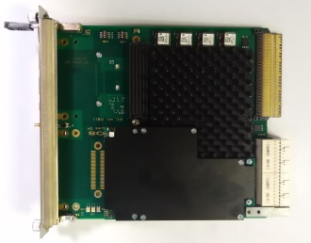
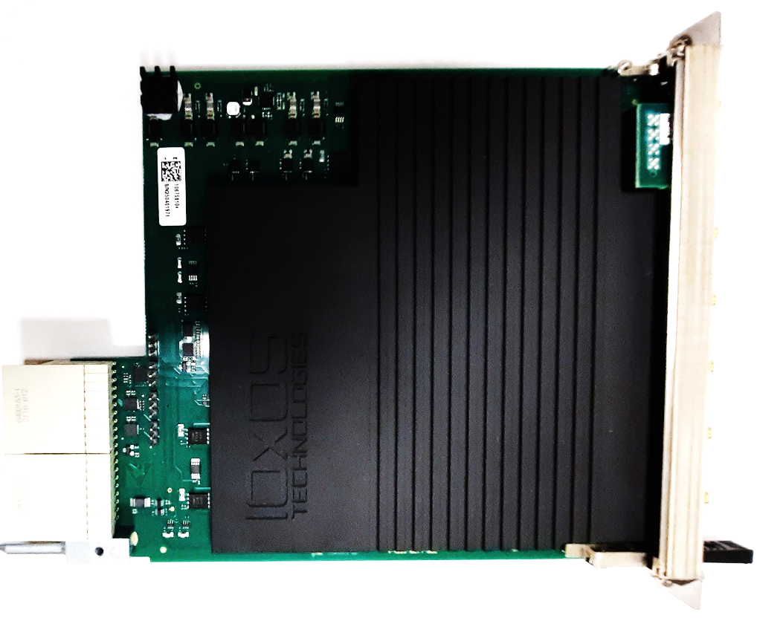
IOXOS boards
Hardware IOXOS technologies
-based of the LLRF feed back
System with New version of
the RF front-end received last week
IFC-1420
RDC_1470v2
IFC_1411
CPU POWERPC
FPGA Kintex ultrascale
DAQ_1430
10 ADC 16bits-250MSPS
4 DAC 16bits-1000 MSPS
4 channels Downconverter linked to ADC
2 channels Upconverters liked to DAC
RF synthetiser + PLLs producing
all clocks and LOs
Modification of the configuration
Characterisation to do (SNR, …)

Slide 11
Timing Distribution
Timing disciplined by WR distribution µRTM
Requirements close to be finalized
Design will be started in November
Example of Schematic

Slide 12
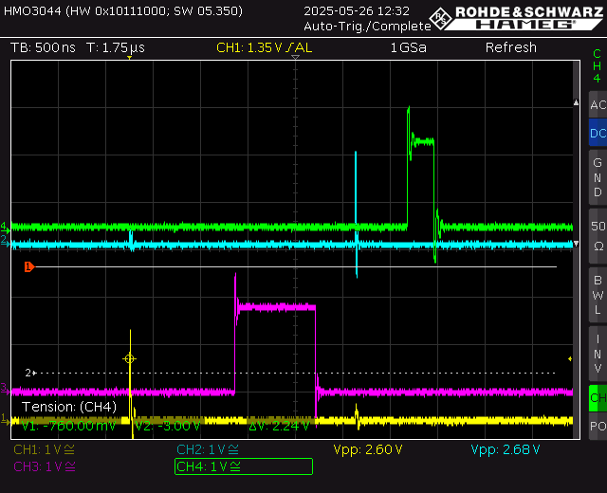
Timing Distribution
Courtesy : X. Lafay
Voie 1
Voie 0
Configuration
Tests in progress to implement this solution to the FPGA of the IDROGEN board,
waiting the final requirements of the timing system planned before this end of year.

Slide 13
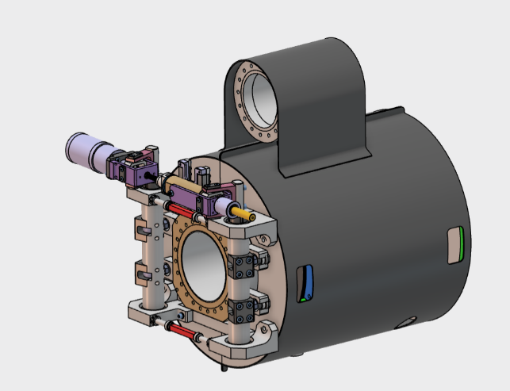

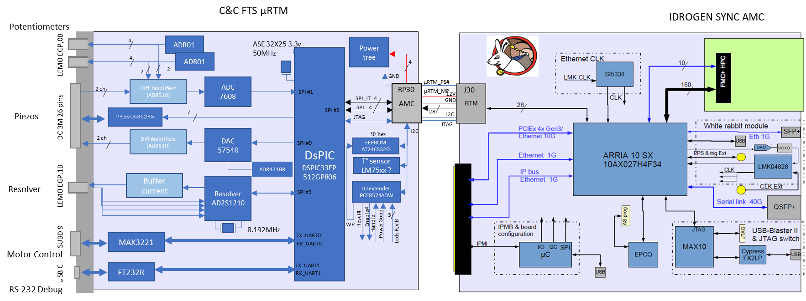
C&C Frequency Tuning system
Design and CAD schematic realized
Layout in progress at IP2I Lyon with a first prototype beginning of 2026.

Slide 14
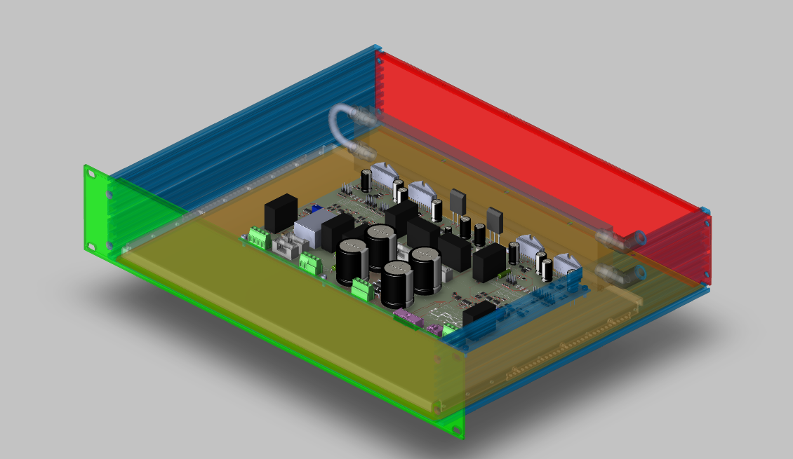
FTS : Piezo Amplifier
Adaptation in progress of a solution developed in the framework of the MYYRHA project by LPSC and IJCLab :
Modification of the layout of the two electronic boards due to obsolete components
Air Cooling system changed by Water cooling system
Limitation of the height of the rack 19” ( from 3U to 2U)
Courtesy: J-F Yaniche and S. Berthelot

Slide 15
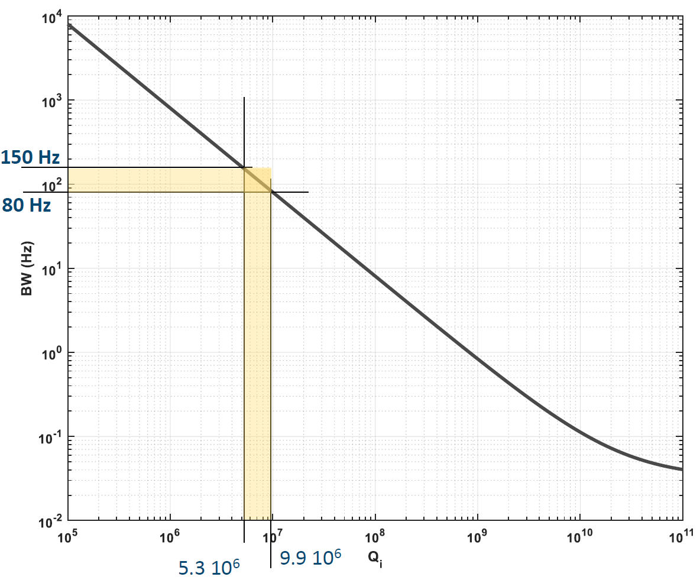
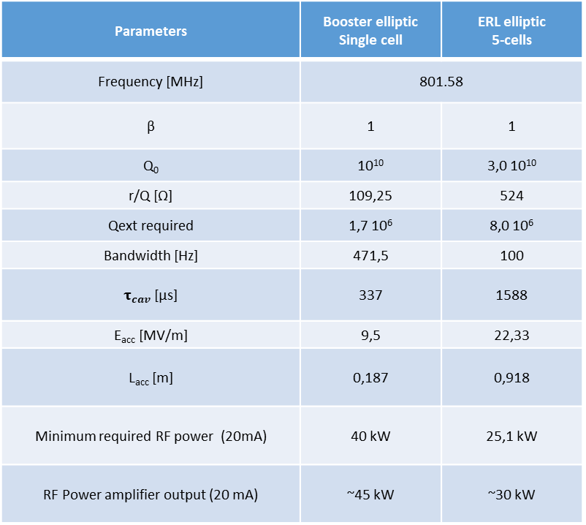
RF power systems : requirements
Coupling chosen
Parameters | Booster elliptic Single cell | ERL elliptic 5-cells
Frequency [MHz] | 801.58
β | 1 | 1
Q₀ | 10¹⁰ | 3,0 10¹⁰
r/Q [Ω] | 109,25 | 524
Qext required | 1,7 10⁶ | 8,0 10⁶
Bandwidth [Hz] | 471,5 | 100
$τ_{cav}$ [µs] | 337 | 1588
E_{acc} [MV/m] | 9,5 | 22,33
L_{acc} [m] | 0,187 | 0,918
Minimum required RF power (20mA) | 40 kW | 25,1 kW
RF Power amplifier output (20 mA) | ~45 kW | ~30 kW
Efficient FTS regulation

Slide 16
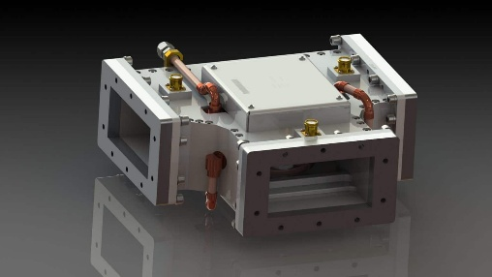
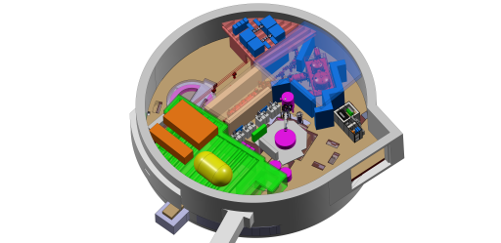
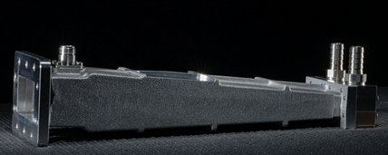
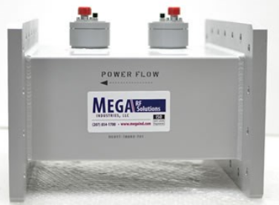
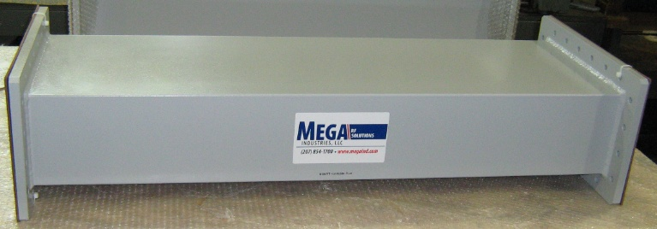
RF system implantation
292.1 mm x 146.05 mm
RF Circulator WR1150
RF power load WR1150
RF bi-direction Coupler WR1150
Waveguide WR1150
To implement with the IGLOO
constraints and for limiting the distance:
Ferriteinc.com
microwave.com
Booster Amplifiers +on the roof close to the booster
ERL amplifiers close to the cryomodule with probably one on the roof to keep a free space for the valve box
- Two options needed for the amplifier output position ( top and bottom) to facilitate the implantation
Images of WR1150 components extracted to web site ferriteinc.com, aft-microwave.com and megaind.com

Slide 17
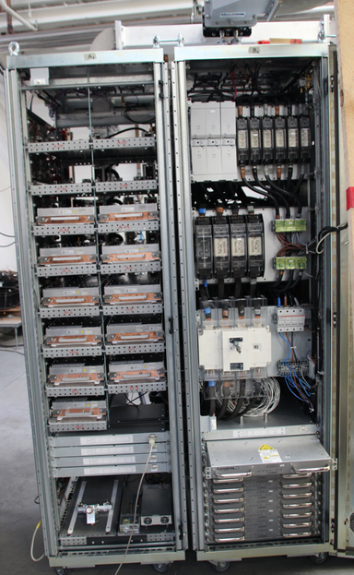
RF Power Solid State Amplifier
Basic premise is : one RF power amplifier by cavity and lower RF power needed
Modularity interest : To adapt the RF power to needs
- for the booster in function of the Beam current phase
and regulation margins
- for the ERL cryomodule, in function of the recuperation performances
- Spread out the financial expenses
Call for tender preparation in progress of a
~10kW Solid State Amplifier upgradable to 60kW
JEMA FRANCE
example

Slide 18
LLRF and RF power prospects
Thank you for your attention

