Slide 1
PERLE Collaboration Meeting
Injector Status
and
Plan
R. Roux

Slide 2
Outline
Injector
Laser
Photogun
Buncher
The booster
Beam dump
The merger

Slide 3
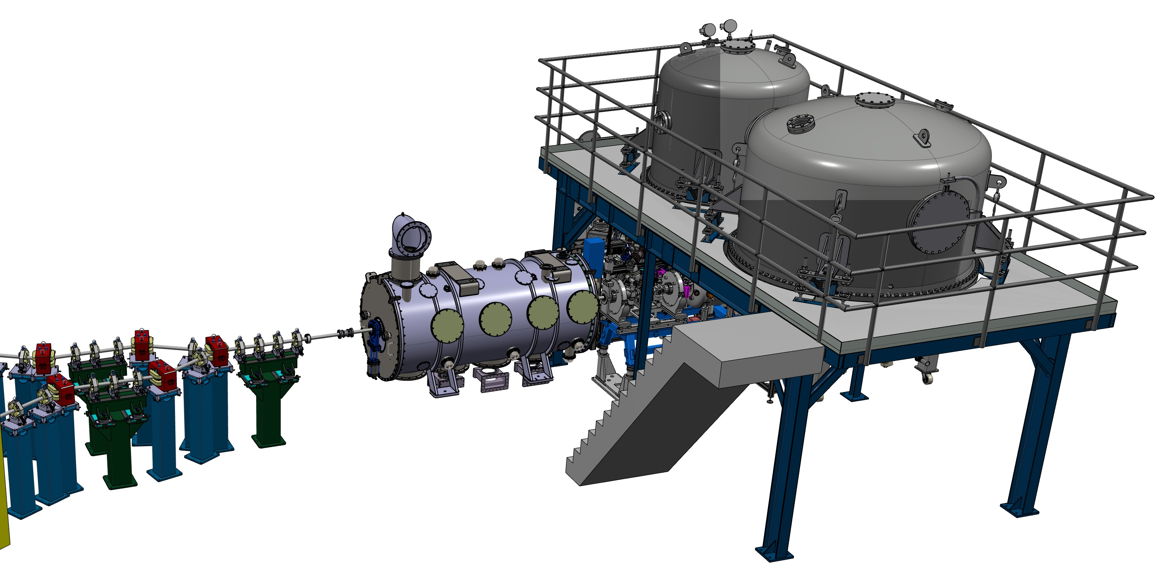
1. Injector
Merger
Gun, HV platform
Photocathode prep. chamber
Booster
Buncher

Slide 4
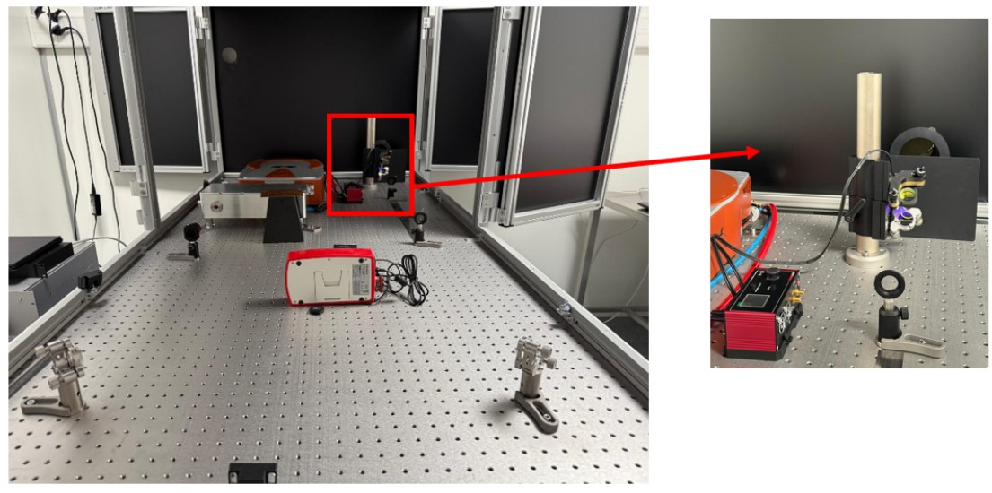
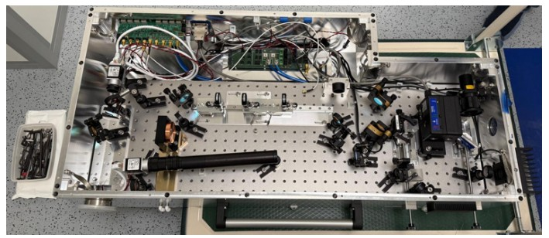
1. Injector
The laser
Moved to the clean room
next to the gun in July, 15th
Laser operational and aligned to the hole to be
transported to the gun
Diagnostic box just in front of the
entrance window of beamline
optics removed to get the
maximal transmission

Slide 5
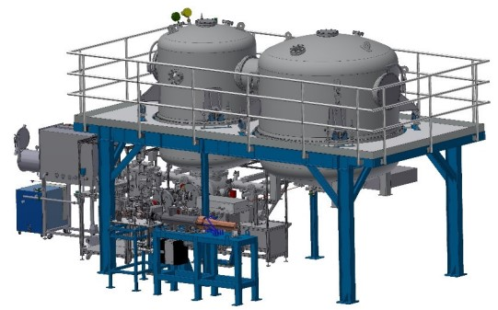
1. Injector
The gun
See the M. Baylac’s talk
Big achievements:
Almost all components installed
< 10⁻¹¹ mbar in the gun
One photocathode made
To be done:
Install Faraday cup and its chamber
Bake out of the beamline
Cabling and HV conditionning

Slide 6
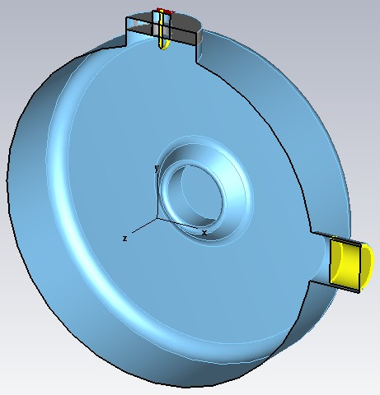
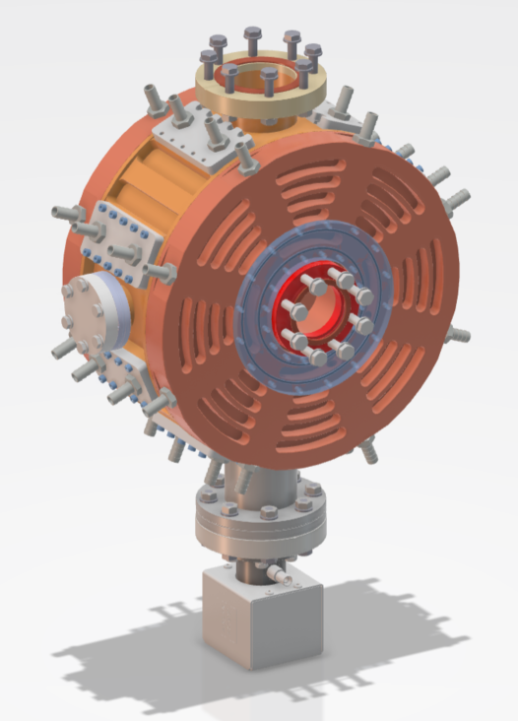
1. Injector
The bunching cavity
April 2025, ESS Bilbao focused on their own project
I finished the RF design implementing the coupler and a plunger and lengthening the cavity
Samuel almost completed the technical drawings, see his presentation for more details
Next:
Ask a quotation to PMB company in November
Call for tender beginning of 2026
Hope for a delivery for next collaboration meeting

Slide 7
1. Injector
The booster
Single-cell cavities: « Jlab design » done (adapted from the 5cell cavity of the ERL cryomodule).
But, the FCC design is also a valuable option.
(See Akira’s talk) R&D on single-cell cavities with CERN:
1st vertical test with the « Jlab » cavity (repaired by CERN) in Dec.
Next dvpts with new FCC-type single-cell cavities built by CERN.
IJCLab vertical cryostat will be adapted to host single-cell, 5cell and 6cell cavities.
The single-cell “FCC-type” cavities in the PERLE cryomodule could be the first FCC cavities to see a beam!
Decision to change Q_{ext} to save power at low current
Initially, Q_{ext} = 7.10⁵ => 30.7 kW for 20 mA but 12 kW for 5 mA (instead of 7.7 if optimized for it)
We chose Q_{ext} = 1,6.10⁶ => 8,3 kW for 5 mA and 36,3 for 20 mA
Power coupler is the same as for 5 cells cavity, change the height of the coupling port on the cavity

Slide 8
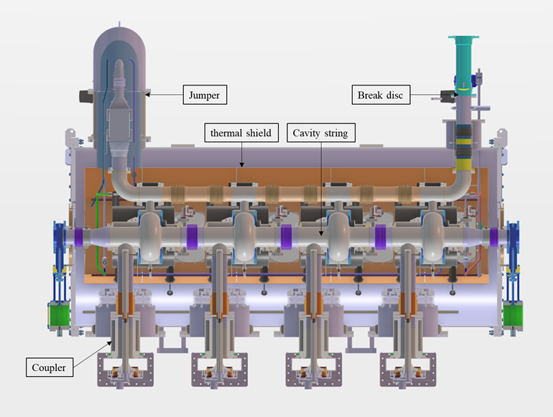
1. Injector
The cryomodule of the booster
Design: ESS type
1,2 m
Design
By
Samuel
Marchal
2,9 m
14/10/2025
PERLE collaboration meeting
8

Slide 9
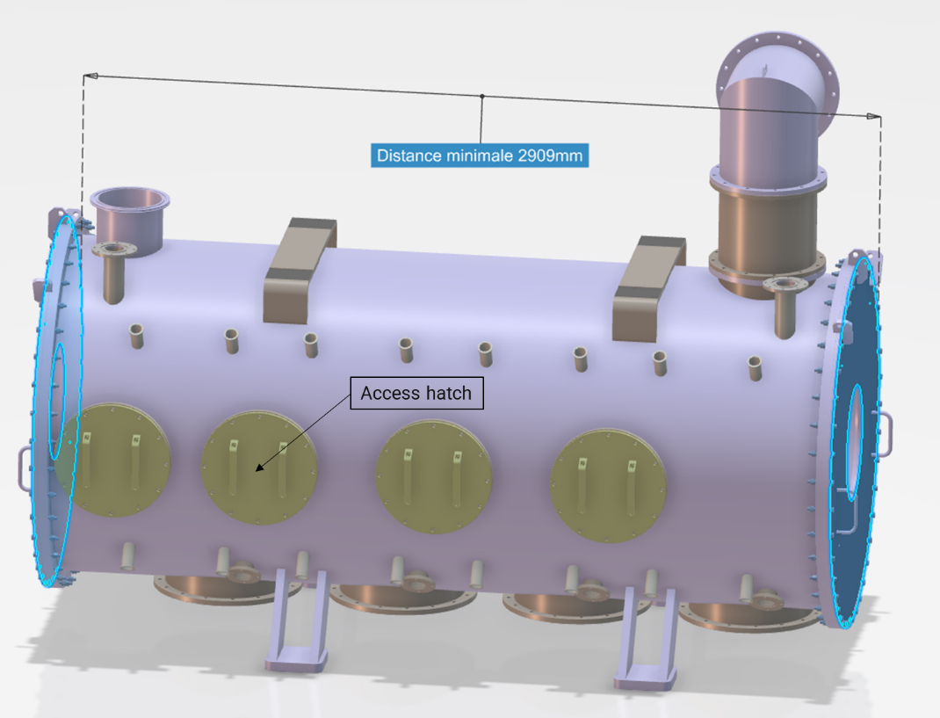
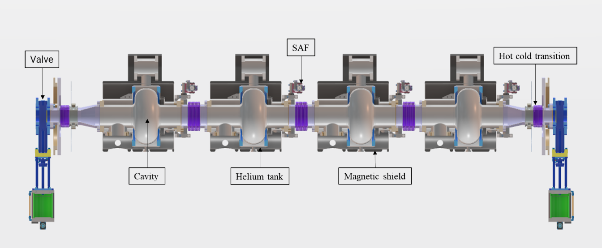
1. Injector
Ready to call for tender in April 2026

Slide 10
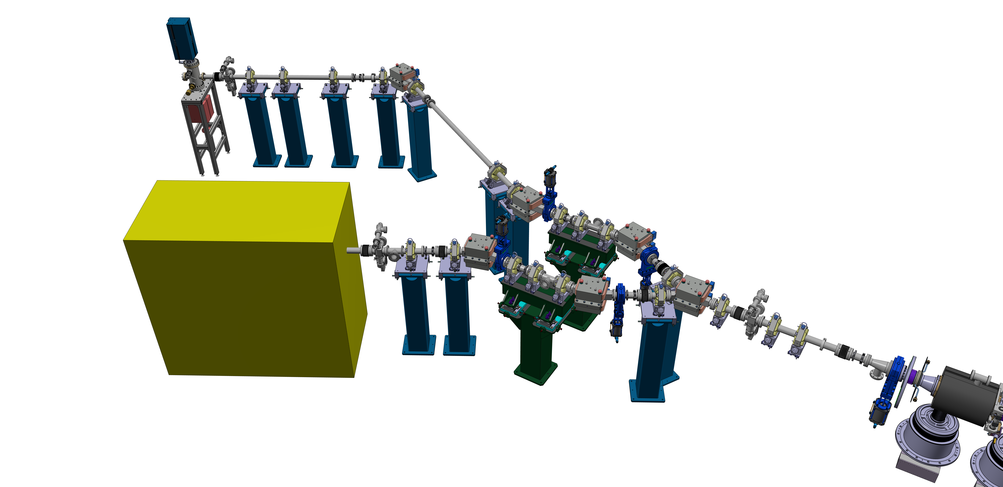
2 Merger
Transfer beamline between the injector and the ERL
screen
Magnets designed for
beam pipe φ = 63 mm
ICT
BPM + stereers

Slide 11
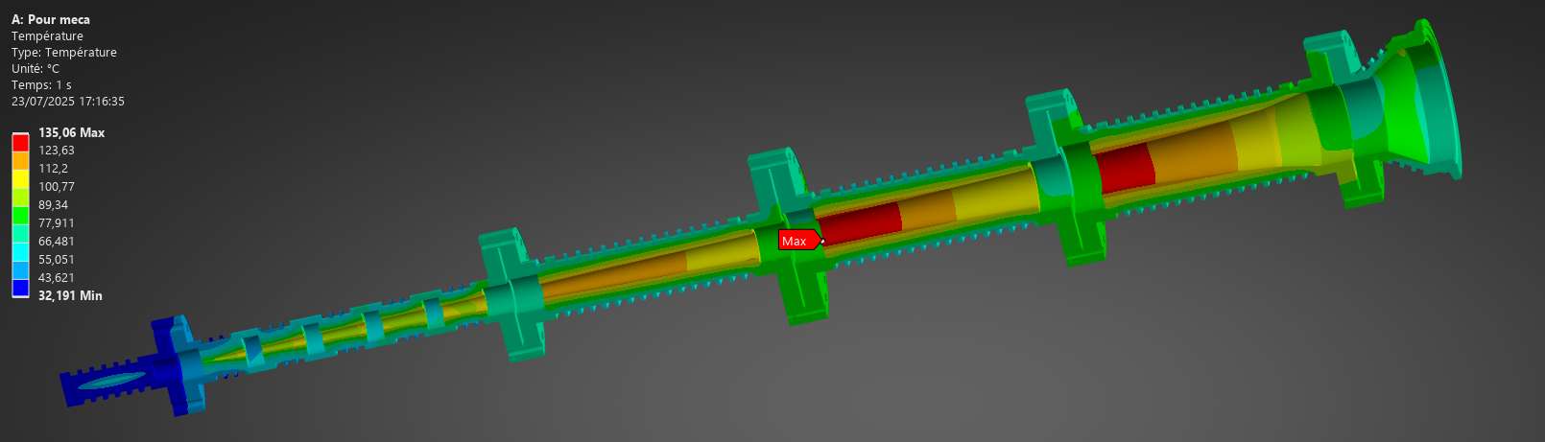
Beam dump for 20 mA => 130 kW
Collaboration with Emilie Schibler from IP2I from Lyon
Use the same design as the so called SAFARI beam dump for 200 kW deutons.
L ≈ 1,9 m
Simulations for 7 MeV e⁻ have to be performed to check if it is well matched but no big worries

Slide 12
CONCLUSION
Installation of gun completed by the end of 2025, HV conditioning last milestone => beam in January 2026?
Call for tender for bunching cavity ready for beginning of 2026.
Cavities of booster should be ordered next year
Technical drawings of Cryomodule to be finished in next spring => call for tender
3D design of the merger is nearly finished, detailed drawings have to be done
Beam dump ready to be fabricated, maybe adapt it in the next years

