Slide 1
CP-5: Laser beam system
Eduardo Granados (SY-STI)
On behalf of the LP section

Slide 2
Agenda
Optical boxes design and integration
Control systems
Diagnostics
Timing
Access and safety systems
Cabling
Services required
Compressor procurement

Slide 3
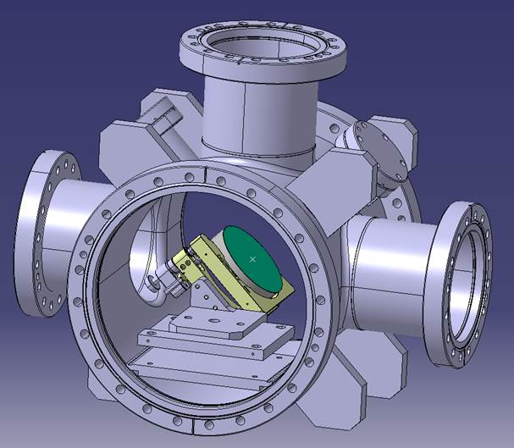
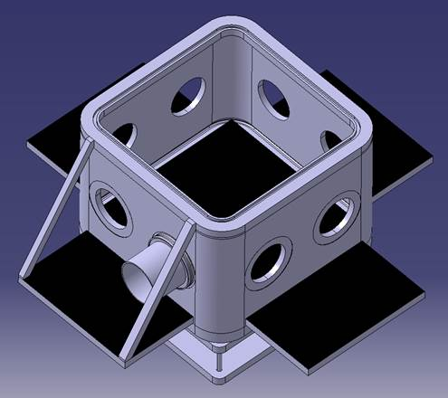
Optical boxes design
UHV turning box
Primary vacuum - transport
Similar to run 1, but narrower
Left-hand / right-hand versions
Design of supports is next
Built in-house, design stage not completed
Top cover attachment under study (hinges)
Clamping -> ISO-KF 100 for now
N. Chritin

Slide 4
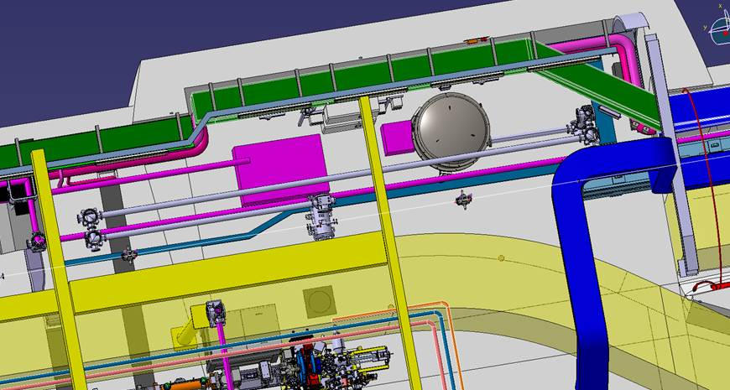
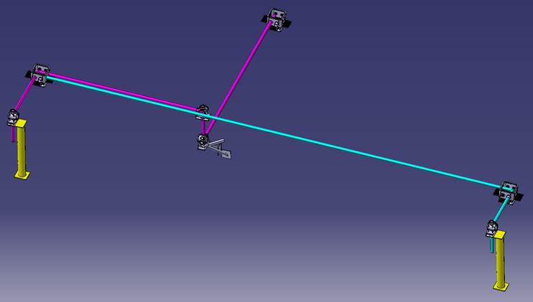
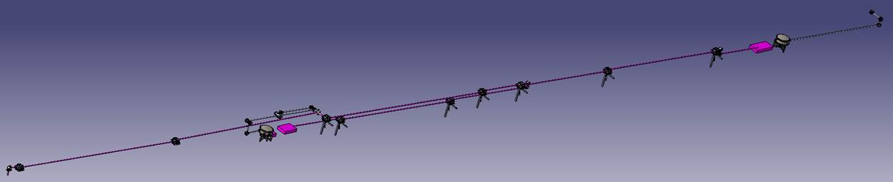
Integration
Compressor 1 optical table split
UV lines – Good progress
Split
Compressor 1
Compressor 2
Laserlab
Need anchors in ceiling for compressor lids
IR lines

Slide 5
Diagnostics
Laser transport lines:
Position -> debate between quadrant detectors or cameras (binned)
Pulse energy -> can use sum signal of quadrant or power meters
Laser beam delivery lines:
Best overlap possible -> virtual line with minimal optical elements
Timing -> For installation phase, cross-correlator
UV shaping capability -> to be tested in CTF2 (upcoming stretcher + iris)

Slide 6
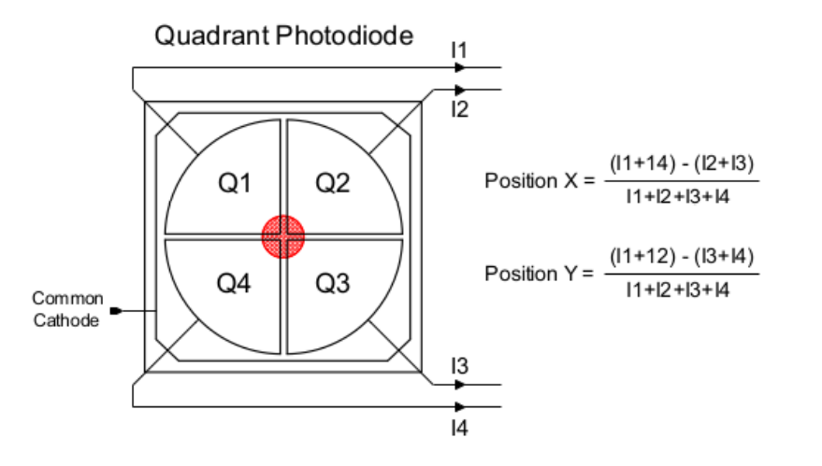
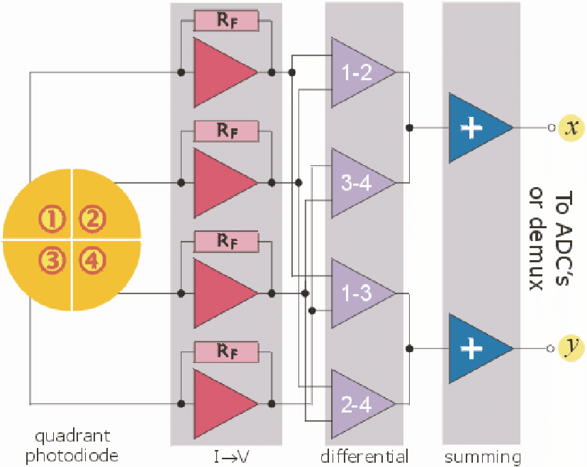
Quadrant detectors
PROs:
High bandwidth / low latency
Robust and compact, great dynamic range (think of high power and low power shots)
Possibly does not need filterwheel
Insensitive to ambient light
Similar price to a CCD camera
Energy measurement possible
CONs:
Requires development, and integration into DAQs
No beam profile information (what if shape changes?)
Requires accurate centering (if large drift happens?)
Solution? Perhaps a combination of CCDs and QPDs…

Slide 7
Multiplexing QPDs (BI team idea)
To acquisition card
y1
y2
x2
x1
…
…
…
Combiner
Delay
Delay
Combiner
y2
x2
Combiner
y1
x1
…
Box N
Box 2
Box 1
In principle, a single BNC-type cable connecting the boxes could act as ‘bus’, and the entire signal decoded using a single acquisition card

Slide 8
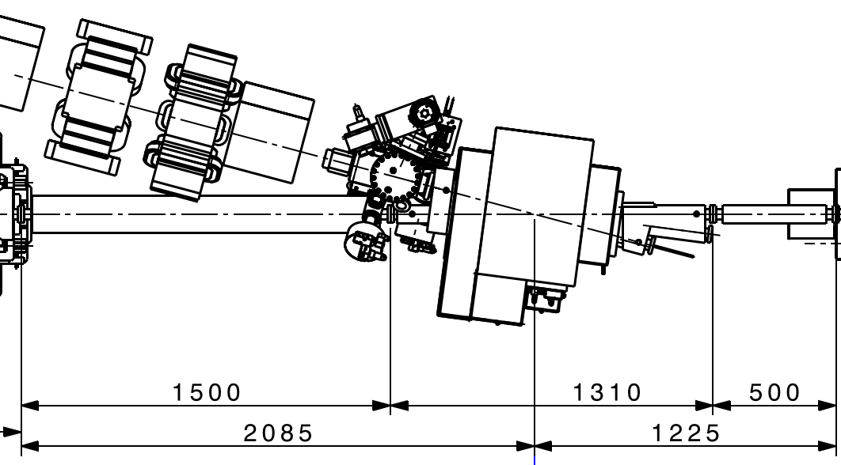
IR timing
CCD
X⁽²⁾
PC1
PC2
Definition of IR beam crossing point:
For initial timing, cross-correlator will be needed
After synchronization is achieved, the correlator will be placed in the virtual lines
Reflective prism
Unfortunately this device is located at the injection point of e- bunch to 2nd cell

Slide 9
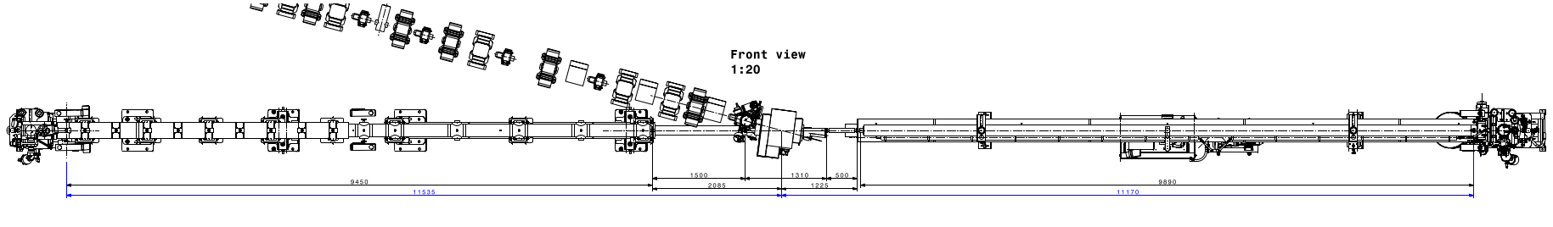
IR timing
Virtual plasma source 1
New T₀ reference
Virtual plasma source 2
BTV
BTV
BTV
BTV
Vapor source #2 is shifted downstream by 0.5 m, making the IR beam delivery path #2 longer. Easy to compensate by using the delay lines in the compressor #2 conditioning optical table.

Slide 10
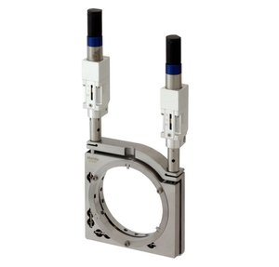
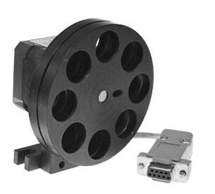
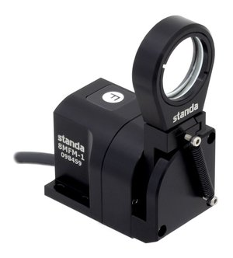
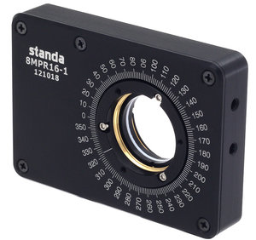
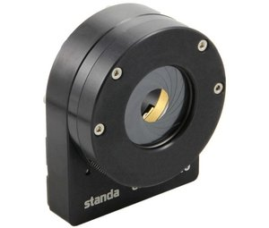
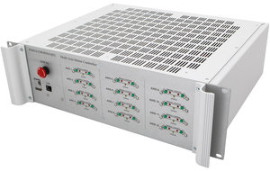
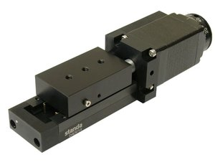
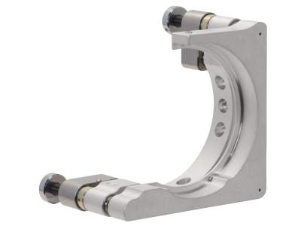
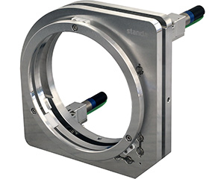
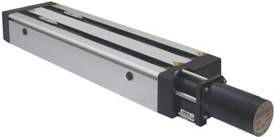
Motorization
Transport line steering
Power control
Motorized iris
Delay control
Focusing control
Delivery line:
UHV picomotors

Slide 11
Controls
“Beam transport”
“Beam delivery”
“Machine protection”
CMW / beam pos
Power meters
LBDPs
Vetos / Access
Filter positions
BI
Standa controllers
PLC
(picomotors)
LSS
PLC
(MPS)
Delay / irises
Position / power
Flip mounts
UHV Pico motors
Laser trigger
Screen Vetos
LBDPs / Shutters

Slide 12
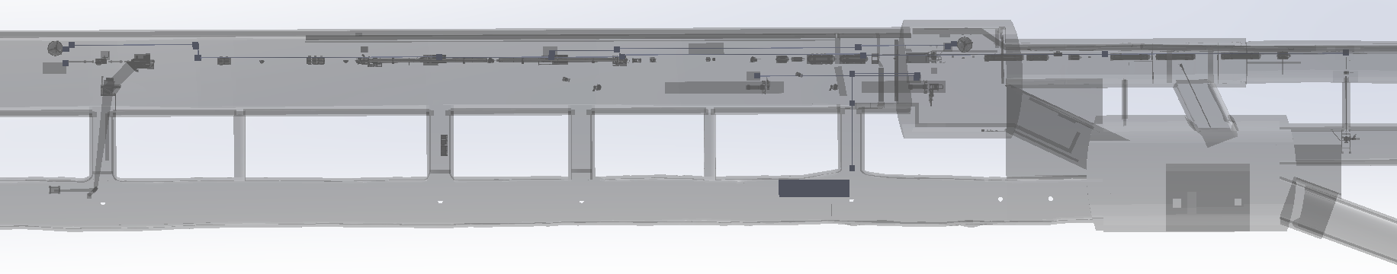
Cabling overview
IRC2
PP5
PP4
IRBL1.1
PP3
IRBL1.2
PP2
PP1
IRBL2.2
IRBL2.1
IRBL0.5
IRBL0.4
PP6
IRBL0.3
IRC1
IRBL0.2
IRBL0.1
UVC2
UVBL4
UVBL2
UVBL3
UVC1
31
29
85
30
28
26
84
27
UVBL1
BI racks for cameras is #42
Pending to define diagnostics to complete cabling request!!

Slide 13
Cabling overview
Essentially only laser beam controls and diagnostics so far
Not included:
Access systems
Laser safety systems
Timing and RF links
PLCs and interlocks (both MPS and LSS)
Ethernet for racks, powering
Vetos for screens…

Slide 14
Open questions – some answers
IR beams
Compressor lids -> need anchoring / crane
Compressor #2 procured.
Time 0 defined. To recalculate position of elements in IR line #2.
To define: areas between LBDPs
Access system requirements / modes of operation
UV beams
Testing in CTF2 with improved relay imaging?
Pulse shaping in transverse/longitudinal capabilities? -> Replicate capabilities existing in run 2a,b but keep the design open for future upgrades.
Procurement of control components started
Construction of UV stretcher started.

Slide 15
Thank you for
your attention!

Slide 16
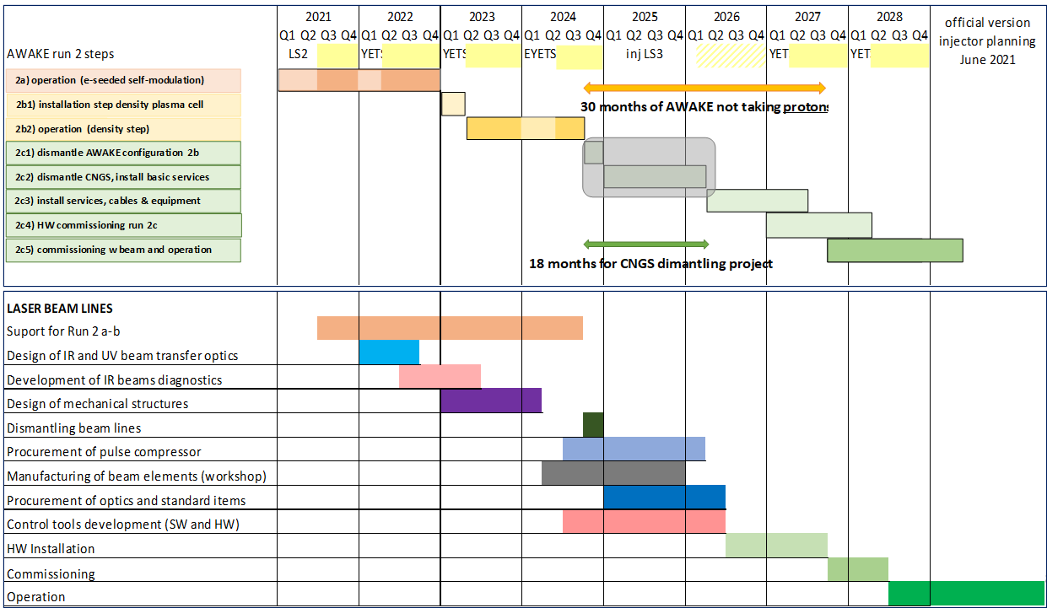
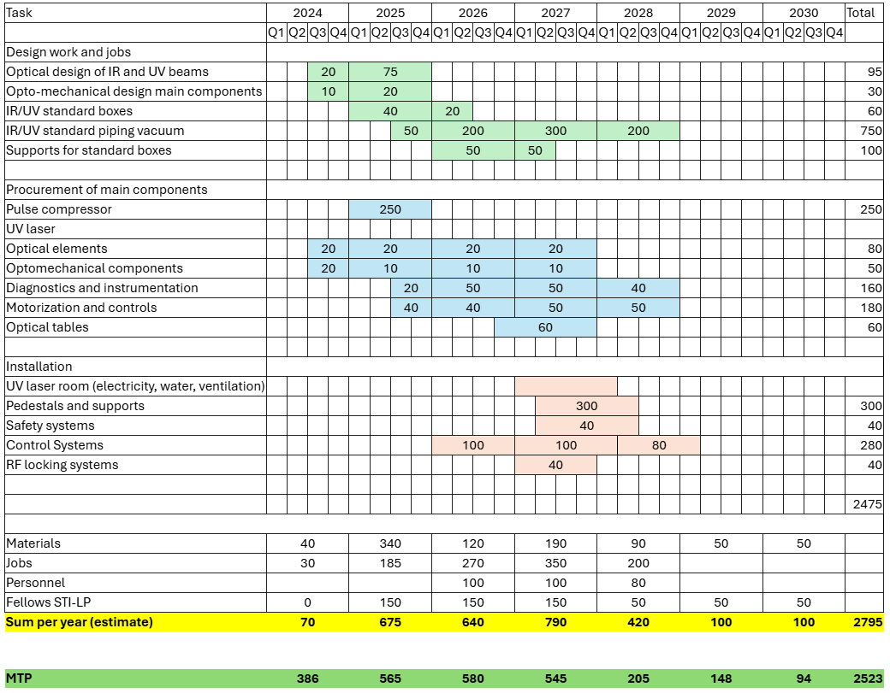
Schedule of activities and spending profile

