Slide 1

Awake CSCP Meeting #18
Simplified Layout and Integration
Frédéric Galleazzi EN/ACE/INT
08/10/2025

Slide 2
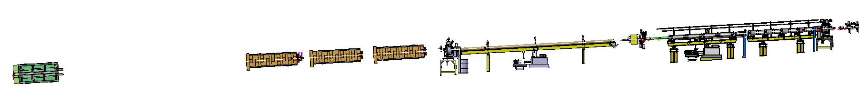
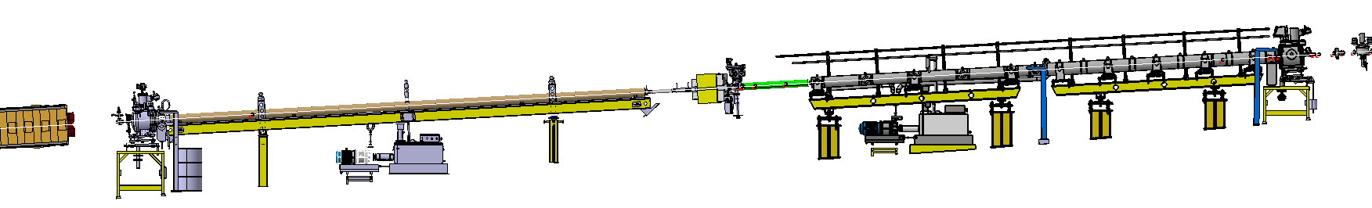
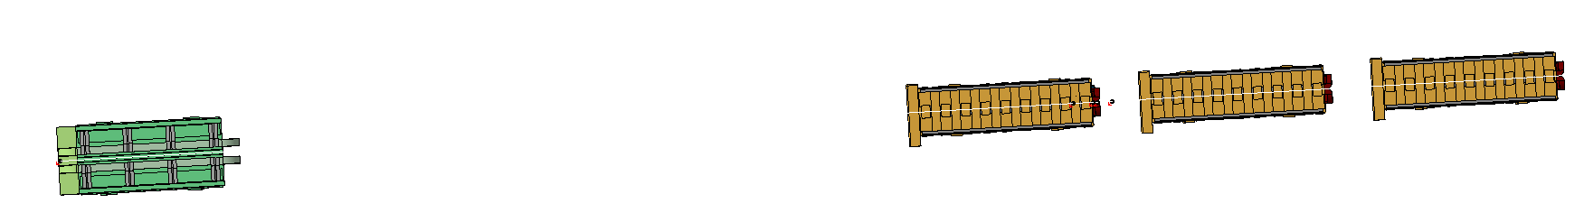
Awake Run 2C – Experimental Area Beam Line
Reminder
Experimental Area : Beam Line Layout
Period 412400-412500
Period 412500-End Line
e- 150 MeV
Last dipole
Plasma Cell 1
Plasma Cell 2
TCC4
Start of Period
Period 412400-412500
QNL (Quad)
QNL (Quad)
QNL (Quad)
HB2 (Dipole)
Start of Period
Period 412500-End Line

Slide 3
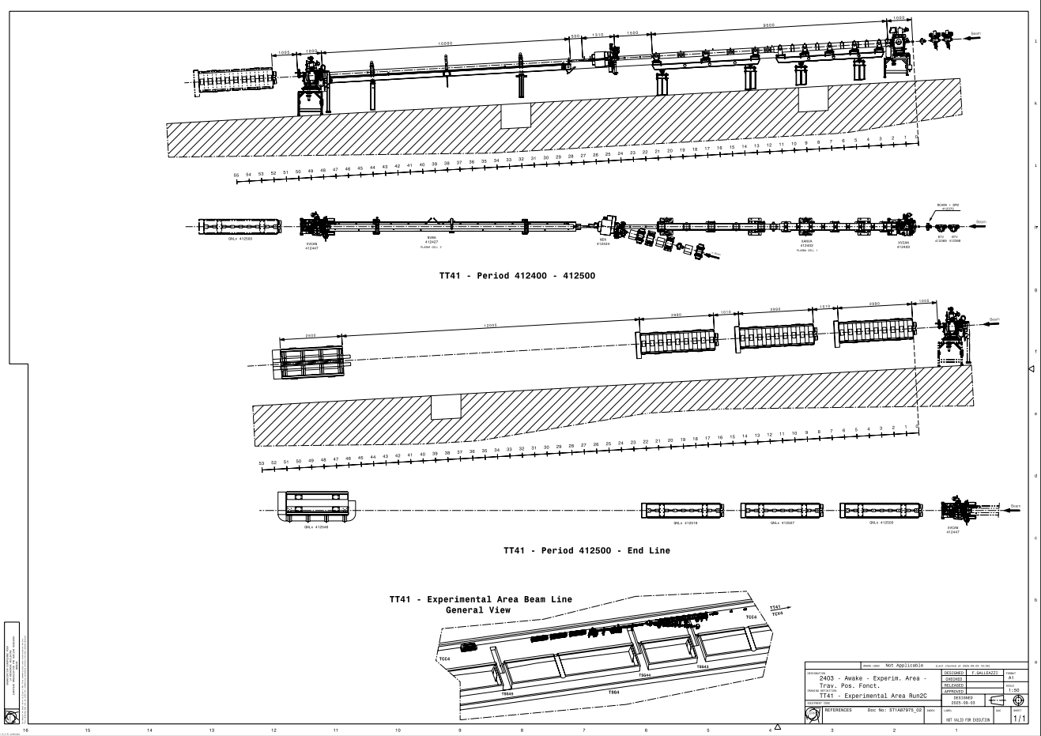
Awake Run 2C – Experimental Area Beam Line
Experimental Area : Beam Line Layout
Layout Drawing

Slide 4
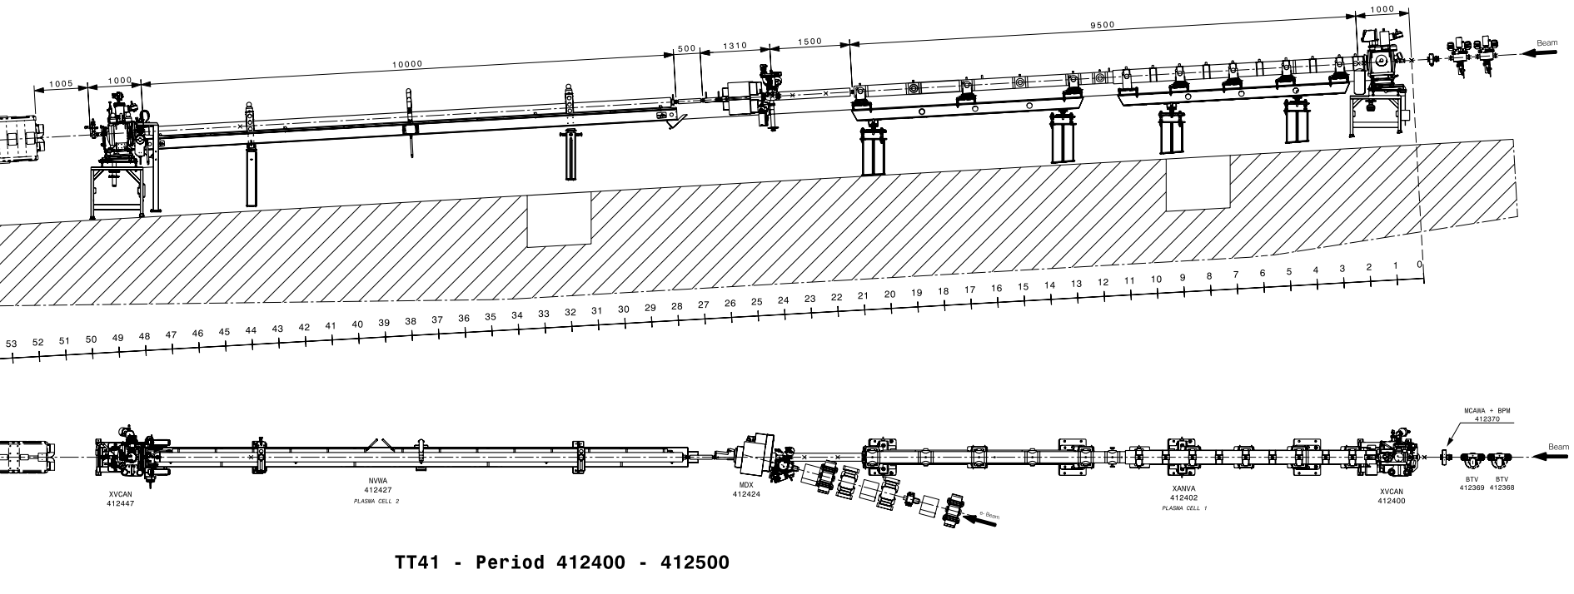
Awake Run 2C – Experimental Area Beam Line
Experimental Area : Beam Line Layout
Same codes as previous configuration…

Slide 5
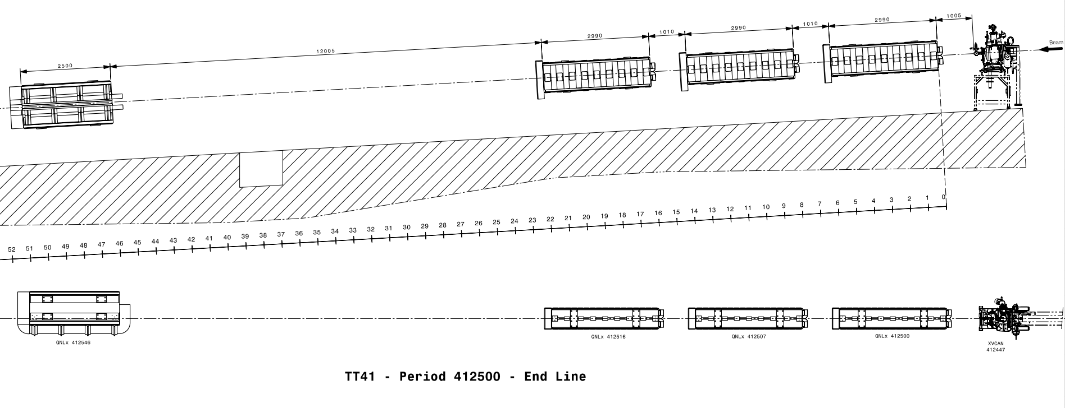
Awake Run 2C – Experimental Area Beam Line
Experimental Area : Beam Line Layout
Magnet HB2 ?
Magnets QNL : QNLD ? – QNLF ?

Slide 6
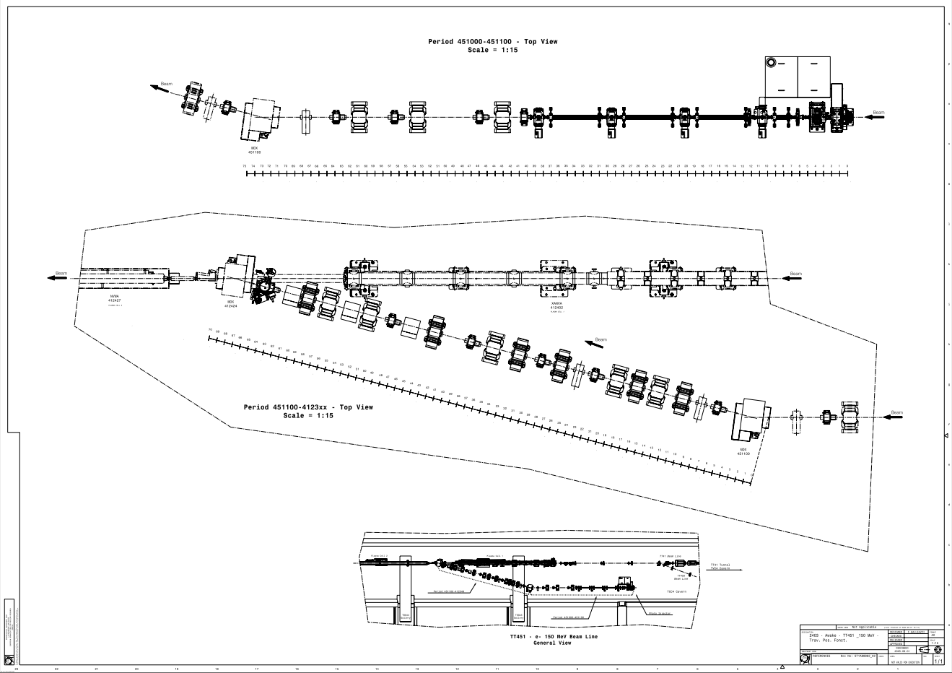
Awake Run 2C – TT451 Beam Line (e- 150 MeV)
e- (150 MeV) Beam Line : Layout
Layout Drawing

Slide 7
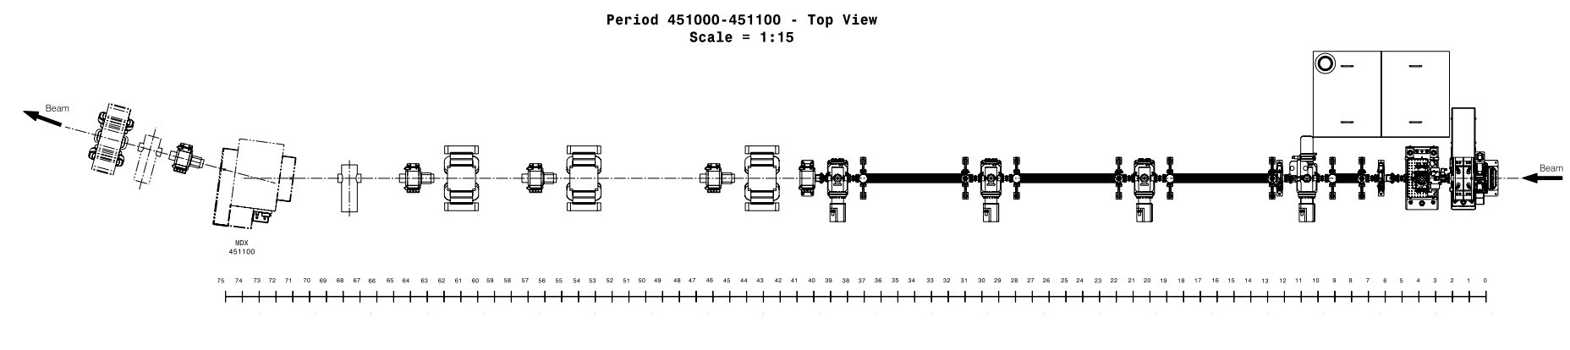
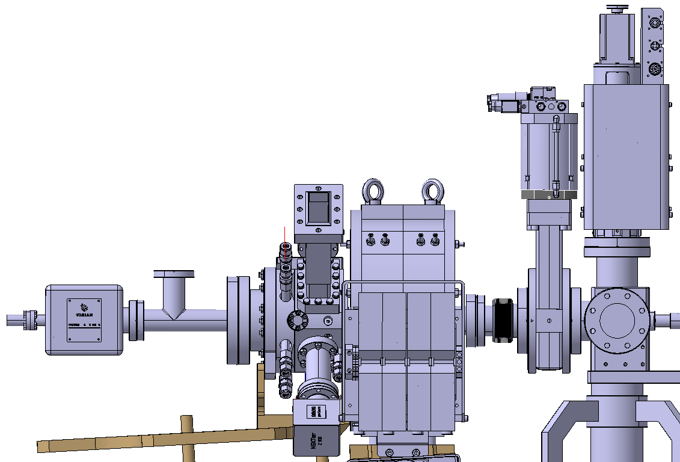
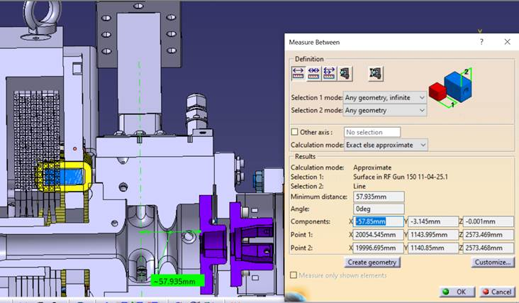
Awake Run 2C – TT451 Beam Line (e- 150 MeV)
e- (150 MeV) Beam Line : Layout
Codes of Elements ? - Origin of Beam Line ?
Scale
Origin
proposed
Origin
proposed
Functionnal Positions ?

Slide 8
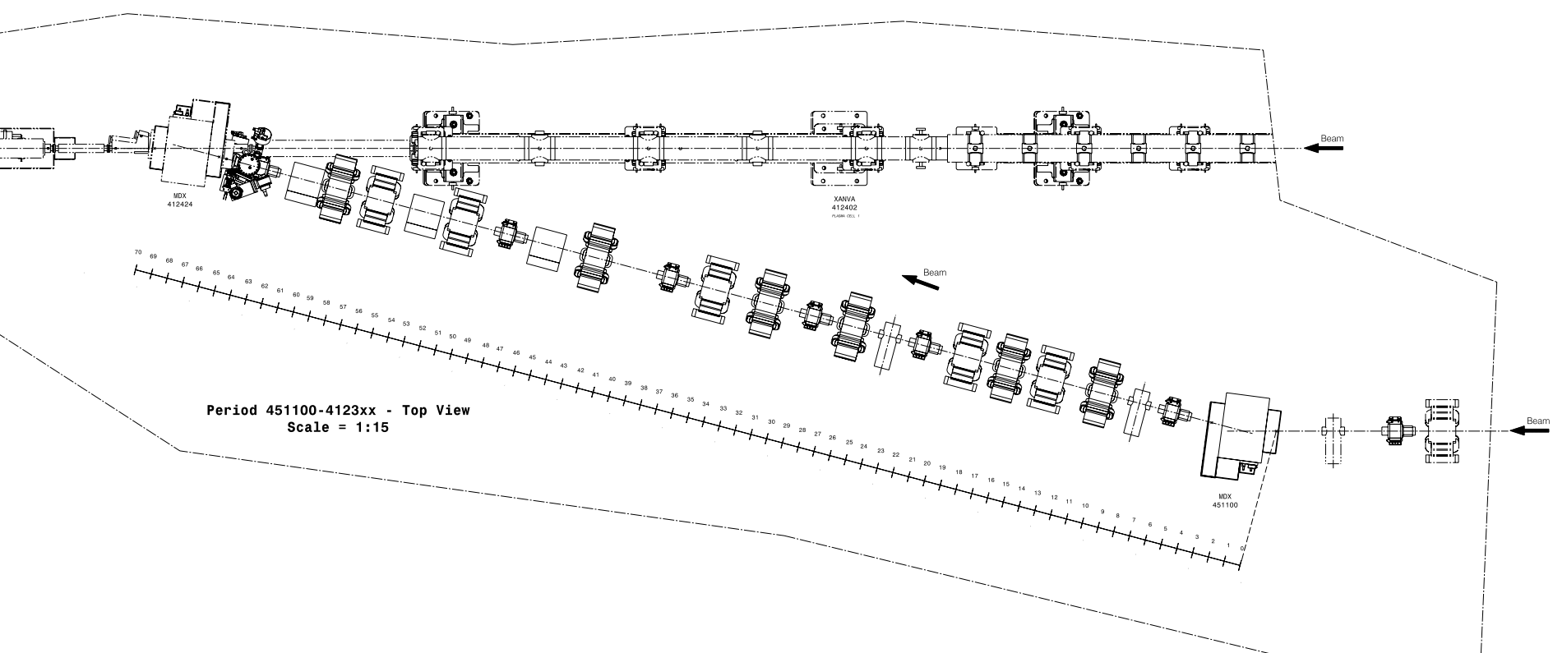
Awake Run 2C – TT451 Beam Line (e- 150 MeV)
e- (150 MeV) Beam Line : Layout
Codes of Elements ?

Slide 9
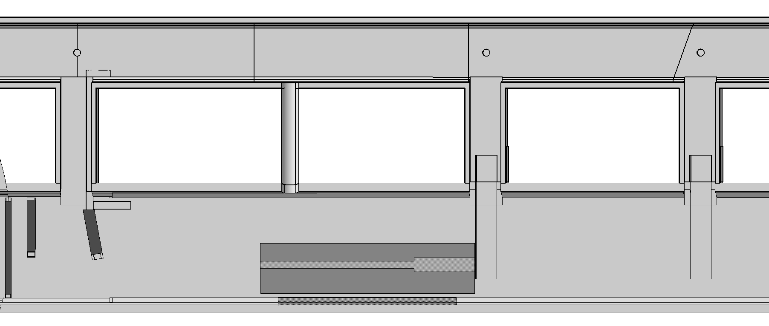
Awake Run 2C – TCC4 - Trenches
TCC4 : Extension of Trenches (for Cable Trays)
TSG4
TSG42
TSG43
TSG44
TCC4
Same extension for TSG45 and TSG46

Slide 10
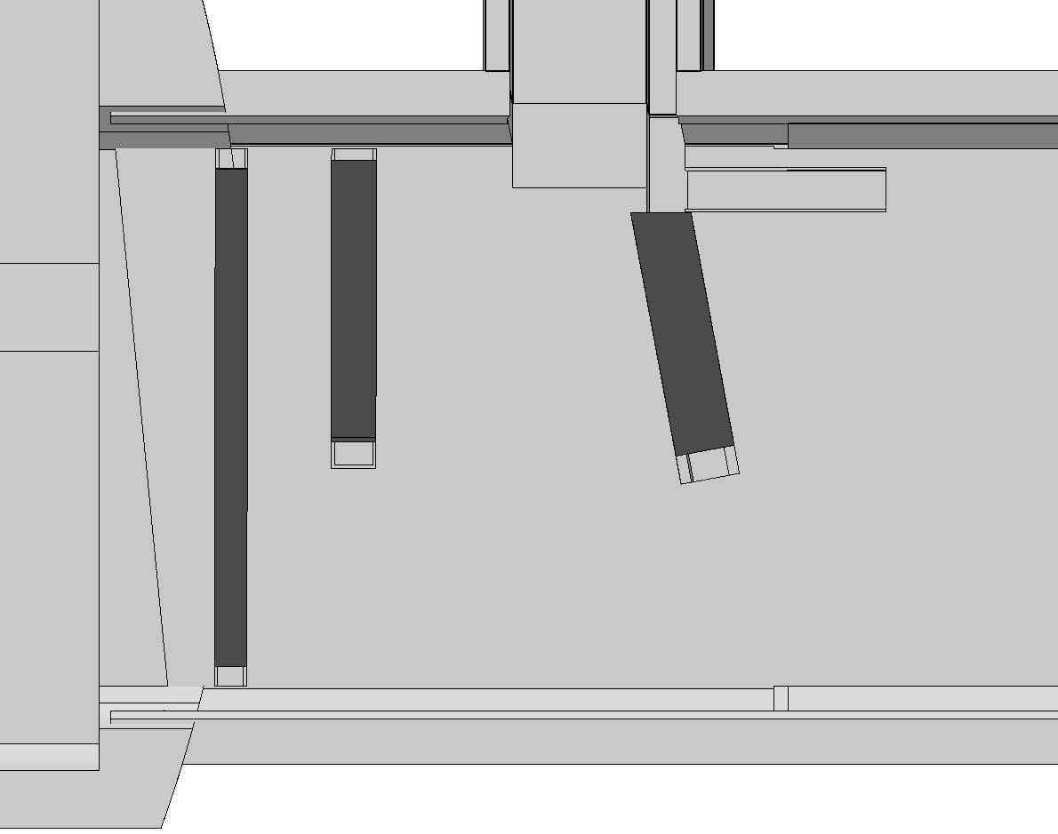
Awake Run 2C – TCC4 - Trenches
TCC4 : Extension of Trenches (for Cable Trays)
TSG42
Extension :
Same depth as existing part
TCC4
Gap Trench / Vault = 10 cm

Slide 11
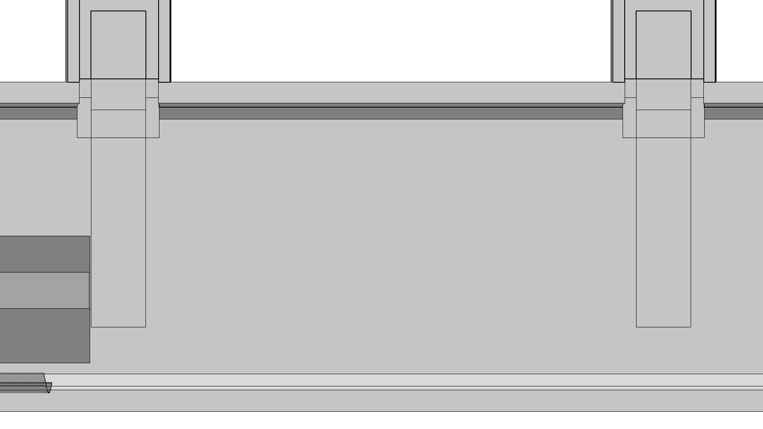
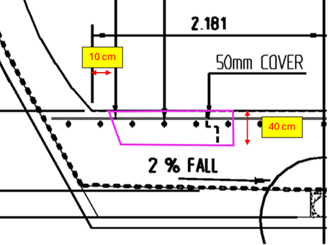
Awake Run 2C – TCC4 - Trenches
TCC4 : Extension of Trenches (for Cable Trays)
TSG43
Extension Proposed by SCE
TSG44
TCC4
Same extension for TSG45 and TSG46

Slide 12
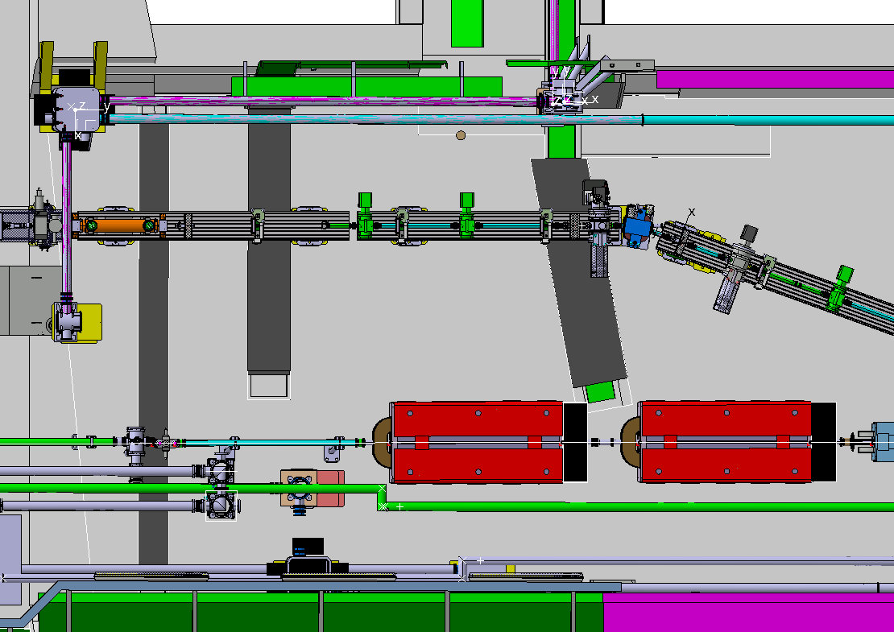
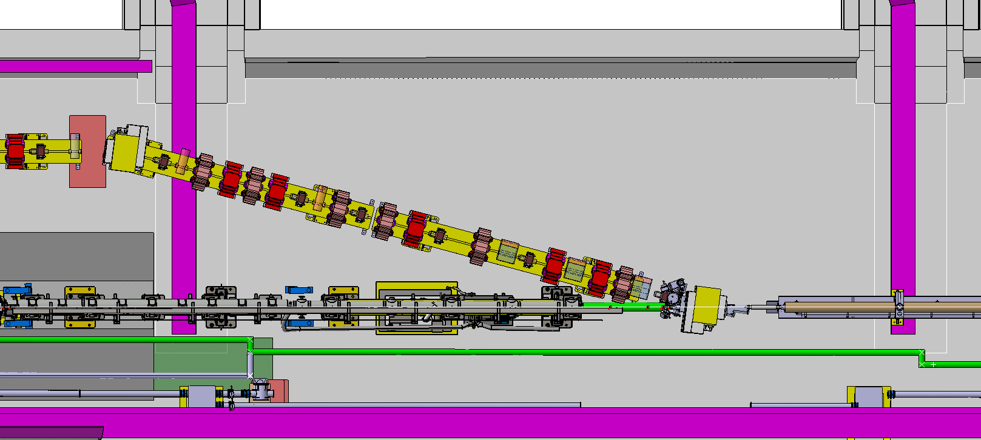
Awake Run 2C – TCC4 – Trenches vs Supports
TCC4 : Extension of Trenches (for Cable Trays)
Supports on Trenches

Slide 13
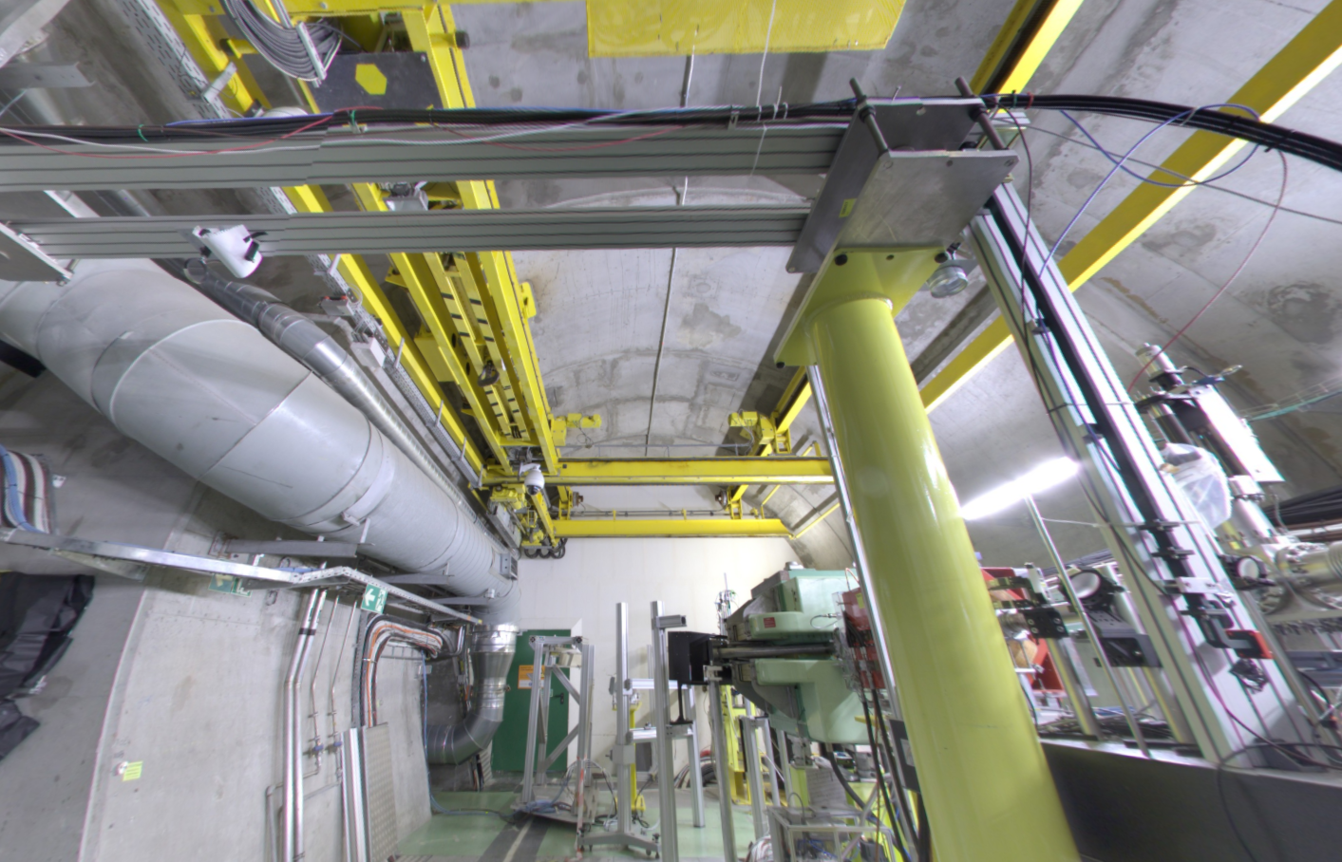
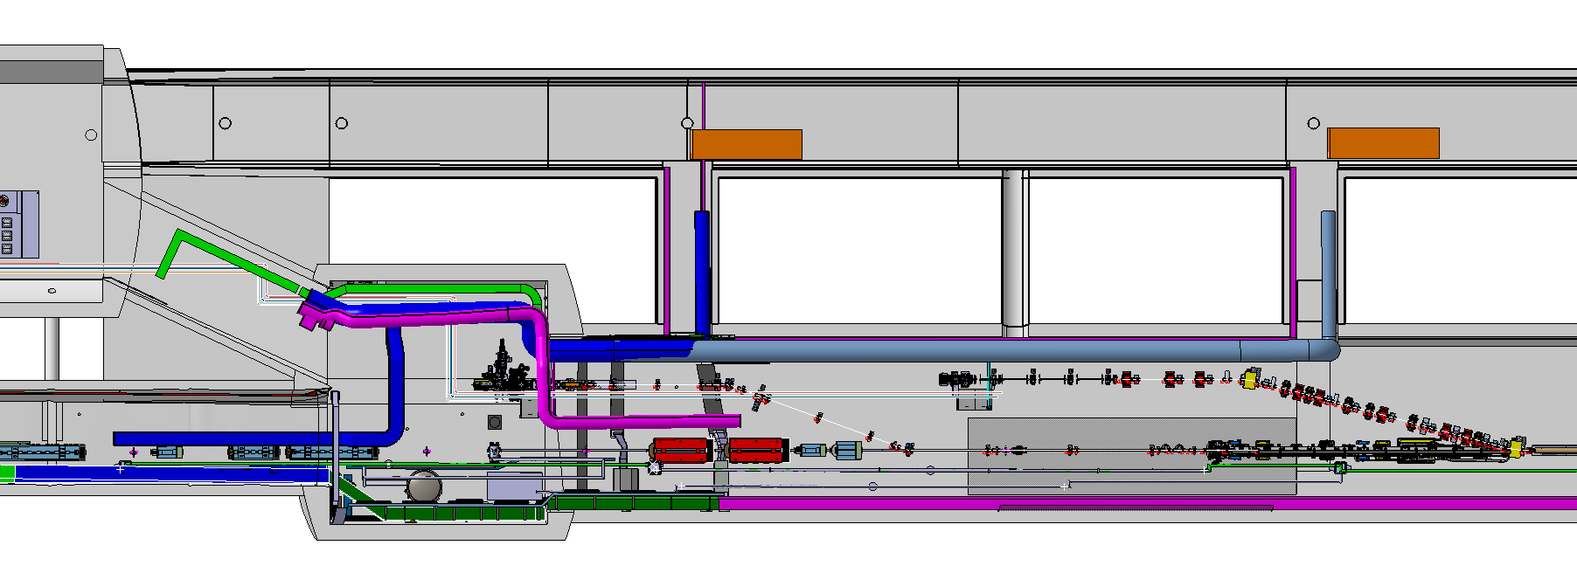
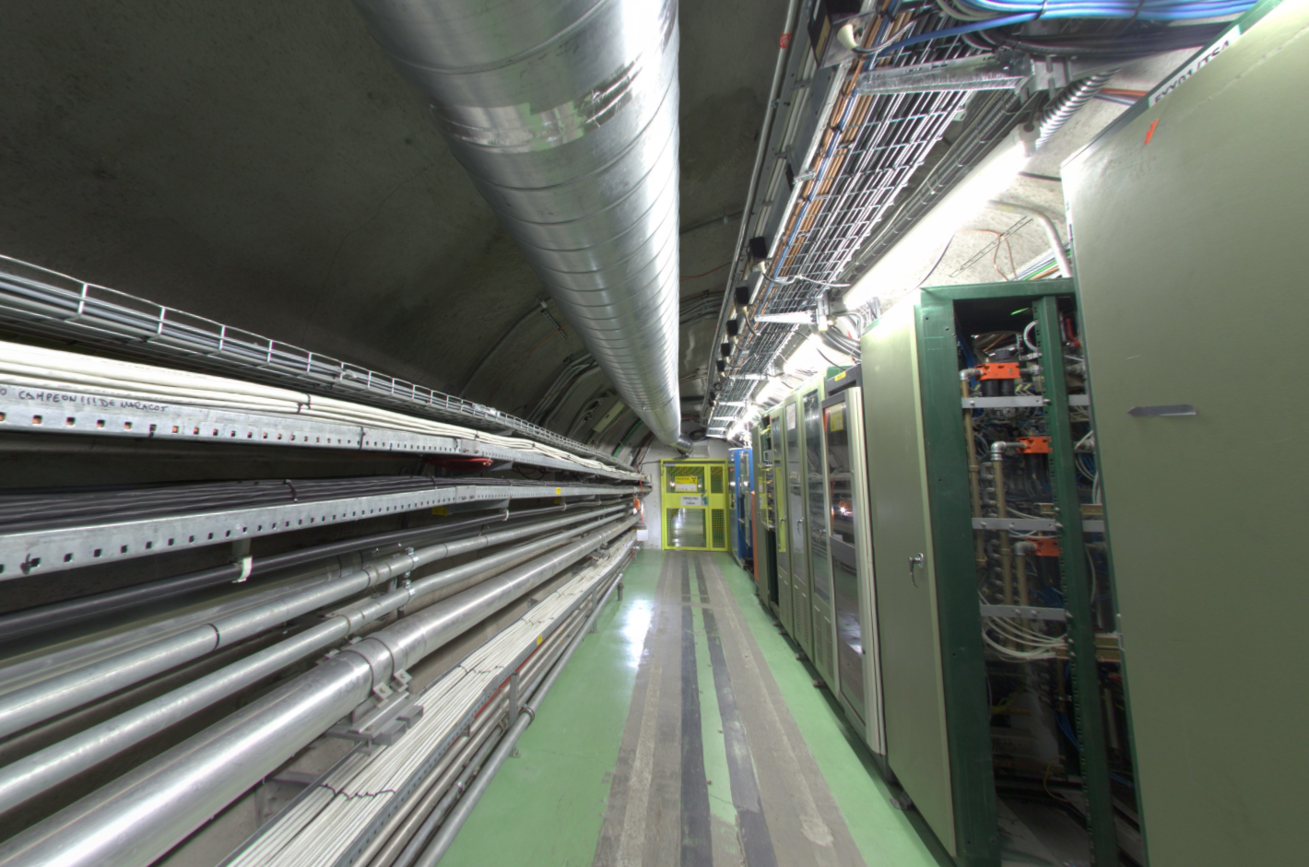
Awake Run 2C – Ventilation
TCC4-TSG4 : Ventilation
New Routing 1 ?
REMINDER
TSG4
TSG42
TSG43
TCC4
Existing Ventilation Duct
1st Modification proposed
New Routing 2 ?
No Space for Additional Ventilation Duct…

Slide 14
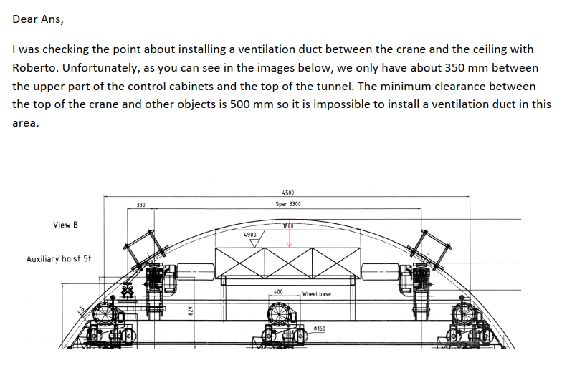
Awake Run 2C – Ventilation
X
TCC4-TSG4 : Ventilation
New Routing 1 ?
TSG4
TSG42
TSG43
TCC4
1st Modification proposed
X
Existing Ventilation Duct
What routing for the ventilation duct ?
The final routing could have big impact on the current studies !!!
New Routing 2
Not possible

Slide 15
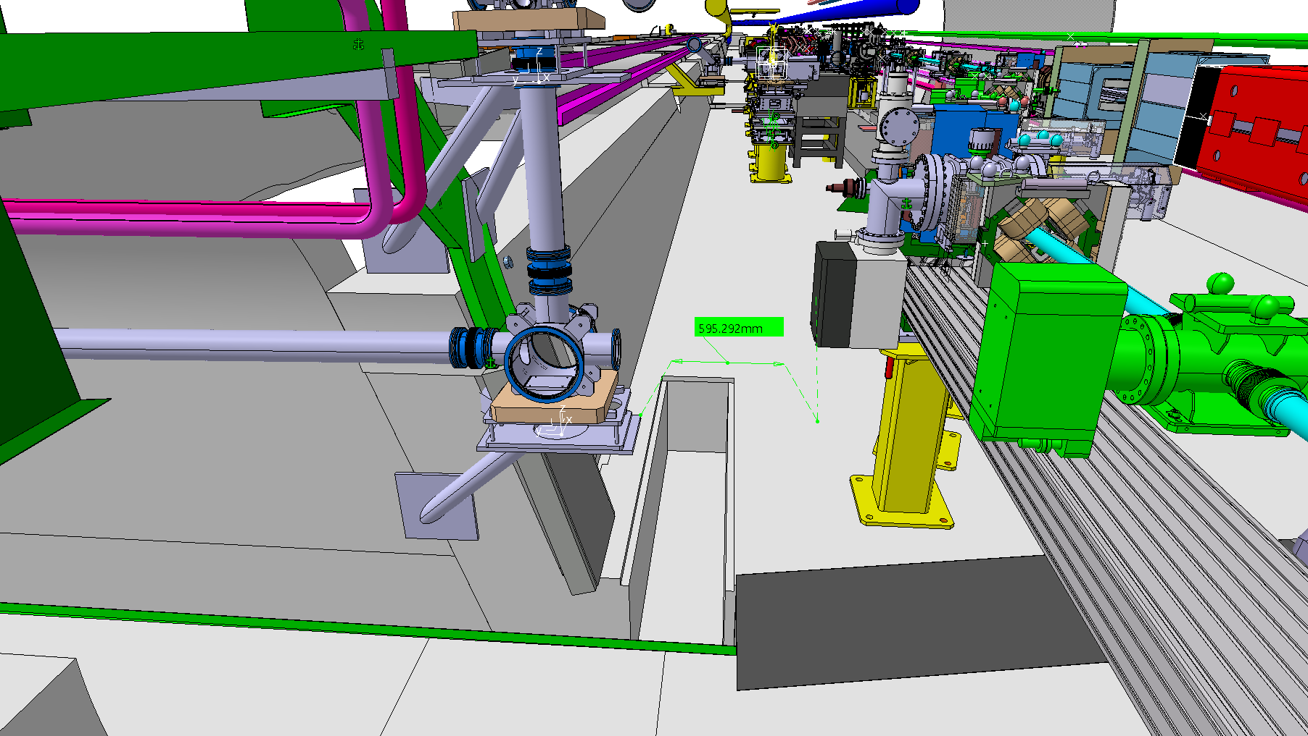
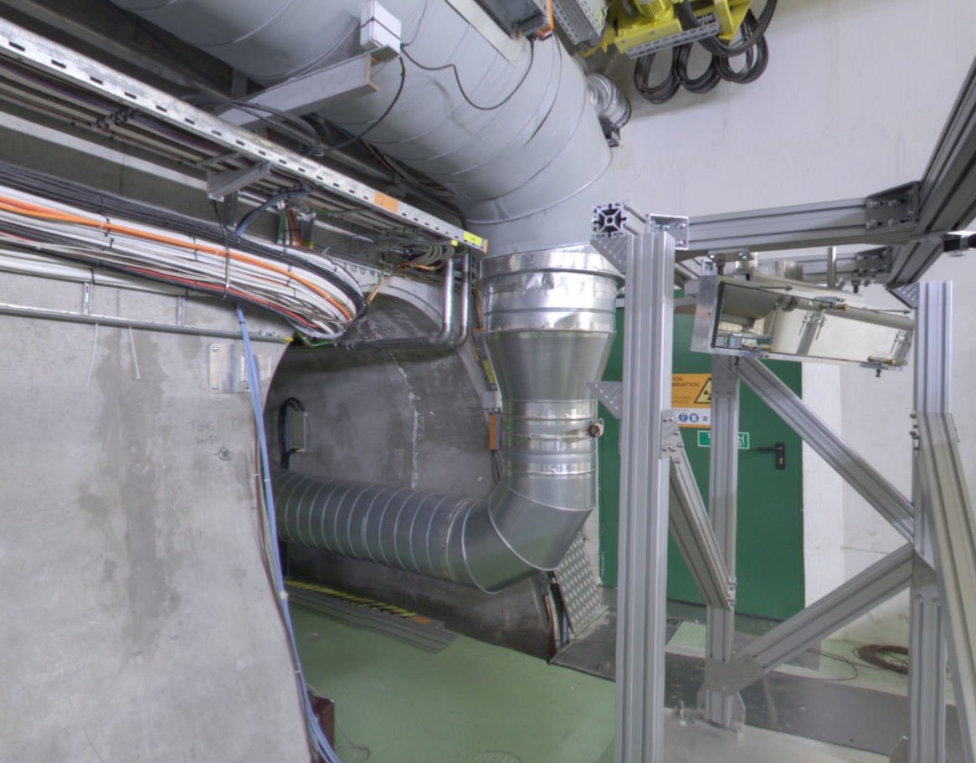
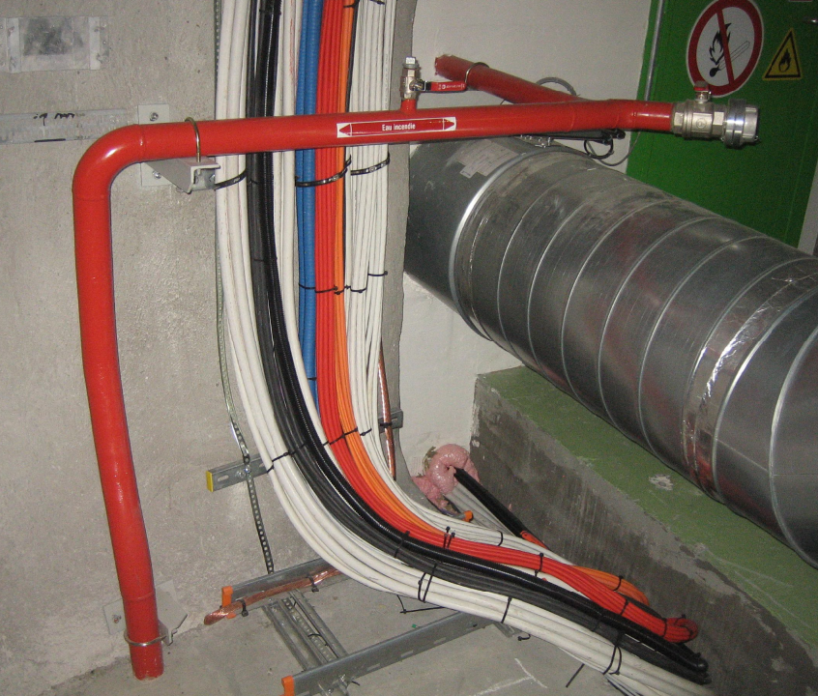
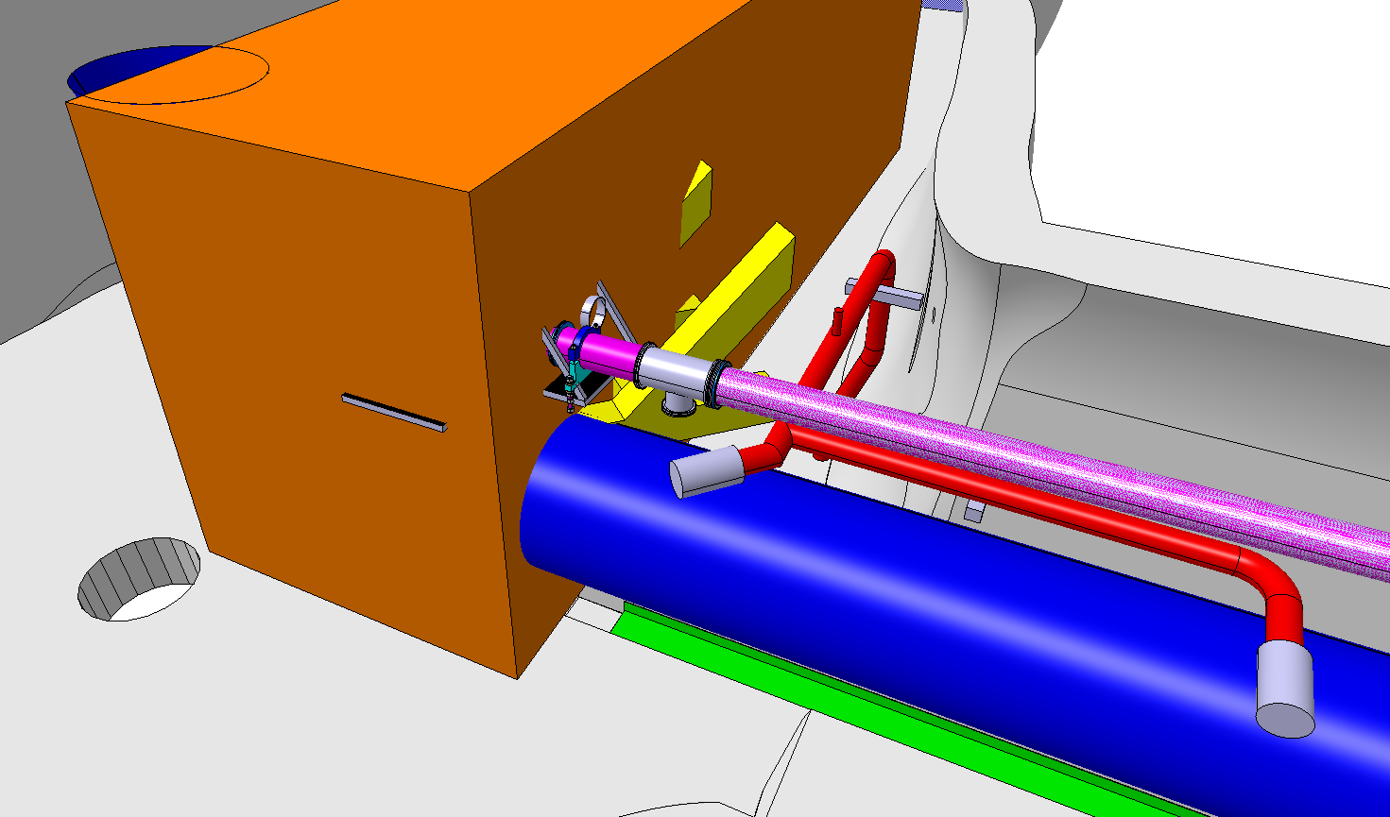
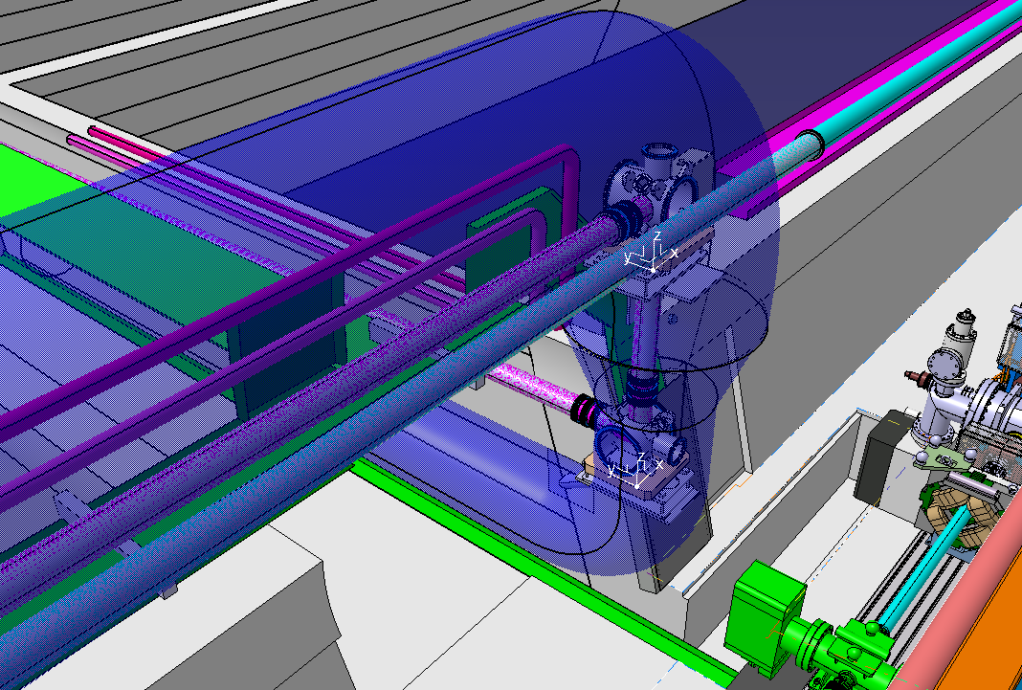
Awake Run 2C – TSG42
TSG42 Area :
Ventilation ?
Existing Services to be modified
Cable Trays Access
Vincent is working on the drawing.
It will be available soon
Vacuum
Pump

Slide 16
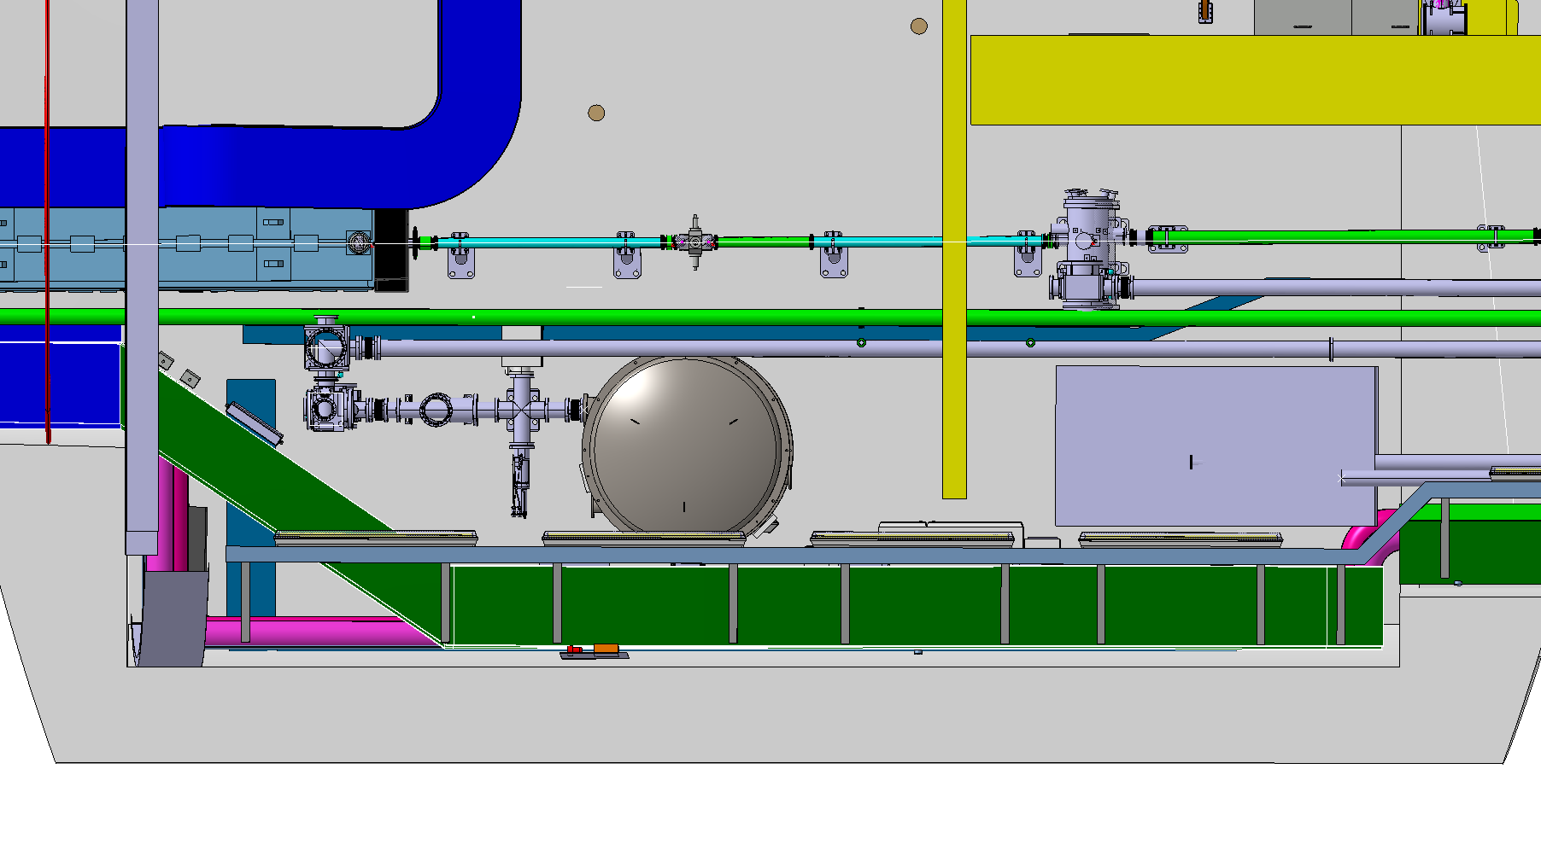
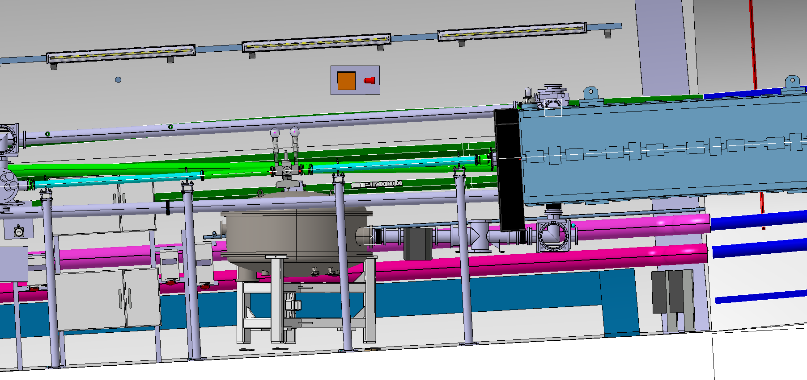
Awake Run 2C – Laser Beam Lines
TCC4 Area :
Vincent is working on the drawing.
It will be available soon
600 mm
Access ? Cover Handling ?
Free Passage !!

Slide 17
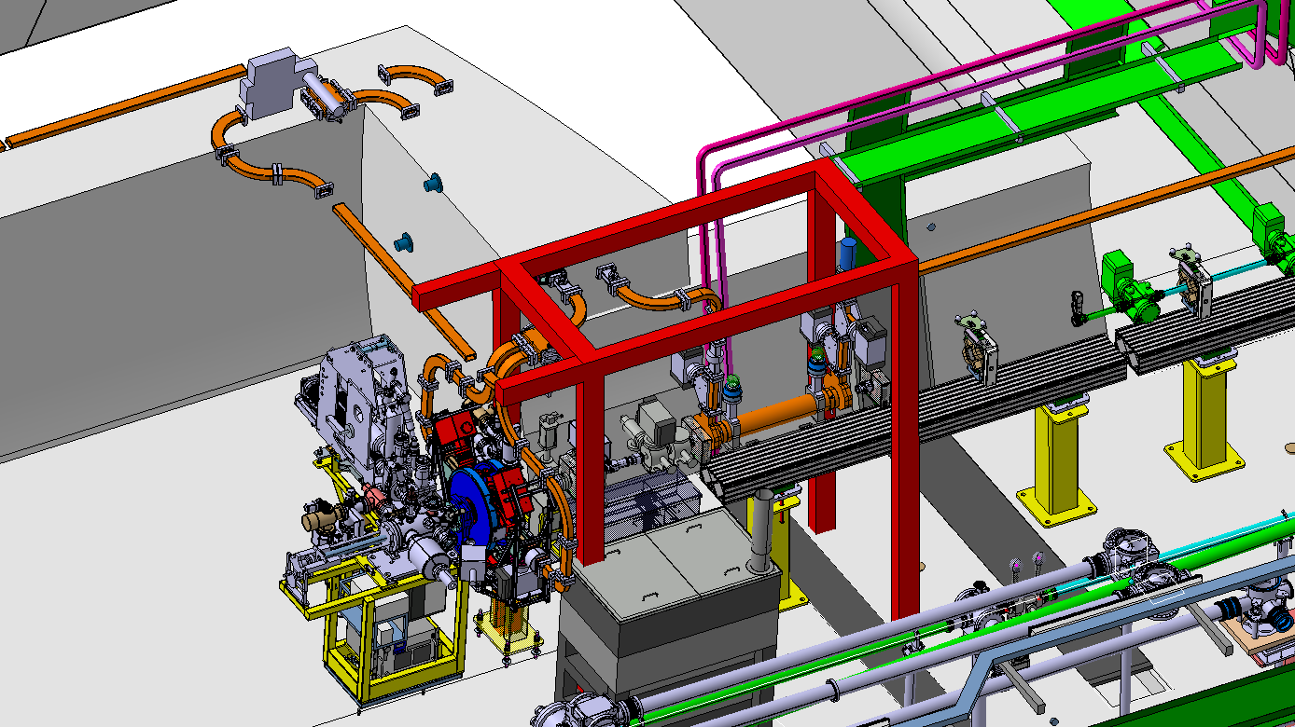
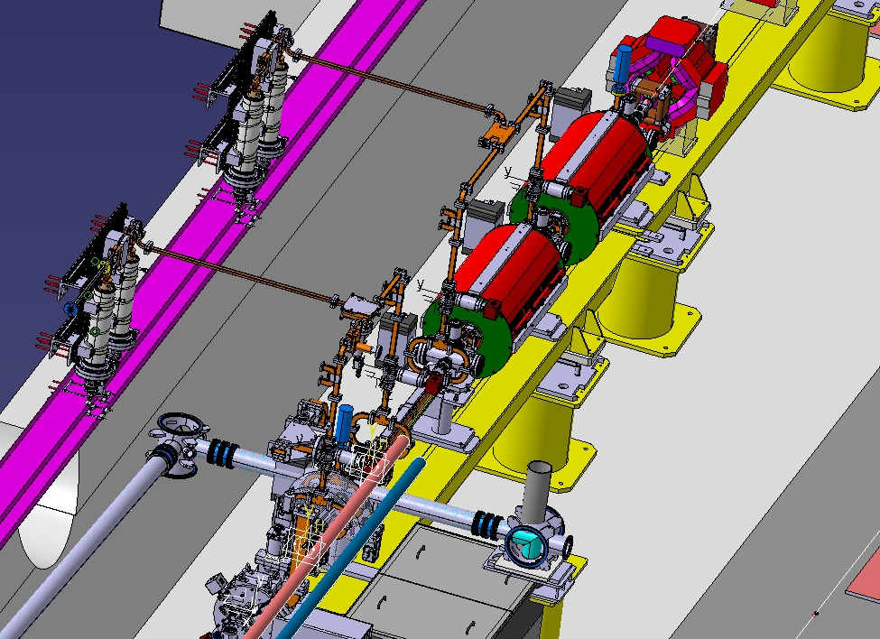
Awake Run 2C – RF Wire Guides
TCC4 Area :
Wire Guides Study on going
Check by Integration to be done

Slide 18
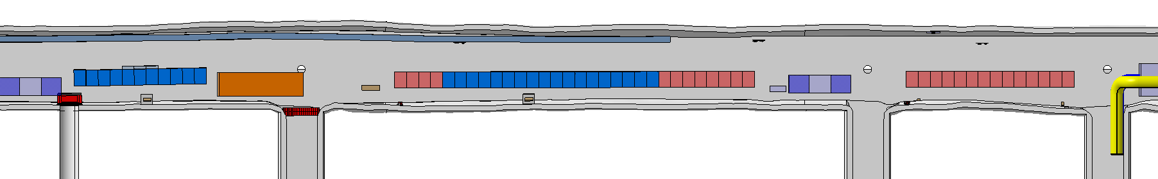
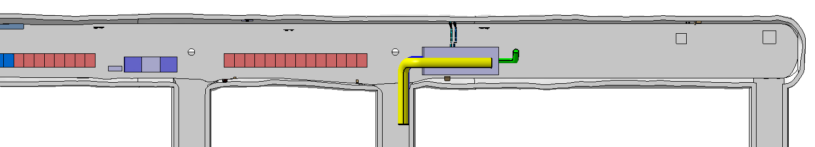
Awake Run 2C – TSG4
TSG4 Area :
STREAK ROOM
TSG4
Shieldings
TSG45
4 NEW RACKS
8 NEW RACKS
TSG46
14 NEW RACKS
TSG47
VENTILATION UNIT
COOLING UNIT ?
TSG4
8 NEW RACKS
TSG46
14 NEW RACKS
TSG47
3 NEW RACKS
FREE SPACE NEW RACKS ?
TSG48

Slide 19
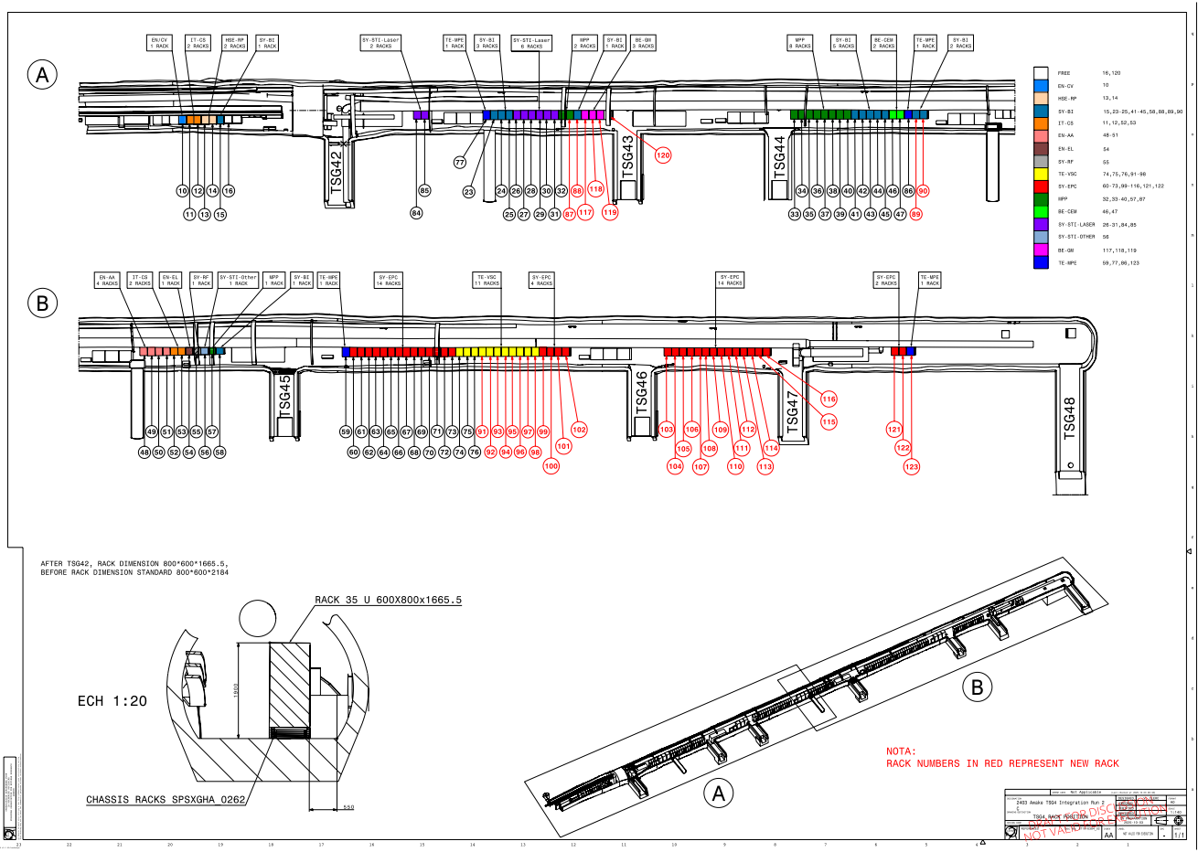
Awake Run 2C – TSG4
TSG4 Area :
Vincent is working on the drawing.
It will be available soon

