Slide 1



The NHMFL 40 T All-SC Magnet Project
Dr. Mark D. Bird
Chief Technology Officer
National High Magnetic Field Laboratory
Florida State University, Tallahassee, Florida, USA

Slide 2
1 Lab. 3 Sites. 7 User Facilities | Users
DC @ FSU: continuous fields. | 631
Nuclear Magnetic Resonance @ FSU: solution and solid-state NMR and animal MRI. | 341
Advanced Magnetic Resonance and Spectroscopy @ UF: high-resolution and solid-state NMR, in-vivo imaging and spectroscopy, MRI microscopy, and diffusion. | 262
Ion Cyclotron Resonance @ FSU: ultra-high resolution and high mass-accuracy Fourier transform ICR mass spectroscopy. | 246
Electron Magnetic Resonance @ FSU: continuous & pulsed techniques associated with unpaired electron spins. | 173
Pulsed Field @ LANL: short, ultra-intense field pulses. | 155
High B/T @ UF: high fields combined with ultra-cold electron temperatures to 0.4 mK. | 18
Total = 1826 users in 2023

Slide 3




The Development of Superconducting Solenoids
“A design . . . study should be conducted for the construction of a 20 T, . . . 65 cm diameter . . . magnet suitable for . . . human subject research.” – MagSci Report, 2013, pg. 18
MagLab 40 T
There is only 1 commercial magnet supplier building magnets at 30 T, for NMR only.
Hi-Strength Hi-T_{c} Tape
High-T_{c} Materials
Magnets
MagLab 32 T
Hi-T_{c} User
The first Ultra-High Field High-T_{c} user magnet.
Hi T_{c} Test Coils
Existing User Magnets > 23.5 T Worldwide
Low-T_{c} User Magnets
Field | Conductors | Maker | Location | Year
25 T | Bi-2223 + LTS | Toshiba | Sendai | 2017
25.8 T (1.1 GHz) | REBCO + LTS | Bruker | Nashville | 2019
28.2 T (1.2 GHz) | REBCO + LTS | Bruker | Florence + 12 | 2020
32.1 T | REBCO + LTS | MagLab | Tallahassee | 2017
26 T | Bi-2223 + LTS | IEE-Beijing | Huairou | 2023
30 T | REBCO + LTS | IEE-Beijing | Huairou | 2023
MagSci 40 T Challenge
Several Other Projects Underway Worldwide!

Slide 4
40 T All-SC Magnet Requirements
Key Performance Parameters:
Central field: 40 T
Operating lifetime: 50,000 cycles or 20 years
Field set-ability: ≤ 10 mT across the range of field
Cycling repeatability: ≤ 10 mT
Operating temperature: 4.2 K in LHe
Cold bore diameter: ≥ 34 mm
Ramp rate: ≥ 0.5 T/min
Homogeneity: ≤ 500 ppm over a 1 cm DSV
Stabilization time: < 3 minutes to stabilize at a set point
10 Gauss fringe field: < 5.4 m from the axis of the magnet at the mid-plane
SCS & fatigue testing are important
REBCO SCIF generates ~0.2T
NI-REBCO not likely

Slide 5
Stored Energy in HTS Coils
As magnets get larger, stored energy increases along with potential for damage during quench!
Quench Damage
1 MJ ~ 1 stick of dynamite.
Some coils destroyed during quench
Org. | Field | Energy | Year
MIT | 30.5 T | 80 kJ NI-REBCO | 2018
RIKEN | 28 T | 30 kJ I-REBCO x 2 | 2017
Tohoku U | 25 T | 350 kJ I-REBCO | 2016
Numerous other HTS test coils around the world have destroyed themselves.
26 T
32 T
34 T
25 T
We need more development to handle increase in stored energy.

Slide 6

Tape Magnets: Screening Currents

Slide 7
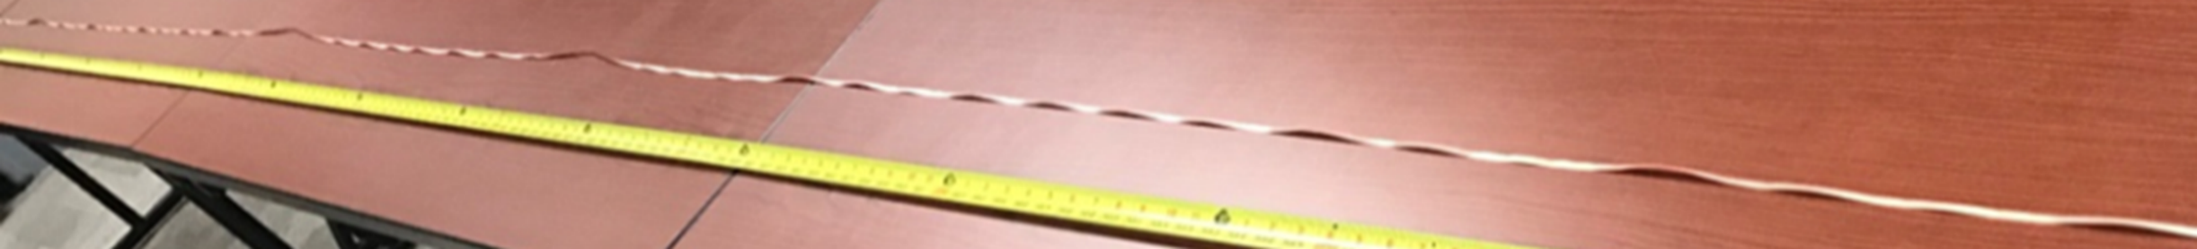
Screening Currents: Tape Conductors
B_{z}
J_{t} = transport current in θ direction.
J_{θ}
F_{r}
During charging of the magnet, B_{r} creates screening currents, J_{s}, in the tape.
B_{r}
J_{s}
J_{t}
J_{s} reacts with B_{z} to give radial forces F_{r}, in addition to those created by the transport current.
This gives rise to a Diamagnetic Torque and Twist and strain that is not uniform across the width of the tape.
Tape removed from test coils can display plastic deformation!
Axis
F_{r}
D. Kolb-Bond, M.D. Bird, I.R. Dixon, T.A. Painter, J. Lu, K.L. Kim, K. Kim, R.P. Walsh, F. Grilli, SuST, 34, 095004 (2021).
Y. Yan, P. Song, C. Xin, M. Guan, Y. Li, H. Liu, and T. Qu, SuST. 34 (2021) 085012 (13pp)
Photo credit: Paul Hu
Confidential FSU/NHMFL

Slide 8
Computed Screening Currents: With and Without Rotation (2020)
Strain in a mini-fatigue coil (~5m REBCO)
Tiny solenoid energized in a background field.
Outboard Strain Gauge
Strains due to screening currents now agree with measurements for small coils.
Screening current induced field calculations also now agree.
“Traditional” calculation
Uniform j
Computed, w/ coupling
Inboard Strain Gauge
Measured
Measured
Computed, w/ coupling
“Traditional” calculation
D. Kolb-Bond, M.D. Bird, I.R. Dixon, T.A. Painter, J. Lu, K.L. Kim, K. Kim, R.P. Walsh, F. Grilli, SuST, 34, 095004 (2021).
Y. Yan, P. Song, C. Xin, M. Guan, Y. Li, H. Liu, and T. Qu, SuST. 34 (2021) 085012 (13pp)

Slide 9
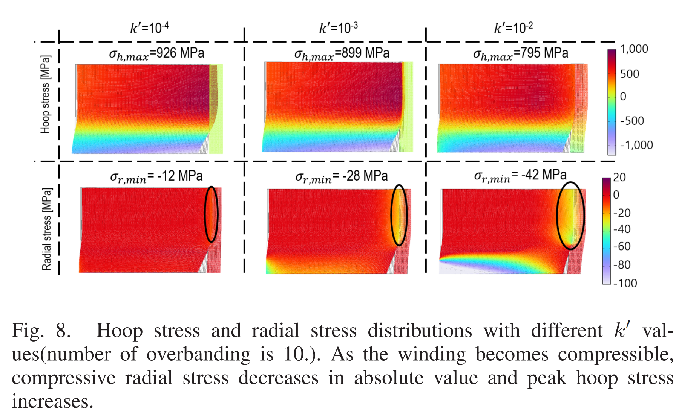
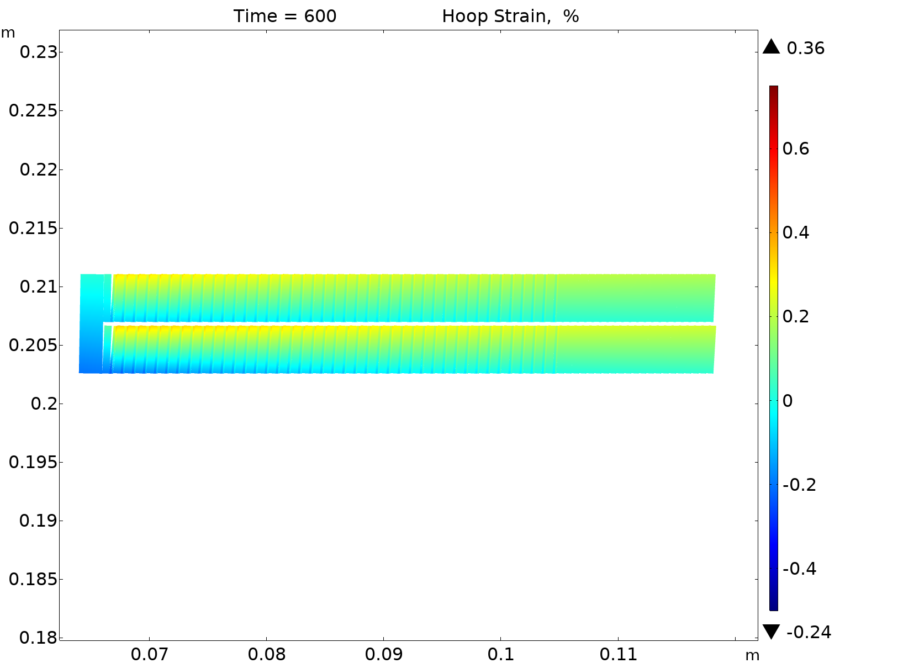
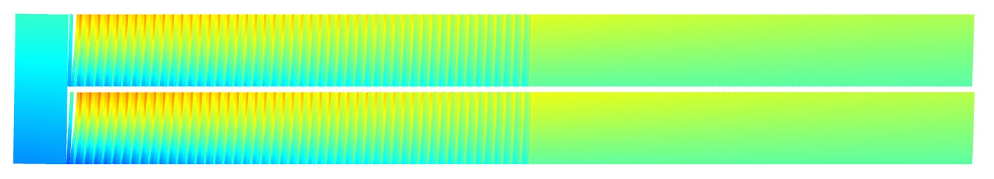
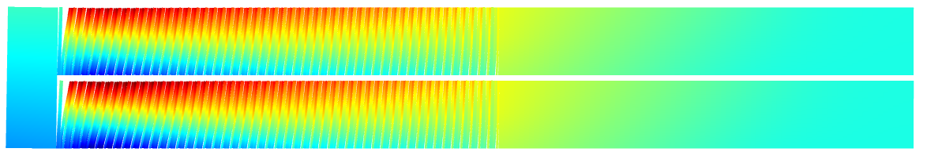

Impact of non-Uniform REBCO (Cu) Thickness
Exaggerated REBCO tape cross-section.
High radial compressibility.
Traditional model = low radial compressibility
Electroplated Cu results in a non-uniform cross-section in REBCO tape.
We are adding additional co-wound steel.
4 mm
0.1 mm
MagLab end module
Hoop strain [%]
w/o Winding Compressibility
J. Park et al., IEEE-TAS 35, 5, Aug. 2025, 4801805, doi: 10.1109/TASC.2025.3538680.
w/ Winding Compressibility (REBCO, OB)
Y. Suetomi, et al., Fri-Mo-Or2-02

Slide 10
REBCO Challenges

Slide 11
Unpredictability of REBCO I_{c} Tape-to-Tape
32 T Magnet: 2012 – 2014
SuperPower tape
Temp | Ave | St. Dev. | St. Dev. | Min | Max | Ratio
4.2 K | 393 A | 94 A | 24% | 200 A | 725 A | 3.6
77 K | 130 A | 15 A | 12% | 100 A | 175 A | 1.8
4K
84 mm
There is significant variation in I_{c} at 4 K between tapes.
It cannot be predicted from a 77 K measurement.
(Present variation seems to be less than in the past.)
77K
Dima Abraimov

Slide 12
I_{op}/I_{c} of outer REBCO coil of 40 T all-SC
60% | 63% | 64% | 63% | 60% | 56% | 53% | 51% |  | 89% | 93% | 94% | 92% | 88% | 82% | 78% | 74%
63% | 65% | 65% | 63% | 61% | 58% | 56% | 54% |  | 87% | 89% | 89% | 87% | 84% | 80% | 77% | 74%
65% | 66% | 65% | 64% | 62% | 60% | 58% | 56% |  | 85% | 86% | 85% | 84% | 81% | 78% | 76% | 73%
66% | 66% | 66% | 64% | 63% | 61% | 59% | 57% |  | 82% | 83% | 82% | 81% | 79% | 76% | 74% | 72%
67% | 67% | 66% | 65% | 64% | 62% | 61% | 59% |  | 80% | 80% | 79% | 78% | 76% | 75% | 73% | 71%
67% | 67% | 67% | 66% | 65% | 63% | 62% | 60% |  | 78% | 78% | 77% | 76% | 75% | 73% | 71% | 70%
67% | 67% | 67% | 66% | 65% | 64% | 62% | 61% |  | 76% | 76% | 75% | 74% | 73% | 72% | 70% | 69%
67% | 67% | 67% | 66% | 65% | 64% | 63% | 61% |  | 74% | 74% | 74% | 73% | 72% | 71% | 69% | 68%
67% | 67% | 67% | 66% | 65% | 64% | 63% | 62% |  | 73% | 73% | 72% | 72% | 71% | 70% | 68% | 67%
66% | 66% | 66% | 66% | 65% | 64% | 63% | 62% |  | 71% | 71% | 71% | 71% | 70% | 69% | 68% | 66%
66% | 66% | 66% | 66% | 66% | 65% | 63% | 61% |  | 70% | 70% | 70% | 70% | 70% | 69% | 67% | 65%
65% | 65% | 66% | 66% | 66% | 65% | 63% | 61% |  | 69% | 69% | 69% | 69% | 69% | 68% | 66% | 65%
66% | 66% | 67% | 67% | 66% | 65% | 64% | 63% |  | 68% | 68% | 68% | 68% | 68% | 67% | 65% | 64%
66% | 66% | 66% | 66% | 66% | 65% | 64% | 63% |  | 67% | 67% | 67% | 67% | 67% | 66% | 65% | 63%
66% | 66% | 66% | 66% | 66% | 65% | 64% | 63% |  | 66% | 66% | 66% | 66% | 66% | 65% | 64% | 63%
66% | 66% | 66% | 66% | 66% | 66% | 65% | 63% |  | 66% | 66% | 66% | 66% | 66% | 65% | 64% | 62%
65% | 65% | 65% | 65% | 66% | 66% | 64% | 62% |  | 65% | 65% | 65% | 65% | 66% | 66% | 64% | 62%
63% | 64% | 64% | 64% | 65% | 66% | 64% | 61% |  | 63% | 64% | 64% | 64% | 65% | 66% | 64% | 61%
63% | 63% | 63% | 63% | 64% | 66% | 64% | 61% |  | 63% | 63% | 63% | 63% | 64% | 66% | 64% | 61%
64% | 64% | 64% | 64% | 65% | 67% | 65% | 62% |  | 62% | 62% | 62% | 62% | 63% | 65% | 63% | 60%
67% | 66% | 66% | 66% | 66% | 67% | 66% | 63% |  | 61% | 60% | 60% | 60% | 61% | 61% | 60% | 58%
68% | 68% | 67% | 68% | 68% | 68% | 67% | 65% |  | 58% | 58% | 58% | 58% | 59% | 58% | 58% | 56%
68% | 68% | 68% | 68% | 68% | 68% | 67% | 65% |  | 56% | 56% | 56% | 56% | 56% | 56% | 56% | 54%
68% | 68% | 68% | 68% | 68% | 68% | 67% | 66% |  | 55% | 55% | 55% | 55% | 55% | 55% | 54% | 53%
68% | 68% | 68% | 68% | 68% | 68% | 67% | 66% |  | 53% | 53% | 53% | 53% | 53% | 53% | 52% | 51%
68% | 68% | 68% | 68% | 68% | 68% | 67% | 66% |  | 52% | 52% | 52% | 52% | 52% | 52% | 51% | 50%
68% | 69% | 69% | 69% | 69% | 69% | 68% | 66% |  | 50% | 51% | 51% | 51% | 51% | 51% | 50% | 48%
68% | 68% | 69% | 69% | 69% | 69% | 68% | 66% |  | 49% | 49% | 49% | 49% | 49% | 49% | 49% | 47%
68% | 68% | 69% | 69% | 69% | 69% | 68% | 66% |  | 47% | 47% | 47% | 47% | 47% | 47% | 47% | 45%
69% | 69% | 69% | 69% | 69% | 69% | 69% | 67% |  | 45% | 45% | 45% | 45% | 45% | 45% | 45% | 44%
69% | 69% | 68% | 68% | 68% | 69% | 69% | 67% |  | 44% | 43% | 43% | 43% | 43% | 43% | 43% | 43%
69% | 68% | 68% | 68% | 68% | 69% | 69% | 68% |  | 42% | 42% | 42% | 42% | 42% | 42% | 42% | 41%
69% | 68% | 68% | 68% | 69% | 69% | 70% | 68% |  | 41% | 40% | 40% | 40% | 40% | 41% | 41% | 40%
68% | 68% | 67% | 67% | 68% | 69% | 70% | 68% |  | 39% | 39% | 39% | 39% | 39% | 40% | 40% | 40%
66% | 66% | 65% | 65% | 66% | 68% | 71% | 68% |  | 38% | 38% | 38% | 38% | 38% | 39% | 41% | 39%
67% | 66% | 65% | 65% | 66% | 67% | 71% | 68% |  | 37% | 37% | 36% | 36% | 37% | 38% | 39% | 38%
68% | 67% | 66% | 65% | 65% | 66% | 67% | 66% |  | 36% | 36% | 35% | 35% | 35% | 35% | 36% | 35%
66% | 65% | 64% | 63% | 62% | 62% | 62% | 62% |  | 36% | 35% | 34% | 34% | 34% | 33% | 33% | 33%
65% | 63% | 62% | 61% | 60% | 59% | 59% | 58% |  | 35% | 34% | 33% | 33% | 32% | 32% | 32% | 31%
65% | 63% | 62% | 60% | 59% | 58% | 57% | 57% |  | 34% | 33% | 32% | 32% | 31% | 31% | 30% | 30%
64% | 62% | 60% | 59% | 57% | 56% | 55% | 54% |  | 34% | 33% | 32% | 31% | 30% | 29% | 29% | 29%
62% | 60% | 58% | 56% | 55% | 53% | 52% | 51% |  | 33% | 32% | 31% | 30% | 29% | 28% | 28% | 27%
61% | 59% | 57% | 55% | 53% | 52% | 50% | 50% |  | 33% | 32% | 31% | 30% | 29% | 28% | 27% | 27%
61% | 59% | 56% | 54% | 52% | 51% | 49% | 48% |  | 33% | 31% | 30% | 29% | 28% | 27% | 26% | 26%
61% | 58% | 56% | 54% | 52% | 50% | 48% | 47% |  | 32% | 31% | 30% | 29% | 28% | 27% | 26% | 25%
59% | 57% | 54% | 52% | 50% | 48% | 46% | 46% |  | 32% | 31% | 30% | 29% | 27% | 26% | 25% | 25%
59% | 56% | 54% | 52% | 50% | 48% | 46% | 45% |  | 32% | 31% | 30% | 28% | 27% | 26% | 25% | 25%
58% | 55% | 53% | 51% | 49% | 47% | 45% | 44% |  | 32% | 31% | 30% | 28% | 27% | 26% | 25% | 25%
I_{c} variation is helpful.
I_{c} | Min | Max
Uniform | 25% | 94%
graded | 44% | 71%
Axis of rotation
84 mm
If I_{op}/I_{c} varies, quench protection is harder,
SCS can be excessive.
Mid-Plane

Slide 13
Unpredictability of REBCO I_{c} Dropouts
YateStar measurement of critical current at 77K of SuperPower tape M4-352-5 0912
77 K measurements with TapeStar & YateStar indicate there can be spots along a conductor with low critical current.
Similar measurements at 4K have not been made.
Variation at 4K is unknown.
84 mm
MagLab (& others) are using multiple tapes in parallel.
Paul Hu

Slide 14
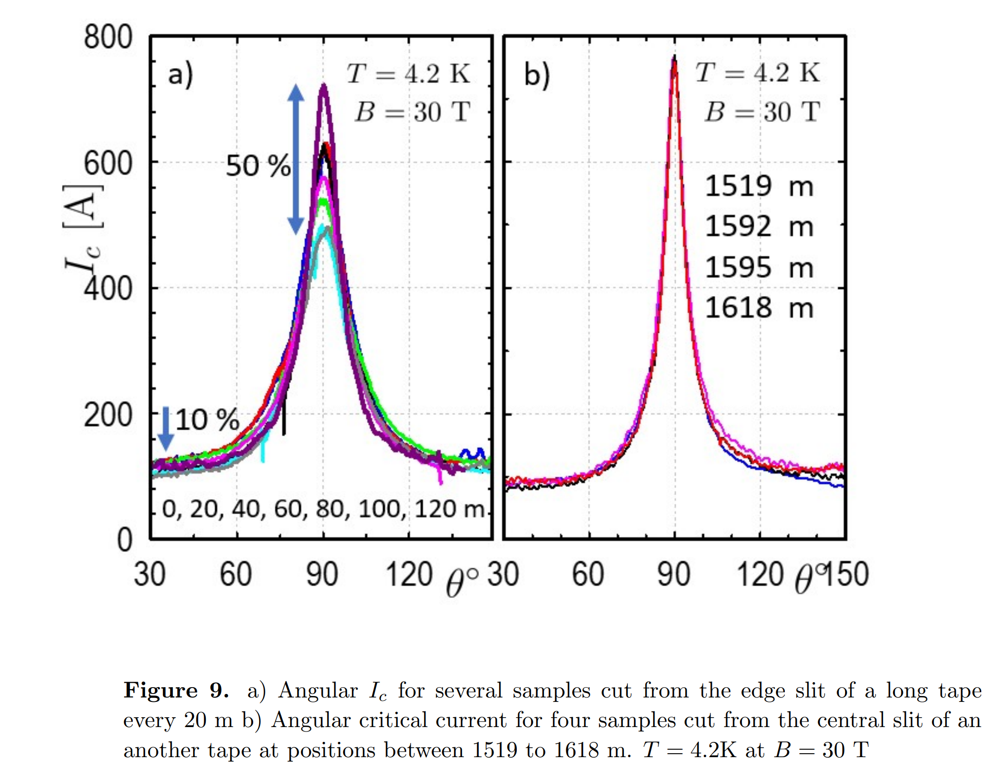
I_{c} Variation at low angles
It is difficult to measure I_{c} of REBCO tape at 4 K at angles close to the ab-plane.
For MagLab 32 T magnet we adopted measurements at 18° from the ab-plane, and extrapolation.
>1/2 of 32T & 40T operate at <5°.
There is typically a variation in microstructure along the edge of REBCO (12 mm) tape as it is fabricated.
Recent measurements suggest that this variation might contribute to significant variation in I_{c} along the length of 4 mm tapes cut from the edges as opposed to the center.
Transport measurements at appropriate angle, field, temperature are rare.
84 mm
J. Jaroszynski, et al., arXiv:2502.02706v2, 11 Feb. 2025. Sat-Mo-Or3-05

Slide 15
No-Insulation REBCO Challenges & Status

Slide 16
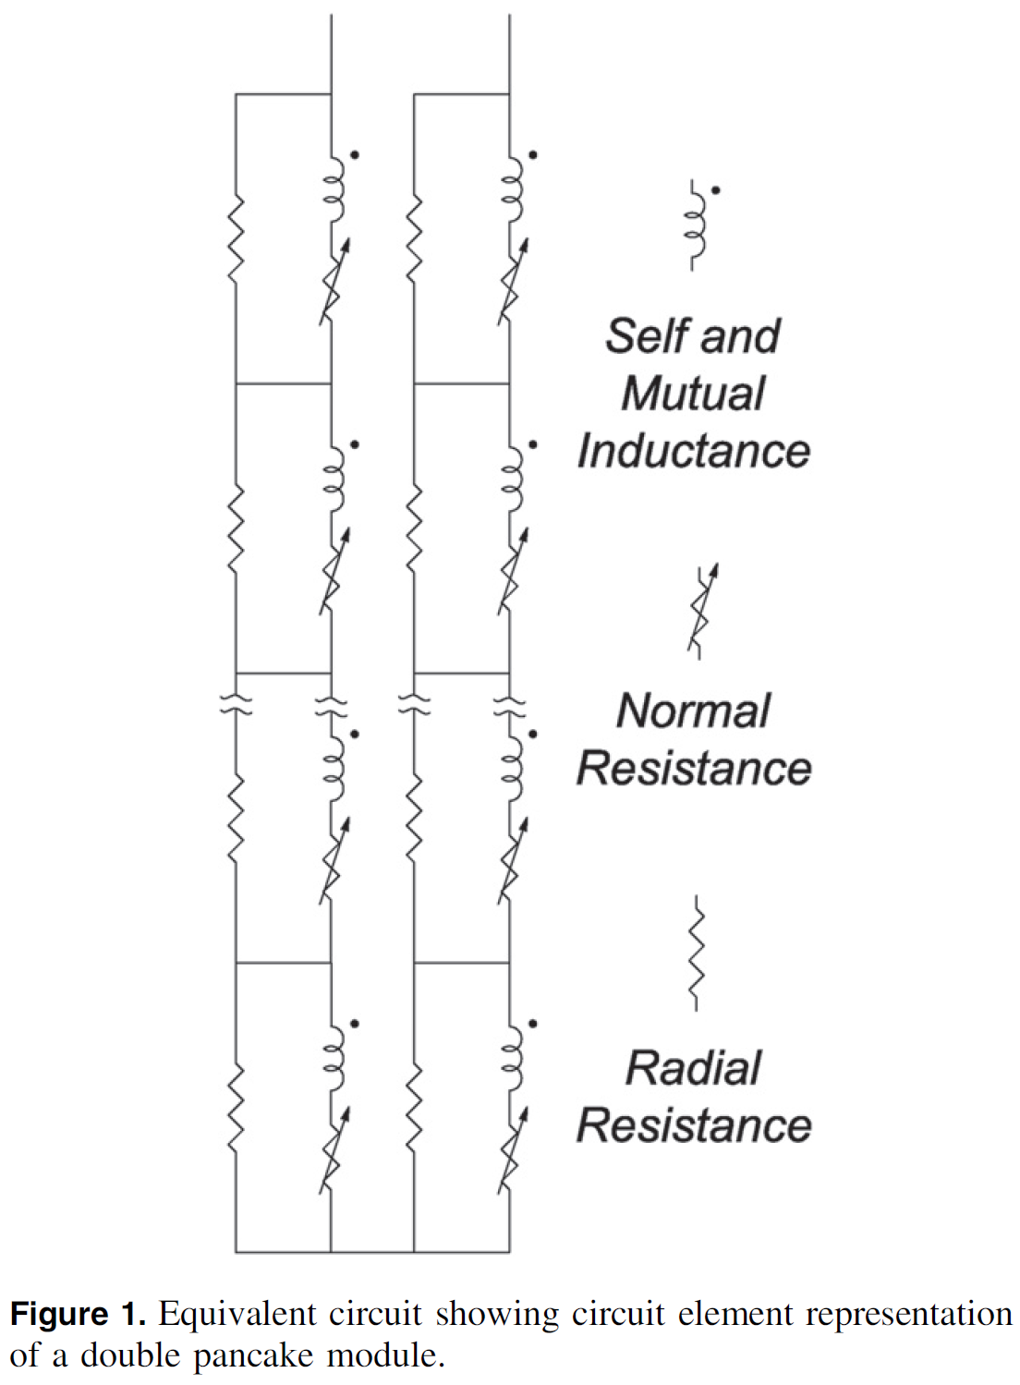
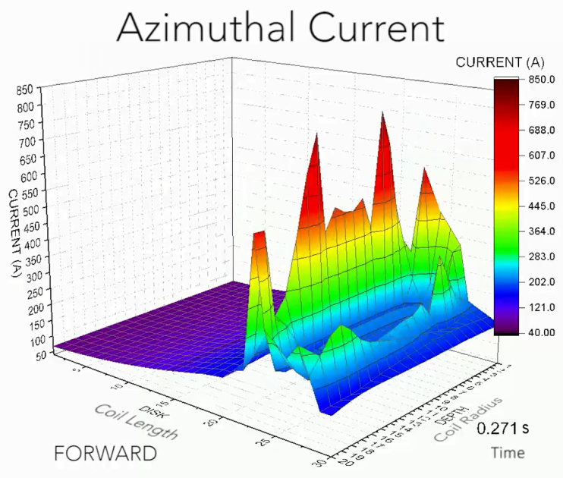
Quench
Each turn of an NI-REBCO coil includes:
During quench, current can flow radially between turns.
Quench is inductively driven
As current drops in a turn, increased current will be induced in nearby turns, driving them normal.
This can result in large current spikes with large forces (concentration of stored energy).
Large NI-REBCO coils require controlled inter-turn resistance (and active protection?)
NI-REBCO shows similar current spikes to those of diode-protection.
Many more degrees of freedom.
Markiewicz, et al., SuST, 29, (2016) 025001. Markiewicz, et al., SuST, 32 (2019) 105010

Slide 17
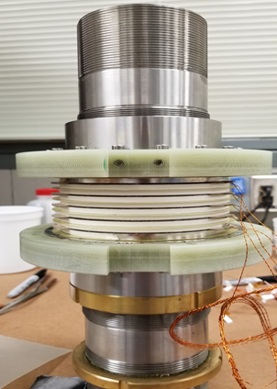
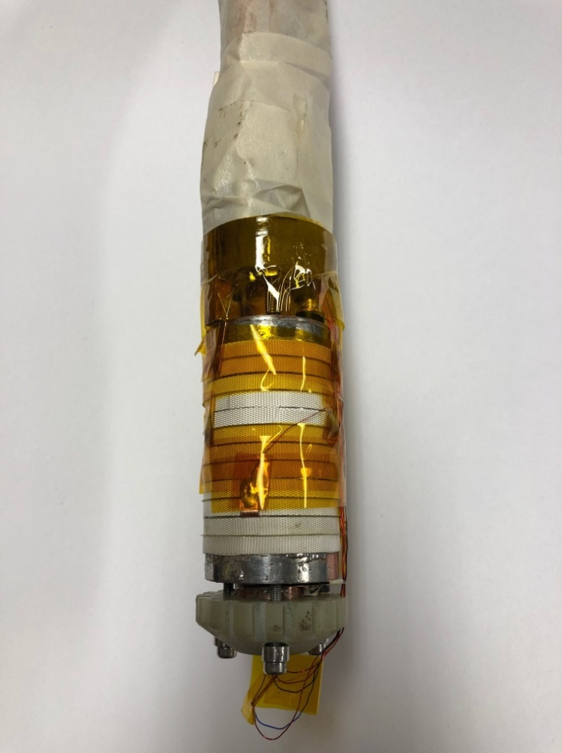
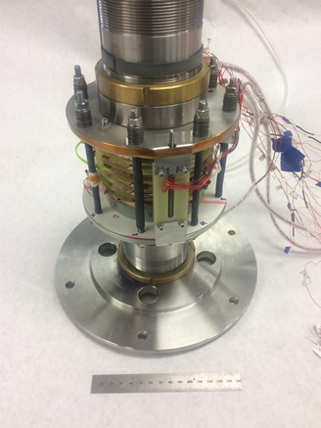
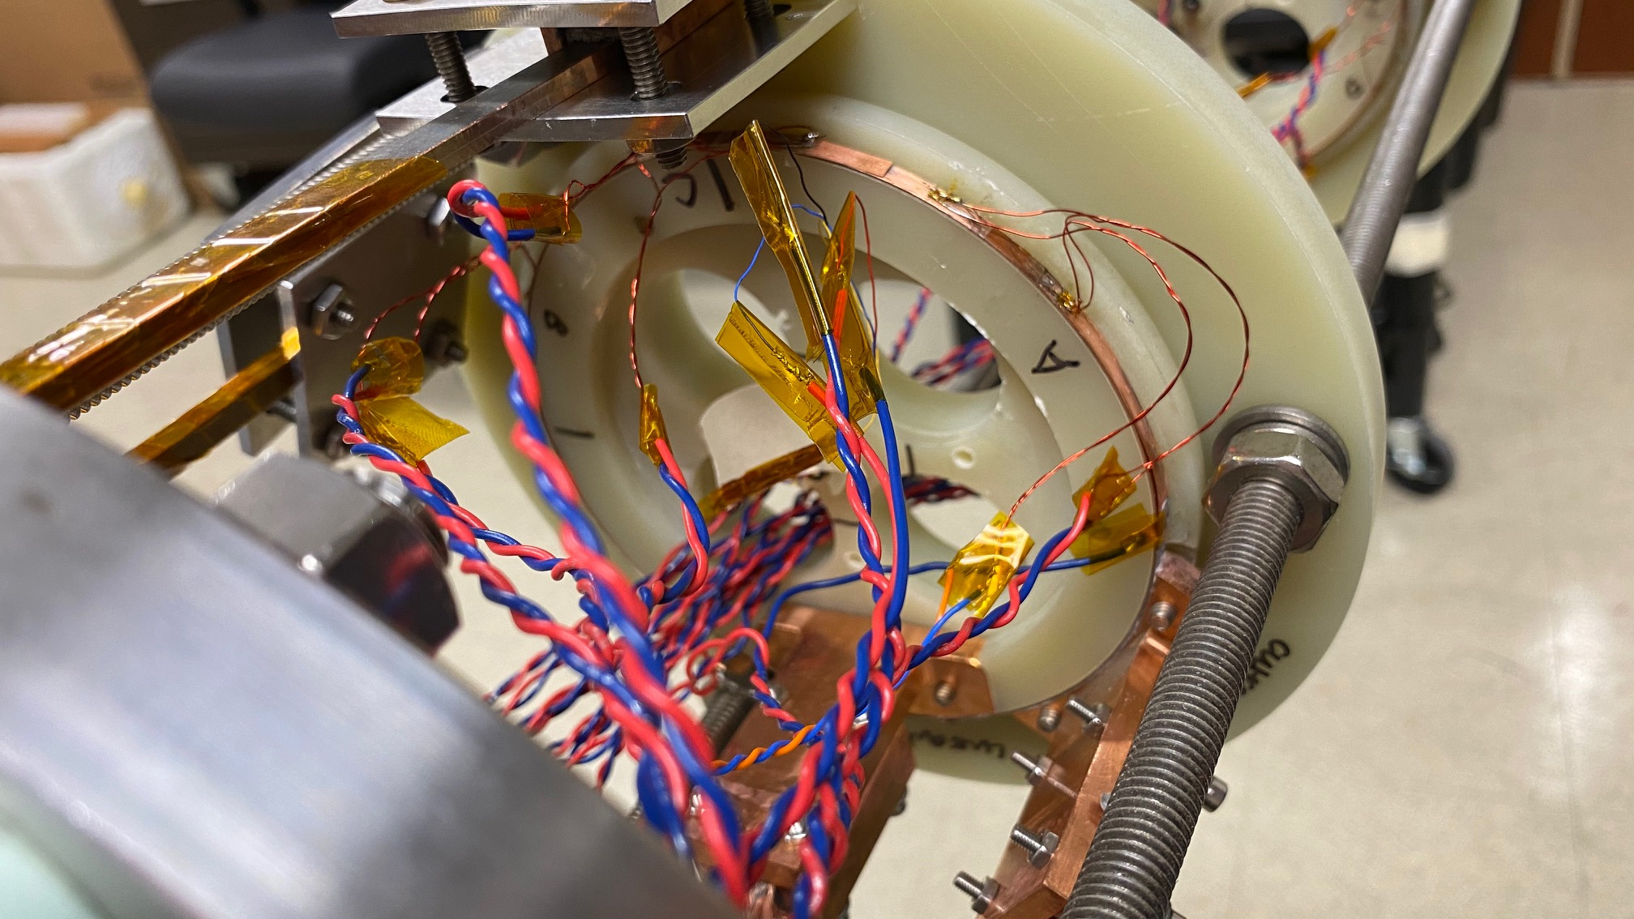
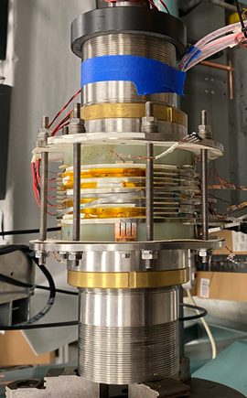
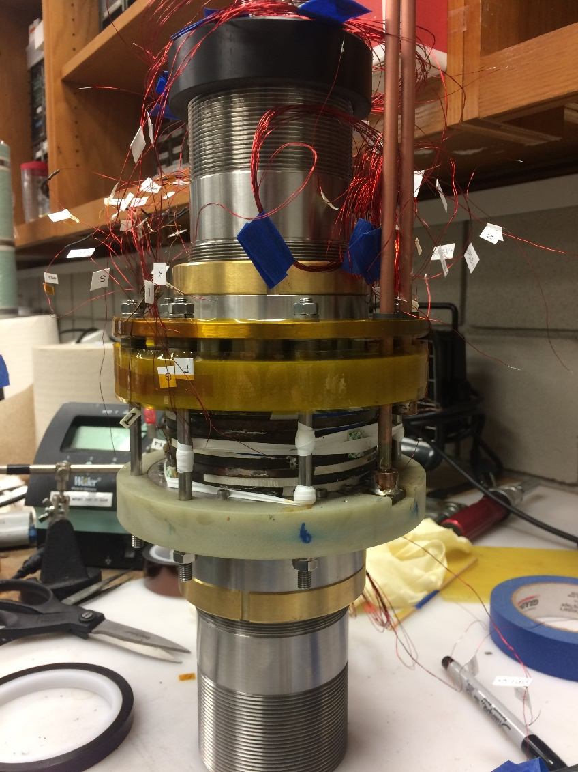
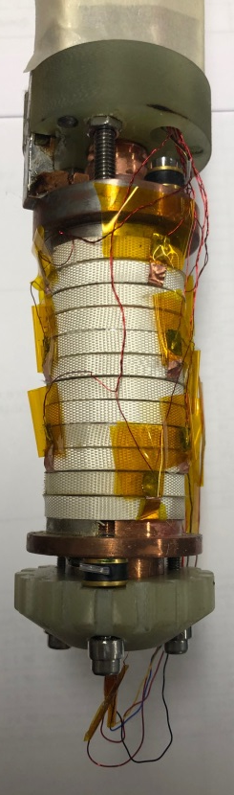
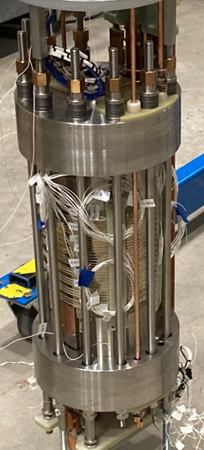
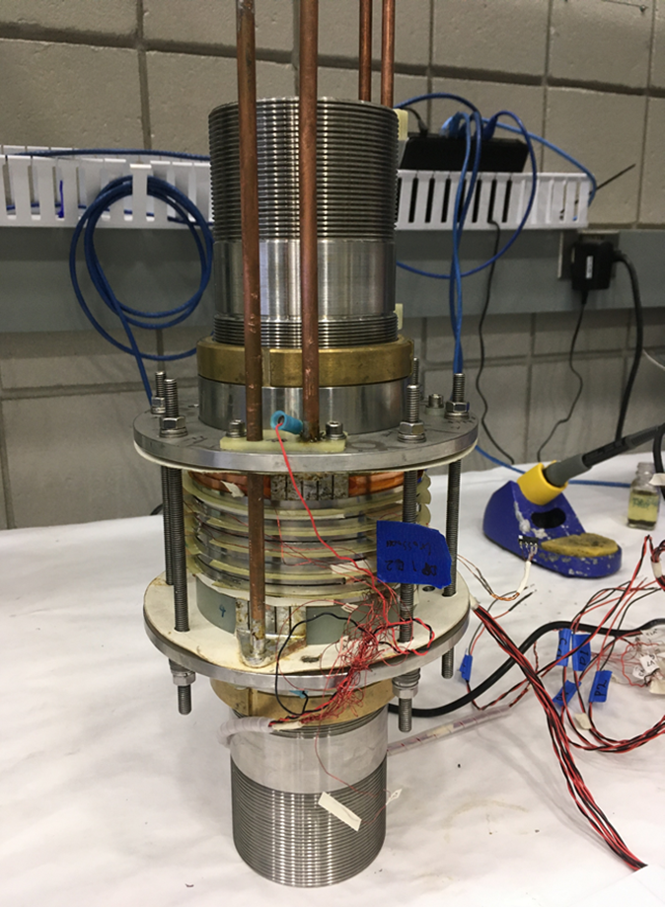
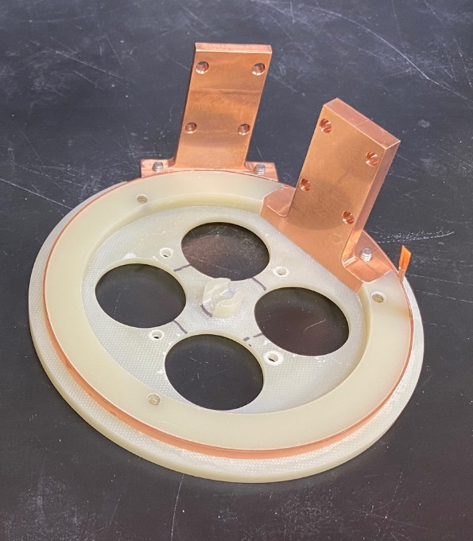
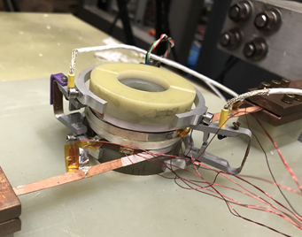
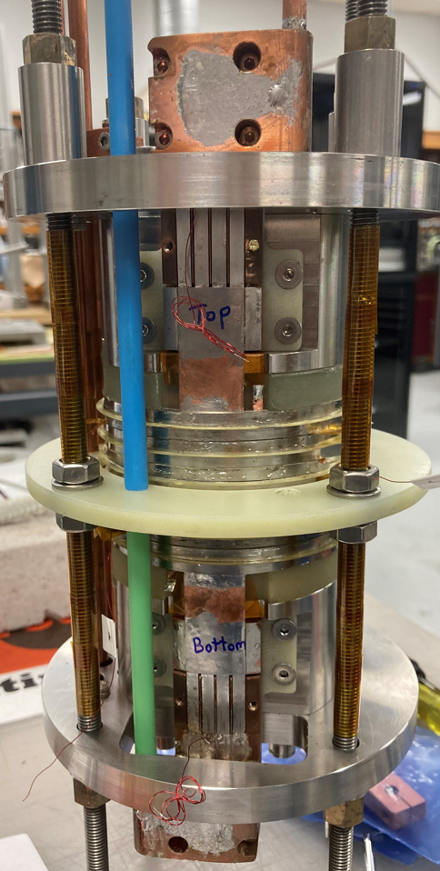
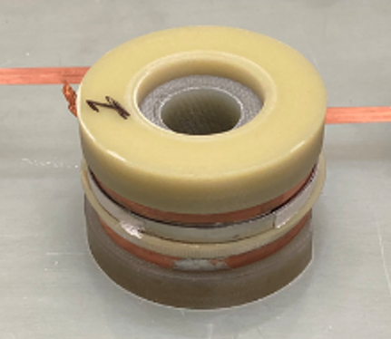
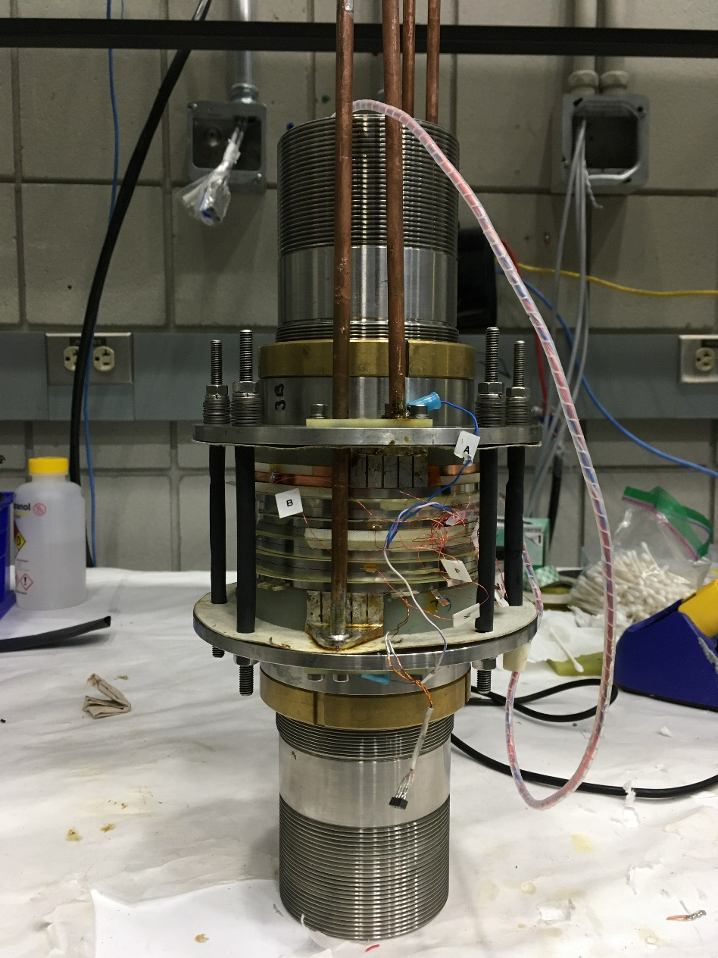
RI-REBCO Test Coils at the MagLab
Mini fatigue coil
– Off centered
(Jun 2020)
PT3
(July 2020)
PTC1
(Apr 2019)
LBC-AR
(Apr 2019)
PTC2
(Jun 2019)
LBC-CO
(Aug 2019)
PTC1R
(Oct 2019)
158 mm
2022: Were not able to consistently control the quench dynamics
RI-NC (Sep. 2022)
Axial pressure
test coil:
two in hand
(April 2021)
Axial pressure
test coil:
two in hand
(April 2021)
Mini fatigue coil
– centered
(Mar 2021)
Axial pressure
test coils
(Mar 2021)
PTC4
(Dec 2020)
PT6
(June 2021)
PTC5
(Mar 2021)

Slide 18
I-REBCO Technology for 40 T SC

Slide 19
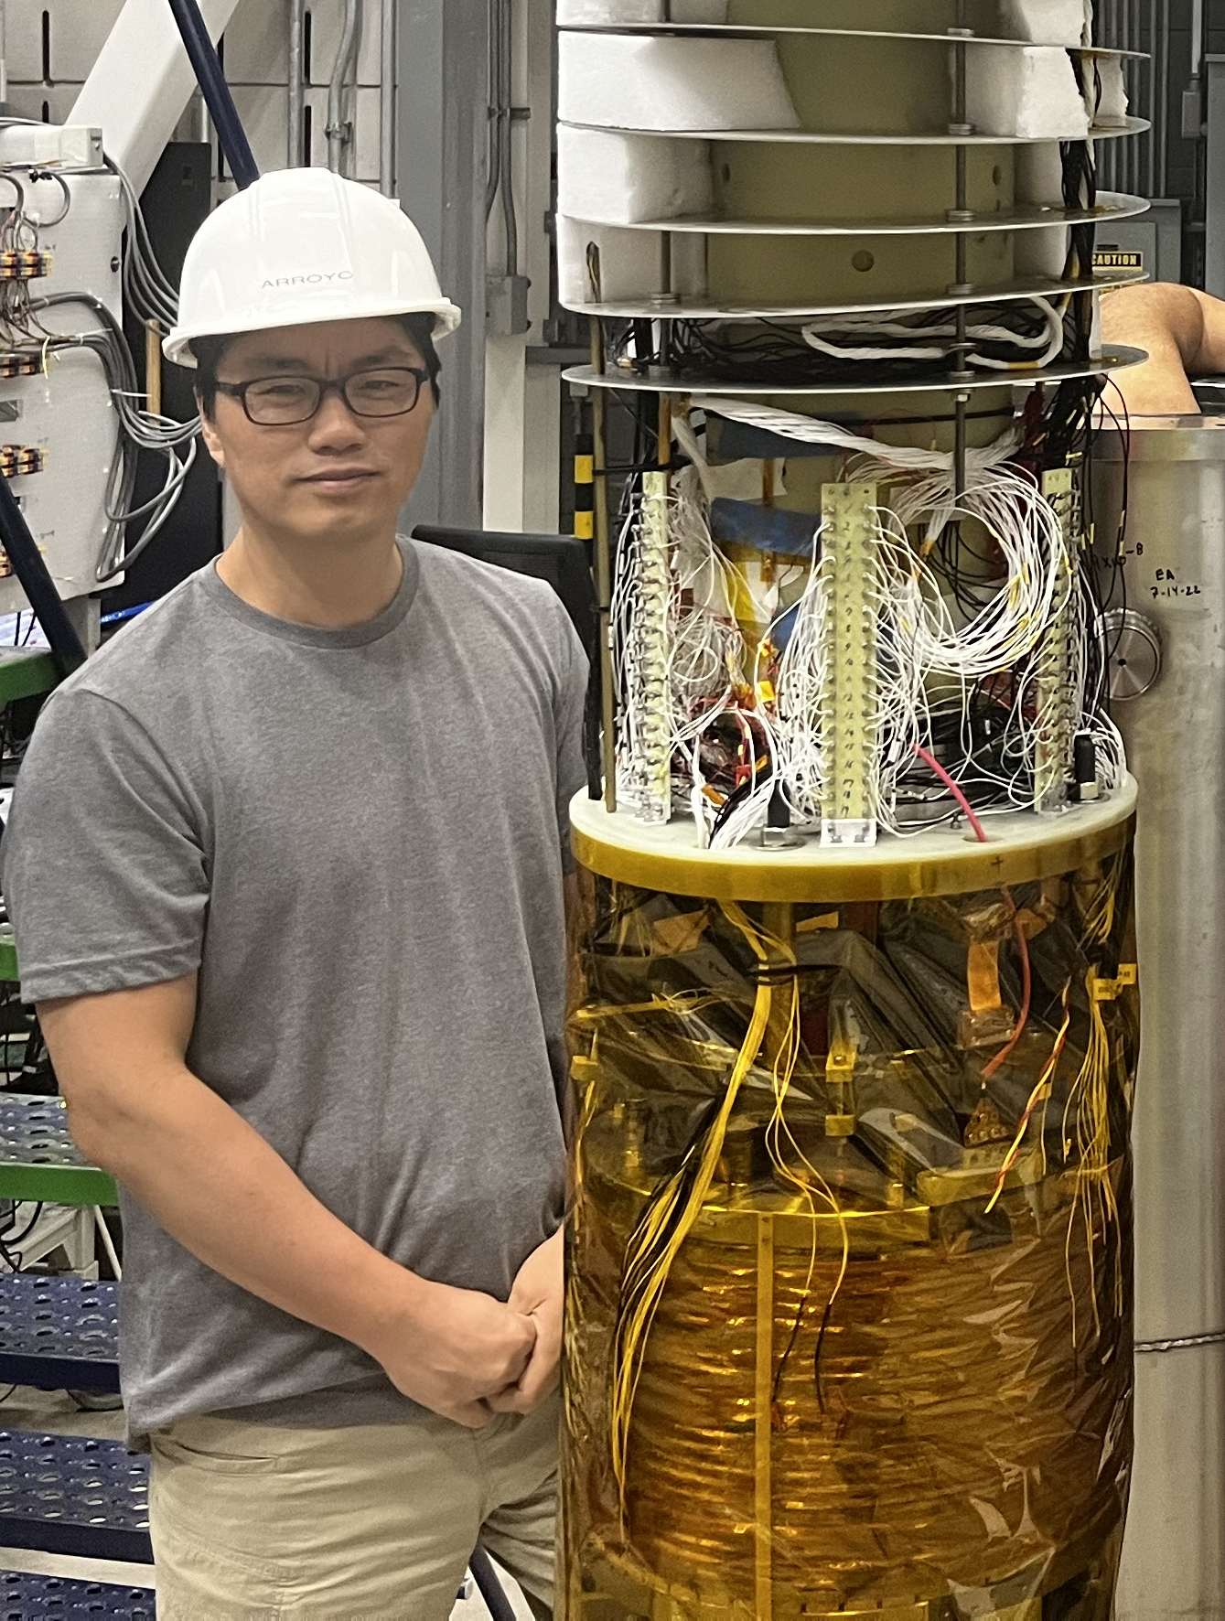
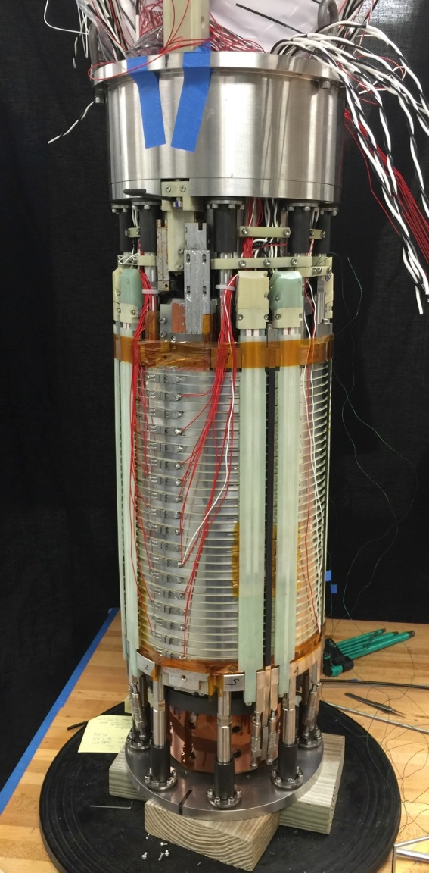
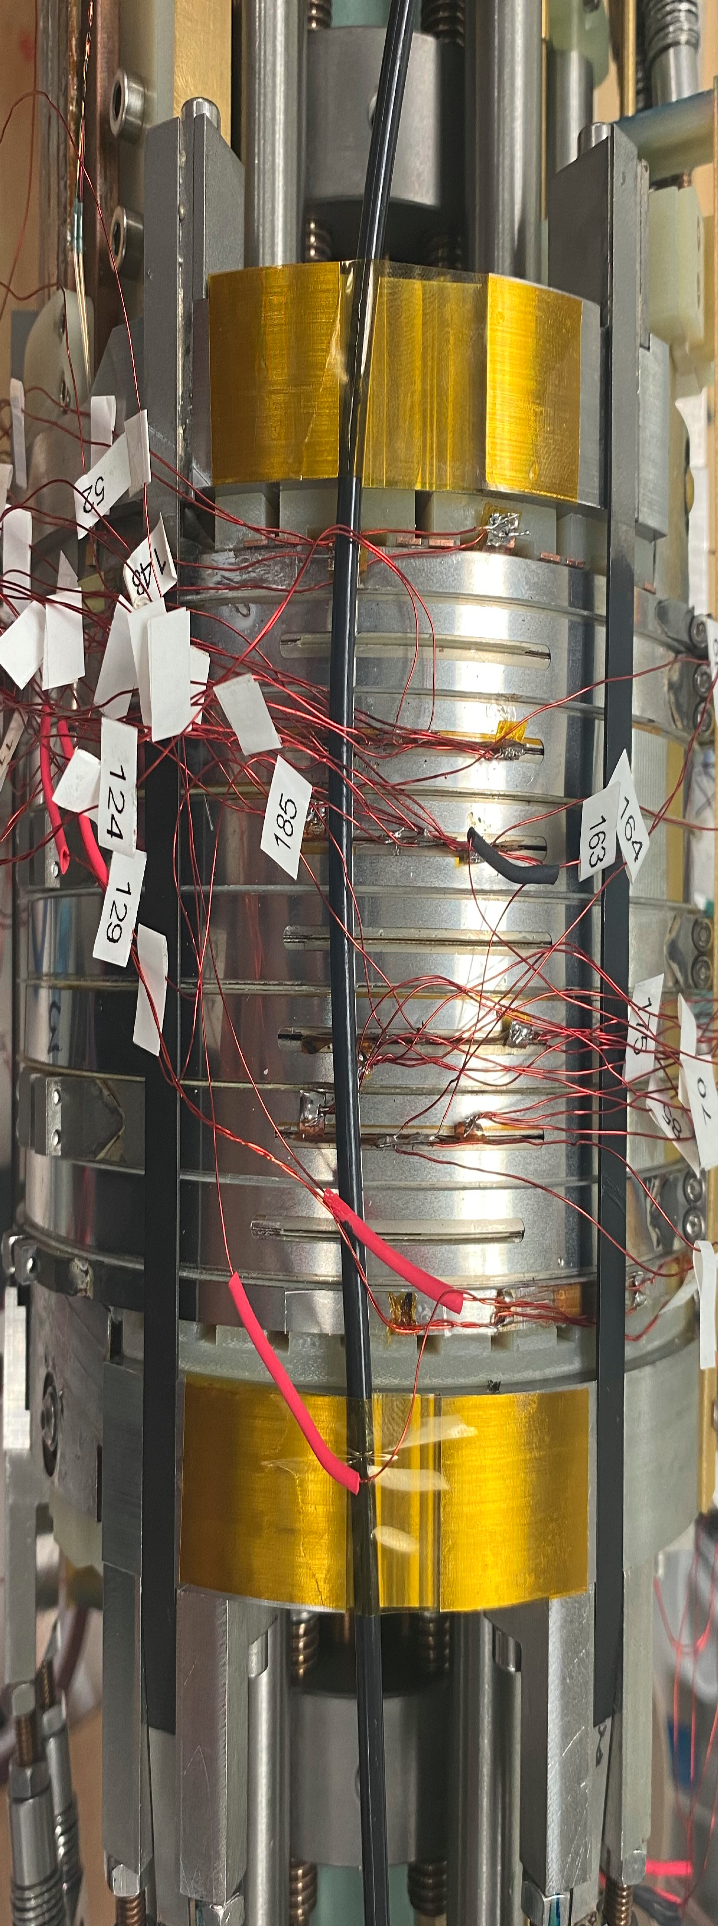
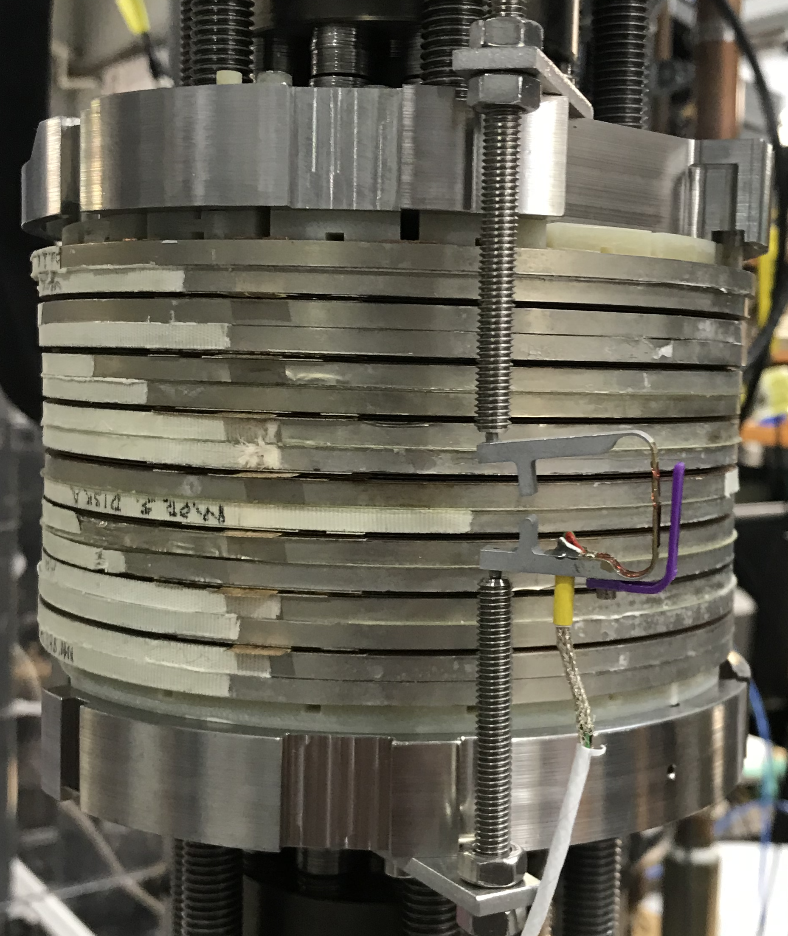
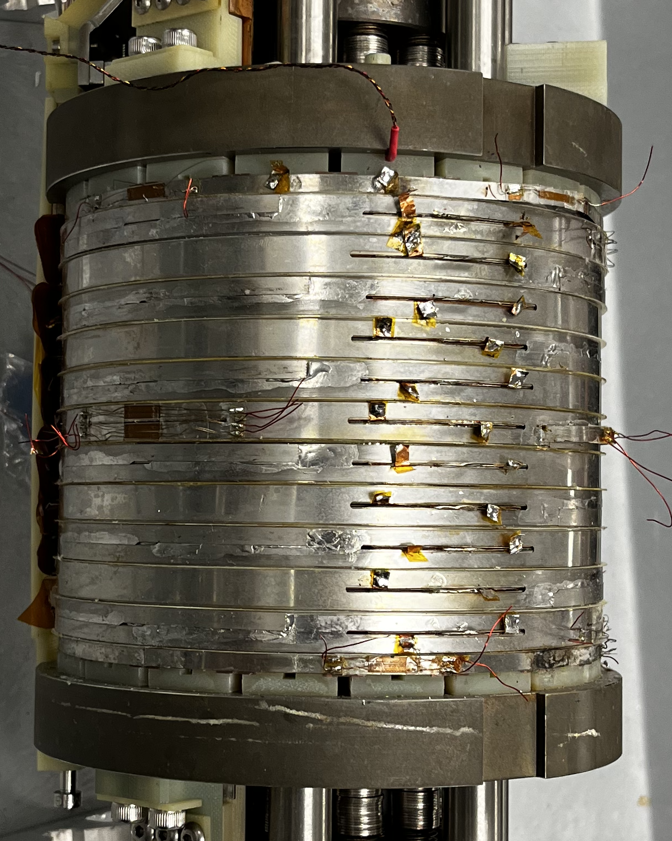
I-REBCO Coils at the NHMFL
Axial pressure
test coil:
two in hand
(April 2021)
Axial pressure
test coils
(Mar 2021)
Axial pressure
test coil:
two in hand
(April 2021)
LSC
(Nov 2024 &
Oct 2025)
232 mm
32 T
(2015)
320 mm
140 mm
TC2 (August 2022)
TC0
(October 2020)
TC1
(May 2021)
Axial pressure & TC are on same scale

Slide 20

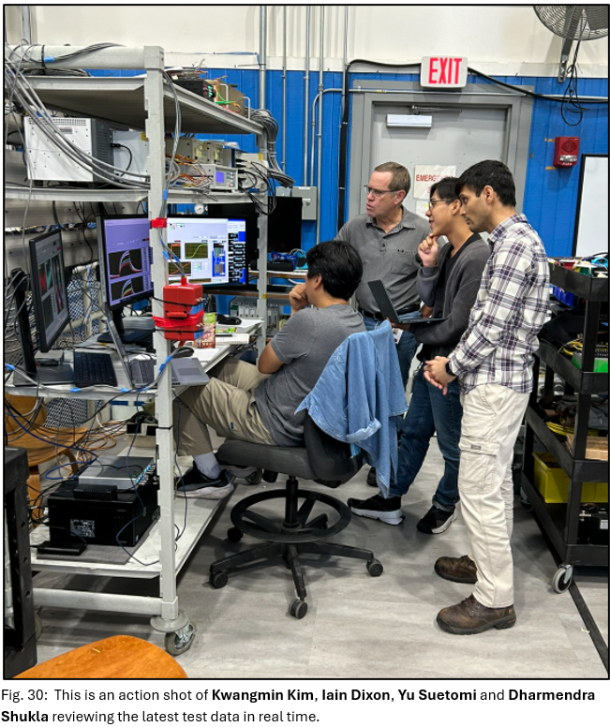
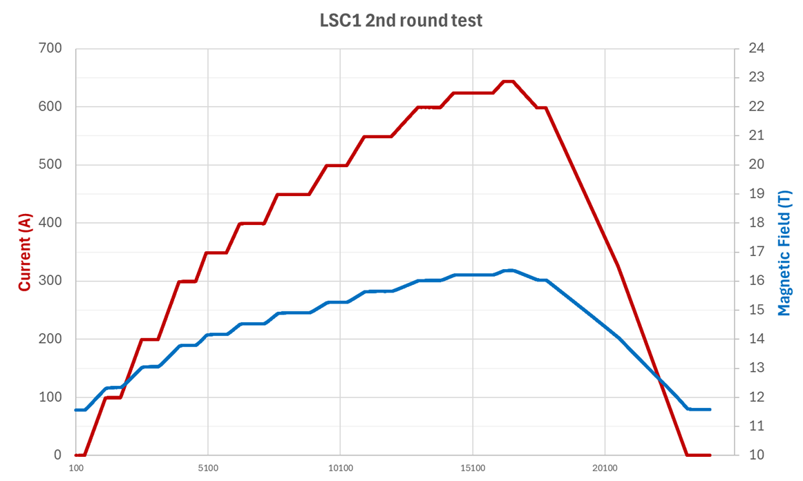
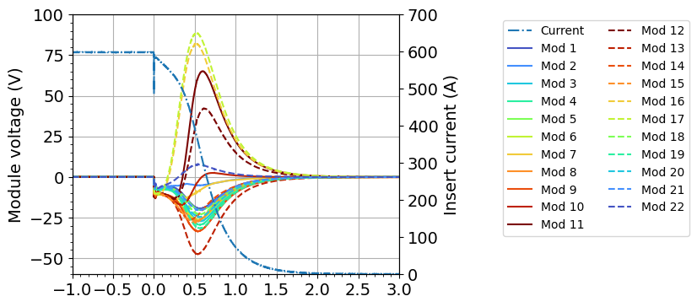
Large Scale Coil Test Oct. 7 – 17, 2025
The coil reached the full design current of 645 A in a background field of 11.4 T, corresponding to 70% of the coil’s critical current.
Kwangmin Kim, Iain Dixon, Yu Suetomi, and Dharmendra Shukla reviewing test data.
161 mm
Troy Brum
3: 600 A / BM 11.2 T / PFN 500 V
298 mm
7 intentional quenches were conducted with various combinations of background field, insert current, and PFN voltage.
No Degradation was observed!
Measured voltages agreed well with predictions!
Iain Dixon, Yu Suetomi, et al.

Slide 21
The 40 T SC Magnet at MagLab
Developed software packages to compute screening currents, strains, and field distributions that are being adopted by other labs worldwide.
Developed quench modelling software for both I-REBCO and RI-REBCO coils.
Introduced critical-current graded coils.
Demonstrated coils survive
50,000 cycles with 125 MPa axial pressure
>23,000 cycles at 0.4% strain; >200 cycles at 0.5% strain.
Multiple quenches at high J_{Cu}, I_{op}/I_{c}, & strain.
Increase in copper current density, J_{cu}, compared with 32 T.
Introduced Reinforcement grading.
Demonstrated numerous improvements to quench protection
Tested >20 different REBCO coils.
Presently have funding for Preliminary & Final Design
Expect to submit proposal for Construction in 2026.
Anticipate Construction funding to arrive 2027.
Start placing orders for tape, etc. at that point.
161 mm
Troy Brum
Liz Green
298 mm

Slide 22
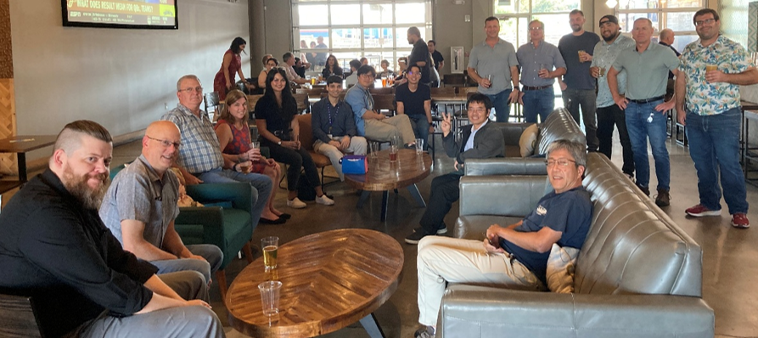
Alex Downey,
Thank You!
Alex Downey, Scott Marshall, Robert Stanton, Kathleen Amm, Shannon Griffin, Dharmendra Shukla, Kwangmin Kim, Yu Suetomi, Lee Marks, Tom Painter, Justin Deterding, Erick Arroyo, Iain Dixon, John Rogers, Hongyu Bai, & Jun Lu celebrate the successful LSC test.

Slide 24
Summary
High Magnetic Fields play an important role in numerous types of basic research in physics, chemistry, biology, materials science, etc.
The HTS materials have (finally) started to enable higher fields.
There are several REBCO-based magnets in operation at 28 – 32 T around the world.
There are still a number of challenges that require further development.

Slide 25
Some NI- & RI-REBCO High Field Magnets & Test Coils
Design | Site | Field | Bore | Year | Status | Protection
Magnets put into Service
IEE-Beijing | Huairou, China | 30 T | 32 mm, 4 K | 2023 | Operational | Passive
IEE-Beijing | Huairou, China | 27 T, 12 ppm/cm | 50 mm, 4 K 30 mm, 1.4 K 27 mm, 20 mK | 2023 | Operational | Passive
Test Coils (Hahn’s list is more comprehensive)
MIT-SuNam | Daejeon, Korea | 26 T | 35 mm, 4 K | 2015 | Out of Service | Passive
MagLab | Tallahassee, FL, USA | 45.5 T | 14 mm, 4 K | 2018 | Test | Passive
LNCMI-CEA | Grenoble, France | 32.5 T | 38 mm, 4 K | 2019 | Test | Passive
Tsingua U. | Beijing, China | 32.4 T |  | 2024 | Test | Passive
ETH | Zurich, Switzerland | 45 T | 4 mm, 4 K | 2024 | Test | Passive
Projects Underway
CAS-IPP | Hefei, China | 46 T? |  | 2025 |  | Passive?
MIT | Boston, MA, USA | 30.5 T | NMR |  |  | Passive
CERN | CERN | 40 T | 50 mm, 4 K |  |  | Active
LNCMI-CEA | Grenoble, France | ≥30 T |  |  |  | Passive

Slide 26
I-REBCO Magnets & Test Coils
Design | Site | Field | Bore | Year | Status | Protection
Magnets Put Into Service
MagLab | Tallahassee | 32 T | 34 mm, 4.2 K | 2017 | Repair Underway | Heaters between modules.
Bruker | Nashville | 25.8 T, 10 ppb | 56 mm, 300 K | 2018 | Operational | ?
Bruker | Florence + 12 | 28.2 T, 10 ppb | 56 mm, 300 K | 2019 | Operational | ?
Test Coils
RIKEN | ? | 27.8 T | 68 mm. 4.2 K | 2018? | Test | ?
Tohoku U | Sendai, Japan | 25 T |  | 2022 | Test | ?
Projects Underway
MagLab | Tallahassee | 40 T | 34 mm, 4.2 K | 2031? | Design nearing Completion. |  | Similar to 32 T.
Tohoku U | Sendai, Japan | 33 T |  | 2027 | LTS fabrication complete, HTS underway. |  | External resistor to limit current-rise.
Bruker |  | 32.9 T, 10 ppb |  |  |  |  | ?
Bruker |  | 35.2 T, 1 ppm |  |  |  |  | ?

Slide 27
Options for 40 T all-SC Magnet

