Slide 1

S. Bettoni, A. Latina, P. Craievich, A. Grudiev,
A. Kurtulus
Report summary meeting n. 22
S. Bettoni
Zoom, 25 July 2025

Slide 2
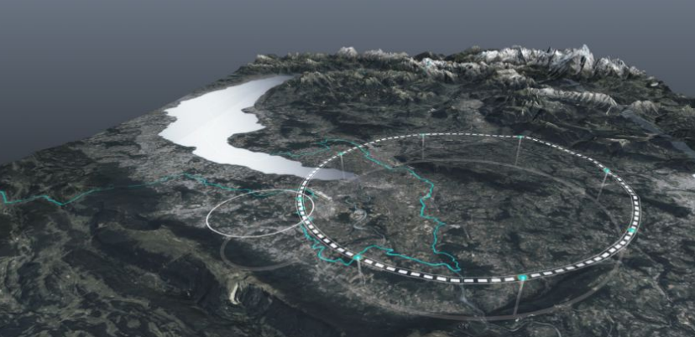
Outlook
Optimization at f = 3 GHz, lattice 2Q2RF
    Transverse static and dynamic single-bunch studies
    Energy compressor single and multi-bunch optimization
    Proposed configuration
Optimization at f = 3 GHz, lattice 1Q2RF
    Transverse static and dynamic single-bunch studies
    Proposed configuration
Optimization at f = 6 GHz, lattice 2Q2RF
    Transverse static and dynamic single-bunch studies
    Proposed configuration
Optimization at f = 6 GHz, lattice 1Q2RF
    Transverse static and dynamic single-bunch studies
    Proposed configuration
Summaries, conclusions and questions

Slide 3
Settings
Single transverse dynamics:
f = 3 GHz, G = 21 MV/m
f = 6 GHz, G = 30 MV/m
I change the bunch length to 0.8 mm (best for the old case EC used in multi-bunch mode)
Transverse jitter amplification:
3 GHz, G = 21 MV/m
6 GHz, G = 30 MV/m
I change the bunch length to 0.8 mm (best for the old case EC used in multi-bunch mode)
Reducing the number of quads (1 quad per 2 RF structures and shortened linac)

Slide 4
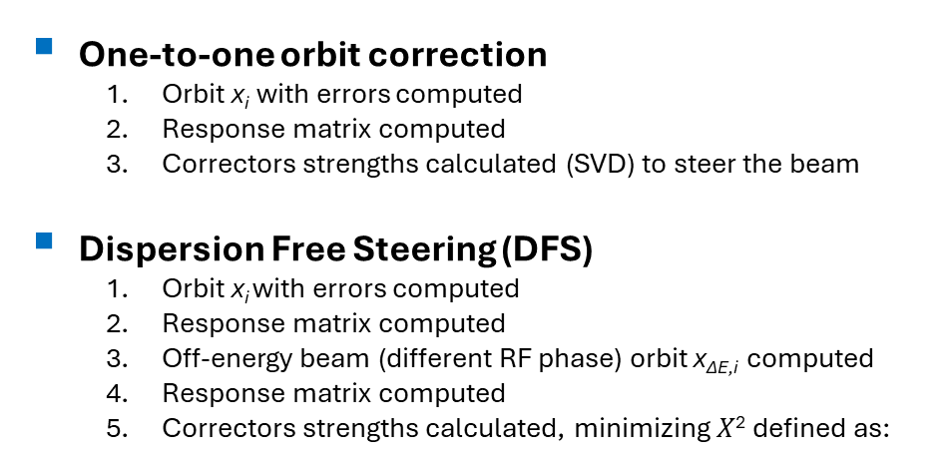
Assumptions
Quadrupoles
Offset x, y = 50 μm rms
Gaussian distribution
RF cavities
Offset x, y = 100 μm rms
Gaussian distribution
BPM
Offset x, y = 30 μm rms
Resolution x, y = 10 μm
Gaussian distributions
Elements
misalignments
Steering algorithms
One-to-one orbit correction
  Orbit x_{i} with errors computed
  Response matrix computed
  Correctors strengths calculated (SVD) to steer the beam
Dispersion Free Steering (DFS)
  Orbit x_{i} with errors computed
  Response matrix computed
  Off-energy beam (different RF phase) orbit x_{ΔE,i} computed
  Response matrix computed
  Correctors strengths calculated, minimizing $X$² defined as:
  Very “conservative” misalignments assumed and more than 98% of the “good seeds” considered (also 90% in other designs)

Slide 5
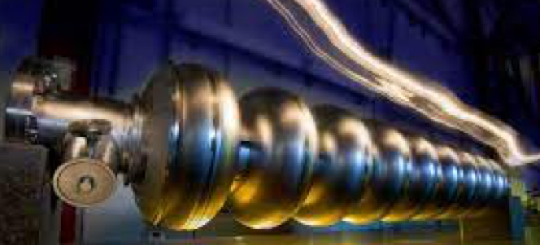
f = 3 GHz, G = 21 MV/m
2 quadrupoles per 2 RF structures (2Q2RF)
S. Bettoni
Zoom, DD Month YYYY

Slide 6
Emittance growth due to static misalignments

Slide 7
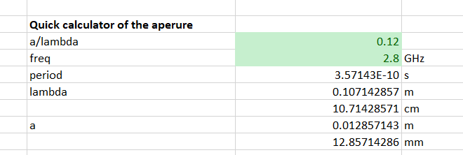
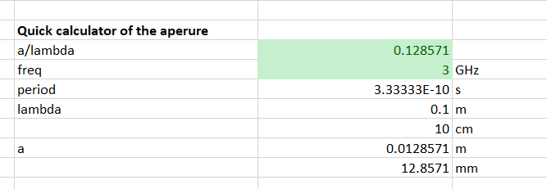
Determining the range
In the previous simulations assumed a/l = 0.12 at 2.8 GHz
f = 2.8 GHz
f = 3.0 GHz
0.12:2.8 = x:3.0 → x = 0.12*3/2.8 = 0.128571
Equivalent a/l ~ 0.13

Slide 8
Where we were at f = 2.8 GHz
Slide FCC Week 2025

Slide 9
Where we are at f = 3 GHz
Scan of a/l
Nbins = 8
I assume bunch length = 0.8 mm (optimal for EC used for multi-bunch). Before it was 1 mm, which was worse for the emittance growth. For the 6 GHz this is beneficial also to keep DE/E to a reasonable value (for the 2.8 GHz this was ~0.55%).
Changed also the gradient
Path: /data/user/bettoni_s/data/FCC/SingleTransv/HE_linac/f_3GHz

Slide 10
a/λ = 0.11
Path (merlin): /data/user/bettoni_s/data/FCC/SingleTransv/HE_linac/f_3GHz/a_l_0p11/N_bins_8
Path(PC): C:\Users\bettoni_s\switchdrive\Backup Documents\FCC\22_Progress_Linacs\TransvEmitt\a_l_0p11\N_bins_8

Slide 11
a/λ = 0.12
Path (merlin): /data/user/bettoni_s/data/FCC/SingleTransv/HE_linac/f_3GHz/a_l_0p12/N_bins_8
Path(PC): C:\Users\bettoni_s\switchdrive\Backup Documents\FCC\22_Progress_Linacs\TransvEmitt\a_l_0p12\N_bins_8

Slide 12
a/λ = 0.13
Path (merlin): /data/user/bettoni_s/data/FCC/SingleTransv/HE_linac/f_3GHz/a_l_0p13/N_bins_8
Path(PC): C:\Users\bettoni_s\switchdrive\Backup Documents\FCC\22_Progress_Linacs\TransvEmitt\a_l_0p13\N_bins_8
Combining the lower gradient (☹), the shorter bunch length (☺) and the higher frequency (☹) we stay in the same aperture as before

Slide 13
a/λ = 0.14
Path (merlin): /data/user/bettoni_s/data/FCC/SingleTransv/HE_linac/f_3GHz/a_l_0p14/N_bins_8
Path(PC): C:\Users\bettoni_s\switchdrive\Backup Documents\FCC\22_Progress_Linacs\TransvEmitt\a_l_0p14\N_bins_8

Slide 14
f = 3 GHz: summary
Limit = 2
a = 13 mm

Slide 15
Transverse beam jitter amplification

Slide 16
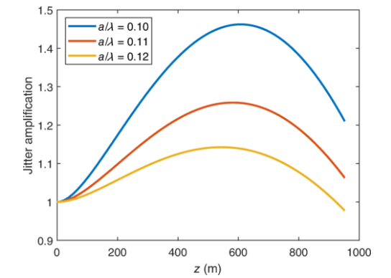
Past and present simulations
f = 2.8 GHz, G = 22.5 MV/m, rms sz = 1 mm
f = 3 GHz, G = 21 MV/m, L = 3 m
In the previous case we still had 22.5 MV/m, instead of the present 21 MV/m -> longer linac
We slightly increased the energy spread for the RF frequency which is 3 GHz instead of 2.8 GHz
We reduced the energy spread, because the bunch is shorter (0.8 mm instead of 1 mm)

Slide 17
New case
f = 3 GHz, G = 21 MV/m, L = 3 m
I plot JA at the end of the HE linac
a/λ

Slide 18
Comparison with the previous case
Assuming similar linac length (zoom of the new case)
New
Old
Better, but what is the main responsible?

Slide 19
Comparisons: frequency and bunch length
G =21 MV/m, 3 GHz, bunch length = 0.8 mm
/data/user/bettoni_s/data/FCC/Jitter_Single/HE_linac/f_3GHz_L_3m/G_21MV_m_0p8mm
G = 21 MV/m, 3 GHz, bunch length = 1 mm
/data/user/bettoni_s/data/FCC/Jitter_Single/HE_linac/f_3GHz_L_3m/G_21MV_m_1mm
a/λ
We are in all the cases at JA<<2
The shorter bunch length has an impact on the JA (expected, but now quantified)

Slide 20
Check and re-optimization of the energy compressor

Slide 21
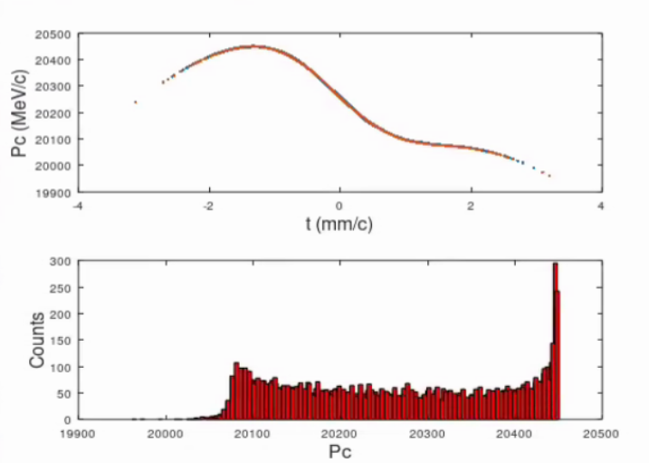
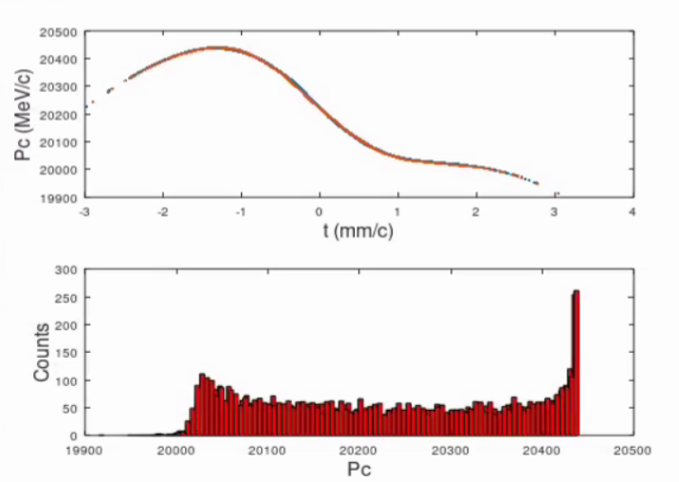
f = 3 GHz, 2 quad per 2 RF structures, phi = 90 deg 1/2
Maybe it can be improved, but JA more than ok, emittance ok, so I simply verify that things are ok in this case
f = 2.8 GHz, sigma_z = 0.8 mm
f = 3.0 GHz, sigma_z = 0.8 mm
f (GHz) | Rms bunch length (rms) | Rms dp/p (%)
2.8 | 0.80724 | 0.60713
3.0 | 0.79952 | 0.68005
Beams at the end of HE linac

Slide 22
EC at f = 3 GHz, a/l =0.13
SAME PARAMETERS case using 0.12
OPTIMIZED 0.13
case using 0.12
V = 580 MV
ANGLE = 0.1598 rad = 9.1605 deg
FINAL BUNCHES
Final bunches n. 1
rms bunch length = 4.0204 mm
rms dp/p = 0.11081%
Final bunches n. 2
rms bunch length = 4.0399 mm
rms dp/p = 0.11004%
Dt = 5.0647 ps
Dp 5 pC = -0.020526%
Dp 5 nC = -0.021141%
Final bunches n. 3
rms bunch length = 4.0579 mm
rms dp/p = 0.10387%
Dt = 9.7302 ps
Dp 5 pC = -0.041016%
Dp 5 nC = -0.041631%
Final bunches n. 4
rms bunch length = 4.0795 mm
rms dp/p = 0.089945%
Dt = 15.3355 ps
Dp 5 pC = -0.070579%
Dp 5 nC = -0.071194%
FINAL BUNCHES
Final bunches n. 1
rms bunch length = 3.6957 mm
rms dp/p = 0.1178%
Final bunches n. 2
rms bunch length = 3.7132 mm
rms dp/p = 0.11659%
Dt = 5.0645 ps
Dp 5 pC = -0.019147%
Dp 5 nC = -0.019634%
Final bunches n. 3
rms bunch length = 3.7294 mm
rms dp/p = 0.11035%
Dt = 9.7298 ps
Dp 5 pC = -0.03834%
Dp 5 nC = -0.038827%
Final bunches n. 4
rms bunch length = 3.7488 mm
rms dp/p = 0.096724%
Dt = 15.3349 ps
Dp 5 pC = -0.066326%
Dp 5 nC = -0.066812%
FINAL BUNCHES
Final bunches n. 1
rms bunch length = 3.9776 mm
rms dp/p = 0.10004%
Final bunches n. 2
rms bunch length = 3.9968 mm
rms dp/p = 0.09823%
Dt = 5.5533 ps
Dp 5 pC = -0.022088%
Dp 5 nC = -0.022564%
Final bunches n. 3
rms bunch length = 4.0144 mm
rms dp/p = 0.09082%
Dt = 10.6688 ps
Dp 5 pC = -0.044443%
Dp 5 nC = -0.044919%
Final bunches n. 4
rms bunch length = 4.0356 mm
rms dp/p = 0.075486%
Dt = 16.8145 ps
Dp 5 pC = -0.07735%
Dp 5 nC = -0.077826%
Applied the same DE used in December
Bunch at the end of HE linac
rms bunch length = 0.79758 mm
rms dp/p = 0.61105%
rms bunch length = 0.79903 mm
rms dp/p = 0.61167%
ONLY TUNING NECESSARY (LARGER DE/E):
LOWERED THE ANGLE
LOWERED THE VOLTAGE
More in the spare slides

Slide 23
Possible improvements

Slide 24
Wakefield-free steering (from Andrea to RF-Track)
RM-based orbit correction: determine the response matrix (RM) → steer the beam to the 0 of the BPMs
DFS: record the orbit at different beam energies → steer the beam to the 0 of the difference of the orbit (dispersion). Used in combination to the RM-based orbit correction. We use it also in cascade to RM-based orbit correction.
WFS: record the orbit at different beam charges → steer the beam to minimize this difference. Used in combination to the DFS and the RM-based orbit correction. We use it also in cascade to RM-based orbit correction.
We use RM-based orbit correction, and after RM-based correction+DFS+WFS together

Slide 25
WFS, f = 3 GHz, a/l = 0.13
Outcomes:
Some improvement compared to DFS
Optimum for N_bins = 12 among the considered cases
N_bins → | 4 | 6 | 8 | 10 | 12 | 14
WFS emittance (mm.mrad) | 74.3659 | 4.9732 | 1.5515 | 1.4032 | 1.3286 | 1.5083
DFS emittance (mm.mrad) |  |  | 1.8049
Path: /data/user/bettoni_s/data/FCC/SingleTransv/HE_linac/f_3GHz/WFS/a_l_0p13/N_bins_*

Slide 26
WFS, f = 3 GHz, a/l = 0.12
Looking at the good results at a/l = 0.13, run also a/l = 0.12
Path: /data/user/bettoni_s/data/FCC/SingleTransv/HE_linac/f_3GHz/WFS/a_l_0p12/N_bins_*
N_bins → | 4 | 6 | 8 | 10 | 11 | 12 | 13 | 14
WFS emittance (mm.mrad) | 324.4501 | 11.4389 | 3.1964 | 1.8037 | 1.6767 | 1.5797 | 1.6318 | 1.6326
DFS emittance (mm.mrad) |  |  | 3.0674

Slide 27
Proposed configuration: 2 quad per 2 RF structure*
Geometry (a/l) | a (mm) | G (MV/m) | L structure (m) | Rms bunch length (mm) | Phase advance/cell (deg)
0.12 | 12 | 21 | 3 | 0.8 | 90
Linac length (m) | ~1070
Emittance (mm.mrad) | ~1.6
JA | ~0.7
N_bins = 12
*Energy compressor also re-optimized for a/l = 0.13 (similar performances with more relaxed parameters)

Slide 28
f = 3 GHz, G = 21 MV/m
1 quadrupoles per 2 RF structures (1Q2RF)
S. Bettoni
Zoom, 25 July 2025

Slide 29
Reducing the number of quads per RF structure
Q
Quadrupole
and ½ quadrupole
RF
D
Drift
Screen
RF structure
1 quad each 2 RF structures (new)
q
RF
RF
Q
D
D
D
2 quad each 2 RF structures
q
RF
Q
RF
Q
D
D
D
D
All the simulations presented so far assumed the 2 quads per 2 RF structures lattice

Slide 30
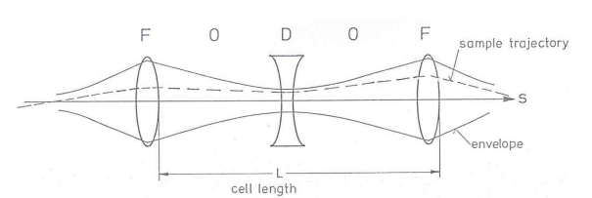
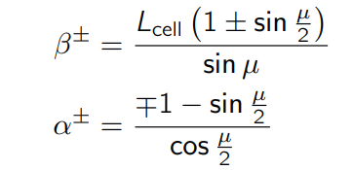
Optics
Andrea’s lecture (https://indico.cern.ch/event/1149120/contributions/4822271/attachments/2428245/4157500/Lectures.pdf )
L_FODO = 6*L_drift_FODO+2*L_quad+4*L_structure;
K1_FODO = (4*sin(Dmu/2))/(L_FODO*L_quad)
L_FODO = 4*L_drift_FODO+2*L_quad+2*L_structure;

Slide 31
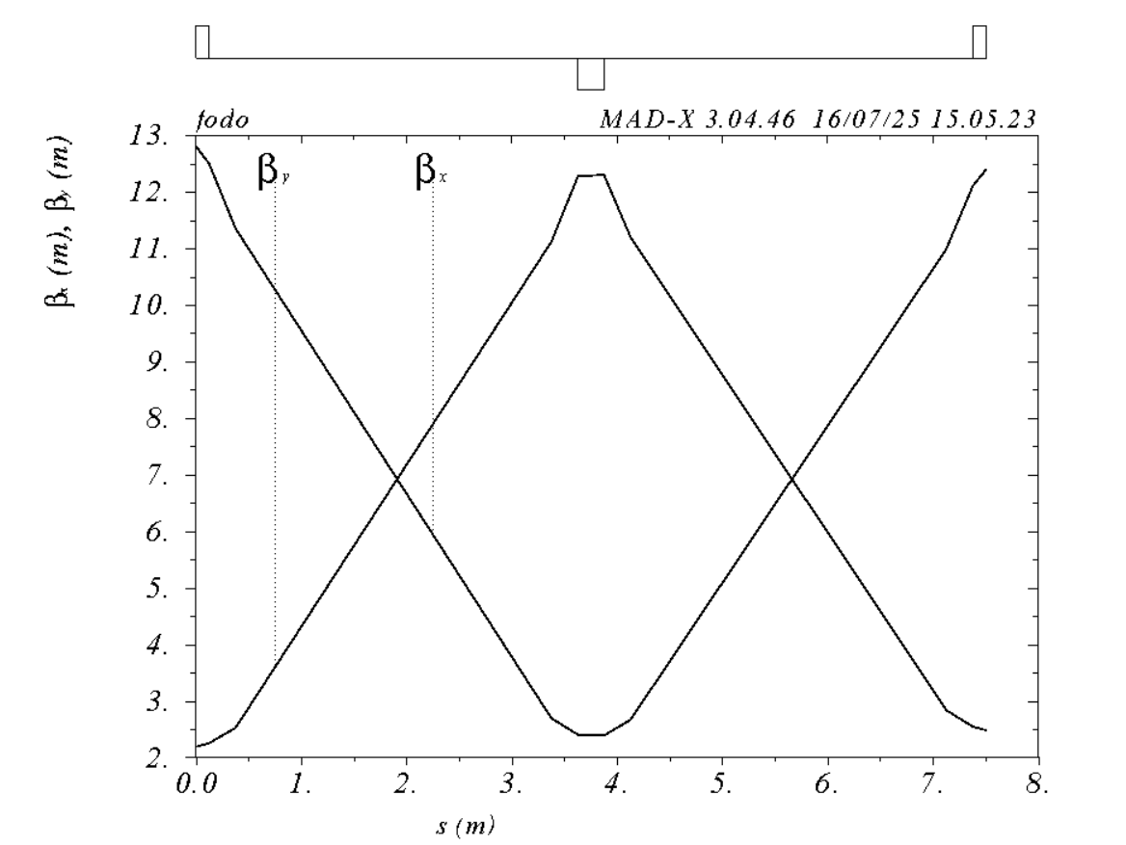
MAD-X model (verification): 2Q2RF lattice
Lstr = 3;
Lquad = 0.25;
Ldrift = 0.25;
mud = pi/2;
Lcell = 2*Lstr + 2*Lquad + 4*Ldrift;
k1 = sin(mud/2) / (Lcell/4) /Lquad; // Here k1 is not integrated
Variable Final Value Initial Value
----------------------------------------------------------------
k1 1.54387e+000 1.50849e+000
betax0 1.28033e+001 1.28033e+001
betay0 2.19670e+000 2.19670e+000
Initial: from the formula
Final: from the matching
Phase advance (dphi) = 90 deg
Ok also without the matching: dphi = 90 deg

Slide 32
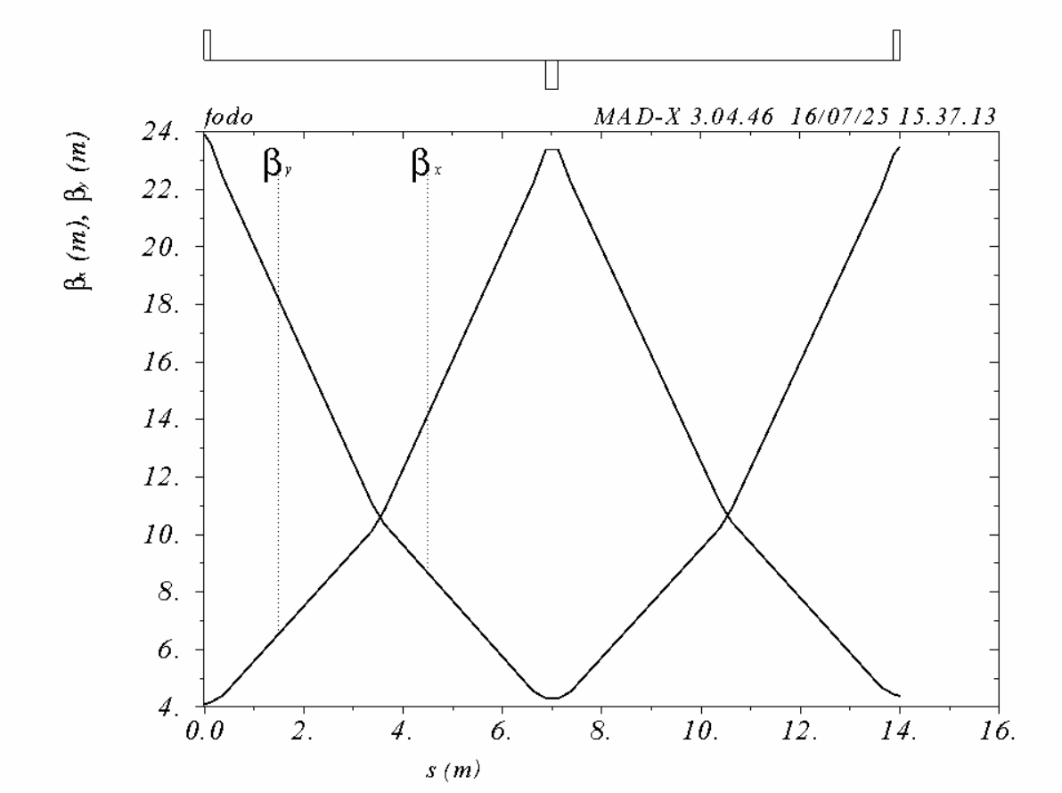
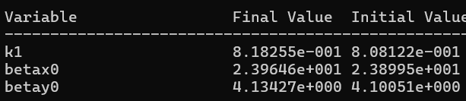
MAD-X model (verification): 1Q2RF lattice
RF-Track
Twiss.beta_x = 23.885 m
Twiss.beta_y = 4.0981 m
K1_FODO = -0.8086
L_FODO = 13.992 m
Initial: from the formula
Final: from the matching
Phase advance = 90 deg
Ok also without the matching: phi = 90 deg
Very similar Twiss and initial values: ok

Slide 33
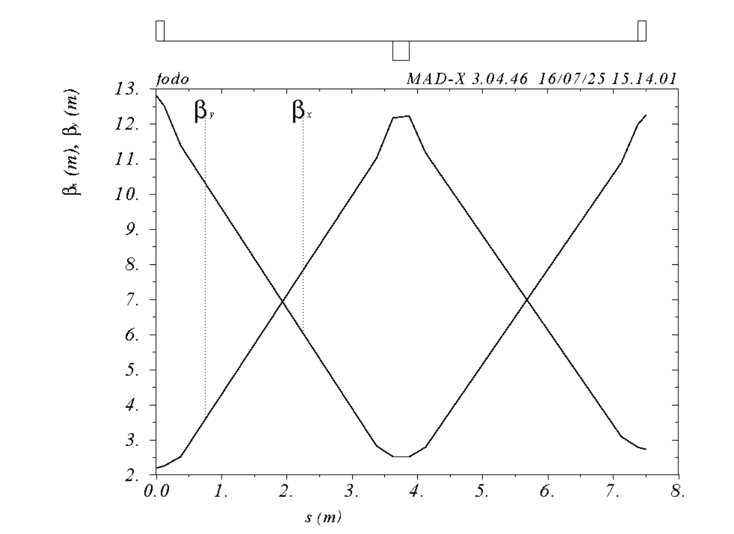
Optics comparison
2 quad each 2 RF structures
1 quad each 2 RF structures (new)
K1~1.5 m^-2
K1~0.8 m^-2
This difference will have a great importance on the emittance growth vs static misalignments

Slide 34
1 quad per 2 RF structures
Path: C:\Users\bettoni_s\switchdrive\Backup Documents\FCC\22_Progress_Linacs\JA_3GHz_3m\OneQuadPerRF_ok\G_21MV_m
1Q2RF
Much worse than the case with 2 quads per 2 RF structures (1Q2RF)

Slide 35
1 quad per 2 RF structures, L = 2 m
I try to see how much I can gain if I reduce the RF structure length → beam focus better maintained without increasing K1 → this option is better for the emittance
Path: C:\Users\bettoni_s\switchdrive\Backup Documents\FCC\22_Progress_Linacs\JA_3GHz_3m\OneQuadPerRF_ok\L_2m

Slide 36
1 quad per 2 RF structures, L = 2.5 m
Path: C:\Users\bettoni_s\switchdrive\Backup Documents\FCC\22_Progress_Linacs\JA_3GHz_3m\OneQuadPerRF_ok\L_2p5m

Slide 37
Summary of the structure length scan
Cumulated a certain Delta phase advance H-T. When the L_str is smaller the number of cells at the same linac location is larger. It would be nice to plot the JA vs number of cells for verification.

Slide 38
1 quad per 2 RF structures, phase advance = 70 deg
I try to see what we can gain changing the phase advance per cell, L_str = 3 m
Path: C:\Users\bettoni_s\switchdrive\Backup Documents\FCC\22_Progress_Linacs\JA_3GHz_3m\OneQuadPerRF_ok\Dmu_70deg

Slide 39
1 quad per 2 RF structures, phase advance = 80 deg
Path: C:\Users\bettoni_s\switchdrive\Backup Documents\FCC\22_Progress_Linacs\JA_3GHz_3m\OneQuadPerRF_ok\Dmu_80deg

Slide 40
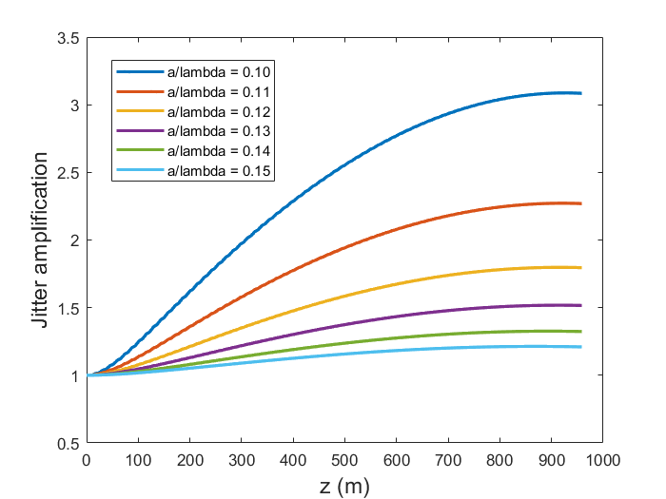
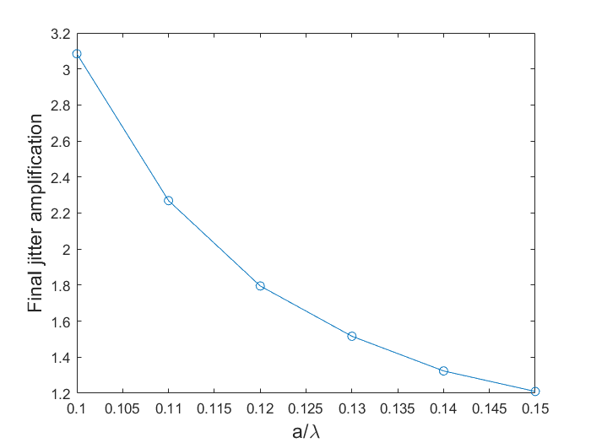
1 quad per 2 RF structures, phase advance = 100 deg
Path: C:\Users\bettoni_s\switchdrive\Backup Documents\FCC\22_Progress_Linacs\JA_3GHz_3m\OneQuadPerRF_ok\Dmu_100deg

Slide 41
1 quad per 2 RF structures, phase advance = 120 deg
Path: C:\Users\bettoni_s\switchdrive\Backup Documents\FCC\22_Progress_Linacs\JA_3GHz_3m\OneQuadPerRF_ok\Dmu_120deg

Slide 42
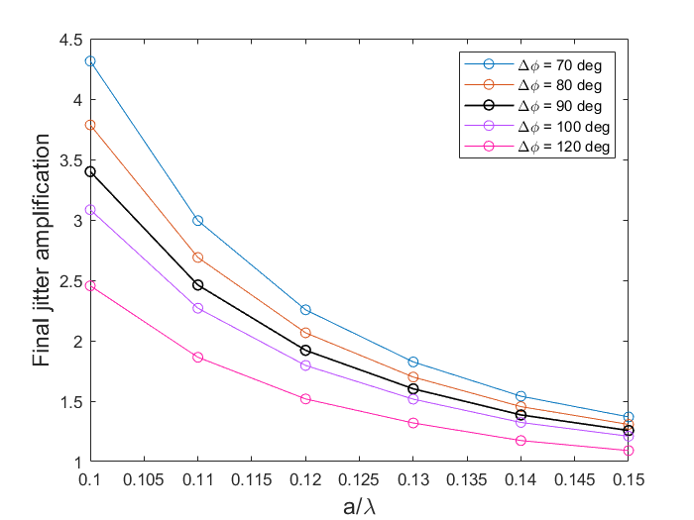
Summary phase advance scan: 1 quad per 2 RF structures
Larger phase advance → better for the JA, but worse for emittance growth due to static misalignments (stronger quads)
Smaller phase advance → worse for the JA, but better for emittance growth due to static misalignments (stronger quads)
In the next slides we try to check the impact of the variation of the phase advance/cell on the emittance growth due to static misalignments

Slide 43
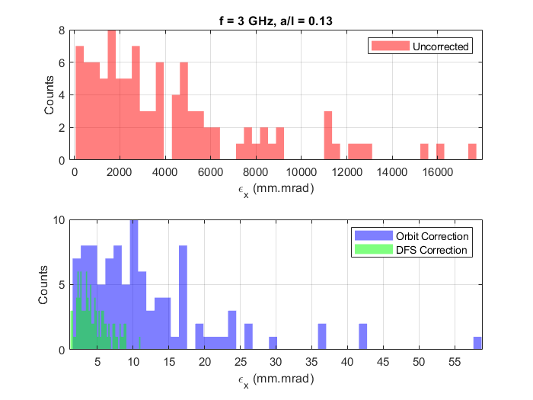
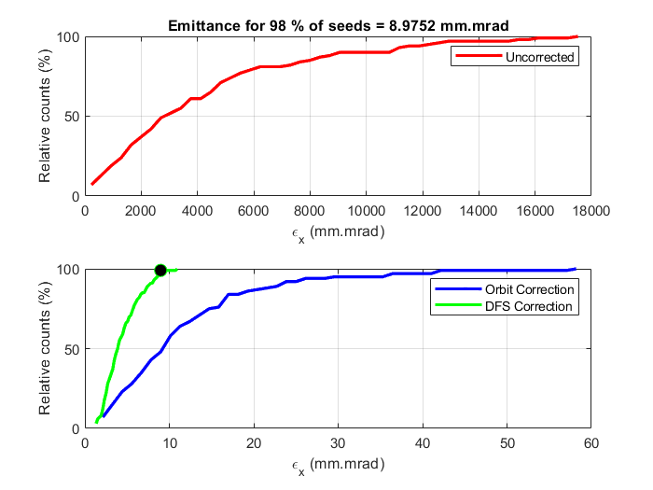
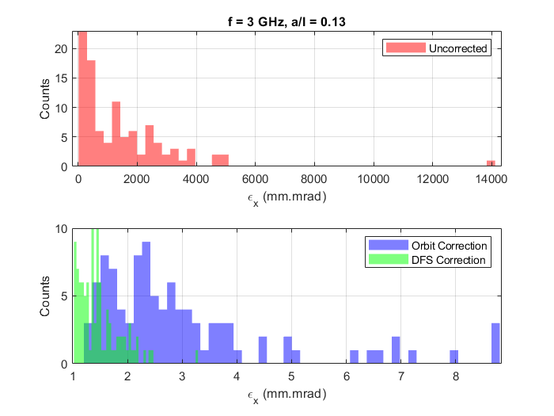
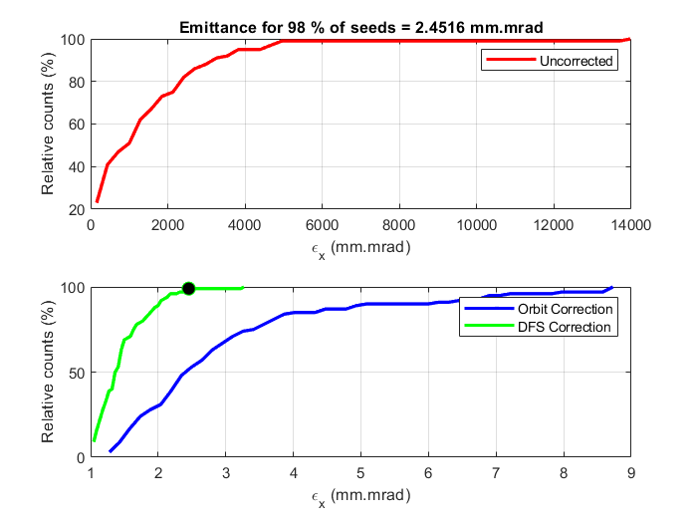
f = 3 GHz, Dmu = 100-120 deg
Checking the impact on the emittance growth due to static misalignments.
Path: /data/user/bettoni_s/data/FCC/SingleTransv/HE_linac/f_3GHz/a_l_0p13/Dmu_*deg/N_bins_8
Dmu = 120 deg
ε = 8.9752 mm.mrad
Still 2 quad per 2 RF structure!
Dmu = 100 deg
ε = 2.4516 mm.mrad

Slide 44
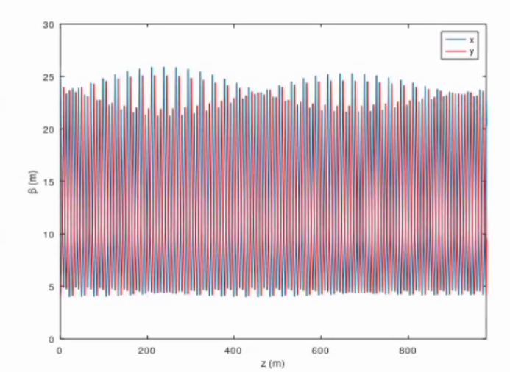
1 quad per 2 RF structure
I put 1 corrector and 1 BPM upstream and downstream respectively of the RF and the quad. Before it was around the quadrupoles.
Nquad = 141, N_BPM = 143, N_corr = 141 (1 BPM around the quad and at the end)
Linac total length ~940 m compared to the 2Q2RF case which is ~1070 m

Slide 45
1 quad per 2 RF structure, L_str = 3 m, Dmu = 90 deg
Path: /data/user/bettoni_s/data/FCC/SingleTransv/HE_linac/f_3GHz/1_quad_each_2_RF_ok/a_0p13/N_bins_8 and N_bins12

Slide 46
1 quad per 2 RF structures, a/l = 0.13, L = 2.5 m, Dmu = 100 deg
Path: /data/user/bettoni_s/data/FCC/SingleTransv/HE_linac/f_3GHz/1_quad_each_2_RF_ok/a_0p13/L_2p5m_Dmu_100deg/N_bins_8 and N_bins_12

Slide 47
1 quad per 2 RF structure, a/l = 0.13, L = 2.5 m, Dmu = 120 deg
Path: /data/user/bettoni_s/data/FCC/SingleTransv/HE_linac/f_3GHz/1_quad_each_2_RF_ok/a_0p13/L_2p5m_Dmu_120deg/N_bins_*

Slide 48
1 quad per 2 RF structures, L = 2 m, Dmu = 120 deg , a/l = 0.13
Path: /data/user/bettoni_s/data/FCC/SingleTransv/HE_linac/f_3GHz/1_quad_each_2_RF_ok/a_0p13/L_2m_Dmu_120deg/N_bins_*

Slide 49
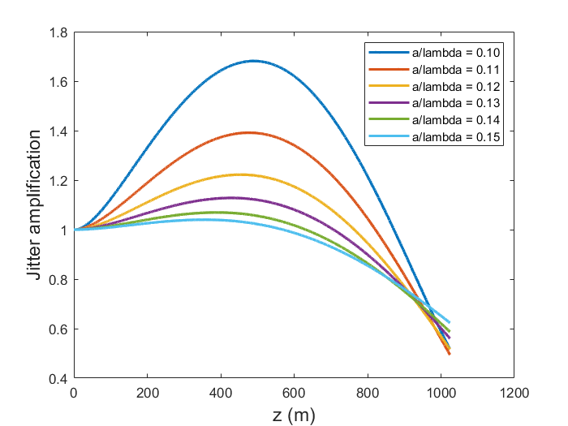
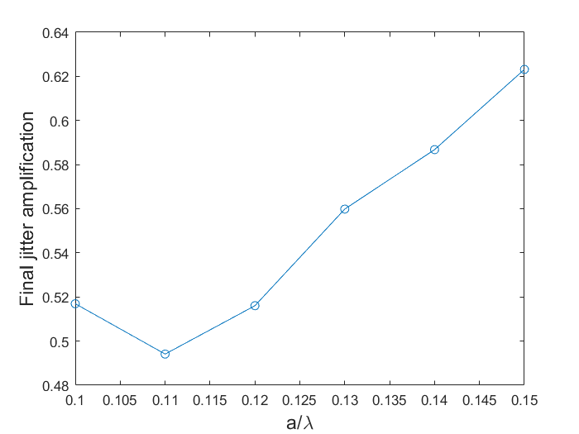
1 quad per 2 RF structures, phase advances and structure length
Phase advance = 120 deg, L = 2 m
I vary both the length of the RF structure and the phase advance per cell
Path: /data/user/bettoni_s/data/FCC/Jitter_Single/HE_linac/f_3GHz_L_3m/1_quad_each_2_RF_ok/Dmu_120deg_L_2m
Great, but to be seen for the emittance growth and the length of the RF structure

Slide 50
1 quad per 2 RF structures, phase advances and structure length
Path: C:\Users\bettoni_s\switchdrive\Backup Documents\FCC\22_Progress_Linacs\JA_3GHz_3m\OneQuadPerRF_ok\Dmu_100deg_L_2p5m
Phase advance = 100 deg, L = 2.5 m
Ok-ish

Slide 51
Proposed configuration: 1 quad per 2 RF structure
Linac length ~ 940 m (for L_str = 3 m)
Geometry (a/l) | a (mm) | G (MV/m) | L structure (m) | Rms bunch length (mm) | Phase advance/cell (deg)
0.13 | 13 | 21 | 2.5 | 0.8 | 100
a/λ | L_str (m) | Δmu (deg) | ε (mm.mrad) | JA | Comment
0.13 | 2.5 | 100 | 1.6 (DFS) | 1.1 | Best and expected margin with WFS
0.13 | 2.5 | 120 | 1.8 (DFS) | 1.3 | Not good JA, not great ε
0.13 | 2.0 | 120 | 3.7 (DFS) | 0.6 | Not good ε
This would be the wish, but we have some margin to adapt to the RF optimal parameters, which are…
To be discussed.

Slide 52
f = 6 GHz, G = 30 MV/m
S. Bettoni
Zoom, 25 July 2025

Slide 53
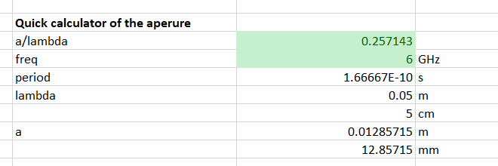
Determining the range
In the previous simulations assumed a/l = 0.12 at 2.8 GHz
We gain in length → we have to check the aperture
f = 2.8 GHz
f = 6.0 GHz
0.12:2.8 = x:3.0 → x = 0.12*3/2.8 = 0.128571
Equivalent a/l ~ 0.25

Slide 54
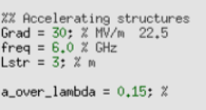
Settings
Path: /data/user/bettoni_s/data/FCC/SingleTransv/HE_linac/f_6GHz
Nbins = 8, if not differently specified, Test in /data/user/bettoni_s/data/FCC/SingleTransv/HE_linac/f_6GHz/a_l_0p20/N_bins_12
and in /data/user/bettoni_s/data/FCC/SingleTransv/HE_linac/f_6GHz/a_l_0p25/N_bins_12
Bunch length = 0.8 mm

Slide 55
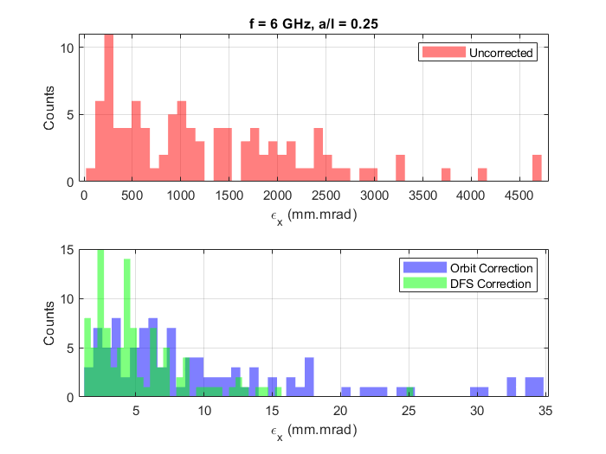
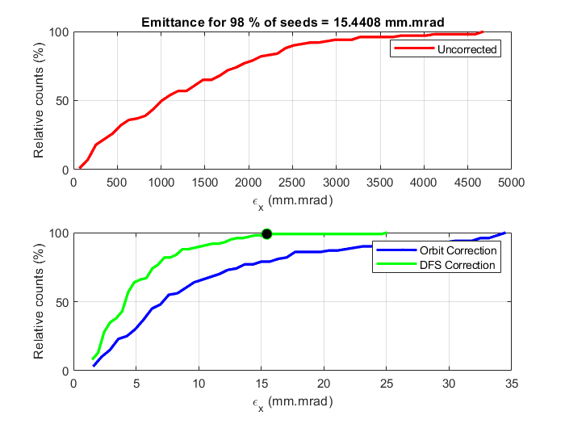
a/λ = 0.15, Nbins = 8-16
N_bins = 8
Some cases particles lost
Always above the specifications
N_bins = 16
Path: /data/user/bettoni_s/data/FCC/SingleTransv/HE_linac/f_6GHz/a_l_0p15/N_bins_16

Slide 56
a/λ = 0.20, N_bins = 8

Slide 57
a/λ = 0.20 , N_bins = 12
Zoom

Slide 58

a/λ = 0.20, N_bins = 16
Even worse (simulations started at the same time-no sequentially-this is why I continued to increase the N_bins)

Slide 59
a/λ = 0.20, N_bins = 6
Considering that the N_bins>8 is worse and worse, I simulate also less
Path: /data/user/bettoni_s/data/FCC/SingleTransv/HE_linac/f_6GHz/a_l_0p20/N_bins_6
Not better than N_bins = 8

Slide 60
a/λ = 0.20, N_bins = 4
Path: /data/user/bettoni_s/data/FCC/SingleTransv/HE_linac/f_6GHz/a_l_0p20/N_bins_4
Not better → 8 seems to be really a good value for this case.

Slide 61
Optimization of N_bins, a/l = 0.20
Confirmed the optimal N_bins = 8 using DFS

Slide 62
a/λ = 0.25
Nbins = 8

Slide 63
a/λ = 0.25
Nbins = 12
Simulations submitted in parallel to the previous scan, but ok for verification

Slide 64
f = 6 GHz: summary
Limit = 2
Similar aperture, considering different gradient and frequency
a = 12.5 mm
a = 10.0 mm

Slide 65
WFS, f = 6 GHz, a/l = 0.20, 0.25
Path: /data/user/bettoni_s/data/FCC/SingleTransv/HE_linac/f_6GHz/WFS/a_l_0p25/N_bins_16 and 14 (a/l = 0.25)
/data/user/bettoni_s/data/FCC/SingleTransv/HE_linac/f_6GHz/WFS/a_l_0p20/N_bins_14 (a/l = 0.2)
N_bins | 4 | 6 | 8 | 10 | 12 | 14 | 16
WFS emittance (mm.mrad) | 16.2897 | 4.6814 | 3.5058 | 3.9406 | 2.8971
DFS emittance (mm.mrad) | 23.1888 | 4.5463 | 3.3321 |  | 4.0592 |  | 15.4408
a/λ = 0.20
N_bins | 4 | 6 | 8 | 10 | 12 | 14 | 16
WFS emittance (mm.mrad) | 1.6619 | 1.7368 | 1.6731 | 1.776 | 1.4805
DFS emittance (mm.mrad) |  |  | 1.7319 |  | 2.0124
a/λ = 0.25
Outcomes
Some improvement compared to the DFS
Optimal a/l expected to be between 0.2 and 0.25 (a between 10 mm and 12.5 mm)

Slide 66
Transverse beam jitter amplification

Slide 67
Settings
Bunch length = 0.8 mm
G = 30 MV/m (instead of 21 MV/m)
f = 6 GHz (instead of 2.8 and 3 GHz)
L_str = 3 m
Bunch length = 0.8 mm
Path: /data/user/bettoni_s/data/FCC/Jitter_Single/HE_linac/f_6GHz_L_3m
Several effects: more rise because of larger wakes (☹), shorter linac (😐), more DE/E due to wakes compared to the 3 GHz case (☺)

Slide 68
f = 6 GHz, G = 30 MV/m, bunch length = 0.8 mm
Path: /data/user/bettoni_s/data/FCC/Jitter_Single/HE_linac/f_6GHz_L_3m

Slide 69
f = 6 GHz, G = 30 MV/m, bunch length = 0.8 mm, L_str = 2 m
Path: /data/user/bettoni_s/data/FCC/Jitter_Single/HE_linac/f_6GHz_L_3m/L_str_2m
It would be nice to see the difference of the head-tail phase advance (to be done), but this is not a case we are considering for the design, so continue for the moment

Slide 70
f = 6 GHz, G = 30 MV/m, bunch length = 0.8 mm, L_str = 2.5 m
Path: /data/user/bettoni_s/data/FCC/Jitter_Single/HE_linac/f_6GHz_L_3m/L_str_2p5m

Slide 71
Different phase advances, L = 3 m
Path: /data/user/bettoni_s/data/FCC/Jitter_Single/HE_linac/f_6GHz_L_3m/Dmu_*deg
90 deg (when not specified), 60 deg, 120 deg
60 deg
120 deg

Slide 72
Counteracting JA at 6 GHz
Possibilities:
Make the RF structure shorter. Optimum ~3-4 m for S-band. For C-band?
Re-optimize the phase advance (like before expected impact on the emittance growth due to static misalignments)
Phase advance/cell = 90 deg
L = 3 m
L = 2.5 m corresponds to JA<1 for a/l = 0.2 and a/l = 0.25
Increased phase advance has a negative impact on the emittance for static misalignments

Slide 73
Proposed configuration: 2 quad per 2 RF structure
Linac length = 754 m
Geometry (a/l) | a (mm) | G (MV/m) | L structure (m) | Rms bunch length (mm) | Phase advance/cell (deg)
0.25 (maybe~<) | 12.5 | 30 | 3, but 2.5 m better | 0.8 | 90 to be seen WFS
*Energy compressor NOT fully re-optimized yet! See later
Phase advance/cell = 90 deg
1.5 mm.mrad (WFS) *
L = 3 m
* Emittance growth computed assuming L_str = 3 m. If we may go shorter it should be better.
* In this case we may consider to slightly reduce a/l

Slide 74
Check and re-optimization of the energy compressor

Slide 75
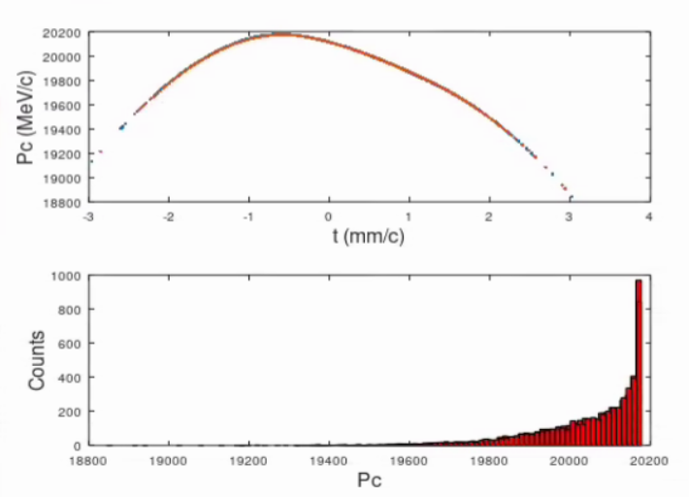
f = 3 GHz, Q2RF lattice, phi = 90 deg
f = 3.0 GHz, sigma_z = 0.8 mm
f = 6.0 GHz, sigma_z = 0.8 mm
f (GHz) | Rms bunch length (rms) | Rms dp/p (%)
3.0 | 0.79952 | 0.68005
6.0 | 0.80844 | 0.73321
Beams at the end of HE linac

Slide 76
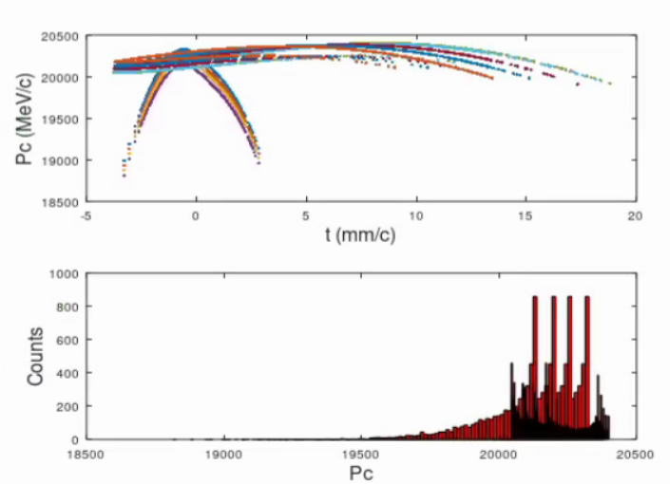
Optimization EC for beam accelerated at 6 GHz
Using f = 6 GHz for the EC cavities
ARRIVED HERE
0.8 mm @ 6 GHz is at the moment excluded.
The bunch length is too long to remain in the linear part of the RF at 6 GHz
Excluded at the moment

Slide 77
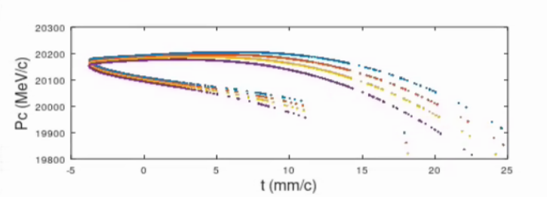
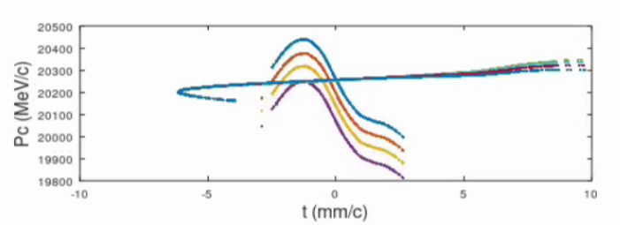
Optimization EC for beam accelerated at 6 GHz
Using f = 3 GHz for the EC cavities
V = 640 (3 GHz: 580) MV
ANGLE = 8.43 (3 GHz: 9.1605) deg
FINAL BUNCHES
Final bunches n. 1
rms bunch length = 3.9254 mm
rms dp/p = 0.12624%
Final bunches n. 2
rms bunch length = 3.9453 mm
rms dp/p = 0.13191%
Dt = 4.7284 ps
Dp 5 pC = -0.039415%
Dp 5 nC = -0.035234%
Final bunches n. 3
rms bunch length = 3.9486 mm
rms dp/p = 0.13695%
Dt = 9.0676 ps
Dp 5 pC = -0.076269%
Dp 5 nC = -0.07209%
Final bunches n. 4
rms bunch length = 3.9325 mm
rms dp/p = 0.14098%
Dt = 14.2556 ps
Dp 5 pC = -0.12324%
Dp 5 nC = -0.11906%
Possible improvements (to be investigated):
  Different bunch length
  A moderate off-crest operation~3-4 deg
  Use few 6 GHz cavities upstream the chicane to linearize → not really efficient, and I would not go to X-band
Presently only solution available to get 4 mm (tunable) and 0.13-0.14% (not much margin like for the previous case)

Slide 78
f = 6 GHz, G = 30 MV/m
1 quadrupoles per 2 RF structures (1Q2RF)
S. Bettoni
Zoom, 25 July 2025

Slide 79
1 quad each 2 RF structures
Also for this case we observe what happens with the other kind of lattice
Path: C:\Users\bettoni_s\switchdrive\Backup Documents\FCC\22_Progress_Linacs\JA_6GHz_3m\OneQuadPerRF_ok\G_30MV_m

Slide 80
1 quad each 2 RF structures, L = 2.5 m
Path: C:\Users\bettoni_s\switchdrive\Backup Documents\FCC\22_Progress_Linacs\JA_6GHz_3m\OneQuadPerRF_ok\L_2p5m

Slide 81
1 quad each 2 RF structures, L = 2 m
Path: C:\Users\bettoni_s\switchdrive\Backup Documents\FCC\22_Progress_Linacs\JA_6GHz_3m\OneQuadPerRF_ok\L_2m

Slide 82
RF structure length scan: summary
C:\Users\bettoni_s\switchdrive\Backup Documents\FCC\22_Progress_Linacs\JA_6GHz_3m\OneQuadPerRF_ok
For emittance a/l>=0.2
Phase advance = 90 deg
Limit = 2 (single- and multi-bunch together)
Outcomes:
If we assume a/l = 0.25 we are ok for transverse static and dynamic (single-) with some margin. In this case a reduction of the RF length is beneficial.
If we assume a/l = 0.2 we have still to optimize static and we probably must reduce the length of the RF structure.

Slide 83
1 quad each 2 RF structures, phase advance = 70 deg
Path: C:\Users\bettoni_s\switchdrive\Backup Documents\FCC\22_Progress_Linacs\JA_6GHz_3m\OneQuadPerRF_ok\Dmu_70deg

Slide 84
1 quad each 2 RF structures, phase advance = 80 deg
Path: C:\Users\bettoni_s\switchdrive\Backup Documents\FCC\22_Progress_Linacs\JA_6GHz_3m\OneQuadPerRF_ok\Dmu_80deg

Slide 85
1 quad each 2 RF structures, phase advance = 100 deg
Path: C:\Users\bettoni_s\switchdrive\Backup Documents\FCC\22_Progress_Linacs\JA_6GHz_3m\OneQuadPerRF_ok\Dmu_100deg

Slide 86
1 quad each 2 RF structures, phase advance = 120 deg
Path: C:\Users\bettoni_s\switchdrive\Backup Documents\FCC\22_Progress_Linacs\JA_6GHz_3m\OneQuadPerRF_ok\Dmu_120deg

Slide 87
Phase advance scan: summary
C:\Users\bettoni_s\switchdrive\Backup Documents\FCC\22_Progress_Linacs\JA_6GHz_3m\OneQuadPerRF_ok
For emittance a/l>0.2
Limit = 2 (single- and multi-bunch together)
L = 3 m
Outcomes:
If we assume a/l = 0.25 we are ok-ish. Some tuning would be beneficial, but I would prefer to reduce the RF structure length, if possible or combine a shorter length with an optimization of the phase advance
If we assume a/l = 0.2 we must vary not only the phase advance, but also the length of the RF structures

Slide 88
JA phase advance AND L_structure
Path: /data/user/bettoni_s/data/FCC/Jitter_Single/HE_linac/f_6GHz_L_3m/1_quad_each_2_RF_ok/Dmu_120deg_L_2m
L_str = 2 m
Dmu = 120 deg
Outcomes:
If we assume a/l = 0.25 we are ok
If we assume a/l = 0.2 we have JA around 1.3. Assuming phase advance = 90 deg we are at ~2.8.

Slide 89
JA phase advance AND L_structure
L_str = 2 m
Dmu = 100 deg
Path: /data/user/bettoni_s/data/FCC/Jitter_Single/HE_linac/f_6GHz_L_3m/1_quad_each_2_RF_ok/Dmu_100deg_L_2m
Outcomes:
If we assume a/l = 0.25 we are ok
If we assume a/l = 0.2 we are not ok

Slide 90
Phase advance AND RF structure length
Path: /data/user/bettoni_s/data/FCC/SingleTransv/HE_linac/f_6GHz/1_quad_each_2_RF_ok/L_2m_Dmu_120deg/N_bins_8
L_str = 2 m
Dmu = 120 deg
a/l = 0.2
N_bins = 8
N_bins = 12
Outcomes:
We are out of the specifications

Slide 91
JA phase advance AND L_structure: emittance check
Path: /data/user/bettoni_s/data/FCC/SingleTransv/HE_linac/f_6GHz/1_quad_each_2_RF_ok/L_2m_Dmu_100deg
L_str = 2 m
Dmu = 100 deg
a/l = 0.25
Outcomes:
Emittance ok!
This would correspond to JA ~ 1.1

Slide 92
Phase advance AND RF structure length
Path:/data/user/bettoni_s/data/FCC/SingleTransv/HE_linac/f_6GHz/1_quad_each_2_RF_ok/L_2m_Dmu_120deg_a_l_0p2/N_bins_*
L_str = 2 m
Dmu = 120 deg
a/l = 0.25
Outcomes:
Emittance ok!
This would correspond to JA ~ 1

Slide 93
Proposed configuration: 1 quad per 2 RF structure
Linac length = 706 m
Geometry (a/l) | a (mm) | G (MV/m) | L structure (m) | Rms bunch length (mm) | Phase advance/cell (deg)
0.25 | 12.5 | 30 | <3 | 0.8 | 90 to be seen WFS
RF structure shorter than 3 m is highly auspicable
Probably we can go to a/l between 0.2 and 0.25
Several solutions, but the best would be that RF should say which is the minimum length, and after we can tune the phase advance.

Slide 94
Conclusions, discussions, questions

Slide 95
Summaries and conclusions f = 3 GHz
2 quads per 2 RF structures (linac length~1070 m):
1 quads per 2 RF structures (linac length~940 m):
a/λ | a (mm) | L_str (m) | ε (mm.mrad) | Δmu (deg) | JA | Comment
0.13 | 13 | 3 | 1.8 (DFS), 1.3 (WFS) | 90 | 0.7-0.8 | EC optimized (more relaxed parameters)
0.12 | 12 | 3 | 3.1 (DFS), 1.6 (WFS) | 90 | 0.7-0.8 | Expected similar for EC
a/λ | a (mm) | L_str (m) | ε (mm.mrad) | Δmu (deg) | JA | Comment
0.13 | 13 | 3 | 1.6 (DFS), WFS not run | 90 | 1.6 | Not accepted
0.13 | 13 | 2.5 | 1.6 (DFS) | 100 | 1.1 | Expected more margin using WFS Expected similar for EC

Slide 96
Summaries and conclusions f = 6 GHz
2 quads per 2 RF structures (linac length~760 m):
1 quads per 2 RF structures (linac length~710 m):
a/λ | a (mm) | L_str (m) | ε (mm.mrad) | Δmu (deg) | JA | Comment
0.25 | 12.5 | 3 | 1.7 (DFS), 1.5 (WFS) | 90 | ~1 | Beneficial to go to L_str<3 m Presently EC with less tunability
a/λ | a (mm) | L_str (m) | ε (mm.mrad) | Δmu (deg) | JA | Comment
0.25 | 12.5 | 2 | 1.5 (DFS) | 120 | ~1 | Presently EC with less tunability
0.25 | 12.5 | 2 | 1.4 (DFS) | 100 | 1.1 | Presently EC with less tunability

Slide 97
Questions
Which is the limit for the RF structure length for 3 GHz?
  3 m or? Could we go to 2.5 m? 2.5 m?
Which is the limit for the RF structure length for 6 GHz?
  Which is the optimum? Could we go to 2.5 m? 2 m?

Slide 98
Scripts
File to analyze the JA single bunch: C:\Users\bettoni_s\Documents\MATLAB\read_JA_ampl_single.m
New file (fully automatized):
C:\Users\bettoni_s\Documents\MATLAB\read_transv_emitt.m
Script EC: /data/user/bettoni_s/merlin6data/RFTrack_sim/Layout_DR_3GeV/EnCompr/NewWayEnCompr.m

Slide 99
Internal use

Slide 100
Optics
Andrea’s lecture (https://indico.cern.ch/event/1149120/contributions/4822271/attachments/2428245/4157500/Lectures.pdf )
L_FODO = 6*L_drift_FODO+2*L_quad+4*L_structure;
K1_FODO = (4*sin(mu/2))/(L_FODO*L_quad);
L_FODO = 4*L_drift_FODO+2*L_quad+2*L_structure;

Slide 101
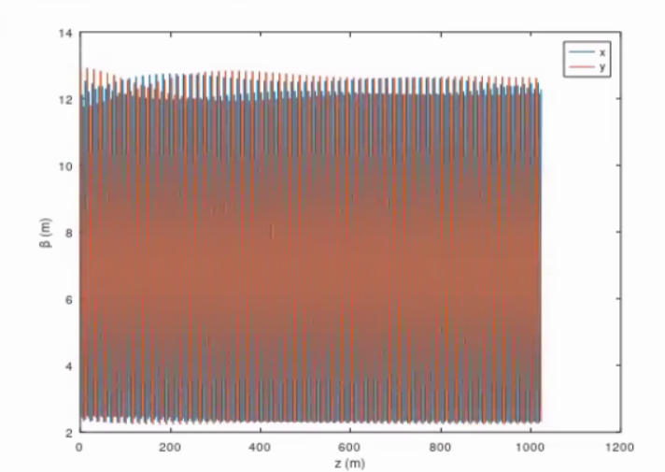
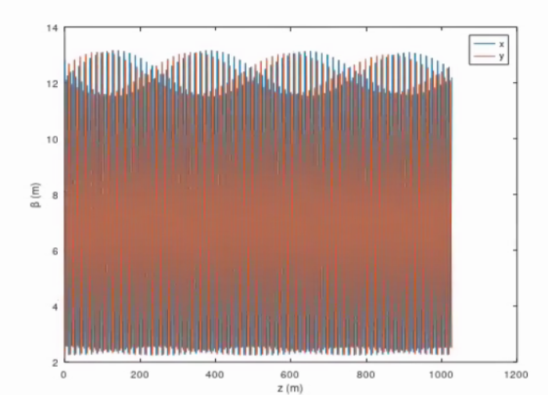
Test 2 quads/2 RF: RF-Track
JUST FOR REFERENCE
Path: /data/user/bettoni_s/data/FCC/Jitter_Single/HE_linac/f_3GHz_L_3m/1_quad_each_2_RF_ok/G_21MV_m/Test_2Q_2RF
Optics in this case [2 quads/2 RF modified from the new file (all computed and half quad, no matching)]
Old file
Twiss.beta_x = 2.5153
Twiss.beta_y = 12.846 m
K1_FODO = -1.5085
Twiss.beta_x = 12.796 m
Twiss.beta_y = 2.1955 m
L_FODO = 7.4958 m
K1_FODO = 1.5093

Slide 102
MAD-X model (verification): 2 quads/ 2 RF
Lstr = 3;
Lquad = 0.25;
Ldrift = 0.25;
mud = pi/2;
Lcell = 2*Lstr + 2*Lquad + 4*Ldrift;
k1 = sin(mud/2) / (Lcell/4) /Lquad; // Here k1 is not integrated
Variable Final Value Initial Value
----------------------------------------------------------------
k1 1.54387e+000 1.50849e+000
betax0 1.28033e+001 1.28033e+001
betay0 2.19670e+000 2.19670e+000
Initial: from the formula
Final: from the matching
Phase advance (dphi) = 90 deg
Ok also without the matching: dphi = 90 deg

Slide 103
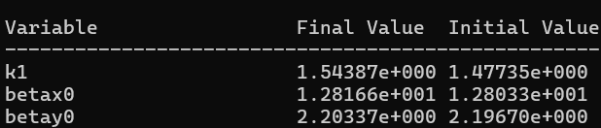
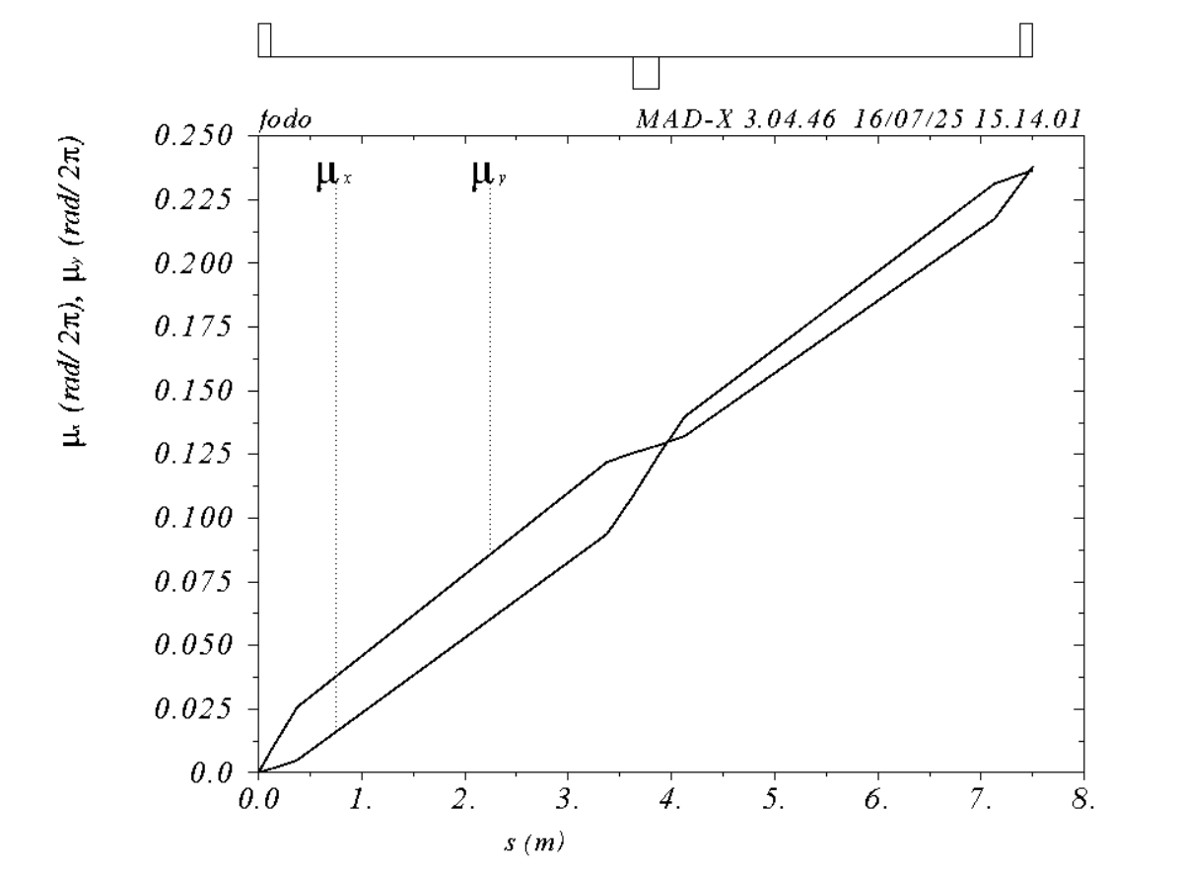
MAD-X model: 2 quads/ 2 RF: optics used so far for dphi = 90 deg with k1 matched
Lstr = 3;
Lquad = 0.25;
Ldrift = 0.25;
mud = pi/2;
Lcell = 2*Lstr + 2*Lquad + 4*Ldrift;
//k1 = sin(mud/2) / (Lcell/4) /Lquad; // Here k1 is not integrated
k1 = 1.477351109;
JUST FOR REFERENCE
Initial: from the formula
Final: from the matching
Phase advance = 90 deg
Ok also without the matching: phi = 90 deg
Very similar Twiss and initial values: ok
Previous runs correct!

Slide 104
1 quad per 2 RF structures
RF-Track
Twiss.beta_x = 23.885 m
Twiss.beta_y = 4.0981 m
K1_FODO = -0.8086
L_FODO = 13.992 m
Initial: from the formula
Final: from the matching
Phase advance = 90 deg
Ok also without the matching: phi = 90 deg
Very similar Twiss and initial values: ok

Slide 105
Optics comparison
2 quad each 2 RF structures
1 quad each 2 RF structures (new)
K1~1.5 m^-2
K1~0.8 m^-2

Slide 106
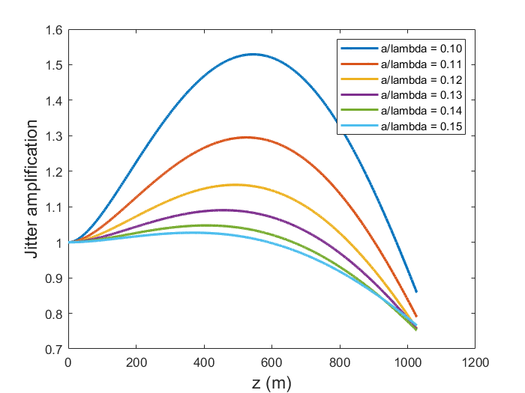
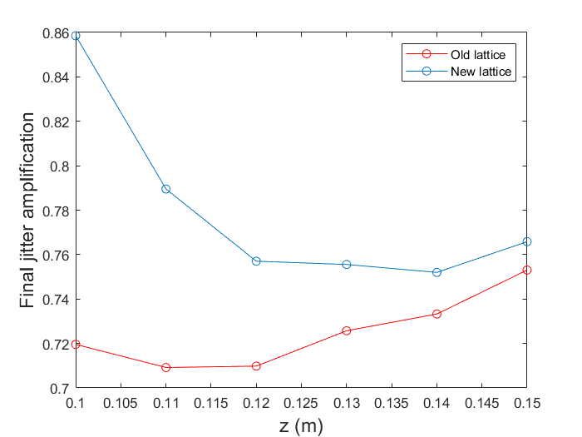
Impact of the lattice change
If I take the new lattice and I transform the 1 quad per 2 RF structures to the 2 quad per 2 RF structures (new), and I compare to the old lattice 2 quad per 2 RF structure (old), I obtain similar (even if not the same) results
Path: C:\Users\bettoni_s\switchdrive\Backup Documents\FCC\22_Progress_Linacs\JA_3GHz_3m\OneQuadPerRF_ok\G_21MV_m\Test_2Q_2RF
Good, but the old lattice even better

Slide 107
1 quad per 2 RF structure
I put 1 corrector and 1 BPM upstream and downstream respectively of the RF and the quad. Before it was around the quadrupoles.
Nquad = 141, N_BPM = 143, N_corr = 141: 1 BPM around the quad and at the end.
Linac total length ~940 m compared to the 2Q2RF case which is ~1070 m

Slide 108
HE length including SRW
3 GHz 2 Q2RF: 1069.5 m
3 GHz 1 Q2RF: 999.5 m
6 GHz 2 Q2RF: 754 m
6 GHz 1 Q2RF: 705.7 m

Slide 109
f = 3 GHz
UNDER OPTIMIZATION
FINAL BUNCHES
Final bunches n. 1
rms bunch length = 4.0204 mm
rms dp/p = 0.090036%
Final bunches n. 2
rms bunch length = 4.0399 mm
rms dp/p = 0.089188%
Dt = 5.0647 ps
Dp 5 pC = -0.02888%
Dp 5 nC = -0.029487%
Final bunches n. 3
rms bunch length = 4.0578 mm
rms dp/p = 0.083387%
Dt = 9.7302 ps
Dp 5 pC = -0.05695%
Dp 5 nC = -0.057556%
Final bunches n. 4
rms bunch length = 4.0795 mm
rms dp/p = 0.070666%
Dt = 15.3355 ps
Dp 5 pC = -0.095388%
Dp 5 nC = -0.095994%
FINAL BUNCHES
Final bunches n. 1
rms bunch length = 4.4368 mm
rms dp/p = 0.16184%
Final bunches n. 2
rms bunch length = 4.4587 mm
rms dp/p = 0.16017%
Dt = 5.7137 ps
Dp 5 pC = 0.0048698%
Dp 5 nC = 0.0042586%
Final bunches n. 3
rms bunch length = 4.4789 mm
rms dp/p = 0.15088%
Dt = 10.977 ps
Dp 5 pC = 0.006681%
Dp 5 nC = 0.0060698%
Final bunches n. 4
rms bunch length = 4.5032 mm
rms dp/p = 0.1304%
Dt = 17.3003 ps
Dp 5 pC = 0.0014202%
Dp 5 nC = 0.00080902%
FINAL BUNCHES
Final bunches n. 1
rms bunch length = 3.9626 mm
rms dp/p = 0.080665%
Final bunches n. 2
rms bunch length = 3.9817 mm
rms dp/p = 0.079859%
Dt = 4.9745 ps
Dp 5 pC = -0.033626%
Dp 5 nC = -0.034228%
Final bunches n. 3
rms bunch length = 3.9994 mm
rms dp/p = 0.074527%
Dt = 9.557 ps
Dp 5 pC = -0.065916%
Dp 5 nC = -0.066518%
Final bunches n. 4
rms bunch length = 4.0206 mm
rms dp/p = 0.062994%
Dt = 15.0626 ps
Dp 5 pC = -0.10909%
Dp 5 nC = -0.10969%
Lower R56
Angle = 0.1523 rad
Lower R56
Angle = 0.1509 rad

Slide 110
Optimized
f = 3 GHz
FINAL BUNCHES
Final bunches n. 1
rms bunch length = 4.0204 mm
rms dp/p = 0.11081%
Final bunches n. 2
rms bunch length = 4.0399 mm
rms dp/p = 0.11004%
Dt = 5.0647 ps
Dp 5 pC = -0.020526%
Dp 5 nC = -0.021141%
Final bunches n. 3
rms bunch length = 4.0579 mm
rms dp/p = 0.10387%
Dt = 9.7302 ps
Dp 5 pC = -0.041016%
Dp 5 nC = -0.041631%
Final bunches n. 4
rms bunch length = 4.0795 mm
rms dp/p = 0.089945%
Dt = 15.3355 ps
Dp 5 pC = -0.070579%
Dp 5 nC = -0.071194%
f = 2.8 GHz
FINAL BUNCHES
Final bunches n. 1
rms bunch length = 4.052 mm
rms dp/p = 0.11362%
Final bunches n. 2
rms bunch length = 4.0715 mm
rms dp/p = 0.11251%
Dt = 5.7137 ps
Dp 5 pC = -0.014045%
Dp 5 nC = -0.014563%
Final bunches n. 3
rms bunch length = 4.0895 mm
rms dp/p = 0.10579%
Dt = 10.9768 ps
Dp 5 pC = -0.028895%
Dp 5 nC = -0.029413%
Final bunches n. 4
rms bunch length = 4.1112 mm
rms dp/p = 0.090883%
Dt = 17.3 ps
Dp 5 pC = -0.052486%
Dp 5 nC = -0.053004%
freq_EC = 3
Lstr_EC = 31.343
angle_d = 0.1523 rad (less)
L_dip = 7.2139
V = 640 MV (more)
Just moderate re-adjustments
By mistake I optimized it with a/l = 0.12. Check for a/l = 0.13. See next slide

Slide 111
EC at f = 3 GHz, a/l =0.13
SAME PARAMETERS case using 0.12
OPTIMIZED 0.13
case using 0.12
V = 580 MV
ANGLE = 0.1598 rad = 9.1605 deg
FINAL BUNCHES
Final bunches n. 1
rms bunch length = 4.0204 mm
rms dp/p = 0.11081%
Final bunches n. 2
rms bunch length = 4.0399 mm
rms dp/p = 0.11004%
Dt = 5.0647 ps
Dp 5 pC = -0.020526%
Dp 5 nC = -0.021141%
Final bunches n. 3
rms bunch length = 4.0579 mm
rms dp/p = 0.10387%
Dt = 9.7302 ps
Dp 5 pC = -0.041016%
Dp 5 nC = -0.041631%
Final bunches n. 4
rms bunch length = 4.0795 mm
rms dp/p = 0.089945%
Dt = 15.3355 ps
Dp 5 pC = -0.070579%
Dp 5 nC = -0.071194%
FINAL BUNCHES
Final bunches n. 1
rms bunch length = 3.6957 mm
rms dp/p = 0.1178%
Final bunches n. 2
rms bunch length = 3.7132 mm
rms dp/p = 0.11659%
Dt = 5.0645 ps
Dp 5 pC = -0.019147%
Dp 5 nC = -0.019634%
Final bunches n. 3
rms bunch length = 3.7294 mm
rms dp/p = 0.11035%
Dt = 9.7298 ps
Dp 5 pC = -0.03834%
Dp 5 nC = -0.038827%
Final bunches n. 4
rms bunch length = 3.7488 mm
rms dp/p = 0.096724%
Dt = 15.3349 ps
Dp 5 pC = -0.066326%
Dp 5 nC = -0.066812%
FINAL BUNCHES
Final bunches n. 1
rms bunch length = 3.9776 mm
rms dp/p = 0.10004%
Final bunches n. 2
rms bunch length = 3.9968 mm
rms dp/p = 0.09823%
Dt = 5.5533 ps
Dp 5 pC = -0.022088%
Dp 5 nC = -0.022564%
Final bunches n. 3
rms bunch length = 4.0144 mm
rms dp/p = 0.09082%
Dt = 10.6688 ps
Dp 5 pC = -0.044443%
Dp 5 nC = -0.044919%
Final bunches n. 4
rms bunch length = 4.0356 mm
rms dp/p = 0.075486%
Dt = 16.8145 ps
Dp 5 pC = -0.07735%
Dp 5 nC = -0.077826%
Bunch at the end of HE linac
rms bunch length = 0.79758 mm
rms dp/p = 0.61105%
rms bunch length = 0.79903 mm
rms dp/p = 0.61167%

