Slide 1
3GHz structure preliminary studies
Adnan Kurtulus, Alexej Grudiev
25/07/2025

Slide 2
Parameters for the structure:
f = 3 GHz, Length = 3m, Q_{0,SLED} = 2e5, T_{klystron} = 3 us, P_klystron = 31 MW,
a/λ | λ (mm) | a (mm)
0.12 | 99.93 | 11.992
0.13 | 99.93 | 12.991
0.14 | 99.93 | 13.990
0.15 | 99.93 | 14.990

Slide 3
Phase advance = 2π/3 without wakefield constraints

Slide 4
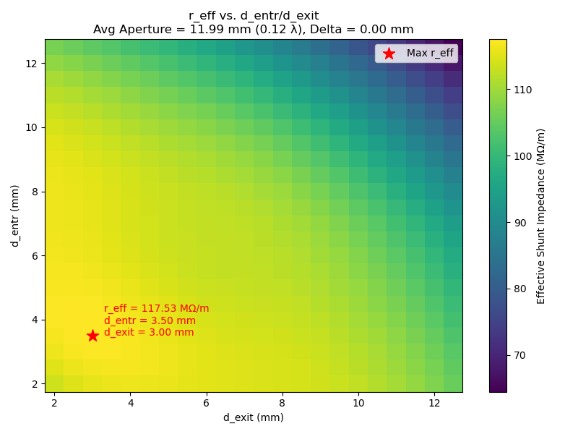

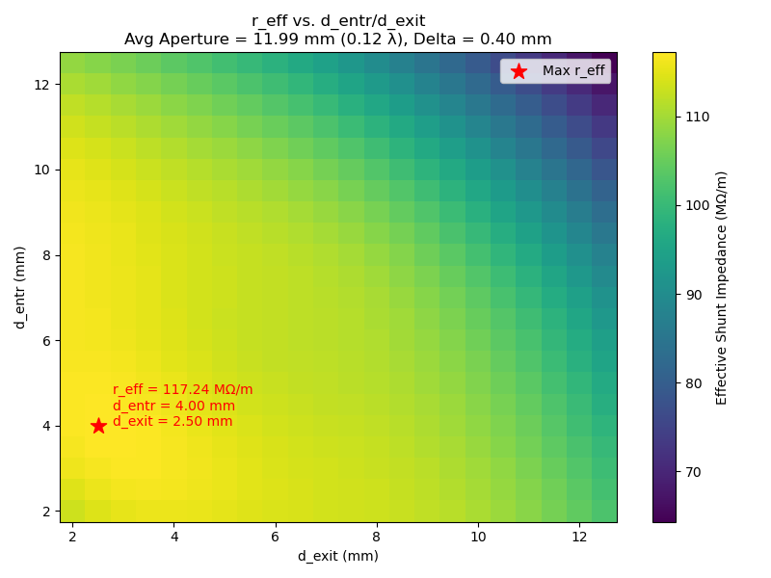
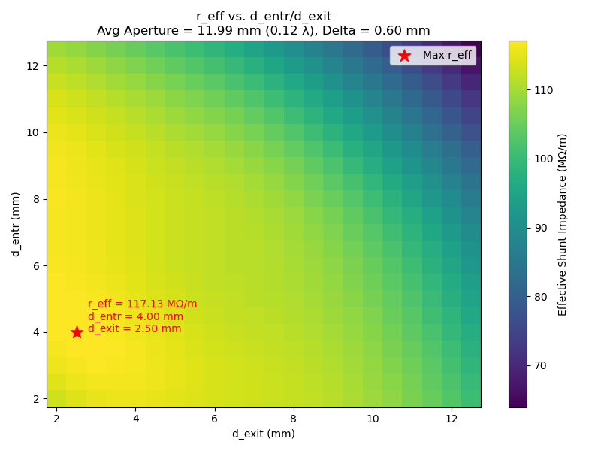
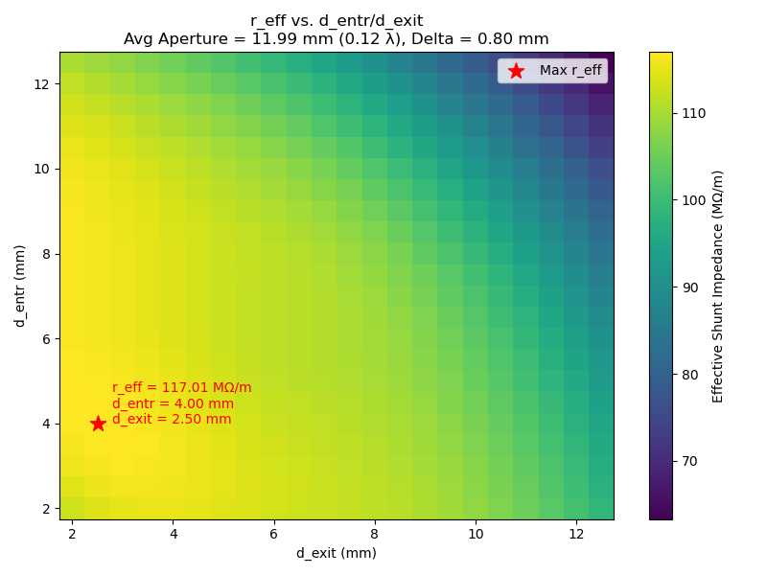

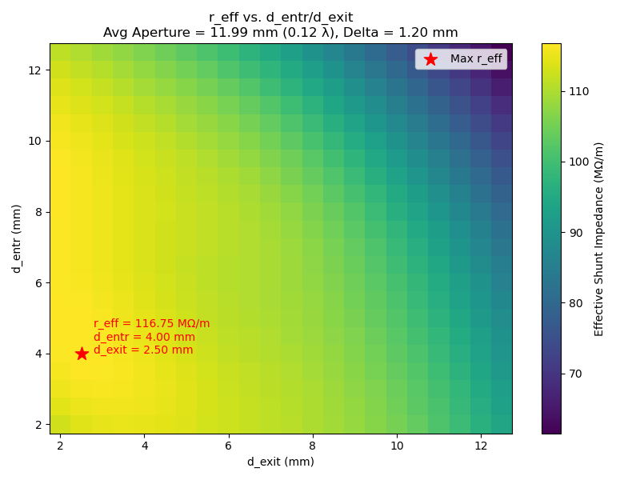

Effective Shunt Inpedance Scans
Parameters for the structure:
f = 3 GHz, Length = 3m, Phase advance = 2π/3, Q_{0,SLED} = 2e5, T_{klystron} = 3 us, P_klystron = 31 MW,
a/λ= 0.12 to 0.15, delta= 0 to 4mm

Slide 5
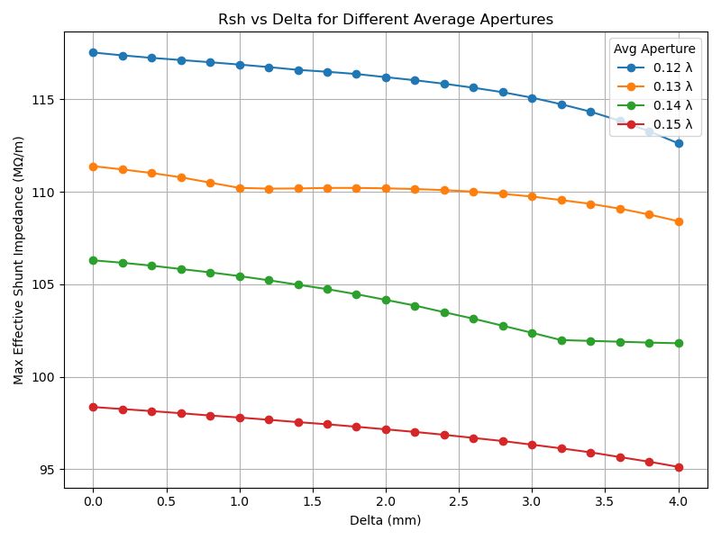
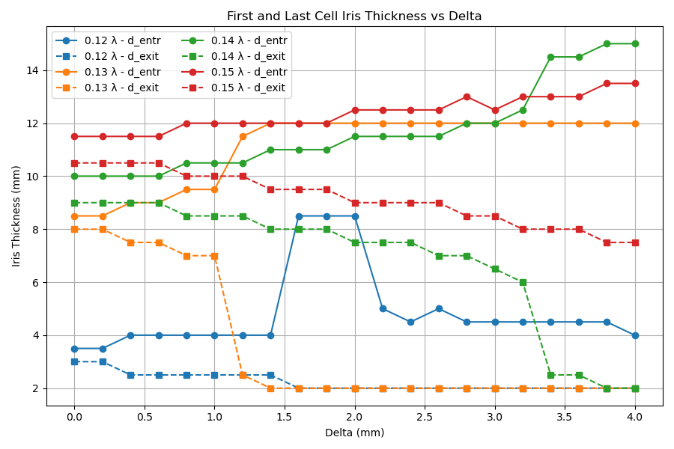
Effective Shunt Inpedance Scans
Parameters for the structure:
f = 3 GHz, Length = 3m, Phase advance = 2π/3, Q_{0,SLED} = 2e5, T_{klystron} = 3 us, P_klystron = 31 MW,
a/λ= 0.12 to 0.15, delta= 0 to 4mm

Slide 6
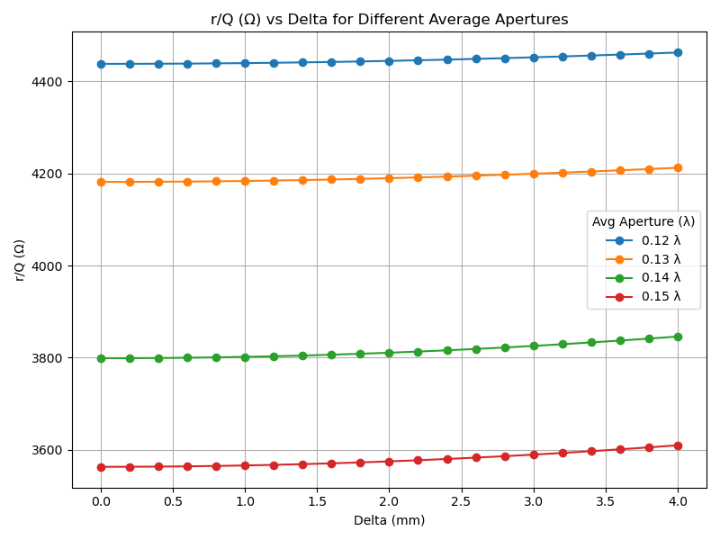
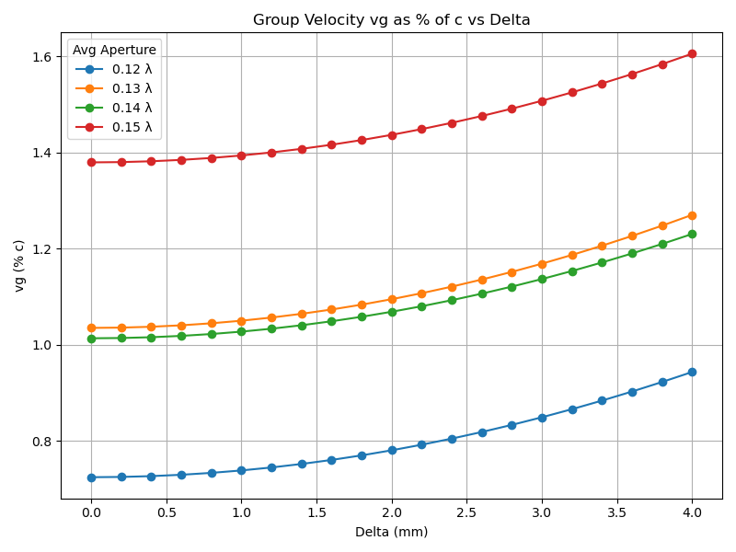
RF parameter Scans
Parameters for the structure:
f = 3 GHz, Length = 3m, Phase advance = 2π/3, Q_{0,SLED} = 2e5, T_{klystron} = 3 us, P_klystron = 31 MW,
a/λ= 0.12 to 0.15, delta= 0 to 4mm

Slide 7
Phase advance = 5π/6 without wakefield constraints

Slide 8
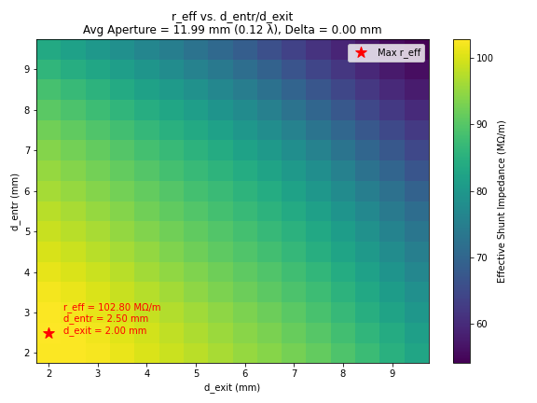
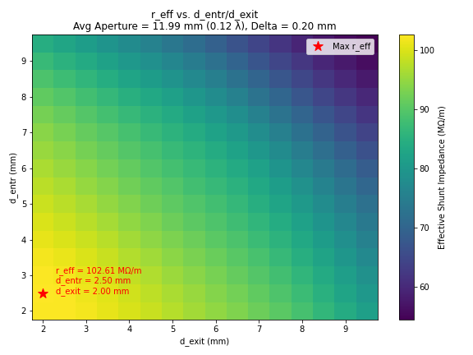
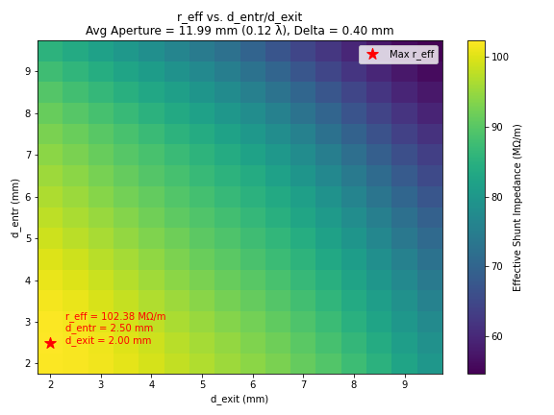




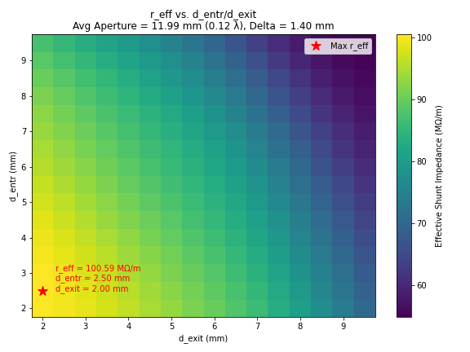
Parameters for the structure:
f = 3 GHz, Length = 3m, Phase advance = 5π/6, Q_{0,SLED} = 2e5, T_{klystron} = 3 us, P_klystron = 31 MW,
a/λ= 0.12 to 0.15, delta= 0 to 4mm

Slide 9
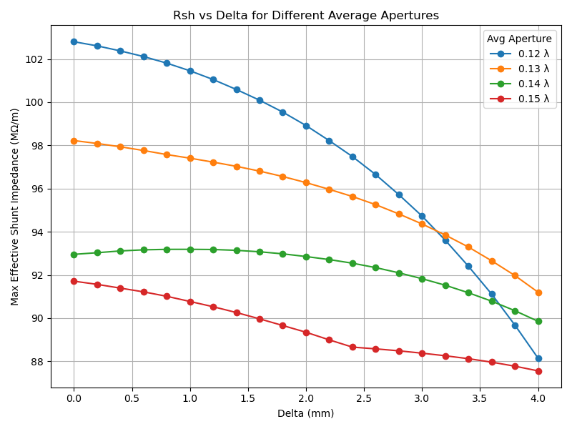
Parameters for the structure:
f = 3 GHz, Length = 3m, Phase advance = 5π/6, Q_{0,SLED} = 2e5, T_{klystron} = 3 us, P_klystron = 31 MW,
a/λ= 0.12 to 0.15, delta= 0 to 4mm

Slide 10
Parameters for the structure:
f = 3 GHz, Length = 3m, Phase advance = 5π/6, Q_{0,SLED} = 2e5, T_{klystron} = 3 us, P_klystron = 31 MW,
a/λ= 0.12 to 0.15, delta= 0 to 4mm
2π/3
5π/6

Slide 11
Phase advance = 2π/3 with wakefield constraints

Slide 12
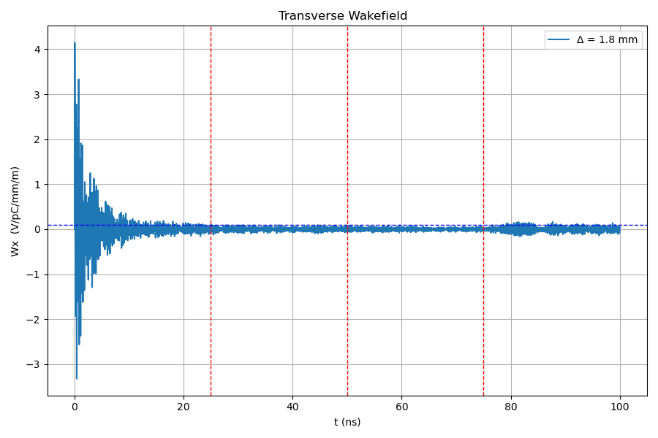
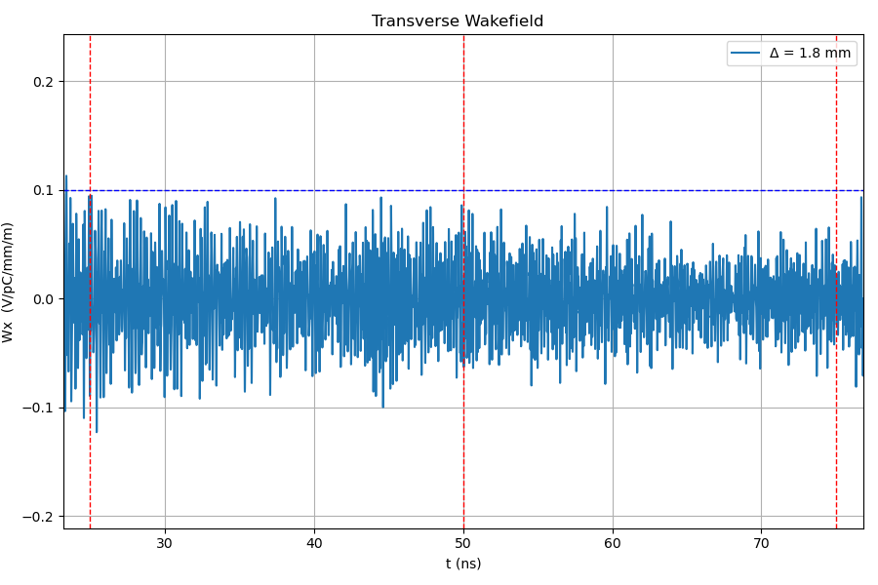
Parameters for the structure:
f = 3 GHz, Length = 3m, Phase advance = 2π/3, Q_{0,SLED} = 2e5, T_{klystron} = 3 us, P_klystron = 31 MW,
a/λ= 0.12 to 0.15, delta= 0 to 4mm, Wt < 0.1 V/pC/mm/m at 25, 50 and 75 ns.

Slide 13
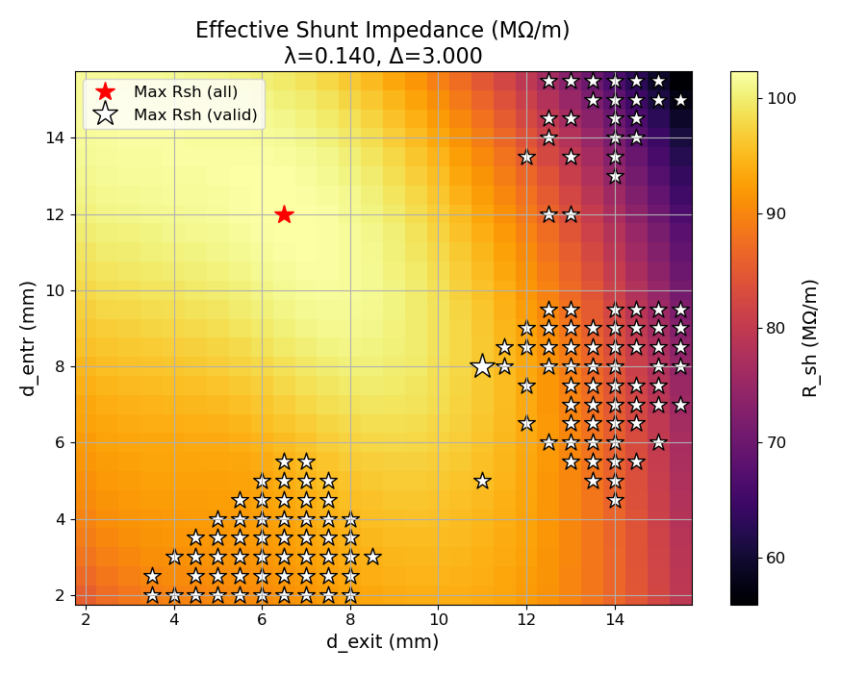
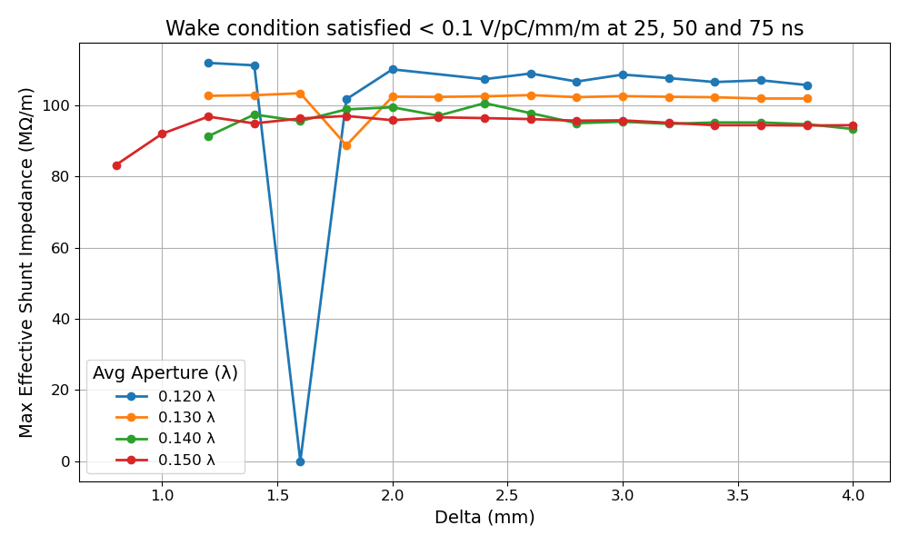
Parameters for the structure:
f = 3 GHz, Length = 3m, Phase advance = 2π/3, Q_{0,SLED} = 2e5, T_{klystron} = 3 us, P_klystron = 31 MW,
a/λ= 0.12 to 0.15, delta= 0 to 4mm, Wt < 0.1 V/pC/mm/m at 25, 50 and 75 ns.

Slide 14
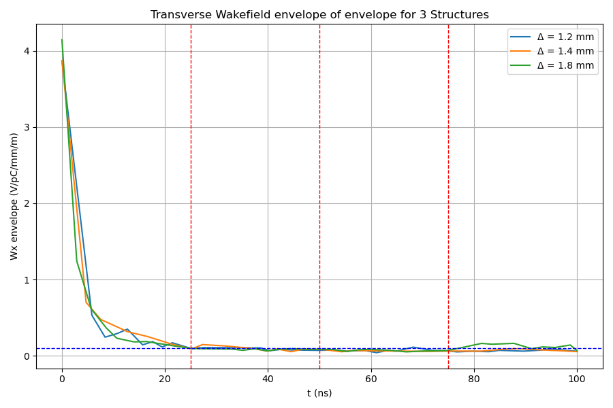
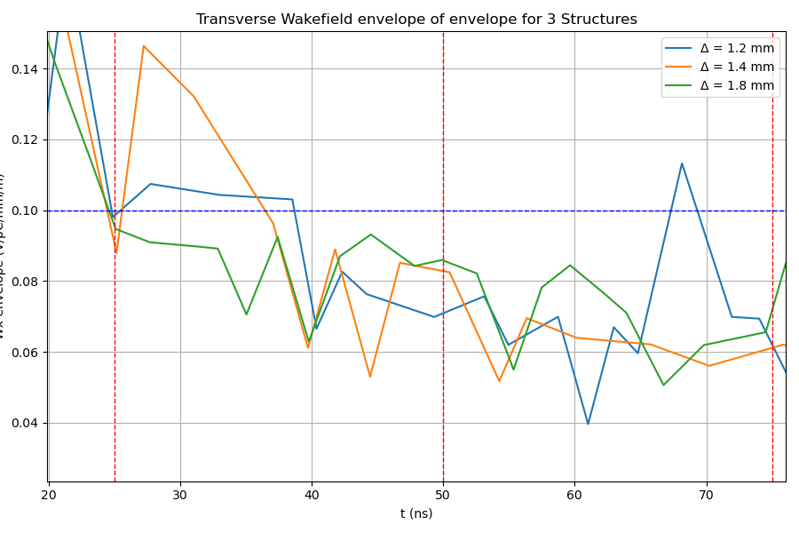
Parameters for the structure:
f = 3 GHz, Length = 3m, Phase advance = 2π/3, Q_{0,SLED} = 2e5, T_{klystron} = 3 us, P_klystron = 31 MW,
a/λ= 0.12 to 0.15, delta= 0 to 4mm, Wt < 0.1 V/pC/mm/m at 25, 50 and 75 ns.

