Slide 1
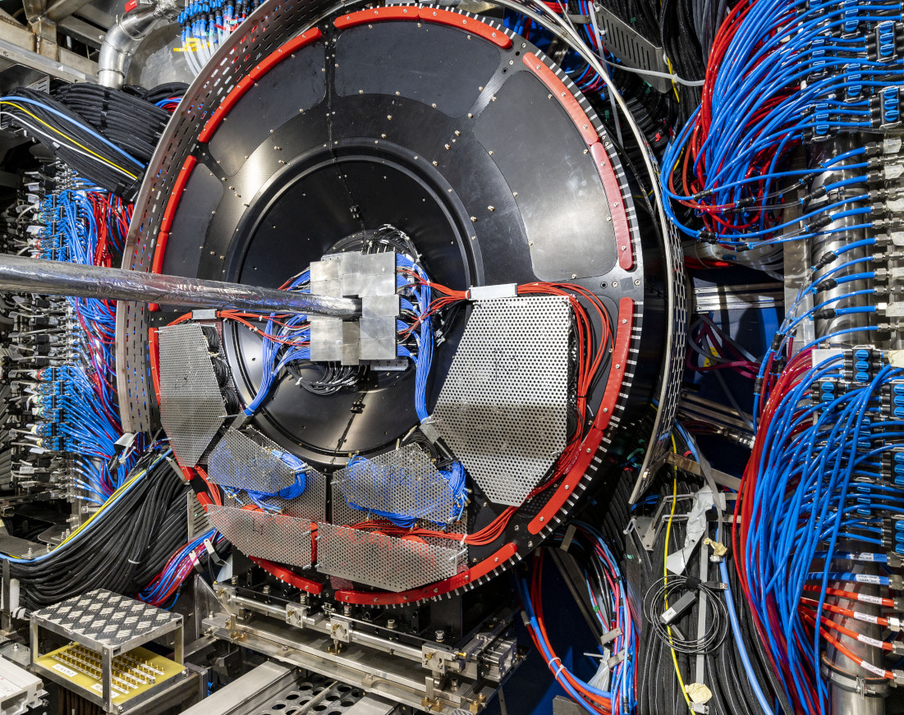
Introduction to the FIT's projects
Krystian Rosłon
WUT's delegation to CERN

Slide 2

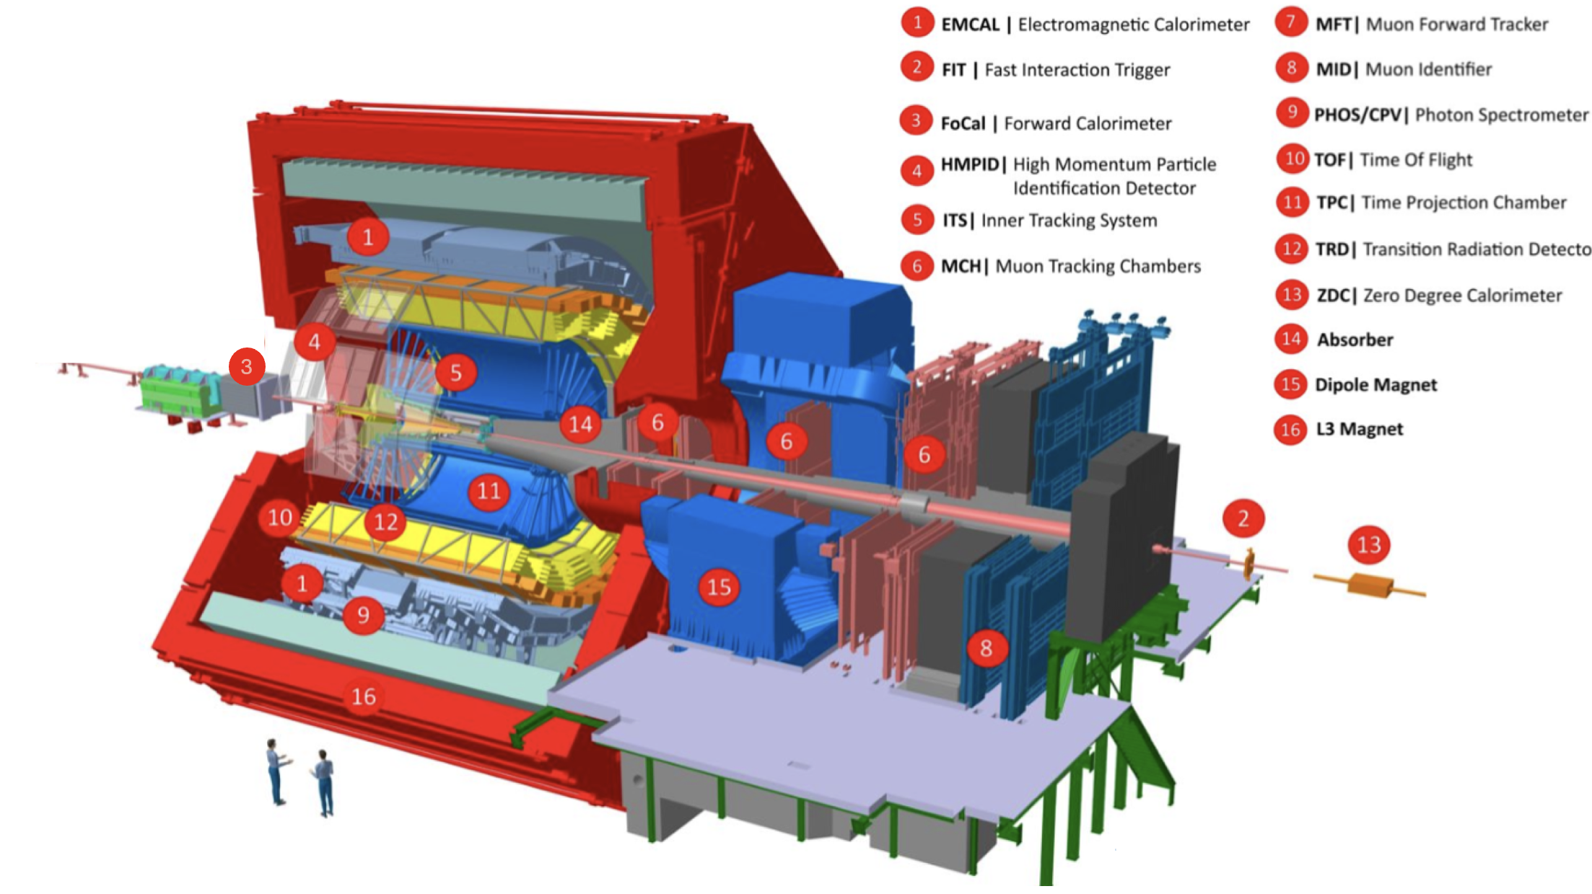
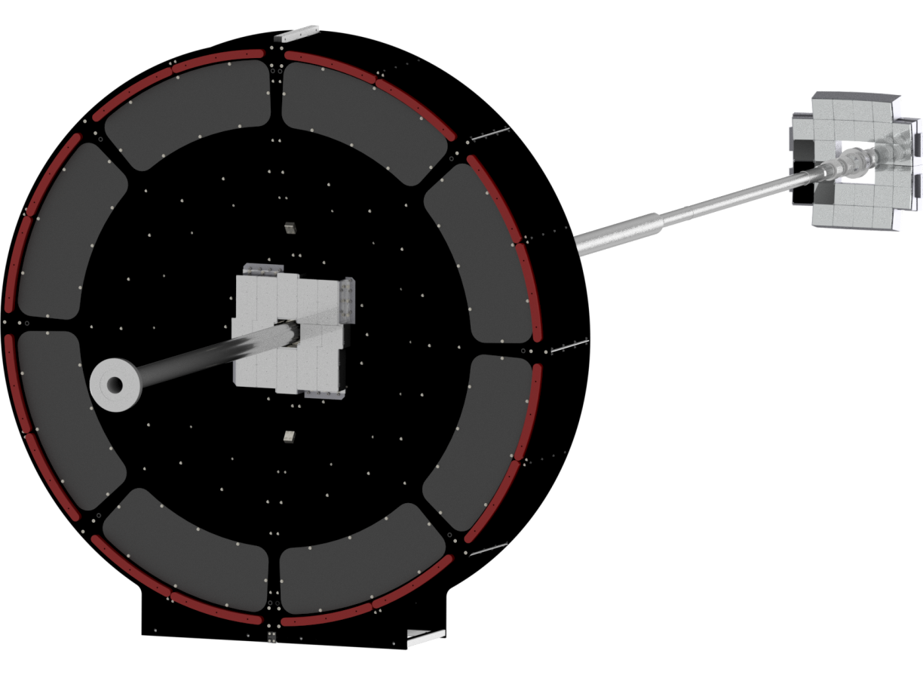
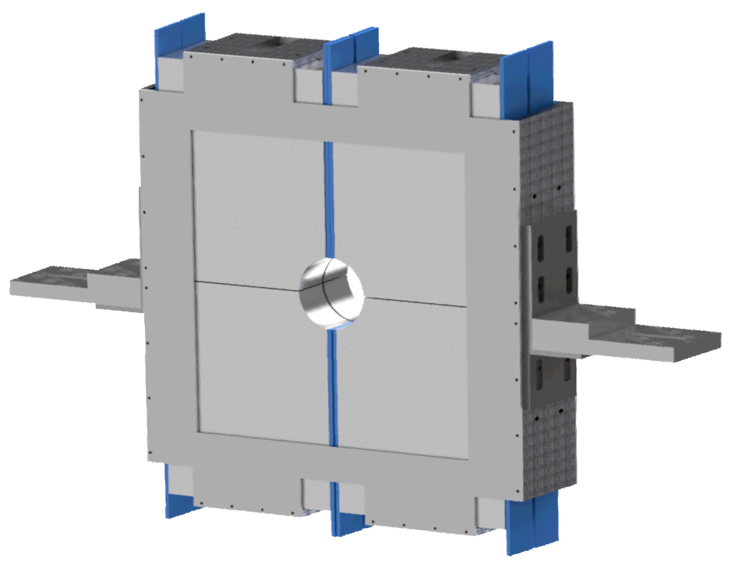
ALICE Fast Interaction Trigger (FIT)
Delivered Functionality
Fast min. bias collision trigger with latency < 425 ns;
Time resolution: 4 ps in Pb-Pb and 17 ps in pp collisions;
Luminosity and background monitor;
Centrality measurement;
Event plane determination;
FDD-C
-7.0 < η < -4.9
-20m from IP
FV0: 2.2 < η < 5.1
3m from IP
FT0-C
-3.3 < η < -2.1
-1m from IP
Fig. 1: ALICE detector
FDD-A
4.8 < η < 6.3
17m from IP
FT0-A
3.5 < η < 4.9
3m from IP
Fig. 2: ALICE FIT detector

Slide 3
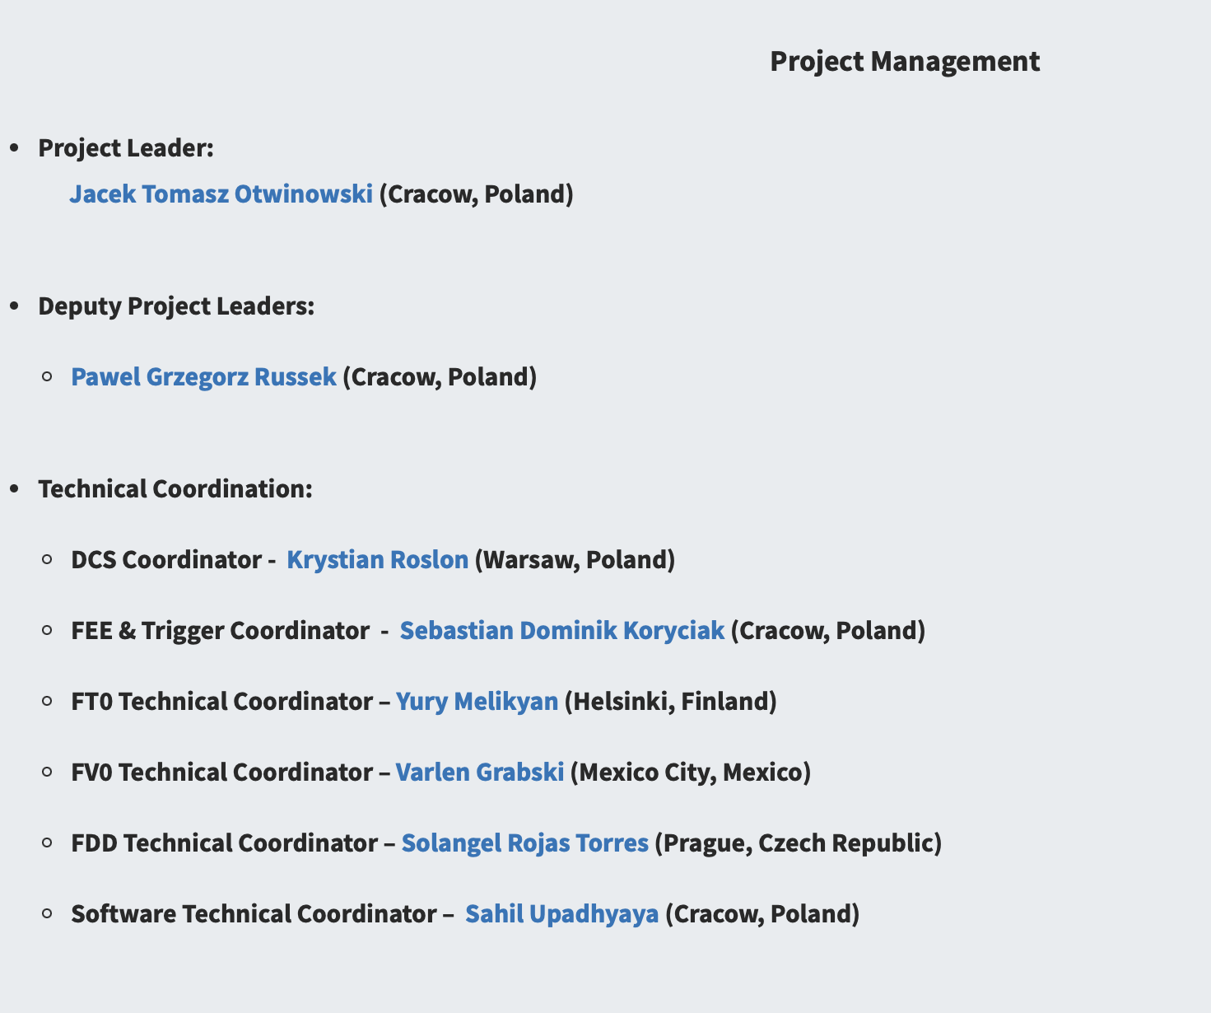
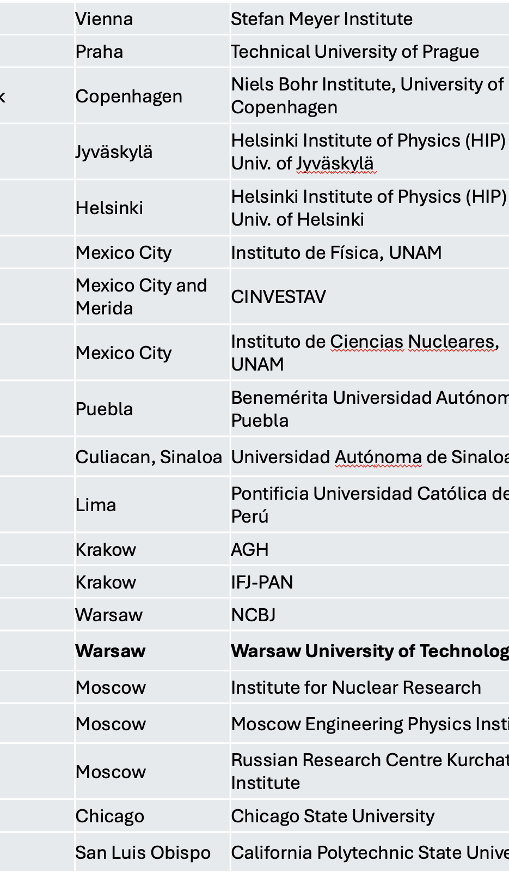
System Run Coordinator Sandor Lokos (Cracow, Poland)
Deputy System Run Coordinator Krystian Roslon (Warsaw, Poland)

Slide 4
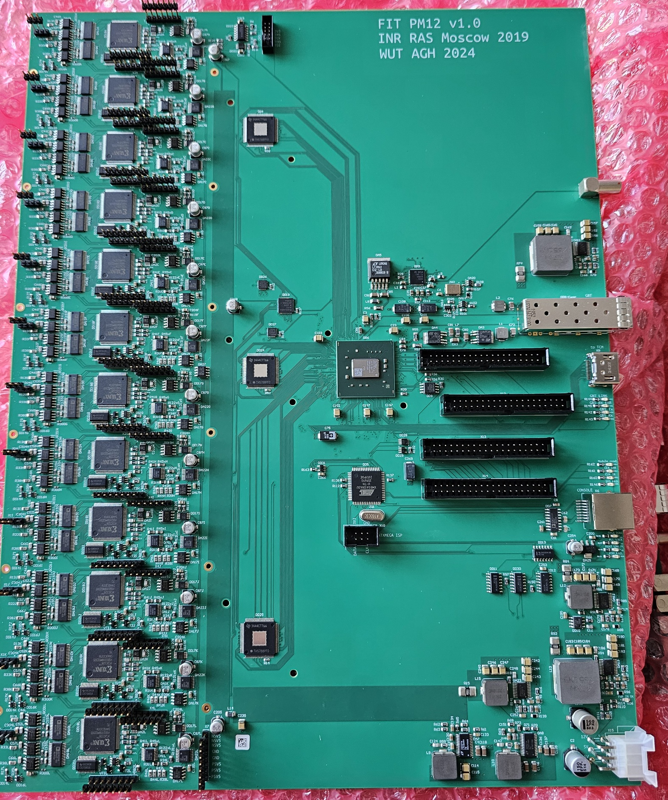
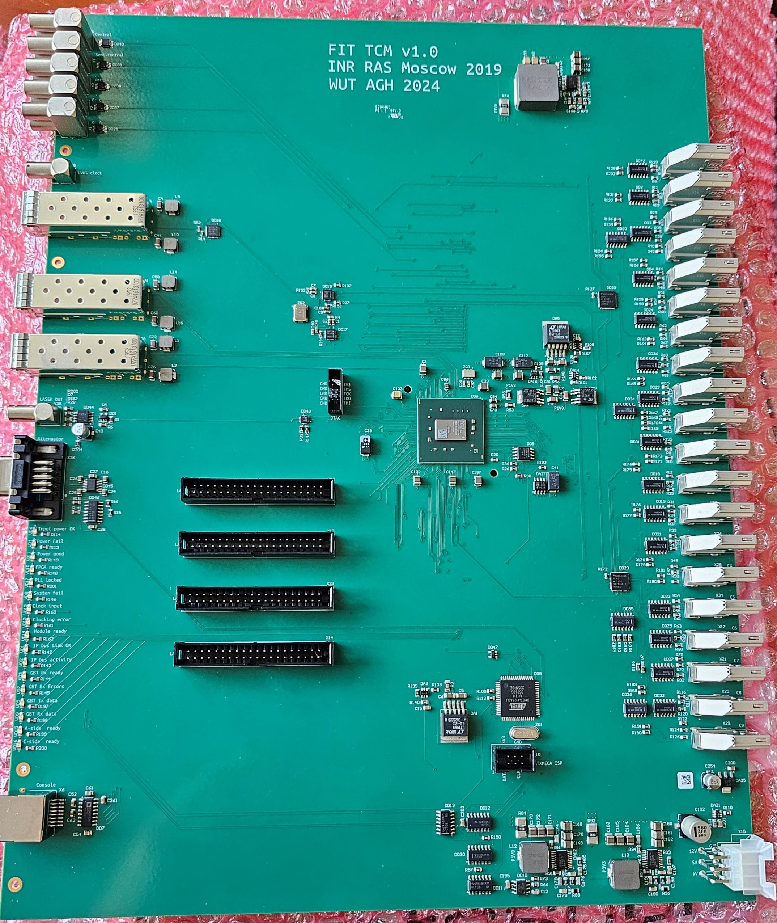
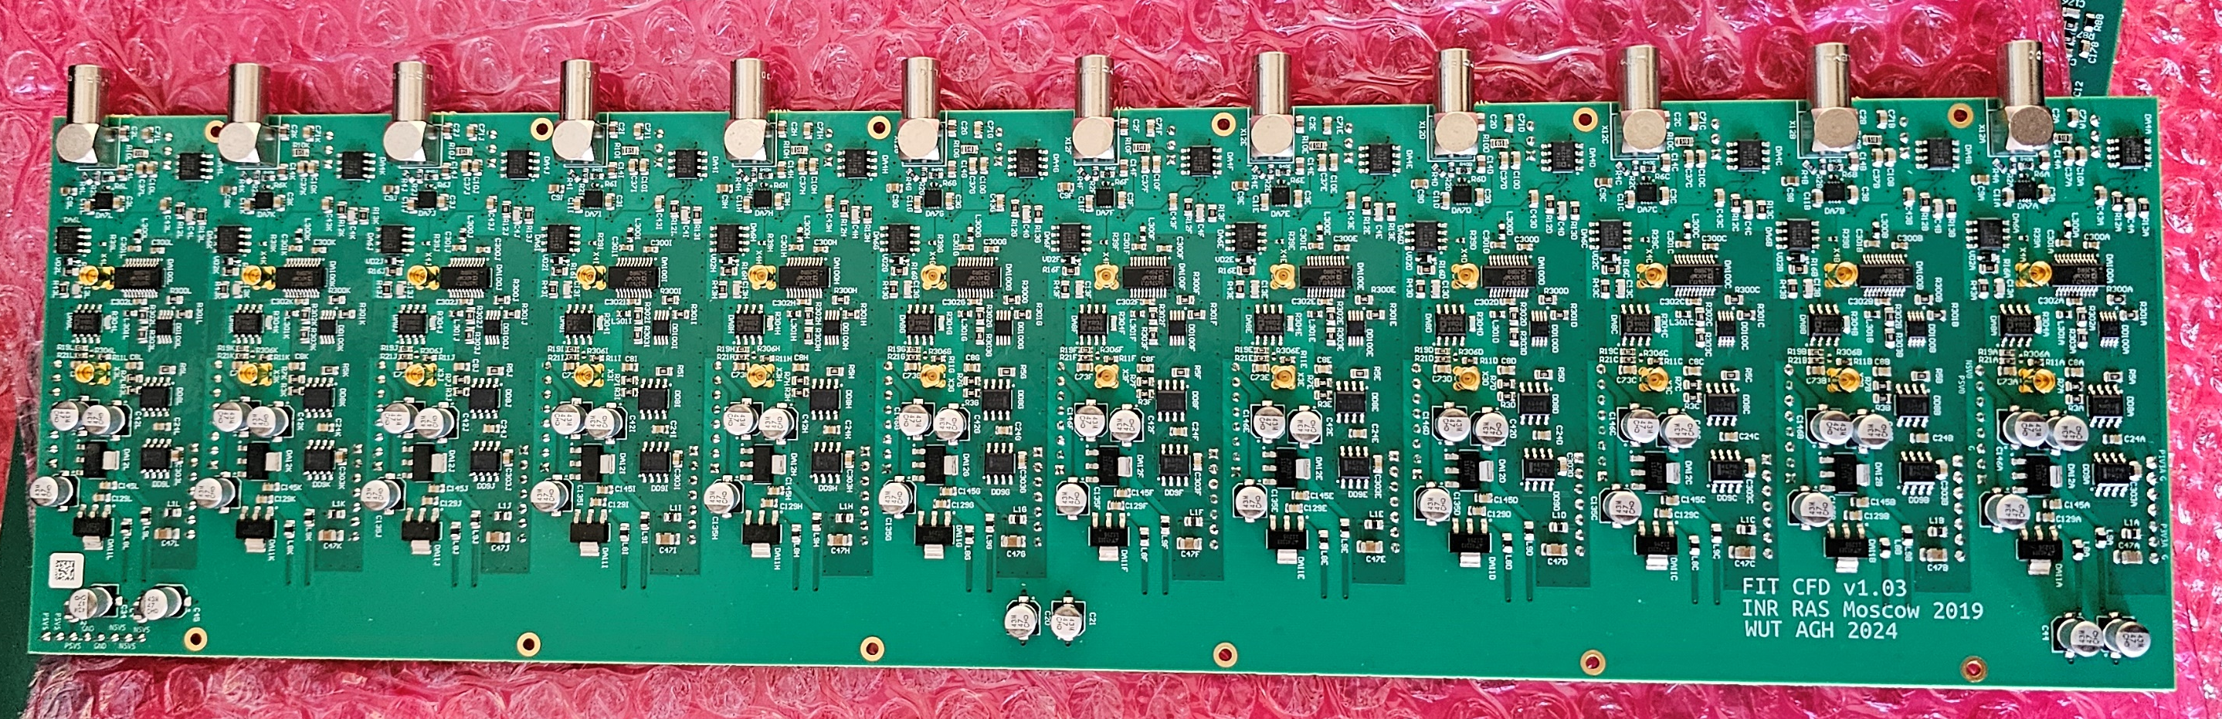
TCM and PM & CFD reverse engineering
Grant ALICE-PL for the ALICE Upgrade
All PCBs re-designed using official CERN libraries
4 TCM + 6 PM + 6 CFD produced
V1.0 as it’s a very close copy of existing boards
Delivered to AGH

Slide 5
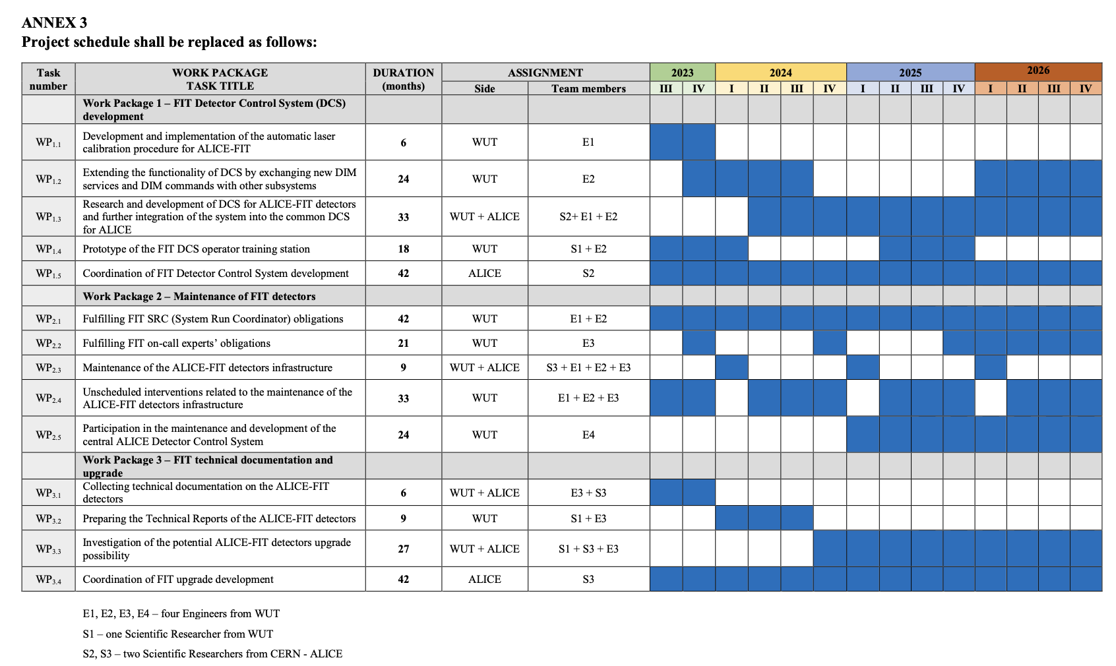
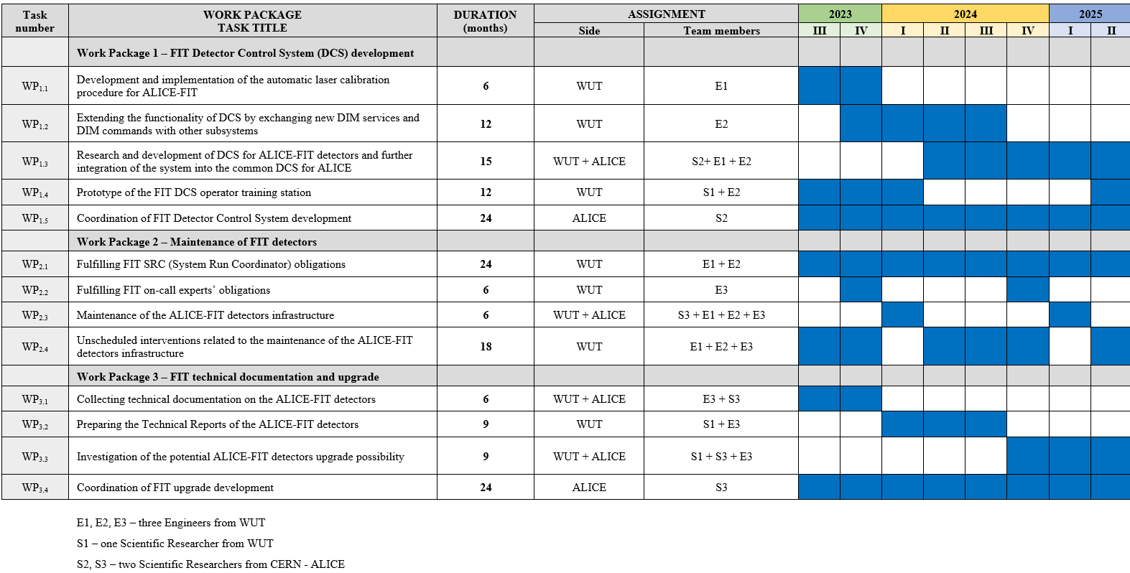
ALICE-FIT

Slide 6
Work beyond the grant’s original scope that is nevertheless funded
SPARC 2024 – Students Practices for Advanced Research projeCts): Exclusive programme for WUT’s students: 2 students for FIT , 3 students for FoCal (Maciej’s contribution) https://indico.cern.ch/event/1399036/
Transition from internship to permanent collaboration with CERN – a student from the Faculty of EiTI (Ignacy Mermer) was accepted for a long-term internship and, since March 2025, has been actively involved in projects in Geneva.
Completion and defence of a bachelor’s thesis at the Faculty of Electrical Engineering based on a project carried out at CERN.
Preparation of further diploma theses (bachelor’s at the Faculties of EiTI and Mechatronics, and master’s at the Faculty of SiMR) drawing on experience gained at CERN.
Establishment of two research and engineering teams:
Presentation of research results at the international IEEE Eurocon 2025 conference (by M.Sc. Eng. K. Rosłon and Dr. Eng. J. Możaryn).
Acquisition of a grant to continue and develop student collaboration between the Faculty of Mechatronics and CERN (project leader: Prof. Michał Józwik).
Initiation of cooperation with the Faculty of Civil Engineering – Dr. Eng. R. Michalczyk (winner of the “Best of the Best PW II” program) joined the team working on the FoCal project.

Slide 7
Work beyond the grant’s original scope that is nevertheless funded
Faculty of Electrical Eng.: Local supervisor: Prof. Łukasz Kolimas
Building the Sensor Tester including PS;
Feliks BRZEZIŃSKI, Mikołaj CHWOJNICKI, Przemysław KINASZ, Kacper OLSZEWSKI, Patrycja PŁODOWSKA
defence of a bachelor’s thesis (Przemysław KINASZ)
Faculty of Mechatronics: Local supervisor: Dr. Jakub Możaryn
Building the FIT FEE simulator → Digital Twin of FIT detectors;
Konrad KOSUGE, Timafiei MANDZIK, Przemysław SPYTEK;
Presentation of research results at the international IEEE Eurocon 2025 conference (by M.Sc. Eng. K. Rosłon and Dr. Eng. J. Możaryn).

Slide 8
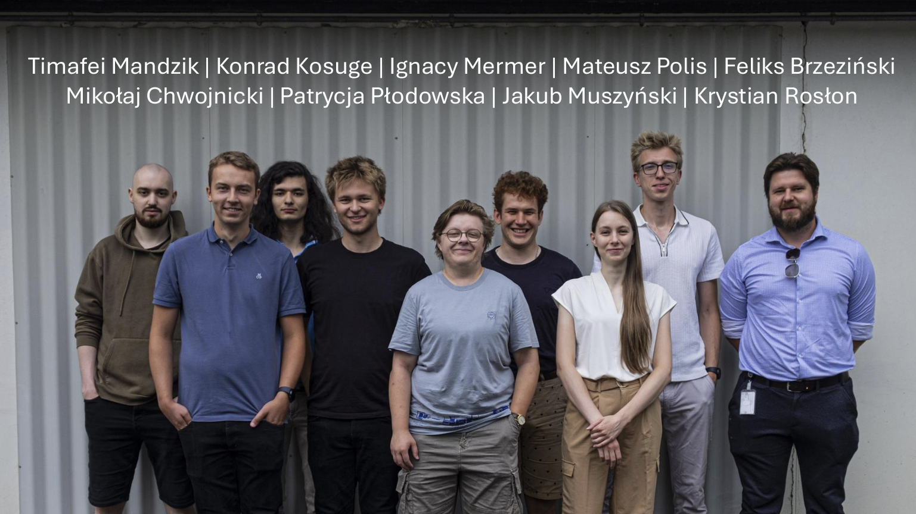
SPARC 2025 – 8 WUT’s students work for FIT

Slide 9
Work beyond the grant’s original scope that is nevertheless funded
SPARC 2025: 7 students for FIT, 5 students for FoCal https://indico.cern.ch/event/1537741/
Setup for Investigating the Influence of Input Voltage on the Operation of PMT and SiPM Photosensors (Mikołaj Chwojnicki, Elektryczny) → Applied for PhD at WUT
Design of a Hardware Abstraction Layer (HAL) for Photomultiplier Characterization (Feliks Brzezinski, Elektryczny) → Interested in writing master thesis.
Development of SCADA system in WinCC OA software for sensor test station → (Patrycja Płodowska, Elektryczny)
ADC/MIP Calibration & Ageing in FT0 and FV0: Methods, Trends, and O² QC Deployment (Jakub Muszyński, MiNI) → Interested in writing master thesis.
FITDetectorToolkit - Ageing Analysis (Mateusz Polis, MiNI)
FIT FEE Simulator backend (Timafei Mandzik, Mechatronika) → Interested in writing bachelor thesis.
FIT FEE Simulator frontend → (Kondrad Kosuge, Mechatronika)

Slide 10
Work beyond the grant’s original scope that is nevertheless funded
FIT - DCS Technical Coordinator;
Run Manager 2024, 2025;
Supervision of theses;
Doing Service Works for WUT;
Doing central shifts (WUT’s FIT participants are classified as an experts and emergency shifters);

Slide 11
Team from WUT
Supervisor: Krystian ROSŁON
Profesors:
Łukasz KOLIMAS (Elektr.)
Adiunkts:
Grzegorz KASPROWICZ (EiTI)
Jakub MOŻARYN (Mechatro.)
Daniela RUGGIANO (Fizyki)
PhD Student:
Zuzanna CHOCHULSKA (Fizyki)
Mikołaj CHWOJNICKI (Elektr.)
Students:
Feliks BRZEZIŃSKI (Elektr.)
Przemysław KINASZ (Elektr.)
Konrad KOSUGE (Mechatro.)
Timafiei MANDZIK, (Mechatro.)
Ignacy MERMER (EiTI)
Jakub Muszyński (MiNI)
Kacper OLSZEWSKI (Elektr.)
Mateusz POLIS (MiNI)
Patrycja PŁODOWSKA (Elektr.)
Przemysław SPYTEK (Mechatro.)

Slide 12

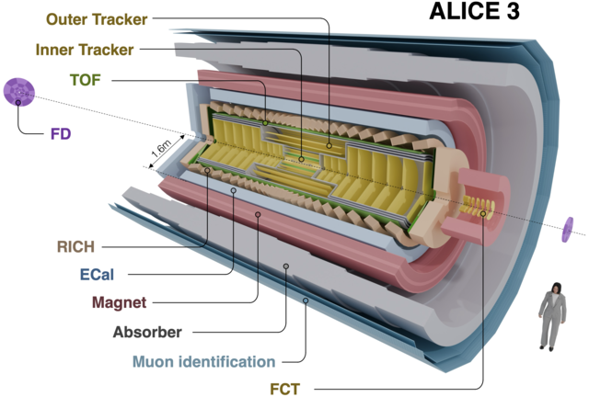
Summary
July 2026:
DCS for ALICE-FIT Ready
Forward Detector (FD) - installation: LS4, operation from RUN5:
Detector placed at the FDD position (ALICE 3)
FV0 like design
Two segmented scintillator disks
R&D with different scintillation materials PEN/PET
Readout with fine-mesh PMTs or SiPMs.

Slide 13
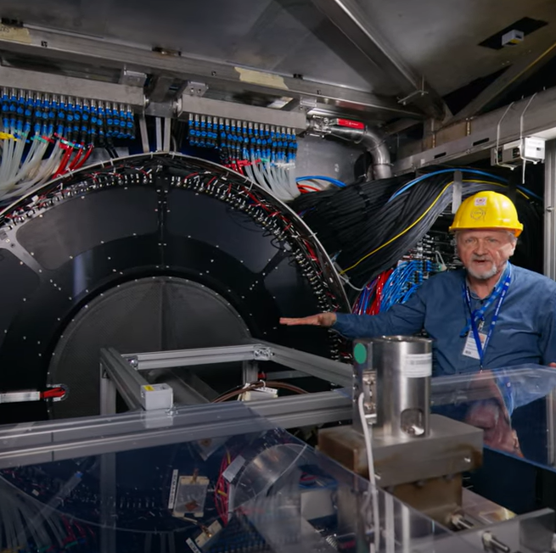
FIT videos viewed
YouTube:
English; https://youtu.be/PjsBIbKsuO0
Spanish; https://youtu.be/qR_lG7K3pfs
Polish; https://youtu.be/31s8jix2omo
Russian; https://youtu.be/phN0AohEDKI

